Slide 1
A New Way to Get Around in
COMING
MARCH 2017
Revised: January 27, 2017

Slide 2
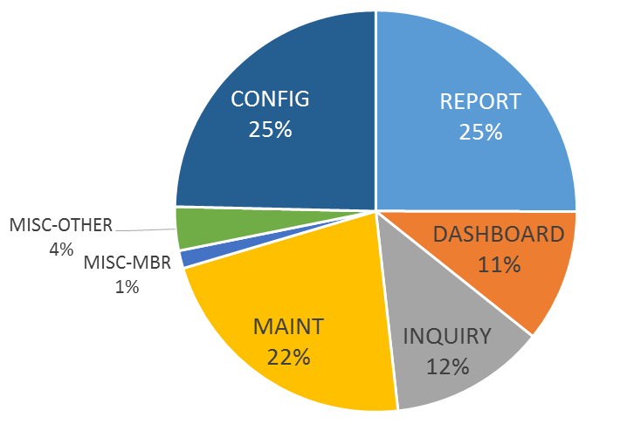
A New Day-to-Day Experience for CU*BASE Users
Coming in march 2017
784 CU*BASE tools
When it comes to the employee experience, it doesn’t get much closer to home than the way users navigate CU*BASE
Serving the Google generation – searching is the new norm
Serving the “it’s me” generation – set things up the way you like to work
More than just a pretty new face – this project is a completely new infrastructure on which we can build for years to come
Notes:
Maintenance includes Teller (tools that post data to a file or take some action on a member account, GL acct, etc.)
Misc-Mbr is for things that aren’t posting tools but not exactly lookup inquiries, either, like printing loan coupons and starter checks, CD forms, notices, etc.
Misc-Other is office stuff like resetting passwords, outqs, etc.
Doing the work is 27% (22 + 4 + 1)
Setting the rules is 25%
Seeing the work you’ve done is 48% (25 + 11 + 12)

Slide 3
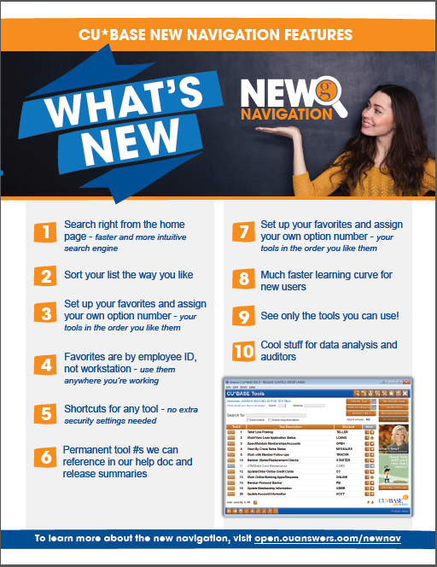
“But I liked it the way it was before!”
go-to points so you can be a cheerleader for the new navigation
Search right from the home page – faster and more intuitive search engine
Sort your list the way you like
Set up your favorites and assign your own option number – your tools in the order you like them
Favorites are by employee ID, not workstation – use them anywhere you’re working
Permanent tool #s we can reference in our help doc and release summaries – no more outdated references
Shortcuts for any tool – no extra security settings needed
90 new shortcuts on day one!
See only the tools you can use – but you can still get curious about new tools to explore
Old MNXXXX shortcuts are still available to help with the transition – we haven’t forgotten about our current power users!
Much faster learning curve for new users – designed for both mouse and keyboard users
Cool stuff for data analysis and auditors, too – embedded tools to explain program names
Notes:
Next go to the software, show how to log in, stop on the Emp ID/pw “Welcome” window, explain how in order to display just the tools you use, we need to know who you are
Play around with all the features, then come back to the slide show to review

Slide 4
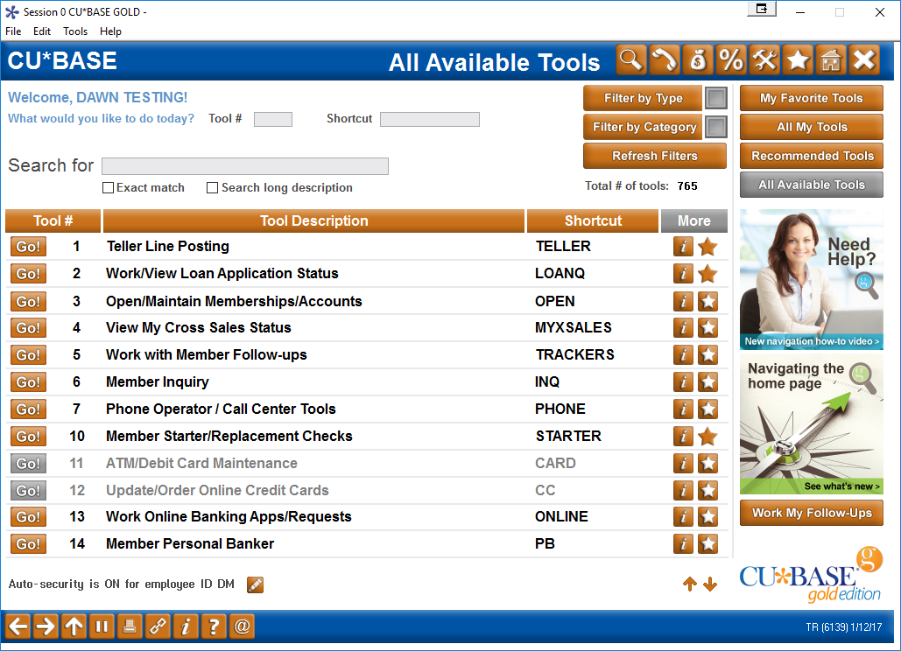
A new way to navigate to CU*BASE tools
Coming in March!
The CU*BASE menu-driven navigation system is being replaced by the new CU*BASE Tools home page
Notes:
Quick Tour of the screen
Can mention how we did a query of 5 CUs to see top 50 most-used programs, which is why these are in this particular order

Slide 5
A new way to navigate to CU*BASE tools
Coming in March!
The CU*BASE menu-driven navigation system is being replaced by the new CU*BASE Tools home page
Driven by a powerful new search engine
Shorter learning curve for new users
Search tools built right into the home page
Notes:
Explain this isn’t quite like Google search (which is a popularity contest)
Try using “Search long description” if you can’t find something
Let us know if you have trouble getting a search to work, we can add keywords easily

Slide 6
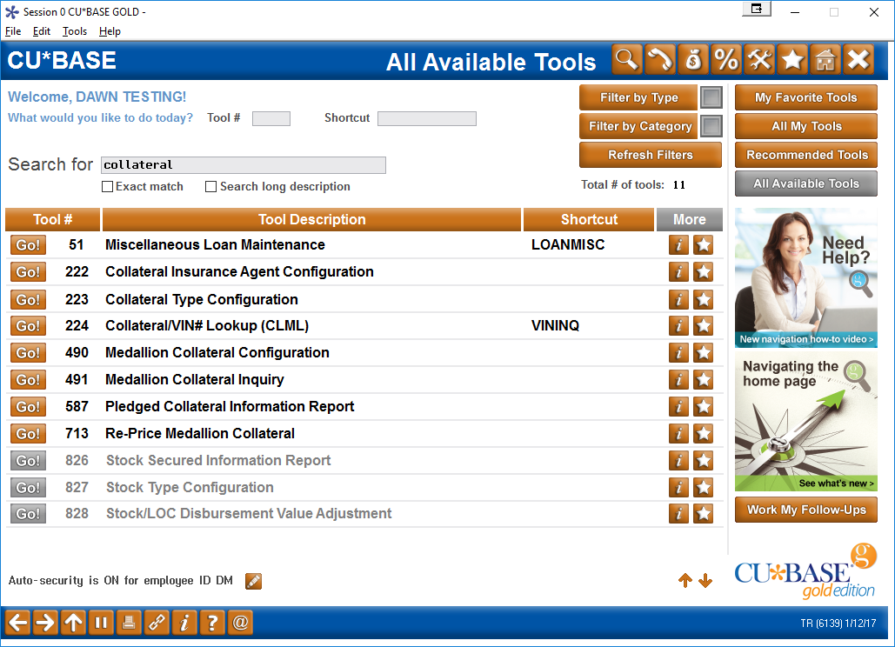
A new way to navigate to CU*BASE tools
Coming in March!
The CU*BASE menu-driven navigation system is being replaced by the new CU*BASE Tools home page
Driven by a powerful new search engine
Shorter learning curve for new users
Notes:
This shows what the results are if you searched for “Collateral” – see how Misc Loan Maintenance shows up? That’s because of the keywords we entered to the database

Slide 7
A new way to navigate to CU*BASE tools
Coming in March!
Flexible interface with an “it’s me” approach – organize your tools the way you like
Show just the tools you want to see...
...to control whether or not you see options you can’t access
Notes:
show both balloons close together

Slide 8
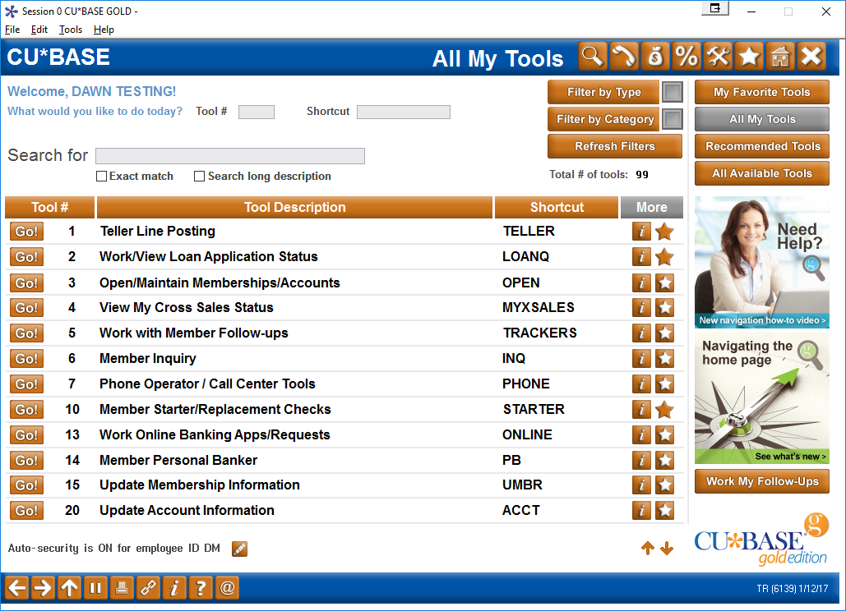
A new way to navigate to CU*BASE tools
Coming in March!
Flexible interface with an “it’s me” approach – organize your tools the way you like
So if I switch to “All My Tools”…
…see how those grayed-out ones disappeared?

Slide 9
A new way to navigate to CU*BASE tools
Coming in March!
Flexible interface with an “it’s me” approach – organize your tools the way you like
Click to sort by any column
Permanent tool #s that we can refer to in doc
More shortcuts than ever for your keyboard power users
Notes:
If you have access to the tool, you have access to the shortcut . . . And vice versa

Slide 10
A new way to navigate to CU*BASE tools
Coming in March!
Flag your favorites and make your own custom “menu”
Flexible interface with an “it’s me” approach – organize your tools the way you like

Slide 11
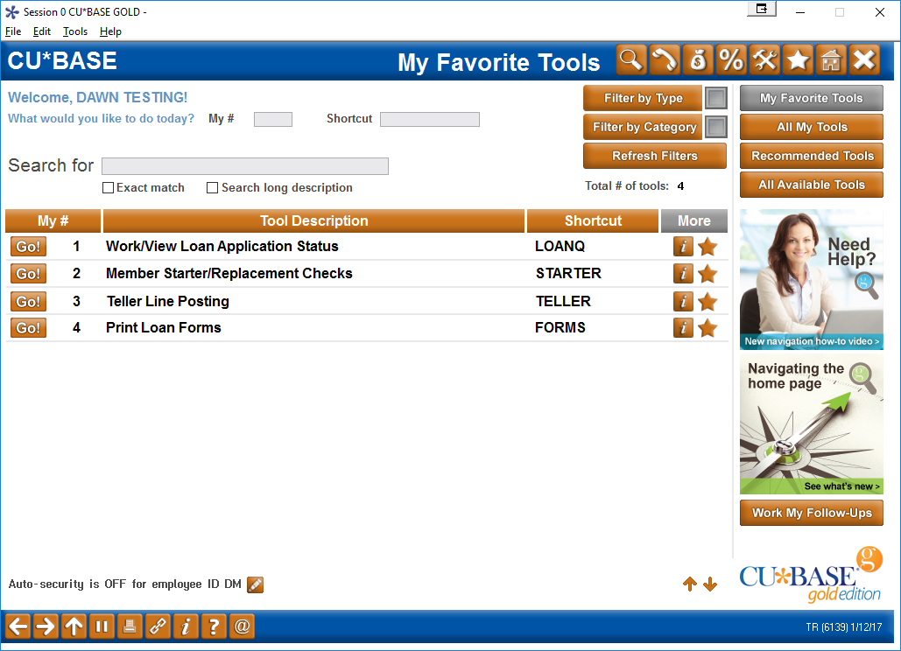
A new way to navigate to CU*BASE tools
Coming in March!
Flexible interface with an “it’s me” approach – organize your tools the way you like
Notes:
Click once to flash the yellow box over “My Favorite Tools”
Click again to flash the yellow boxes over My #

Slide 12
A new way to find what you need
Coming in March!
Filters to see all related tools in one place
Search by key word
OR
Filter by Category
Notes:
There isn’t a picture of the Filter by Type – just mention these are the broad categories we mentioned on that chart on the first slide (Reports / Configs / Maint / Inquiry etc.)
Categories are the equivalent of the old menus
(You can combine these – i.e., to get G/L reports, choose Reports under Type and GL under Categories)

Slide 13
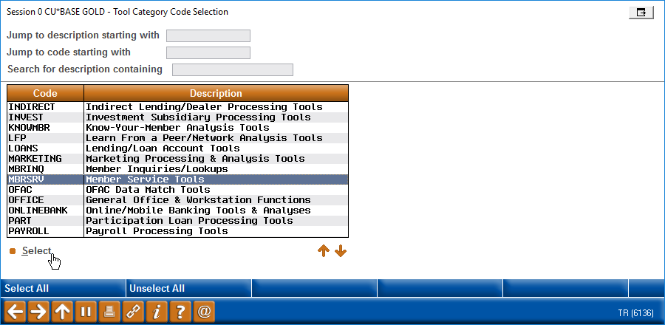
A new way to find what you need
Coming in March!
Filters to see all related tools in one place
Search by key word
OR
Filter by Category
Notes:
Categories are the equivalent of the old menus, but we combined things
Example: instead of 2 Auditing menus, there is now just one Auditing category that has all of those tools in it

Slide 14
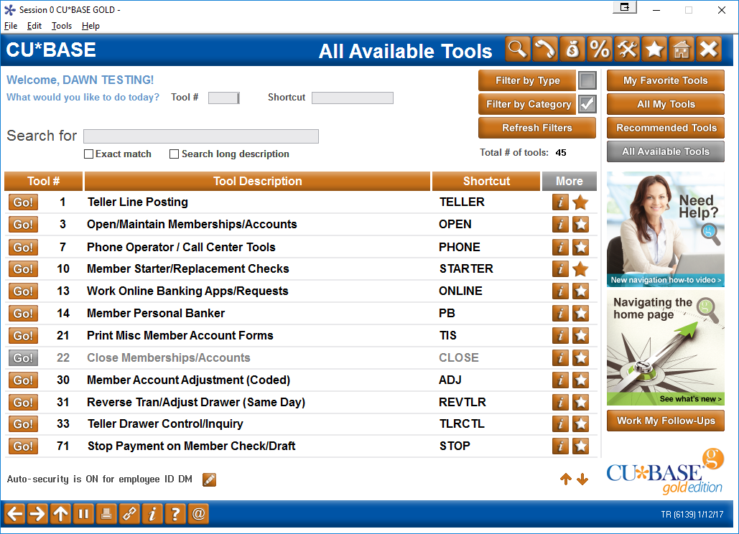
A new way to find what you need
Coming in March!
Search by key word
OR
Filter by Category
Notes:
See how after you run the filter the checkmark appears
Plus notice the # of tools changed

Slide 15
A new way to learn about CU*BASE tools
Coming in March!
Employees, managers, and security officers will have ready access to details about what the tool does and who should be using it
Learn while you work
Notes:
(Notice the title and bullet point changes on this slide)

Slide 16
A new way to learn about CU*BASE tools
Coming in March!
Employees, managers, and security officers will have ready access to details about what the tool does and who should be using it
Learn while you work

Slide 17
Changes to Employee Security

Slide 18
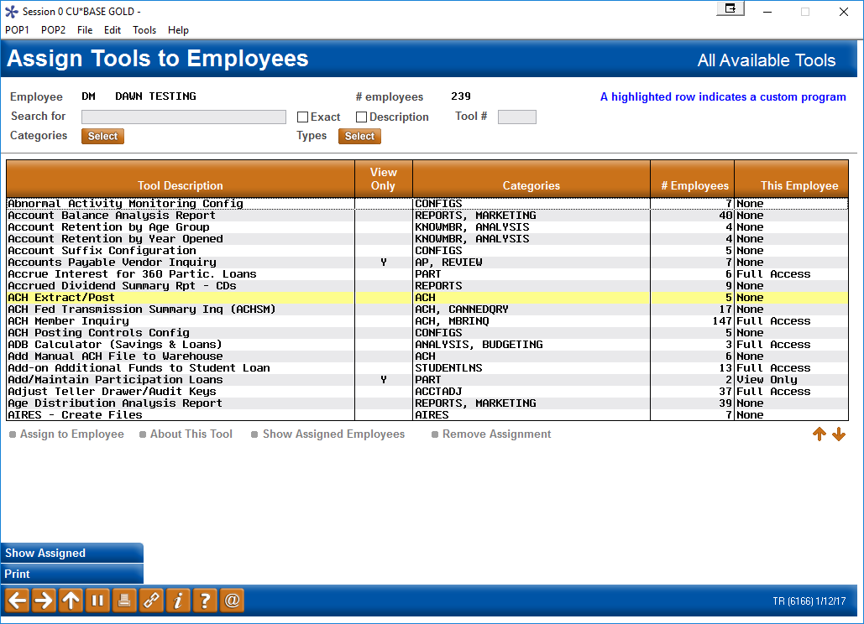
There is one group that won’t need much cheerleading...
Things just got about a thousand percent better for your security officers
VS.
Notes:
From a report with meaningless Ys and Ns to an interactive dashboard

Slide 19
There is one group that won’t need much cheerleading...
Things just got about a thousand percent better for your security officers
Releases will no longer change anyone’s security settings – tool #s and tool assignments are now permanent!
New programs added in CU*BASE releases will no longer be automatically assigned to any employees
“NEW” category will make it a breeze to see only the tools added in the most recent release
“Dashboard” view to see who can do what, and who can’t – no more reports with cryptic columns of Ys and Ns
Search for employee IDs by name
Jump to an ID in the list
Sort your list the way you like
Assign many tools to a single employee
Assign many employees to the same tool
Record start date, email address, and NMLSR# for all employees – ready for your next custom form updates!
Notes:
After this slide go to the software and play around, then come back to the next slide to review

Slide 20
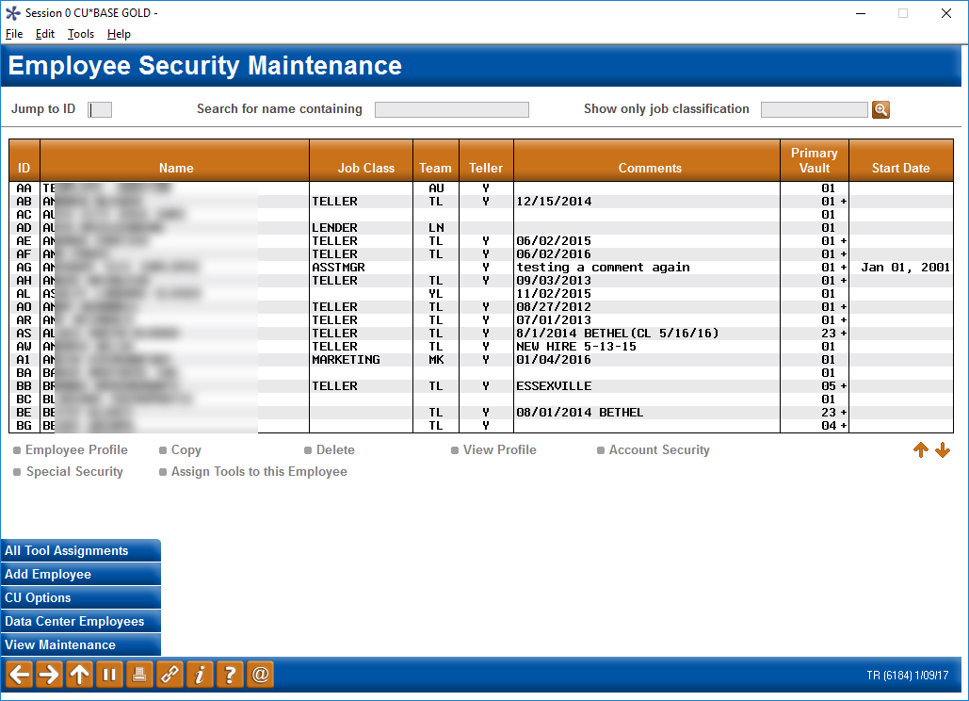
Improvements for security officers and auditors
Coming in March!
Jump to an ID
Search for a name
Streamlining the CU*BASE Employee Security tools
Sort by any column

Slide 21
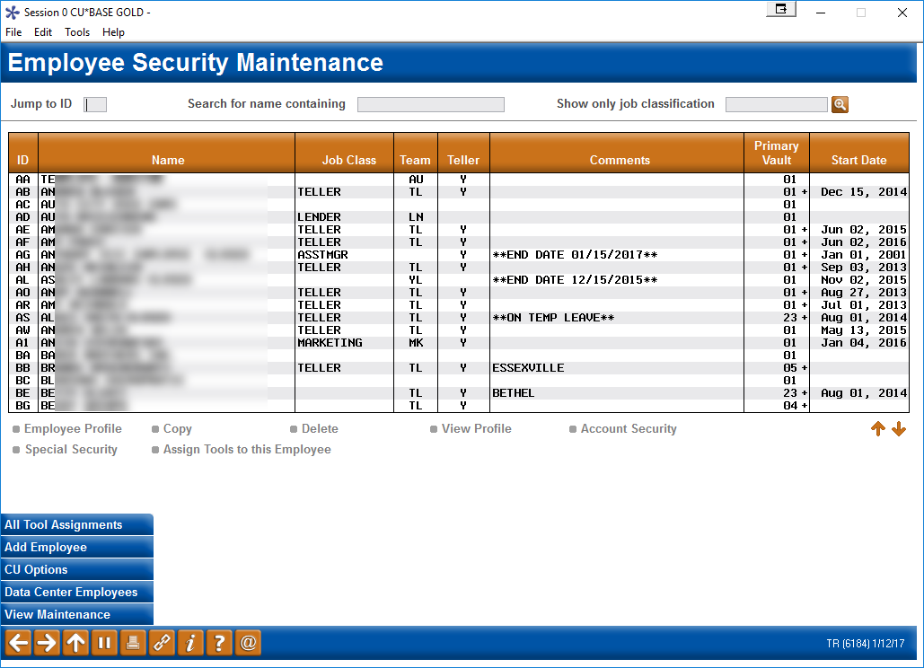
Improvements for security officers and auditors
Coming in March!
Streamlining the CU*BASE Employee Security tools
See all your comments and notes at a glance

Slide 22
Improvements for security officers and auditors
Coming in March!
Streamlining the CU*BASE Employee Security tools
NEW FEATURE!
Record all employee start dates; sort the list by this date

Slide 23
Improvements for security officers and auditors
Coming in March!
Streamlining the CU*BASE Employee Security tools
As before, the Team feature (formerly called Job Category) still lets you create templates and copy settings from one ID to another
Notes:
Explain Job Category was just re-labeled as Team, but works exactly like now
This is where you could talk about your work with Alpena Alcona, and how you recommend templates be used

Slide 24
Improvements for security officers and auditors
Coming in March!
Streamlining the CU*BASE Employee Security tools
NEW FEATURE!
Job Classifications will allow us to make recommendations to security officers about which tools should be assigned, based on job responsibilities (more on these in a moment...)
Notes:
Make sure to emphasize this is completely separate from Team and they have nothing to do with each other from a technical standpoint

Slide 25
Improvements for security officers and auditors
Coming in March!
Jump quickly to an ID…
Streamlining the CU*BASE Employee Security tools

Slide 26
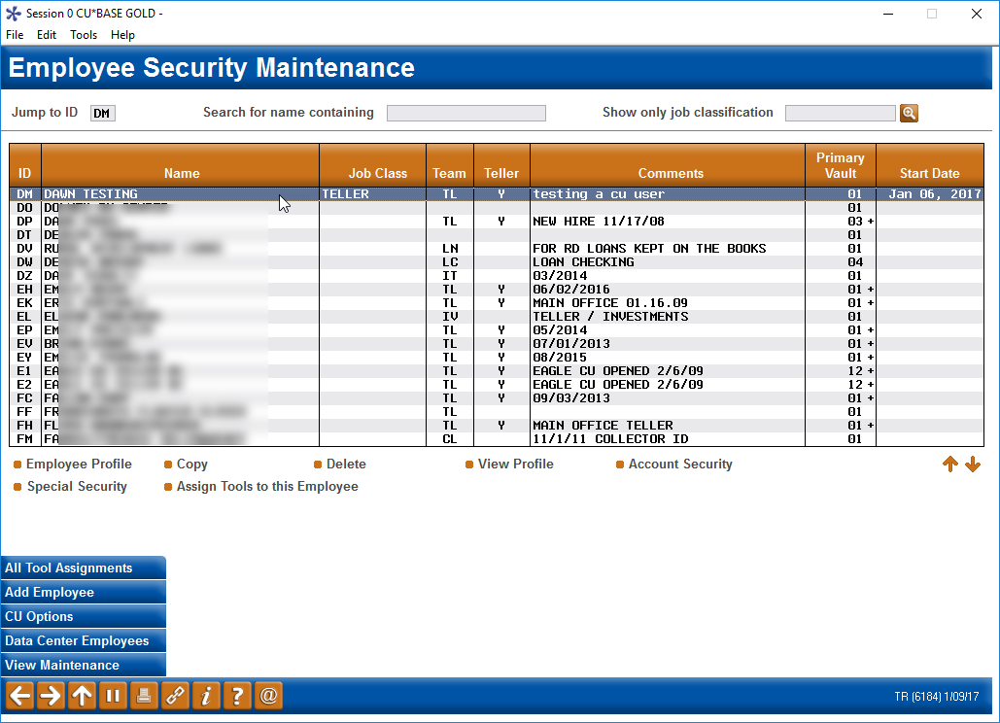
Improvements for security officers and auditors
Coming in March!
Streamlining the CU*BASE Employee Security tools
…and it comes to the top of the list
Now let’s take a look at the new data you can now record for this employee

Slide 27
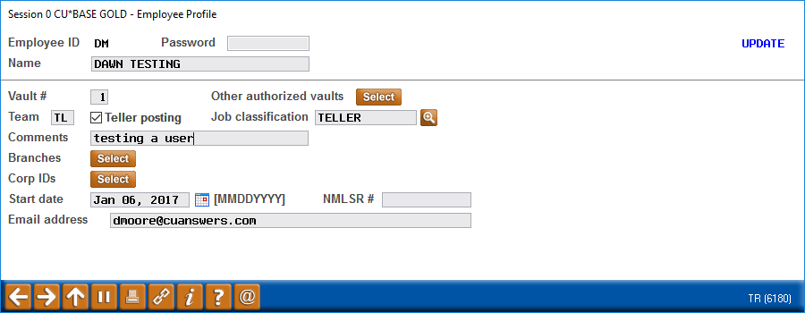
Improvements for security officers and auditors
Coming in March!
More data about your employees
Start date
NMLSR # for custom loan form programming
Email address for use with new CU*BASE tools
Notes:
NMLSR# won’t appear on forms until you make a change to your form and we re-program it

Slide 28
Improvements for security officers and auditors
Coming in March!
More data about your employees
New Job Classification code (you must assign these)
This controls what a user sees when they click the
button on their home page
Notes:
Go to the software now to see what the Recommended Tools button does on an ID that has no assignment, then assign a Job Class and try it again

Slide 29
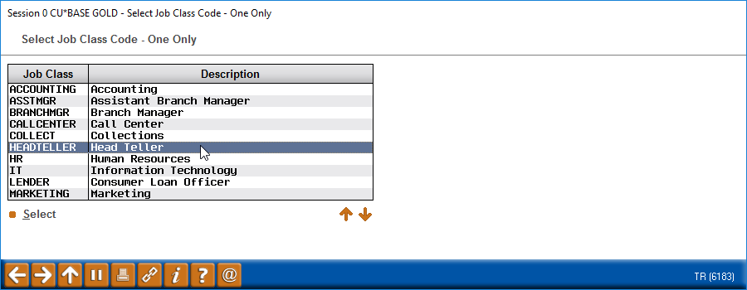
Improvements for security officers and auditors
Coming in March!
More data about your employees
Job Class codes let us give security officers our recommendations for tool assignments
Notes:
Mention that we’ve only just begun inventing features for Job Class, and a lot of cool ideas are already on the drawing board. The first step, though, is for Security officers to start assigning these to employee IDs.

Slide 30
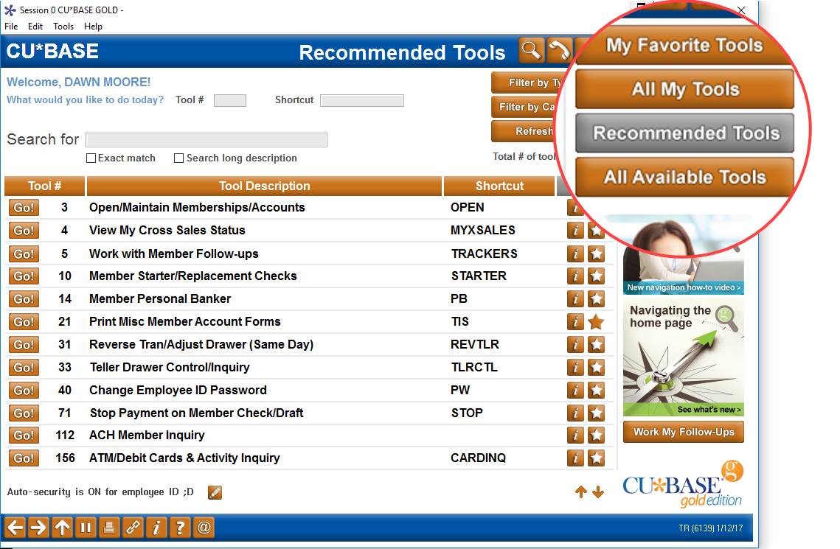
Improvements for security officers and auditors
Coming in March!
More data about your employees
After you’ve assign a job class, the employee will be able to click this button to see which tools we recommended for them
Job Class codes let us give security officers our recommendations for tool assignments
Notes:
Mention that we’ve only just begun inventing features for Job Class, and a lot of cool ideas are already on the drawing board. The first step, though, is for Security officers to start assigning these to employee IDs.

Slide 31
Improvements for security officers and auditors
Coming in March!
A whole new way to assign tools to your employees
Set up what this employee can do…
…or work with what all your employees can do (let’s try this one)
Notes:
Mention that other than the employee profile, which we just saw, the other options below the list (Special Security, Account Security, Copy, etc.) work exactly the same as they do now
So the only other major change is how tools are assigned to employees

Slide 32
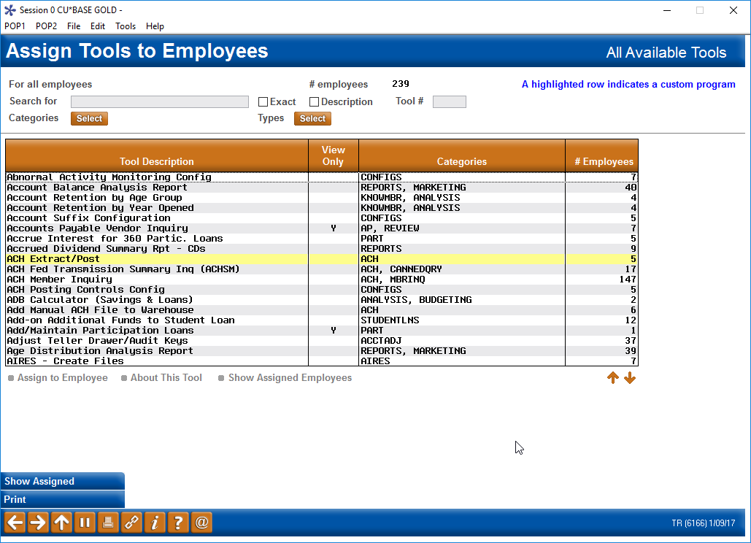
Assigning tools to your employees
Coming in March!
Search for a single tool or show similar tools
A whole new way to assign tools to your employees
Sort by any column
How many employees can use this tool?
All tools in one place
Notes:
Mention the yellow means custom

Slide 33
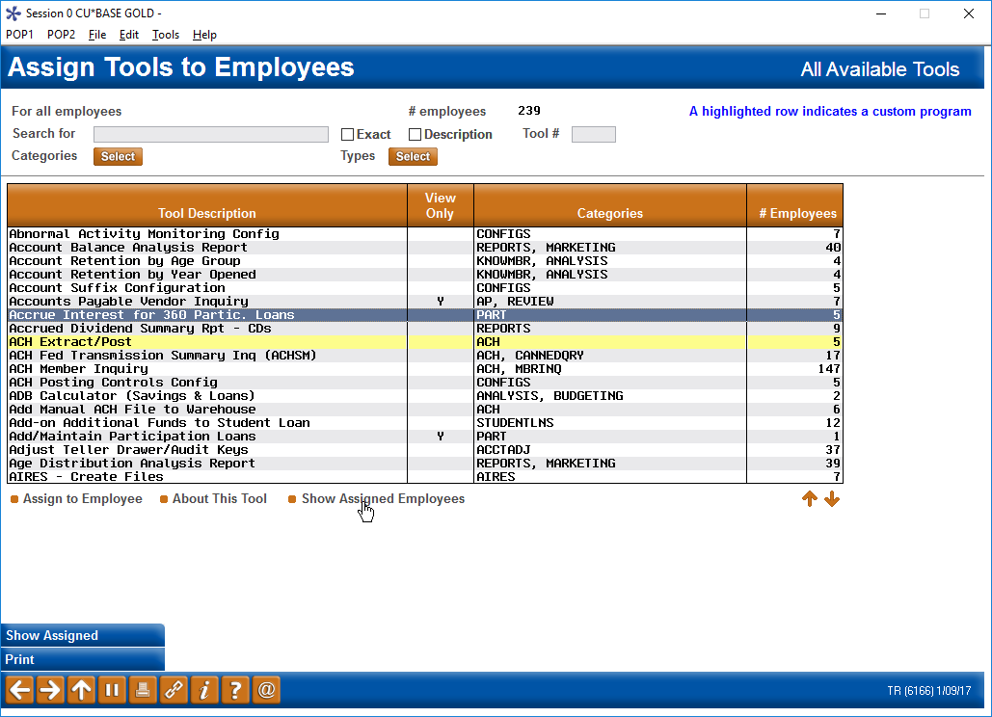
Assigning tools to your employees
Coming in March!
More visibility of who can use your tools
Which employees can use this tool?

Slide 34
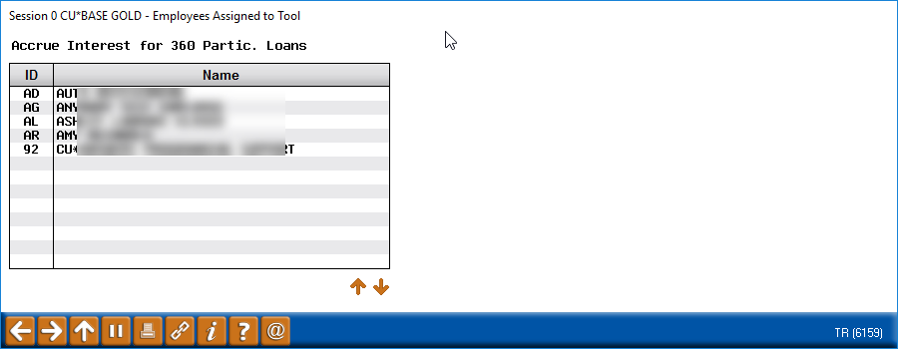
Assigning tools to your employees
Coming in March!
More visibility of who can use your tools
Which employees can use this tool?
Notes:
Suggest just going to the software now and showing the difference between the “All Tools” and the “Assign to This Employee” feature as much as you like

Slide 35
New Reports for Auditing your Security Settings
Beyond the dashboard
Notes:
Same report as they have now, with the “menu” item replaced by the new Assigned Tools one, similar to the conversion report

Slide 36
Understanding the Changes to Auto Security
The auto-security feature is now controlled via a button on the home page
If it’s on, you don’t have to enter your ID and password over and over every time you launch a tool
CU*BASE still checks against your access privileges, though!
Employees can still set Preferences to activate auto-security automatically after logging in
Auto-security will be available to all employees, unless you deactivate it (for everyone) in CU*BASE Employee Security (CU Options)
Notes:
Auto-security works exactly like it always did as far as the person turning it on or off and, when having multiple users using the same workstation
The only change is that now, the CU cannot block just one person from using it
Remember that your employee ID now controls what’s on the home page and your favorites, not just security access, so sharing a workstation will be very different
Don’t forget that Teller Posting also has a setting at the workstation level so you could still require an ID every time there (for your drive-thru workstation, for example)

Slide 37
Changes to Employee Security
Converting Your Existing Access Settings

Slide 38
Converting your existing security settings
You’ll be ready to go on release day
This report will be in your HOLDxx output queue on the day of the release
If you want it routed to CU*Spy, you can move this report to MONTHxx or another OUTQ
All existing your permissions will be translated to the new structure for you
Notes:
Report is similar to what they’ll get when they print the employee security reports, just without the “OLD” line

Slide 39
Converting your existing security settings
You’ll be ready to go on release day
Tips:
If a person had access to either the speed sequence OR the menu option, they’ll have access to the new tool# (remember, this automatically gives them access to the shortcut, too!)
For features that appeared on multiple menus, if a person had access to any one of the locations, they’ll have access to the new tool#
For tools that currently have view-only and update versions, the system will be smart enough to grant the same access level as now
This report will be in your HOLDxx output queue on the day of the release
If you want it routed to CU*Spy, you can move this report to MONTHxx or another OUTQ
Notes:
Report is similar to what they’ll get when they print the employee security reports, just without the “OLD” line

Slide 40
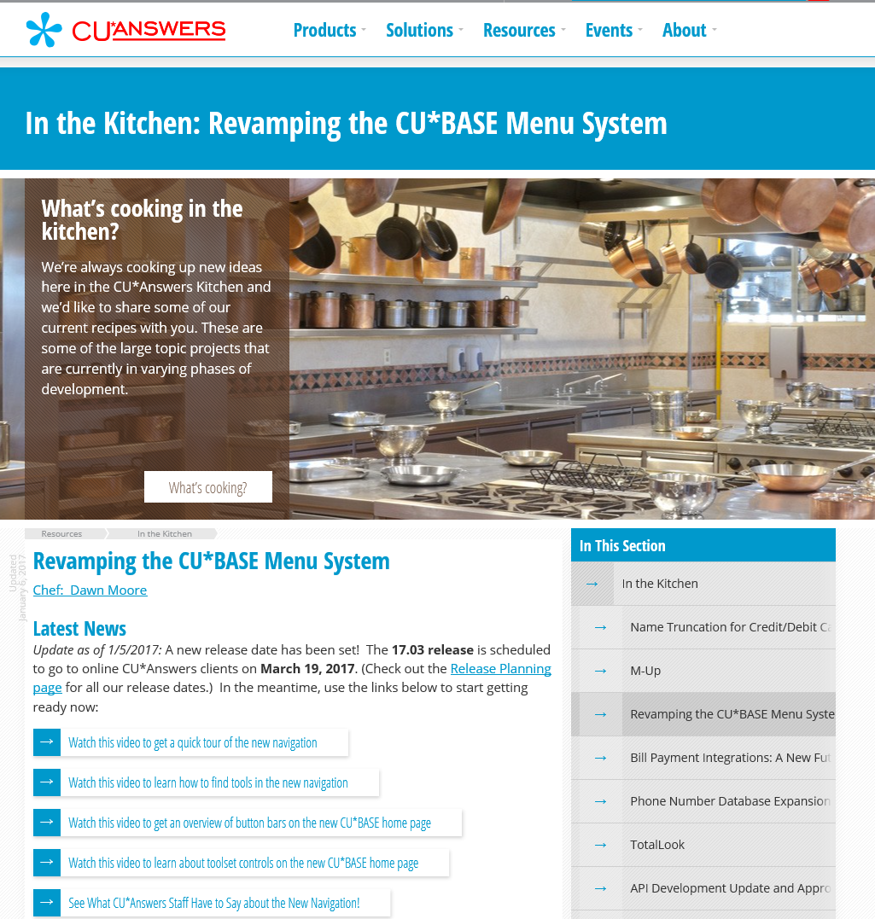
Keeping up with news about the rollout...
https://www.cuanswers.com/resources/kitchen/
Ask us about an Employee CU*BASE Security Review for your credit union!
auditlink.cuanswers.com

