Slide 1
Governance
FFIEC Risk Assessment
Building a Solid
Cybersecurity
Foundation
Risk Based Audit Program
Encryption (DLP)
Cyber Security Policy
Change
Management
Physical Security
Logical (Computer) Security
NACUSO Las Vegas
April 4, 2016
PLATINUM PARTNER

Slide 2
Your Presenter
Patrick Sickels, CU*Answers
Internal Auditor for 9 years
Financial Compliance for 6 years
Attorney in Michigan
Member of ISACA
Patrick Sickels
Overview
Fundamentals
Dave Wordhouse
W10
RSA
Jim Vilker
Vendors
CU*BASE
Show case
Jim Lawrence
DR/BR and Cybersecurity
12.00

Slide 3
Cybersecurity Fundamentals
Governance
Risk Based Assessment
FFIEC Risk Assessment
Knowledge
and
Best Practices
Response Program
Risk Based Audit Program
Encryption (DLP)
Business Resumption
InfoSec
Program
Cyber Security Policy
Risk Mitigation (Contractual)
(Insurance)
Segregation of Duties
Change
Management
Physical Security
Vendor Management
Network Monitoring and Intrusion Detection
Logical (Computer) Security

Slide 4
Old Wine New Bottles
03
Fundamental Position of CU*Answers is that Cybersecurity does not fundamentally alter the requirements of protecting member information.
History
Notes:
Important to use new names, show that you are paying attention.

Slide 5
When do you need a Cybersecurity Program?
03
Personally Identifiable Financial Information of Members
History
Trade Secrets or other Privileged Information from a Financial Institution

Slide 6
Source: gemalto

Slide 7
Credit Unions: Industry Stats
01
06
2015 largest credit union breach:
Winston-Salem based Piedmont Advantage CU ($308M)
Had to notify 46,000 members of a missing laptop that contained PII
2014 Average spend on Cybersecurity: $136K (source: NAFCU)
2014 Average spend costs associated with merchant data breaches: $226K (source: NAFCU)
Notification law is based on where the member resides
Firewall Run Sheets
System Change Controls
Network Run Sheets
Respect & Best Service for our Customers
DR/BR Program
System Change Controls
FM200 Fire Suppression
High Availability
Respect & Best Service for our Customers
Source: CU Times/ Safenet

Slide 8
CFPB: UDAAP (Unfair/Deceptive Practice)
01
06
2016 first action by CFPB on cybersecurity:
Online payment processor
Accused of lying about PCI Compliance
Accused of lying about their security procedures (encryption)
Released apps without testing security
Fined $100,000
Cease and Desist Order
Fix application release process
FTC claims the same authority (Wyndam Hotels)
Firewall Run Sheets
System Change Controls
Network Run Sheets
Respect & Best Service for our Customers
DR/BR Program
System Change Controls
FM200 Fire Suppression
High Availability
Source: CFPB

Slide 9
Governance
Oversight and Reports
01
06
“Does the board of directors approve of and oversee the development, implementation, and maintenance of the program, including assigning specific responsibility for its implementation and reviewing reports from management?”
On an annual basis, make sure the Board Minutes reflect that the Information Security (and Cybersecurity Policy) were approved by the board. What else?
Respect & Best Service for our Customers

Slide 10
Governance
Oversight and Reports
01
06
Reports of Policy Violations
Reports of Internal and External Audit Exceptions
History
Reports of Incident Responses

Slide 11
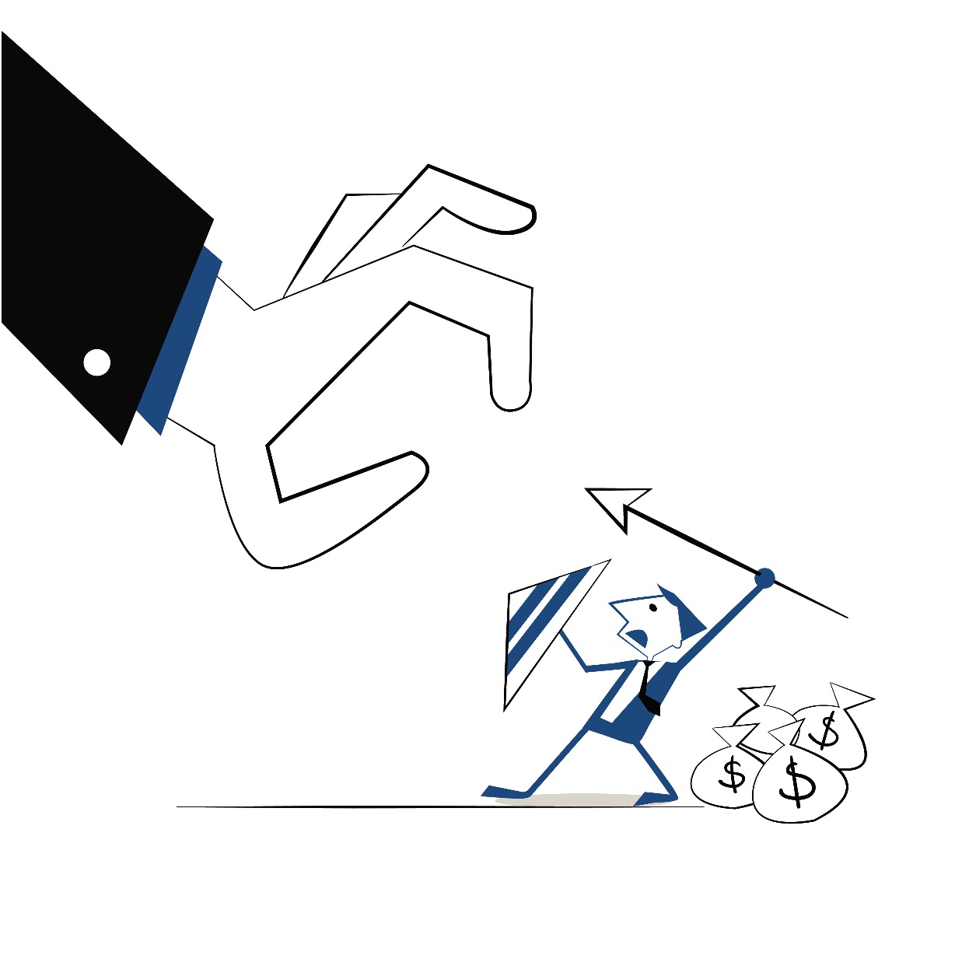
Governance
Oversight and Reports
01
06
Remember, it is okay to fight (especially when it comes to business)

Slide 12
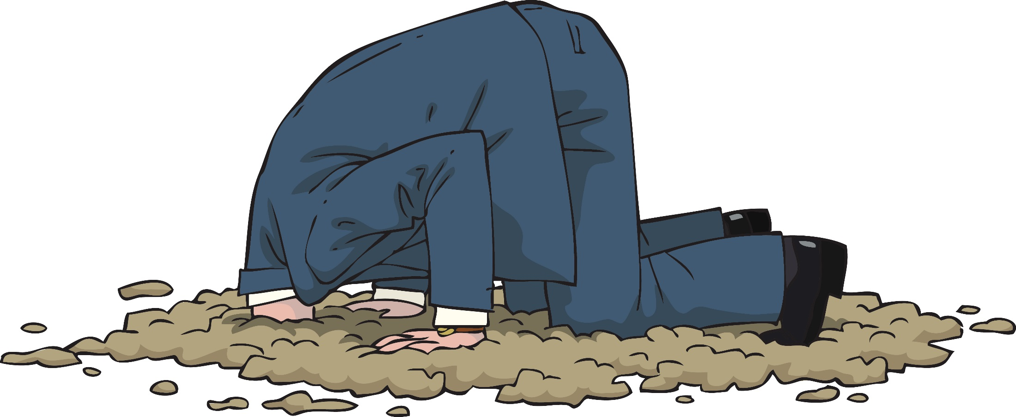
Governance
Oversight and Reports
01
06

Slide 13
Cyber Security Policy
InfoSec
Program
Comprehensive InfoSec Plan
01
04
“… a comprehensive written information security program including administrative, technical, and physical safeguards appropriate to the nature and scope of its activities“
Add the word Cybersecurity to your InfoSec Plan or even create a brand new Cybersecurity Policy. Your Cybersecurity Policy can state what your employees are responsible for.

Slide 14
Cyber Security Policy
InfoSec
Program
Comprehensive InfoSec Plan
01
05
“… ensure the security and confidentiality of member information; protect against any anticipated threats or hazards to the security or integrity of such information; and protect against unauthorized access to or use of such information that could result in substantial harm or inconvenience to any member”
Respect & Best Service for our Customers

Slide 15
Logical (Computer) Security
Logical Access Controls
01
01
06
05
“… Access controls on member information systems, including controls to authenticate and permit access only to authorized individuals and controls to prevent employees from providing member information to unauthorized individuals who may seek to obtain this information through fraudulent means”
Identify systems with member info
Regularly determine who has access
Reasonably remove access in a timely fashion

Slide 16
Physical Security
Physical Access Controls
01
06
“… Access restrictions at physical locations containing member information, such as buildings, computer facilities, and records storage facilities to permit access only to authorized individuals”
Identify physical locations with member data
Regularly determine who has access
Reasonably remove access in a timely fashion

Slide 17
Encryption (DLP)
Data Encryption Data Loss Prevention
01
06
“… Encryption of electronic member information, including while in transit or in storage on networks or systems to which unauthorized individuals may have access”
Encryption Controls for Sending (email)
Encryption Controls for at Rest
USB Ports CD-W
Email Detection

Slide 18
Network Monitoring and Intrusion Detection
Intrusion Detection and Prevention
01
06
“… monitoring systems and procedures to detect actual and attempted attacks on or intrusions into member information systems”
Respect & Best Service for our Customers
Intrusion detection systems work by either looking for signatures of known attacks or deviations of normal activity. These deviations or anomalies are pushed up the stack and examined at the protocol and application layer.

Slide 19
Change
Management
System Modifications
Change Controls
01
06
“… Procedures designed to ensure that member information system modifications are consistent with the … information security program”
Do you patch? (One of the most important)
System checklists (Server builds)
Change management doesn’t override security

Slide 20
Segregation of Duties
Segregation of Duties
01
06
“… Dual controls procedures, segregation of duties, and employee background checks for employees with responsibilities for or access to member information”
Background Checks
Segregation of Duties
Dual Controls

Slide 21
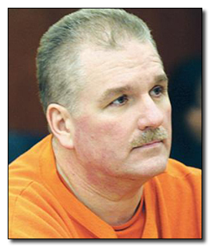
Segregation of Duties
Terry Childs
01
06
Network Manager for the City of San Francisco
Designed their FiberWAN and even received a copyright for it
Was the only person with passwords, and the only person who could support it (completely protective of his turf)
Network was being audited without his knowledge (he claimed theft and intrusion by the security professional doing the audit)
They demanded the usernames and passwords for the network and he would not give the passwords to the city
He was arrested and finally gave the information directly to the Mayor, who visited him in his cell
Sentenced to four years on a felony account of computer tampering, and ordered to pay $1.5m in fines

Slide 22
Response Program
Response Program
01
06
“… Response programs that specify actions to be taken when … unauthorized individuals have gained access to member information systems, including appropriate reports to regulatory and law enforcement agencies”
Notify Clients
Notify Vendors
Notify Law Enforcement
Firewall Run Sheets
System Change Controls
Network Run Sheets
Respect & Best Service for our Customers

Slide 23
Business Resumption
Business Resumption
01
06
“… Measures to protect against destruction, loss, or damage of member information due to potential environmental hazards, such as fire and water damage or technical failures”
Environment Protection (fire, moisture, heat)
Backups (restoration in time and restoration far enough back)
Testing the Plan at least annually

Slide 24
Business Resumption
Six Lines of Code
01
06
Tim Lloyd was an 11 year network engineer with Omega Engineering
He was angry at a demotion and was eventually fired for insubordination
He wrote six lines of code that deleted all of Omega’s software
Omega did not have sufficient backups
Omega stayed in business but laid off 80 employees and lost $10 million in sales
1. 7/30/96
2. F:
3. F:\LOGIN\LOGIN 12345
4. CD \PUBLIC
5. FIX.EXE /Y F:\*.*
6. PURGE F:\ /ALL

Slide 25
Vendor Management
Vendor Management
01
06
“… Measures to protect against destruction, loss, or damage of member information due to potential environmental hazards, such as fire and water damage or technical failures”
Environment Protection (fire, moisture, heat)
A Business Resumption Plan
Testing the Plan at least annually

Slide 26
Risk Mitigation (Contractual)
(Insurance)
Cyber Liability Insurance
01
06
We will not give an opinion on the quality of a particular carrier’s insurance. Our recommendation is to ensure that your organization has a clear understanding of:
Coverage (example: member notification)
Exclusions (very critical)
Payout triggers
Carrier control
Limitations
Deductibles

Slide 27
Knowledge
and
Best Practices
Knowledge and Best Practices
01
06
Cybersecurity Resources
Firewall Run Sheets
System Change Controls
Network Run Sheets
Respect & Best Service for our Customers
DR/BR Program
System Change Controls
FM200 Fire Suppression
High Availability
Respect & Best Service for our Customers
http://www.cuanswers.com/resources/cybersecurity/

Slide 28
Knowledge
and
Best Practices
Knowledge and Best Practices
01
06
Cybersecurity Resources
Firewall Run Sheets
System Change Controls
Network Run Sheets
Respect & Best Service for our Customers
DR/BR Program
System Change Controls
FM200 Fire Suppression
High Availability
Respect & Best Service for our Customers

Slide 29
Knowledge
and
Best Practices
Knowledge and Best Practices
01
06
Cybersecurity Resources
CU*Answers Cybersecurity Policy (PDF)
CU*Answers Information Security Policy (PDF)
CU*Answers Acceptable Use Policy (PDF)
Cybersecurity Policy Template for Credit Unions (Word)
Information Security Program for Credit Unions (Word)
Acceptable Use Policy Template for Credit Unions (Word)
Firewall Run Sheets
System Change Controls
Network Run Sheets
Respect & Best Service for our Customers
DR/BR Program
System Change Controls
FM200 Fire Suppression
High Availability
Respect & Best Service for our Customers

Slide 30
Knowledge
and
Best Practices
Knowledge and Best Practices
01
06
Cybersecurity Resources
The Critical Security Controls for Effective Cyber Defense Version 5.0
Firewall Run Sheets
System Change Controls
Network Run Sheets
Respect & Best Service for our Customers
DR/BR Program
System Change Controls
FM200 Fire Suppression
High Availability
Respect & Best Service for our Customers
https://www.sans.org/media/critical-security-controls/CSC-5.pdf

Slide 31
Knowledge
and
Best Practices
Knowledge and Best Practices
01
06
Cybersecurity Resources
System Change Controls
Network Run Sheets
Respect & Best Service for our Customers
DR/BR Program
System Change Controls
FM200 Fire Suppression
High Availability
Respect & Best Service for our Customers
http://www.asd.gov.au/publications/Mitigation_Strategies_2014.pdf

Slide 32
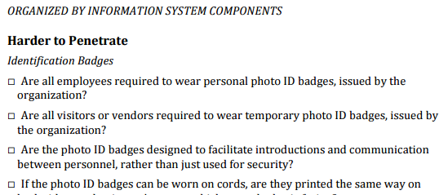
Knowledge
and
Best Practices
Cybersecurity Checklist
01
06
Plain-language checklist
Basic controls to protect systems and data
Easy to understand
Not an official standard, but one we need to pay attention to
Over 1,000 items
Usccu.us
Firewall Run Sheets
System Change Controls
Network Run Sheets
Respect & Best Service for our Customers
DR/BR Program
System Change Controls
FM200 Fire Suppression
High Availability
Respect & Best Service for our Customers

Slide 33
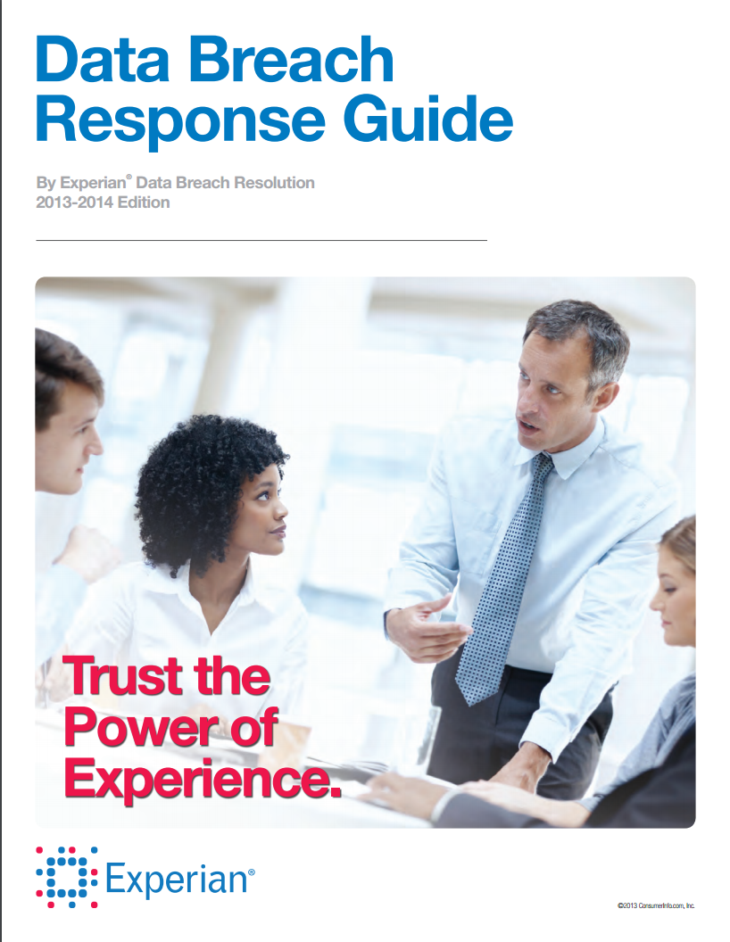
Knowledge
and
Best Practices
Incident Response: Tactics
01
06
Test the plan before a breach
Identify the breach response team
Have a communications plan locked and loaded
Understand regulations and contracts that govern post-breach obligations
Determine what experts you will engage in advance
Respond in an “all out fashion” when breach detected
Preserve evidence
Engage insurance carrier
Engage regulators and law enforcement early
Firewall Run Sheets
System Change Controls
Network Run Sheets
Respect & Best Service for our Customers
DR/BR Program
System Change Controls
FM200 Fire Suppression
High Availability
Respect & Best Service for our Customers

Slide 34
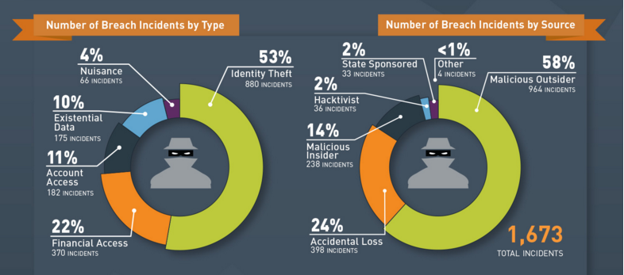
Source: gemalto

Slide 35
FFIEC Risk Assessment
FFIEC Cybersecurity Tool
01
06
Risk Matrix
Firewall Run Sheets
System Change Controls
Network Run Sheets
Respect & Best Service for our Customers
DR/BR Program
System Change Controls
FM200 Fire Suppression
High Availability
Respect & Best Service for our Customers
http://www.cuanswers.com/wp-content/uploads/FFIEC-Cybersecurity-Assessment-Inherent-Risk-Base-Worksheet.xlsx

Slide 36
FFIEC Risk Assessment
FFIEC Cybersecurity Tool
01
06
Maturity Models
http://www.cuanswers.com/wp-content/uploads/FFIEC-Cybersecurity-Assessment-Tool-2.xlsx
Firewall Run Sheets
System Change Controls
Network Run Sheets
Respect & Best Service for our Customers
DR/BR Program
System Change Controls
FM200 Fire Suppression
High Availability
Respect & Best Service for our Customers

Slide 37
FFIEC Risk Assessment
FFIEC Cybersecurity Tool
01
06
Maturity Models
First of all, the Maturity Model statements are not well correlated to the risks identified in the FFIEC Inherent Risk Tool.
Second, there is a significant amount of arbitrariness in the ranking of the various Maturity levels. (The FFIEC
requires that a financial institution meet all of the categories of one Maturity before moving on to the next level). For example, to get to the “Advanced” Maturity of Oversight, an institution must be able to answer affirmatively that “The budget process for requesting additional cybersecurity staff and tools maps current resources and tools to the cybersecurity strategy.” This requirement is not well thought out and does not seem to have a clear relationship to cybersecurity. Clarity of expected output is missing in many of the Maturity Tool statements.
In addition, there are certain categories that do not appear at all to be relevant in the credit union space. Very few credit unions will be able to answer that “Supply chain risk is reviewed before the acquisition of mission-critical information systems including system components.”
System Change Controls
Network Run Sheets
Respect & Best Service for our Customers
DR/BR Program
System Change Controls
FM200 Fire Suppression
High Availability
Respect & Best Service for our Customers

Slide 38
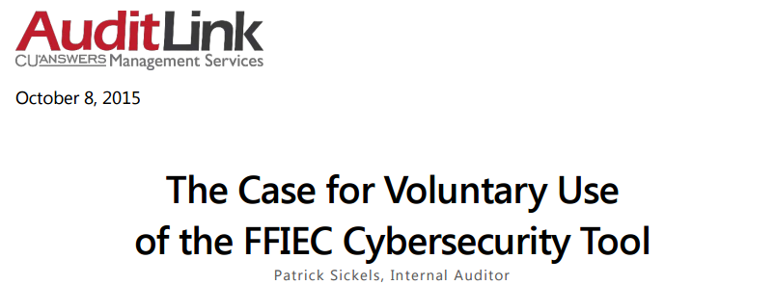
FFIEC Risk Assessment
FFIEC Cybersecurity Tool
01
06
Maturity Models
http://www.cuanswers.com/wp-content/uploads/The-Case-for-Voluntary-Use-of-the-FFIEC-Cybersecurity-Tool-v2.pdf
Firewall Run Sheets
System Change Controls
Network Run Sheets
DR/BR Program
System Change Controls
FM200 Fire Suppression
High Availability
Respect & Best Service for our Customers

Slide 39
Breach Prevention or Breach Management?
01
06
The evidence shows breaches cannot be stopped
Prevention strategies are still important but in 2016 the focus and priorities will shift to breach acceptance strategies
Breach Acceptance Tactics/Perspective:
Incident Response Plan Priority
Data security centric
Sliding scale authentication strategies
Refocus on the endpoint
Firewall Run Sheets
System Change Controls
Network Run Sheets
Respect & Best Service for our Customers
DR/BR Program
System Change Controls
FM200 Fire Suppression
High Availability
Respect & Best Service for our Customers

Slide 40
Incident Response: Data Security Centric Tactics
01
06
Data will be moved across systems
Containing data reduces value to end users
Think “Big Data” / “Data Warehouses” / Cloud computing
Encryption of PII data
PII data that has been encrypted is less valuable to attackers
Increasing the cost of attacking your organization will significantly reduce the threat of a breach (attackers have costs, too).
Encrypt PII data everywhere it is at rest (i.e. stored), regardless of system
Encrypt PII data motion on the network
Firewall Run Sheets
System Change Controls
Network Run Sheets
Respect & Best Service for our Customers
DR/BR Program
System Change Controls
FM200 Fire Suppression
High Availability
Respect & Best Service for our Customers

Slide 41
Encryption: “Gotchas”
01
06
Encryption increases the cost of an attack – that’s good
Encryption increases costs to the organization – that’s reality
Key management – protecting the material that encrypts the data
Do you have a key management policy?
How do you keep key material secure / private?
Encryption is under attack
SSLv2; SSLv3, TLS, SSH, etc.
Successfully attacking even weak encryption is still hard
Encryption requires maintenance
Patching / Compatibility issues
Moving to new forms is expensive and requires coordination with members/partners
Network security devices (firewalls/IDS/IPS) can’t inspect encrypted traffic for threats
Firewall Run Sheets
System Change Controls
Network Run Sheets
Respect & Best Service for our Customers
DR/BR Program
System Change Controls
FM200 Fire Suppression
High Availability
Respect & Best Service for our Customers

Slide 42
Data Breach Management: User Authentication/Access Tactics
01
06
More authentication types than we can shake a stick at (passwords, biometrics, one-time passwords, cell phones, USB sticks, etc.)
A data-centric perspective on security:
Authentication barriers based on the context of the user action
Layers of authentication based on the risk
Sliding scale of authentication barriers based on the risk of the request/transaction
Outsourcing authentication
Can outside experts make authentication decisions more accurately than we can?
Will members demand external authentication (cell phones, google authenticator, etc.?)
How will internal/external authentication processes be layered/implemented?
Firewall Run Sheets
System Change Controls
Network Run Sheets
Respect & Best Service for our Customers
DR/BR Program
System Change Controls
FM200 Fire Suppression
High Availability
Respect & Best Service for our Customers

Slide 43
User Authentication Tactics: Your Network
01
06
When will we shift to sliding-scale risk based authentication for internal/network users?
When will passwords be relegated to low-risk activities only?
Readily available systems can compromise 19 character passwords in less than 3 weeks (low cost to attacker)
27% of US employees would sell their passwords for $1,000 or less (source: Sailpoint.com survey)
Password strength is NOT improving (#1 password is still 123456 and #2 is password)
What you will budget over the next 3 years to implement a tactic to address this concern
Firewall Run Sheets
System Change Controls
Network Run Sheets
Respect & Best Service for our Customers
DR/BR Program
System Change Controls
FM200 Fire Suppression
High Availability
Respect & Best Service for our Customers

Slide 44
Breach Management: Refocus on the Endpoint
01
06
Users interact with PII at the workstation/PC/laptop (endpoint)
Bad actors are targeting the workstation to exfiltrate PII
They will also target mobile devices in hopes they’ll find your PII there
They are overwhelming traditional AV solutions with sheer volumes of malware
You need a plan for assessing workstation security and addressing weaknesses in 2016
Firewall Run Sheets
System Change Controls
Network Run Sheets
Respect & Best Service for our Customers
DR/BR Program
System Change Controls
FM200 Fire Suppression
High Availability
Respect & Best Service for our Customers

Slide 45
Breach management: Mobile Strategies
01
06
Have a policy that governs use of mobile devices and PII
Implement technical controls that can wipe mobile devices
Audit mobile devices against the policy and software updates
Educate users on security best practices
Firewall Run Sheets
System Change Controls
Network Run Sheets
Respect & Best Service for our Customers
DR/BR Program
System Change Controls
FM200 Fire Suppression
High Availability
Respect & Best Service for our Customers

Slide 46
Pros and Cons of Cloud Computing
01
06
Pros
Low start up costs
Automatic software upgrades
Ease of use
Ease of access – internet connection
Scalability – provided by cloud provider
Security – cloud providers like Microsoft take it seriously
Cons
Subscription based pricing means you’re never done paying
Less flexibility
Security – lack of visibility into what’s happening under the covers
On site technology not eliminated – still require some infrastructure
Firewall Run Sheets
System Change Controls
Network Run Sheets
Respect & Best Service for our Customers
DR/BR Program
System Change Controls
FM200 Fire Suppression
High Availability
Respect & Best Service for our Customers

Slide 47
Govern- ance
FFIEC Risk Assessment
Risk Based Audit Program
Encryption (DLP)
Questions?
Cyber Security Policy
Change
Management
Physical Security
Logical (Computer) Security

