Slide 1

Building Blocks to
Online Account Opening
Precise ID
Online Identification Verification
May 19
3-4 PM ET
Part of the FREE Webinar Series

Slide 2
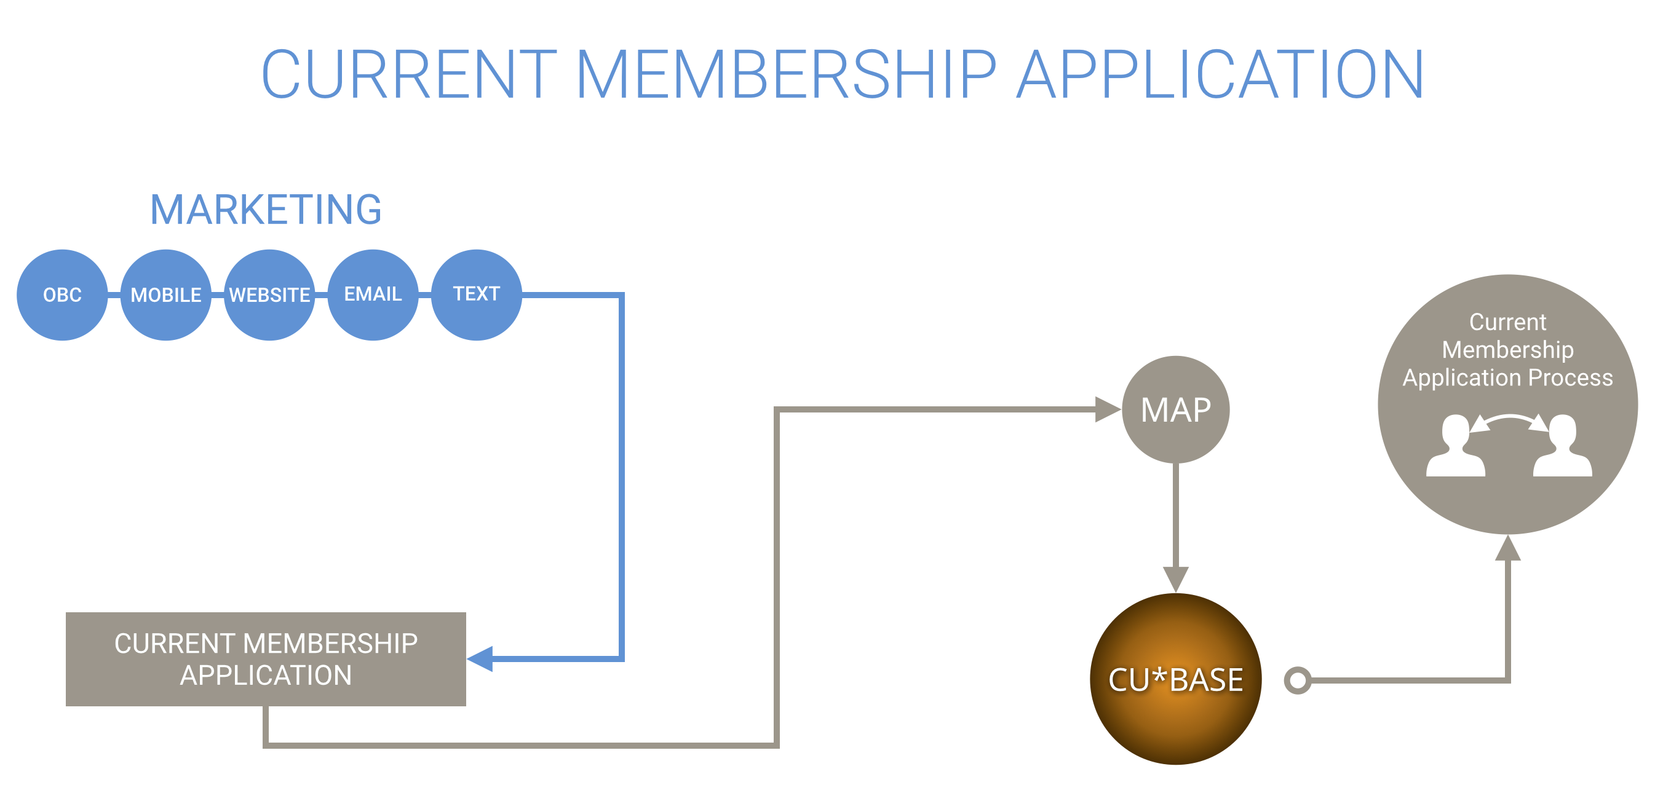


Slide 3
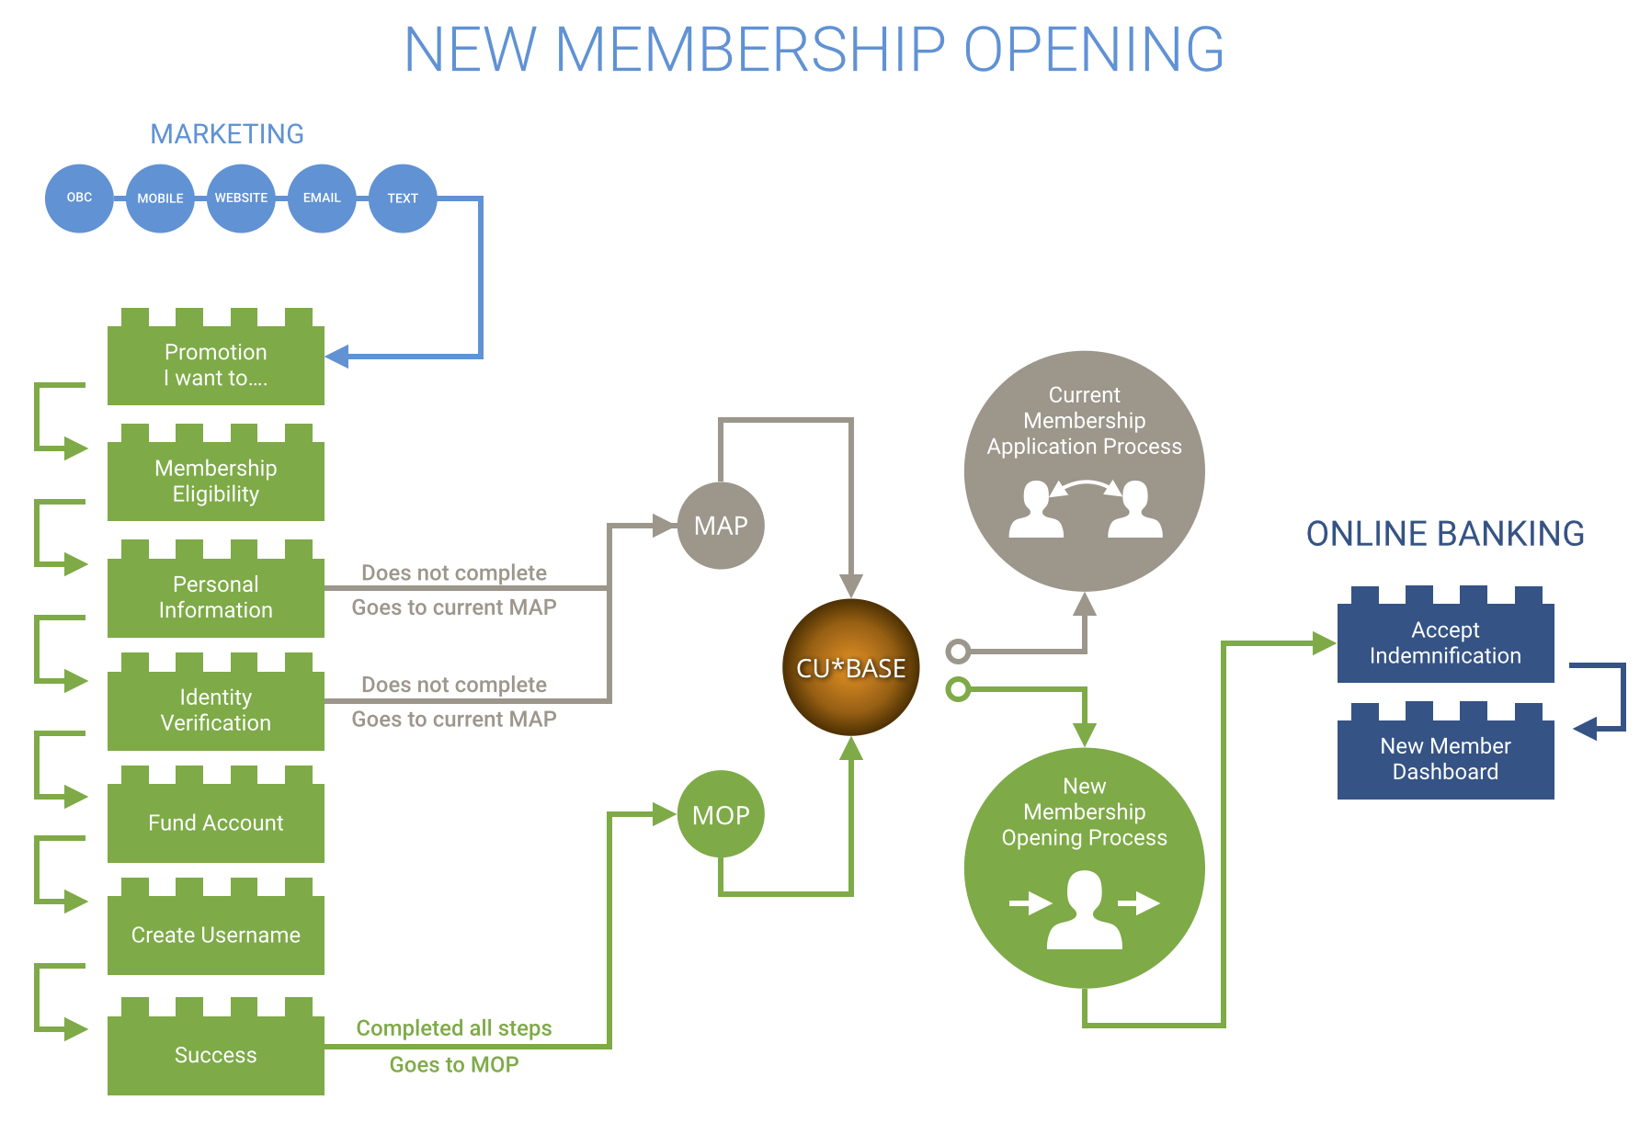


Slide 4
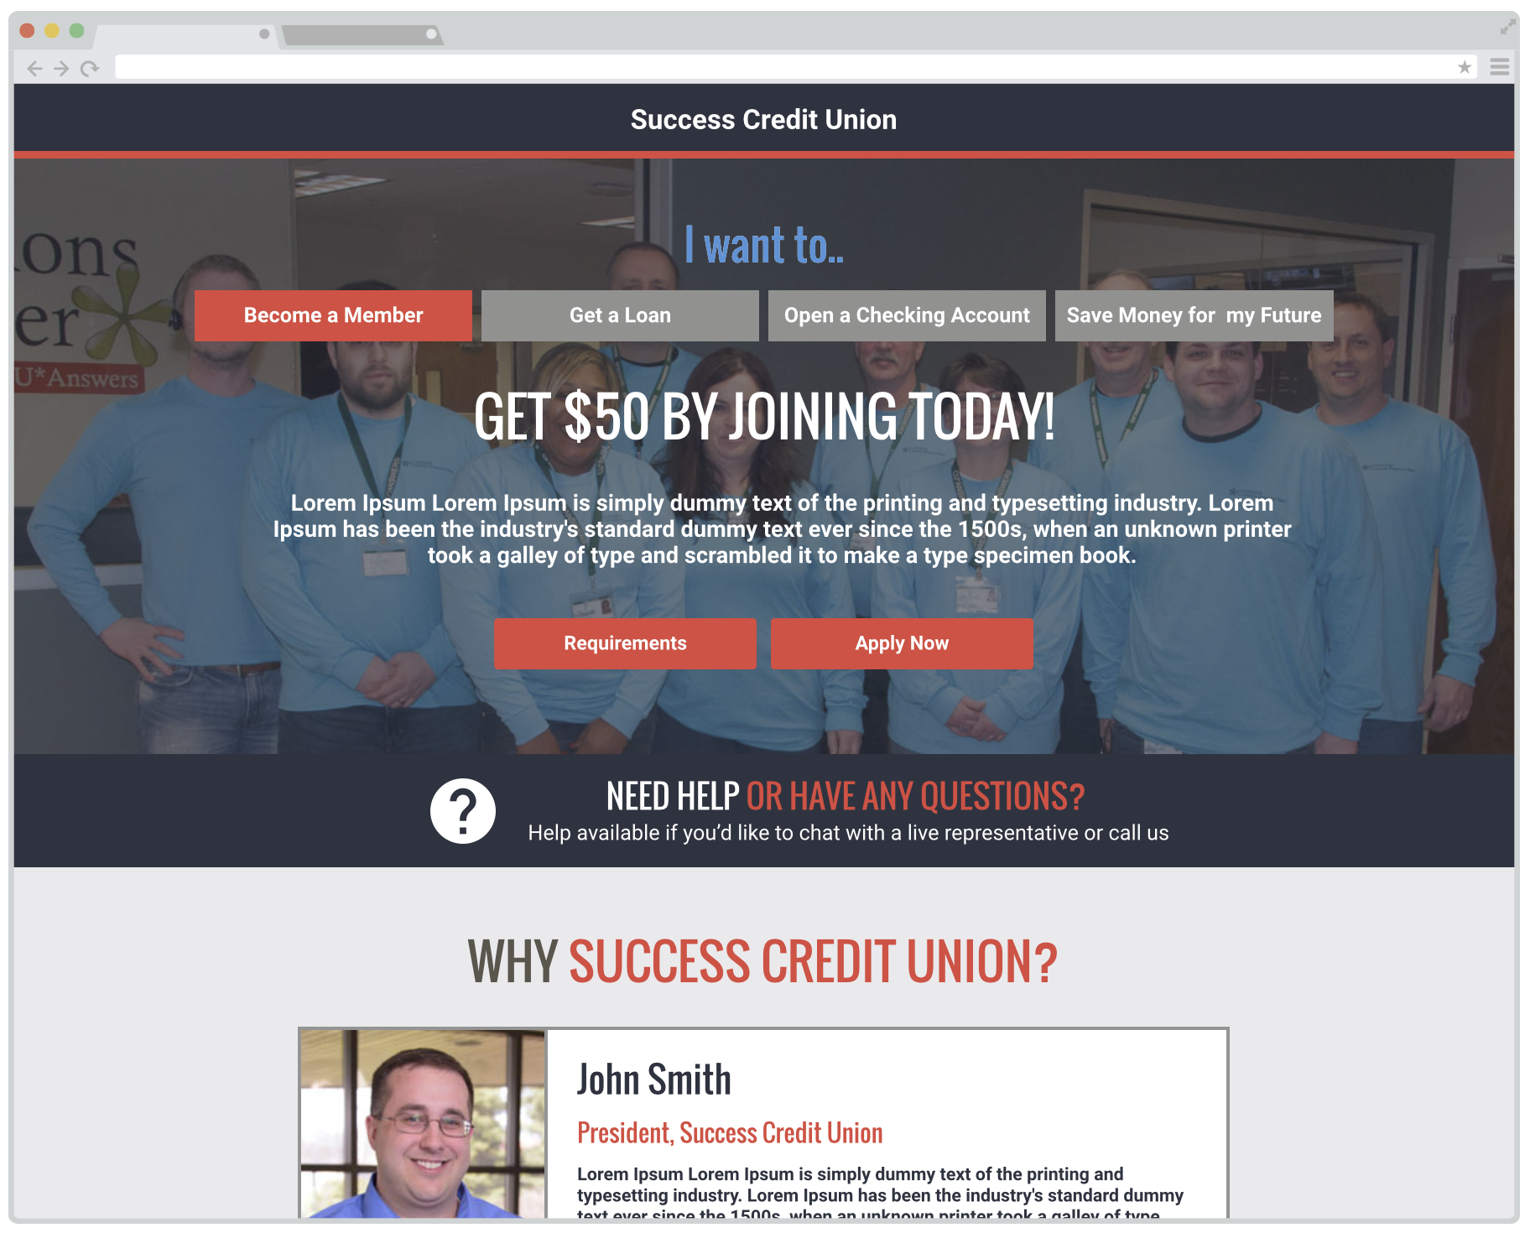

Slide 5
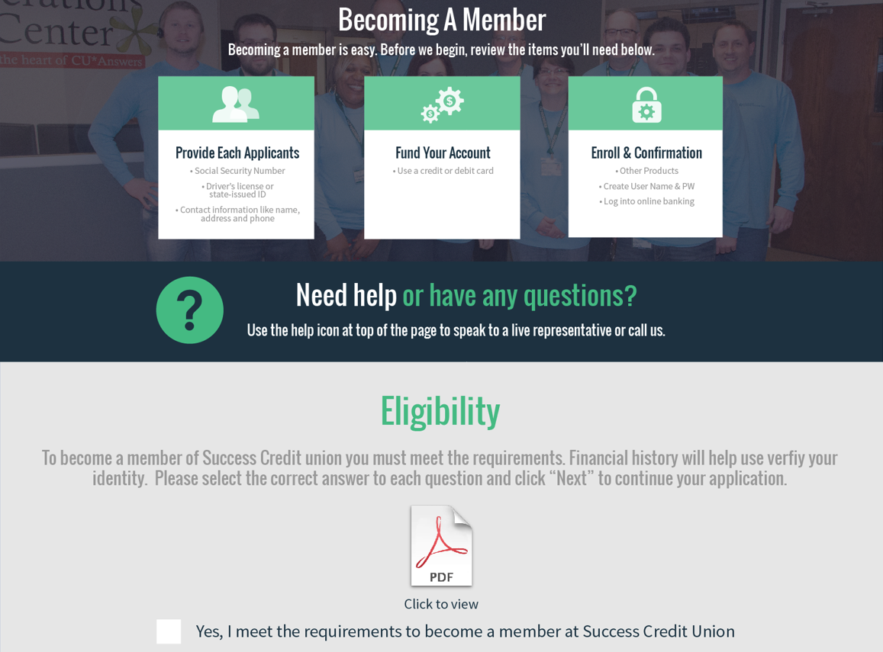

Slide 6
Personal
Information

Slide 7

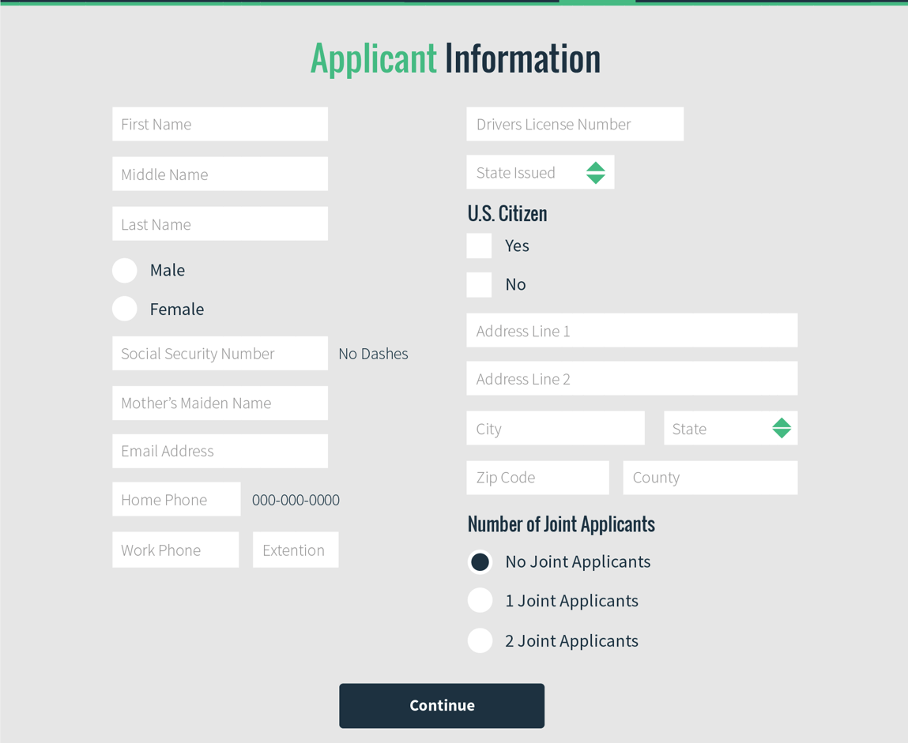

Slide 8
Identification
Verification

Slide 9

Agenda
Precise IDSM for
Account Opening
FRAUD LANDSCAPE & CHALLENGES
THE PRODUCT IN ACTION
QUESTIONS & ANSWERS
IMPACT ON OUR CLIENTS
SOLVING THE PROBLEM
Notes:
I’d like to frame this review with the items listed here on the Agenda.
First, we’ll review the fraud landscape and challenges our credit union clients are facing in this area.
We’ll then review the actual solution offering, Precise ID with Knowledge IQ and review a sample process flow of how the transactions flow through the decision engine.

Slide 10




Pressure to be a steward of identity and
behavioral information
TECHNOLOGY
ECONOMIC
SOCIAL
OPERATIONS
Expanded use of mobile devices has made the Internet a covert and fertile breeding ground tor fraudsters
As fraud grows in complexity and magnitude, the potential for losses and rising operational costs is increasing
Limitless choices and options makes the need to minimize friction on existing relationships a primary member experience concern
Know Your Customer and Customer Identification Program accountability and urgency can strain operations and increase costs
HIGHER COST AND COMPLEXITY

Slide 11



The fraud landscape
Threats continue to grow and evolve
INDUSTRIALIZATION OF FRAUD
PHISHING
10,000
Estimated number of fraud rings in the U.S. alone
80%
Annual increase in phishing attacks
DATA BREACHES
MALWARE
2,200,000,000
The number of records exposed as a result of data breaches in 2014
75,000,000
Estimated annual unique strains of malware
Source: Risk Based Security/Open Security Foundation, Data Breach Quick View (February 2014)

Slide 12

Precise IDSM
Summary of services
Precise IDSM is a single-platform hosted solution that delivers real-time or batch identity authentication services across various customer lifecycle process points. Precise ID enables holistic fraud prevention and identity authentication via the customizable delivery of:
Identity and identity element validation and verification results
High risk condition alerts
Relational data appends
Identity transactional link analysis and risk assessment
Identity risk scores and attributes
Knowledge-based authentication via Knowledge IQ component
Decisioning strategies
Notes:
Precise ID is Experian’s flagship Fraud and Identity authentication platform. It is a hosted solution delivering identity authentication services in both real time and batch offerings. Clients may implement Precise ID directly into your member facing or internal applications such as for online account opening or leverage our web user interface for operational use at the credit union.
PID was launched in 2005. Today we’re processing over 150 MM transactions per year, operating in industries such as Financial Services, public Sector, e-commerce, automotive lending, direct to consumer, healthcare, telecommunications, and many more.
What you get:
Checks of your customer’s name, address, SSN, date of birth, and more against our files
Alerts if that information appears risky
Useful data appended, like previous addresses and when first seen
Fraud score summarizing risk, and recommended decision
An IT-friendly, single point of contact for multiple layered authentication

Slide 13







The more we know about your members…
The better you can serve them
Our business is information…enhanced by powerful analytics…
CONSUMER
CREDIT
500m plus consumers
globally
BUSINESS
CREDIT
c. 50m businesses
globally
VEHICLE HISTORIES
c. 65m
vehicles
in US & UK
INSURANCE DATABASES
c. 30m
policies in UK
CATALOG PURCHASING HABITS
c. 110m US households
CONSUMER
MARKETING
c. 110m US households
INTERNET
TRAFFIC DATA
Daily internet usage of over 25m consumers
LOAN
MONEY TO CONSUMERS
EXTEND
CREDIT TO BUSINESS
DETERMINE NEW CAR PURCHASE
PAY ON INSURANCE CLAIMS
OFFER PRODUCTS TO CONSUMERS
SEND
CONSUMERS
OFFER
MONITOR WEBSITE PERFORMANCE
…equals real customer insights and profits

Slide 14

Precise ID - Precise Match
What is Precise Match?
DATABASE ENGINE POWERING PRECISE ID
Precise ID database engine that represents Experian's next generation of demographic and identity element matching.
IMPROVED SEARCH AND MATCH LOGIC
Enhanced match result codes across several confidence levels, clients can reduce fraud and increase customer approval rates
ROBUST DATA ASSET ENHANCEMENTS
Incorporation of new data elements used to drive better decisions
INCREASED GRANULARITY
Increased granularity and standardized descriptions for name and address results

Slide 15

Precise Match
Search and Match Logic
Each match situation receives a unique match code rank-ordered by match confidence then split out into 6 groups for decisioning.
Every application is assigned one out of over 400 results codes that describe the match condition.
  Level 5: (7) Exact Match Conditions
  Level 4: (66) High Confidence Match Conditions (minor amount of typos)
    Example: C1- Misspelling of either first OR last name; Exact match on address
  Level 3: (142) Partial Match Conditions (medium typos)
    Example: G1 - First name does not match or is missing, exact match on last name; Exact match on address
  Level 2: (171) Low Confidence Partial Matching Conditions
    Example: G6 - First name does not match or is missing, exact match on last name; No match to street number (all other fields match)
  Level 1: (54) No Match with Detail
    Example: G4 - First name does not match or is missing, exact match on last name; Different Street number and different street name (all other fields match)
  Level 0: (2) No Match without Detail

Slide 16

Knowledge Based Authentication evolution
Unweighted questions only
Without question weighting, and
without incorporating a behind-the-scenes fraud score, there are only a few possible degrees of freedom in the outcome of
a KBA session
This provides less decisioning flexibility,
and less granularity in being able to find that sweet spot of a low fraud rate and low false positive rate
KBA score Example with four questions
0 | 25 | 50 | 75 | 100
Fail | Fail | Fail | Pass | Pass

Slide 17
Knowledge Based Authentication evolution
Score and unweighted questions
When you include a fraud score into your KBA decisioning strategy, you create a matrix with which to decision
You end up with many more degrees of freedom in your ability to decision
In this example, a customer getting
a very high-risk fraud score (1-299)
will have to get 100% of questions correct to pass
In this example, a customer getting
a very low-risk fraud score (755-999) will only have to get 25% of
questions correct to pass
 | KBA score Example with four questions
Fraud score | 0 | 25 | 50 | 75 | 100
1 – 299 | Fail | Fail | Fail | Fail | Pass
300 – 364 | Fail | Fail | Fail | Fail | pass
365 – 429 | Fail | Fail | Fail | Pass | Pass
430 – 489 | Fail | Fail | Fail | Pass | Pass
490 – 529 | Fail | Fail | Fail | Pass | Pass
530 – 569 | Fail | Fail | Pass | Pass | Pass
570 – 624 | Fail | Fail | Pass | Pass | Pass
625 – 679 | Fail | Fail | Pass | Pass | Pass
680 - 754 | Fail | Pass | Pass | Pass | Pass
755 – 999 | Fail | Pass | Pass | Pass | Pass

Slide 18
Knowledge Based Authentication evolution
Score and weighted questions
 | KBA score
Fraud score | 0-9 | 10-19 | 20-29 | 30-39 | 40-49 | 50-59 | 60-69 | 70-79 | 80-89 | 90-99 | 100
1 – 299 | Fail | Fail | Fail | Fail | Fail | Fail | Fail | Fail | Fail | Pass | Pass
300 – 364 | Fail | Fail | Fail | Fail | Fail | Fail | Fail | Fail | Pass | Pass | Pass
365 – 429 | Fail | Fail | Fail | Fail | Fail | Fail | Fail | Pass | Pass | Pass | Pass
430 – 489 | Fail | Fail | Fail | Fail | Fail | Fail | Pass | Pass | Pass | Pass | Pass
490 – 529 | Fail | Fail | Fail | Fail | Fail | Fail | Pass | Pass | Pass | Pass | Pass
530 – 569 | Fail | Fail | Fail | Fail | Fail | Pass | Pass | Pass | Pass | Pass | Pass
570 – 624 | Fail | Fail | Fail | Fail | Pass | Pass | Pass | Pass | Pass | Pass | Pass
625 – 679 | Fail | Fail | Fail | Fail | Pass | Pass | Pass | Pass | Pass | Pass | Pass
680 - 754 | Fail | Fail | Fail | Pass | Pass | Pass | Pass | Pass | Pass | Pass | Pass
755 – 999 | Fail | Fail | Pass | Pass | Pass | Pass | Pass | Pass | Pass | Pass | pass
Score plus weighted questions allows for the greatest possible fraud risk stratification in a decision matrix
This granularity helps to achieve more precise performance results
in both the fraud rate and the pass rate

Slide 19
Precise ID with Knowledge IQ
How it works
KNOWLEDGE IQSM
A dynamic identity tool that evaluates true consumers by questions generated from a wide dataset of personal information and is used in combination with an identity-based risk score.
.
WEBSITE
NAME + ADDRESS
MORE INFO AS AVAILABLE
PASS
CALL CENTER
QUESTIONS GENERATED
SCORE & QUIZ EVALUATED
DECISION
FCRA-BASED AGGREGATED SCORE
PRECISE MATCHSM CODES
HIGH-RISK ATTRIBUTES
INTERNAL CHECKS
EXTERNAL THIRD PARTY CHECKS
NO PASS
FACE TO FACE
PERFORMANCE REPORTING

Slide 20

Precise ID with Knowledge IQ
Setup
Experian provides a best practice default configuration while enabling customization for each credit union
QUESTION CONFIGURATION
SCORING MATRIX
SELECTION
MULTI-LAYERED
WEIGHTING
CONFIGURABLE
ORDER
OVERRIDES
CUSTOM TEXT
VELOCITY CHECKS

Slide 21
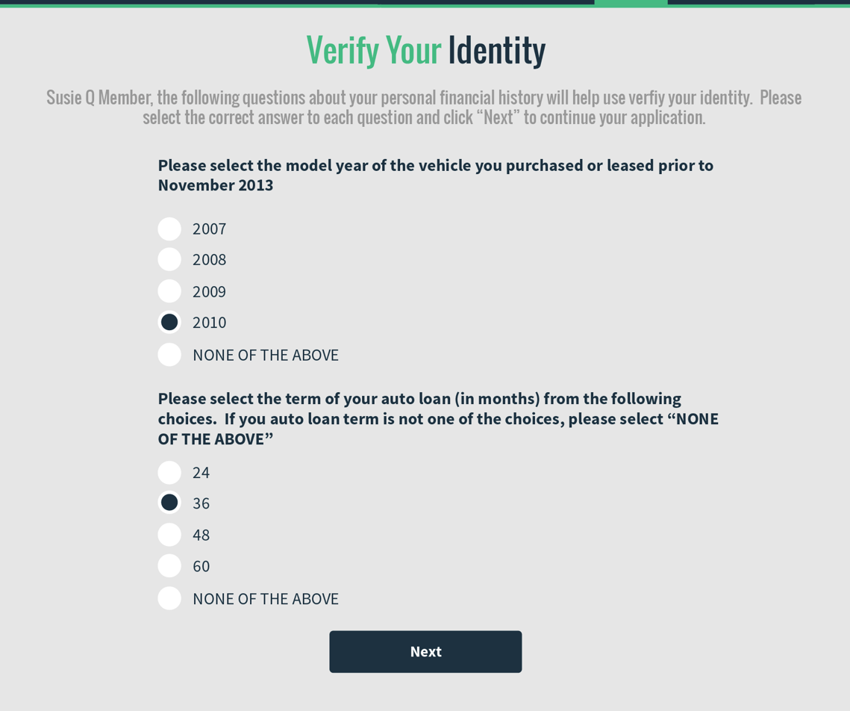

Slide 22
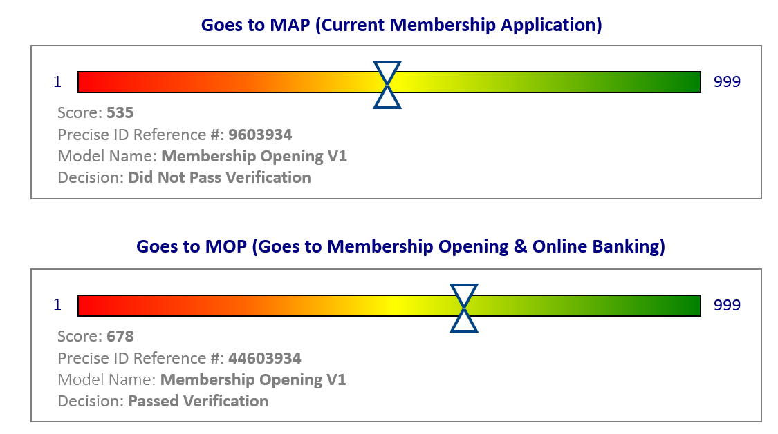
Examples of what CUs will see

Slide 23
What are my next steps?
Stay tuned for more ‘Building Block’ webinars
Sign up HERE to get more info and start your due diligence process
Contact Pete Winninger for more details Pete.Winninger@cuanswers.com

Slide 24
QUESTIONS?

