Slide 1
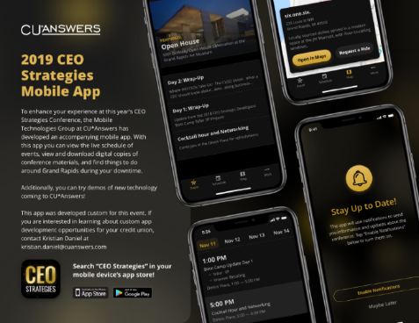
Welcome!
Have you downloaded the conference app?
Catch a ride: Map > Conference Location
November 11-14, 2019
Check it out in the app!
WIRELESS ACCESS: DeVos Place
PASSWORD (VOUCHER): CUA50years!

Slide 2
Boot Camp Update
AN UPDATE ON THE PROJECT FROM LAST YEAR’S CEO STRATEGIC DEVELOPERS BOOT CAMP NOVEMBER 14, 2019

Slide 3
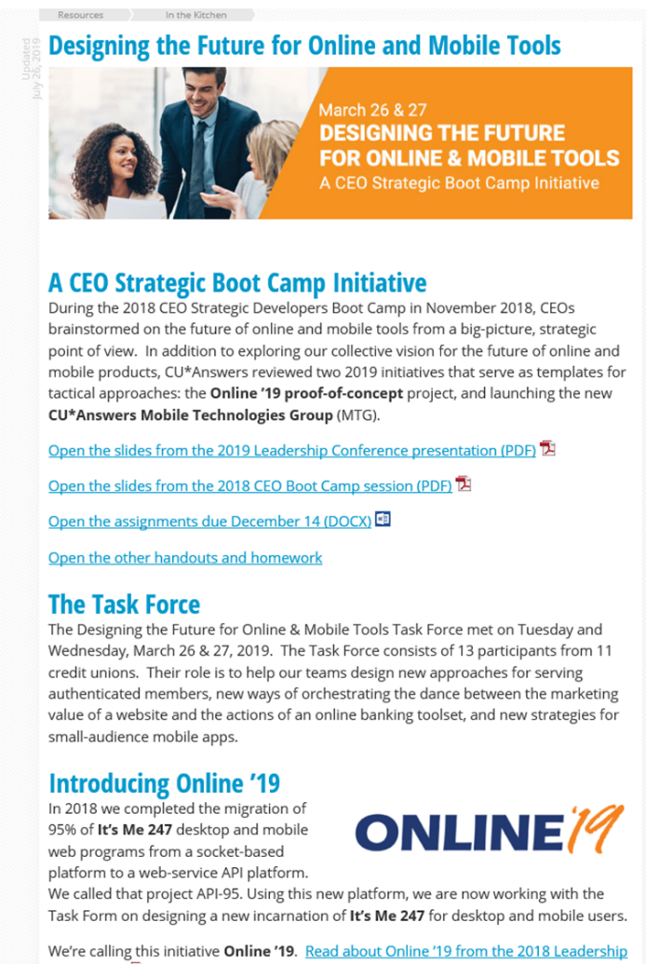
A special Thank you to the Task force
Jeff Holschuh, Advantage Credit Union
Bob Listen, Community West Credit Union
Scott Flak, Community West Credit Union
Joseph Eckley, Day Air Credit Union
Linda Bodie, Element Federal Credit Union
Anita Stefanovsky, Frankenmuth Credit Union
Cody Morris, Honor Credit Union
Nate Springer, Honor Credit Union
Emily Thurston, Isabella Community Credit Union
Rori Ross, Kellogg Community Credit Union
Karen Padrevita, Metrum Community
Kelly Zilinsky, NorthStar Credit Union
Jasen Hutchens, TBA Credit Union
Keep up with project updates in the Kitchen:
open.cuanswers.com/onlinemobile

Slide 4
Remember this from Tuesday?
MTG IS THE FOUNDATION FOR OUR BOOT CAMP PROJECTS

Slide 5
Mobile app 4.0
1

Slide 6
Mobile app 4.0
A new train schedule for our flagship app evolution going forward
When | What
Feb 2017 | Mobile 3.0 Rollout | 3-5 upgrades have been pushed out since then
Dec 2019 | Mobile 4.0 Rollout | 4 CUs in beta now (Honor, Metrum, Shoreline, and Meijer); general release date is 12/2/2019
July 2020 | Mobile 3.0 Sunset | 215 CUs are on 3.0 today (representing 430 apps between the device stores), and all need to move by July 2020
Nov/Dec 2020 | Mobile 5.0 Rollout | Beta October, general release November-December
July 2021 | Mobile 4.0 Sunset | All 4.0 users will need to be moved to 5.0 by July 2021
See the pattern?

Slide 7
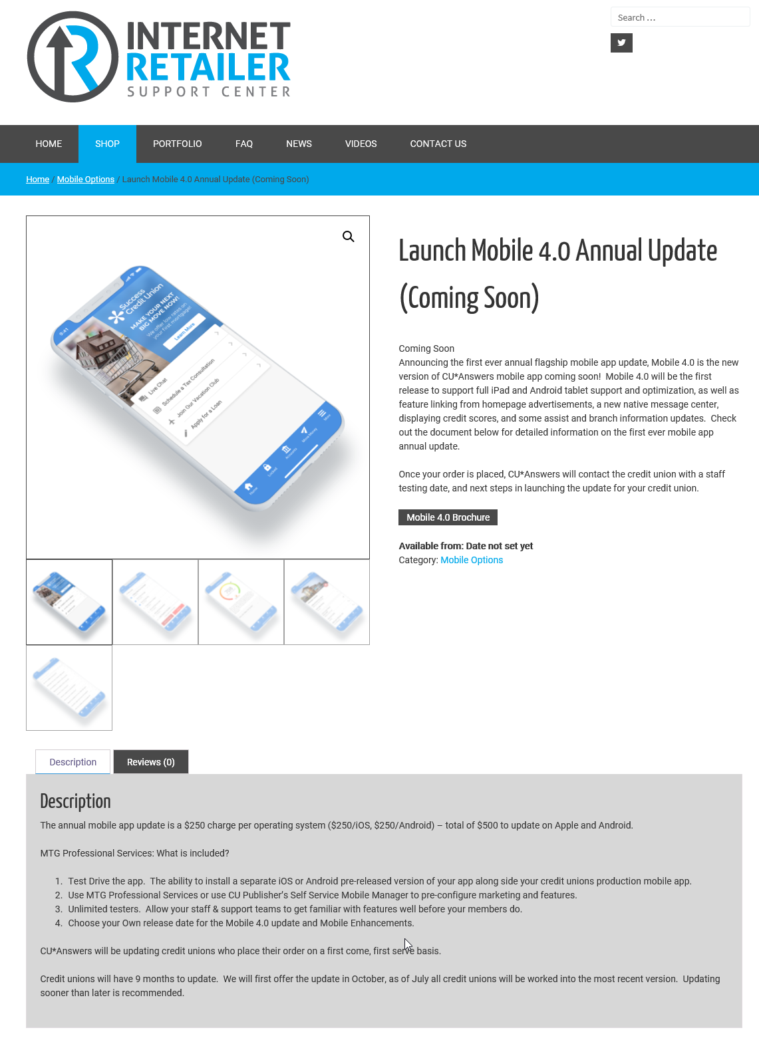
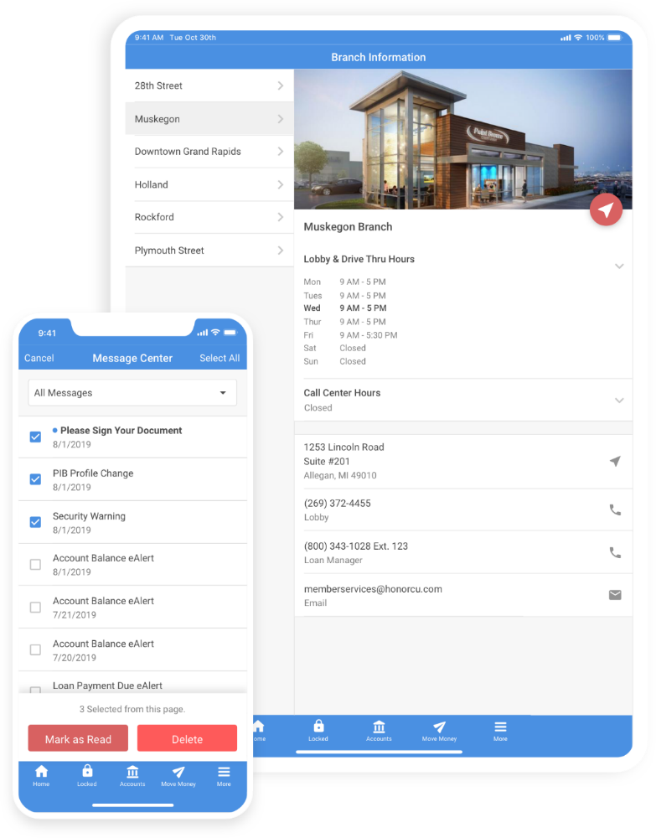
Mobile 4.0
Your team needs to manage this project by July 2020!
irsc.cuanswers.com/product-category/mobile

Slide 8
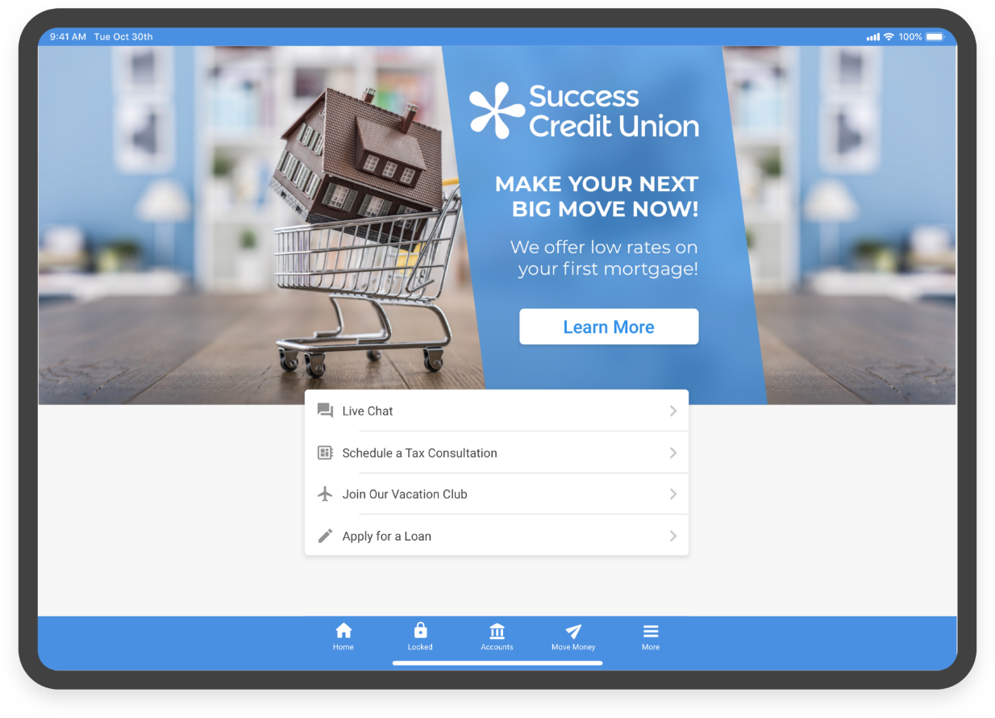
Mobile 4.0 tablet support and a new Native home screen
All powered by
Content caching for faster performance
Customizable mobile links
Robust feature linking – push members to the things you want them to see
Portrait & landscape tablet modes
Analytics so you can see what your members are doing
Mobile alerts
Might this be the future of desktop banking?

Slide 9
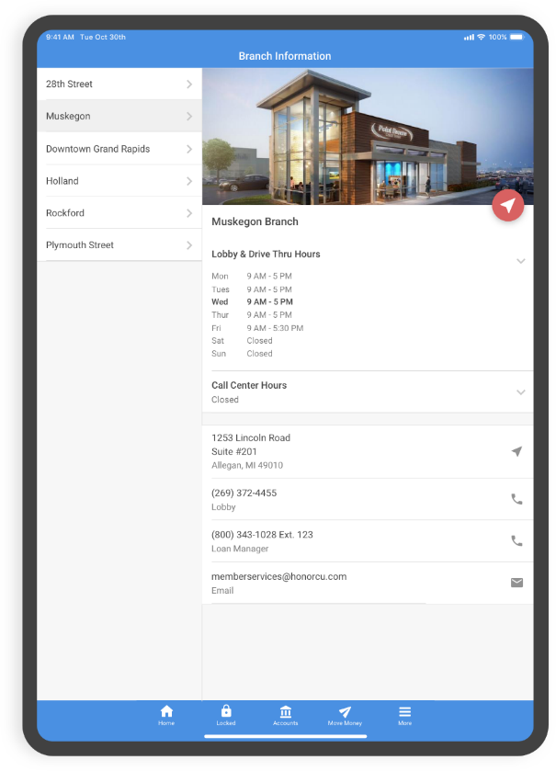
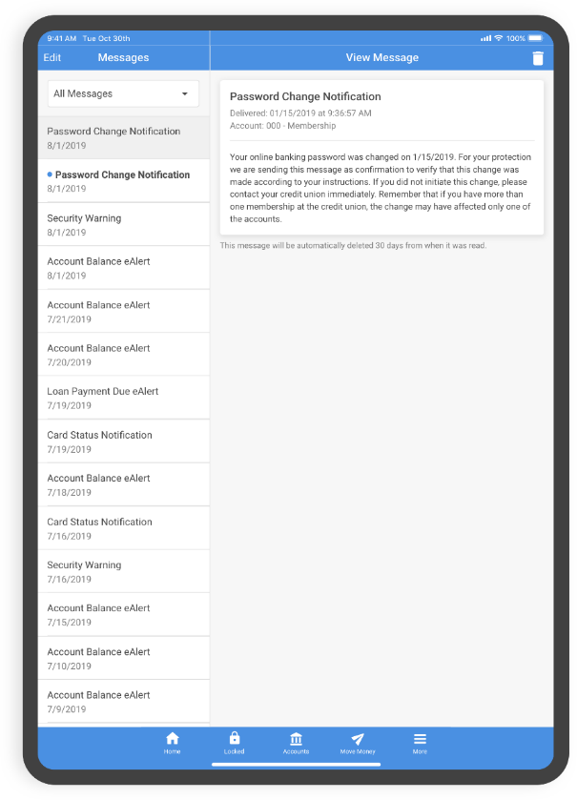
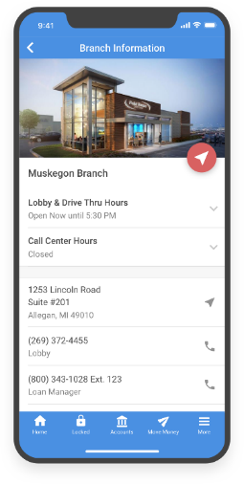
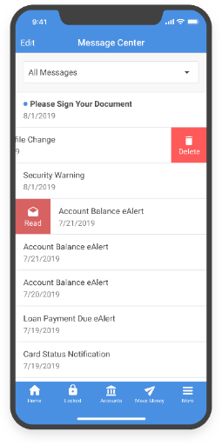
Native animations • gestures • split views
Tablet
Phone

Slide 10
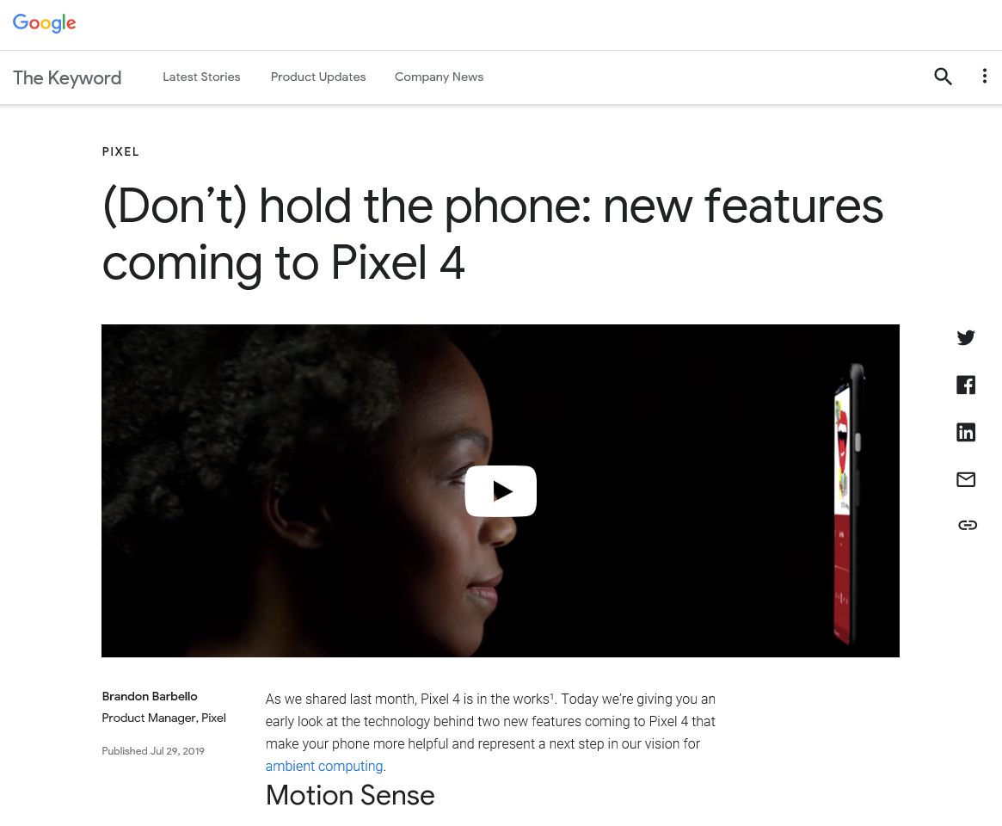
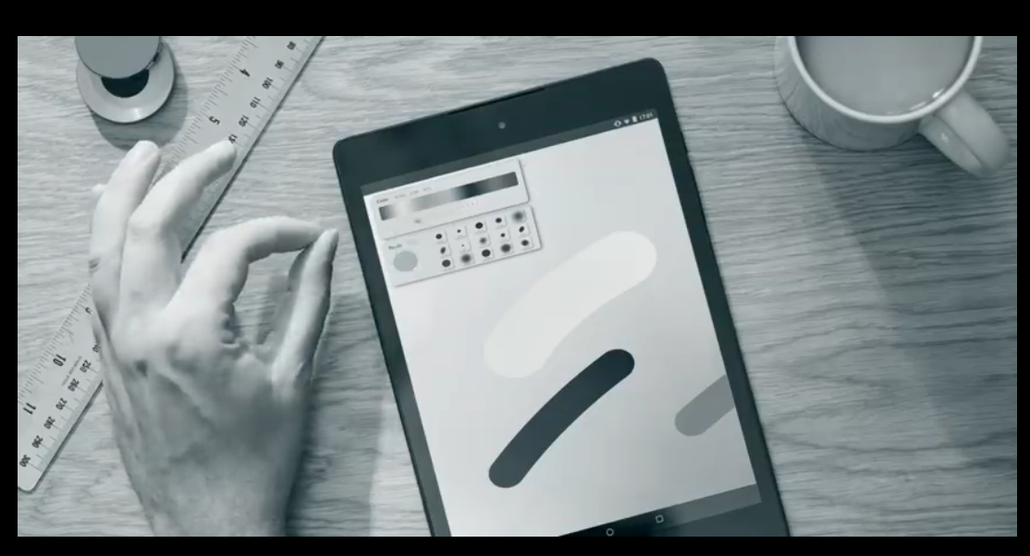
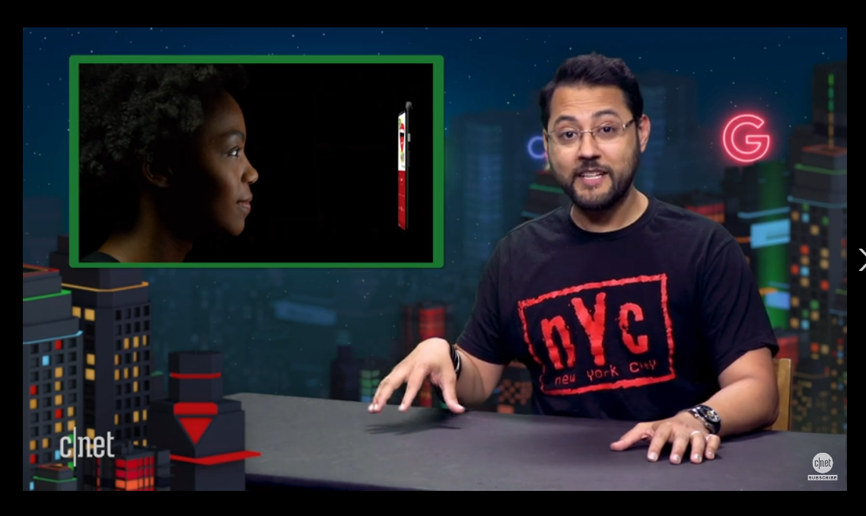
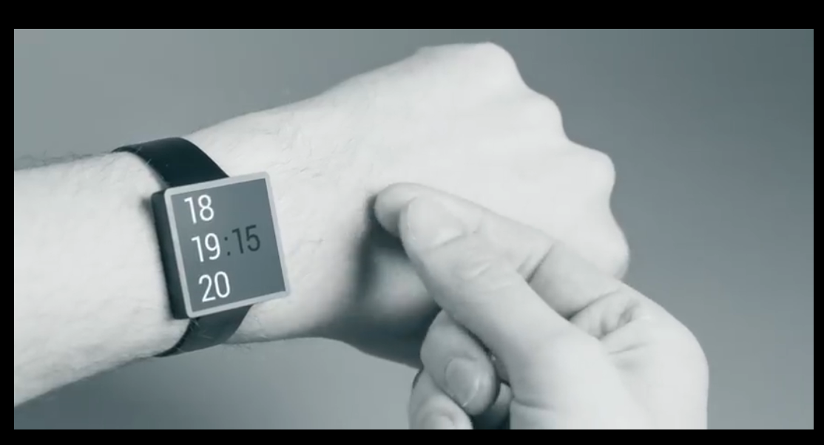
Native animations • gestures • split views
Wonder what this is?
Think your hands interacting with your mobile device
Tablet
Phone

Slide 11
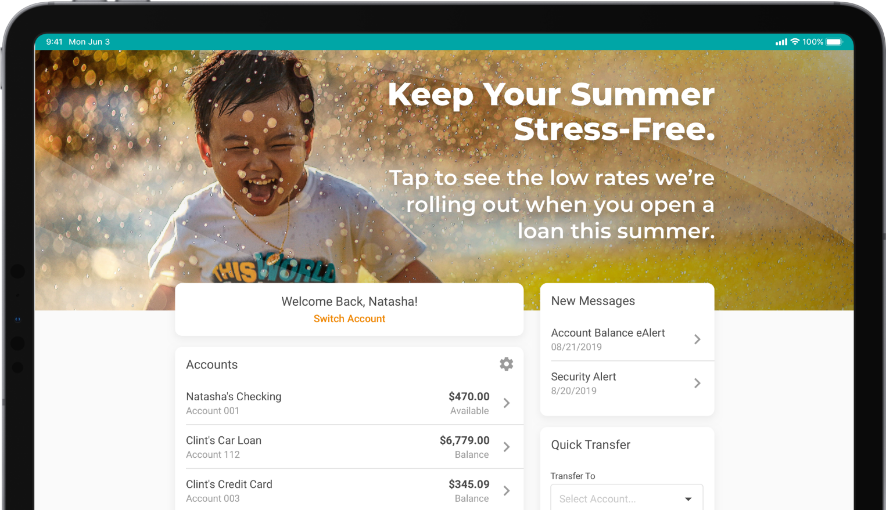
the only missing ingredient is anticipation
Mobile 3.0, 4.0, & 5.0 need to build a track record of great things to come for members
MOBILE 5.0 COMING FALL 2020

Slide 12
Affordable deployment fees
2
Revenues that sustain the effort, on the way to new futures

Slide 13
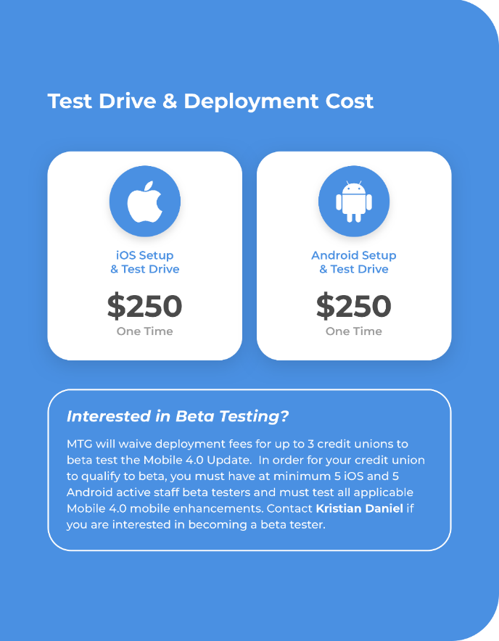
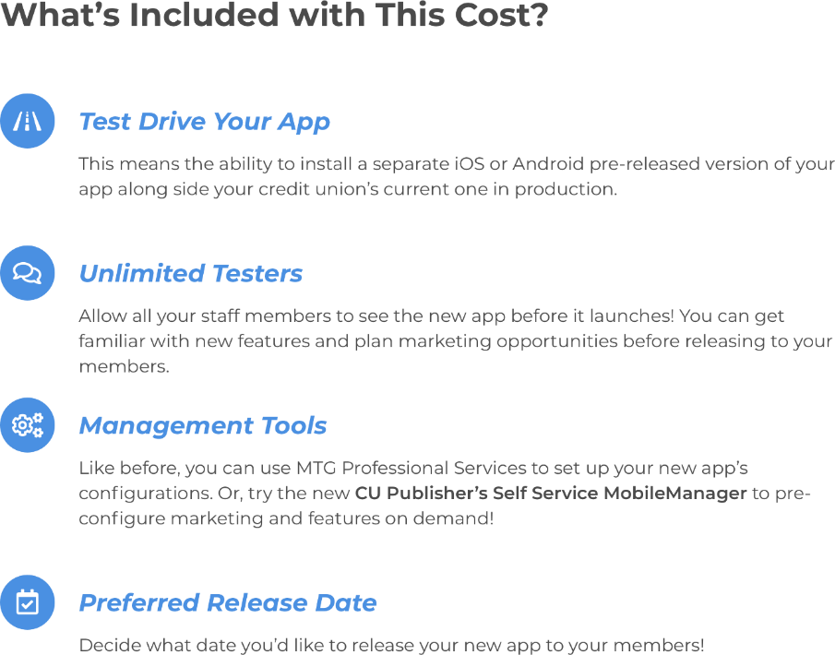
Driving mtg revenues for success
A new deployment fee program will start with mobile 4.0

Slide 14
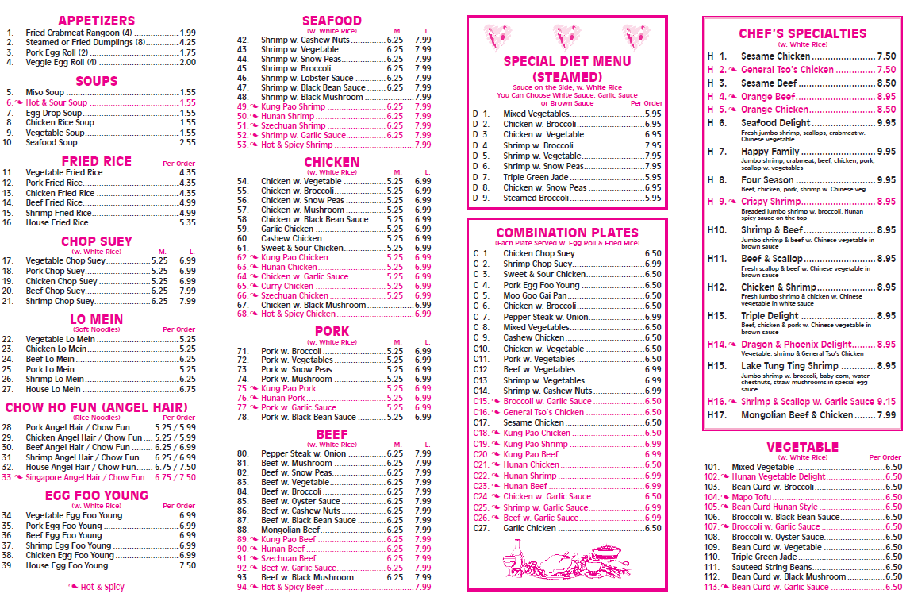
Mobile is a small-ball game
Lots of professional services involved in tweaking, packaging, and deploying
For us to be a successful CUSO, we must find a way to fund the activities, so that we can support the copyrights and the big-picture design work – without major fees

Slide 15
Mobile app 5.0
3
The vision that will pull it all together for year-end 2020 and 2021

Slide 16
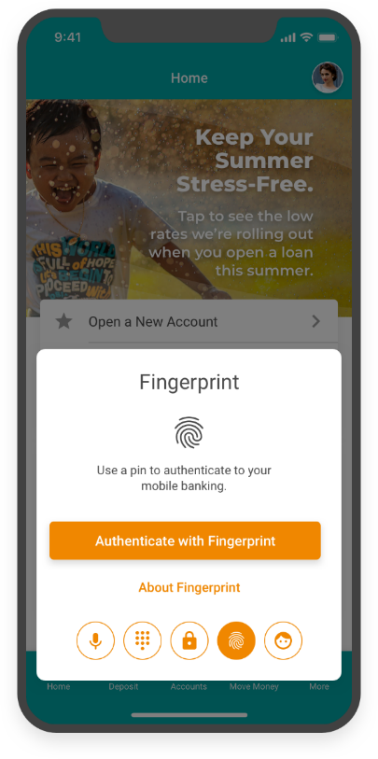
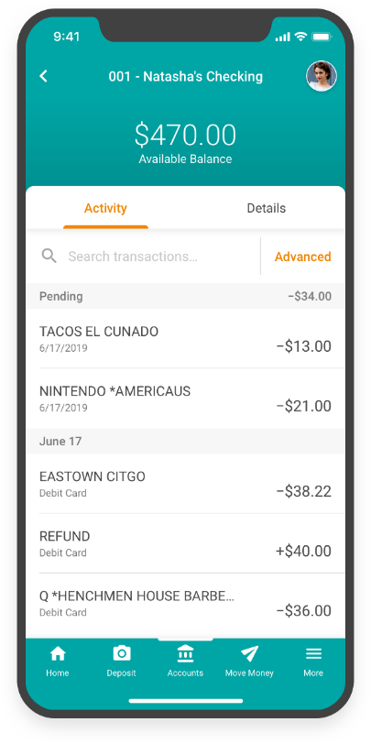
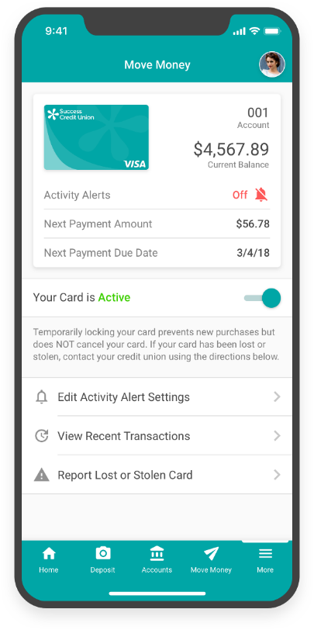
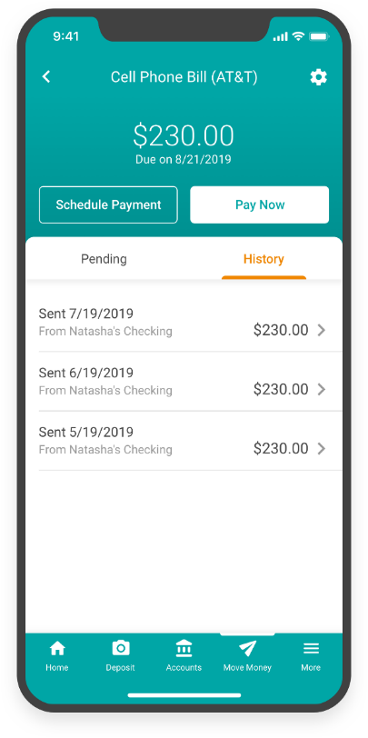
Mobile 5.0 concepts (early preview)

Slide 17
Mobile 5.0 concepts (early preview)

Slide 18
What’s unique about mobile App 5.0?
A year ago, Mobile App 5.0 would simply have been the vision for the functionality of next year’s mobile solution
But this year, Mobile App 5.0 represents the foundation that will drive:
The new navigation for It’s My Biz 247 mobile web
The new navigation for It’s Me 247 mobile web
The foundation for the future of desktop banking for It’s Me 247
The potential infrastructure to drive the next iteration of Online ’19
And finally, the vision for reorganizing our programming teams and how we develop products for internet channels
Talk about “mobile first” – Mobile App 5.0 is part of a very big vision

Slide 19
Micro-apps
4

Slide 20
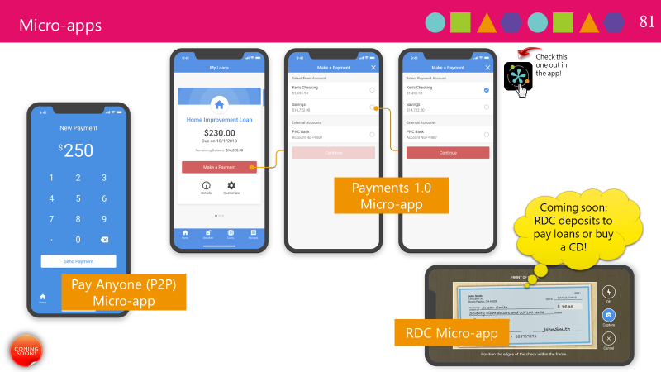
Carving out space to keep our promises
Space to experiment, innovate, and reduce the risk of real-time market analysis
Pay Anyone 1.0 (P2P)
Beta-test by Jan 2020
General release by April 2020
Payments 1.0
Beta-test by March 2020
General release by May 2020
RDC 1.0 (micro-app)
Right on the heels of Payments 1.0

Slide 21
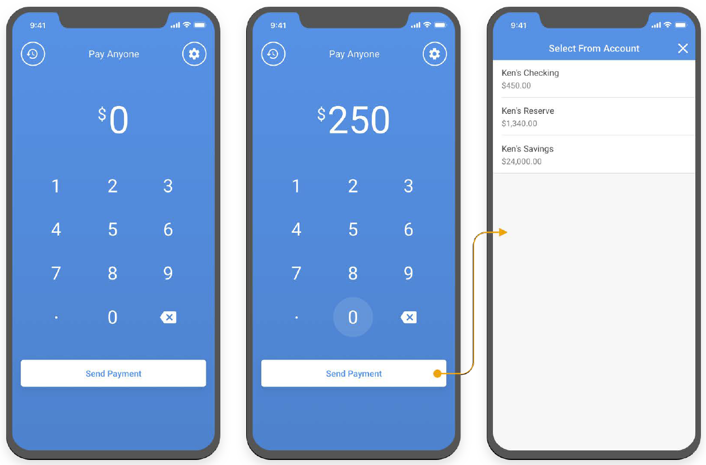
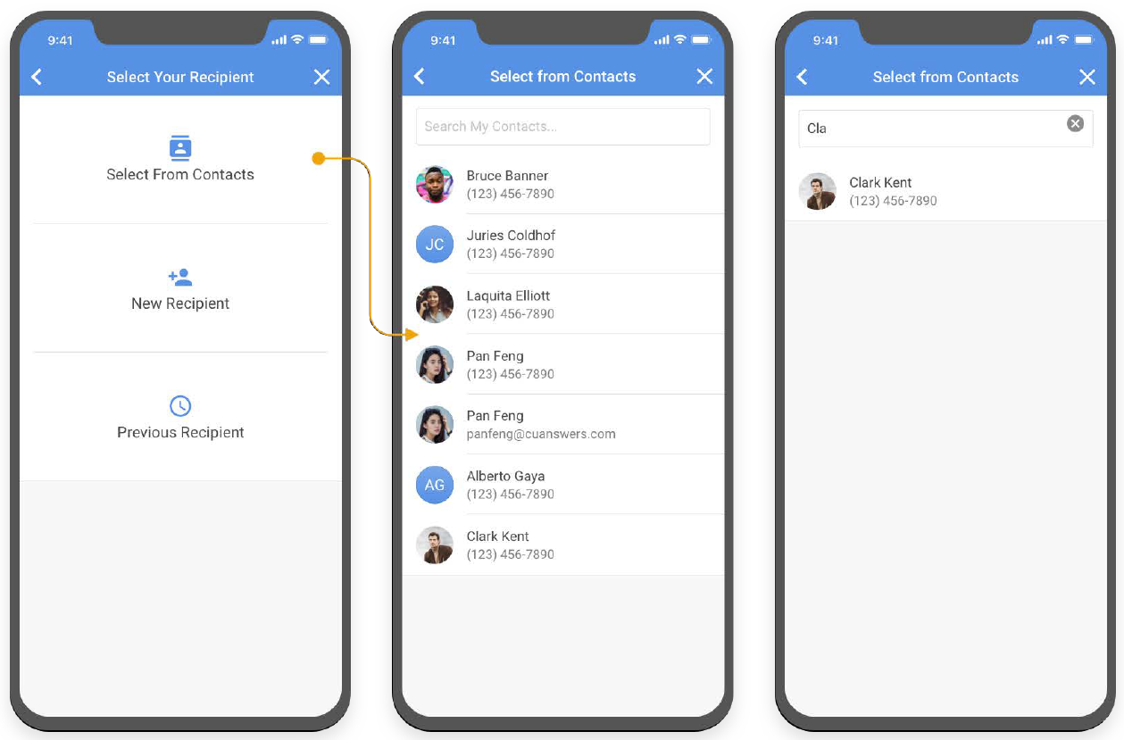
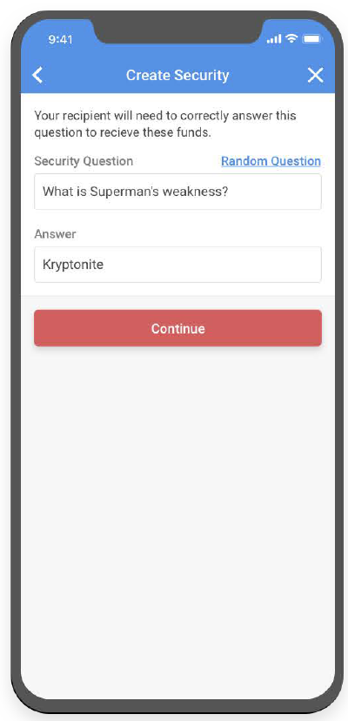
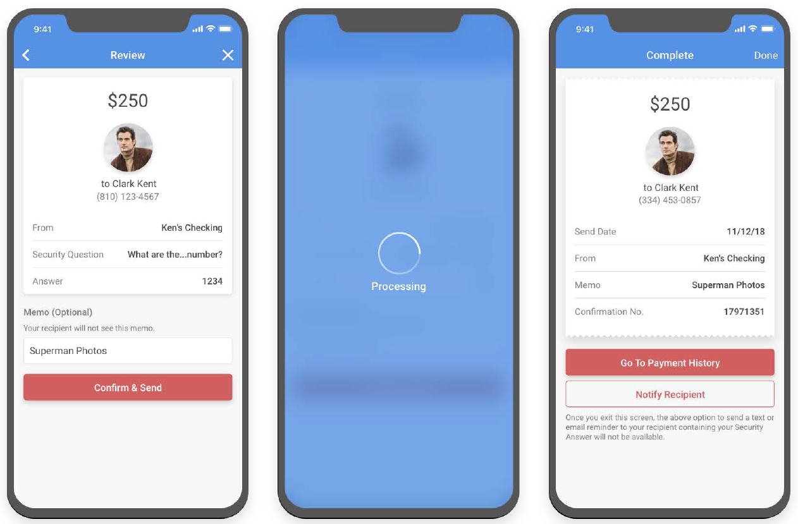
Pay Anyone 1.0: powered by Payveris Settlement
CHOOSE A RECIPIENT
MAKE A PAYMENT
CONFIRMATION
SET UP SECURITY

Slide 22
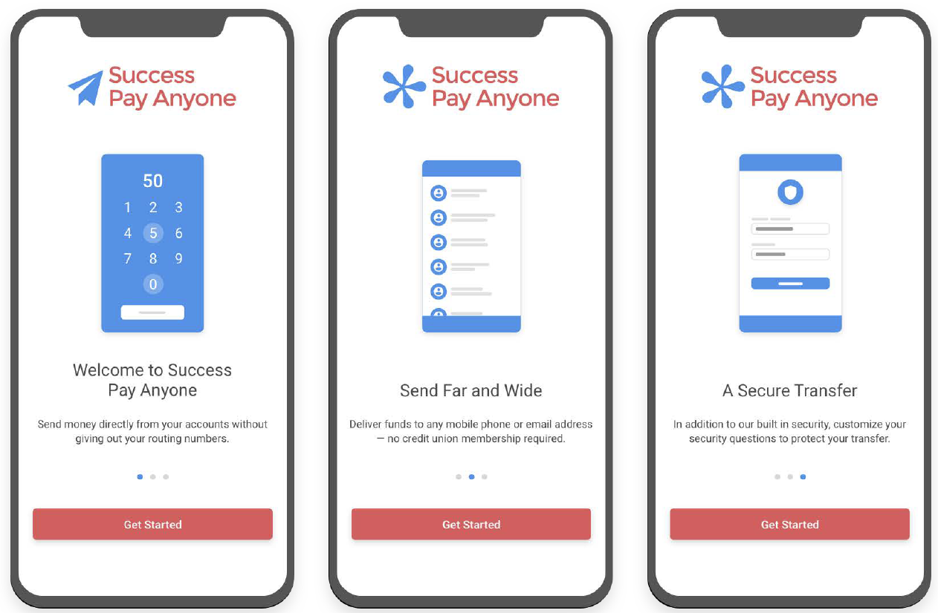
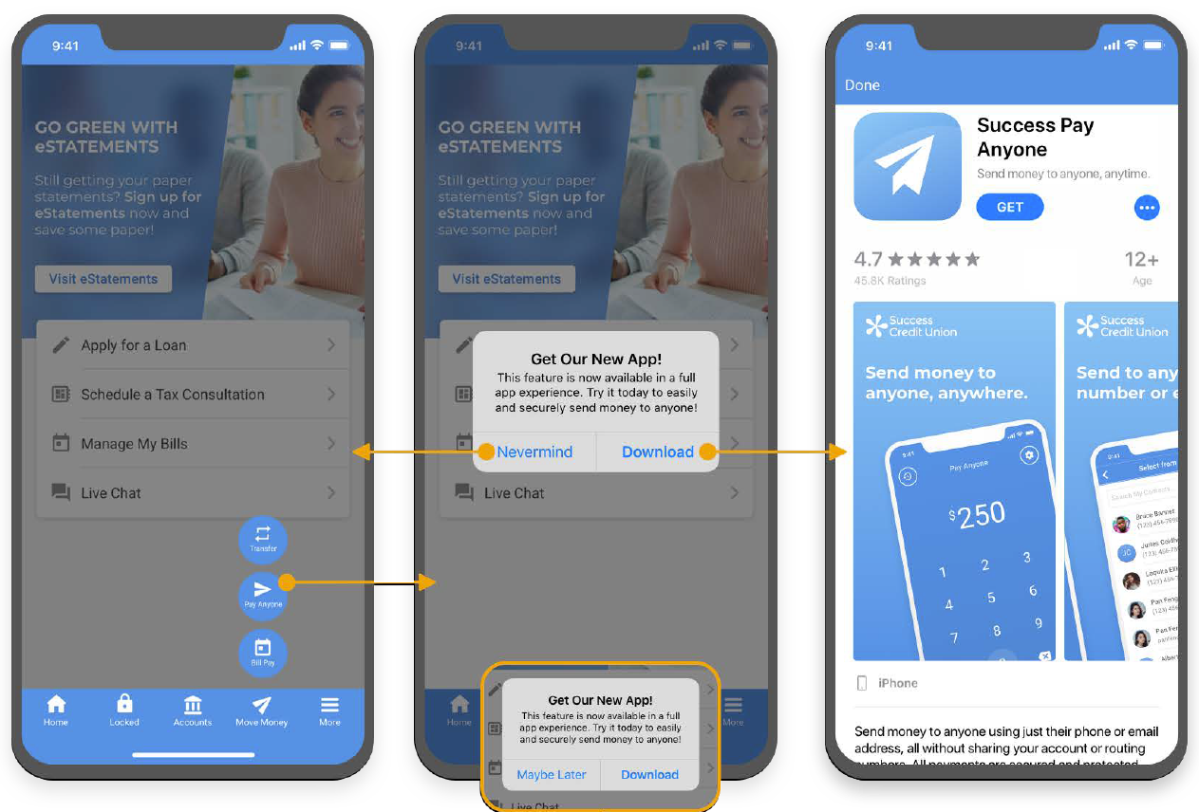
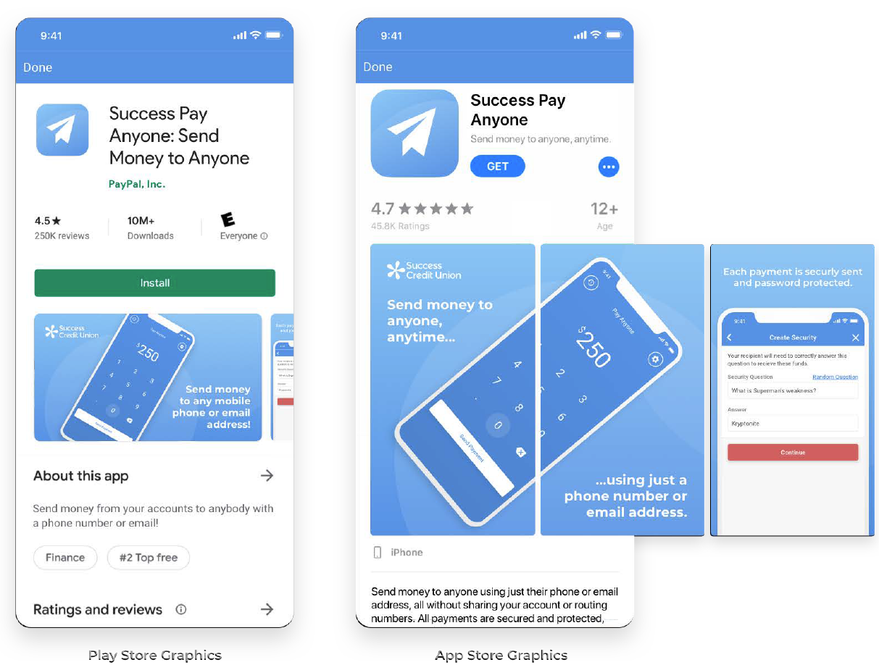
Pay Anyone 1.0: powered by Payveris Settlement
QUICK TOUR ON FIRST DOWNLOAD
APP LINKING
PREMIUM OPTIONS FOR PROMOTING YOUR APP IN THE APP STORES

Slide 23
P2P via Payveris Settlement
Payveris P2P works like this:
Party 1 sends money to Party 2
Party 1 is a Payveris CU and the member is debited via CU*BASE on the effective date
Party 2 receives the money into their account at their FI via ACH, originated by Payveris
The ACH is actually originated by Payveris’ bank (Webster Bank)
The Fed handles the one-sided credit to Party 2 and moves the money to Party 2’s financial institution

Slide 24
How do other p2p network settle?

Slide 25
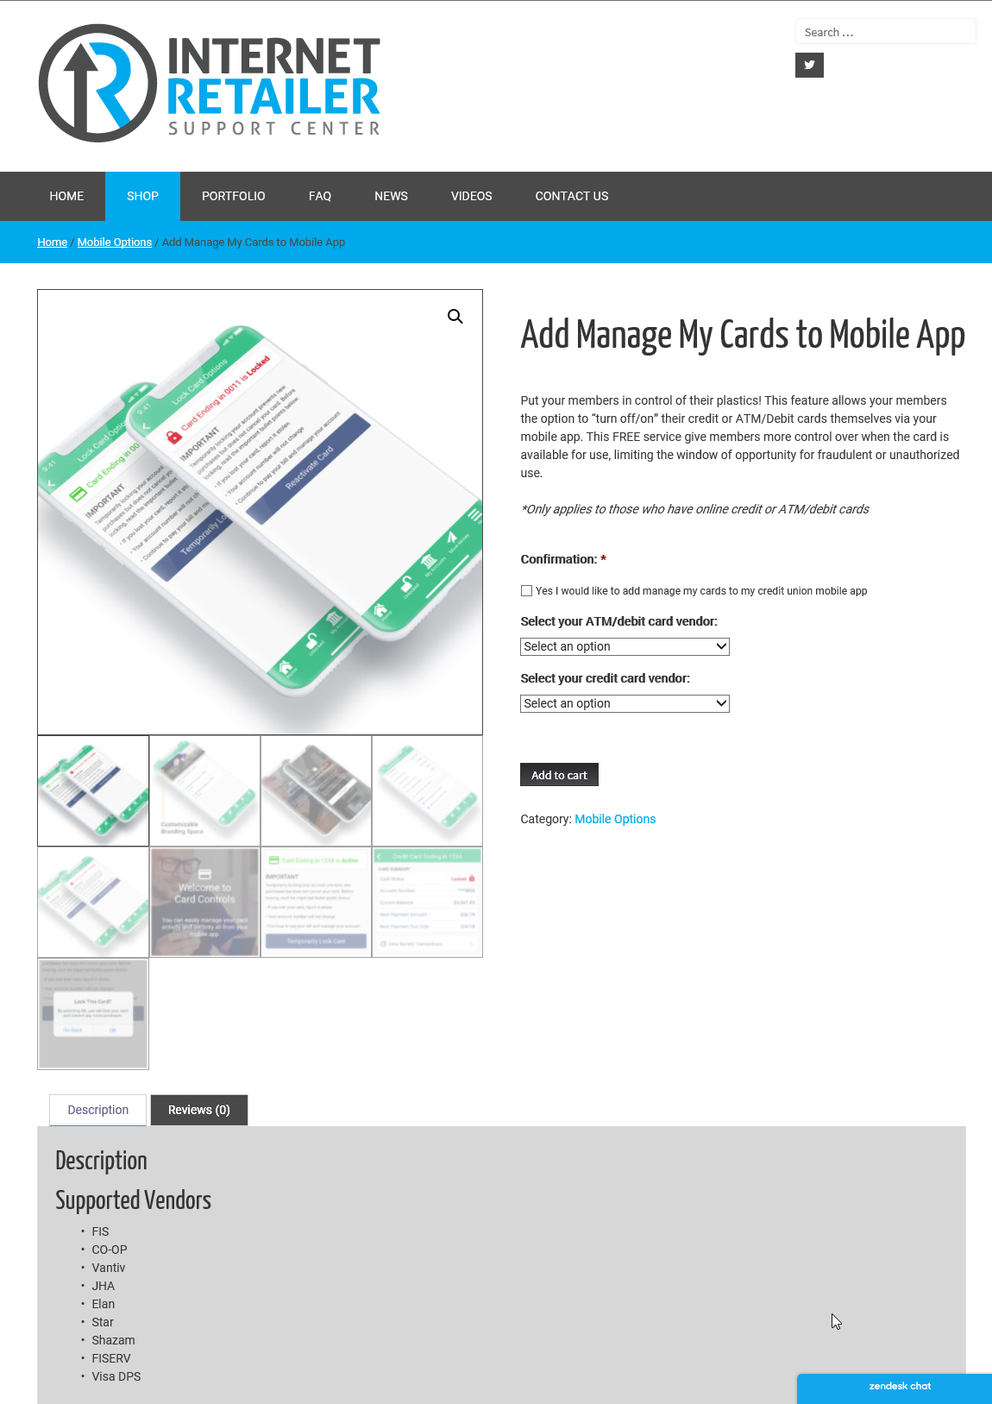
CARD controls
“Manage my cards” is another micro-app
Today, card controls are an embedded function inside our flagship apps
What isn’t clear is how far we should take these features, and where an advanced card app would live
Is there room in the flagship app to get the member’s attention?
If we went with a more advanced set of features, would we have to count on a micro-app to garner the member’s attention?
Would credit union CEOs pay for this? Do we need a premium approach to card controls?
irsc.cuanswers.com/shop

Slide 26
A new UI front-end leadership team
5
UI is the foundation of UX

Slide 27
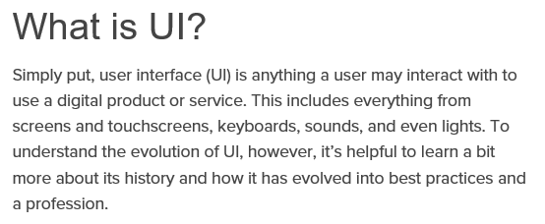
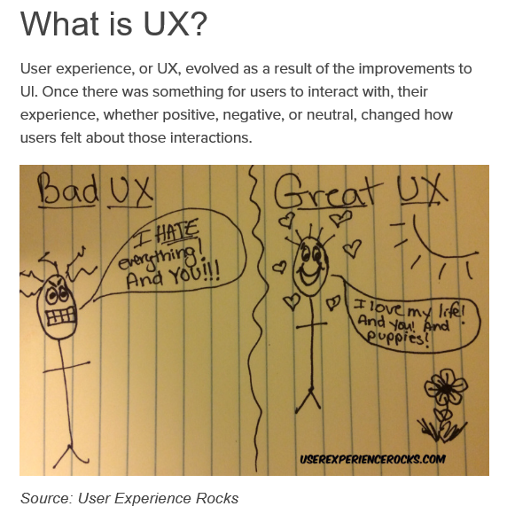
UI (User interface) is the foundation of uX (user experience)
UX is focused on the user’s journey to solve a problem, UI is focused on how a product’s surfaces look and function

Slide 29
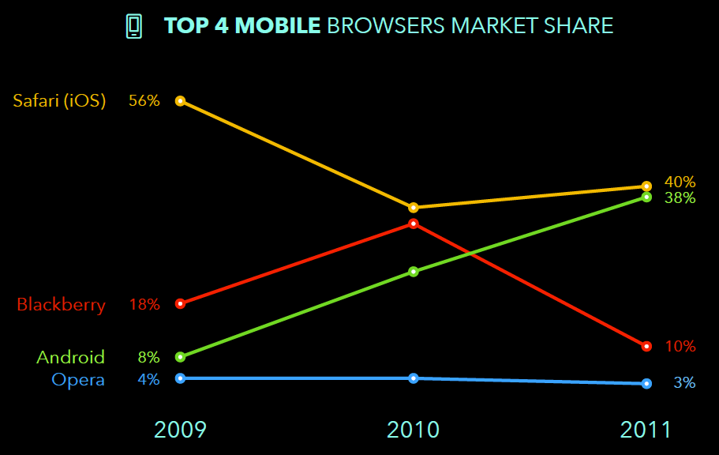
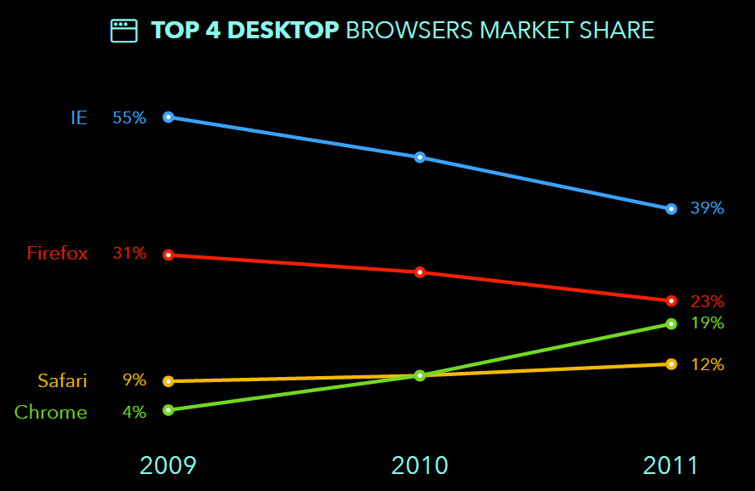
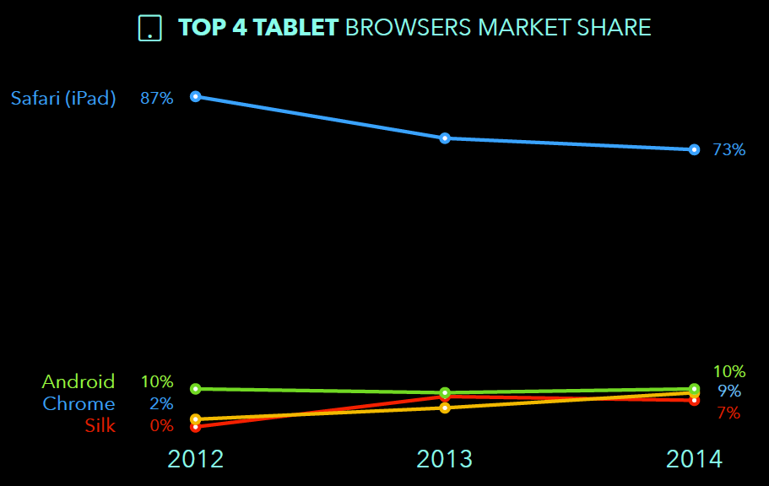
The rise and fall of internet browsers

Slide 31
2019
2019

Slide 32
Web modules and independent navigation
6

Slide 33
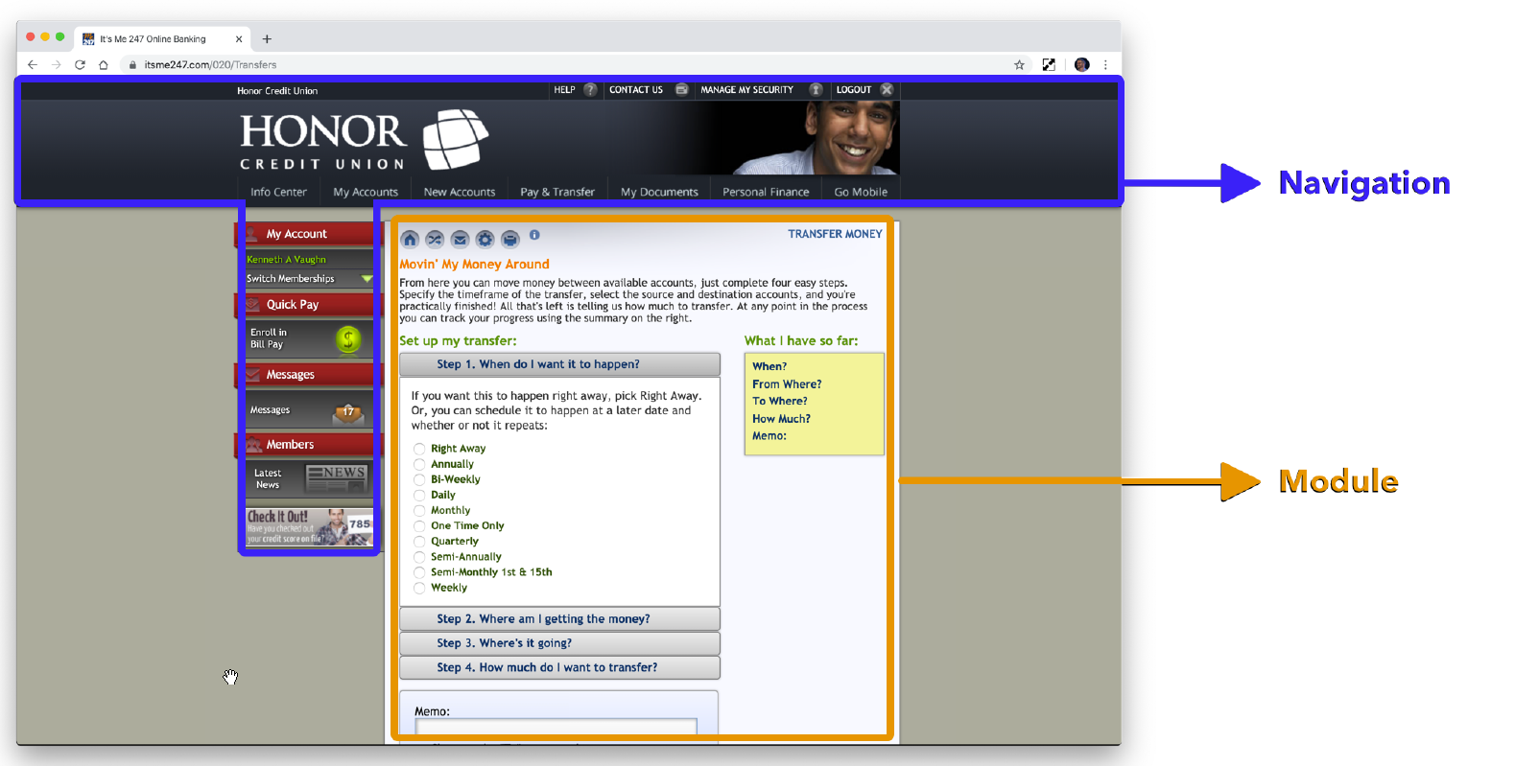
Separating navigation from core features

Slide 34
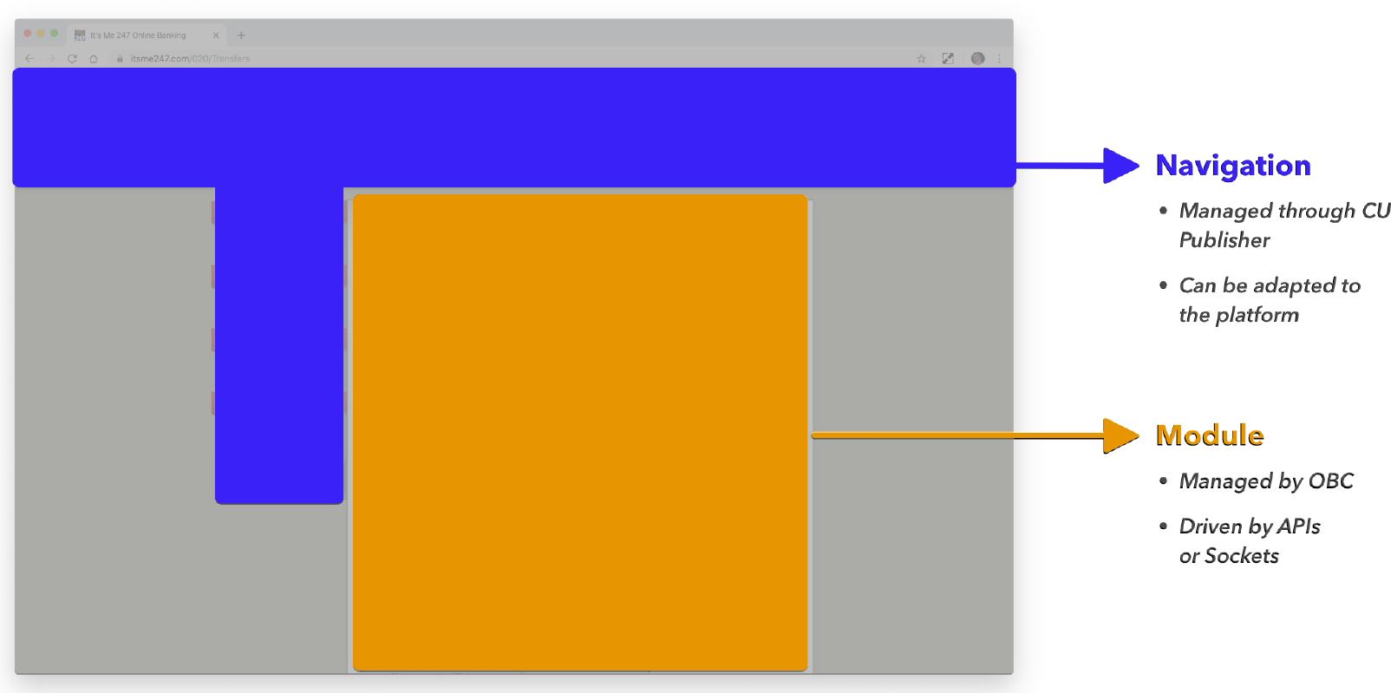
Separating navigation from core features

Slide 35
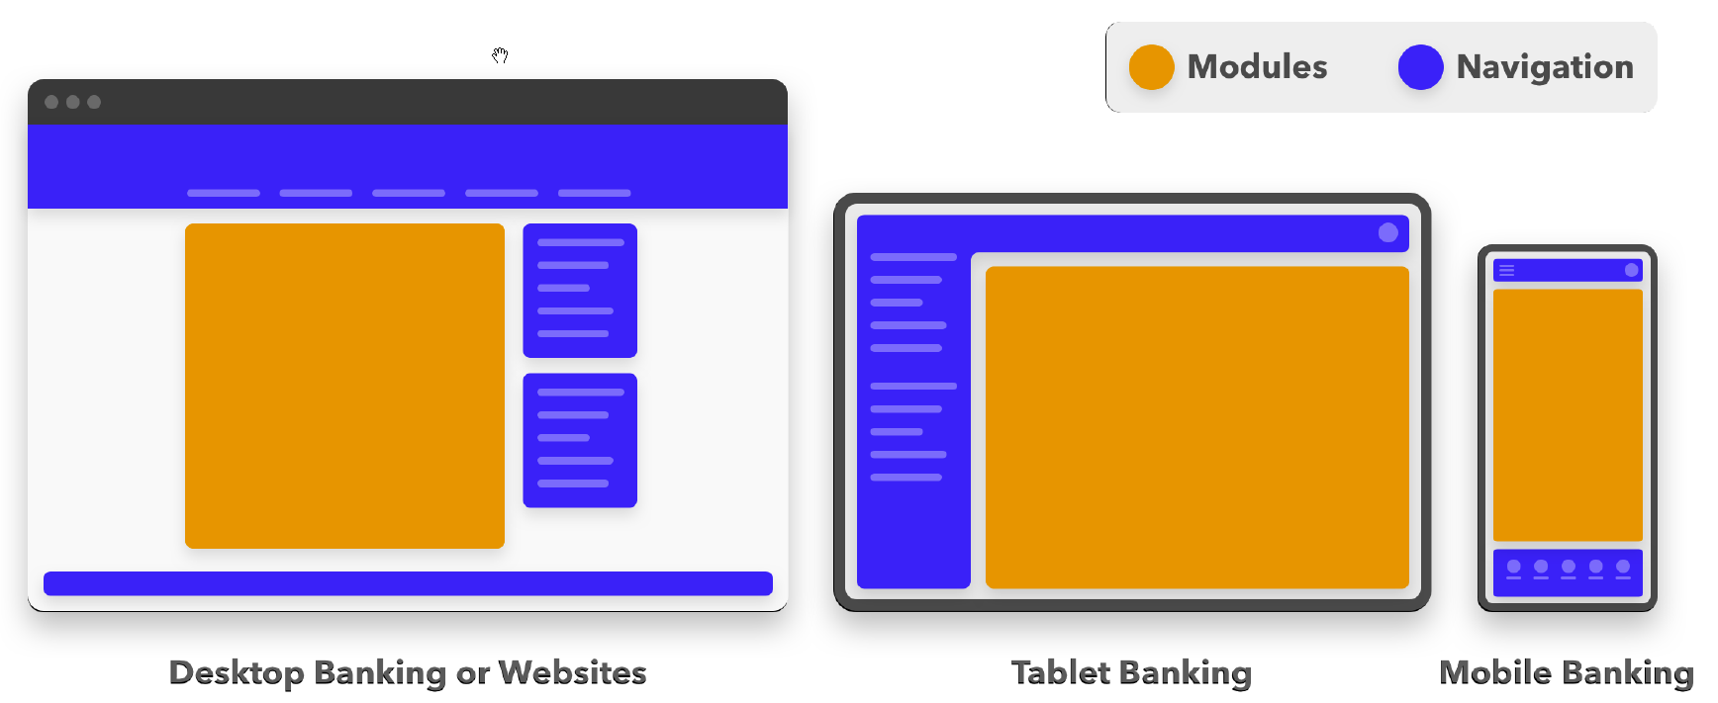
Separating navigation from core features

Slide 36
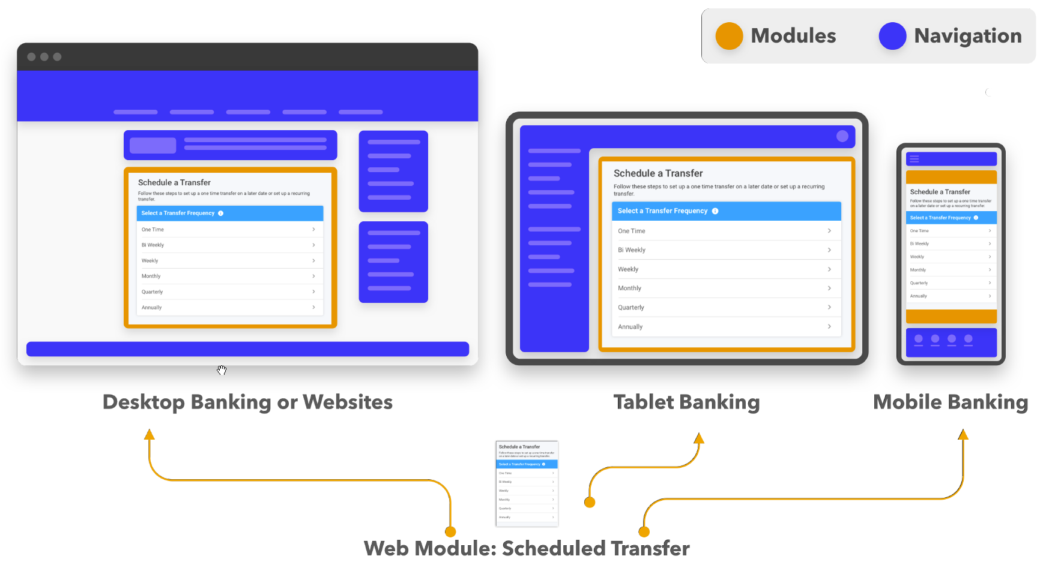
Separating navigation from core features

Slide 37
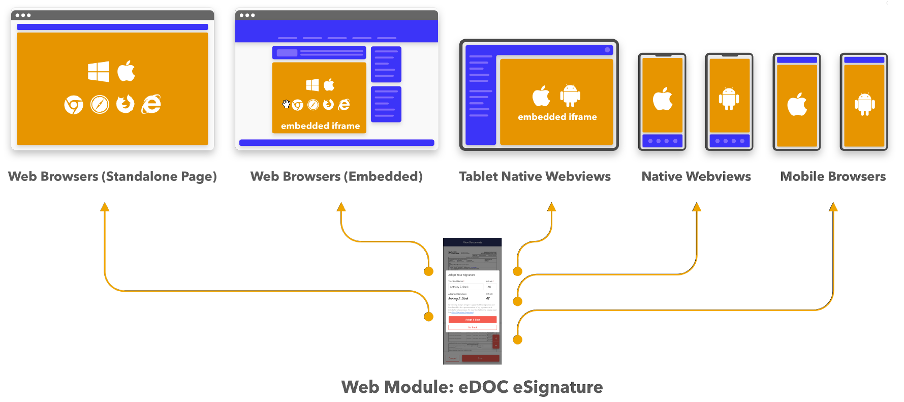
The potential of web modules and partners
If mtg is going to be effective in working with third parties, we need options

Slide 38
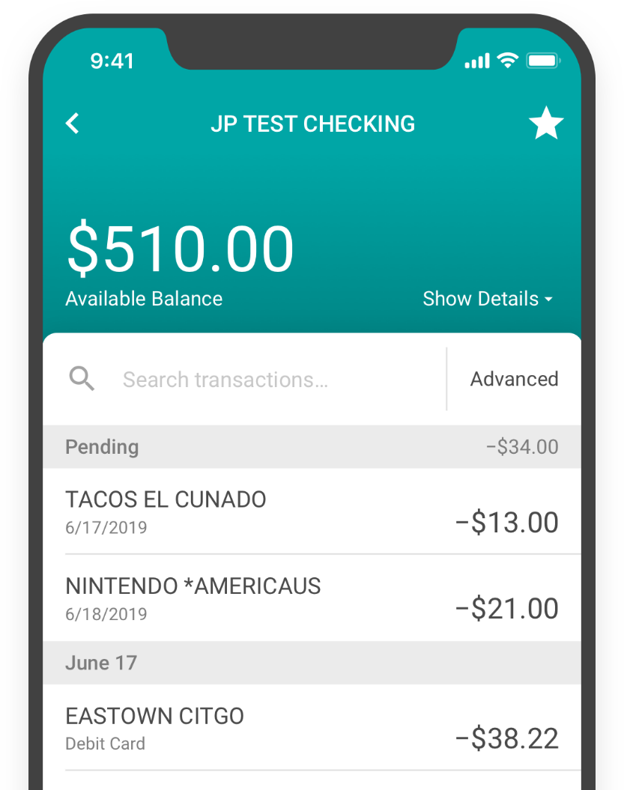
Apis AND WEB MODULES?
More ‘Micro’ approaches vs macro approaches
Less risk!...Moving away from big releases to modular releases
QC departments will have the ability to qualify specific features independent of the web solution.
Development teams can create processes to deploy updates to modules without updating the entire web or mobile applications.
Easier to support 1 web module/features across 3 web solutions
CUA to Client
Client to Member

Slide 39
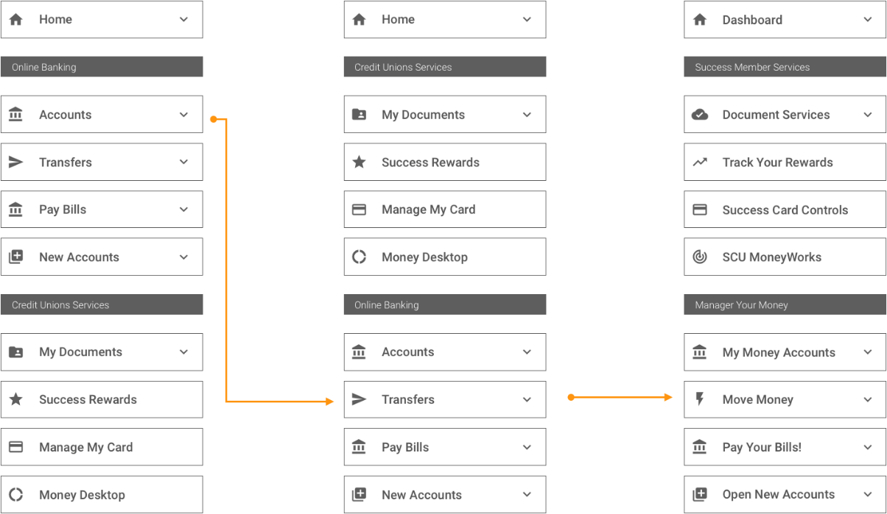
Imagine designing your own navigation or renaming any feature
CU Publisher may be the tool that makes this a reality for credit unions in the future...
...and the future isn’t that far away
Clear as mud, Ken...but we might need a few details

Slide 40
Tablet designs as the intersection
7
BETWEEN DESKTOP & MOBILE PHONES

Slide 41
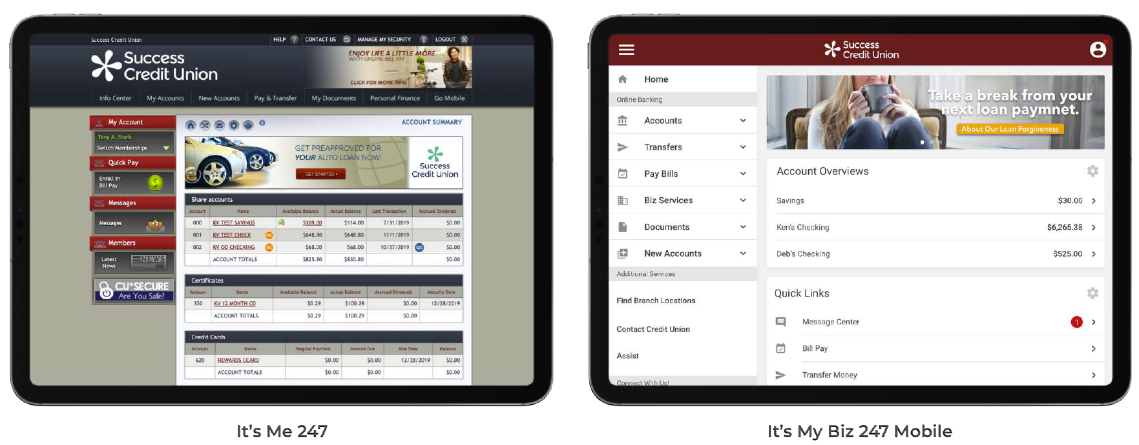
Tablets as the intersection between desktop & mobile phones
It’s not a choice between the one on the left and the one on right... it’ll probably be a hybrid of both (leaning more to the one on the right)

Slide 42
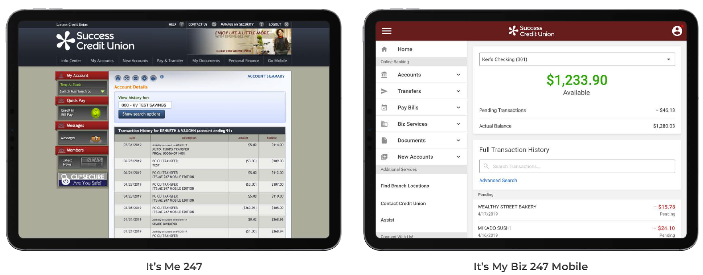
Tablets as the intersection between desktop & mobile phones
It’s not a choice between the one on the left and the one on right... it’ll probably be a hybrid of both (leaning more to the one on the right)

Slide 43
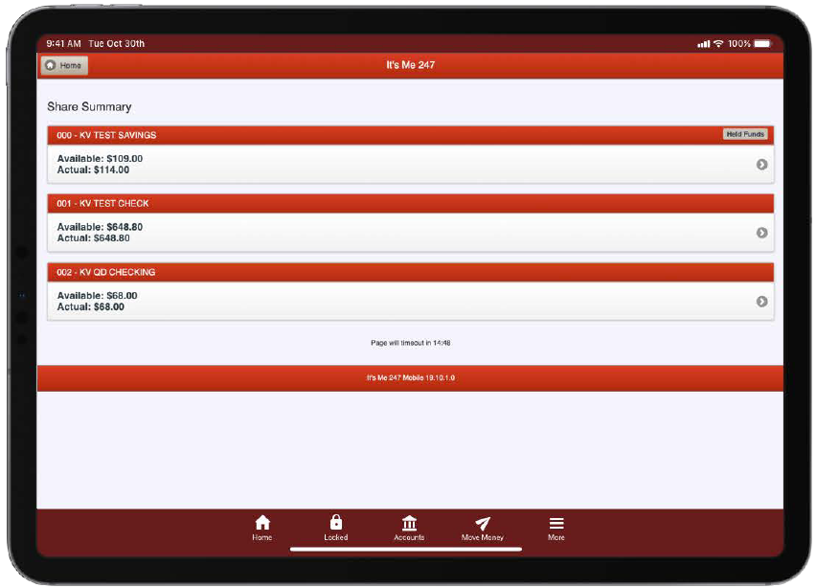
Either way, we’ll have a new look and feel for it’s me 247 desktop by 2020/2021
Make sure you’re tuned in for the discussions along the way

Slide 44
Cu publisher as a self-service copyright
8

Slide 45
Self service Products launching in 2019-2020

Slide 46
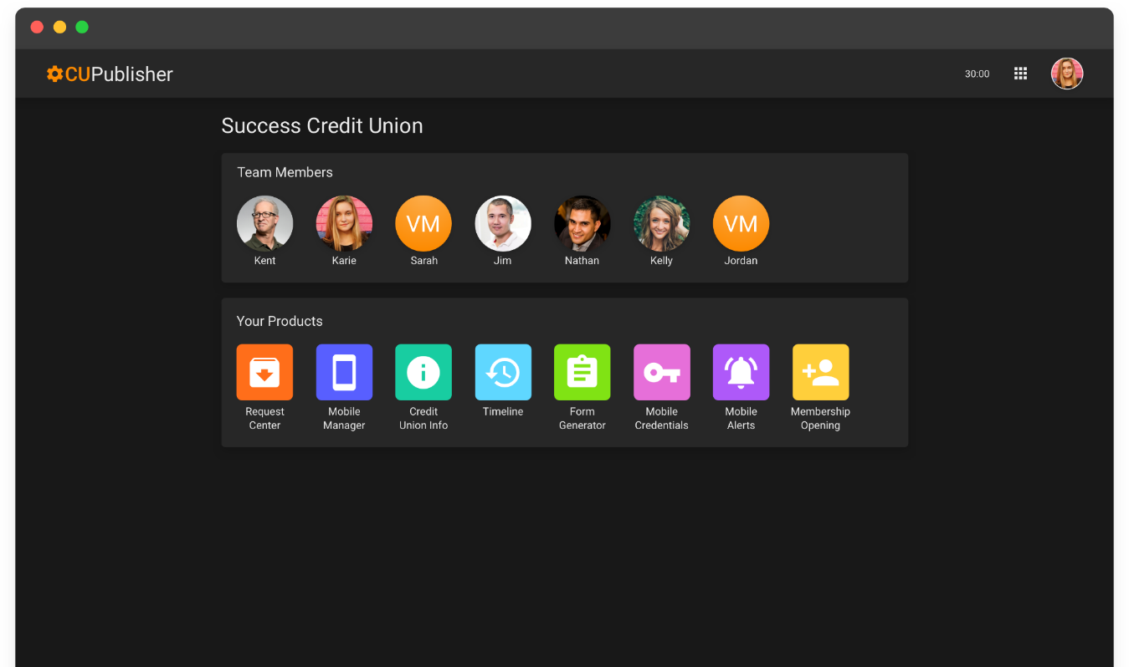
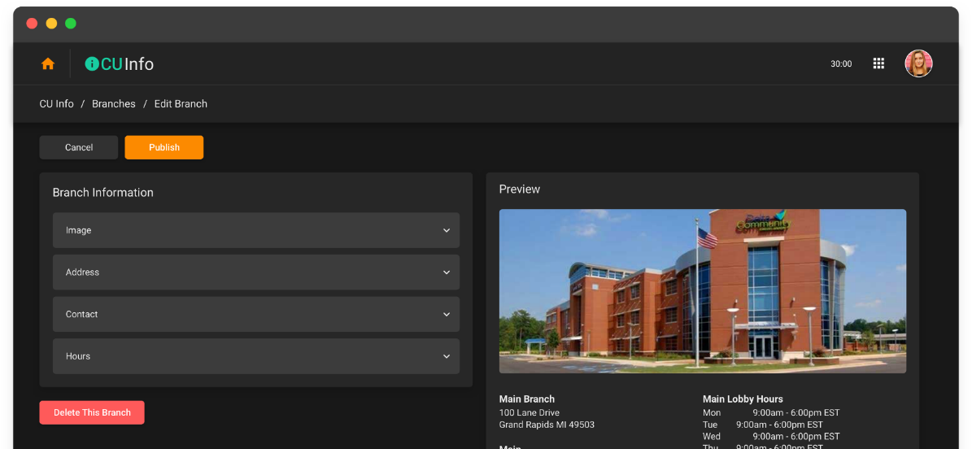
MANAGE YOUR TEAM • BRANCH INFO • TESTIMONIALS
Includes ENHANCED SEARCH TO LOCATE AND ACCESS A FEATURE

Slide 47
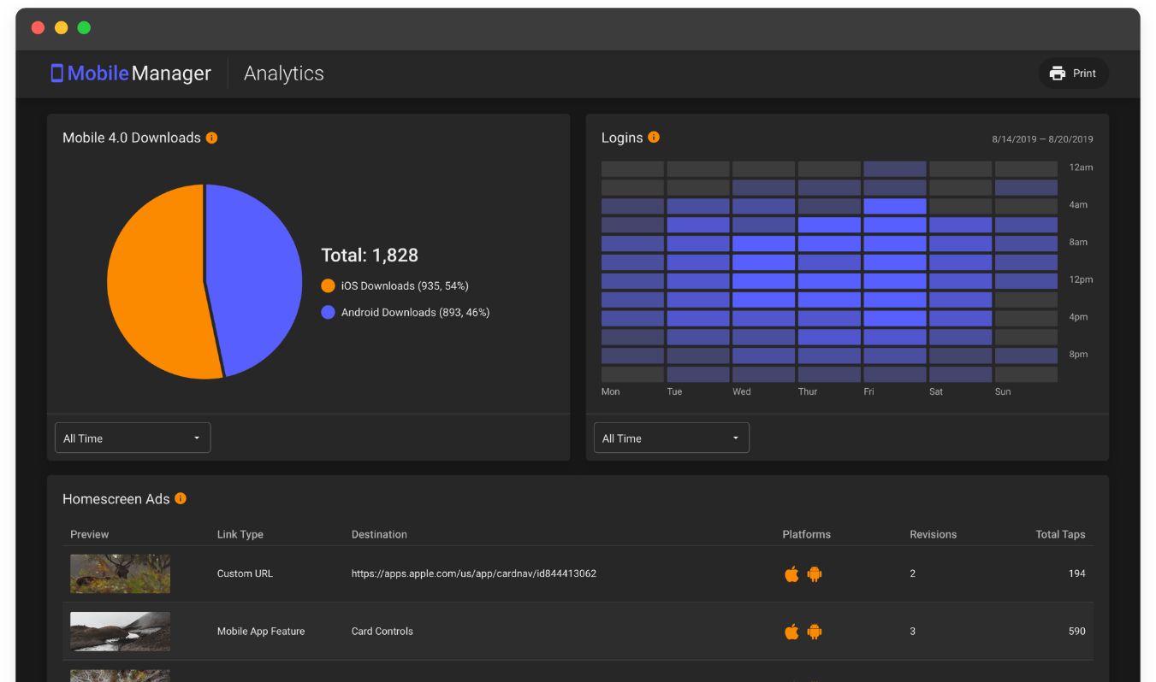
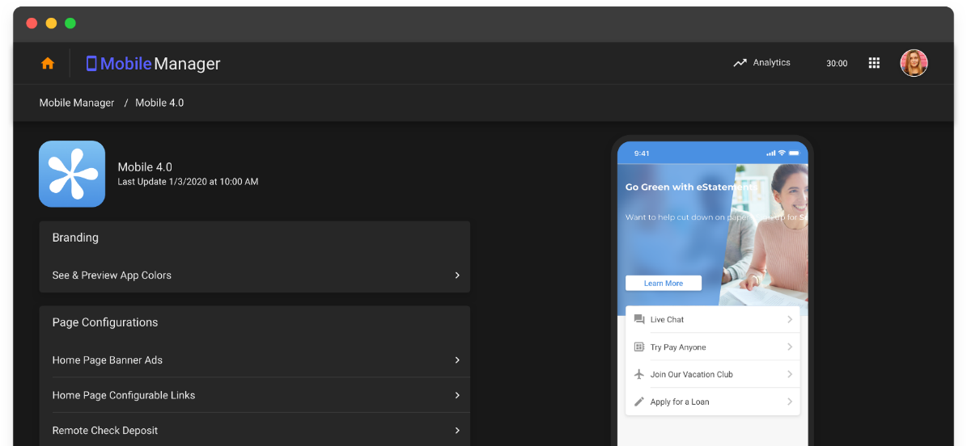
REQUIRES MOBILE 4.0

Slide 48
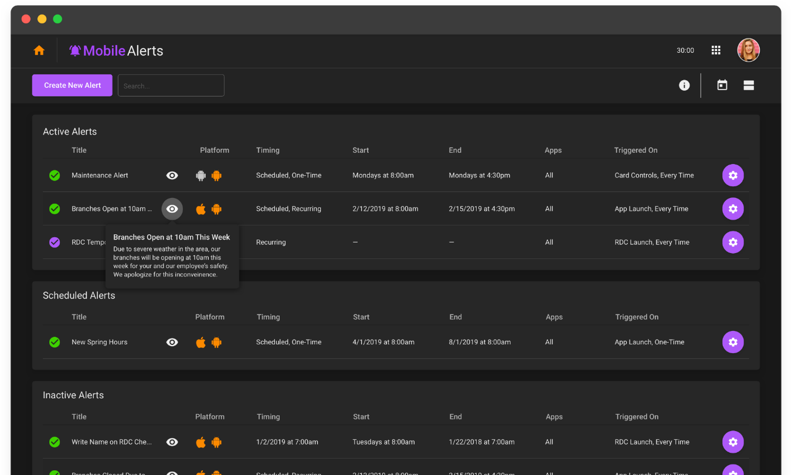
SUPPORTS MOBILE 4.0 and BIZ MOBILE 1.0

Slide 50
Are you ready for a new mobile It’s Me 247?
9

Slide 51
Preparing for a new look and feel for it’s me 247 mobile web by year-end 2020
It all starts with the rollout of it’s my biz 247 mobile web, underway now
Kill two birds with one stone: roll out your BizLink mobile apps and go to school on your next version of the mobile app

Slide 52
Currently 6 cus in the beta-test, planning to roll to members within 30 days
We will marry the style here with the mobile 5.0 concepts for it’s Me 247 by year-end
Contact the beta CUs and get a sense of how your members might respond to a new format for mobile navigation

Slide 53
It’s my biz 247 mobile web will be available for cus in January
The plan is to have a year’s worth of experience before 5.0 rolls out next year
This will be the first comprehensive solution using web modules...and just a few short months later, we’ll roll out the new It’s Me 247 desktop version with the same foundation

Slide 54
Envisioning the next Online ’19 project
10
Back to the drawing board

Slide 55
Back to the Drawing Board
Time for a new name, too
Notes:
Third Party cookies never worked on Apple Safari
In May, Google Chrome announced they would also block them.
Firefox quickly followed.
This meant we could not set cookies on the It’s Me 247 Domain (itsme247.com) and use them to authenticate on the Credit Union Domain (tbacu.com, honorcu.com, Frankenmuth.com)
Browser change, we’re always adjusting.

Slide 56
Back to the Drawing Board
Introducing...
WAM
Websites for Authenticated Members
MERGING BROCHURE-WARE & BANKING WEBSITES
Time for a new name, too
Notes:
for the website architect - To allow them to include banking activities seamlessly

Slide 57
WAM Websites for Authenticated Members
MERGING BROCHURE-WARE & BANKING WEBSITES

Slide 58
Merge Website
Because Web Modules are self contained, we could embed them in your website

Slide 59
Merge Website
Notes:
Example Credit Union Website

Slide 60
Merge Website
Notes:
Credit Union website with Online Banking Menu

Slide 61
Notes:
Web module embedded in the middle of the credit union website

Slide 62
Notes:
If the member isn’t authenticated… would prompt for Authentication.
Username/Password/Security question… or this could be where we start using Daon on “desktop” banking
- Though desktop and mobile banking merge? This feels out of place

Slide 63
Notes:
Logged in, see transaction activity on the CU website

Slide 64
Notes:
Mobile view
Could do a slide on browser stats of Desktop/Mobile/Tablet for CU websites?

Slide 65
Future Phases
Modules are a new Foundation
Build in a tracking mechanism to know the member and their actions
Build in marketing to suggest actions to the known member
...?
This isn’t a done deal… there are still challenges to be resolved
Notes:
“Telemetry”
All the “other stuff”
How to document it for members?
Service alerts?

Slide 66
Wrapping up the week...

Slide 67
Membership Opening 2.0 (did you see it in the app?)
Improved eSign Experience
UI refresh and support for more devices
Check it out in the app!
Joint MOP Applicants with ID verification

Slide 68
Thanks for the day (and the week)!

