Slide 1
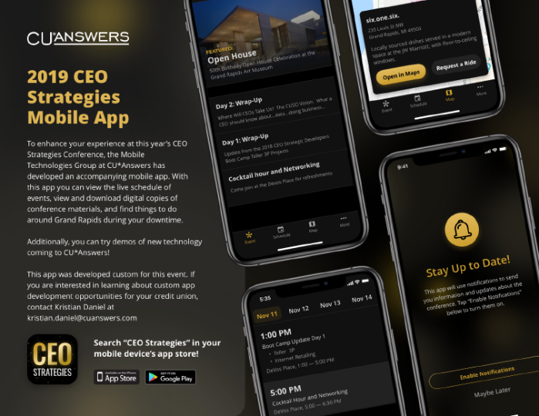
Welcome!
Have you downloaded the conference app?
Catch a ride: Map > Conference Location
November 11-14, 2019
Check it out in the app!
WIRELESS ACCESS: DeVos Place
PASSWORD (VOUCHER): CUA50years!

Slide 2
CEO Roundtable
Where will Credit Union CEOs Take Us? The Credit Union Vision
November 12, 2019

Slide 3
Welcome to the 2018 CEO Roundtable
Greetings from the Board
Your 2019-2020 Board of Directors
Hint at the 2019 dividend checks
CEO Roundtable
CEO brainstorming: CUSO initiatives to act on going forward
cuasterisk.com CEO Live Chat Room
CEO networking: Talking with each other with networking as the point
TODAY’S AGENDA
And don’t forget tonight’s special event:
50th Anniversary Open House at the Grand Rapids Art Museum

Slide 4
During the CEO Roundtable, CEOs break it down with their peers, and we see where the room goes on credit union industry challenges and opportunities
I’m putting on my listening hat!

Slide 5
This year we’re trying something new: a live chat room where you can network, with networking being the whole point
I’m putting on my listening hat!

Slide 6
Chairman’s Report

Slide 7
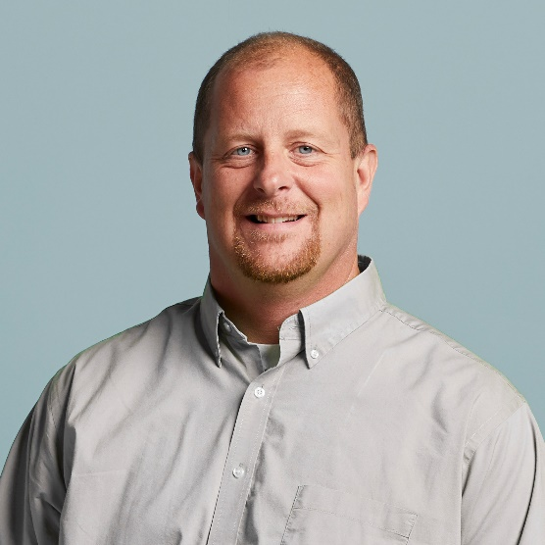
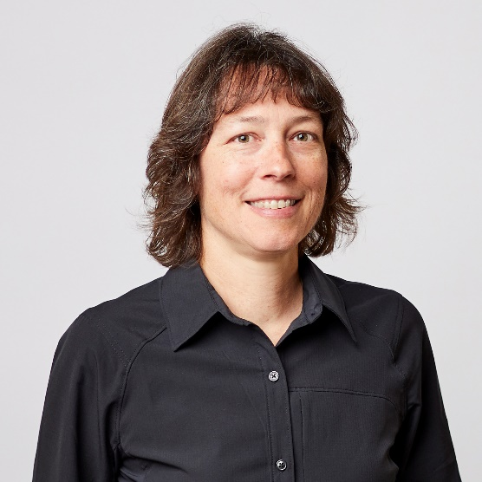
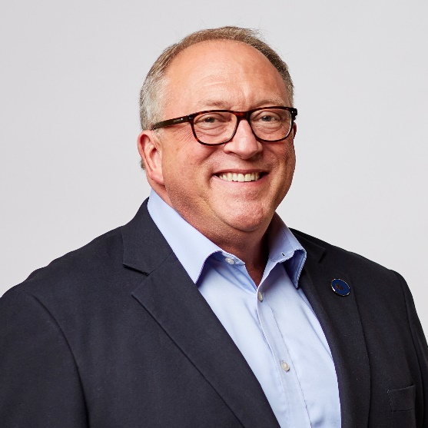
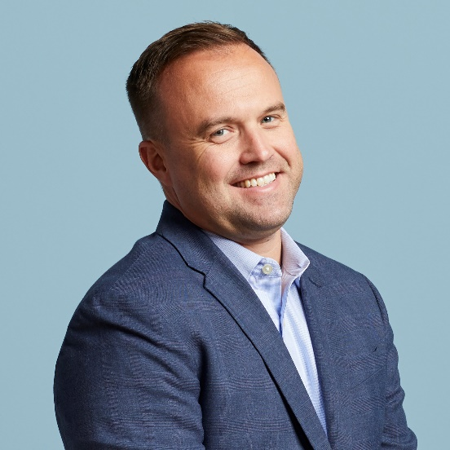
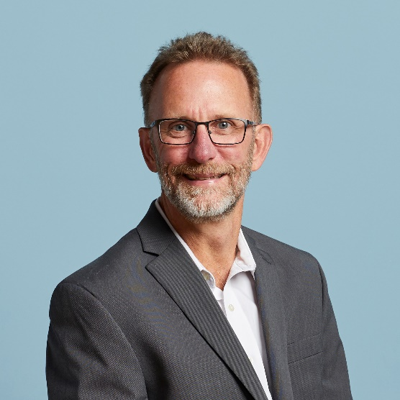
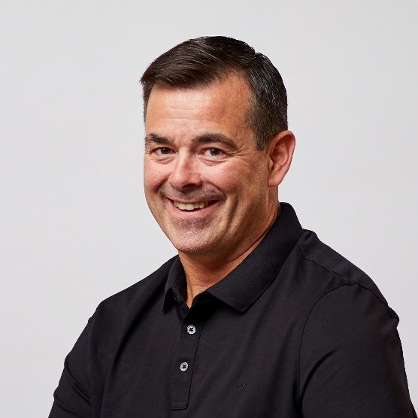
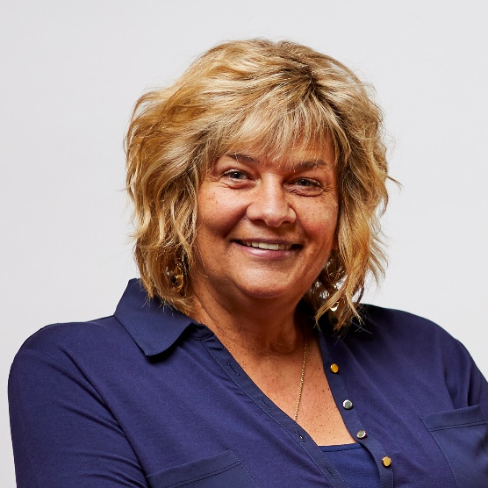
Your 2019-2020 Board of Directors
Scott McFarland, Chairman
CEO, Honor Credit Union
Board Member since August 2009
Linda Bodie
CEO, Element Federal CU
Board Member since October 2013
Tom Gryp
President/CEO, Notre Dame FCU
Board Member since October 2016
Kris Lewis, Director
CEO, Allegan Community CU
Board Member since October 2018
Jeff Jorgensen, Director
CEO, Sioux Empire Federal CU
Board Member since December 2009
Dean Wilson, Director
CEO, Focus Credit Union
Board Member since January 2008
Vickie Schmitzer, Sec./Treasurer
CEO, Frankenmuth Credit Union
Board Member since October 2007
THANK YOU!
Notes:
Thank your Board and move forward to the election and the nominating committee (hand off to Tom)

Slide 8
A Hint on This Year’s Numbers
Declared 2019 Patronage Dividends:
$ 2,250,000 Standard Patronage Dividend
$ 3,750,000 Bonus Patronage Dividend
$ 6,000,000
$ 842,820 Ownership Dividend
$ 6,842,820
Projected Stock Dividend: 4.00%
Projected Increase in Stock Equity: 5.25%
All are projections, to be finalized by our CPA in December

Slide 9
My goals for today’s interactions
CEO Roundtable
cuasterisk.com Live Chat Room
A morning full of robust conversations that inspire our board and our CEO to propose new initiatives for our CUSO to take on in the future
Put on your thinking caps and let’s hear about what you would do if you were the CEO of this CUSO, listening at the sidelines
No rules
No expectations
No judgment
No Randy
What do you want to talk about that might change your world?

Slide 10
Time for some roundtable brainstorming...

Slide 11
Here’s how it will work:
3 topics, 45 minutes each
Scribes will take notes for your group (ask your scribe if you’d like them to email you a copy of their notes)
Choose a spokesperson from your group to give the summary report, if you’re called upon
Introduction by Randy | 5 minutes
Roundtable group brainstorming | 30 minutes
Summary report from 1 group | 10 minutes
I’ve got my listening hat on!

Slide 12
Growing the Pie for Your Teams
What are the top 3 tactics a CEO could deploy to radically increase the compensation of their core team members in 2020?
How do you grow the pie that you split with your professional teams in the next 5 years?
Topic #1
Talking about growth can be fuzzy when there’s no goal from the results of growth
Nothing challenges the CU industry more than creating careers for the people who will sustain their day-to-day activities

Slide 13
Increasing Returns for Your Members
What are the top 3 tactics a CEO could deploy to radically increase returns to members in 2020?
What member groups do you think have the chance to see the biggest increases in the next 5 years?
Topic #2
You all have plans for consumers, but sometimes stumble when you talk to individuals face to face as owners
What does the owner’s persona get out of supporting your organization, beyond vague good intentions?

Slide 14
The Next 5, 15, or 50 Years
Of the current trends debated in the industry today, which one of them do you want to count on for your future?
Which one of them do you think will be a bust for your CU looking forward?
Which one seems to be a “group-think loser” and you want nothing to do with it?
Go counter to the flow!
Topic #3
Thought leaders love to list key success factors, best practices, and the trends you can’t ignore
But the truth is, it’s all up to you – what would you have the CUSO pay attention to, given today’s CU headlines and marketplace ideas?

Slide 15
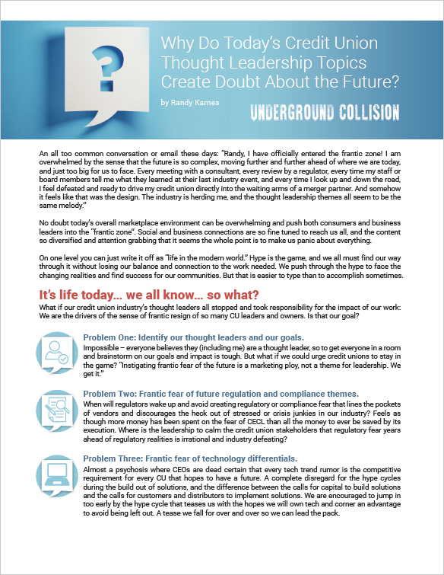
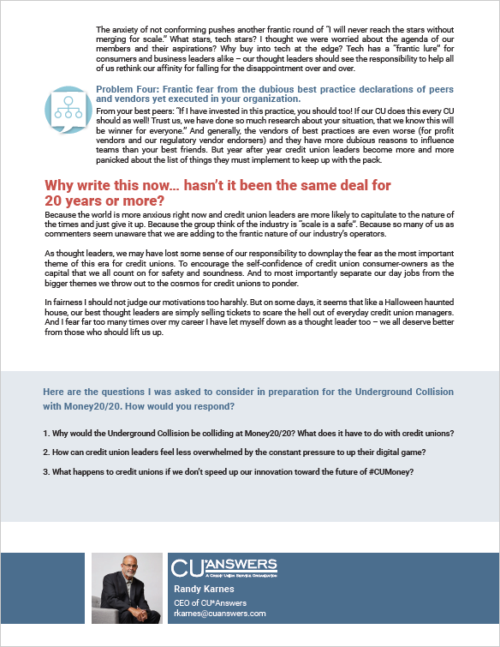
It can all be so frantic!

Slide 16
Time for lunch!

Slide 17
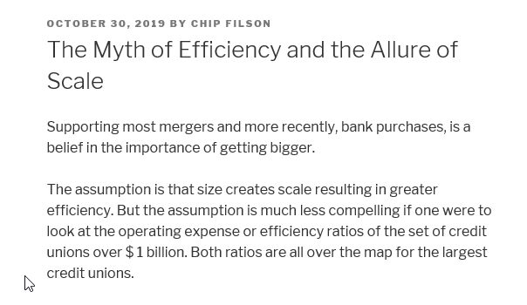
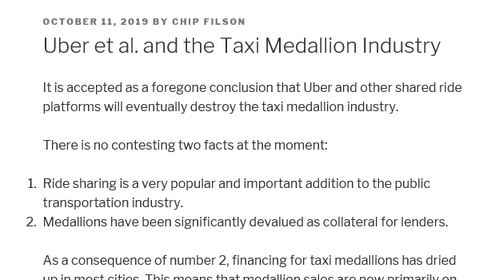
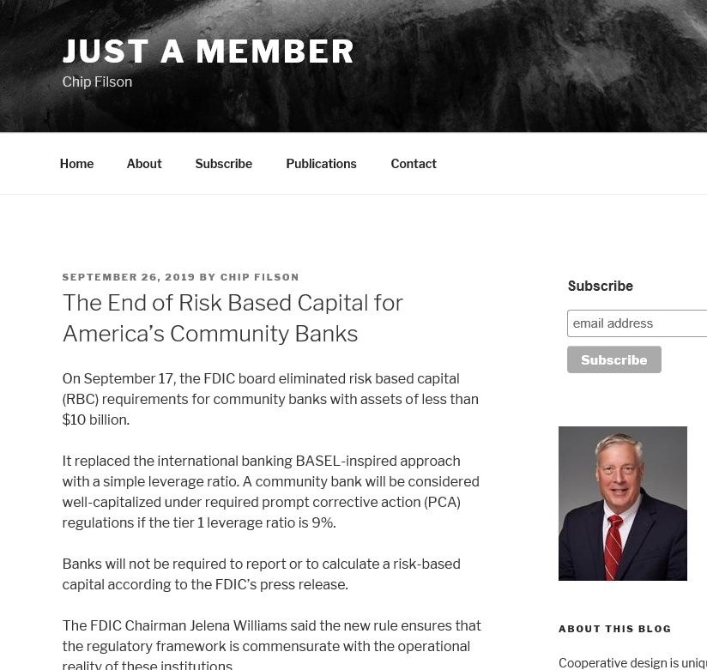
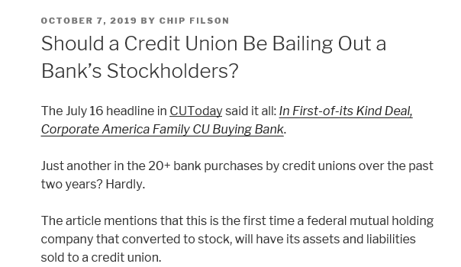
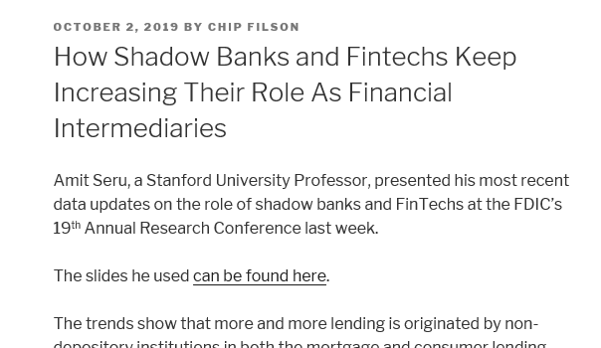
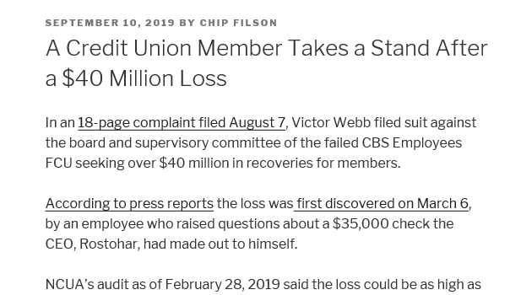
https://chipfilson.com/

Slide 18
Now let’s try something new...
You have until we wrap up at 2:45:
Your facilitators:
Mark Richter, CEO of First United CU
Matt Selke, CEO of Pinnacle CU
Introduction by Randy | 5 minutes
Introduction and explanation by your facilitators | 15 minutes
Robust networking session, credit union CEO to credit union CEO, without CUSO participation | 75 minutes
cuasterisk.com CEO Live Chat Room

Slide 19
Wrap-up

Slide 20
Join us at the party!!
Help us kick off the year-long celebration of our 50th anniversary
Drinks and refreshments will be served
Shuttles will be running between the JW Marriott and the GRAM throughout the entire event
(catch one from the ballroom entrance at the JW, off Campau Street, NOT the main lobby/valet entrance)
at the
Grand Rapids Art Museum (GRAM)
101 Monroe Center St, NW
artmuseumgr.org

Slide 21
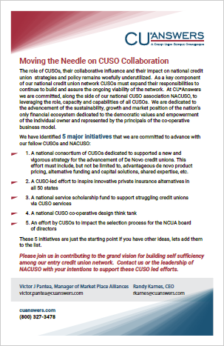
How do we champion an industry when we’re so busy selling our own agendas?
LOOK FOR OUR AGENDAS THROUGHOUT 2020

Slide 22
Thanks for the day!
See you at the party!

