Slide 1
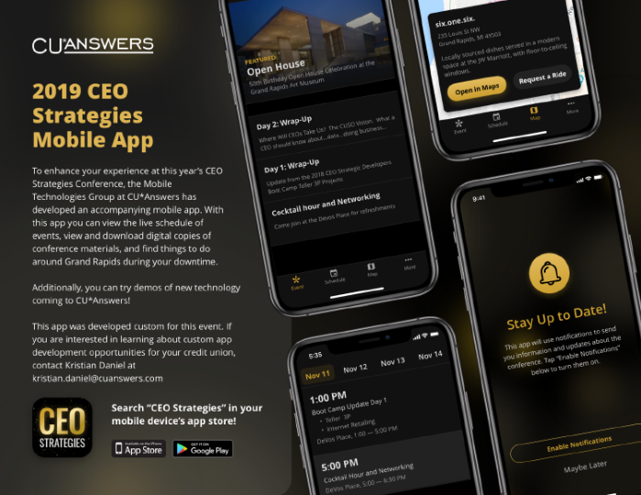
Welcome!
Have you downloaded the conference app?
Catch a ride: Map > Conference Location
November 11-14, 2019
Check it out in the app!
WIRELESS ACCESS: DeVos Place
PASSWORD (VOUCHER): CUA50years!

Slide 2
2019 CEO Strategies
Where will Credit Union CEOs Take Us? The CUSO Vision
November 12, 2019

Slide 3
Two agendas for CEO schools throughout the year
After a decade of CEO School, it’s time for some new tricks
Schooling each other on current strategy:
A school for CEOs of cooperatives in our network:

Slide 4
Today’s Agenda
What a credit union CEO should know about...
Data
CU*Answers’ calling card for the next decade
Business Memberships
Leading the way towards a new collaborative competency
ACH
Thinking about everything “payments”
Mobile & Desktop Internet Solutions
Preparing for a new day, from top to bottom
Succession Planning
It’s a network thing – why CU*Answers stakeholder confidence in the process is critical
...and what a CUSO CEO should consider from the perspective of his peers
I’m putting on my strategies hat!

Slide 5
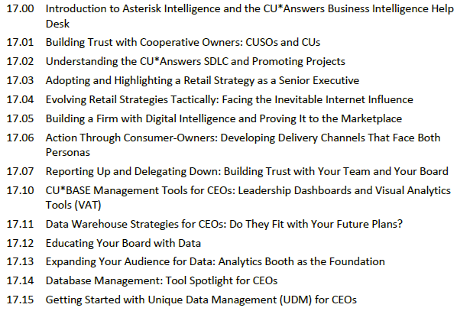
So what about CEO school?
We’ll still have a full week for cu senior executives with the CU*Answers CEO
Mark your calendars:
March 30-April 3, 2020
An extension of the CU*Answers Executive Study series, for students of cooperative design leadership

Slide 6
Let’s Get Acquainted
Your name and credit union
Of the five topics on today’s agenda, which one is the most intriguing to you as a CEO? Which is the least?
What topic that we’re not covering today is high on your list for 2020?
ROUND-ROBIN INTRODUCTIONS 45 MINUTES

Slide 7
Data in 2020
CU*Answers’ calling card for the next decade

Slide 8
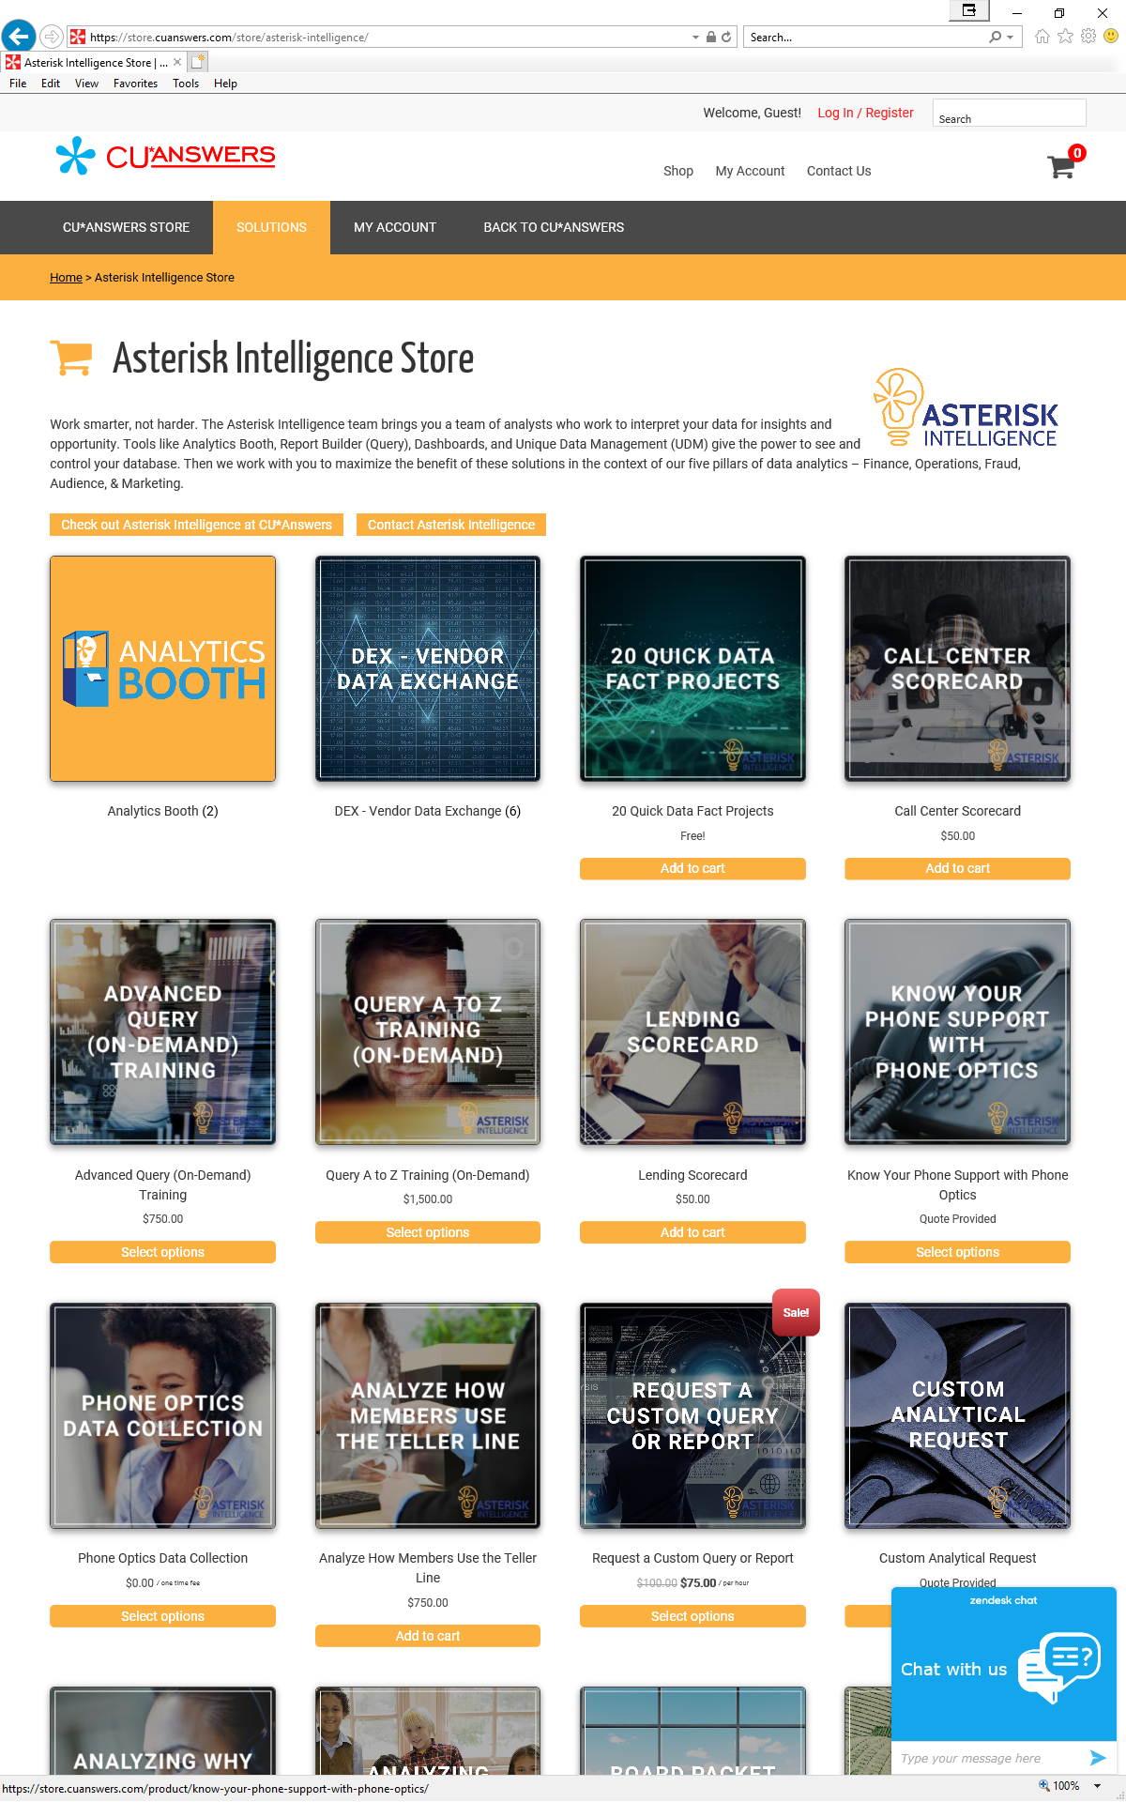
Our calling card for the next decade
More than tools, asterisk intelligence is a business
Create data
Maintain data
Analyze data
Act on data
Add data job descriptions
Build business intelligence teams
Store data and create data warehouses
Move data from warehouse to warehouse
Sell the value of data
Arm stakeholders with the power of data
Enhance your career with a grasp of data

Slide 9
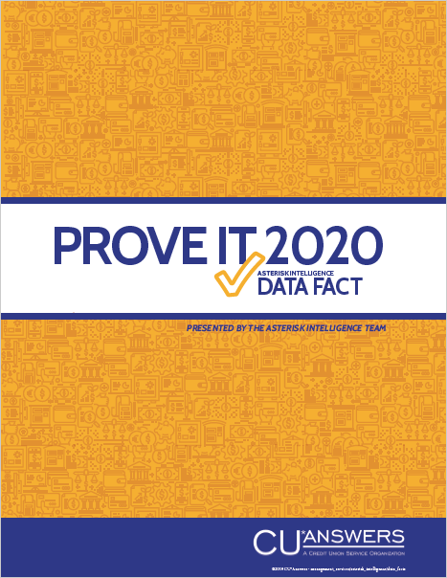
2020 priorities for our network
More than tools, asterisk intelligence is a business
Create data
Maintain data
Analyze data
Act on data
Add data job descriptions
Build business intelligence teams
Store data and create data warehouses
Move data from warehouse to warehouse
Sell the value of data
Arm stakeholders with the power of data
Enhance your career with a grasp of data

Slide 10
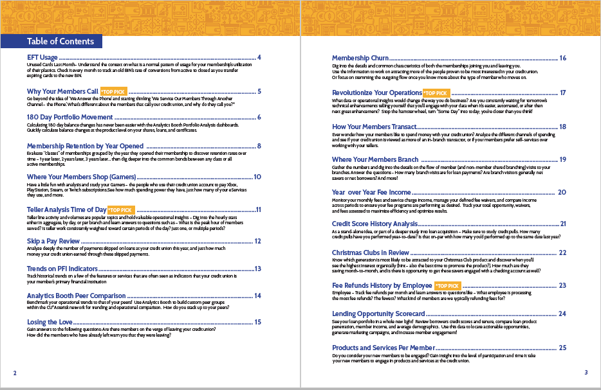
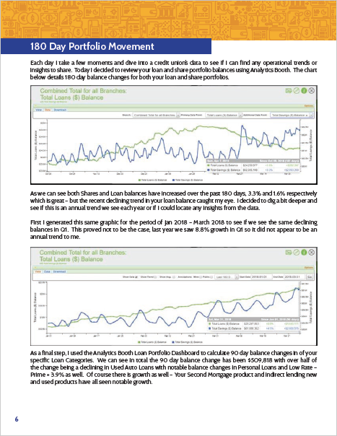
The reports of tomorrow that will move the ball

Slide 11
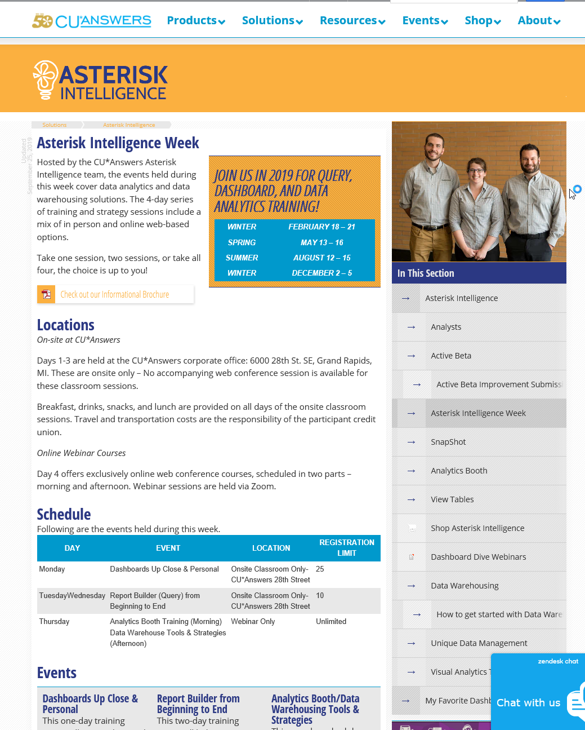
AI Week: An active community
Waiting for your strategy to engage
open.cuanswers.com/AIWeekInfo

Slide 12
Arming stakeholders with the power of data
From CEO school to our entire network, and now to your board and your vendors
Choose one: May 14 (Thursday), 1:00-4:00pm May 16 (Saturday), 10:00am-2:00pm
Saturday event is same as Thursday except with lunch provided
Maximum of 2 people per CU (any combination of CU professionals and/or board members)
May 19 (Tuesday), 5:30-7:30pm
At CU*Answers, 28th St. in Grand Rapids
Refreshments served

Slide 13
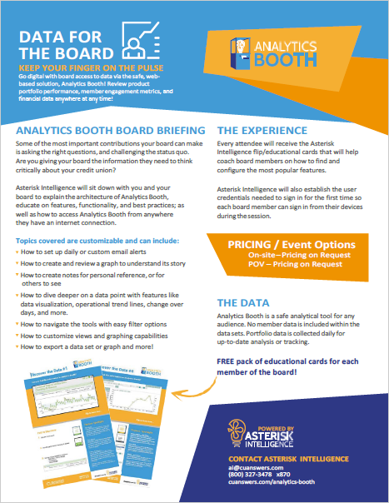
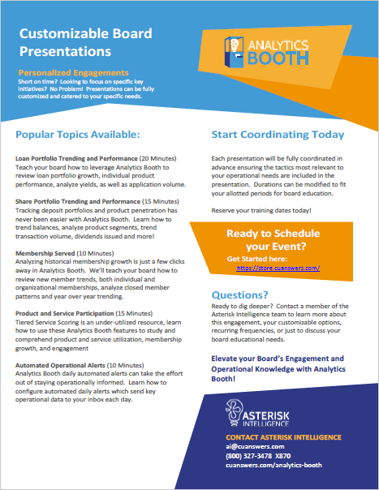
Analytics Booth Training for Board Members

Slide 14
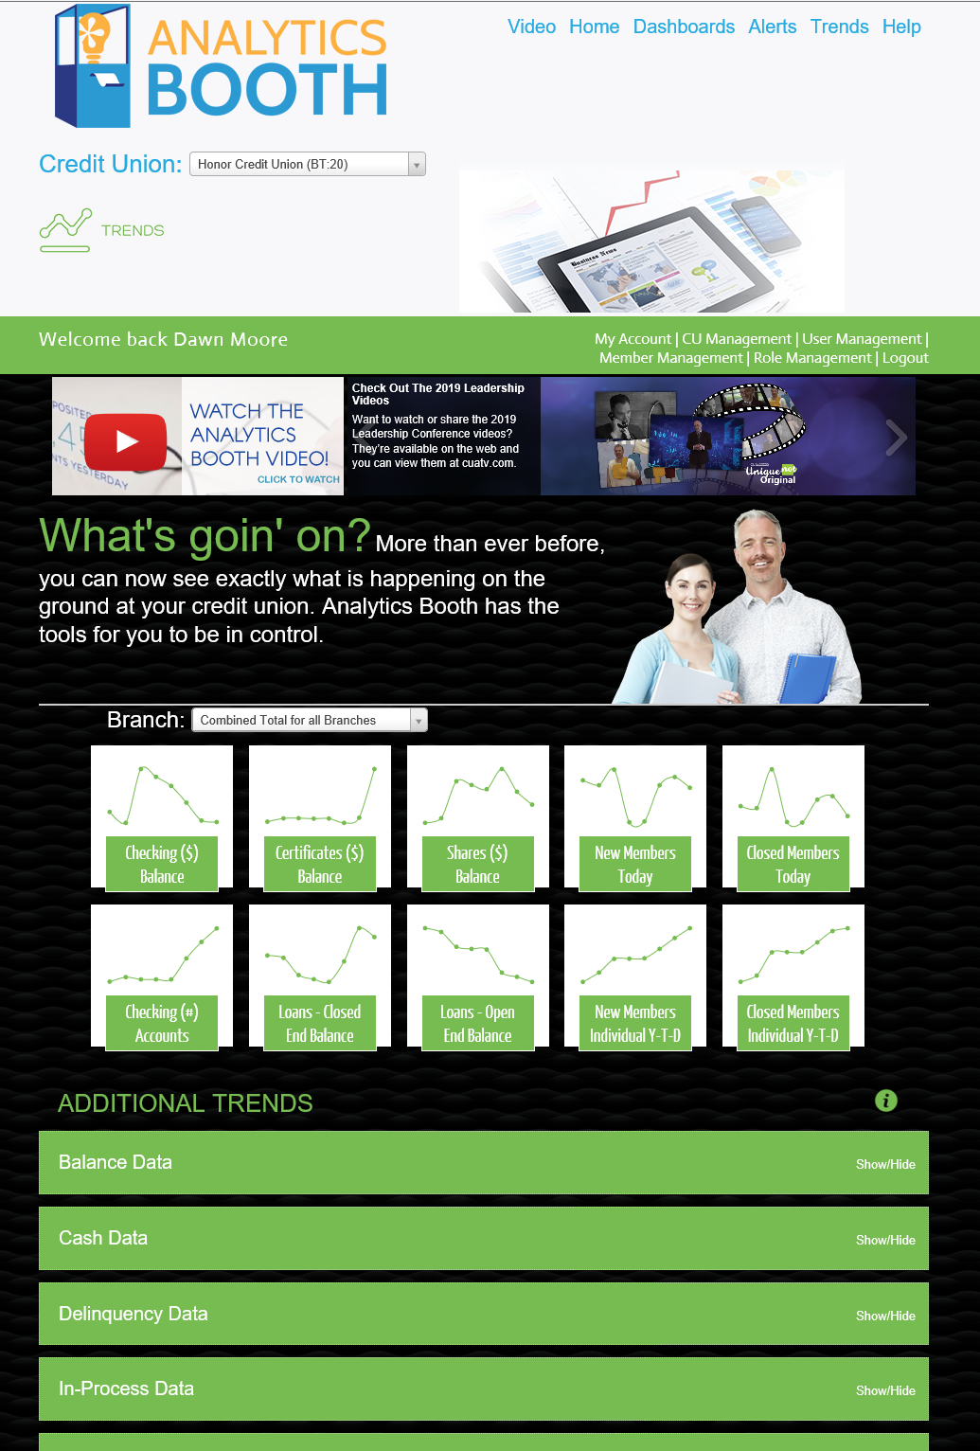
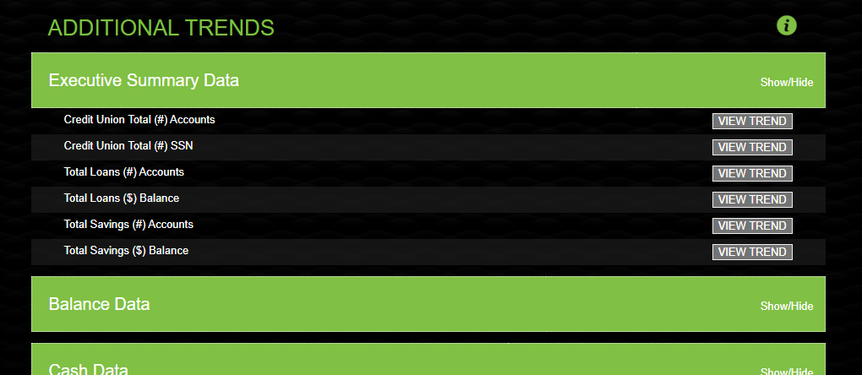
Analytics Booth opens the door to new markets for our products
In 2020, we will look at cu board directors and vendors as a target audience
Coming in February 2020

Slide 15
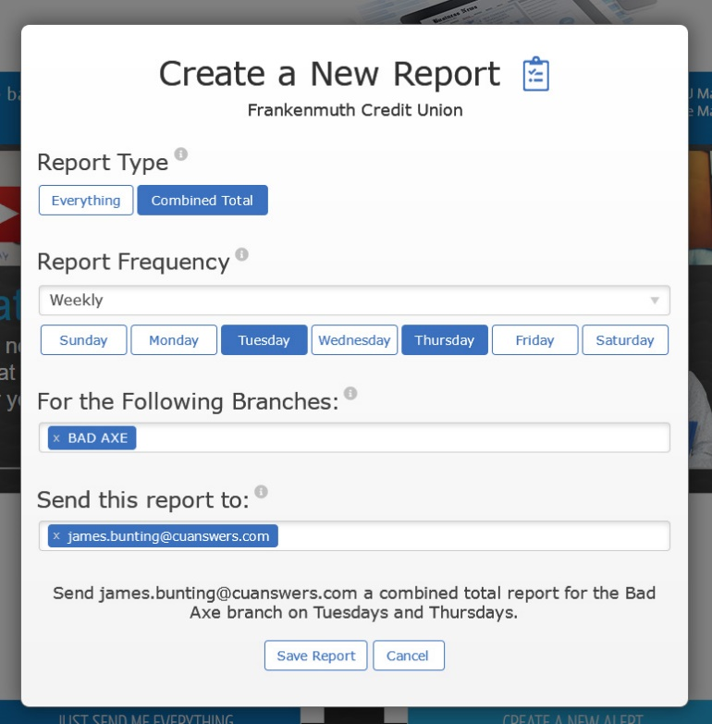
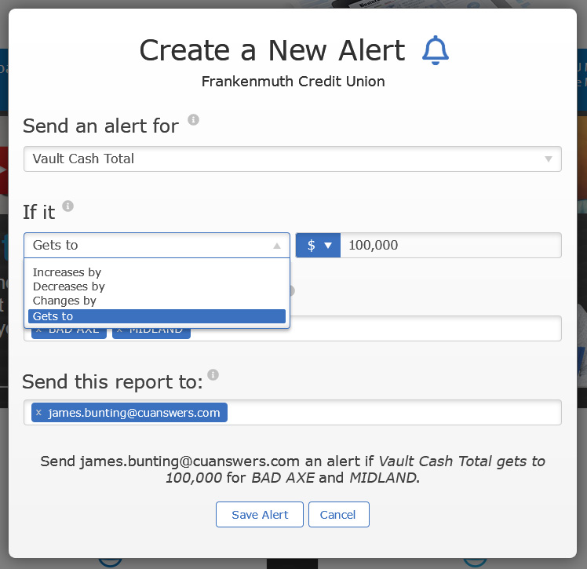
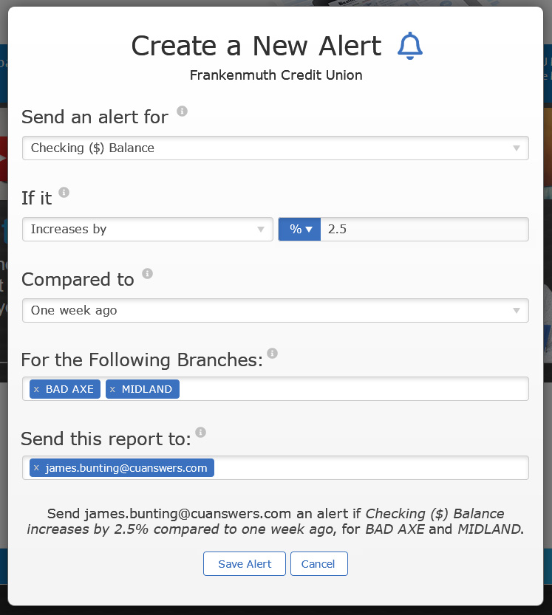
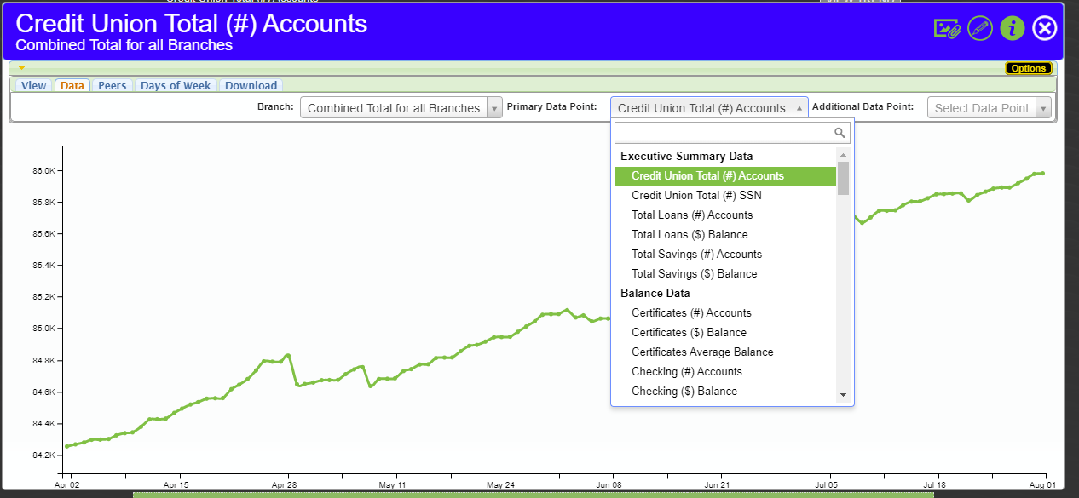
We’re excited about the February 2020 AB release
More than just new tools, it’s the launch of a new copyright and the factory to leverage it
Watch for more news about this release in January!

Slide 16
Analytics Booth started as an extension of CU*BASE and some neat features for inside of CU*BASE, but now it’s about to be a major copyright and calling card for our network
Imagine the day when you say “CU*Answers” and people think CU*BASE for core, Analytics Booth for data, and MTG for internet channels
New properties that add to the asset register of CU*Answers and the value of a CU*Answers share
Do you know the difference between a copyright, a feature, and a branded CMS support team?

Slide 17
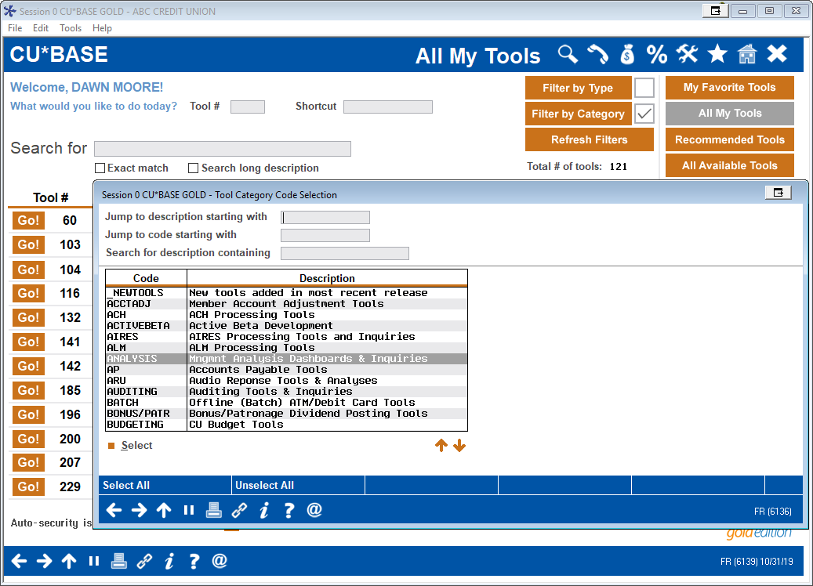
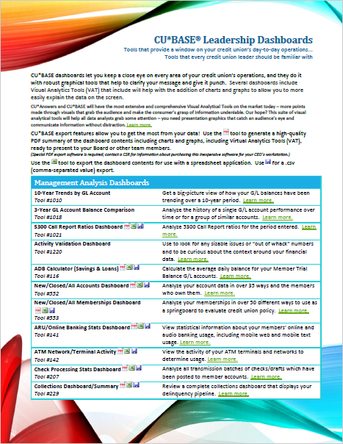
AI and CU*BASE in 2020
We’ll continue to be very active with CU*BASE users in 2020
There are 121 analysis dashboards in CU*BASE

Slide 18
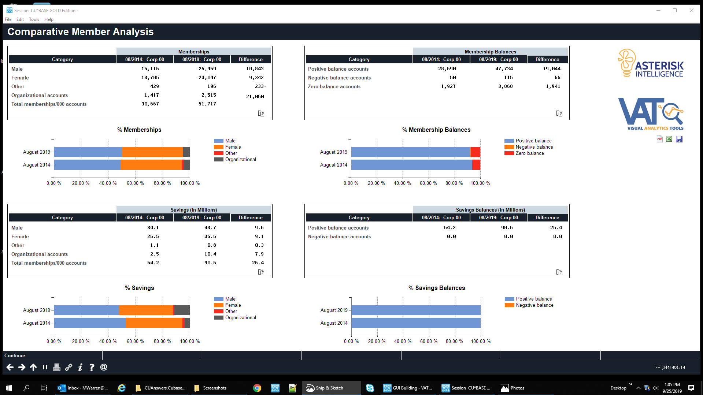
Built for presenters and big rooms

Slide 19
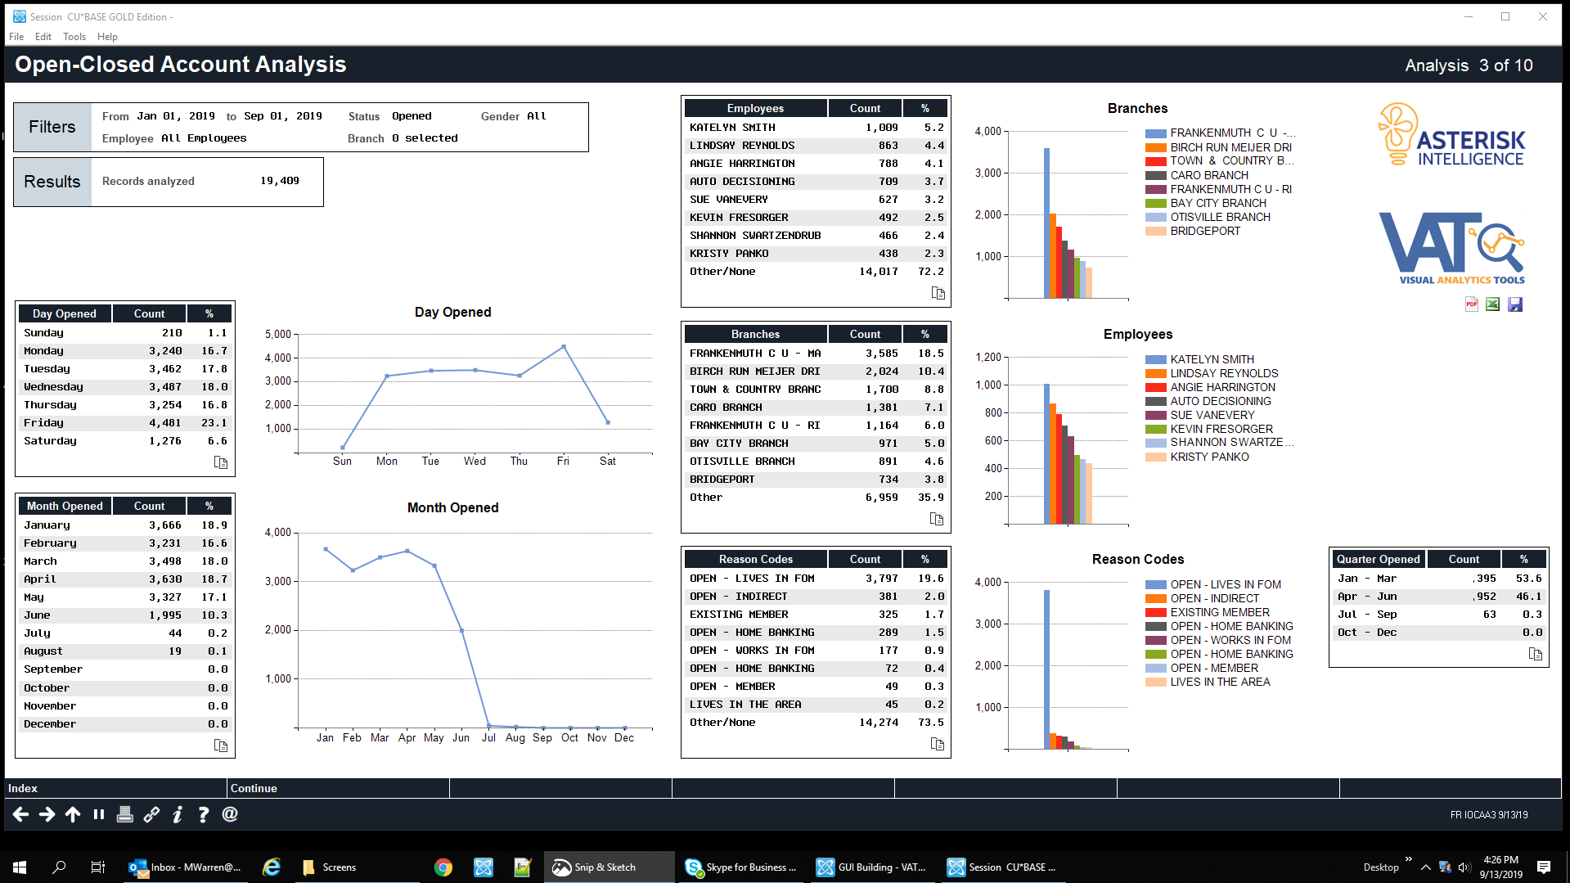
Combines tables and graphs for both points of view

Slide 20
These’ll have on-the-fly sizing, too ➔
(Randy’s pushing for these screens to be in the 20.05 release!)
Combines tables and graphs for both points of view

Slide 21
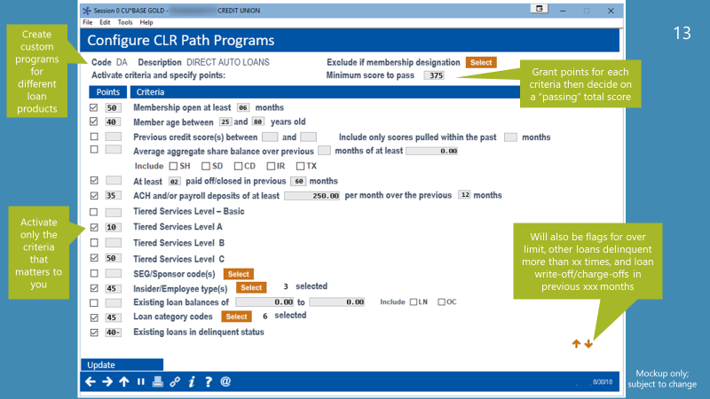
AI teams are inspiring every developer to go deep with data
Your data can help you stand out as an independent thinker and actor

Slide 22
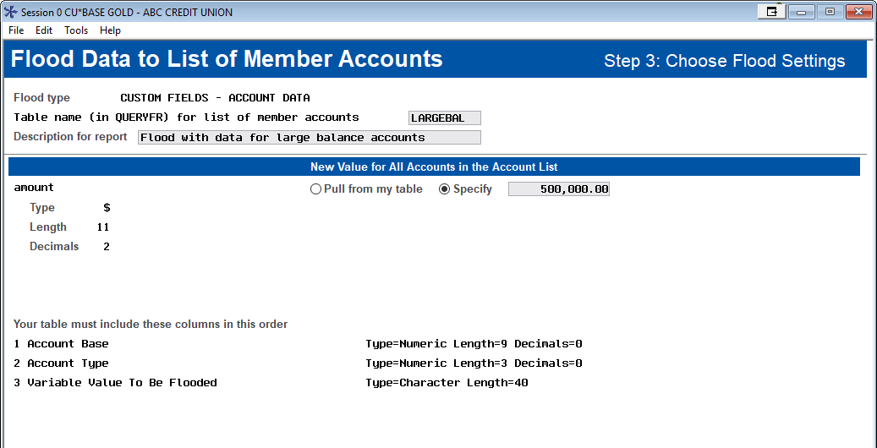
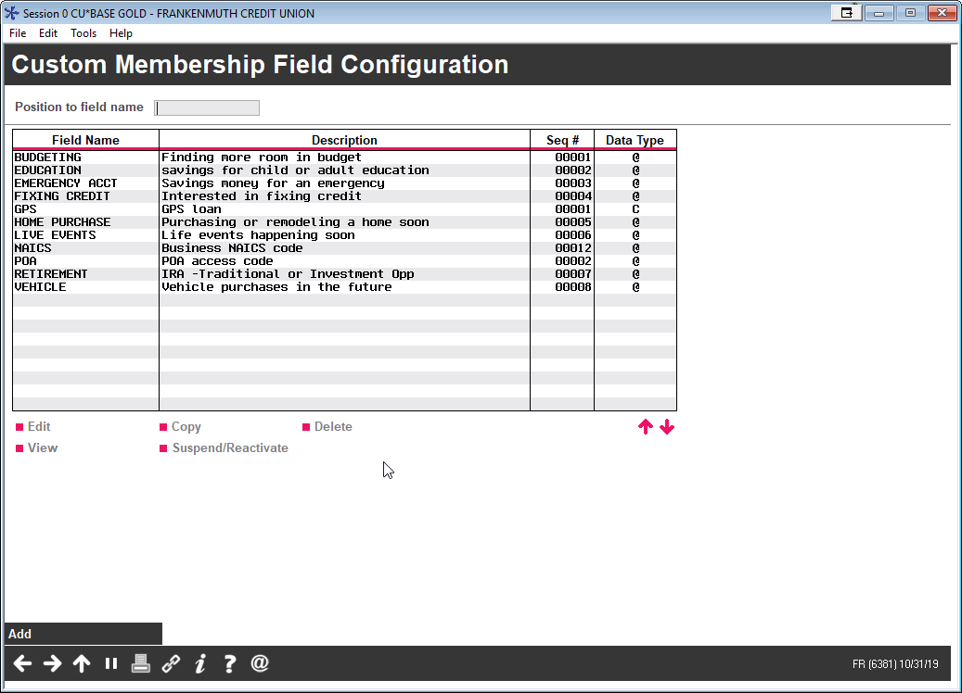
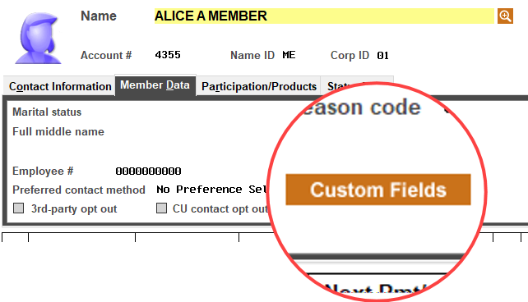
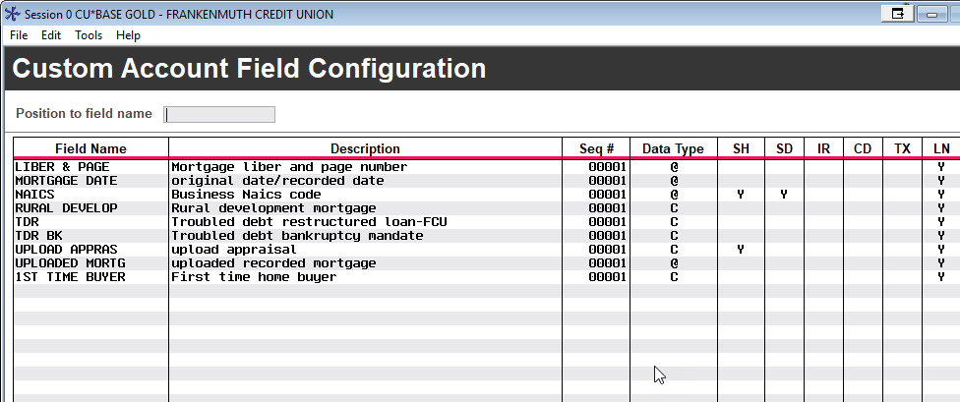
UDM and CDM: Think bigger than a user-defined field
What will you do when your database administrators become data designers?
Have you really considered what it means for your credit union to create unlimited data as part of CU*BASE?
You create the data points, you create the process to collect the data, and you design the ways to use the data – all without a programmer or external designer

Slide 23
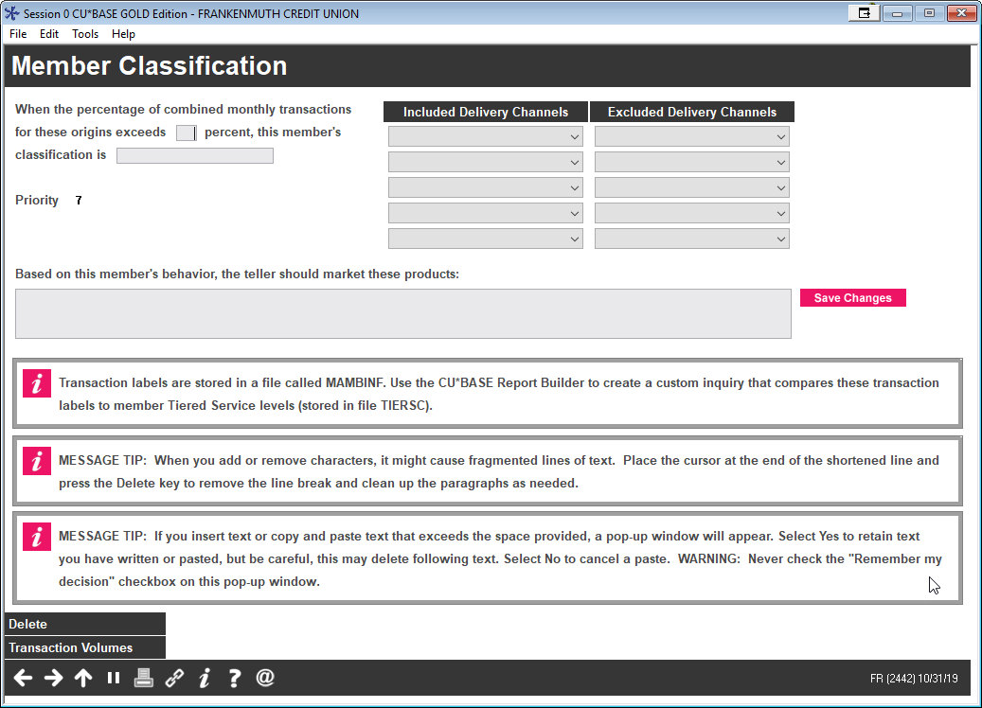
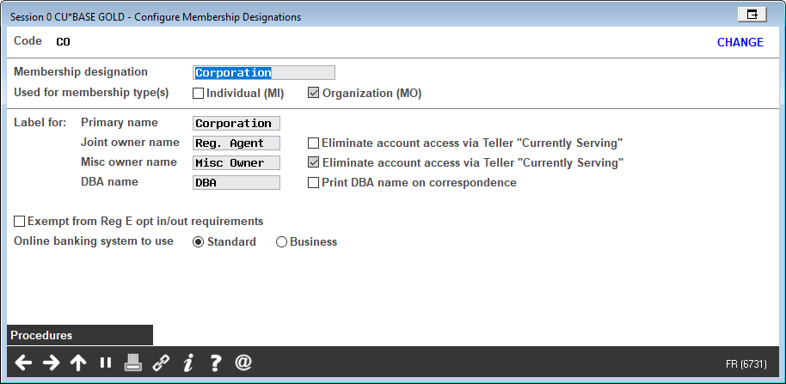
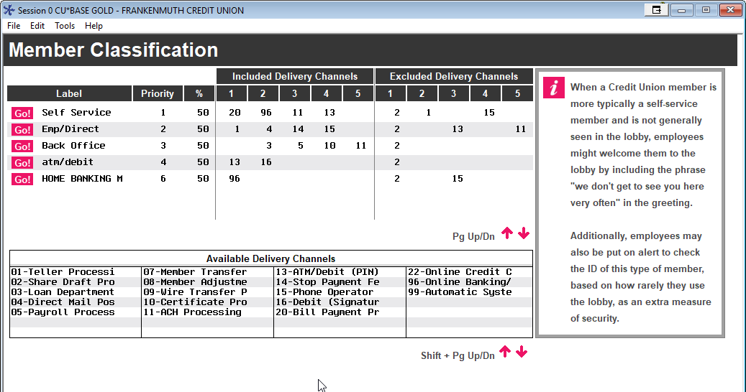
A new acronym CDM: Custom Data Markers
An Underestimated capability, about to grab some attention in 2020
Before data can be valuable, there must be data markers that you can recognize to delineate how records are the same, different, or unique
It’s your personalized ability to analyze data

Slide 24
THE HOLY GRAIL
What if you could create your own formula for what designates someone as a direct deposit member?
This label would let you manage the relationship, reward it, and rethink how payment labels might be an important tactic in your future

Slide 25
THE HOLY GRAIL
How long have we been searching for the perfect “Next Suggested Product” calculator?
OTHER

Slide 26
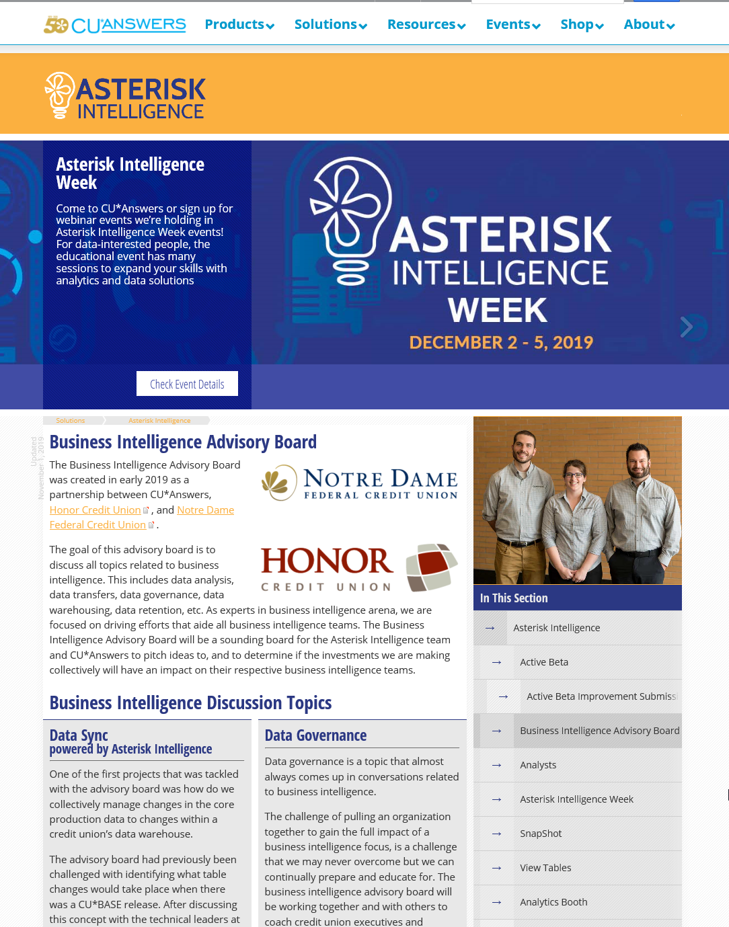
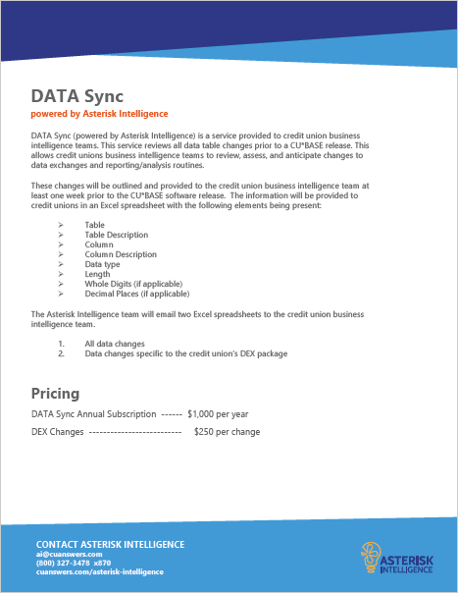
Introducing the Business Intelligence Advisory Board
how is this different from the BizLink Advisory BOARD?
(we have a lot of advisory BOARDS these days)
One of the first projects to emerge from the Business Intelligence Advisory Board

Slide 27
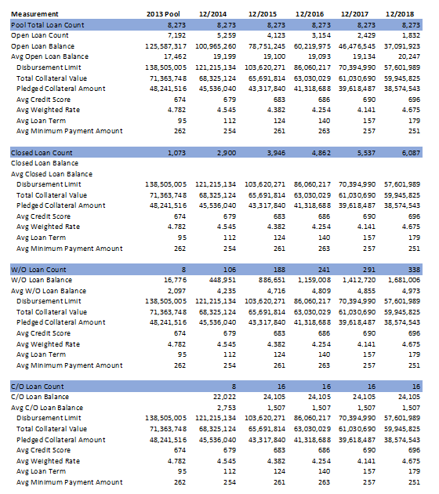
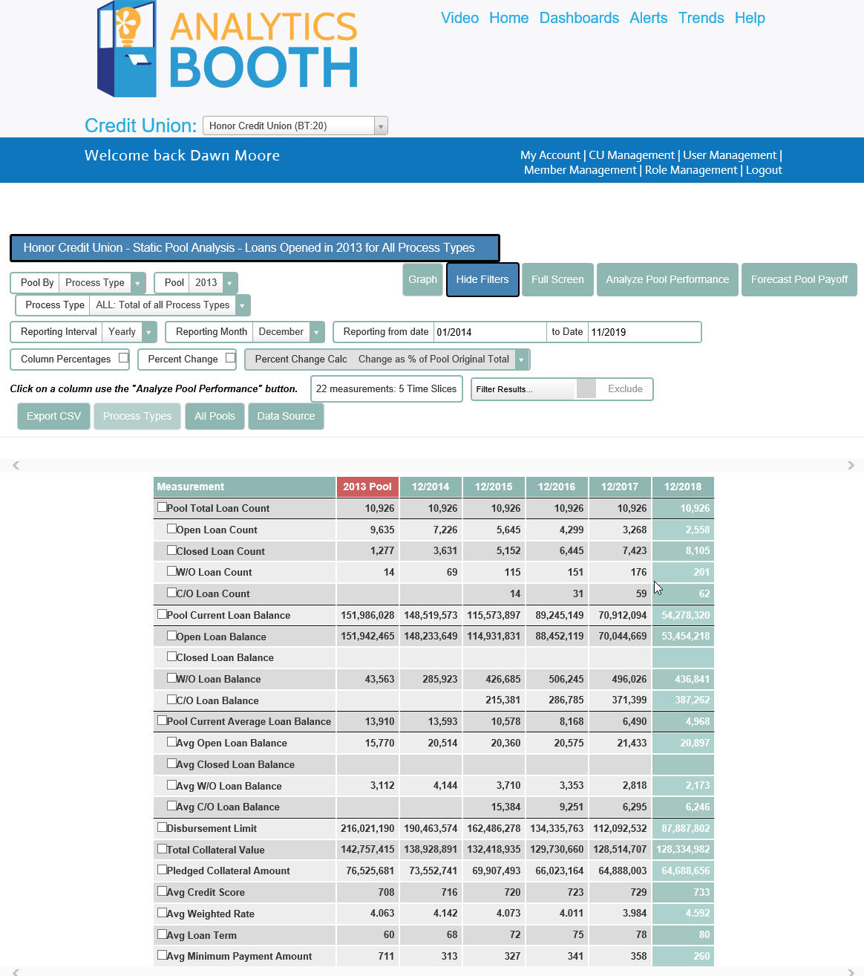
Static Pool Analysis Phase 2
Will SPA die without the fear of CECL?
Worksheet mockup only and subject to change; figures not accurate

Slide 28
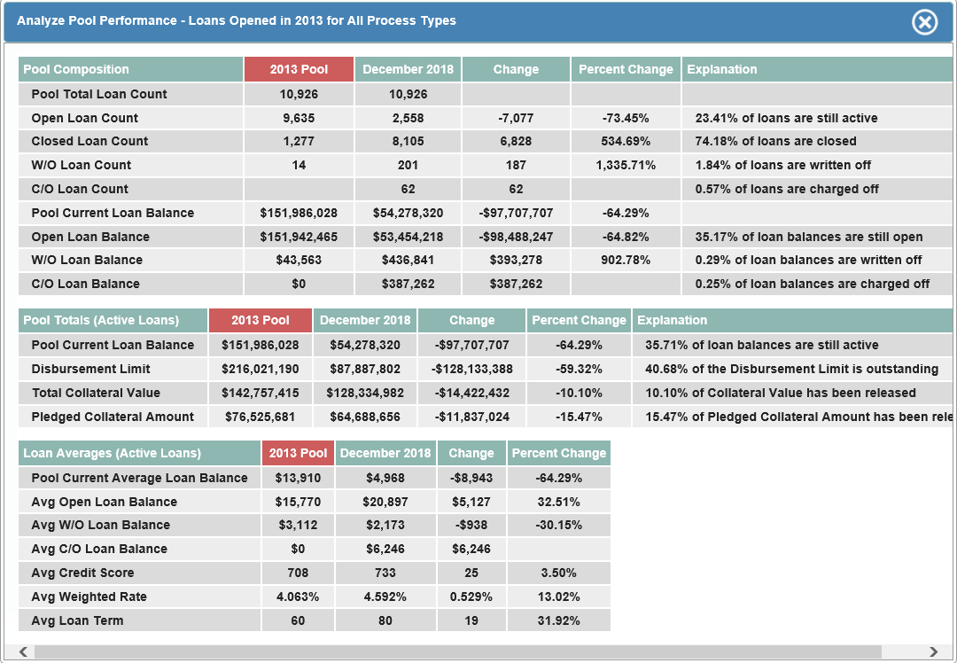
Static Pool Analysis Phase 2
You can see the pool, and it’s a cool spreadsheet...but can you see what else to do?
CEOs and CFOs need to sit down and think about what they can DO with these tables, besides just look at them

Slide 29
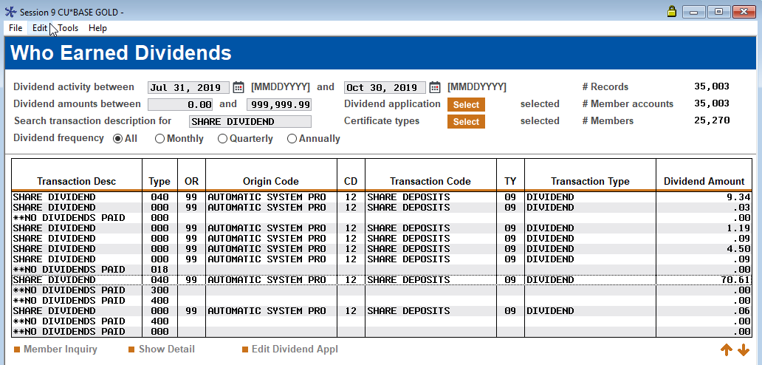
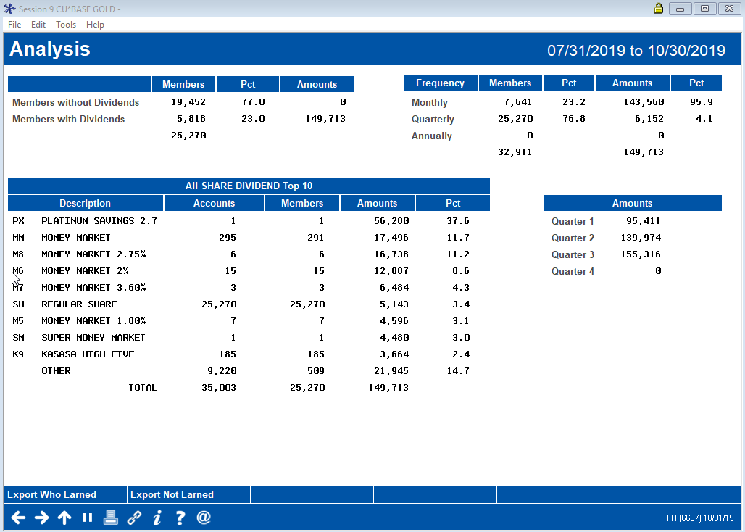
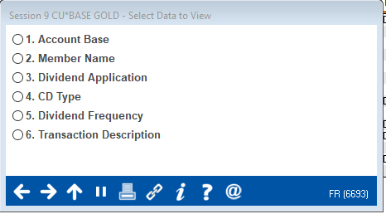
Who gets dividends?
Do you even wonder who benefits or loses every time you pay dividends?
Tomorrow, our chairman will announce $6.8 million in dividends to be paid out in 2019
Who, what, when, how, and why are constantly on my mind

Slide 30
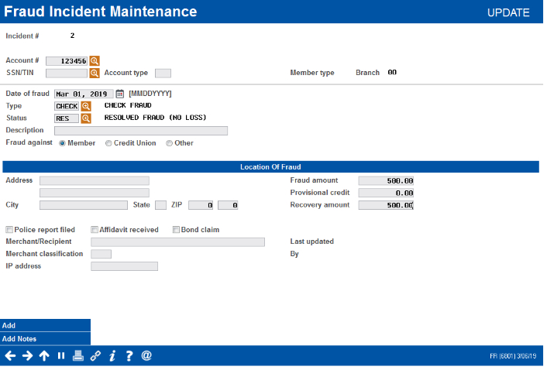
A project in search of enthusiasts
Acting on the hints from fraud data
If you want to change the dynamic when it comes to mitigating fraud, you need to be ready to change the transaction, live and in real time
For us to do that, we need some new tools, and that starts with data
We have 2 major projects in 2020:
Convince you to build a fraud incident database
Design our block list toolkit

Slide 31
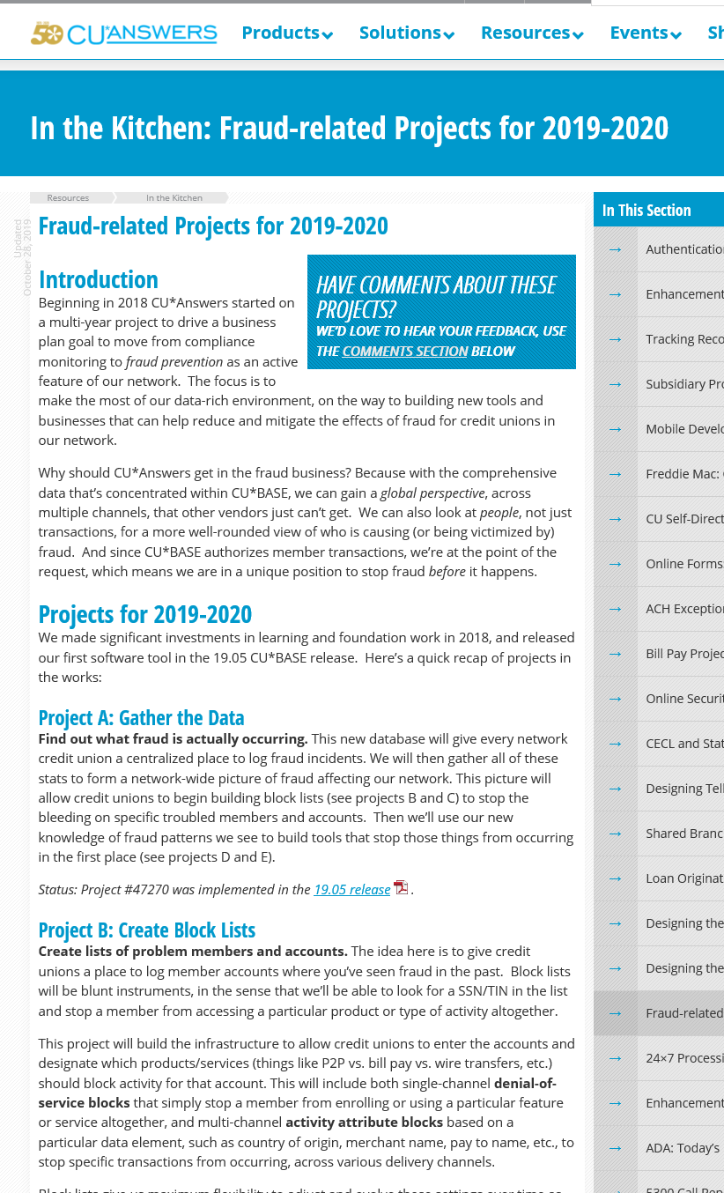
Block Lists: something we can do, when many can’t
Track along in the kitchen, and drive these projects
Project A: Gathering Fraud Data from the Network
New with 19.05: Tool #1715 Fraud Incident Maintenance and Tool #1710 Fraud Incident Dashboard
Projects B & C: Block Lists
In development now, targeted for 20.05
Project D: Monitoring for Patterns of Fraud
Enhancing the Abnormal Activity Monitoring toolkit to watch for “velocity” patterns, such as a dramatic increase in the volume or amount of transactions, heavy activity following a period of inactivity, etc.
Spec work underway; in development by Jan
Project E: Interactive Denial-of-Service Blocks
cuanswers.com/resources/kitchen/

Slide 32
Business Memberships
Leading the way towards a new collaborative competency

Slide 33
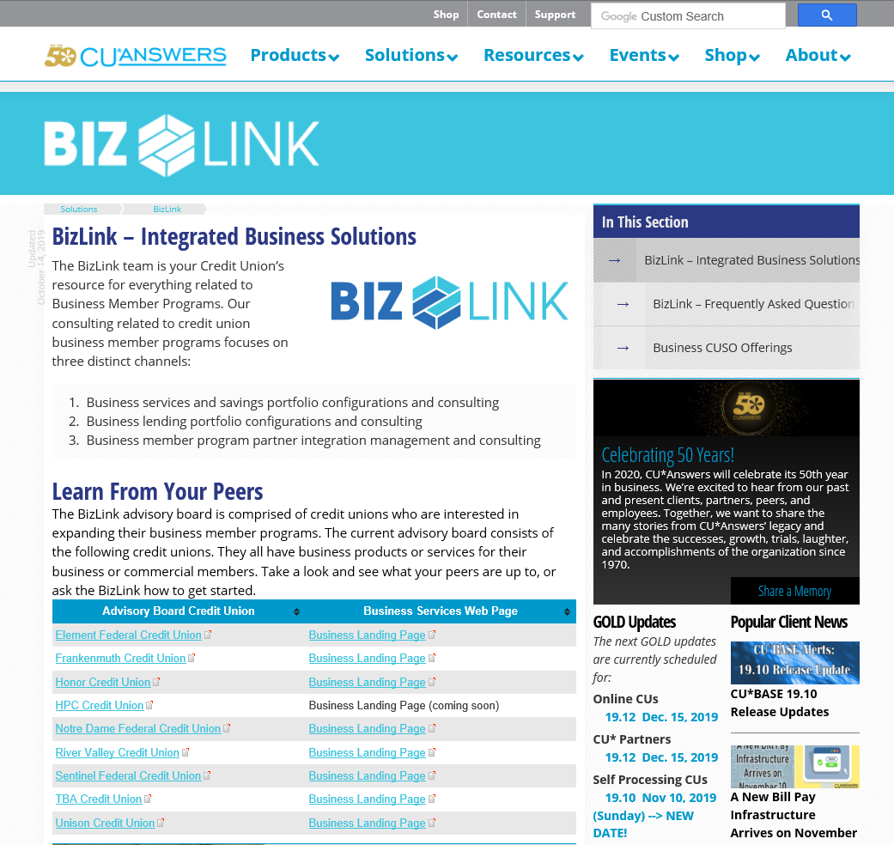
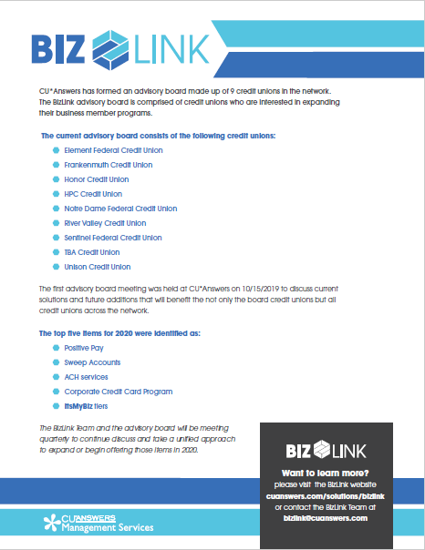
A new approach to an on-again, off-again strategy
More than tools, our network needs a support community for cu business departments
The BizLink Advisory Board:
Element FCU
Frankenmuth CU
Honor CU
HPC Credit Union
Notre Dame FCU
River Valley CU
Sentinel FCU
TBA Credit Union
Unison Credit Union
cuanswers.com/solutions/bizlink

Slide 34
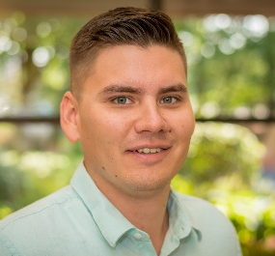
Yep, another advisory board
If we are to be successful, the BizLink team will have to balance native solutions, integrated solutions, and referenced solutions more than ever before
Pete Winninger
Leading from the Lender*VP perspective to drive lending solutions for business members
Keegan Daniel
Combining the power of Earnings Edge and Asterisk Intelligence to make sure business services meet diverse needs
Charlie Dean
The ultimate networker, building a knowledge base and connection to the marketplace solutions that credit unions need for their business member strategies
Because if we want to build a business around business members, we need CEOs to round out the picture

Slide 35
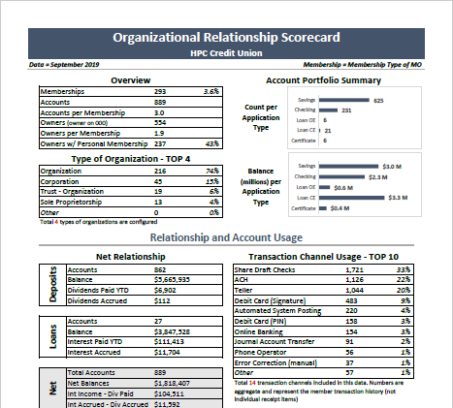
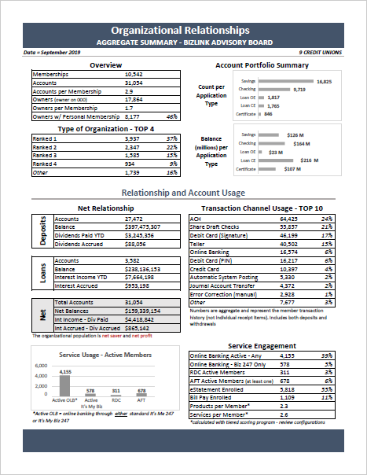
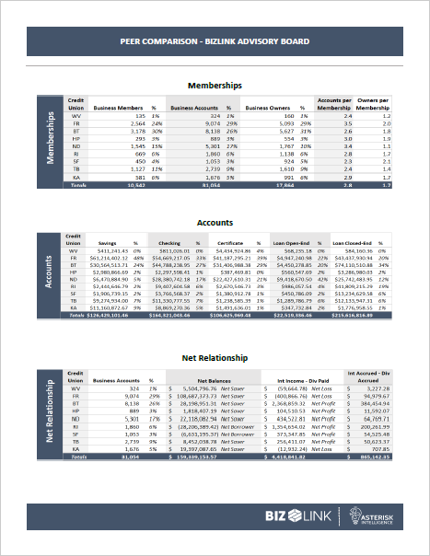
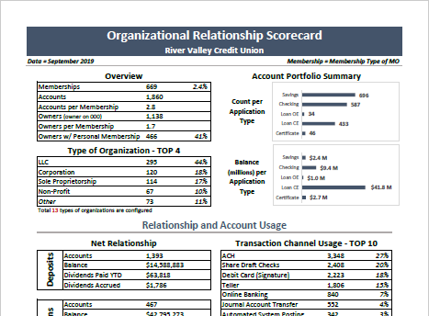
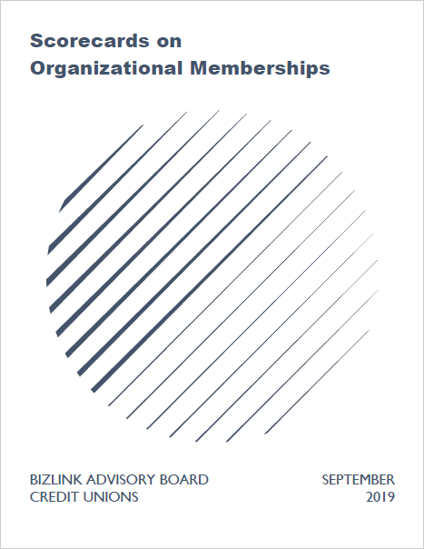
We are community xxx,xxx business members strong
But sometimes we don’t agree on how to count, how to talk, or how to describe our business communities
If you’d like your own scorecard, contact the Asterisk Intelligence team ai@cuanswers.com

Slide 36
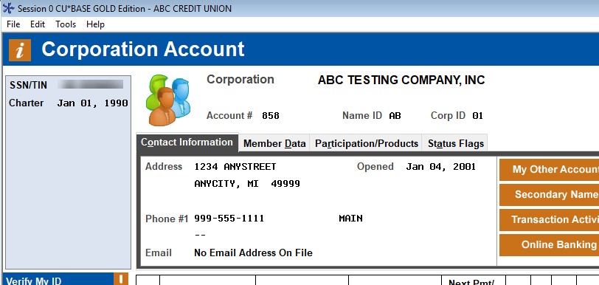
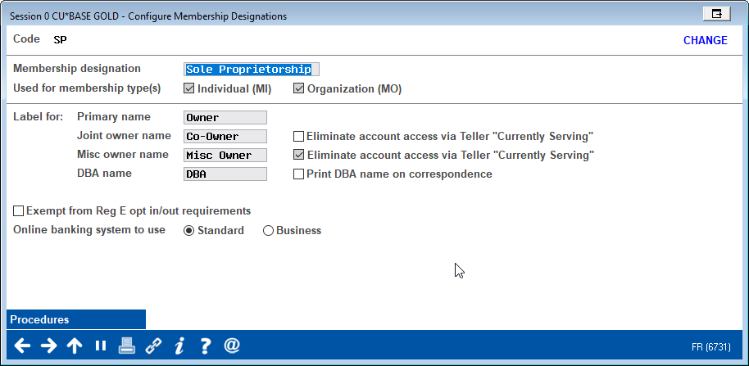
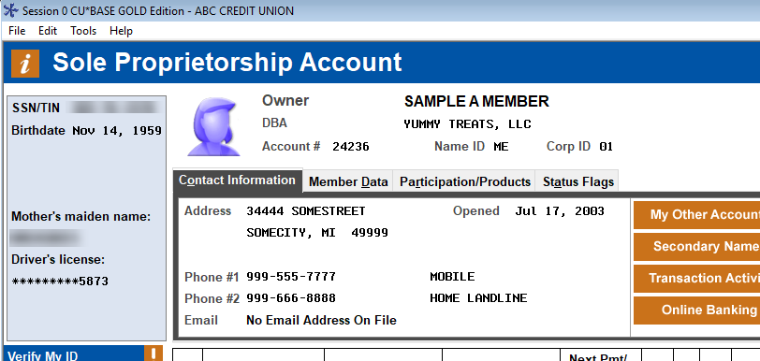
Nomenclature challenges: Tech vs. CU vs. business members

Slide 37
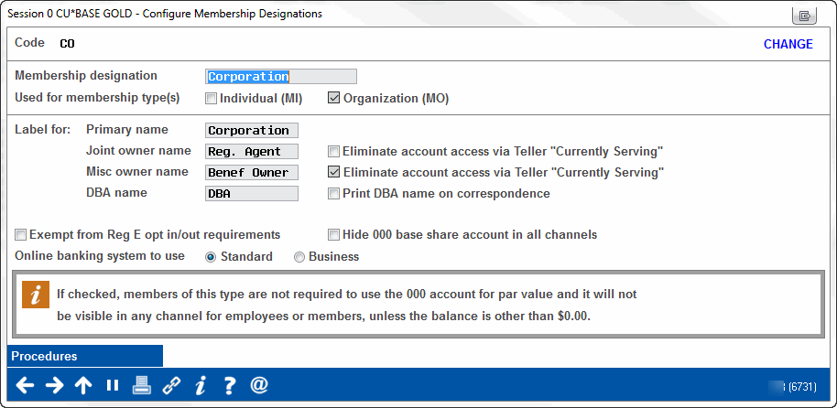
To base share (suffix -000 with par) or not to base share...that is the question
For years, Fox Communities CU used this for their business members who struggled with the need for a savings account for par
It appears Ohio has made it official, and Pathways will champion some additional changes where no base share is required and you simply collect the par as a membership fee

Slide 38
Drilling down on the BizLink Advisory Board’s Top 5 for 2020
A consensus on the nomenclature is goal #1
It’s My Biz 247 Tiers
Internet solutions that fit many business member audiences
Positive Pay
The “A” model – send us your check register
The “B” model – we’ll send you check clearings to approve
Corporate Credit Card Program
What are the top 10 attributes CUs will offer?
Sweep Programs
Will we ever agree on what constitutes a sweep program?
ACH Services
CU services vs. consumer ACH vs. business ACH
cuanswers.com/solutions/bizlink

Slide 39
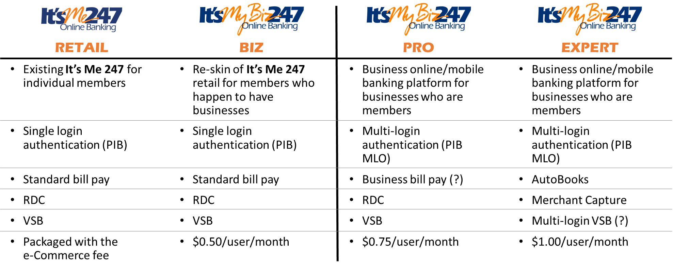
Deciding on a menu of services to fit each business profile
Clear as mud...an evolving solution for an evolving community
An Honor Credit Union DHD Project

Slide 40
Deciding on a menu of services to fit each business profile
Clear as mud...an evolving solution for an evolving community
2 separate software platforms
The key distinction is that one is single login authentication, the other is multi-login authentication (PIB-MLO)
We’re modifying both the It’s Me 247 platform and the current It’s My Biz 247 platform
Changes will result in 4 different products that can be branded for member audiences
In the end, there will be multiple feature variations, developed over time
The earliest versions will use bill pay variations, RDC variations, and Virtual Strongbox variations to create the product mix
For example: At the Advisory Board meeting it was determined that AutoBooks was actually a small business product, and not best suited for the Expert product

Slide 41
Who is the customer for packaged business services?
quickbooks.intuit.com
autobooks.co

Slide 42
Internet retailing is the aggregate of audience-designed solutions
Later today we’ll talk about the difference between mobile flagship apps and micro-apps

Slide 43
Deciding on a menu of services to fit each business profile
Clear as mud...an evolving solution for an evolving community
Desktop Banking
Mobile Web and Mobile Apps
In 2020, both It’s Me 247 and It’s My Biz 247 will move to a “mobile first” look and feel
We’ll discuss this more in the MTG discussions, but the look and feel will track along with the new mobile tablet template
By early 2021 we anticipate the desktop and mobile UIs will merge into a very consistent template
We will complete the It’s My Biz 247 mobile web beta and have all CUs on the new look-and-feel navigation by Q2 2020
We will complete the vision for Mobile 5.0 in Q1 2020 and use that as the unifying vision for a new It’s Me 247 mobile web version by year-end 2020
Early in 2021 the look and feel of our internet channel solutions will be reset and ready for the next decade

Slide 44
CU*BASE Positive Pay, powered by eDOC Innovations
Watch for a contest to name this new product – we hate “positive pay”

Slide 45
New CU*BASE tools to support Positive Pay services
Released in 19.10
Additional enhancements coming soon to in-house drafts

Slide 46
New CU*BASE tools to support Positive Pay services
Before we could finish positive pay, Linda’s business account said we were doing it all wrong – they want “negative pay”
Released in 19.10
Additional enhancements coming soon to in-house drafts

Slide 47
An interesting case study
What is the difference between presenting yourself to a prospective retail member and answering an RFP for a prospective business member?
What have you experienced in trying to deal with a member in the government sector?
How do you anticipate working with your new member when it comes to change?
How are you dealing with the expectation gap between services that sound sophisticated but end up being pretty basic?
Medical Cannabis Banking Services in West Virginia
Element FCU will provide a deposit and disbursement account for the state treasurer’s office, allowing the state of West Virginia to bank the state’s medical cannabis program
Notes:
They wanted one-time passwords for multi-login employees
They wanted transfer requests with approvals by at least 2 employees
They have wanted things that sound like immediate needs that turn out to be things they won’t use for years
The membership itself is controversial for you as a credit union, and there is official resistance (US Attorney)
It sounds like a marijuana account, but your issues have been a little different from what I hear from other CUs dealing with members in the cannabis industry

Slide 48
Corporate Credit Cards
What are the top 10 attributes CUs will offer?
The BizLink team and Advisory Board are calling on CUs to help them identify the top 10 attributes needed for a CU*BASE solution
The SettleMINT team and BizLink are partnering to get their ideas to the spec team by 3/31/2020
We hope to have a project spec and announcement on our direction by next year’s Leadership Conference
Whenever we need to modify statements, we anticipate a robust project
This is the first time we might recommend native credit card servicing via CU*BASE combined with a third-party vendor program for credit card businesses

Slide 49
Will we ever agree on what constitutes a sweep program?
Square pegs and round holes...we need a 2-way, independent transfer process
We have the transactions
What we haven’t done is to coordinate a process to work together:
A withdrawal and deposit in the morning, with a corresponding opposite withdrawal deposit in the evening
Timed to benefit the member as to maximizing their dividends or interest on funds
There are rules that determine transfer amount, minimum balance left in the account, etc.
Configured by the CU and sometimes the member
Pretty old school approach, but not every old dog can be trained to do it the CU way

Slide 50
ACH
Thinking about everything “payments”

Slide 51
What should a CEO know about ACH in 2020?
Where is classical ACH settlement going through the core?
Where is ACH becoming a more out-front solution for retail consumers? For business members?
What happens when you merge ACH with other settlement networks?
To date, ach has been a back-office function, with almost no discussion among CEOs
What do you think you’ll say about it in the future to differentiate yourself?
Is it something you just have to do, or something at which you can excel?

Slide 52
Classical ACH settlement through the core
It’s a race to real-time, but have you thought about how you would use that?
What would you tell a member about these?
1st Run (5:00am ET) “On my way to work”
2nd Run (1:30pm ET) “On my way back from lunch”
3rd Run (5:00pm ET) “On my way home”
4th Run (10:00pm ET) “On my way to the bar”
CU*Answers is currently analyzing moving share draft postings to 10:30pm-midnight, to take advantage of all potential ACH deposits for members
Is that marketable?
Tool #113 ACH Posting Controls Config
This is creating a great deal of expense and potential for mistakes and mis-postings

Slide 53
How long can you keep breaking the rules?
The market is full of early postings and other fi processes that might not fit the future
CU*BASE batch posting on-demand (via Tool #368 Extract/Post Single ACH Company)
CU*BASE on-demand posting, one member at a time (via Phone Op)
Coming soon, member on-demand posting via It’s Me 247
“Post Now” will appear on deposit transactions waiting in the warehouse

Slide 54
How long can you keep breaking the rules?
Real-time posting will defeat almost all batch posting tactics
What does this mean to your member message?
The market is full of early postings and other fi processes that might not fit the future
CU*BASE batch posting on-demand (via Tool #368 Extract/Post Single ACH Company)
CU*BASE on-demand posting, one member at a time (via Phone Op)
Coming soon, member on-demand posting via It’s Me 247
“Post Now” will appear on deposit transactions waiting in the warehouse

Slide 55
Classical ACH settlement through the core
It’s a race to real-time, but have you thought about how you would use that?
Is this a vendor war, or a collaborative project for everyone’s future?

Slide 56
Leveraging the back office
OPsEngine is no longer just for your accounting team
Creating a 24x7 persona for your credit union
Understanding how to take advantage of time zone personas
Matching your marketing with the OpsEngine train schedule
Marketing high availability and business continuity to a consumer base that counts on it
Looking for strategy in the weeds

Slide 57
ACH as a solution for retail consumers and business members
Our best chance to leap forward in 2020: think eDOC and the integrations we’ve built

Slide 58
ACH as a solution for retail consumers and business members
Our best chance to leap forward in 2020: think eDOC and the integrations we’ve built
42 CUs in our network use this for loan payments
Website, desktop banking, and mobile: Where will these products fit, and how will we use a CU*Answers UI to deliver them to members?

Slide 59
ACH as a solution for retail consumers and business members
Everyone knows the potential; we just need to get started with the right priorities
How far will you take your tactics related to ACH and payments with your members in the next few years?
CUs tell us they want research, but they don’t tell us what they’ll do with it
Mockups only; subject to change

Slide 60
ACH as a solution for retail consumers and business members
How does a CEO know when they have a hole in their roster of ach solutions?
FCU Services for Retail Members
FCU Services for Business Members
Classic ACH transactions
Received from the Fed and processed by CU*Answers Operations
A2A and A2AFT (recurring)
Bill Pay (when sent via ACH)
AutoBooks
Classic ACH transactions, including for employee payroll
Received from the Fed and processed by CU*Answers Operations
A2A and A2AFT (recurring)
Business Bill Payment (powered by iPay)
Payroll and bill pay via ACH
Why does FCU feel like they have all the ACH solutions they need, and so many other CUs feel they don’t have any?
Notes:
Per Charlie:
Breaking out Frankenmuth’s response on how they work with Magic Wrighter.
Pay payroll ACH Direct
Make tax payment ACH Direct
Transfer funds amount their accounts elsewhere A2A (M-W) setup in CU*BASE
Auto debit for monthly payments such as a water bill or for monthly services due ACH Direct or MPay Xpress
Auto debit for one time payments such as a one-time payment of a receivable ACH Direct or MPay Xpress
At Frankenmuth, when a business member is interested in ACH Direct, the credit union submits a request form to Magic Wrighter. Magic Wrighter then does the onboarding and training for the requested product. The members are setup with a website branded with their business name/logo and are given a standalone login/password form Magic Wrighter.
I put a follow up into Magic Wrighter to clarify the product name, AmplifFI is the whole product suite, each product has its own name. In this case Frankenmuth actually has two product offerings, ACH Direct or MPay Xpress to handle the items they identified. There is a bit of overlap of services between the two products, so depending on which solution Frankenmuth uses on the setup form and contract is what the business will be offered form Magic Wrighter. At a high level ACH Direct is more geared towards business that have ACH payments with varying payment amounts that would be updated monthly. MPay Xpress would be more geared towards a recurring set ACH amount for things like rent or association dues. Magic Wrighter will make suggestions to change products based on business needs identified if they are involved in the training process.
Magic Wrighter also indicated it is up to the institution for how much they would be involved with the training and support when a business signs up. Frankenmuth chooses to have MW handle all of that on their behalf, others may choose to not have MW involved with the members at all. I just want to clarify that what Frankenmuth does might not be the same as Honor etc. A lot more will be learned about these products with demo from Magic Wrighter on Monday.
From Hollie at Frankenmuth:
Our members log in on a MW website with a user name and PW from them. Our member work with MW directly once they sign up. Cheryl fills out a form and submits to MW with the members information and the products they are interested in. Then MW works directly with the business member to train them on their system and set them up with credentials. Cheryl follows up with our member to make sure they are satisfied, all set after MW sets them up.
The actual product name is AmpliFI – and this covers corporate transfers, payroll, pre auth debits, etc. When you sign a business up for AmpliFI, they select the services they will need to use and they are charged accordingly by MW.
Autobooks is an invoicing tool and offers bill pay. AmpliFI is strictly ACH processing. The duplicate is payroll - AB offers payroll via third party, Gusto. MW’s payroll option only is a mechanism to pay out the payroll via direct deposit – no W2s, taxes, etc. AutoBooks doesn’t offer capability to send out ACH. They can accept payments via invoice that can be ACH. They can’t pull via ACH. They do have bill pay – that could end up being an ACH, but that’s iPay’s configuration, however they determine to pay the bill ( Ipay is Autobooks bill pay behind the covers)

Slide 61
Speaking of A2A...
Runs the gamut From “keepin’ up with the joneses” to a real solution
Month/Year | # of CUs | # of A2A Trans | Avg # of Trans
April 2019 | 112 | 34,412 | 307
May 2019 | 116 | 35,510 | 306
June 2019 | 117 | 36,552 | 312
July 2019 | 121 | 33,830 | 280
August 2019 | 120 | 38,434 | 320
Sept 2019 | 123 | 39,504 | 321
October 2019 | 122 | 38,968 | 319
TOTALS | 118.7 | 257,210 | 309.3
Highest traffic: Notre Dame FCU (~ 3,000/month)
Lowest traffic: Delta County CU and Lenco CU (1/month)
Are you talking to each other about how to make this tactic real for your members?

Slide 62
ACH as a solution for retail consumers and business members
Top 10 projects for us to work on
Services for Retail Members
Services for Business Members
Do we need to be a better business network to hook people up? Do we need to improve the UI experience? Or do we need to write native solutions?

Slide 63
What happens when you merge ACH with other settlement networks?
From a recent vendor proposal:
The most extensive and flexible Payment distribution capabilities on one platform
Powered by today’s most common settlement vendors (e.g., Mastercard RPPS, ACH, Direct to Biller)
Settling via the debit card rail
Mastercard Bill Pay Exchange (BPX) for real-time bill payments
Moving money on the vendor’s network
New networks can easily be added (e.g., shared branching) in the future
Almost every vendor today promises a link to the most popular outlets

Slide 64
What happens when you merge ACH with other settlement networks?
Something to research and ponder:
Almost every vendor today promises a link to the most popular outlets
Will Rtp be a requirement?

Slide 65
In a fractured market, how long can we be a buyer’s club for payments?
iPay
Payveris
Fiserv (previously CheckFree)
Payrailz
RDC
Is it time to move towards an EFT model?
What would that mean to your credit union?
Being vendor agnostic is getting easier to envision for credit unions, but still very tough for the model vendors offer the CUSO

Slide 66
A new foundation for CU payment vendor strategies
Join a community, surf a community, or compete with a community

Slide 67
A new foundation for CU payment vendor strategies
Live Nov. 10th
Join a community, surf a community, or compete with a community
Available now!

Slide 68
Payment networks versus payment tools
Vendors can give you the tech of Zelle, but does that tech have the same appeal to your members?
VS
When is the community or branded network more (or less) important than the capabilities of a transaction?

Slide 69
RDC payments may be an ace in the hole for our network
Working with eDOC, we plan to make native RDC payment transactions
Are you ready to advertise to your members the ability to make loan payments via RDC?
Have you worked with your accounting team on the processes, should an RDC loan payment bounce?
Can you envision RDC as the wholesale replacement for all check deposits (like replacing ATM deposits)?
Configs are live with 19.10; watch for announcements on the mobile app upgrades that will use them

Slide 70
Mobile & Desktop Internet Solutions
Preparing for a new day, from top to bottom

Slide 71
We’re going to something different today...
We’re going to include the business developers of MTG
We’re going to make some high-level announcements and set up a deeper dive on Thursday morning, and announce an in-the-weeds special event in February
A CEO-to-CEO brainstorming session on the mobile technologies group

Slide 72
Why is CU*Answers introducing MTG?
Mobile is not an online service
Flagship apps are free for all of time...MTG will introduce deployment fees to the market in 2020
We need to specialize in mobile development and delivery
Release strategies are different for mobile solutions...MTG will go to annual versioning
We need to extend the shelf life of mobile solutions for credit unions
A CU mobile program is not a single solution, but can members keep up with all the offerings?
Because we’re Preparing for a new day, from top to bottom

Slide 73
Why is CU*Answers introducing MTG?
We need to create delivery resources and financial engines to do so
Deploying to device app stores is a one-at-a-time process...MTG will field a team to do it hundreds of times a year
We need to address the forward progress of mobile with consumers and credit union strategies (think “mobile first”)
MTG will signal that our network has passed the tipping point for internet channel design
Because we’re Preparing for a new day, from top to bottom

Slide 74
Why is CU*Answers introducing MTG?
We need to rethink the UI for desktop banking and the merger of look-and-feel between desktops, tablets, and mobile phones (eye of the beholder)
By year-end 2020, MTG will propose a whole new look for It’s Me 247 and It’s My Biz 247
We need to reorganize how our desktop banking and mobile teams work together and rethink our front-end programming expertise
When it comes to internet channels, MTG’s front-end programming leadership will take the helm in 2020
Because we’re Preparing for a new day, from top to bottom

Slide 75
Why is CU*Answers introducing MTG?
We need to envision the next decade and how we make MTG a powerhouse, not only for credit unions, but also for cuasterisk.com and our CUSO partners
This time next year, MTG will be in the middle of everything when it comes to internet retailing
Because we’re Preparing for a new day, from top to bottom

Slide 76
OPEN HOUSE
Send your most engaged players in February:
Meet the MTG team
Meet the 2020 MTG Advisory Board members
It’s My Biz 247 Next Steps
Micro App Updates and the Business Plan Behind Them
MTG Pricing Model and the Future
Mobile 4.0 Rollout
Getting Ready for Mobile 5.0
Brainstorming with the Advisory Board
February 18-19, 2020
Tuesday
4:30-6pm Networking cocktail hour
Wednesday
8:30-2pm Deep Dive on MTG
The key today is briefing CEOs on why this is important; February is about a deep dive with CU leaders for whom this is a passion

Slide 77
...to be continued
Mobile App 4.0
Affordable deployment fees
Mobile App 5.0
Micro-apps
Merging under a new UI front-end leadership team
Web modules and independent navigation
Tablet designs as the intersection between desktop and mobile phones
CU Publisher as a self-service copyright
Are you ready for the new mobile It’s Me 247?
Envisioning the next “Online ’19” project
Join us on Thursday morning as we continue talking about MTG and look at some exciting tactics

Slide 78
Succession Planning
It’s a network thing – why CU*Answers stakeholder confidence in the process is critical

Slide 79
Succession is a process we all should endorse
YOUR INVESTMENT MIGHT COUNT ON IT
Here’s a look at the goals for our board and management team

Slide 80
YOU’RE INVITED TO BE AN ACTIVE PARTICIPANT IN THE PROCESS
Audit the process as an investor
Audit and join the process as a volunteer
Join the process as a candidate
Consider our process for your own organization
studyguide.cuanswers.com

Slide 81
Wrapping things up...

Slide 82
Can we envision the format for CEO Strategies in 2020? In 2025?
PREPARING THIS YEAR WAS TRULY FUN, BECAUSE I CAN SENSE THE OPPORTUNITIES AHEAD
2020 is truly a turning point in our network
It just happens to be our 50th anniversary
It just happens that we are facing a CEO retirement in 36 months
But the reason this is a turning point is that many of the things we count on most need another round of committed investment
We are facing retooling our launchpads and readying ourselves for takeoff
Our new launchpads must deal with marketplace consolidation and a new calculus for how to sustain our CU community and our CUSO allies
Our launchpad must deal with the transition of core competencies required by CUs for the future – and therefore needing to be our CUSO’s specialty

Slide 83
Thanks for the day!
TOMORROW I’LL BE SWITCHING TO MY LISTENING HAT (PROMISE!)
The CEO Roundtable will start at 9:00 in this room

