Slide 1
Boot Camp Update
AN UPDATE ON THE PROJECTS FROM LAST YEAR’S CEO STRATEGIC DEVELOPERS BOOT CAMP NOVEMBER 11, 2019

Slide 2
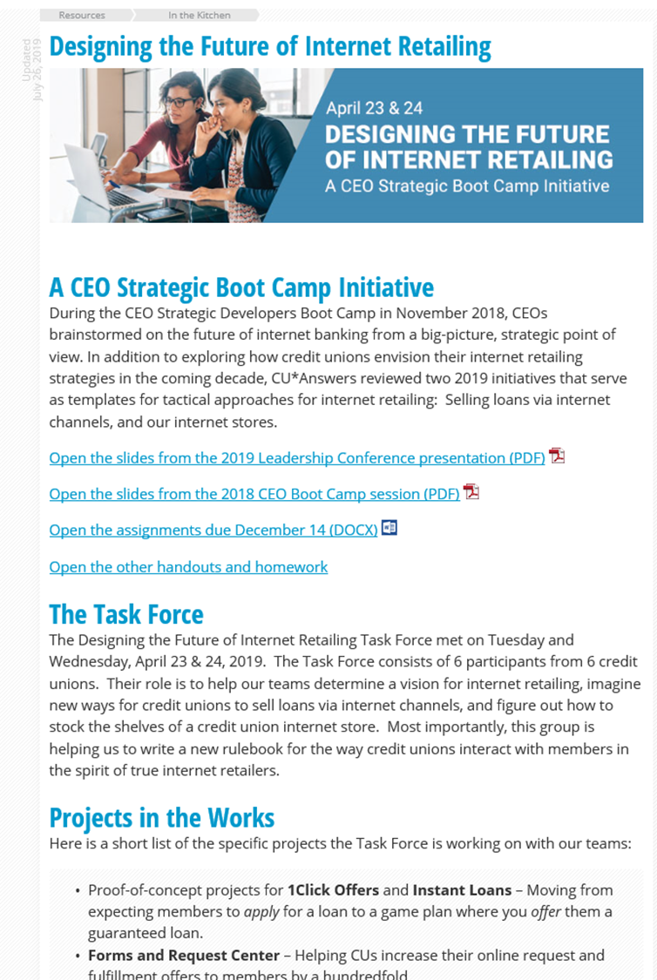
A special Thank you to the Task force
Daniel Phillips, BlueOx Credit Union
Hollie Britton, Frankenmuth Credit Union
Scott Rushforth, Horizon Utah Federal Credit Union
Lindsey Law, Kellogg Community Credit Union
Kaj Johansen, TruChoice FCU
Adam Pomerleau, TruChoice FCU
Keep up with project updates in the Kitchen:
open.cuanswers.com/internet-retailing

Slide 3
PROJECTS THAT INSPIRE AND PROVE OUR POINT
RETAILING: ACTIVITIES INVOLVED IN SELLING GOODS TO ULTIMATE CONSUMERS
1Click Credit Card Offers
Asking the member if they want a loan: transferring the power of deciding to the consumer
CD-secured Loans
Shock and awe: a click in an unexpected place that creates an unexpected transaction
Loan Modifications
Maintenance re-envisioned as goods to be sold via the internet
CLR Path and automated decision models
Highlighting what you know is more important than what everyone knows
A New eSigning Experience
Upgrading a symbolic ceremony for speed, convenience, and opportunity
Firing up a new approach for internet lending via the CU*BASE LOS platform
Armed with CEO Strategic Developers Boot Camp projects, we’ll take another crack at the perfect internet LOS approach

Slide 4
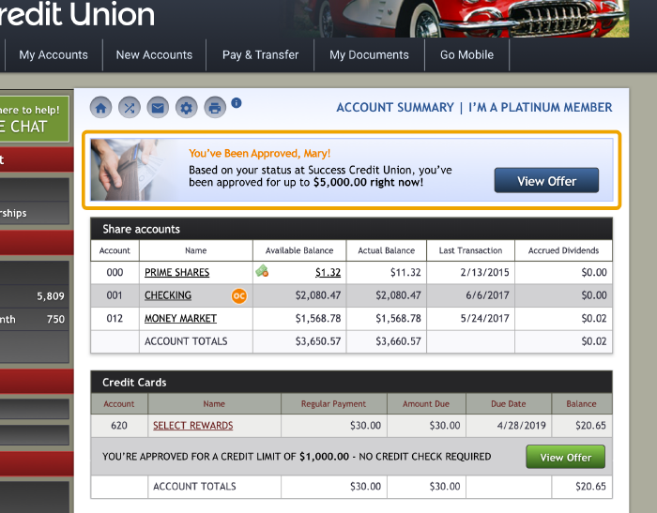
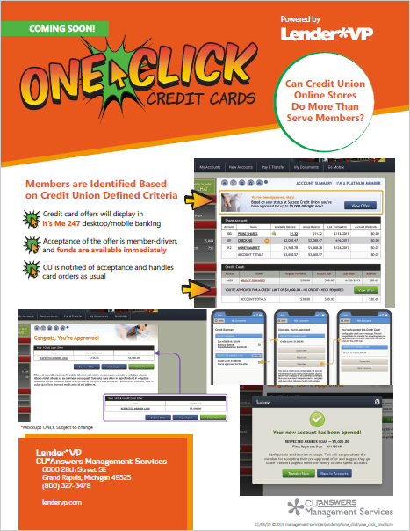
1Click credit card offers via It’s Me 247 desktop and mobile
Target: 20.10
transferring the power of deciding to the consumer
Members are identified based on credit union defined criteria
Credit card offers will display in It’s Me 247 desktop/mobile banking
Acceptance of the offer is member-driven, and funds are available immediately
CU is notified of acceptance and handles card orders as usual

Slide 6
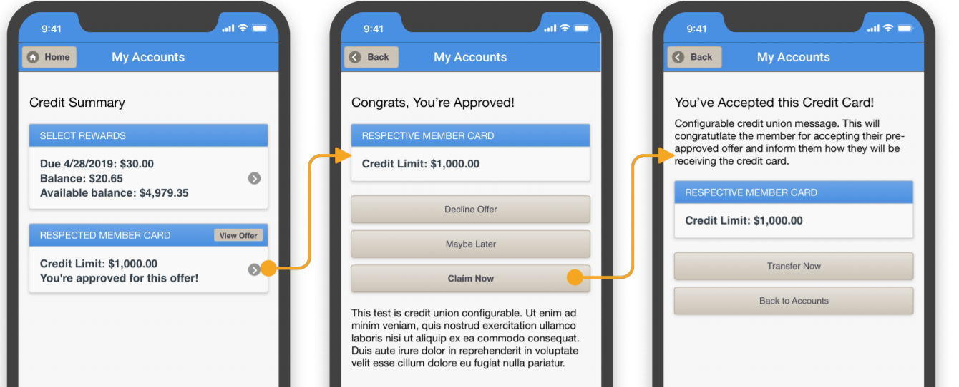

Slide 7
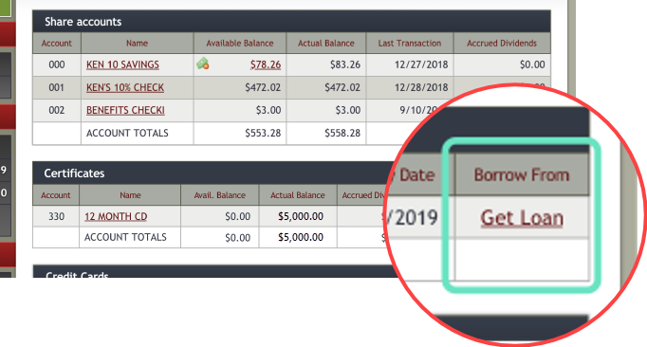
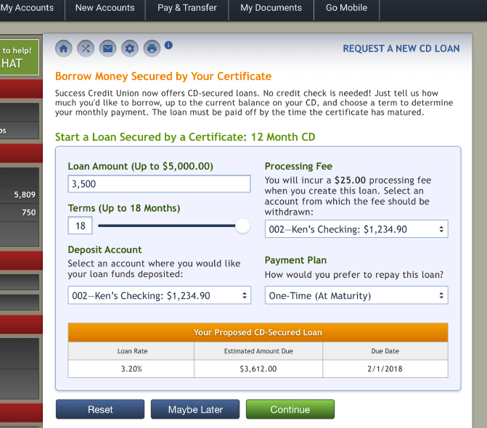
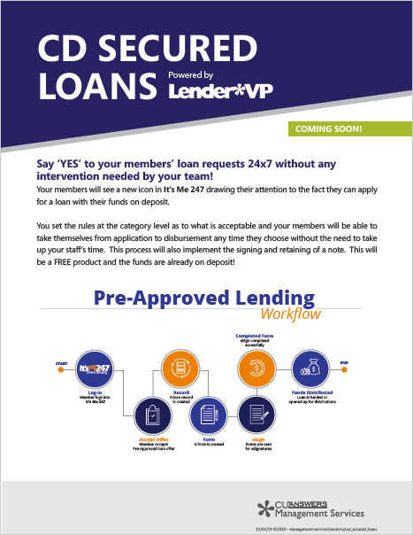
CD-secured loans with instant account creation
Target: 20.10
a click in an unexpected place that creates an unexpected transaction

Slide 9
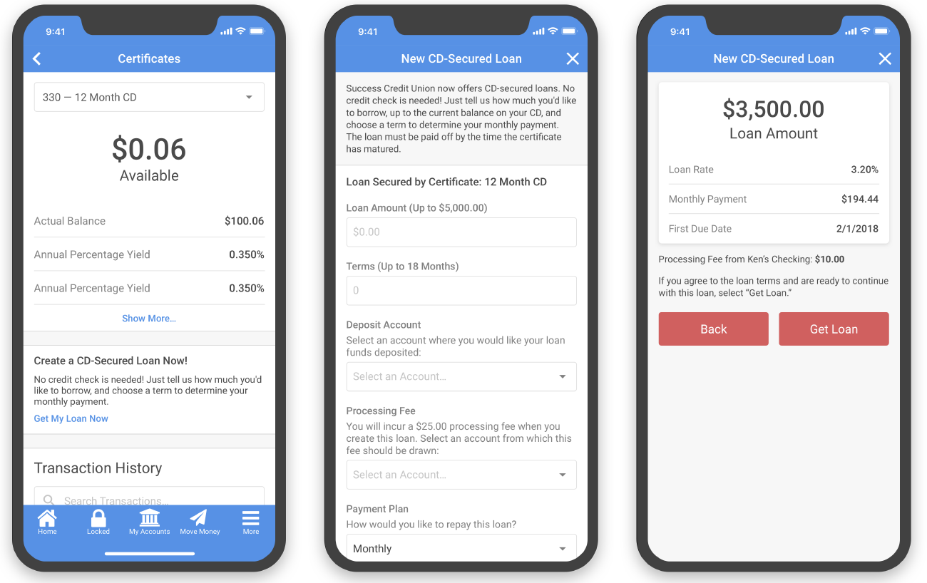

Slide 10
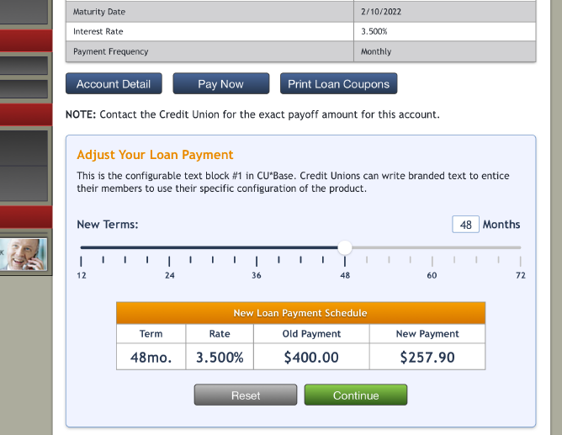
Loan modification requests (auto-approved or sent directly to your underwriter queue)
Can credit union online stores do more than serve members?
Target: 20.05

Slide 12
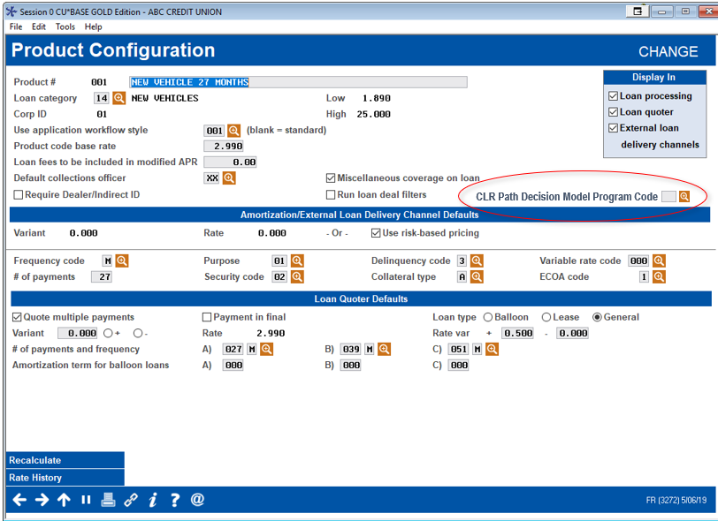
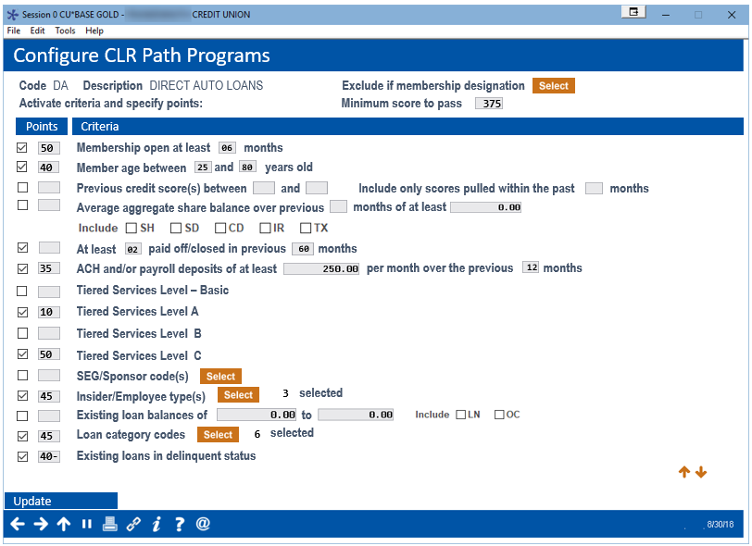
A non-FICO decision model for the gray areas
Highlighting what you know is more important than what everyone knows
A decade ago, did you predict you would be a model-based lender?
Are you still waiting?
By the end of 2020, CU*Answers will offer 4 different model approaches
3 of them are based on what everyone knows
1 of them will be based on what you know
How will you blend these models? What do you predict for a decade from now?
Mockups only; subject to change

Slide 13
Create custom programs for different loan products
Grant points for each criteria then decide on a “passing” total score
Activate only the criteria that matters to you
Will also be flags for over limit, other loans delinquent more than xx times, and loan write-off/charge-offs in previous xxx months
Mockup only; subject to change

Slide 14
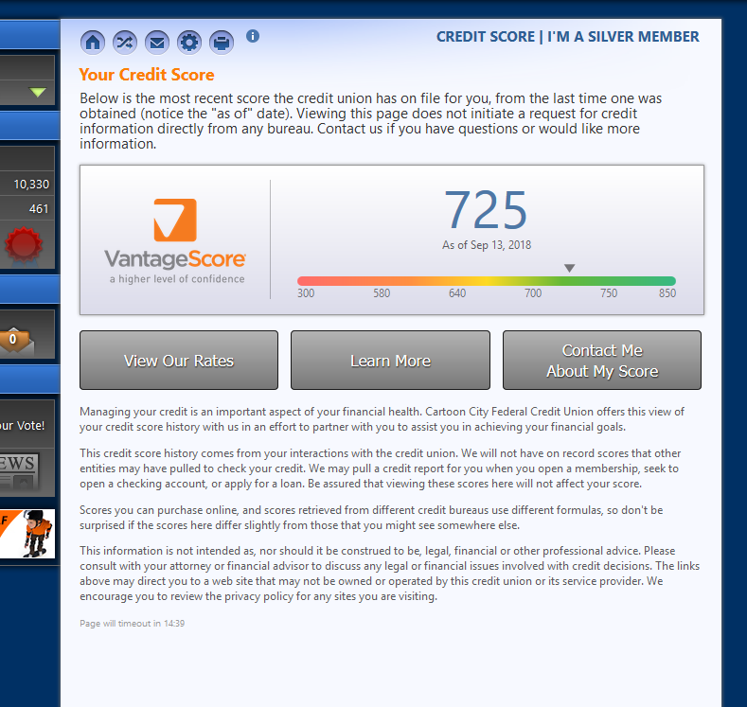
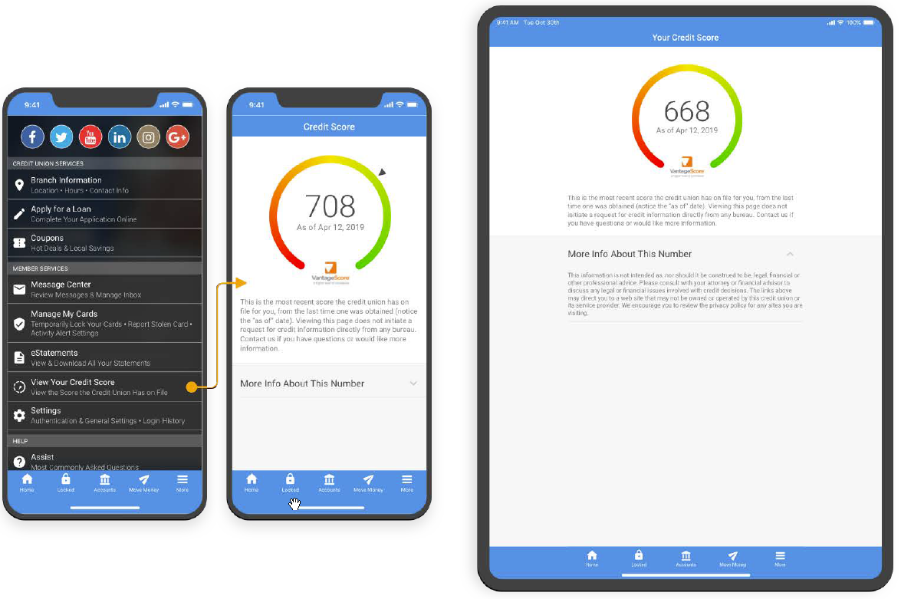
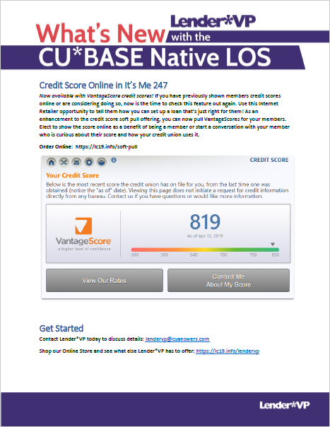
COMING TO THE APP WITH MOBILE 4.0
AVAILABLE NOW IN DESKTOP AND MOBILE WEB BANKING
Are you tracking the coming price increases for FICO-based scores? Will you be converting to the VantageScore?

Slide 15
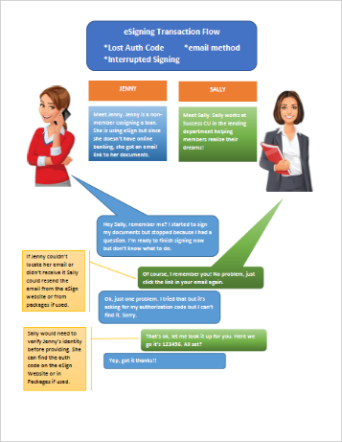
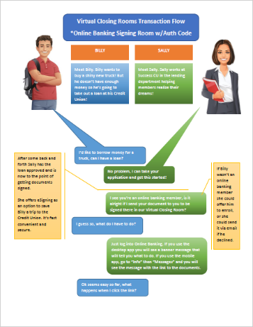
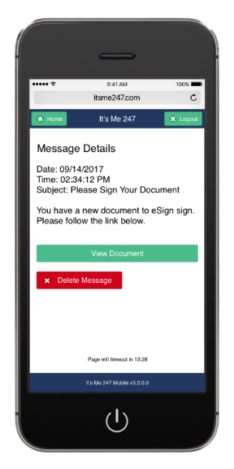
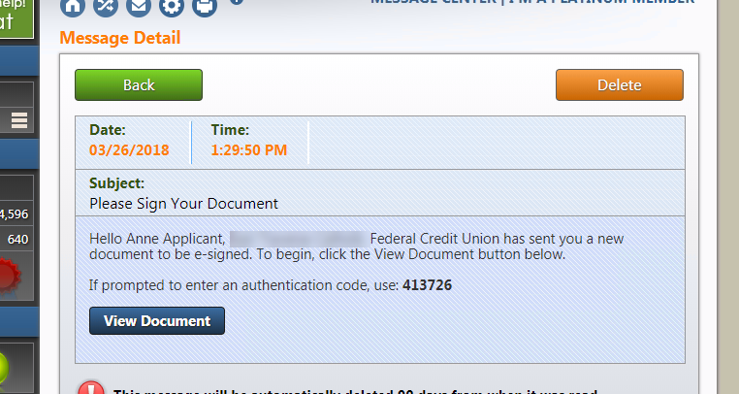
A New eSigning Experience
Upgrading a symbolic ceremony for speed, convenience, and opportunity
Yesterday: Identify a generic electronic signing product, and just start using it
Today: Rebrand a generic electronic signing product to your locations, and start specializing a unique e-closing experience for your members
Tomorrow: Refine unique e-closing experiences to include automated e-closings, presented by CU*BASE and verified by CU*BASE, resulting in instant disbursement of funds in a single stream
ondemand.cuanswers.com/e-signature-virtual-closing-rooms-in-its-me-247/
Watch the video!

Slide 16
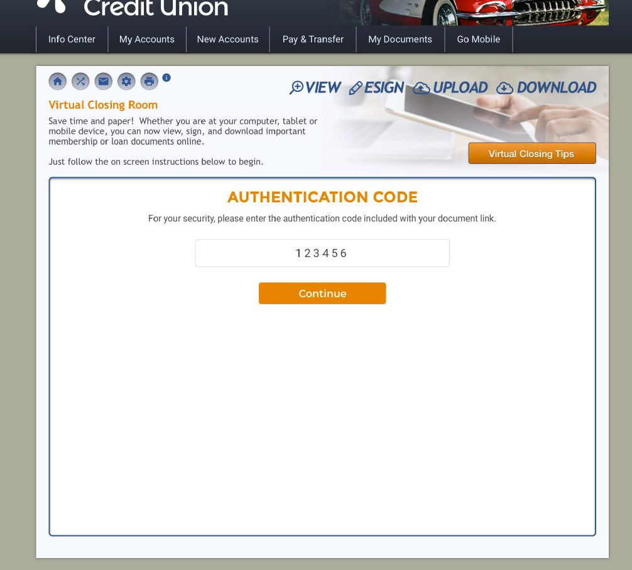
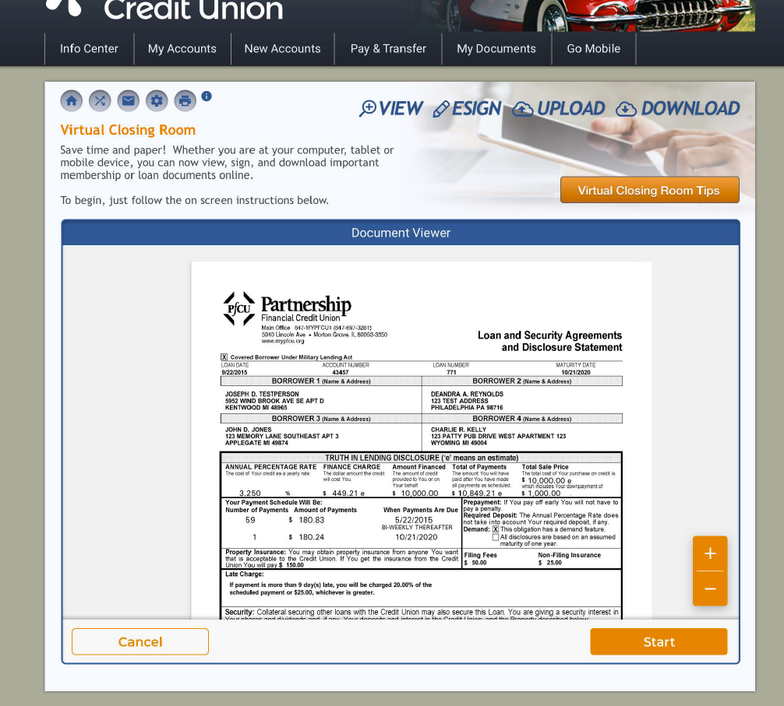
A New eSigning Experience in It’s Me 247 desktop and mobile
New “home” page for the Virtual Closing Room, right within It’s Me 247
Review the document before you sign

Slide 17
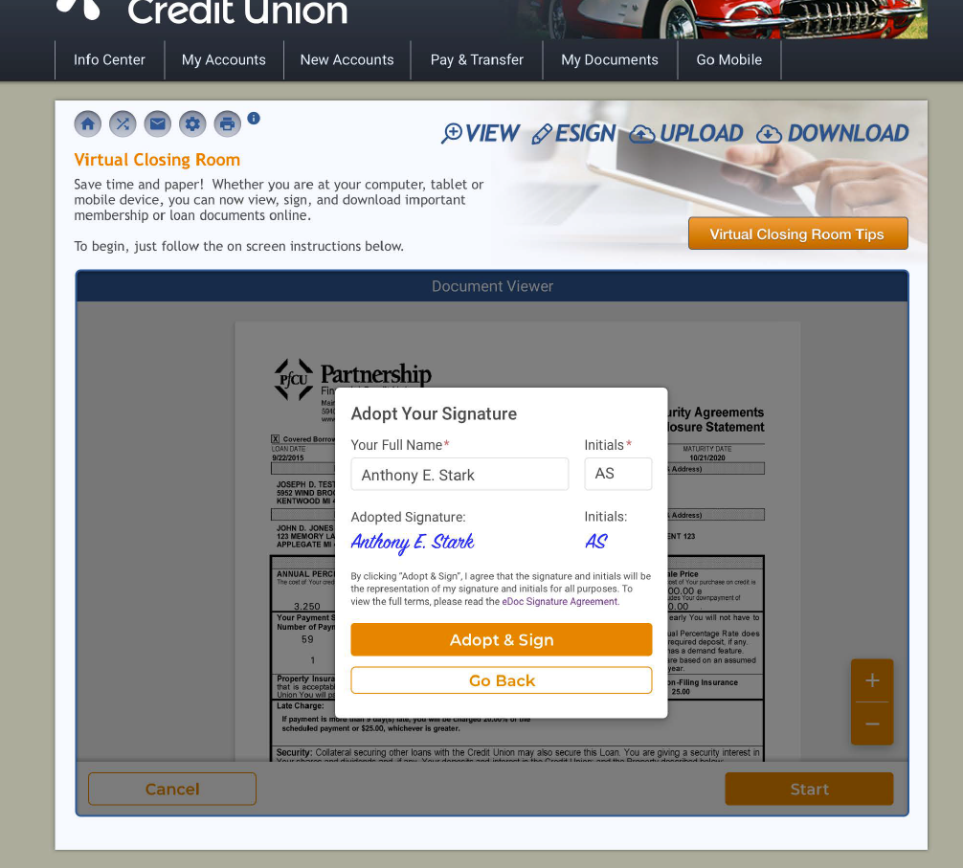
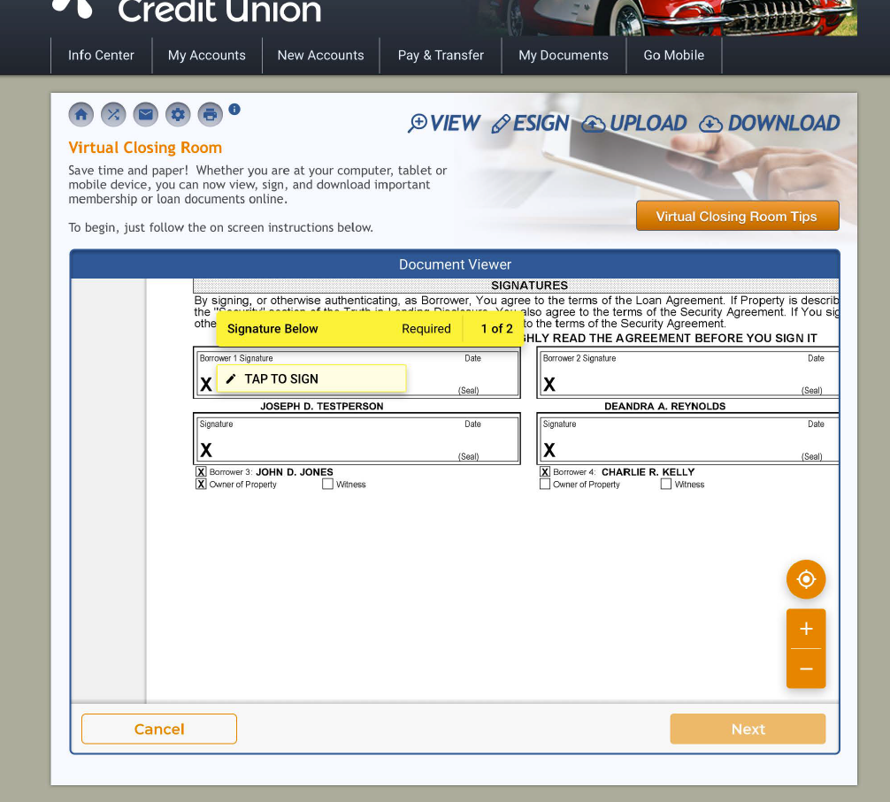
A New eSigning Experience in It’s Me 247 desktop and mobile
When you’re ready to sign, click Start
1-step signature setup
Document zooms into the right spot so you can just tap to sign!

Slide 18
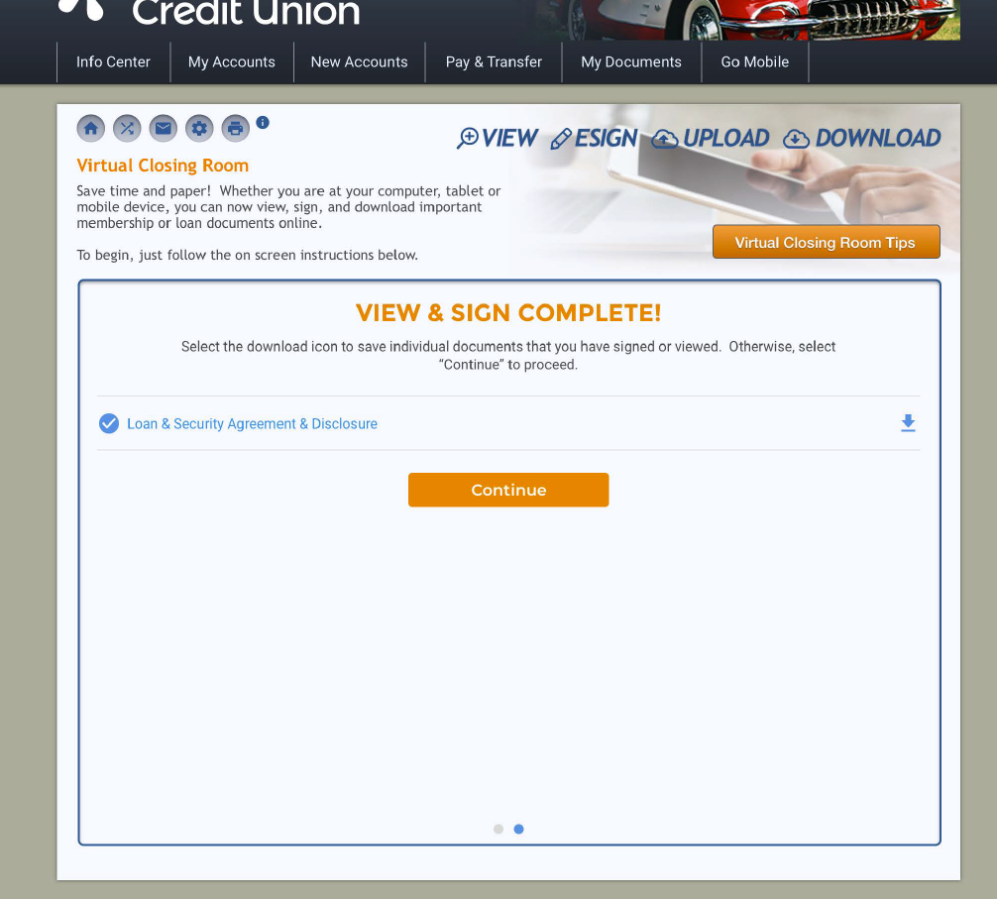
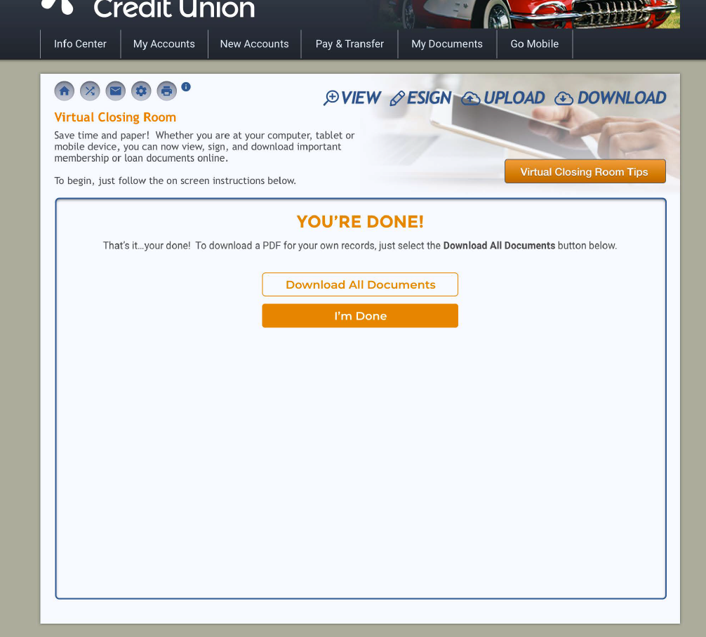
A New eSigning Experience in It’s Me 247 desktop and mobile
Use the Next button to work your way through all of the signature boxes
Then you’ll return to the home page for additional documents, if any
Optionally download documents to save them

Slide 19
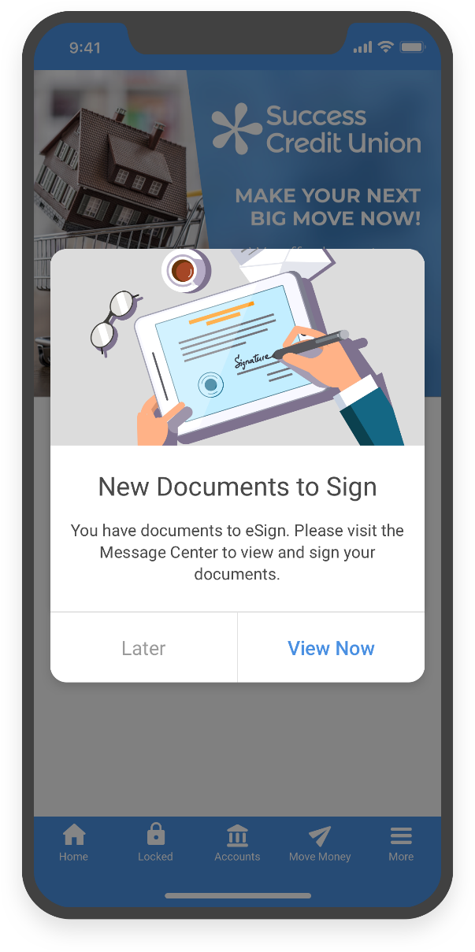
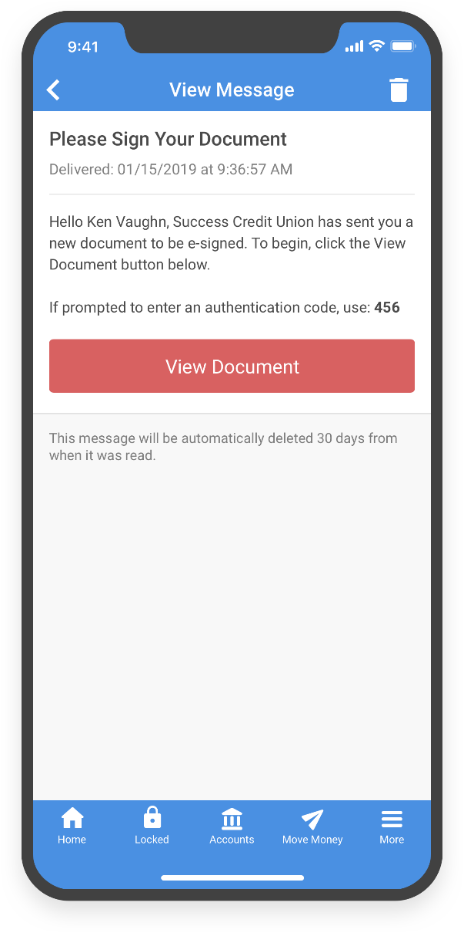
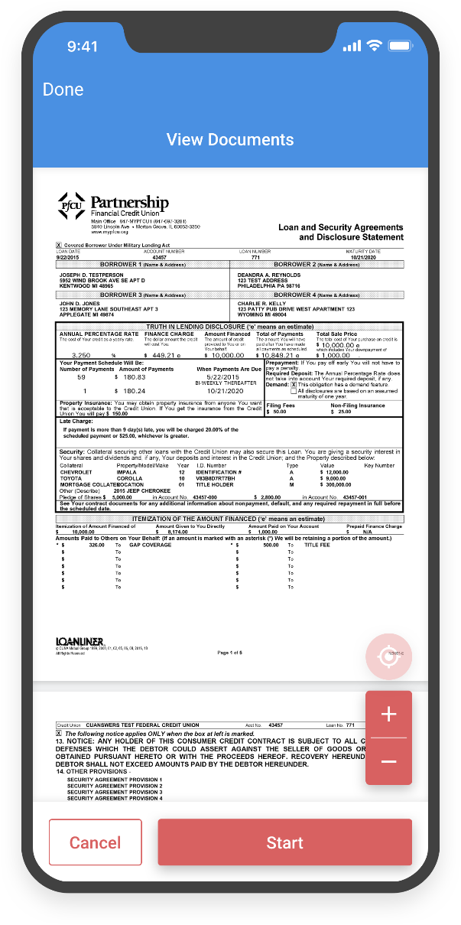
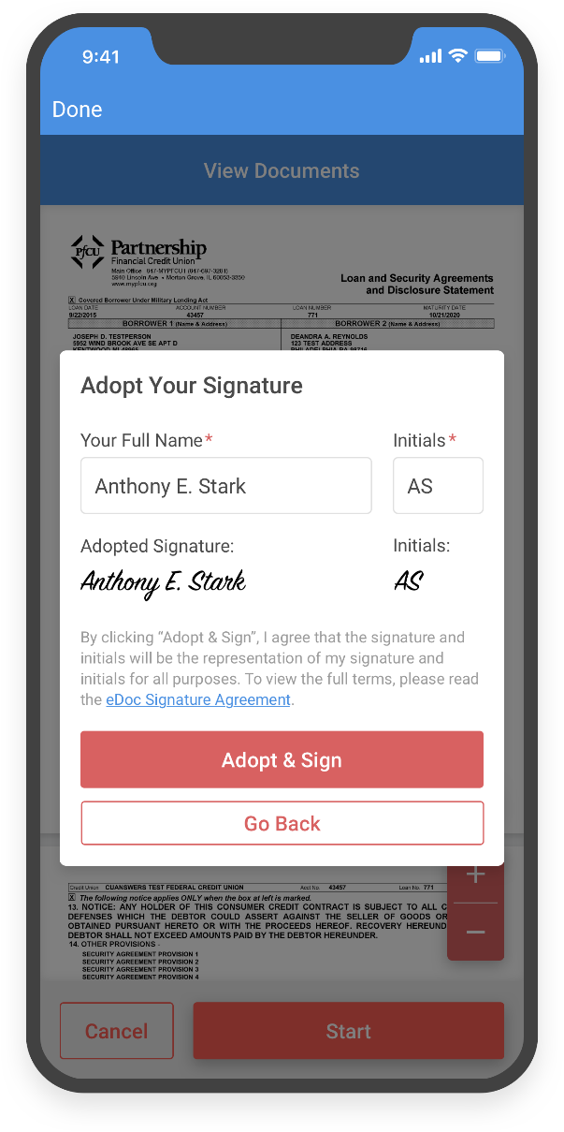
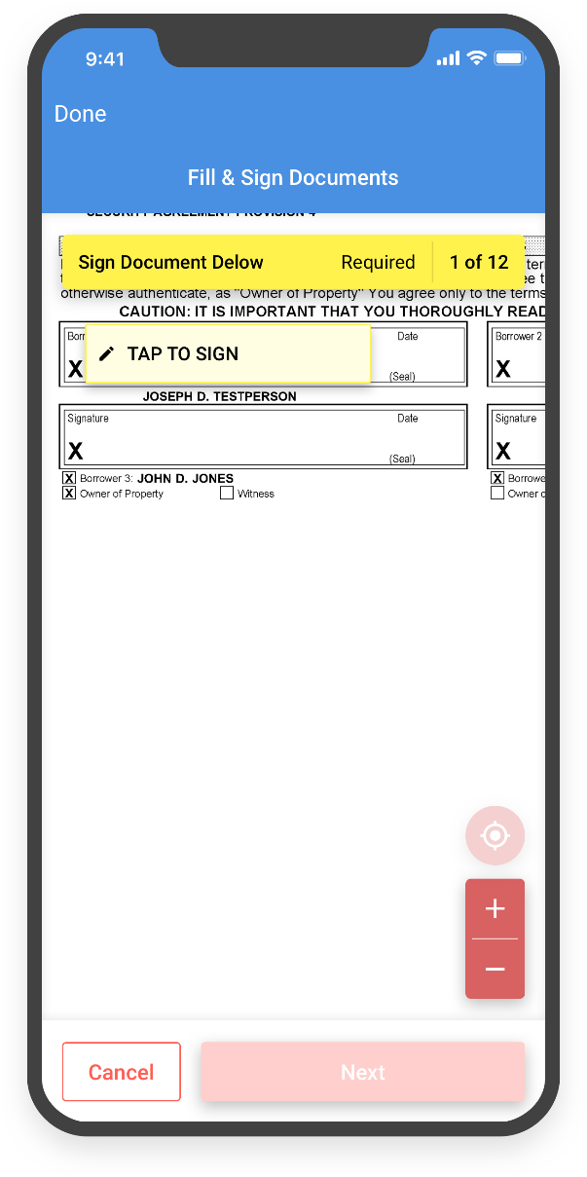
Check it out in the app!
A New eSigning Experience in It’s Me 247 desktop and mobile

Slide 20
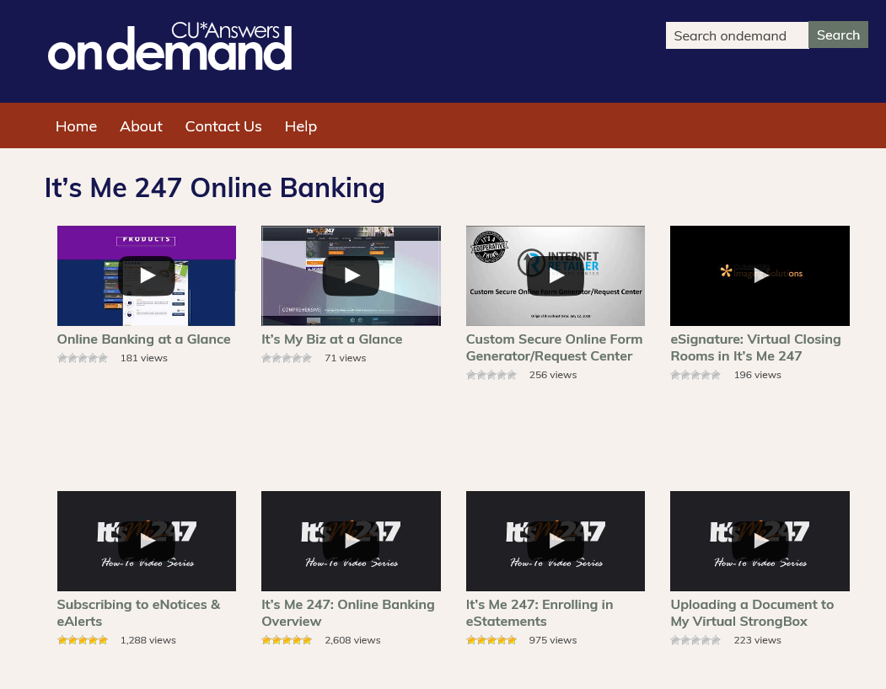
Firing up a new approach for internet lending via the CU*BASE LOS platform
What derailed a pretty good product?
Armed with CEO Strategic Developers Boot Camp projects, we’ll take another crack at the perfect internet LOS approach
You can’t improve you can’t see
What do we all know about our CUSO’s internet LOS from a member’s perspective? From a strategic perspective? From your staff’s perspective? From your perspective?
Announcing a new video lab to better understand our internet LOS

Slide 21
Firing up a new approach for internet lending via the CU*BASE LOS platform
Let’s take a test
How many loan products can you sell from It’s Me 247?
Can a member get an approval from an It’s Me 247 loan app?
Is risk-based pricing offered during an It’s Me 247 loan app?
Does the online app offer an “as low as” rate as well as an actual rate to the member?
What is the difference between an internet-enabled member and a non-member?
99 loan products can be sequenced to appear on the rate board
Yes, with a 247 Lender decision
Yes, after permission is granted to pull a credit report
Yes, actual rate appears after permission is granted to pull a credit report
Non-members must complete all data; members don’t need to fill in personal info

Slide 22
Firing up a new approach for internet lending via the CU*BASE LOS platform
Let’s take a test
If not internet-enabled, a member is forced to log in before proceeding
What is the difference between a member who is not internet-enabled, and one who is?
Are there more or less than 30 pieces of data needed to complete an app?
How many pieces of data are required prior to saving a lead?
Can the member expedite a loan application for a faster decision?
Can you offer insurance/debt protection to the member as part of the app?
Less than 30
13 pieces are required to save a lead
No, other than a comment that a loan officer would need to notice
Yes, presented as an option after granting permission to pull credit

Slide 23
Announcing the next version of our internet LOS for member applications
It will start with a CEO project in 2020, and move quickly to your teams in 2021
Non-members
Non- internet-enabled members
Internet-enabled members
ONE-WAY FORMS
ENABLE
SMART APPLICATIONS
SMART APPLICATIONS
A focus on good, better and best development approaches
Notes:
Non-member loans booked (from Keegan)
where loan open date = membership open date

Slide 24
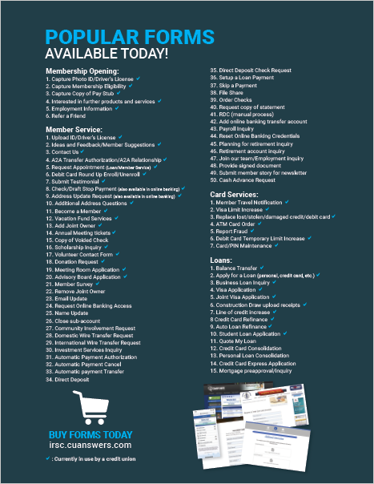
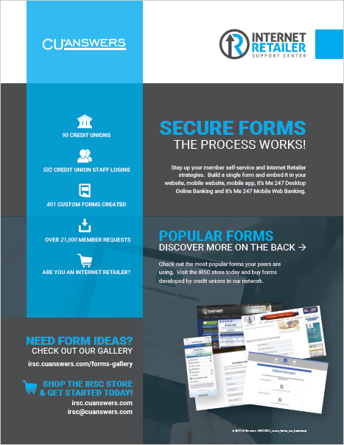
One-way forms
Non-member apps are a cu specialty
Self-service forms creation coming in 2020
A POC project to test a partnership between UDM and credit union-defined forms by the end of 2020
A high-energy effort to create an active forms community and best practice-approach to increase forms usage tenfold
New front-end routing to increase member awareness of form gateways

Slide 25
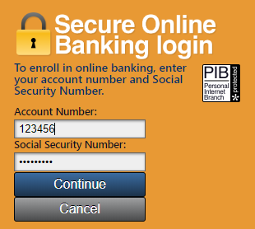
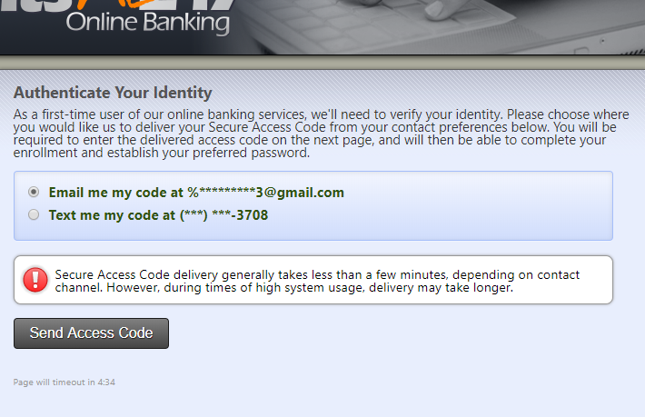
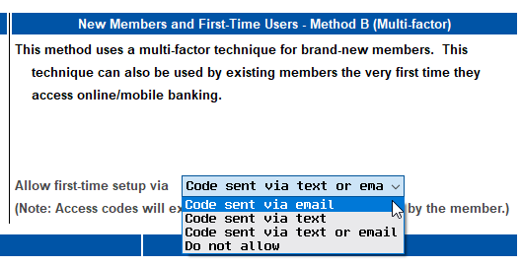
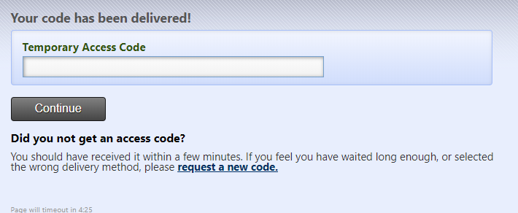
New activation scheme for first-time online banking users
Enabling internet channels for borrowing members should be no big deal
Just turn it on: Tool #569 Online/Mobile/Text Banking VMS Config > Online Banking Password and Security Settings

Slide 26
Where to begin?
How would you prioritize these?
The member experience
The CU loan officer’s experience
The lending VP’s experience
The credit union CEO’s experience
If it’s all about experience, then whose experience matters the most?
It might surprise you what I learned in some credit unions this summer

Slide 27
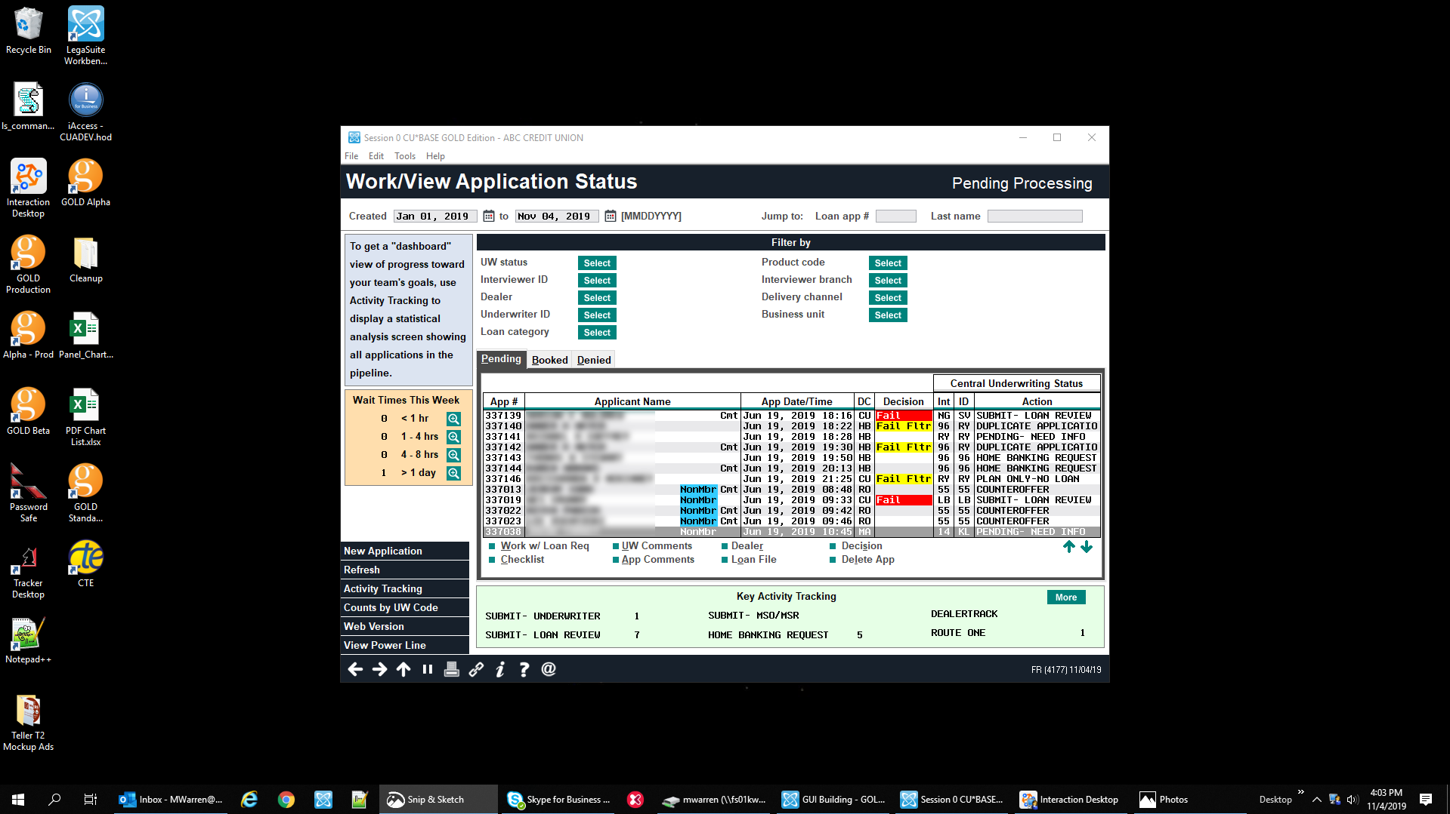
LOS
Today’s CU*BASE LOS “The Loan Queue”
Mockup only; subject to change

Slide 28
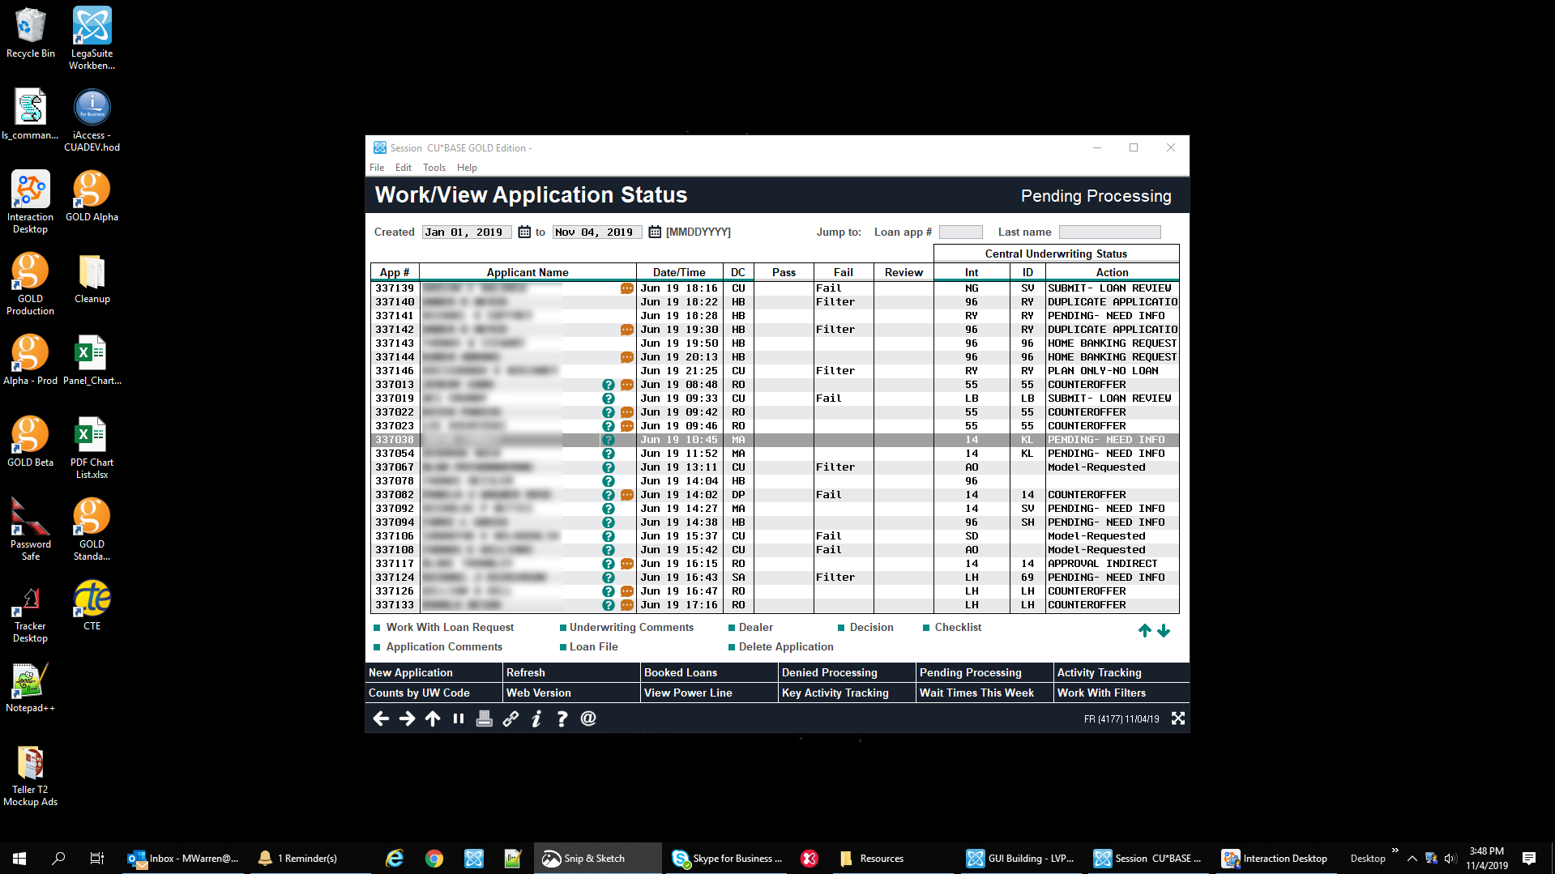
Today’s CU*BASE LOS
(standard size)
Mockup only; subject to change

Slide 29
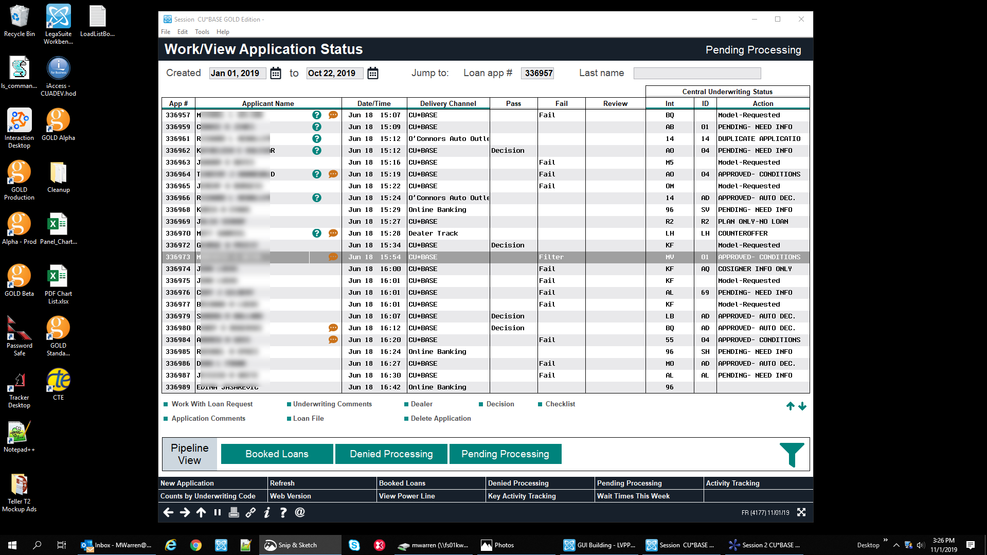
Tomorrow’s CU*BASE LOS (size L)
Mockup only; subject to change

Slide 30
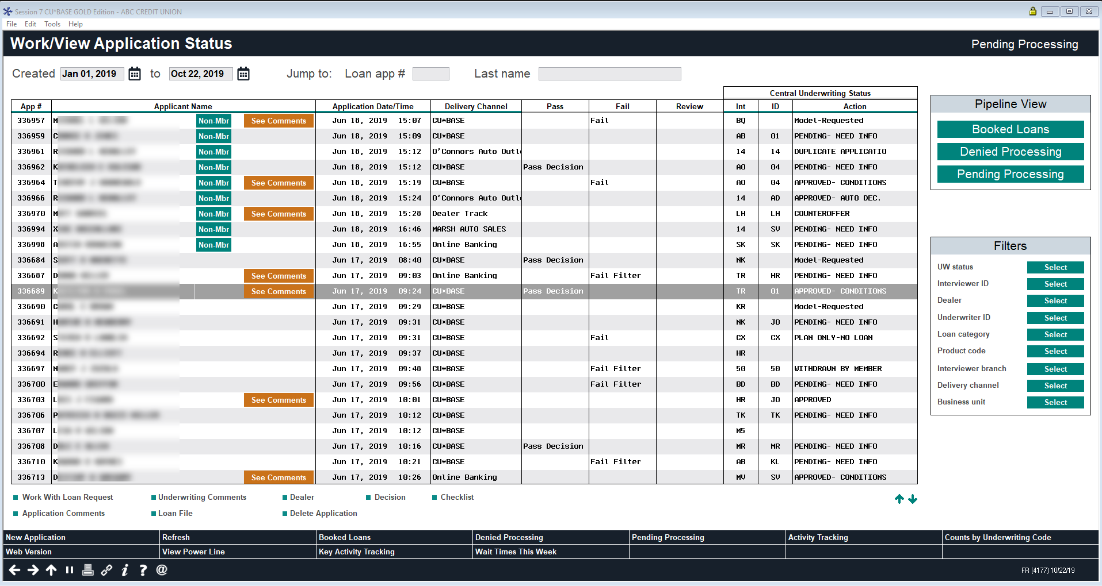
LOS
Tomorrow’s CU*BASE LOS (size XL)
Mockup only; subject to change

Slide 31
LOS
Larger font sizes
Separate columns, no more cryptic color-coding
Delivery channel descriptions, not codes
Embedded list functions
Emphasis is on the queue, not the filters
Mockup only; subject to change

Slide 32
LOS
COMING SOON: A new “Save Filters” button that will save a user’s favorite sort order and filter settings, then automatically restore them the next time the queue is opened
Larger font sizes
Separate columns, no more cryptic color-coding
Delivery channel descriptions, not codes
Embedded list functions
Save Filters
Emphasis is on the queue, not the filters
Mockups only; subject to change

Slide 33
Firing up a new approach for internet lending via the CU*BASE LOS platform
Mockup only; subject to change
Other Ideas we’re working on now
Allow members to tell us when they want the loan
Sort apps in the queue based on this selection and add new procedures to streamline the process
Change how leads are captured and followed up
Add configs to process loan apps differently if they are incomplete, or if they don’t include credit pull authorization, etc.
Create “come-back-and-finish” functionality for internet-enabled members
Build Member Reach-type responses to sort loan apps and clear the queue more effectively

Slide 34
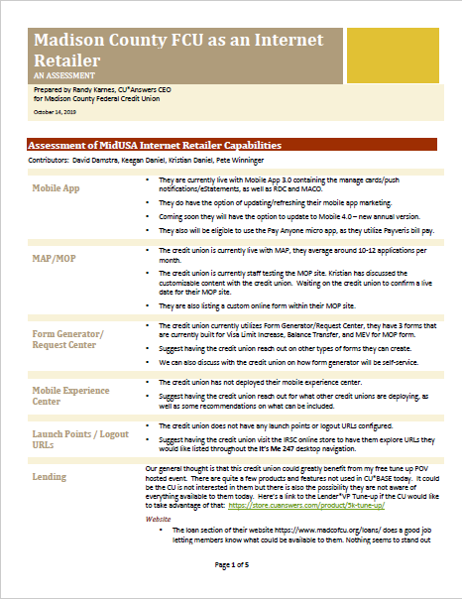
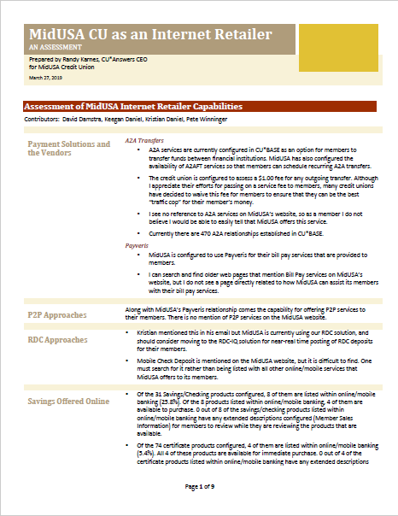
Now a project for you
Are you launching enough tactics to inspire a new culture?
What project recommendations would four CU*Answers experts make for turning your credit union into a better internet retailer?

Slide 35
Thanks for the day!

Slide 36
Traffic alert!
There’s a parade starting nearby tonight at 7:00pm
If you parked in the DeVos parking garage, exit via Michigan Street, not Monroe

