Slide 1
Welcome!

Slide 2
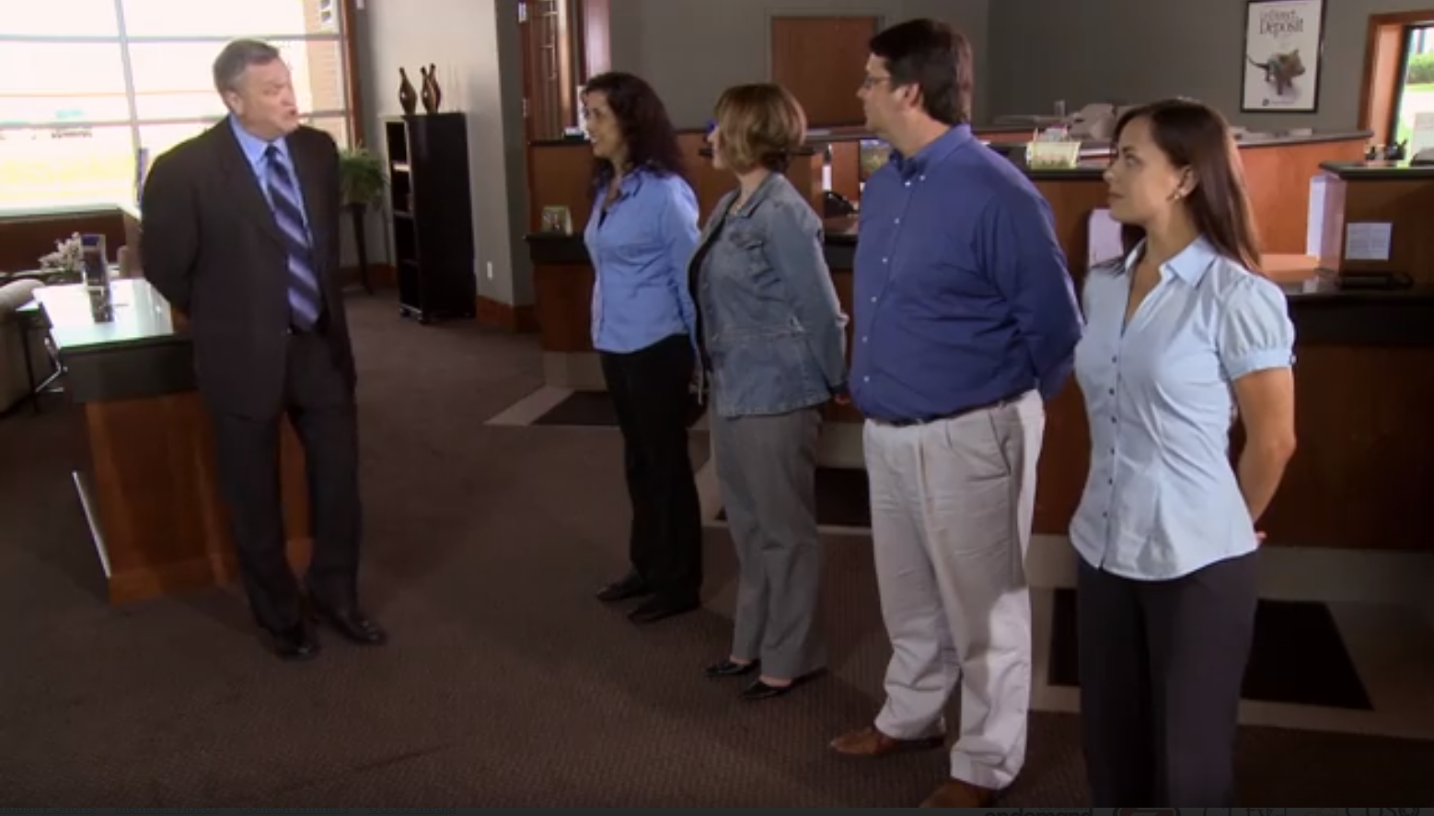
The Owners are here!
A cooperative rallying call that generates excitement and anticipation

Slide 3


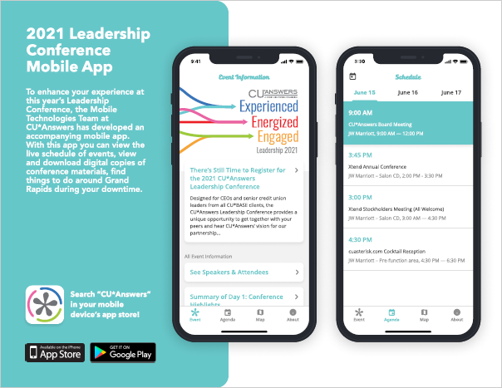



Today’s Agenda
Have you
downloaded the conference app?
Preview prototypes:
About > Coming Soon
Catch a ride:
Map > Conference Location
Experienced, Energized, Engaged:
Get ready for the party!
Launching in 2021
  Projects that have consumed the spotlight for the past 3 years, ready for launch
The next spotlight-grabbers
  How this year’s product launches prepare us to dive into building on our vision for internet retailing for lending
Initiatives that should be on your radar
  Not the usual suspects
User
Customer
Check it out in the app!
Owner

Slide 4
My entire career, I have assumed everyone was at the party, everyone was engaged, and everyone was just as excited as I was...
But over the last 14 months, I’ve never felt so much like a supervisor

Slide 5
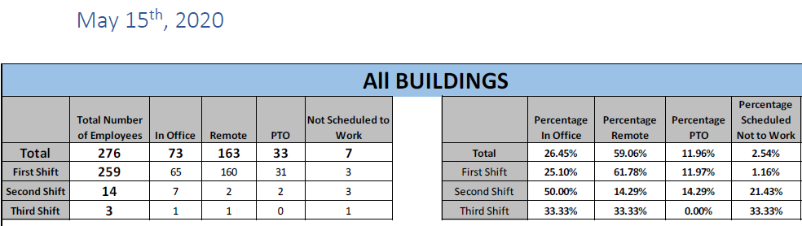

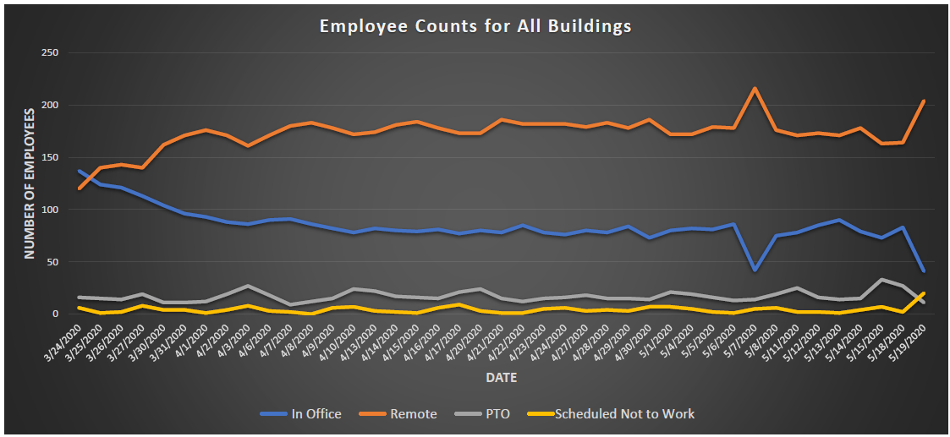
CU*Answers Daily Census

Slide 6

CU*Answers Daily Census
I don’t want to lament about the last 14 months...
I just want to blow it all up, analyze the pieces, and dream about where to go from here

Slide 7

After months of empty branch lobbies, are we going to blow them all up, or restart the party?

Slide 8
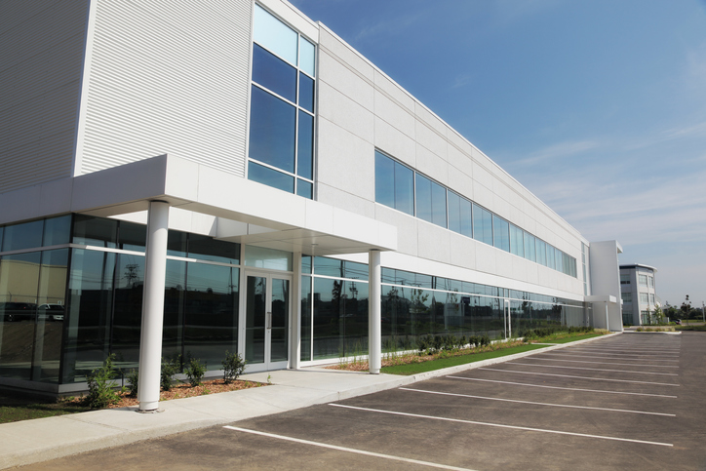
Are we going to redesign work and the need for employee campuses?

Slide 9


Are we going to shift our retailing from physical locations to something bigger? Can we all be internet retailers?

Slide 10

Defining the party crowd
If you were going to a party that was going to last for ten years, what would you hope to find there to keep it going?
Beyond the happening venue, beyond the over-the-top beverages, and even beyond the fantastic music, what do you really hope will be ahead to make this party a success? The people!
What kinds of people are you hoping to party with?
For as long as I can remember, I have been surrounded by this party crowd...the CU*Answers party crowd, and it’s never let me down

Slide 11
Experienced
COVID-19 will likely define a generation of business people who survived this trial, forever changed by balancing the goals of an industry and the plight of the customer-owners who define it
Energized
After we take stock of what it means to go on from here, I can’t imagine a generation more energized to smell the roses and stay forever engaged in their community’s success
Engaged
After 14 months of screen time, I can’t imagine a generation more ready to engage people, their dreams, and a future based on everyone’s success

Slide 12
Experienced
We have the resumes to change it all
Energized
We have the energy to see it through
Engaged
We have the passion to inspire our entire industry

Slide 13
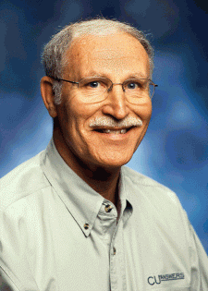
The
Robert H. Mackay Leadership Award
Speaking of passion to inspire our industry...
  “The challenge of leadership is to be strong, but not rude; be kind, but not weak; be bold, but not bully; be thoughtful, but not lazy; be humble, but not timid; be proud, but not arrogant; have humor, but without folly.”
Words to live by, shared by Bob Mackay
Taken from a quote by Jim Rohn
EST. 2005
And our winner is...
Notes:
Speaking of passion to inspire our industry...

Slide 14
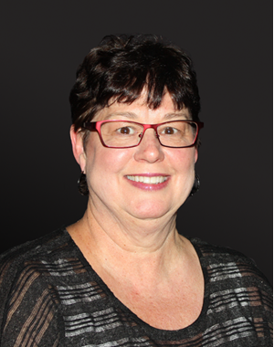

The
Robert H. Mackay Leadership Award
Our 2021 honoree:
Debie Keesee
President/CEO since 1997 of
Spokane Media FCU
EST. 2005
CU*NorthWest Board Secretary/Treasurer since 2005
On the CUNA Board since 2016
On the National CU Foundation Board since 2018
Northwest Credit Union Association Lifetime
Achievement Award 2019
Notes:
Retiring from the CU*NW board
Brought CU*A to the NW via her being the first client
A force for the expansion of CU*NW, and a driver of her CU via collaboration - league and our national cuasterisk.com efforts

Slide 15
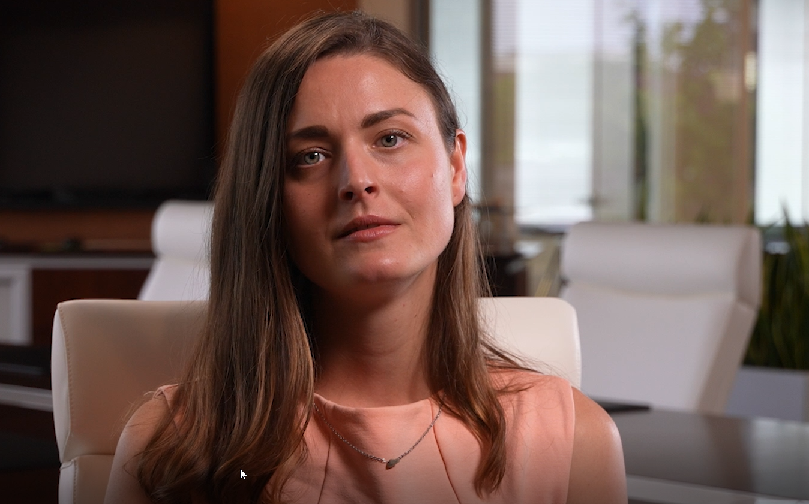
Our party’s theme:
Walk, talk, and live an internet retailer’s future for the next 10 years
This theme will be a recurring one all day long...it’s inspirational for me, because it says “do things other people can’t do” . . . manufacture something new

Slide 16
Let’s get today’s party started...

Slide 17

New Peers to Greet
15
New CU*Answers clients
in 10 states since last time!
Hawaii
  Kaua'i Government Emp FCU
  Lihue, HI
Illinois
  Services CU
  Naperville, IL
Missouri
  Columbia CU
  Columbia, MO
Nebraska
  Columbus United FCU
  Columbus, NE
Michigan
  Chippewa County FCU
  Sault Ste Marie, MI
  Federal Employees of Chippewa County CU
  Sault Ste Marie, MI
  Great Lakes First FCU
  Escanaba, MI
  Limestone FCU
  Manistique, MI
  Rivertown Community FCU
  Grand Rapids, MI
Ohio
  Miami University Comm FCU
  Miami, OH
Oklahoma
  Growing Oaks FCU
  Goldsby, OK
Pennsylvania
  Pheple FCU
  Greensburg, PA
South Carolina
  Greenwood Municipal FCU
  Greenwood, SC
Texas
  LiFE Federal CU
  Denton, TX
  Rio Grande Valley CU
  Harlingen, TX
Includes CU*Answers clients signed/LOI as of 5/30/2021

Slide 18



Welcome to our newest community!
New Jersey
  Research 1166 FCU *
New York
  IRS Buffalo FCU
Pennsylvania
  A C B A Federal CU *
  Alcoa Pittsburgh FCU
  Alcose CU
  Allegheny Central Employees FCU *
  Allegheny Kiski Postal FCU
  Allegheny Ludlum Brackenridge FCU
  A&S Federal CU *
  AT&T Emp Pittsburgh FCU
  Centerville Clinics Empl FCU *
  Cheswick Atomic Division FCU
  CraftMaster FCU *
  Fisher Scientific Employees FCU
  Friendly Federal CU
  Iron Workers FCU
  JDHM FCU
  LESCO FCU
  Local 520 UA Federal CU
  Mercer County Community FCU
  Morning Star Baptist FCU *
  Mt Lebanon FCU
  Newcastle Bellco FCU
  North Districts CU
  Penn Hills Municipal FCU *
  Penn-Trafford School Empl FCU
  Pittsburgh FCU
  Post-Gazette FCU *
  Sarco FCU
  Spojnia CU *
  Strategic FCU
  Swindell Dressler CU *
  The East End Food Co-Op FCU *
  URE Federal CU
  Valley Pride FCU *
= CU*BASE conversion completed!

Slide 19




Credit Unions Served by State
347
CU*BASE Credit Unions
in 42 States
# of CUs by State
1
10
3
4
79
2
8
12
2
1
1
1
8
2
1
4
4
1
9
33
6
1
24
11
24
3
1
1
6
2
2
1
✪
1
1
3
1
2
2
1
2
4
2
1
1
1
1
5
4
5
2
3
3
14
8
198
5
66
5
2
48
US Virgin Islands
35
Includes all cuasterisk.com network partners, all clients under contract as of 5/30/2021

Slide 20
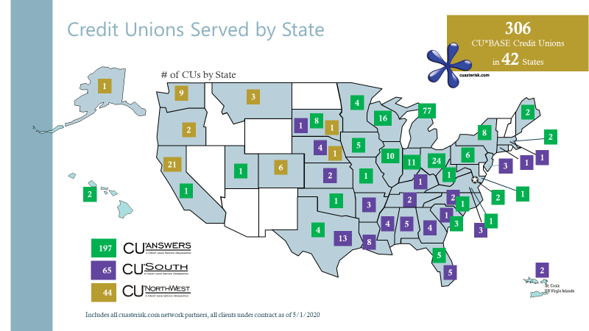
Credit Unions Served by State
347
CU*BASE Credit Unions
in 42 States
Compare this to last year...
# of CUs by State
1
10
3
4
79
2
8
12
2
1
1
1
8
2
1
4
4
1
9
33
6
1
24
11
24
3
1
6
41 new relationships and a whole new network joining the team for the future
1
41 new relationships and a whole new network joining the team for the future
2
2
1
✪
1
1
3
1
2
2
1
2
4
2
1
1
1
1
5
4
5
2
3
3
14
8
198
5
66
5
2
48
US Virgin Islands
35
35
Includes all cuasterisk.com network partners, all clients under contract as of 5/30/2021

Slide 21
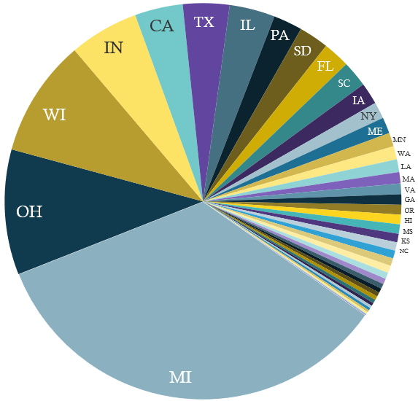
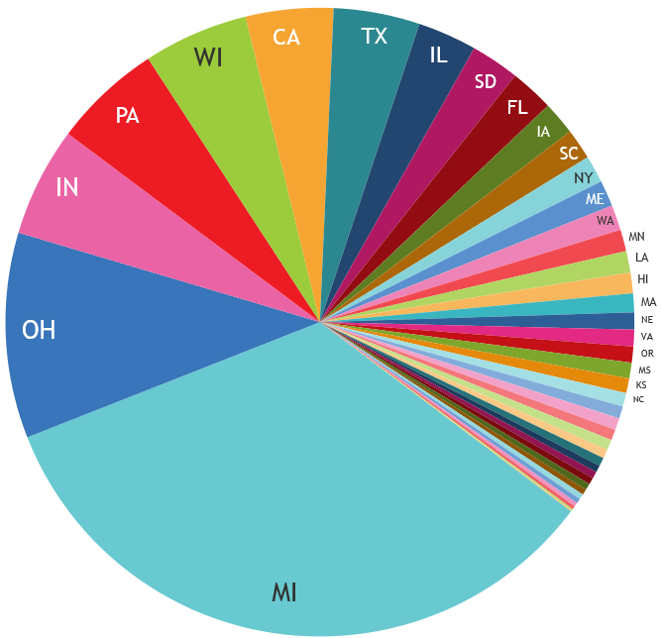
And now for the rest of the story...
2020
2021
Up 13.4%
CU*BASE Credit Unions:
306
Total Members:
2,534,800
CU*BASE Credit Unions:
347
Total Members:
2,486,400
Down 1.9%

Slide 22
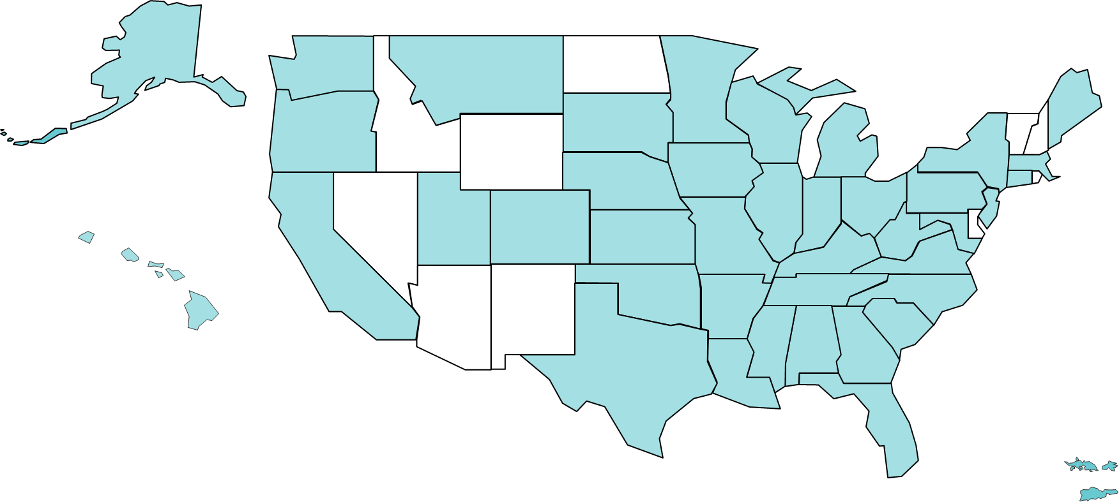
I am more optimistic than ever about the party ahead
We believe in THE relationships THAT WERE added between 2020 and 2021
These 41 new CU relationships extend our annuity for a decade
  And a new certified CU*BASE distributor brings another CUSO to our party
The average membership size per CU shrank by 1,200 members...but with 347 total relationships, we’ll replace those members easily
With a store that has over 1,000 products to sell to institutions, we’ll have more buyers at our party than ever before
But we are down 48,400 members overall, and that is a rare year for our network
So we have some things to prove to ourselves and for the members of our network

Slide 23
The Spirit of CU*Answers Award
Speaking of adding more buyers to the party...
Since 2011 the Spirit of CU*Answers award has recognized the CU that:
  Best exemplifies our Leadership Conference theme
  Maintains a strong and vital volunteer program
  Demonstrates the principle of being all about the member
  Shows an innovative example of collaboration and cooperation (the highest Collaborative Score)
  Has started a business in the network
  Exhibits strong execution and performance, especially in the face of adversity
  Has hit the ground running with adoption of CU*BASE tools or plunged into tools in a new way
  Has started a new initiative that really demonstrates the credit union spirit, that moves the industry in a positive direction, that is inspirational to other CUs
EST. 2011
And the winner is...
Notes:
Speaking of adding more buyers to the party...

Slide 24
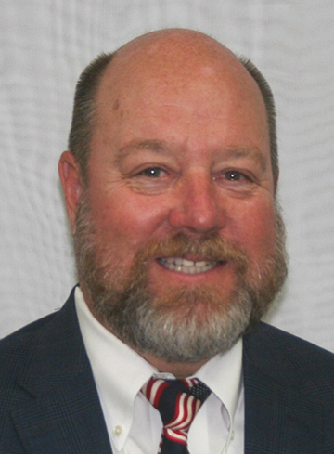

The Spirit of CU*Answers Award
Our 2021 honoree:
Bill Nikolauk
President/CEO
1st Community FCU
San Angelo, Texas
EST. 2011
Brought 1st Community FCU, Hawaii Central FCU, and Rio Grande Valley CU to our network
Chairman of the Sync1 board

Slide 25
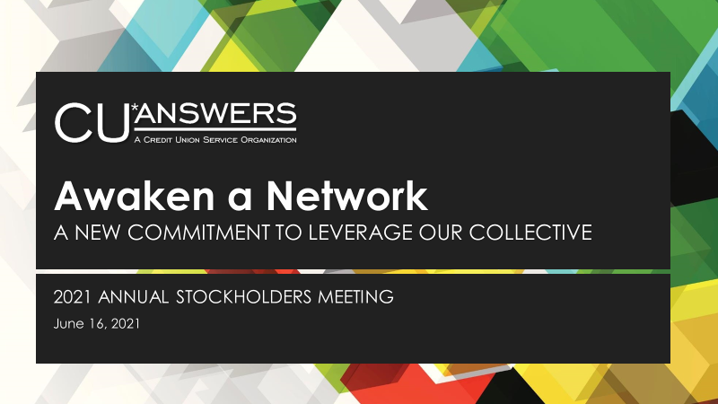
I want you to be as optimistic as I am
In a world of conflicting signals, our network needs to be a constant in moving forward
For the rest of today we’ll talk about tactics that will fuel the balance of 2021 through 2023
Tonight, we’ll spend time
with our investors on how we’ll
sustain the effort for the next 10
years
We’ll talk about why everyone
should be confident about our
network’s next steps

Slide 26



2021 CEO Strategies | November 8-10, 2021
Monday, November 8
OUR NATIONAL EFFORT FOR CEO COLLABORATION
12:00noon-3:30pm
EVENING NETWORKING EVENT
Tuesday, November 9
ARE WE THE CEOS TO CHANGE IT ALL?
8:00am-5:00pm
EVENING NETWORKING EVENT
Wednesday, November 10
CEO ROUNDTABLE
8:00am-12:00noon
Watch for more news to come, later this summer

Slide 27

Launching in 2021
A decade of evolution ahead

Slide 28
Get on with it, already!
To do something big, It seems we have to talk about it forever
Introduce the promise of new solutions
Hype the potential to change everything
Launch the project
Settle in to the evolution to reach promised goals
The Life Cycle of a Product
Peak
Settled In
Introduction
Plateau
The “Tipping Point”
In 2021, even we’re bored with talking about some of these projects...so let’s just get on with it

Slide 29
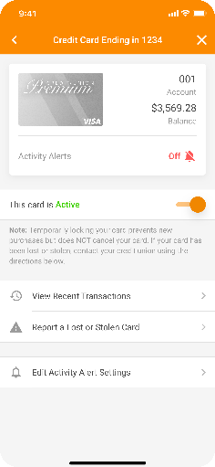
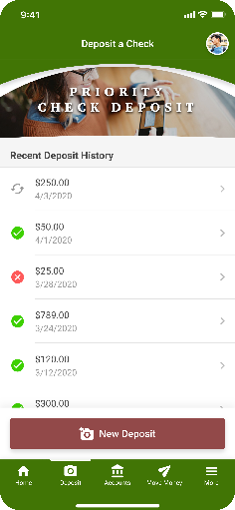
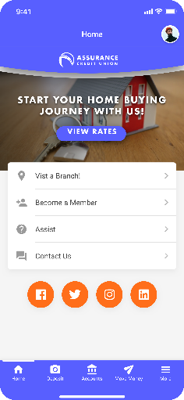
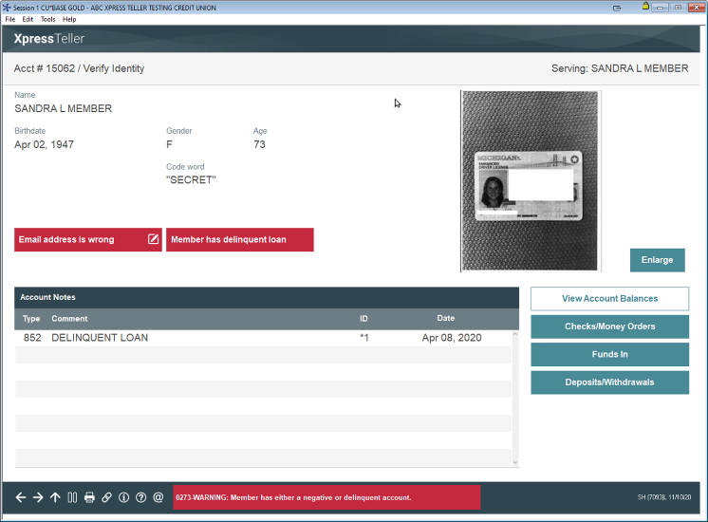
Get on with it, already!
After years of anticipation, these projects will fuel our day-to-day evolution for another decade
“Mobile first” will change the way we think,
design and plan
  For generating mobile apps for app stores
  For managing online banking products (desktop/tablet/phone)
  The world will now go through CU Publisher for designer control
Xpress Teller will provide a concrete example of how CUs can evolve their over-the-counter services
  (Assuming they stay in the teller business)

Slide 30
Mobile First
“A rallying cry for everything we create, write about, or dream about in this next era.”
Mobile 5.0
The New Look for It’s Me 247

Slide 31
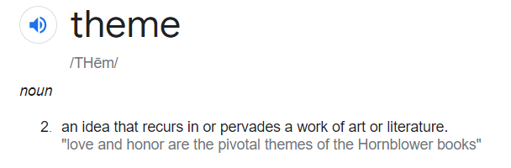
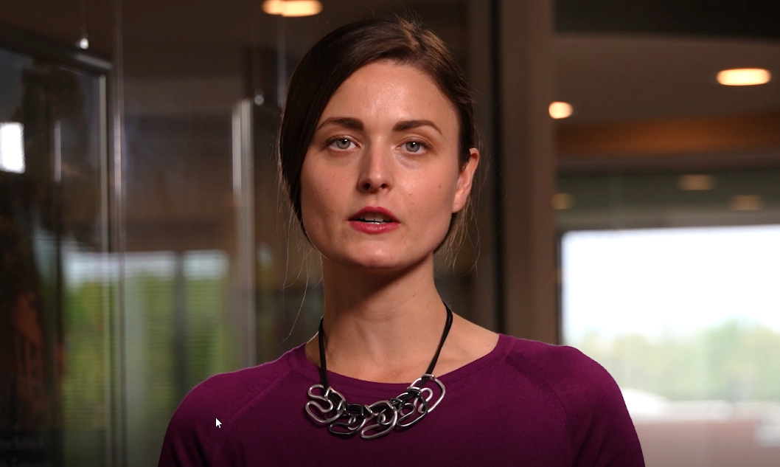
“Mobile First” is a theme to change our future
From easily-identified internet solutions all the way to the lobby and lender desks
A rallying cry for everything we create, write about, or dream about in this next era
Your members have a fixation on phones; I guess you should, too

Slide 32
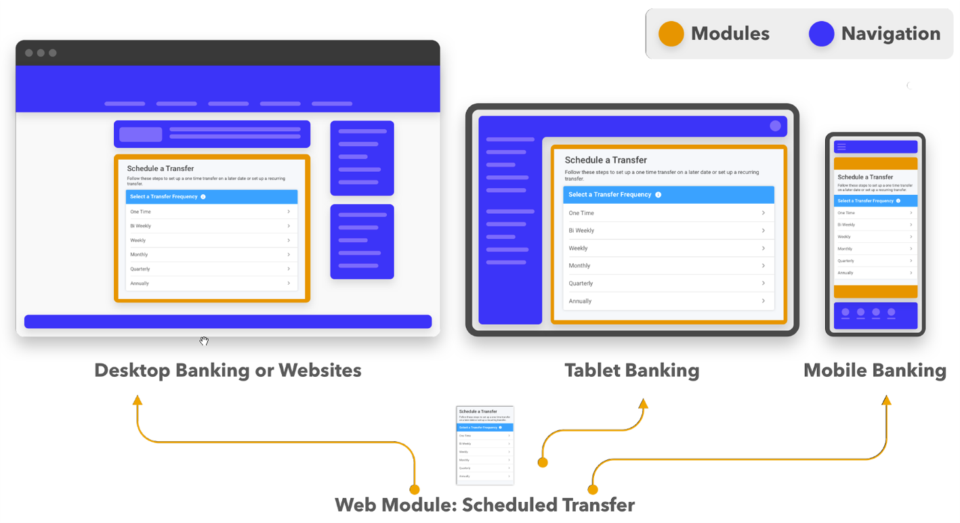
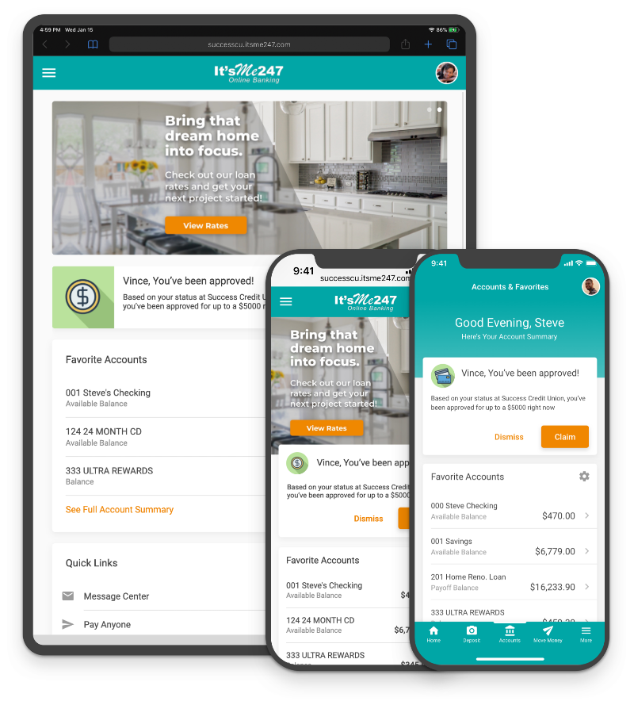
The vision of modules launched a whole new family of desktop and mobile web banking
One software, any device

Slide 33
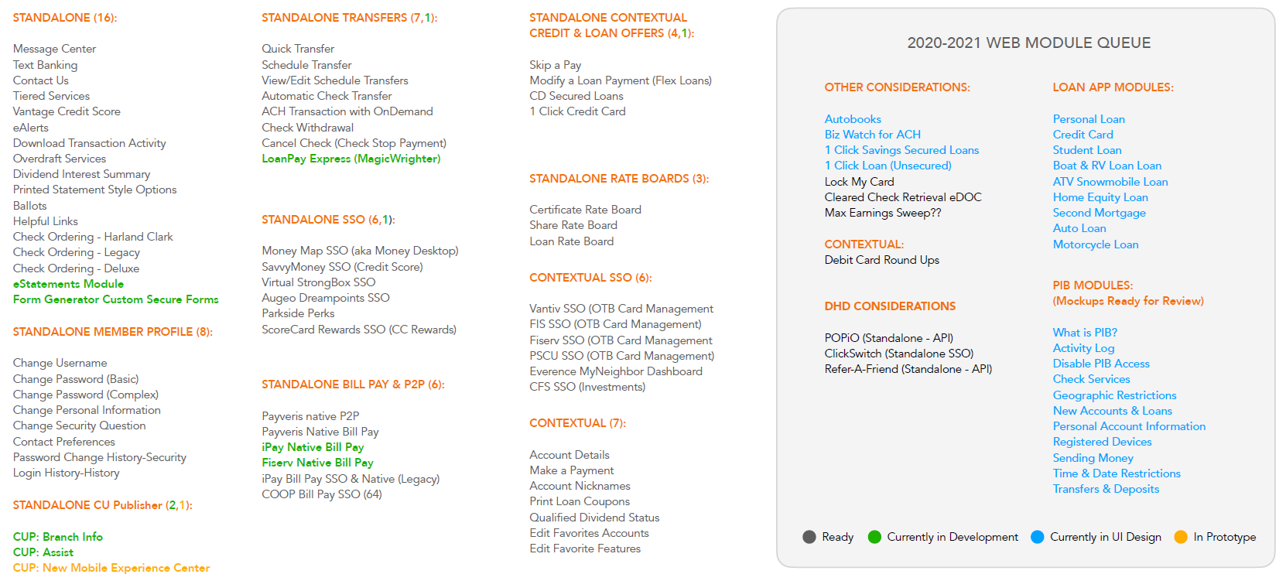
The vision of modules launched a whole new family of desktop and mobile web banking
Modules that have been developed for mobile 5.0 and the new look for it’s me 247

Slide 34
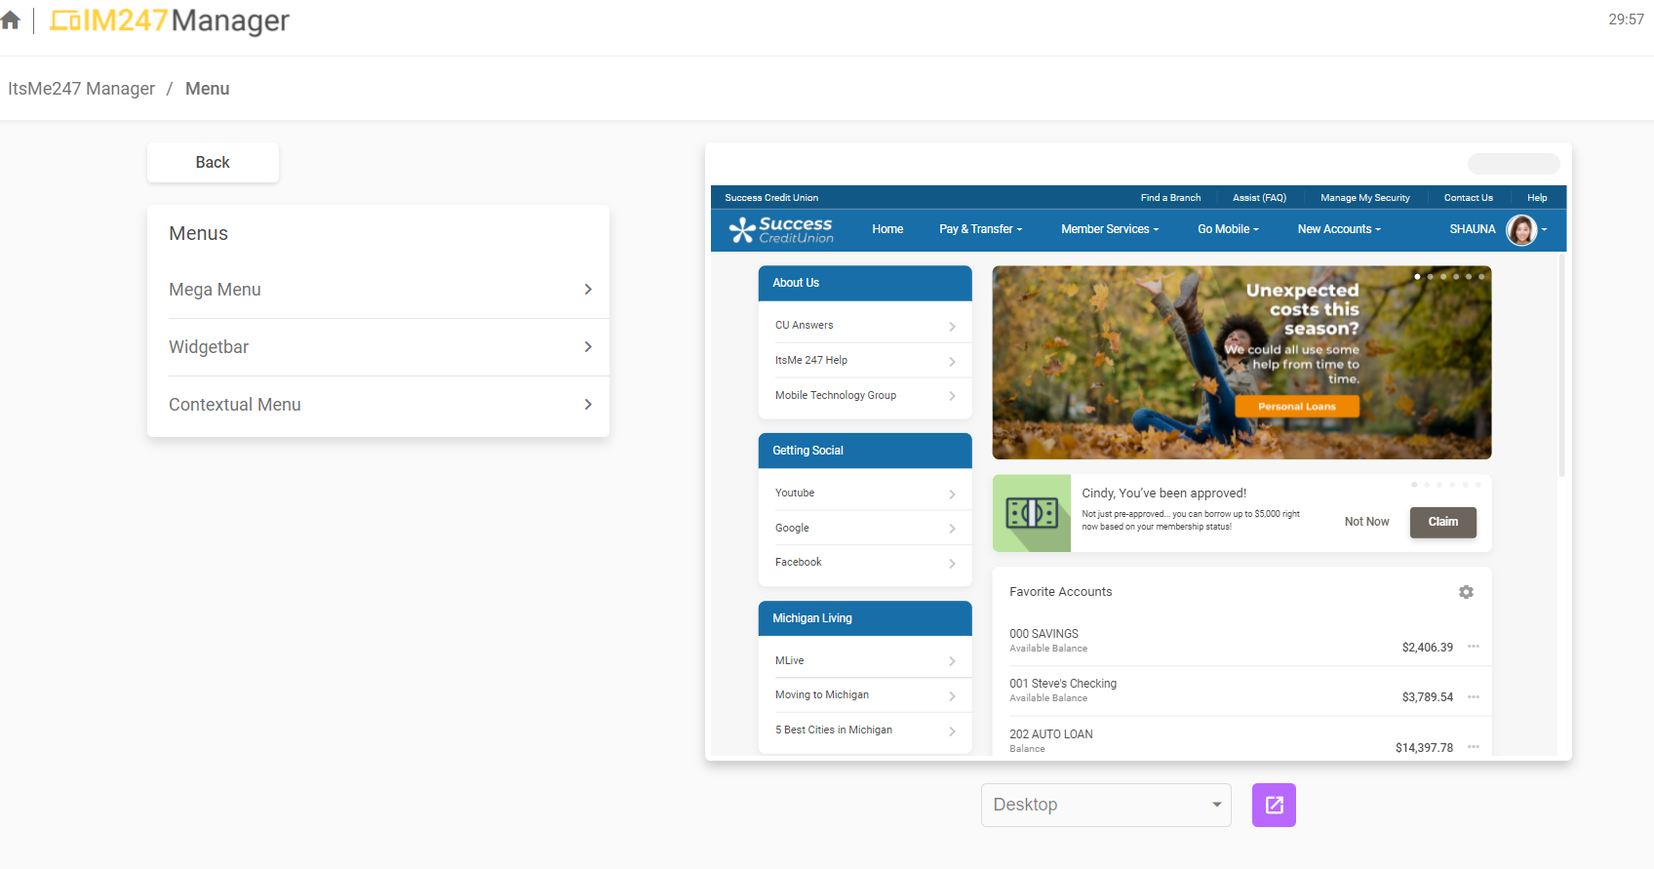
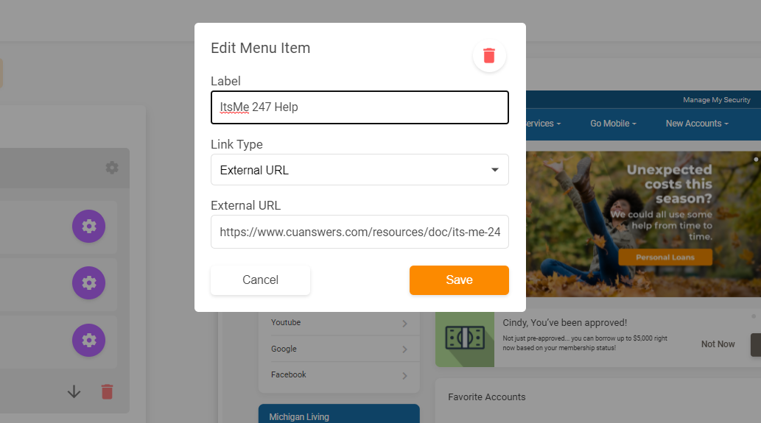
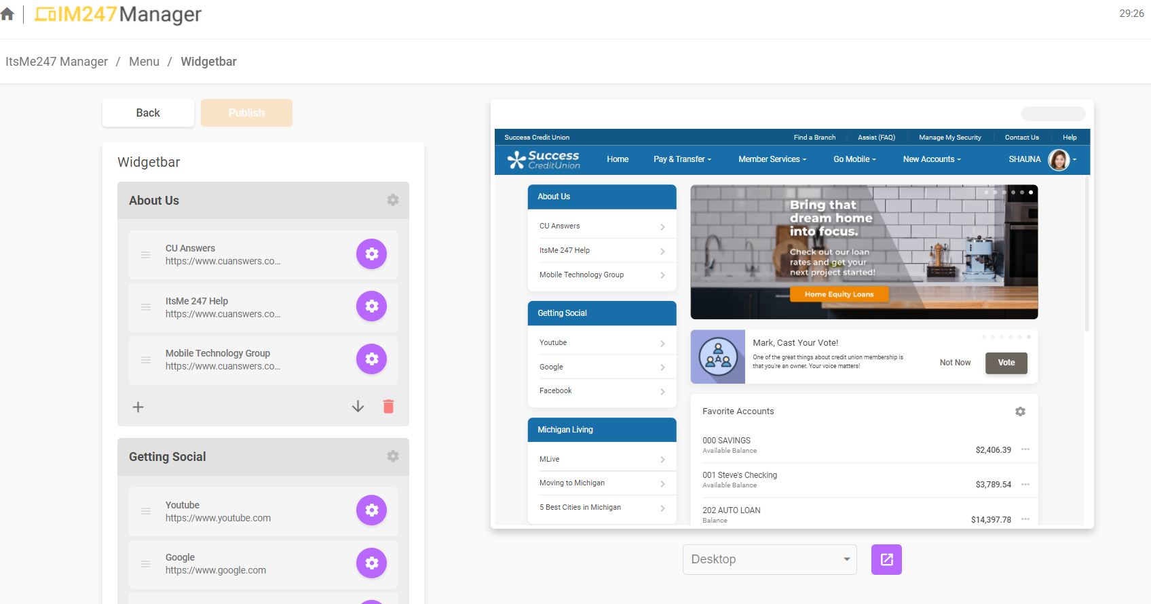
The missing piece: a vision of click-and-drag navigation design
Designed not only for CU*Answers:
CU Publisher will release the designer in YOU

Slide 35

CU Publisher will be at the core of almost unlimited options for CU solutions
In a world of unique member experiences, look and feel might define success
Our most aggressively-priced and carefree option
70%
Will use as designed by CU*Answers
20%
Fees a la carte based on chosen designer
Will seek out designers to customize
10%
Will become designers and power users
CU Publisher license fees
100%
CUs must adopt a manufacturer’s perspective to truly earn from being an internet retailer
Notes:
70% Will use the product as designed by CU*Answers
Our most aggressively-priced and carefree approach to a generic product for their members
20% Will seek out designers to customize based on their vision
An a la carte fee program based on the CU’s selected designer partner and their CU Publisher skills
10% Will become power users and legitimate designers for their own solutions
License fees for CU Publisher as the foundation for how far they wish to take their solutions for their members

Slide 36
CU Publisher will be at the core of almost unlimited options for CU solutions
If CUs apply themselves,
these numbers might be
different in just a few years
In a world of unique member experiences, look and feel might define success
Our most aggressively-priced and carefree option
70%
Will use as designed by CU*Answers
10%
Use as designed
20%
Fees a la carte based on chosen designer
Will seek out designers to customize
40%
Find a designer
10%
Will become designers and power users
50%
Become a designer
CU Publisher license fees
100%
CUs must adopt a manufacturer’s perspective to truly earn from being an internet retailer
Notes:
This was the purpose of all of this work – not pretty picture, or group vision of the ultimate user experience
It was about building a tool where CUs have the autonomy to design that for themselves
That’s why it took so long

Slide 37
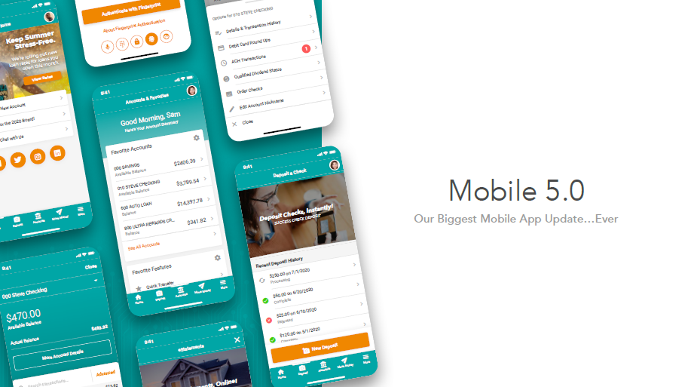


Mobile 5.0 is the best example yet of the power of CU Publisher
MTG enlists credit unions to join us in developing new solutions, in a new way
Our biggest update so far
Entirely new foundation
70+ mobile web modules
Native and customizable navigation
Native member messages 1.0
Native account summaries
Native Jump
RDC improvements
Goodbye, mobile web! (well, not really)
open.cuanswers.com/Mobile5
Notes:
Giving credit unions autonomy when it comes to manufacturing internet products
Mobile web isn’t really going away, but we won’t be emphasizing it anymore – it’s just part of the It’s Me 247 product and how it works on any device

Slide 38

Mobile 5.0 is the best example yet of the power of CU Publisher
MTG enlists credit unions to join us in developing new solutions, in a new way
More effective than APIs, modules have redefined the way designers will configure unique solutions
Mobile 5.0 relies on new
CU Publisher capabilities to
configure navigation approaches
Mobile 5.0 was the catalyst to a reset for our
It’s Me 247 suite and where it goes from here
open.cuanswers.com/Mobile5

Slide 39
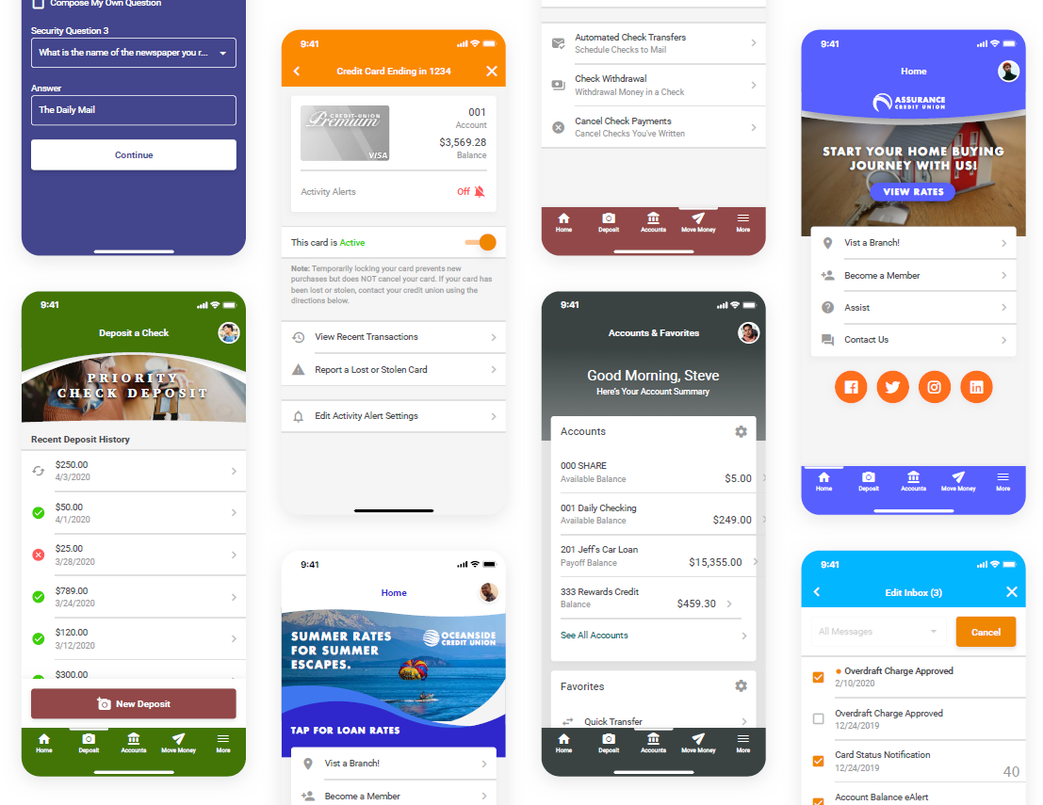
The most intense software project in our history
For years, CUs have said they want more creative control over their internet solutions
This will do it! But you’ll need to dig in
You’ll need to assign a coordinator to work with MTG
You may want to assign a designer to learn how to promote your own version of mobile apps
open.cuanswers.com/Mobile5

Slide 40
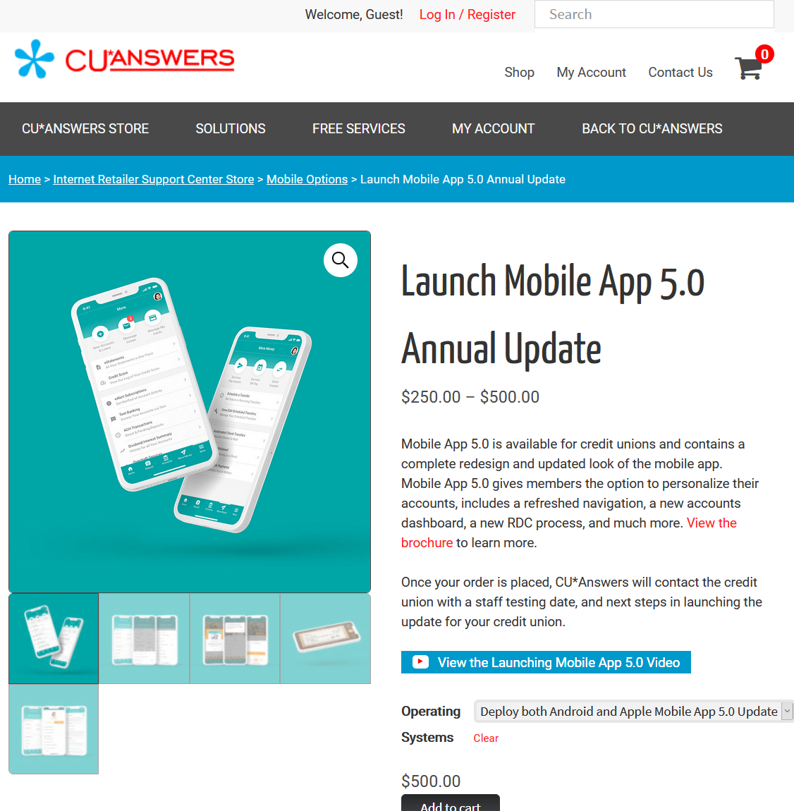
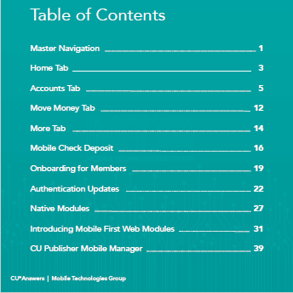
Designed for active mobile program managers and the designer’s heart
You can’t learn it from a high-level overview...you have to dig in
open.cuanswers.com/Mobile5

Slide 41
Mobile 5.0 Release Update
There’s an army at work here, and CUs are taking control over the marching orders
14 CUs are live in Apple & Android app stores
  2 CUs pending with Apple
102 CUs in staff testing
  700+ Android staff testers
  1,000+ Apple staff testers
7 newly converting CUs will deploy
direct to Mobile 5.0
The new jump module will be available for staff testing by early July
open.cuanswers.com/Mobile5

Slide 42


MTG mobile app development
An annual wash-rinse-repeat routine
Deploy the current release (5.0)
Dec
Jan
Feb
Mar
Apr
May
Jun
Jul
Aug
Sep
Oct
Nov
Dec
Jan
Decide what’s in the next version (6.0)
Do the development work for the next version
= CU*BASE release

Slide 43
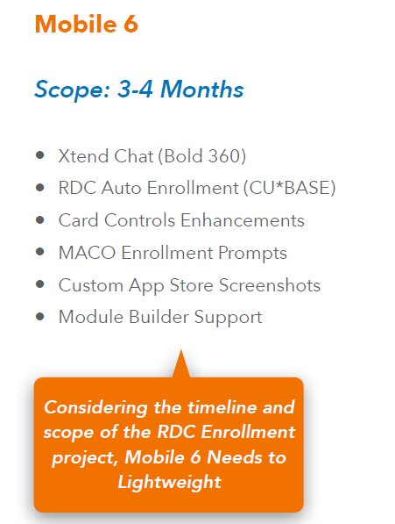
Mobile 6.0 is only 9 months away
So what’s being planned for the next update?
Is your organization ready to enhance your mobile program once a year?
  Will you build a factory to do it?
  Can you be Apple and Android, and get your marketplace ready for the next big thing?
  Are you going to use our version of the next big thing, or be a designer and tweak your own?
Are you ready to go beyond being just a user of a tool, to being a true internet channel retailer?
Considering the timeline and scope of the RDC Enrollment project, Mobile 6 needs to
be fairly light weight

Slide 44

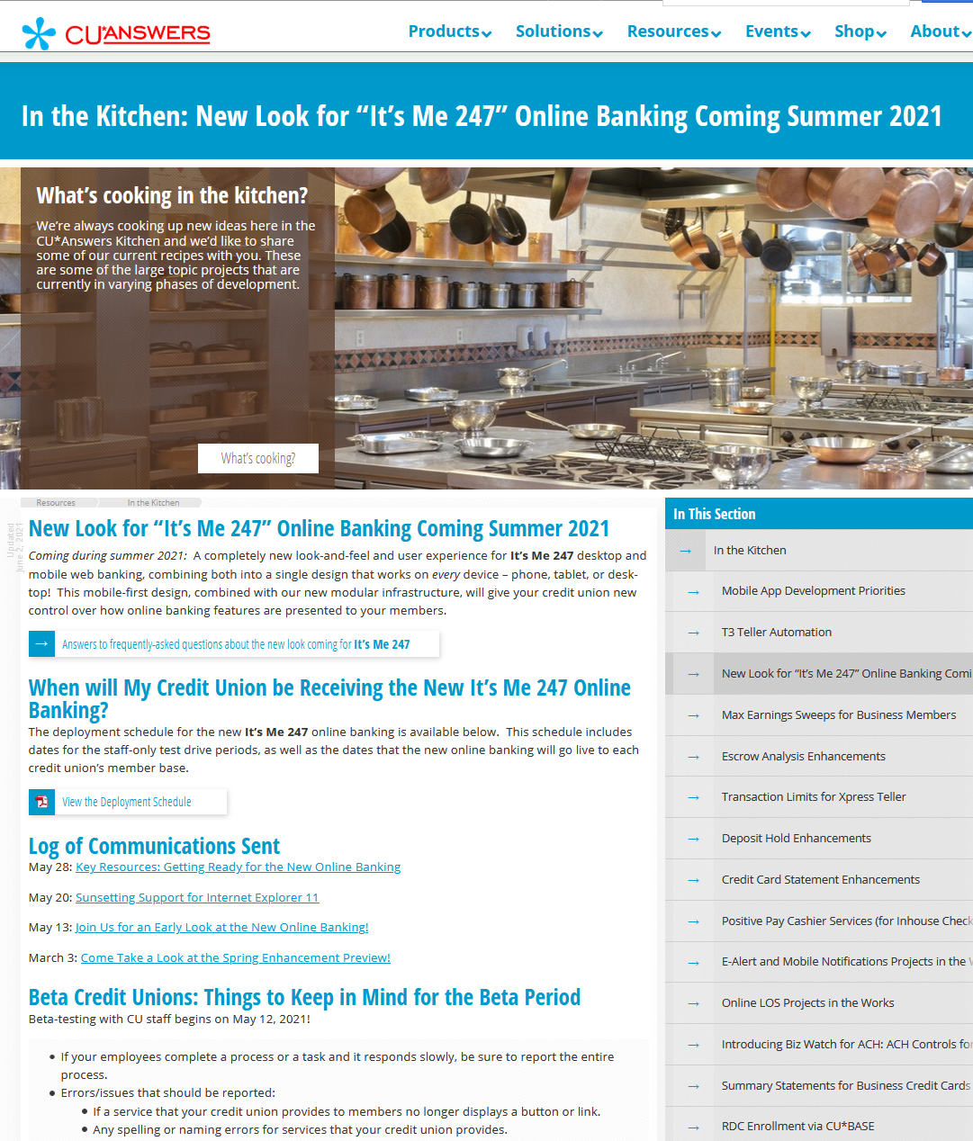
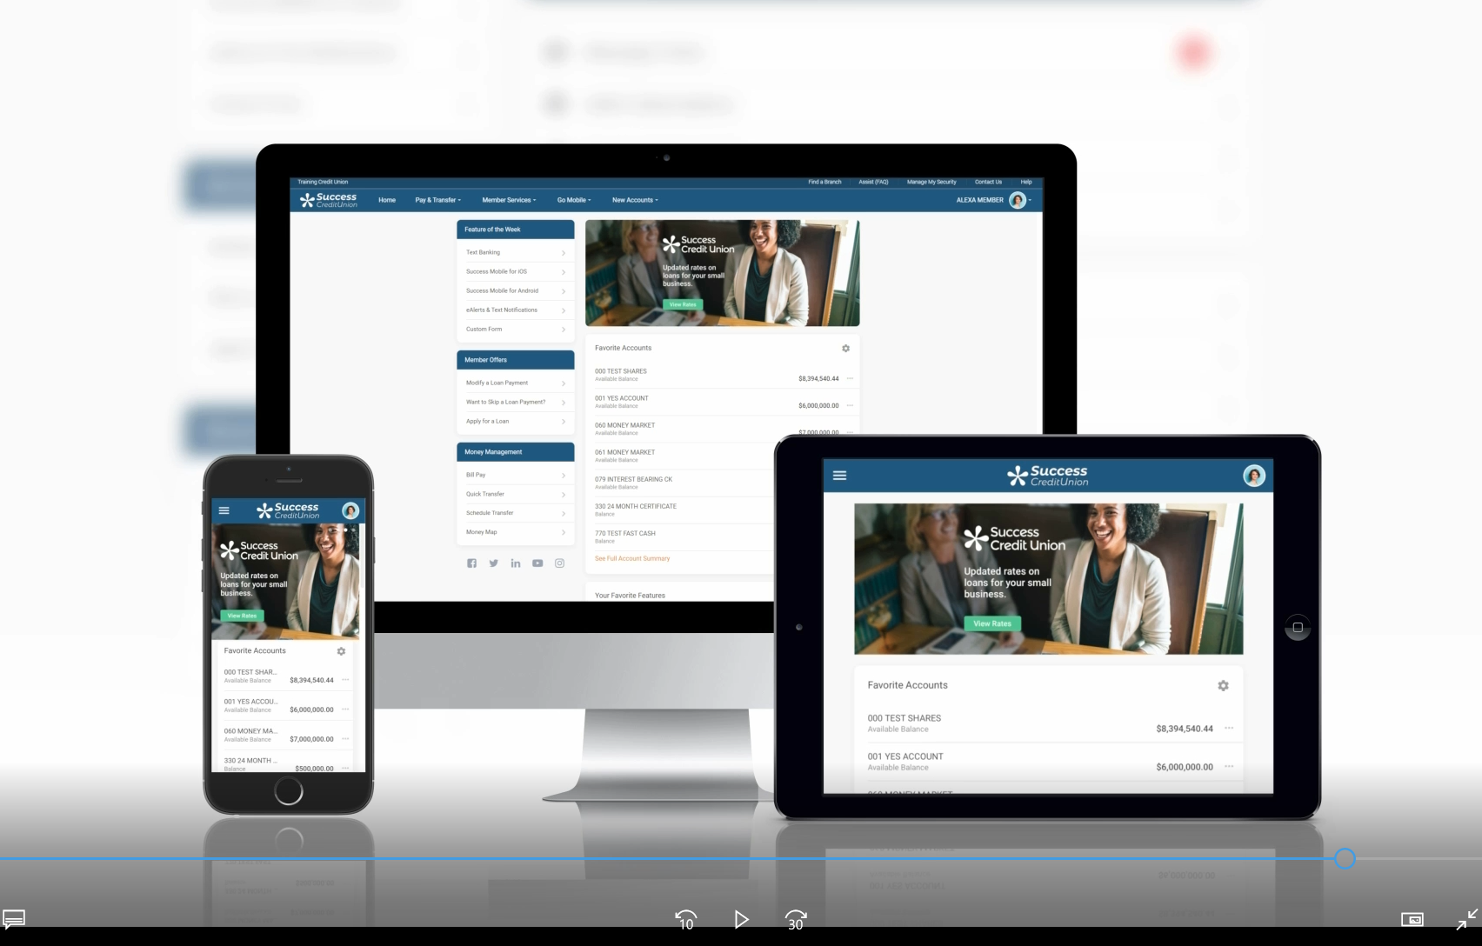

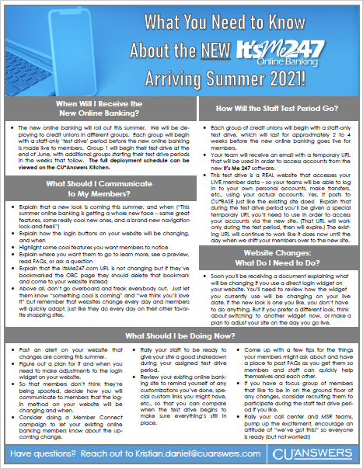

Let’s take a look...
Promo
Feature overview
open.cuanswers.com/NewLook2021

Slide 45
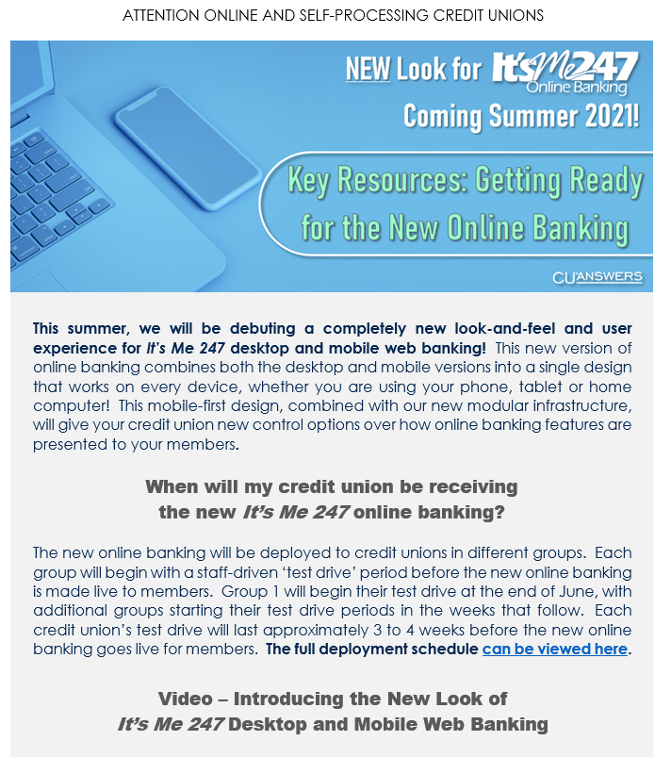
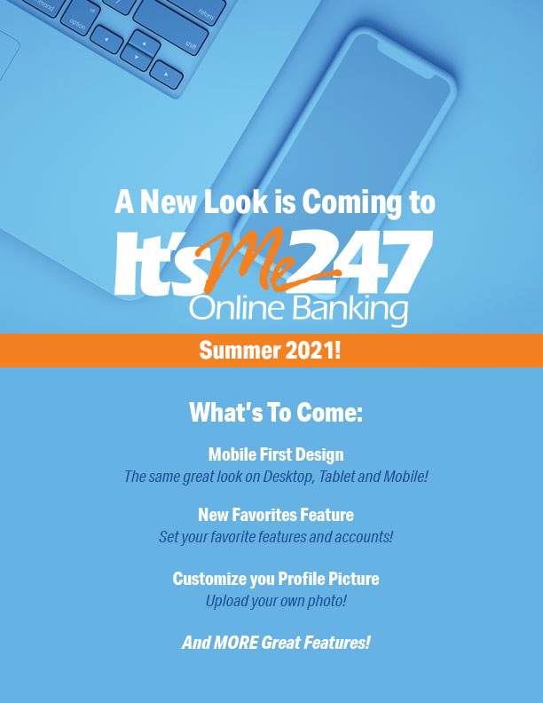
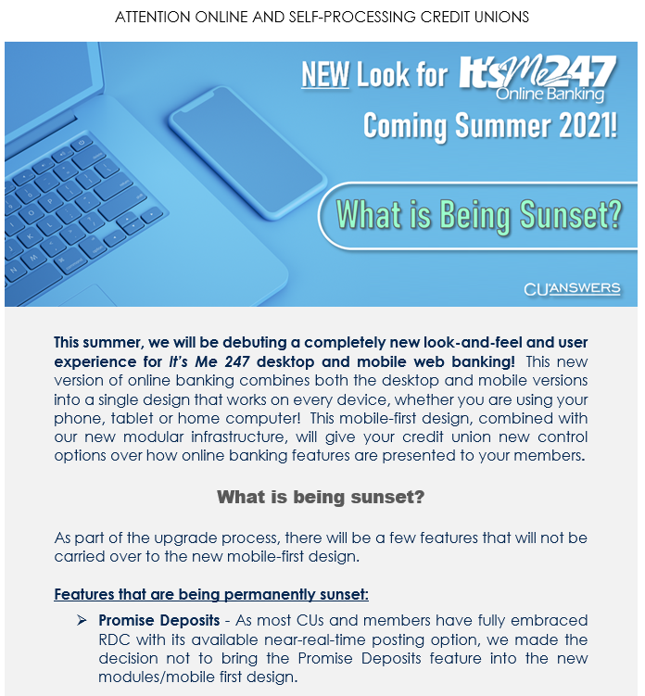
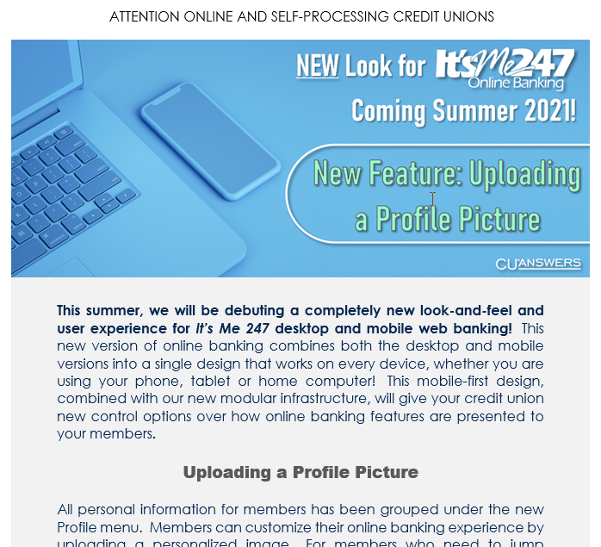
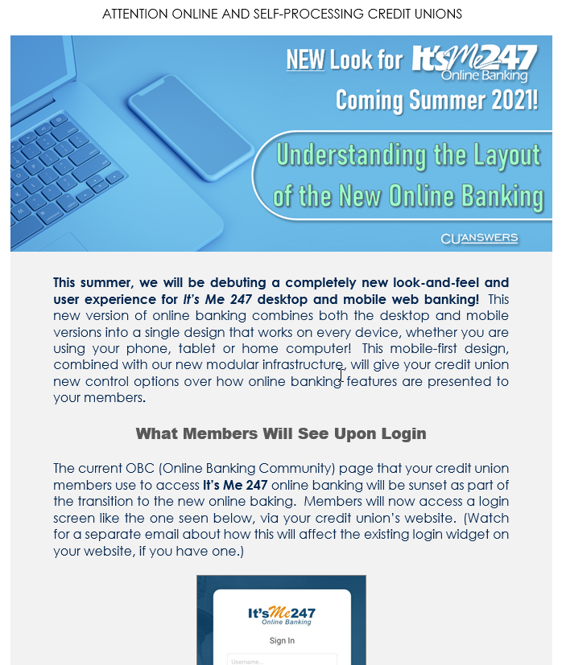
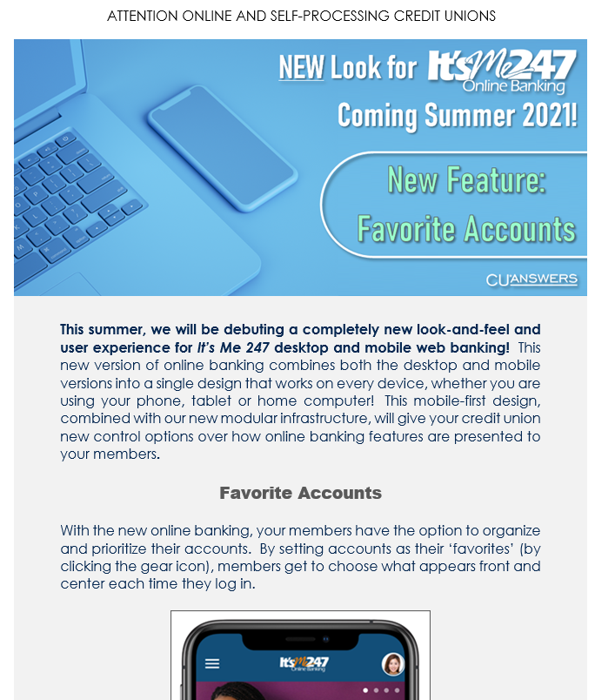
Customizable marketing kit with poster and web banners
Phased rollout
  7 CU groups, June-October
  CU staff get a 2-4 week test drive,
  then live to members
  After this introduction, releases will
  go back to our usual routine
See the Kitchen for your test-drive and go-live dates
  As with Mobile 5.0, you need to dig in!
“New Look 101” Email Series
open.cuanswers.com/NewLook2021
Notes:
Will be about 15 emails in the series
Groups were chosen based on traffic, so we could manage system performance
Test drives are so you can check your custom links/branding, and do customized marketing to your members

Slide 46
These dates aren’t “tentative” or negotiable
We usually have just 1 release date – the only difference this time is we have 7 of them
Customizable marketing kit with poster and web banners
Phased rollout
  7 CU groups, June-October
  CU staff get a 2-4 week test drive,
  then live to members
  After this introduction, releases will
  go back to our usual routine
See the Kitchen for your test-drive and go-live dates
  As with Mobile 5.0, you need to dig in!
“New Look 101” Email Series
open.cuanswers.com/NewLook2021

Slide 47
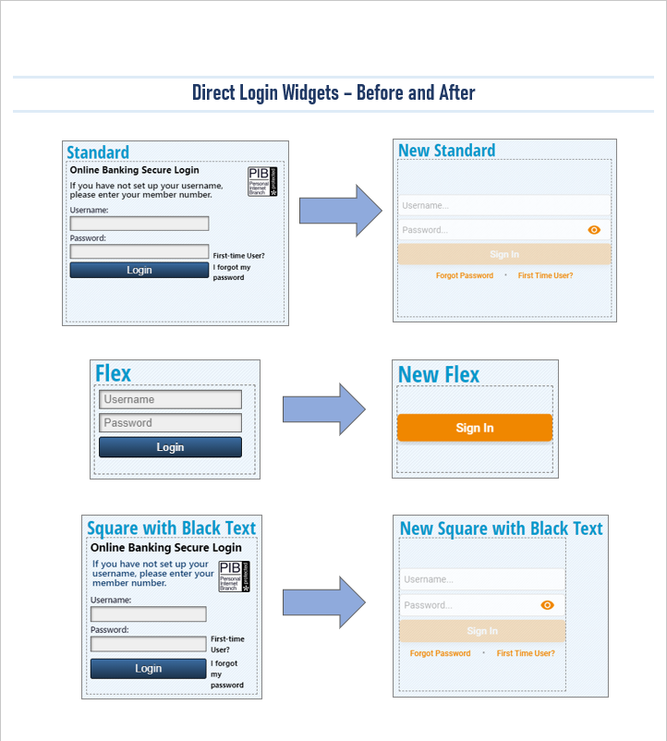
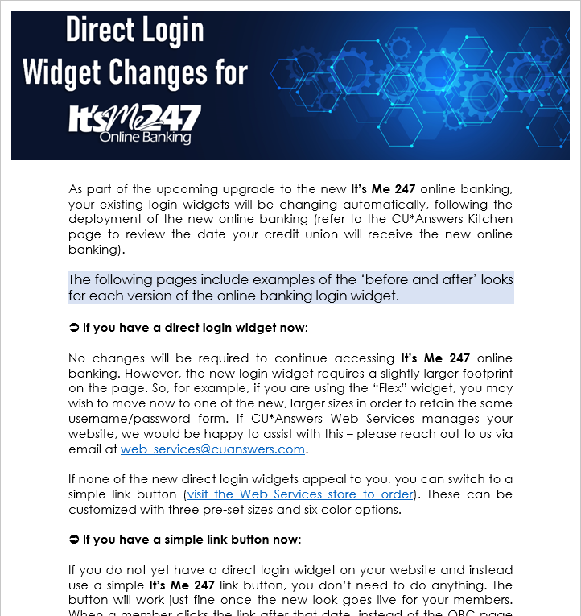
No more OBC
  New login page can be customized
Your website login widget might need to be changed
  They’ll all work when you go live to members, but you might want a different look to fit your website design
Watch your email for this, coming soon!
open.cuanswers.com/NewLook2021

Slide 48
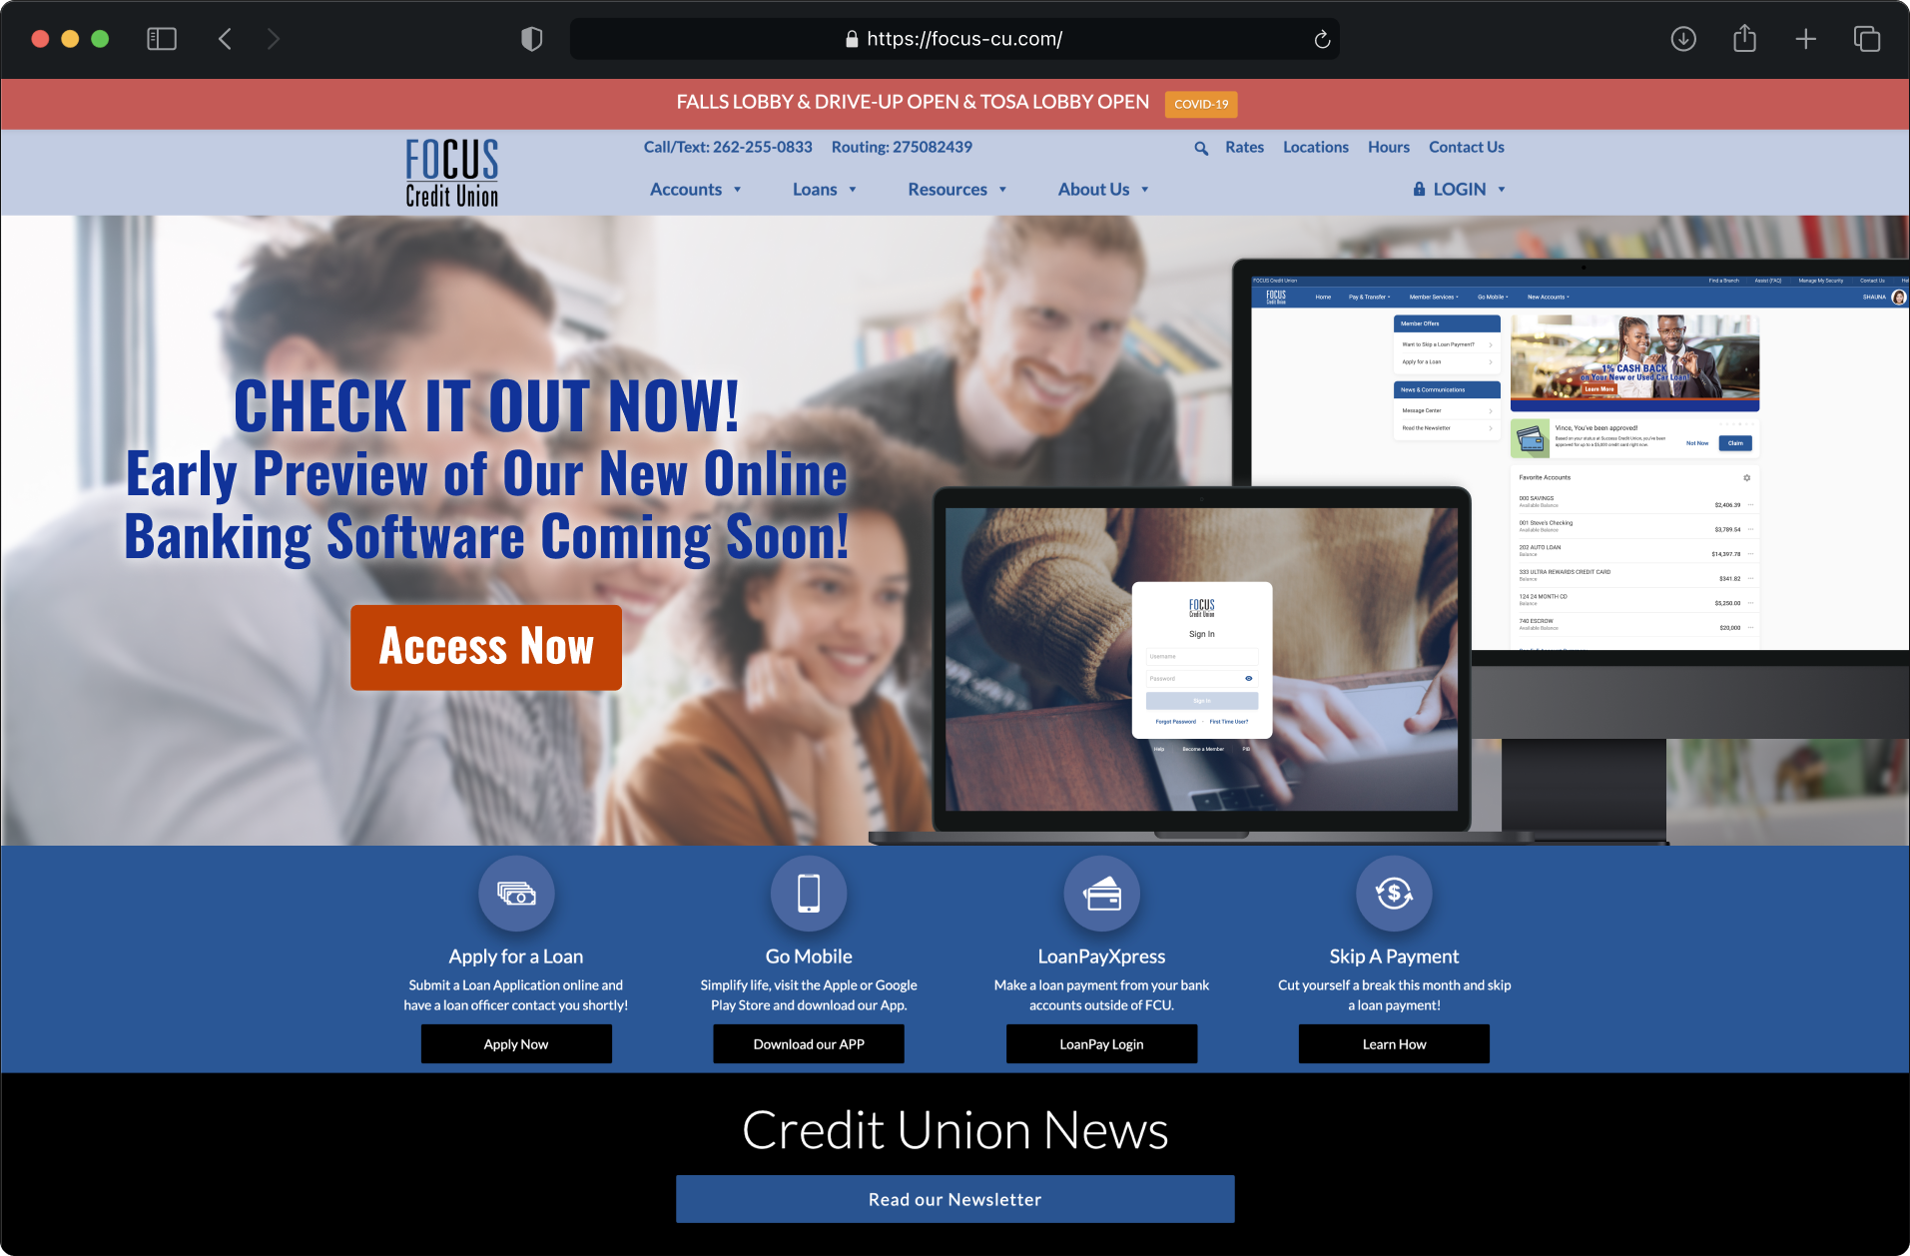
How’s the beta-test going?
Beta CUs in staff testing: 14
  # of connections: 300,000
“Jump” is coming June 22
  Pre-release “try it now” lets beta members use the new or the old until then
New CUs converting now will go directly to the new look
Notes:
Sample from FOCUS is so we can start the beta with members by June 11, before Jump is available on June 22

Slide 49



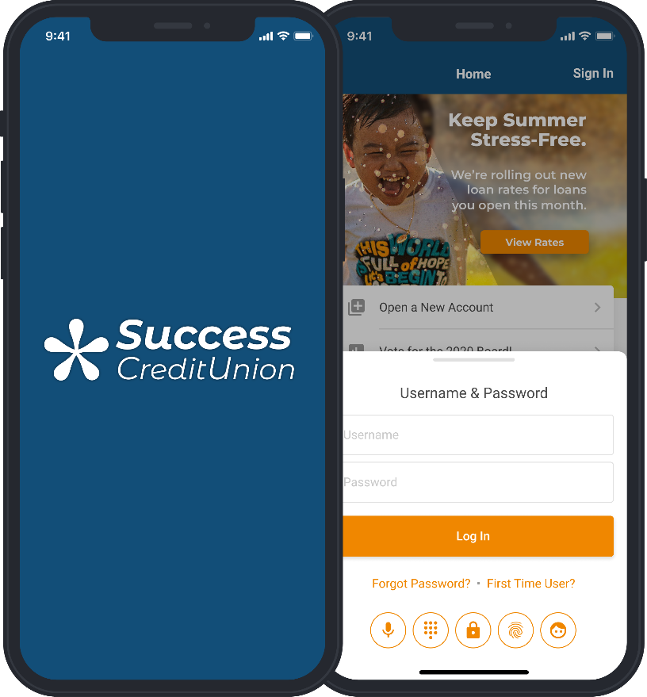
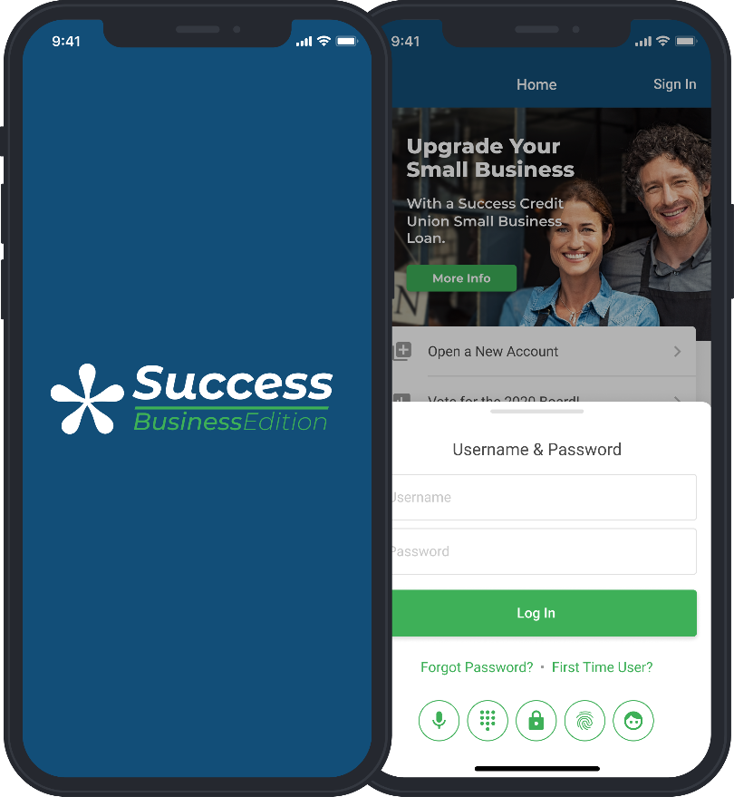
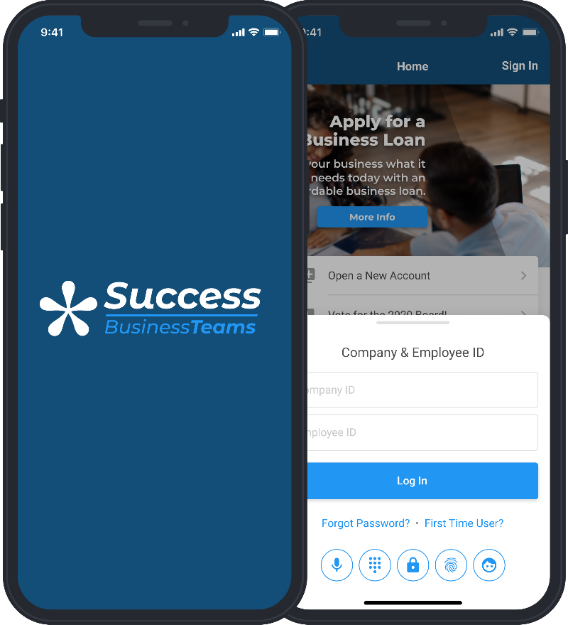
The vision of modules launched a new capability for delineating internet audiences
Look-and-feel designs that fit addressable audiences
Notes:
These will be 3 separate apps in the app stores
In desktop/mobile web banking, will be 2 URLs

Slide 50


Which kind of credit union are you?
FLUID
CLEAR SEPARATION
Single tool with two brands
These two brands are the left and right hands of a CU that wants to address traditional members, as well as businesses that act like traditional members
Two separate tools
When presented this way, these two brands are the left and right hands of a CU subsidiary that focuses only on business members
  Sole proprietors and LLCs who act like traditional members
  Larger organizations and their employees who all need to interact with the software

Slide 51

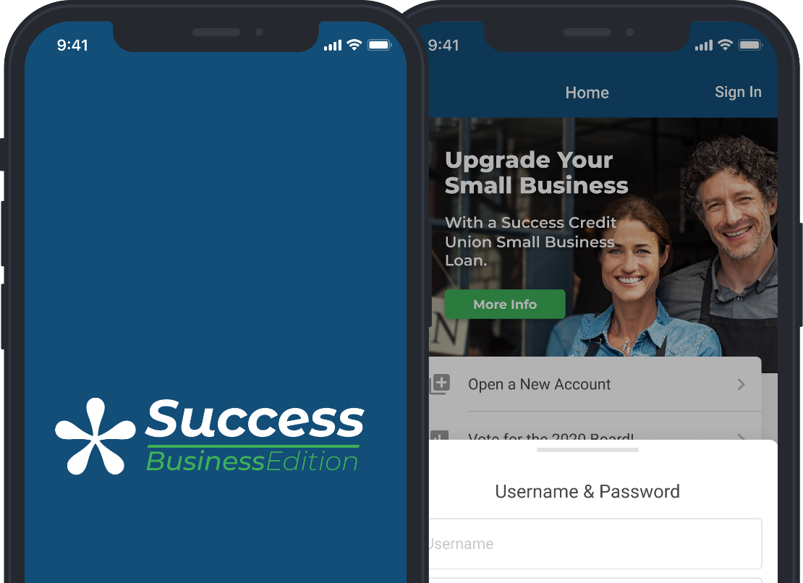
Launching later this year!
Business banking that will launch 100+ business programs for CU*BASE credit unions
Engaging thousands of businesses hiding among our everyday members
Proven tactics (retail banking), labeled and presented as business banking for small and medium-sized businesses
A new calling card for CUs who want to address and evolve their relationship with this audience
A CU*Answers freemium on the way to premium business banking for all
The vision is to allow every CU*BASE credit union to launch a member business program in the next 3 years

Slide 52

It’s been a heck of a journey; let’s review
A multi-logon business product for a limited audience
  Maybe ??? CUs and ??? business members max
Last step will be to bring it up to speed with modules and master navigation controls
  More consistency between all three online banking solutions
  Coming later this year!
2014 Launched It’s My Biz 247 desktop
2018 Launched It’s My Biz 247 mobile
2021 Rebranded to BizLink 247
2021 Active at 20 CUs
Used by 1,652 members in May

Slide 53
As we add features, we’ll always have to consider the fork in the road
FLUID
CLEAR SEPARATION
Consumer to business “jump”
AutoBooks available for both
RDC available for both
Merchant Capture for MyBIZ
Consumer bill pay for both
One URL (itsme247.com)
Two mobile apps
BizLink 247 cannot jump
AutoBooks available for both
RDC and Merchant Capture for both
Bill pay? (even I have to check)
Two URLs (itsme247.com, bizlink247.com)
Two mobile apps

Slide 54

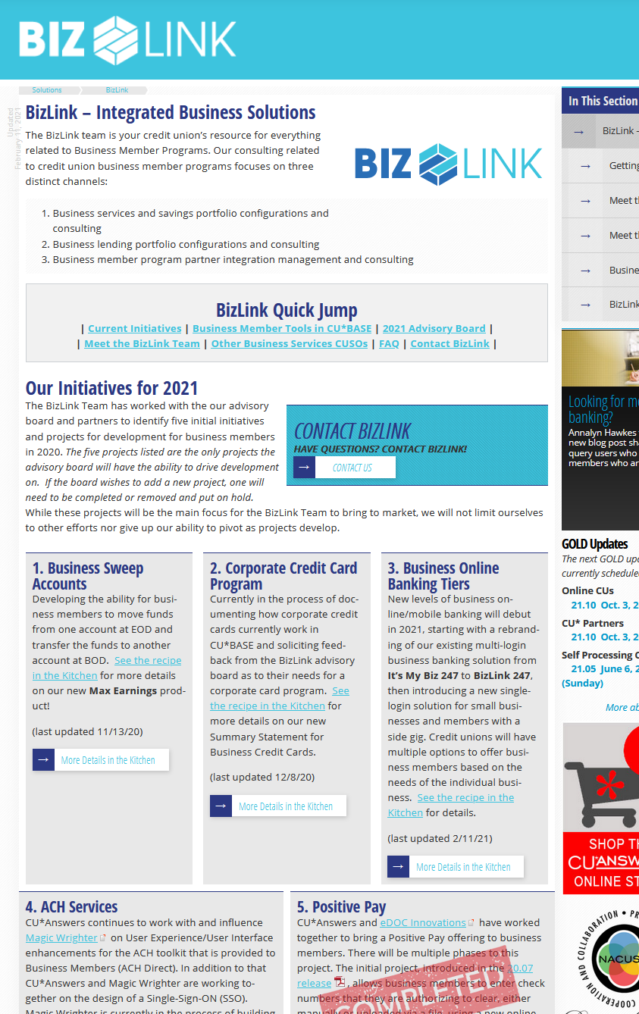
The BizLink Advisory Board is a partnership between some first-mover CUs and CU*Answers
These CUs are building brands for business members, almost to the point of standalone subsidiaries
CU*Answers wants to help every CU in our network to have product offerings for businesses as
part of their total menu of products
cuanswers.com/solutions/bizlink/
Notes:
The advisory group and emerging subsidiary, not the online banking brand

Slide 55
Our internet banking solutions are the gateway for business members to interact with the credit union
The products that BizLink are designing are the features for internet and CU*BASE business member services
The future will have a greater focus on developing and supporting
the roadmaps for CUs who wish
to start new business initiatives
cuanswers.com/solutions/bizlink/

Slide 56
Two pools of investment capital for the future of business member programs
How our network uses advisory boards might be key to the success of our inventions
The BizLink Advisory Board’s Focus | CU*Answers’ Focus as to Business Member Solutions
Solutions needed by CUs who have developed business member initiatives, and who consider themselves on the path to sophisticated strategies for the business member | Create the inspiration and the gateway products for CUs who wish to someday have a developed business member initiative, or who simply want to define a brand to identify with their members who happen to have businesses
2021: 5% of today’s network 2022: 20% of the network | 2021: 20% of today’s network 2022: 80% of the network
Working on 5 tactical solutions at a time | Working on developing an audience for the future
Example: Develop an integration with Jack Henry’s business member ACH origination solution | Example: Develop a partnership with Magic-Wrighter’s suite as the gateway for business member ACH origination

Slide 57
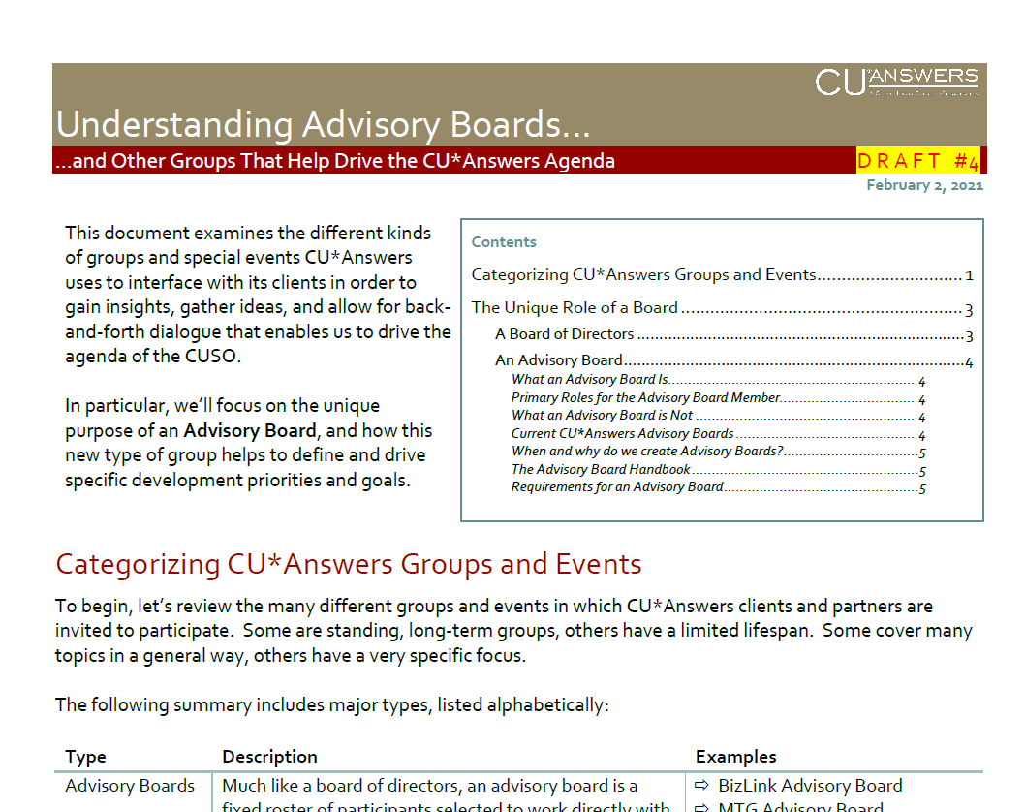
Imagine this for the future...
Board
Board Committee
Board Committee
Board Committee
Client Board Committee
Client Board Committee
Client Board Committee
Client Board Committee
Board Committee
Client Board Committee
A project for us all in 2022

Slide 58
Xpress Teller
“It’s a different cat altogether...Xpress Teller is more than just a new tool; it represents a whole new strategy for your front line.”
A second teller platform for CU*BASE
new search engine
Vertical receipts

Slide 59

Xpress Teller
An alternative future, not the only future
A new foundation for a decade of innovation and evolution
The shakedown cruise has only just begun
  Our 4 beta CUs accessed the tool 1,420 times during May
  34 CUs at least tried it during the first couple days of June (19 CU*A, 15 S-4)
  A GOLD update on June 6 tweaked a few things based on early feedback
Earnings Edge has done 15 engagements so far with CUs, helping them dig deeper and develop their strategies
Let’s take a look...
This is the first of several Xpress Teller how-to videos we are planning...stay tuned to ondemand.cuanswers.com for more!

Slide 60
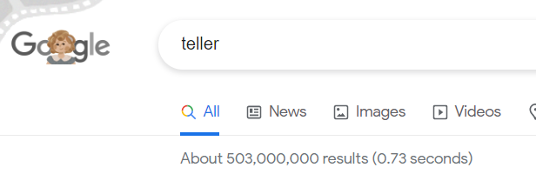

Feedback so far on Xpress Teller and the new search engine in XT and Inquiry
As predicted, “make it more like regular teller” tops the list!
Xpress Teller
The New Search Engine
Where’s the transfer proc code?
How do I get to Cross Sales and Trackers and Wrap-up Codes?
How do I get to Phone Op?
Where’s transaction history?
It doesn’t ask for name ID?
Where’s balance forward?
Why only 20 checks at a time?
Everyone loves the phone number, email, and driver’s license searches
Everyone hates the name searches
  Yep, we’re making tweaks to improve how these work!
(This is what everyone thought they wanted)

Slide 61

What’s next for
Xpress Teller?
Working together to build something new
Printing checks/money orders to remote printers for new tellerless branch strategies
Transaction limits by teller
Different privacy controls and ID verification tools for shared branch members
New receipt printing options and controls
Other new functionality that’s unique to Xpress Teller
open.cuanswers.com/XpressTeller

Slide 62


Don’t mistake our intentions
We’re excited to be off to the races, but we’re on two different racetracks
CU*BASE Teller Line Posting
CU*BASE Xpress Teller
Current focus group for our
soup-to-nuts teller
We’re listening to this group
about this solution
But we’re not listening to one group about the other solution
New focus group of dreamers and a growing list of converts
We’re listening to this group about this one
Notes:
Every good idea sends us down a rabbit hole

Slide 63


Speaking of wish list items...
Coming this fall in Xpress teller: CLEAN UP PHOTO IMAGES IN YOUR VAULT
We’re adding a new “Edit” tool to Xpress Teller
Zoom, rotate, or crop photo ID images so they’ll look their best on the Xpress Teller ID Verification screen
  Changes are saved as a separate image in the vault
Brought to you by:
Notes:
This will be a “unique to Xpress Teller” feature at launch
Will incorporate it other places later on, when we get around to putting IDs on GOLD screens elsewhere

Slide 64

What’s next for the new search engine?
Working together to build something new
Improved name searches and advanced search controls
New workflow controls for configuring search settings
Adding the engine to other places in CU*BASE as the new global search
Search in more places?
(VIN#? Street address? Closed accounts?)
open.cuanswers.com/NewSearch2021
Notes:
Search was added to Member Inquiry, not just Xpress Teller, so it would get a good shakedown

Slide 65

Vertical Receipts
Born from Xpress teller designs, but used across all of CU*BASE
7 CUs are active now
66 CUs currently in the pipeline
  Will convert in the next 90-120 days
What’s next?
  More controls for what prints in the account balance summary
  Native eReceipts with receipt review and signature right on the GOLD screen
store.cuanswers.com/product/vertical-receipts/

Slide 66

Speaking of what’s next...
Building a native engine for receipts...on the way to many end points
Give the programming team an inch and they’ll take a mile...
Every great idea for Xpress Teller leads to conversations about what else we could do
Not only in soup-to-nuts teller, but in almost every other member contact channel, such as a mobile app
And here I thought receipts were a dying idea...until the other day when a CU*BASE receipt printed on an NCR ITM
Notes:
Sets the foundation for ITMs
Sets the foundation for tablet tellering
Sets the foundation for sending receipts to members via phones and online banking

Slide 67

Speaking of what’s next...
Building a native engine for receipts...on the way to many end points
Reaching into eDOC vaults to deliver receipt images to CU*BASE GOLD, ITMs, It’s Me 247, and your member’s mobile phone
Converting eDOC from a third-party fixed vision to one where a collaborative piece of software, owned by the network, can innovate anywhere in the network
Beta-testing by fall 2022, full-out launch spring 2023

Slide 68
It takes time to get around to what we really want to do
When it comes to lending, Where will CU*BASE focus in the next couple of years?

Slide 69
Mapping Lender*VP’s concerns
For the past 3 years, we have been looking for an opening to change it all
Third-party LOS
Across the desk
Via the internet
Exposing more decision models
Deepening integrations
Keeping up with the Joneses
Native LOS
Across the desk
Via the internet
Evolving CLR Path
Competing with 3rd party LOS solutions
Redefining lending
Servicing Loans
Evolving a product set
Exposing new services to the internet
Automating member-initiated fulfillment
Redefining lending

Slide 70


Mapping Lender*VP’s concerns
For the past 3 years, we have been looking for an opening to change it all
Third-party LOS
Across the desk
Via the internet
Exposing more decision models
Deepening integrations
Keeping up with the Joneses
store.cuanswers.com/store/lendervp

Slide 71
Lender*VP has built a factory to include 3rd-party players
153 CUs -- roughly 50% of all CU*BASE clients -- are working with these CU*Answers solutions
3 Misc Coverage
integration partners
12 Ready2Look integration partners
Retailer Direct
  6 CUs / 371 apps FYTD
TCI
  7 CUs / 9,061 apps FYTD
Dealertrack
  27 CUs / 11,617 apps FYTD
RouteOne
  32 CUs / 32,587 apps FYTD
(GAP/warranty)
Frost
  2 CUs / 879 quotes FYTD
CUNA Protection Advisor
  20 CUs / 1,725 quotes FYTD
Allied (iQQ)
  15 CUs / 1,854 quotes FYTD
CUDC
  2 CUs / 371 apps FYTD
LSI
  1 CU / 442 apps FYTD
Allegro
  4 CUs / 2,256 apps FYTD
Fannie 3.2 DU Import
  20 CUs / 1,367 apps FYTD
  (AMX, Calyx Pointe, Mortgage Bot, Mortgage Computer, Encompass)

Slide 72



Lender*VP has built a factory to include 3rd-party players
Our deepest los integrations
Live with Sync1: 7
  FYTD applications: 5,431
  CUs in development: 5
Live with MeridianLink: 4
  FYTD applications: 4,764
  CUs in development: 0
Live with Lending 360: 4
  FYTD applications: 9,456
  CUs in development: 0
Live with CUDL (indirect-only): 3
  FYTD applications: 1,352
  CUs in development: 2

Slide 73
Lender*VP has built a factory to include 3rd-party players
Our deepest los integrations
Live with Sync1: 7
  FYTD applications: 5,431
  CUs in development: 5
Live with MeridianLink: 4
  FYTD applications: 4,764
  CUs in development: 0
Live with Lending 360: 4
  FYTD applications: 9,456
  CUs in development: 0
Live with CUDL (indirect-only): 3
  FYTD applications: 1,352
  CUs in development: 2
Live with Sync1: 7
  FYTD applications: 5,431
  CUs in development: 5
Becoming our primary credit bureau partner
Championing new loan disbursement integration

Slide 74


Lender*VP has built a factory to include 3rd-party players
103 CUs using one or both of our decision models
Live with the FUEL
decision model: 8
  # of pulls March-April 2021: 1,207
  CUs in development: 12
  CUs in sales/demo process: 5+
Live with 247 Lender decision model: 39
  Getting ready to move to
  FUEL: 5
  Live as of Jan. 1: 56
17 CUs
have migrated to Sync1 and FUEL since January!
Live with Sync1 credit report pulls: 20
  # of pulls March-April 2021: 1,889

Slide 75






Mapping Lender*VP’s concerns
For the past 3 years, we have been looking for an opening to change it all
Native LOS
Across the desk
Via the internet
Evolving CLR Path
Competing with 3rd party LOS solutions
Redefining lending
store.cuanswers.com/store/lendervp

Slide 76
Mapping Lender*VP’s concerns
For the next 2 years we’ll prioritize these things (and we mean it!)
Native LOS
Across the desk
Via the internet
Evolving CLR Path
Competing with 3rd party LOS solutions
Redefining lending
❺ Invest in what happens after the LOS that sets us apart
❸ A deep and intense focus on the internet-engaged member
❹ Focus CUs on separating themselves from their competitors
❶ Invest and develop things that only our LOS can do
❷ A deep and intense focus on the internet-engaged member
Notes:
We might be tone deaf to other requests

Slide 77
Where should Lender*VP focus, and when?
Non-members
Internet-enabled members
Non-
internet-enabled members
ONE-WAY FORMS
SMART APPLICATIONS
ENABLE
Forms generation/fulfillment
Websites, mobile, desktop
For the least trusted borrower
Build the ultimate mobile first solution for internet retailers and their most trusted channels
For the most seasoned internet member relationships
SMART APPLICATIONS
Add an enhanced process for the new member
For the newest internet users

Slide 78
Where should Lender*VP focus, and when?
Non-members
Internet-enabled members
Non-
internet-enabled members
ONE-WAY FORMS
SMART APPLICATIONS
ENABLE
2020/21
2022
2023
Forms generation/fulfillment
Websites, mobile, desktop
For the least trusted borrower
Build the ultimate mobile first solution for internet retailers and their most trusted channels
For the most seasoned internet member relationships
SMART APPLICATIONS
Add an enhanced process for the new member
For the newest internet users

Slide 79



Secure online forms for your least trusted borrowers: non-members
Non-members
158 active CUs
150 via IRSC designers / 8 DYI-ers
1,000+ custom forms in play
113,000+ forms submitted
store.cuanswers.com/store/irsc

Slide 80


For your most seasoned internet member relationships
Internet-enabled members
A focus on serving authenticated members
Reducing the clutter in the loan queue
  Automatic “store and return” for incomplete apps
  Urgency prompt
Quoting insurance coverage up front
Smarter handling for secured vs.
unsecured apps
New payment estimator, pulling
from your core config
open.cuanswers.com/LOSProjects

Slide 81

Database Lending
What might we create that would set our processes apart?
We don’t want to keep up with the Joneses, we want to play a whole new game
Redefining Lending

Slide 82
Building an internet retailer’s loan department
We need to prove the point now so CU designers will add another cylinder
Taking Orders | Making Offers
Inspiring people to apply | Inspiring people to take the loan
Higher cost-of-sales investment | Potentially zero cost-of-sales investment
Members are apprehensive about being approved | Members are more confident that all will go well
In-the-moment underwriting | Campaign-based underwriting
Relies on a proactive member: higher barrier to entry | Takes advantage of impulse-buying: lower barrier to entry
More likely to require CU employee participation | Requires only up-front CU employee participation
Will always be part of the CU’s lending approach | In a short time, should surpass the volumes of order-taking lending

Slide 83
Dream with me a bit...
(a marketer’s math that might make your head swim)
    14 campaigns in a year
    400 members per campaign
  5,600 members offered a loan each week
  291,000 offers made to targeted members per year
  5,600 members being offered a loan
  4.5 average views per targeted member per week
  25,200 opportunities for a member to say yes per week
  1.3 million opportunities for a member to say yes per year
If you only receive 1,000 applications a week, with one chance for you and the member to say yes, you only get 52,000 opportunities for it to work out

Slide 84


Building an internet retailer’s loan department
20.07 1Click Credit Card Offers
(Also launched Flex loans
& a new eSign experience)
Can we convince you to invest in a future where you make secured loans via database offers?
Should we modify loan apps to receive collateral verifications and remove the employee from the transaction altogether?
20.11 CD-secured Loan Offers
21.10 1Click Unsecured Offers (for signature loans & LOCs)
Coming soon!
Coming soon!
21.10 Savings-secured Loan Offers

Slide 85
Stop sharing member relationship data with the world
Every day, you compete with lenders who are more powerful, more successful financially, and able to reach more consumers than you can dream of
You think you have the secret sauce for success
In reality, everybody uses the same secret sauce to say yes or no
Redefining Lending
To give yourself a lending edge, can you rely on what you, and only you, know about your members?

Slide 86


CLR Path Decision Advisor
Underwriting decisions based on what you already know about your members
Introduced in the 20.11 release
Active CUs: 28
  19 CU*Answers, 9 Site-4
Templates configured: 48
  Most CUs have just one or two
CLR Path scores pulled: 16,381
We’ll be adding CLR Path to:
  Teller tools
  Phone Operator
  New Membership Workflow

Slide 87
Initiatives That Should Be On Your Radar
Setting a target beyond your members might be exactly what your members need
Notes:
I need to generate money from more than just your members, so we can use the profits for your CUs
By extending our businesses outside of our CU*BASE communities, we’ll have an opportunity to fund our CU*BASE priorities and keep your costs down

Slide 88

“It is said that to be a great leader, you need to know how to follow.
“Thank goodness I have so many great leaders to follow.”

Slide 89

What’s up with ?
Highlights from the past year
Sales never slowed, and we never missed a day of log management
  112 daily log management clients
  25 abnormal activity monitoring clients
Released Vendor Monitor site and new Contract Management site
  85 vendor management clients
Announced AuditLink Lite for FREE
  30+ takers so far
store.cuanswers.com/store/auditlink/

Slide 90


What’s up with ?
Highlights from the past year
New alliances with Lillie and Vizo
Launched new monthly fraud group
(50+ clients)
Published advice on dealing with brute force attack; held 3 companion webinars
NASCUS speaking engagement
6th annual Conversations on
Compliance
Published a new Employee
Security Audit resource
Check out our channel on ondemand.cuanswers.com

Slide 91

Racing towards the golden ring of
Stop-Go-No for fraud management
Abnormal Activity Monitoring transaction patterns in the 21.05 release
AuditLink created the default configurations for all CUs
  10 velocity, 10 out-of-the-ordinary, and
  10 idle activity patterns
AuditLink reviewed activity for the 21.05 beta CUs
  To build a validation and governance model
  To give confidence to third party examiners and commentators
We’re now compiling time
studies on the work done for
the betas, getting ready to
roll out a new service...
Daily Abnormal
Activity Pattern Monitoring
brought to you by

Slide 92
Activity Pattern Monitoring Services from
Compromised Cards
Money Laundering
P2P Hack
RDC Fraud
Human Trafficking
Unemployment Fraud
Elder Abuse
ATM Fraud
PPP Fraud
Account Takeover
Compromised ACH
Online Banking Hack
Check Kiting
store.cuanswers.com/store/auditlink/

Slide 93


Slide 94
When a credit union asks,
“Can your tools do this?” that starts a conversation
“Could you tweak it to do it a little better?”
  ...and we make money as a tool manufacturer
“How could we share the work needed to use the tool?”
  ...and we make money as a service provider
“How could we share the tool and the work with even more CUs?”
  ...and we struggle to go beyond our CU*BASE communities

Slide 95

“It is said that to be a great leader, you need to know how to follow.
“Thank goodness I have so many great leaders to follow.”

Slide 96

Asterisk Intelligence: Engineered for a big future...even a spin-off
A partnership between AI and everything CU*BASE
A partnership between AI, Xtend, and our CU marketing teams to campaign for more opportunity
A partnership between AI and our overall sales effort to expand to larger markets
A partnership between AI and CU boards/management teams driving for financial success
A partnership between AI and AuditLink
Notes:
Unlike AuditLink, I was all about this
From the very start we decided that CU data competency would create a long-term competitive advantage for our network and beyond
Give general overview of its evolution, the pillars, where we have to go yet

Slide 97



cuanswers.com/solutions/asterisk-intelligence/
store.cuanswers.com/asterisk-intelligence/

Slide 98


2022 will be a big year for AI
New team investments and outreach to CU*Answers & cuasterisk.com markets
Become a major vendor for every credit union board team
Proof-of-concept for serving non-CU*BASE credit unions
Identify & train new data analyst positions for CUs and other CUSOs

Slide 99




Prove It: Inspire analysts everywhere
We had a goal to send 1,000 teaser emails a year – I think we exceeded our goal
And if you didn’t get the original, I’m sure I sent you a copy one day later

Slide 100



Proving to analysts they can work anywhere, no matter their role in the CU
21.06 release coming June 27
New look and feel
Updates to trendline navigation
% change at a glance
Enhancements to the Static Pool Analysis dashboard
Find this on our Release Summaries page

Slide 101





Data warehouses: inspiring mini-storage buyers everywhere
What if CU*BASE data is not enough to change your world?
cuanswers.com/solutions/asterisk-intelligence

Slide 102

Data warehouses: inspiring mini-storage buyers everywhere
We’ll build a business with you for shared and independent data warehouse solutions
Services for 3rd-party data you choose for your warehouse
New CU*Answers-architected data that you choose to use in your warehouse
New data warehouse software solution: AI Engaged
New AI Engaged Ops team to move data, from wherever you find it into the data warehouse,
on a train schedule
Eventually, we will select a 3rd-party data warehouse tool approach for those who
want to go it alone
Once we prove CU*BASE CUs have mastered this, we’ll go outside our network so other networks can use AI data warehouses

Slide 103

AI Engaged: a new development sandbox with a live audience
More than a laboratory, AI Engaged will be the foundation for some very big investments our network is facing in coming years
2022: Introduce a new Query solution
2022: Test the viability of data encrypted at rest
2022-23: Preview new presentation layer options
2023-beyond: Template our talents to deliver additional software copyrights and toolsets beyond CU*BASE
How do you risk it all to prove where you’re going, without risking it all?
Design a customer-owner factory where we can all manufacture the future

Slide 104


Optics will put our data warehouse initiative on the map
2022 will be the year we prove our Optics toolkits are more than just a flashy FYI
The anchor store of our data warehouse mall: Optics
  Online Banking Optics
  Phone Optics
  Card Activity Optics
Unique to AI Engaged
An acquired taste for CU business plans
Designed to make our data warehouse offerings a key resource for every CU looking for unique insight

Slide 105


A growing partnership
2022 will be the year we prove our Optics toolkits are more than just a flashy FYI
Of the 3 Optics solutions, Card Activity Optics is uniquely engineered to be more than just AI
We’re engineering the data to be the foundation for dozens of CU*BASE programs
  SettleMINT drives the activity for AI insight inside of CU*BASE
  AI drives the data insight from our data warehouses
Notes:
ISOFILES - a huge initiative for our collective network - the drive to be experts in CU disciplines
Add a database to CU*BASE to upgrade our network’s insight to earn from EFT data that was ONCE beyond our clients’ reach

Slide 106

A busy team in 2022
ISO data will be the inspiration for new activities and outreach to members
New data in debit/credit card transaction records (coming this summer)
  Merchant category code (MCC)
  Card present indicator
  Last 4 digits of card #
  ISO sequence #
  Pinless PIN indicator
  Smart ATM cash-only deposit indicator
  Recurring card trans indicator
Card # randomization (coming 21.10)
Card Activity Optics
  New ISOCUDTA table in each CU’s file library
  Configurable MCC Groups
  Last 4 digits of card # in the transaction record
Summary statement for business credit cards
New Instant Card Issue (ICI) integrations
8-digit BIN mandate
“APBATCH4” nightly batch maintenance changes
  To enhance debit card fraud offerings from CO-OP
  Rollout begins Jan. 2022

Slide 107
Projects in the works to leverage ISO data
Description | Target | Proj#
Create new ISOCUDTA table in FILExx libraries, compiling data from ISO files | DONE (Oct 2020) | 53312
Expand TRANSx/HTRANSx for new EFT data from the ISO files | DONE (21.05) | 53033
Merchant Category Code (MCC) Group Configuration | 21.10 | 52070
Populate new fields in TRANSx in all EFT posting programs | July-Aug 2021 | 53260
Mobile App Card Controls Enhancement: Filter Transactions by Card # | Mobile 6 (Spring 2022) | 56236
Analysis Dashboard: Transaction Activity by MCC Group | 21.12 or 22.05 | 55272
Debit Card Activity Rebates by MCC Group | To be assigned | 55258
Credit Card Cash Back rewards by MCC Group | To be assigned | 55259
Credit Card Promotional Interest Rates by MCC Group | To be assigned | 55260
Display last 4 digits of card # and MCC Group on member statements | To be assigned | 56539
Display last 4 digits of card # and MCC Group in It’s Me 247 account details | Spec in process | TBD

Slide 108


An award-winning partnership

Slide 109




The Tearsheet award means we’re on the right track for our future with payment strategies...
DATA is the key
Notes:
The catalyst behind selecting Payveris for our bill pay future was DATA
We wanted to own the data and all its potential for CU futures
We knew it would be based on how SettleMINT could help CUs execute with bill pay, and how AI could drive CU hunger to do more with payments through data analysis
Recently we completed all of this for iPay as well
The Tearsheet award means we’re on the right track for our future with payment strategies – DATA is the key

Slide 110

Why does a CU leave a long-time core processor relationship?
They might justify it by $$, or complaints about specific tools or features, but what are the emotional reasons?
  They are out of touch with why things were set up the way they are
  Not everyone on the team is on the same page with how tools are being used
  They’re bored!
Whatever else it might be, a conversion
is an exciting project that shakes things
up and gets people moving in the same direction
CU*BASE has 230+ separate config tools, and that’s just the ones you can see
Add to that 70+ OPER configs, and that’s 300 opportunities for your next big thing!

Slide 111

Introducing Conversion2
Another growing partnership
The task with Conversion2 is to analyze how your data (AI) could be configured (Conversions) for a new future, without having to change
core data processing vendors
  I believe we’ve picked the right two
  teams and leaders to get this started
We’ll commit a budget to field
a new set of teammates to execute with CUs
We’ll commit to evolving this new process over the next 2-3 years as one that drives a competitive advantage for our CUs and our CUSOs

Slide 112

Shareholders: You know we’ve been changing our response to a consolidating CU industry for years. Remember these slides for tonight’s conversations

Slide 113
When a credit union asks,
“Can your tools do this?” that starts a conversation
“Could you tweak it to do it a little better?”
  ...and we make money as a tool manufacturer
“How could we share the work needed to use the tool?”
  ...and we make money as a service provider
“How could we share the tool and the work with even more CUs?”
  ...and we struggle to go beyond our CU*BASE communities

Slide 114



“Brands that were behind the curtain are now moving to the front of the stage.”

Slide 115


Nothing can force you to evaluate what you must do like a pandemic
When everyone goes home, who keeps the lights on and fulfills your contractual responsibilities?

Slide 116

2022: Updating your pandemic contingency plan
You might not be ready, but we see this as a new economic pressure on CUs and CUSOs alike
Are you anticipating an NCUA guideline on documenting your new policy?
  What experts will you count on to help you?
How will you deal with parsing “essential” and “optional” activities?
  Do you know who and what is contracted, even in extreme conditions?
  How will you document your plan for responding to the unexpected?
Is there a business here for us?
In the minds of many, pandemics are no longer low-probability events, but inevitable ones

Slide 117



Consistency you can count on
March 2020 through May 2021
3 CU*Answers HA rollovers
3 Site-4 HA rollovers
Stimulus payments (It’s Me 247, CU*Talk, ACH processing, etc.)
2020 tax processing deadline extensions
Third-party vendor integrations (16 direct connections and dozens indirect)
4 software releases
What would you list as the most important contractual warranties when it comes to CU*Answers?

Slide 118


Consistency you can count on

Slide 119

Connections you can count on
Everyone wants a piece of what used to be exchanging cash
  “Pay your babysitter with your phone!”
But millions of times a day, people get paid
  Their paycheck, their Social Security or pension benefits, etc.
How do you stay connected, and who is driving the volume?
Fintechs focus on personal payments, but who does the heavy lifting to support your members’ lifeline to a networked world?

Slide 120

Cybersecurity
(another word for “more expenses ahead”)
June 2020-June 2021
Phishing
  1-2 phishing attacks/week
  Warning email to staff about every
  2 weeks
Security Events
  Microsoft Exchange (107 hours)
  Unix/Linux SUDO
  SonicWall SMA and Net Extender
  F5 (two vulnerabilities in 2020)
  Apple Safari Caching (affected
  programming, not CNS)
  Orion SolarWinds (did not affect CU*Answers)
Source: X-Force Red
Tech in the weeds is now becoming a major conversation in the boardroom

Slide 121



Are we built for consistency when it comes to managing cybersecurity?
How do we reduce the cost related to the fear of cyber-risk?
In 2022, ACIO will lean in with CUs to respond to the growing pressure and expense of cybersecurity
  Awareness
  Preparedness
A cybersecurity alert costs our network 400 hours
  From research, to knowing whether to set off the alarms, to understanding how to mitigate the attack

Slide 122
Wrapping Up the Day

Slide 123


Also in your packet...
27 articles
8 advertisers
23 authors from 10 organizations

Slide 124








Also in your packet...

Slide 125










Also in your packet...

Slide 126
Talk about experienced, energized, and engaged . . .
Let’s give our crew a hand!

Slide 127
Conclusion
For some of you, today was maybe too much of a one-man show
It’s my last show, and I promise you something different for next year
There’s a new party coming...
...let the world know what party favors you plan to bring

Slide 128
Thank you for the day!

