Slide 1
Welcome to the 2021 Annual Stockholders Meeting
June 16, 2021

Slide 2
Remember this from last year’s show?

Slide 3
Agenda
Call to Order
Review 2020 Minutes
Chairman’s Comments
2020: A Year for the Record Books
Update on the CEO Succession Project
2021 Election
CFO Report
A Look at the 2020 Numbers
A Great Year in Spite of the Asterisk
CEO Report
Awaken a Network: A New Commitment to Leverage Our Collective
Adjourn

Slide 4
2020: A Year for the Record Books
CHAIRMAN’S REPORT Scott McFarland, CU*Answers Board Chairperson

Slide 5
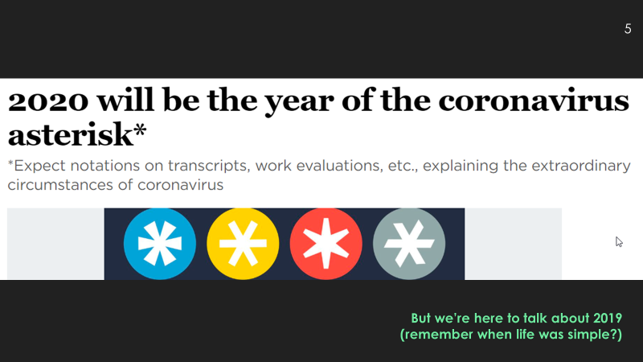
2020: A Year for the Record Books
To us, the asterisk is part of our brand
But when it comes to the impact of COVID on trendlines, I’m not sure we want to be associated with the pain and chaos
It’s likely 2021 will be another year of the asterisk
What can we do to impact the trendlines of our network for the next 10 years?
*
“The word asterisk comes from the Greek word ‘asteriskos’ meaning little star and is considered one of the oldest punctuation signs.” Source: fontsmith.com/blog
*Remember this from last year?

Slide 6
Welcome to 12 new CU*Answers owners in 8 states!
Chippewa County CU Sault Ste Marie, MI
Columbus United FCU Columbus, NE
Department of Labor FCU Merrifield, VA
Gabriels Community CU Lansing, MI
Great Lakes First FCU Escanaba, MI
Greenwood Municipal FCU Greenwood, SC
Limestone FCU Manistique, MI
Maui Teachers FCU Wailuku, HI
Meijer Credit Union Grand Rapids, MI
Mission City FCU Santa Clara, CA
Partnership Financial CU Morton Grove, IL
Rio Grande Valley CU Harlingen, TX
Member size range: 1,500 to 17,100 members Average size: 7,300 members

Slide 7
Our Community of Owners
197 Credit Union Owners in 36 States
57% of all Client CUs
1
7
2
1
68
2
2
4
1
11
1
3
1
4
1
5
13
5
9
14
1
4
3
1
1
1
✪
1
1
1
1
1
1
1
2
1
2
1
145
3
3
2
31
4
3
1
21
US Virgin Islands
Notes:
Who will take us to the future – our owners, current and future

Slide 8
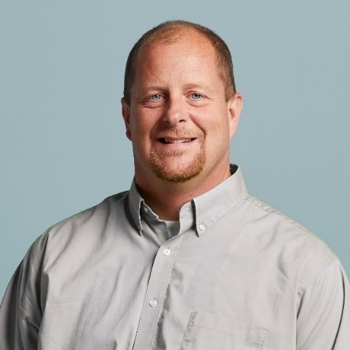
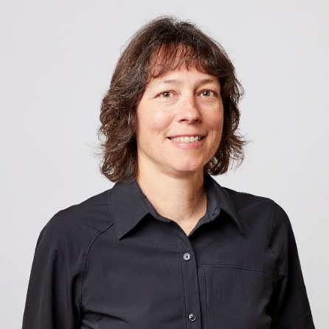
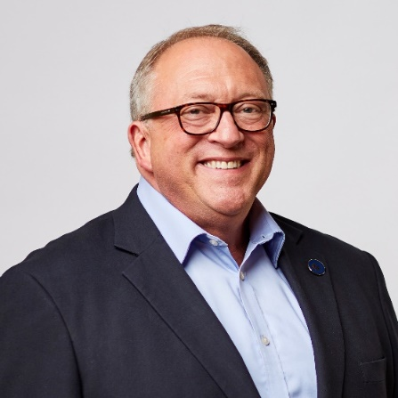
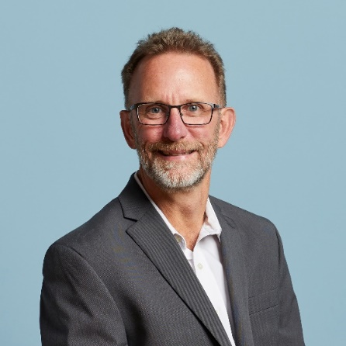
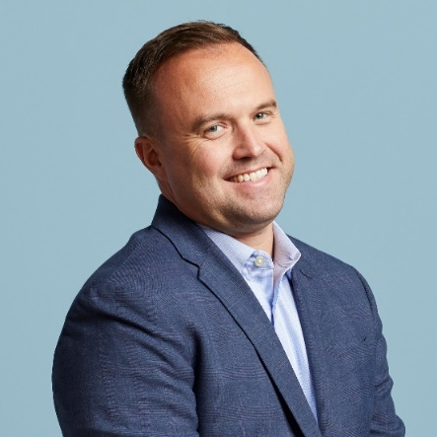
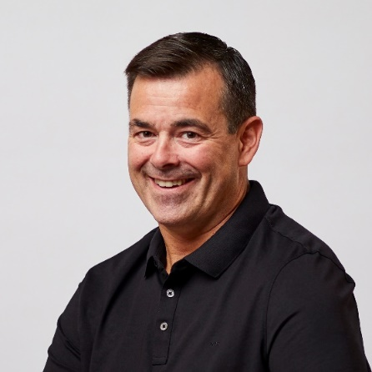
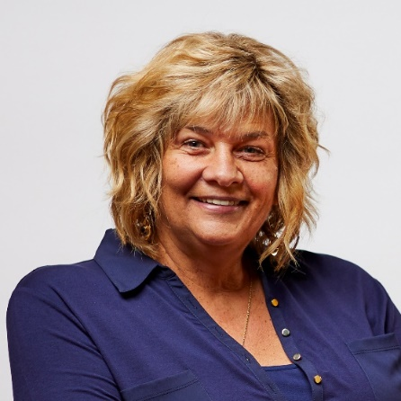
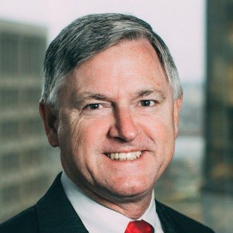
Your 2020-2021 Board of Directors
Scott McFarland, Chairman
CEO, Honor Credit Union
Board Member since Aug 2009
Linda Bodie, Director
CEO, Element Federal CU
Board Member since Oct 2013
Tom Gryp, Director
President/CEO, Notre Dame FCU
Board Member since Oct 2016
Jeff Jorgensen, Director
CEO, Sioux Empire Federal CU
Board Member since Dec 2009
ASSOCIATE BOARD MEMBERS
Bill Burke
CEO Day Air CU
Carolyn Mikesell CEO Public Service CU
Kris Lewis, Director
CEO, Allegan Community CU
Board Member since Oct 2018
Dean Wilson, Director
CEO, FOCUS Credit Union
Board Member since Jan 2008
Vickie Schmitzer, Sec’y/Treas.
CEO, Frankenmuth Credit Union
Board Member since Oct 2007
Thank you!
As always, I want to thank my fellow Board members for another great year, and for all their hard work

Slide 9
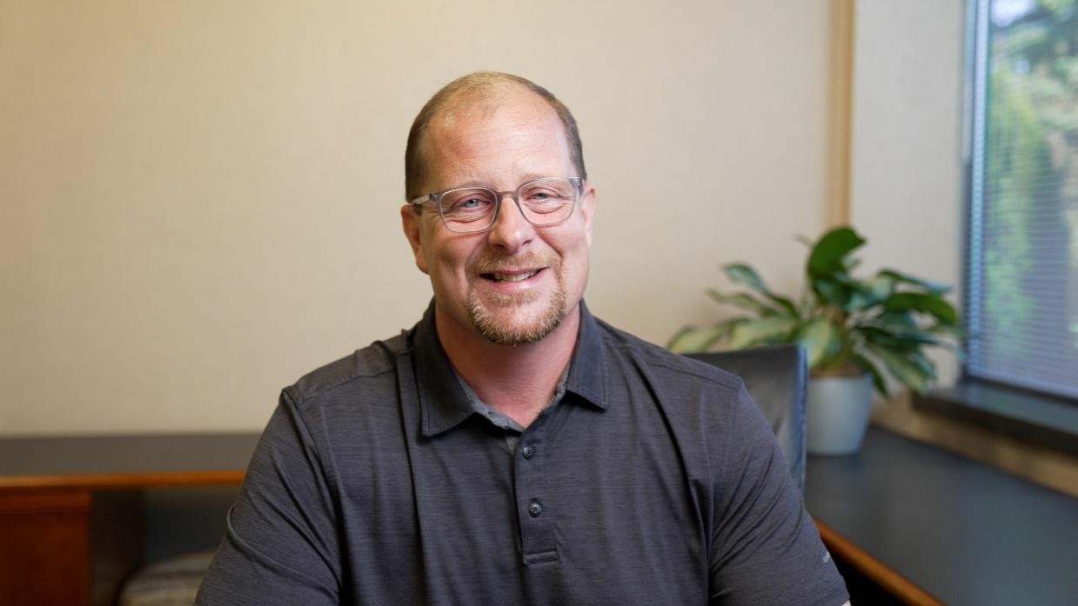
CEO Succession Project Update
A personal message from the Board about the ongoing process to find a successor for our retiring CEO
Scott McFarland
Chairman of the CU*Answers Board of Directors

Slide 10
2021 Board Elections
NOMINATING COMMITTEE Dean Wilson, Nominating Committee Chair

Slide 11
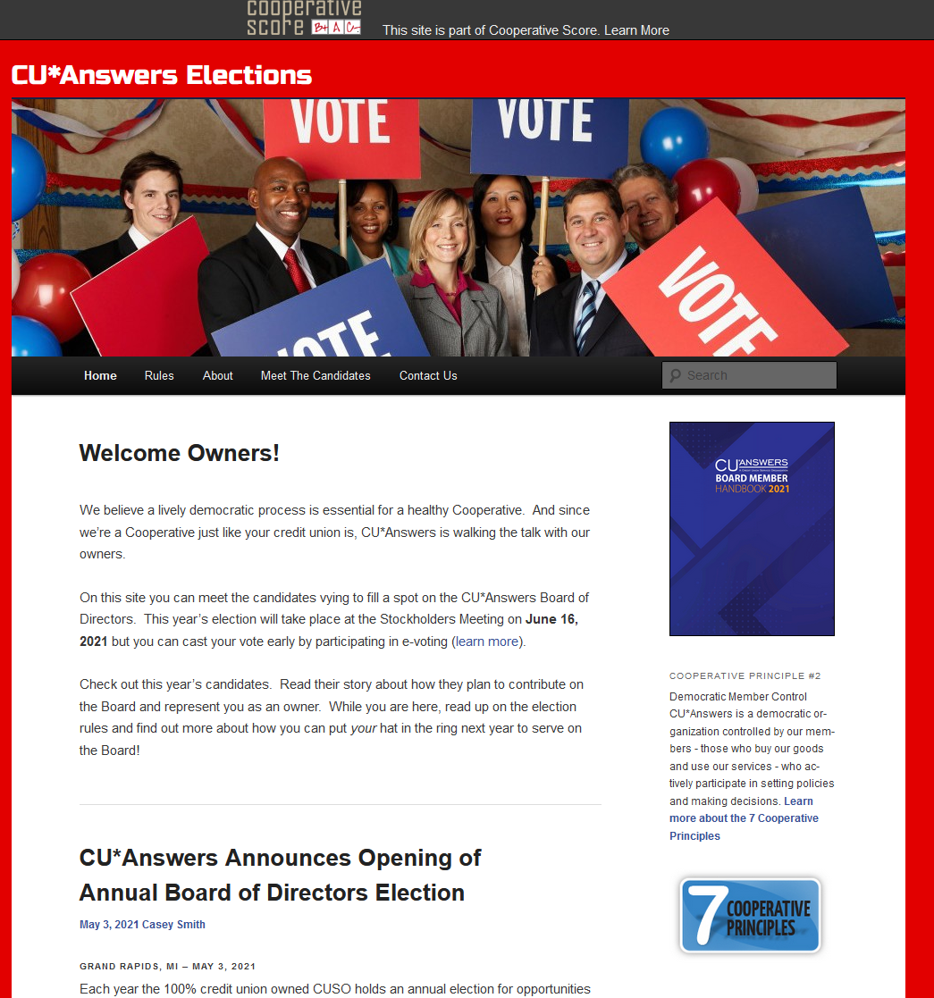
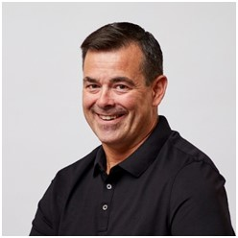
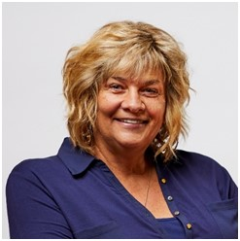
Your 2021 Nominating Committee
COMMITTEE CHAIR
Dean Wilson
Vickie Schmitzer

Slide 12
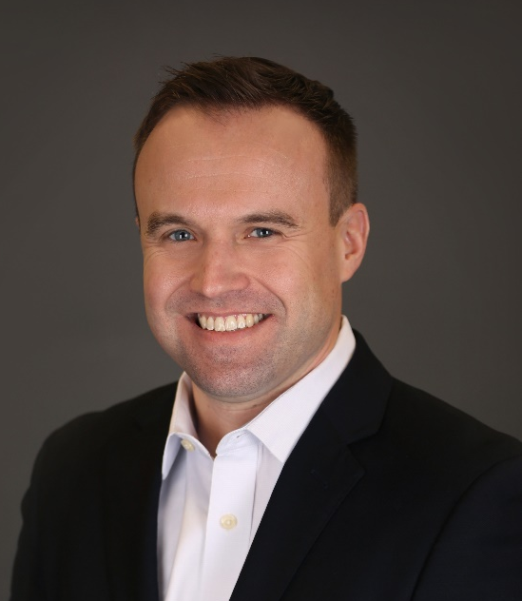
This year’s candidates
Thomas Gryp
CEO, Notre Dame FCU (Notre Dame, Indiana)
Incumbent
Kris Lewis
CEO, Allegan Credit Union (Allegan, Michigan)
Incumbent
Scott McFarland
CEO, Honor Credit Union (St. Joseph, Michigan)
Incumbent
Notes:
We have two great candidates with long resumes of service, not only to CU*Answers but to our CU industry. Ask if they want to address the group.

Slide 13
This year’s candidates
Let’s vote!
Or perhaps there’s a motion for a call for a unanimous resolution?
Thomas Gryp
CEO, Notre Dame FCU (Notre Dame, Indiana)
Incumbent
Kris Lewis
CEO, Allegan Credit Union (Allegan, Michigan)
Incumbent
Scott McFarland
CEO, Honor Credit Union (St. Joseph, Michigan)
Incumbent
Congrats to our winners!
Notes:
We have two great candidates with long resumes of service, not only to CU*Answers but to our CU industry. Ask if they want to address the group.

Slide 14
A Look at the 2020 Numbers A GREAT YEAR IN SPITE OF THE ASTERISK
CFO REPORT Bob Frizzle, CFO

Slide 15
We are built for challenging times
We won’t throw a party when we hit $50 million in assets, but we do rely on the equity you bestow on us, and count on the cash for rocky moments
Vested owners, win-win attitudes, and everyone playing the long game will sustain us long into the future
It’s easy these days for people to throw shade on our industry, on cooperatives, and on our viability as a vendor
But I would tell you that we are built for moments just like this

Slide 16
Net Income & Patronage Dividends What do shareholders get, and what are we putting away for our future?
$8.87M
$9.40M
$2.25M
$4.25M
$4.75M
$???

Slide 17
2020 Numbers Worth Celebrating
Detail | YE 2019 | YE 2020 | 2020-2019 % Change | 2019-2018 % Change | 2018-2017 % Change
Total Assets | $42,539K | $45,821K | 7.72% | 9.10% | 14.35%
Total Liabilities | $21,920K | $23,282K | 6.21% | 12.06% | 5.39%
Total Equity | $20,618K | $22,538K | 9.31% | 6.13% | 25.05%
Retained Earnings | $4,220K | $4,740K | 12.32% | 8.85% | 8.03%
Book Value of Class A Stock ($ per share) | $758.04 | $822.59 | 8.5% | 5.40% | 15.80%
Book Value of Ownership | $151,608 | $164,518 | 8.5% | 5.40% | 15.80%

Slide 18
Year-end 2020 Dividend Payments These numbers can flex, and I predict they will again in the future
Detail | YE 2019 | YE 2020 | 2020-2019 % Change | 2019-2018 % Change | 2018-2017 % Change
Patronage Dividend ($) | 2,250,000 | 2,250,000 | 0.0% | 12.5% | 14.3%
Bonus Patronage ($) | 3,750,000 | 4,750,000 | 26.7% | -6.3% | 45.5%
Ownership Dividend Rate | 4.0% | 4.0% | 0.0% | 0.0% | 0.0%
Ownership Dividend ($) | 844,071 | 928,544 | 10.0% | 8.8% | 21.5%
Book Value of Class A Stock ($ per share) | 758.04 | 822.59 | 8.5% | 5.4% | 15.8%
Price to Purchase CUSO Ownership | 330,000 | 330,000 | 0.0% | 0.0% | 13.8%
2021 Net Earnings as of May 2021: $3.4M after adjustments for $2.8M patronage dividends and $1.1MK taxes (projected to be $4M by 9/30/21)

Slide 19
2020 Return on Investment
2020 Gross Income Submitted by Owners to CU*Answers $ 31,029,637 (Excludes all vendor pass-throughs)
2020 Patronage Dividends Paid $ 7,000,000
2020 Class A Stock Dividends Paid 928,544 (4.0%)
2020 Interest Paid Credit Unions on Loans 313,977 (~5.0%)
Total Revenue Returned to Credit Unions $8,242,521
2020 Return Per Total Dollars Received: $0.2656
$8,242,521 ÷ $31,029,637 (excludes vendor pass-throughs) = 26.56% return per CU*A $ received

Slide 20
Understanding this formula is important to how we set the boundaries for our future
2018 Return Per Total Dollars Received: $0.2510
$7,060,522 ÷ $28,132,658 (excludes vendor pass-throughs) = 25.10% return per CU*A $ received
2019 Return Per Total Dollars Received: $0.2308
$7,161,206 ÷ $31,025,688 (excludes vendor pass-throughs) = 23.08% return per CU*A $ received
2020 Return Per Total Dollars Received: $0.2656
$8,242,521 ÷ $31,029,637 (excludes vendor pass-throughs) = 26.56% return per CU*A $ received

Slide 21
Investing in a community and building a network
20% ownership stake
1.11% ownership stake
48% ownership stake
10% ownership stake
<1% ownership stake
3.12% ownership stake
A convertible debt investment

Slide 22
Thinking About 2021 Year-end cuasterisk.com Network Revenue Numbers Continue To Impress
CU*Answers Direct Revenues
Projected for 2021 $62M
Projected for 2020
Our Network Partners
eDOC Innovations $5.5M
CU*NorthWest $5.6M
CU*South $7.0M
Xtend $4.4M
Site-4 $932K
Grand Total: $85.4 million
Visit www.cuasterisk.com to keep up with network partners, products and services

Slide 23
Projecting Shareholder Value Depending on when you bought in, your perspective is different
THE PRICE OF OWNERSHIP OVER THE YEARS
1991: $59.31
2000: $176.00
2005: $460.00
2010: $495.00
2015: $1,125.00
2020: $1,650.00
2021: $1,800.00
15.8%

Slide 24
The Importance of Our Per-share Price Balancing today’s payback against the value of your equity
Let the Board know how you hope they vote: Current year dividends to help your operations, or shareholder value for the long term

Slide 25
Awaken a Network A NEW COMMITMENT TO LEVERAGE OUR COLLECTIVE
CEO COMMENTS Randy Karnes, CEO

Slide 26
What does a CEO emphasize at his last stockholder’s meeting?
I will have all of next year to coach and mentor CU*Answers internal teams (are you scared for them?)
But this is my last chance to talk to you as shareholders, and to encourage you as the #1 resource for building this business

Slide 27
What does a CEO emphasize at his last stockholder’s meeting?
My five tips for driving a successful cooperative’s future:
Do not over serve the customers’ short-term interests
Know the difference between a customer and a user
Feed the owner’s heart, and respect the need to pay for capital and the patronage of owners
Budget their wins equally to the wins of internal stakeholders
Invest in the owner’s agenda, and remember it’s outside your own
The success of your marketplace is the only chance you have at success

Slide 28
What does a CEO emphasize at his last stockholder’s meeting?
My five tips for driving a successful cooperative’s future:
Know the difference between evolution and revolution – innovate
You survive on nuance, you thrive on meaningful intent
Over share: teach owners about and include them in the inside game
Businesses are built by partners overcoming uncomfortable truths

Slide 29
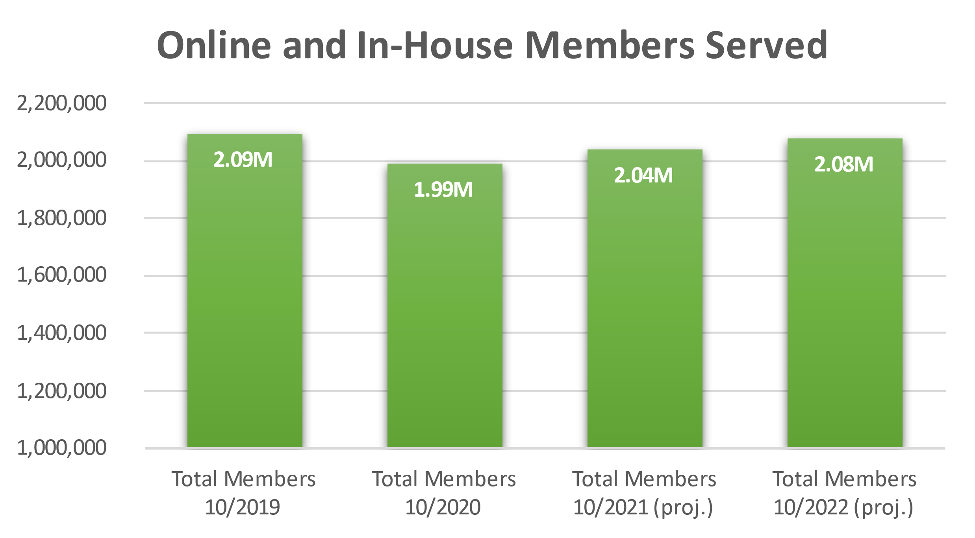
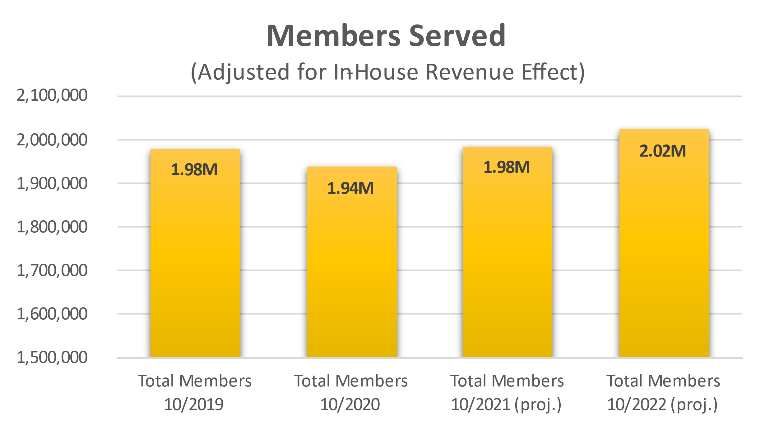
Building tools is a game of leapfrog Building companies is a game of changing focuses
Trust that our cooperative is more resilient than you think
But be ready to take on the challenge of changing the minds of the people entrenched in cookie-cutter, templated business plans

Slide 30
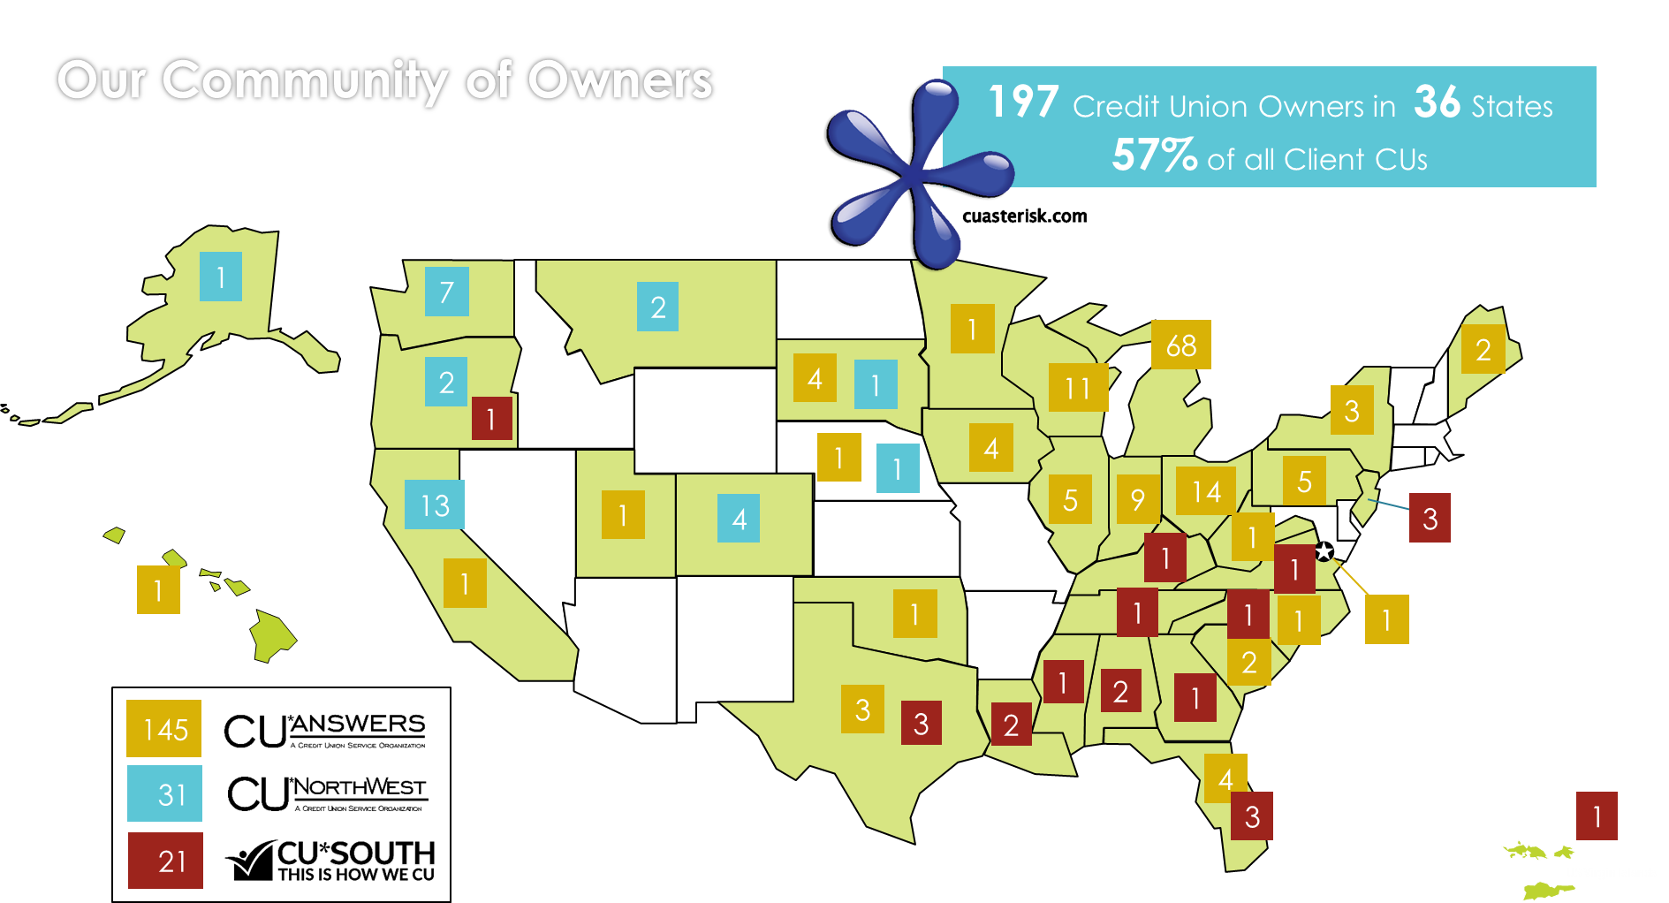
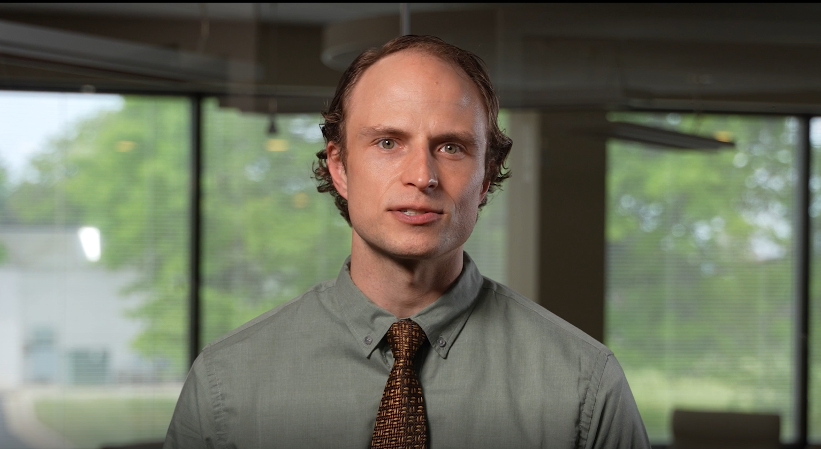
Inspiring collaboration is a never-ending investment
Every manager loves internally-managed delegation, but to win big, you need to count on external, empowered collaborators
Notes:
`

Slide 31
What do you do when people’s perceptions of who you are limit what you might become?
You go to Vegas!
A traditional branch for west of the Rockies
A very unconventional branch, built with the intent to redefine who we might become
A neutral site – no one has the home field advantage
An center for innovation, air-gapped to hold our business developers’ feet to the fire
Our grand opening is only 4 months away!

Slide 32
Our first national CEO collaboration
3.5 CUSO communities
350 CEOs who think CUSO boundaries indicate where they should go
A brand-new, neutral site, built to inspire a mind shift
Selling the vision that CEOs should have the skills to change everything
CEOs don’t go to users’ meetings – they go to events where they can flex their leadership muscles to define the future

Slide 33
A new job in 2022
Do you remember the excitement the first time you were about to graduate from something?
The sense of accomplishment from graduating high school...the awe that came from finally finishing college
Each time, you were full of enthusiasm and anticipation for the future
No matter what specific projects I’ll be working on next year, I plan to approach my next chapter with the same enthusiasm as a 22-year-old kid the day after college graduation
What the heck is a “Director of Special Projects?”
Join me next year as I find out

Slide 34
Back to Our Chairman
Do we have a motion to adjourn?

Slide 35
Thank you for attending!

