Slide 1

What should be on a CEO’s radar for 2022?
2021 National CEO Strategies Webinar
November 9, 2021

Slide 2
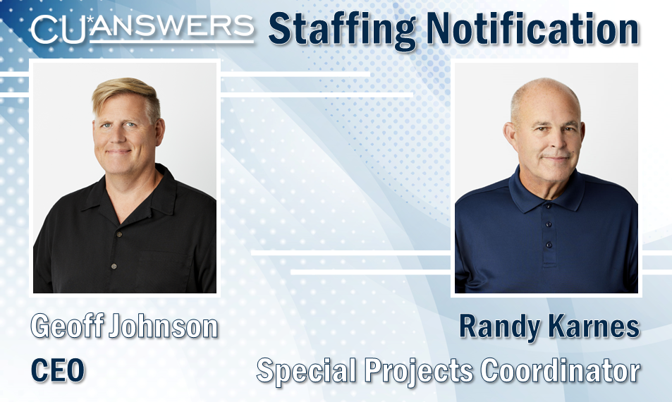

Slide 3
Randy’s Dozen
Tools You Should Be Using Now

Slide 4

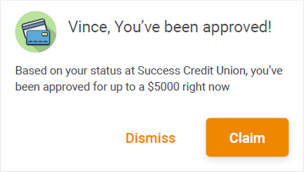

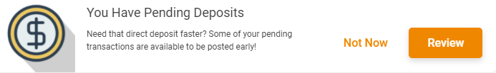
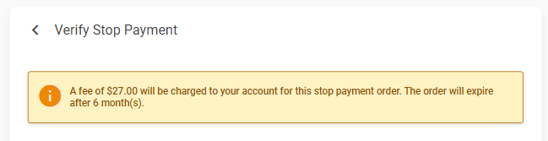


Tools for Internet Retailers
1
Driving for Online and Mobile Channels to be More than Informational
In this economy, the trick to generating revenue is creating more opportunities to collect service income, priced below the level of consumer resistance
Sell everything you do for members, over and over again – truly go 24x7
store.cuanswers.com

Slide 5


Using What You Know
CLR Path Decision Advisor
2
A non-credit report approach to making lending decisions (and more!)
CLR Path uses the data about your members in CU*BASE (FREE data you already own)
Get advice on lending decisions, opening new accounts, offering services...you name it
Coming in 2022: Access to decision advice via Phone Op & Teller screens
What you know about your members is the difference from all those who share data from the same 3rd-party sources
What will you do with it?
store.cuanswers.com/store/lendervp

Slide 6

Using What You Know
FUEL Decision Model
3
Customized decision model using credit bureau data
3 templates: Direct, Indirect, Unsecured
20+ static attributes you can customize
  Credit score, # of open trades, DTI, LTV, etc.
Use FICO or VantageScore data
Today’s version of the holy grail: automated underwriting to speed lending decisions through a matrix of the CU’s design
Improve your confidence in automated decisions with this new approach
store.cuanswers.com/store/lendervp

Slide 7

1Click Offers
The Introduction of Database Lending
4
Build a machine to push offers to your members, day in and day out
1Click Credit Card Offers (available now)
1Click Signature Loans (coming in 21.12)
  Get more small (and not-so-small) signature loans into your portfolio
  No employee needed
  Add a custom form for e-sign
It’s called 1Click to catch your attention, but it really should be labeled the launch point for a transformation in how CUs fund their futures...while doing the same for members
Database lending is a skill no one should underestimate
store.cuanswers.com/store/lendervp

Slide 8
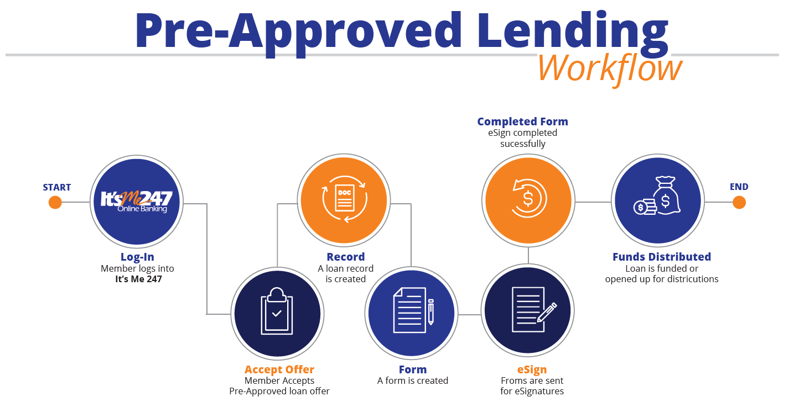
CD-secured Loan Offers
Database Lending for Secured Loans
5
Surprise your member with a new source of liquidity...their own money!
The next step towards automating your entire set of loan offers to work seamlessly with 100%-automated member fulfillment
Creating opportunity instead of waiting for members to ask
COMING IN 2022:
Share-secured Loan Offers
store.cuanswers.com/store/lendervp

Slide 9
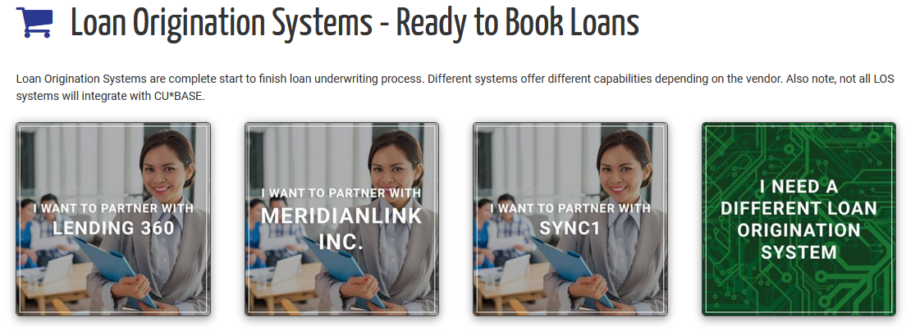
Loan Origination Integrations
6
CU*BASE supports a dozen loan origination integrations
153 CUs (roughly half of all CU*BASE clients) are working with these CU*Answers solutions
  Coming with 21.10: Open Lending
  Coming in 2022: Automate loan
  distributions from a 3rd-party LOS
External loan applications, 3rd parties to complement your lending
New distribution workflow for staff sets stage for new types of ready-to-service integrations
store.cuanswers.com/store/lendervp

Slide 10
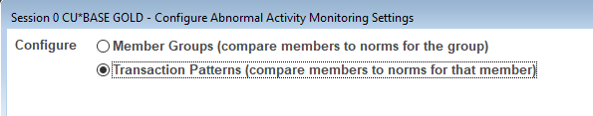

A Fraud Management Superstar:
Abnormal Activity Monitoring
7
A second configurable dashboard, Introduced in the 21.05 release
Detect potential fraud by watching member transactions
30 patterns pre-configured by the fraud experts at AuditLink
  COMING SOON: New AuditLink services for configuration and daily monitoring
It’s not magic...today you can learn as your members act
Reward members whose activities reward the credit union, and head off members whose intent might not be so genuine
store.cuanswers.com search: abnormal activity

Slide 11


Fraud Protections for EFT
8
Available with the 21.10 release
Make it harder for someone to guess the next card number you will assign
Randomize a portion of the card number
  Or randomize the increment for assigning the next card #
Randomize the card
expiration month
Reduce brute-force BIN attacks and mitigate card fraud
This was a 2021 stop-the-trains project...contact SettleMINT to learn why
store.cuanswers.com/settlemint-eft

Slide 12
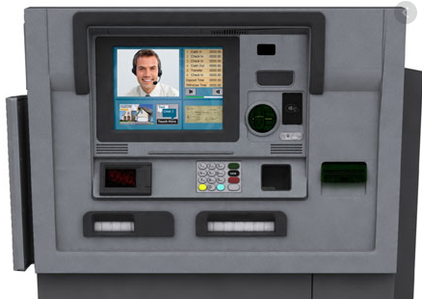
ITM Integrations
9
Progress with these vendors has been slow but we continue to PUSH FORWARD
ITM integration update
  Hyosung (in beta now!)
  NCR
  Diebold
  Glory
Looking for interested players to join our new ITM Collaborators focus group!
On the way to every member carrying a branch in their pocket, some people will still need solutions, other than phones, to replace yesterday’s teller interactions
It’s getting easier...what’s your path forward?
imaging@cuanswers.com

Slide 13
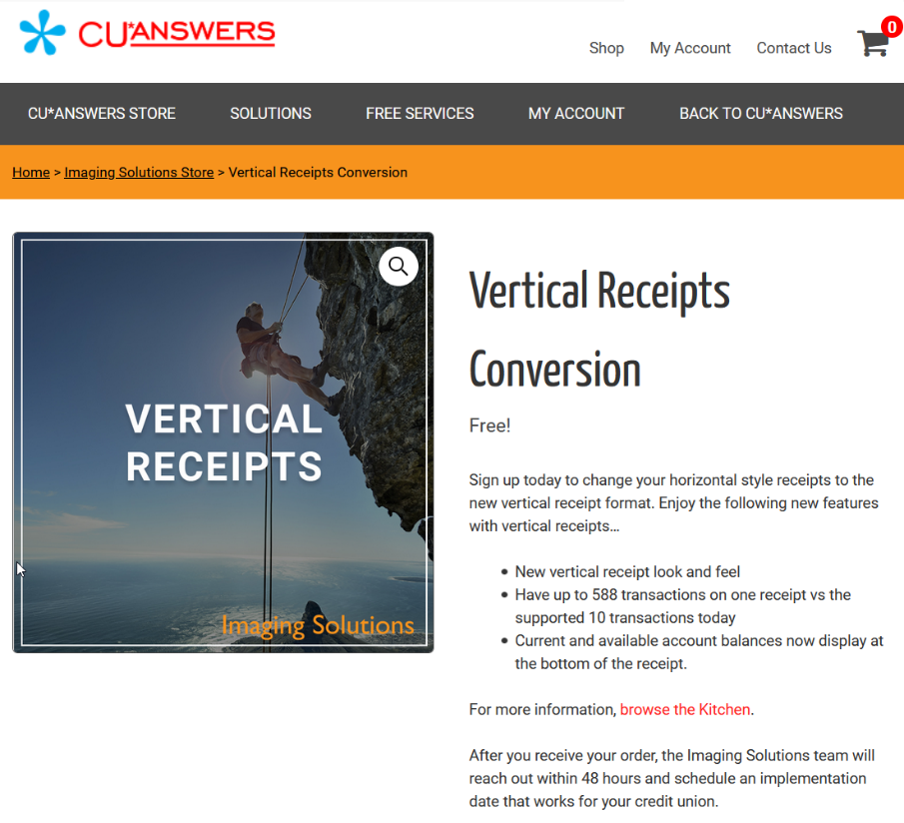
Vertical Receipts
10
₇₅ credit unions active now, ₂₄ more in the pipeline to convert next 90-120 days
The marketing machine will kick in again as soon as the pipeline empties out
When will
you make
your move?
A significant baby step on the way to no receipts at all
A required step to engage ITMs still kicking out receipts
Much ado about nothing to members who continue to deny needing receipts
store.cuanswers.com/product/vertical-receipts/

Slide 14



“Mobile First” Online Banking Solutions
11
3 products will be live by the first six months of 2022
The new mobile first design launches another decade of evolution
Decades years ago, OLB represented our hopes for a new, modern teller line replacement
Today, the internet channel represents our hopes for new branching styles, new retailing styles, and new organizations for where our members are going
Does your business plan sound like you’re going there, too?
Online banking services designed for business teams
A new single-login option for serving your business members
Beta starts Jan 2022

Slide 15
Virtual Branches that Represent Business Members
Today’s storefront is based on a URL or a mobile app
If you’re just getting started
with your business program, you already lost the brick-and-mortar fight to attract this audience
Get on the street: get on the ‘Net
Multi-login for business teams
Single-login for business members
Beta starts Jan 2022
How will you hang out your shingle as a business ready to attract and maintain relationships with business members?

Slide 16




Data Warehousing
12
Tap into an affordable shared data warehouse space
  $0 software/hardware investment
Data storage for decision-makers:
  Project files, data collected from
  3rd parties, results from surveys...
  Long-term archives of Tracker
  notes, custom reports...
  Optics data to gain insights
  from non-transactional
  member activity
There’s a new scorecard for CU operators
It’s based on your grasp of data and your creativity for acting on it
Don’t bet your jobs on yesterday’s belief that data is someone else’s job
cuanswers.com/solutions/asterisk-intelligence

Slide 17
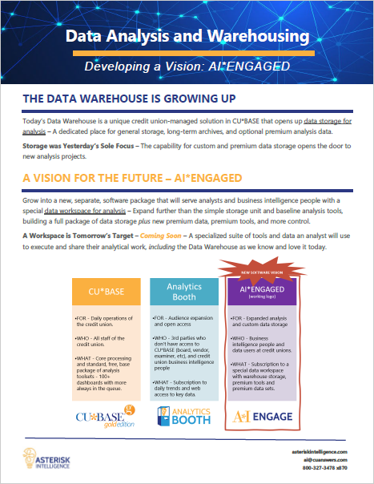

Data Warehousing
Introducing AI*Engaged
12
A new copyright coming in 2022
A new data workspace for analysis
For CUs with a data warehouse
A set of premium
dashboards designed
just for data analysts
The problem with keeping up with the Joneses is that the Joneses had a plan...do you?
AI*Engaged is a kick-starter for new skills and new ways of thinking about data for your future
AI*Engaged
cuanswers.com/solutions/asterisk-intelligence

Slide 18
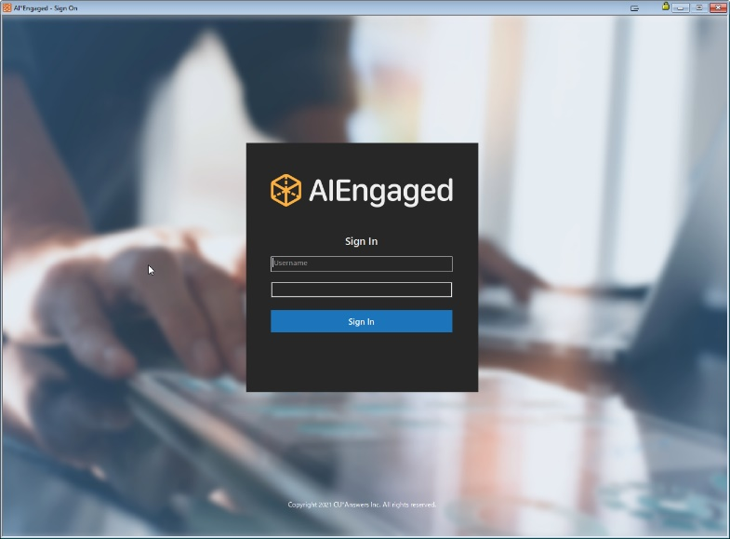
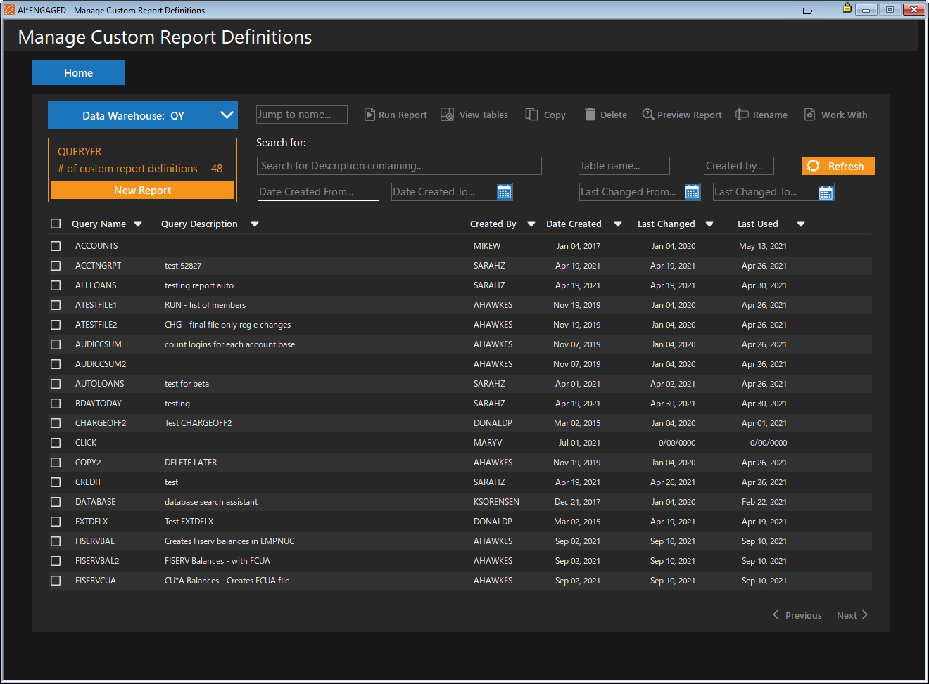
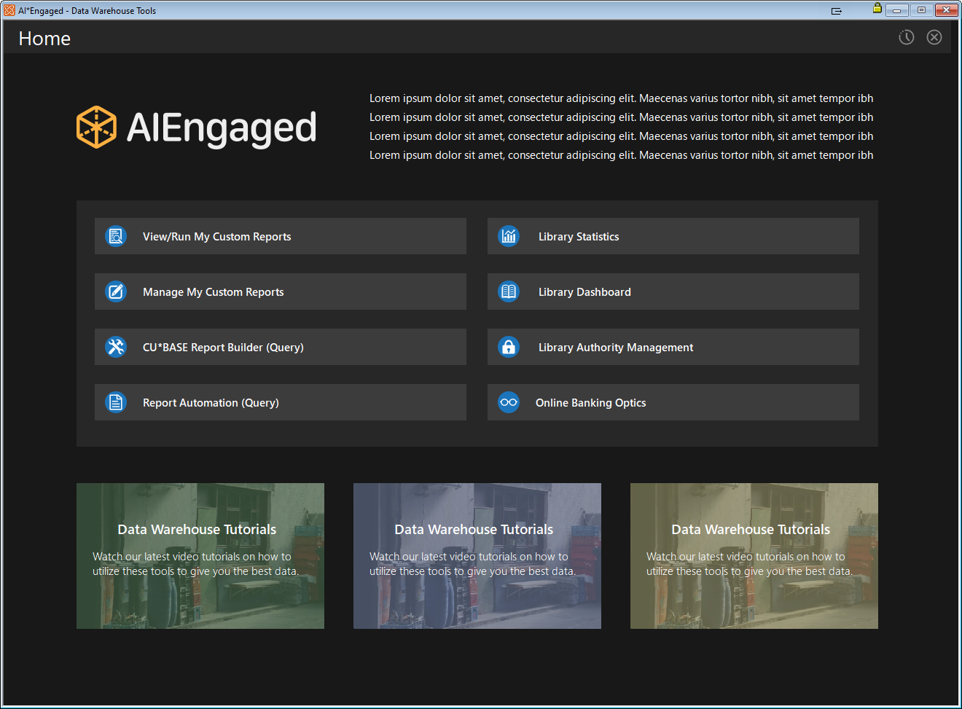
Introducing AI*Engaged
A completely new, web-like look and feel
AI*Engaged
AI*Engaged

Slide 19
Also rans...
“Who Earned Dividends” dashboard
“Where Your Members eSign” dashboard
Internet retailer pricing tools
  ANR fees by delivery channel
  Separate pricing for ACH instant deposits and stop pays via It’s Me 247
Nostradamus: A new engine for predictive retailing
Summary statements for business credit card programs
Randy’s Dozen Tools You Should Be Using Now
cuanswers.com/resources/doc/release-summaries/

Slide 20
Geoff’s Dozen
Development Projects to Watch
COMING IN 2022 & 2023

Slide 21
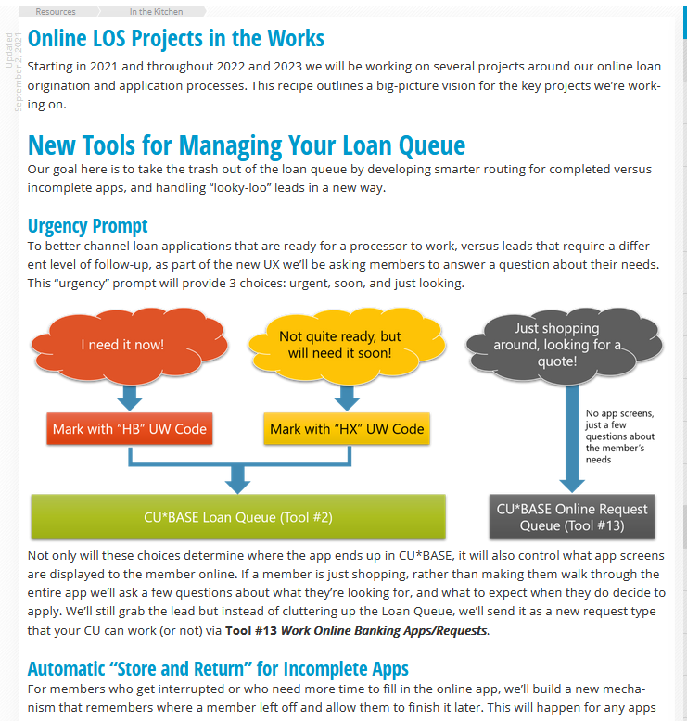
Online LOS Projects
1
An intense focus on internet-enabled, authenticated members
New tools to manage the queue
  Remove incomplete apps from your loan queue...or move them to a separate marketing queue
  “Store and return” for incomplete apps
  Urgency prompt
Improvements to
the online app
We’ll give you tools to manage online applications differently in the future
cuanswers.com/resources/kitchen/
Notes:
Building a premium experience for when authenticated members apply for a loan via desktop or mobile banking
A native integration with CU*BASE that takes advantage of everything we know about a member, and everything that happens after you say yes
Moving opportunities beyond the loan department for the next time a member needs a loan or needs to complete an interrupted loan application process
What will your credit union do with this new approach to online lending?

Slide 22

New Foundations for Keeping Pace with the EFT Vendor Market
2
Coming in 2022 & 2023
8-digit BIN mandate
  Implementing CU*BASE changes in April 2022
Setting the stage for digital issuance and provisioning to online wallets
  APBATCH4
Mandates
Building a foundation for future fraud management and digital issuance tools
Notes:
EFT vendors are looking for relevance in the future
Way beyond ATMs or POS, they want to be relevant to all payments via all channels
We’ll take major steps in 2022 related to P2P via debit card rails and automating cards and credit card loans into digital wallets and emerging payments systems
Our focus on cybersecurity and new security approaches and verifications are a signal that we’re planning for an active CU*Answers and cuasterisk.com community

Slide 23

Card Activity Optics Projects
3
Earning from your member eft activity
Analyze where members shop, all the way down to the merchant level
  Configure your own Merchant Category Code (MCC) groups
Give members a special deal based on where they shop
  CC promo rates by MCC group
  CC cash back programs by MCC group
  Debit card rewards by MCC group
Earn on what you know about how members spend their money
cuanswers.com/resources/kitchen/card-activity-optics
Notes:
It’s not enough to hope you have active members and enough of them these days
You have to encourage, urge, and constantly find new ways to get your members to use their cards to your advantage
The key is data, whether it be getting more transactions, activating more cards, participating in virtual marketplaces, or avoiding fraud, you have to learn the language of EFT networks and the processes that smooth out your members’ experience

Slide 24
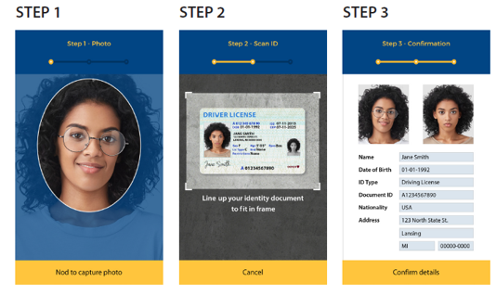
MACO for MOP: Digital Identity Proofing
4
Replacing precise id for underwriting new memberships
Uses facial recognition to compare a photo ID
image to
a selfie
taken by
the new
member
Records the photo ID in your archive
Secures a 1-year MACO license for
the member to use for mobile app authentication
Change with the times
Relies less on the person’s memory of past activity and more on today’s retailing approaches
Notes:
MOP and MAP were not a one-time task – sourcing opportunity from the internet is now a forever development project
MACO for MOP is the latest upgrade planned for how you underwrite saying yes or no to a potential new member
It also improves the process by killing two birds with one stone – save a driver’s license as you evaluate whether a person is who they say they are
Combine the purchase of a MACO authentication license with the modeling of their identity
MACO for MOP is just another tactic where CUs see the growing importance of images as more than just pictures – and another endorsement of how the member’s love for cell phones is part of a CU’s everyday business

Slide 25


Starting the Evolution for
5
Bear with us as we work on merging MTG and OLB development approaches
MTG release approach:
  Multiple versions in the field at a time
  Annual schedule for new versions
  You choose when to release the next version of the app to members
OLB release approach:
  Single version in the field
  Automatic updates to via the CU*BASE release schedule and periodic updates
As internet retailers, CEOs must adopt the vision for online and mobile banking being a cohesive strategy
If you embrace the channels as one, CU*Publisher will help you manage a consistent user experience
Notes:
While the tools are in year 2 or maybe year 3 of development, most CUs are in year one when it comes to leveraging the concepts of “mobile first” and how mobile phone experiences are now taking the lead in what people expect from internet interactions
CUs now have a larger voice than ever in how the experience looks, what is marketed, and the overlap between websites, online banking products, and mobile products
But they have to embrace CU Publisher content management as the tool to do it
Whether they develop designers internally or use third-party consultants (Xtend) or simply use the defaults, they’ll need to do so consciously, understanding the desired results from their internet channel interactions with members
It’ll take a while for mobile first ideas to be top-of-mind, but once engaged it’ll be simpler and more comprehensive for credit union strategists
Imagine when CU*Answers starts to use mobile first thinking as it redesigns the CU*BASE user experience in the future

Slide 26



Projects in the Works
New authentication options
  Expanding the first-time authorization method (email or text code) for other purposes
Making “Mobile First”
a two-way street
  Finding ways to have a deeper and richer experience for both desktop and mobile users
MACO for desktop banking
  New authentication models that reduce the need for passwords and security questions
New tools for managing a portfolio of businesses
  Jump between business memberships via BizLink 247
New tools for members to manage their lives and their business
  Jump between and It’s Me 247
  and MyBIZ
Other tweaks based on your early feedback
...and much, much more!

Slide 27
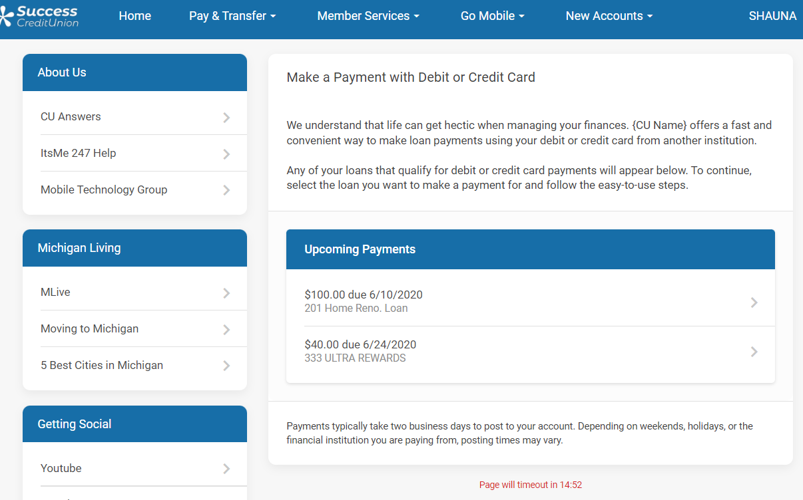
“Pay By Card” Module for
6
Integration to Magic-Wrighter’s LoanPay Express from online banking and the mobile app
Everyone is trying to facilitate payment processes everywhere, for everybody
So we’re building payment processing into our channels as well
Coming in 2022
Notes:
From the very beginning, CUs promised they would help their members with all of their financial management and challenges
We started with encouraging members to be better savers and smarter borrowers, but today member’s need help with payments like never before
They want to reach people and accounts outside of the credit union’s balance sheet and brand – they want to cross-utilize debit card rails for retail bill pay – they want to engage ACH activities from wherever they are
Today’s modern member financial marketplace is alive with opportunity, but members still need us to make it easy, convenient, and part of our relationships
Each year, the promise of electronic payments is becoming more and more real, and CU*Answers will focus this year in making some great leaps forward

Slide 28

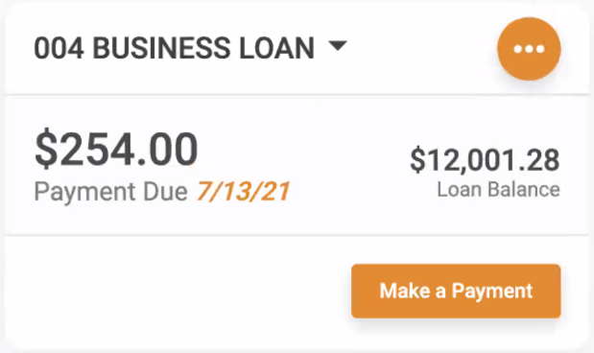
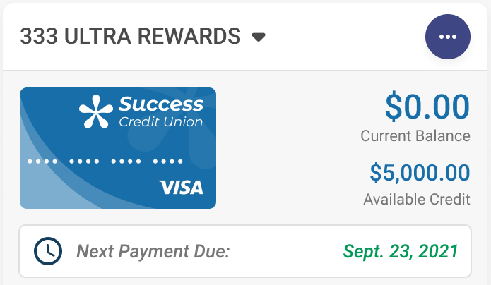
What’s Coming for the Mobile App?
Projects we’re working on now
RDC Enrollment via CU*BASE
  Auto-enrollment control...
  enroll and immediately make your first deposit
  Direct CU control of daily limits
  New enrollment analytics
Enhancements to the
Card Controls app
  Show transactions for a
  specific card only
  Include pending
  transactions in the list
Loan widget
  What do I owe?
  Make a payment now!
Card widget
  What’s my available credit?
  When’s my next payment?

Slide 29
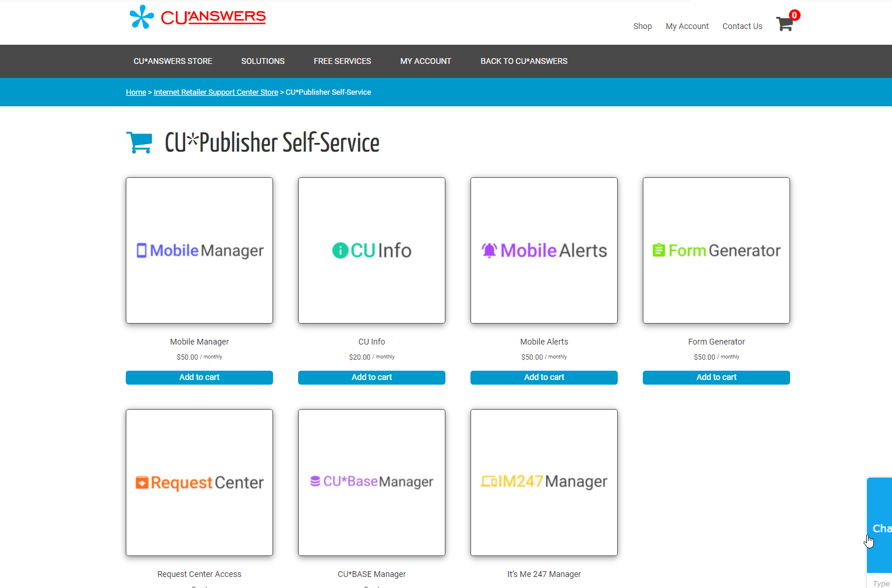
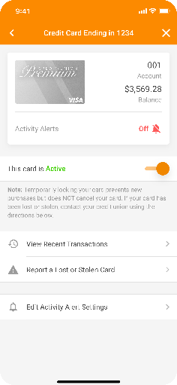
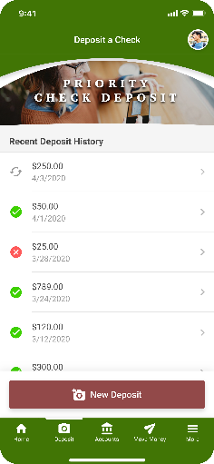
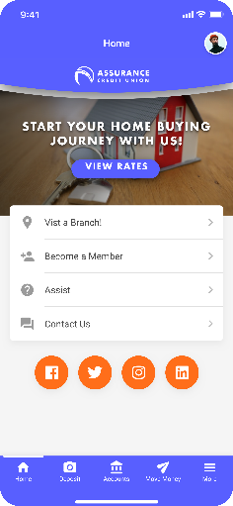
CU*Publisher
7
The most powerful content management system we’ve ever produced
Going live as a CU user tool – how will this change your world?
You’ve always asked for the
power to manage the member experience...what will you do with it, now that you have it?
Staff a team that can use it, contract with a vendor to use it, and understand how your power is growing
store.cuanswers.com/store/irsc
Notes:
The biggest change in the future for how CUs will see mobile apps is not what is the next cool feature embedded in the app
We’re approaching a saturation point with kitchen-sink apps
The biggest change is going to be how credit unions manage their apps, with autonomy and automation
CU Publisher development will be the headline development for the next couple of years, allowing CUs to have more active apps at once, to pick and choose when versions are released to their members and staff, to be more active in beta tests and feature quality, and finally, to own the member experience in a new way
CEOs need to develop staffing plans for these activities, investment plans for managing maintenance and the marketing of mobile apps as an ever-changing tool, and our CUSO will build entirely new client service departments and consultants that will make CU internet channels more dynamic and intense for a membership that will demand change

Slide 30
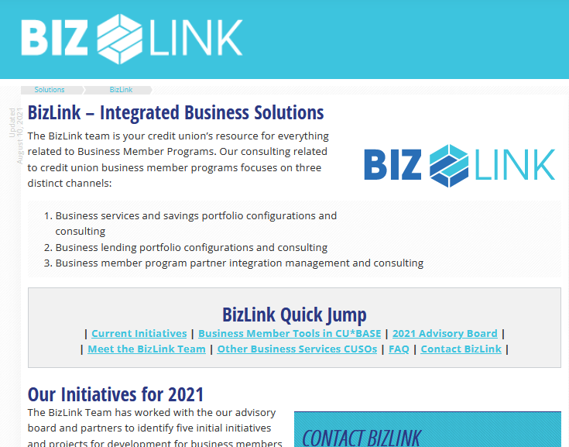
BizLink: Solutions for Business Members
8
Helping you launch a business department at your credit union
The BizLink Advisory Board is driving 5 tactical development projects at a time
CUs with business programs — and goals to be a comprehensive CU for business members — are leading the way
Should our CUSO help CUs with the goals to have a business program, or just the tools?
cuanswers.com/solutions/bizlink
Notes:
Several years ago CU*Answers quietly changed its approach to business banking. After years of developing features as tactical projects, we started to wonder why we weren’t seeing more CUs with a full-out business program and department.
We wanted to encourage CUs to evolve their model from being CUs with members who just happened to be businesses, to a model where they were credit unions FOR businesses, with a business format focus
CU*Answers wants to help CUs start business programs, and believes that one day our community will approach as many as 150 credit unions with full-out business programs
The BizLink effort is designed to get us there
BizLink Advisory Board is a new governance model

Slide 31


BizLink Advisory Board Tactical Initiative:
Business Sweep Accounts
Helping business members maximize their earnings on operational accounts
Daily sweep from operational to investment account...just in time to accrue dividends
  Leave the funds there or sweep them back again, ready for the next day’s business
Flexible monthly fees, custom for each business relationship
MaxEarnings
COMING IN 2022 VIA:
8
cuanswers.com/resources/kitchen

Slide 32

BizLink Advisory Board Tactical Initiative:
ACH Posting Controls for Businesses
Allowing business members to control what hits their accounts via ach
Block all ACH debits
Max $ limits
Approved company IDs
Non-approved company IDs
Flexible monthly fees, custom for each business relationship
BizWatch
COMING IN 2022 VIA:
9
cuanswers.com/resources/kitchen

Slide 33
Tracking Recoveries
9
Enhancements to CU*BASE Loan Write-off/Charge-off Tools
Coming in 22.05:
  Calculate daily accruals on written-off loans
  Expand the database to allow you to find data on recoveries
Up next:
  Create a payoff calculator
  Collecting payments that include interest since write-off, fees, fines
  More behind-the-scenes automation and tracking/analysis tools
Tracking the big picture related to loan servicing life cycles
Think “static pool analysis”
cuanswers.com/resources/kitchen
Notes:
This project is related to a much bigger issue: understanding a loan portfolio and the net earnings from that portfolio
In other words, CECL
What is the true income and losses related to making loans? How much can you predict? How can you mitigate the risks? What is the future value of your loan portfolio?
If you write off $100K auto loan, is that the net loss? Generally, no. So what did you recover six weeks or months down the road, and what does it mean to the big picture of your loan portfolio?

Slide 34

Native Receipts
An Imaging Solutions 2022 Development Priority
10
Making room for innovation with new technologies
  More customizable workflow controls
  Marketing on receipts?
Foundational project for replacing ProDOC (forms)
Freshen up the receipts process with a new integrated approach (think photo IDs in Xpress Teller)
  No print session
  No ProDOC for receipts
Our partnership with eDOC has given our network insights into the possible future of receipts, and how transaction data can be used
The concept of native receipt data will lead to changes in all our futures
Notes:
Receipts used to be based on “here’s your copy, Mr. Member” – the printed piece of paper represented the member’s ability to track whatever details they needed
The retailer (CU) kept a copy for their reasons
The printed piece of paper WAS the data
Today, data is much more virtual and the printed piece of paper is not nearly as important as it used to be
Today, receipts are native to a processing system because they’re just the data, not the piece of paper
Because it’s data, organizations have more options for where it’s stored, how it’s presented, how long it’s archived
CU*Answers in 2022 is going to up our game again and take advantage of these options like never before, given our ownership of eDOC

Slide 35
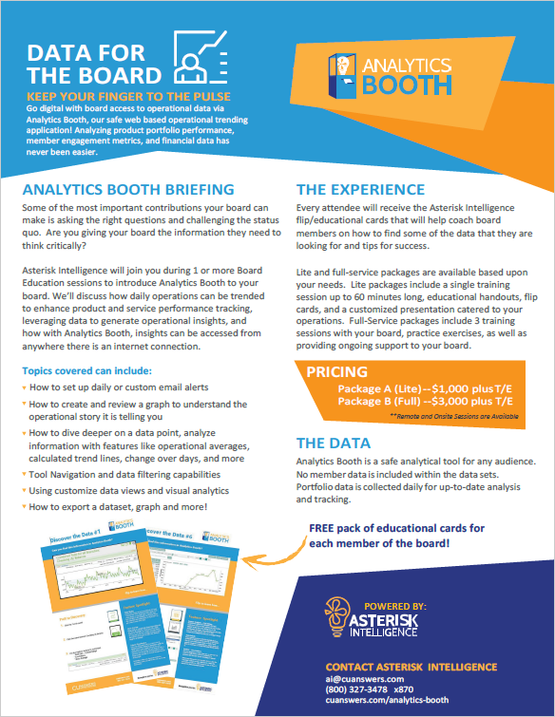

Analytics Booth
11
A new look and feel in 2021, and big goals for 2022
2022 Goal: Teaching and consulting with credit union board members
Are you ready to
engage your board
members with the
power of
Analytics Booth?
Shorter board meetings...consent agendas...dim lights in the boardroom...more trips
Give board members a significant role, and tools that encourage them
cuanswers.com/solutions/asterisk-intelligence
Notes:
From the beginning, Analytics Booth was a business application targeted at new audiences, targeted to be used in new spaces outside the office, and targeted to be used by new devices other than a desktop anchored PC
It continues to evolve, and in 2022 with some new releases will become more specialized for these original targets
The biggest pushes will be in two areas:
Continue the drive to get executives to count on data processed and presented for their unique points of view
Develop a CU board member audience and build a beachhead for the development of toolkits that CU members might engage to better understand their role as CU owners
CU employees want to get deep into doing the data work for analysis, building reports for presentation, archiving of data into warehouses
Analytics Booth doesn’t do any of that – it presents live presentations that trend data and give instant access to the answers, via data, to new audiences
As CUs want to claim that their grasp of data is growing and becoming more competent, they will need to prove it from the top down, starting with their boards and executive teams on the fly

Slide 36
Xpress Teller
12
Why do we have two? How will we continue to make them distinctly different?
By focusing on features that are unique to Xpress Teller
In development:
  Posting limits by teller
  Memo transactions for check-cashing
On the drawing board:
  Printing checks/money orders to a tellerless branch
  Adding a 3rd instrument (for Cashier’s or Treasury Checks)
Designed for different environments, different front-line strategies
cuanswers.com/resources/kitchen
Notes:
“Different strokes for different folks” is not always a mode of operations that everyone appreciates
But in today’s marketplace, with so many diverse approaches to the teller line, in-branch services, and member experiences, having only one teller line approach simply does not allow for enough diversity
We need multiple platforms to experiment with – CUs need options as to how much, or how little, to include in a teller line offering
New ITM integrations are only adding a dozen transaction types, because they’re built just to do the lion’s share of member activity
The equivalent of just the lion’s share in a modern teller line would be Xpress Teller
We’ll continue to work out the bumps in both platforms, but we don’t have any intention of merging the two

Slide 37
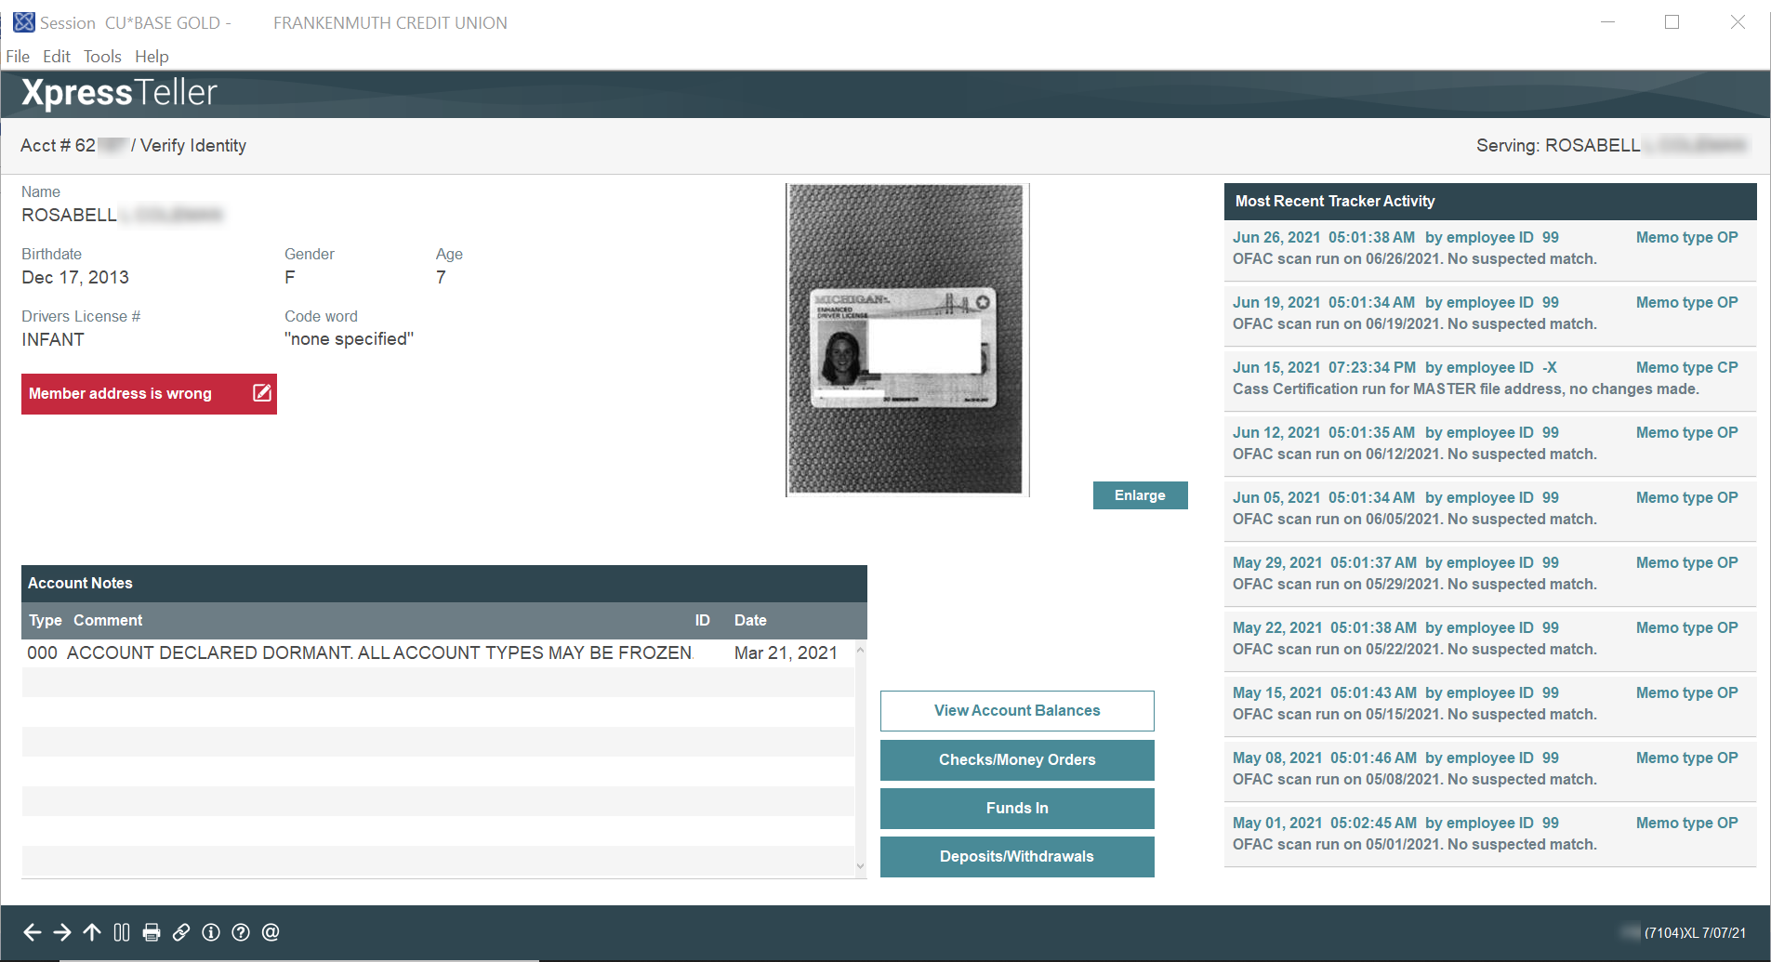
Xpress Teller: A Place to Try New Things
Available now:
On-screen photo IDs with a new image editor
Edit
Enlarge
Coming in 2022: Read recent tracker conversations with this member while you post their transaction

Slide 38
The Future of CEO Strategies Events

Slide 39


Staying Engaged with CEOs
Staying Engaged with Your Teams
  CEO Strategies Zoom Event
  March 2022
  (date to be announced)
2022 Leadership Conference,
Annual Stockholders Meeting,
& Golf Outing
June 14-16, 2022
At the JW Marriott in downtown
Grand Rapids, MI
  CEO Strategies Face-to-Face Event
  (Visit the Innovation Center in Las Vegas, NV!)
  November 2022
  (dates to be announced)
FOR CREDIT UNION CEOS ONLY
FOR CEOS, BOARD MEMBERS, & KEY CU LEADERS

Slide 40
Thank you!

