Slide 1

Welcome to the 2020 Annual Stockholders Meeting
June 17, 2020

Slide 2

2020: the Year of “Virtual Meetings”
All participants have been muted,
all web cameras deactivated
To make a motion or ask a question, please use the Chat feature
You may chat directly to the host,
or to all participants.

Slide 3
Call to Order
As chairperson, I move for unanimous consent to accept the Minutes of the 2019 Annual Stockholders Meeting
  Published here: elections.cuanswers.com
If there is a second, please send the word “Second” in a chat
If there is any opposition, please send the word “Opposed” in a chat
We’ve done this 50 times before, but in the year of the asterisk, this’ll be our first “virtual” version

Slide 4
2020: The Year of the Asterisk*
CHAIRMAN’S REPORT
Scott McFarland, CU*Answers Board Chairperson

Slide 5
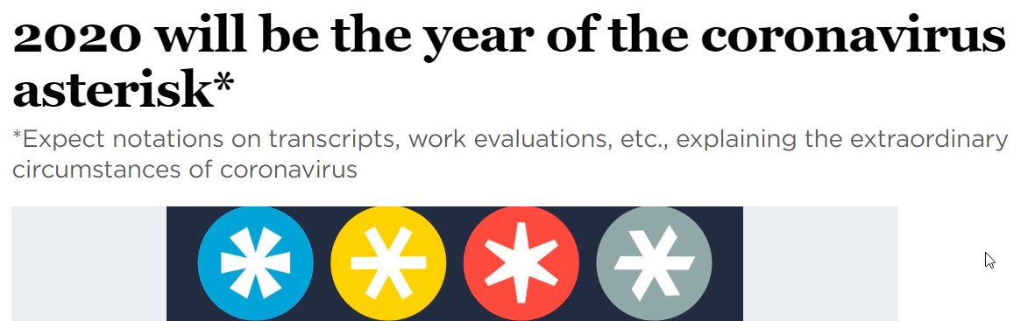
But we’re here to talk about 2019 (remember when life was simple?)

Slide 6

Welcome to 5 new owners in 5 states!
DayMet CU
Dayton, OH
EmpireOne FCU
West Seneca, NY
Illinois Community CU
Sycamore, IL
Ingersoll-Rand FCU
Athens, PA
TLCU Financial
Mishawaka, IN
Member size range: 4,100 to 10,500 members
Average size: 7,040 members
Thank you!

Slide 7




Our Community of Owners
180 Credit Union Owners in 33 States
57% of all Client CUs
1
6
2
1
66
2
2
4
12
3
4
5
9
14
5
11
1
4
3
1
1
✪
1
1
1
1
1
1
1
2
1
137
2
3
2
26
4
3
17
Notes:
Who will take us to the future – our owners, current and future

Slide 8
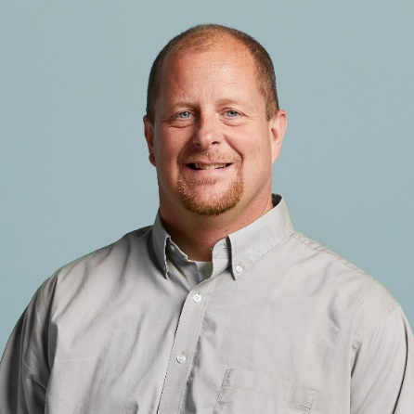
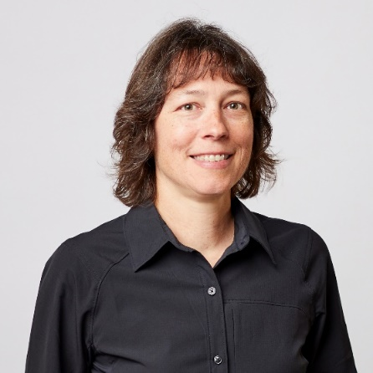
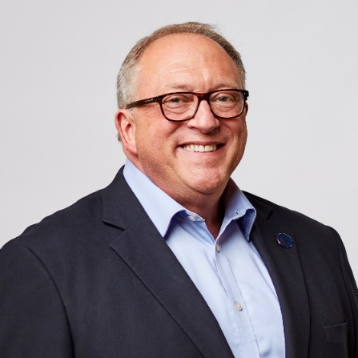
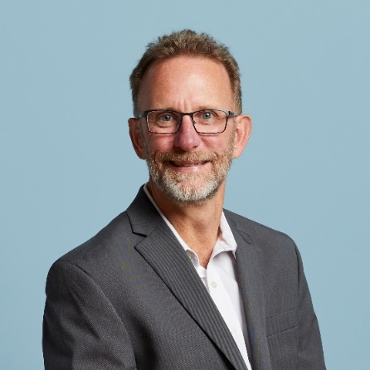
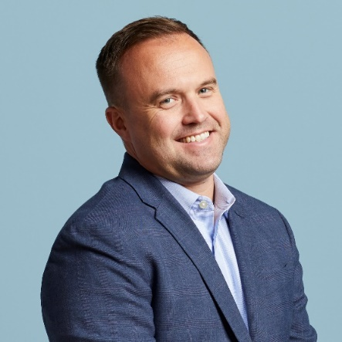
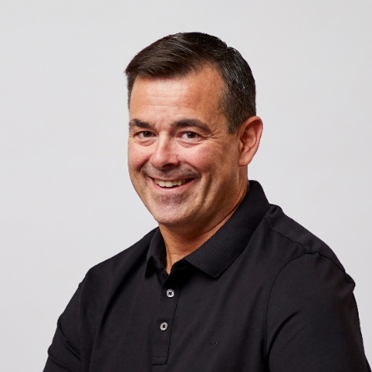
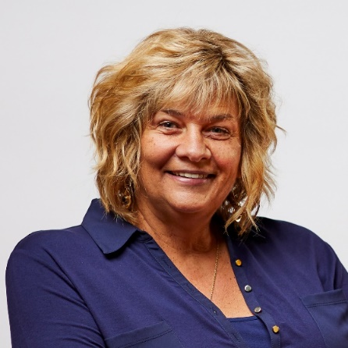
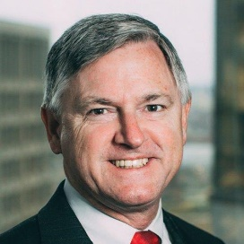
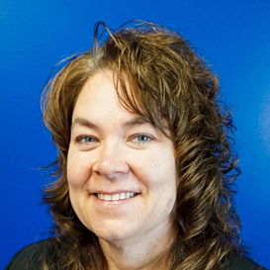
Your
2019-2020
Board of
Directors
Scott McFarland, Chairman
CEO, Honor Credit Union
Board Member since Aug 2009
Linda Bodie, Director
CEO, Element Federal CU
Board Member since Oct 2013
Tom Gryp, Director
President/CEO, Notre Dame FCU
Board Member since Oct 2016
Jeff Jorgensen, Director
CEO, Sioux Empire Federal CU
Board Member since Dec 2009
ASSOCIATE BOARD MEMBERS
Bill Burke
CEO
Day Air CU
Carolyn Mikesell
CEO
Public Service CU
Kris Lewis, Director
CEO, Allegan Community CU
Board Member since Oct 2018
Dean Wilson, Director
CEO, FOCUS Credit Union
Board Member since Jan 2008
Vickie Schmitzer, Sec’y/Treas.
CEO, Frankenmuth Credit Union
Board Member since Oct 2007
Thank you!
As always, I want to thank my fellow Board members for another great year, and for all their hard work

Slide 9
2020 Board Elections
NOMINATING COMMITTEE
Tom Gryp, Nominating Committee Chair

Slide 10
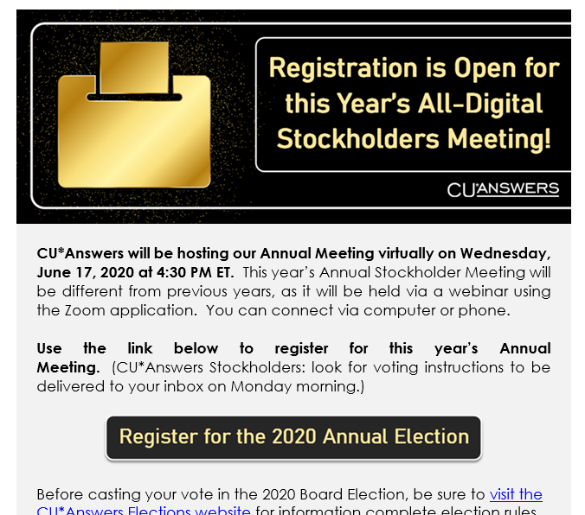


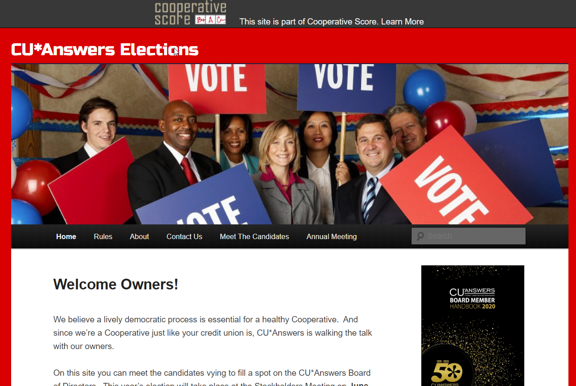

A year for the record books
ONLINE VOTING PARTICIPATION HITS AN ALL-TIME HIGH
YOUR 2020
NOMINATING COMMITTEE
COMMITTEE CHAIR
Tom Gryp, Notre Dame FCU
Scott McFarland, Honor CU

Slide 11
Today’s Election Protocols
All votes have already been counted; no new votes will be accepted at this time
You’ve already heard from the candidates via the elections website, so no live speeches this time around
Enough electronic votes have been received to achieve a quorum
If you wish to change your previous vote, send an email in the next 10 minutes to:
A list of shareholders entitled to vote has been published at cuanswers.com
stephanie.underwood@cuanswers.com

Slide 12
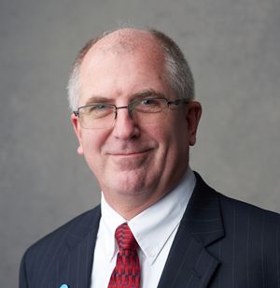
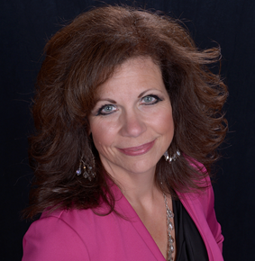


Thanks to this year’s candidates!
Gregory Gurka
Forest Area FCU
Val Mindak
Park City CU
Vickie Schmitzer
Frankenmuth CU
(Incumbent)
Dean Wilson
FOCUS CU
(Incumbent)
We’ll come back and reveal the results in a bit...

Slide 13
A Look at the 2019 Numbers
THE BENCHMARK BEFORE THE ASTERISK
CFO REPORT
Bob Frizzle, CFO

Slide 14
Net Income & Patronage Dividends
What do shareholders get, and what are we putting away for our future?
$7.5M
$8.2M
$2.25M
$2.25M
$3.75M
$???

Slide 15
2019 Numbers Worth Celebrating
Detail | YE 2018 | YE 2019 | 2019-2018 % Change | 2018-2017 % Change | 2017-2016 % Change
Total Assets | $38,989K | $42,539K | 9.10% | 14.35% | 7.3%
Total Liabilities | $19,562K | $21,920K | 12.06% | 5.39% | 8.3%
Total Equity | $19,427K | $20,618K | 6.13% | 25.05% | 6.3%
Retained Earnings | $3,877K | $4,220K | 8.85% | 8.03% | 22.8%
Book Value of Class A Stock ($ per share) | $719.53 | $758.04 | 5.40% | 15.80% | 8.8%
Book Value of Ownership | $143,906 | $151,608 | 5.40% | 15.80% | 8.8%

Slide 16
Year-end 2019 Dividend Payments
These numbers can flex, and I predict they will again in the future
Detail | YE 2018 | YE 2019 | 2019-2018 % Change | 2018-2017 % Change | 2017-2016 % Change
Patronage Dividend ($) | 2,000,000 | 2,250,000 | 12.5% | 14.3% | 16.7%
Bonus Patronage ($) | 4,000,000 | 3,750,000 | -6.3% | 45.5% | 37.5%
Ownership Dividend Rate | 4.0% | 4.0% | 0.0% | 0.0% | 0.0%
Ownership Dividend ($) | 775,868 | 844,071 | 8.8% | 21.5% | 6.9%
Book Value of Class A Stock ($ per share) | 719.53 | 758.04 | 5.4% | 15.8% | 8.8%
Price to Purchase CUSO Ownership | 330,000 | 330,000 | 0.0% | 13.8% | 5.5%
2020 Net Earnings as of May 2020:
$3.1M after adjustments for $1.5M patronage dividends and $1MK taxes
(projected to be $1.7M by 9/30/20)

Slide 17
2019 Return on Investment
2019 Gross Income Submitted by Owners to CU*Answers $ 31,025,688
(Excludes all vendor pass-throughs)
2019 Patronage Dividends Paid $ 6,000,000
2019 Class A Stock Dividends Paid 844,071 (4.0%)
2019 Interest Paid Credit Unions on Loans 317,135 (~5.75%)
Total Revenue Returned to Credit Unions $7,161,206
2019 Return Per Total Dollars Received: $0.2308
$7,161,206 ÷ $31,025,688 (excludes vendor pass-throughs) = 23.08% return per CU*A $ received

Slide 18
Understanding this formula is important to how we set the boundaries for our future
2017 Return Per Total Dollars Received: $0.1979
$5,346,530 ÷ $27,023,005 (excludes vendor pass-throughs) = 19.79% return per CU*A $ received
2018 Return Per Total Dollars Received: $0.2510
$7,060,522 ÷ $28,132,658 (excludes vendor pass-throughs) = 25.10% return per CU*A $ received
2019 Return Per Total Dollars Received: $0.2308
$7,161,206 ÷ $31,025,688 (excludes vendor pass-throughs) = 23.08% return per CU*A $ received

Slide 19







Investing in a community and building a network
20%
ownership stake
1.23%
ownership stake
48%
ownership stake
10%
ownership stake
<1%
ownership stake
3.70%
ownership stake
A convertible
debt investment

Slide 20
...and now, turning to the asterisk* year
Member behavior and the
impact on our revenue streams
  What will be impacted, how much and how long?
Staffing/employee expenses
  Impact of hiring freeze, opportunity to grab newly unemployed talent: Operation Clawback
Customer/market interaction
  T&E impact – not just financial
  50th anniversary celebrations
  Trade shows
  Client visits/priorities

Slide 21

Thinking About 2020 Year-end cuasterisk.com Network Revenue Numbers Continue To Impress
CU*Answers Direct Revenues
Projected for 2020 $62.0M
Projected
for 2020
Our Network Partners
eDOC Innovations $5.9M
CU*NorthWest $5.0M
CU*South $7.0M
Xtend $3.8M
Site-4 $900K
Grand Total: $83.9 million
Visit www.cuasterisk.com to keep up with network partners, products and services

Slide 22
Projecting Shareholder Value
Depending on when you bought in, your perspective is different
THE PRICE OF OWNERSHIP
OVER THE YEARS
1991: $59.31
2000: $176.00
2005: $460.00
2010: $495.00
2015: $1,125.00
2020: $1,650.00
6.3%

Slide 23
The Importance of Our Per-share Price
Balancing today’s payback against the value of your equity
Let the Board know how you hope they vote: Current year dividends to help your operations, or shareholder value for the long term

Slide 24
The Big Question
Will our economy bounce back in 2021, or will we see an echo of the coronavirus?
While we have contingencies, we’re going in to 2021 confident and optimistic
The big wrinkle will be how big and how fast we can build our future in Las Vegas
If I could predict this with any certainty, I’d already be a commentator on Fox

Slide 25
Diet Coke and Lemonade
CEO COMMENTS
Randy Karnes, CEO

Slide 26
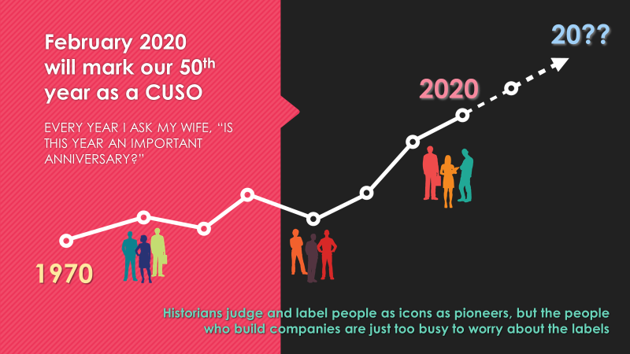
Diet Coke and Lemonade
No year started off with higher expectations than 2020
  We were going to have record-breaking parties
  We were going to debut multiple new generations of some old standards
It was going to be hectic, and
I planned to be on a diet Coke caffeine high from last June right until today
If everything had stayed on plan, I already would have wowed you with 120 Leadership Conference slides

Slide 27

On March 24th, 2020 became the year of the asterisk*

Slide 28
Making Lemonade: Adjustment #1
Refocus Our Financial Engine
Reengineer revenue for a marketplace turned upside down
Respond with precision to being an essential business
Refocus our expenses for the critical, maximize our refunds, and invest in the moment
Focus on paying $6 million in total dividends to invest in our shareholders’ success and their budgets for an asterisk year

Slide 29
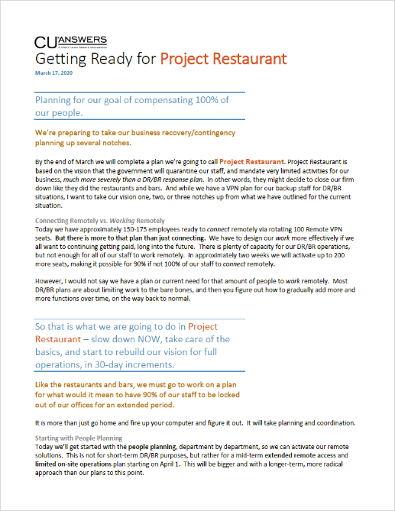
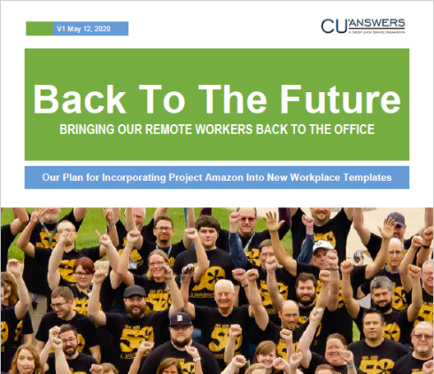
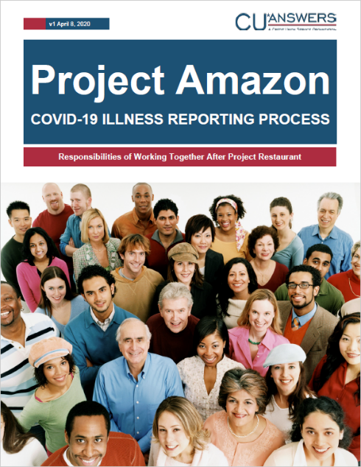
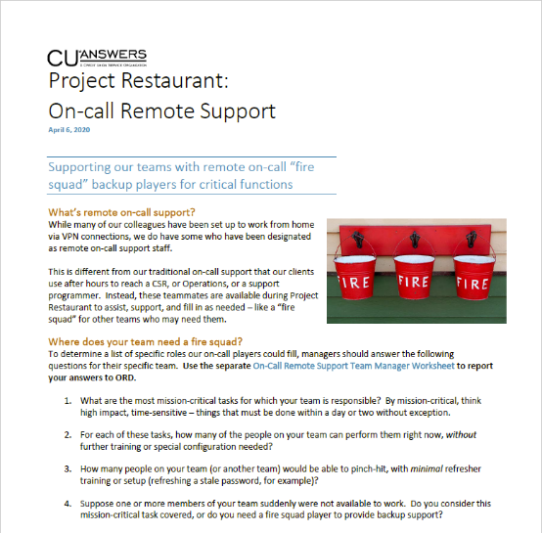
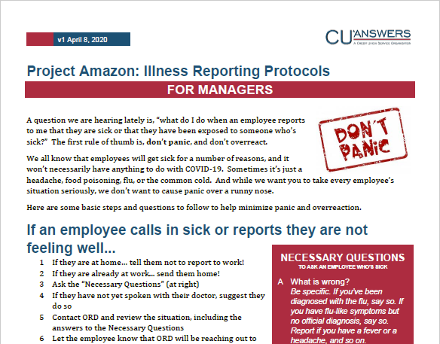
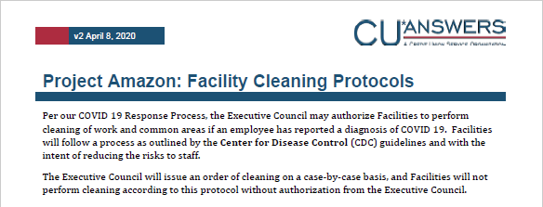
Making Lemonade: Adjustment #2
Build a High Availability People Plan
No year should be wasted, and 2020 will go down as the year we proved we’re ready for anything, with new time-tested designs

Slide 30
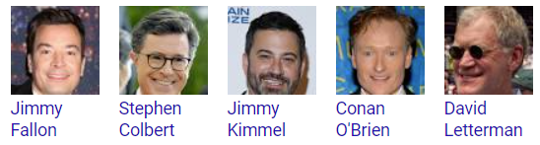
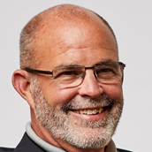
Making Lemonade: Adjustment #3
Write a New Script for the 2020 Leadership Conference
Randy
Karnes

Slide 31

Making Lemonade: Adjustment #3
Write a New Script for the 2020 Leadership Conference
The CU*Answers
Leadership Conference Show
Debuting on cuanswers.com
July 1
Randy
Karnes

Slide 32

Unexpected gifts from 2020:
Time to rethink priorities
  Who, what, when and where
A glimpse of what’s next
  The inspiration to address it now
The confidence to endure
  A picture of new leaders to come, with the experience to win in the future
The inspiration of local reliance
  Cooperative communities at their best

Slide 33

The party’s been moved
But for it to be a party, you all have to show up ... please be bold!

Slide 34
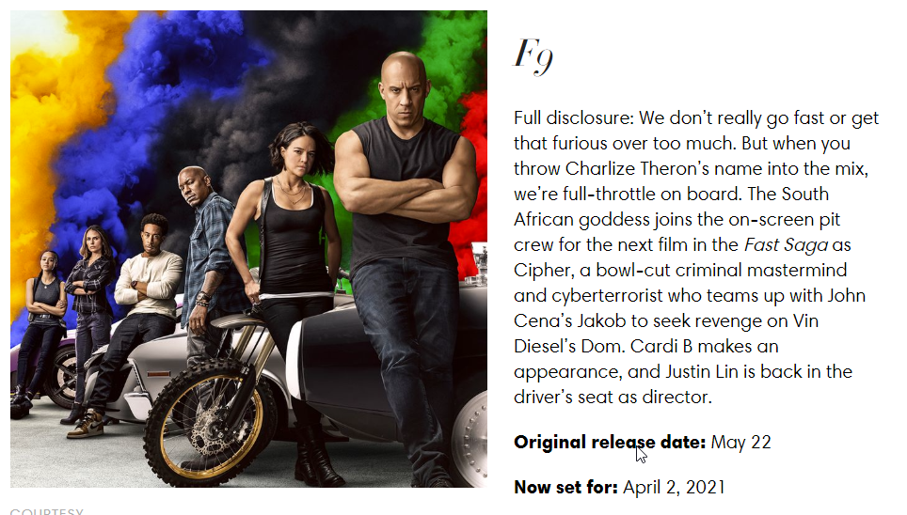
2021: Back to an Action Flick
While most of you are too sophisticated for this franchise,
Fast & Furious is the perfect title for
what I hope we all anticipate for next year
...Now on to the next 50 years!

Slide 35
And now let’s get the results of the election!
...and the winners are

Slide 36

Your
2020-2021
Board of
Directors
Scott McFarland
Honor Credit Union
Linda Bodie
Element Federal CU
Tom Gryp
Notre Dame FCU
Jeff Jorgensen
Sioux Empire Federal CU
ASSOCIATE BOARD MEMBERS
Bill Burke
CEO
Day Air CU
Carolyn Mikesell
CEO
Public Service CU
Kris Lewis
Allegan Community CU
Dean Wilson
FOCUS Credit Union
Vickie Schmitzer
Frankenmuth CU
Congratulations, Dean and Vickie!

Slide 37
Back to Our Chairman
Do we have a motion to adjourn?

Slide 38
Thank you for attending!

