Slide 1

Let’s get started...

Slide 2
2020
Will Be Our Cooperative’s
50th Anniversary
Three major events will give us the chance to highlight the successes of the past and the opportunities and challenges for the future:
  Today’s Leadership Conference and Annual Stockholders Meeting
  November’s CEO Strategies Event
  Nov 11-14, 2019
  Next year’s Leadership Conference and Stockholders Gala
  June 2020 (date to be announced)
I’m throwing down this challenge:
to make 2020 a year of celebration and chances to renew our energies and commitment to the next half-century
More than just a party, 2020 will be the year where we call for new pioneers and the spirit to build a new, unique CU*Answers to meet the challenges of the next 50 years

Slide 3

New Peers to Greet
17 New CU*Answers Clients Since Last Time!
19
Hawaii
  Hawaii Central FCU
  Honolulu, HI
Illinois
  First Financial Servicing LLC
  Skokie, IL
  Partnership Financial CU
  Morton Grove, IL
Indiana
  Fire Police City County FCU
  Fort Wayne, IN
Maine
  TruChoice Federal CU
  Portland, ME
Minnesota
  Village Financial Cooperative
  Minneapolis, MN
Michigan
  ABD Federal CU
  Warren, MI
  Belle River Community CU *
  Richmond, MI
  Unity CU
  Warren, MI
New York
  Empire One FCU *
  Buffalo, NY
Ohio
  DayMet CU
  Dayton, OH
  First Miami University Student CU
  Oxford, OH
  Heartland FCU
  Dayton, OH
  River Valley CU
  Miamisburg, OH
Oklahoma
  Cherokee Strip CU
  Ponca City, OK
Pennsylvania
  Ingersoll-Rand FCU *
  Athens, PA
South Carolina
  SPC Credit Union *
  Hartsville, SC
  Santee Cooper CU *
  Moncks Corner, SC
Wisconsin
  County-City CU
  Jefferson, WI
Includes CU*Answers clients currently under contract or converted after 7/1/18
*Will convert in fiscal year 2020

Slide 4




Credit Unions Served by State
294
CU*BASE Credit Unions
in 41 States
# of CUs by State
1
9
5
6
79
2
8
18
2
1
1
8
2
3
5
22
5
1
18
6
8
10
3
1
2
1
1
1
✪
1
2
2
2
1
1
2
1
1
1
2
4
5
4
2
2
11
8
192
5
60
5
2
42
St. Croix
US Virgin Islands
Includes all cuasterisk.com network partners, all clients currently under contract

Slide 5

The
Robert H. Mackay Leadership Award
Speaking of celebrations...
EST. 2005
The mackay award
  “The challenge of leadership is to be strong, but not rude; be kind, but not weak; be bold, but not bully; be thoughtful, but not lazy; be humble, but not timid; be proud, but not arrogant; have humor, but without folly.”
Words to live by, shared by Bob Mackay
Taken from a quote by Jim Rohn
And our winner is...

Slide 6


The
Robert H. Mackay Leadership Award
Our 2019 honoree:
Greg Hilbert
CEO
EST. 2005
Notes:
Greg Hilbert, FOX Communities
Converted to CU*BASE in 1997
Stockholder since 2000

Slide 7
Unique, not Original
Drawing Confidence about the Future
From Our Connections to the Past

Slide 8
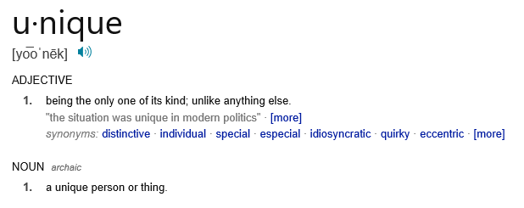
Unique
Every credit union and person in our network is unique
  This moment in time is unique
  The set of individuals who comprise the community is unique
  The challenges are unique, the
  opportunities are unique
Your response to your situation must be bolstered by your enthusiasm to be unique, current, and matched with where you’re going: forward
For our cooperative to be strong, we must trust that every organization’s creativity and need to be unique is honored and fostered by our collective
It is never same old, same old...it is always a fresh start for what might be
Notes:
Can’t demand conformity, have to be unique
This is why it’s only no until it’s yes, only yes until it’s no
The future demands that we see ourselves inspired to be something we have yet to be

Slide 9
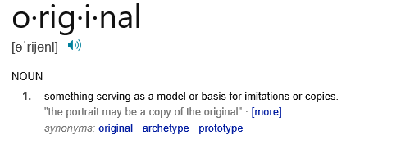
Original
To be original is to be the first of something
  Something that’s worth replicating
  Something’s that worth recognizing as unique
  Something that is a template for the future
What is it about the credit union model that is original and worthy of carrying forward to the future?
What is it about our cooperative network that is original and worthy of carrying forward to the future?
Why should we be confident about our abilities to meet future challenges, based on what we hold onto from what was original about both models and our network?

Slide 10
Unique, not Original
We should we emboldened to take on the future based on our unique qualities in the here and now
We should be confident based on our connections to the original concepts, organizations, and individuals who proved that consumer-owners could succeed
We are the pioneers of our future, as were people just like us who were the pioneers of the past, creating templates for success
We must see the next 50 years in the same light they did
I am unique, but I am not alone, for the original are with me and all around me
I am connected

Slide 11

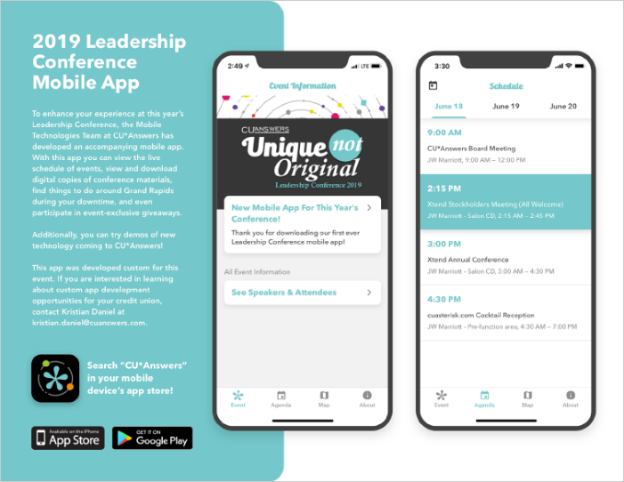



Today’s Agenda
Have you downloaded the conference app?
Preview prototypes:
About > Coming Soon
Catch a ride:
Map > Conference Location
Can we be transformative pioneers for our futures?
  Conversations with some industry icons
Can we spark a credit union retailing revolution?
  It might all start with the Internet
What is the future of the It’s Me 247 suite?
  How will the mobile business change how we think about these channels?
Defining teller platforms for our future
  Retail strategies in flux require investments that cover the board
Check it out in the app!
Notes:
description of the presentation and how it ties with the agenda – Why is Chip and Ed here and what I hope it will mean to the audience and what is next, even a year from now.
The front row crew and the hopes for wrinkles through the day
The app and what is next

Slide 12
Can we be transformative pioneers for our futures?
Notes:
Renewal is the responsibility of leaders in the present, planning to hand off to leaders in the future

Slide 13
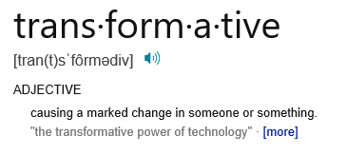
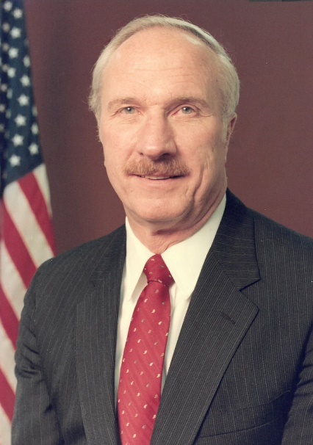
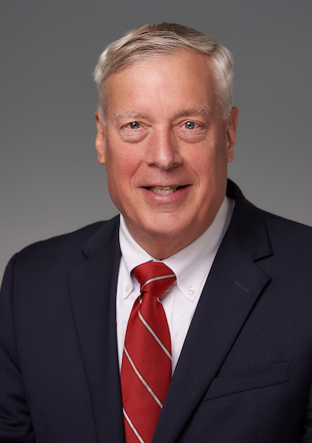
Can we be transformative pioneers?
Is there an echo in here?
Over the years, there have been many moments when our industry has been transformed
There have been many individuals who took the chance to push us forward – what can we learn from our connections to some of these pioneers?
As we face the future, how will future generations step up and transform our industry and organizations again and again?
The future is here
Ed Callahan
Chip Filson
Notes:
Introduce the format for this section – explain that I hope they get caught up in the emotion of hearing Chip and Ed on stage together and that the impact moves them to do something, to be a pioneer
It make take a few times to catch all the points and ideas from this presentation – in your packet are some materials that will help you think more about this when you leave today – audio/videos will be posted online
Introduce Chip
For five decades Chip has been observing, analyzing, writing and working with credit unions at all levels in the movement. His vantage points as a regulator and industry counselor have led him to focus on macro trends and movement strategy.
His starting point is data: what are the individual or industry trends and what do they mean for now and in the future?

Slide 14
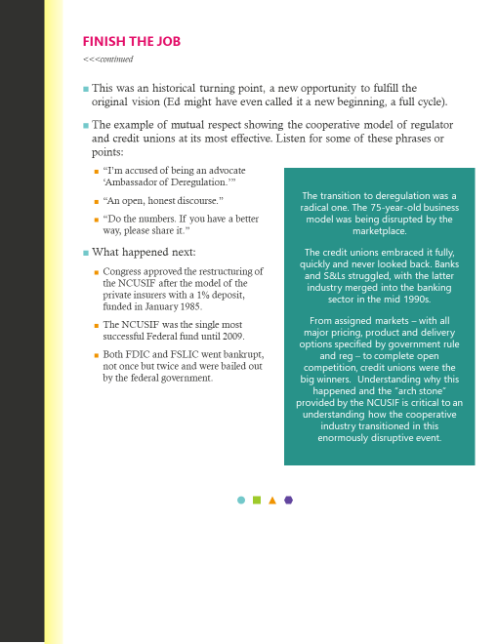
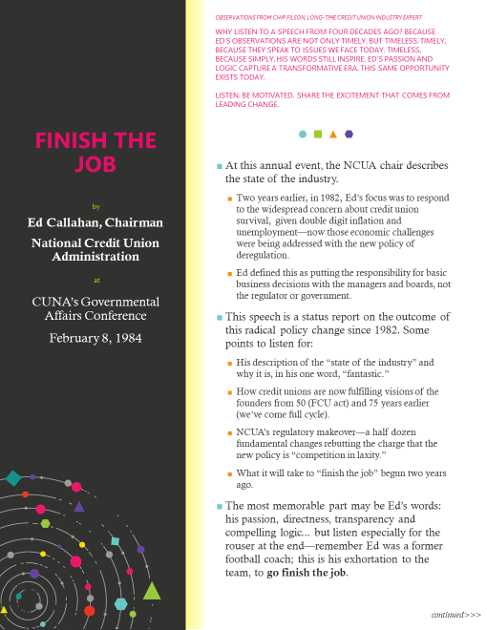
Finish the Job
Ed Callahan, Chairman
National Credit Union Administration
CUNA’s Governmental Affairs Conference
February 8, 1984
Notes:
In my mind, the job is never done

Slide 15
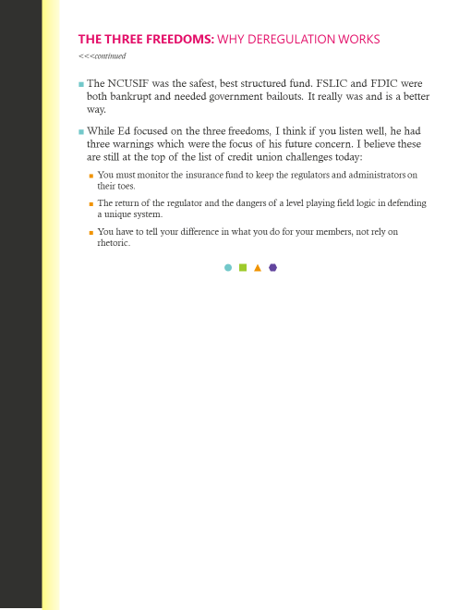
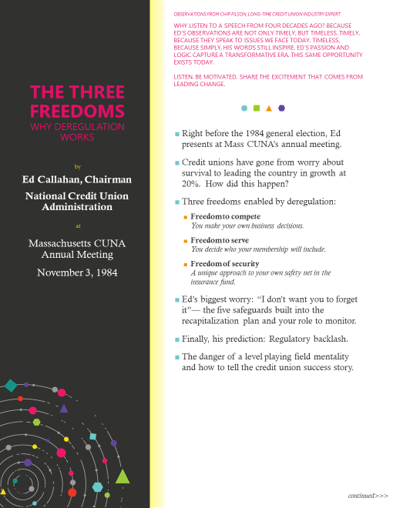
The Three Freedoms
Why Deregulation Works
Ed Callahan, Chairman
National Credit Union Administration
Massachusetts CUNA Annual Meeting
November 3, 1984

Slide 16
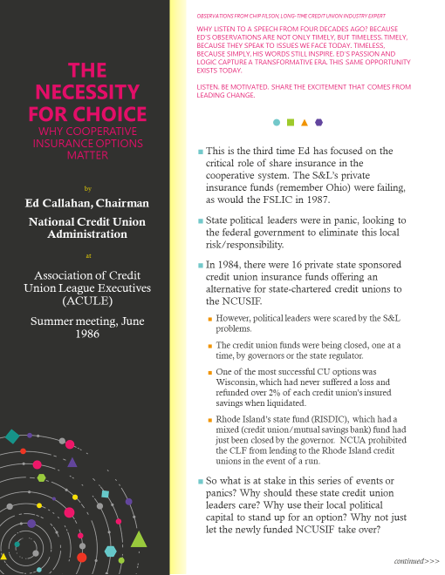
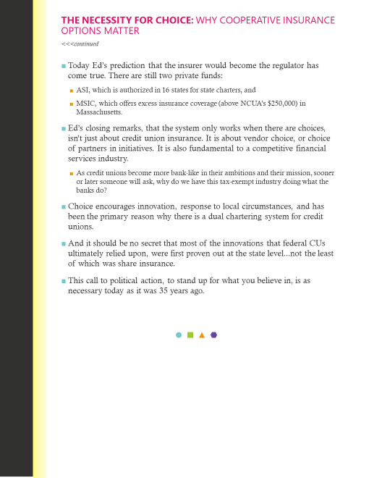
The Necessity for Choice
Why Cooperative Insurance Options Matter
Ed Callahan, Chairman
National Credit Union Administration
Association of Credit Union League Executives (ACULE)
Summer meeting,
June 1986

Slide 17
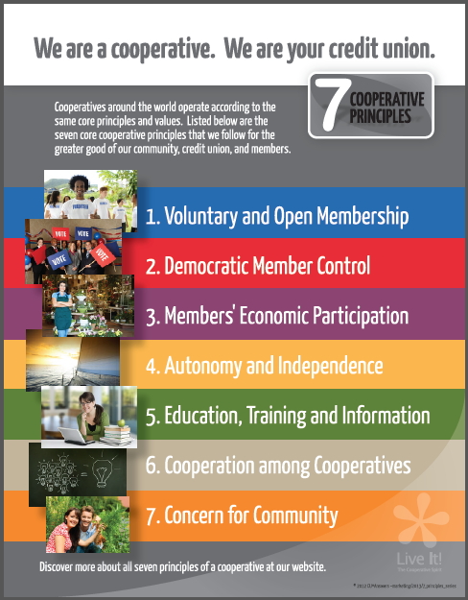
Unique, not Original
We live in the present, and are focused on the future
So we can sometimes overstate the challenges and see the future as more daunting than anything faced in the past
The truth is, we can be sure the pioneers who came before us felt the same way
Like them, we are armed with the same skills and ability to extend our industry well into the future...if we simply step up
The pioneers of our future are right here in this room
Icons only become icons through their day-to-day efforts in simply showing up
Notes:
Tie this experience with the experiences in front of us all - lift it all up
Don’t forget to bring it all down to real - still just the work and the effort - working stiffs who transform the world three steps at a time.
One thing we all have in common is we put our faith in the 7 principles – applied to our daily lives and for our futures
pioneers and ICONs put their pants on like the rest of us…..the future is not that daunting, we are tooled to take it on, and we simple need to accept we can and go to work. Chance to send a visual on CU principals and talk about the timeless trust we should have with those ideas

Slide 18

Transformative
Enhance intra-industry cooperation, where the fate of any individual institution is also the concern of the networks (often CUSOs) in which they participate
Increase the cooperative literacy, and hence, the roles that members play in the credit union—moving from being consumers of products to owners focused on effectiveness of the institution in carrying out its purpose
Reestablish the mutual respect between the industry and its regulators—to expand choice of regulatory oversight and cooperative innovation for system security and strength
Three ways chip Filson believes our industry can be Reinvigorated
Are we up to the challenge? Can we identify projects that would push us forward?

Slide 19

Transformative
Five major initiatives that we are trying to push with NACUSO and national CUSOs:
A national CUSO fund for de novo credit union support
A CUSO-led effort to inspire private insurance alternatives in all 50 states
A national CUSO service scholarship fund to support struggling credit unions via CUSO services
A national CUSO cooperative design think tank
An effort by CUSOs to impact the selection process for the NCUA board of directors
Can CUSO collaboration be a force for change going forward?
NACUSO CEO Jack Antonini will be visiting CU*Answers on July 18th to discuss this agenda

Slide 20
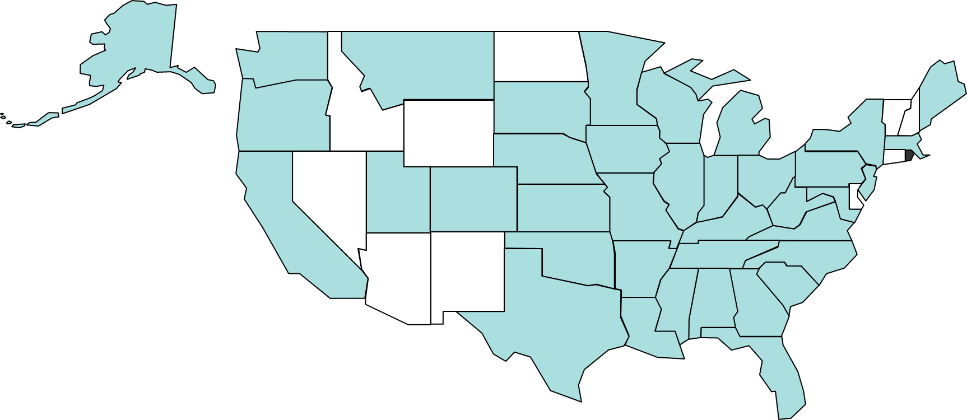


Transformative
Spark a retailing revolution: it all starts with the Internet (with Call Centers close behind)
Redefine how websites and automated banking sites interact and engage members
Rethink how we use the Internet to serve, vs. how we use the Internet to earn
Transform lending opportunities: from an application process to dynamic loan offers, 24x7
Build our own loan decision model as an alternative and complement to the FICO approach
Inspire a generation of credit union analytical leaders and a CU stakeholder community armed with data
Leverage APIs for builders, not just to hook up to things you buy
CAN OUR COMMUNITY COMBINE STRATEGIES AND TACTICS THAT WILL SET US ALL APART GOING FORWARD?
These are the opportunities we’ll cover over the next few hours
Notes:
These are the pretty words I used to describe the agendas from everyone who participates in our boot camps and other collaborative events

Slide 21
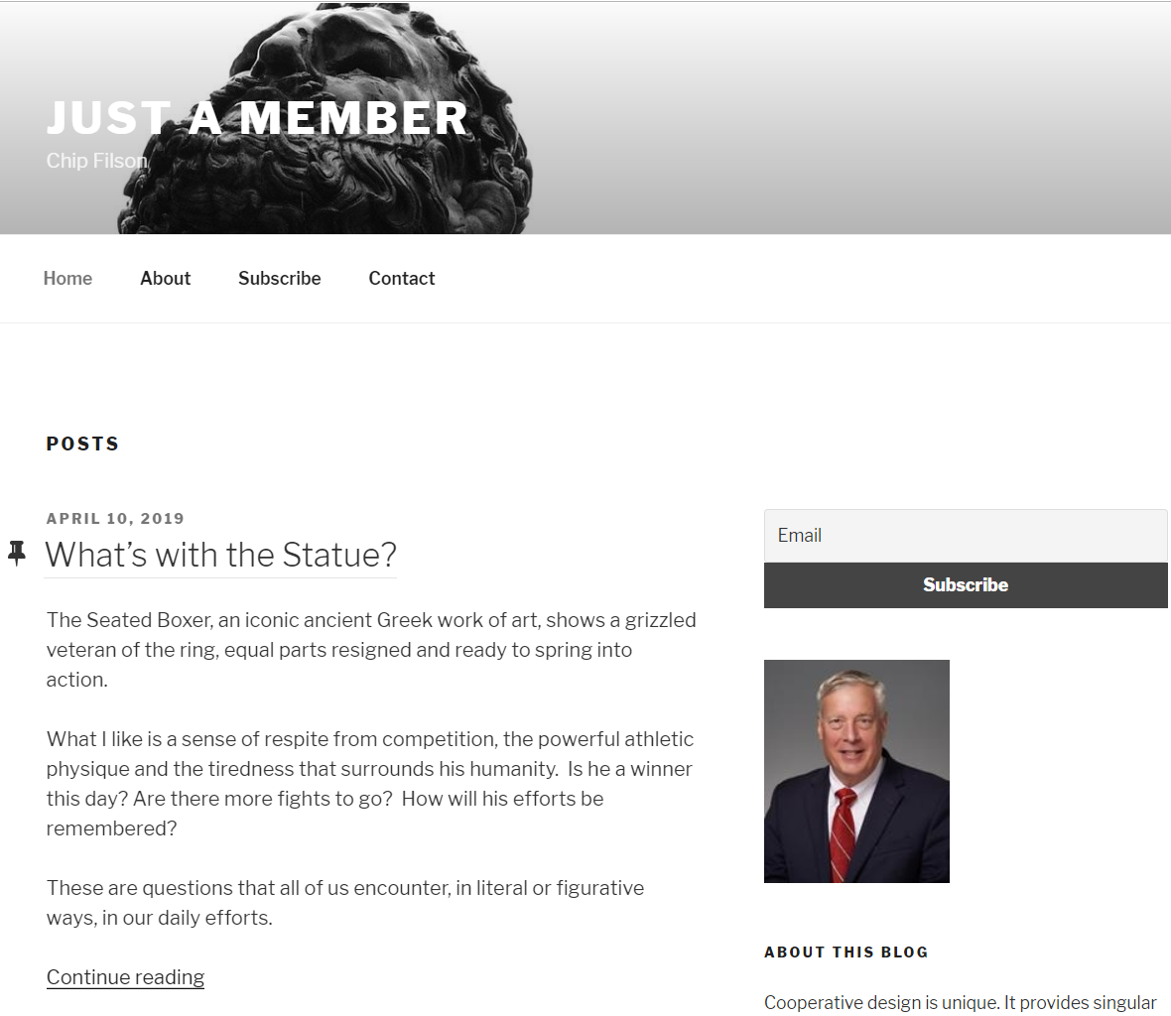

What’s next for Chip?
Join the conversation...
subscribe today!
Telling the credit union story
Place members at the center of the story – make sure you’re working on their agendas as your own
Connect the founders’ passion and purpose to our evolving multi-tiered cooperative system
Highlight the incredible opportunities of the cooperative design
Listen, analyze, and communicate my wonder about it all
https://chipfilson.com/
Chip Filson won the
Robert H. Mackay award in 2012
Notes:
Something about the NCUA insurance money??
Chip’s thoughts:
The Hamilton musical’s final challenge: Who tells your story?
My goal: Continue to connect today’s multi-tiered credit union system with the purpose and values of the founders. To always put the members interest first.
How: Listening, analyzing, writing and speaking about the incredible opportunities of cooperative design-and its challenges.
Result: To support the next generation of cooperative leaders however I can.

Slide 22
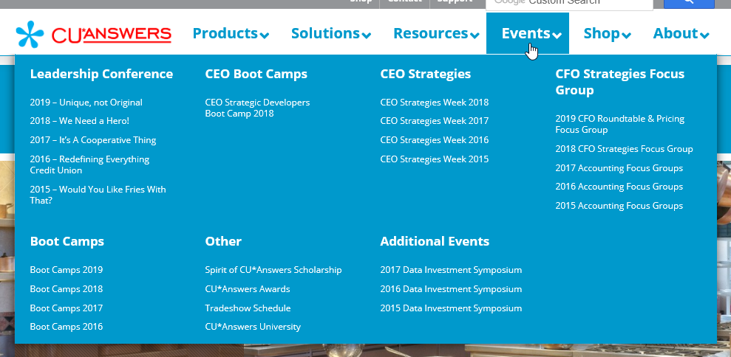
How are we inspiring pioneers?
By our collaboration and our cooperative’s drive
We simply show up and do the work to understand each other’s agendas and commit to working together on all of those agendas
When it comes to the task of building technical solutions, pioneers are stepping up every day in our network
Notes:
pushing the fact that we are doing the work, getting in rooms together, and building the pioneers every day – ICONs yet recognized
This was a different kind of year for boot camps, by design
We knew we were approaching our 50th anniversary, and there is a unique opportunity to work with everyone on what will be unique about the next 50 years
Do we want to jump the track and think differently than the constant push of evolution – are we ready to think about revolution
This was a year when we were in search for the specs for the next generation
We found some short-term wins that are driving us this year, and will drive us hard in 2020
But we also found a hunger for what we can do even further out into the future
But the farther you look into the future, the harder it is to find a documented, guaranteed spec
But we have to encourage this hunger, increase this hunger, and leverage this hunger so we can sustain our efforts and inspire another generation of pioneers
2016: Building Solutions in a Network and What Makes Data Valuable
2018: Added the DHD Bootcamp
2019: Dropped the Solutions/Data boot camps, added CEO Strategic Developers Boot Camp

Slide 23
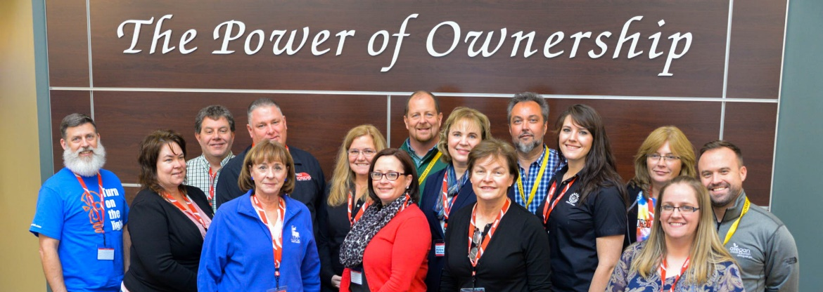
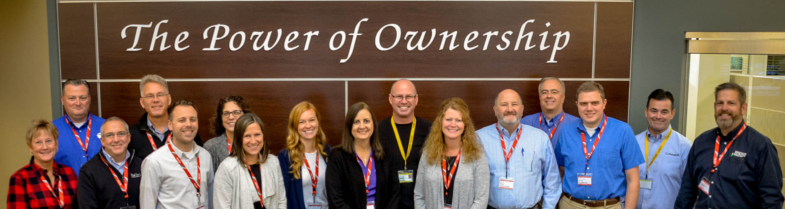
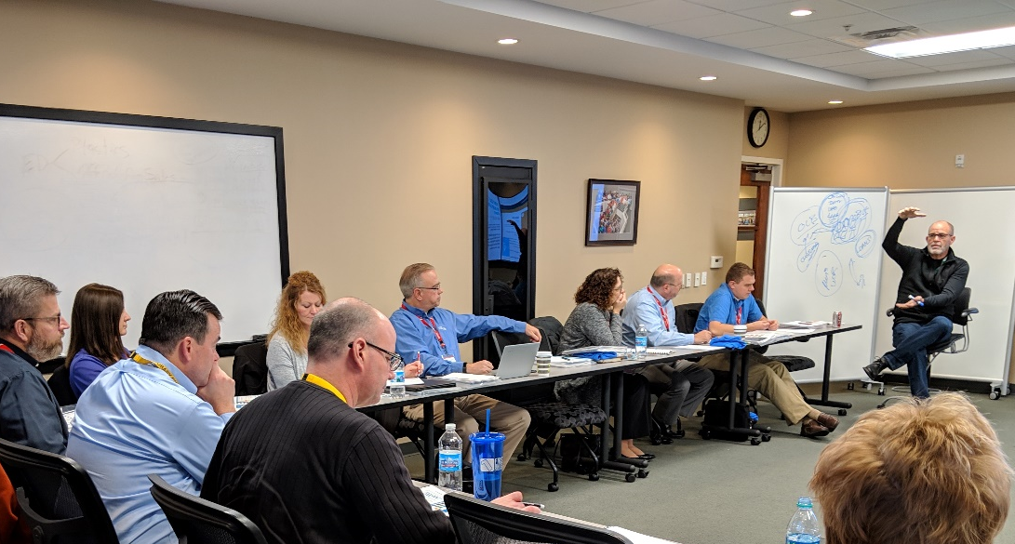
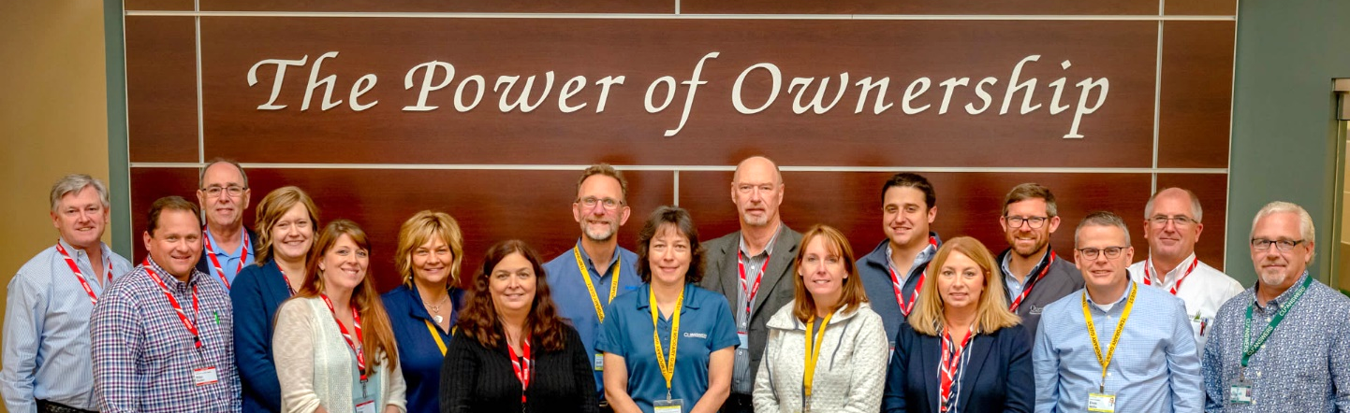
How are we inspiring pioneers?
Are these tomorrow’s icons?
CEO Strategic Developers Boot Camp
November 2018
Notes:
thanks to the people who worked so hard this year

Slide 24

Collaborating on a Builder’s Agenda
CEO Strategic Developers Boot Camp to outline the direction that our CUSO and CEOs wanted to prioritize
Webinars to let CU teams know what the CEOs were collaborating on and thinking about for the future
Task Force meetings for people who would engage and be the foundation of our beta-tests and rollout
Finding customer-owners who want to take ownership of where we’re going, and why
Reinforcing our culture of including the customer-owner as the most important ingredient for our cooperative
Notes:
We take the time to include the owner even when they don’t want to be, when you have to beg them to join
Have to convince owners that they run the show – you signed up to make them care, to prove to them that you care

Slide 25
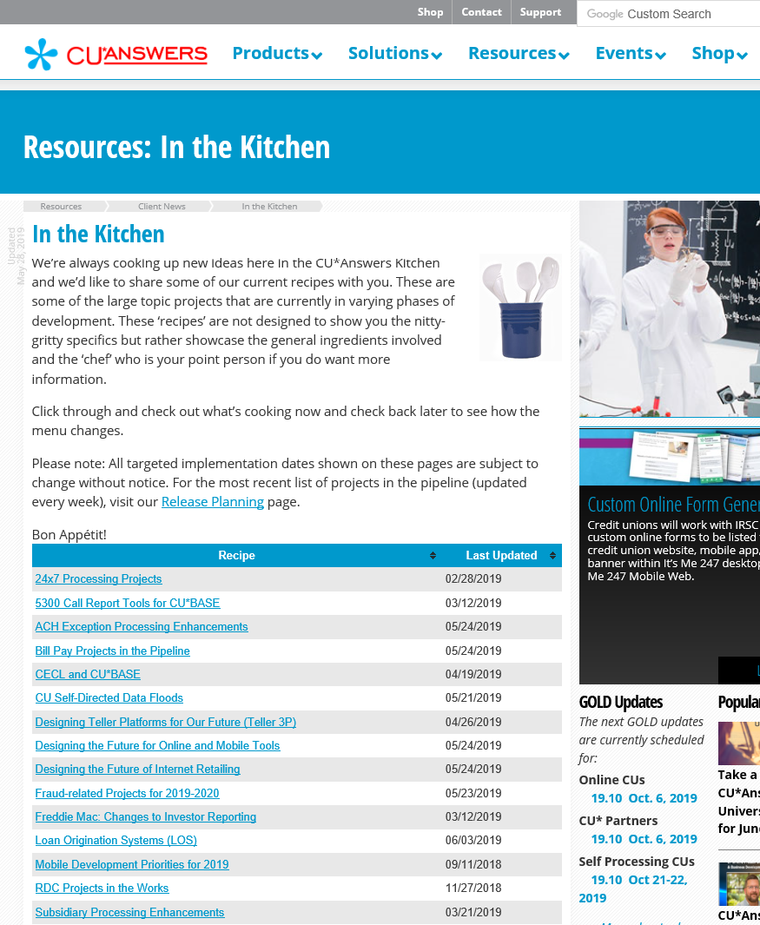


Keep an eye on the work of our network’s pioneers
It’s easier than you think to be inspired
ownersview.cuanswers.com
cuanswers.com/resources/kitchen
ownersvoice.cuanswers.com
Notes:
great things are happening everyday if you look to see it – skill and talent is everywhere, and the leaders we needs are all around us.

Slide 26

Unique, not Original
Tying it all together

Slide 27
Can we spark a credit union retailing revolution?
IT MIGHT ALL START WITH THE INTERNET
Notes:
Introduce this section and two co-hosts, David and Geoff
David selling the Internet Store concepts
Geoff selling the fact that to make our point about making money via the Internet, we chose loans

Slide 28
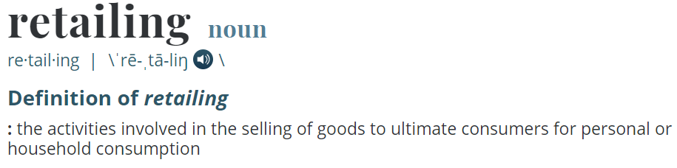





Can we spark a credit union retailing revolution?
Thumbnails of videos
Amazon is a sexy store, and can be held up as an example of the ultimate endpoint
But we need to start with who we are, how we wish to change, and how that would yield a better model and a new outcome
Advertising
Location, Location,
Location
Product Display
Convenience
The Online Store
Notes:
Consider telling the group you’re not sure how these videos are going to play out today
Our hope is they are a fun way of making our point that they should think about retailing strategically, and analyze what they are doing today and why, then compare that to who they hope to be in the future
To transform their retailing, they need to reset their foundations and look for the “ah ha” moments

Slide 29
Advertising: Where are you focusing for the future?
Things vs. themes (who would think amazon.com could sell 600 million things?)
ADVERTISING THE INTENT OF
OUR SOLUTIONS:
Selling things and our task-based expertise
ADVERTISING THE HOPE OF OUR COLLABORATIVE:
The voice of our owners and our community
Digital content about our products
Email blasts
Education events
POV contacts
Online stores
Etc.
Championing the virtues of the cooperative business design
Adding our voice to industry leadership as owners of cooperatives
Building win-wins with the owners of credit unions
Extending our market to extend our community

Slide 30
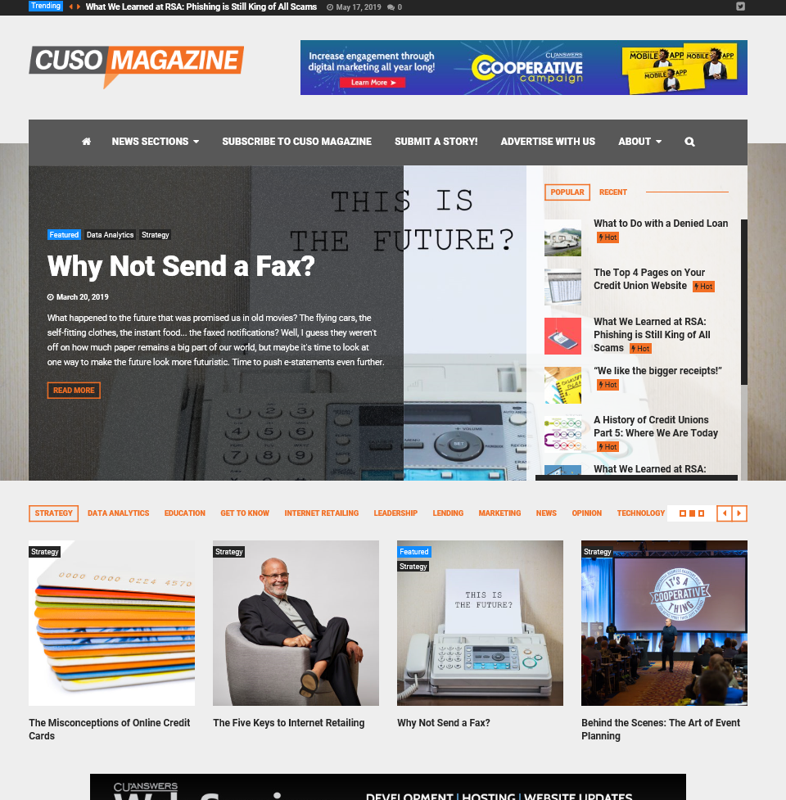
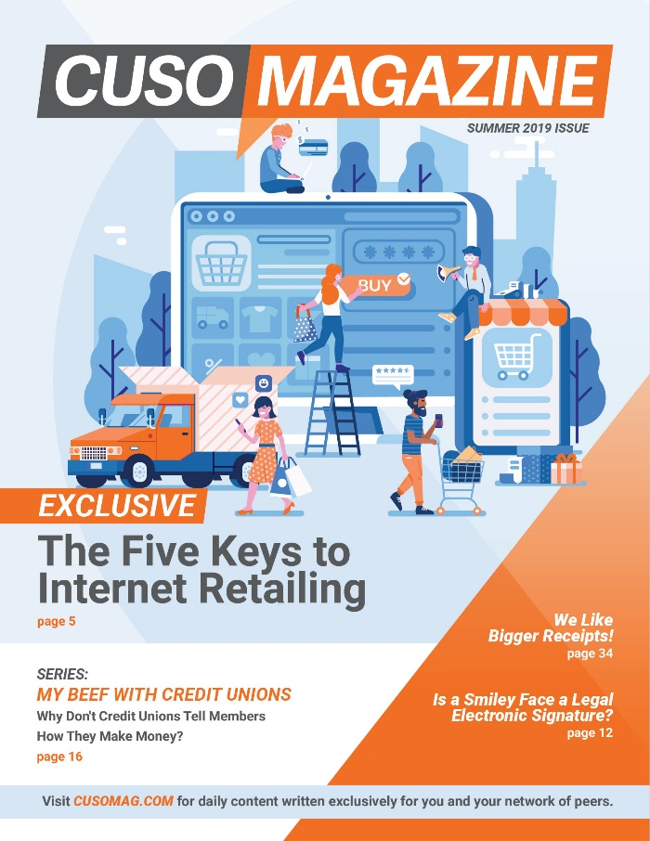
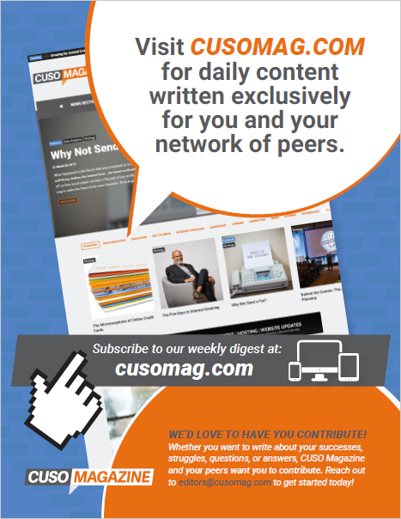
Why we’re investing in CUSO Magazine
Because the internet changed the game: our community is the focus
cusomag.com
Hang this one in your breakroom!

Slide 31
Location, Location, Location
The internet has changed the “where” we reach members
It used to be whether you had enough branches, and whether they were on the right corners
Today it’s more about where you’re retailing, and the forms of retailing, than just the simple duplication of a single strategy, over and over
  Do you have a retail call center?
  Do you have the right online branch?
  Is mobile taking over your branch strategy?
  Do you have an Internet-based store?
  Are you growing in the right locations?
Teller
Call
Center
OLB
Mobile
Online Stores
2019 CEO Strategic Developers Boot Camp Projects
In the past, we looked for projects that improved an internal process...today we’re studying how to activate a retail channel and add it to your overall approach to the market

Slide 32
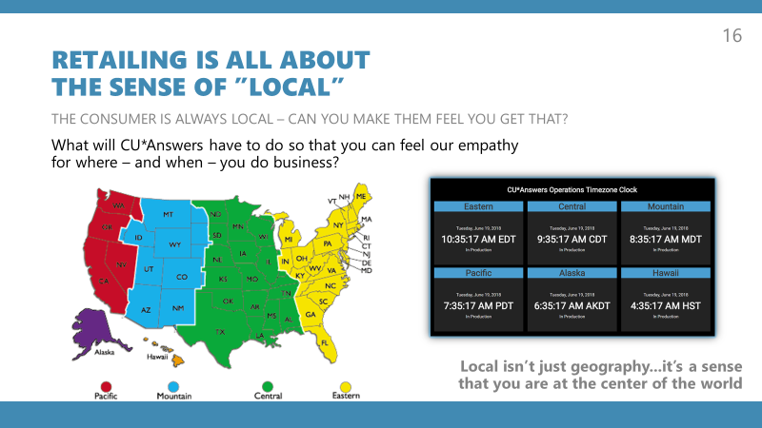
Location, Location, Location
The internet changes the WAY YOU CAN FOCUS ON LOCAL
A focus on time
(24x7)
Your commitment to local (Ops time zone processing)
Your emphasis on when your retailing is available
(2nd shift client support and network services)
Your investment in a community (geographic, lifestyle, affinity) of customers

Slide 33
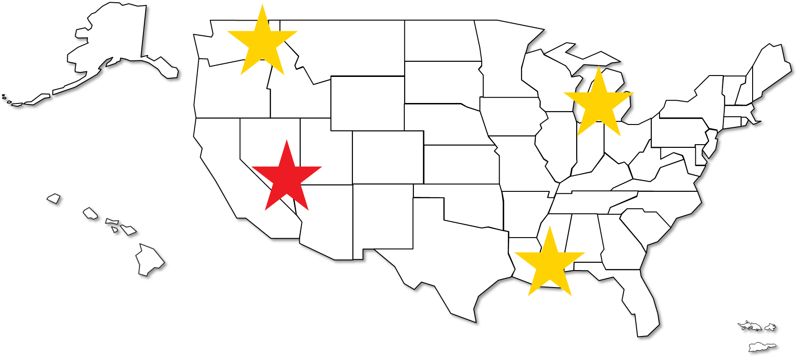

Location, Location, Location
What would you think about a new CU*Answers location in Las Vegas?
A client support center,
a programming center, and a new
marketplace persona
The internet changes the WAY YOU CAN FOCUS ON LOCAL
A focus on time
(24x7)
Your commitment to local (Ops time zone processing)
Your emphasis on when your retailing is available
(2nd shift client support and network services)
Your investment in a community (geographic, lifestyle, affinity) of customers

Slide 34
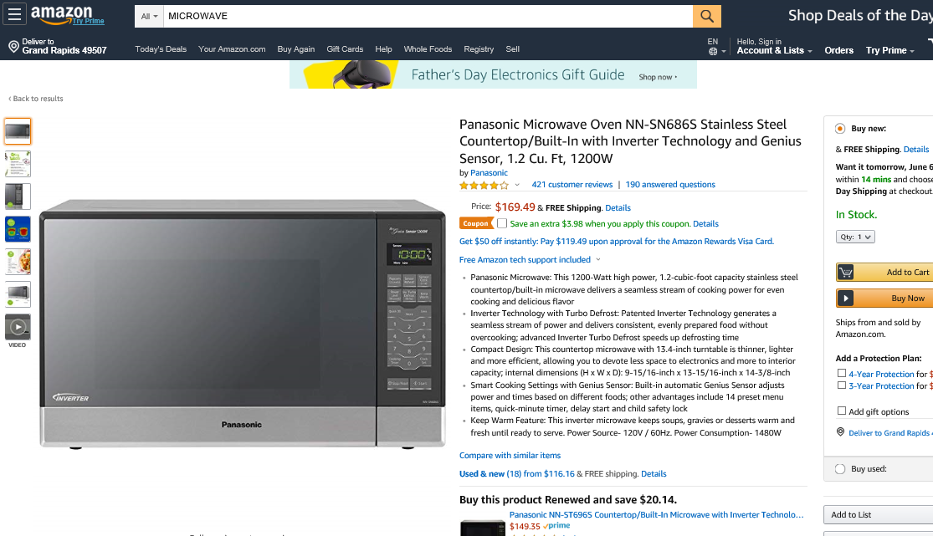
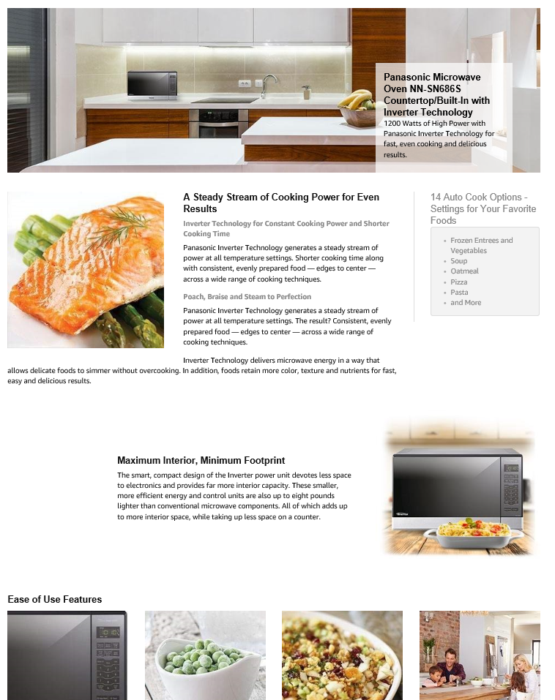
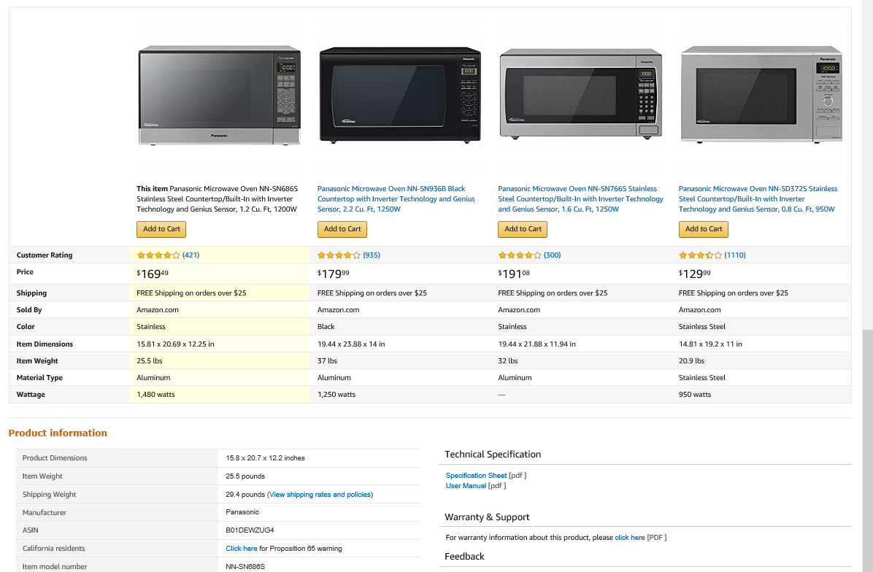
Product Display
The internet forces retailers into a new contract with customers
More than anything else, the Internet has redefined how you display, describe, and inform your customer about your products, services, and inventory
Digital content is king
Access to that content must be shared between the internal employee and external customer
Practical data about what you sell is as respected as the glitz that you use to sell it
You can’t rely on your customer understanding the commodity you sell – you must explain it as if it was something brand new

Slide 35
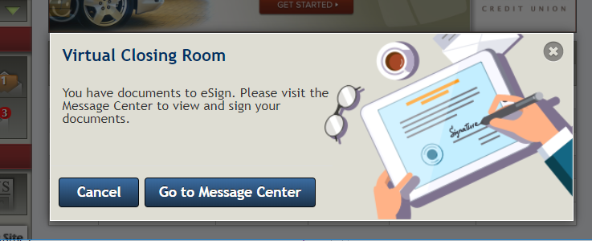
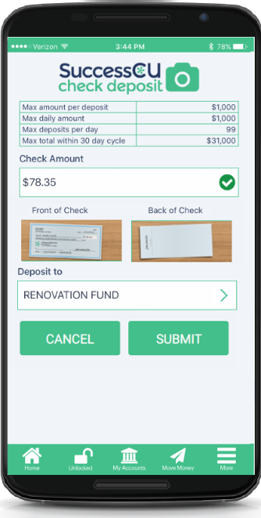
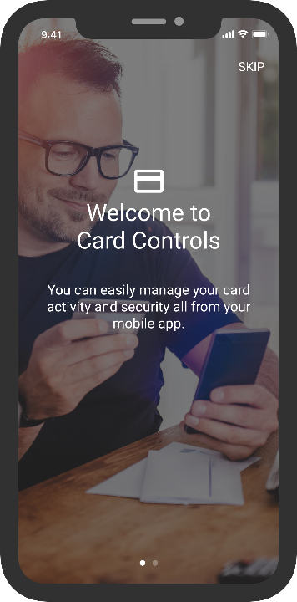
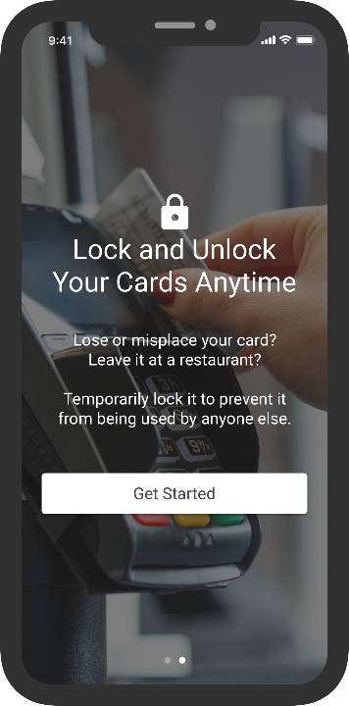
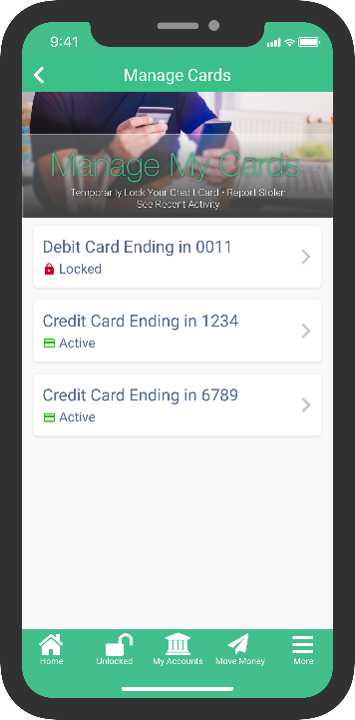

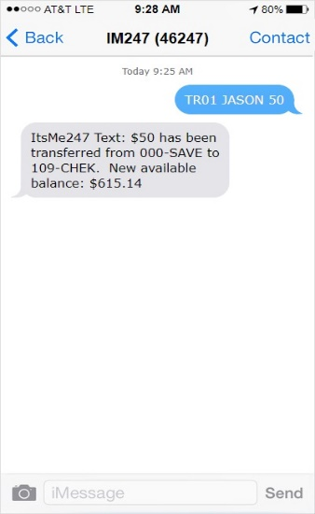

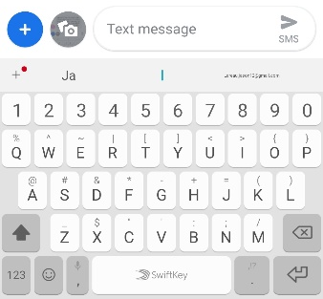

Convenience
Another word for “in your face”
Today’s retailer can be with the customer no matter where the customer is
90% of our projects are about convenience, either the member’s or your staff’s
Look for even more in the future
Are you ready to collect revenue for being more convenient, in a world where customers pay for it every day?
Notes:
Today’s retailer can be with the customer no matter where the customer is
But does that mean it’s convenient? It might just be invasive
This is where to announce we’ve extended the contract with MACO – have the details ready

Slide 36
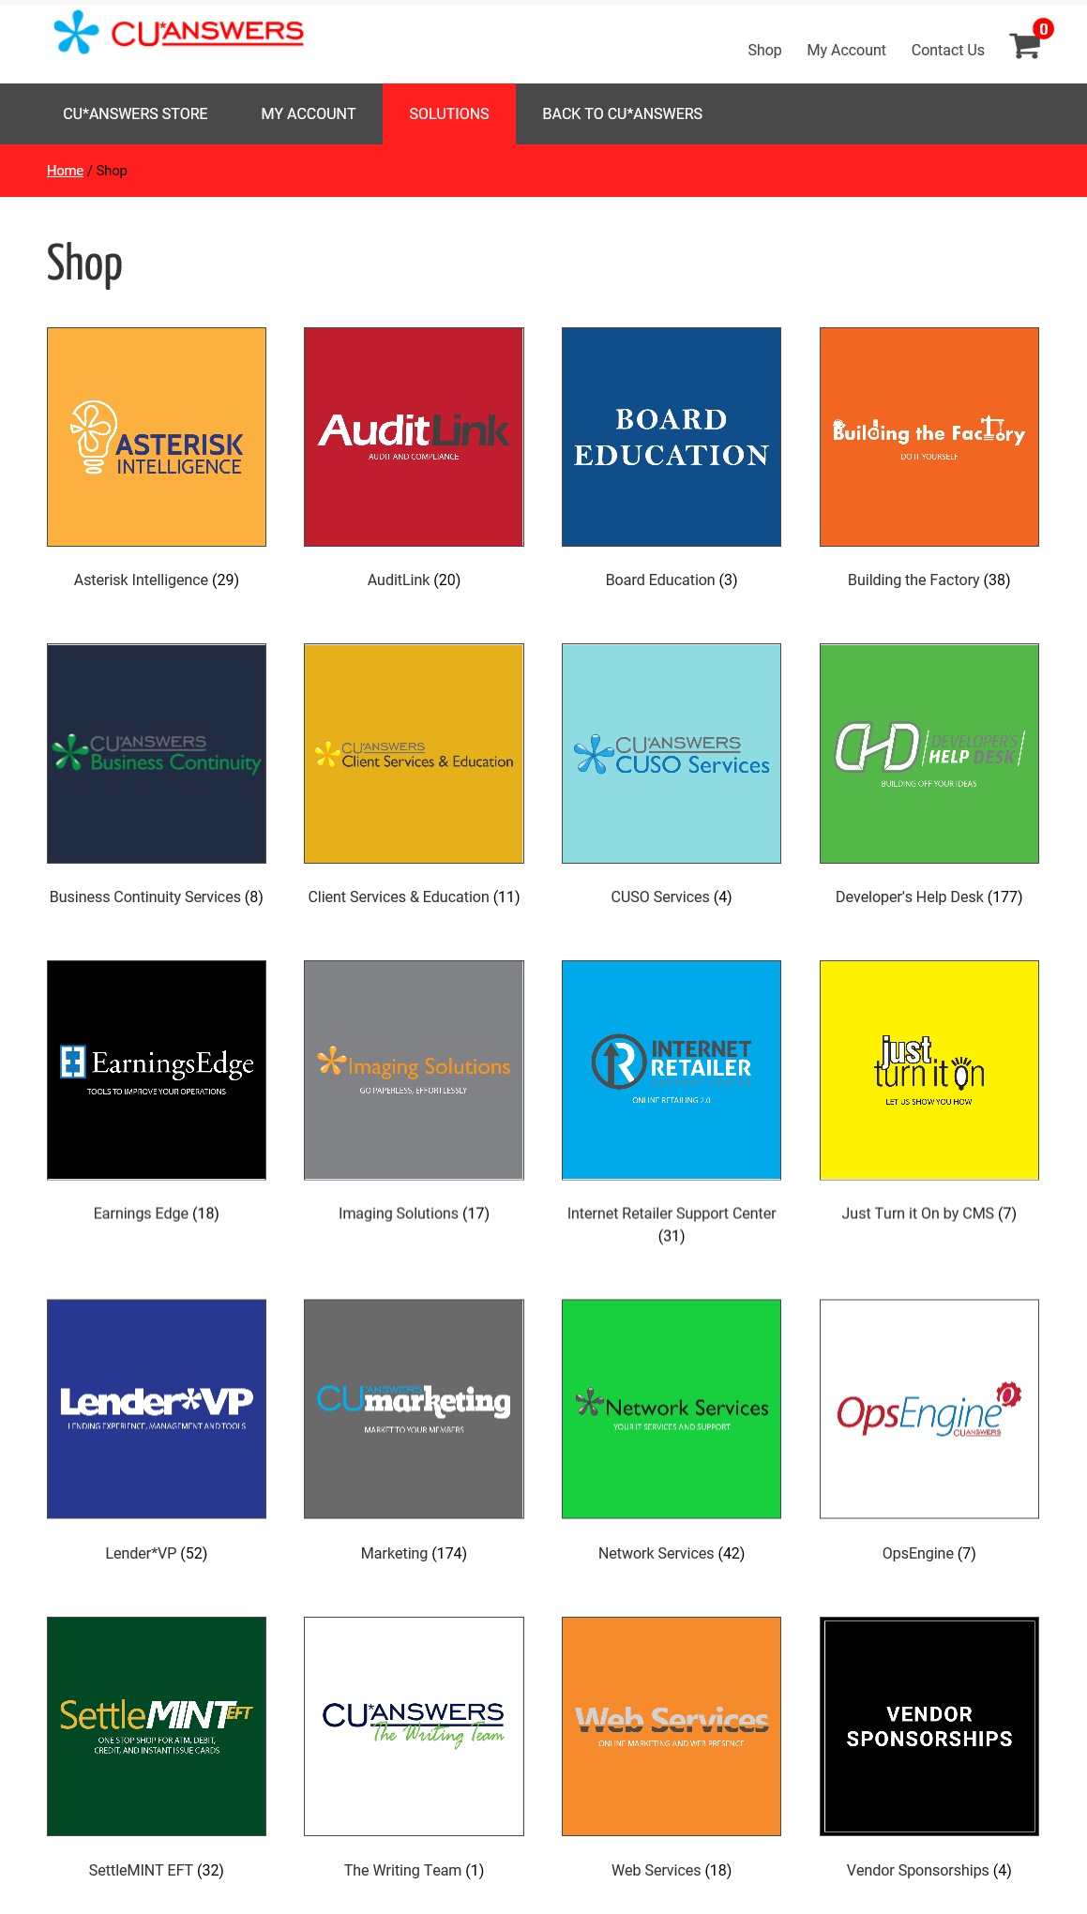
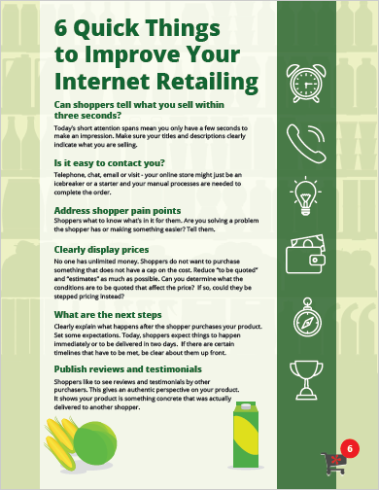

The Online Store
Is it time to rip off & duplicate?
More than just being a template, CU*Answers wants to be a firm that helps you build online stores
If you build an online store in earnest, it will change your organization, how you see the world, and how the world sees you
It’s more than a task, it’s an awakening to how business has been changed by Internet commerce and the expectations of consumers for everything they buy, even if they don’t buy it on the Internet
We want to help you change your retailing
store.cuanswers.com

Slide 37
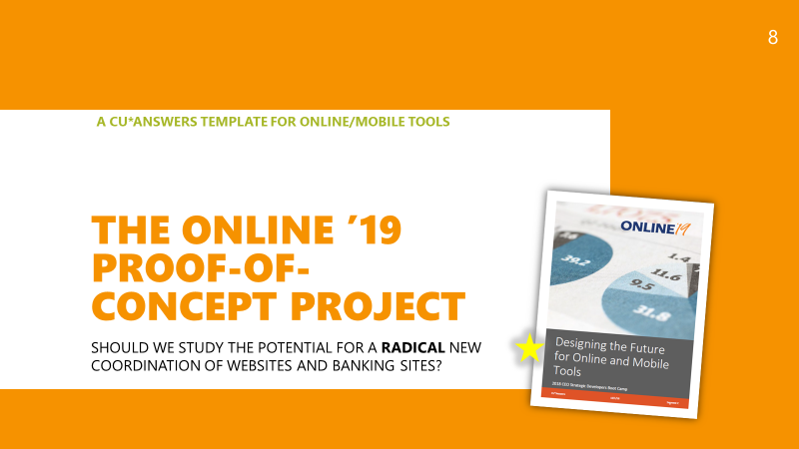

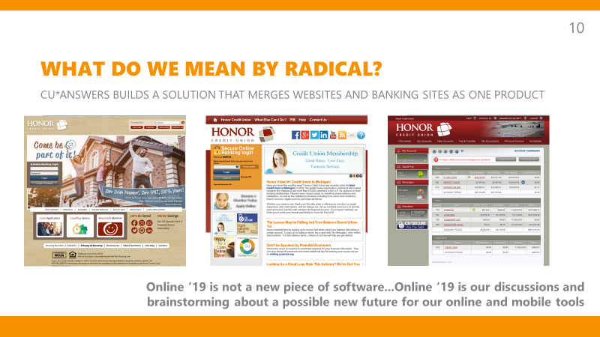
Where should credit union online stores live?
desktop banking? Mobile banking? The website? Or a combination of them all?

Slide 38
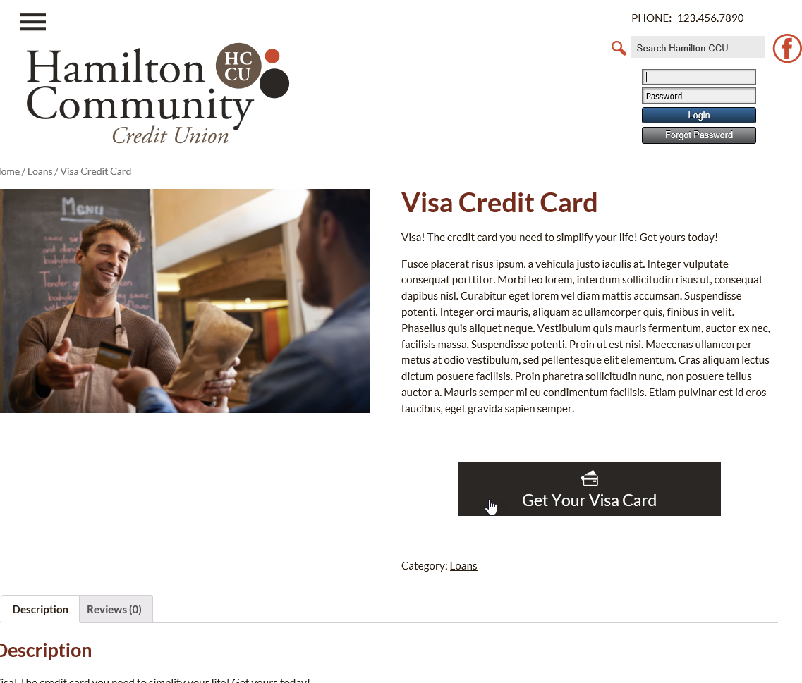
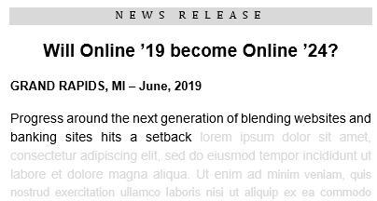
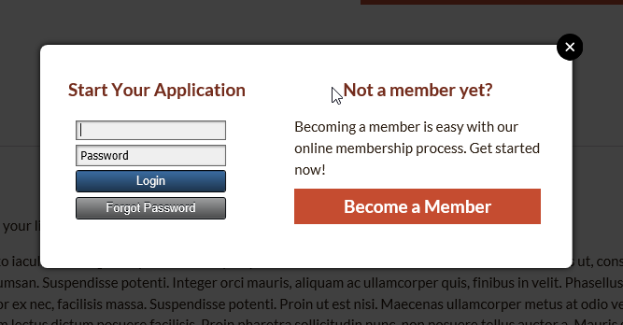
Where should credit union online stores live?
desktop banking? Mobile banking? The website? Or a combination of them all?
I haven’t given up on this goal yet, we’re just going back to the drawing board based on some Internet browser changes

Slide 39

Can credit union online stores do more than serve members?
Is it too radical to think credit union Internet services would directly collect revenue?

Slide 40
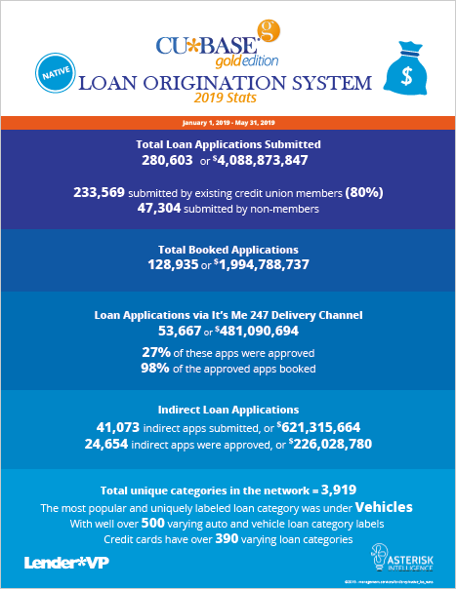
Do you do loans instantly on the Internet without any employee intervention?
A common RFP question for our CUSO and for credit unions
We want everyone to be able to answer YES to this question
  It only took writing one new program to be able to say our software can do it
It will take a little more work to say our community does it, in a big way
This is the project that we took on with our CEOs this year: Change the
minds of all our participants that this is possible, and they should do it
  Bypass the application and make it a simple click to open a loan
  Make sure that click is available as close to 24x7x365 as we can
  Let credit unions ease into it, on the way to bigger and better things
  Use the power of data and intuition to make offers, instead of
  waiting for requests
  Without a doubt, reinforce that the Internet generates revenue
Notes:
In the past people asked me if we had internet loan application services, and we did
But when the question here got asked, I had to say no, because we stopped short of actually opening the loan – we still left that up to the CU’s processes post the application
Now we just have to connect the program to tools that close the loan
FYI, CU*@HOME had loan applications probably as far back as 1999 or very shortly thereafter – I found a mention of the rate boards in a 2001 release summary but it was obviously just an enhancement to something already in place

Slide 41

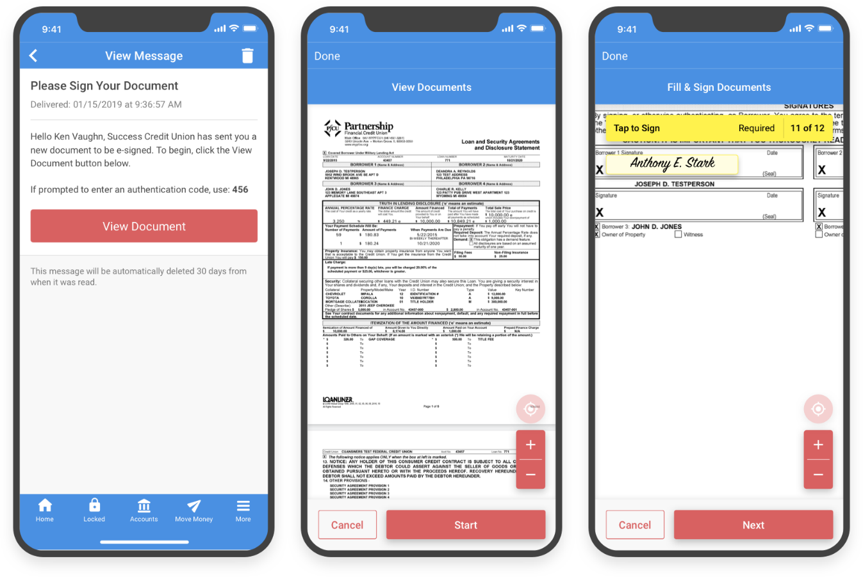
What makes this strategy possible?
What will give you the confidence to join us in this effort?
You can catch the attention of the member (location, location, location)
You have processes (data) to make the right offers and control the risk
The member can accept and it’s a done deal (convenience and trust)
The member can validate their intentions and sign on the dotted line
The member has immediate access to funds, via a familiar environment
Introducing...
Notes:
The timing of this is right

Slide 42

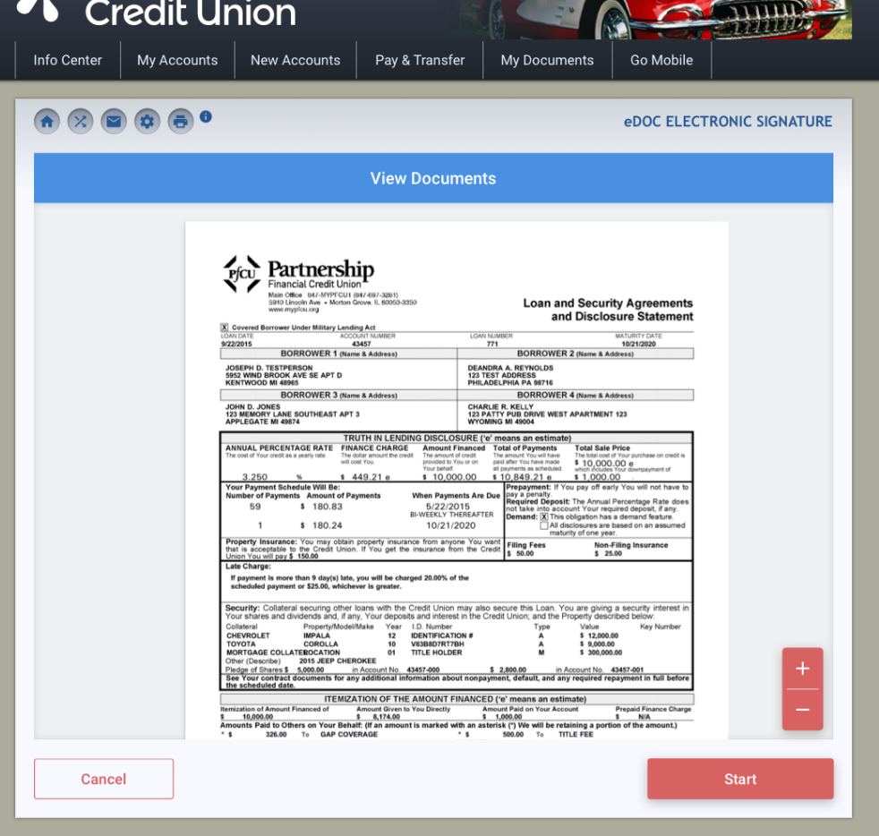
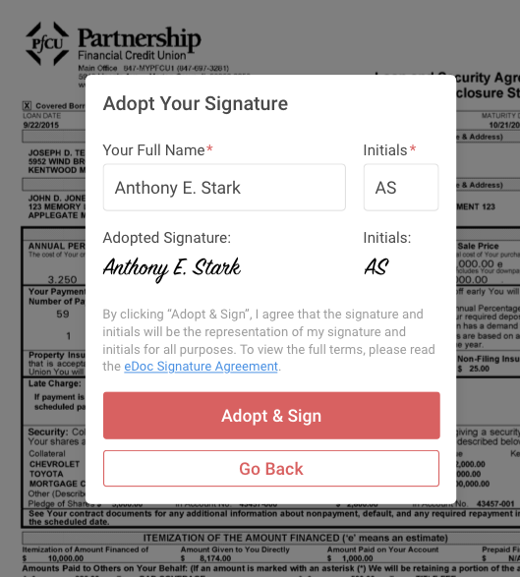


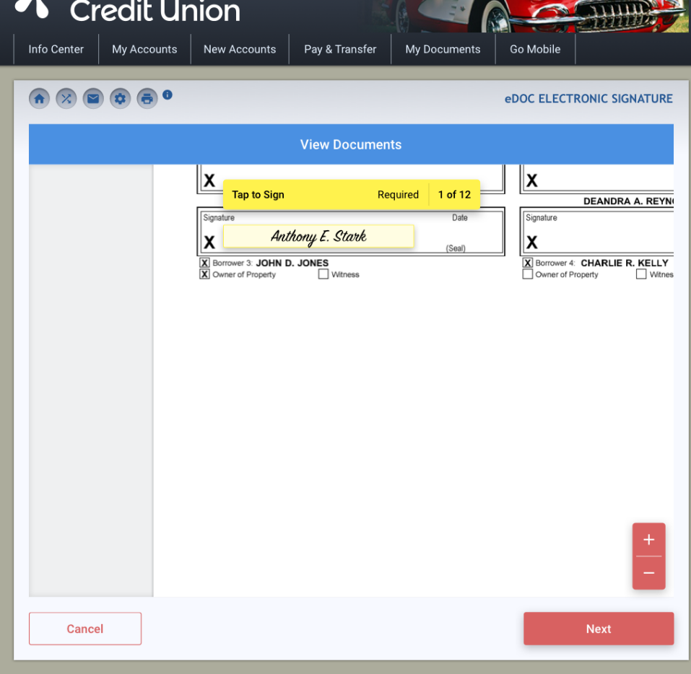
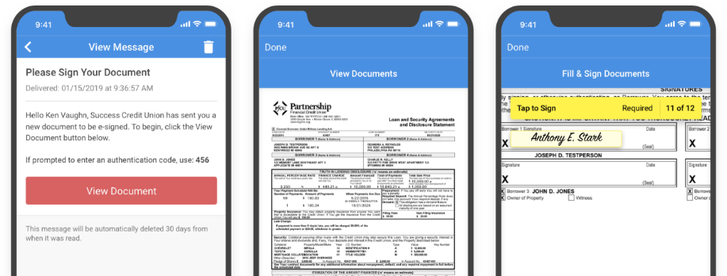
A New eSigning Experience
in It’s Me 247 desktop and mobile
Document appears inside of It’s Me 247
Can see the document before you sign
1-step signature setup
Document zooms into the right spot so you can just tap to sign!
Check it out in the app!
Notes:
A new eSign experience is coming in It’s Me, a new engine that will become a part of virtual closing rooms, embedded in It’s Me, used by 1Click and other similar products, etc.

Slide 43


1Click credit card offers via It’s Me 247 desktop and mobile
Can credit union online stores do more than serve members?
Members are identified based on credit union defined criteria
Credit card offers will display in
It’s Me 247 desktop/mobile banking
Acceptance of the offer is member-driven, and funds are available immediately
CU is notified of acceptance and handles card orders as usual

Slide 44



1Click credit card offers via It’s Me 247 desktop and mobile
Can credit union online stores do more than serve members?

Slide 45


CD-secured loans with instant account creation
Can credit union online stores do more than serve members?

Slide 46



CD-secured loans with instant account creation
Can credit union online stores do more than serve members?

Slide 47


Loan modification requests (auto-approved or sent directly to your underwriter queue)
Can credit union online stores do more than serve members?

Slide 48



Loan modification requests (auto-approved or sent directly to your underwriter queue)
Can credit union online stores do more than serve members?
OR

Slide 49


On-demand ACH deposits for a fee
Can credit union online stores do more than serve members?
“Post Now” appears on deposit transactions waiting in the warehouse

Slide 50


Introducing a new alternative for auto-decisions
Can credit union online stores do more than serve members?
So you approved a loan because you knew the person and
trusted the experience you already had with them...
CLR Path will help you validate what you claim to know, and confirm that you checked
Mockup only; subject to change

Slide 51


What data do you think defines a relationship?
CU*Answers has architected our database – what are you doing?
Later today we’ll talk about the AI team, but I want you to consider what you’re doing with new database administration tools that allow you to define data, collect it, and use it interactively with CU*BASE and It’s Me 247 products
Beyond what CU*Answers plans for CLR Path, what data might you add via UDM that would give your member the nod of approval for a loan?
  CU-directed data floods to UDM is coming in the 19.10 release
Harness the power of data in 2020
We’ll start with a yes/no evaluation
of the member’s relationship...
where it goes from there is up to you
Notes:
Other AI stuff comes later
It’s the second year of UDM, which I think was one of the most powerful things we wrote in 2018 – explain where it could go when partnered up with data floods and a growing interest
Announce a new formal business intelligence focus group beta that we’re working on with Notre Dame and Honor

Slide 52





What’s up with our LOS solutions?
Ready-to-look (R2L) loans:
  Vendors: 9
  Integrated relationships: 83
  Apps YTD: 41,073
  Loan $ YTD: $226,028,780
Ready-to-book (R2B) loans:
  Vendors: 2 (1 in development)
  Integrations: 5
  Apps YTD: 7,502
  Loan $ YTD: $103,389,715
Notes:
Reference the native CU*BASE LOS flyer and all the great things we’re doing
Sell the concept of Charlie Dean managing 3rd party LOS integrations and our progress there
Sell the fact that we are now going to partner with Sync1 and add another auto-desicioins tool

Slide 53








Other Resources from Lender*VP
store.cuanswers.com
We want to inspire your trust...You’ll want to trust but verify
Join us on the way to the future

Slide 54
What is the future of the
It’s Me 247 suite?
How will the mobile business change how
we think about these channels?

Slide 55
What is the future of the It’s Me 247 suite?
Let’s focus on online banking first
Online banking mirrors CU*BASE in that it is one software application that serves many
  It’s Me 247 serves nearly 300 CUs with 2.5 million members, and handles over a million sessions a month
The It’s Me 247 brand and its general look turns 12 years old this year
  Last November CEOs discussed what’s next for the brand and the look-and-feel – is it time for a simple facelift, or is it time for a radical change?
Now that the foundation of It’s Me 247 is approaching a tipping point as to its use of APIs, we do have radical options should we decide to invest – the biggest idea is blending online banking services with websites (Online ‘19)
The primary projects we’ll take on over the next 12 months:
  Internet LOS already discussed
  A partnership with MTG to revitalize PIB as a base security platform for how members use these channels
  A partnership with MTG to complete a new navigation for our HTML
  It’s Me 247 Mobile Web
  Deeper dive with It’s My Biz 247
Everyone will drive the OLB team over the next 18 months to activate their priority APIs

Slide 56

Personal Internet Banking (PIB) re-envisioned for the next decade
Mobile and MACO may finally make this a member tool
Since the introduction of PIB in 2006 (yes, PIB even pre-dates It’s Me 247!), the world has changed
  We built an amazing foundation to appease the regulatory/security community, but the member experience was something CUs never really wanted
Opportunities to take everything prime time:
  Create a mobile PIB dashboard, ready for members to use
  Revisit and remove some security concepts that have fallen out of favor
  Re-document, retrain, and recommit our network to the idea that members control their experiences via desktop banking or mobile access
QUICK PIB STATS
FOR CU*ANSWERS ONLINE CLIENTS
AS OF 11/2018
67 CUs (35%) have it enabled
69 CUs (37%) don’t have
PIB enabled at all
54 CUs (28%) don’t let members change their
own PIB settings
Notes:
Learning to know the difference between what to put into mobile for the right reasons, and when do you take things out of online banking because they no longer fit
Turn off P2P in online banking and only make it mobile and/or add a confirmation code for P2P in PIB

Slide 57



Personal Internet Banking (PIB) re-envisioned
No more wizard...jump right to the setting you need
Check it out in the app!

Slide 58
A new navigation for mobile web, both It’s Me 247 and It’s My Biz 247
Our html mobile web solutions at the core of everything mobile
Early in 2019 we committed to a mobile web solution for It’s My Biz 247
  While it’s not clear that every business wants a mobile solution, it does provide us a new opportunity
We decided to introduce a new mobile navigation through It’s My Biz 247 users, as a proof-of-concept and testing ground
  By now both the market and our internal teams have a new expectation for what mobile web should look like and what features it should have
By October 2020, we will work with CUs to introduce this new nav as the foundation for all It’s Me 247 mobile web users in the network
It’s My Biz 247 mobile web beta tests are underway right now, but the limited audience is both a blessing and a curse – we need to get more people involved

Slide 59



A new nav for mobile web, starting with
Check it out in the app!
Quick look at balance and recent transactions
Full support for tablets
Choose your “favorites” to show on the home page

Slide 60

Is the Internet the best place to engage a new class of members?
Are business services old school, or can we start with a new school approach?

Slide 61
Is the Internet the best place to engage a new class of members?
Are business services old school, or can we start with a new school approach?
We’re implementing this fee in
October 2019

Slide 62
Announcing our first 2020 Boot Camp:
A formal business platform design team
2019 saw a rash of inquiries about our business platform design
Throughout 2020, I want to work with CU leaders who are focused on the business member community and its opportunities:
  Developing a member approach and the data configuration that identifies opportunities and results
  Plant the stake: what to call out on the Internet that announces your arrival as a CU for businesses
  Approaches for savings products and miscellaneous savings-related services
  Approaches for lending prices and miscellaneous loan services
  Internet online/mobile channel products
  Analyzing business members as direct members and their potential membership impact as SEGs
  Developing packages for business profiles
  3rd party vendor integrations and products, and services the CU is planning on
Is developing a business platform a CUSO investment, or it is a credit union a la carte shopping experience? We need to answer this question in 2020
Notes:
People don’t think we have a business platform
We don’t think you have a business platform
Talk to Geoff about having Charlie Dean to head up this effort and work with Pete and Keegan as a team

Slide 63



Announcing our first 2020 Boot Camp:
A formal business platform design team
The CMS consulting team that will coordinate our business platform development and advisory board
KICKOFF MEETING AT THE NOVEMBER 2019 CEO STRATEGIES EVENT
2019 saw a rash of inquiries about our business platform design
Throughout 2020, I want to work with CU leaders who are focused on the business member community and its opportunities:
  Developing a member approach and the data configuration that identifies opportunities and results
  Plant the stake: what to call out on the Internet that announces your arrival as a CU for businesses
  Approaches for savings products and miscellaneous savings-related services
  Approaches for lending prices and miscellaneous loan services
  Internet online/mobile channel products
  Analyzing business members as direct members and their potential membership impact as SEGs
  Developing packages for business profiles
  3rd party vendor integrations and products, and services the CU is planning on
Is developing a business platform a CUSO investment, or it is a credit union a la carte shopping experience? We need to answer this question in 2020
Notes:
People don’t think we have a business platform
We don’t think you have a business platform
Talk to Geoff about having Charlie Dean to head up this effort and work with Pete and Keegan as a team

Slide 64

The 2019 CEO Strategies Event
All events at the DeVos Convention Center
Update on
Last Year’s CEO Strategic Developers Boot Camp
Update on
Last Year’s CEO Strategic Developers Boot Camp
The CU*Answers 50th
Birthday Project:
Where will CEOs take us in the next 50 years?
1pm-5pm Boot Camp Update Day 1
Teller 3P
Internet Retailing
6pm Cocktail hour and networking, optional dinner
9am-4pm Where Will CEOs Take Us Day 1: Our Vision
5pm Cocktail hour and networking, optional dinner
9am-3pm Where Will CEOs Take Us Day 2: CU Vision/ CEO Roundtable
3pm-5:30pm 50th Birthday Open House Celebration
6pm Optional networking dinner
9pm-1pm Boot Camp Update Day 2
Online ‘19
Online/Mobile Banking

Slide 65

Speaking of boot camps...
The 2019 dhd boot camp has filled our docket, and has us all thinking
Cody Morris, Honor CU
  It’s My Biz 247 Enhancements
David Jezewski, CommStar CU
  Predictive retailing/cross sales enhancements (“Nostradamus”)
Karen Padrevita, Metrum CCU
  Cross sales enhancements
Jonathan Weirauch, Frankenmuth CU
  Integration between phone systems and CU*BASE (Mitel)
Kelli Hall, TBA CU
  Online/Mobile Payments (Magic-Wrighter)
Linda Bodie, Element FCU
  Direct deposit analysis/Earnin’-style mobile app
2019 DHD Boot Camp
We’re going to take these projects to the next phase in 2020, so look for your opportunity to start all over again in 2021

Slide 66
Takeaways from the 2019 DHD boot camp
projects I hope to unveil at the 2020 leadership conference
Nominations from the Boot Campers | CU*Answers’ Vision (Phase 1)
It’s My Biz 247 Enhancements | 3 skins for It’s My Biz 247 (Base, Pro, and Expert)
Predictive retailing/cross sales enhancements (“Nostradamus”) | Calculator engine/program to spit out a verifiable answer (similar to the PPM/SPM calculator)
Integration between phone systems and CU*BASE (Mitel) | Write an integration between CU*BASE Phone Op and a call center software tool (Mitel)
Online/Mobile Payments (Magic-Wrighter) | Write a new tool to pull funds from a credit/debit card and post them as a deposit/payment into a member account (offset to a Magic-Wrighter receivable)
Direct deposit analysis/Earnin’-style mobile app | A new dashboard to identify direct deposit members, based on the CU’s definition
I hope you will encourage these project champions to hang in there and work with use for the next 12 months – there are some valuable solutions here

Slide 67
Positive Pay: A partnership between eDOC and CU*BASE
Why we need a business platform design team and a broader vision
One of the products that seems to be on people’s minds for 2020 is Positive Pay
How it works:
  A business member’s check register is used to verify whether a check should be cleared or not by the check processor
    eDOC holds the member’s check register
  The checking account needs to be identified in CU*BASE in case any checks are presented via in-house drafts or converted to an ACH item
    CU*BASE verifies activity against eDOC’s member check file
Potential issues:
  Should CU*Answers support multiple check processing vendors? What happens if the check processor’s approach is different?
  How do we handle CUs who may want to provide check clearing services across the counter to these members? What other features will CUs differ on in using a Positive Pay platform?
  There is no standard to certify against or ratify for the CU or the member – just competitive solutions to consider
Notes:
Are we going to build the same kind of drive for business members as we did for Asterisk Intelligence?
Or just hook up to everyone else?
$25/month/member - $300/year

Slide 68




Positive Pay from eDOC Innovations

Slide 69



Speaking of things specific to check processors...
Live for CU*Check IP clients in 19.05; doors open for others in 19.10
Access to check images from trans history and working daily exceptions
Notes:
19.05 for our IP clients (we turned it on for everyone)
19.10 can open the door for other item processors (only request so far is from Pathways for Corp 1)

Slide 70




DHD Driving API Utilization
See Scott Page at the DHD vendor table if you need an updated API catalog for your 2020 projects

Slide 71










New first-time user activation scheme for It’s Me 247
In beta now, releasing in 19.10
Project champion: TruChoice FCU
Notes:
Not for password resets (yet), only first-time users ‘cuz the existing of prior security questions renders this feature not available for an existing member
“Best effort” feature – we send the code and help it makes it through the gauntlet of phone carrier/ISP, WiFi zone, etc. to the member

Slide 72



Private Contacts via It’s Me 247
Coming Spring 2020
Project champion: TruChoice FCU

Slide 73



Private Contacts via It’s Me 247
Can optionally activate secure replies, or use it simply to receive more detailed incoming messages from members
Project champion: TruChoice FCU
Notes:
Remember we’ll talk about the other TruChoice project (self-enrollment) later on

Slide 74
The Spirit of CU*Answers Award
Since 2011 this award has recognized the CU that:
  Best exemplifies our Leadership Conference theme
  Maintains a strong and vital volunteer program
  Demonstrates the principle of being all about the member
  Shows an innovative example of collaboration and cooperation (the highest Collaborative Score)
  Has started a business in the network
  Exhibits strong execution and performance, especially in the face of adversity
  Has hit the ground running with adoption of CU*BASE tools or plunged into tools in a new way
  Has started a new initiative that really demonstrates the credit union spirit, that moves the industry in a positive direction, that is inspirational to other CUs
EST. 2011
And the winner is...

Slide 75

The Spirit of CU*Answers Award
Our 2019 honoree:
EST. 2011
trufcu.com
Notes:
Converted March 1, 2019
Attending from TruChoice: Ken Acker, CEO
Also Sarah Perkins, Kaj Johansen, Jessica Holland, Adam Pomerleau, and Lisa Rowley

Slide 76
Introducing the Mobile Technologies Group (MTG)
Building the next generation of
mobile app production

Slide 77


Introducing the MTG
Building the next generation of mobile app production
Providing mobile apps is not like CU*BASE; it’s a different business
  Due to device stores and their requirement for CUs to have a developer’s identity, MTG must do everything over and over, once per client
  It’s more of a shrink-wrap, a la carte business
While it starts with a common template, that template must be enhanced to create the CU’s image of the app
  These enhancements require repetitive work and, eventually, processing fees
In the earliest years of app development, we focused on creating a foundation for our
It’s Me 247 mobile flagship apps:
  Mobile Web
  Apple
  Android
We did this collectively as a CUSO, and guaranteed these apps would always be free to participants going forward
But starting later this year, we are going to start managing these flagship apps a bit differently

Slide 78

Introducing the MTG
It starts with a specialized business development team
Like our data initiative with Asterisk Intelligence, the production of mobile apps and the business design to market, support, and evolve them, requires a distinct and separate approach
Ken and Kristian have proven themselves as specialists in this area
They’re now fast-tracking as business developers, alongside their technical capabilities, to help us make MTG more than just a brand among brands
As much as the products we develop in 2020, CUs will recognize a new approach to customization, integration, and independent solutions from our CU*BASE and It’s Me 247 suites

Slide 79
Project priorities for MTG
HELP US
BUILD THE MTG
SPECIAL EVENT PLANNED FOR THIS FALL
Elect an MTG advisory board (3-5 people)
Deep dive on the new MTG pricing model
In-depth review of the
2019-2020 MTG project development queue
Brainstorming on the future
Understanding the MTG micro-app approach
Over the next 12 months
Business development projects:
  Partner with AI on an independent QC and documentation team
  Develop a new release strategy for flagship apps, starting with Mobile 4.0
  Develop new client markets for mobile solutions, outside of cuasterisk.com
  Become a vendor for the individual cuasterisk.com CUSOs
  Develop and release the first pricing guide to cuasterisk.com credit unions for an extended menu of mobile products (due Oct 1, 2019)
Technology development projects:
  Mobile app 4.0 release (Q4 2019)
  Micro-apps
    Pay Anyone P2P standalone app
    Payments 1.0
    RDC
  Activating CU*Publisher with the CU community
    Form Generator/Request Center
    Mobile Manager for flagship apps
    Biz Mobile Manager for
    It’s My Biz 247 apps

Slide 80


Mobile App 4.0
Coming this fall!

Slide 81



Micro-apps
Check this one out in the app!
Payments 1.0 Micro-app
Coming soon: RDC deposits to pay loans or buy a CD!
Pay Anyone (P2P) Micro-app
RDC Micro-app

Slide 82



Forms Generator/Request Center
Do you know when to use an integration API vs. a launch point vs. the Related Links feature?
It continues to amaze me that when I challenge how many requests your members can make from the Internet, CUs have no number, and have made no effort to aggressively prove the point that they’re Internet retailers

Slide 83


Mobile Manager
Do a live test-run of your app
Feature linking: link your ads to another feature of your app

Slide 84



Summing it up and preparing for 2020
Two channels moving beyond one-time tasks
 | # of apps
It’s Me 247 mobile web | 1
It’s My Biz 247 mobile web | 3
It’s Me 247 mobile app for Apple | 1
It’s My Biz 247 mobile app for Apple | 3
It’s Me 247 mobile app for Android | 1
It’s My Biz 247 mobile app for Android | 3
MTG micro-apps 2020 | 3
Total # of apps | 15
The Mobile Experience Center was our first version of Internet retailing

Slide 85
Defining Teller Platforms for our Future
Retail strategies in flux require investments that cover the board

Slide 86
A renewed focus on tellers and the lobby retailing channel
Many of you are thinking, “it’s about time, idiot”
T1: Soup-to-nuts
The next generation of our existing comprehensive teller platform
Will borrow enhance-ments from what we learn with T2
Will track through our normal release processes through 2019-2021
T2: KISS (Express Teller)
Across-the-counter teller tool, streamlined and simplified for today’s tellers
“New write” – building from the ground up, not just rewriting T1
Expect a grand opening by fall of 2020
T3: Floating
App for roving teller, API-based to support non-CU*BASE teller integrations
Facilitating ITM vendor solutions, preparing for an MTG app solution
Reliant on champions and third-party investments
These have been some of the most fun sessions for me in 2019 – getting back to some of our earliest designs

Slide 87

On the way to the future, things change
Trust we’re moving forward, but constantly verify where and how
open.cuanswers.com/Teller3P

Slide 88

Prototyping Express Teller
Some of our favorite ideas that are heading for t2 – and ultimately for t1
A new standard for GOLD screens
JUNE M SAMPLE
Images displayed right on your CU*BASE screen!
Exploring new look-and-feel ideas, making better use of white space
Mockups only; subject to change

Slide 89


Prototyping Express Teller
A new standard for search
Mockups only; subject to change

Slide 90



Prototyping Express Teller
A new standard for receipts
A new style of eReceipt from CU*Answers Imaging Solutions
Are we headed towards truly paperless teller lines?
Mockups only; subject to change

Slide 91




Prototyping Express Teller
A new standard for workflow controls
More than 50 workflow controls exclusive to Express Teller
Mockups only; subject to change

Slide 92




Prototyping Express Teller
Stepping up to today’s (and tomorrow’s) screen sizes
Standard (1024x768)
Room for Tracker conversations? Recent transactions? Account comments? Other warnings? Or...?
Large
(1280x1024)
XL
(1920x1080)
Mockups only; subject to change

Slide 93
What we’ve committed to for Express Teller phase 1
Working prototypes by June 2020!
New search engine
  CU-defined defaults, advanced search
Zoned marketing images on the search screen
  Graphics upload management engine
GOLD look-and-feel changes
Screen sizing (S, L, XL)
Integrated auto-security
“Currently Serving” as standard flow
Photo IDs on the ID verification screen
  Via API integration to eDOC vault
New workflow controls
  Separate from existing controls for S2N
New host screens and back-end coding for all supported transactions
Other probables:
  No more proc codes, fewer features
  Auto-prompt for drawer activation, quick-change button to choose a drawer
  Changes to receipt handling
...and we’ll keep a running list of all other ideas!

Slide 94






An update from our T3 General Contractor
It’s a race to see who will change credit union lobbies more...
The ITM manufacturers, or an MTG tablet app?
jbeauchamp@cuanswers.com
open.cuanswers.com/Teller3P
Keep up with our progress in the Kitchen
Notes:
John on stage?
Quick interview on the nuances of this project, how he surveyed clients, how he is trying to attract champions, what is he learning about their strategies, leading vendors involved, where does he expect to get his breakthru, and what is next
Pose the question about when we finally sit down with Ken and MTG to write our first app, how does he see that going – potentially call out Ken and ask him a question

Slide 95



TODAY
ONLY!
First 10 credit unions to order VSB Premium from the Online Store get the implementation fee waived...a $3,000 value!
First 10 credit unions to order the New Member Engagement program from the store get the implementation free waived...
a $500 value!
Special 2019 leadership conference offer
Our VSB contract has been extended to 2022!
store.cuanswers.com
Orders must be received during the conference
Notes:
renewing of our VSB agreement for 3 yrs. Expires 4/2022

Slide 96

The AI Team
Helping credit unions become as good
with data as they are with money

Slide 97






Update on Asterisk Intelligence initiatives
2019: set the foundation . . . 2020: prove its value
Keegan Daniel
VP Professional Services, Asterisk Intelligence
Josh Peacock
Manager, Asterisk Intelligence Product Development

Slide 98



Building an army of practitioners
From bi teams to every operational unit in a credit union

Slide 99


Making our point in 10 minutes
Harnessing insight doesn’t have to be a weeks-long team project

Slide 100



A copyright ready to challenge CU*BASE and the It’s Me 247 suite as one of our more important properties

Slide 101




Analytics Booth
Reaching out to every CU*BASE user and every credit union stakeholder as the common data view for your credit union

Slide 102
Analytics Booth
Will you introduce Analytics Booth to your board?
YOU AND YOUR BOARD ARE INVITED TO THE 1ST ANNUAL
CREDIT UNION BOARD OF DIRECTORS DAY
Focus: Developing online tools for data conscious
board members to interact with Analytics Booth as the ultimate tool for engaging volunteers
DETAILS TO BE ANNOUNCED AT CEO STRATEGIES IN NOVEMBER
Engaging two new audiences with CU*Answers technology
Will you allow your consultants, regulators, and data vendors see it all?
YOU AND YOUR BOARD ARE INVITED TO
ANALYTICS BOOTH OPEN HOUSES
Focus: Encouraging your allies to ask you for permission to
engage your data via Analytics Booth, to enhance their interactions
DETAILS TO BE ANNOUNCED AT CEO STRATEGIES IN NOVEMBER

Slide 103

NCUA Remote Audits
the pace of data exchanges with the NCUA is going to speed up
Promises, promises, promises...
But even the NCUA realizes that the world is ready for a different approach to transparency, adjustments, and examination interactions
You should start now
  Rethink your 5300 processes
  Analyze all data exchanges with the NCUA (AIRES)
  Practice exchanging data with the world, in preparation for new processes (Analytics Booth)

Slide 104





New with 19.05
A partnership that will lead to a breakthrough in 2020
KEEP AN EYE ON THE KITCHEN FOR UPDATES
Notes:
Talk about the two projects, how the fraud database is at the center of all our intelligence about fraud incidents and will give us the ability to activate denials of service and transactions in a new way
Briefly touch on the project that we are designing for block lists
Talk about the enthusiasm of the AuditLink community for abnormal activity monitoring data and their growing projects with credit unions to understand what to do with the data

Slide 105
Wrapping It Up
Some events that got us thinking, and some events to plan for

Slide 106


ANR and ACH
ACH exception handling: an event that got us thinking
What happens when the world changes and your processes don’t?
A changing ACH environment is a perfect reason to rethink our network’s approach to courtesy pay income and CU*BASE ANR configurations
  Channel pricing – should the ANR fee be different for ACH, checks, debit cards, etc.?
  Add a no-fee transaction amount to ANR processing (today we have no-fee available balance tolerance)
  Redesign ACH re-post process (see the Kitchen)

Slide 107






Bill Pay and the 19.05 Release
Sometimes “change before you have to” can try your patience
Bill Pay vendors vs. Payment vendors:
No community of vendors is trying harder to redefine themselves and stake out a territory
What’s next? Why do we think it’s great for your future?

Slide 108
Coming this fall: New Production POWER i Systems
Hopefully a gentle wave, but let’s prepare for a tsunami
 | Who We Were in August 2016 | Who We’ll Be in August 2019 | 3-year Growth
# of online CUs | 161 | 173 | 7.5%
# of online members | 1,635,034 | 1,826,329 | 11.7%
Monthly ATM/debit trans | 15,759,645 | 17,972,916 | 14.0%
Monthly credit card trans | 1,191,968 | 1,257,990 | 5.5%
Daon licenses | None | 116,000 | 100%
MACO logins | None | 4.9M | 100%
Ready-to-book loan channels | Did not exist | ✓ | 100%
Asterisk Intelligence | Did not exist | ✓ | 100%
Data warehouses (FILExxDW & FILExxSS) | Did not exist | ✓ | 100%
Data optics (phone & online/mobile banking) | Did not exist | ✓ | 100%
Custom Training Edition | Did not exist | ✓ | 100%
24x7 operations | Did not exist | ✓ | 100%
Time-zone processing | Did not exist | ✓ | 100%
Pressure for encryption | Did not exist | ✓ | 100%

Slide 109


Speaking of the POWER i upgrade...
Evolving security for your examination community
Giving in to the password nuts and easing conversations between your examination coordinators and regulators about CU*BASE credentials
Later this fall we’ll adopt a new security protocol from IBM for expanded password requirements
  This might be the only screen that signals the change

Slide 110












Also in your packet:

Slide 111



Thinking about Tonight’s Stockholders Meeting
Unique organizations pioneering the next 50 years
In 2020 our shareholders will be too busy partying at the gala to dig into the work, so we’ll get started tonight

Slide 112
As always... thank you to our hard-working crew!

Slide 113



Keeping up: It really takes a plan
Coming in 2020: CU*BASE release management from CMS
We win accolades from the marketplace for our existing approach for release management, and all the things we do to help credit unions keep up on our software changes
  Release summary announcements, release training webinars, online help, reference booklets, AnswerBook items, etc.
But there can be a gap between these tactics and your strategic moments, like board planning sessions and writing your business plan
Announcing a new service that can help to close the gap: CU*BASE Release Management
We know that we make mountains out of thousands of molehills, all year long, hoping some of it will stick

Slide 114
Give these words some consideration...
Some of it you learn the hard way
Some of it you read on a page
Some of it comes from heartbreak
Most of it comes with age
And none of it ever comes easy
A bunch of it you maybe can't use
I know I don't prob'ly know what I think I do
But there's somethin' to
Some of it
Excerpt from “Some of It”
by Eric Church
...and thank you for the day!

