Slide 1
Unique Organizations Pioneering the Next 50 Years
Annual Stockholders Meeting June 19, 2019
Notes:
Scott, welcome the group and call the meeting to order.

Slide 2
Agenda
Call to Order
Review 2018 Minutes
Chairman’s Comments
We Are Evolving Pioneers
Election
CFO Report
Armed With a Model for the Future
CEO Report
Unique Organizations Pioneering the Next 50 Years
Adjourn
Notes:
Review the agenda and get the minutes approved

Slide 3
Welcome to 3 new owners in 3 states!
1st Community FCU San Angelo, TX
SPC Credit Union Hartsville, SC
Straits Area FCU Cheboygan, MI
Member size range: 12,942 to 21,393 members Average size: 18,412 members
Thank you!
Notes:
Identify our new owners:
1st Community should be there
SPC should be there
Straits Area is not signed up

Slide 4
We Are Evolving Pioneers
Chairman’s Comments
Notes:
There are three backdrop slides for your comments – we made some suggestions but use them any way you wish

Slide 5
In the future, many of you will be seen as pioneers of our next era...will you be one?
What did you think when you saw this slide this morning?
I’m fired up to earn the title of pioneer by 2035...and I look forward to the day-to-day work that will guarantee it
Notes:
Randy set this up so that you might speak to these things:
Post our 2020 anniversary celebration, we enter the next era of CU*Answers as an organization owned by you and your CU peers
Like eras before this, CU leaders will step up and be recognized as the unique ingredients that led to success - that’s why we have the Mackay award
Randy’s hope is that Scott McFarland will be recognized as one of those pioneers of the next era of CU*Answers (2021-2035)
Randy’s hope is that many of our current shareholders would be seen that way as well as yet-to-be-identified contributors
This should give you an opportunity to inspire the crowd, remind them of their responsibilities as owners, and challenge them to be builders of the firm they hope will help them be successful
This should give you the chance to thank all of the contributors that work with you right now in 2019 and will work with you for the remainder of their board terms

Slide 6
Our Community of Owners
176 Credit Union Owners in 33 States
60% of all Client CUs
1
6
2
1
68
2
2
4
14
3
4
4
8
12
4
8
1
4
3
1
1
✪
1
1
1
1
1
1
1
2
1
136
2
3
2
23
4
3
17

Slide 7
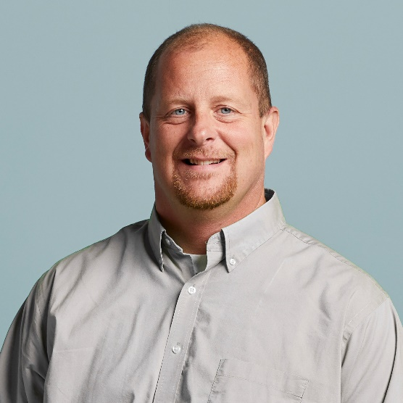
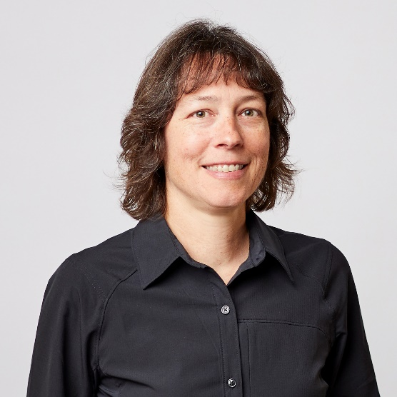
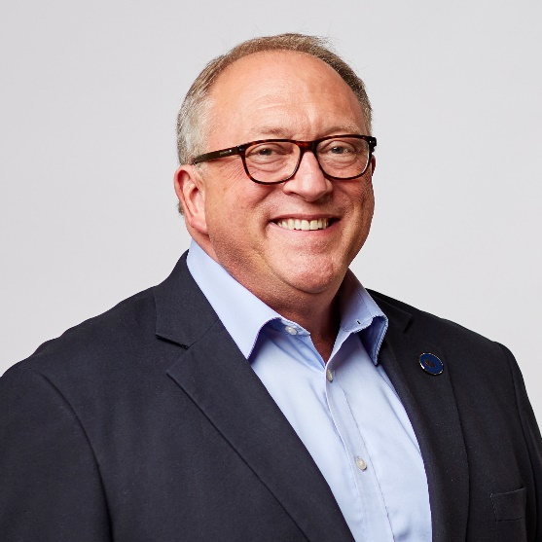
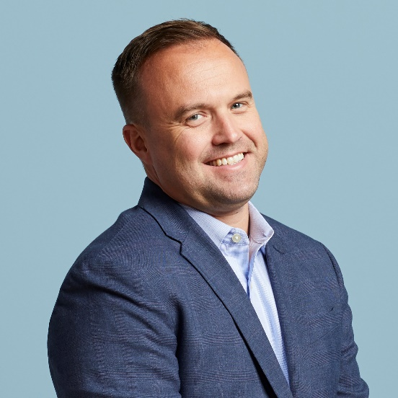
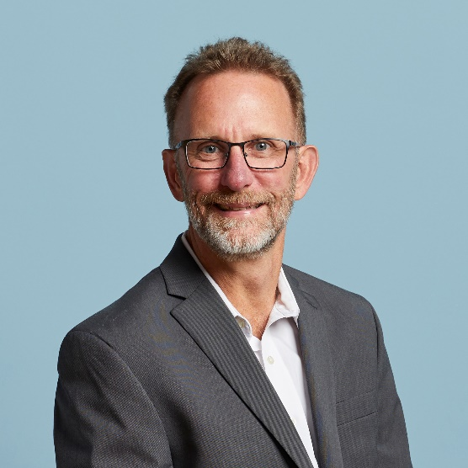
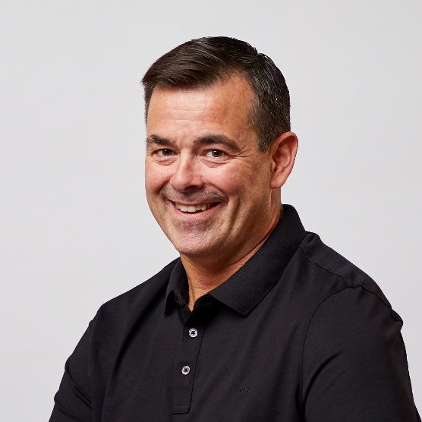
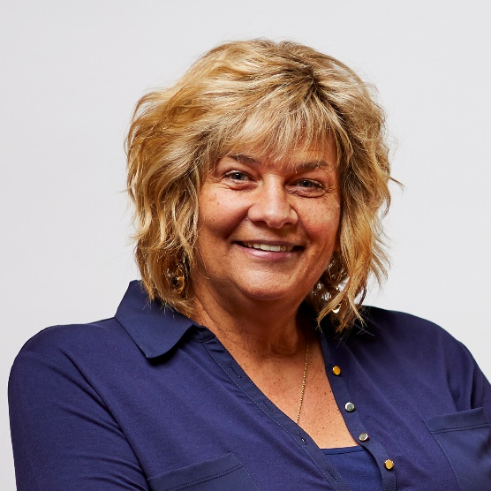
Your 2018-2019 Board of Directors
Scott McFarland, Chairman
CEO, Honor Credit Union
Board Member since August 2009
Linda Bodie
CEO, Element Federal CU
Board Member since October 2013
Tom Gryp
President/CEO, Notre Dame FCU
Board Member since October 2016
Kris Lewis, Director
CEO, Allegan Community CU
Board Member since October 2018
Jeff Jorgensen, Director
CEO, Sioux Empire Federal CU
Board Member since December 2009
Dean Wilson, Director
CEO, Focus Credit Union
Board Member since January 2008
Vickie Schmitzer, Secretary/Treasurer
CEO, Frankenmuth Credit Union
Board Member since October 2007
Thank you!
As always, I want to thank my fellow Board members for another great year, and for all their hard work
Notes:
Thank your Board and move forward to the election and the nominating committee (hand off to Tom)

Slide 8
2018 Board Elections
Representing the 2019 Nominating Committee: Tom Gryp
Notes:
Scott will hand off to Tom
Tom, pause here to greet the group and make some comment about how cooperatives cannot take our democratic processes for granted

Slide 9
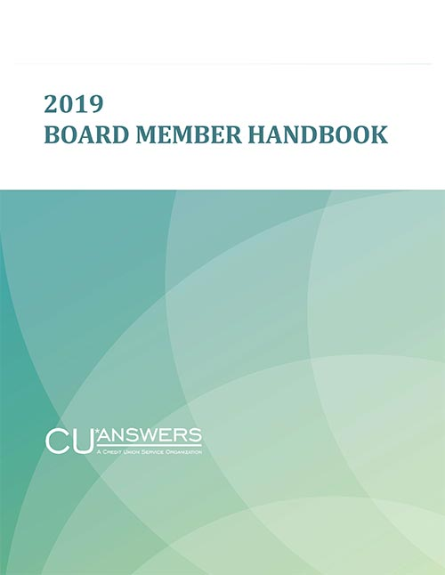
Your 2019 Nominating Committee
Each year we work from a well-documented process
The Board Member Handbook helps us dot all the i’s and cross all the t’s
Ensures we keep our promise to keep ownership participation alive and well in our Cooperative
Dean Wilson, Director
CEO, Focus Credit Union
Tom Gryp, Committee Chair
President/CEO, Notre Dame FCU
Scott McFarland, Director
CEO, Honor Credit Union
Notes:
Introduce and thank the nominating committee for they work they do and the sincere intent they print to the work to encourage any and all shareholders to step up and join the board

Slide 10
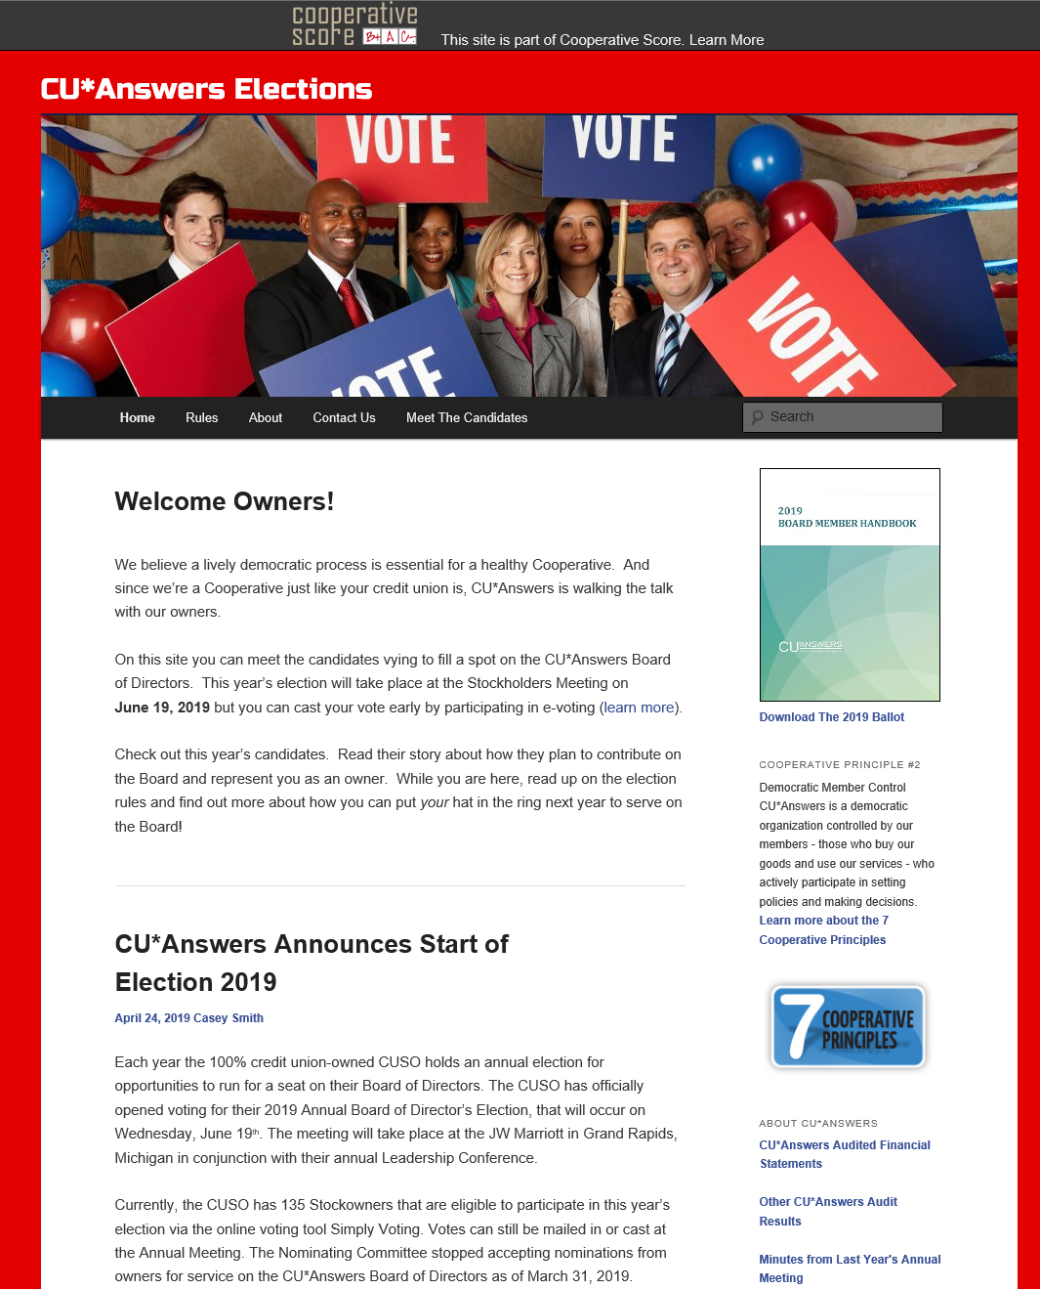
Elections Market the Power of Ownership
A lively democratic process is essential for a healthy cooperative
Your participation in choosing Board members and volunteering for leadership means we’re walking the talk
Thank you for participating as owners!
Notes:
One of the most important principles of a co-op is its constant belief in the fact that our board of directors is elected openly from our peers, and that elections are to be celebrated as part of our culture and our commitment to our business model.
In an era where every CUSO has plenty of paid professionals, it’s easy to delegate the power and the commitment of ownership to people who oversee the day to day. Maybe too easy. Stop and think.
Our role as stockholders is not the day to day heavy lifting, it is inspiring a commitment, a mission, and the license for our company to get things done.
The more seriously we take our democratic processes, the more seriously the marketplace takes us and the power of ownership that drives cooperatives to success.

Slide 11
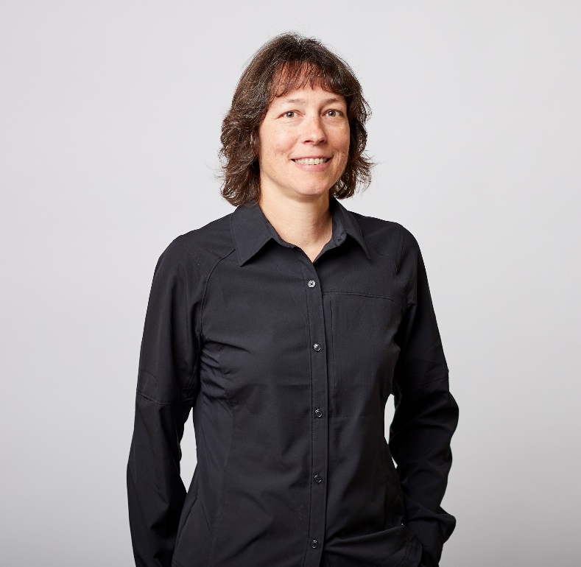
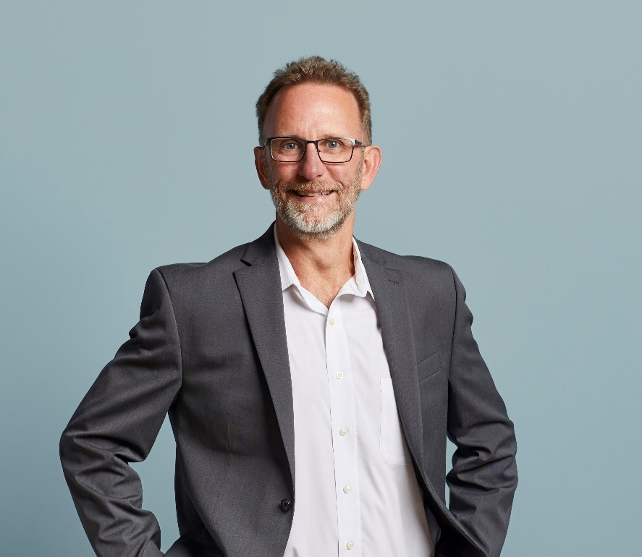
Let’s Hear From the Candidates
Linda Bodie CEO, Element FCU Charleston, West Virginia
Jeff Jorgensen President, Sioux Empire FCU Sioux Falls, SD
Notes:
Introduce each candidate and encourage them to say a few words for the crowd
(It can be difficult when there’s not a race for the audience or even the candidates to feel a message is needed, but the sentiment that they wish to serve, that they enjoy serving, and that they take everything seriously and not for granted is important to convey.)

Slide 12
Let’s Hear From the Candidates
Let’s vote!
Or perhaps there’s a motion for a call for a unanimous resolution?
Linda Bodie CEO, Element FCU Charleston, West Virginia
Jeff Jorgensen President, Sioux Empire FCU Sioux Falls, SD
Congrats to our winners!
Notes:
Introduce each candidate and encourage them to say a few words for the crowd
(It can be difficult when there’s not a race for the audience or even the candidates to feel a message is needed, but the sentiment that they wish to serve, that they enjoy serving, and that they take everything seriously and not for granted is important to convey.)

Slide 13
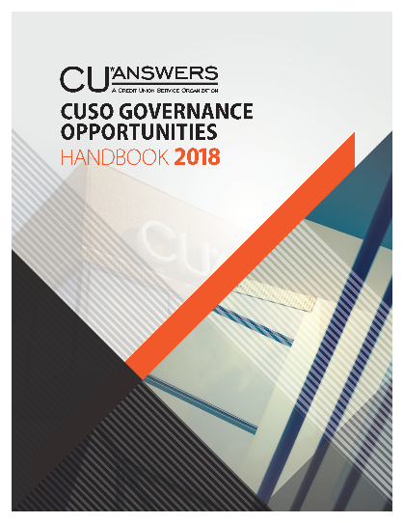
Another announcement from the 2019 Nominating Committee
Introducing 3 new CUSO volunteers who will be working with the CU*Answers Board of Directors:
ASSOCIATE BOARD MEMBERS
COMMITTEE VOLUNTEER
Bill Burke, CEO Day Air CU
Carolyn Mikesell, CEO Public Service CU
Don Mills, CEO Alpena Alcona Area CU
Serving on the Investment Committee
Welcome new pioneers, to these new CUSO governance opportunities!

Slide 14
Armed With a Model for the Future
CFO Report

Slide 15
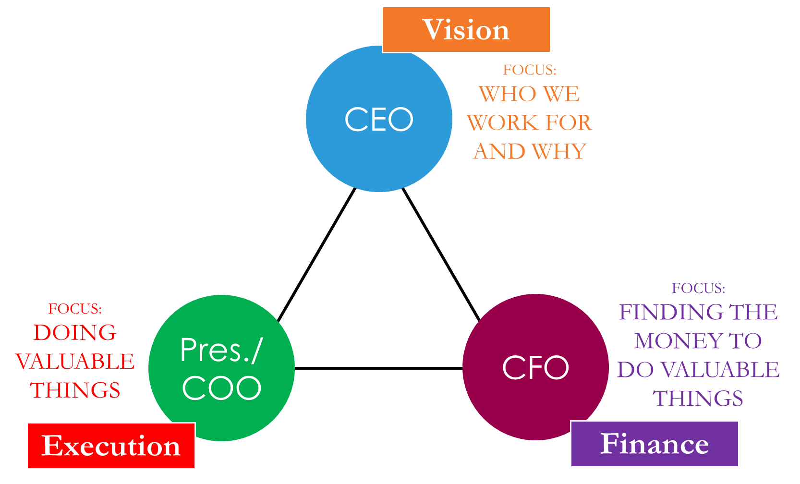
Walking the talk is simple when you keep the design simple, too
After a day like today, it’s an understatement to say that CU*Answers is a documented firm
Techies have a saying that you can’t change the future without a schematic where you can see where you are
Our board does an excellent job working with management to ensure our future via our digital content
For me it’s a bit harder than just “finding” money, but my track record is pretty good

Slide 16
Net income & patronage dividends What do shareholders get, and what are we putting away for our future?
$6.7M
$2.25M
$???

Slide 17
2018 numbers worth celebrating
Detail | YE 2017 | YE 2018 | 2018-2017 % Change | 2017-2016 % Change | 2016-2015 % Change
Total Assets | $34,096K | $38,989K | 14.35% | 7.3% | 14.5%
Total Liabilities | $18,561K | $19,562K | 5.39% | 8.3% | 15.8%
Total Equity | $15,535K | $19,427K | 25.05% | 6.3% | 13.0%
Retained Earnings | $3,588K | $3,877K | 8.03% | 22.8% | 19.7%
Book Value of Class A Stock ($ per share) | $621.41 | $719.53 | 15.80% | 8.8% | 9.5%
Book Value of Ownership | $124,282 | $143,906 | 15.80% | 8.8% | 9.5%
Two steps forward, one step back...it’s nice that our dips are still in the black

Slide 18
Year-end 2018 dividend payments These numbers can flex, and I predict they will again in the future
Detail | YE 2017 | YE 2018 | 2018-2017 % Change | 2017-2016 % Change | 2016-2015 % Change
Patronage Dividend ($) | 1,750,000 | 2,000,000 | 14.3% | 16.7% | 50.0%
Bonus Patronage ($) | 2,750,000 | 4,000,000 | 45.5% | 37.5% | 33.3%
Ownership Dividend Rate | 4.0% | 4.0% | 0.0% | 0.0% | 0.0%
Ownership Dividend ($) | 638,456 | 775,868 | 21.5% | 6.9% | 12.9%
Book Value of Class A Stock ($ per share) | 621.41 | 719.53 | 15.8% | 8.8% | 9.5%
Price to Purchase CUSO Ownership | 290,000 | 330,000 | 13.8% | 5.5% | 12.2%
2019 Net Earnings as of May 2019: $2.4M after adjustments for $1.5M patronage dividends and $830K taxes (projected to be $3.3M by 9/30/19)

Slide 19
2018 return on investment
2018 Gross Income Submitted by Owners to CU*Answers $ 28,132,658 (Excludes all vendor pass-throughs)
2018 Patronage Dividends Paid $ 6,000,000
2018 Class A Stock Dividends Paid 775,868 (4.0%)
2018 Interest Paid Credit Unions on Loans 284,654 (~4.25%)
Total Revenue Returned to Credit Unions $ 7,060,522
Return Per Total Dollars Received: $0.2510
$7,060,522 ÷ $28,132,658 (excludes vendor pass-throughs) = 25.10% return per CU*A $ received

Slide 20
Understanding this formula is important to how we set the boundaries for our future
2016 Return Per Total Dollars Received: $0.1708
$4,284,086 ÷ $25,075,368 (excludes vendor pass-throughs) = 17.08% return per CU*A $ received
2017 Return Per Total Dollars Received: $0.1979
$5,346,530 ÷ $27,023,005 (excludes vendor pass-throughs) = 19.79% return per CU*A $ received
2018 Return Per Total Dollars Received: $0.2510
$7,060,522 ÷ $28,132,658 (excludes vendor pass-throughs) = 25.10% return per CU*A $ received

Slide 21
Thinking about 2019 year-end cuasterisk.com Network Revenue Numbers Continue To Impress
CU*Answers Direct Revenues
Projected for 2019 $59.0M
Projected for 2019
Our Network Partners
eDOC Innovations $5.2M
CU*NorthWest $4.5M
CU*South $5.0M
Xtend $3.3M
Site-4 $0.8M
Grand Total: $78.0 million
Visit www.cuasterisk.com to keep up with network partners, products and services

Slide 22
Investing in a community and building a network
20% ownership stake
1.25% ownership stake
48%
ownership stake
<1% ownership stake
4.55% ownership stake
A convertible debt investment

Slide 23
Projecting shareholder value Depending on when you bought in, your perspective is different
THE PRICE OF OWNERSHIP OVER THE YEARS
1991: $59.31
2000: $176.00
2005: $460.00
2010: $495.00
2015: $1,125.00
2016: $1,225.00
2017: $1,375.00
2018: $1,450.00
2019: $1,650.00
8.5%

Slide 24
The importance of our per-share price Balancing today’s payback against the value of your equity
Let the Board know how you hope they vote: Current year dividends to help your operations, or shareholder value for the long term

Slide 25
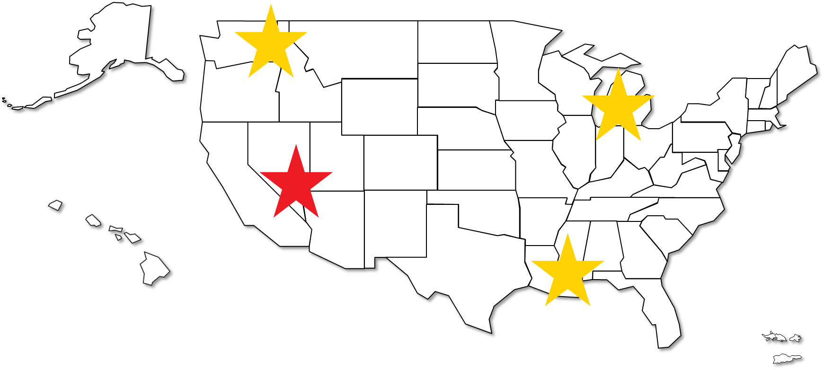
Retail innovation “Just find the money, Bob”
Randy was serious this morning when he called for your input
And I am telling you right now, that input will be important to the numbers you see in the next few years
What would you think about a new CU*Answers location in Las Vegas?
A client support center, a programming center, and a new marketplace persona

Slide 26
Unique Organizations Pioneering the Next 50 Years
CEO Comments

Slide 27
February 2020 will mark our 50th year as a CUSO
20??
2020
EVERY YEAR I ASK MY WIFE, “IS THIS YEAR AN IMPORTANT ANNIVERSARY?”
1970
Historians judge and label people as icons as pioneers, but the people who build companies are just too busy to worry about the labels

Slide 28
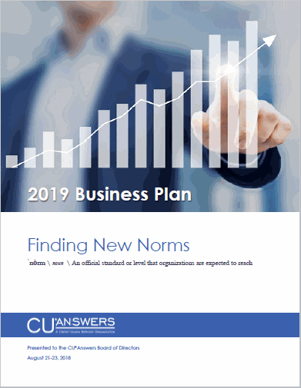
We’ve been preparing for this milestone
A characteristic of virtual ownership is that the values created over time are willed forward to infinite generations, with the intent of sustaining those values, without end
Every generation will fear that theirs is the last
At every milestone, we are challenged by the fact that we might not be able to do it again (another 50 years?!)
Despite all the challenges, I still think we will
We have not made it 50 years based on the roles of people; we’ve made it this long because of the will of cooperative organizations

Slide 29
We’ve been preparing for this milestone
Facing a New Norm in the CU Industry
To make it another 50 years, our strength must be in our ability to redefine ourselves as quickly as our communities do
Tactics for Finding and Accepting New Norms
To redefine ourselves, we must collaboratively communicate within each other to define the common ground we have as our key success factors
Honing the Core Competencies that Secure Our Future
New operational norms do not mean that you abandon the timeless principles that drive success

Slide 30
We’ve been preparing for this milestone
Each year we have to remind ourselves of the things we hold dear, that remain the underlying drivers of our success
Our focus and commitment to the agendas of our stakeholders
Our skills at building networks and fostering communities of cooperatives
Our skills at developing assets via the use of capital, people, and solutions
Our drive to deliver value to the customer-owners that drive it all: CU members and CU organizations

Slide 31
How do you define the timeframe for the next “era”? How far ahead do we dare look?
A strange way to tell you that I have faith in who you are today to improve on the work of pioneers and icons that came before

Slide 32
Will our mindset be determined by our best angels or by our situation?
Unique – All of us today, and all of us in the future
One year from today, the unique will show up for a party to celebrate our 50th anniversary
The next day, we’ll all go to work on our way to the next milestone
We’re confident that we are armed with the same capabilities, vested with the same hopes, and ready to meet the challenge
Original – All of us from yesterday, all the way back to February 1970
A generation of professionals and organizations like us celebrated many milestones
The next day, they simply went to work to get us to this point
So were they, and they were right
We are unique, but we are not alone, for the original are with us and all around us...we are connected

Slide 33
Back to Our Chairman

Slide 34
Not so fast...we have another milestone to celebrate today!
Congratulations and thank you!
July 1 marks Randy’s 25th year as CU*Answers’ CEO

Slide 35
Back to Our Chairman
Do we have a motion to adjourn?

