Slide 1
Designing the future for Online and Mobile Tools
Online ‘19
SEGMENT C

Slide 2
Topics for this segment
Discuss our collective vision for the future of online banking and mobile products
Discuss what It’s Me 247 optics and network data might be hinting at
Review and discuss two CU*Answers templates:
The Online ’19 proof-of-concept project vs. the evolution of our It’s Me 247 suite
Launching the new CU*Answers Mobile Technologies Group

Slide 3
How do you see the future of credit union websites?
How are you coordinating the internet channel and its tactics (websites, online banking, mobile banking)?
Organized and budgeted as independent silos
Organized and budgeted as a single silo
Not sure
We are:
Committed to our desktop and mobile websites
Phasing out our desktop website and moving to mobile only
Not sure what to do next
In a couple of sentences, sum up how you measure the value of your website traffic, and your satisfaction with your return on investment
Online banking for desktop and tablet approaches
(30 minutes)
Notes:
Bring out the pain points and headaches
We’ll start with the website, then move to online banking, then mobile
Next concept is do they even have the data that identifies the headache?

Slide 4
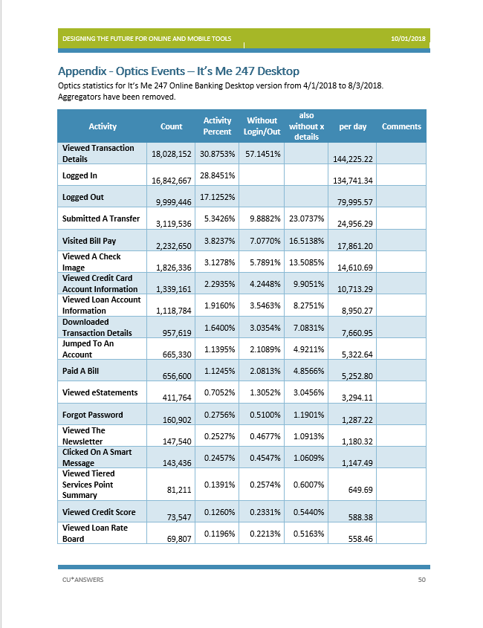
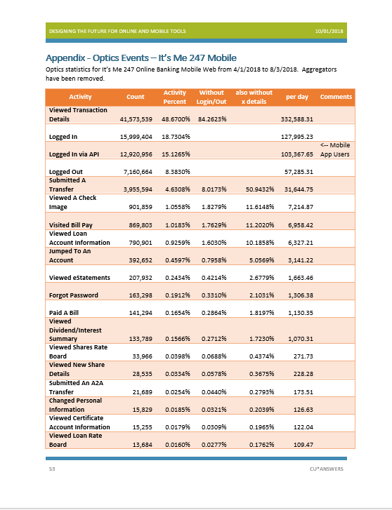
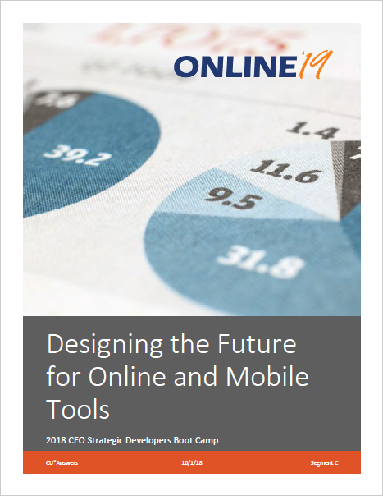
Why 2019 optics projects might change your mind
Non-transactional analysis might be one of the biggest abstract ideas to change how you think about concrete channels

Slide 5
optics that might change your mind
It’s Me 247 Desktop Optics
Note that not all features are in Optics, notably Message Center
Spoiler: 60% of all activity is viewing transaction details
Add the next 4 actions and we’re already over 90% of activities
Is that good enough? What would be?
Orchestrating the dance

Slide 6
optics that might change your mind
It’s Me 247 Mobile Optics
Spoiler: 85% of all activity is viewing transaction details
What if you had a micro app that just showed balances and transactions?
The next 8% are doing transfers
Just these two actions cover 93% of all mobile web activity
Orchestrating the dance...on a phone

Slide 7
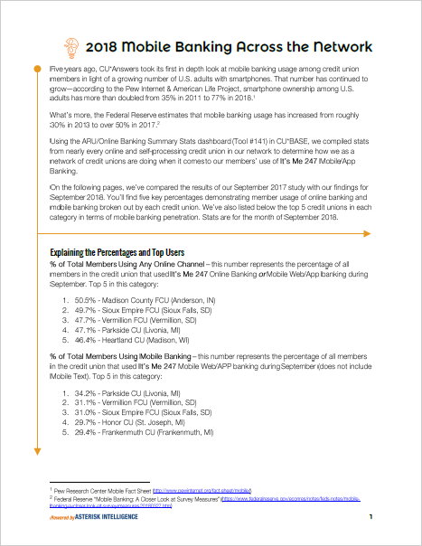
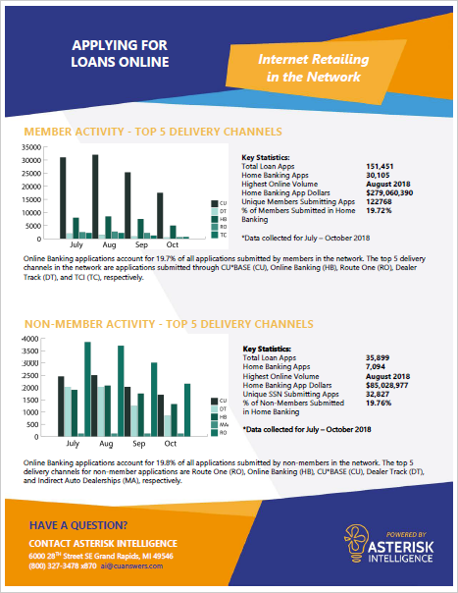
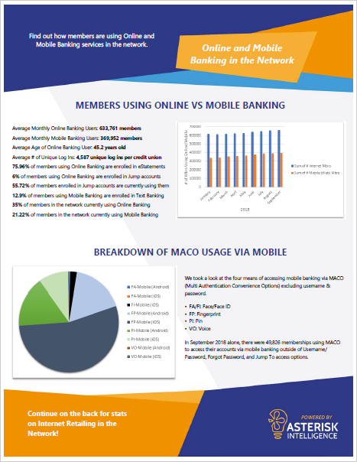
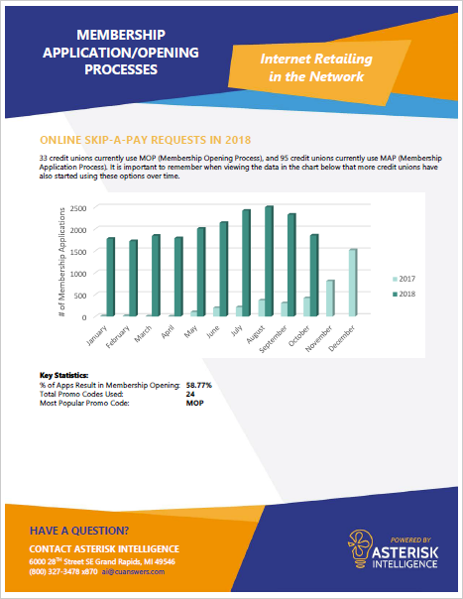
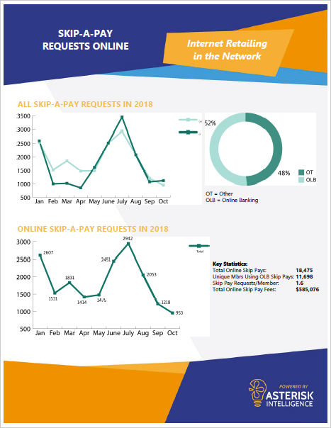
Additional data to get you thinking
What’s the difference between you and the network?
Notes:
Make sure Brian is in the room

Slide 8
THE Online ’19 PROOF-OF-CONCEPT PROJECT
A CU*ANSWERS TEMPLATE FOR ONLINE/MOBILE TOOLS
SHOULD WE STUDY THE POTENTIAL FOR A RADICAL NEW COORDINATION OF WEBSITES AND BANKING SITES?

Slide 9
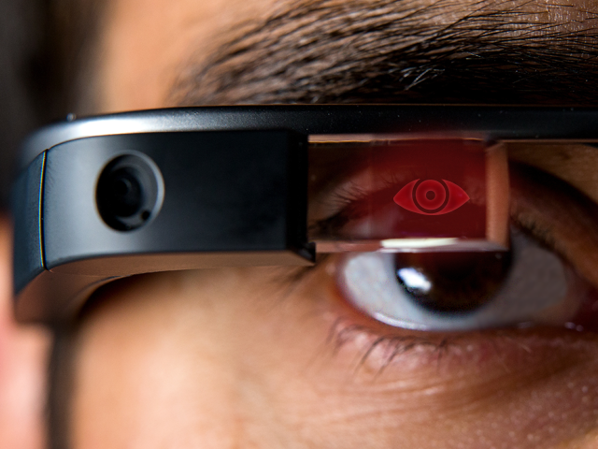
CEO STRATEGIC Developers Boot Camp Segment C: Designing the Future for Online banking (Online ‘19)
We’ll study this throughout 2019, across the network
We’re at a crossroads: The next generation of the current approach vs. a radical new approach
Adopting a member-authenticated CU website
How would CUs see the channel if they knew 80-85% of the visitors, and channeled differently the people they did not know?
A new approach to dual navigation and an orchestrated dance between the values of a website and the actions of a banking toolset

Slide 10
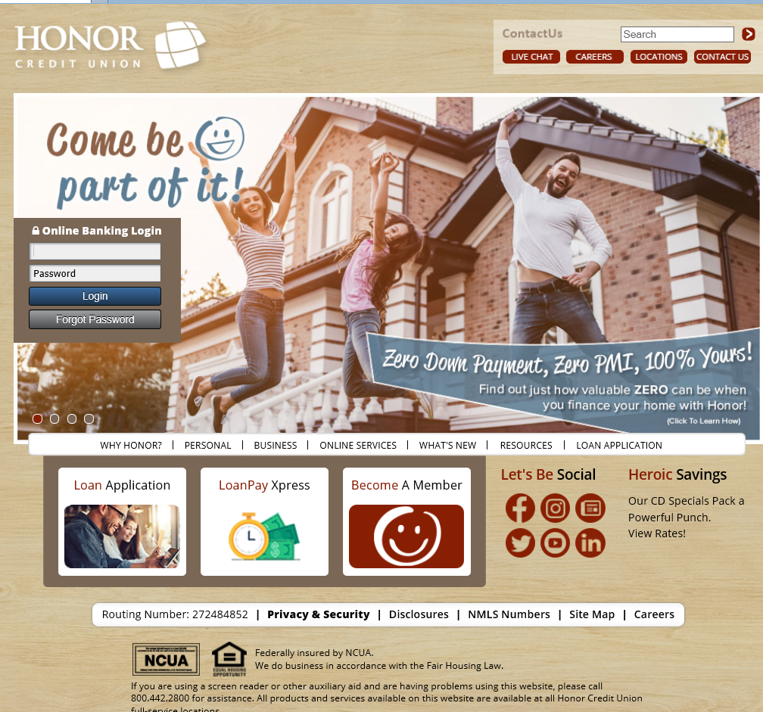
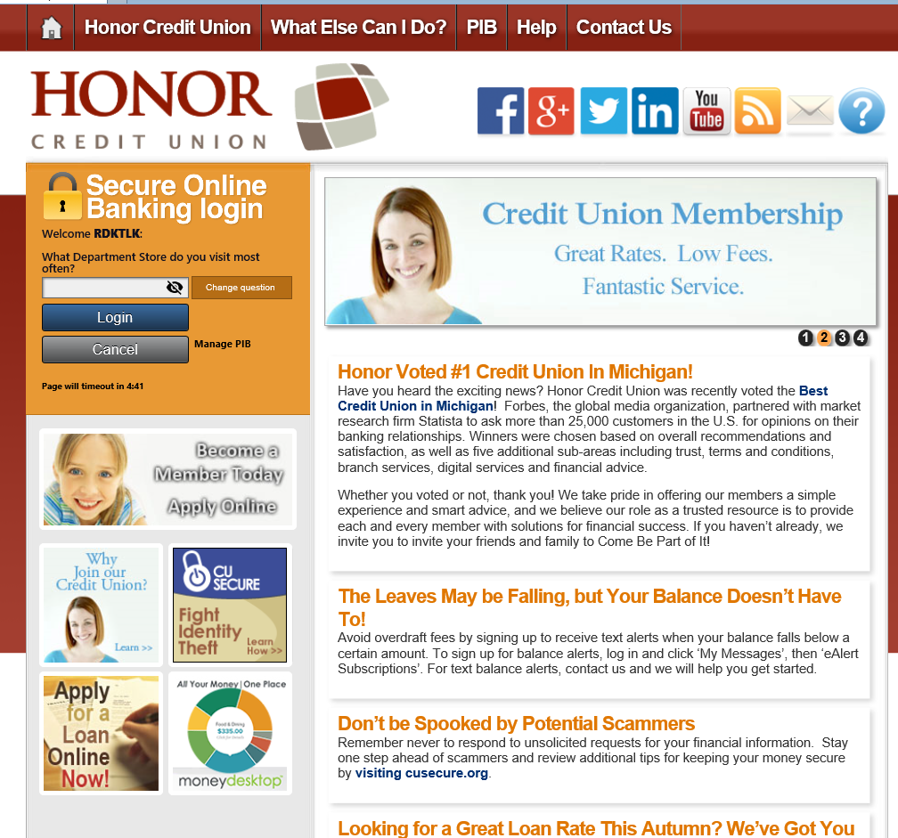
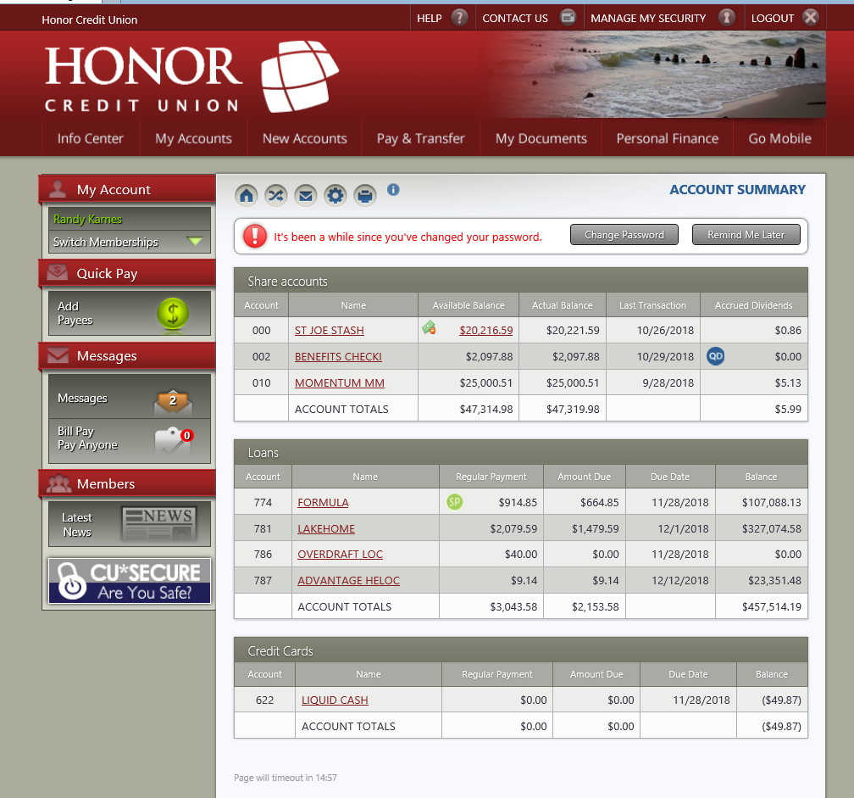
WHAT DO WE MEAN BY RADICAL?
CU*Answers builds a solution that merges websites and banking sites as one product
Online ‘19 is not a new piece of software...Online ‘19 is our discussions and brainstorming about a possible new future for our online and mobile tools

Slide 11
YOUR assignment: a deep dive into the potential
Your mission, should you choose to accept it...
Participating in the Online ‘19 proof-of-concept project will not be for everyone
You must have an open mind to the concept of trying to authentic 90-95% of your traffic as a pseudo-requirement to surf your website
Less than 5% of the website would have content for non-authenticated visitors
We’re looking for 10-20 CUs that would be open and dedicated to designing a radical approach as an option to the It’s Me 247 suite
We asked the same questions of some key CU*Answers leaders, and this booklet is the result

Slide 12
What would it take – what payoff would you need to authenticate 90-95% of visitors to your website?
Do you see a payoff in vesting yourself and your leadership political capital in this project during the 2019 business year?
What are the top 3 points you would sell to your organization that would vest your project managers, board and other stakeholders?
Can you commit to completing this workbook and having it back to CU*Answers by February 15, 2019?
What are the top 3 changes to the It’s Me 247 suite that you will need in 2019 while CU*Answers is investigating the Online ’19 POC?
Do we have any champions right out of the gate, or will it take a little longer?

Slide 13
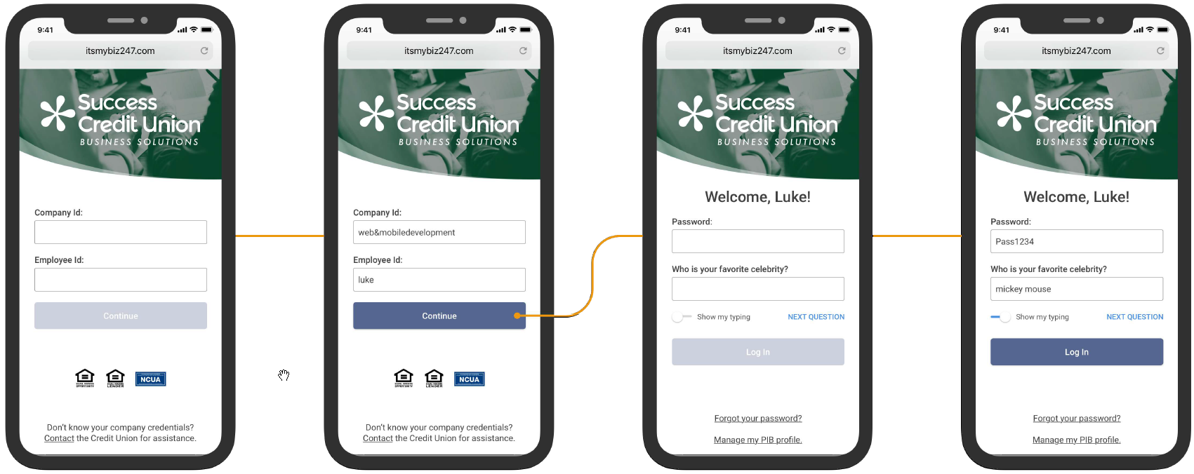
What do we know for sure?
It’s Me 247 will not go away in the next 24 months
The It’s Me 247 suite will continue to evolve for 2019 and potentially longer
New navigation and UX for PIB is coming in 2019
It’s My Biz 247 has been extended and a mobile web version will be launched early in 2019
Assuming people like it, It’s My Biz 247 mobile web version will be the prototype for a new It’s Me 247 mobile web to launch late in 2019
Given the growing noise around DIY efforts, I believe one or two champions will arrive in 2019-2020 and drive an integration of a 3rd-party online banking solution into the mix
Remember, the cost of this is $35,000 startup plus an additional $3,500/mo. over e-commerce fees
Notes:
Demo Biz mobile web look and feel
Talk about how it will still be an OLB initiative because of its .NET foundation

Slide 14
Not our typical work
There’s no spec here...just a search for one – do you want to join?
This is not a well-baked spec or even a proposal – it is the brain-dump of a group of people saying “what if...?”
Let’s take 20 minutes and look through it together

Slide 15
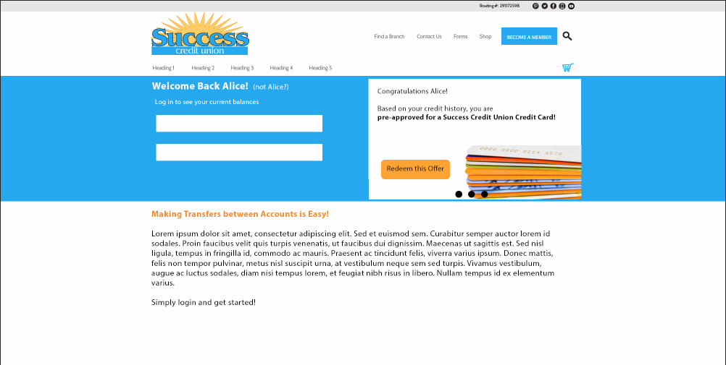
Concept – Not Logged In – Transfer Money
Showing side-by-side quick account reference, member has not logged in, therefore marketing content is shown in the body.

Slide 16
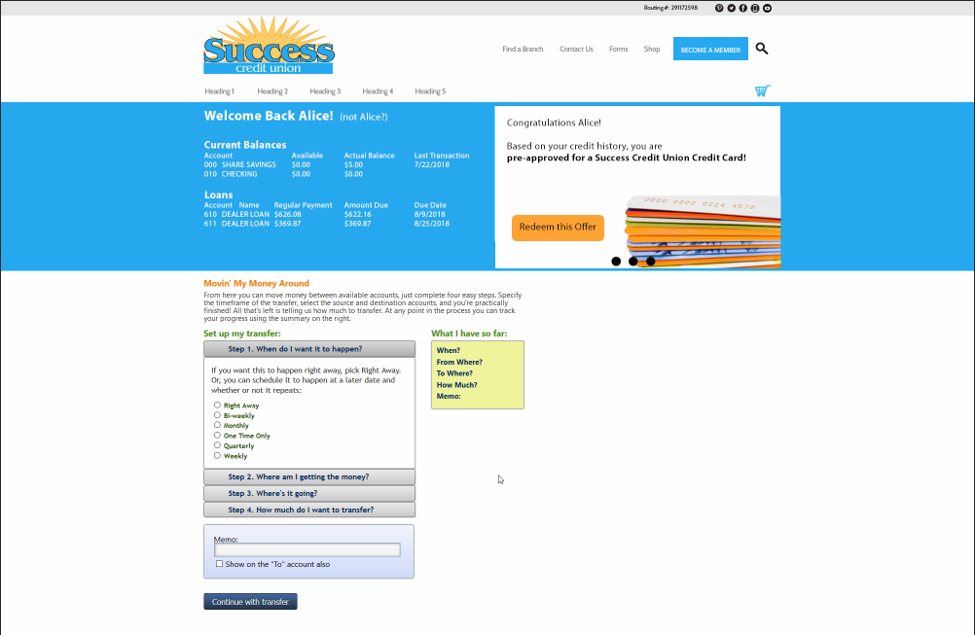
Concept – Logged In – Transfer Money
Member has logged in. Main body content is now transactional online banking and quick account reference is shown.

Slide 17
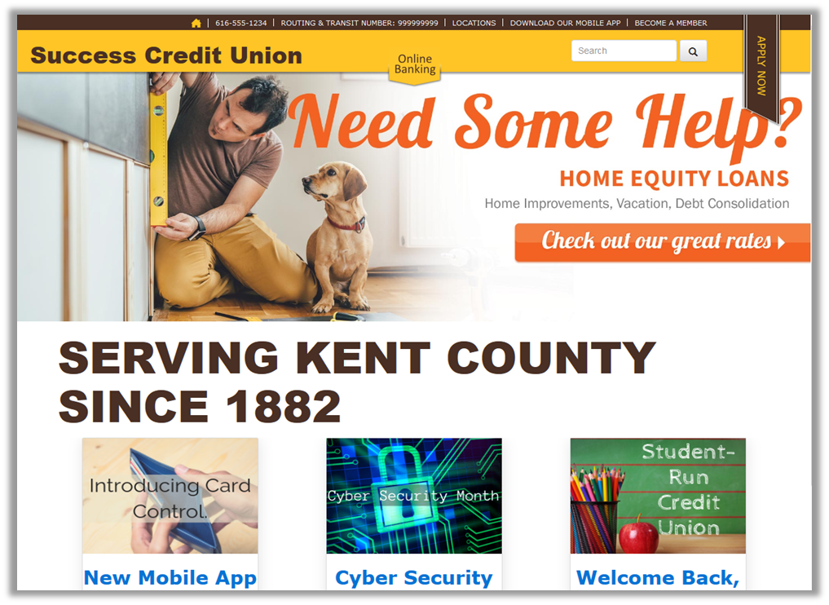
Concept – Drawer Slide Out Online Banking (closed)
Showing a slide-out drawer concept for online banking. The drawer is currently closed.

Slide 18
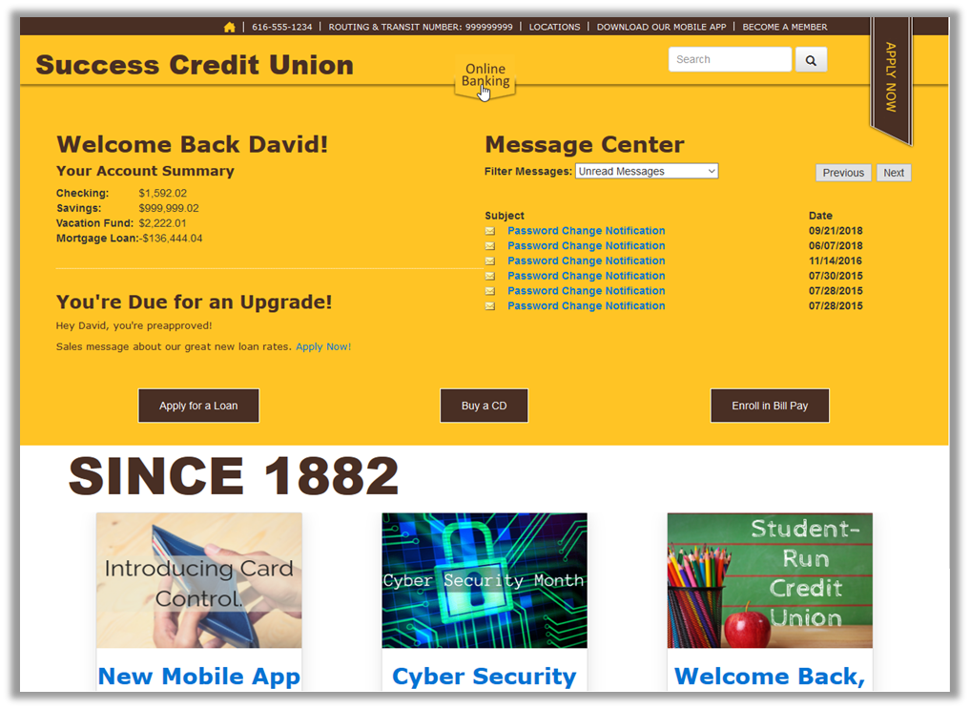
Concept – Drawer Slide Out Online Banking (open)
Member opens the drawer to view online banking. Drawer is context aware of which page of the website the member is on.

Slide 19
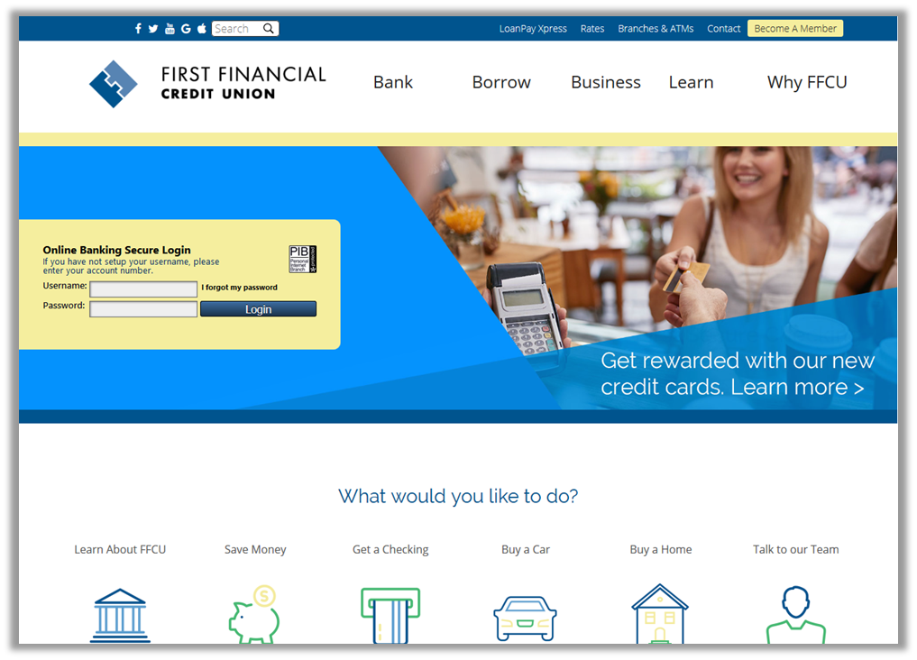
Concept – Partial Authentication – First Visit
Showing first visit, or unauthenticated visit to a website. Once authenticated a cookie is set on the browser for future visits

Slide 20
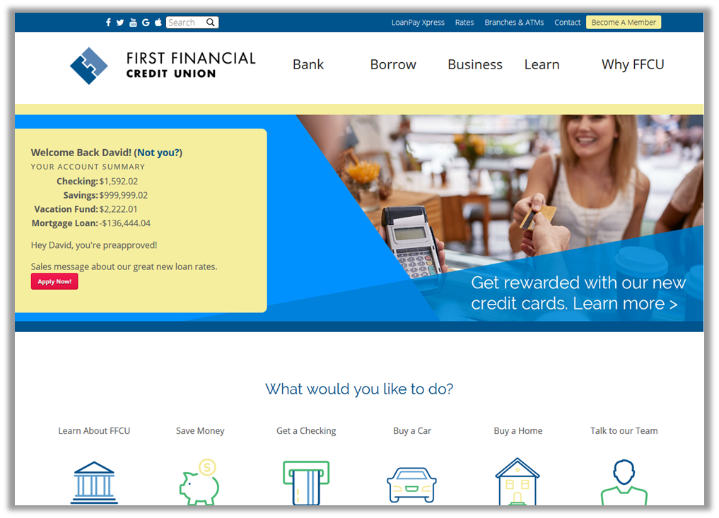
Concept – Partial Authentication – Welcome back
Showing a return visit. Member does not need to reauthenticate to view quick account reference.

Slide 21
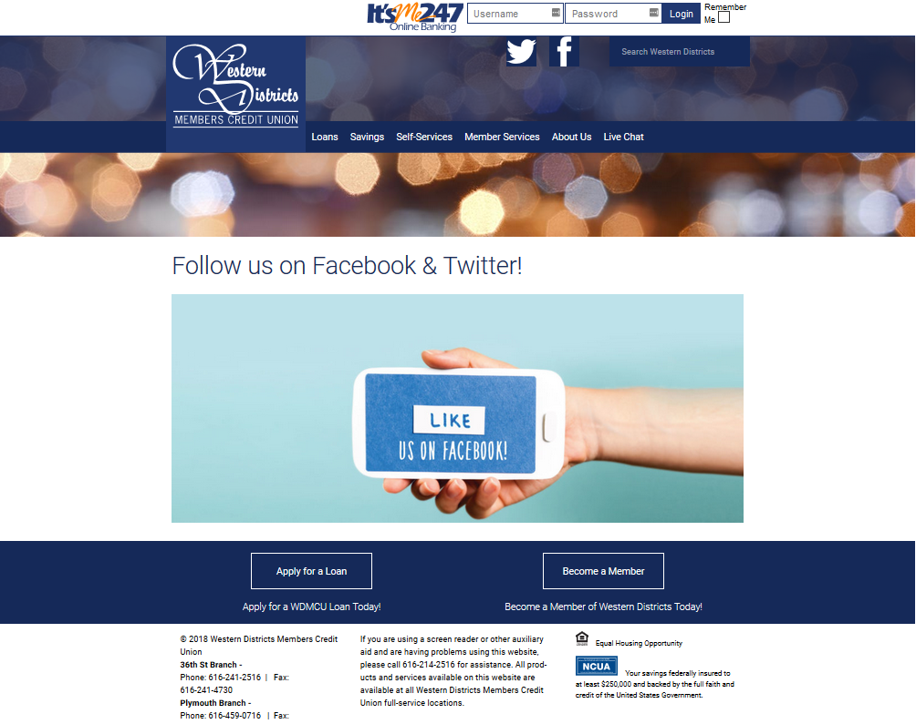
Concept – Partial Authentication – First Visit
Concept for a partial authentication scheme, where members are shown basic information but must reauthenticate to perform any transactional actions. On first visit, or if partial authentication is reset, the member must log in to online banking.

Slide 22
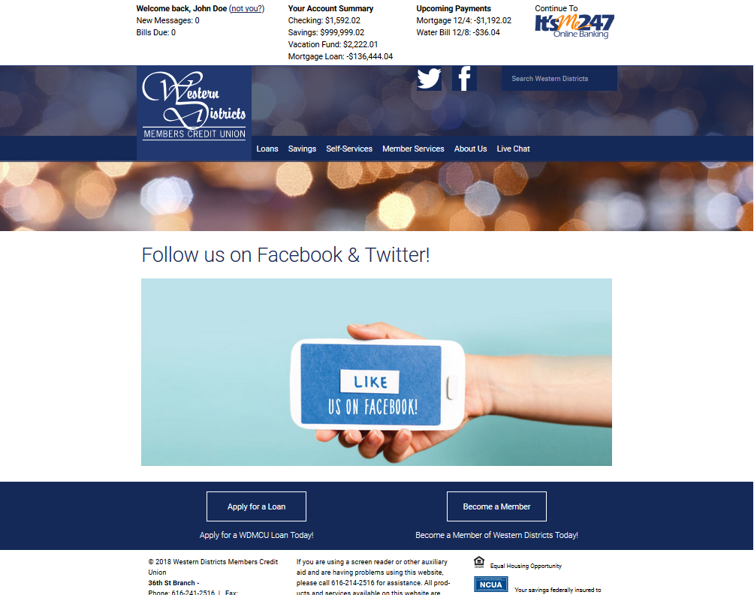
Concept – Partial Authentication – Returning Visit
Concept for a partial authentication scheme, where members are shown basic information but must reauthenticate to perform any transactional actions. On return visit, basic account details are shown. Member must log in to perform any transactions.

Slide 23
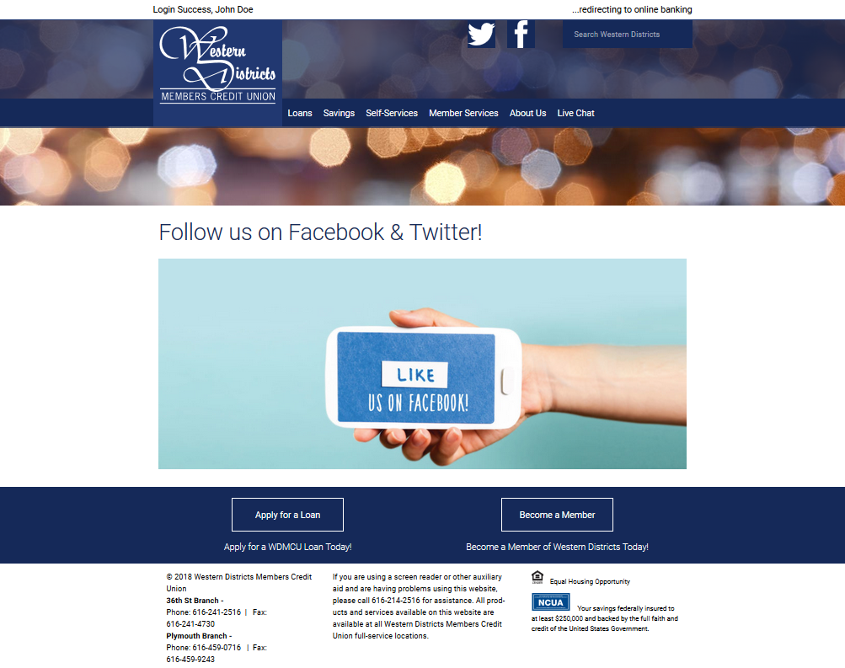
Concept – Partial Authentication – Log In
Concept for a partial authentication scheme, where members are shown basic information but must reauthenticate to perform any transactional actions. Log in to perform transactional online banking.

Slide 24
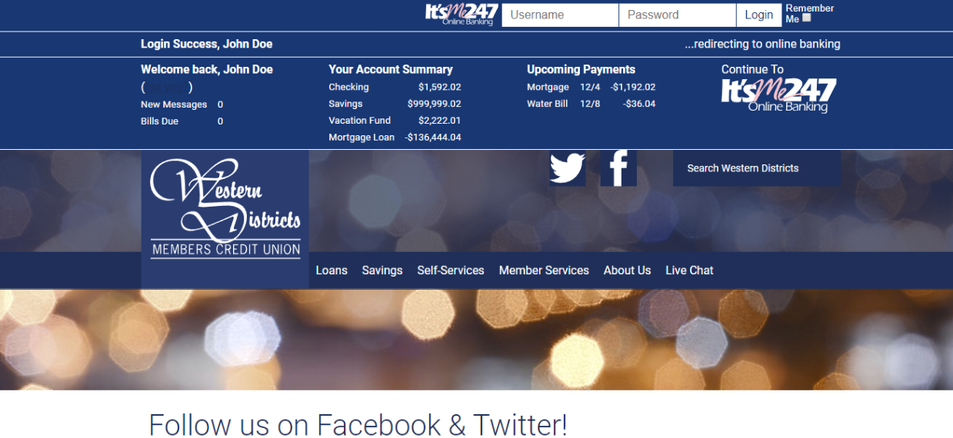
Concept – Partial Login – Dark Panels
Showing all three partial login panels - stacked, but with a matching color scheme.
Notes:
Wrap this up with the idea that they have some time to commit – I know I asked them to commit today, but I want everyone to participate but if they decide on Feb 14 that’s okay

Slide 25
The Mobile technologies group
A CU*ANSWERS TEMPLATE FOR ONLINE/MOBILE TOOLS

Slide 26
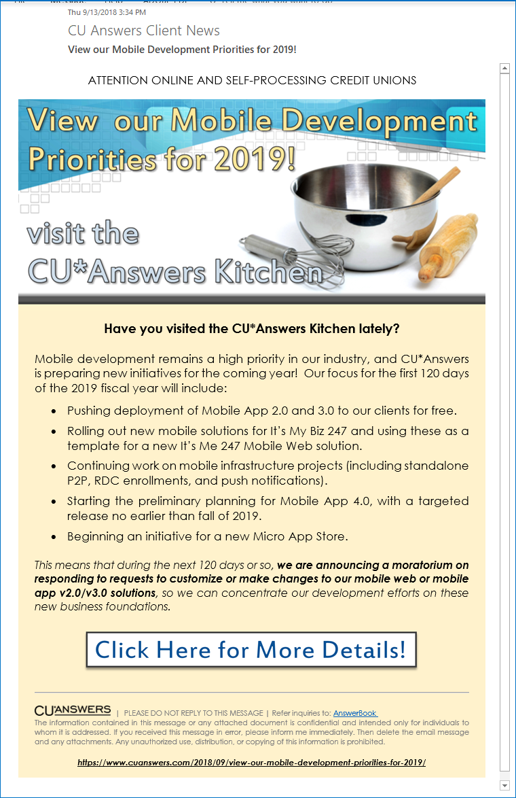
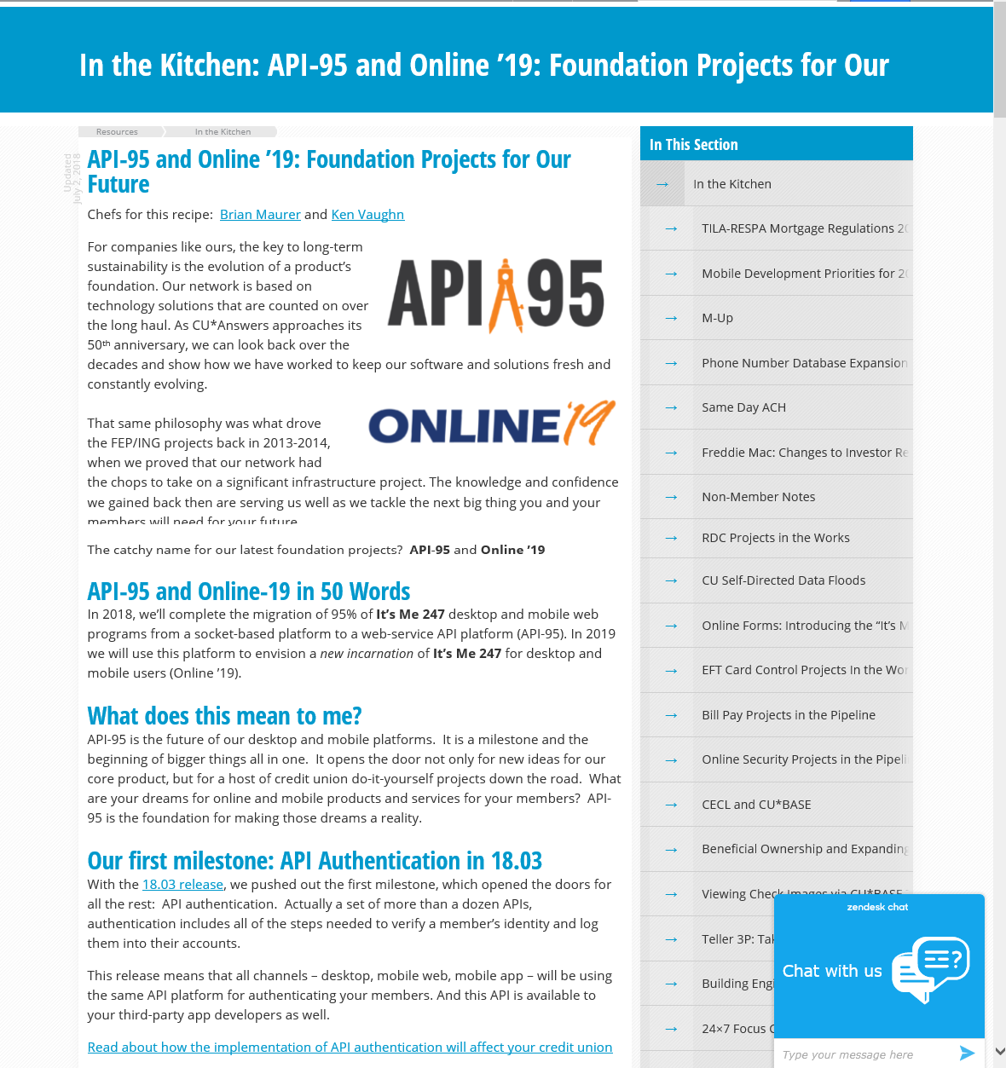
Putting a stake in the ground
The Sept 13th announcement signaled some big changes
https://www.cuanswers.com/resources/kitchen/

Slide 27
What is different about the mobile app business?
How would you characterize the mobile app business as compared to the way our network creates core processing solutions?
To have a device app, you must have a developer’s license and manage your own store – who does that for you?
Did you write a business plan or strategic statement for your board on where your mobile app strategies will take you in the next 3 years?
Do you have a budget? Do you have a team lead? Or is this just another feature in a long list of features your CU deploys?
Can you list 3 other mobile tech vendors that are active in the market today and aggressively gaining traction?
The mobile app business is a different cat than our core processing package approach

Slide 28
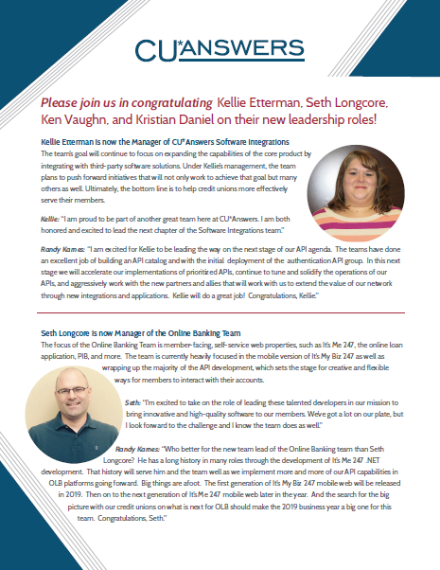
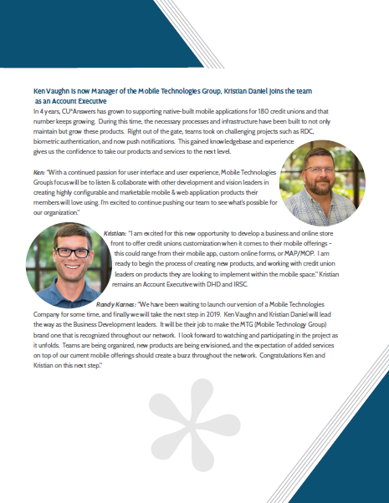
Introducing The Mobile Technologies Group (MTG)
In 2019, we’ll launch an internal department to emulate standalone approaches
Two business development leaders: Ken Vaughn and Kristian Daniel
Direct the development of new copyrighted intellectual properties
Drive device store apps for large-audience and small-audience tactics
Continue CU*Answers “freemium” approach and build a suite of premium offers
Launch the micro-app store and market apps the CUSO wishes to sell
In 2020, launch a professional service approach to support CU-originated apps
To guarantee no-invoice smart phone banking for the long term, we need to build revenue-generating models around our core

Slide 29
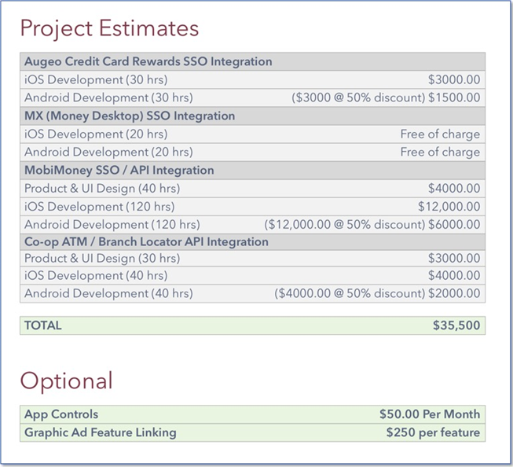
Premiums
When free doesn’t seem so free
Like APIs, if our network has the budgets and drive for extensions, I see a big store in our future
But unlike CU*BASE, you won’t flip a switch in a configuration and update 10,000 member apps
Deployment is one CU at a time, one store at a time, unless we build it into the mobile web chewy center
Mobile apps are not like ASP online banking solutions – you shrink-wrap them and deploy them, one CU at a time

Slide 30
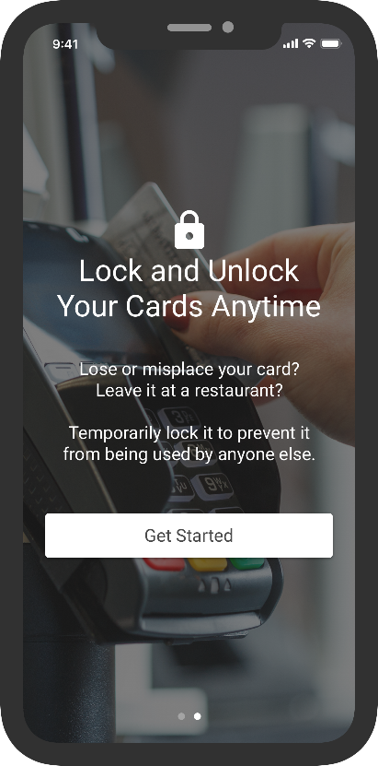
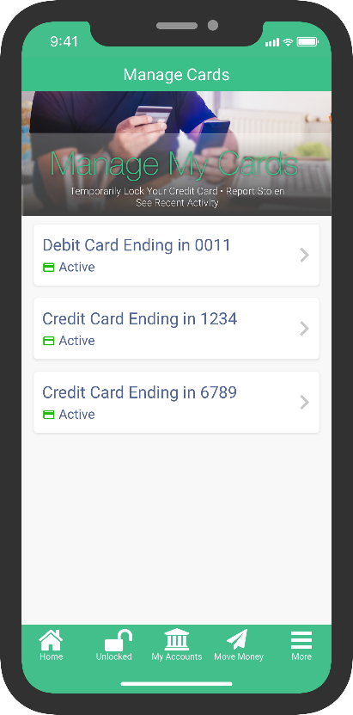
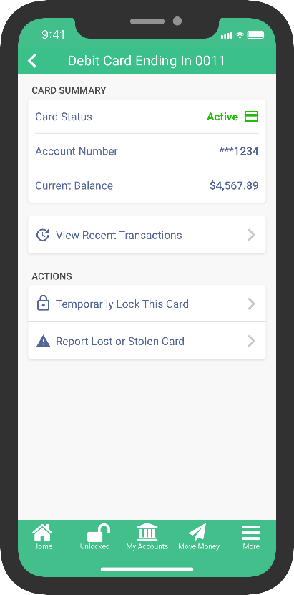
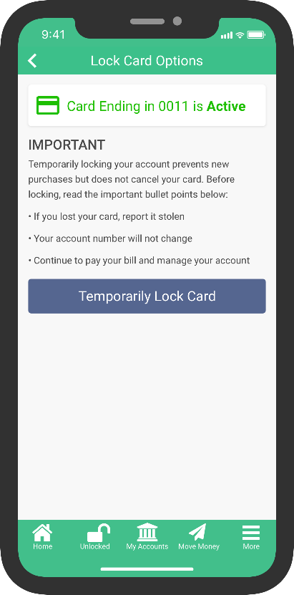
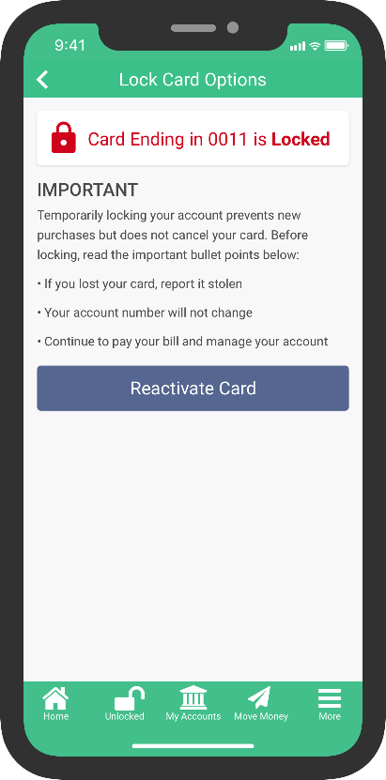
The Card controls project was not a premium
When we build for disruptive prices, we need to maintain a native focus
CARD CONTROLS FOR MOBILE APP (18.07)
Sends a warm-card status to the vendor
Member can reactivate at any time
Indicator showing card status

Slide 31
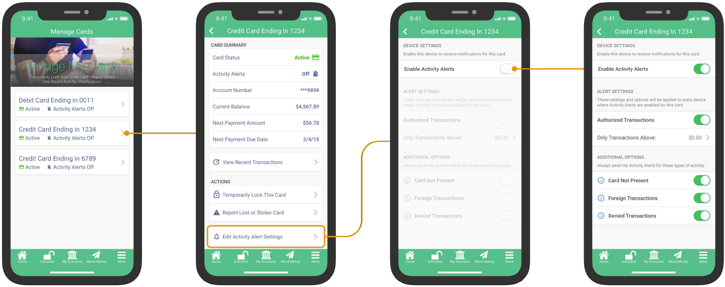
Better yet, push notifications are based on an engine we can leverage
Extensions to third parties can only be leveraged by third parties
CARD NOTIFICATIONS FOR MOBILE APP (18.10)
Alerts for all transactions
OR, alerts for certain types only

Slide 32
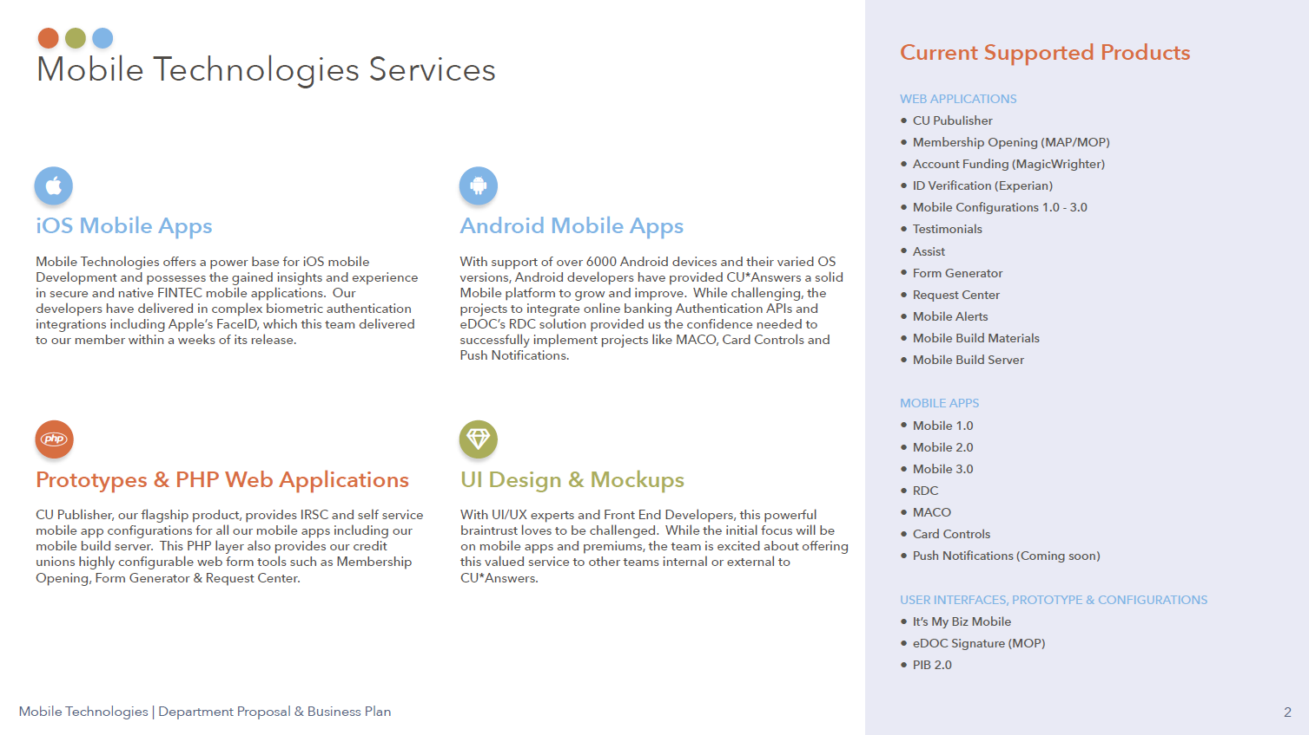

Slide 34
What small-audience app approaches make sense to you?
When you think about your primary apps for smart phone banking today, how many features can be crammed into that approach?
So far, CUs have not felt satisfied with special, standalone apps – is that a marketing problem or an internal stock-the-shelves problem?
What small-audience headaches do you have today for which you would like to create smart phone banking aspirin?
Is it possible for you to create a marketing program that would not only sell specialty device apps, but also educate members on multiple HTML approaches?
Micro apps will create a rich environment for innovation...the key to change

Slide 35
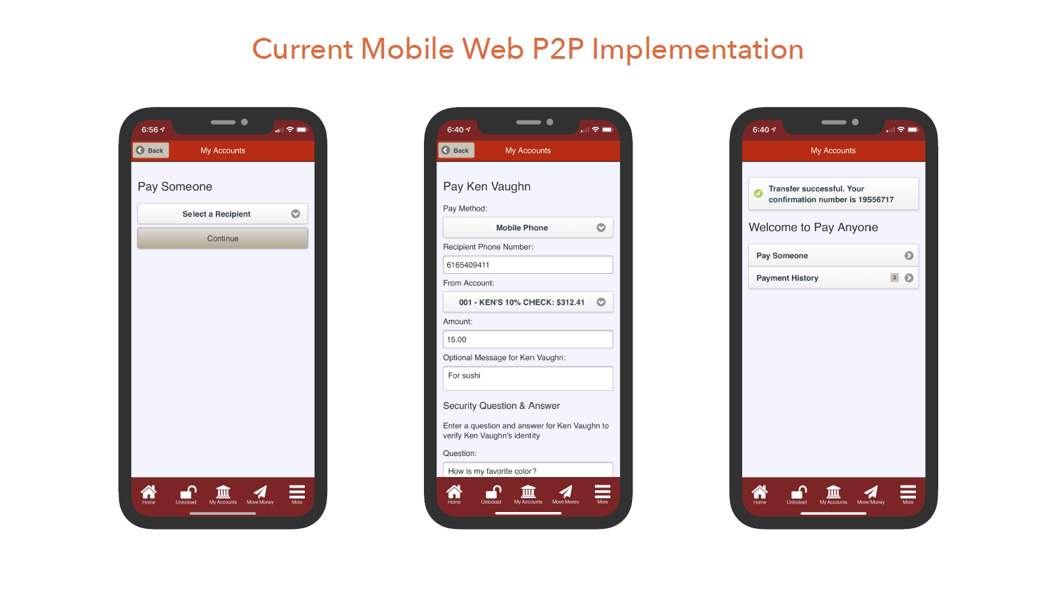

Slide 36
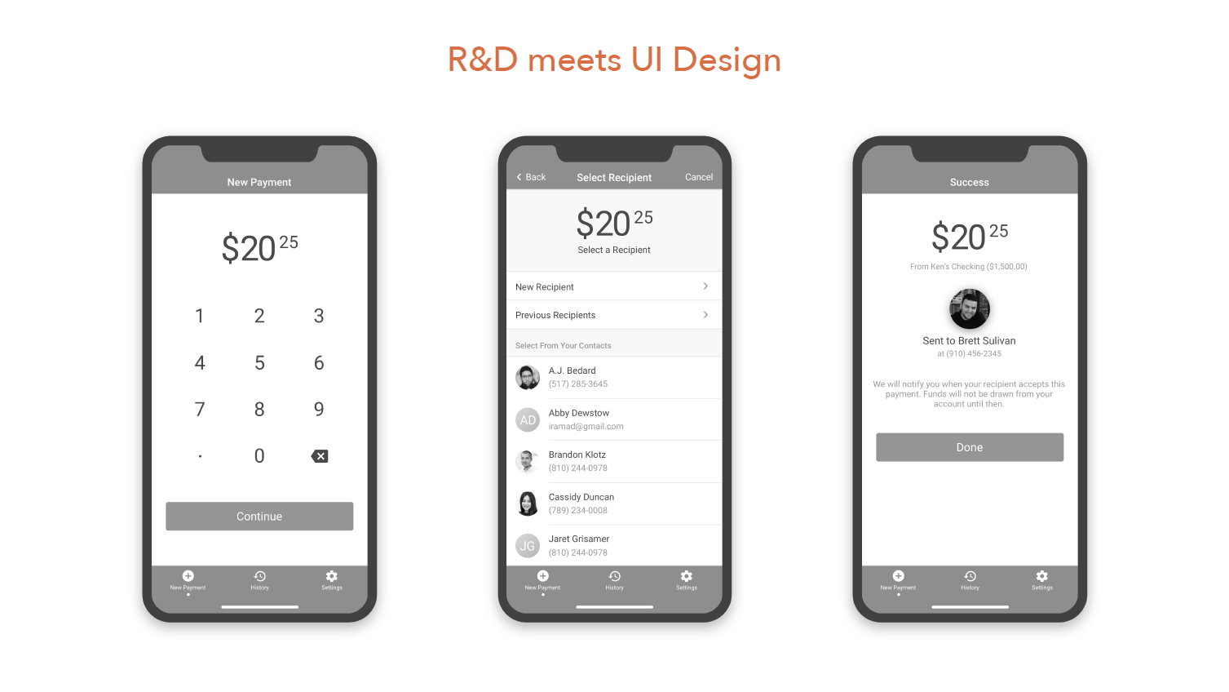

Slide 37
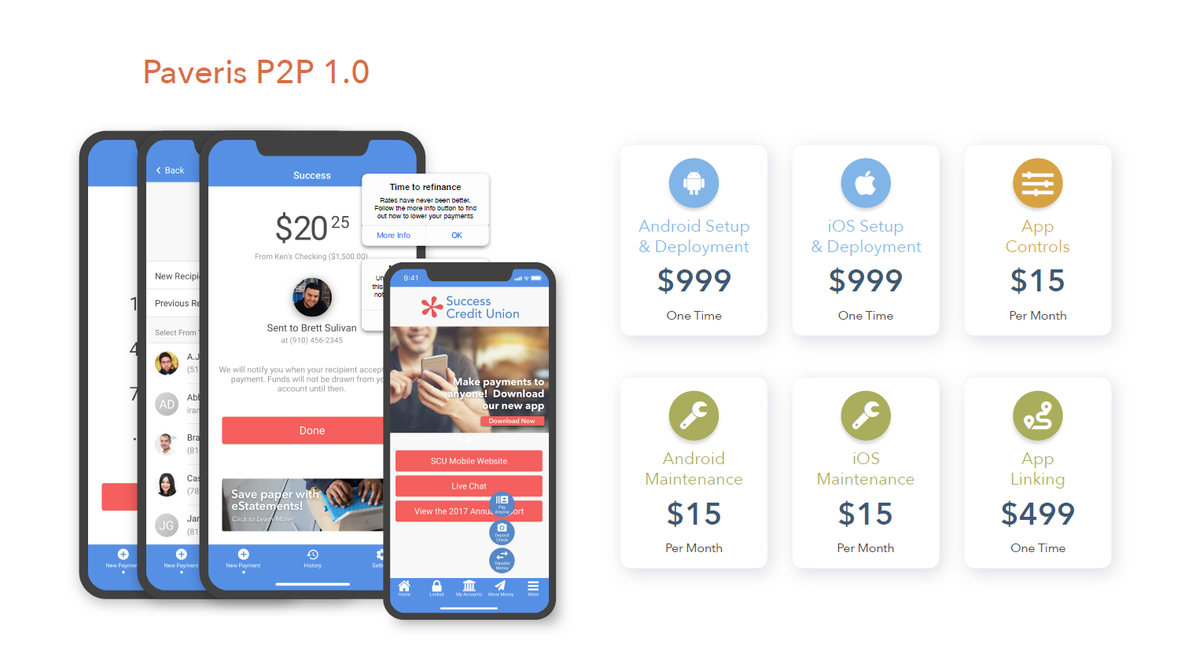
Notes:
At this point just go into a series of demos and conversations with Ken about any ideas he has for the first 6 months of our micro-app development

Slide 38
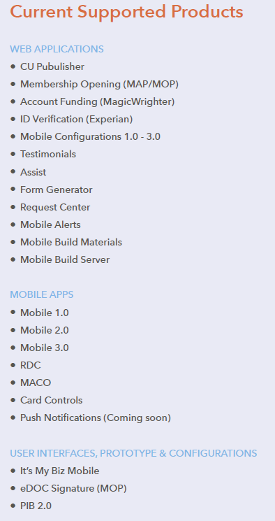
2019-2020 will be aggressive years for map/mop
Will CU business plans mirror the cuso’s investment?
Add joint owners via MOP
Integrate with the Form Generator and Request Center to upload forms and images
Process signatures
Continue to build a toolset and business support model that encourages CUs to take more chances in soliciting non-members from the ‘net
What would you have us do?

Slide 39
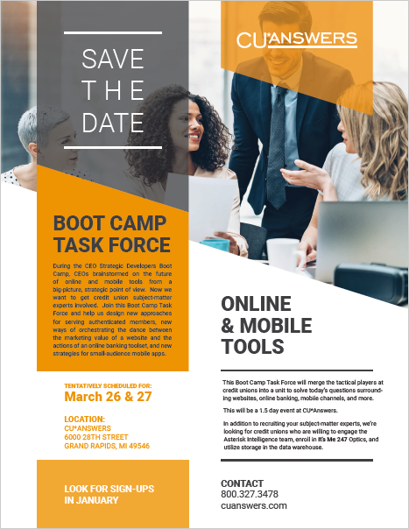
What’s next?
BOOT CAMPS ARE all ABOUT ASSIGNMENTS...
Your assignment today is to send me an email on your takeaways from this early conversation
We’re going to work with 25-40 CUs who will take this to the next tactical level and drive some key projects in our CUSO in 2019-2020
What would you focus on?
Look for all of the emails to be posted by mid-January 2019

Slide 40
Let’s take a few minutes and envision your email

Slide 41
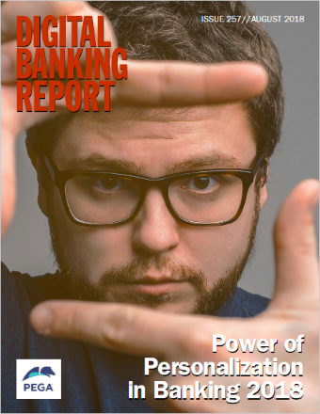
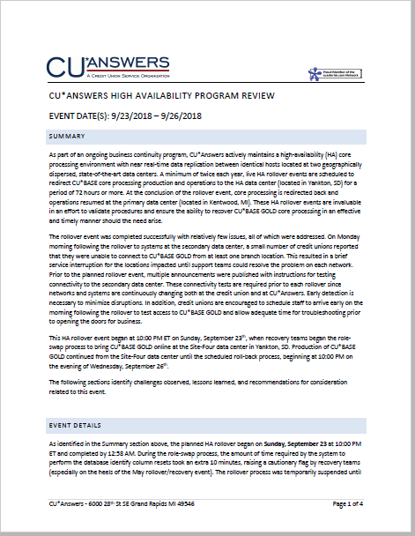
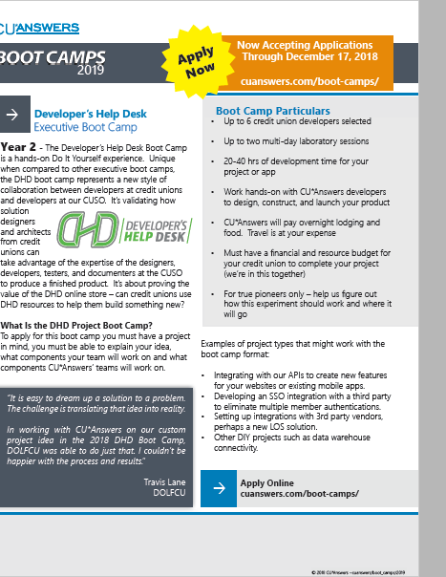
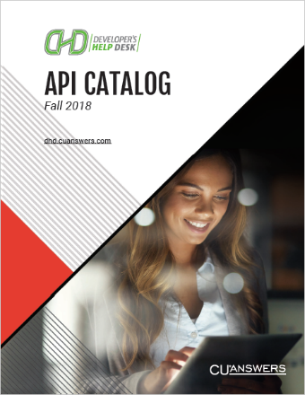
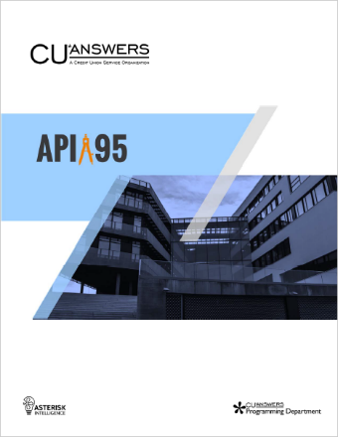
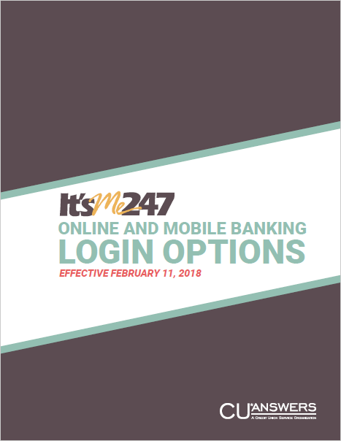
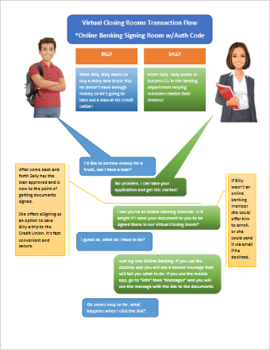
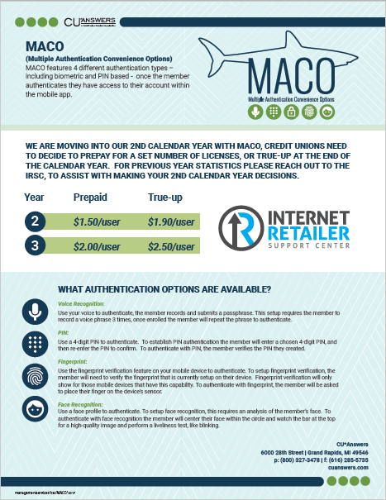
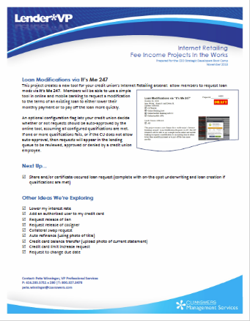
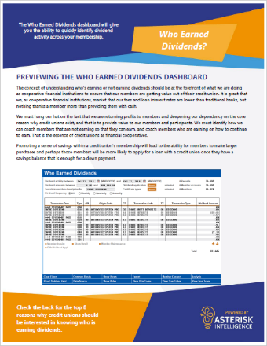
Remember the other in-between ideas
In your packet
Now that we have your attention...
Whenever we get together with CEOs, we can’t miss out on the chance to engage you on a thousand other topics that are percolating around CUs and solutions coming down the pipe
We won’t get agenda time for every one of these issues, but if you’re looking to talk with someone, I hope you will reference this packet of materials
Notes:
THIS ONE ONLY SHOWS ITEMS NOT MENTIONED ELSEWHERE ON THE SLIDES

Slide 42
2018 CEO Strategic Developers Boot Camp
THANK YOU!

