Slide 1
Designing the Future of Internet Retailing
SEGMENT A

Slide 2
CEO STRATEGIC Developers Boot Camp Segment A: Designing the Future of Internet Banking
We’ll study this throughout 2019, across the network
What is the group’s vision for internet retailing in 2020-2029?
CU*ANSWERS TEMPLATES FOR ACTION
Selling loans via internet channels: What should we build now?
Design for a 4th LOS engine
Internet store shelves
How do we repeat the success of a fulfillment product like Skip-Pay for other internet-sold services?

Slide 3
CEO STRATEGIC Developers Boot Camp Segment A: Designing the Future of Internet Banking
A CU*ANSWERS TEMPLATE
A proposed tactical approach and set of project ideas that support a strategic initiative or direction
A catalyst for collective action
We’ll study this throughout 2019, across the network
What is the group’s vision for internet retailing in 2020-2029?
CU*ANSWERS TEMPLATES FOR ACTION
Selling loans via internet channels: What should we build now?
Design for a 4th LOS engine
Internet store shelves
How do we repeat the success of a fulfillment product like Skip-Pay for other internet-sold services?

Slide 4
What’s your vision for internet retailing in 2020-2029?
If you proudly declared, “I am an accomplished internet retailer,” what 3 traits would support that confidence?
If you launched a project inside your CU so that everyone was confident about your internet retailing strategy, what would be your first 3 steps?
If you hung your hat as an internet retailer on 3 tactical investments, what would they be?
45 minutes

Slide 5
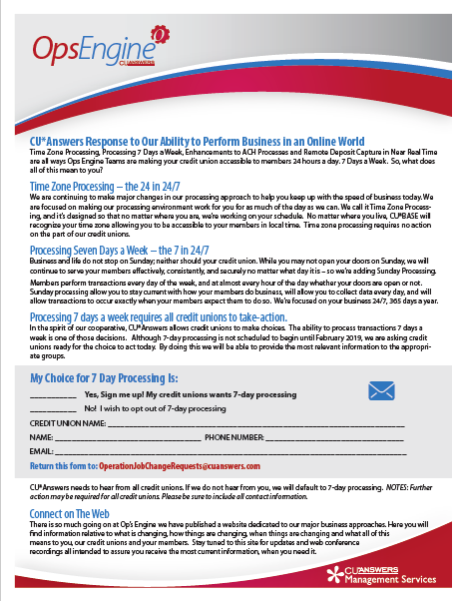
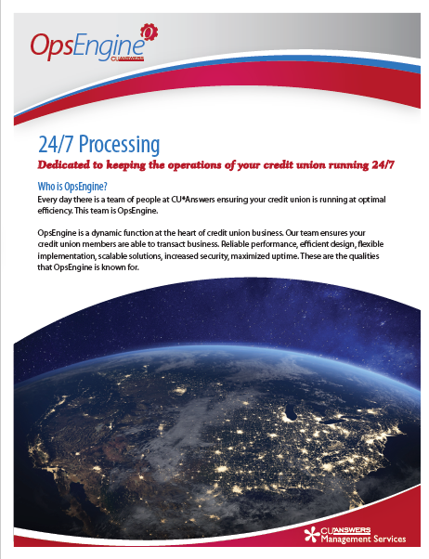
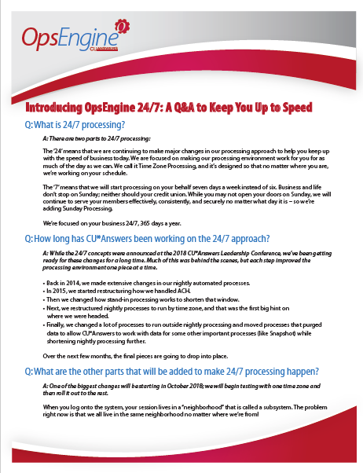
Responding to an internet retailing perspective
We’ve been working on this for a year – it will roll out in 2019
We’re ready to discuss the rollout plan for our 24/7 revolution
By January 2019 you will need to declare your CU’s intention
Default to 7-day/week processing, or opt out to a “banker’s week”
By no later than March 2019 we will all be living with a new awareness about how our network interacts locally, no matter where the member is or what day of the week it is
Notes:
Sell the default approaches:
Contrast the old 5/6 model with the new 7-day model
Sell the fact that this is now cheaper and more value without an invoice – 7 days are now free, teller or not
Is a day a day? Are we heading towards doing the same things every day, and potentially even on holidays?
Explain the difference between opt-in options
Explain the difference between how to think about the 7-day model for CU employee access vs. CU member online access
Be specific about whether a teller line is engaged or not on a Sunday
Explain the difference in managing when local groups are engaged with CU*Answers (QINTER)
Explain the narrowing maintenance windows and the importance of our HA environments as we move forward
Explain the new dynamic for stand-in processing and why past investments no longer fit

Slide 6
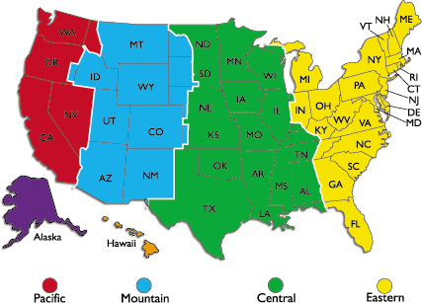
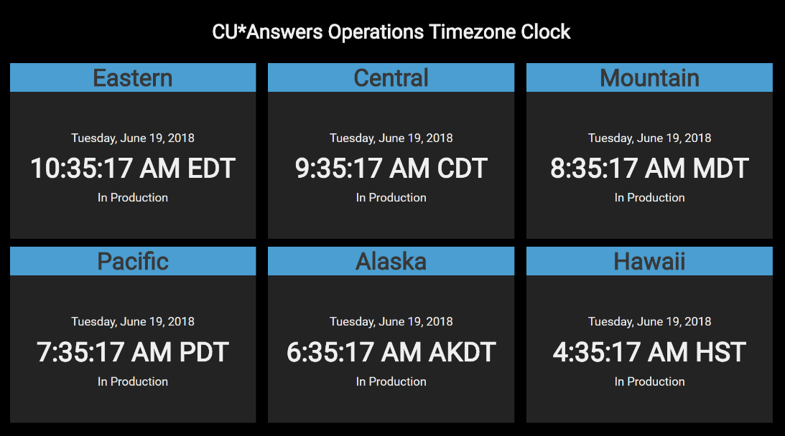
Retailing is all about the sense of ”local”
The consumer is always local – can you make them feel you get that?
What will CU*Answers have to do so that you can feel our empathy for where – and when – you do business?
Local isn’t just geography...it’s a sense that you are at the center of the world

Slide 7
Selling loans via internet channels
A CU*ANSWERS TEMPLATE FOR INTERNET RETAILING
What should we build now?

Slide 8
Engines for the future of loan origination systems
why we’re going to go crazy with los options for CUs in the next 5 years
Engine | Loan Origination System | Plans in 2019
1 | CU*BASE native soup-to-nuts LOS solution | Invest, invest, invest – the foundation for all innovation, from start to finish for a loan
2 | CU*BASE integrations for ready-to-look LOS solutions | Continue to evolve solutions with our 9 vendors, on the way to xx vendors
3 | CU*BASE integrations for ready-to-book LOS solutions | Two new vendors going live in 2018 betas, launch network-wide in 2019
4 | CU*BASE integrations for internet channel LOS solutions | Complete internal beta with Forms Generator, launch network-wide in 2019, find the audience that will spur big investment going forward

Slide 9
CU*BASE native soup-to-nuts LOS solution
Randy’s hints at key success factors (what are yours?)
Credit Union KSFs
Know the native approach and its value proposition
Origin and proving ground for all lending capabilities
Leverage the manufacturer’s advantage
Charging here is the CUSO’s option
Rely on your creativity for building business processes
Fast-to-market options based on readily available tools
CUSO KSFs
Stay vested in all things lending, build teams that respect how lending drives CU success
Avoid cost accounting and stay focused on the package’s ultimate value creation
Be the nucleus for innovation, keep costs low by extending and leveraging over significant new investments before CU revenue models mature
Let’s brainstorm
Notes:
This is a placeholder for the room to have conversations about this platform segment
List the things that we want CEOs to know about the 2019-2020 S2N investments
See Lender*VP input and highlight Geoff and Pete processes here, but do not oversell – the point of this section is internet lending

Slide 10
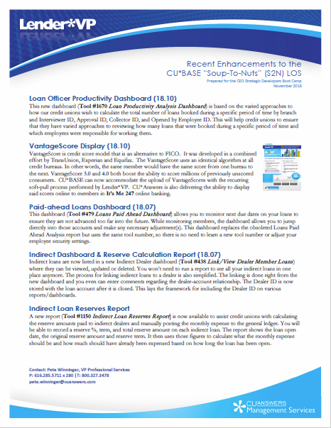
S2N – Lender*VP Hints
Are you clued in to the development agenda?
Release Planning website cuanswers.com/resources/doc/release-planning/
Ask us about monitoring our weekly Product Team “factory floor” meetings, Tuesdays at 2:30p
Working Release Schedule (updated weekly) cuanswers.com/pdf/release_summaries/CurrentReleaseSchedule.pdf
Release Summaries cuanswers.com/resources/doc/release-summaries/
Client News cuanswers.com
Lender*VP webinars via CU*Answers University cuanswers.com/resources/edu/ HINT: Joint Pete at the Learning Café on November 20!

Slide 11
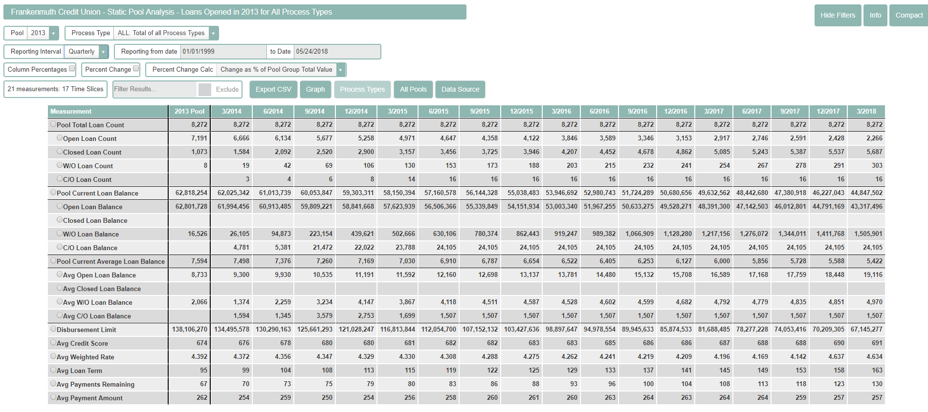
S2N: Why it is important in this integrated world?
Origin and proving ground for all lending capabilities
CECL
Static pools
CECL

Slide 12
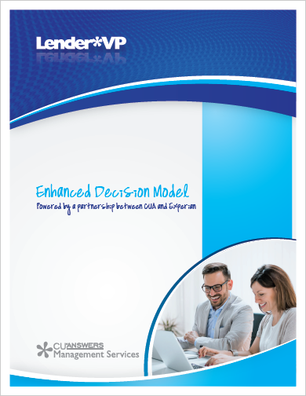
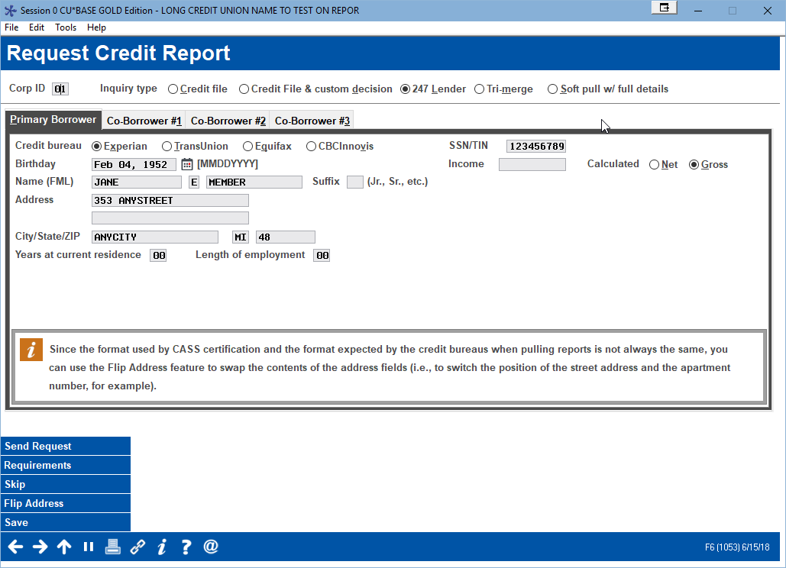
S2N: Auto-decision solutions
In 2019-2022 cu choices for decisioning will explode
store.cuanswers.com
Coming: Two choices from CU*BASE in 2019, and a new vision to use anyone’s auto-decision to close a deal

Slide 13
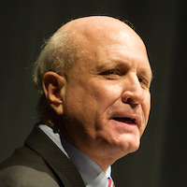
S2N: Auto-decision solutions
Are we selling tickets to a party the world may never attend?
In 2019-2022 cu choices for decisioning will explode
store.cuanswers.com
Coming: Two choices from CU*BASE in 2019, and a new vision to use anyone’s auto-decision to close a deal

Slide 14
CU*BASE integrations for ready-to-look LOS solutions
Randy’s hints at key success factors (what are yours?)
Credit Union KSFs
Adopt a mindset to use the tool where the member is
Location and process convenience over monolithic control
Selling products is the gateway to relationships
Location and process convenience over monolithic business plans
Balance process specialties with your own SOP
Compromise for the opportunity but not on the approval
CUSO KSFs
Drive throughput as our #1 priority
Amplify our skills at finding loan opportunities
Extend our network reach and innovate at the edge
Let’s brainstorm
Notes:
Notes for the CUSO KSFs:
Driving throughput vs. process speed – recognize which one is more effective and will change a credit union’s execution more effectively
Focusing and constantly refocusing the work we need to do to contribute to the credit union’s agenda (everybody needs more work)
The spec is the most expensive thing in what we do – learning is at the edge, not mandated from the center

Slide 15
Our ready-to-look vendor relationships
CUs need to make the choice on whether indirect lending is their forte
But the marketplace is becoming less focused on finding you when they need something
store.cuanswers.com

Slide 16
CU*BASE integrations for ready-to-Book LOS solutions
Randy’s hints at key success factors (what are yours?)
Credit Union KSFs
Avoid jumping out of the frying pan and into the fire
Avoid the long trek towards moving everything to one solution
Set realistic expectations for the lift and the return on specialty spending
Buying over building is a short-term high
Process capacity is not opportunity – know the difference
Be ready to invest to put people to work, not to find time
CUSO KSFs
Open the network to alternative solutions, and learn
Create opportunities for credit union reorganizations and consolidation
Expand CUSO opportunities to sell our packages without alienating special relationships held by prospects
Let’s brainstorm

Slide 17
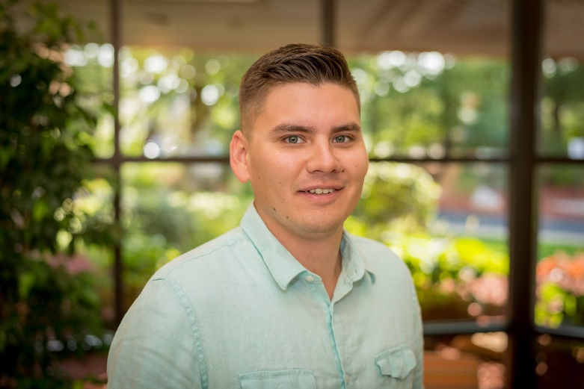
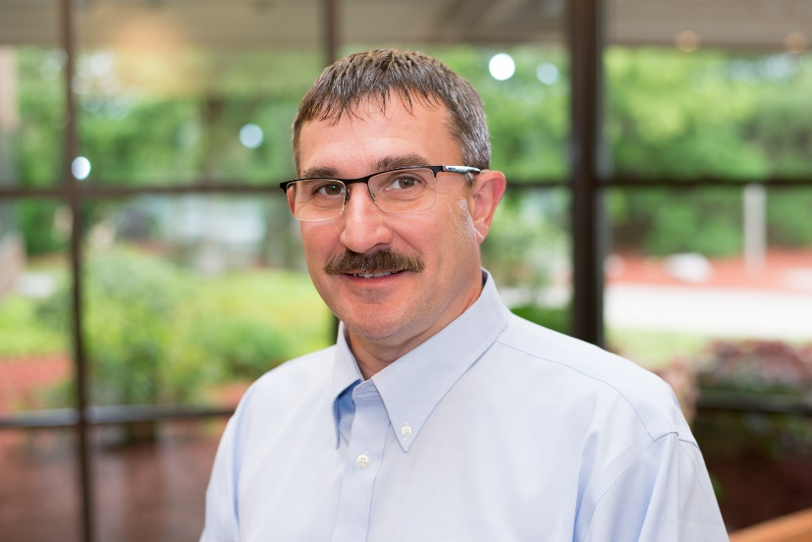
Our ready-to-book vendor relationships
Open the network to alternative solutions, and learn
Meet Charlie Dean, our new LOS Coordinator
John Beauchamp CU*Answers Imaging Solutions
Just make it work
You can’t enhance what you don’t understand
store.cuanswers.com

Slide 18
CU*BASE integrations for internet channel LOS solutions
Randy’s hints at key success factors (what are yours?)
Credit Union KSFs
Know the difference between a member request without the need for automated underwriting, and a loan origination system that requires it
Affinity and targeting your audience are more important than the tool
More is more – build throughput and chances to aggregate small audiences
CUSO KSFs
Build factories that generate endpoints and multiple channels, not a one-size-fits-all approach
Avoid complicated models that emulate the employee’s job – build what the member needs for their job
Focus on zero-cost models to extend our outreach, over professional service models that do not share the risk
Let’s brainstorm

Slide 19
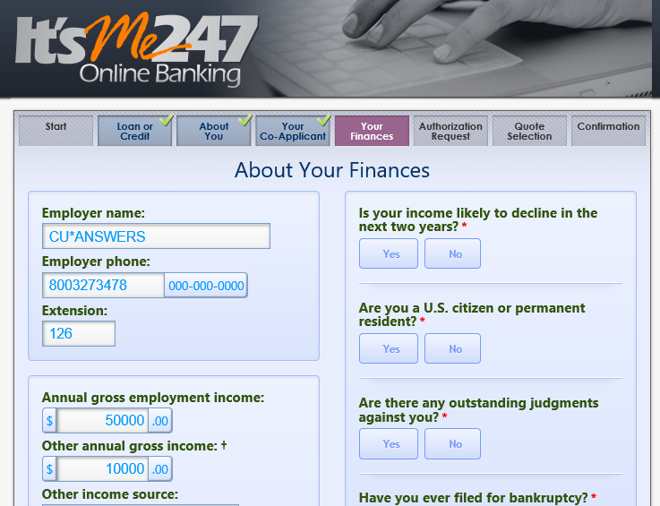
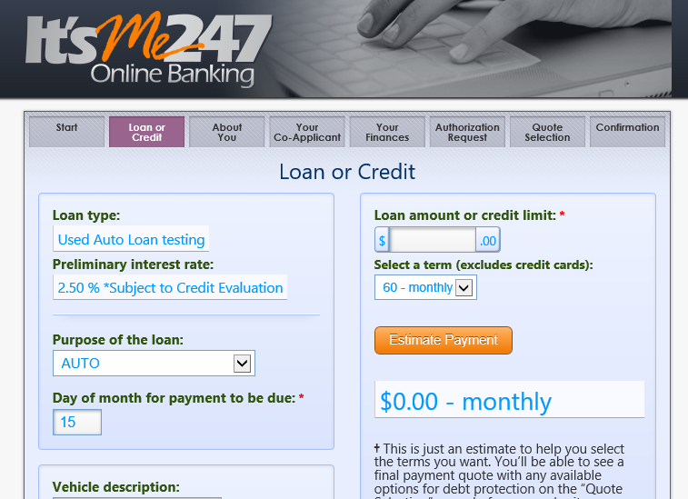
Reengineering internet LOS for 2019
We’re going back to the drawing board
Weaknesses to address
What do we do to with data provided by non-authenticated members?
How far should we go in asking for data while still maintaining a pleasant member experience?
What does a CU want to handle via a CU-designed form vs. a classic application underwriting process?
Goals
Envision and design from Sept.-Dec. 2018
Begin coding new solutions by March 2019
Release solutions throughout the year
Make the call: CU*Answers specializes in authenticated services for credit unions
The wildcard: When we open the gates for 3rd-party LOS integrations, who will CUs pick?

Slide 20
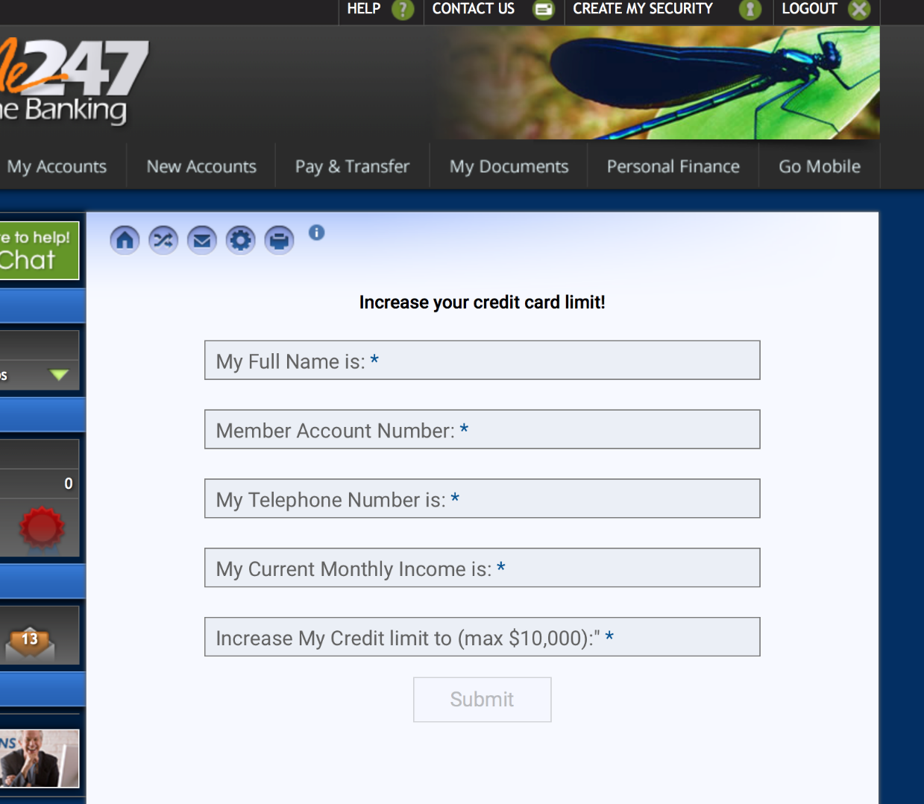
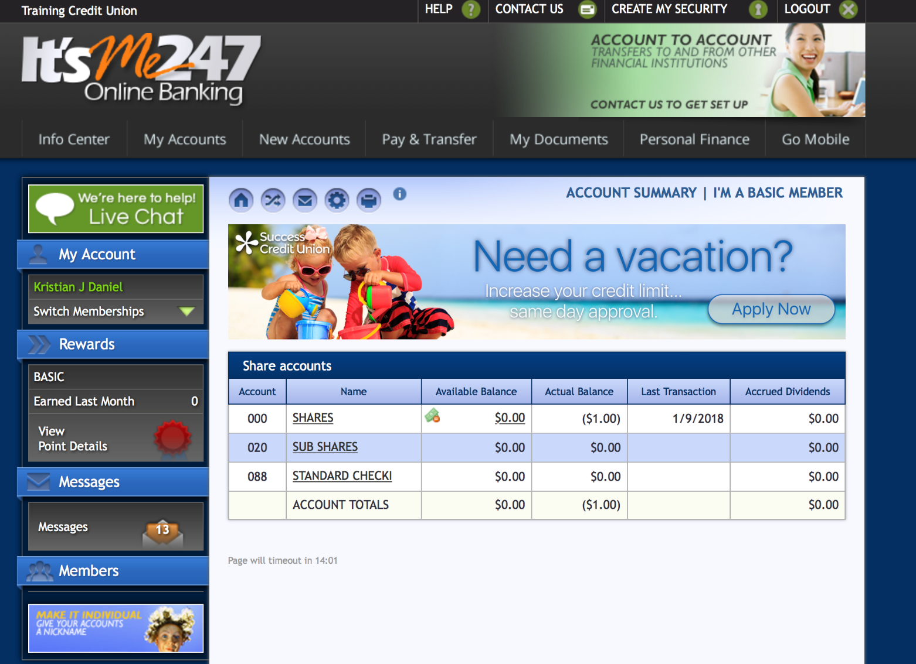
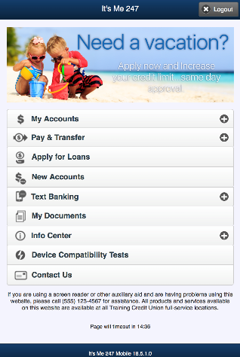
Unlimited forms when automated applications are not needed
FORMS GENERATOR
REQUEST CENTER

Slide 21
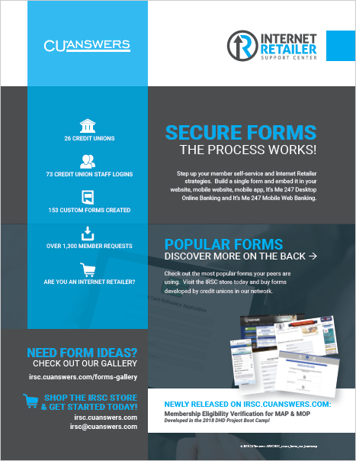
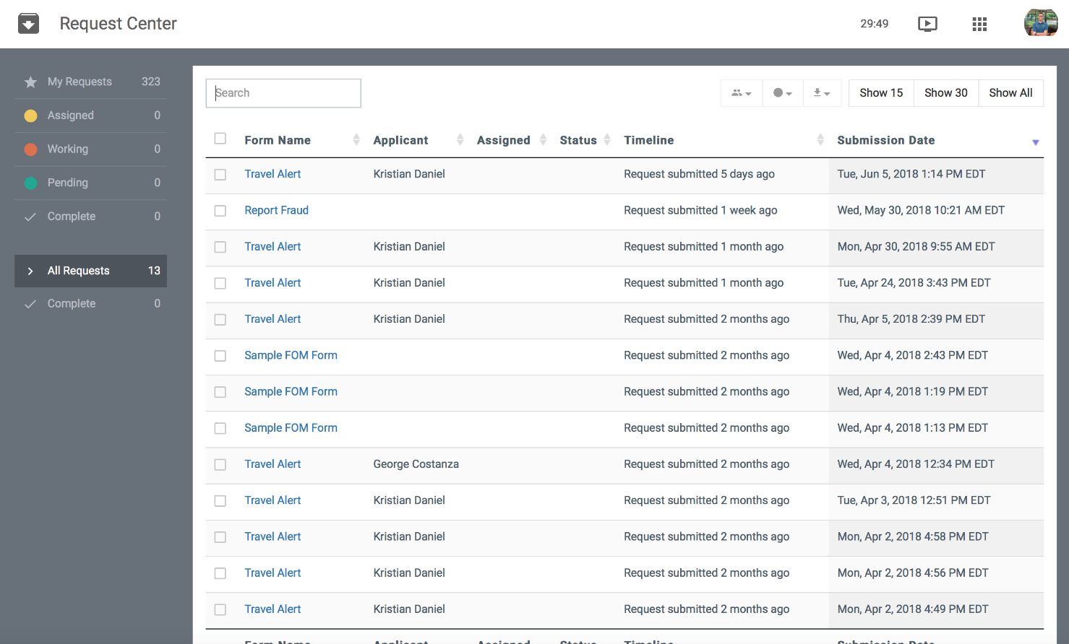
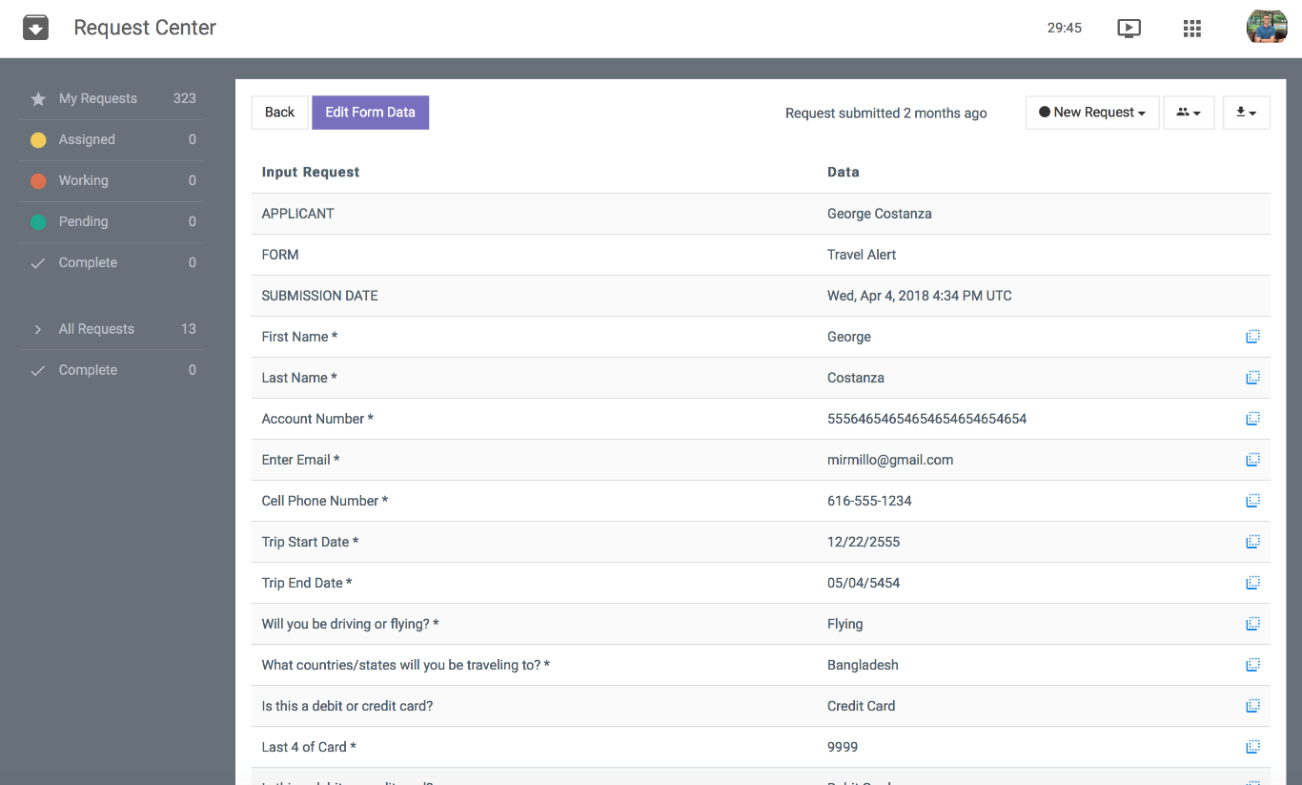
Forms Generator and the Request Center

Slide 22
Internet store shelves
A CU*ANSWERS TEMPLATE FOR INTERNET RETAILING
How do we repeat the success of Skip-Pay for other internet-sold services?

Slide 23
Internet store shelves
Randy’s hints at key success factors (what are yours?)
Credit Union KSFs
Recognize that everything is data, even your value proposition
If people can’t see it, it doesn’t exist
Digitize your value proposition and make it the center of commercial exchanges
Members need it, employees need it, your next opportunity needs it
CUSO KSFs
Heed your own advice – build a template and machine that everyone in the network can emulate and use
Build new capabilities into CUSO intellectual properties that facilitate exposing members and employees to digitized value propositions on the way to transactions
The word “data” does not adequately evoke the type, intent, or value of the content – data isn’t always statistics
Let’s brainstorm

Slide 24
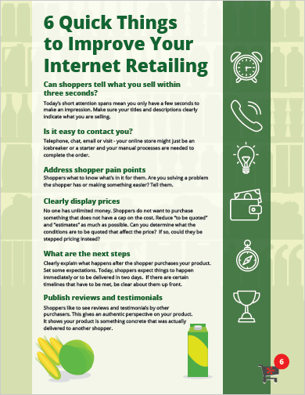
CU*Answers Internet Stores as a template
scorecard
SCORECARD
It’s not what you expect, it’s what you inspect
Every third Tuesday we coach/learn together
The scorecard exercise forces us to focus on the details of our products
Think consumer experience, cut the jargon
From the web to the back office, you improve it all
store.cuanswers.com
You’re constantly asking us to improve our retailing, and that will never stop
Internet retailing is where it’s at...invest in the future, don’t just try to fix the past

Slide 25
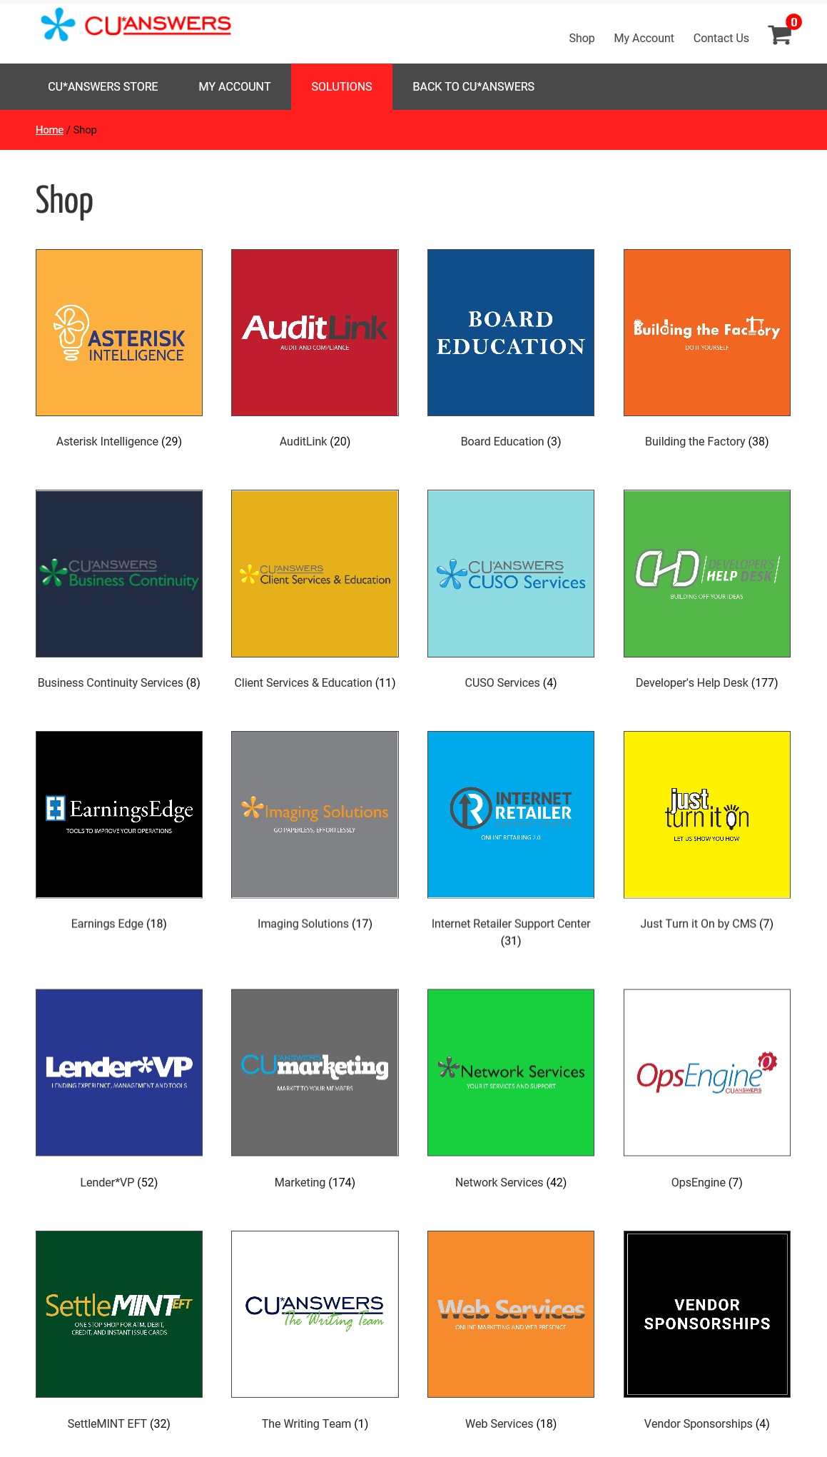
You’ll know us by our online stores
store.cuanswers.com
A new and long-term plan of attack to improve our retailing
The approach to service, support, and the intent to do a good job as a vendor to any market has changed forever
As you encourage and challenge us to be the vendor that best serves the CU marketplace, understand that we’ll respond with an internet retailer’s tone, tactic, and best intentions
Notes:
Prototype of DHD with the API categories: https://store.cuanswers.com/the-developers-help-desk/

Slide 26
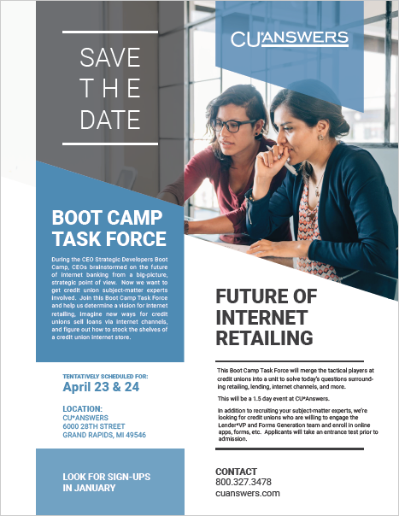
What’s next?
BOOT CAMPS ARE all ABOUT ASSIGNMENTS...
Your assignment today is to send me an email on your takeaways from this early conversation
We’re going to work with 25-40 CUs who will take this to the next tactical level and drive some key projects in our CUSO in 2019-2020
What would you focus on?
Look for all of the emails to be posted by mid-January 2019

Slide 27
Let’s take a few minutes and envision your email
...or maybe you can get started at tonight’s networking session

Slide 28
2018 CEO Strategic Developers Boot Camp

