Slide 1
2017 Data Investment Symposium
Driving Development and Building a Network of Leaders with a Data Focus
February 22, 2017

Slide 2
Data Investment Symposium
THE FINAL YEAR TO WRAP UP OUR DIRECTION
Year 1: Testing the waters
  Introduced the concept of specialized investments for selling, creating, and supporting data warehouse environments for our network
  Discussed possibilities for a third-party solution
  Small, vested group of people who would drive the investment
Year 2: Serving CUs that stuck with the ideas
  Sharing new warehouse designs and building a business for the 10% of CUs who will one day have an aggressive investment
Year 3: An “in-the-business” approach
  Use what we’ve learned to go into the data warehouse business for the long term

Slide 3
Data Investment Symposium
WHERE MY HEAD IS TODAY
After 2+ years of thinking about how the data craze fits into our future, we are ready to launch extended data services and project management for our network
  We’ll start by offering new ideas about where to store data, and what data warehouses to offer
  We’ll consider how CUs who like to share things will use our solutions, and how CUs who like to do it by themselves will need support
Data warehouses are the foundation of data analytics, and we’ll align them with our goals to enhance the data analysis capabilities in our network

Slide 4
FOCUS GROUP INPUT
Round 1: Introduce Yourself
Tell us your name, credit union name, and your position
Which of these best describes your role:
  Writing the plan to maximize data?
  Encouraging others to maximize data?
  On the front lines, responsible for finding, presenting, and creatively leveraging the data towards action for success?
Is this your first Data Investment Symposium?

Slide 5
FOCUS GROUP INPUT
Round 2: Which one are you?
Where does your credit union fall among our emerging audiences?
  “My CU has studied the data warehouse provider market and we are getting close to investing or reinvesting in new data strategies and tactics”
  “My CU has casually been watching the projects at CU*Answers, at the Boot Camps, etc., and we are ready to propose some of these ideas to our business plan authors and leaders”
  “I’m more interested than my CU is, and I need some help to engage my CU around these ideas”

Slide 6
Today’s agenda: Steps for moving forward with our commitment to the data warehouse business
Options for how we change our current data management, understanding that new warehouses give us new options
Considering what it would mean for CU*Answers to buy an Intel data warehouse product and share it with CUs via an online business model
Attacking the low-hanging fruit when it comes to building a data warehouse business: FILExxDW

Slide 7
Considering our options related to CU*BASE data
When we think about our current data warehouse (FILExx), what changes could we make so that every CU is better off in 2018?

Slide 8
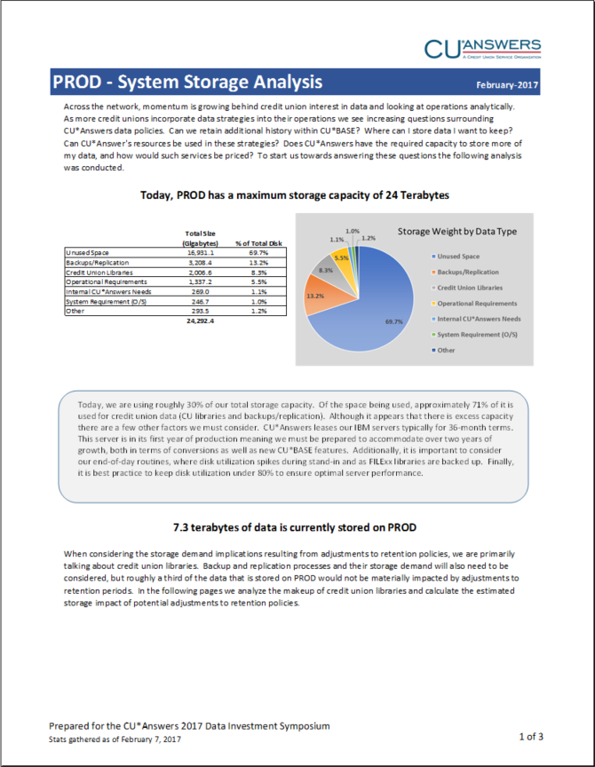
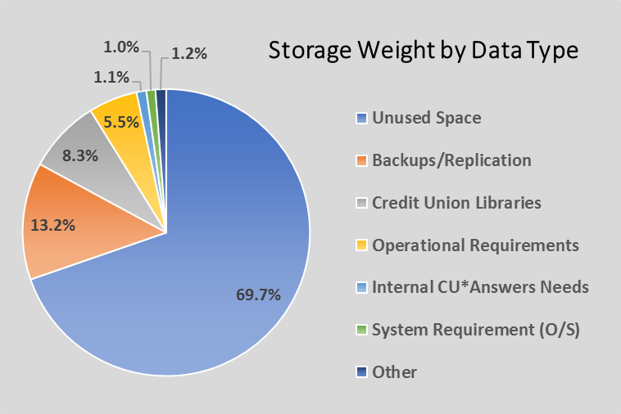
Some facts about our existing data warehouse
Average size of CU file library
7.2 Gb
Largest
CU file
library
57.5 Gb
Average size of CU EOM library
2.2 Gb
Largest
CU EOM library
28.9 Gb
Average size of CU Query library
0.2 Gb
Largest
CU Query library
8.4 Gb
All stats gathered from online CU*Answers clients as of February 7, 2017

Slide 9
Thinking about the most basic CU*BASE data retention policies
Type of Data | Standard Online Retention
Savings/checking history | 6 months
Certificate history | 24 months
IRA history | 24 months
HSA history | 24 months
Club account history | 24 months
Tax Escrow history | 24 months
Loan history | 24 months
EOM libraries | 3 months
GL trans history | 24 months
Check register | 24 months
Credit report detail | 60 days or life of loan
Credit report summary | 6 months
Statements | 18 months online
Reports | 90 days online
Before we add a data warehouse where it costs extra for retaining more of your existing CU*BASE data, should we consider just retaining more data in FILExx right now?
We don’t want the new data warehouse to be simply a place to pay for the ability to be a packrat for data you’ll never use
Our new data warehouses need to lift up CU capabilities, not just extend old ideas

Slide 10
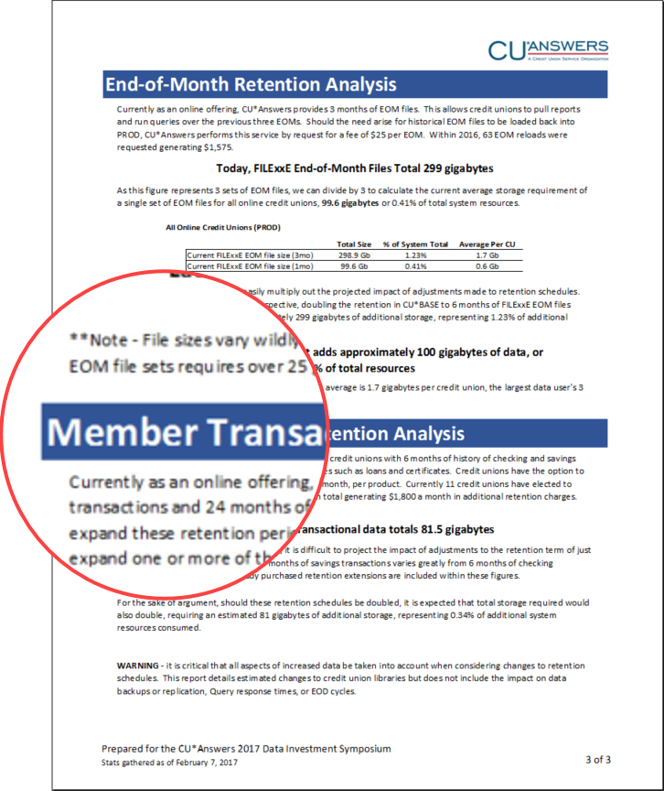
What if we added more member transaction history to our retention schedule?
We gathered some stats about transaction data stored
at our GR data center
  How did we set the retention policies way back when?
  Given the size of boxes and the way people think about data, the actual storage used seems rather insignificant – is it?
If we keep this, will we be extending CU*BASE Inquiry/Phone Op simply for the sake of seeing more? Or is there analysis?
  Remember, this will lead to other projects, like what you can view in online and mobile banking
What is a reasonable extension? Double? Quadruple? Shares vs. checking vs. loans, etc.
We’re going to do something before June – what ideas do you have?

Slide 11
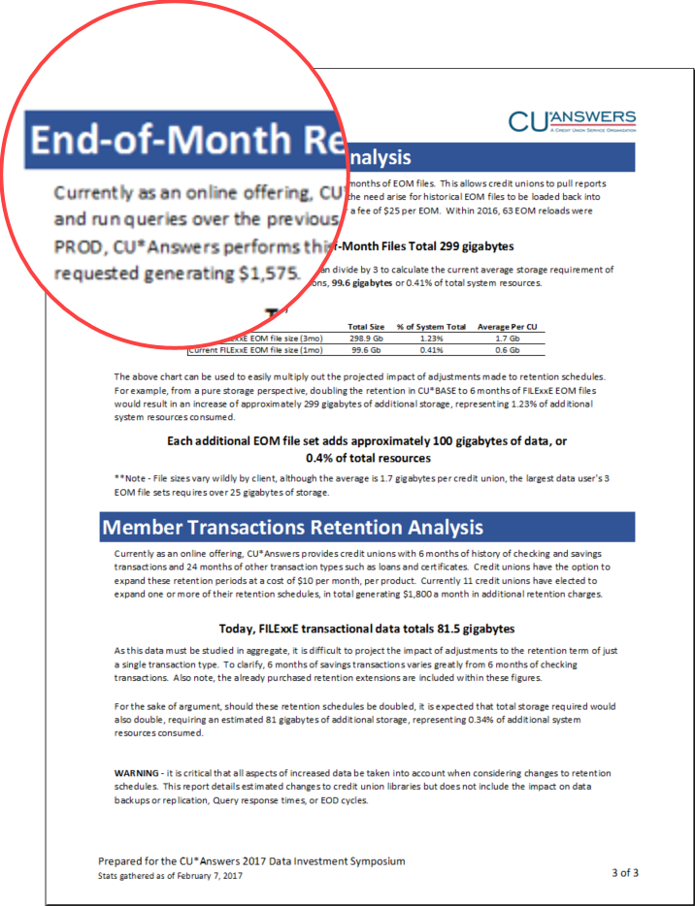
What would it mean to keep more month-end periods available online?
We gathered some stats about EOM snapshots stored
at our GR data center
  How did we set the retention policies way back when?
  Given the size of boxes and the way people think about data, the actual storage used seems rather insignificant – is it?
EOM files are more about researching, but generally related to some kind of member service request – if we doubled to six months, do you think it would change the way you use these files?
What would be a reasonable change to our policy?
Should we leave it at 3 months and spend the money on trans history?

Slide 12
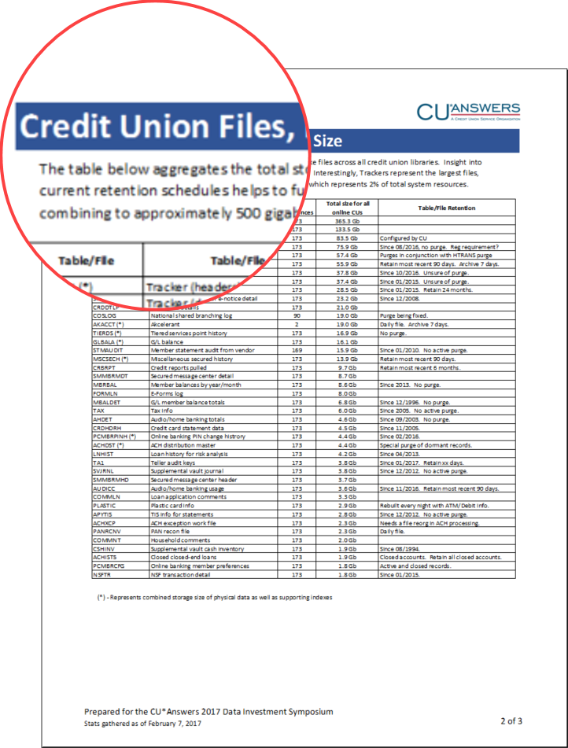
What about data outside of transaction history and EOM snapshots?
We gathered some stats about other data stored at our GR data center data such as Trackers, GL history, OFAC scan results, credit bureau reporting history, etc.
  How did we set the purge procedures way back when?
What is different about these files compared to transaction history?
Should we be aggressive and adjust the purge routines to retain more data – or purge more of it?
  Duh, who would vote for less? But we should really think about why we shouldn’t keep this data forever
We’re going to do something before June – what ideas do you have?

Slide 13


Christmas in June!
TO BE ANNOUNCED AT THE JUNE LEADERSHIP CONFERENCE?
Type of Data | Standard Online Retention
Savings/checking history | 6 months 12 months
Certificate history | 24 months 48 months
IRA history | 24 months 48 months
HSA history | 24 months 48 months
Club account history | 24 months 48 months
Tax Escrow history | 24 months 48 months
Loan history | 24 months 48 months
EOM libraries | 3 months 6 months
GL trans history | 24 months
Check register | 24 months
Credit report detail | 60 days or life of loan
Credit report summary | 6 months
Statements | 18 months online
Reports | 90 days online
We’re not restoring old data, but we will be changing the retention schedule to start building new trendlines
We want to give this a try and see if we get what we all think we’re buying: better member service and a more active set of credit union analysts
Time will tell…retention schedules are meant to be adjusted
Our new data warehouses need to lift up CU capabilities, not just extend old ideas

Slide 14
Should we make room for a new kind of client-architected data in CU*BASE?
Currently in development, targeted for the 17.05 release:
  #43454: Custom data fields at the account (MEMBER1-6) level
  #43455: Custom data fields at the membership (MASTER) level
Modeled after the 5300 account code database to allow CUs to create their own field names and data types, attached either to a specific sub-account or to the membership itself
  Dollars $xxx,xxx,xxx.xx
  Quantities xxx,xxx,xxx
  Percentages xxx.xx%
  Date
  Yes/no checkbox
  Free-form text
  CU-defined list (with lookup)
Let’s take a look…

Slide 15

Mockup only; subject to change
Custom Account Field Configuration
Field name
CRDTGRADE
Display sequence #
00015
Pre-defined values section at the bottom appears for the “List” data type
Description
Credit grade at time of loan approval
Data type
Choose from a List
Percentage
Application type
Pre-defined Values
Code | Value
1 | Whatever description you want
B | Credit grade 2
EX1 | Credit grade 3
TST | Credit grade 4
5 | Credit grade 5
Code = 3 characters
Value = 30 characters
(both alphanumeric)
■ Edit  Delete  View  Suspend/Reactivate
Individual values can be suspended without affecting data already entered on a member account
Add Value

Slide 16
This example is for account-level fields for AplTyp LN and OC
Mockup only; subject to change
Custom Account Information
Member
123456789
JOE Q MEMBER
Account
789
SIGNATURE LOAN
Position to custom field
Search for description containing
Custom Field
Description
Content
ORIGLTV
Original LTV (before backend)
$14,234.93
CRDTGRADE
Credit grade at time of loan approval
TST – Credit grade 4
COAPSCORE
Co-applicant score
COAPPTYPE
Co-applicant type
ORIGLNCATG
Original loan category (for write-offs)
LASTREPRICE
Date of last rate reprice
Lookups will display your list of configured values
LOCOPTOUT
CC automatic LOC increase opt out
Just like on the 5300 Call Report screen, GOLD will display an appropriate fill-in field based on the data type
Show Filled In Only

Slide 17
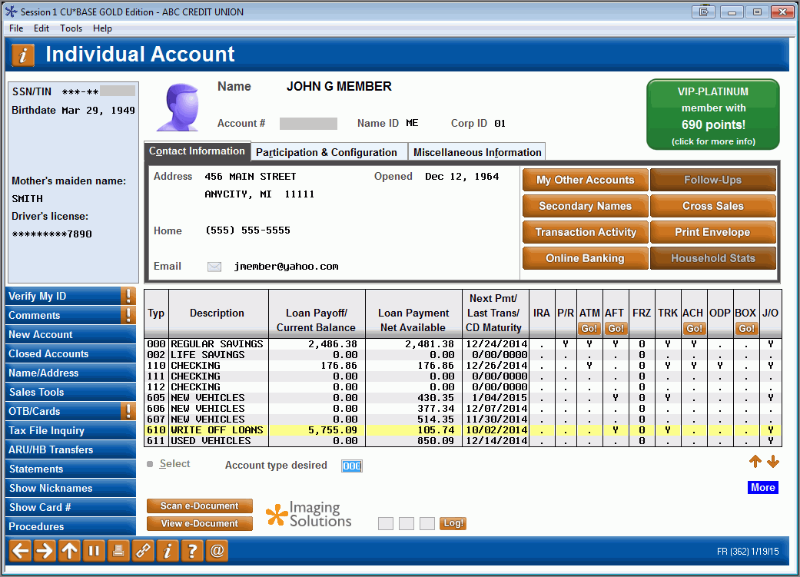
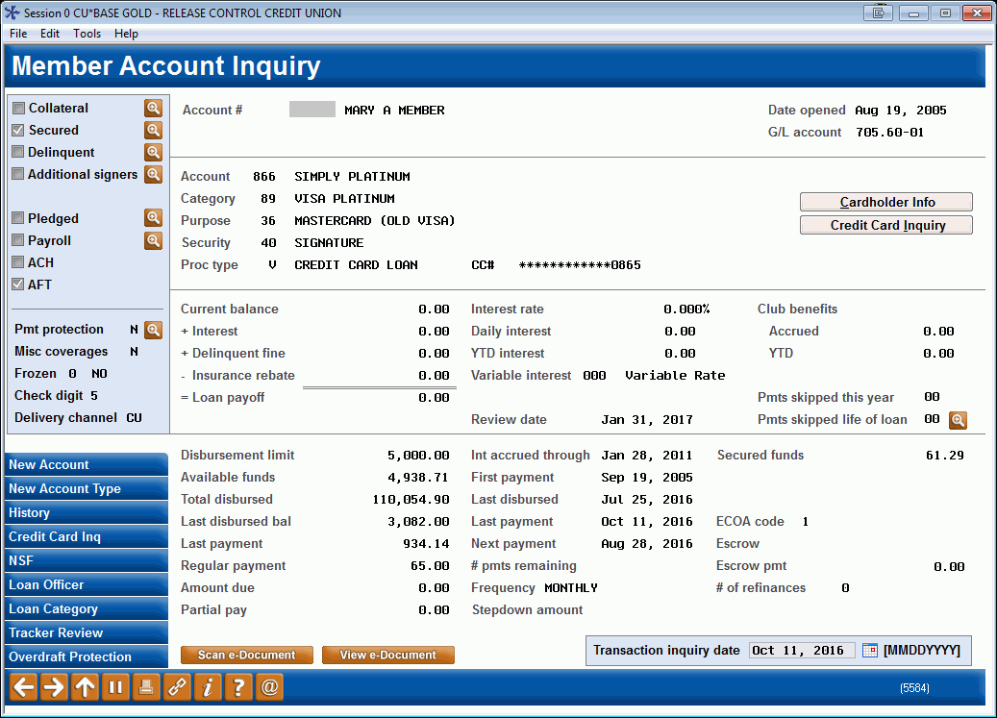
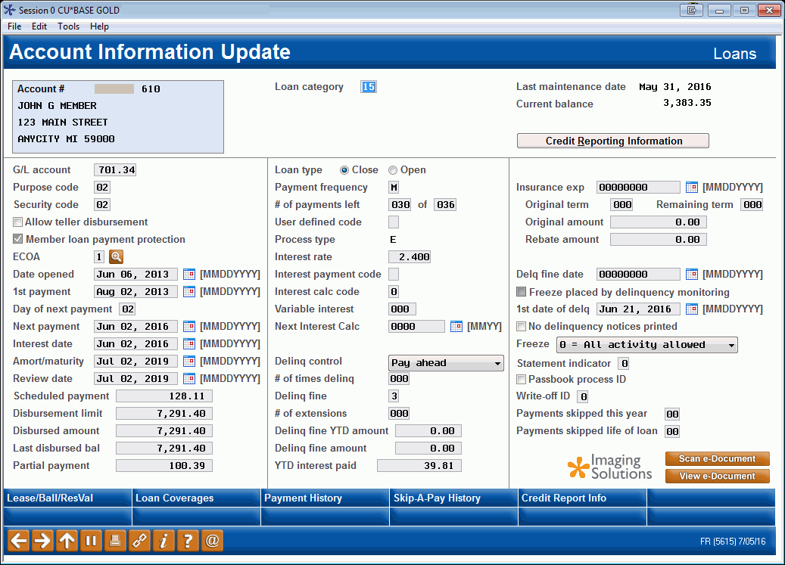
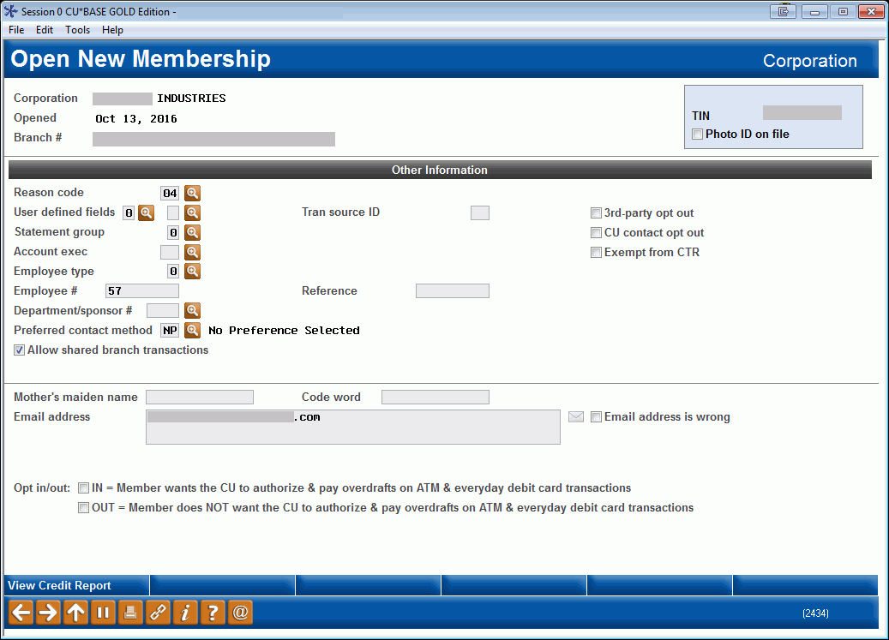

Custom Account and Membership Fields
Access points for entering or viewing custom data:
  Custom fields can be maintained via membership creation/update
  and via account information update
  Custom data can be viewed via Inquiry/Phone Op main screens and account inquiry screens
  Custom data will also be available for use with Query
A product looking for a name: Randy offered a cash prize to Boot Campers for a workable brand name … ideas, anyone?

Slide 18
FILExxDW
The low-hanging fruit when it comes to building a data warehouse business
By adding a second cylinder to our online environment, we can leverage our data center investments and our primary computing environment

Slide 19
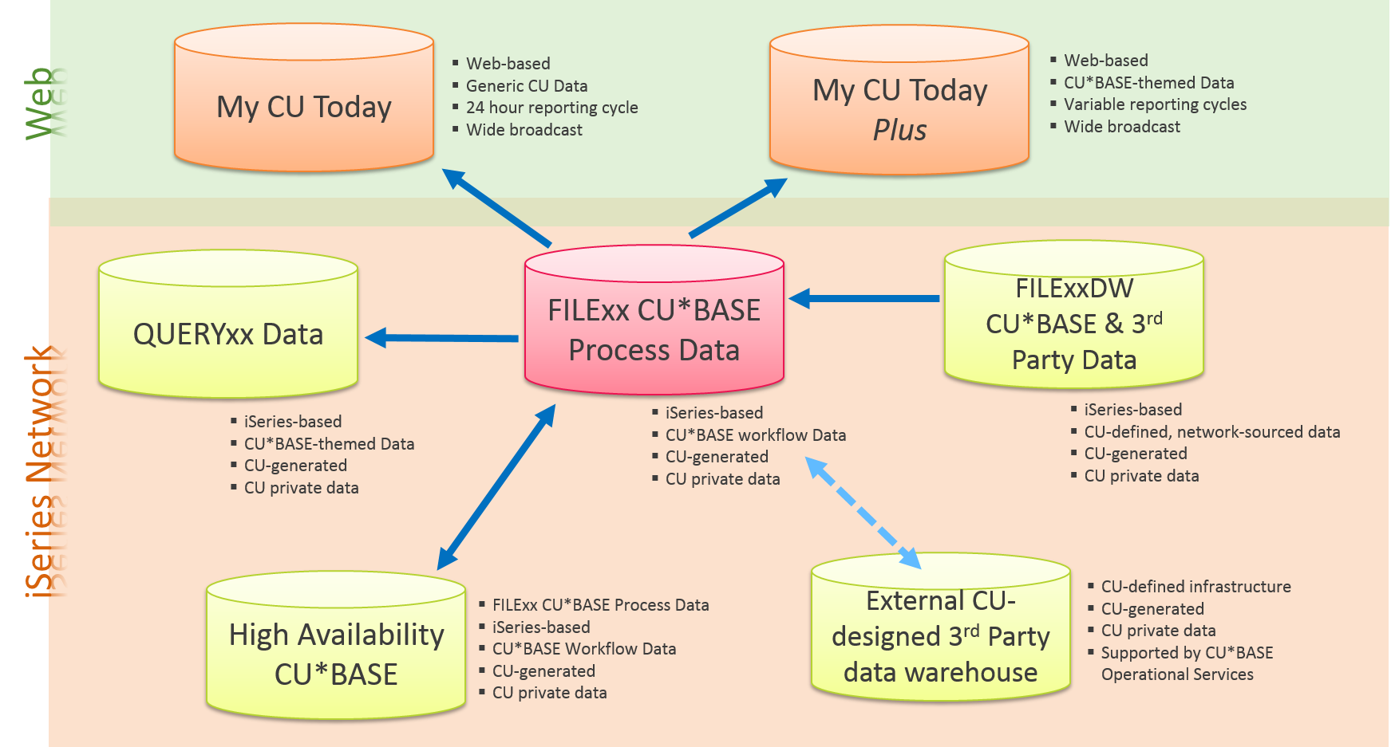
From last year’s Leadership Conference…

Slide 20
How do you support the investments and work necessary to offer a data warehouse? Fees!
Everyone understands we have to charge for the additional space we’ll need to build and maintain
But it’s much more than that…
  What/how much data is allowed, how to control?
  How to manage?
  What about redundancy, high availability?
  Backups – Frequency, impact on nightly operations, ability to restore?
  Access – Embedded in CU*BASE vs. kept separated?
  Encryption – How do we stay safe and compliant? (What if your tables contain PANs?)
Over the next few months we need to publish procedures and controls and design a revenue model that makes this a long-term offering

Slide 21
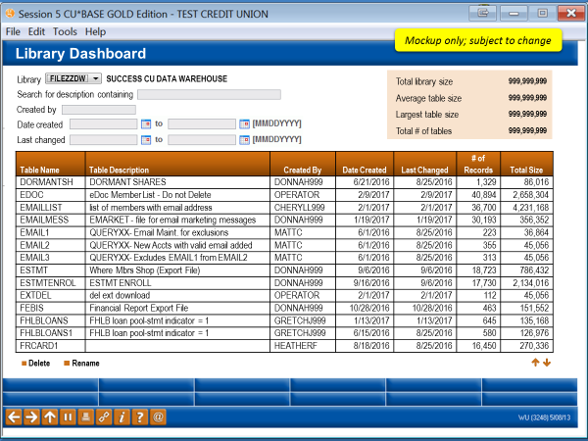
For example, if we charge by storage space used…
…how would you inventory what is in your warehouse?
…how would you know how much space you’re using?
…how would you delete unused data?
…how would you keep your files organized?
We need to build something for the data warehouse user group and the CU’s database administrator
How about this?

Slide 22
Mockup only; subject to change
Library Dashboard
Library
FILEZZDW
SUCCESS CU DATA WAREHOUSE
Total library size
999,999,999
Search for description containing
Average table size
999,999,999
Created by
Largest table size
999,999,999
Date created
Total # of tables
999,999,999
Last changed
Table Name | Table Description | Created By | Date Created | Last Changed | # of Records | Total Size
DORMANTSH | DORMANT SHARES | DONNAH999 | 6/21/2016 | 8/25/2016 | 1,329 | 86,016
EDOC | eDoc Member List - Do not Delete | OPERATOR | 2/9/2017 | 2/9/2017 | 40,894 | 2,658,304
EMAILLIST | list of members with email address | CHERYLL999 | 2/1/2017 | 2/1/2017 | 36,700 | 4,231,168
EMAILMESS | EMARKET - file for email marketing messages | DONNAH999 | 1/19/2017 | 1/19/2017 | 30,193 | 356,352
EMAIL1 | QUERYXX- Email Maint. for exclusions | MATTC | 6/1/2016 | 8/25/2016 | 223 | 36,864
EMAIL2 | QUERYXX- New Accts with valid email added | MATTC | 6/1/2016 | 8/25/2016 | 355 | 45,056
EMAIL3 | QUERYXX- Excludes EMAIL1 from EMAIL2 | MATTC | 6/1/2016 | 8/25/2016 | 313 | 45,056
ESTMT | Where Mbrs Shop (Export File) | DONNAH999 | 9/6/2016 | 9/6/2016 | 18,723 | 786,432
ESTMTENROL | ESTMT ENROLL | DONNAH999 | 9/16/2016 | 9/6/2016 | 17,730 | 2,134,016
EXTDEL | del ext download | OPERATOR | 2/1/2017 | 2/1/2017 | 112 | 45,056
FEBIS | Financial Report Export File | DONNAH999 | 10/28/2016 | 10/28/2016 | 463 | 151,552
FHLBLOANS | FHLB loan pool-stmt indicator = 1 | GRETCHJ999 | 1/13/2017 | 1/13/2017 | 645 | 135,168
FHLBLOANS1 | FHLB loan pool-stmt indicator = 1 | GRETCHJ999 | 6/15/2016 | 8/25/2016 | 580 | 126,976
FRCARD1 |  | HEATHERF | 8/18/2016 | 8/25/2016 | 16,450 | 270,336
■ Delete  Rename

Slide 23
The easy part is thinking about what CU*Answers will put into FILExxDW
CU*BASE
  Phone optics
  It’s Me 247 optics
  OTB raw data
  Bill pay subscribers, payees, activity
  Purged data/extended retention (trans, Trackers, GL, etc.)
Snapshots
Other, TBD
  Conversion data?
  ??
It’s easy because we are the architects of the data, and we’ll set up the rules

Slide 24
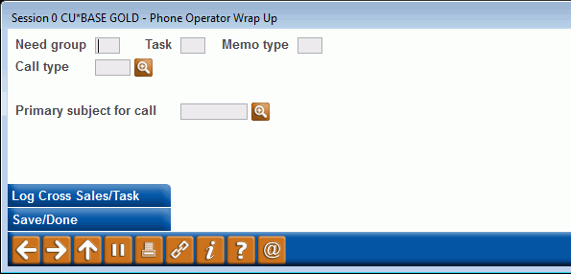
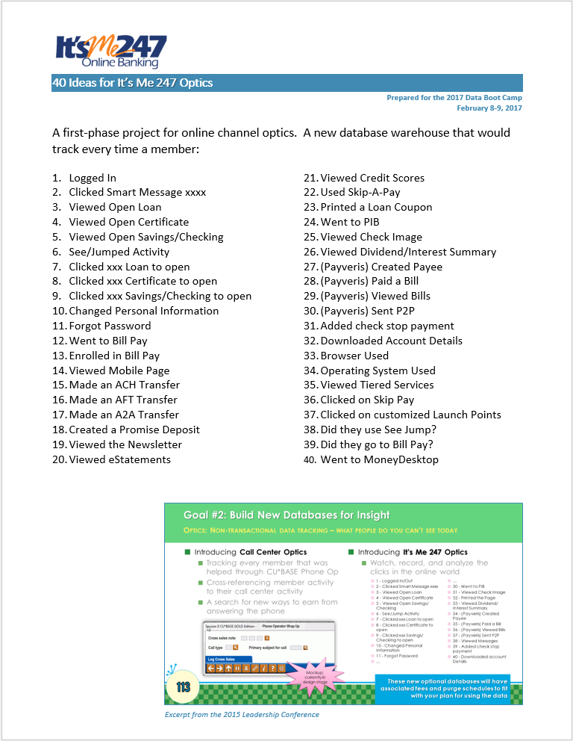
SPEAKING OF GETTING DATA INTO CU*BASE…
Let’s take a look at a couple of projects we talked about last year
Phone Op Wrap-up Codes were released in 16.05
  One-click Trackers were added to the wrap-up window in 16.10
Coming in 2017-2018:
  Phone Center Optics (repositioning
  this project for FILExxDW)
  It’s Me 247 Optics

Slide 25

The hard part is thinking about how to control the things you’ll put into the warehouse
What kind of controls can we even put into place?
  We can’t really know content or amount of data being uploaded
How do we prevent someone from attempting to upload so much data it crashed the system (exceeds available DASD space)?
Research to be done on if and how we can control the size of libraries
We can create FILExxDW and be ready
for every CU, but still need to decide
which credit union employees have access
As a customer of the data warehouse, what rules do you think would be reasonable?

Slide 26

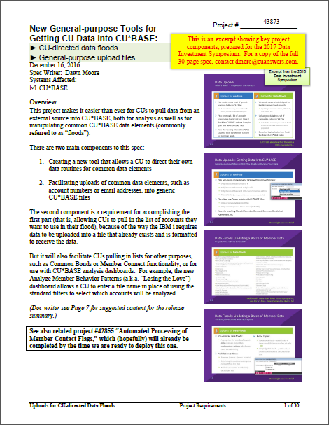
SPEAKING OF UPLOADS…
Coming in 2017: CU-directed data floods of common CU*BASE fields
Run your own data floods for FREE
  Built-in audit and exception reports; validation to ensure only clean data is written to member files
  Values can be selected from a config or even pulled out of your uploaded file
Upload any account list for data analysis or floods
  New generic tables (complete with *.FDF files needed for the upload process) into which you can pull data
  Phase 1 includes 26 different flood types, such as:
    ANR limits, due diligence flags, ECOA codes,
    electronic hold groups, freeze codes,
    delinquency fine codes, loan purpose and
    security codes, reason codes, opt in/outs,
    statement style codes...and many more!

Slide 27

Pricing Strategies
BUILDING A REVENUE MODEL
As customer-owners, you need to wear both hats and help us build something we can all afford and that your CU can earn a return on
Pricing strategies to consider:
  Storage
    Amount of data in the warehouse on the last day of the month?
    Peak usage? (Track usage each day of the billing cycle and bill the highest day)
    Peak average? (Average out the 3 highest days)
    Monthly average?
  Access (number of people using the warehouse)
  Bandwidth (amount of data being uploaded per period)
  Processing (for now, just the work to extract purged
  data over to the warehouse)

Slide 28

FILExxDW and our 2017 Calendar
Phase 1 (July 2017): Come to market with FILExxDW for CU*Answers-generated data only
  Complete a review of FILExx files
  Why and how these files might move to FILExxDW
Phase 2 (Oct 2017): Introduce data warehouse uploads to complete the FILExxDW business approach
  Complete a beta with a CU that has an aggressive plan to use third-party data with CU*BASE data on the same system
Phase 3 (Nov 2017): Introduce our data warehouse
business at the CEO Strategies event and launch a
long-term effort

Slide 29
Sharing an Intel-based server data warehouse
What would it mean for CU*Answers to buy an Intel data warehouse product and share it with CUs via an online business model?

Slide 30

Thinking about Intel-server-based data warehouses
Once we have an audience that’s aggressive about data
warehouses and analyzing third-party data, we believe
there will be a market for CUs who need CU*Answers to:
  Provide an Intel server-based warehouse as a shared property, or
  Be the facilities manager for a credit union’s own Intel server-based data warehouse
At the first Data Investment Symposium we introduced OnApproach… but it was too early
  During 2018 we’ll work with interested CUs to search for a third party data warehouse platform
  We have a lot of work to do in 2018
Many individual CUs are doing this work today; we may have a ready-made template by 2018

Slide 31
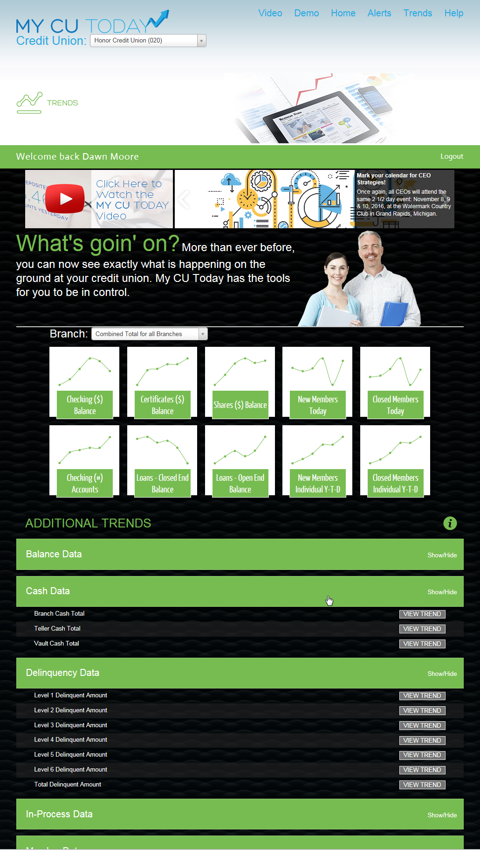

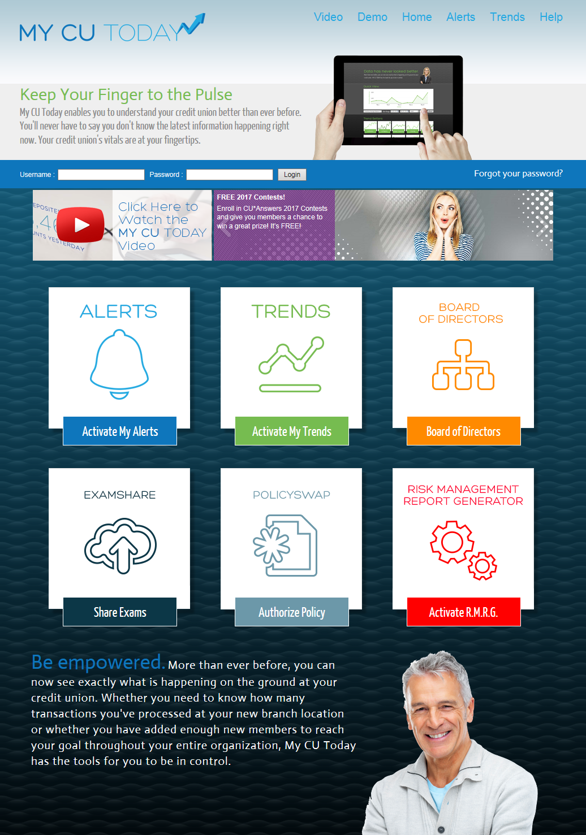
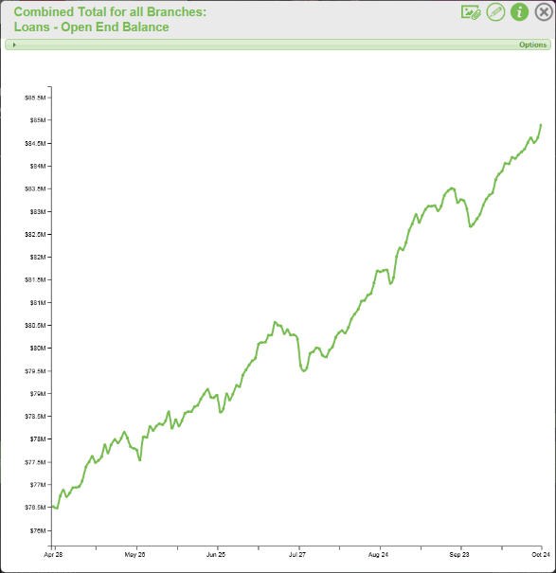
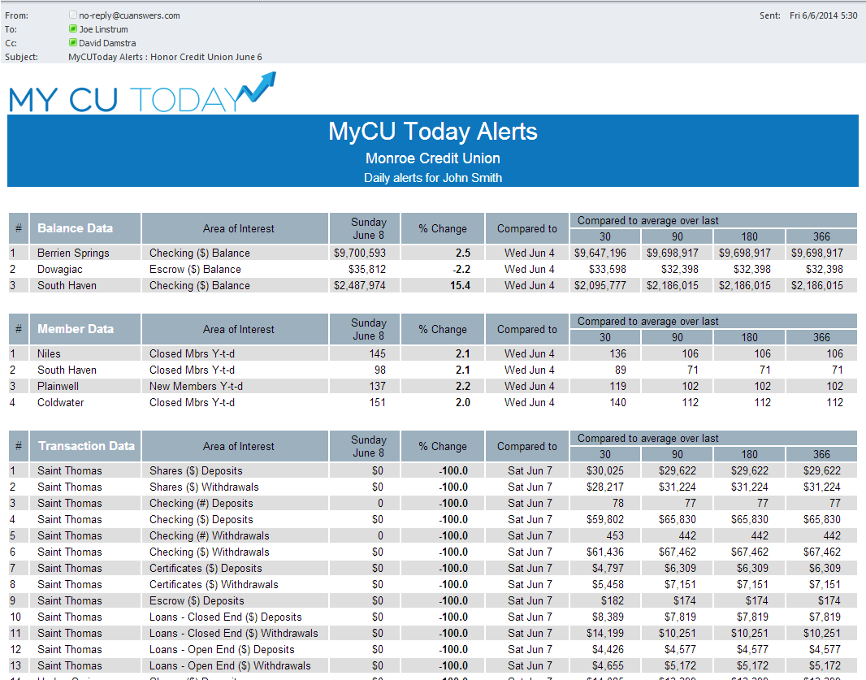
We are further along than you might think
What is the future of MY CU TODAY as a data warehouse for analysts?

Slide 32
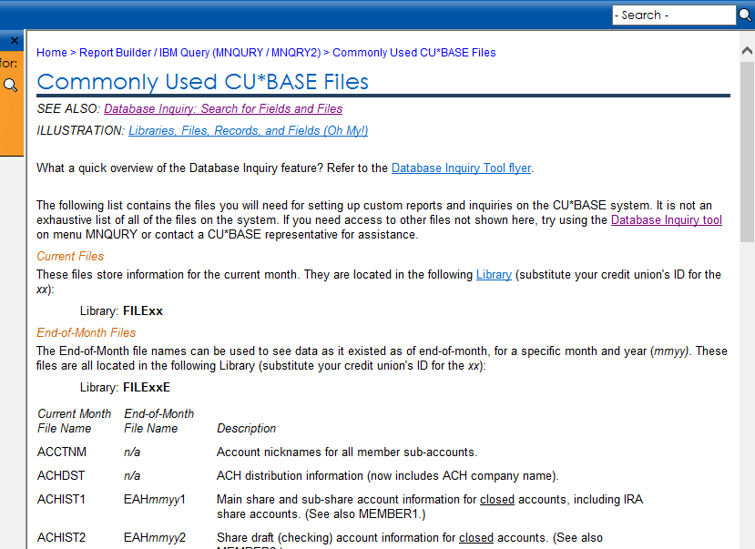
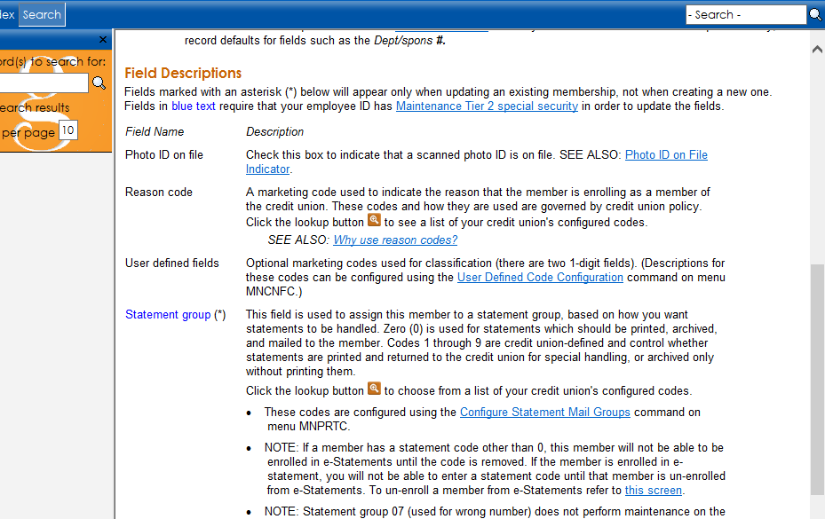

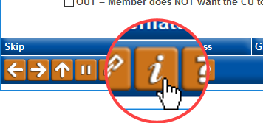
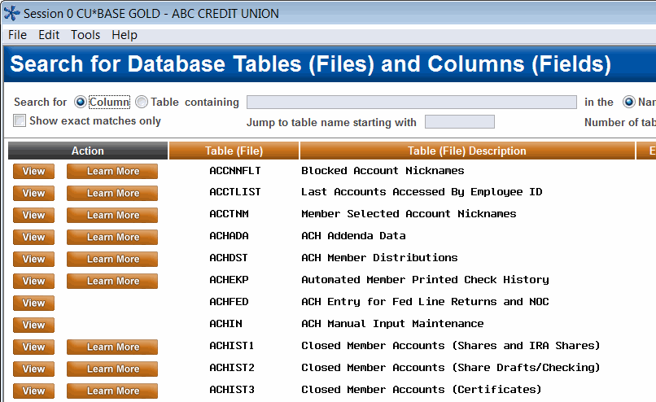
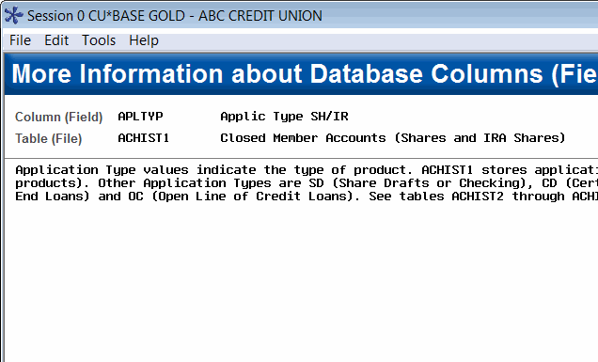
Continuing to teach CUs our tables and how they can work for them
  And coming in 17.05:
  Enter your own comments into the Database Search Assistant!

Slide 33
Thinking about external data warehouses and the future
Some stats from our most aggressive data warehouse user to date, Notre Dame CU:
  Current data warehouse stores 1.25 terabytes
  CU receives daily uploads from CU*BASE (some add records, some simply replace the prior day’s data)
  Also take some snapshots of daily balances or perform other calculations to record specific data points
  Backup storage at two sites
  Only 4 users have authority to log in to the data warehouse
  Full-time staff dedicated to data warehouse activities

Slide 34
Wrap-Up
Remember, data warehouses are not the point…earning from data analytics and what you see in the data is what will save your future

Slide 35
Thanks for the day!

