Slide 1
CEO School
Where everyone’s a teacher, and everyone’s a student
Wednesday

Slide 2
CEO School helps CEOs understand what they should be thinking about when it comes to getting the most from their investments in technology and our network

Slide 3
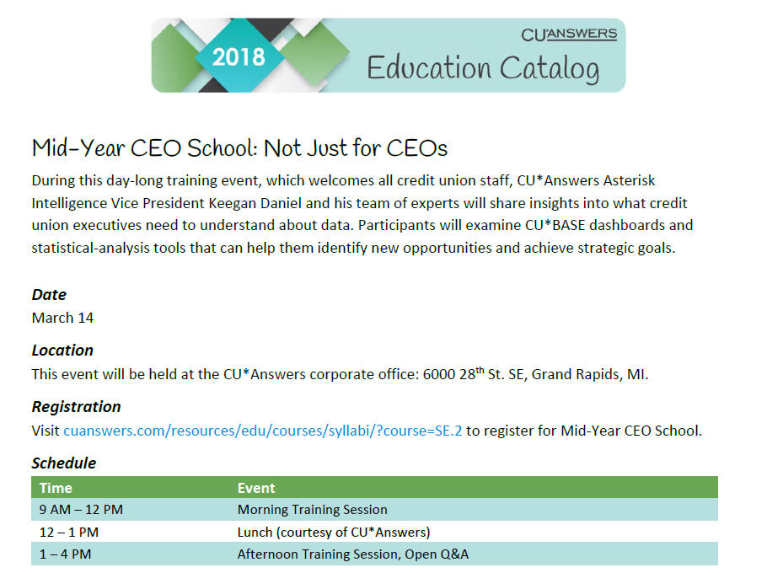
A Second Shot at CEO School Every Year

Slide 4
Remember our new rhythm for this year’s interactions...
For each topic:
Briefing targeted to CEOs
Randy will introduce the topic
Presentation by marketplace experts
Tactical responses to the topic from our technical or other teams (including software demos, etc.)
CEO discussion/brainstorming
A TNT session designed to bring out CU leaders ready to Teach, Negotiate and Tell their point of view
And as other thoughts occur to you over the next few weeks, go to the CEO Strategies page and leave a comment!

Slide 5
Today’s Focus
1
Data in action
What does it mean to double down on all of our investments over the past decade?
Will CUs do the same?
2
What does data mean to an Internet Retailer?
Projects CEOs should consider – not just for your consumers, but also for your volunteers
How can we make this a headline in CU business plans?
3
What does it mean to add a data administrator to your organizational chart?
What if you as a CEO had to add these new duties to your daily work?
Building teams that will change your future

Slide 6
CEO School Part 1 Data in Action
What does it mean to double down on all of our investments over the past decade?
Will CUs do the same?

Slide 7
A Decade of CEO School
It’s intuitive that data is the key to answering the riddles that perplex every business . . . but what is intuitive is not always simple to act on
At CU*Answers, we’re pushing our network and customer-owners to crack the riddle
2007 | What a CEO Should Know about Member Data; Leading Meetings; Driving the Buzz With Your Membership; Understanding Service Income; Networking Credit Unions for Growth; Working Under the Best Contracts
2008 | What CEOs Should Have On Their Radar: Achieving the lowest cost of going active with innovation; Having the lowest cost in the industry for compliance; Being known as one of the most aggressive mortgage servicing networks
2009 | Getting a Handle on Automated Service Income; Pinning Down the “Duh” Statistics; Learn From a Peer; Reviewing CEO Dashboards
2010 | Putting on your Developer Hat; Introducing the Analytics Team; A new style/template for analysis; Micro-awareness vs. Micromanagement; Pushing the buttons (or assigning someone to push them for you)
2011 | Building Solutions With the Spirit of Collaborative Venture Capitalists: What a CEO Needs to Know (pushing the buttons or having someone push them for you); CEOs as Solution Designers; CEOs Inspiring Your Teams to be Developers; CEOs Creating an Innovator’s Culture
2012 | A Community Focused On Driving Opportunity: Actionable Analytical Approach; Making Ownership Real; Do You Have an Online Channel Strategy?
2013 | Responding to the Challenges of Big Data: Actionable Analytical Approach 2.0; Patronage Databases; Big projects where CEOs need to lead the way
2014 | A Day of Mentoring and Coaching around Using CU*BASE Tools: Actionable Analytical Approach 3.0; Moving Data to the Edge of Your Cooperative; Retooling for the Next Decade at CUs & Our CUSO
2015 | A Day of Mentoring and Coaching around Using CU*BASE Tools: Data 2016, Behind the Firewall; Data 2016, Out in the Open, Extended for the World to See; Building a Collaborative Bench of Data Analysts
2016 | Engaging a Data Focused World: Executive Awareness Of Data and Trends, Internal Tools Moving Outside of CU*BASE, What are your employees doing?, Virtual Contact Channels

Slide 8
ASAP: Ask, See, Act, Profit
A development roadmap from 2006 that continues to evolve today
Ask
We started with polling users on what questions they would ask of data
We built dashboards and Query approaches so that questions were stored, ready to automate
We are now searching to embed questions in interactive data engagements with members, instantly
Ask more, See more, Act faster, and Profit more
Profit instantly, from every member interaction

Slide 9
ASAP: Ask, See, Act, Profit
A development roadmap from 2006 that continues to evolve today
See
We started with reports and tried to engage an audience with color, graphs, and better presentation
We pushed hard for CU end-users to generate their own versions for presentation
We are now searching to let everyone (members, employees, regulators, etc.) see in every delivery channel and every engagement
Ask more, See more, Act faster, and Profit more
Profit instantly, from every member interaction

Slide 10
ASAP: Ask, See, Act, Profit
A development roadmap from 2006 that continues to evolve today
Act
We focused on education and training methods so CUs could act
We automated member communications (email contacts, online messages, etc.) and built shared resources like Xtend so we could all act together
We are now on the cusp of creating the ability for members to act on their own, with the computer, instantly
Ask more, See more, Act faster, and Profit more
Profit instantly, from every member interaction

Slide 11
ASAP: Ask, See, Act, Profit
A development roadmap from 2006 that continues to evolve today
Profit
We still leave that up to you
Ask more, See more, Act faster, and Profit more
Profit instantly, from every member interaction

Slide 12
“I see it, but I’m not sure I see what to do”
Asterisk intelligence is an effort to shorten the gap between ‘see’ and ‘act’
the See-to-Act Gap
Ask
See
Act
Analysis
Converting what you see into something actionable
Remember those Magic Eye pictures from the 90s? You could see a picture, but not everyone could see the true picture inside – and if they couldn’t, then they missed the value of the picture
Analysts help you with the value in what you see

Slide 13
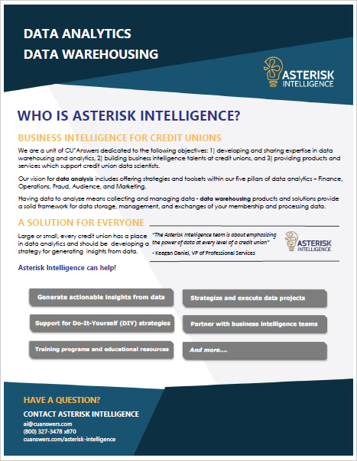
Data in Action
Asterisk Intelligence will drive a Monday-Friday, 8 hr/day focus
What does it mean for all network participants now that the CUSO is committed to a data analyst business line and a new data warehousing technology platform?
How might credit union CEOs think about this for their 2018 and 2019 business plans?
Will these new business lines be the next breakout CUSO for CUs to consider making equity investments? Or will these new lines simply be new department offerings for the next couple of years?
As CEOs, how do you make the call? In what direction should we move?
These are the questions for this section
We’ll brainstorm and think about the actions after some presentations from our teams

Slide 14
Data in Action
Can asterisk intelligence monetize data for our network?
Excerpt from “A Guide to Monetizing Data: How to Create Intelligent Applications and Products”
For our network to succeed with data monetization, it needs:
Vision. Executives who understand the potential for monetizing data and allocate their time, energy, and trusted lieutenants to execute the vision.
Team. A close-knit team of product managers, data architects, analytics specialists, application developers, and sales and marketing professionals who turn data into dollars.
Data. Voluminous data with lots of attributes that is clean, consistent, and timely. Product usage data and customer transaction and interaction data are good candidates.
Analytics. Analytics that provides shape and meaning to the data through categorization, calculations, summarizations, benchmarks, and models. Data becomes more valuable the more it is processed and analyzed.
Processes. A development process that tailors data and analytics to target customers and go-to-market processes that price, sell, market, service, and enhance the data product throughout its lifecycle.
Delivery. A delivery system that distributes analytics to users. It can be as simple as a PDF document delivered by email, or as sophisticated as an embedded analytic service within a cloud application.
www.eckerson.com

Slide 15
Now for the tactical presentations...
Data in Action

Slide 16
Tactic #1: Continue to enhance dashboard toolkits
Improve the competency of cus: what they ask and how they see the answers
Our standard for CU*BASE dashboards:
Select a group of records with something in common (loan apps processed in Oct, new members last year, checking accounts opened last month)
See the list and use various options to work the records, one at a time (approve the app, send TIS disclosures, order a debit card)
You are also presented with a set of analyses that show pertinent facts about that group of records (# of apps still pending, new members by age and gender, checking accounts opened by a specific employee)
Step 1 is like a report, Step 3 is like the totals or summary section on a report, but Step 2 creates a unique palette of opportunity to work and analyze at the same time
Embedded in these dashboards is the ability to go active, right now, every time...and all you have to do is plan to do so
Have you created a communication manager and assigned them regular dashboard activities to ensure a low-cost reach-out to your members?
Is this gaining traction in your shop?

Slide 17
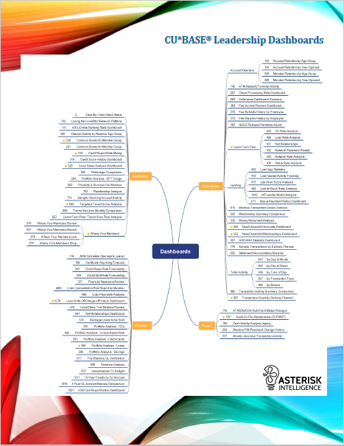
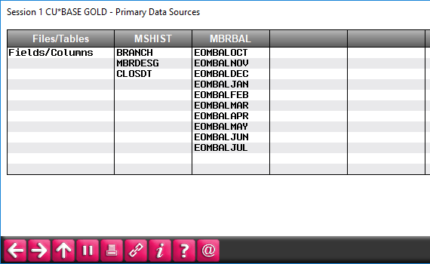
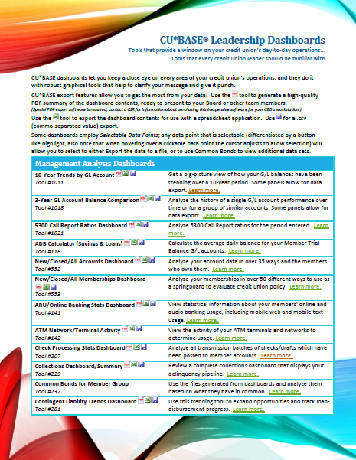
Tactic #1: Continue to enhance dashboard toolkits
Improve the competency of cus: what they ask and how they see the answers
CU*BASE users will continue to push us to development more dashboards and improve features inside dashboards for years to come...
But the big move is to think of dashboards as repeatable analytical approaches
Notes:
Keegan:
Tell the audience we still believe our current strategies are robust and will continue to have an active development future
Reports – we continue to see people want more effective sorting, selection criteria, etc., and new strategies with CU*Answers Imaging Solutions
Query – we continue to enhance database lookup tools; will announce a second Query presentation tool sometime in 2018
Dashboards – educate, educate, educate – webinars and now new services for certification as to being an expert dashboard user
Pick your favorite 3 dashboards and do a flyby
One old one
One not so old
One new one from 2017

Slide 18
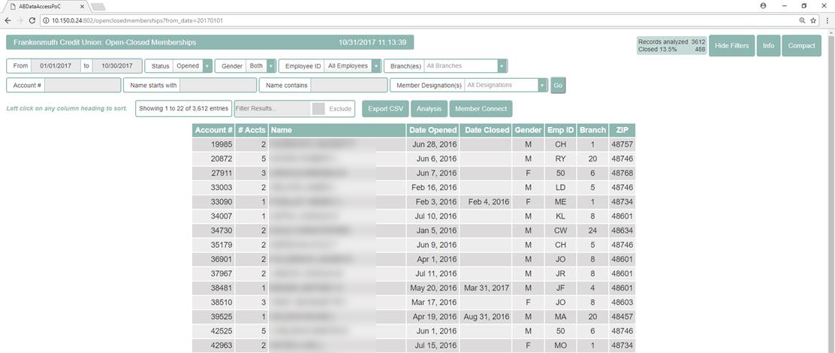
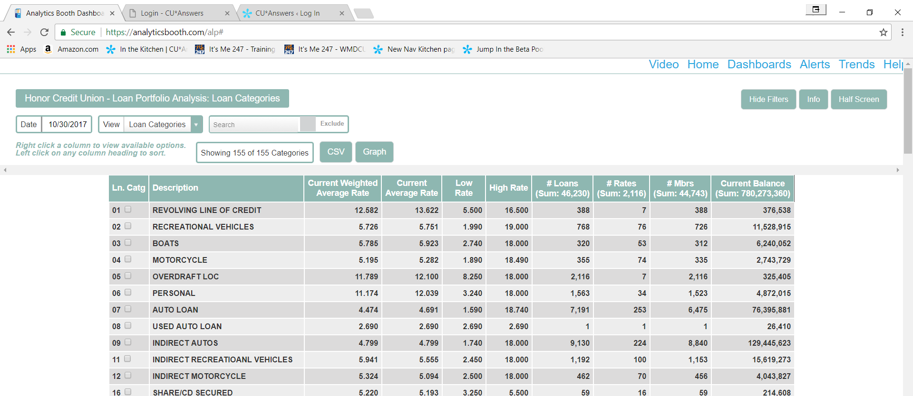
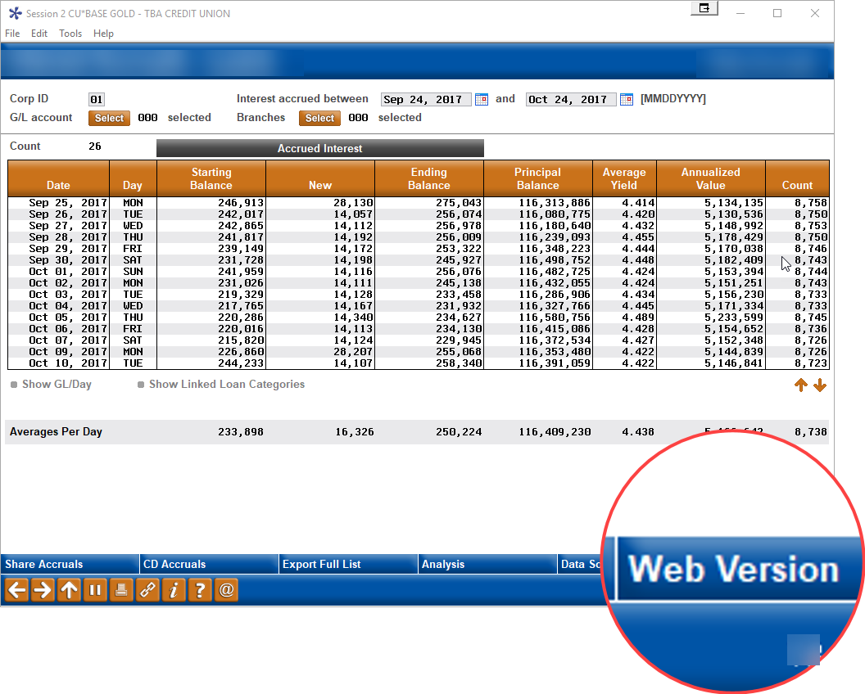
Tactic #2: Develop presentations with two audiences in mind
Private / Browser
Web / Browser
FILExx and FILExxE
AB web repository
Private member data
Public or scrubbed member data
Creating a bridge between CU*BASE users and web users
Notes:
Josh:
Analytics Booth demos
Executive Summary / trend lines
Loan Accruals dashboards ??
Validation dashboards??

Slide 19
Tactic #3: Create excitement around the See-to-Act gap
match the diversity of the Ai approach with the talents of your cu
AI has a broad and diverse business plan designed to include as many stakeholders as possible
Looking at data for insight:
Analytics Booth - cuanswers.com/solutions/asterisk-intelligence/analytics-booth
Custom Analytics - store.cuanswers.com/product/custom-analytical-request
Asterisk Intelligence Store - store.cuanswers.com/product-category/asterisk-intelligence
Creating ways to store data for insight:
Data Warehousing - cuanswers.com/solutions/asterisk-intelligence/data-warehousing
Arming a data management leader or team with tools:
Unique Data Management - store.cuanswers.com/product/unique-data-management-udm-custom-data-fields
CU Self-Directed Data Floods - cuanswers.com/resources/kitchen/cu-directed-data-floods
Do your homework to see the value prop here – as a user, and someday as a potential investor
Notes:
Keegan and Josh:
This is where you would introduce your web site and your store. Do not spend too long on it, because the whole point is for the CU to go home and study and surf your business plan via these pages.
Keegan, explain the difference between a report and a briefing. Stress the idea that you’re going to add analytics to a report presentation.

Slide 20
Now let’s do some CEO-to-CEO brainstorming...
What does it mean for all network participants now that the CUSO is committed to a data analyst business line and a new data warehousing technology platform?
How might credit union CEOs think about this for their 2018 and 2019 business plans?
Will these new business lines be the next breakout CUSO for CUs to consider equity investments? Or will these new lines simply be new department offerings for the next two years?
As CEOs, how do you make the call? In what direction should we move?
“A TNT session designed to bring out CU leaders ready to Teach, Negotiate and Tell their point of view”

Slide 21
Now let’s do some CEO-to-CEO brainstorming...
What did you hear in Randy’s briefing that interested you? What did you disagree with?
What tactical options did you see that you weren’t aware of?
What tactics did you wish you’d seen?
What tactics are you already working on related to these ideas?
As other thoughts occur to you over the next few weeks, go to the CEO Strategies page and leave a comment!
“A TNT session designed to bring out CU leaders ready to Teach, Negotiate and Tell their point of view”
Notes:
Leaving a comment:
See the agenda handout for the URL
Show the page to the group

Slide 22
CEO School Part 2 What does data mean to an Internet Retailer?
Projects CEOs should consider – not just for your consumers, but also for your volunteers
How can we make this a headline in CU business plans?

Slide 23
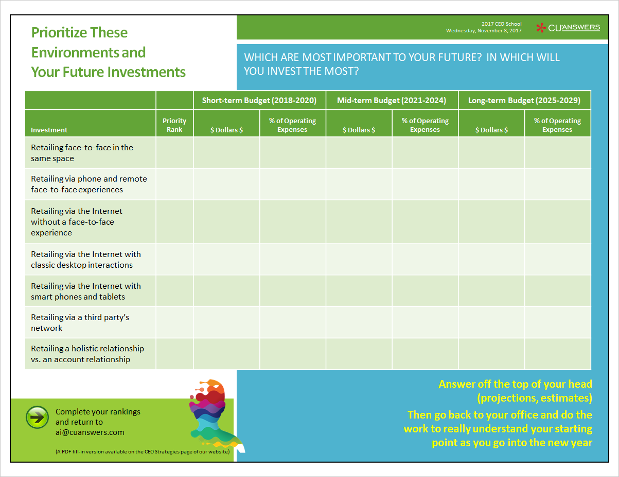
Prioritize these environments and your future investments
Which are most important to your future? IN Which will you invest the most?
When you left the Leadership Conference this year, did you sit down and prioritize these member experiences? In what order did you rank them? Did you assign any budget numbers to these priorities?
Retailing face-to-face in the same space
Retailing via phone and remote face-to-face experiences
Retailing via the Internet without a face-to-face experience
Retailing via the Internet with classic desktop interactions
Retailing via the Internet with smart phones and tablets
Retailing via a third party’s network
Retailing a holistic relationship vs. an account relationship
Now’s your chance...

Slide 24
Can you define yourself as a retailer? It’s a big project
Overwhelming
“Used to describe something that is so confusing, difficult, etc., that you feel unable to do it”
Only a CEO can describe where you wish to go
Retail
“The sale of commodities or goods in small quantities to ultimate consumers; also the industry of such selling”
Only a CEO can demand a new narrative
Cultures
“The characteristic features of everyday existence shared by people in a place or time”
Only a CEO can force a new default reaction

Slide 25
As a CEO, can you tackle culture change and win?
We have to move from Internet service to a new set of goals for investing in new economies
You do not change culture by selling a set of philosophical ideas about how great it’ll be when you get there
You change culture by
Declaring the need for a new reality
Repeatedly making small, symbolic investments that support where you want to go
Enforcing the default reaction from your organization, creating new muscle memory so that people are acting in new ways, without even thinking about it
INTERNET RETAILING
24x7 member experiences
Break down everything that is the CU value proposition into small consumables, sold via Internet interactions with members
Consumer value exchanges
Owner value exchanges
At-large market value exchanges
3rd-party stakeholder value exchanges

Slide 26
It’s a little different with members and the outside world
The outside world has to intuitively feel the culture change through interactions and data
In other words, you have to prove it to them as you’re interacting with them
From the consumer’s standpoint
Does your culture blend with how consumers interact with today’s retail market players?
Do not trust that everything old is new again unless you’re looking for a nostalgic niche...or not
From the owner’s standpoint
Data, data, data – the currency of letting people know their ownership is important
From everyone else’s standpoint
Making it easy to work with you and convenient to know you
INTERNET RETAILING
24x7 member experiences
Break down everything that is the CU value proposition into small consumables, sold via Internet interactions with members
Consumer value exchanges
Owner value exchanges
At-large market value exchanges
3rd-party stakeholder value exchanges

Slide 27
Now for the tactical presentations...
What does data mean to an Internet Retailer?

Slide 28
Tactic #1: Create the 24x7 member experience
24 hours a day, 365 days a year, and a data footprint that proves it to your members
Flipping the script: CU*Answers will now default to 7-day/week processing, and CUs will have to opt out
Eradicating the idea of stand-in processing by individualizing the process in a condo stack
Time zone processing – looking local no matter where your host computer resides
In the past, lobby hours defined your service...now it is a patchwork of services that defines your daily hours
Adding time to our ops cycle, and adding new data transfer cycles around the clock
It was a great year for our OpsEngine Production Center development, and in 2018, you’ll get to know why

Slide 29
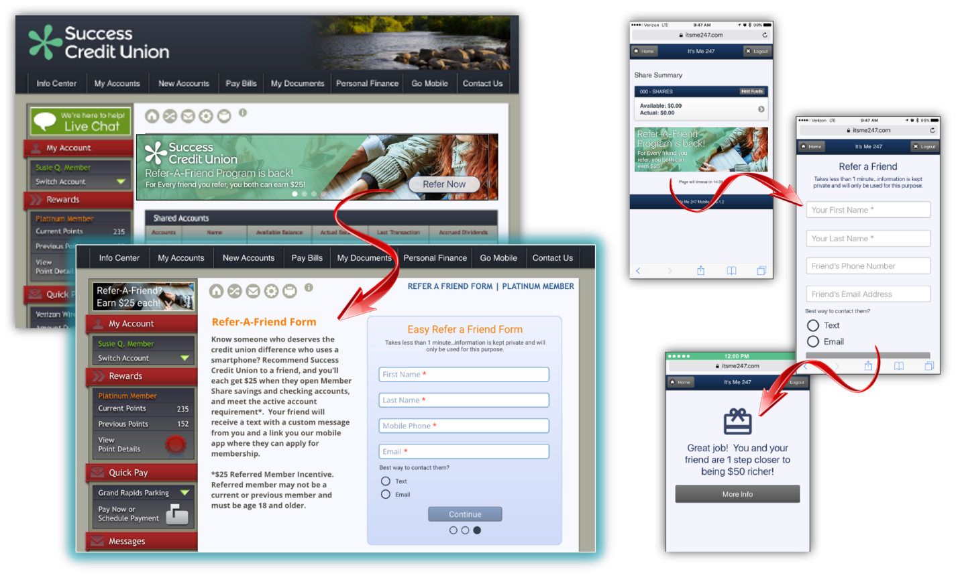
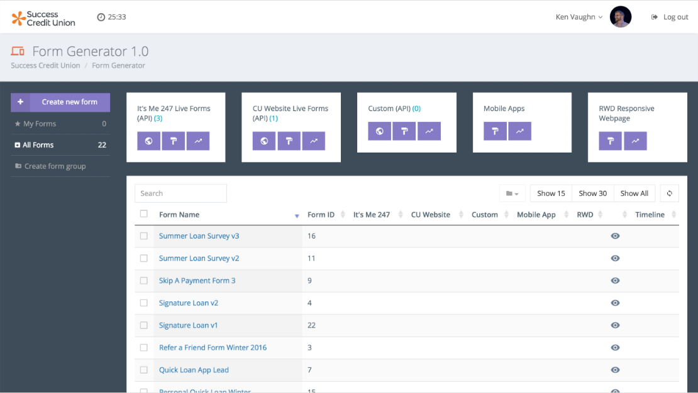
Tactic #2: Continuity across Internet delivery channels
New services that will allow cus to customize and standardize channel approaches
The It’s Me 247 Request Center: Drop a form into a website, a mobile app, desktop banking, and a micro-sales site – all via one process
Respond to all of these delivery channels from a single fulfillment center
The success of both forms and the fulfillment center will be a compass to what’s next via CU*BASE and CU*Answers Internet channels
Notes:
Kristian and Ken and David:
Demo the Forms Generator
Demo the Request Center
Talk about how we used a forms generator solution with the Daon beta
Talk about our goals for IRSC to become the new support center for generating forms, as phase 1, and the development of CU self-service for forms as phase 2
Talk about Web Services as the heavyweight user as they look at the future of web pages and forms
Commit that this is the final step before CU*Answers turns its attention to creating a first class set of integrated applications, especially loan apps

Slide 30
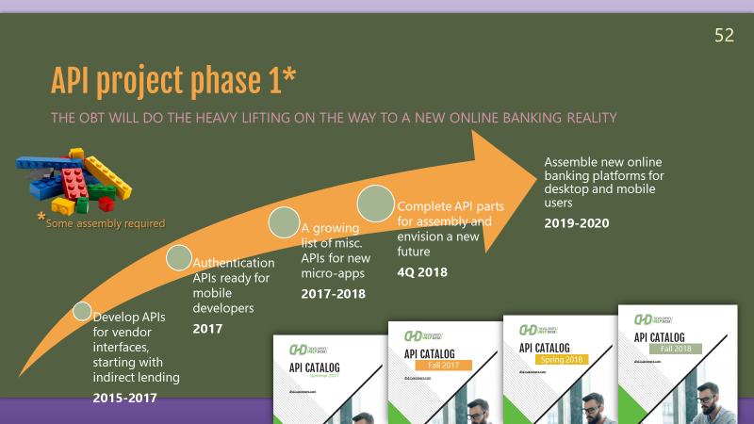
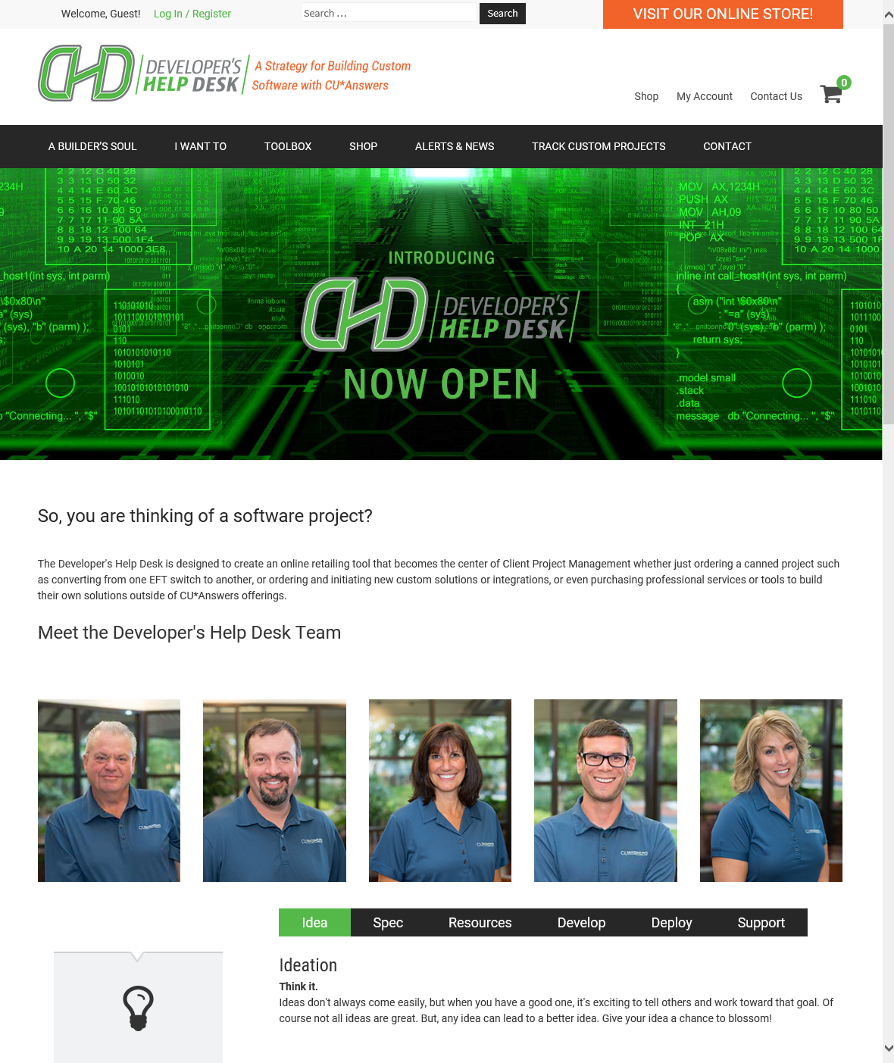
Tactic #2: Continuity across Internet delivery channels
New services that will allow cus to customize and standardize channel approaches
API95 will support consistent multi-channel development
In Feb 2018 we plan for both mobile apps and desktop banking to use the same authentication API – what does this mean to you as a CEO?
From the 2017 Leadership Conference
dhd.cuanswers.com
Notes:
Ken and Brian:
Be prepared to do a Q&A with Randy on APIs – less than 5 sentences
Jump out to the DHD store, overview the team, our intentions and specifically how we’re going to keep the marketplace aware of our APIs and how they are used now, so others can dream up ways to use them in the future

Slide 31
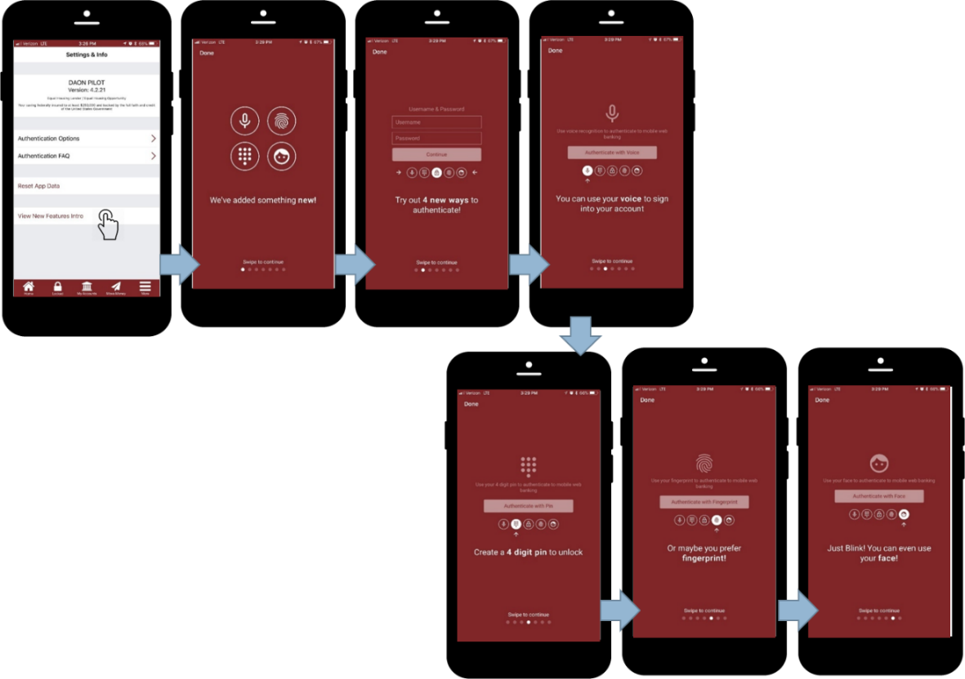
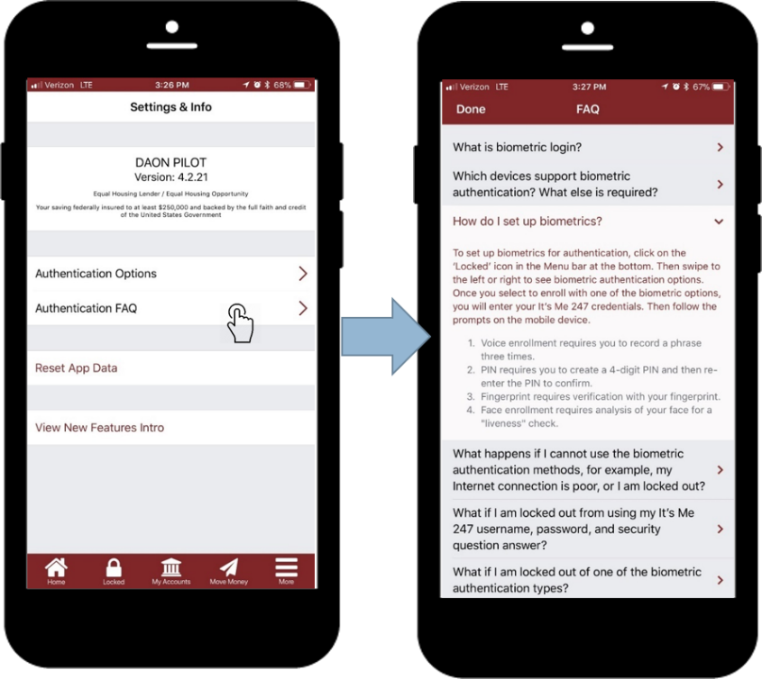
CUs need to be in the business of tactical authentication styles, security, and innovation
2017 Daon Authentication Beta Project
Total # of users | 918 | 26% of these are active
# of authentications attempted | 7,409 | 95% of these were successful
Notes:
Ken and Kristian:
As part of our goals for API authentication, we’ll demo and discuss the Daon beta

Slide 32
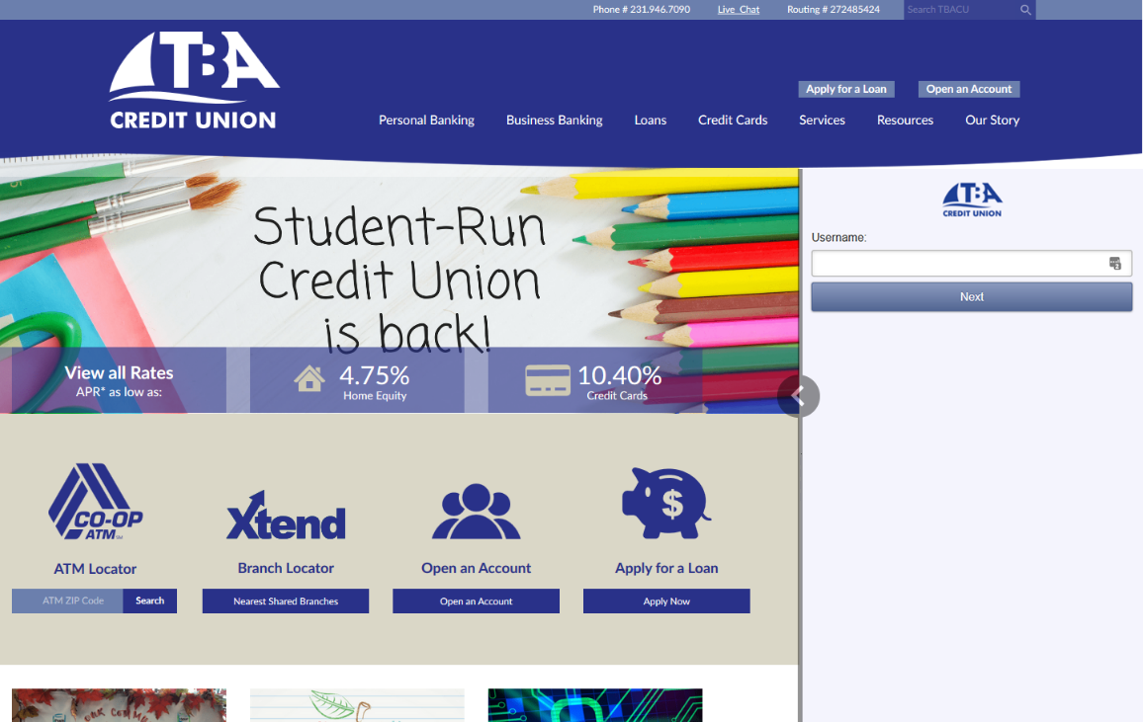
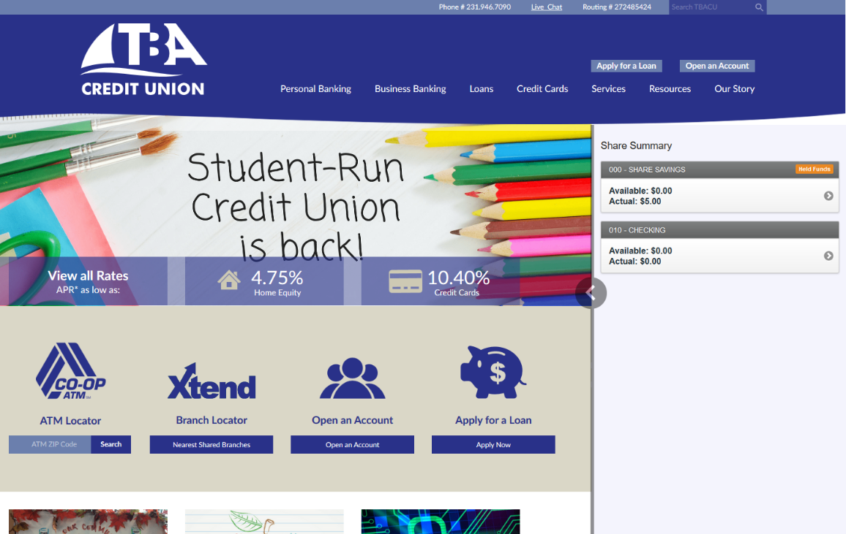
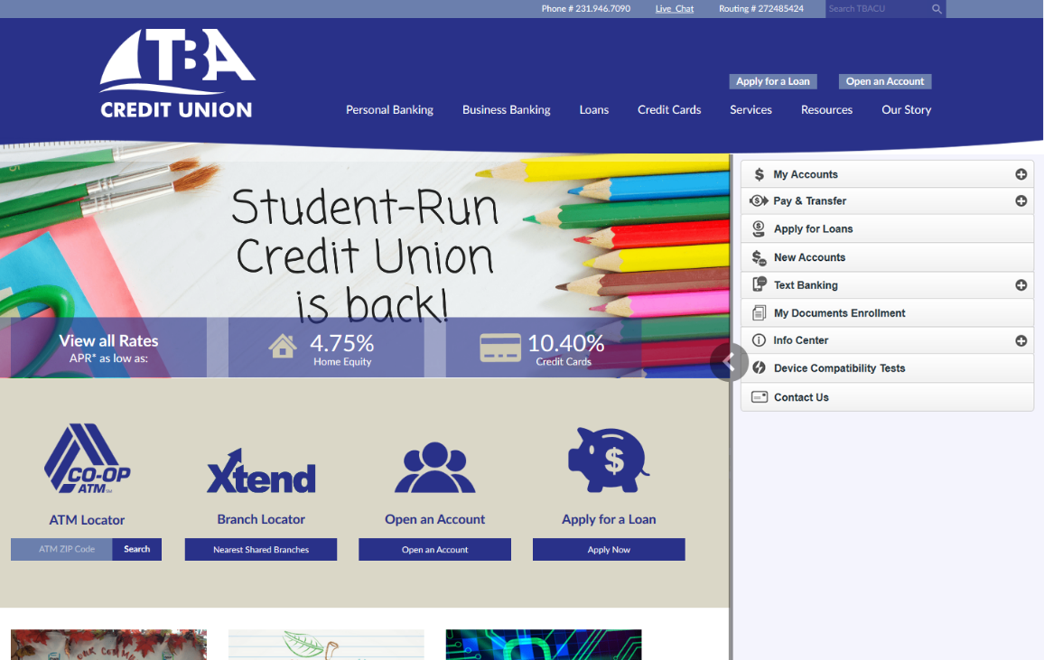
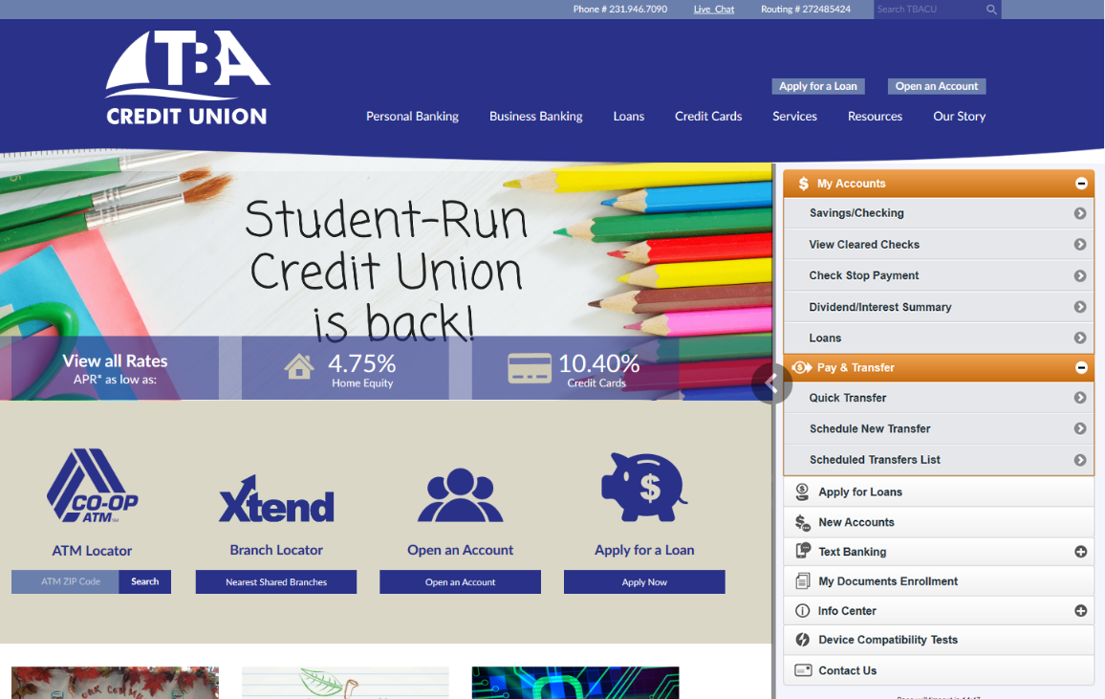
Tactic #2: Continuity across Internet delivery channels
New services that will allow cus to customize and standardize channel approaches
Online19 will merge websites and interactive online banking via website authentication approaches
When your member visits the lobby, how do you log them in?
Notes:
Ken and David:
Be ready to do a Q&A with Randy on Online19

Slide 33
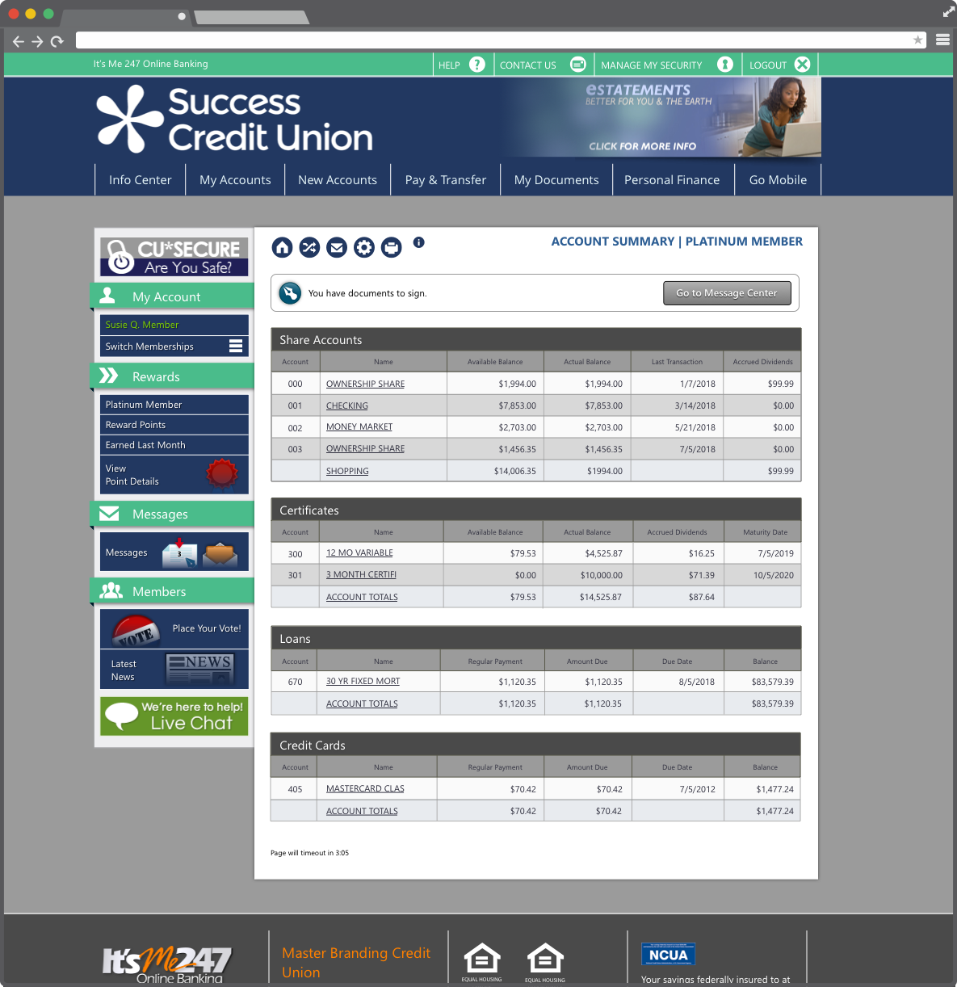
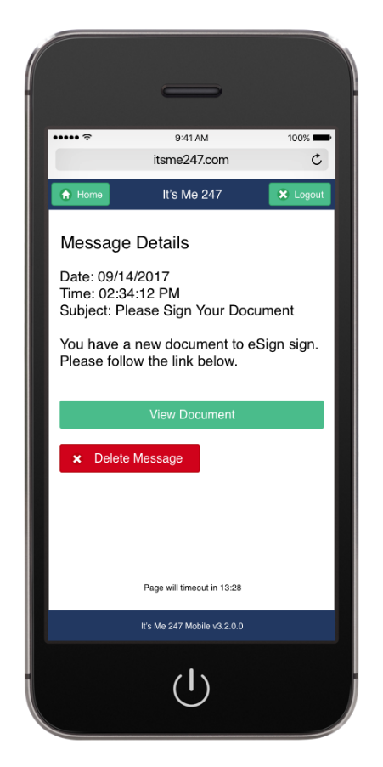
Tactic #3: Shift from service to the heavy lifting needed to be a retailer
Build services on the ‘net that allow you to eliminate services in the lobby
Add new virtual closing rooms to desktop/mobile
How would this change in-person closings?
Notes:
Ken and John B:
Discuss the new virtual closing rooms and how they will work – John, do a pitch for eDOC e-sign and how that is working as well
Our goals are for these volumes to exceed current CU channels that do the same thing – we are enticing CUs to move to new channels and track the performance so someday they might swap out the expense
CLICK THE PHONE TO GO TO THE PPT SHOWING THE EMAIL MESSAGE

Slide 34
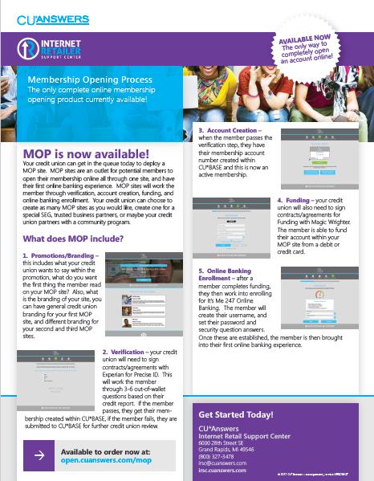
Tactic #3: Shift from service to the heavy lifting needed to be a retailer
Build services on the ‘net that allow you to eliminate services in the lobby
When will MAP/MOP sites overwhelm your in-person membership openings?
How would this change your budget for supporting outlets in decline?
Honor CU leads the pack with 216 memberships opened
# OF CUS | APPS REC’D | MBRS OPENED
18 | 1,576 | 837
Buy it:
store.cuanswers.com
Most CUs in production since May 2017
Identity Verification
Account Creation
Funding via credit or debit card
Online banking enrollment and initial login
I Want to Become a Member
Notes:
Kristian and Ken:
Discuss the MAP/MOP project and the stats as to where we are today with CUs and their penetration (# of members in our network today that came via this channel, etc.)

Slide 35
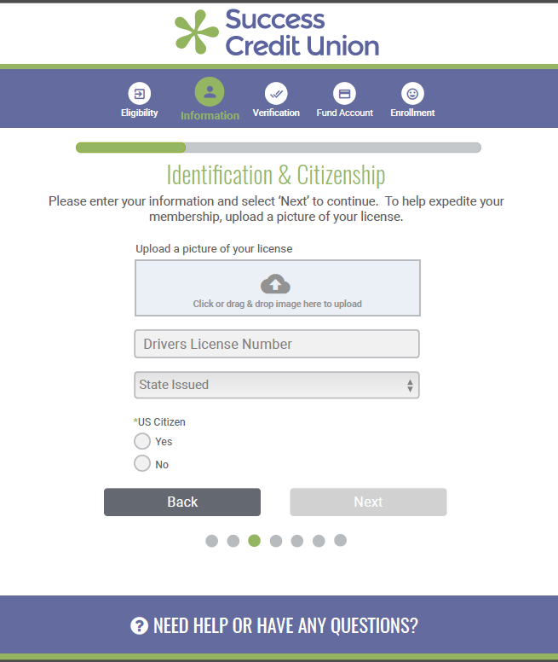
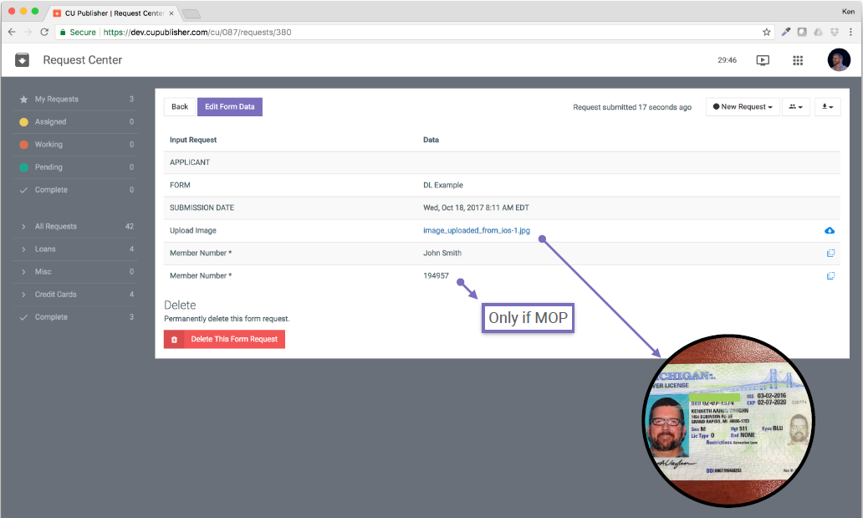
Not a lot planned for MAP/MOP in 2018, other than increasing usage
We will push for images and signatures – what else would you have us do?

Slide 36
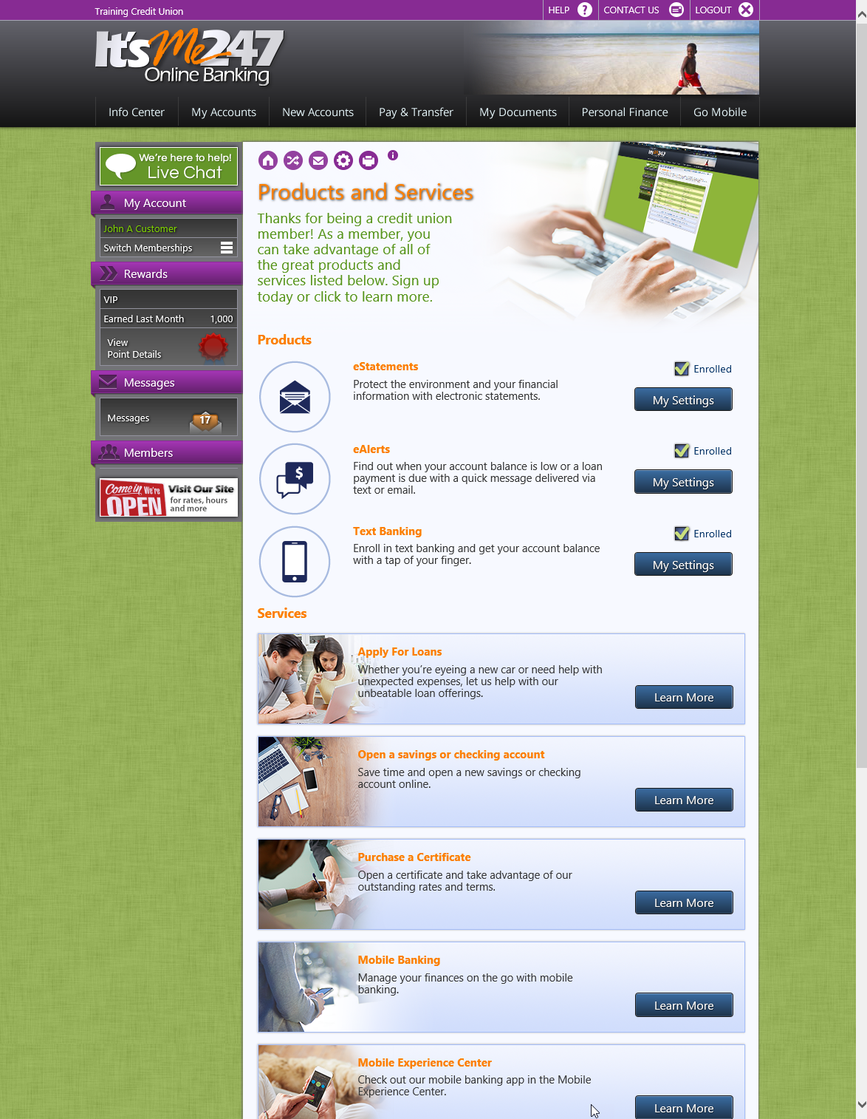
Moving from MAP/MOP to AAP/AOP (Account Application & Opening)
As retailers, we need to move from just selling a relationship to greatly increasing our effectiveness and options for selling accounts
Leverage funding for deposits and payments
Rethink indirect outlets for more than loans
Should we have AAP/AOP micro-sites outside of It’s Me 247?
What have we learned so far from MAP/MOP that sets the roadmap for improving our AAP/AOP processes?
Is it too early? Or should we get started?

Slide 37
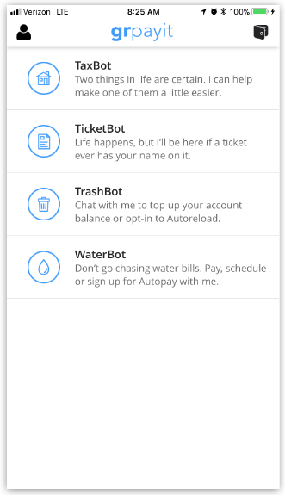
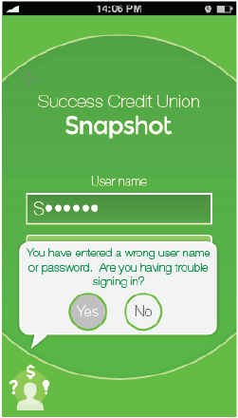
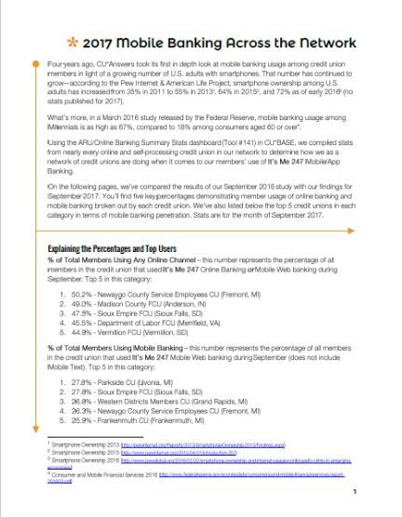
Tactic #3: Shift from service to the heavy lifting needed to be a retailer
Build services on the ‘net that allow you to eliminate services in the lobby
So far, most of mobile banking development has been catching up with desktop banking, and recreating services from other channels
Even RDC and Daon authentication don’t strike us as innovations towards redefining a phone from a service device to a retail interaction with members
We need to sell things, significant things, and transfer our retail investments from old channels to the mobile device
Notes:
Ken and Brian:
Talk to the group about how you see the future of mobile web solutions and their inclusion in mobile app solutions as well
Is a chat bot mobile app a viable mobile app for credit unions?

Slide 39
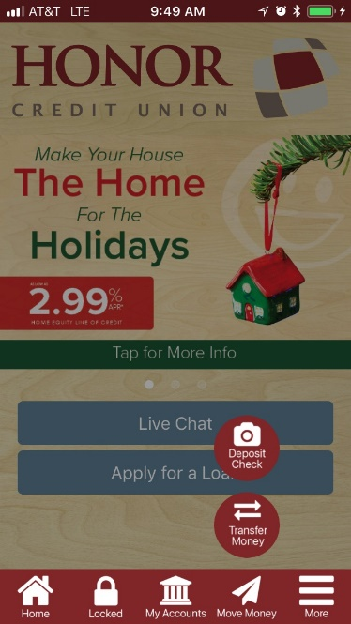
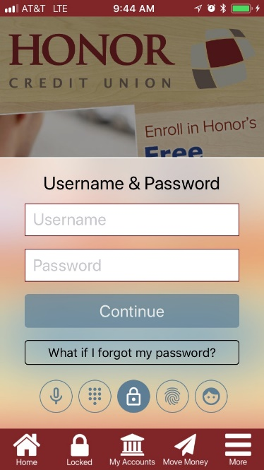
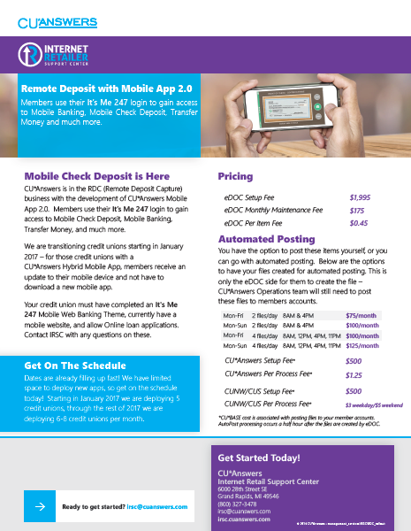
Mobile App 1.0 will be sunset in January – where will you go?
Mobile App 1.0 Sunsetting 1/15/2018
Mobile App 2.0
1.0 + RDC
Mobile App 3.0 1.0 + RDC + Daon
Notes:
Ken and Brian:
Ken, highlight what’s going to happen with Mobile 1.0, 2.0 and 3.0 in 2018 – do you think there will be a mobile app 4.0 in 2018?

Slide 40
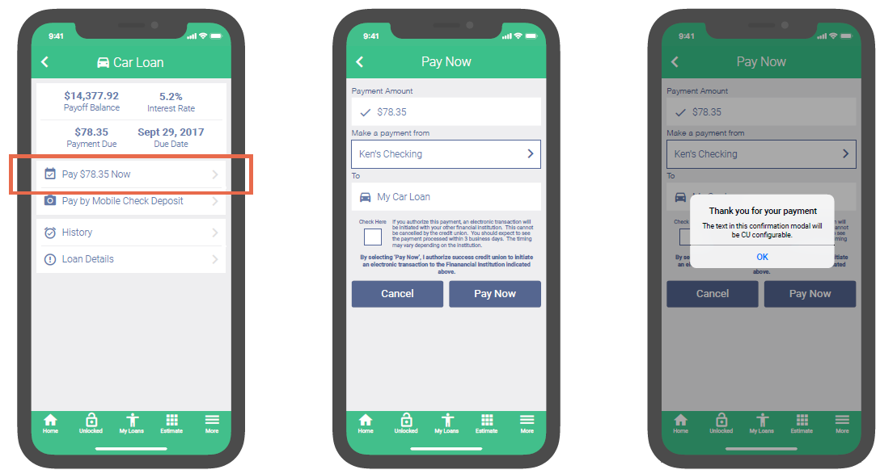
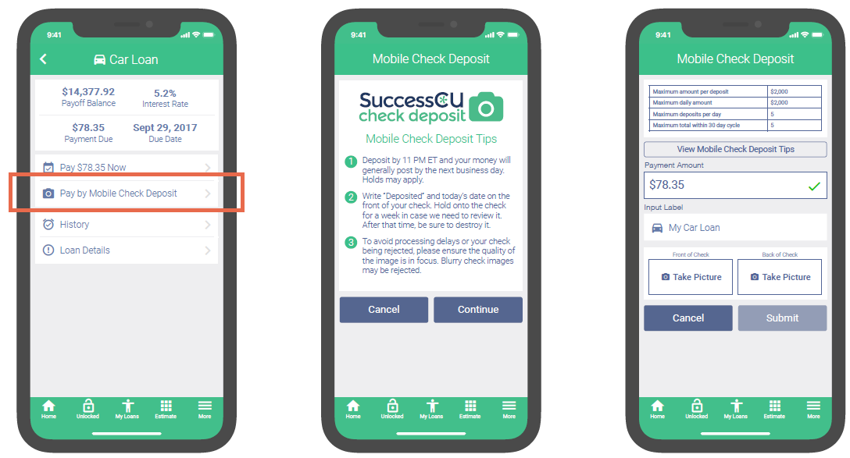
Tactic #3: Shift from service to the heavy lifting needed to be a retailer
Build services on the ‘net that allow you to eliminate services in the lobby
Focus on the disengaged member
How will low- or no-impact authentication allow you to work more effectively with indirect members?
Can micro-apps allow you to run two channels when you are running two membership models?
PAY NOW VIA TRANSFER
PAY NOW VIA CHECK DEPOSIT
Notes:
Ken:
Be ready to discuss micro-apps with Randy and the visuals from mobile payments
Be ready to discuss how API95, once completed, will open the floodgates for small micro-apps using APIs in small groups for very specific reasons and affinity approaches
CLICK ON EITHER SIDE TO BLOW UP LARGER

Slide 41
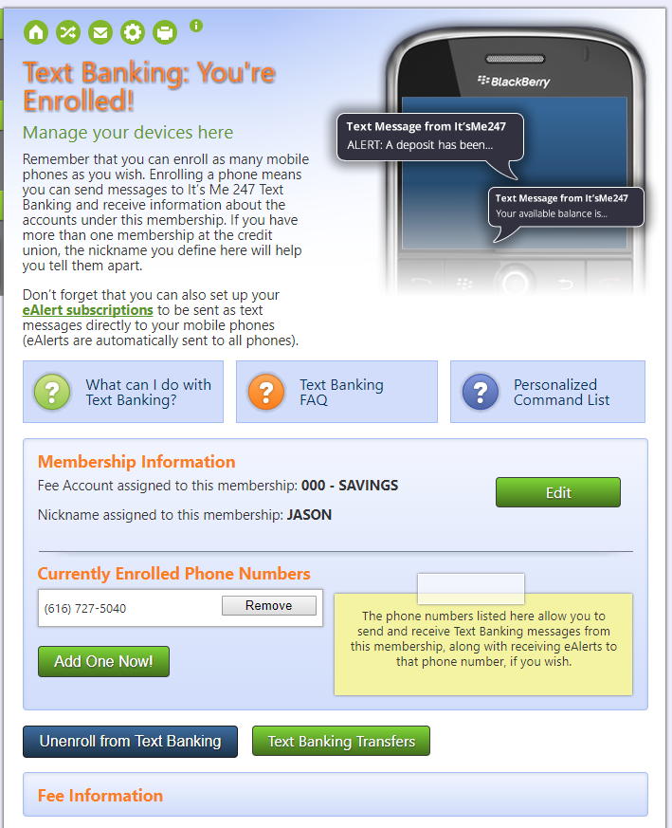
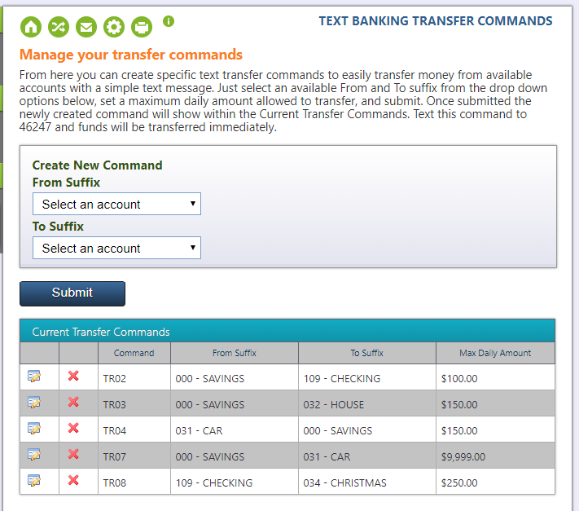
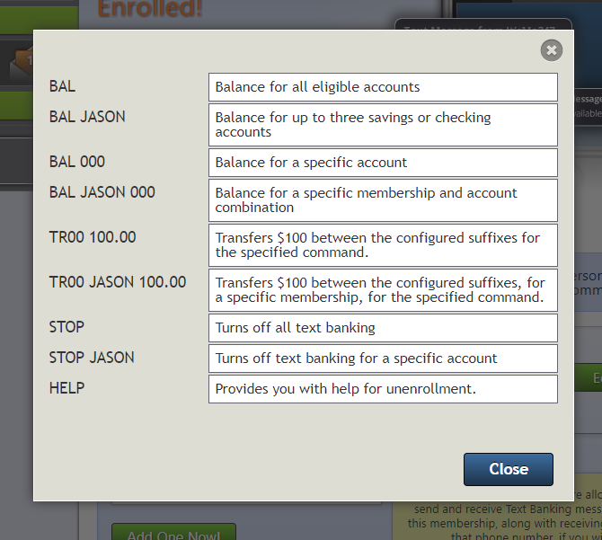
Creating solutions without heavy authentication
Text transfers – a solid concept but the look and feel is still a work in progress
Shooting for possible beta prior to June Leadership

Slide 42
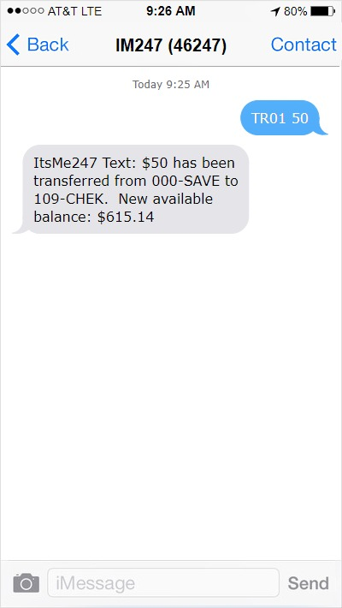
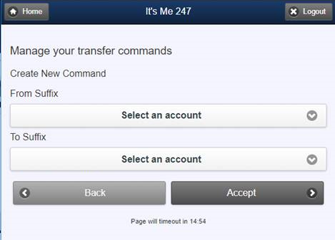
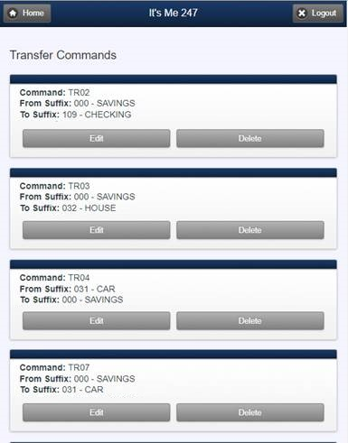
Creating solutions without heavy authentication
Text transfers – a solid concept but the look and feel is still a work in progress
Shooting for possible beta prior to June Leadership

Slide 43
Now let’s do some CEO-to-CEO brainstorming...
Do you need a new cultural response to your members and their needs?
Do you think it will be black and white (an organized process, declared and tracked) or will it happen organically?
We’re about to be 20 years into the new century – do you have a choice as you watch the world change around us?
What was once an interesting alternative for retailers will soon redefine everything for employees and customer-owners
“A TNT session designed to bring out CU leaders ready to Teach, Negotiate and Tell their point of view”

Slide 44
Now let’s do some CEO-to-CEO brainstorming...
What did you hear in Randy’s briefing that interested you? What did you disagree with?
What tactical options did you see that you weren’t aware of?
What tactics did you wish you’d seen?
What tactics are you already working on related to these ideas?
As other thoughts occur to you over the next few weeks, go to the CEO Strategies page and leave a comment
“A TNT session designed to bring out CU leaders ready to Teach, Negotiate and Tell their point of view”

Slide 45
CEO School Part 3 What does it mean to add a data administrator to your organizational chart?
What if you as a CEO had to add these new duties to your daily work? Could you? Should you?
Building teams that will change your future

Slide 46
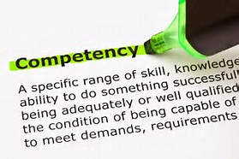
Data, data, data: A competency you must secure
Do you need a person? Do you need a team? How do you build new competencies?
Data competency is not like choosing to enter a new business
For example, adding mortgage loans as something new to sell
In every business today, there is an intuitive belief that everyone, providers and consumers, need to be better at data
Better at finding digital content
Better at consuming digital content
Better at acting on content to solve a problem
Better at navigating a world based on content that is instantly available
Who is leading this charge at your credit union?
What job title do they have today? What will it be tomorrow?
What external team might you engage with your internal resources?

Slide 47
Digital content is not the same as statistical analysis – specialize in both
Digital documentation
Education
Paper documentation
An expectation of self-service
Knowledge base (AnswerBook)
Consulting and networking focus groups
Webinars and POV
Digital documentation
Education
Paper documentation
An expectation of self-service
Knowledge base (AnswerBook)
Consulting and networking focus groups
Webinars and POV
Personalized call center response
Personalized call center response
An explosion of how-to videos
An explosion of how-to videos
Your Online Stores
For Internal Users
For Internal Users
For Clients
For Clients

Slide 48
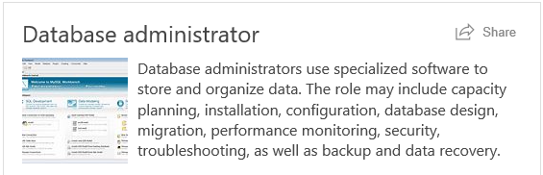
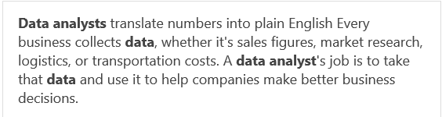
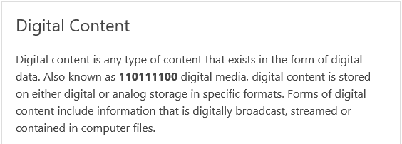
Why all of this is a CEO project (and problem)
One more thing for you to consume, or to bake into your organization’s resume
??
CIO
The Team
COO

Slide 49
What is the expectation for the work product from your business intelligence team?
What kind of analysis will you get for your investment in infrastructure and tools?
Types of analysis (From “Six Types of Analyses Every Data Scientist Should Know” by Dr. Jeffrey Leek, Assistant Professor of Biostatistics at John Hopkins Bloomberg School of Public Health”, https://datascientistinsights.com)
Descriptive (least amount of effort): The discipline of quantitatively describing the main features of a collection of data. In essence, it describes a set of data
Exploratory: An approach to analyzing data sets to find previously unknown relationships
Inferential: Aims to test theories about the nature of the world in general (or some part of it) based on samples of “subjects” taken from the world (or some part of it). That is, use a relatively small sample of data to say something about a bigger population
Predictive: The various types of methods that analyze current and historical facts to make predictions about future events. In essence, to use the data on some objects to predict values for another object
Causal: To find out what happens to one variable when you change another
Mechanistic (most amount of effort): Understand the exact changes in variables that lead to changes in other variables for individual objects
Google “types of analysis” and you’ll get 192 million hits

Slide 50
Now for the tactical presentations...
What does it mean to add a data administrator to your organizational chart?

Slide 51
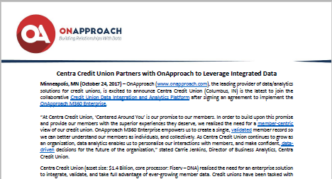
Tactic #1: Build the data warehouses...and the mentality
SO You’ve hired a database administrator – what will they administer?
Today, most CUs have key vendors who have data, and have assigned key leaders in the CU to specialize in understanding this data
In other words, who knows the data that’s important to your credit union via your relationship with CU*Answers?
A database administrator sees the forest, not the trees
Sooner or later, they’ll want a warehouse that gives the forest perspective, as a central place from which to work
Data warehouses are simply places where people store data
But getting your hands around the data that is stored in dozens of places can be a daunting task, and sooner or later, a data administrator will a special storage place

Slide 52
Why these people get excited about data warehouse strategies
Database Admin.
COO
CIO
The Team
Analysis is intangible, Data and Data warehouses are tangible (and buying is fun)
FILExx
Your primary production database
FILExxSS
A constant view as of previous EOD
FILExxE
EOM snapshots
QUERYxx
Storing your analytical approaches
FILExxDW
You control the data as it merges for your tactics
Analytics Booth
Outside of the POWER i, space for innovation

Slide 53
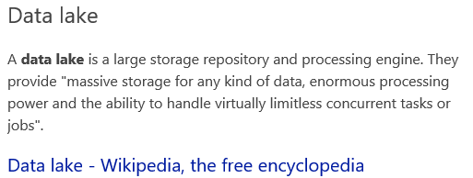
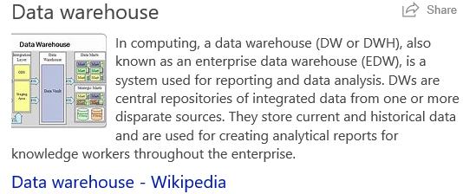
What will you buy, and how will you use it?
Asterisk Intelligence is entering the data warehousing business
When you complete your due diligence you may want to use our data warehouse and create your own data lake
You may want to do neither, but after you send someone to learn about it, they’ll want you to make the call
Remember this: you have already paid for two-thirds of the data in the CU*Answers data warehouse, and the fees for the final third are low and based on participation

Slide 54
CU*Answers Data Warehouse Strategies
Part of the two-thirds you’ve already bought
In 2017:
We doubled the amount of transaction history retained by CU*BASE
We added UDM (Unique Data Management)
Data customized by your CU
For accounts and general membership information
In 2018:
Envisioning new CU self-directed data flood features
Additional files for UDM
CU self-directed floods for UDM data
FILExx
Your primary production database
Keep an eye on the Kitchen for news about this project!

Slide 55
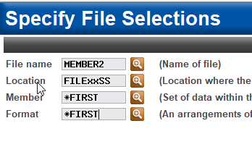
CU*Answers Data Warehouse Strategies
Part of the two-thirds you’ve already bought
In 2017:
A new library for consistent data transfer processing
Daily snapshot of the prior day’s activity
Data transfer programs are now being migrated to the FILExxSS library
In 2018:
Introduce FILExxSS as a CU-employee accessible file for Query
FILExxSS
A constant view as of previous EOD

Slide 56
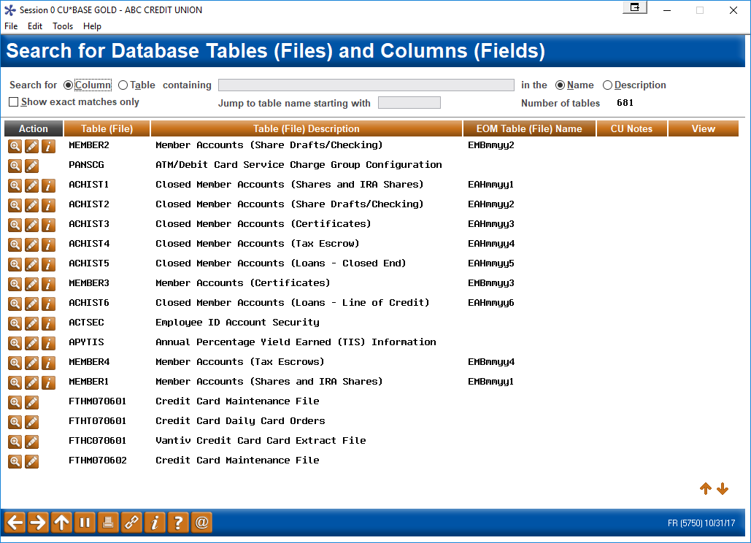
CU*Answers Data Warehouse Strategies
Part of the two-thirds you’ve already bought
In 2017:
Doubled the number of month-ends available to online clients, from 3 to 6
FILExxE
EOM snapshots
Tool #332 Database Search Assistant

Slide 57
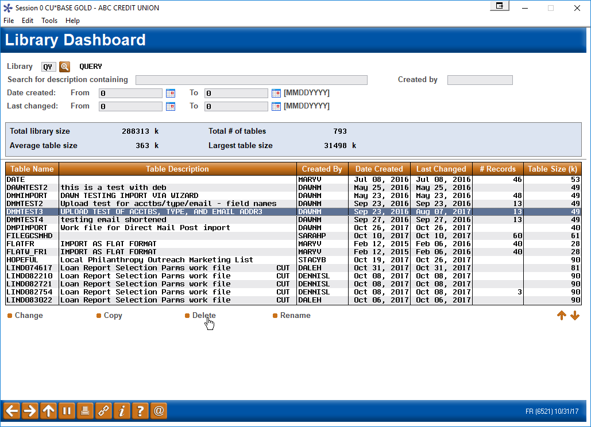
CU*Answers Data Warehouse Strategies
Part of the two-thirds you’ve already bought
In 2017:
Added a new Library Dashboard to analyze the database files your teams create via Query
In 2018:
Add another premium tool for Query and presentation
Tool #1980 Library Dashboard
QUERYxx
Storing your analytical approaches

Slide 58
Tactic #2: FILExxDW as a new frontier
Working with cu architects, building the data warehouse they wish to have
Today, CUs want to design their own approach and value propositions for the data they put into their individual warehouses
Share someone else’s computer (coming in 2018)
Have your own (selling turn-key in 2019)
Our FILExxDW warehouse will be a CU-directed space
The only data in it will be what you tell us to put there
We’ll create unique data opportunities for CU*BASE users, but CUs will choose whether or not to put that data into their warehouse
https://www.cuanswers.com/events/2017-data-investment-symposium/

Slide 59
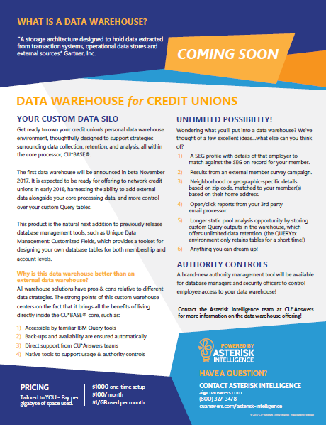
CU*Answers Data Warehouse Strategies
Will start slow, but based on the attention cus are giving to data warehouses, will pick up speed
In 2017:
Created the Library Authority Management tool
In 2018:
Rolling out to clients late 2nd half of 2018
CU-defined data
About 80% sourced from CU*BASE data warehouses
About 20% sourced from third-party sources
Priced based on CU sign-ons + space used
Premium tool for Query and presentation
Developing DEX (Data Exchanges) with analytical warehouses as a transfer approach
FILExxDW
You control the data as it merges for your tactics
Tool #1981 Library Authority Management

Slide 60
CU*Answers Data Warehouse Strategies
Analytics booth will become a hybrid: presentation + direct analysis + web repository
In 2017:
Sanitized database, safe for external web users
Time-sliced based on short feedback loops
Browser-based presentation
Accessible anywhere WiFi or Internet services are available
Foundation for audience expansion for both CU*Answers as a CUSO and for CUs and their communities
In 2018:
Add ability for analysts to sign on directly to the AB database and work with their own presentation tools and skills
Expand sales of AB from the CU*Answers network to any CU in the country, independent of their core processing solution
Analytics Booth
Outside of the POWER i, space for innovation

Slide 61
Tactic #3: Develop a data transfer business
What if data transfer routines increased by 10x?
We would have to build a new machine
DEX is a transfer protocol and service from CU*Answers that will grow from 1x today (2 CUs) to 10x or more in the next two annuals
DEX moves data to analytical databases where CU administrators and analysts do their work
Today, DEX is a technical setup, tomorrow it will be an AI setup, and the day after that, it will be a self-service tool for a database administrator
Daily Operations
Limited time window before CUs are open for business
Data Transfers (FILExxSS) Unlimited time window for data transfers and other vendor interactions

Slide 62
Now let’s do some CEO-to-CEO brainstorming...
How will you build data competency in your organization?
Who will lead the effort? Will it be a team? Or will it be an external resource?
How will you be accountable?
This has been our most tactical presenta-tion: put your best people on this project, with a budget that expresses it as a priority
Can you do it? Will you do it?
How can CU*Answers help?
“A TNT session designed to bring out CU leaders ready to Teach, Negotiate and Tell their point of view”

Slide 63
Now let’s do some CEO-to-CEO brainstorming...
What did you hear in Randy’s briefing that interested you? What did you disagree with?
What tactical options did you see that you weren’t aware of?
What tactics did you wish you’d seen?
What tactics are you already working on related to these ideas?
As other thoughts occur to you over the next few weeks, go to the CEO Strategies page and leave a comment
“A TNT session designed to bring out CU leaders ready to Teach, Negotiate and Tell their point of view”

Slide 64
Wrap-up

Slide 65
Things I wish I would’ve had time for...
A deeper dive on DHD and the development of a DIY movement at CU*Answers
More time with you to get into the nuances of retail stores on the Internet
A project update on card controls and a new push notification engine, coming to CU*Answers in 2018
A project update on the development of our second auto-decision engine, and what it might mean to how we do credit reports
Why Daon means more about how we think, than about the cool gadgets we’ll promote to members
A deeper dive on ten other things from the Leadership Conference
Your top 10 CEO issues, if you had time to give me a list
We’re all busy, but we don’t meet often enough wearing our CEO hat, focused on one thing: the art of leading cooperatives

Slide 66
The value of stage fright to a CEO
Where do you prove to the marketplace that you have grasp of your situation?
Where do you prove that your focus on execution results in big things?
When was the last time you feared that a board event wasn’t enough to impress?
When was the last time you tried to impress your staff?
Get on stage
Do you get on stage often enough to inspire you to excel?
Try as hard with others as you do with regulators and examiners (I know you have stage fright when they come to town)

Slide 67
Also in your packet...

Slide 68
Topic for tonight’s networking session
How many of you saw this movie? I think it’s wonderful imagery for what the CU industry faces today
You are the leaders of our industry and network
Because local is where all big things start
You face the project of what to take to the future
Your ark is a business plan – what do you plan to take to the future? When will you pack?

Slide 69
Thanks for the day!
See you in the morning for even more focused CEO-to-CEO interactions

