Slide 1
Engaging the Builder’s Soul
It was the first problem for our founders, and it’s the best clue we have on how to sustain our future
Annual Stockholders Meeting
June 22, 2016
Welcome!

Slide 2
Agenda
Call to Order
Review 2015 Minutes
Chairman’s Comments
How do we engage the builder’s soul?
Election
CFO Report
Review the 2015 financial reports
CEO Report
Engaging the builder’s soul: The key to solving a riddle is identifying the tricky part
Election Results
Adjourn

Slide 3
How do we engage the Builder’s Soul?
Are the answers to this problem different in this generation?
Chairman’s Comments

Slide 4
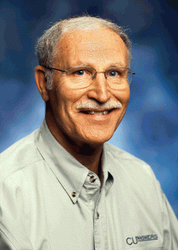
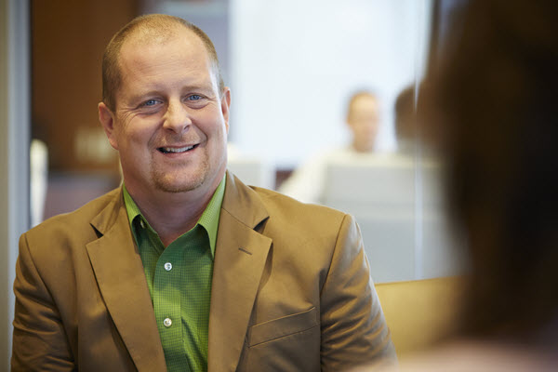
Past and future
The CU*Answers founders had to find a way to inspire their peers to want to build their own solutions
They knew that CU*Answers would never be successful at selling solutions, unless its stakeholders had a passion for building their own
They had a “rad” idea (or whatever the 70s equivalent) that there was an advantage in igniting a builder’s soul in their peers
Today, Randy reminded us that our ongoing success relies on the fact that as peers, we can still foster the builder’s soul
We can count on ourselves to create the advantage that will sustain our organizations

Slide 5
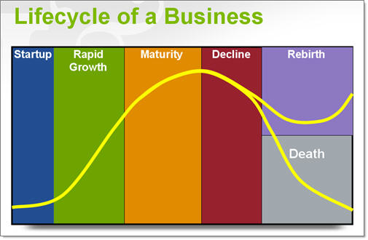
Why we might be considered founders to the next generation of CU*Answers stakeholders
Rebirth of a business, or even an industry, requires some key people to understand how to disrupt the path they’re on
They might even need to ignore what they’ve learned, in search for new paths forward
“Burning it down” means we challenge ourselves to remove barriers and consider new possibilities for our success
“Revolution for evolution” is simply a call for the effort it will take, the energy required, and what we must risk
As CEOs, we have to do more than just ponder what ifs, we have to pick which ones to act on
We have to vest in building new realities...we have to be the founders of the future

Slide 6
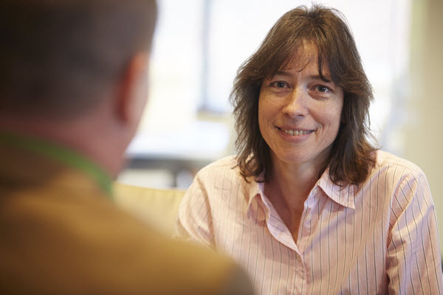
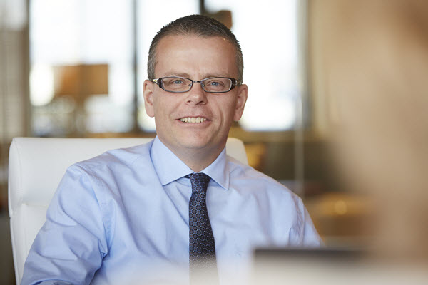
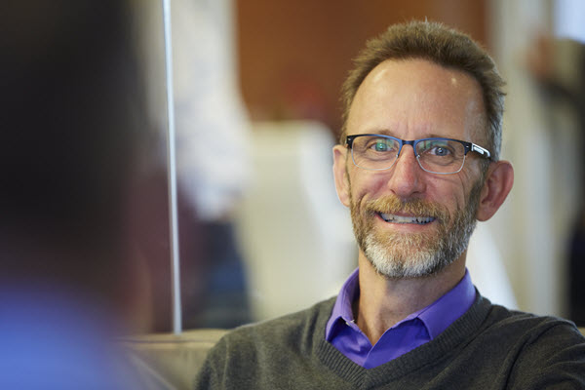
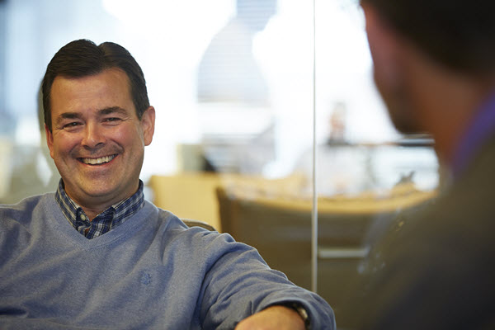
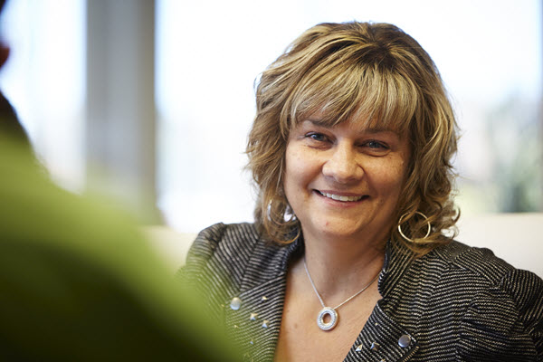
Your 2015-2016 Board of Directors
Scott McFarland, Chairman
CEO, Honor Credit Union
Berrien Springs, Michigan
Board Member since August 2009
Linda Bodie
CEO, Element Federal CU
Charleston, West Virginia
Board Member since October 2013
Don Mills, Director
CEO, Alpena Alcona Area CU
Alpena, Michigan
Board Member since June 2010
Jeff Jorgensen, Director
CEO, Sioux Empire Federal CU
Sioux Falls, South Dakota
Board Member since December 2009
Dean Wilson, Director
CEO, Focus Credit Union
Wauwatosa, Wisconsin
Board Member since January 2008
Vickie Schmitzer, Secretary/Treasurer
CEO, Frankenmuth Credit Union
Frankenmuth, Michigan
Board Member since October 2007
Thank you!
As always, I want to thank my fellow Board members for another great year, and for all their hard work

Slide 7
Speaking of thank you... Welcome to 6 new owners in 3 states!
Allegan Community FCU (Allegan, MI)
Cincinnati Police Federal CU (Cincinnati, OH)
First General CU (Muskegon, MI)
Glacier Hills CU (West Bend, WI)
Post Community CU (Battle Creek, MI)
Shoreline CU (Manitowoc, WI)
Thank you!
Member size range: 6,500 to 14,500 members
Average size: 10,050 members
Challenges: Unlimited
Ideas: Priceless
Potential: To be the customer owner that changes everything

Slide 8
Our Community of Owners
1
8
2
1
70
1
2
3
15
4
3
5
7
11
4
1
3
1
1
✪
2
1
1
1
2
1
1
4
1
161 Credit Union Owners
in 28 States
129
3
20
1
Percent of Total CUs: 62%
12

Slide 9
2016 Board Elections
Representing the 2016 Nominating Committee: Dean Wilson
Let’s vote!

Slide 10
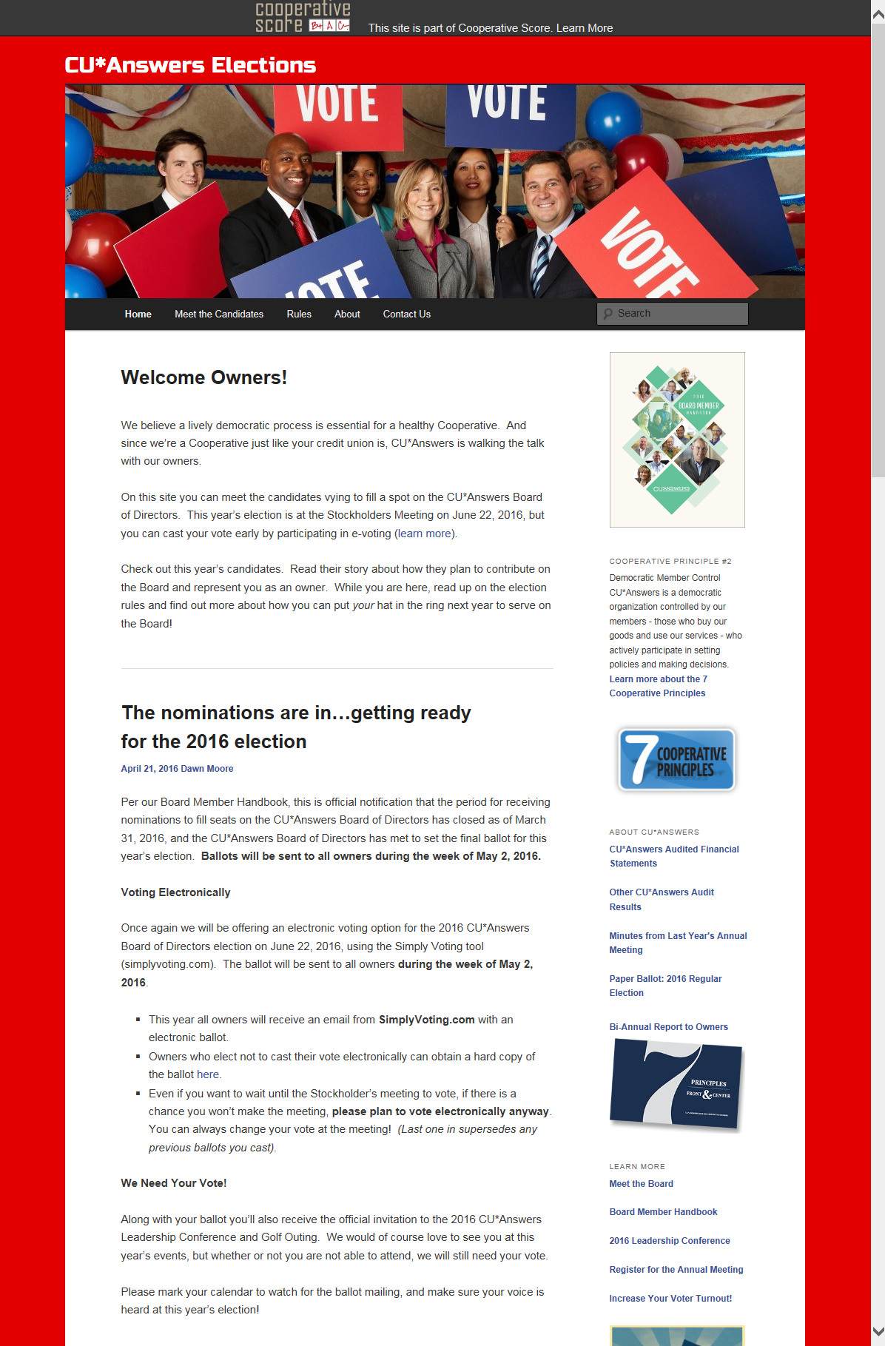
Elections Market the Power of Ownership
A lively democratic process is essential for a healthy cooperative
Your participation in choosing Board members and volunteering for leadership means we’re walking the talk ... THANK YOU for participating as owners
Year 4 for the CU*Answers Elections website (did you visit?)
Year 4 for the e-Voting option

Slide 11
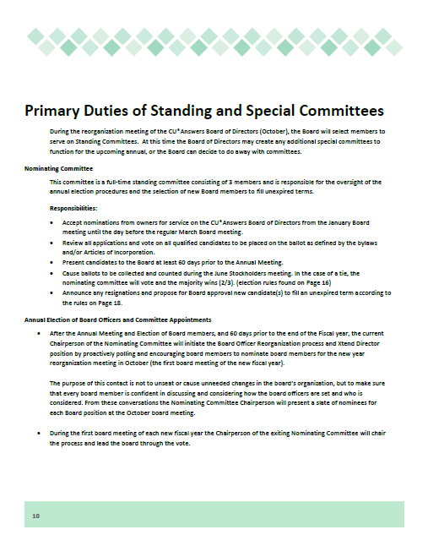
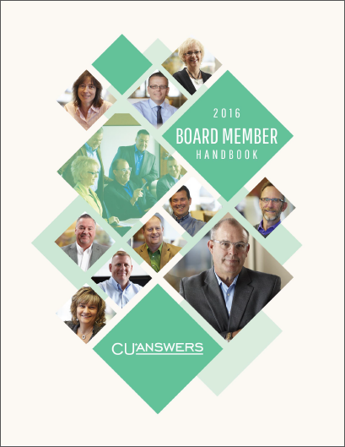
Special thanks to this year’s Nominating Committee
Each year we work from a well-documented process
Helps us dot all the i’s and cross all the t’s
Ensures we keep our promise to keep ownership participation alive and well in our Cooperative
Dean Wilson, Director
CEO, Focus Credit Union
Don Mills, Sec./Treas.
CEO, Alpena Alcona Area CU
Vickie Schmitzer, Vice Chair
CEO, Frankenmuth Credit Union

Slide 12
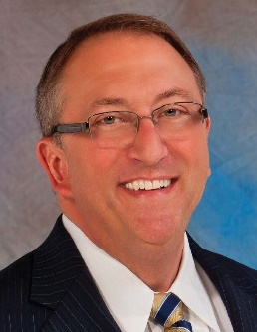
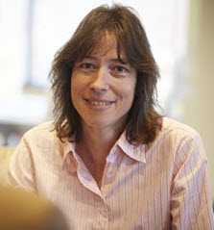
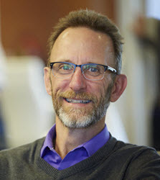
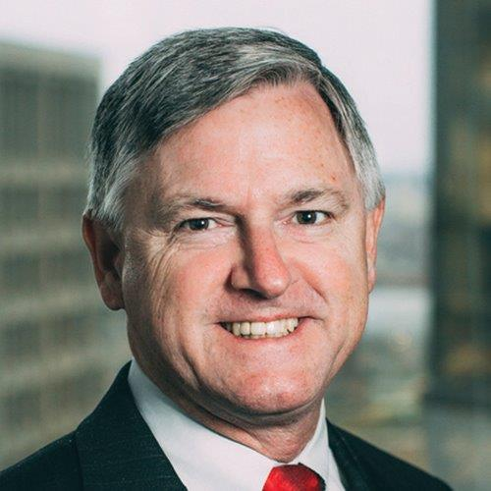
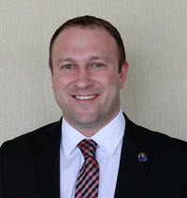
Let’s hear from the candidates
Tom Gryp
CEO, Notre Dame FCU (Notre Dame, Indiana)
Jeff Jorgensen
CEO, Sioux Empire FCU (Sioux Falls, South Dakota)
Incumbent
Nick Montie
CEO, Thunder Bay Area CU (Alpena, Michigan)
Linda Bodie
CEO, Element FCU (Charleston, West Virginia)
Incumbent
Bill Burke
CEO, Day Air Credit Union (Kettering, Ohio)

Slide 13
Let’s hear from the candidates
Let’s vote!
Tom Gryp
CEO, Notre Dame FCU (Notre Dame, Indiana)
Jeff Jorgensen
CEO, Sioux Empire FCU (Sioux Falls, South Dakota)
Incumbent
Nick Montie
CEO, Thunder Bay Area CU (Alpena, Michigan)
Linda Bodie
CEO, Element FCU (Charleston, West Virginia)
Incumbent
Bill Burke
CEO, Day Air Credit Union (Kettering, Ohio)

Slide 14
A Look at The Numbers
CFO Report

Slide 15
Net Income & Patronage Dividends What do shareholders get, and what are we putting away for our future?
$5,115M
$1.5M
$???

Slide 16
2015 Numbers Worth Celebrating
Detail | YE 2014 | YE 2015 | 2015-2014 % Change | 2014-2013 % Change | 2013-2012 % Change
Total Assets | $26,862K | $27,739K | 3.2% | 3.1% | 13.5%
Total Liabilities | $14,344K | $14,802K | 3.1% | (8.2%) | 5.9%
Total Equity | $12,518K | $12,937K | 3.2% | 19.9% | 27.1%
Retained Earnings | $2,125K | $2,442K | 14.9% | 7.4% | 1.33%
Book Value of Class A Stock ($ per share) | $488.99 | $521.64 | 6.3% | 10.5% | 14.2%
Book Value of Ownership | $97,799 | $104,327 | 6.3% | 10.5% | 14.2%

Slide 17
Year-end 2015 Dividend Payments These numbers can flex, and I predict they will again in the future
Detail | YE 2014 | YE 2015 | 2015-2014 % Change | 2014-2013 % Change | 2013-2012 % Change
Patronage Dividend ($) | 800,000 | 1,000,000 | 20.0% | 0.0% | 14.3%
Bonus Patronage ($) | 1,250,000 | 1,500,000 | 16.7% | 127.3% | (45.0%)
Ownership Dividend Rate | 4.0% | 4.0% | 0.0% | 0% | (10.1%)
Ownership Dividend ($) | 502,829 | 529,117 | 5.0% | 23.7% | 11.5%
Book Value of Class A Stock ($ per share) | 488.99 | 521.64 | 6.3% | 10.5% | 14.2%
Price to Purchase CUSO Ownership | 225,000 | 245,000 | 8.2% | 25.0% | 20.0%
At yesterday’s Board meeting, I reported 2016 Net Earnings of $1,745,000 as of May 2016, (after adjustments for $1,000,000 Patronage Dividends and $1,228,000 Taxes)
(Projected to be $2,167M by 9/30/16)

Slide 18
2015 Return on Investment
2015 Gross Income Submitted by Owners to CU*Answers $ 21,688,292 (Excludes all vendor pass-throughs)
2015 Patronage Dividends Paid $ 2,500,000
2015 Class A Stock Dividends Paid 529,117 (4.0%)
2015 Interest Paid Credit Unions on Loans 193,700 (~5.1%)
Total Revenue Returned to Credit Unions $ 3,222,817
Return Per Total Dollars Received: $0.1486
$3,222,817 ÷ $21,688,292 (excludes vendor pass-throughs) = 14.86% return per CU*A $ received

Slide 19
Understanding this formula is important to how we set the boundaries for our future
2013 Return Per Total Dollars Received: $0.1280
$2,117,353 ÷ $16,539,398 (excludes vendor pass-throughs) = 12.80% return per CU*A $ received
2014 Return Per Total Dollars Received: $0.1489
$2,907,759 ÷ $19,517,845 (excludes vendor pass-throughs) = 14.89% return per CU*A $ received
2015 Return Per Total Dollars Received: $0.1486
$3,222,817 ÷ $21,688,292 (excludes vendor pass-throughs) = 14.86% return per CU*A $ received

Slide 20
Fueling a Rebirth
2005 Return Per Total Dollars Received: $0.080
$ 554K ÷ $ 6,926K (excludes vendor pass-throughs) = 8.0% return per CU*A $ received
2015 Return Per Total Dollars Received: $0.1486
$3,222,817 ÷ $21,688,292 (excludes vendor pass-throughs) = 14.86% return per CU*A $ received
Success can lead to wanting more and more of a good thing
But picking the right thing at the right time might mean disrupting the path we’re on

Slide 21
Thinking About 2016 Year-End cuasterisk.com network revenue numbers continue to impress
CU*Answers direct revenues continue to evolve
Projected for 2016: $51.86M
CU*Answers’ influence continues to grow through partnering with other networks and investing in new initiatives
eDOC projected for 2016: $4.2M
CU*NW projected for 2016: $3.9M
Xtend projected for 2016: $3.2M
CU*S projected for 2016: $3.3M
BuffaloPacific projected for 2016: $0.5M
Site-4 projected for 2016: $0.5M
ChatterYak projected for 2016: $0.2M
Grand Total: $67.66 million
Visit www.cuasterisk.com to keep up with network partners, products and services

Slide 22
Investing in a Community and Building a Network
15% ownership stake
1.2% ownership stake
48%
ownership stake
1% ownership stake
1.18% ownership stake
20% ownership stake
5% ownership stake
A convertible debt investment

Slide 23
Projecting Shareholder Value Depending on when you bought in, your perspective is different
Ownership price 1991: $59.31, 2000: $176, 2005: $460, 2010: $495, 2015: $1,125; 2016: $1,225
5.94%

Slide 24
The importance of our per-share price Balancing today’s payback against the value of your equity
*Restated 9/30/08
Let your Board know how you hope they vote: Current year dividends to help your operation, or shareholder value for the long term

Slide 25
What a CFO might consider “burn it down” barriers
What do we need to burn down?
Where do we need to be revolutionists?
“Customers should pay for what you’ve built” (legacy)
“Equity is the fuel for your future”
“The only ROI that matters is measured in hard dollars”
“Chasing the customers with the widest profit margin will secure your future”
“Cashing out at your highest value optimizes your owners’ interests”
Build a firm where people pay for what you’re doing today, not what you did yesterday
Today’s patronage is far more valuable than yesterday’s residual
With every dollar earned, you pay a tax; with everything learned, your future is secured
Be careful – good companies abandon more markets than find big whales
Optimizing of the value of our firm is not more important than sustainability and the agenda of our customer-owners

Slide 26
The key to solving a riddle is identifying the tricky part
Engaging a Builder’s Soul
CEO Comments
Notes:
WATCH THE VIDEO FROM HERE, COME BACK TO NEXT SLIDE

Slide 27
The key to solving a riddle is identifying the tricky part
Riddles are at the center of any lifetime work worth doing
Business school prepares you for the easy answers
Life teaches you to look for the tricky part before you answer
Capital is not the tricky part, earning is
Technical skills are not the tricky part, user engagement is
Ideas (templates) are not the tricky part, fitting a credit union ROI model is
Competition is not the tricky part, finding your own path is
Buying solutions is not the tricky part, fitting them to your condition is
Q: Who’s buried in Grant’s tomb?
Cooperatives count on working with customers who are constantly facing the tricky parts
That’s why cooperatives give customers the power of ownership

Slide 28
The key to solving a riddle is identifying the tricky part
What they teach you in business school | What customer-owners taught me
The tricky part is earning... | ...in a cooperative community
The tricky part is user engagement... | ...with the customer who built the company to engage
The tricky part is fitting a credit union ROI model | Slim margins, diverse opinions, local is everything
The tricky part is finding your own path | Second-to-market tactics for a unique situation
The tricky part is fitting solutions to your condition | Take the customer-owner’s specification
Our network came together because of a unique understanding of its own needs
It anticipated the tricky parts, and was stubborn about building solutions that would fit those needs
It ignited a community of builders

Slide 29
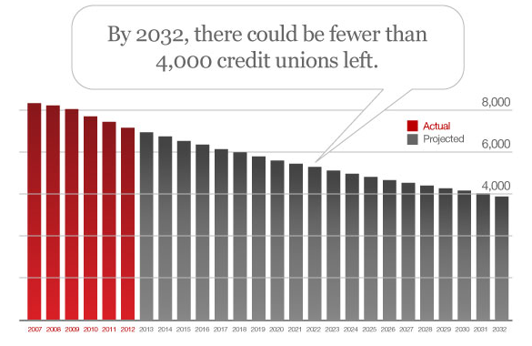
Why I believe we need to be builders together
Builders plan for rebirth
They look ahead
They take responsibility for altering the path
They persevere through the process to the other side
But our rebirth will not be ensured by crafting an industry response, or by looking to build an industry or change its path
Our rebirth counts on what you will teach us about what you need for your rebirth
Our rebirth depends on the builder in each of you to teach us what is unique about your riddle

Slide 30
I trust the path to sustainability starts with you
It’s customer-owners who are constantly challenging our sustainability
They want to know if we’ll be ready for the future they will face
It’s customer-owners who should lead and give the firm a sense of urgency about its future, with rebirth constantly in mind
When customer-owners leave it to their vendors to decide what is urgent or not, they risk that what they’ll need for the future will be late
As Scott reminded us earlier, “We have to vest in building new realities...we have to be the founders of the future”
CUSO or credit union, our sustainability is squarely in the hands of customer-owners willing to come forward and build

Slide 31
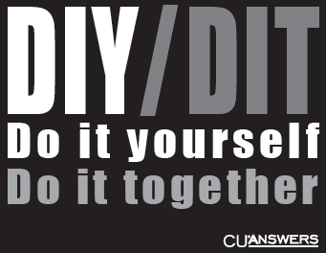
I trust the path to sustainability starts with you
To ignite a builder’s soul, every individual needs to feel that they are significant on the path to the solution’s ultimate design
An owner has the right to decide where to engage on that path, and should have our trust

Slide 32
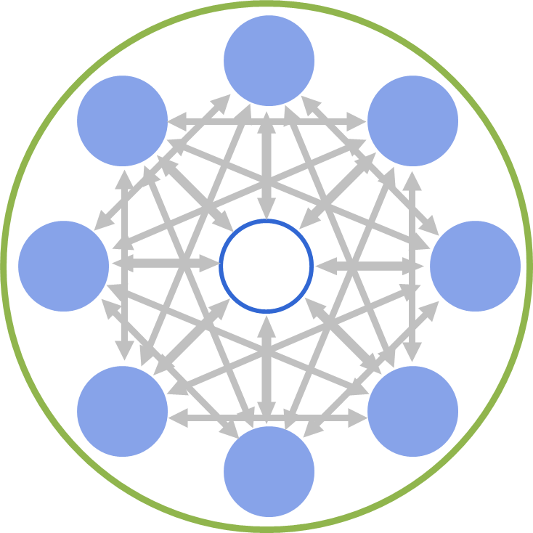
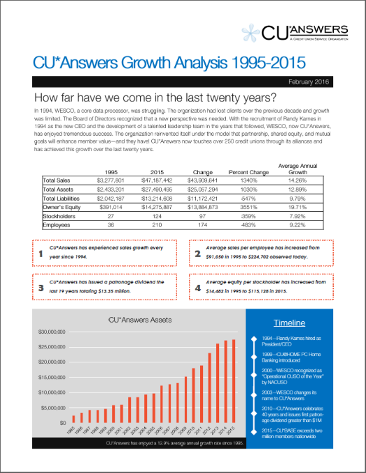
I trust the path to sustainability starts with you
In a network, all innovation is the result of what happens at the edge
In our network, our innovation starts with you and your members
It starts with you being ready to burn down the barriers and lead as a builder, with the passion of a revolutionist

Slide 33
Election Results
Let’s see who won!
And the winners are...

Slide 34
Back to the party!

