Slide 1
CEO School
WEDNESDAY
A Day of Mentoring and Coaching around Using CU*BASE Tools
2015
CEO Strategies
November 5 & 7, 2013

Slide 2
What is CEO School?
We Are All Cooperative Business Designers
Why has CEO School become a tradition at CU*Answers?
With the expansion of our network, we have more talented CEOs than ever, and the value put on collaborative efforts is at an all time high
CEOs need to develop networks where they can coach and mentor each other from the unique position of being a CEO
More than ever, today’s CEO is expected to be engaged with technology and the concepts of data mining, opportunity demographics, and being plugged in
CEOs wear more than one hat, and CEO School is a safe training environment

Slide 3
Today’s Agenda
Data 2016:
Behind the Firewall
What is available in CU*BASE? Where will our data analytics focus be for people who use CU*BASE?
Data 2016:
Out in the Open, Extended for the World to See
Extending the value of credit union data beyond the CU*BASE login
Building a Collaborative Bench of Data Analysts
Launching a project to crack the riddle that seems to challenge every organization: What to do next with all the data available to us?

Slide 4
Data 2016: Behind the Firewall
What is available in CU*BASE? Where will our data analytics focus be for people who use CU*BASE?

Slide 5
Before CU Employee Push the Buttons, a Leader Must Push Theirs
are you building a culture driven by data awareness?
Actionable
Analytical
Approach
Analysis with an expected outcome: I will act
Before you ask for data, before you read a report, before you hear a proposal for action, you already anticipate doing something
Data is not just noise to you
The ability to analyze: A budgeted commitment
You’ve prioritized analysis, put some of your best thinkers on the project, budgeted time and cash to the project, and you’re determined to get an ROI on the data work you do
A manner in which a problem is solved: A plan
You’ve made a commitment to yourself and your Board that this is a management priority and approach
You’ve sold it as one of your talents
How could CU*Answers build a collaborative investment for analysis?
Why we’re all here: to share and exchange plans in the hope that a group of thinkers is better than one
You’re here to commit to action by knowing what is possible

Slide 6
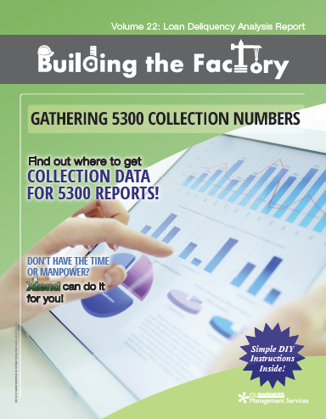
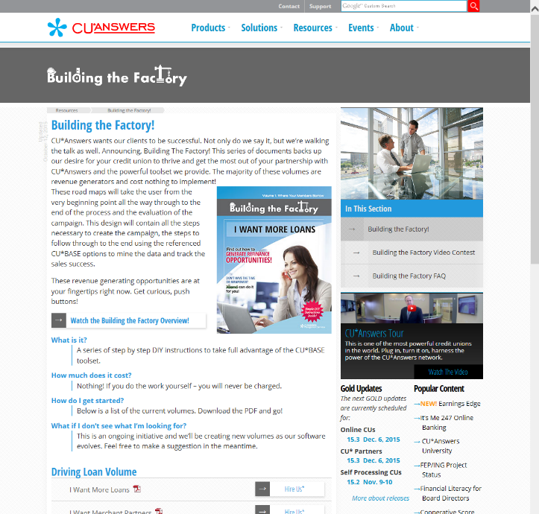
A Leader Must Connect the Dots
Process vision embedded in help
The “Building the Factory” documents help you complete the ASAP process with each CU*BASE dashboard
Ask a targeted question
See the potential members to contact
Act on the potential with intent: the message with the method
Profit (you’re on your own here)
http://www.cuanswers.com/resources/building-the-factory/

Slide 7
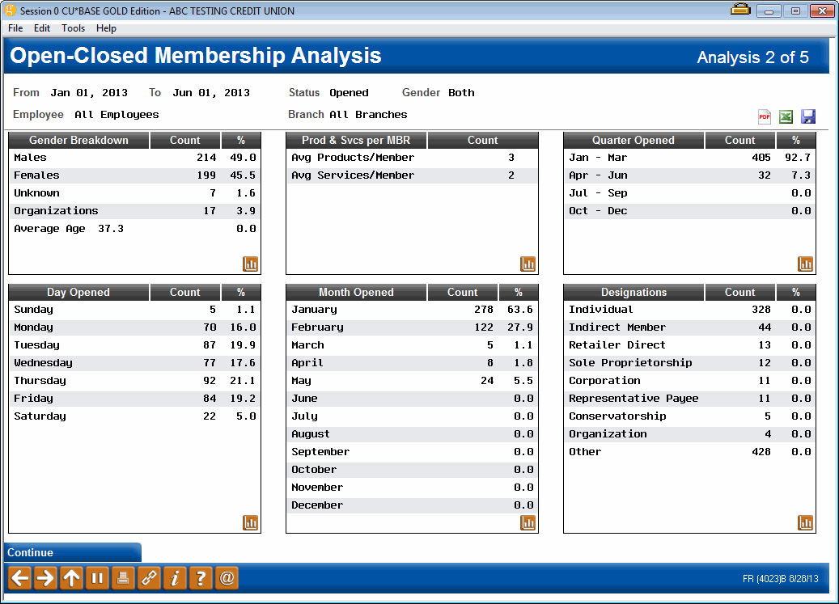
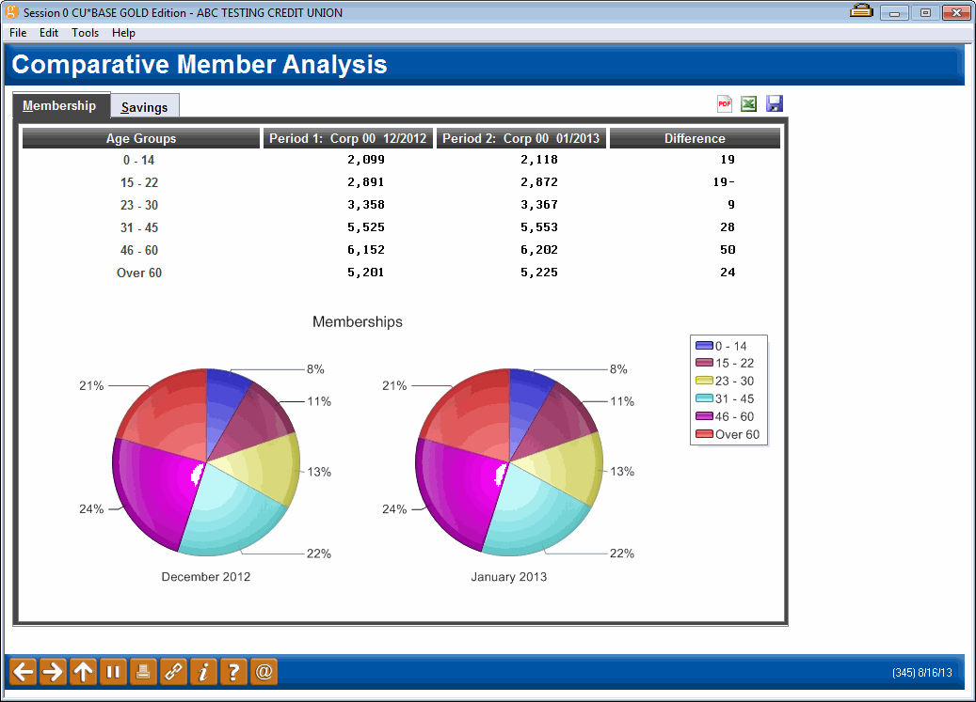
A Leader Must Prepare a Team for the Stage
Steer the debate based on what you know
PDF/Excel Exports added to 9 dashboards since last year!
Where are you on the evolution of data presentation in your operation?
We’ve gone from print, to on-screen presentation, to delivering PDFs...and today we’re discussing web presentations
Are you maximizing all of your options? With your staff? With your senior team?
Can you move data directly to your board and the everyday customer-owner?
New in the 15.2 release!
Who at your credit union has a graphical eye that could add to the development effort focused on presenting data to win?

Slide 8
A Leader Should Know Why We Do the Work
When gathering data is more important than knowing the data, you’re off the mark
To comply with archival regulations and best practices
To validate and affirm the results of our efforts
To present to examiners and Board members and create a corporate record
To present to management and use in performance analysis (staff)
To comply with third-party obligations such as the 5300
To analyze and calculate adjustments to our plans and futures
Know our member and make adjustments to keep their attention
Know our operations and make adjustments to build an effective factory
Know our identity and validate the response to who you think you are
Know our plan through verifying the hypothesis and the hopeful outcome
Gathering Data (reduce $ cost)
Analyzing Data (increase time)
Acting on Data (multiply the events)
When was the last time you really challenged your ROI on these activities and your effectiveness around crafting designs and planning data-related tactics?

Slide 9
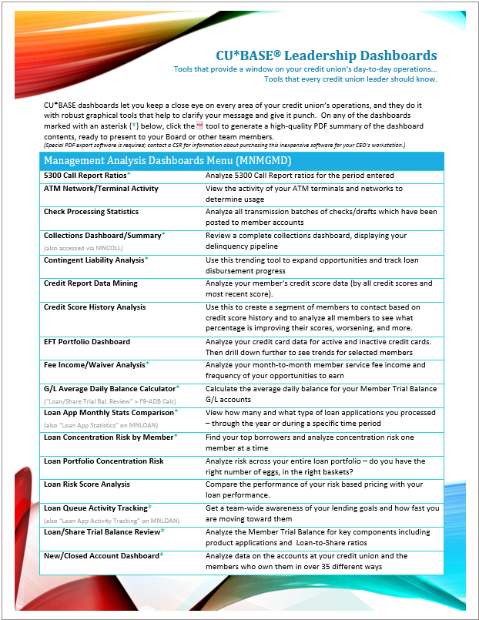
A Leader Should Know Why We Do the Work
Can you link a job description with a tool to get the job done?
70 dashboards and counting…here are some of my favorites:
Dashboard | Purpose of Dashboard
EFT Portfolio Dashboard | Analyze your credit card data for active and inactive credit cards. Then drill down further to see trends for selected members
Credit Report Data Mining | Analyze your member’s credit score data (by all credit scores and most recent score).
Loan Portfolio Concentration Risk | Analyze risk across your entire loan portfolio – do you have the right number of eggs, in the right baskets?
New/Closed Membership Dashboard | Analyze your memberships in over 50 different ways to use as a springboard to evaluate credit union policy
Targeted Tiered Score Analysis | View a side-by-side comparison of how a selected group of members score in Tiered Services versus your general membership
Account Retention by Year Opened | View account retention data by the year the account way opened
Where Your Members Shop | Analyze where your members spend their money, by transaction description and retailer name

Slide 10
How Do You Determine Who Will Engage Your Data?
Is it you? General team members in their daily roles? Or specialists?
CEO School is about raising your awareness about the tools that are available to your organization and business plan
Engaging these tools requires that you be the catalyst to action
Direct assignment...why are there so few employees with access to these commands?
Asking questions that force the tools to be used...why do we see such infrequent use of these features?
Changing processes to make people find new solutions...why do we see people continuing to pay us for Queries that have dashboard counterparts?
Requiring brainstorming sessions to use CU*BASE presentation tools...why do we see so many people asking the same questions over and over, and promising more research will be presented “at the next meeting”?
You are the catalyst to culture change, but it takes the initiative to force your organization to develop the muscle memory to default to data, to default to automated tools...can you do it?

Slide 11
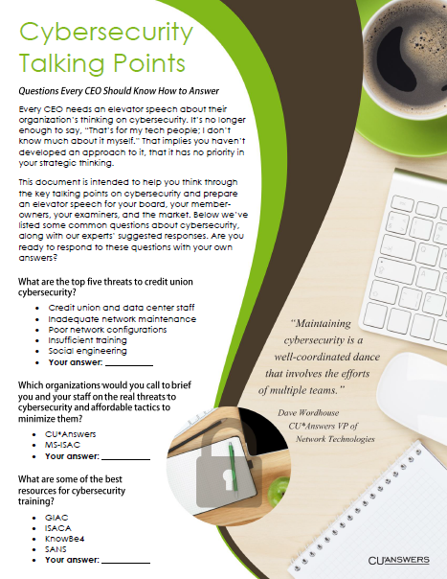
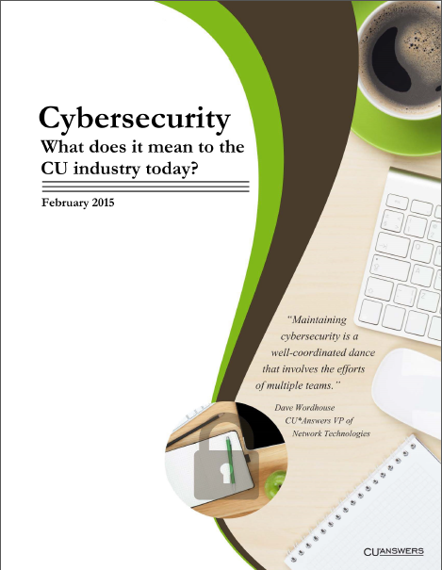
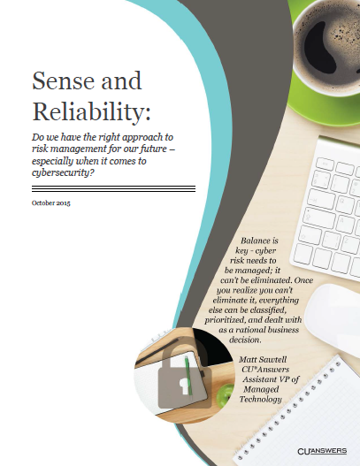
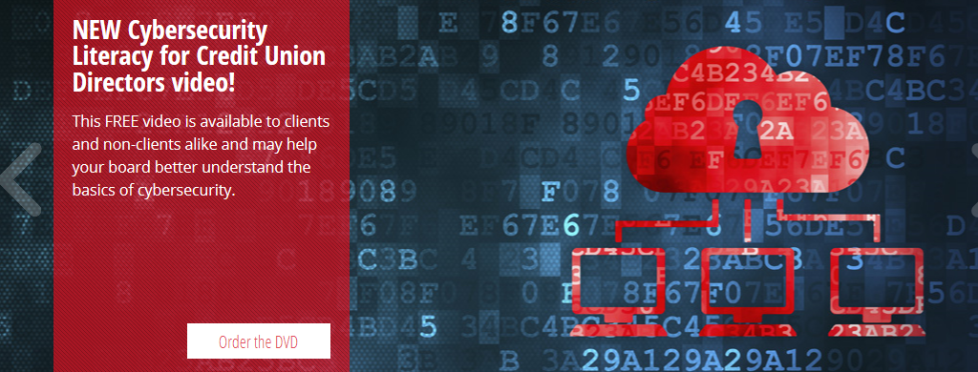
You Can’t Talk Data Without Thinking About Security ARE YOU READY TO LEAD WHEN IT COMES TO CYBERSECURITY RISKS?
http://www.cuanswers.com/resources/cybersecurity/

Slide 12
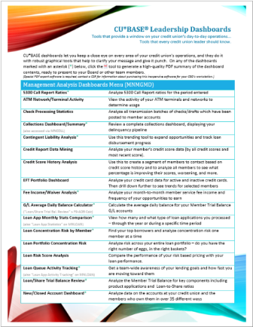
Insider Dashboards
Dashboards for trusted individuals
Blending analytical insights with the private member data needed to get the job done

Slide 13
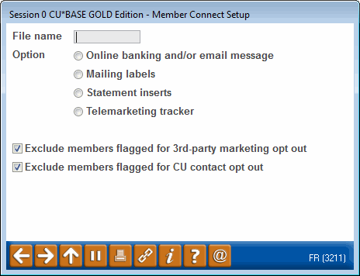
Insider Dashboards
A.A.A. Moment
Embedded in these dashboards is the ability to go active, right now, every time...and all you have to do is plan to do so
Have you created a communication manager and assigned them regular dashboard activities to ensure a low-cost reach-out to your members?
A Novelty That Has Become an Expectation
Our standard for CU*BASE dashboards:
Select a group of records with something in common to analyze (loan apps processed between Oct 1 & 31, members who joined the CU last year, checking accounts opened last month, etc.)
The user is presented with a series of options to work with each of these records, one at a time (approve the app, send TIS disclosures, order a debit card, etc.)
The user is presented with a set of analyses that take the selected records and show as many pertinent facts as possible about that batch (# of apps pending, # of members who joined by age or gender, checking accounts opened by a specific employee, etc.)
Step 1 is like a report, Step 3 is like the totals or summary section on a report, but Step 2 creates a unique palette of opportunity to work and analyze at the same time
Is this gaining traction in your shop?

Slide 14
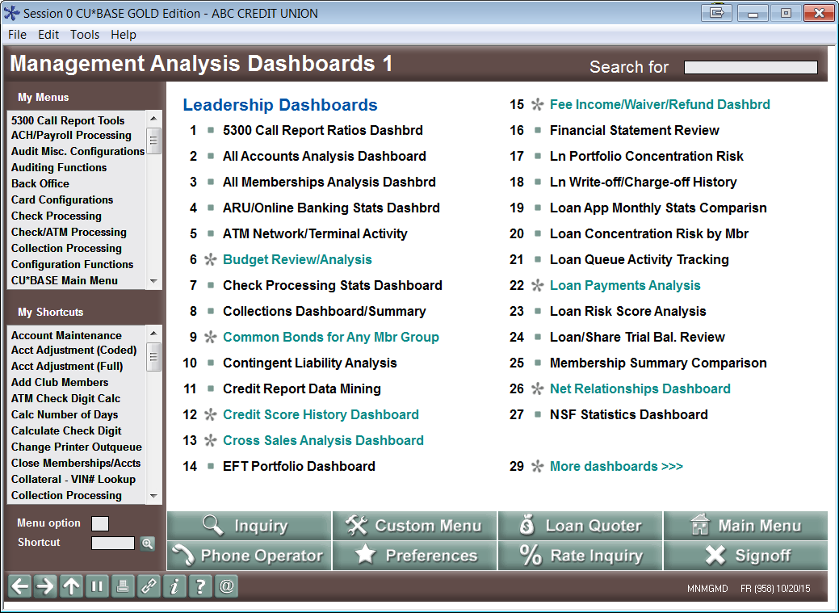
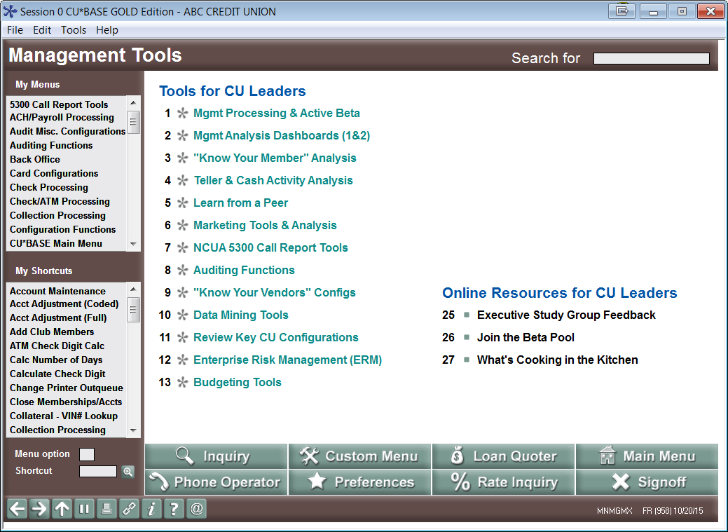
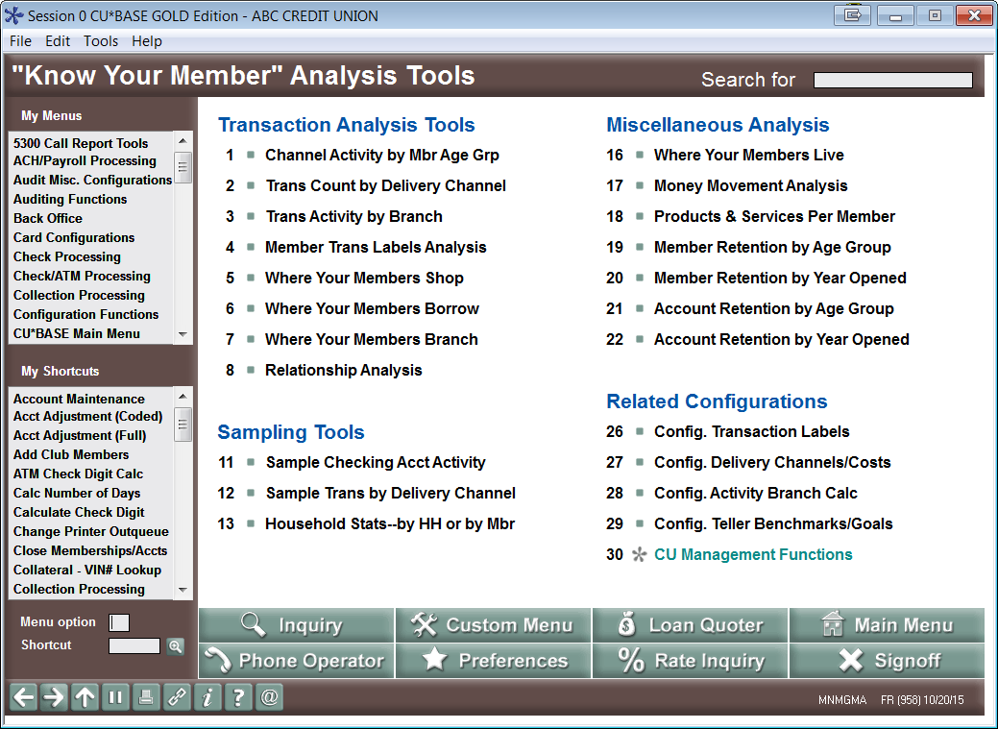
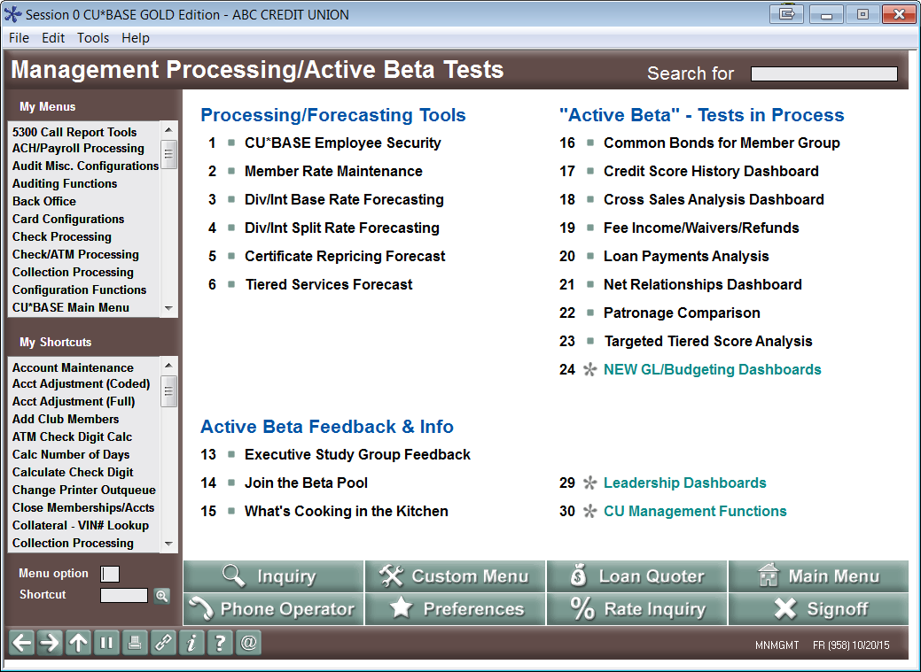
One Stop Shopping for Management Tools
Login > #4 CU Management Processing
Notes:
Suggest showing the login > #4 process, then when you are navigating to these menus, as much as possible use “back” to go to MNMGMX and choose the menu name from there (rather than using the MNXXXX shortcut)

Slide 15
Management Processing/Active Beta Tests Menu

Slide 16
Management Analysis Dashboards 1 Menu

Slide 17
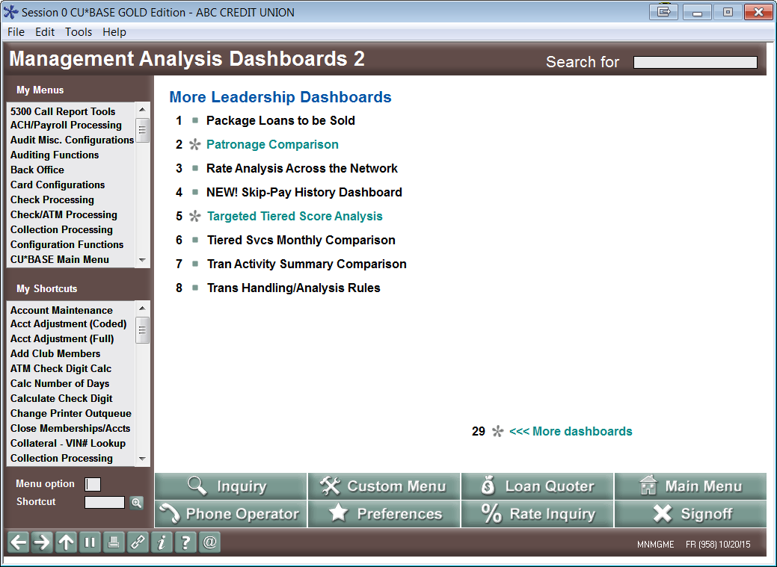
Management Analysis Dashboards 2 Menu

Slide 18
“Know Your Member” Analysis Tools Menu
Notes:
#16 is just a relabeling of the existing “Member Demographics” option
#18 got enhancements in the 15.2 release – added text banking, e-notices, e-alerts to PPM/SPM config

Slide 19
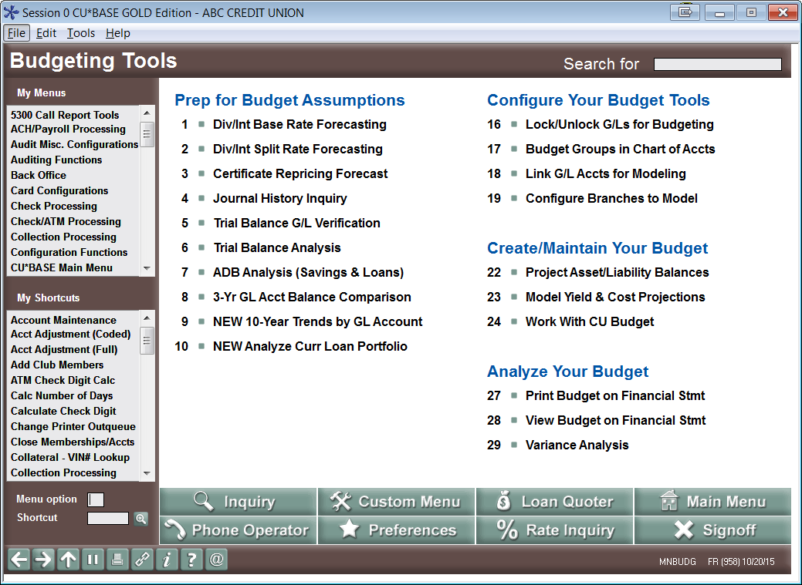
Budgeting Tools Menu
Notes:
See next few sidebar slides for #8, #9 & #10

Slide 20
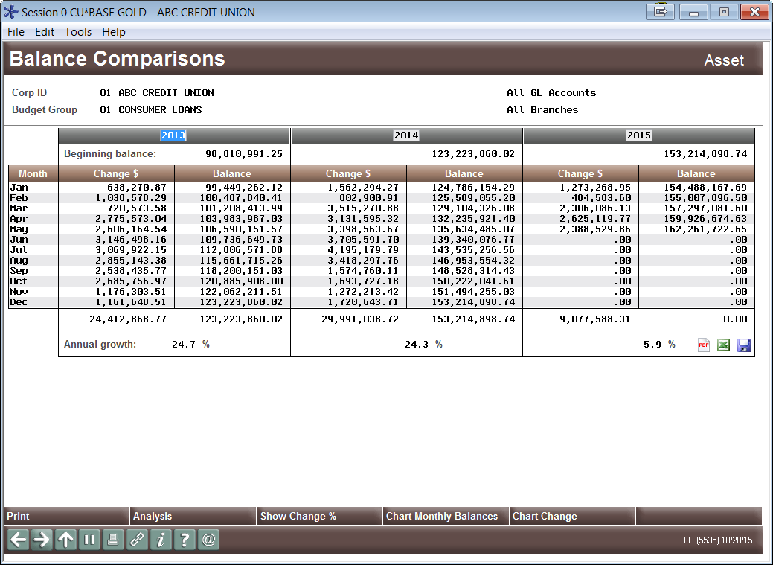
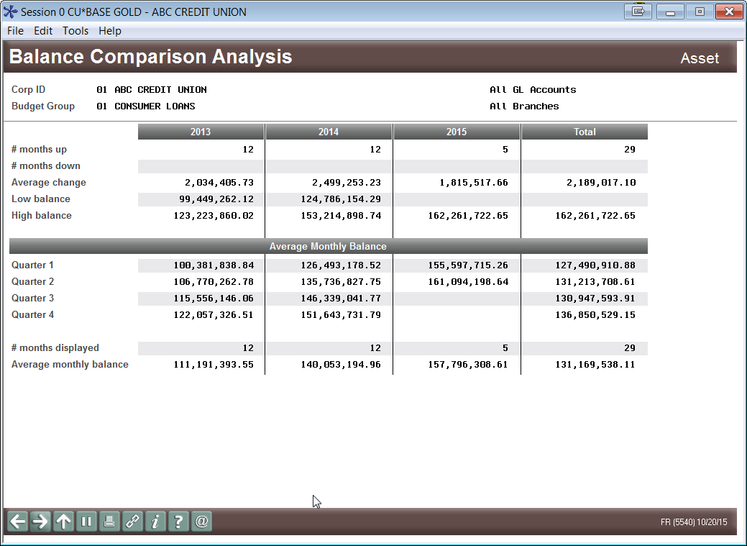
Budgeting Research Tools: A New Kind of Analytics
Budgeting Tools Menu (MNBUDG): 3-Yr GL Acct Balance Comparison
Notes:
Was released last Fall with the Budget phase 1 project

Slide 21
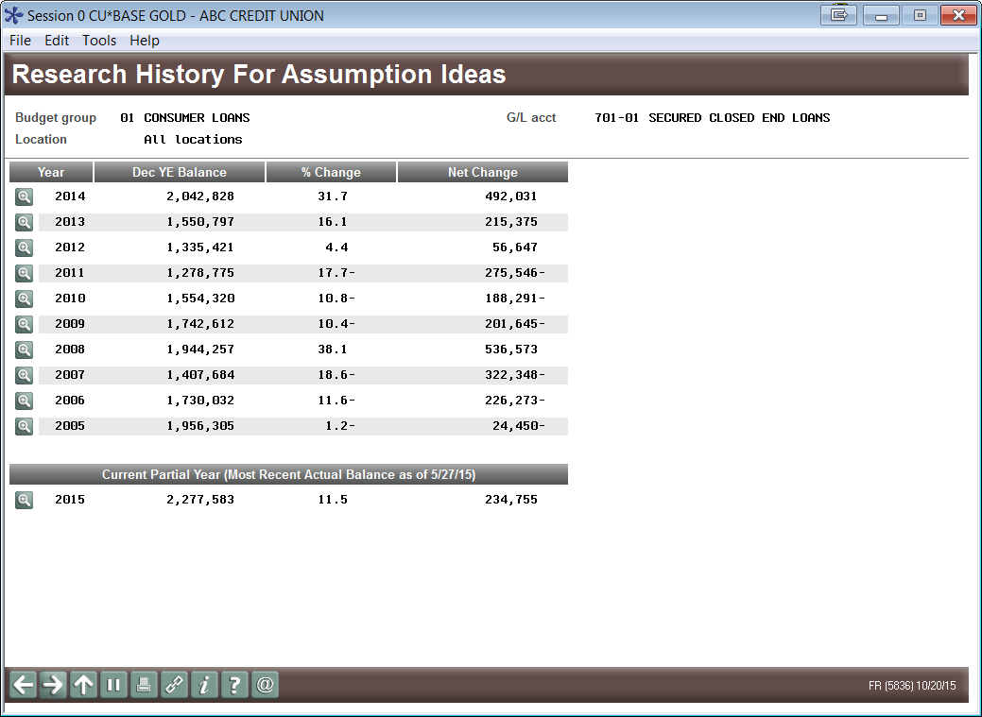
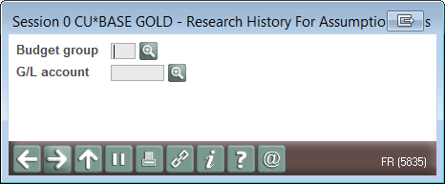
Budgeting Research Tools: A New Kind of Analytics
Budgeting Tools Menu (MNBUDG):
10-Year Trends by GL Account
On the drawing board: Will be removing the confusing “current balance” from here

Slide 22
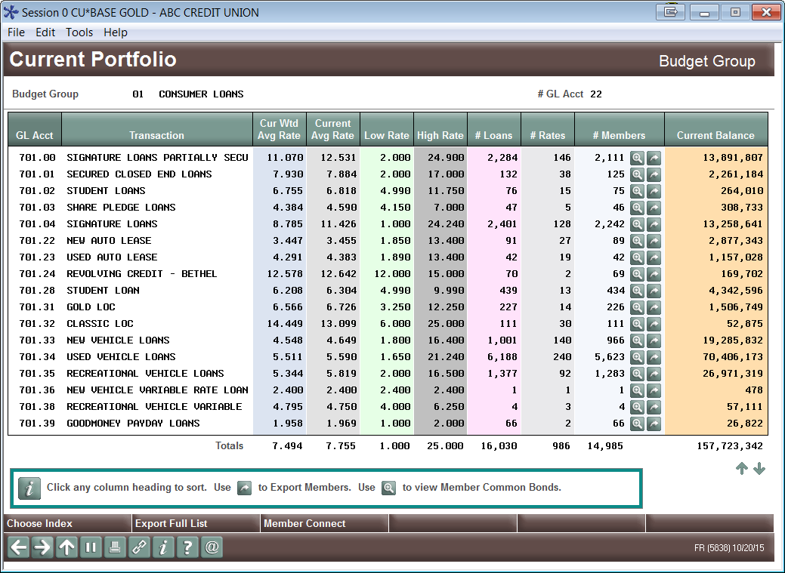
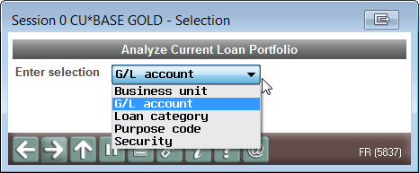
Budgeting Research Tools: A New Kind of Analytics
Budgeting Tools Menu (MNBUDG): Analyze Current Loan Portfolio
On the drawing board: Will be excluding written-off loans (by either loan category or loan account)
On the drawing board: Will be adding an “as of” date for EOM snapshot
On the drawing board and coming soon: Savings Portfolio and Certificate Portfolio
Notes:
Other portfolio dashboards are MNNEW 19 & 20

Slide 23
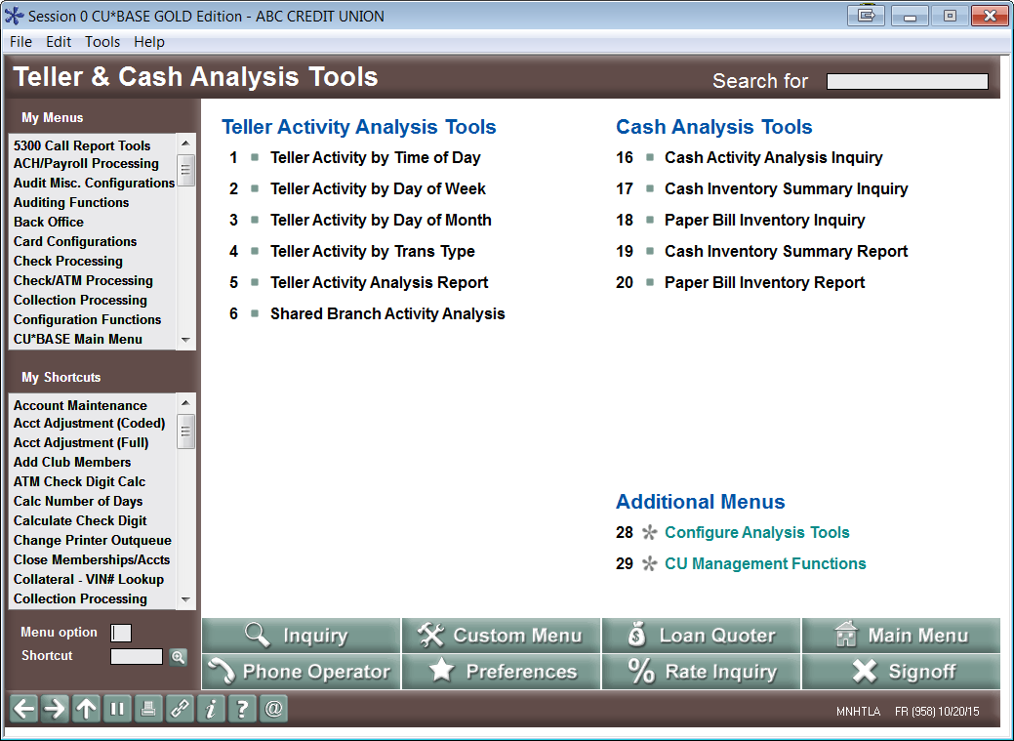
Teller & Cash Analysis Tools Menu

Slide 24
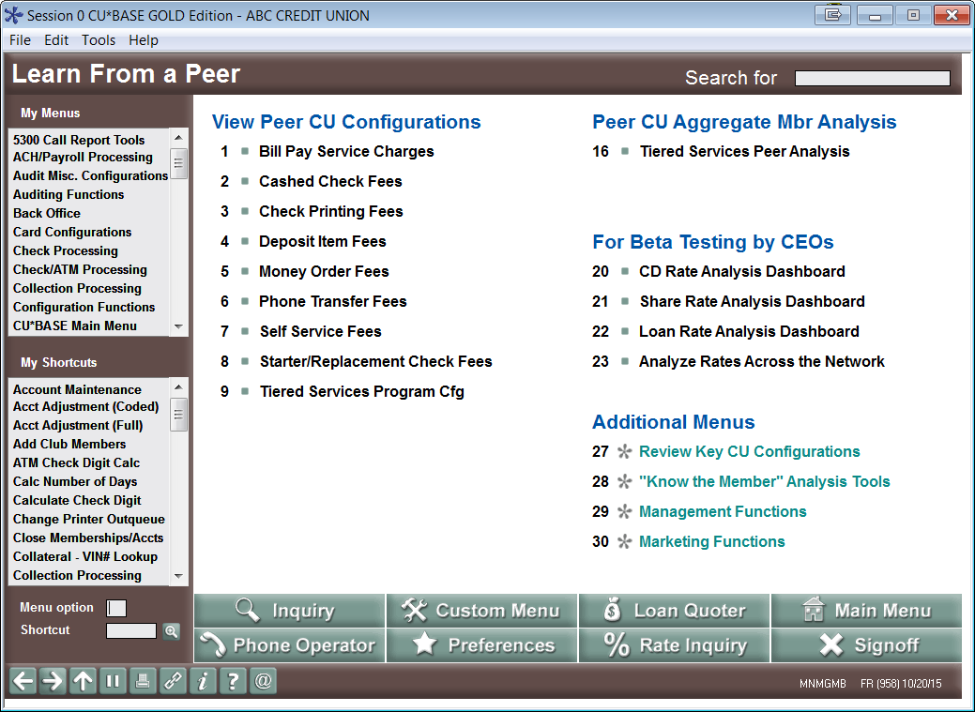
Learn From a Peer Menu

Slide 25
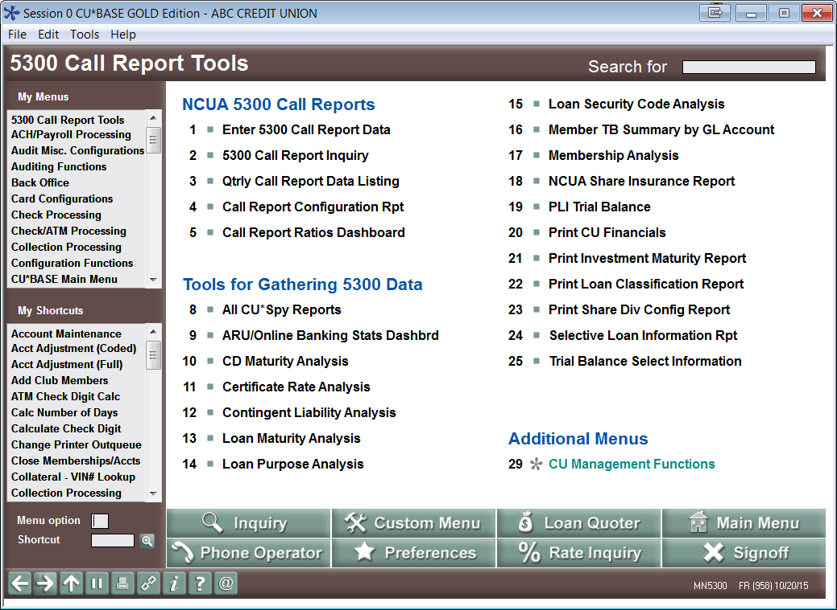
5300 Call Report Tools

Slide 26
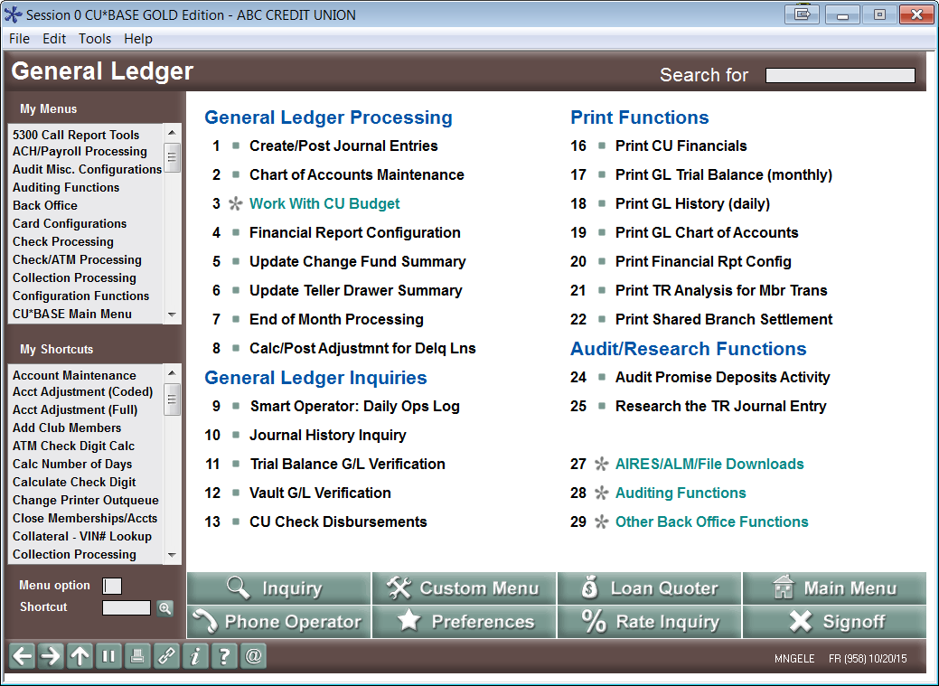
General Ledger Menu

Slide 27
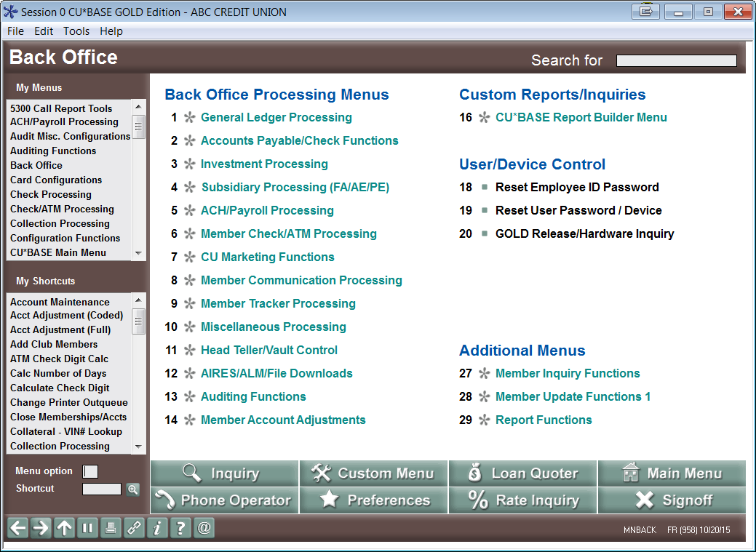
Back Office Menu

Slide 28
What’s coming next?
Projects currently in the analytics laboratory
Dashboard standardization
Common Bonds
Exports for Member Connect and Query
Sortable columns
Standard filters and navigation aids
Dashboards for financial statements, other GL data
Print income/expense budget figures on an income statement
Print asset/liability projections on a balance sheet
Learn-From-a-Peer versions of current dashboards
Starting with the Net Relationships dashboard
Written-off/Charged-off Loans Dashboard Analysis
Audit Board approvals
Bankruptcy trends
List Generator Dashboard Output
Notes:
WO/CO dashboard is MNNEW 20
PIN/password resets is MNNEW 21
Nothing on LFP net relationships or List Generator dashboard output yet
Nothing on closed mbr analysis or the credit score clicks thing
Other portfolio dashboards are MNNEW 19 & 20

Slide 29
What’s coming next?
Shifting gears: moving away from insider dashboards to new solutions
In 2016-2017 we’ll slow down on the insider dashboard projects
This toolbox is maxing out – it’s time to change the focus and get more for our investments at both the CU and the CUSO level
In 2016-2017 we will push to expand the audience for CU*BASE data by expanding user access via the web and a browser presentation
Will partner the insider dashboard toolkit with a new external toolkit
The goal is to reach more credit union stakeholders (professionals, volunteers, and even interested third parties)
In 2016-2017 we will push to expand the services related to CU*BASE data by offering a shared data analyst service
Our community is starting to feel saturated with information, while starving for the insight that will change the future – solving this riddle must be our focus for the next few years

Slide 30
Data 2016: Out in the Open, Extended for the World to See
Extending the value of credit union data beyond the CU*BASE login

Slide 31
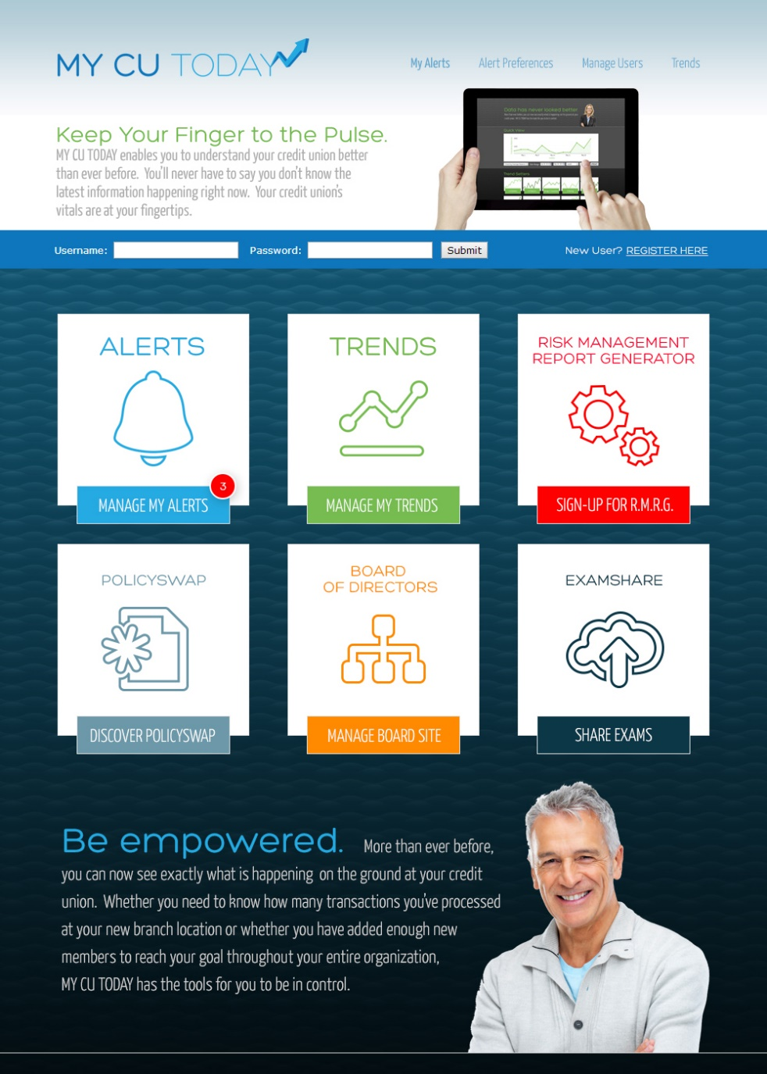
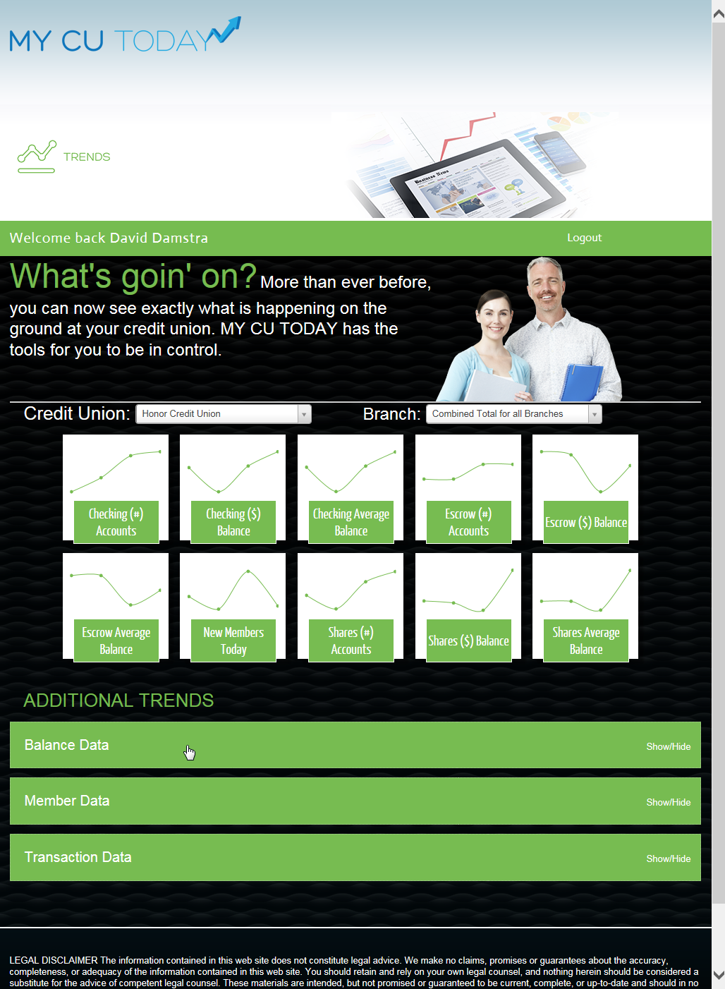
Capturing the Attention of People Who Never Sign On to CU*BASE
Phase 1: redefine the audience for core processing data
Let’s take a look at My CU Today going into 2016 and think about how this tool can expand everything you do with data...

Slide 32
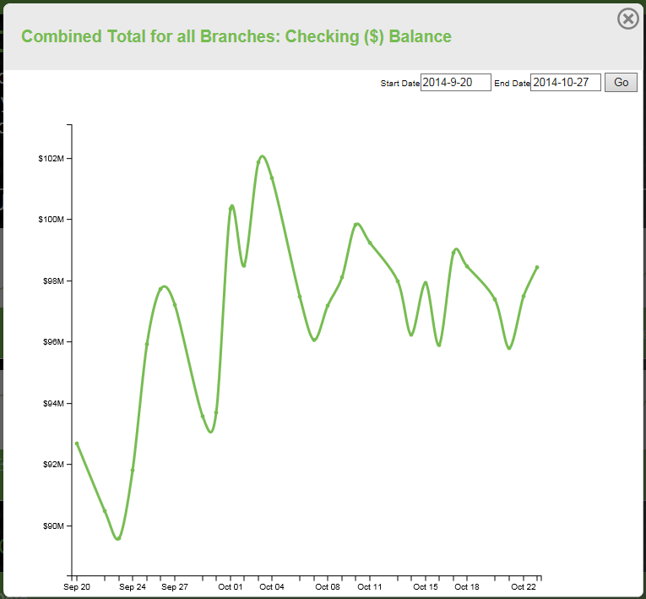
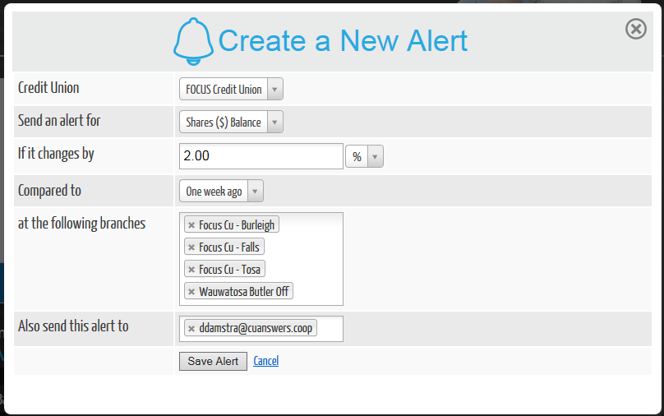
Capturing the Attention of People Who Never Sign On to CU*BASE
Phase 1: redefine the audience for core processing data
Push alerts to the people who need a trigger to act on data:
Invite people to a warehouse of data to see the answers:

Slide 33
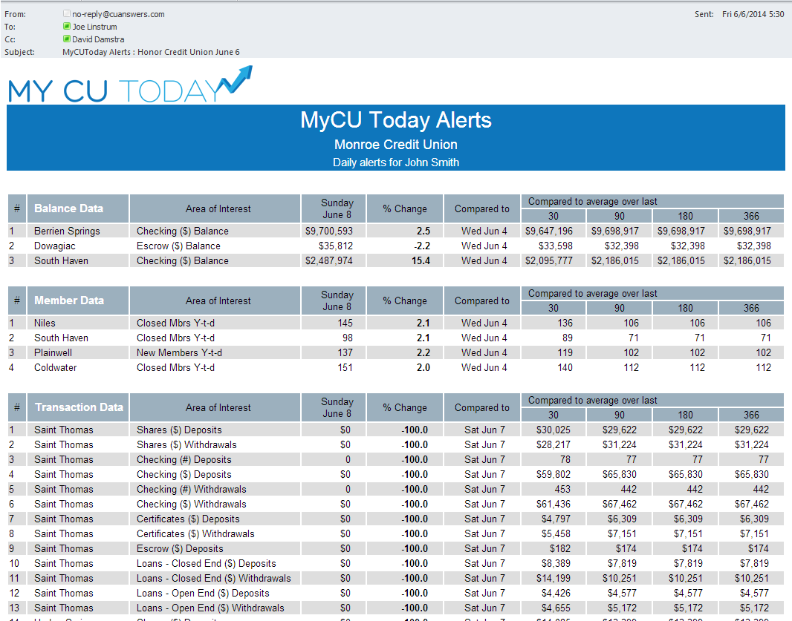
Capturing the Attention of People Who Never Sign On to CU*BASE
Phase 1: redefine the audience for core processing data

Slide 34
Capturing the Attention of People Who Never Sign On to CU*BASE
Phase 1: redefine the audience for core processing data
The Process:
Sign up to build your My CU Today data warehouse
CU*BASE EOD/BOD processes will generate daily data to send to the My CU Today data warehouse servers – a daily cumulative process, building trends
Manage your My CU Today web product
Set up authorized users, configure alerts where they make sense
Develop processes and plans for your teams, your Board, your trusted vendors, and even your examiners to use My CU Today solutions
Commit to evolving this process with CU*Answers to include the data you need beyond your CU*BASE sign-ons

Slide 35
My CU Today Going Forward
Recent releases and some goals for 2016
Goals for future releases:
Improving the graphs
Improving usability
Improving alerts
Improving distribution lists
Increasing the amount of data
General evolution of the first concepts related to My CU Today
Improvements since last year:
Download graph images to your desktop
Choose your own 10 favorite mini-graphs
Add both public and private annotations to trend graphs
Specify additional email recipients for “Send Me Everything” Alerts
Access context-sensitive help
My CU Today has a generic industry approach to the data you would find at any credit union
In the next few years, we’ll focus on including more credit unions, increasing the speed and frequency of data updates, and activating a broad audience of people who focus on our industry

Slide 36
My CU Today Plus (It’s My Data)
Migrating insider dashboards to the outside world
In2016 we will rebrand It’s My Data goals under My CU Today Plus
Same intent:
Push the value of analyzing core processing data without the risk of private member information being exposed to the web
Capture the attention of credit union stakeholders: professionals, volunteers, and the general marketplace who are focused on your specific situation
Make it easy to push external insights towards the people who get the work done via CU*BASE
Continued development of CU*BASE and self-service products for members
Introducing new products such as the Board website and “It’s My Data 247” for the mobile world
Introducing new products such as the Board website and “It’s My Data 247” for the mobile world
Leveraging “It’s My Data 247” through It’s Me 247 for the owner’s perspective in every member
Can you think of any dashboards you saw earlier today that would be your top 3-5 to move to the web?

Slide 37
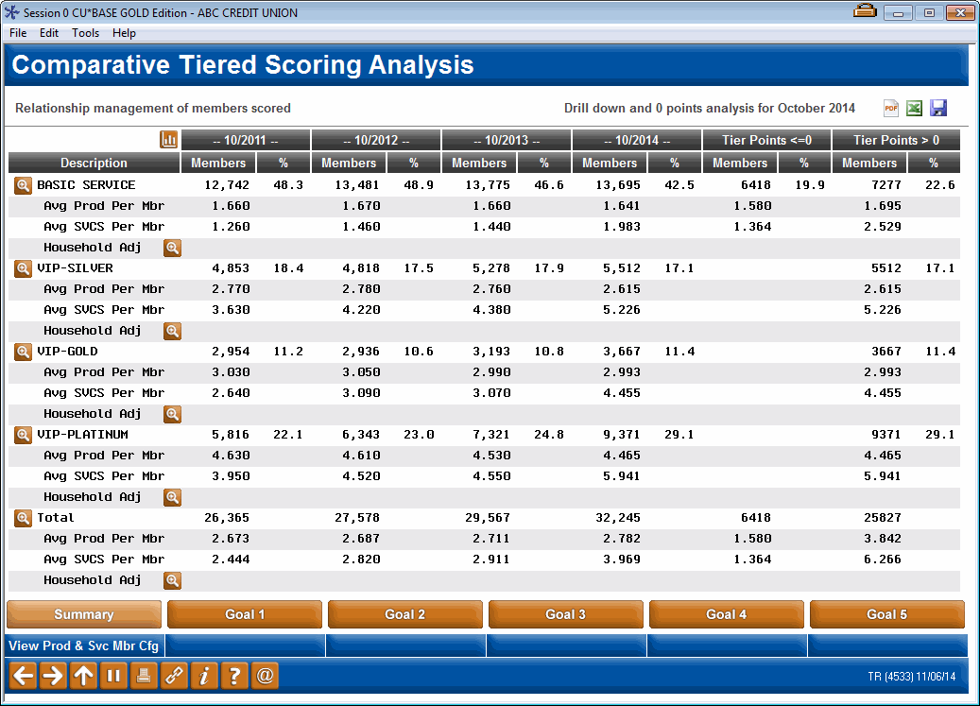
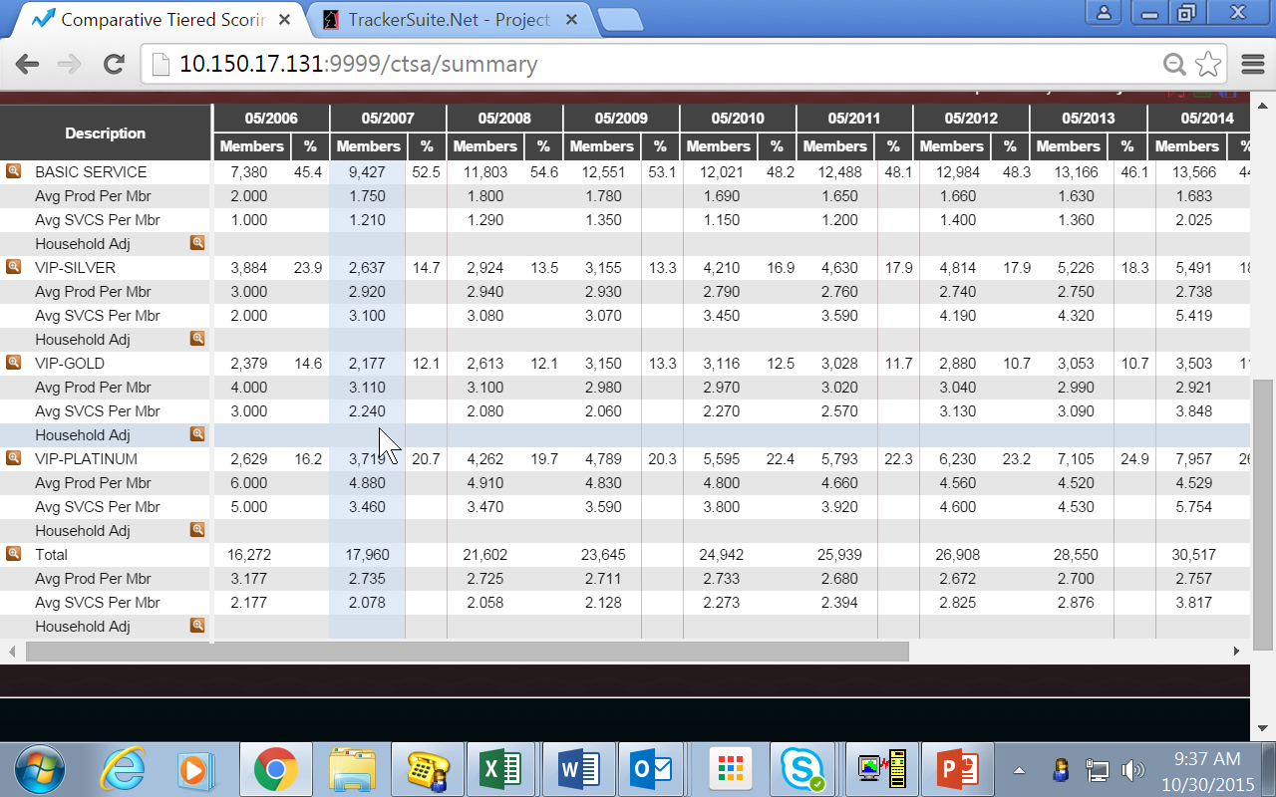
Starting with the Gold Standard for Understanding Data in CU*BASE
Tiered Services Analysis: Relationships and Penetration
CU*BASE
My CU Today Plus

Slide 38
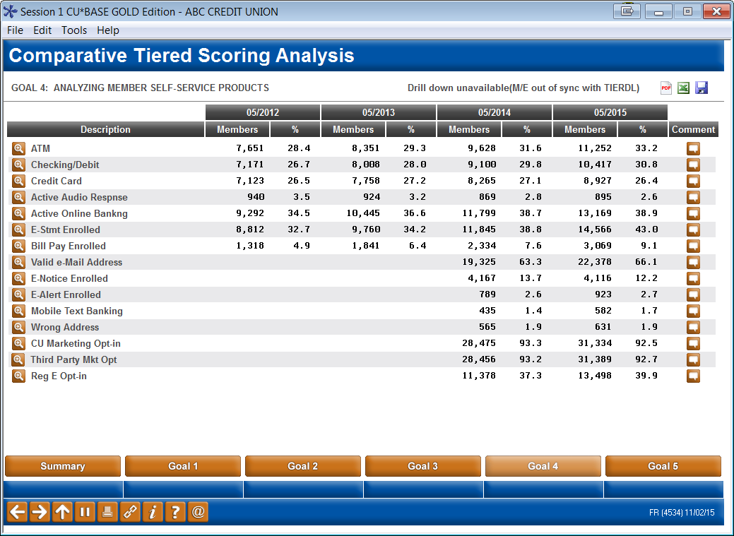
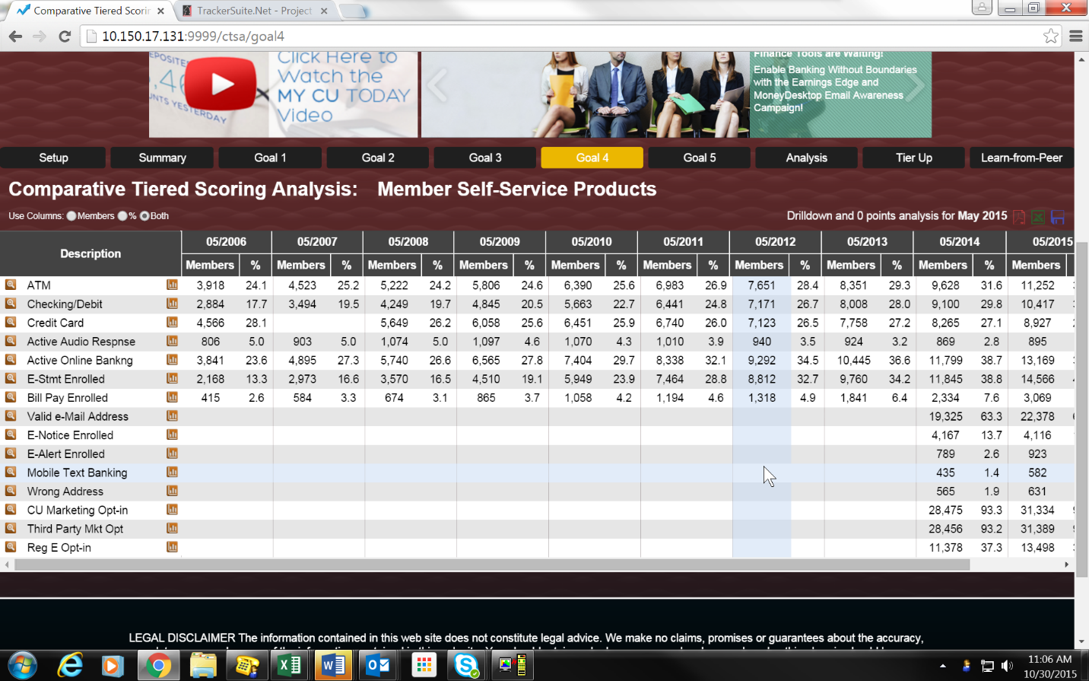
Starting with the Gold Standard for Understanding Data in CU*BASE
Tiered Services Analysis: Relationships and Penetration
CU*BASE
My CU Today Plus

Slide 39
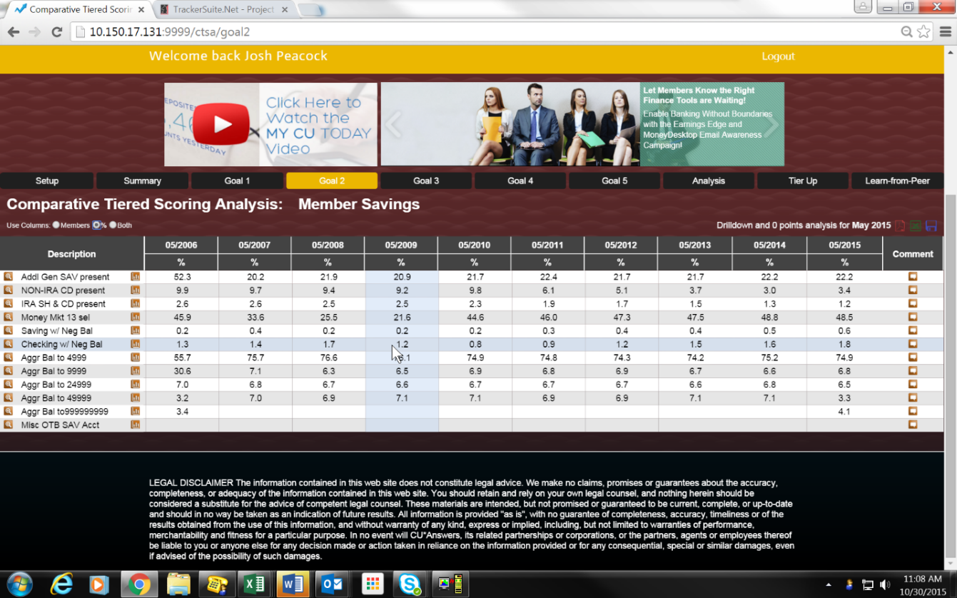
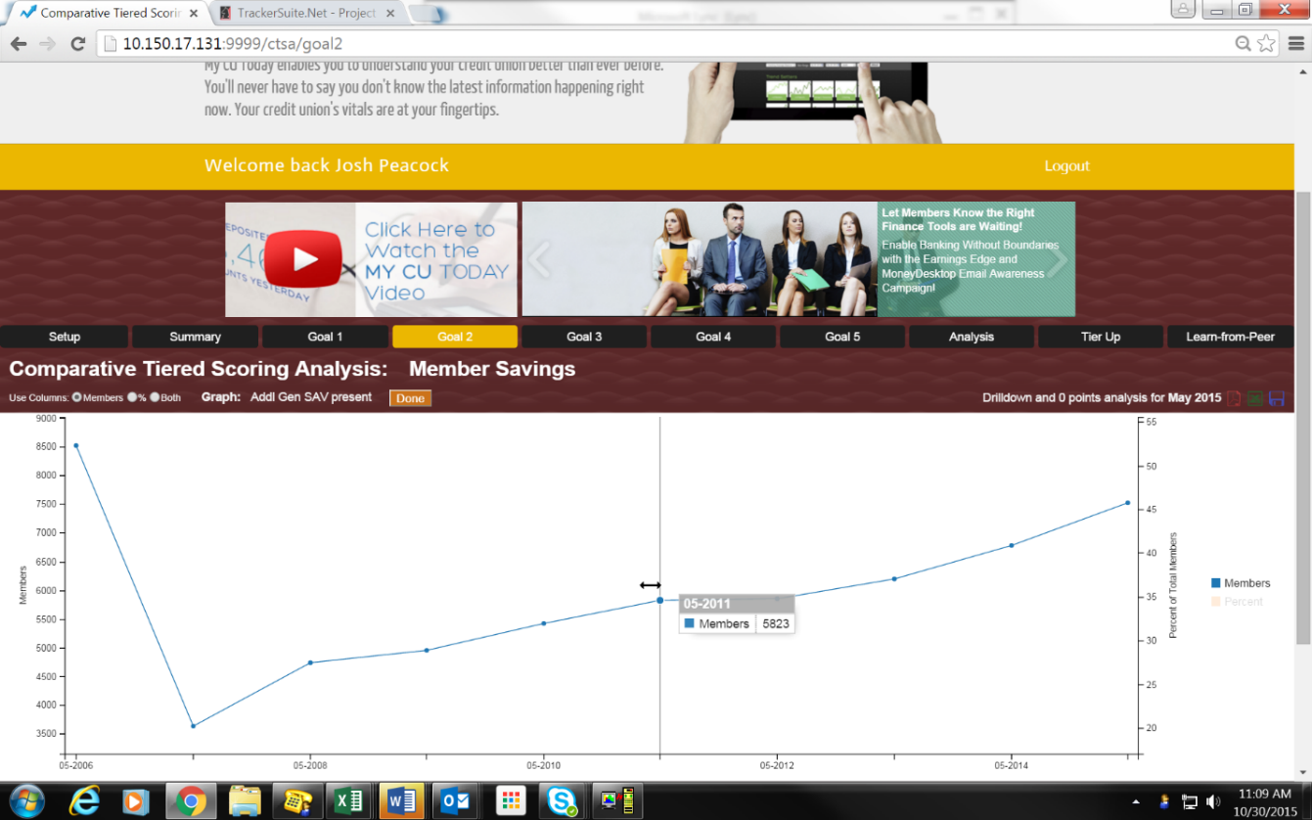
Starting with the Gold Standard for Understanding Data in CU*BASE
Tiered Services Analysis: Relationships and Penetration

Slide 40
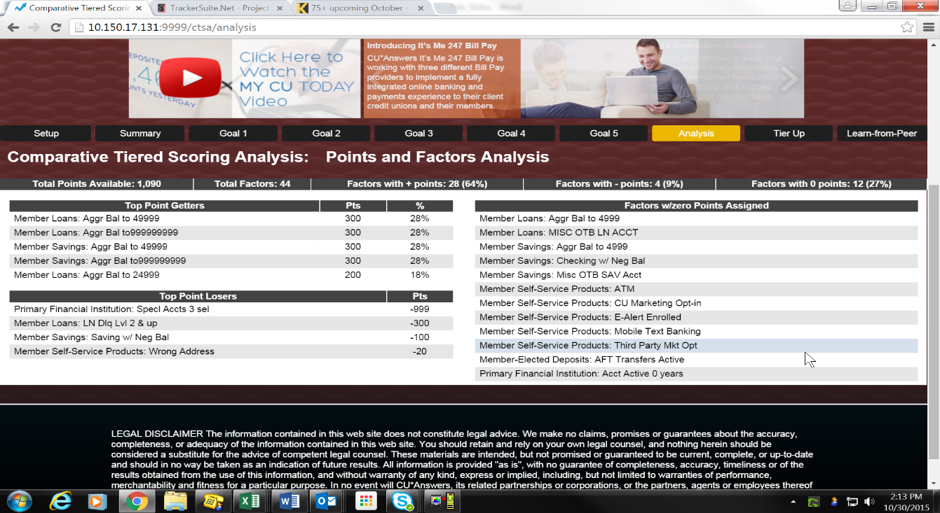
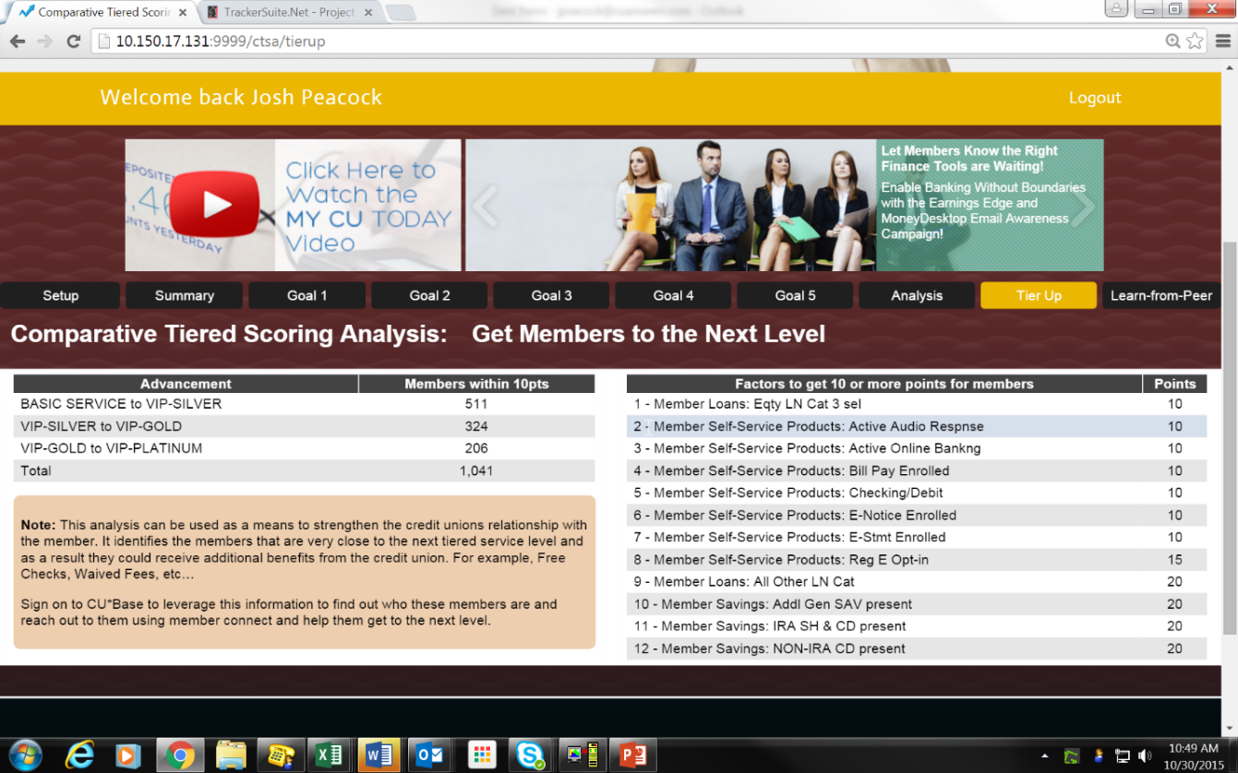
Starting with the Gold Standard for Understanding Data in CU*BASE
Tiered Services Analysis: Relationships and Penetration
Ideas for improving your program

Slide 41
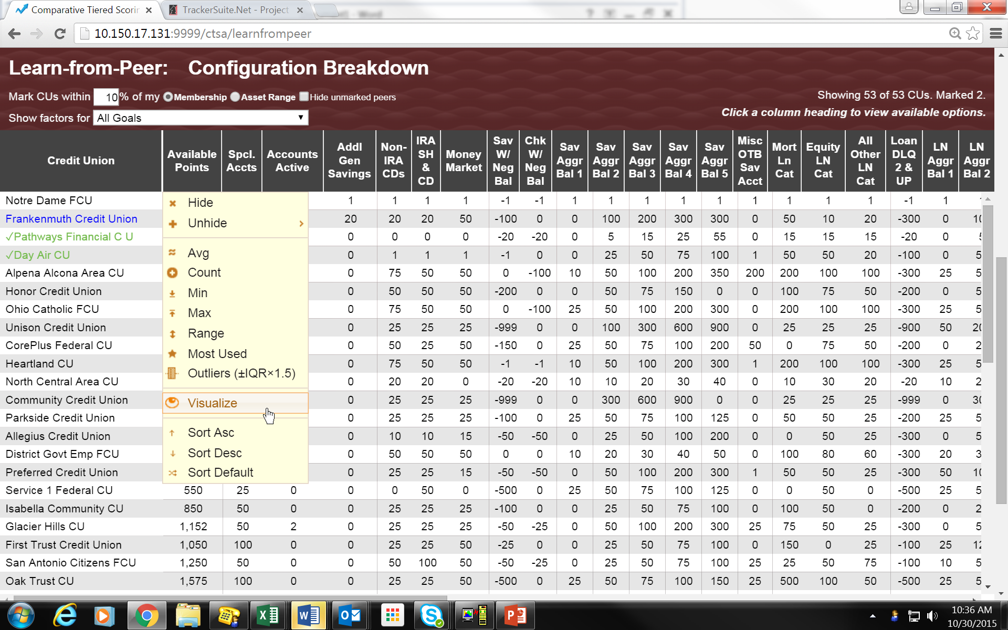
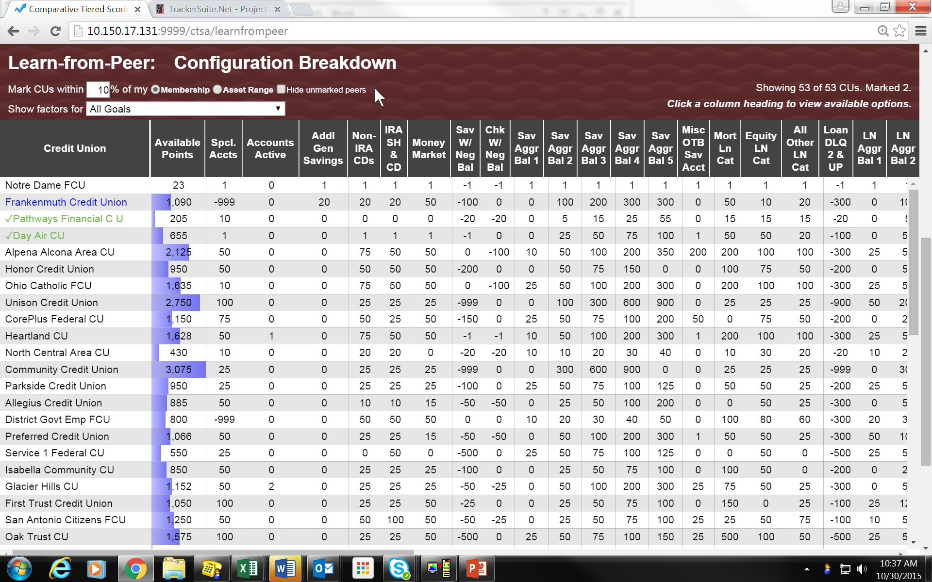
Starting with the Gold Standard for Understanding Data in CU*BASE
Tiered Services Analysis: Relationships and Penetration
Interactive Learn-from-a-Peer Analyses

Slide 42
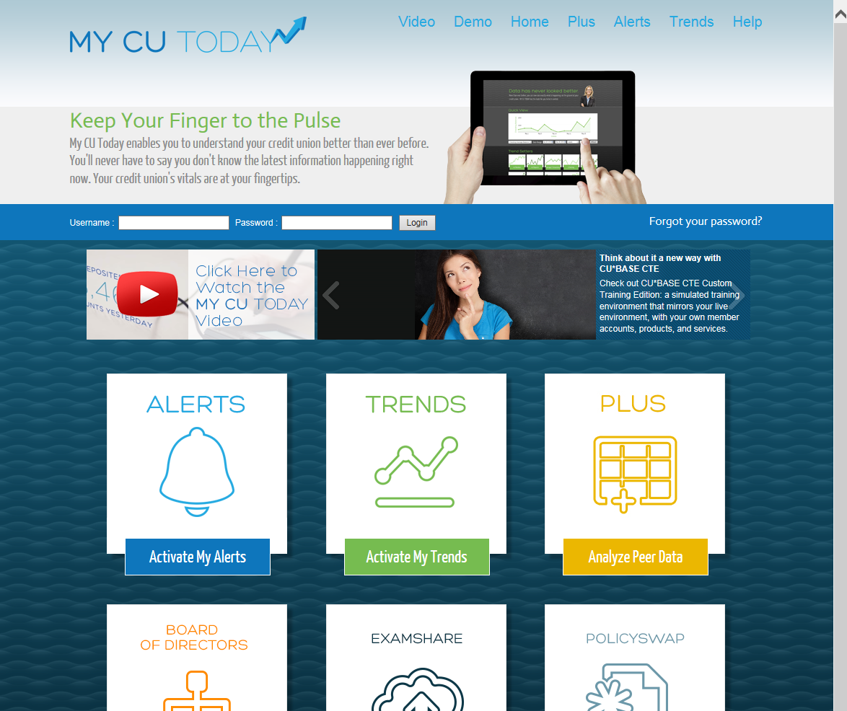
My CU Today Plus: Where do we go from here?
Nominate the next set of CU*BASE insider dashboards that make sense for this new user base
The leading contender: The new budget/modeling/historical dashboards from CU*BASE
Consider the expansion of web tools like My CU Today Plus as the template for browser-based CU*BASE
Should CU*BASE insider dashboards be the first CU*Answers browser-based module? What about the CU*BASE LOS?
What are the priorities for an examiner portal? What CU*BASE tools should we prioritize as the ones we would share with the examination community?
What are the priorities for our Board/volunteer portals? What CU*BASE tools should we prioritize as the ones we would share with our member community?
Imagine a mobile app for interested credit union owners

Slide 43
Examination Innovation We’ve been busy; let’s get an update

Slide 44
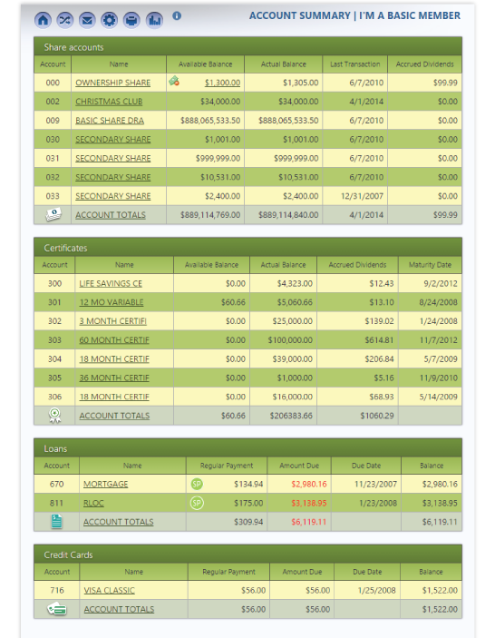
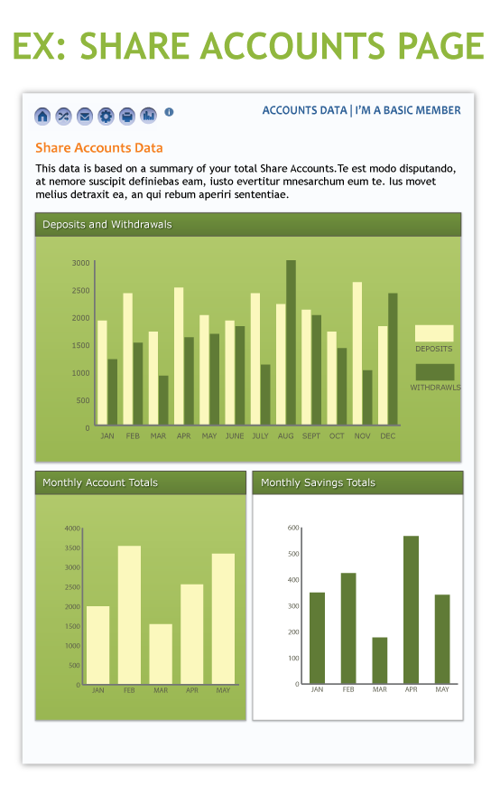
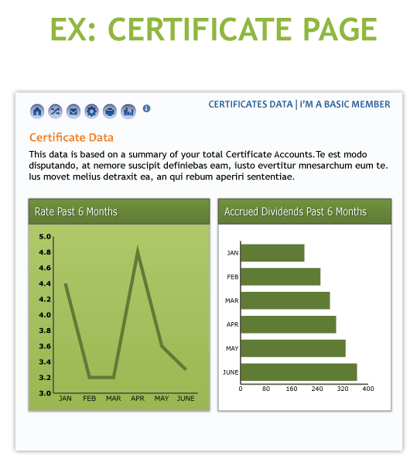
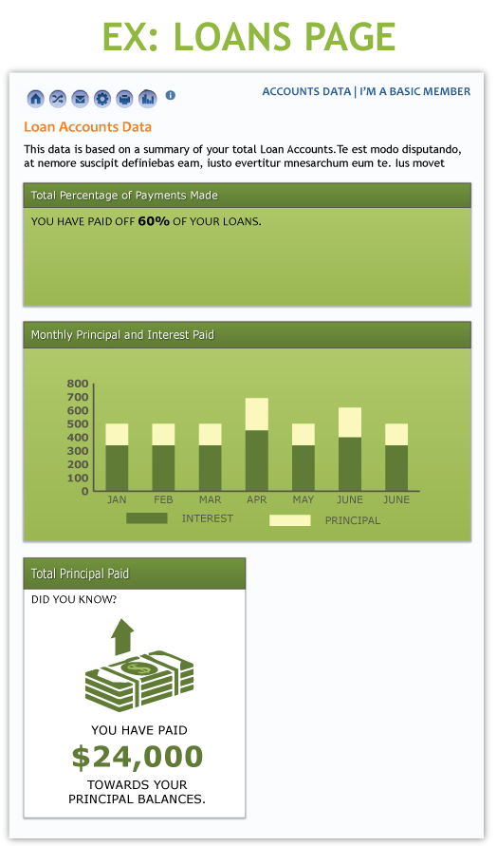
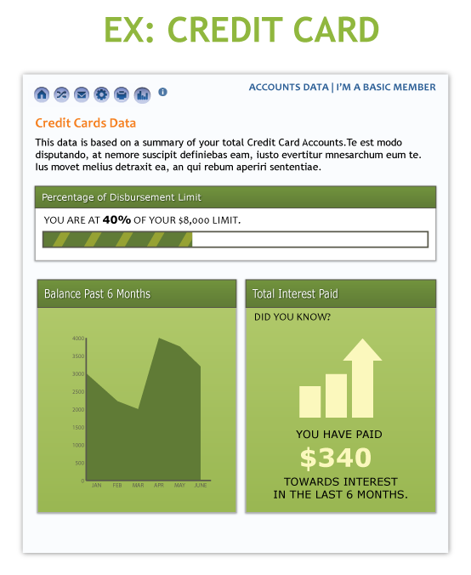
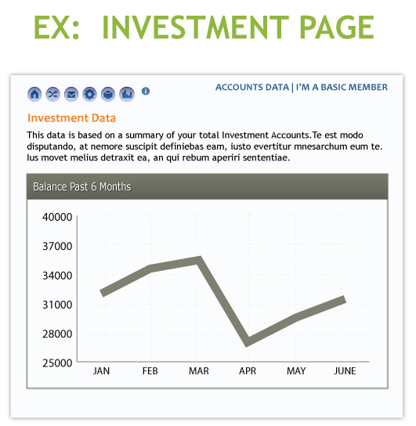
Speaking of It’s Me 247... Core processing data that we should share with members as Personal finance management (PFM) data

Slide 45
How Do You Determine Who Will Engage Your Data?
Is it you? General team members in their daily roles? Or specialists?
CEO School is about raising your awareness about the tools that are available to your organization and business plan
Engaging these tools requires that you be the catalyst to action
My CU Today tools are for you...you on the move, using the devices that executives generally consider standard today
My CU Today tools are for your Board...give them a login ID, give them an assignment, include them in the brainstorming around data, and change their experience
My CU Today tools are for anyone interested in your credit unions...earn the goodwill that comes from being an open book
My CU Today Plus tools are the beginning of marrying informed executives with the day-to-day line staff who use these tools within CU*BASE...team up and do more
You are the catalyst to culture change, but it takes the initiative to force your organization to develop the muscle memory to default to data, to default to automated tools...can you do it?

Slide 46
Building a Collaborative Bench of Data Analysts
Launching a project to crack the riddle that seems to challenge every organization: What to do next with all the data available to us?

Slide 47
Where are we, and where do we go from here?
We’ve done the easy stuff, but the experts tell us we have a long way to go
Ask a targeted question | The toolkits have more ways to ask a question from databases than ever before. They serve more audiences than ever, and have more reach than many of us even want to activate.
See the potential members to contact | The toolkits present answers in more ways than before, but do we see the clues about what to do next as clearly as we should?
Act on the potential with intent: the message with the method | Our network is well on the way to having more shared resources to reach out to members than ever before. Our investments in online retailing will create more virtual contact sites than ever. Will we know what do when members respond?
Profit (you’re on your own here) | While some CUs seem to profit from mastering their data, as a collective can we afford to invest so much and wait so long for people to catch on?
It’s time to activate a network of analysts and drive home the value of our data and the results we can harvest with our members

Slide 48
Have we over-built based on our network’s response?
Our CUs like these ideas, but can they realistically consume these strategies?
Show me something once and you pique my interest
In this economy, anything data intensive sells
In today’s CU industry, CUs feel like they don’t have enough information to win
In our network, we’re not sure we have enough human resources to turn information into knowledge
Show me something as it changes over time and you’ll put me to work!
We have put marketers and outbound campaigners to work, but who else?
We see spontaneous, one-off efforts around data presentation, but it hasn’t become as routine as we’d hoped
There’s debate about the data processing styles but not a lot about the art of analyzing the data
For our network to go to the next level, I think it’s time we get very serious about building a bench of analysts who are focused on the return from analyzing data as their day jobs, more than on selling toolkits

Slide 49
Have we over-built based on our network’s response?
Our CUs like these ideas, but can they realistically consume these strategies?
For you, the question may look more like this:
“For credit unions to go to the next level, I think it’s time they get very serious about building a bench of analysts who are focused on the return from analyzing data as their day job, more than on selling memberships, accounts, or even convenience”
For all of us, the trick in transitioning to new skills and business models is balancing the old with the new
When everyone is so busy fulfilling the current value proposition, can they change and see how a new one might take them to new heights?

Slide 50
Looking for Clues: Executive Study Boot Camp 2016
What Makes Data Valuable?
In 2016 we’ll move beyond our collaboration as CEOs and include some of the most active leaders from credit union executive teams
My goals for this boot camp will be to:
Define realistic roles in credit unions and our network for data analysts and their skills
Design a cooperative business initiative that would allow all of us to share in the benefits of an active bench of data analysts
Initiate profitable activities in credit unions and in our CUSO that require insights from the data and tools we already have
Can we start a race to build dozens of these initiatives? I thought by now many of you would be far ahead of my efforts

Slide 51
Why do I feel this way? Why should you?
Is active beta working?
We never have to fear that there won’t be an active and critical audience of our releases related to lending, EFT, ACH, or teller posting – there’s a focus
We’ve yet to achieve the same focus and constant attention to analysis from the user base
Things linger in Active Beta far too long
How many of the things that have come out in Active Beta have you mainstreamed into your daily operations?

Slide 52
Why do I feel this way? Why should you?
New data is being created...just solutions looking for a problem?
Let’s take another look at the Net Relationships dashboard
Management Processing/Active Beta Tests menu (MNMGMT) #22 “Net Relationships Dashboard”

Slide 53
Why do I feel this way? Why should you?
Trending engines...is it worth our time?
Now let’s look at Concentration Risk Analysis
Do you define segments?
Do you trend segments?
Do you do it consistently?
Management Analysis Dashboards 1 menu (MNMGMD) #17 “Ln Portfolio Concentration Risk”

Slide 54
Why do I feel this way? Why should you?
Trending engines on the way
Coming in 2016: Loan Static Pools Analysis
Identifying pools of accounts for consistent analysis over time
Automating data snapshots that create trend lines
New presentation tools for trend analysis
New options for where the data lives
Imagine that you create three different static pools from your loan portfolio every year, and you trend each pool with quarterly snapshots for three years...at the end of 5 years, you will have 15 pools with over 160 time slices
Who is going to do the work, report, and get a yield from this investment?

Slide 55
Why do I feel this way? Why should you?
The potential to earn from reporting on the forest (learn from a peer)
We’ve built several processes to pull data from CUs (the trees), no matter which system they’re on, and present them for analysis as a network (the forest)
We have yet to put a dedicated resource on these tools, to deliver the value to our community...potential yet to be realized
Harvester is coming...
Notes:
Change to 50 > Enter > Enter > F9
Liblist:
0
10 QTEMP
20 PROJ40349F
30 TESTBT
40 TESTBTE
50 PROJ40349
60 CUBASEPTF
70 CUBASE
80 CUBASEFILE
90 CUBASEQ
100 OPERATOR
110 QGPL
120 WESCOSUPP
130 WESCOSUPP2
140 OPERWDW

Slide 56
Why do I feel this way? Why should you?
We haven’t forgotten about Optics
We can design more to trap the data we need
Credit scores are about attracting borrowers
If we design data as optional to sell to an audience of data analysts, will anyone buy it? If no one buys it, should we design it?

Slide 57
Why do I feel this way? Why should you?
THERE IS AN APPETITE FOR DATA WAREHOUSES THAT EXCEEDS THE APPETITE FOR DATA ANALYSIS
What: Data Investment Symposium #2 A cuasterisk.com network brainstorming & strategizing session
When: Wednesday, February 24, 2016 12:30p lunch, 1:15-4:30p ET
Who: Credit union leaders focused on developing analytical approaches for credit union data, starting with CU*BASE
Where: CU*Answers Learning Center 6000 28th Street Grand Rapids
Mark your calendar!
Your employees sense your data analysts need more than core data – should you build it alone, or should we change our priorities as a collective?

Slide 58
A Glimmer of Hope: Database Search Assistant
New in the 15.2 release!
Read a summary with tips about how the data is used by CU*BASE
See what pieces of data are in this data table
CU*BASE Report Builder 1 (MNQURY) #2 Database Search Assistant

Slide 59
Why I Want to Spend Big Bucks to Build a New SRS
Because the automation of what we know is the key to a bright future
If we want to revolutionize our response to member needs, we need for our processes to respond more quickly to what data means and to what we can do with it
Who to market to, and how
Who we’re doing business with, and how to protect ourselves (abnormal activity databases)
How to adjust our model to fit our members’ changing lives
How to streamline processes to improve the employee and member experience
How to respond effectively to examiners and auditors
How to involve the customer-owner in the businesses they own
How to extend our value proposition through virtual networks, anywhere and at any time
How to earn more with less, move faster at a lower price, and improve our chances of long-term survival
In our guts we know that finding a way to use data more effectively in the future is the key to that future...are we spending enough today to ensure we find our way forward?

Slide 60
Why I Want to Spend Big Bucks to Build a New SRS
This is not a build-or-buy challenge
Either way, you must invest to consume data, field a team that will use it, and learn from using it if you want to succeed in the future
Let’s build a network of accomplished practitioners
Because the automation of what we know is the key to a bright future
If we want to revolutionize our response to member needs, we need for our processes to respond more quickly to what data means and to what we can do with it
Who to market to, and how
Who we’re doing business with, and how to protect ourselves (abnormal activity databases)
How to adjust our model to fit our members’ changing lives
How to streamline processes to improve the employee and member experience
How to respond effectively to examiners and auditors
How to involve the customer-owner in the businesses they own
How to extend our value proposition through virtual networks, anywhere and at any time
How to earn more with less, move faster at a lower price, and improve our chances of long-term survival
In our guts we know that finding a way to use data more effectively in the future is the key to that future...are we spending enough today to ensure we find our way forward?

Slide 61
Wrap-up

Slide 62
Also in your packet...
Are you tracking the It’s Me 247 bill pay rollout? Keep an eye on the Kitchen
Have your members ever asked you to email them a receipt? You can, for FREE – so why haven’t you turned this on?

Slide 63
Join us!
After you leave here you can participate online for the balance of the year
Dashboard Dives
Active Beta Study Group
http://study.cuanswers.com
Notes:
Click on the picture to go to that URL

Slide 64
Thanks for the day!
Question #1:
Have you implemented processes with your executive team or Board to use My CU Today as an active tool for general awareness, brainstorming sessions, or your leadership regimen?
Now to get ready for tonight’s networking session...
Question #2:
Have you developed a job description and a budget for a data analyst to work directly with your team? If the CUSO had a shared resource solution for data analytics (much like SRS Bookkeeping), name 1-3 things you might purchase from this new service.
Cocktails begin at 5:00!

