Slide 1


CEO Roundtable
THURSDAY
Focusing on CEO-to-CEO Brainstorming
2015
CEO Strategies

Slide 2
Welcome to the 2015 CEO Roundtable
A new format and a new chance to take our networking up a notch
Today’s Agenda
Welcome message from our new CU*Answers Board Chair, Scott McFarland
  Changes on the CU*Answers Board of Directors
  Hint at the 2015 dividend checks
  Kicking off the 2016 business year
Introducing today’s Roundtable event, Randy Karnes, CEO
  Discuss the format
  Introduce the scribes
  Ready the teams to make group presentations for each topic
Wrapping up 2015 CEO Strategies Week

Slide 3
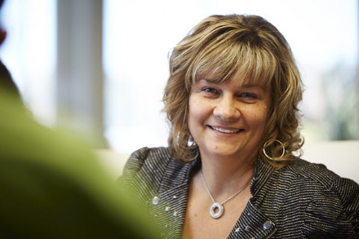
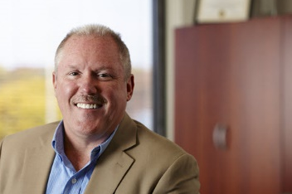
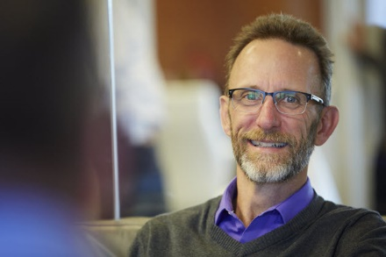
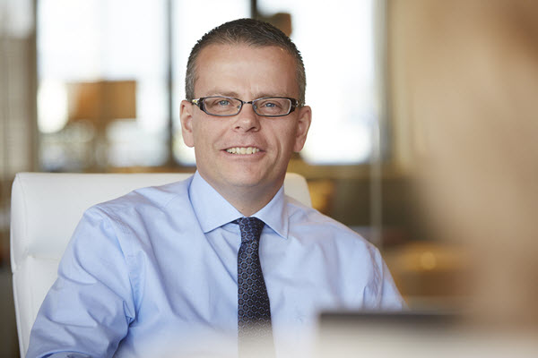
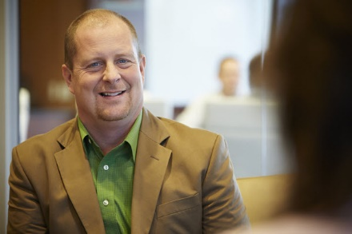
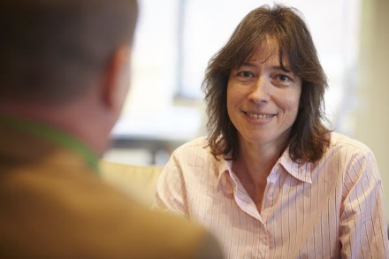
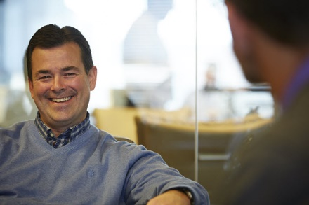
Your 2015 Board of Directors
Vickie
Schmitzer
Chris
Butler
Jeff
Jorgensen
Don
Mills
Scott
McFarland
Linda
Bodie
Dean
Wilson

Slide 4
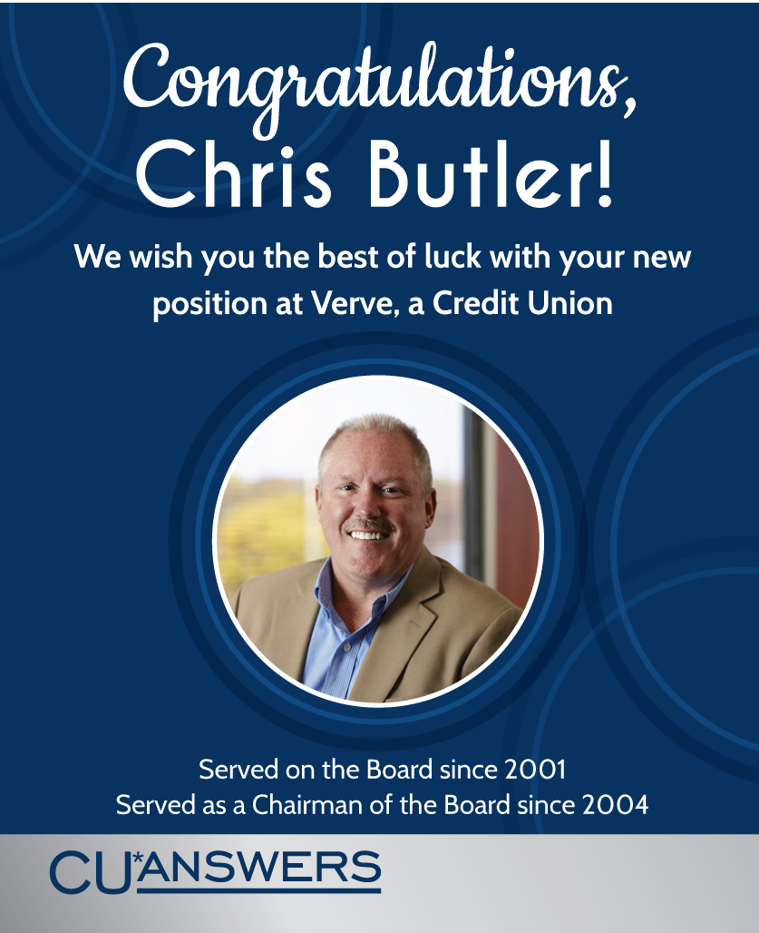
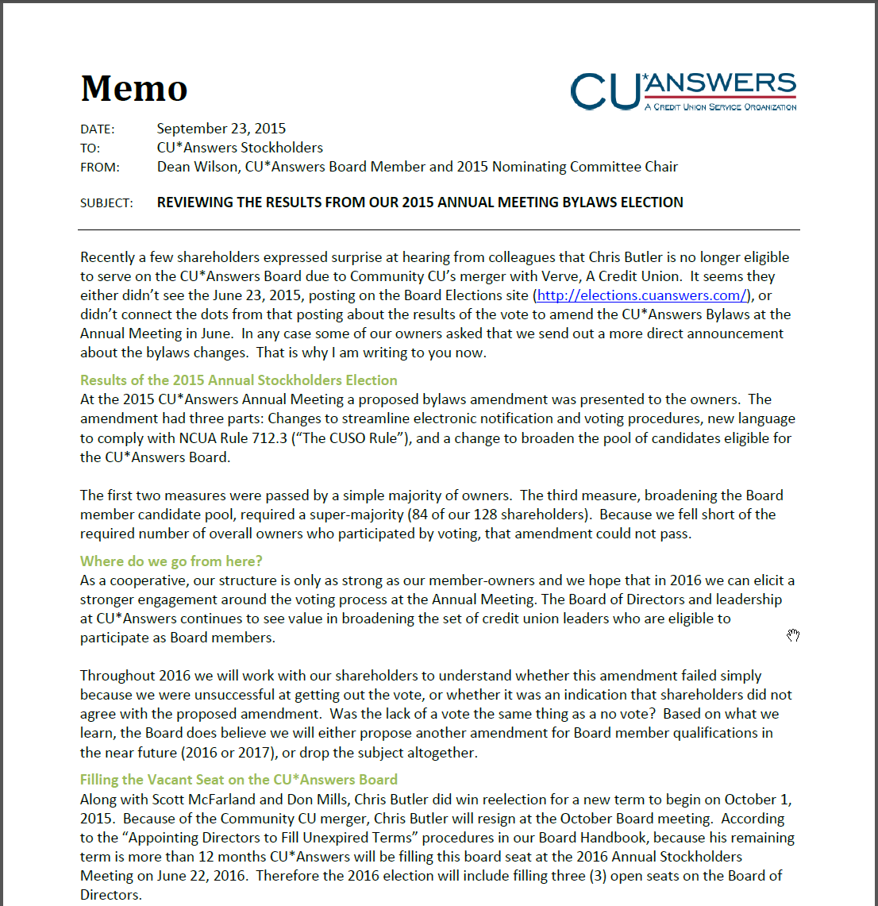
The 2016 Board election next June will now include 3 open seats

Slide 5
Your 2016 Board of Directors
Congrats to Scott McFarland, our new Board Chairperson
Vickie
Schmitzer
Jeff
Jorgensen
Don
Mills
Scott
McFarland
Linda
Bodie
Dean
Wilson

Slide 6

A Hint on This Year’s Numbers
The board’s instructions to our cpa for closing the year
Declared 2015 Patronage Dividends:
  $ 1,000,000 Standard Patronage Dividend
  $ 1,500,000 Bonus Patronage Dividend
  $ 2,500,000
  $ 560,000 Ownership Dividend
  $ 3,060,000
  Year #5 for a Bonus Patronage Dividend
Projected Stock Dividend: 4.00%
Projected Increase in Stock Equity: 7.12%+
All are projections to be finalized by our CPA in December...then look for a check!

Slide 7

It’s Been a Great Year...
...now on to 2016!
In August, the BOD approved the 2016 Business Plan and Budget
  This marked the end of our 2016 planning season, and now we’re on to executing the plan – our new year started 10/1/2015
Today’s event is the first in our planning season for 2017
  Think about 2017 planning when you are in your roundtable group discussions throughout the day today
  There are many more events planned for 2016, as part of our 2017 planning season – from our Board meetings to focus groups to all of our education contacts
The next major event is our Leadership Conference
  June 21-23, 2016 – mark your calendars!
We truly appreciate your participation, and respect your dedication in leading this cooperative

Slide 8
Time for some roundtable brainstorming...

Slide 9
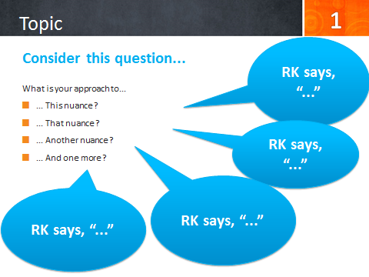

Here’s how it will work:
4 questions: 1 hour each
Introduction by Randy | 10 minutes
Brainstorming with group | 30 minutes
Recap / summary report from 1-3 groups | 20 minutes
Topics 1, 2 & 3 will be before lunch (12:30p), then Topic 4 after lunch (1:30p)
Scribes will take notes for your group
  Notes from all groups will be posted by Nov. 20th on the CEO Strategies website
Choose a spokesperson from your group to give a summary report
These are intended to spur conversation . . . Randy’s not always right!
Get ready to switch tables after lunch

Slide 10
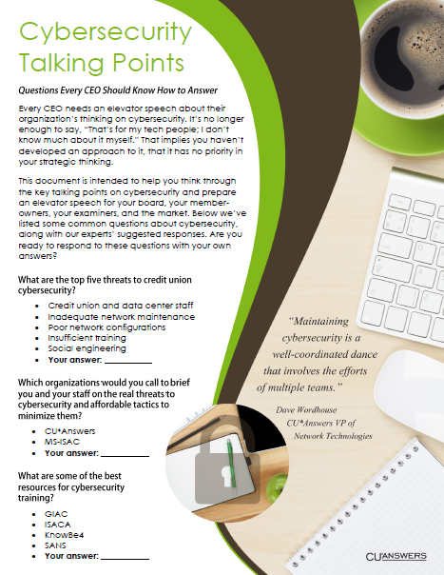
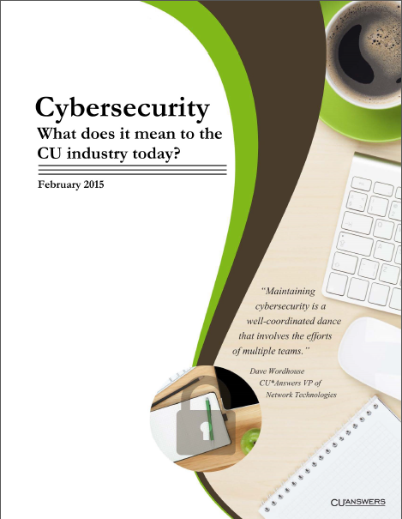
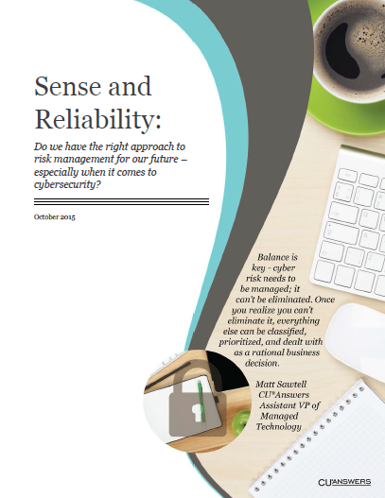
Taking the Lead in Assuming More Cybersecurity Risk
The majority of CU prognosticators predict that for credit unions to be successful in the future, they must become more active as online retailers
This means credit union leaders will have to navigate even more cybersecurity risk in the future
What keeps you up at night as you plan to take your credit union into a new, more hostile environment?

Slide 11
Taking the Lead in Assuming More Cybersecurity Risk
1
RK says, “Necessity is the mother of invention. A CEO has to find the middle ground between members who are totally unaware and the security nuts that would have us do nothing.”
Let’s discuss the leadership quandary in pushing an organization to take more risk for its success:
How do you balance the compelling need to operate in a hostile environment against all of the commentators who think you have other options?
Can you balance the need to be proactive in the cyber marketplace against the risks? Will people follow you?
Can you afford to ensure against the risk (risk mitigation), and can you inspire the confidence to move forward?
Will the expense for the perceived risk doom the opportunity?
RK says, “It’s not hard to imagine that this generation of consumers will follow you. But how do you hedge against examiners and risk managers who go off to big, scary trade events preaching doom and gloom?”
RK says, “What is the difference between insure and ensure? How do you keep up and give your organization the confidence it needs to find in your grasp of the situation?”
RK says, “By striving for a perfect world with no perceived holes in your plan, will you price yourself out of business?”

Slide 12

Self-service vs. Online Retailing
For years, CUs have thought of virtual channels as the place for convenience, where members can take advantage of self-service options that fit their lives
Self-service concepts have dominated the designs on online banking and mobile solutions: quick, down and dirty, no fuss, no muss
But as CUs look to the future and they have to make a buck via virtual channels, how will you rethink your goals for earning from online members?

Slide 13
Self-service vs. Online Retailing
2
RK says, “You have the chance to build a 10+ virtual branch network for yourself where you could never have built 10+ physical branches. Will you act?”
Discuss the chance to build a robust virtual branch network for your credit union: virtual opportunity sites that reach out and sell your capabilities beyond the brick and mortar of old networks.
Can you wrap your head around the fact that you might need 25 websites or landing pages in the future, to speak to 25 virtual communities like you serve physical ones today?
Can you envision collecting mobile apps and building a suite of offerings, instead of a single one? Can you see yourself like Amazon.com, stuffing your shelves with the things people want, as much as the things you feel compelled to sell directly?
Do you see the need for a help desk to build a different future?
RK says, “Today’s consumer has a try-it-then-throw-it-away attitude about mobile apps. Is that the future for financial service apps as well? How many products will you sell in your virtual channels on the way to being your own version of Amazon.com?”
RK says, “Your employees are used to calling CU*Answers as users. If you go crazy in building a virtual store, what kinds of service responses will you need from cuasterisk.com?”

Slide 14



The Transformation of In-Person Service Models
It’s not enough just to talk branch transformation, even though that’s huge
It’s really about how you deal with members when you’re not present, face to face (opening memberships, completing a loan application, cash services, etc.)
How do you plan to redesign your member service processes for the future?
  Document transfer, remote closings, following up with leads, web chat, text, FaceTime, Skype, telepresence...everything seems to be screaming for new skills and new approaches
  Do you have a timeline for getting started?

Slide 15
The Transformation of In-Person Service Models
3
RK says, “It can be tricky when you don’t have enough repetition to burn in new processes – like electronic signature closings. How are you training your staff for the new things that still don’t happen often enough to create good habits?”
Discuss how person-to-person service is changing in your world. Can you be a retailer of solutions and a capturer of virtual opportunity?
The problem with transformation is the need to be half in the old game and half in the new one. How do you afford it?
Sometimes what is “cool” is not profitable. Sometimes what is popular doesn’t end up paying the bills. How can we afford to transition to new models that don’t appear to have good financial foundations?
It’s quickly becoming a call center world, and not for answering questions but for closing the deal and fulfilling a member’s needs in a new way. Do you have the plan to transition your investments? When will you begin?
RK says, “In a ‘you must do everything’ world, some new services are simply so scale-dependent that you can only do them cooperatively, in a network. How do you tell your team you have to go outside the CU to fulfill a new service?”
RK says, “Everybody talks about transitioning old investment models so they can use those funds to build new solutions. Easier said than done. Do you have a game plan?”

Slide 16
Time for lunch!
Be back at 1:15pm – and remember to choose a different table!

Slide 17
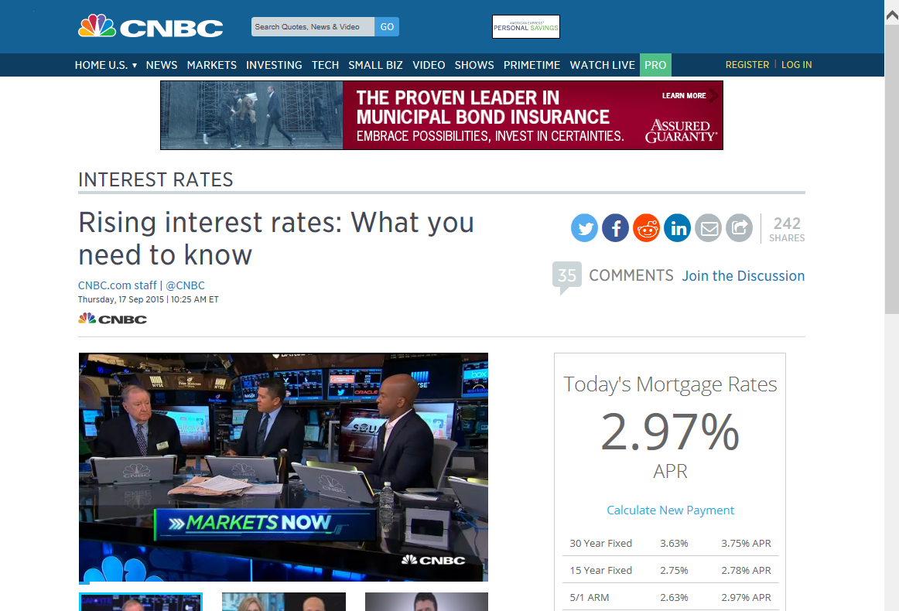
Rate Shock: Are Members Ready?
It’s been almost a decade since consumers even had to consider what rising interest rates might mean to them – are consumers ready for loan rates and mortgage rates to actually play into the decision of when to get a new car or buy a home?
More than economics, how do you see your members reacting to the realities of a new, more active rate environment?
More importantly, is your financial modeling ready to shift into gear after such a long, stagnant, ho-hum rate landscape?
Liquidity looms large, quick increases in cost of funds could be a reality – do you expect 2016 to be materially different from the last five years?

Slide 18
Rate Shock: Are Members Ready?
4
RK says, “We all talk about rate increases as professionals, but what do you do with a generation of members that cannot remember a 12% mortgage?”
Discuss the possibility that the psychology for members facing a rising interest rate marketplace might be more of an issue than dealing with the financial realities for your credit union.
“I have to pay WHAT for a loan?!? I can’t remember the last time I even thought about the interest rate when considering if I could afford something.”
“I thought rates were going up. Why are savings rates still so flat? I hear about reward checking – why don’t you have it? How about bumping the rate on my certificates?”
How are you going to market your products in a transitioning financial environment? Are you ready to dust off specialty products like variable rate loans and creative savings rate models? How are you going to sell when the price of things is going the wrong way?
RK says, “Advertising a great savings or loan rate is an imperative in a rising interest rate market. But increasing rates across the board will put you out of business. How are you going to effectively market products for a rate-sensitive membership?”
RK says, “Don’t suffer narrowing margins because you won’t get creative and market specialty products. Expand your offerings before you have to tighten your belt to transition new expectations.”

Slide 19
Wrap-up

Slide 20
Redefining Yourself Only Takes the Will to Do So
On one hand, it seems like the world is changing at the speed of light
On the other, if you just hang with the same members, doing the same things every day, it all feels pretty much the same
You can fool yourself into thinking the world is changing everywhere else, just not here at home – until you wake up and figure out you’re standing pretty much alone in an empty room
This week we’ve been in crowded rooms, talking with a lot of people about how they see the need for change, and at what pace
Don’t go home and fall right back into that groove that makes you think you can put off tough decisions, challenging projects, and facing the future as an enthusiastic leader
Is our industry’s consolidation a dynamic, positive solution to tough challenges, or simply the result of too many people waiting too long to reengineer a model for the future?

Slide 21
Thanks for the day!
...and for the week!

