Slide 1
Welcome!
September
22 & 23
Thanks to site-four for hosting our event today

Slide 2
Today’s Agenda
Introductions
Our Network of Self-Processors
IBM Review
Production Center Review
Best Practices
CU*BASE Update
High Availability, Production Redundancy and Business Continuity
What’s on the Horizon?
Wrap-up

Slide 3
Introductions
Let’s warm up your vocal cords. Give us your:
Name
Title or position
Credit Union or CUSO
City and state
What new items did you put in your 2015 budget directly related to your IBM investment or your Operations Department?
What’s on your mind?
What is your biggest pain point you have that we might help with?
What is something you want to learn today?

Slide 4
Our Network of Self-Processors

Slide 5
Our Network of Self-Processors
Profile of our peer group
14 Data Centers
7 States – Wisconsin leads with 36%
26 IBM i Systems in our extended network
Potential growth
New self-processor converting in 2015
Potential new multi-processor in the Northeast in 2015/2016
CU*Answers is upping our game in order to improve and increase in-house business!

Slide 6
IBM Review
Facilitator: JODY KARNES

Slide 7
Our Commitment to IBM i CU*Answers visit to IBM Labs in Rochester, MN
Bi-annual visit to IBM Briefing Center in November 2013 by CU*Answers executive and technical leaders
Briefing from IBM on new technologies, future direction of software and hardware, and their commitment to the platform, as well as a discussion on our current and future challenges and opportunities
Highlights and key discussion areas
Database Modernization - building business rules into the database
Performance monitoring – identifying areas for improvement (i.e. applications, database access, system configurations)
Application Evolution – using newer options, tools and strategies (i.e. mobility: write code once, deploy to any platform)

Slide 8
Our Commitment to IBM i CU*Answers visit to IBM Labs in Rochester, MN
Highlights and key discussion areas (continued)
Web services – allowing connections to external points
Flexible data masking – conditional security (available in O/S 7.2)
Business Analytics and Business Intelligence – what else can we do with CU*BASE dashboards, big data, predictive analysis
Security – continued focus and concentration on tools, audits, monitoring, and responsiveness
IBM Briefing Center visits are a critical component of our strategic technology planning

Slide 9
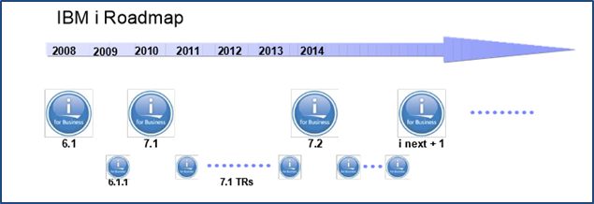
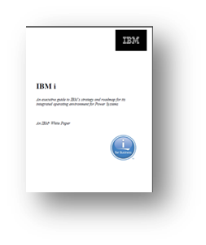
IBM Review
IBM i Announcements
POWER 8
O/S 7.2
Recertification of Sales and Technical skills
Strategic Direction thru 2025
What are we researching?
Data replication – what other options are available?
Flash drive technology
Data recovery (point-in-time) solutions
Shared HA

Slide 10
Managing and Maintaining Your IBM i Investment
System Maintenance
IPLs and PTFs – coordinated with i-Plan team
Management of licensed products handled by i-Plan team
Health Checkup – Monthly i-Plan reports
Who reviews?
Recorded?
O/S Upgrades
V7R2 announced April 2014
CU*Answers estimating to upgrade in 2015 primarily based on needs from development folks
The i-Plan team will contact you to schedule your upgrade dates shortly thereafter

Slide 11
Production Center Review
Facilitator: Jeff miller

Slide 12
Introducing
What is OpsEngine?
It is a suite of products, services and people to help turn business strategy into business execution at the production level
Why OpsEngine?
Upping our game and commitment to the in-house marketplace
It is the Production Center at CU*Answers focused on making your data center a business priority
Who is OpsEngine?
(Hint, it’s not just Lora and Jack anymore...)

Slide 13
Introducing
Who is OpsEngine?
Jack Carpenter, VP of Production
Jeff Miller, Production Business Development Mgr.
Darrell Stickler, Asst. Mgr. Software Development, Production Team
Paul DeConinck, Programmer: Production Team
Lora O’Connor, Programmer: Production Team
Phil Plomp, Programmer: Production Team
Don Ponozzo, Programmer: Production Team
Todd Underhill, Production Center Operations Mgr.
The Operations Team (10)
Todd Wolcott, iSeries Administration Manager
Brian Walters, iSeries Administrator
Jim Smith, iSeries Administrator

Slide 14
Introducing
Who are our clients and our prospects?
Online Credit Unions
In-House Credit Unions (Self-Processors)
Service Bureaus / Data Centers
Group Providers
Credit Unions Service Organizations
Non-Network Businesses (potential new business line)
Let’s explore the three key components of OpsEngine: Production, Tools and Services

Slide 15
OpsEngine: What it’s about
PRODUCTION
TOOLS
SERVICES

Slide 16
What should be in your shopping cart today?
ASP Production Services | Standby Remote Operations | ACH Continuity Partnering | CU*Archive Services | Full Remote Operations | ACH Partner Processing | CU*BASE Operator Edition
Data Center Toolbox | OpsEngine Automation Suite | DefenseMD | DefenseDB | Firewall/ iShield Security | OPER Audit | Performance Management Toolkit
 | i-Plan | Automation Support | Production Programming Services | Processing Audit/ Workflow Review | Backup Assessment
 |  | OpsEngine Training | IBM-i Systems | BCRS Products and Services
 |  | Xtend Services | Document Imaging Solutions | CMS / CNS

Slide 17
OpsEngine: PRODUCTION
Using Production Center Resources to execute for you

Slide 18
OpsEngine: PRODUCTION Using Production Center Resources to execute for you
ASP Production Services (Operations)
Daily processing for over a 150 credit unions
Clients: CU*Answers
Why does this matter to you?
Processing at this scale has given us the expertise and understanding to assist you.
Demonstrates our ability to handle your business effectively, consistently, and securely on a larger scale.
Standby Remote Operations
OpsEngine is your backup Operator: they have your run sheets, are trained on your nightly processing, and fill in for your operator when needed
Cover vacations and emergencies, part of your business continuity plan
Participants: 1

Slide 19
OpsEngine: PRODUCTION Using Production Center Resources to execute for you
ACH Continuity Partner (previously known as Buddy Bank)
Acquire your ACH files in recovery situations
Part of your BCRS plan
Participants: 10
ACH Partner Processing
OpsEngine becomes your morning FRB operator
Would your members like access to their ACH monies before your operator gets to work in the morning? ACH files are received and processed before your staff even arrives
Participants: 2

Slide 20
OpsEngine: PRODUCTION Using Production Center Resources to execute for you
CU*Archive Services
Store archival data to storage media
Reports, Member, Credit Card and Mortgage Statements, Teller Receipts, Taxes
Participants: 4
Full Remote Operations
Production Services applied to your business.
OpsEngine is your IT Operator, running your CU*BASE back office processing

Slide 21
OpsEngine: TOOLS
Leading edge products to augment and enhance your data center operations

Slide 22
OpsEngine: TOOLS Leading edge products to augment and enhance your data center operations
OpsEngine Automation Suite powered by HelpSystems Robot
Optimized End-of-Day/Beginning-of-Day processing lets you end your day and let your system do the work of nightly processing
System message and resource monitoring catches issues as they arise
E-mail alerts keep your team on top of the system even when you are away from your desk – or your office
Participants: 8
DefenseMD powered by Townsend Security Alliance Encryption
Tools to encrypt media (tape backup data)
Ensure privacy and security of member data off-system
Participants: 12

Slide 23
OpsEngine: TOOLS Leading edge products to augment and enhance your data center operations
DefenseDB powered by Linoma Crypto Complete
Tools to encrypt plastic card data at rest (on disk)
Meets PCI compliance requirements
Ensure privacy and security of PANs, even for CU employees
Participants: 4
i-Shield Security powered by SeaSoft Firewall
Controls uploads and downloads of data from core system
Helps prevent system intrusion and data theft
Daily and monthly activity reports for use by internal/external audits
Participants: 3

Slide 24
OpsEngine: TOOLS Leading edge products to augment and enhance your data center operations
OPER Audit powered by SeaSoft iSecurity Audit
Provides real-time monitoring of system related activities
Initiates responses to potential threat
Examples: Repeated failed sign-on attempts, system value changes (i.e. password controls, system date/time)
Participants: 2
Recover Now! powered by Vision Solutions
Allows restoration of data to previous point in time
Tool has been sunsetted; CU*Answers looking for similar product

Slide 25
OpsEngine: SERVICES
Assorted support, training, education and planning opportunities

Slide 26
OpsEngine: SERVICES Assorted support, training, education and planning opportunities
i-Plan
Comprehensive support plan for your system
Data replication monitoring and management
OS release and PTF management
Participants: 11
Automation Support
All the “under-the-hood” support and upkeep for your automation suite
Configuration changes and application updates, job and resource monitor maintenance
Calendars, date objects, OS/Release/System Maintenance support, license updates
Participants: 8

Slide 27
OpsEngine: SERVICES Assorted support, training, education and planning opportunities
Programming Services
Sometimes you just have to do things your own way; that’s where customized process programming comes in
Adapt CU*BASE GOLD processes and custom jobs to automation
Change a process to fit your environment
Processing Audit / Workflow Review
Have you ever wondered if you are working as effectively as you should be? What standards and best practices should you be using?
Engage our experts – we’ll review your processes and data center operation and look at process, security, recovery strategy, and policy review
We’ll help you document your data center

Slide 28
OpsEngine: SERVICES Assorted support, training, education and planning opportunities
If you look at your operations department, are there procedures or best practices that you are not doing? Are there tasks that you are struggling with (timing, resources, etc.)? How can CU*Answers help?
ISO Purges
This valuable task needs to be performed to keep your system lean and mean, but it needs to be run during off hours . . . want CU*Answers operators to run it for you?
G/L History and Check Master Purge
These jobs need to be performed when your employees are not using CU*BASE . . . want off-hours help?
What other maintenance and upkeep do you need a hand with?

Slide 29
OpsEngine: SERVICES Assorted support, training, education and planning opportunities
Backup Assessment
Complete review of your backup and data recovery processes
Documentation review
Media cycle recommendations
OpsEngine Training
Onsite or online
Operator training – get your operator schooled by our production center professionals
Automation training – how your jobs run, best practices and standards, what’s under the hood
ISO Environment Operations
CU*BASE Operator Edition training
Special Requests
Get certified in 2015!
Ask for a quote

Slide 30
OpsEngine: What it’s About
PRODUCTION
TOOLS
SERVICES
Prices will be changing in 2015!

Slide 31
CU*BASE Operator Edition
Built specifically for the CU*Answers data center community, geared for you

Slide 32
An update on Operator Edition
The first specialized module from CU*Answers, built specifically for the CU*Answers data center community, geared for self-processors, and built for production by production staff
It is an integral part of the CU*Answers Production Center Offering
It is not optional – you will get this!
As existing self-processors, CU*Answers is giving this to you for free
This will change the way we use our applications as credit unions and data centers
Operator Edition is a new, central interface for daily operations

Slide 33
An update on Operator Edition
A new GOLD look
Centralized, aggregated data center processes
A distinctive and specialized product designed specifically for your data center staff
New menu systems and features
Built for the Data Center
Online Help
Security for processes
Integration with ToolBox
Secure your command line
Familiar user interface
Think of CU*BASE GOLD as the CU*BASE application for the front office; then picture a version of GOLD for your data center operations
A new look, a new focus, a new brand...watch for it in 2015!

Slide 34
The CU*BASE ToolBox
One tool is already in use in CU*Answers Operations: The ToolBox
Menu access to command line entry
Easy and intuitive to use
Great for users unfamiliar with IBM i command line
Familiar work interface
Greater control over commands
Secure access to you command line
Safety
Separation of work functions
Audits

Slide 35
The CU*BASE ToolBox

Slide 36
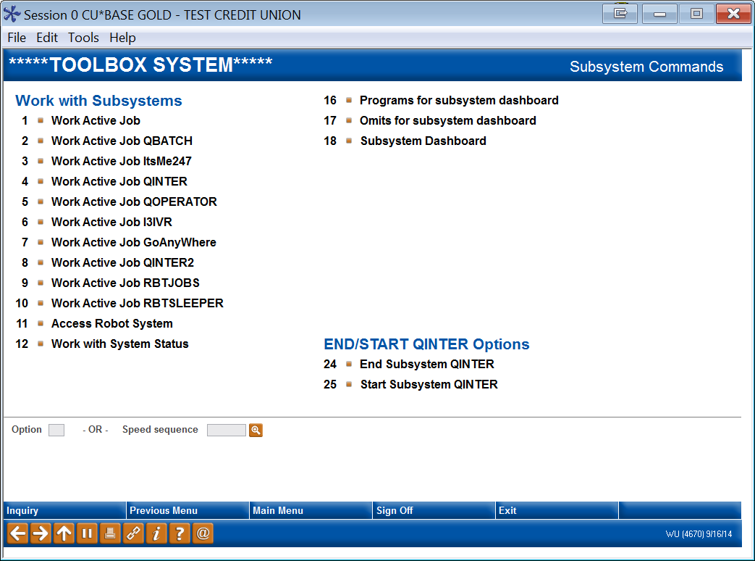
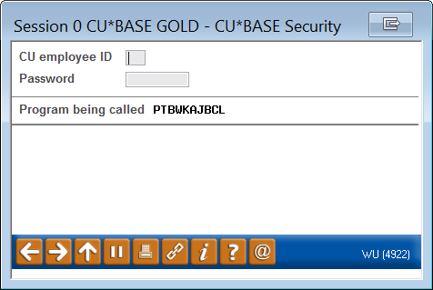
The CU*BASE ToolBox

Slide 37
Automation: Nightly Processing

Slide 38
Automation: Nightly Processing
This was the #1 topic of interest at our last meeting and quickly became our #1 goal for delivering automated services to you...let’s review where what has transpired over the past two years
There are three different approaches to processing End-of-Day/Beginning-of-Day (EOD/BOD):
Manual - Take menu options in sequence to complete all the necessary work.
Scheduled EOD/BOD – Partially automated but manned and controlled by an operator. Limited in scope.
Optimized Nightly Processing – A robust and carefully engineered process that runs your night cycle while keeping you informed along the way.

Slide 39
What is Optimized Nightly Processing?
Optimized Nightly Processing is a suite of tools designed to execute a complete EOD/BOD cycle and does ncluding system monitoring that keeps you informed via emails/texts.
CU*Answers has partnered with HelpSystems, one of the foremost providers of automation software for IBM i systems, to deliver a robust suite of automated applications.
Key modules from HelpSystems:
SCHEDULE – a robust and sophisticated job scheduling tool
CONSOLE – a monitoring system (i.e. CPU utilization, sub-system status)
ALERT – a communication job that keeps your operators in the loop

Slide 40
What are the benefits of Optimized Nightly Processing?
Consistency – your jobs will run at the same time, the same way, every time
Planning – you’ll know exactly when your nightly processes are going to run so you can plan around them
Tracking – it’s easy to make sure what ran, when, and for how long
Reduce Risk – processes run like clockwork, human error is eliminated, nobody will push the wrong button or forget to run a job

Slide 41
Building a suite of jobs eligible for Optimized Nightly Processing
CU*Answers continues to build a portfolio of jobs that are eligible to be automated
To be eligible:
The job cannot have a prompt screen
The job must be run the same way each time
The job cannot have parameters that change from run to run
The job cannot require manual tasks (i.e. log on to a remote web site)

Slide 42
Current nightly jobs that can be automated
EOD/BOD
Clear message queues
Automation reports and maintenance
OUTQ cleanup / spool file maintenance
Automated OFAC process
Retrieve bad e-mail addresses
ISO and G/L History purges
Delete old user profiles
Automated Reports & Queries
Print writer redirects
iShield Daily & Monthly Reports
Learn From Peer data exchange
Custom requests:
Member and corporate draft post
Create ACH return file
Clear shared branch file
FinCen acknowledge and send
Create and send mid-day OTB file

Slide 43
Nightly jobs that still must be run manually
End-of-Month
Why? This is a critical processing period; many member-facing jobs get run and there are verifications that need to be done; the job flow changes from one month to the next
FRB Processing
Why? The big obstacle to automation is credentials: the FRB site requires a passcode, a token, and is interactive – not conducive to automation
File Transmissions
Why? Often require off-system actions, have changing filenames, do not always occur at a specific time, often have screens or changing parameters
. . . and other non-traditional, non-standard jobs
Of course we say we’ll never do something…until we decide to do it

Slide 44
Building a suite of jobs eligible for Optimized Nightly Processing
Jobs that are on the list to enable for automation
Custom jobs by CU (typically jobs that are specific to a vendor)
What we call “low-hanging fruit”
Jobs that won’t translate to automation without some work, but which don’t require huge changes
Jobs which, if changed, will benefit several clients
Jobs that require changes that can be generalized to other processes
How do you get on the list?
Complete a custom programming request
We don’t work for free (but we’re pretty reasonable…)

Slide 45
Who’s using Optimized Nightly Processing today?
Ask a peer how they like Optimized Nightly Processing or how they are reaping the benefits from this product
These CUs are using the feature today:
Prospera CU
Harris County FCU
Superior Choice CU
Fox Communities CU
Horizon Utah FCU
Ripco CU
Contact Jeff Miller for additional information so you can get started using this valuable tool

Slide 46
Best Practices
Facilitator: jody karnes

Slide 47
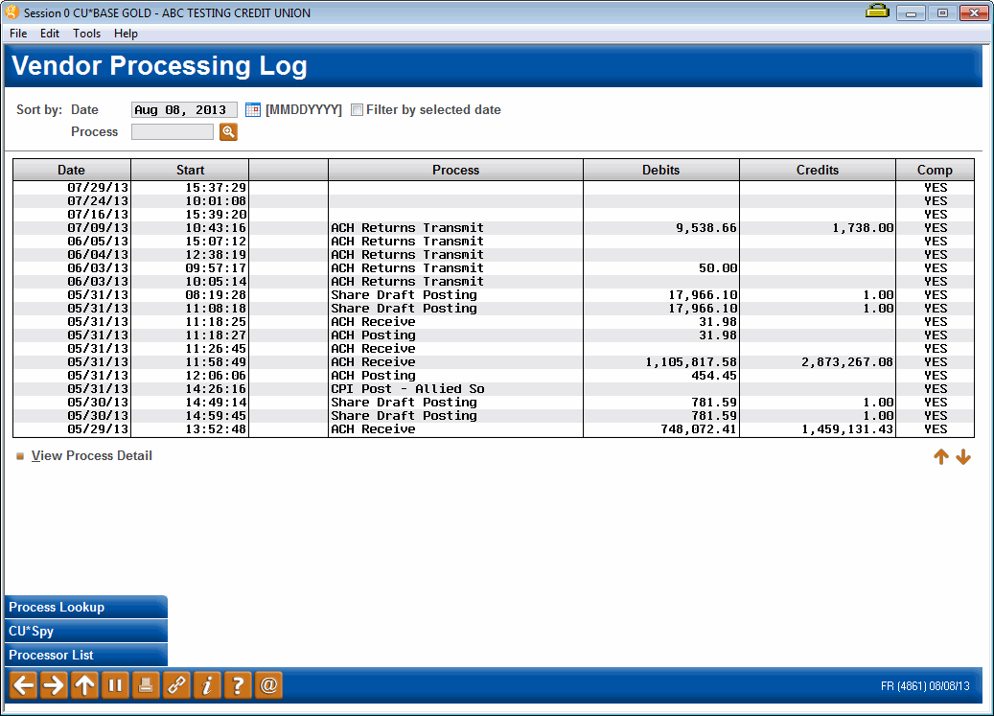
Best Practices: Are your procedures and processes up to date? Smart Operator (MNGELE #9)
Do your Operations and Accounting departments use this valuable tool today to ensure smooth and accurate processing?
Are all daily vendor processes included? If not, contact Jeff Miller

Slide 48
Best Practices: Are your procedures and processes up to date? Process Tracking
Do you have a record of what time jobs are normally run? Are there deadlines you need to have documented?
Do you know how long a job ordinarily takes? Track the typical times that jobs run so we know when abnormalities occur – trends over time can tell you a lot!

Slide 49
Best Practices: Are your procedures and processes up to date? User/Employee Controls
How to reduce one of the biggest risks: People
User ID Dashboard and History – MNAUDT 27
User IDs not used in past xx days
History with IDs purged, deleted, added, reset
Employee departures
Removal of User ID in a timely fashion
Employees changing positions
When employees change departments or job duties, are both the user ID and employee ID reviewed for relevance of authorities?
Monthly/quarterly audit of user IDs – what is your policy?
How many employees have command line access?

Slide 50
Best Practices: Are your procedures and processes up to date? CU*BASE Purges
Why worry about these? Because they have a direct impact on performance, including system response, tape backups, and disk utilization
ISO (related to ATM, Debit and Credit Card processes)
Contains extensive data for online EFT activity used in ATM/Debit/Credit card activity inquiries, reconciliation reports, and transaction reversals
Because of the pure amount of data, these files are extremely large and need to be purged monthly (but require the EFT switches to be down)
G/L History and Check Master
Should purge regularly to reduce file sizes

Slide 51
Best Practices: Are your procedures and processes up to date? CU*BASE Purges (con’t)
Statement Files
There is NO need to keep statement files (that we know of)
Around the 25th of the month, delete ALL CU*BASE statement files using OPER-6 options 11-Regular Stmts, 20-Credit Card Stmts, and soon to come 24- Mortgage Stmts
OUTQs
Do you regularly monitor OUTQs for old reports that should be purged?
Such as HOLDxx

Slide 52
Best Practices: Are your procedures and processes up to date? Bad Email Addresses
Avoid being blacklisted by ISPs by making sure you are only sending emails to valid email addresses
Manual – flag single accounts using “Email Address Maintenance”
Automated Process (see handout)
“Fatal” delivery errors are collected throughout the day (i.e. eAlerts, eStatements, PIB and password changes, Member Reach messages)
Import collected bad emails and loads into CU*BASE (OPER – 7 – 28)
Beginning-of-day will update ‘Wrong Email’ flags (CUFMNT)
Can be included as part of Automation: Nightly Processing
Additionally, Xtend offers a service to contact members in order to obtain updated email addresses

Slide 53
Best Practices: Are your procedures and processes up to date? Run Sheets
Check for completeness – If someone relatively unfamiliar with your operation’s had to step in, how confident are you that everything would get done as intended?
Make a backup – Are your current run sheets backed up, preferably off-site, so they can be referenced in the event your primary computer center and/or network are not available?
Do your run sheets contain the very important vendor contact information?

Slide 54
Best Practices: Are your procedures and processes up to date? Encryption
Tape and Disk encryption already discussed under OpsEngine
Transmission (vendors and third parties) – These are typically custom processes where the rules are negotiated with each vendor
Session (PC connectivity to host) – Ensure data transmitted from your core system to your workstations and branches are secure
Requires digital certificates on the IBM i host (both production and H/A)
PCs require:
Configuration change to invoke encrypted session
Use of domain name to access hosts (versus I/P addresses)
Access to the internet to verify certificate information

Slide 55
Best Practices: Are your procedures and processes up to date? Monthly Verifications
Statement verifications
How thoroughly do you verify statements and their contents before sending them to the print vendor and e-statement channel?
http://www.cuanswers.com/pdf/spec_interest/StatementProcessingandVerificationTasks.pdf
Monthly accounting and back office verifications
What is on your monthly check list?
http://www.cuanswers.com/pdf/cb_ref/SPMonthlyVerifications.pdf

Slide 56
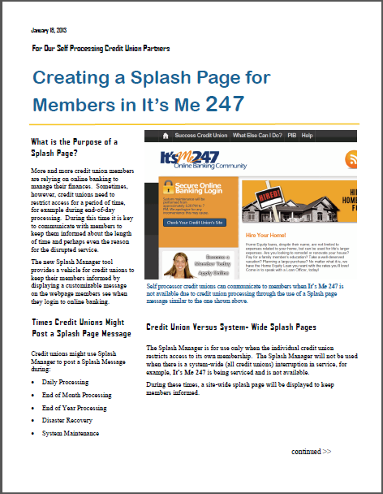
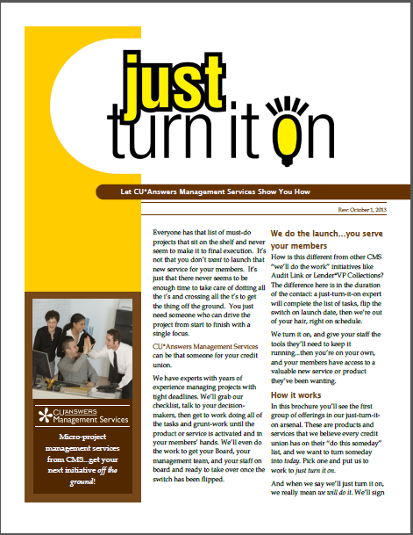
Optional Products and Services
It’s Me 247 Splash Page Manager
Are you using this valuable tool to let your online banking members know when there are service interruptions?
Just Turn it On
Struggling to launch new products, features or services?
How can CU*Answers help?

Slide 57
CU*BASE Update
Faciltator: Randy Karnes

Slide 58
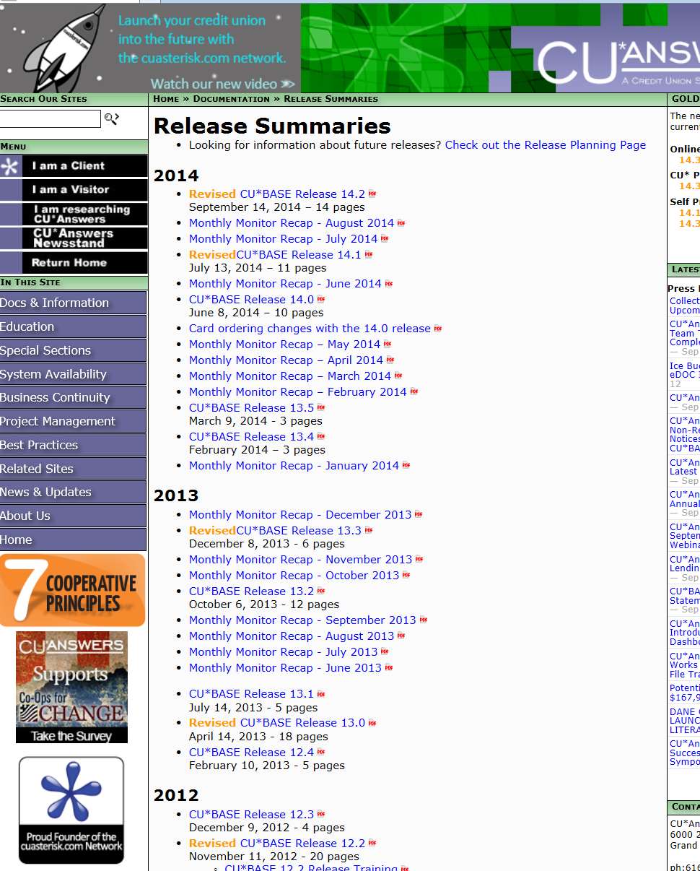
What’s New in CU*BASE?
A few new features added since we last met:
Automated Reports and Queries
Learn from a Peer ---- across the network
Retention of multiple EOM Files
Printed Statement Fees and Style Options
FEP
What’s your favorite recently added feature?

Slide 59
CU*BASE Update FEP: File Expansion Project
211 CUs converted, 13 to go, including 1 self-processor (Oct 5)
We’re looking forward to all CUs on the same software level
Included expansion and standardization of MEMBER account files
Mostly internal, under the cover changes (members not really aware)
Biggest effect on CUs was probably custom Queries
Trivia –
288 files changed
1,600 CU*BASE programs changed (and just as many custom programs)
Over 56,000 hours (programming and quality control)

Slide 60
CU*BASE Update M-Up: Membership Update
M-Up: The next file expansion project
“Membership Update” for MASTER related files/fields
Will be more visual to credit unions and members than FEP because it will involve changes to how we store and use data about members
See handout for what we are thinking and planning
Rough timeline:
Nov 2014 – Reveal plan (80%) at CEO Strategies
Feb 2015 – Final plan due for what is included and how we will get it done (current staff, contract labor, etc.)
April 2015 – Start the work
Follow along in the Kitchen

Slide 61
What’s New in CU*BASE? What is in the works?
MyCUToday
It’s My Data 247 – 4 versions
It’s Me 247 bill pay UI
New bill pay vendor relationship
A broad API library
It’s Me 247 API version
Mobile app store
CU*Answers’ first mobile app
CU*Answers native RDC
Lending Top 10 Priorities
Accounting Top 10 Priorities
Cycled statements
Misc. It’s Me 247
It’s My Biz 247 business platform
Are you getting the news on the development of everything CU*BASE?
Can you clearly delineate how that fits your day-to-day operational role?
Are you the catalyst for everyone in your organization to keep up with the evolution?

Slide 62
High Availability and Business Continuity

Slide 63
High Availability Understanding High Availability
Most in this room are doing High Availability
What is High Availability?
The ability to recover from adverse events with minimal interruption and minimal data loss
Possible causes that would trigger utilization of an H/A solution:
Hardware failure on primary system
External system failure at production site (i.e. power, telecommunications)
Regional crisis
Primary reason for an H/A solution: We live in a 24x7 world where transactions and activity come from multitudes of channels, and recovering from a historic, point-in-time backup is no longer reasonable or viable
H/A solutions must be tested and documented on a regular basis

Slide 64
High Availability Understanding the Scope of a High Availability Plan
What do you get today with your high availability contract (either with CU*Answers or Site-Four)?
Installation and configuration of HA application
HA application maintenance and upgrades
Monitoring and support of replication services
What is not included that you should have separate plans or arrangements for?
Procedures and documentation (can’t emphasize this enough)
Third-party vendor connectivity
Workstations, printers, phones

Slide 65
Business Continuity Understanding Business Continuity
A Business Continuity Plan is a roadmap for continuing operations under adverse conditions (i.e. interruption from natural or man-made hazards)
A Business Continuity Plan is designed to:
Protect people and property (assets)
Minimize the financial losses to the organization
Serve customers with minimal disruptions
Mitigate negative effects of disruptions of business operations
Who in this room has a solid Business Continuity Plan?
Let’s take a high level look at CU*Answers’ Business Continuity Plan...

Slide 67
What’s on the Horizon?

Slide 68
CU*BASE Operations News & Updates
Member Notices
Are you tired of printing daily notices in-house, and folding and stuffing and mailing? Are your volumes growing?
CU*Answers is announcing a new option to send your notices to third-party print vendors
OFAC and new files (FSE list)
FinCEN
Stand-in Processing
Currently testing a version that does not require EFT (ISO) switches to be bounced
Moving everyone to the Statement Flat File
Sunset of ‘print’ version is 12/31/2014 – who is still using this versus the newer flat file solution?
CU Training Environment
Hopefully you are using this feature today!
An even cooler “Custom Training Edition” is coming that will have new features

Slide 69
Upcoming Events Mark your calendar!
2014 CEO Strategies
November 3-5 or 5-7, 2014 in Grand Rapids, MI
This year’s theme: Adopt an Internet Retailer Mindset...consumers are plugged in
Data Symposium
February 25, 2015 in Grand Rapids, MI
A cuasterisk.com network brainstorming and strategizing session for CU leaders who can commit their organizations to investment and utilization of new data tactics and strategies
Annual Leadership Conference
June 16-17, 2015 in Grand Rapids, MI
Next year’s theme: What’s next? Building a response to everything member

Slide 70
Site-Four Overview Presented by Tim Kenney and Dave Wright

Slide 71
Site-Four Overview Presented by Tim Kenney and Dave Wright
Tour (Monday evening)
Overview of services offered
Server hosting
HA offering with vendor testing
A little bit about Site-Four
Board
Staffing
Site highlights
Connectivity
Redundancy
Security, power, cooling and more

Slide 72
Xtend
A word from scott collins

Slide 73
Xtend Who We Are
Separate C-Corp CUSO from CU*Answers
Cooperative-like business model
79 owners ($30K buy-in)
Approaching $3M in revenue
64 full and part-time employees

Slide 74
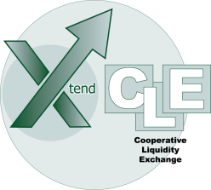
Xtend What We Do
Bookkeeping Services (100+) – full service, stand-in, 5300 configuration
Compliance Monitoring (40+) – log management duties for BSA/CTR, OFAC, dormancy, employee/file maintenance reviews
Member Reach (100+) – targeted plain-text and HTML execution machine, E-Newsletter, Custom messaging, HTML eStatement Notifications
Xtension Call Center (50+)
Inbound member service during expanded hours, loan line, DR/BC
Outbound sales engine – A-S-A-P, recurring, special campaigns
Chat
HyperDrive
Liquidity awareness – CLE, TRUST, NCB

Slide 75
Xtend What We’re Working On
Ramping up ESN and eNewsletter patronage
Actively seeking non-CU*BASE partners and credit unions
Bringing solutions to the mid-market
Member Investment program
Reputation management
Group purchasing
Rewards fulfillment
Vendor risk management
Business development
Building the Factory project with Lender*VP
HyperDrive 2.0
New member onboarding

Slide 76
Wrap-up

Slide 77
Wrap Up
Want to do this again?
Every other year?
Time of the year?
Location for next meeting?
Thank you to our hosts, Site-Four
Thank you to everyone for coming!

