Slide 1
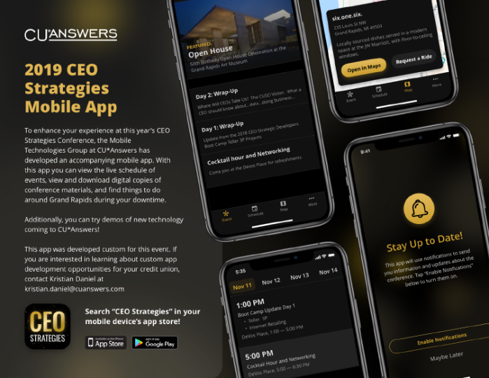
Welcome!
Have you downloaded the conference app?
Catch a ride: Map > Conference Location
November 11-14, 2019
Check it out in the app!
WIRELESS ACCESS: DeVos Place
PASSWORD (VOUCHER): CUA50years!

Slide 2
We’ll be wearing several hats this week...
I’m putting on my projects hat today!
For Today and Thursday
For Tuesday
For Wednesday’s Roundtable

Slide 3
CEO STRATEGIC DEVELOPERS BOOT CAMP
PROJECTS WHERE WE ENVISION A DIFFERENT FUTURE...AND 80% OF THE WORK IS THE ENVISIONING
Projects that speak to alternatives and unique niches within our community
Projects that challenge us: what if we went 180 degrees from our traditions?
Projects that anticipate an emerging audience, more than responding to the status quo
Waiting for CEO mindsets to change, and for credit union strategies to pick up speed towards new targets

Slide 4
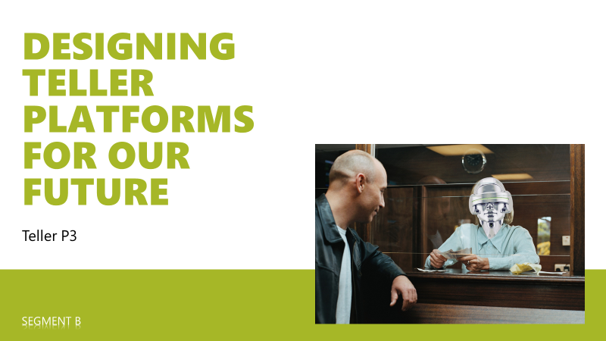
Boot Camp Update
AN UPDATE ON THE PROJECTS FROM LAST YEAR’S CEO STRATEGIC DEVELOPERS BOOT CAMP NOVEMBER 11, 2019

Slide 5
Progress on T2
What we’ve been up to since last year on Express Teller

Slide 6
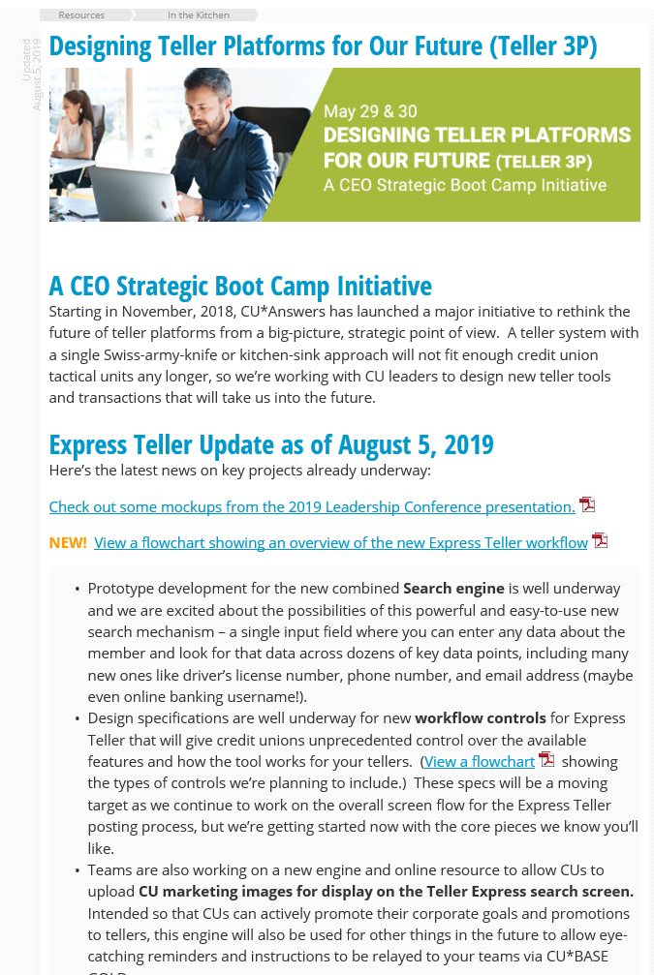
A special Thank you to the Task force
Karen L Smith, Cumberland County FCU
Jody Perkins, Forest Area Federal Credit Union
Karla Glowiak, Frankenmuth Credit Union
Erin Olson, kstate CREDIT UNION
Kinsey Turbiville, kstate CREDIT UNION
Amber Cecil, Northern Colorado Credit Union
Alyssa Barber, Notre Dame Federal Credit Union
Lindsey Borski, Peninsula Federal Credit Union
Diana McKnight, Peninsula Federal Credit Union
Amanda Boring, Pinnacle Credit Union
Nicole Hitchings, TBA Credit Union
Keep up with project updates in the Kitchen:
open.cuanswers.com/Teller3P

Slide 7
Express teller: The projects
Proj # | Description | Status | Programming Completion Target
51946 | T2 Project 1 – Search Module | Development began 09/16/2019 | 11/30/2019
51947 | T2 Project 2 – Graphics on Home Screen | Combined efforts of GOLD, MTG, and Applications teams; project kicked off 10/23/2019 | TBD
51948 | T2 Project 3 – API for Photo ID Display | Spec work well underway with Imaging Solutions team | TBD
51949 | T2 Project 4 – Workflow Controls | Development began 10/28/2019 | 12/13/2019
51950 | T2 Project 5 – Screens & Posting | Development began 10/22/2019 | 1/10/2020
51951 | T2 Project 6 – Vertical eReceipts | Combined effort of Applications and Imaging Solutions teams; spec work underway | TBD

Slide 8
Express teller: The projects
OUR NEXT MAJOR PROJECT UPDATE WILL BE AT THE END OF MARCH 2020
Our vision for a T2 release
Our vision for using the new search in other tools
What’s next for our new photo ID standard
The big picture for vertical receipts
What’s next for GOLD screen sizes, and where we’ll use them
Proj # | Description | Status | Programming Completion Target
51946 | T2 Project 1 – Search Module | Development began 09/16/2019 | 11/30/2019
51947 | T2 Project 2 – Graphics on Home Screen | Combined efforts of GOLD, MTG, and Applications teams; project kicked off 10/23/2019 | TBD
51948 | T2 Project 3 – API for Photo ID Display | Spec work well underway with Imaging Solutions team | TBD
51949 | T2 Project 4 – Workflow Controls | Development began 10/28/2019 | 12/13/2019
51950 | T2 Project 5 – Screens & Posting | Development began 10/22/2019 | 1/10/2020
51951 | T2 Project 6 – Vertical eReceipts | Combined effort of Applications and Imaging Solutions teams; spec work underway | TBD

Slide 9
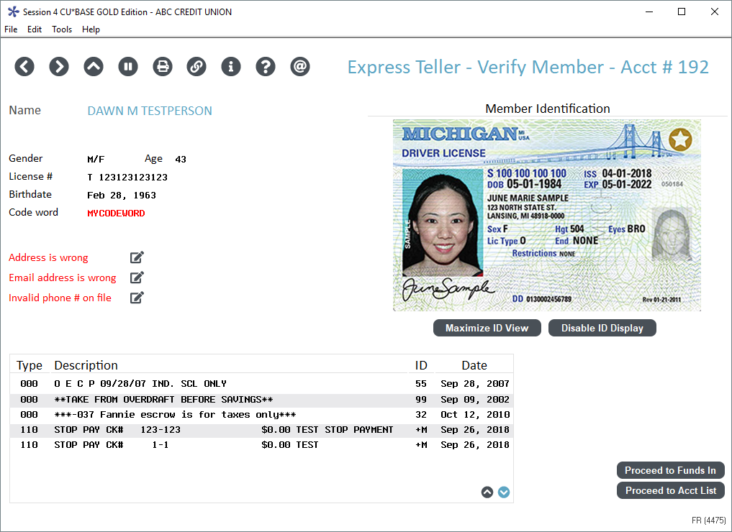
A new standard for GOLD screens
Images right on CU*BASE GOLD screens via APIs to the vault
What’s next?
Photo IDs and receipts are a natural
What about other documents? (remember the size of a document compared to size of a GOLD screen, even at the largest size)
JUNE M SAMPLE
Mockups only; subject to change

Slide 10
Our research on screen sizes
Data gathered from over 6,000 workstations (PROD)
43 unique resolutions were captured
The top 8 sizes are shown in the graph
The remaining 35 resolutions represent just 7% of all workstations
Starting with the 19.05 release
Our plan for the Express Teller module:
Extra Large: 1920x1080
Sets the stage for future iterations of the GUI
Large: 1280x1024
Gives us more height than 1600x900, and 57% of current monitors could immediately plug and play
Standard: keep the existing 1024x768
Covers existing 6% of workstations at this size, plus ones that fall between this and 1280x1024
Stepping directly up to 1280x1024 would eliminate support for 2,631 monitors (43%)
...and if successful for Express Teller, we’ll incorporate into more modules over time

Slide 11
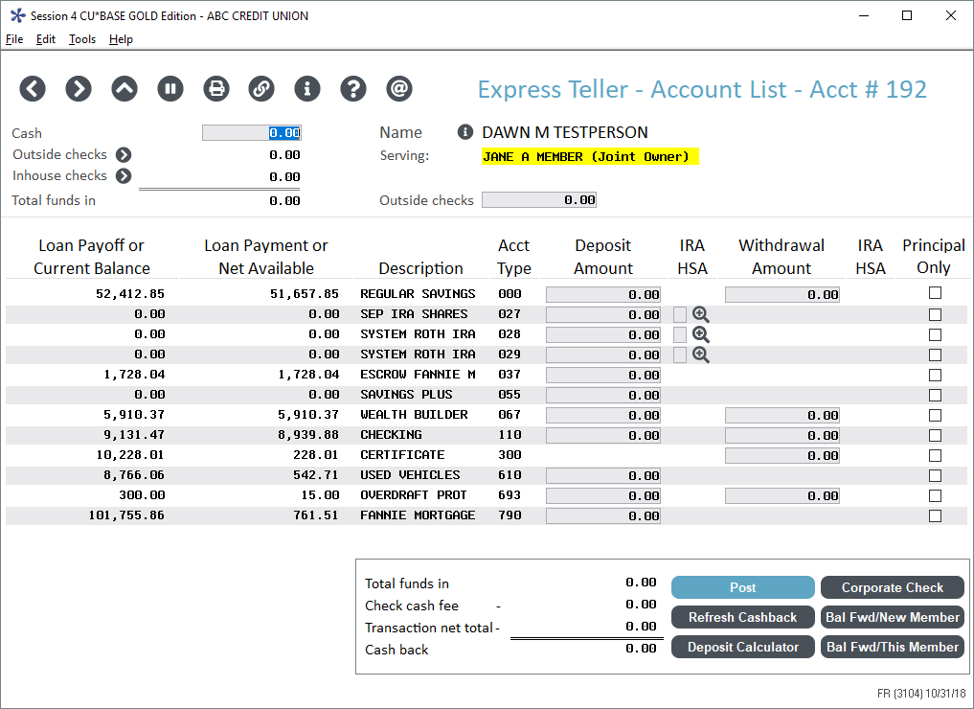
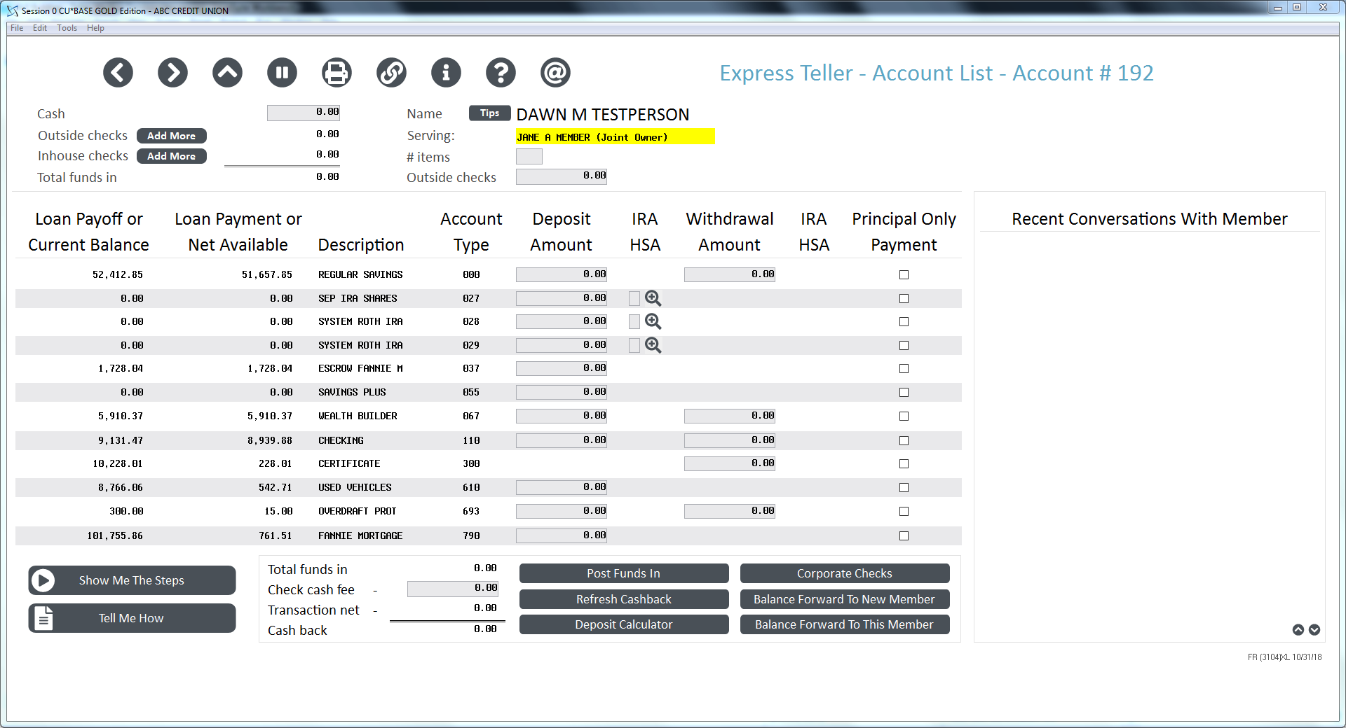
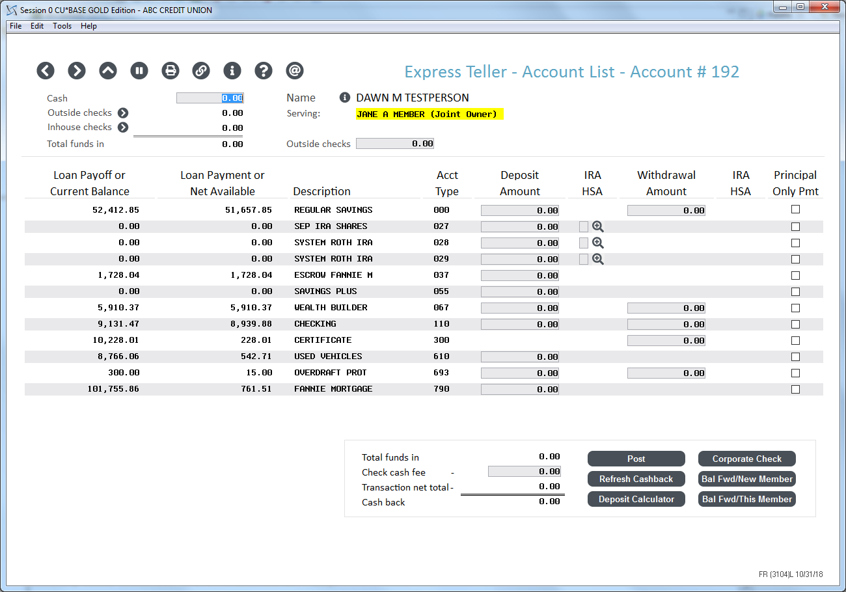
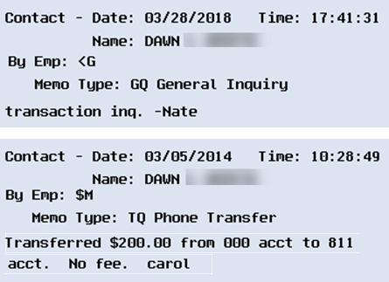
Stepping up to today’s (and tomorrow’s) screen sizes
Standard (1024x768)
Room for Tracker conversations? Recent transactions? Account comments? Other warnings? Or...?
Large (1280x1024)
XL (1920x1080)
Mockups only; subject to change

Slide 12
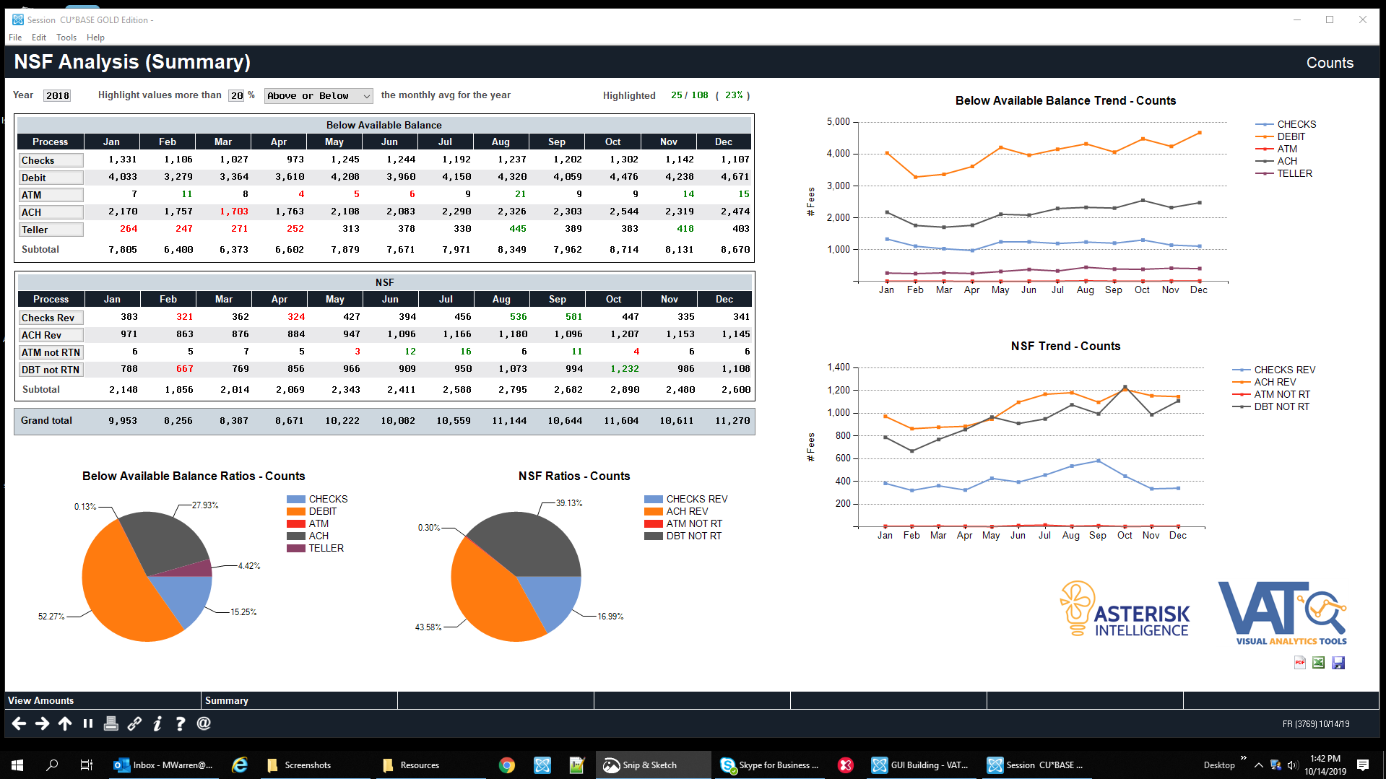
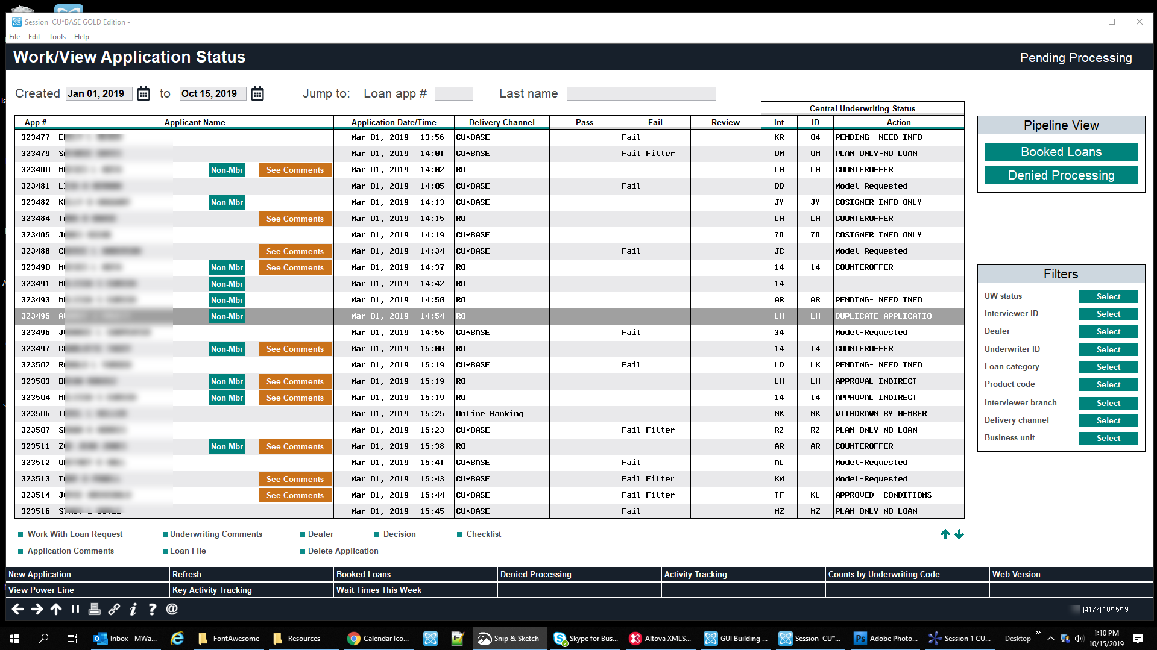
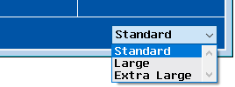
Speaking of screen sizes
FOR EXPRESS TELLER
FOR VISUAL ANALYTICS TOOLS (VAT)
FOR THE CU*BASE LOS
Also introducing panel sizing on the fly
Mockups only; subject to change

Slide 13
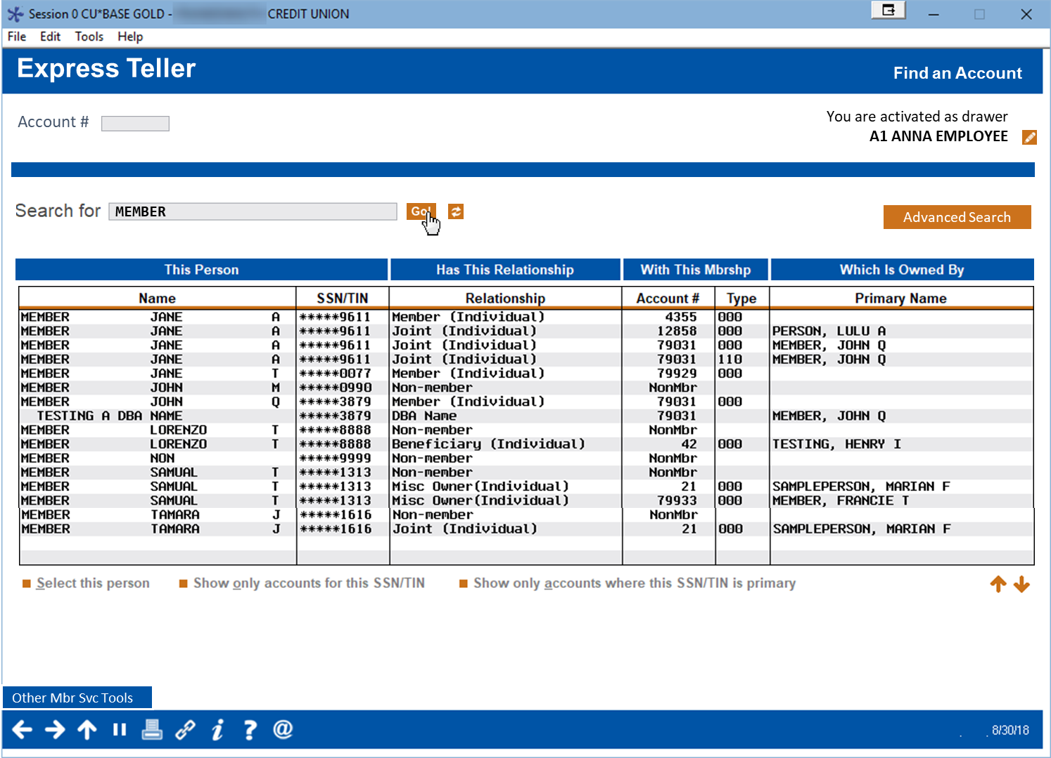
MARKETING TO YOUR STAFF ON VIA EXPRESS TELLER
Mockups only; subject to change

Slide 14
A NEW STANDARD SEARCH engine...headed for t2 (and t1)
Single Google-style search field (CU-defined list of data elements)
Mockups only; subject to change

Slide 15
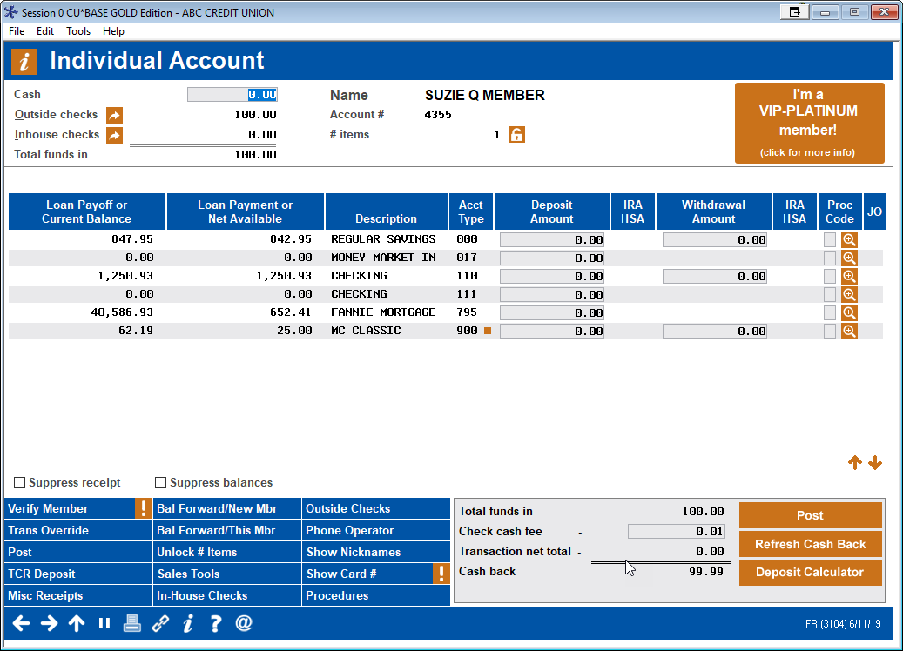
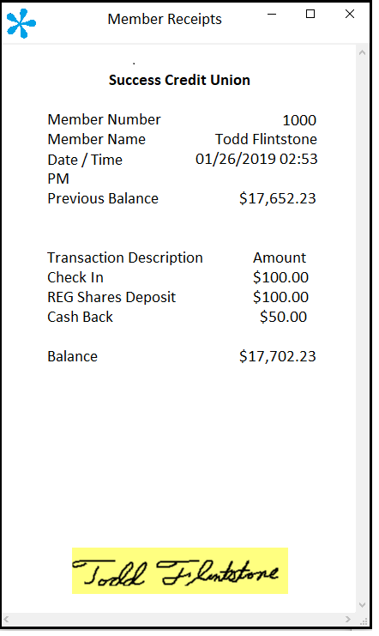
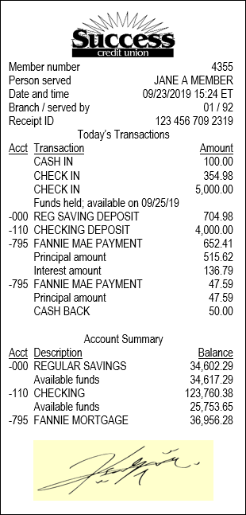
Introducing vertical receipts
Step 1: Vertical receipts text output to support ITMs (a T3 project)
Step 2: Vertical receipts as standard output for Express Teller
Step 3: eReceipts without ProDOC from CU*Answers Imaging Solutions
Vertical receipts, and eReceipts without ProDOC, coming from Imaging Solutions
Speaking of Imaging Solutions....
Mockups only; subject to change

Slide 16
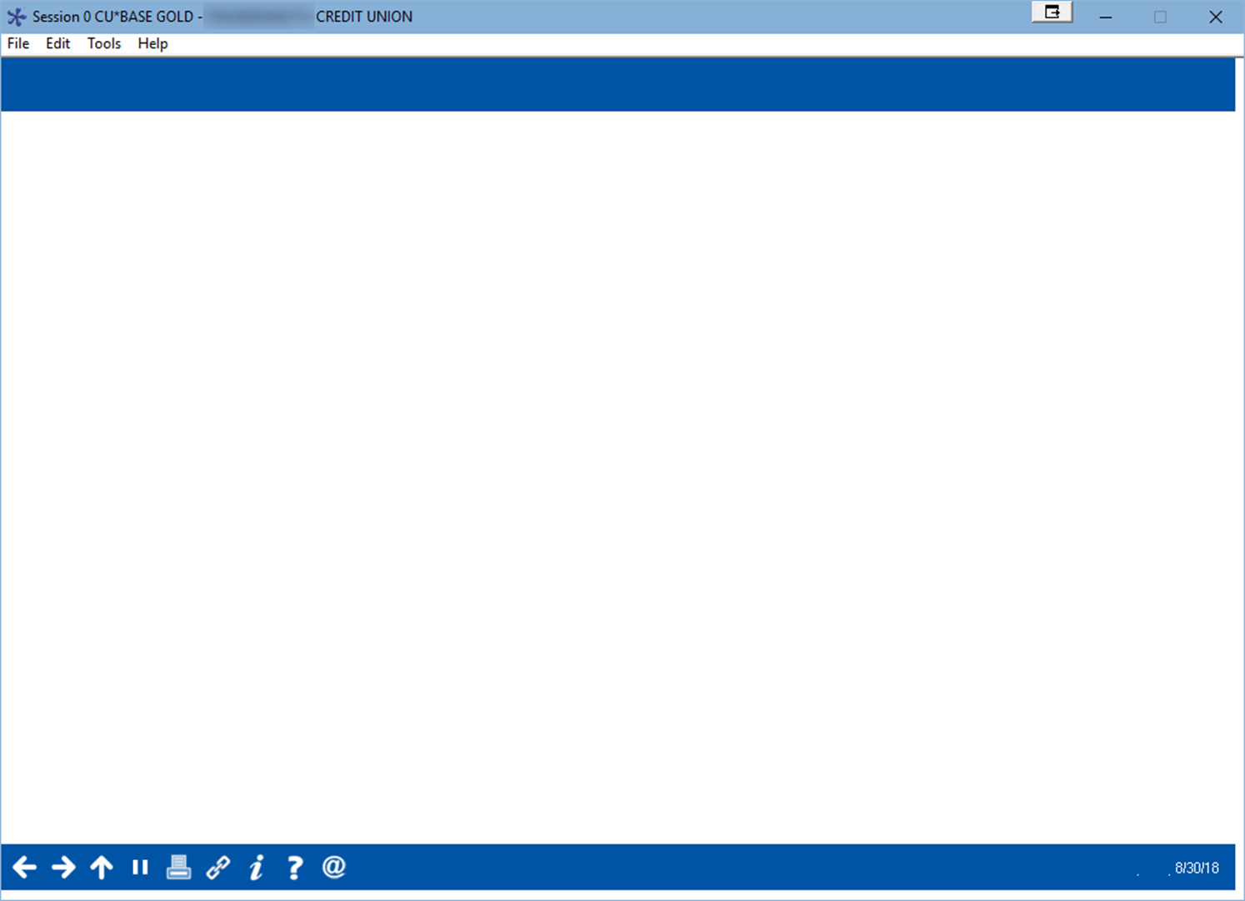
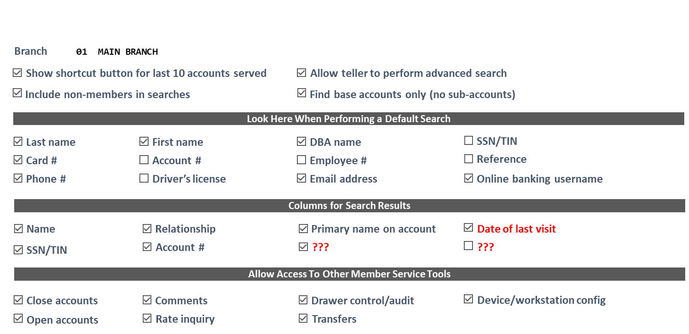
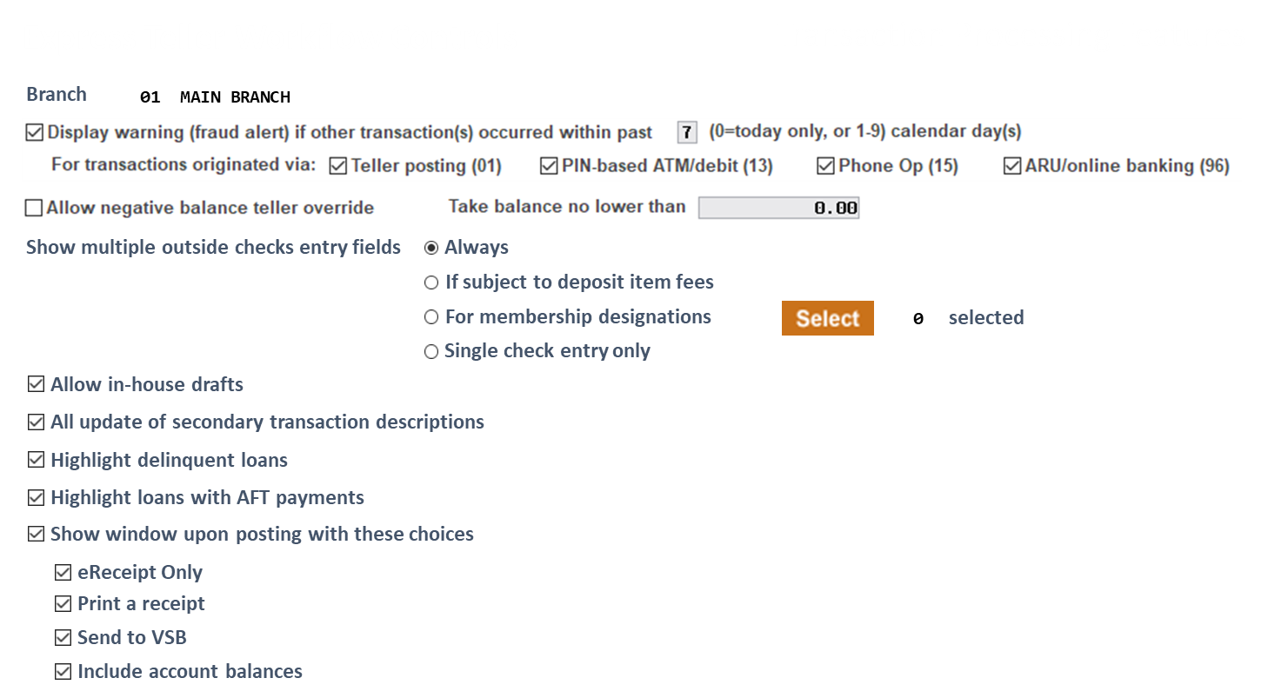
More workflow controls than ever before
More than 50 workflow controls will be exclusive to Express Teller
Are you using the controls we already have?
We’ll have a big push for all CUs to rethink the way they control what their employees see
Process governance
Data governance
Experience governance
Do you need a refresh?
Mockups only; subject to change

Slide 17
Coming in June 2020:
A new service from CMS rolling out at our next leadership conference
Have you ever considered what has changed in our network since you converted to CU*BASE? Has it been five years? A decade? Three decades?
How many releases have there been since your conversion date?
How many of your key leaders (the ones that did the work) are still with you?
How many times have you reorganized your processes and the way you look at data?
How many workarounds have you created to fit the way you were, back then?
If you repeated your conversion today, what are the top 10 things you would change?
Conversion₂ might be your biggest strategic move in 2021, and your best opportunity to reset your data and teams to be ready for the next decade
The ultimate refresh: CU*BASE version Yesterday converted to CU*BASE version Today

Slide 18
Progress on T3
What we’ve been up to since last year on teller api integrations

Slide 19
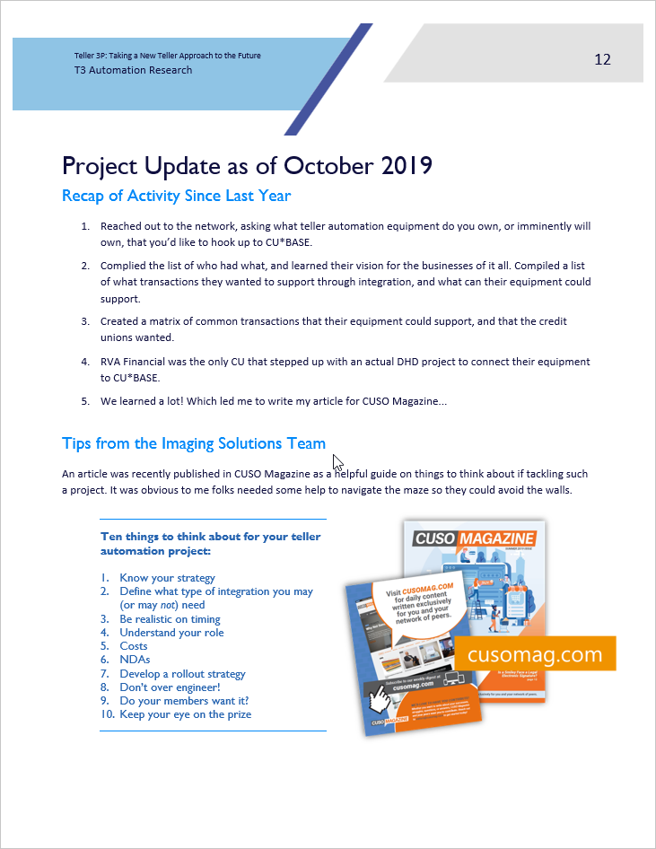
An update from our T3 General contractor
open.cuanswers.com/Teller3P

Slide 20
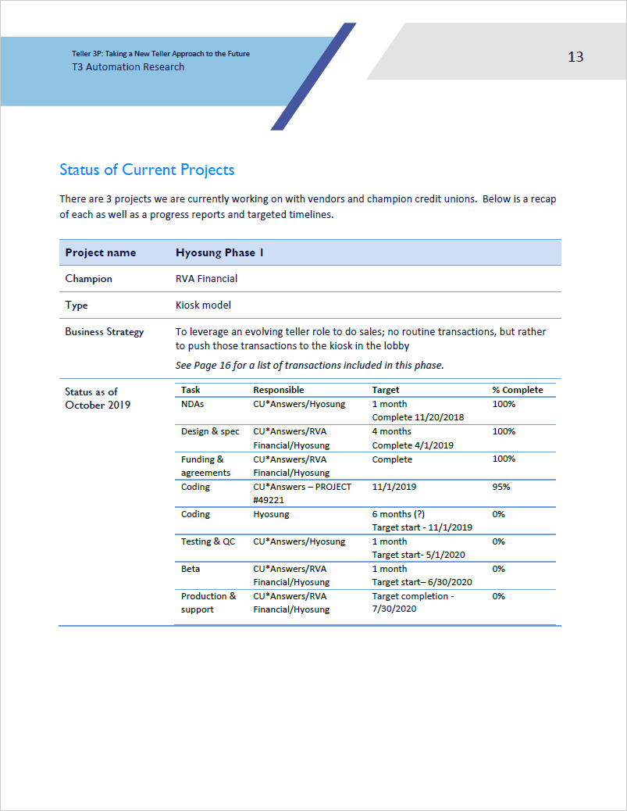
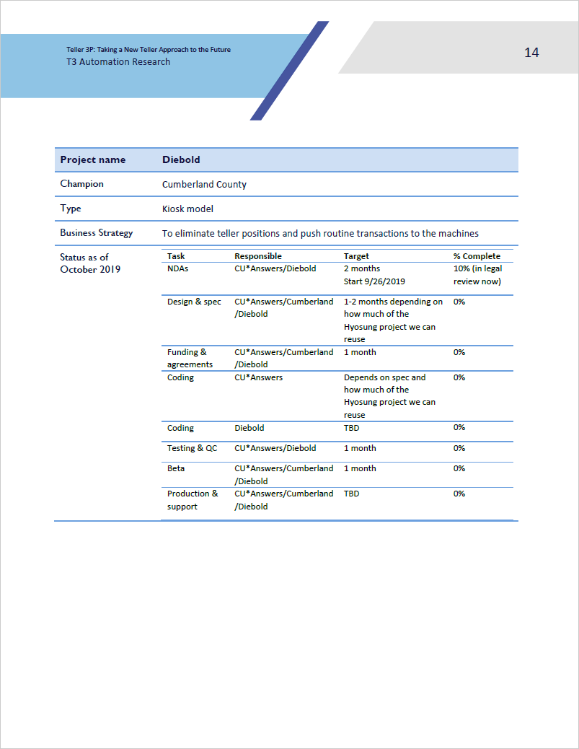

Slide 21
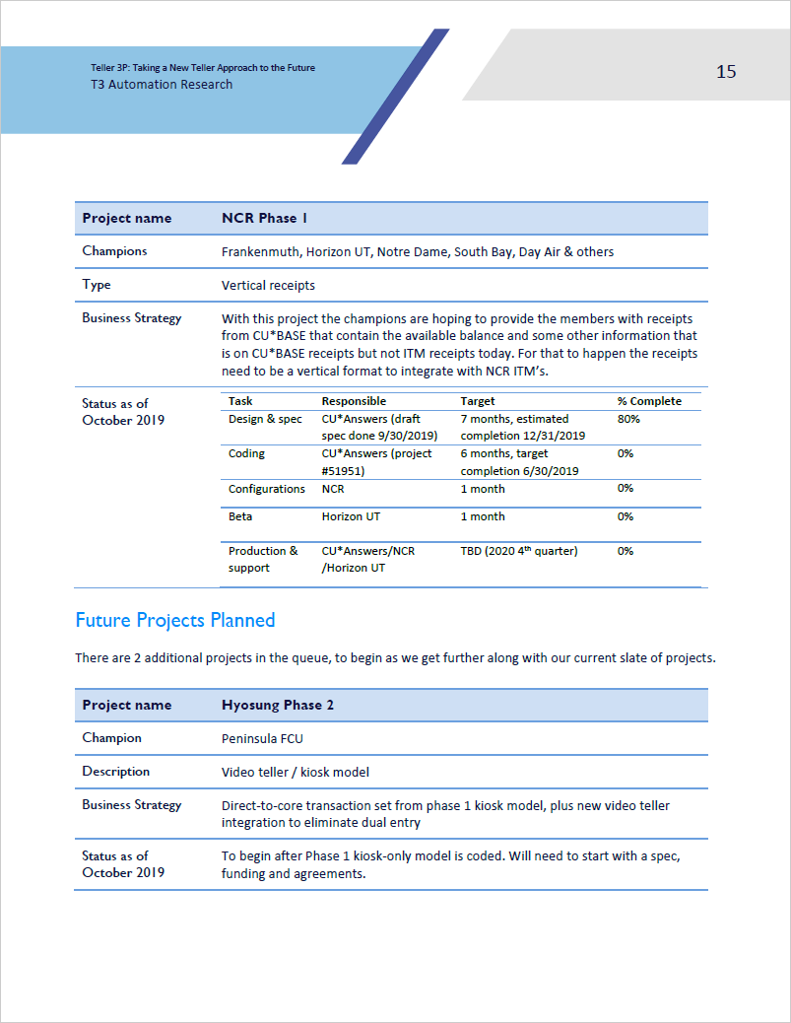
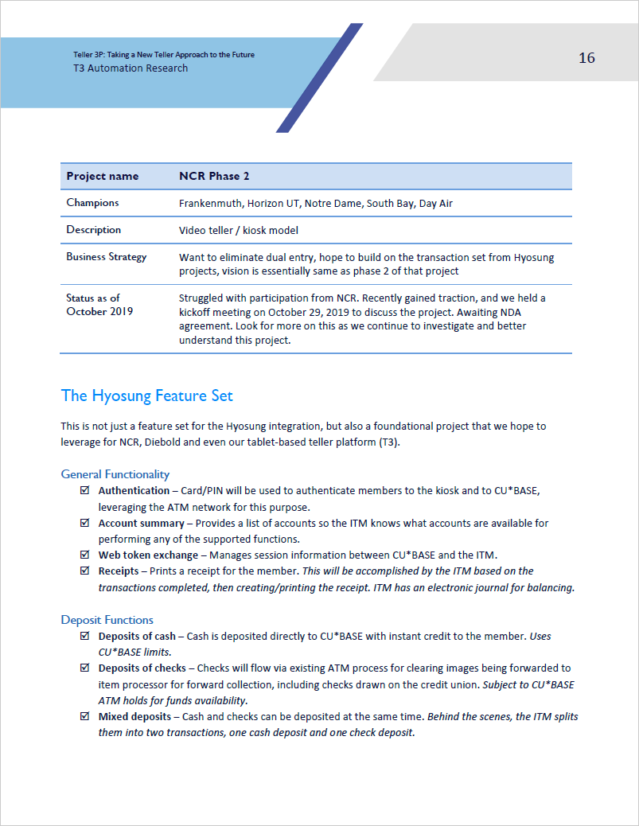

Slide 22
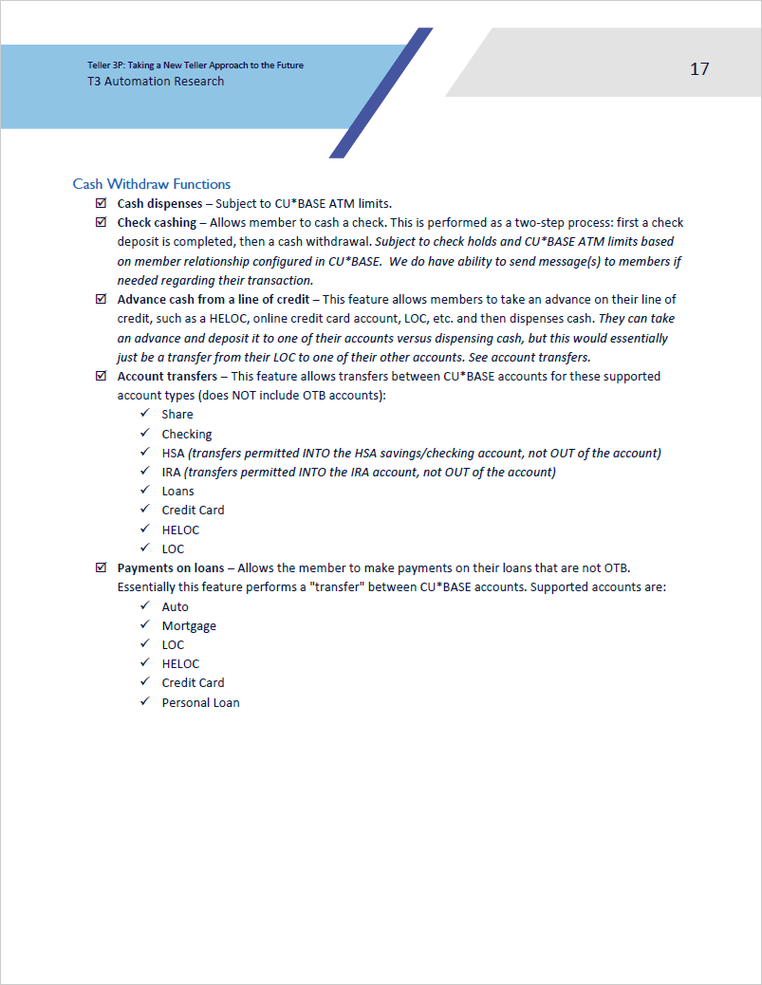
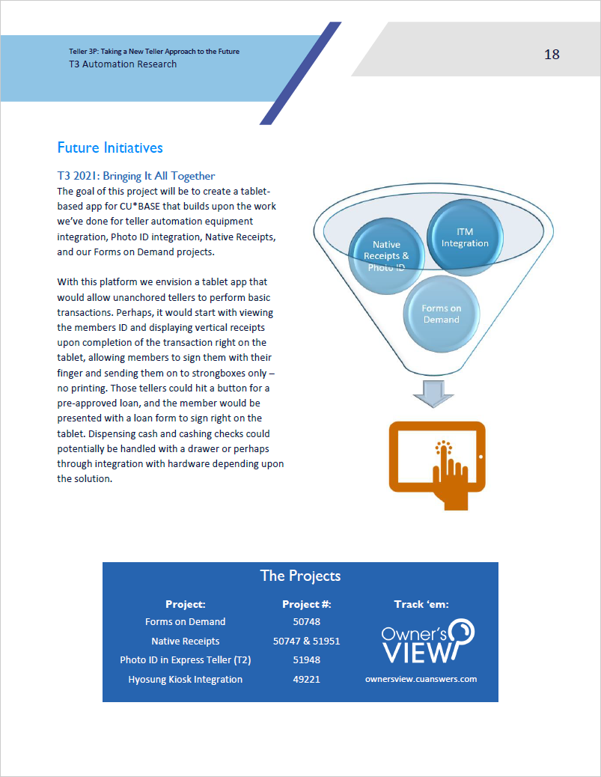

Slide 23
On to our next boot camp update

