Slide 1




Welcome!

Slide 2

Walking in the Members’ Shoes
Kicking the day off with a winner

Slide 3
Looking for a New Future
While maintaining your core principles
Everyone can feel it, and everyone’s talking about it
We need to respond to our members’ evolving perceptions about what financial services are, how they are delivered, and from whom
Planning to transform takes vision
Planning to transform takes the intent – to be more, to be different, to be...?, to decide that the time is right
trans·form
[v. trans-fawrm; n. trans-fawrm] verb (used with object)
1. to change in form, appearance, or structure; metamorphose.
2. to change in condition, nature, or character; convert.
This is where we are all equal as leaders
This nervous feeling in our stomachs that something is about to break – break for the good, break for the bad – and it’s our job to envision a plan to make sure it breaks for the good

Slide 4




What signals transformation? You do, our network does
# of CUs by State
1
13
3
6
87
1
11
21
1
2
7
3
6
8
17
1
1
2
1
1
1
✪
1
1
9
1
1
4
1
1
1
1
2
8
1
1
1
245
CU*BASE Credit Unions
in 35 States
9
4
180
4
1
30
35
Includes all cuasterisk.com network partners, all clients currently under contract

Slide 5

Who will be the catalysts to ensure transformation? You will
New CU*Answers Clients Since Last Time
Michigan
Chief Financial CU
Pontiac, MI
Kellogg Community CU
Battle Creek, MI
Lakes Community CU
Lake Orion, MI
Monroe County Comm. CU
Monroe, MI
Post Community CU
Battle Creek, MI
Village Community CU
Dearborn, MI
Washtenaw FCU
Ypsilanti, MI
Minnesota
Northern Eagle FCU
Nett Lake, MN
Toro Employees CU
Bloomington, MN
Missouri
1st City Credit Union
St. Louis, MO
Wisconsin
Citizens First CU
Oshkosh, WI
Indiana
Chiphone FCU
Elkhart, IN
Notre Dame FCU
Notre Dame, IN
Ohio
First Ohio Community FCU
North Canton, OH
Illinois
Western Illinois CU
Macomb, IL
Includes all CU*Answers clients currently under contract

Slide 6
Who will drive home the point?
Your members will
# of Mbrs
by State
IN
OH
SD
IL
MN
WI
TX
WA
CA
NY
FL
AL
CT
OR
ME
MA
LA
CU*BASE Credit Unions: 245
Total Members: 1,936,000
MI
Includes all cuasterisk.com network partners, all clients currently under contract

Slide 7
Can we predict the future of how CUs will make money?
Can we transform the economic drivers of our industry?
Necessity is the mother of invention, and I believe many CUs will finally have to face this transformation
CUs will need to
  Reject the concept that everything is for defense and saving member relationships
  Refine how they invest for competitive advantage, and make it real
  Ensure every program has some revenue contribution
  Aggressively invest in or buy opportunity, and blatantly call it out as a talent
Vendors and our CUSO will have to adjust to this new era
  Redefine who takes the risk in making offers to credit union members
  Create concrete returns, or don’t charge
  Earn when the credit union earns
  Fee for execution, not legacy investment
  Pay credit unions to reach consumers, and share the harvested results
  Specialize in models for cooperative designs, and match the expense to the credit union’s opportunities
Hear how at tonight’s Stockholders Meeting
They’re fuzzy, but they’re guidelines for us all
In 2015, I believe you’re going to have to tell your board and owners the math must change

Slide 8
What is driving the pressure to transform?
Nothing new, but are we approaching a tipping point?
An explosion of personal devices is changing the retail world
It’s getting harder and harder to make a buck
Interchange income is morphing...but to what is anyone’s guess
Cooperatives are trendy, but participation in owning and driving one is waning
Solving the “under-banked consumers” issue is creating new opportunities for the banked
Retailer account servicing (like stored credit and rewards programs) is on the rise
Internet-based data sales concepts seem counter-culture to our industry
Regulatory and compliance costs continue to escalate
The NCUA continues to overreact and destroy member value
It costs more to defend our organizations against competition, with less ROI on the tactics
Is there anything really new here?
Or are we just getting to the point where these threats seem to have aggregated to the point where we feel we have to DO something?

Slide 9
It can come down to fight or flight
We survived a crisis...but do we have the energy to fight for a NEW future?
FIGHT | FLIGHT
Adopt a new mindset and architect member experiences for the future | Accept that the way we do things is no longer relevant, and fade away
Replace one set of opportunities with another – accept new challenges from our members and embrace them | Continue to spend more on less activity, and ensure our obsolescence
Evolve new core competencies and attract the talent required for the future | Accept that you cannot learn or hire your way out of a hole, and fade away
Become agile and adaptable; bake it into your organization’s design | We are who we are, and we’d rather give up the fight than change
Some people do have to eventually give up the fight, but that’s not the same thing as abandoning the ideas of our industry and its promise for the American consumer
In the next five years, our network will generate $200 million to creatively
reinvest in transformation – can you get your mind around that?

Slide 10
It can come down to fight or flight
This is not a call to fight alone
This is a call for us to fight as a collaborative, for us to declare goals that none of us might set alone, but that we can easily envision as allies
For example, what if multiple mobile app solutions were available to every CU without a single penny of expense?
We need to reach for a
different future
We survived a crisis...but do we have the energy to fight for a NEW future?
FIGHT | FLIGHT
Adopt a new mindset and architect member experiences for the future | Accept that the way we do things is no longer relevant, and fade away
Replace one set of opportunities with another – accept new challenges from our members and embrace them | Continue to spend more on less activity, and ensure our obsolescence
Evolve new core competencies and attract the talent required for the future | Accept that you cannot learn or hire your way out of a hole, and fade away
Become agile and adaptable; bake it into your organization’s design | We are who we are, and we’d rather give up the fight than change
Some people do have to eventually give up the fight, but that’s not the same thing as abandoning the ideas of our industry and its promise for the American consumer
In the next five years, our network will generate $200 million to creatively
reinvest in transformation – can you get your mind around that?

Slide 11

Preparing for the next decade
My ultimate motivator:
So what have you done for me lately?
This is Jody’s and my 20th annual meeting, and we are driven today by the same premise we started with in 1994:
What’s next?
2015 – 2025 ... A rush to the future, never looking back
Some people fear that our members’ experiences are out of date...or close to it
  So let’s talk about how we envision and architect new member experiences
Some people say the writing is on the wall, and has been for a long time – we’re approaching (or past) a tipping point on what our members want from us
  So let’s talk about how we meet the train at the station instead of running to catch up
Most say that the clues are in the data, and that we need to spend more time responding to what members are telling us through their actions
  So what opportunities are there to make data the spark for transformation?
Transformation

Slide 12





Today’s Agenda
Walking in the Members’ Shoes
What’s changing about today’s consumer’s expectation?
Can we design an experience
that measures up?
Passing the Tipping Point
Tipping point noun: “The point at which an object is no longer balanced, and adding a small amount of weight can cause it to topple.”
Is this your business?
Is this our industry?
Data Analytics
and
Big Data
(Year 2)
What the world knows about us just might be more important than who we actually are

Slide 13
Walking in the Members’ Shoes
Why a cliché might change everything about the way we think about business...and it might start with the way you think about being a member of your own credit union
Do you design for a member’s experience...or for your staff, your auditor, or the expectations of yesterday’s ideal?

Slide 14

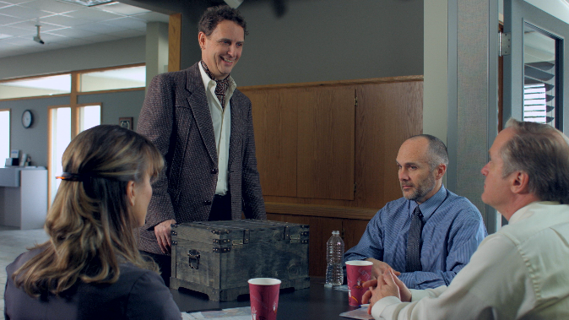
A wake-up call to walk in the members’ shoes
Perception is everything...do you have the right one?
We’re not talking about doing a member survey
We’re talking about doing business with your credit union as a member
  From the outside in, with no special privileges or insider knowledge
  From the outside in, with the same tools, the same access, and the same day-to-day pressures the average consumer faces
  From the outside in, worried more about a personal agenda than a professional one
A wake-up call doesn’t come from fielding a customer’s complaint – it comes from a personal experience that gets you thinking
2012: Taking Your Business Plan Viral
(He’s baaaack!)
2014: Walking in the Members’ Shoes

Slide 15
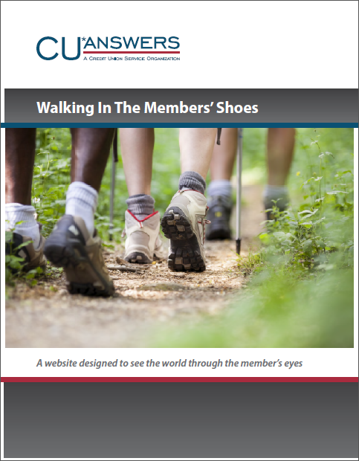
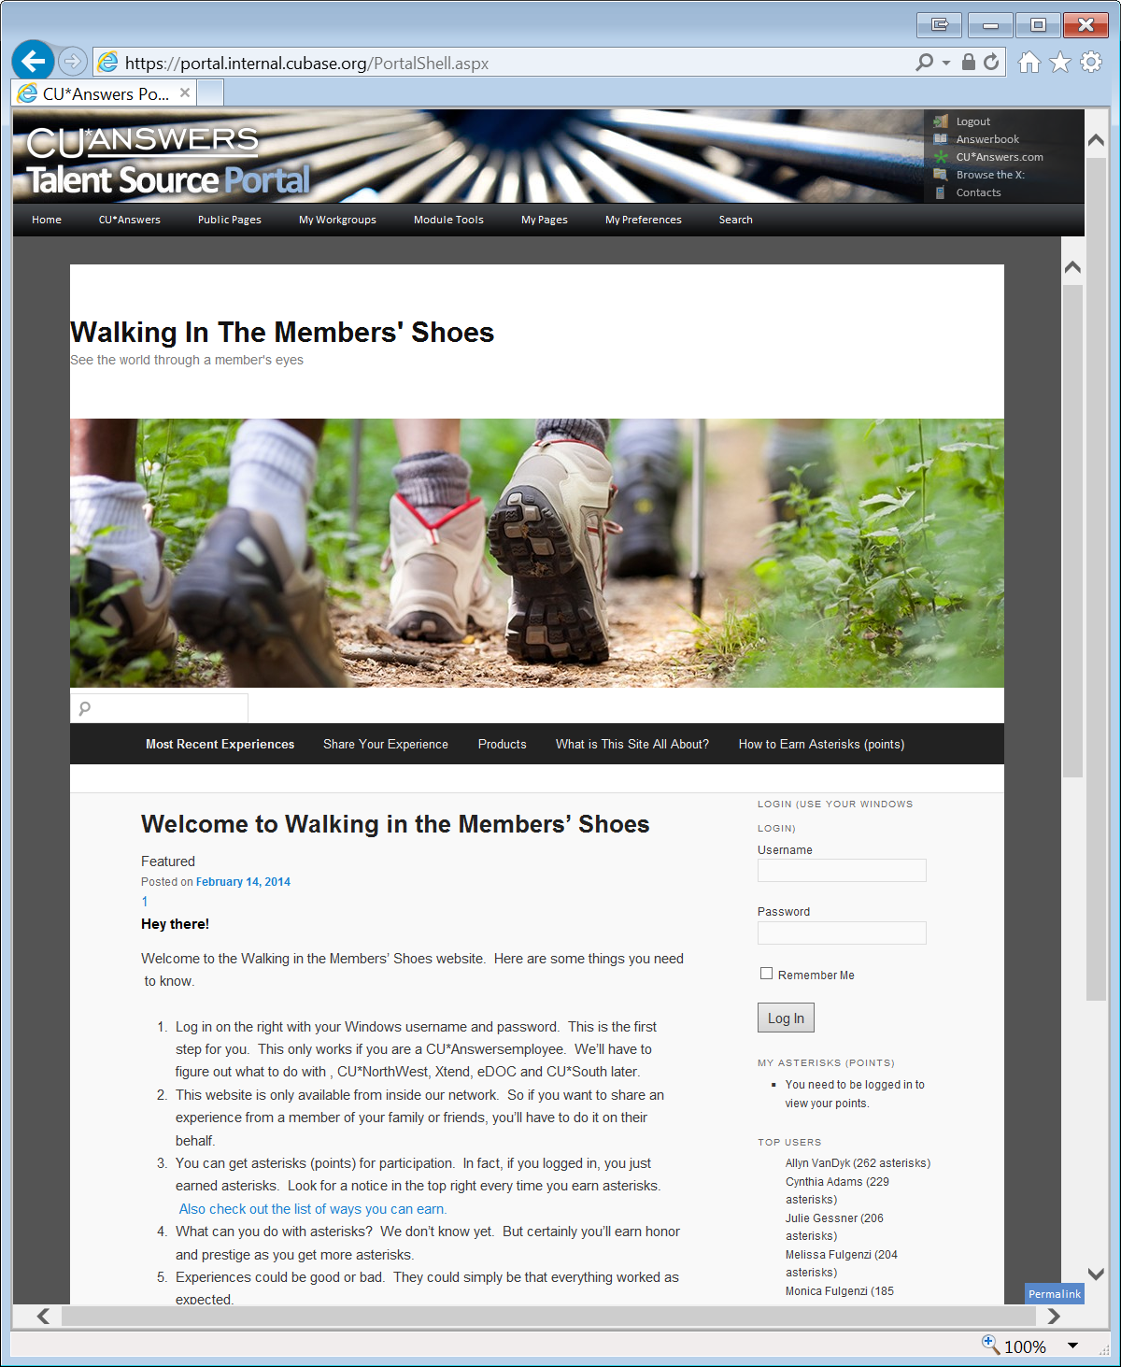
CU*Answers is not immune to the problem
are we focused on designing the right member experience?
We’re no different from you... we have to live the solutions we design
  We have to be members of a credit union to have the right to represent customer-owners
  We have to experience products and services to respect the need for change
  We have to evolve our own interactions with the credit union to understand the members of the future
  We have to be first-person advocates
So we’re investing to get our team to walk the talk

Slide 16
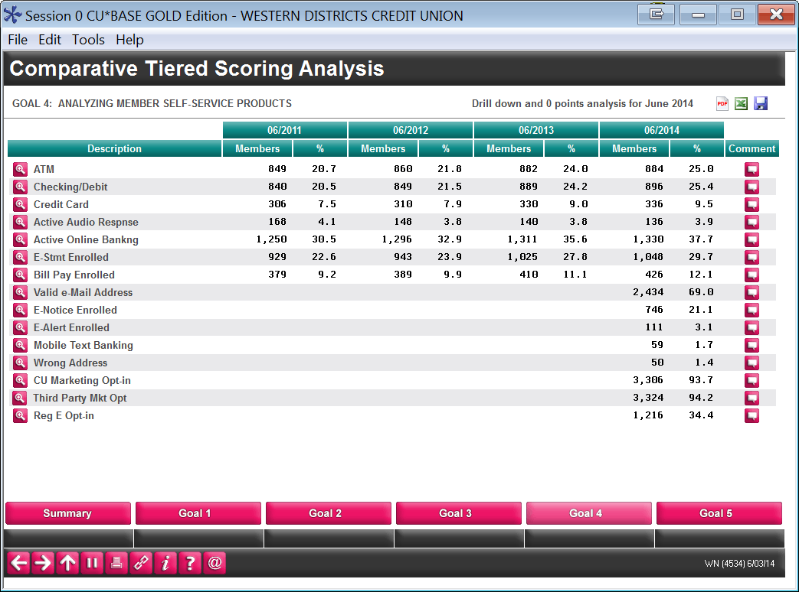
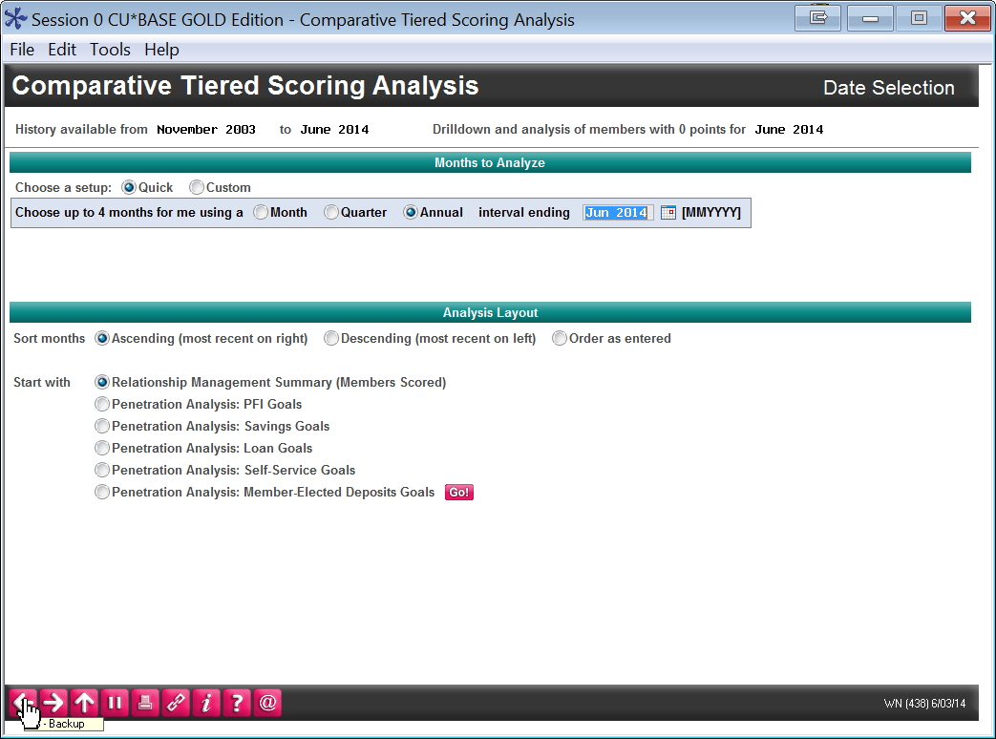
Walking in the Members’ Shoes
It all comes down to advocacy, and maintaining a balance between old and new
  Who is an advocate for new products and gadgets?
  Who is an advocate for the tried and true?
  Who is an advocate for where you are going?
MNMGMD #24 Tiered Svcs Monthly Comparison
Understanding who is using what, and when, can help you prioritize the evolution of
your members’
experiences
The dilemma of “which shoes” – whose perspective do you live?

Slide 17
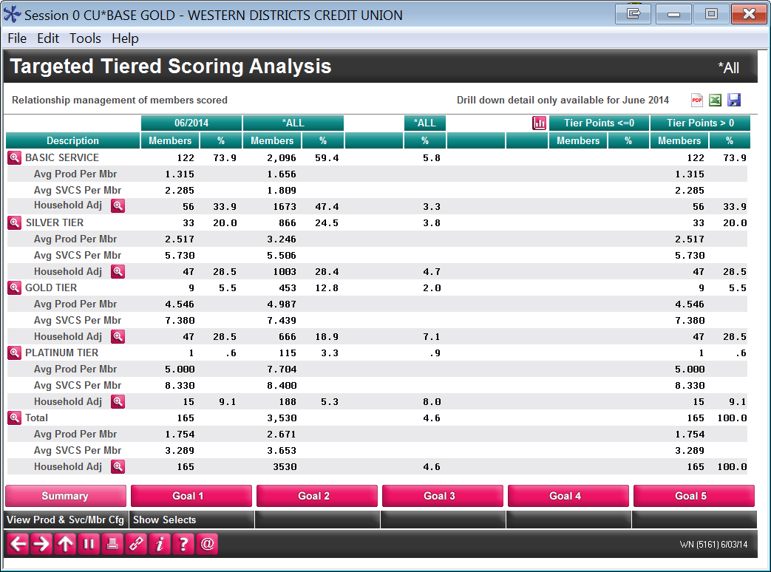
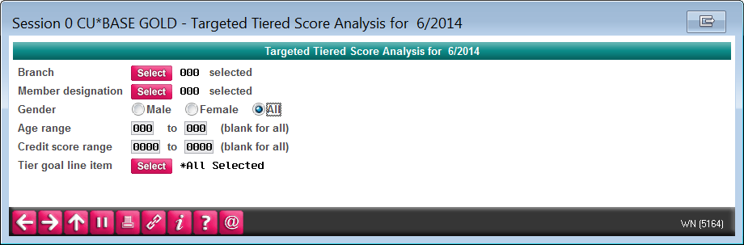
Identifying with members living the experience
Drilling down on who is experiencing what, and what they have in common
In 2014 we added demographics to Tiered Services analysis so you can judge member experience by gender, age, credit score, etc.
You can create insights by tracking members by branch, membership types, or products
You can cross-reference a common bond – like people who use online banking or a mobile phone
Would you like to confirm the experiences your employee-members are having?
In 2015 we’ll add “Insider/Employee Type” as a selection, so you can get your insiders’ scores
MNMGMT #22 Targeted Tiered Score Analysis

Slide 18
Walking in the Members’ Shoes
The dilemma of “which shoes” – whose perspective do you live?
Transformation demands a program where your best people (leaders) live, breathe, and experience who you wish to be...and then help you adapt the experience to your own local conditions
  Use it, verify its value, evolve the solution, and commit to the future in the first person
  “I know what it’s like to do this for myself”
  “I love using this tool every day”
  “I trust this tool for my own family”
You cannot change the mind of others
without changing your own
trans·form
[v. trans-fawrm; n. trans-fawrm] verb (used with object)
1. to change in form, appearance, or structure; metamorphose.
2. to change in condition, nature, or character; convert.
It’s not always easy to be in the first person, but a business designer has to find a way to get their organization to be empathetic to the customer experiences that members are demanding for their futures
How will you transform your
business model for tomorrow’s world?

Slide 19
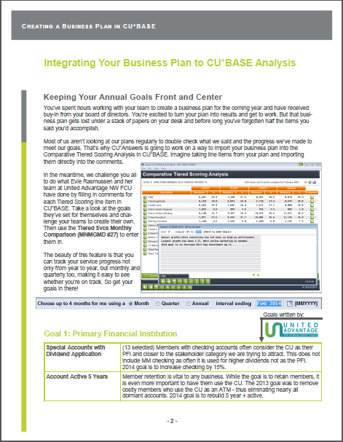
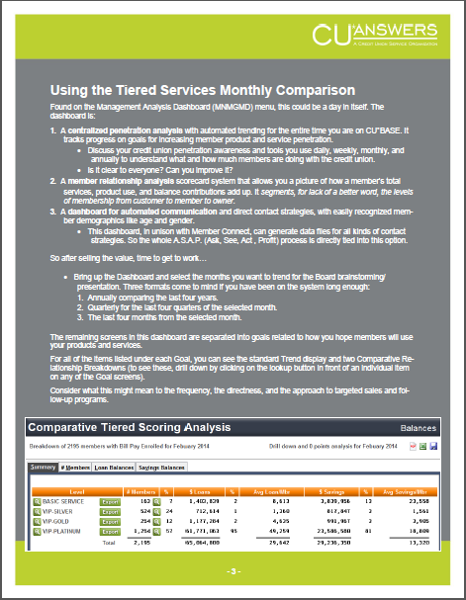
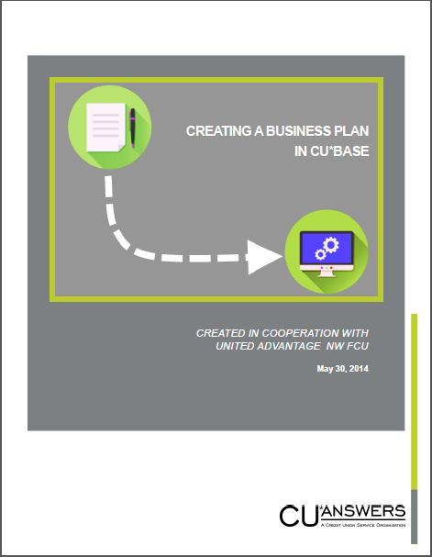
Pairing your intent with your results
In 2015, CU*Answers will work with credit unions to embed their plan for member experiences through the Tiered Services penetration analysis, line item by line item
  Did you have a plan for more people to use the things being tracked by this tool?
  Do you have a goal for people to score more points?
  Do you have a sales plan?
  Do you have a plan to improve the member’s experience?
How can you put your plan alongside the trending of your members’ participation?

Slide 20
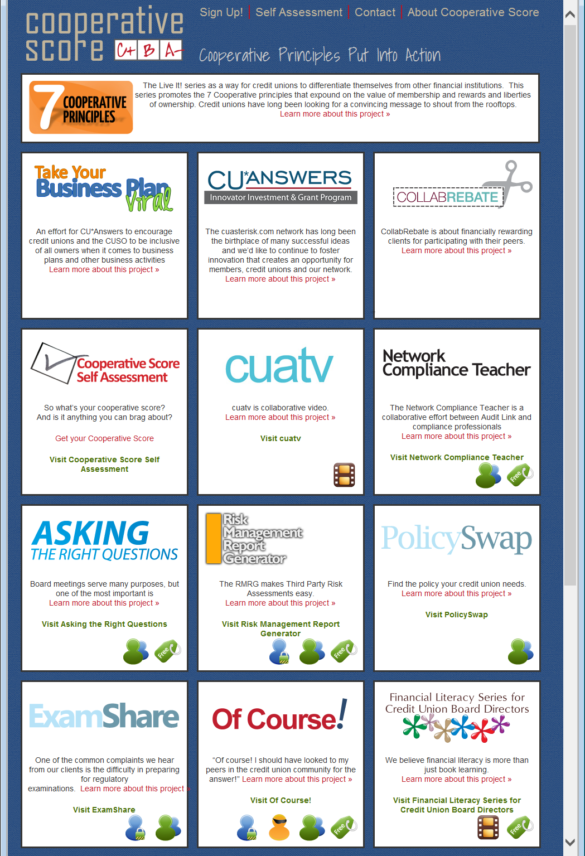
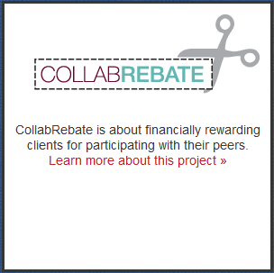
Who do you pay to experience your products?
In 2014 we’ve been aggressive with CollabRebate dollars
  65+ credit unions are being paid to participate in the FEP beta (nearly $80K)
  Credit unions like UANWFCU earned for their contributions to our software design
How much money are you investing in
capturing the ideas of your members?
Earn $1,000 for your team in 2015
  Submit a new way for CU*Answers to pay members
  for ideas on designing the member experience they
  want
  Look for details during CEO Strategies week
  (November 3-7, 2014)
http://score.cuanswers.com
Start with your insider members ... Then consider every member

Slide 21
Engineering Member Experiences...
...For the mobile consumer via mobile web
...For the mobile consumer via mobile apps/APIs
...For every-thing via APIs: the evolution of desktop online banking

Slide 22
Engineering Member Experiences...
...For the mobile consumer via mobile web
...For the mobile consumer via mobile apps/APIs
...For every-thing via APIs: the evolution of desktop online banking

Slide 23
What’s changed about creating products and services?
The “wow” factor is gone, and the competition is getting creative
There’s a difference between what the member wants, and what you have to do to give it to them
  In a face-to-face contact, the employee handles what needs to be done, so the member just gets what they need
In our first attempts at self-service, many of us got it wrong
  We thought it was about getting the member to do our work for us
  The experience was more about taking over for a CU employee than it was about being
  well served as a member
For the next round of service through virtual channels, we need to reengineer member experiences so that members can be members, and we can succeed as credit union professionals
Do you design for a member’s experience...or for your staff, your auditor, or the expectations of yesterday’s ideal?

Slide 24
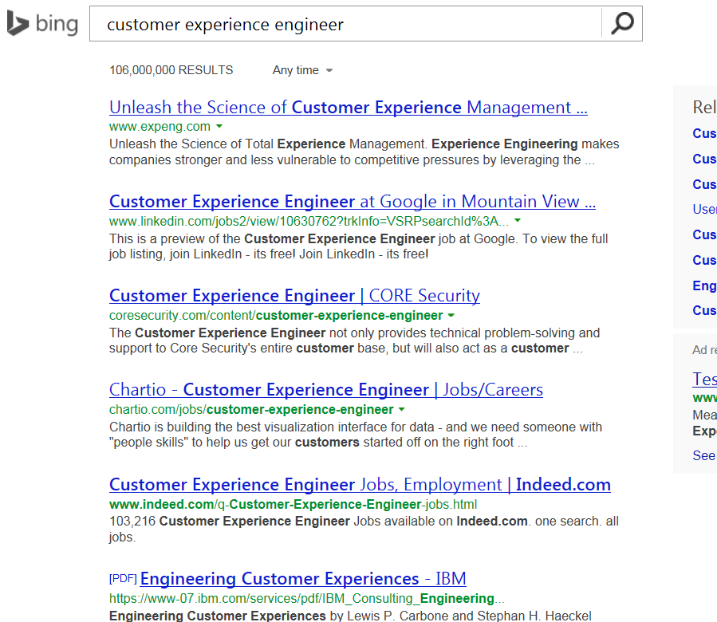
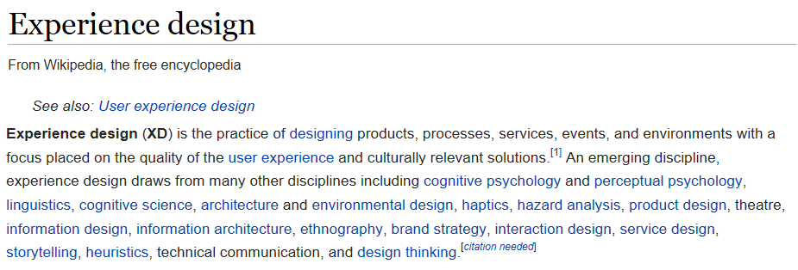
The world caters to your member
Customer experience design is changing what members expect
What do we have to change about our mindset that will allow us to engineer member experiences in a new way?
  Where compliance, ROI, employee convenience, and our internal perspectives are secondary
  Where we could feel confident that the member’s perspective was ruling the day

Slide 25
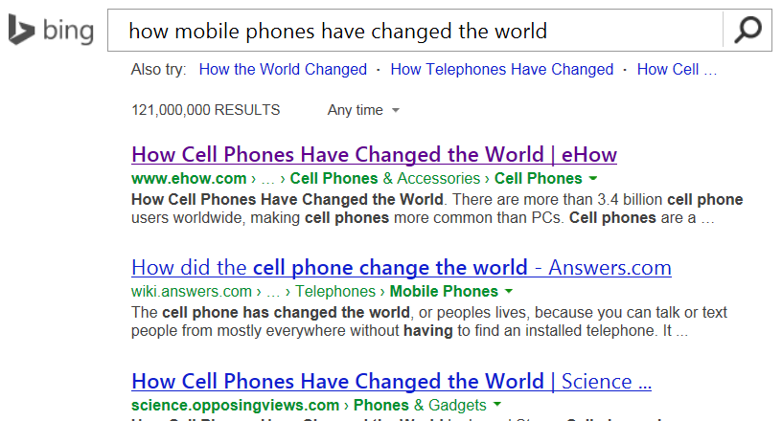
Designing for the mobile consumer
Can we match the expectations of our members in the next decade?
Almost everyone believes the mobile device is going to change the world, unlike anything we’ve seen before
  And many think it already has
The experiences members want on their phones today have moved from just access
to wanting to be entertained, amazed, and
instantly informed about things that meet their needs right now
That said, most “banking” apps have simply made a lateral move
  What you could do on a desktop, you can now do on a phone
Banking has not been revolutionized, but members and consumers are sure it will be soon...

Slide 26
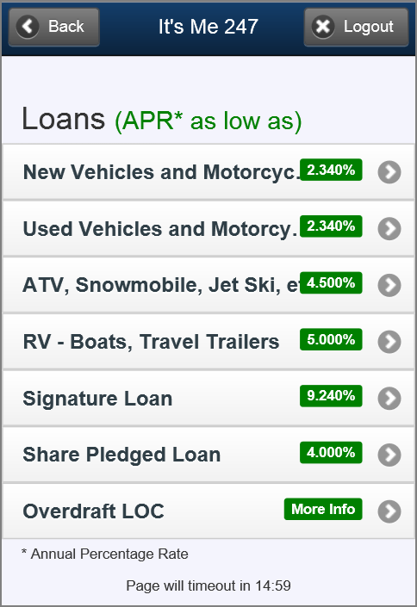
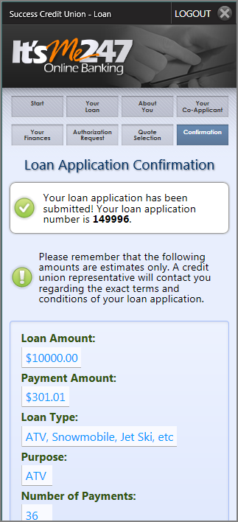
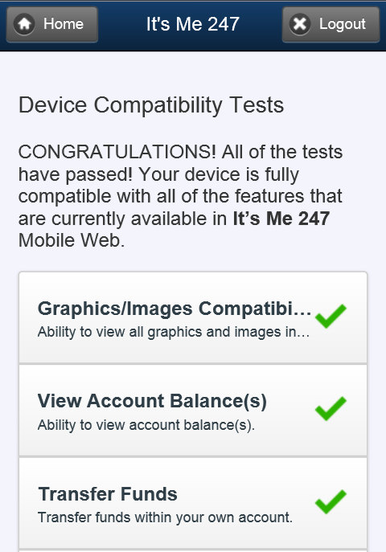
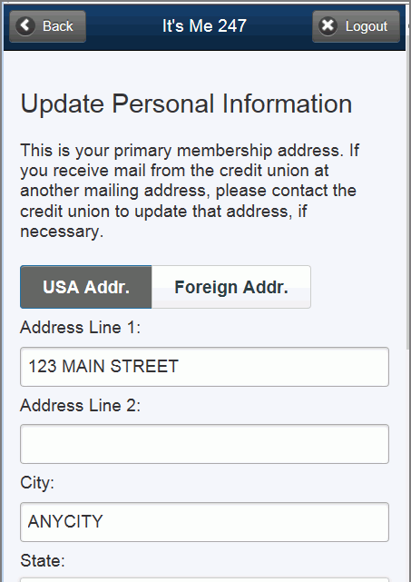
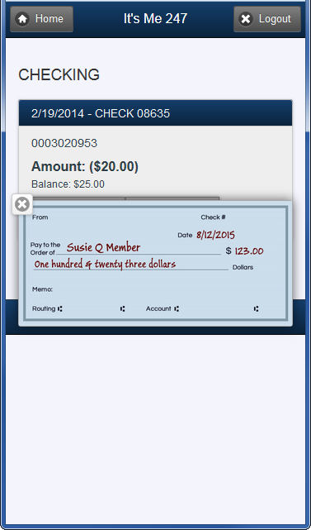
Completing the lateral move for It’s Me 247
Mobile Web Enhancements Since Last Year
Members can now...
  Apply for a loan via mobile web
  View rate boards via mobile web
  Open sub accounts
  Update their personal information
  View a cleared check
  Confirm their device supports mobile web features
And coming in July...
  Jump to their other memberships!
  (more on that in a moment...)

Slide 27
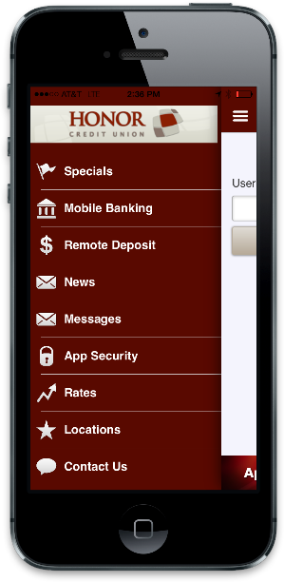
Completing the lateral move for It’s Me 247
For credit unions using mobile apps with wrappers around It’s Me 247 Mobile Web, these new features were available day one
But they create an interesting conflict between what is native through Mobile Web and what you might be managing through your mobile app’s configuration system
Mobile Web Enhancements Since Last Year
Members can now...
  Apply for a loan via mobile web
  View rate boards via mobile web
  Open sub accounts
  Update their personal information
  View a cleared check
  Confirm their device supports mobile web features
And coming in July...
  Jump to their other memberships!
  (more on that in a moment...)

Slide 28
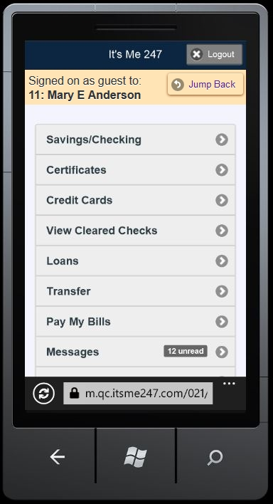
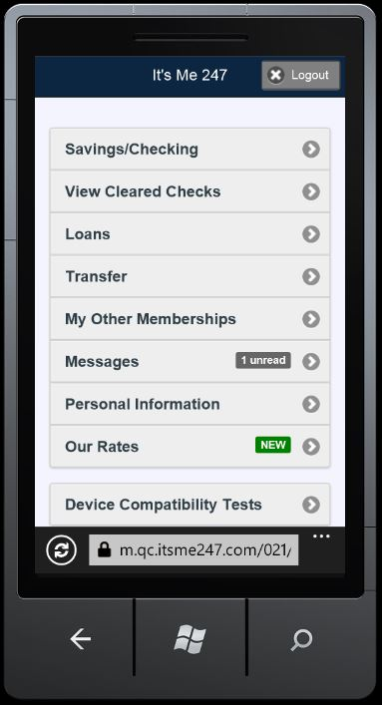
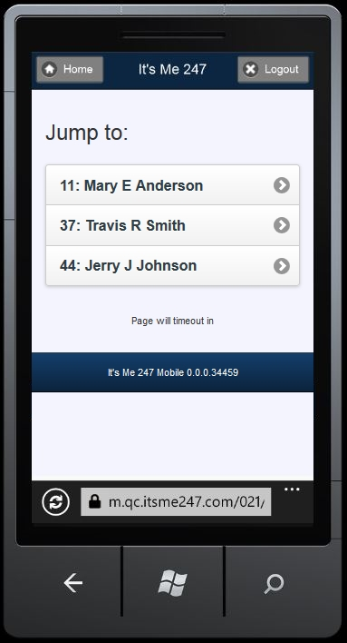

Jump for Mobile Web
Coming in July for FEP Beta CUs ONLY
What’s next on the agenda?
Print an e-statement from your mobile device (leftover from last year’s list)
Browser-based RDC
Other user interface enhancements (slider menus?)
Push marketing, links back to a CU’s mobile website
Web page brochure content, merged with web banking

Slide 29
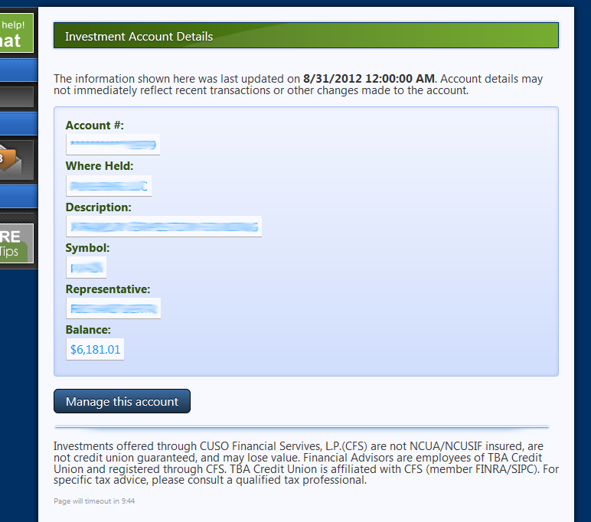
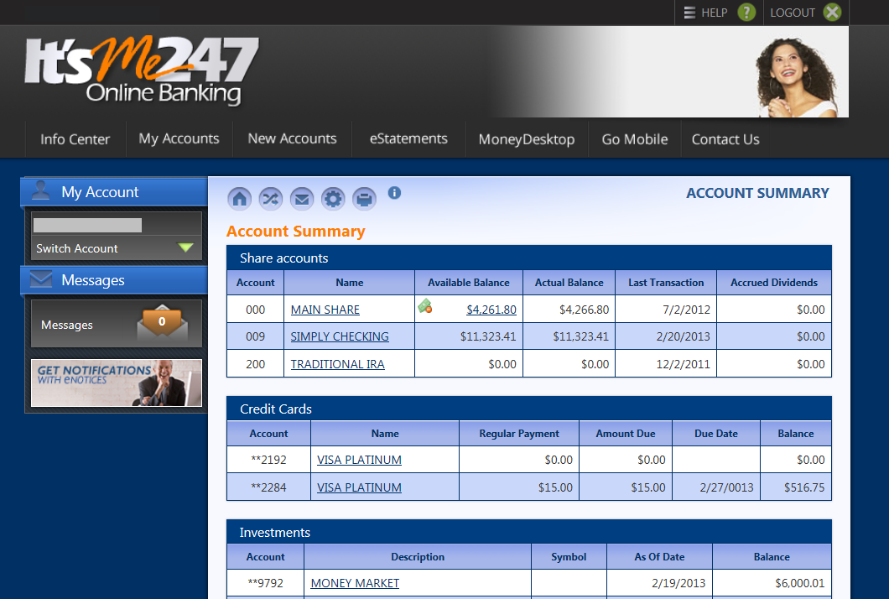
OTB in Mobile Web
Loans, credit cards and savings are there, but not cfs investments (yet)
When is too much information a
bad thing?
We need to go back to the drawing board on CFS presentations in 2015
http://gividends.com/its-me-247-investment-center/
One of my priorities for after FEP is to attack the CFS data exchange and take this up a notch

Slide 30
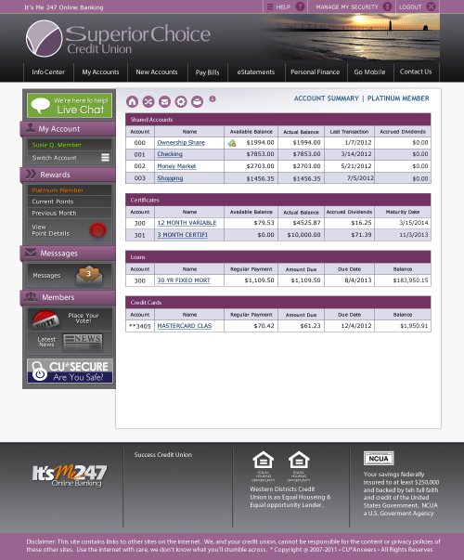
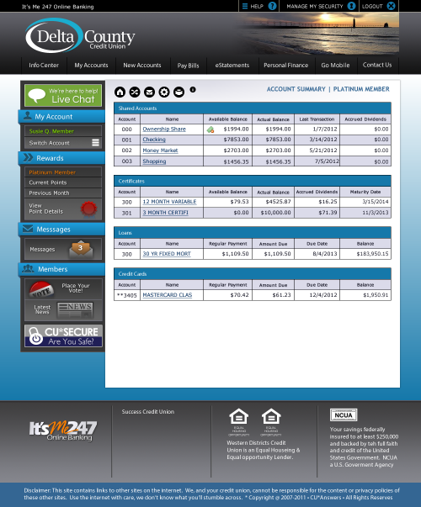

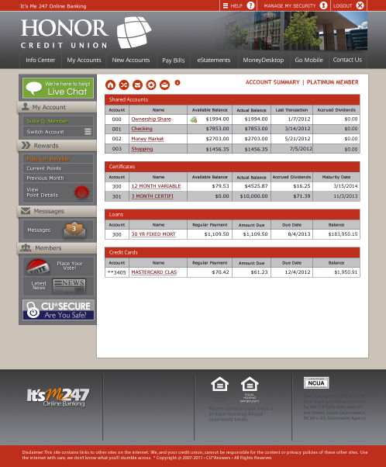
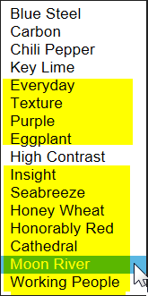
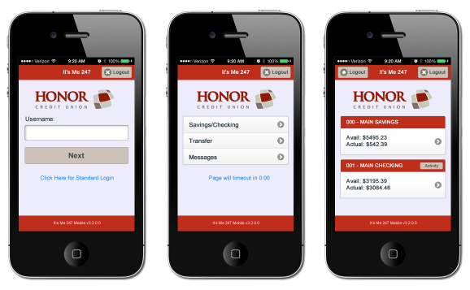
Custom Branding for It’s Me 247 Desktop and Mobile
A success story I would not have predicted
Introduced March 2014, and we’ve
already completed:
9 Custom Desktop Themes
13 Custom Mobile Themes
17 Logo Swaps
3 Photo Albums
2 Custom PFM Brands
...and added 11 new color
themes that all members
can use!
Learn more: http://ws.cuanswers.com/development/self-service-branding/

Slide 31
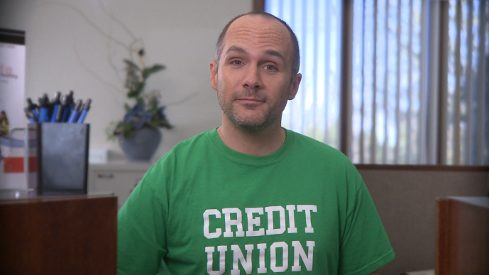
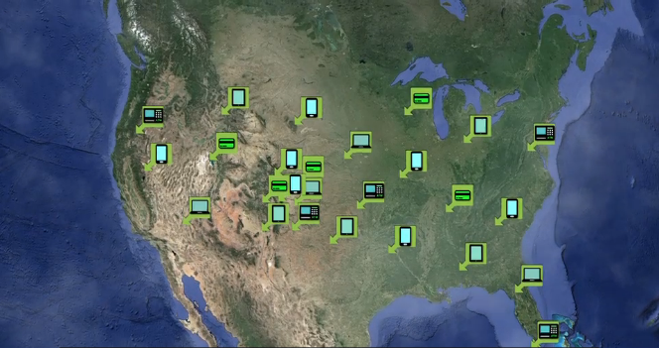
What’s unique about It’s Me 247 Mobile Web?
It’s FREE!
  And it’s guaranteed to be free, part of our It’s Me 247 desktop offering, for all time
  It guarantees every cuasterisk.com credit union has a smart phone banking solution
It can evolve with each new feature we add to It’s Me 247 desktop (and vice versa)
It sets the stage and expectation with the member that their credit union is evolving with them
2010 Contest Winner:
“Your CU is Everywhere”
2014 Video Contest Winner
“Right There With You”
It guarantees that your credit union is everywhere, and is up to speed with the explosion of personal devices

Slide 32
Engineering Member Experiences...
...For the mobile consumer via mobile web
...For the mobile consumer via mobile apps/APIs
...For every-thing via APIs: the evolution of desktop online banking

Slide 33
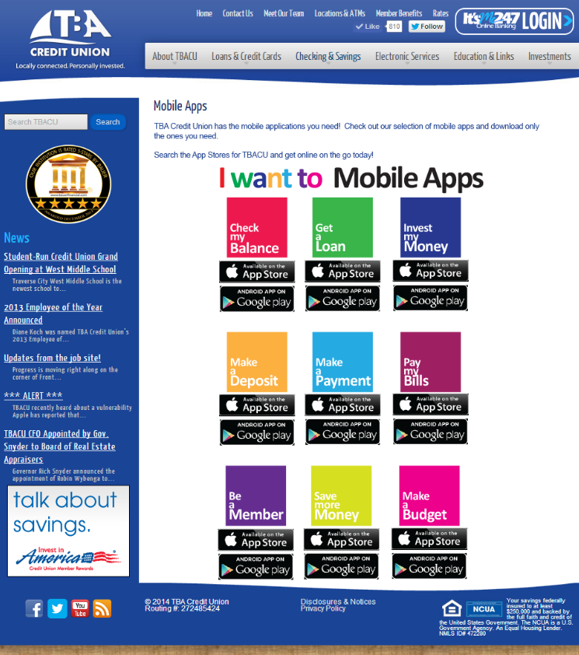
But where do we go from here?
Every credit union, ready to say “I have an app for that”
What if we could create a series of apps that used API interfaces, and guarantee those to our network credit unions, for FREE?
Could credit unions develop the persona of being an app store, tailoring member experiences to what members want, right this second?
Instead of using the kitchen-sink approach, what if we started to build a library of tools members could have fun with, and credit unions could experiment with?

Slide 34
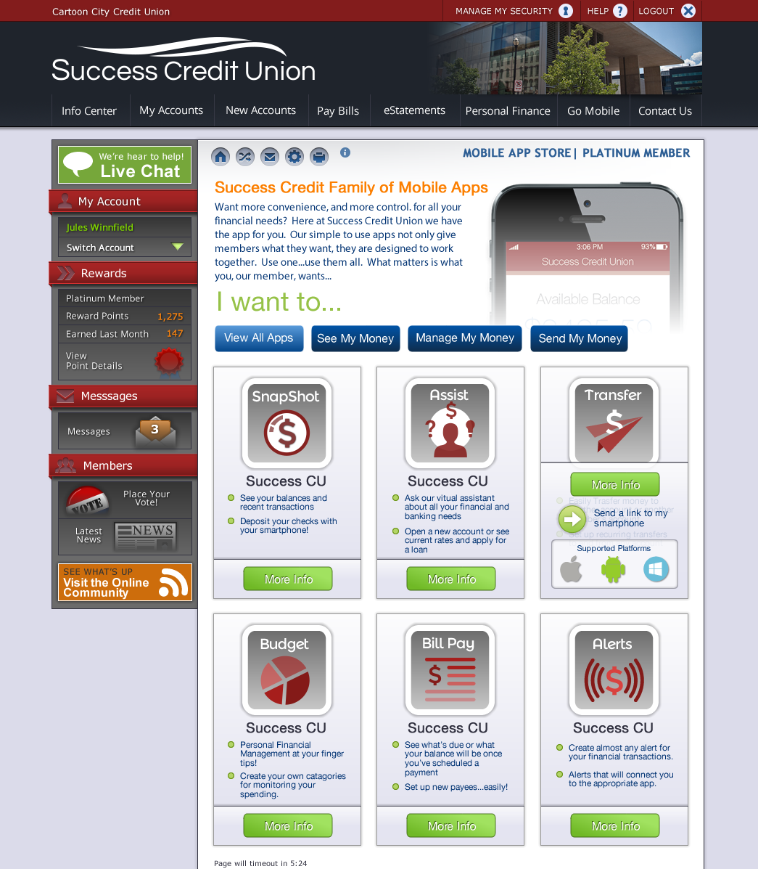
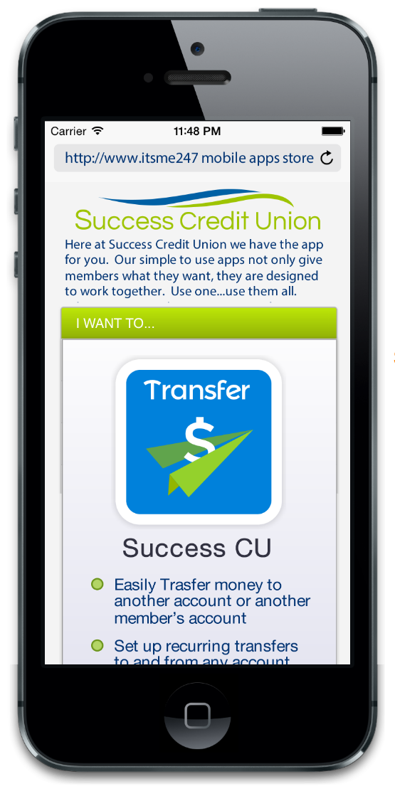
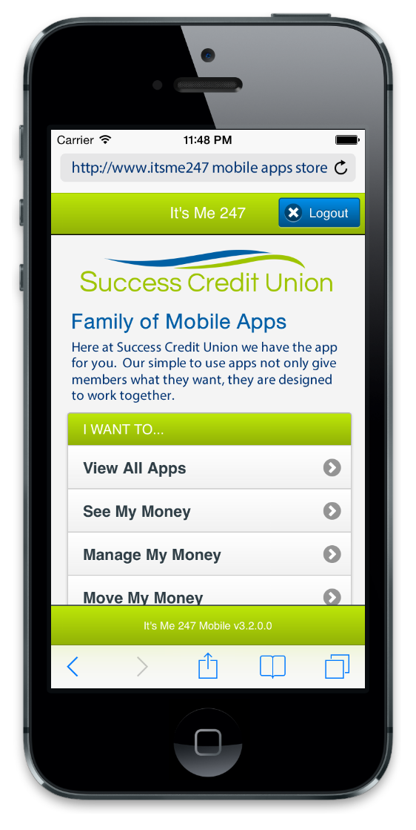
“I have an app for that”
And making the member believe it
Here are a couple of additional app stores that you’ll present in the future

Slide 35
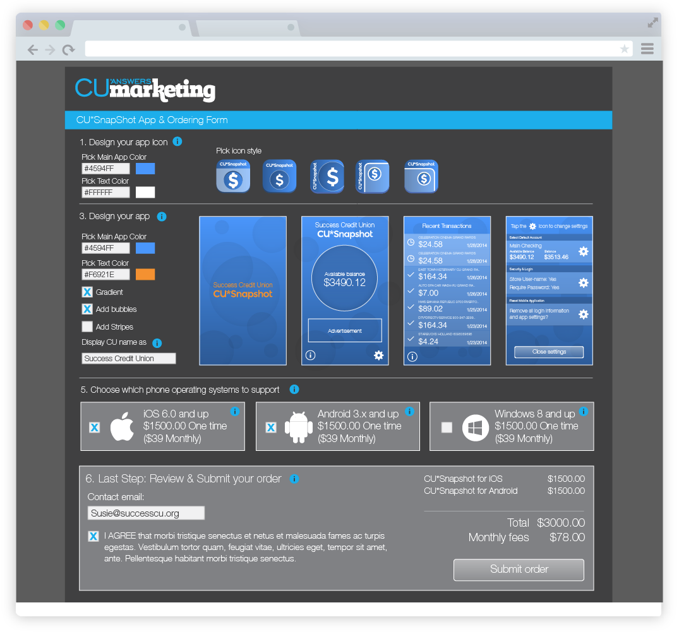
New foundations
Build the business to be an app store
We have to build the foundations to actually move apps from the developer’s bench to your member, effectively
  From our bench and from third parties, too
The concepts for these foundations started when we built the new graphic development tools for
It’s Me 247 online banking

Slide 36
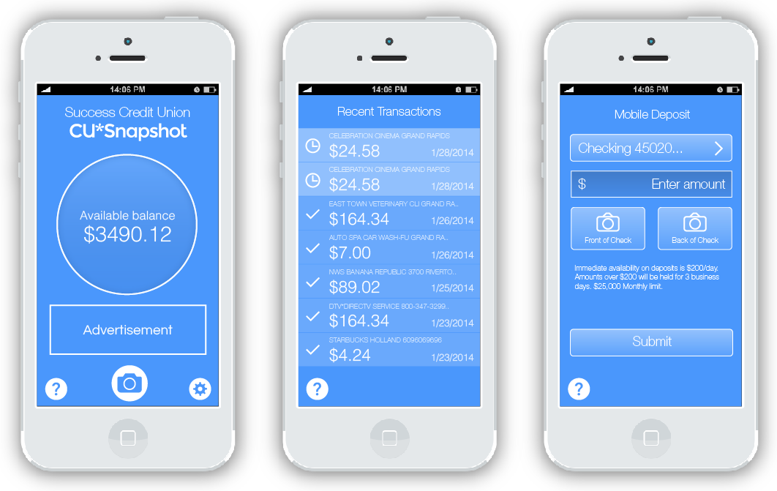
Our first app, on the drawing board now
Fast-to-market Micro apps: the lego blocks for a long future
3 functions
  Quick check of account balance
  Quick look at recent transactions
  Exchange images
Under the covers
  4 key APIs, to be leveraged everywhere
  1 huge business CUs wish we were in
(By the way, BoA beat us to the punch on the “Snapshot” moniker)

Slide 37
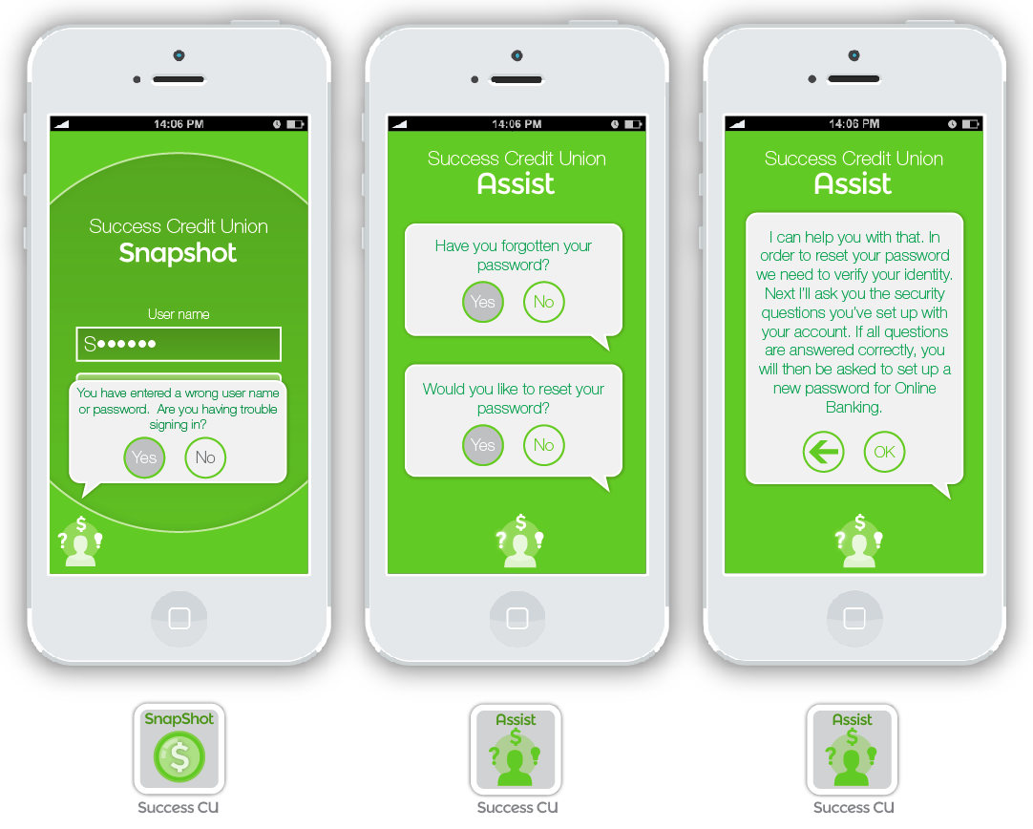
Breaking this down into small pieces
That can adapt rapidly for an emerging vision of what banking will be
I want an app to...
  Deposit a check (image)
  Save money
  Get a great loan
  Pay my bills
  Manage my money
  Invest money
  Get help from my credit union
When we’re done, we’ll hook them all together and we’ll have a kitchen-sink app

Slide 38
The next generation of CUs in the app marketplace
“It’s about me, I have lots of solutions, my store stocks apps from many sources”
Most “banking” apps have simply made a lateral move
  What you could do on a desktop, you can now do on a phone
Banking has not been revolutionized, but members and consumers are sure it will be soon...
will we be ready?
Priority #1 for the CU: build a business model that will be able to distribute apps that revolutionize banking in the future
Priority #1 for CU*Answers: build a factory that can adapt to revolutionary new elements and extend those new capabilities to members
  Plug a new app developed by a third party into the CU’s app store
  Plug the code for that new app into It’s Me 247 as a new “I want to” app
Everybody is tracking new concepts, new companies that are emerging, and small prototypes they hope will revolutionize banking, without putting all of us out of business

Slide 39
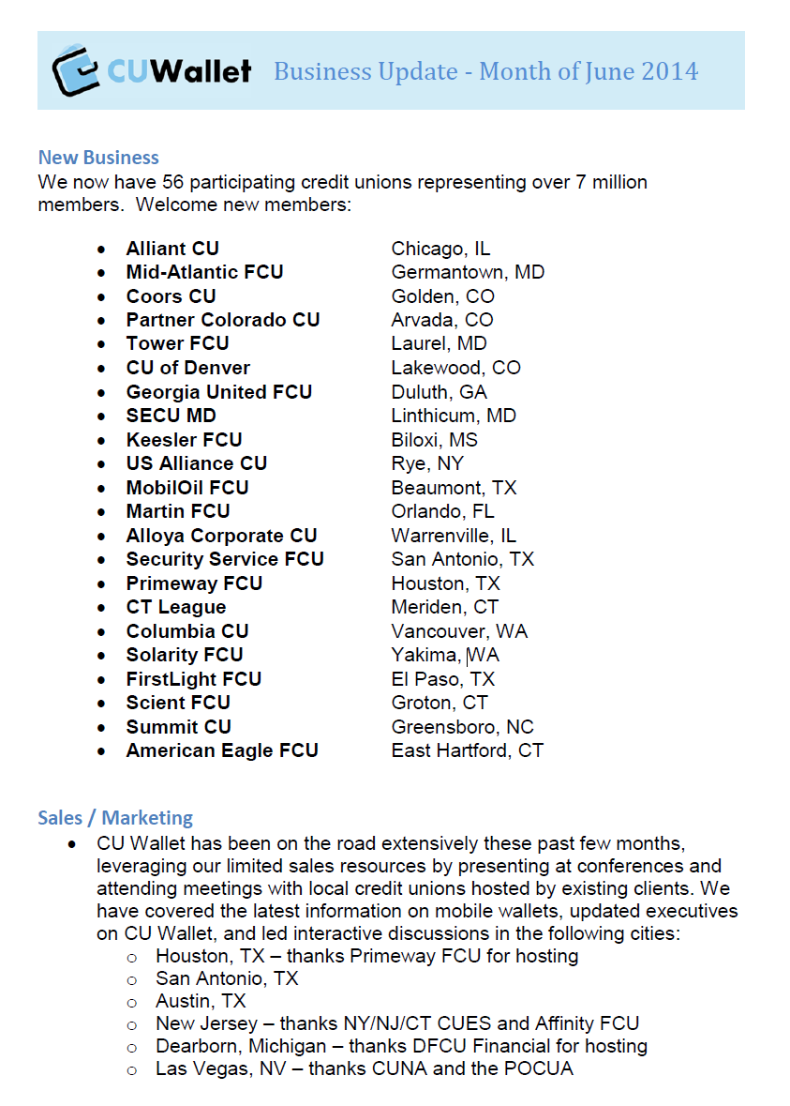
What can you do now, while you are waiting for a new future?
How are you planning to set up your members with new wallet apps?
How will you use a piece of code that takes a picture of a car and turns it into a loan?
How will we blend new things with the easy stuff we already do?
Now is the time for us to build this foundation, and continue to track emerging opportunities

Slide 40
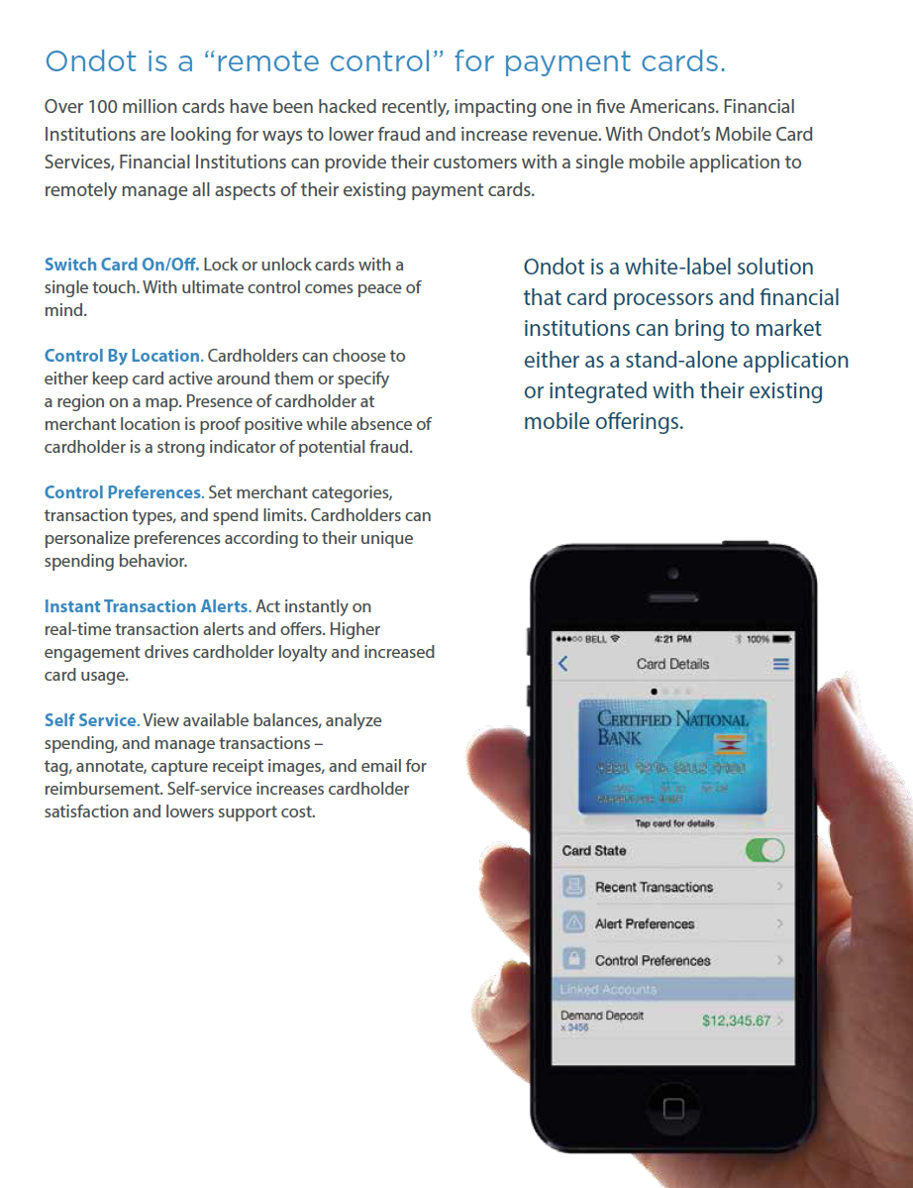
Patience is a virtue
But it’s hard
Ondot
I wish I could say the future’s here, and in some cases the technology is available
But is your business plan ready? Is your culture geared up to make money on these kinds of investments?
Are we (credit unions and the CUSO) ready to make it work, support it, insure it, and stay committed to it?
And sometimes we might not be the right distributor
Mobile apps that control plastics might be better sourced by ATM/Debit/Credit vendors

Slide 41
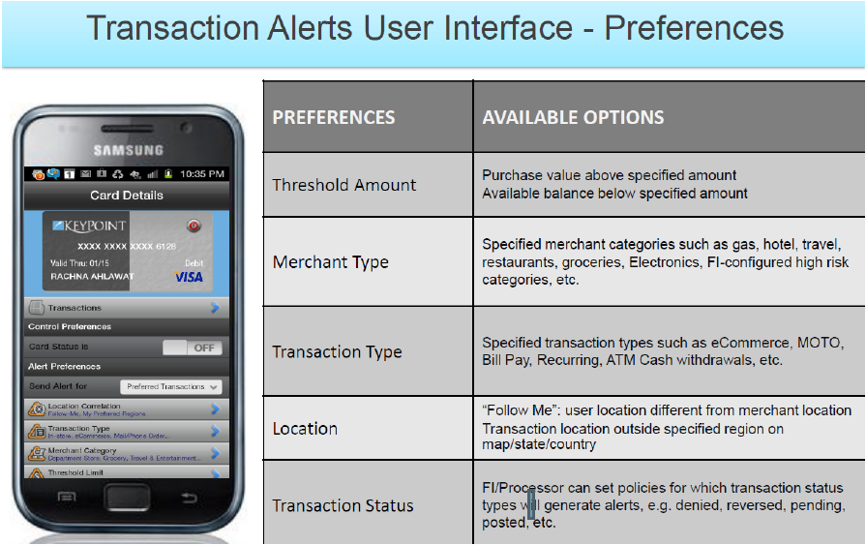
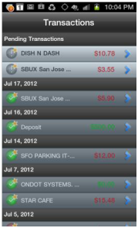

Vantiv and the Ondot partnership
Not sure we can improve on this
What is your vendor doing?

Slide 42
Did you say for free?!?
The API library is the foundation, Mobile apps are the frosting on the cake
CU*Answers must make a fundamental change in the way we interact with online channels, vendors, and even our own internal programs
  Native CU*BASE APIs are paramount to our success in the future...not just for mobile
  To be creative, we cannot rely only on the APIs of third parties
  We need to develop very specific and creative messages so that our data can be exchanged at a pace never seen before
  Therefore, native mobile apps will be the first expression of our growing capabilities for every channel
How will we use it?
  Convert all It’s Me 247 solutions to our API library in 2015-2016
  Continue to expand UCI for vendor integrations
  Develop new modules for mobile CU*BASE users...PHP tablet apps
  Support a growing set of online mobile vendors and credit union-desired extensions
In the end, it will be how we breathe, so mobile apps will be child’s play and available to everyone

Slide 43
Today, you decide with whom you’ll exchange member data
Tomorrow, the member may decide ... Will you be ready?
Think about how the world interacts with you to facilitate your members’ activities with third parties
  Is this your member? Do they have money? I am taking their money, pay me later. Repeat...
  To date, these messages have been locked down, available to a relatively small number of select vendors
  In the future, CUs could be bombarded with reasons to interact with other vendors on their members’ behalf
What if one day the member declared you their personal data liaison to the world?
  Instead of basic transaction messages, what if the world could ask you almost anything about the member, to help that member interact with the world?
  Imagine a store asking you, “what is the underwear size for Randy Karnes?”
The push for APIs has moved
beyond a desire to hook CUs up to vendors
Now we need to be ready to hook members up to the new economy, one message request at a time

Slide 44
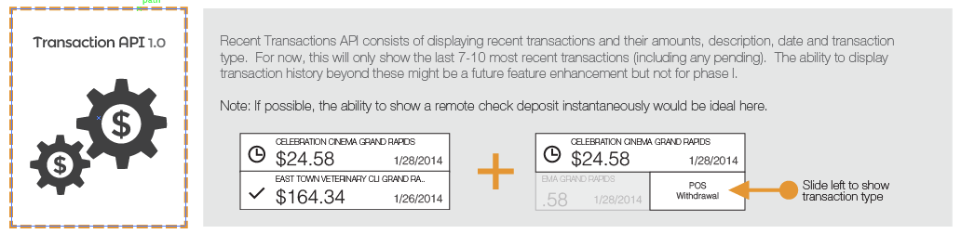
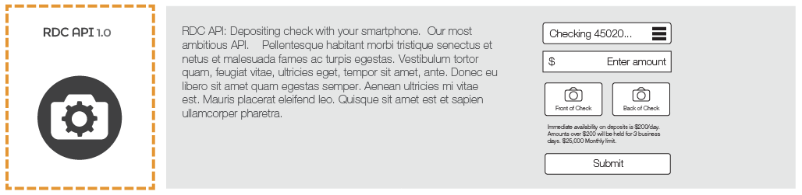
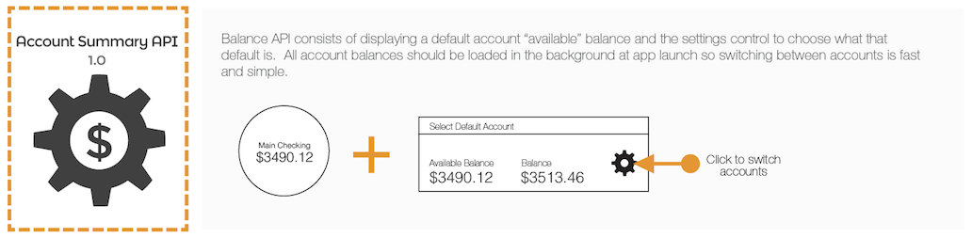
Tomorrow’s APIs will allow databases to exchange data as currency
An API can be the instruction on how a piece of software would authenticate itself and see member information
An API can do the same thing for telling a piece of software how to post to a member’s account or request a balance

Slide 45
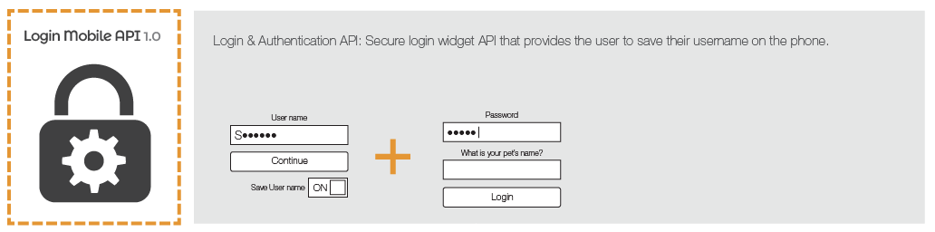
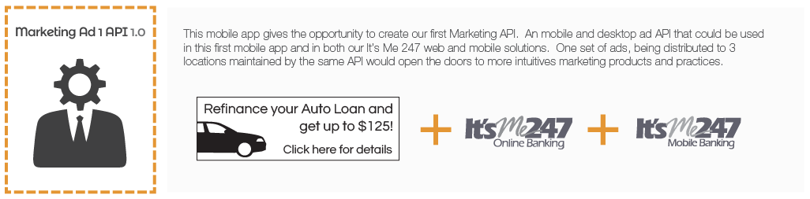
Tomorrow’s APIs will allow databases to exchange data as currency
Build an effective message library
Prove that it works within your own environment
Extend it to vendors and their clients that wish to pay for access
Use the funds to develop additional extensions and front-ends that CU*BASE credit unions need natively
This is a new business for us all, and one that will fund the capabilities of all our organizations

Slide 46
Why was it a “no” last year, and a “go” this year?
It’s always a no, until it’s a yes
The last two years we have been focused on putting a first-generation product into the hands of your members
  Smart phone banking via It’s Me 247 Mobile Web
  App store phone banking via wrapper solutions from third-party vendors
The lateral move is on solid ground, and about 99% completed
  It will continue to evolve as a standard of our CUSO
Everyone is ready for the next generation, providers and consumers
So now is the time to respond to the hopes of credit unions to work with third parties via APIs – and more importantly, to position our own products to push the envelope with APIs
  Build what we can, and prepare for what’s coming down the pipe
Remember, you can host your own project, you can fund your own integrations, and you should always be ready to

Slide 47
Engineering Member Experiences...
...For the mobile consumer via mobile web
...For the mobile consumer via mobile apps/APIs
...For every-thing via APIs: the evolution of desktop online banking

Slide 48
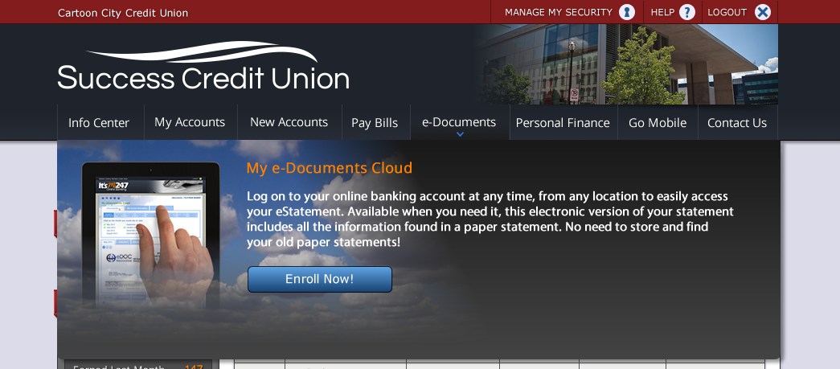




Upping our game
Exchanging images with members
Virtual strongbox
Coming to Community West CU in September!
A new team that will be making a lot of noise in 2015

Slide 49




Images are quickly becoming a common data element
They are currency, they secure relationships, consumers are fascinated by them
CU*Answers Imaging Solutions is a new team focused on the development of solutions specific to our environment
  It’s eDOC Innovations on steroids...but simpler
  More managed, more consistent, more focused on YOU
Electronic solutions can make things seem too easy, too automated – are you auditing the process?

Slide 50

Garbage in, garbage out
It’s an old adage for data, but maybe a new one for images
If we’re going to exchange images with members, store images for members, and do business based on images, we’re going to need a new level of due diligence
When we turn on hundreds of thousands of members to It’s Me 247 images, we could be asking for a lot of our members to call
  Will you show receipts, loan docs, driver’s licenses, and other things you store?
  Do you want to drop a document into a member’s virtual safe deposit box?
This isn’t a new task...it’s a business

Slide 51


Speaking of sharing information with members...
Over the past two years, we’ve done a lot of work to create new tools for retaining, analyzing, and acting on credit report data
Are you ready to tell the member what you know about their credit score?
Calling all designers!
We’ll be asking for your help for the specifics on how to sell this, disclose this, and figure out the configuration options you will need to turn it on

Slide 52


Speaking of sharing information with members...

Slide 53


CU*BASE Features for Analyzing Credit Scores
In Active Beta
with the 14.0 release you just got
Learn more about this feature in the upcoming Active Beta Study Group (Aug/Sept.)
http://study.cuanswers.com/

Slide 54
CU*BASE features designed to take advantage of what you know about your members’ credit score
MNMGMT 16 Credit Report Data Mining
MNMGMT 18 Loan Risk Score Analysis
MNMGMT 21 Where Your Members Borrow
MNCOLL 22 Print Risk Score Analysis
MNMGMD 13 Loan Concentration Risk by Member
MNMGMD 14 Loan Portfolio Concentration Risk
MNMGMD 18 New/ Closed Accounts Dashboard
MNMGMD 19 New/ Closed Membership Dashboard
MNMGMD 21 Package Loans to be Sold
Phone Operator > Cross Sales
MNLOAN 5 Miscellaneous Loan Acct Maintenance
MNLOAN 1 New Loan Request
  Credit Score History
  View Stored Credit Report File
  Open End Loan Contract/ Risk-Based Credit Score
  All Open Active Loans For Which This Borrower is Responsible > Analysis
  After pulling the report in the loan workflow it is also displayed in the upper right hand corner of the loan request screen (as are the results of a decision model if selected)
Member Inquiry
  Cross Sales
  Loan Account Delinquency window
  Household Statistics
MNLOAN 8 Lending Queue > Loan Application > Credit Report
MNRPTE 2 Loan Info Report > Loan Delinquency Analysis
MNMGMT 22 Targeted Tiered Score Analysis
Enterprise Risk Management Tools (ERM) MNRISK 1 Monitor Credit Risk
Enterprise Risk Management Tools (ERM) MNRISK 3 Monitor Concentration Risk
And soon to be in It’s Me 247
...In other words, all over the place!

Slide 55

API Bill Pay Interfaces
Redefining an expensive game
Some goals for our future
  Redefine the math for bill pay pricing
  Increase number of bill pay vendors supported
  Become vendor agnostic
  Create a standard owned by CU*Answers
  Redefine the math for bill pay pricing
  Integrate bill pay transactions into everything
  Blend CU websites with bill pay APIs
  Redefine the math for bill pay pricing

Slide 56


API Bill Pay Interfaces
Redefining an expensive game

Slide 57


Why would we build something new for what we already buy so easily?
Simply put: for a new future
Even the bill pay vendors are moving towards an API future where their network retailers follow this strategy
  Not sure we’ll even be able to buy a canned user interface in the future, from any bill pay provider
That said, it is our plan to offer a configuration switch that allows a CU to pick which interface to use for their chosen vendor
Look for more information soon about a third choice for your bill pay program – would you consider being part of a new solution in 2015?

Slide 58



A new tool to facilitate new extensions
There’s an explosion of new ideas to include tools in It’s Me 247
Timeout warning (mobile and online banking)
  Coming in the 14.3 release (Nov/Dec)
Especially nice for MoneyDesktop users!

Slide 59




It’s My Biz 247
A second online application from CU*Answers
More than an enhancement to It’s Me 247, this is CU*Answers launching a second platform for online banking, and eventually mobile banking
  Currently in beta with 3 CUs, we plan to launch an aggressive rollout after the new year
  We’ll talk about building a credit union for business members at this year’s CEO Strategies events in November
Do you know the difference between serving members who happen to be businesses, and building a credit union for businesses?

Slide 60
On the drawing board for It’s Me 247
Big, Bold Priorities
Also On the Docket
Forcing Usernames
  Configurable...but an examiner priority
  Targeted for 14.2 (Sept. - FEP only)
  Market, market, market!
PFM
  Big-picture messages for members
  Available to everyone
  Use data elements unique to CU*BASE
  Blend brochure-ware with banking
Smart Offers
PIB rewrite (mirroring MLO)
Expanding eAlerts and Smart Messages
Qualified Dividends status
Skip Pay (waiting for CU*BASE)
Secure 2-way messages (will use also for the credit scores project)
Then the trick will be how to make these features in desktop banking flow easily and effectively into our mobile solutions

Slide 61

Designing member experiences
Are you hearing me?
It can feel like we’re on a hamster wheel to add more and more features
  All the things I just showed you could be checkmarks on your tactical wish list
What I really hope you’re hearing is that in the future we must focus on designing these features so members feel they own the joint
You’ve got it, but does the member want it?
The difference can be how they felt about the experience

Slide 62

Designing member experiences
Speaking of how members feel...
Time for another video!
Are you hearing me?
It can feel like we’re on a hamster wheel to add more and more features
  All the things I just showed you could be checkmarks on your tactical wish list
What I really hope you’re hearing is that in the future we must focus on designing these features so members feel they own the joint
You’ve got it, but does the member want it?
The difference can be how they felt about the experience

Slide 63
Passing the Tipping Point
noun: “The point at which an object is no longer balanced, and adding a small amount of weight can cause it to topple”
Is this your business? (I hope not)
Is this our industry? (I kinda hope so)

Slide 64


Consider these two definitions
Where are you, and who do you wish to be? Do you have a green light?
“It’s all too much...compliance, the regulators, the pressure for new products and services.”
“Our services are obsolete, and there’s nowhere to go. How can anyone make a buck in this market?”
“Members have forgotten they are owners. Cooperatives have no place in this market.”
“I just got the green light from my board, and I think they actually mean it this time.”
“Another postage increase. The straw that broke the camel’s back...I can now move forward with my statement fee program.”
“I finally have the n^{th} member ask me why we haven’t launched yet. It only took one more person to ask.”

Slide 65
How do you assess your impending tipping points?
Are you dreading the future? Or Are you anticipating the other side?
This definition could be both positive and negative
  Instead of “I’m just about to give up” it could mean “I guess it’s finally time to act”
It comes down to the same question:
What are you waiting for?
  Do you know? Do you have a plan?
  Will you act in time?
This definition makes me think about someone who’s optimistically anticipating the moment to act, and planning ahead as to what the trigger will be
It comes down to the same question:
What are you waiting for?
  Do you know? Do you have a plan?
  Will you act in time?

Slide 66
Things that seem to be at a tipping point
Do you have a plan b? Do you know when to enact it?
Interchange income
Paper checks
Teller lines
Audio response
Text banking
Free paper statements
Cash
Centralized employees
Everything is free
Desktop computers
Big dollar marketing
Virtual/Internet game plans
Call centers that only answer the phone
Examination processes
In-office loan closings
Using your account number online
Stored value cards
Retailer reward programs vs. financial institution reward programs
The value of owning virtual capital in the credit union
Credit union annual meetings
Credit union elections
______________________
______________________
______________________
______________________
______________________
What are you waiting for?
  Do you know? Do you have a plan? Will you act in time?

Slide 67
Things that seem to be at a tipping point
Do you have a plan b? Do you know when to enact it?
We have all seen the data, and we know the stats
But as leaders, have we shared the mechanics in actually doing something about pending changes we cannot avoid?
Can we learn from each other?
A new goal for Learn From a Peer: What was the straw that broke the camel’s back and made you change the way you were doing business?
What pushed you past the tipping point, and how did you prepare for the future?
Can your peers help you write Plan B and give you a clue on the signals to which you should respond?

Slide 68




Your need for a Plan B is about to smack you in the face
2014 Spirit of CU*Answers Award
The NCUA thinks the insurance fund needs to be more secure, and your future a lot less secure

Slide 69


Tipping Point: Are we about to change the way we comment as cooperative owners?
cuasterisk.com represented approximately 17% of all comments the NCUA received on this issue
Evolution or revolution? Either way, we have to
change the conversation we have with America

Slide 70



From ideas to tactics, from tactics to influence
We need your participation to change the compliance dynamic
For credit unions, AuditLink is quickly becoming an effective place to exchange ideas and improve execution
For CU*Answers, AuditLink is an engine for designing tools and changing the operating expense related to compliance so that credit unions can get on with serving members
Participate with AuditLink as a design engine, and expect your capabilities to increase and your expenses to decrease

Slide 71


From ideas to tactics, from tactics to influence
We need your participation to change the compliance dynamic
We need to track to attack
We need to go beyond venting our frustrations, directly into documenting our issues
We need to launch new prototypes that can help us quantify new approaches and inspire new confidence that compliance is just part of the game
Contests begin next week...watch your email for your chance to get a piece of that $5,000 prize!

Slide 72

Why does it have to be so hard?
Coming soon!
How can we exchange ideas – with the intensity to send something over the top, push it past the tipping point – without making civil people uncomfortable?
http://tellmewhyimwrong.com/

Slide 73
Passing the Tipping Point
Being an Internet retailer for non-members
Being an Internet retailer for existing members
Being an Internet retailer of cooperative activities

Slide 74
At what point would you consider your credit union an Internet retailer?
Some of you may not even have a Plan B to become an Internet retailer
  It’s good enough for you just to do some stuff on the Internet, and your marketplace does not yield the critical mass necessary to make such a drastic statement
For others, making a shift in the way they think about themselves as an Internet retailer is the only way they’ll push over the top with their future membership
  For these CUs, having their culture accept the idea that they’re an Internet retailer will move them from Internet services being just another channel, to Internet services being a game-winning channel
  These CUs have to convince their members, their boards, their staffs, and the marketplace at large that their ability to start relationships, maintain relationships, and grow their business through virtual services is real and the default response to everything credit union
There’s no official certification or standard that declares you an Internet retailer
All of us are trying to define what’s enough, and what it means to DO BUSINESS on the Internet

Slide 75

The pressures to be an Internet retailer
It all comes down to how we harvest opportunity and earn a bottom line
There is growing pressure to supplement (or even replace) our traditional channels for acquiring new members and increasing our wallet share with our existing ones
  Credit unions are trying to crack the code for virtual sales, especially as more
  and more community charters try to figure out how to cover large areas and
  diverse member opportunities
Are you an Internet retailer? Take this test:
  Do you see the different risk, but accept and compensate for it?
  Do you consider it an offensive strategy you default to?
  Are you open for business to any opportunity that finds its way to you?
If you asked today’s Internet shopper what they think makes an Internet retailer, what would they say?

Slide 76
A more classical set of conditions for being an
Internet retailer
You can browse product details and value propositions
You can buy (fund) a purchase directly on the Internet
The funding can come from multiple sources in your “wallet”
You can check out with your virtual shopping cart
You get a deal for shopping on the Internet
You have a reward program that recognizes who you are
You can get coupons from this retailer and sometimes from their allies
You can post suggestions and read your peers’ comments
You can request a live chat or in-person conversation for assistance
You get suggestions about additional products that fit your profile
The experience makes you feel like “this is the place to do business”
It changes often, and you notice something new every time
To date, we’ve imitated some of these things, but we haven’t committed with the intensity that would brand us Internet retailers
I wonder what will push us past the tipping point

Slide 77








We have the foundation
But how do we drive harder to use these techniques?
Live Chat
Customized rates, products names, and sales content for online products
Personalization
Smart Messages
Relationship Tools
What can we do to push us all into the mindset of being an Internet retailer?
Should we?

Slide 78



Consider this...
CU*BASE is full of data markers that could direct and influence interactions
Are CUs ready to have a computer tag a person’s preferences, personality, possible likes and dislikes, then tactically serve them based on that tag?
  Like what Amazon does
MNMGMA #26 Config. Transaction Labels
(There’s that cognitive psychology stuff again...)

Slide 79
Passing the Tipping Point
Being an Internet retailer for non-members
Being an Internet retailer for existing members
Being an Internet retailer of cooperative activities

Slide 80
Being an Internet retailer for non-members
it’s probably not an offensive tactic unless members can join this way
Credit unions do not believe the marketplace will take them seriously as Internet retailers if an interested person cannot join the credit union via a desktop or mobile device
  Consequently, CUs don’t believe CU*Answers wants to be a provider of Internet solutions, unless it has a solution for joining online (actually, multiple solutions)
At CEO Strategies last November, CUs got together to stress the importance of this to the CU*Answers Board – and the Board has dictated to management: CU*Answers WILL have a native membership opening tool
  Available for every CU, priced effectively for every CU, and part of our
  e-Commerce package going forward
My challenge to you: Will you turn it on?
  Can you say Yes to the tests?
I loved getting the green light
to push this over the tipping point
And I love the commitment I’m seeing to building this as a collaborate solution...I hope you’ll get involved

Slide 81



Membership Opening Project
Concept designs we’re working on

Slide 82



Slide 83



Slide 84



Slide 85



Slide 86


Slide 87
Where do we go from here?
What we’re going to do
What you need to do
We believe we’ll have a solid spec by the holiday season, and we’ll preview that with the CEOs at CEO Strategies in November
We’ll start with a significant development effort in the first quarter of 2015
Look for a Kitchen page and regular updates along the way
Take the Internet Retailer Test:
  Do you see the different risk, but accept and compensate for it?
  Do you consider it an offensive strategy you default to?
  Are you open for business to any opportunity that finds its way to you?
Get the green light from yourself to turn this on and help us evolve the process from this point forward

Slide 88


Does this mean we can only do it via CU*Answers?
As an API-based product, we believe the answer is no
We do believe that as Internet retailers, you’ll have to be able to process membership applications from multiple sources, and with multiple tools
We plan to write this product with an API message set that we can interface with other solutions, and earn gateway fees
So start now
  Put membership applications everywhere you can
  Some will be automated to the point of opening the membership in CU*BASE, some you will have to work by hand...but you’ll still have a new member
  Launch additional websites that attract people who want to be members with a different point of view than your primary website

Slide 89



Work the opportunity...GLADLY
Whether the opportunity proceeds all the way to a membership automatically or not, Internet retailers simply want the lead
This year, launch as many portals to gather opportunity as you can
This is the new branching strategy – do you set goals for opening branches? Now set them for opportunity portals

Slide 90
Passing the Tipping Point
Being an Internet retailer for non-members
Being an Internet retailer for existing members
Being an Internet retailer of cooperative activities

Slide 91
The point of the membership opening project isn’t really opening new memberships...
When we’re done with the online membership opening project, we will have tools to
  Authenticate individual identities – take the chance they are who they say they are
  Collect money from people who may not have accounts with us
  Automate the creation of It’s Me 247 credentials and log a person in
  Fund deposits and payments with non-credit union money
  Deliver a person to a specific feature in It’s Me 247 when they sign on (like going directly to opening a checking account)
  Post a deposit or payment against a receivable for the credit union’s accounting
  Exchange documents with an individual and place them in the proper storage vault
...all of which will also be available
for third parties to use, not just us
Can you imagine the next generation of
It’s Me 247 products that will ensure your members believe you are serious about doing business online?

Slide 92

The point of the membership opening project isn’t really opening new memberships...
What if we could do a direct jump to opening accounts or applying for a specific loan product, from anywhere?
  Would still have to ask for credentials, but instead of a lot of member navigation, the process would be automated and to the point
What if it came directly from your web page? From a tablet app for CU*BASE? From an indirect dealer’s web page?
What if the new process could fund the account and do additional new fulfillment functions?

Slide 93




Are you ready to underwrite member requests in a new way?
How can you say yes to more, when it’s your member who’s asking?
Smart Offers

Slide 94





Changing how people get started with It’s Me 247
New tools in it’s my biz and the membership opening project reset our ideas
Current method
New method
Get the picture? We’re building Lego blocks to do new things – online and in CU*BASE – that will create enhancements for years

Slide 95


Changing how we think about the separation between websites and online banking tools
The first versions of app store mobile banking merged a mobile website and mobile banking into a single app
Can we do that with It’s Me 247?

Slide 96
A new contest for 2015
What if your credit union could configure 5 pages inside of It’s Me 247?
Actually take 5 pages from your website and have them embedded into the It’s Me 247 navigation
  This isn’t a link, it’s an actual page in online banking directly related to the credit union’s products and services, sold like you sell them on a website
  This website page, though, would have links that immediately activate an It’s Me 247 feature like it was part of your website, and not a standalone online banking product
Designers Wanted!
Weird, huh?
Can you give me 5 pages that you wish we would embed in It’s Me 247?
Details coming at the November CEO Strategies...put your thinking caps on

Slide 97
We need to develop to our competitive advantage
We own CU*BASE, we own It’s Me 247, we own the right to extend the messaging
Some people would have us simply hook up with others (Meridian Link, Andera)
  But 80% of the work to hook it up is the messaging
  We’ll do this, but then Meridian Link and Andera will control the price, and the evolution, good or bad
Some people would have us be the only solution
  But then 80% of the work would already be done to hook up to others
  The best way to fund that work is by selling gateways to third parties and the credit unions that wish to use them
Everyone will worry about how we do the final 20%
  We have to take advantage of what we can do that others can’t: change CU*BASE, change It’s Me 247, natively integrate the two to evolve together, and allow our customer-owners to control the price and the pace of evolution
Can you build game plans so that our competitive advantage is guaranteed?

Slide 98
Passing the Tipping Point
Being an Internet retailer for non-members
Being an Internet retailer for existing members
Being an Internet retailer of cooperative activities

Slide 99
Can an Internet retailer sell the co-op thing?
Online banking, mobile banking...where are the cooperative activities?
I’ve been trying to coin a phrase that would be the catalyst to a whole new area of development...activities specifically related to the cooperative charter, not just “banking”
  I can look up a balance, but can I vote?
  I can transfer money, but can I check on the financial health of my cooperative?
  I can look at my plan (PFM), but how do I see the credit union’s plan?
  I can pay my bills, but how do I get involved online with the bills my credit union pays?
  I can apply for a loan on my phone, but how do I attend an annual meeting on my phone?
  I can chat online with a call center rep, but can I do that with my credit union’s Board directors?
  I can feel valued as a customer online,
  but I get no sense of ownership from
  my credit union interactions online
This stuff is tough, and it’s taken a long time for us to get ready to be Internet retailers for banking
When will we get started saying we’re Internet retailers for credit union ownership?

Slide 100

A message from management (frustrated management)
Making Ownership Real is the #1 issue in the industry today...the rest of the “banking tactics” are just stuff to do when you can afford it
No wonder members do not get what ownership is: no one wants to write a plan to convince them
$1,000 would buy a lot of banking tactics and pay for something to get started in a CU that is trying to move the ball
Looks like I am pushing up a rope here!

Slide 101

Where is the tipping point when it comes to your boardroom?
The virtual space is 24x7, but more importantly, it’s on demand, and it fits the lifestyle of your Board member – they can work when they want to
Do you let them?
The offer to let your Board have micro-awareness about the firm you are building with them is not the same thing as encouraging micro-management from your volunteers

Slide 102


The intent to push data all the way to the edge
For your eyes only...does it include the owners?
The energy to design products with this intent is dangerously low in our industry today
We all know the reasons, but can we survive if we allow these roadblocks to determine our futures?

Slide 103





Do you remember when we introduced these ideas?
Introduced June 2012
Introduced November 2009

Slide 104

We haven’t completed the lateral move for this yet
How will we ever revolutionize being a co-op? Credit union?
It’s easy to say, “everything must move to a new delivery channel” when it comes to tactical banking approaches
Why is it so hard to be consistent in this thinking when it comes to creating, selling, and motivating cooperative activities in new channels?
If we can’t make the lateral move, how are we ever going to make the revolutionary push?

Slide 105







Do they care? Will they respect the effort?
Pages on our current website: 3,000+
It starts with the belief that
respect is earned by showing respect
In a world where everybody can create a
viral phenomenon, how can we not try harder?
8 out of 10 new clients say they came for the business model, more than the products and services

Slide 106
Data Analytics and
Big Data (Year 2)
“What the world knows about us just might be more important than who we actually are”
...the American Consumer
Databases can evolve as the results of what we do, or they can be architected so we can do more, know more, sell more, and inspire us to attack new opportunities

Slide 107





When I say data, you think...
It’s work...always has been, always will be
How are you investing to get your return on data?

Slide 108




When I think data, here’s what I see
Robert H. Mackay Award

Slide 109

Collaborative priorities: how do we set them?
In the next ten years, we will transform the way our industry thinks about data
That means a whole new generation of investments to take advantage of a world that plays the game by x’s and o’s more than by what you know face to face
  What new activity should we create that will yield data we need?
  What capabilities should we invest in to show us what more
  can be done?
  If we knew more, do we have the factories to do more?
  If we could sell more, would we feel comfortable in acting on it?
  Can we be inspired to play a different way?
Setting investment priorities at CU*Answers
around data is a priority challenge for
its owners and leaders
“What the world knows about us just might be more important than who we actually are”
...the American Consumer

Slide 110
We need to invest with two targets in mind
Credit unions need to be ready to receive – and get an roi – on both
Investing for answers
Investing for raw materials
Reports
Dashboards
MyCUToday
Canned Queries
Data exports to PDF, Excel, *.CSV files
Targeted operational tactics: Do something, sell something, make something happen
  The answer is refined for action
Adding new data elements
Modifying data to fit today’s business environment (bigger fields for $ amounts, etc.)
New upload/download capabilities
New Internet data collection capabilities
Targeted at intuitive resources that can refine data and find insight to act
  Whether at the CU, at a vendor, or through capabilities we build as a network
Sometimes when the answer doesn’t take you where you want to go fast enough, there’s a sense that your intuition would, if only you could see what seems to be hidden from sight
What is more expensive: the answers, or teaching intuition?

Slide 111

We need to invest with two targets in mind
This is why we need your help with
validating, verifying, and evolving the answers
Credit unions need to be ready to receive – and get an roi – on both
Investing for answers
Investing for raw materials
Reports
Dashboards
MyCUToday
Canned Queries
Data exports to PDF, Excel, *.CSV files
Targeted operational tactics: Do something, sell something, make something happen
  The answer is refined for action
Adding new data elements
Modifying data to fit today’s business environment (bigger fields for $ amounts, etc.)
New upload/download capabilities
New Internet data collection capabilities
Targeted at intuitive resources that can refine data and find insight to act
  Whether at the CU, at a vendor, or through capabilities we build as a network
http://study.cuanswers.com
Sometimes when the answer doesn’t take you where you want to go fast enough, there’s a sense that your intuition would, if only you could see what seems to be hidden from sight
What is more expensive: the answers, or teaching intuition?

Slide 112



From CEO Strategies Week November 2013
When will we need to hire these talents in our network?
Should we trust the intuition of data scientists more than the intuition of our network’s leaders and operators?
What was your budget for data analytics in 2014?
  2015? 2016?
Are you ready to study the problem in a new way, so CU*Answers can invest in a new way?

Slide 113

Announcing a Data Investment Symposium
Who will lead and help formulate the next 10 major investments in data?
When: February 2015
Who: Credit union leaders with the authority to commit their organizations
to investment and utilization of new data tactics and strategies
Where: To be determined, depending on participation interest
What: A cuasterisk.com network brainstorming and strategizing session
  Is there a compatible data structure/warehouse that we should add to our network?
  Should the data warehouse be centralized or distributed?
  What human resources capabilities are required in the network or at the credit union?
  What third-party alliances make sense, and at what cost?
  When should we act, and how long is the investment curve before execution?
  Can we invest collaboratively where people cannot invest on their own?
Why: Because saying, “it’s tough” means committing yourself to saying, “it’s time to go to work”
Mark your calendar!
If there’s a template out there, we need to find it, and if there isn’t, we need to figure out when we should create one

Slide 114




IBM Web Query, Marquis, and OnApproach
Some ideas I’m researching for the data symposium
Programming teams and executive leaders are spending time with IBM and others on new techniques for data development and investments
Start your research now

Slide 115
Data Analytics and Big Data
(Year 2)
Completing the File Expansion Project
FEP Phase 2: Expanding Membership Data
Data Mining, Data Analytics, and Data Exchanges

Slide 116
Data Analytics and Big Data
(Year 2)
Completing the File Expansion Project
FEP Phase 2: Expanding Membership Data
Data Mining, Data Analytics, and Data Exchanges

Slide 117





One of our most documented projects
An example of our capacity to endure
2012 Leadership Conference
2013 Leadership Conference

Slide 118
Customer-owners leading our transformation
Beta started in March and continues to July
Validation continues through...forever
  As of June 8th, 67 CUs are in the mix
  First new CU to convert directly to FEP will be Citizens First on November 1st
FEP/ING reset our production concepts
and will transform everything

Slide 119


My thanks to all of the beta teams
Collaborative proxy is the #1 tool we have to keep costs down
Building a product in a very public way
Earning the customer-owner’s trust

Slide 120


Back to the day-to-day
CU*BASE on the move: the pause for a cause that never was
Even before everyone has received the FEP updates, our developers will have moved on to bringing on-hold projects up to the FEP file levels (or as we say, “FEP/ING the project”)
2013-2014 were still huge release years for everyone
  Take a look at all that has been added in the past year as you prepare your 2015 business plan
  And trust that the 2015 business year will be chock-full of rich releases as we clear the project queues
Look for a new SDLC in January based on what we’ve learned from FEP/ING these past two years

Slide 121
Some of my favorite projects to get out the door
(projects you keep reminding me you’re waiting for)
TR Breadcrumbs (coming in 14.1 release!)
Enhanced Tools for Written Off Loans
Automated Skip-Pay for Consumer Loans
Associated Apps (Wisconsin/marital property)
ANR Fee Caps
Recurring A2A Transfers (“A2AFT”)
Streamlining Escrow Analysis processing
ANR notices for Joint Owners
Collection Notice Expansion
GL Trial Balance by Date
GLHIST tracking by employee ID and workstation (coming in 14.1 release!)
Enhancements to the GL Journal Entry function (coming in 14.1 release!)
Improvements to the Show All Codes window in the Lending Queue
Last year we wrote off over $151K in software development expenses for work already completed, in an effort to take a pause
We’ll fire it all back up and get our ROI in the next few quarters

Slide 122



Track along with our team
The squeaky wheel principle is alive and well
http://www.cuanswers.com/kitchen/feping.php
http://www.cuanswers.com/client_release_planning.php
And that’s a good thing...the only way to adjust projects with today’s priorities is when someone pushes based on today’s priorities

Slide 123




FEP is here!
Sent to all CUs May 9th
Are your teams ready?
Sent to all CUs June 9th
Get your teams ready
  Check out the steps on the Kitchen
  Find out your FEP go-live date
Get your Queries ready
  Might be time for some housecleaning
Get your vendors ready
  Heads-up to any vendors to which you send data directly
Check your email or http://www.cuanswers.com/kitchen/feping.php for your credit union’s FEP implementation date!

Slide 124
Data Analytics and Big Data
(Year 2)
Completing the File Expansion Project
FEP Phase 2: Expanding Membership Data
Data Mining, Data Analytics, and Data Exchanges

Slide 125

Back to the future...in other words, here we go again!
Expanding personal data to drive opportunity
We’ve started a list of the no-brainers (larger name and address fields, more email addresses, different handling for phone numbers, etc.)
But what we really need to do is focus on the data that will create factories to do more with the people who might become our members... and even the people who might not
  What does CU*BASE need to process hints about opportunities more effectively?
  What does CU*BASE need to be an effective machine at crunching non-member data opportunity?
  What does CU*BASE need to be the premier source for everything about a person, or business, that is interested in being a contributor to your credit union?

Slide 126
2015: The year of setting the stage and launching the project
CEO Strategies in November 2014 will be the first look at a draft of our membership data expansion project
  By the way, MDE isn’t exactly rolling off the tongue – got an idea for a “FEP”-worthy nickname for this second phase?
2015 Leadership Conference will be a early look at some prototypes and a stake-in-the-ground commitment to this database investment
  We’ll review the results of our February Data Investment Symposium
  We’ll review the existing basic file expansion goals
  We’ll introduce some new files and how they will expand opportunity
  We’ll introduce some new tools and even vendor allies that can help capture the imagination of members
From there, we’ll grind it out just like we did with FEP/ING
But there will be a new target:
How would Internet retailers look at the data they need to be successful?

Slide 127
Data Analytics and Big Data
(Year 2)
Completing the File Expansion Project
FEP Phase 2: Expanding Membership Data
Data Mining, Data Analytics, and Data Exchanges

Slide 128


Slide 129
Transforming the way we think about data
Could we change the way you lead before 6:30 a.m. every day?
What if...?
...you could have an intimate relationship with your data every day?
...you could share it with whomever you wanted, every day?
...we trended that data and made those graphs available no matter where you were?
...we worked together and changed the competitive landscape for an industry and how they thought about data?
An advantage based on the cost of data,
how data makes us different, how we’ll
innovate from data, and how all of our operations will be more effective
What if we could get started on January 1, 2015?

Slide 130
CU*Answers announces the first
data warehouse in its 40-year history
MyCUToday
A warehouse that lives in the Intel server environment and is updated every single day in the CU*BASE processing cycle
A warehouse stripped of personal data and full of the performance data you can share
with the world

Slide 131



Slide 132

Not logged in
Logged in

Slide 133


Slide 134
Grasp at the speed of light
And data that allows everyone to prove they are plugged in
What if you could cut the cost of trending basic data for your board to $0.00?
What if you could direct employees, management, the board, or even third parties to track the key data along with you on a regular basis?
What if we went from a few dozen basic data concepts to hundreds of new answers presented daily?
What if we then pushed all of these answers to our members as well?
  A portal for credit union owners to track along with the business they’re building
What if we set a goal to start a competitive race in the CU industry to prove that online cooperative activities were as cheap as $25 a month?

Slide 135





Slide 136
Transforming where we present data
Responding to the mobility of our changing market
What if...?
...CU*BASE could present our dashboard data in the browser-based tool, safe for anyone to see?
...every wireless brainstorming session had dashboards?
...your board members could safely browse dashboards?
...any third party you wanted to see your opportunities, could do so without any connection to CU*BASE?
Are we ready to fuel a new perspective on searching for opportunity, pushing our dashboards to spaces beyond today’s limits?
What if we could get started in 2015?

Slide 137





Pushing data to the edge
Can you envision doing business in a new way?
Today, CU*BASE data belongs to the people who sign on to CU*BASE
Tomorrow, CU*BASE data could belong to people who do not even know how to sign on at all
  Your credit union executives
  Your credit union board
  Your credit union member-owners
  ...oh heck, anybody you choose to let in
Continued development of CU*BASE and self-service products for members
Introducing new products such as the Board website and “It’s My Data 247” for the mobile world
Introducing new products such as the Board website and “It’s My Data 247” for the mobile world
Leveraging “It’s My Data 247” through It’s Me 247 for the owner’s perspective in every member
It simply takes a mindset shift to say that we can include everyone in the search for opportunity and communicate what was once thought to be insider information with the outside world – in a safe and very quick manner

Slide 138
CU*Answers announces the development of browser-based modules for mobile executives and the people they brainstorm with
Browser-based toolkits that interact directly with CU*BASE data, sanitized to remove all private member information while doing a deep dive on the data about members and your credit union that can make a difference
Coming in 2015/2016

Slide 139



Where would you start in pushing data to members?
Of all the dashboards we have today and will have in the future, could you prioritize the ones you hope to push to members?
Do you know why you post an income statement in your lobby?

Slide 140
One step at a time...to a future everyone is waiting for
“If you can create a browser-based version of dashboards, how about browser-based versions of opening memberships? Opening loans and checking accounts?
“Heck, if you can do this, why not just write a browser-based version of CU*BASE?”
...a CU*Answers employee during a
brainstorming session on It’s My Data 247
My answer?
  One trick at a time
  Let’s build a production facility big enough for that kind of future
  Let’s build an audience ready to take advantage of that kind of future
  Let’s start with the customer-owner of credit unions, so they can get an inside look at their credit union’s opportunities
  It’s only time and money

Slide 141
CU*BASE Analytics
A maturing approach with more expected outcomes than ever before
How do we take it up a notch? Where do we go from here?

Slide 142


If I was in your shoes today...
...i would find some new stats to hang my hat on
All of this data stuff...the features...the webinars...can seem like a lot of noise to teams that are worried about their future
To me, the point of data is to find the insight that will put our teams to work on the things that will ensure our success
We are distracted by the things we must do...for compliance...for reporting...for affirmation...and sometimes we miss the simplicity of what data can tell us:
who we should talk to
If I was at a CU today and wanted to brag about a stat, it’d go something like this:
“We’ve identified 500 pools of members to
talk to regularly, and we completed 100,000 conversations during 2015”

Slide 143



We do it because we think we have to
When will we do this because we know it’s the way to more opportunity?
Today, Abnormal Activity Monitoring is a solution for log-management
  After the fact, review what happened and look for anomalies, research why people are on the list and decide what action is needed
Auditing Functions menu >
#28 Monitor Abnormal Trans Activity
Let Audit Link do the work for you!

Slide 144

Tomorrow we need to master the art of anticipation
A template for tools that monitor activity and respond instantly
Define a group
  Who should we watch?
Define the activity
  What activity are we watching?
Define the thresholds
  What activity is normal, vs. what activity should get our attention?
Rank people’s activity
  Compare activity to the thresholds and show the biggest deviations
Passive monitoring vs. Proactive monitoring
  Watching for things after the fact vs.
  stopping the activity before it happens...
  or accelerating the activity for gain
“Our 100,000 conversations were a combination of phone calls, web chats, and automated responses by our computer system, running on a very tight train schedule”

Slide 145


You must create this core competency in your CU
We’ve always had the desire to stop things, to avoid fraud, to control activities
If we worked just as hard to start things, to engage activities, and to embrace what the member wishes to do, we could turn the corner
  What should we watch?
  What triggers should we respond to?
  How do we make instant offers?
  How do convert the word “abnormal” to “opportunity”?
  How do get you to focus on this so that we focus on this development for the next five years?
If you really wish to be an Internet retailer, we need to be able to script Internet interactions unlike anything we’ve been able to do to date
“We had a long history of choreographing interactions with members to stop stuff...we took what we learned and had 100,000 conversations with our members on how to start stuff”

Slide 146
Knowing what you wish to see and anticipating what you will do with the answers
In the next generation of A.S.A.P. (Ask, See, Act, Profit) dashboards, we need to focus on some bigger answers
  What is the member’s net patronage?
  What net loan payments did we expect, versus what we got?
  What was the last three years’ worth of net activity on any G/L?
  What was the last three years’ monthly yield on any loan G/L?
  What was the fee income variance for the last three years for any fee?
  What commissions were earned by any employee in the last three months?
  What was...?
  What do we anticipate all these things will be next month?
If this list seems short to you, it’s because I know I can get most of the other answers I want by manipulating features we have today
So what will your top 10 questions be for the system in 2015?

Slide 147

What would you do with these 3 pools of members?
Every member, every account they have, analyzed every day

Slide 148

If you worked this list consistently, what would you do?
Every member, every account they have, analyzed every day

Slide 149

Instead of a single view, what if you got creative?
Every member, every account they have, analyzed every day
What if you sliced net savers and net borrowers 365 different ways, 365 days a year, and then you worked it every single day?
What kind of factory would you build?

Slide 150

Building factories
Data as the raw material for manufacturing opportunity
This is how we envision call centers (if we envision them at all)
  Pleasant, rewarding, people helping people, butterflies, puppies, and kittens
But will our vision of how to work opportunity yield the futures that we want and our members need?
Sometimes you have to ramp it up
“We realized that we had about 11 groups identified as opportunity pools...pitiful. We set a goal of finding 500 pools. It took us 3 years, but now I can’t slow down my team”

Slide 151

Building factories
Data as the raw material for manufacturing opportunity
This is the call center I envision if we are going to wake up 2 million people and 250 organizations to the opportunity we have in the future
Everyone wants the results from the work, but do they want to DO the work?
If we had 250 operators mining the data from 250 opportunity pools every day, could we transform our futures?
If you had to list every opportunity pool that you worked consistently, how many would there be?
Can you quadruple that in 2015? Are we just getting too cute with our expectations from data?

Slide 152
Building factories
Data as the raw material for manufacturing opportunity
If 250 operators were pushing people their way, wouldn’t that turn your three credit union employees into superstars for satisfying members?
What if CU*Answers could build 250 opportunity pools for every CU to work?
What if CU*Answers would buy the leads and pay to do the work?
How would you split the proceeds?
“Oh, when I said we completed 100,000 conversations, I meant our network did. My staff, the CUSO’s staff, some external consultants, and our 24x7 software services. It’s a new day. I had to build a new team to get this done.”

Slide 153


Inspiring new A.S.A.P. toolkits from CU*BASE
With the intent to put them to work
We started a program with our staff to build factories to identify opportunity pools, design the template for how we work those pools, and envision how we could field the team
Do you think you could use this template with your staff?
We plan to embed these campaign templates in our help for every dashboard (well, almost every one)

Slide 154




Inspiring new A.S.A.P. toolkits from CU*BASE
With the intent to put them to work

Slide 155
Wrap-Up

Slide 156












What else is in your packet?

Slide 157

Tonight’s Stockholders Meeting
Owners, see you in the “pre-function” area (a.k.a. out in the hall) at 6:30 for cocktails
  Join us for dinner back here at 7:00
Meet your Board
An uncontested election this year...but come hear from the candidates
Come hear what Bob has to say about our numbers, 2012 and year-end 2013

Slide 158

Pass It On...
As always, all materials related to this week’s events will be posted on our website
http://lc2014.cuanswers.com

Slide 159




A big
THANK YOU
to the “shoe crew”...

Slide 160
Thank you
for coming!

