Slide 1
Strategic Priority #1: Reaching for More Opportunity
Strategic Priority #2: Reaching for More Opportunity
Strategic Priority #3: Reaching for More Opportunity
Annual Stockholders Meeting
June 18, 2014
Welcome!

Slide 2
Agenda
Call to Order
Chair of the Board: Year in Review
Review 2013 Minutes
Chairman’s Comments
Election of Board Members
CFO Report
Review Financial Reports
CEO Report
Strategic Priority #1: Reaching for More Opportunity
Adjourn

Slide 3
Building a Cooperative 2
Last year we asked the question, “who better than us to build this cooperative?”
So who better than us to envision a transformation for the next decade?
Chairman’s Comments

Slide 4
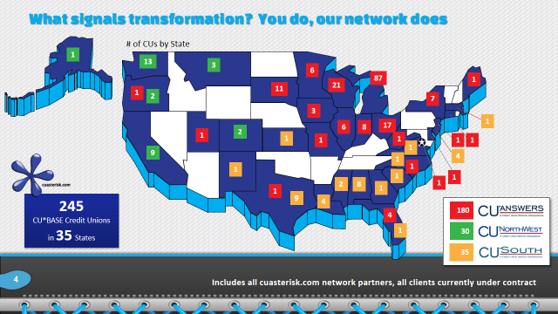
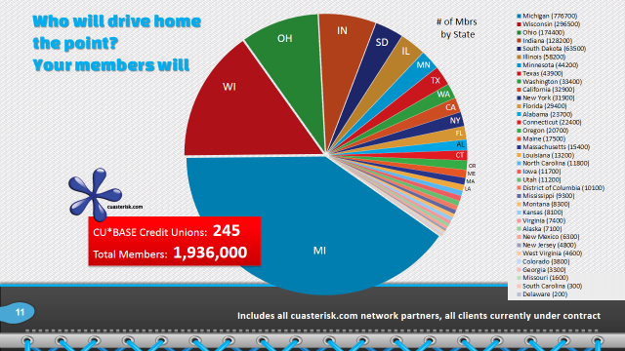
Transformation can occur while no one’s watching...or be engineered by those looking forward
The Board feels very strongly that CU*Answers is a platform for those who are looking forward – to contribute to the engineering of our network’s sustainability

Slide 5
Looking for a new future while maintaining our core principles
This is the balancing act that is best suited by a strong voice from the customer-owner
We must make sure our firm understands our owners’ experience, how our owners judge tipping points, and how our ownership plans to win through our collaborative investments
Our
Our firm can only understand based on its interactions with YOUR agendas, with your business initiatives, and through its participation in the agendas of your member-owners
Engage the power of ownership and wear two hats when you think about today’s presentation...get involved in engineering our future

Slide 6
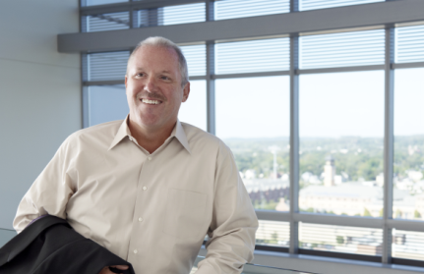
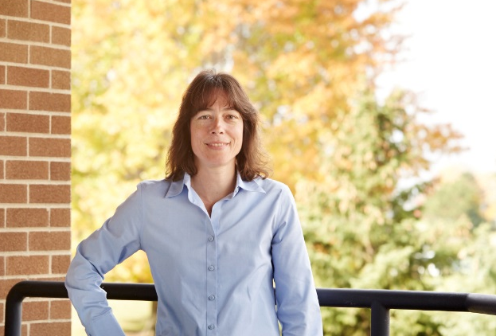
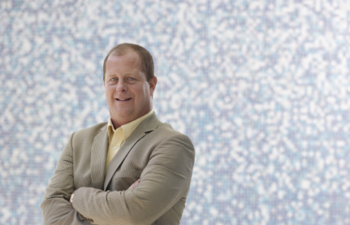
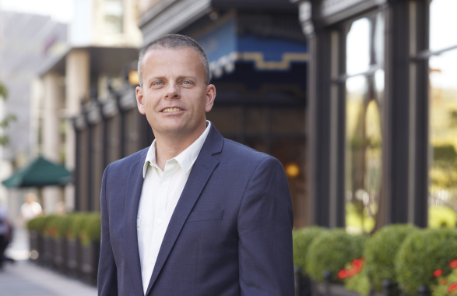
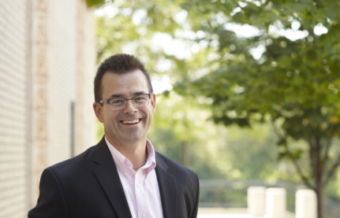
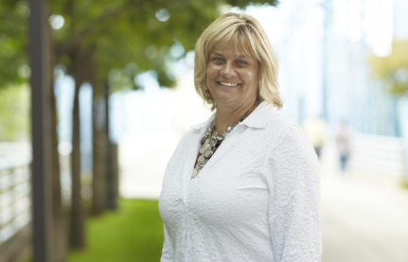
Chris Butler, Chairman
President/CEO, Community CU
La Crosse, Wisconsin
Board Member since March 2001
Linda Bodie
CEO, Element Federal CU
Yankton, West Virginia
Board Member since October 2001
Scott McFarland, Director
CEO, Honor Credit Union
Berrien Springs, Michigan
Board Member since August 2009
Don Mills, Director
CEO, Alpena Alcona Area CU
Alpena, Michigan
Board Member since June 2010
Jeff Jorgensen, Director
CEO, Sioux Empire Federal CU
Sioux Falls, South Dakota
Board Member since December 2009
Dean Wilson, Director
CEO, FOCUS Credit Union
Wauwatosa, Wisconsin
Board Member since January 2008
Vickie Schmitzer, Secretary/Treasurer
CEO, Frankenmuth Credit Union
Frankenmuth, Michigan
Board Member since October 2007
As always, I want to thank the Board for another great year, and for all their hard work

Slide 7
Speaking of thank yous... Welcome to 14 new owners in 5 states!
First Financial CU
Greater Niles Community FCU
Brewery CU
Bay Area CU
Kellogg Community FCU
United Educational CU
First Ohio Community FCU
Chiropractic Federal CU
KALSEE Credit Union
Lakes Community CU
Monroe County Community CU (converts fiscal year 2016)
Greensboro Municipal FCU
Washtenaw FCU
Chief Financial FCU (converts fiscal year 2016)
Member size range: 2,700 to 33,600 members
Average size: 12,500 members
Challenges: Unlimited
Ideas: Priceless
Potential: To be the customer owner that changes everything

Slide 8
The community that will make transformation a reality for our network, continues to grow
1
12
1
1
69
1
1
3
15
4
3
2
5
4
10
1
1
1
1
1
1
1
2
1
2
148 Credit Union Owners
in 24 States
123
3
18
Percent of Total CUs: 60%
7

Slide 9
2013 Board Elections
2014 Nominating Committee Chair:
Don Mills
Let’s vote!

Slide 10
Elections Market the Power of Ownership
A lively democratic process is essential for a healthy cooperative
Your participation in choosing Board members and volunteering for leadership means we’re walking the talk ... THANK YOU for participating as owners
Year 2 for the CU*Answers Elections website (did you visit?)
Year 2 for the e-Voting option (did you participate?)

Slide 11
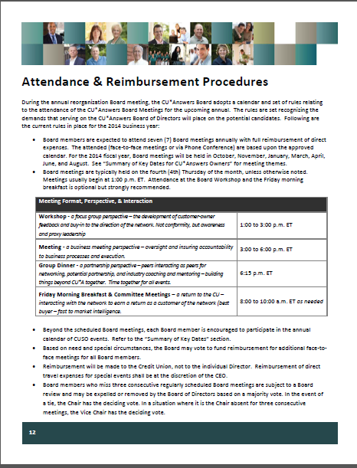
Special thanks to this year’s Nominating Committee
Each year we work from a well-documented process
Helps us dot all the i’s and cross all the t’s
Ensures we keep our promise to keep ownership participation alive and well in our Cooperative
Don Mills, Director
CEO, Alpena Alcona Area CU
Chris Butler, Chairman
President/CEO, Community CU
Scott McFarland, Director
CEO, Honor Credit Union

Slide 12
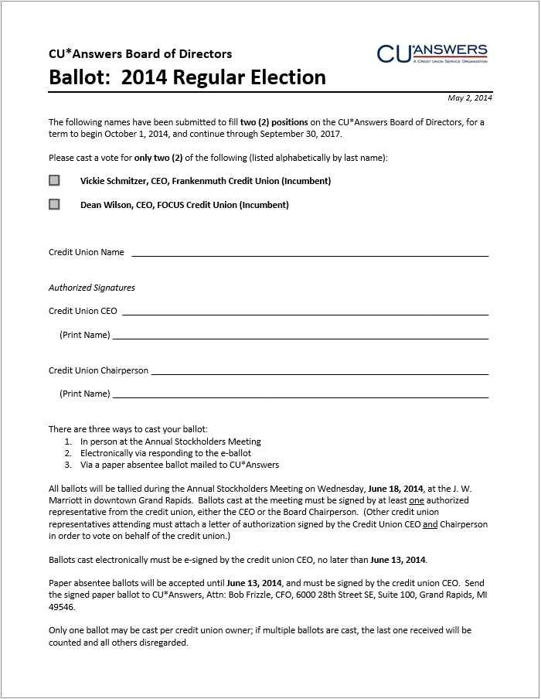
Let’s hear from the candidates (2 uncontested positions this year)
Vickie Schmitzer
CEO, Frankenmuth CU (Frankenmuth, Michigan)
Dean Wilson
CEO, FOCUS Credit Union (Wauwatosa, Wisconsin)

Slide 13
Let’s hear from the candidates (2 uncontested positions this year)
Let’s vote!
(Do I have a motion to cast a vote for unanimous consent?)
Vickie Schmitzer
CEO, Frankenmuth CU (Frankenmuth, Michigan)
Dean Wilson
CEO, FOCUS Credit Union (Wauwatosa, Wisconsin)

Slide 14
A Look at The Numbers
To fend off challenges to our cooperative, we need a stockholder community that can tell the story and prove their grasp of our model
CFO Report

Slide 15
Working with a community of financial planners: Our goal, Your future
How did we do in 2013?
Looking for cycles or trends in this year’s numbers that hint at the future
Seeing the effects of a large investment in our future (FEP)
What is a good year, a great year, and what would be just too much?
How will credit unions make money in the next decade?
Do you agree with Randy’s predictions from today’s presentation?
How will we judge when we’ve passed the tipping point into a new future?
How will we adjust our financial models to a new future?
Do you think a vendor can be successful based on Randy’s goals?
What would you recommend to me in crafting a CUSO financial engine?

Slide 16
Working with a community of financial planners: Our goal, Your future
How did we do in 2013?
Looking for cycles or trends in this year’s numbers that hint at the future
Seeing the effects of a large investment in our future (FEP)
What is a good year, a great year, and what would be just too much?
How will credit unions make money in the next decade?
Do you agree with Randy’s predictions from today’s presentation?
How will we judge when we’ve passed the tipping point into a new future?
How will we adjust our financial models to a new future?
Do you think a vendor can be successful based on Randy’s goals?
What would you recommend to me in crafting a CUSO financial engine?

Slide 17
Inventorying our Assets Can you see our strategy in the trends?
 | 2012 ($K) | 2013 ($K) | 2013-2012 % Change | 2012-2011 % Change | 2011-2010 % Change
Cash | $ 10,430 | $ 10,727 | 2.8% | 35.9% | 14.5%
Accounts Receivable | 2,165 | 1,274 | - 41.2% | 74.0% | 5.8%
Prepaid Expenses | 969 | 1,089 | 12.4% | 19.0% | - 6.5%
Fixed Assets | 5,917 | 8,784 | 48.5% | 7.9% | 2.1%
Miscellaneous | 3,477 | 4,186 | 20.4% | - 6.5% | 16.4%
 | $ 22,958 | $ 26,060 | 13.5% | 21.2% | 9.3%
FEP, FEP, FEP...as we look at the asset side of our balance sheet, you can see that in 2013, we positioned our software investments for a new future
With the release of FEP, next year we’ll be talking about its effect on the income statement and how we earn our return now that it is live in the field

Slide 18
2013 Numbers Worth Celebrating It’s still a party, but you can see the differences from year to year
Detail | YE 2012 | YE 2013 | 2013-2012 % Change | 2012-2011 % Change | 2011-2010 % Change
Total Assets | $22,958K | $26,060K | 13.5% | 21.2% | 9.3%
Total Liabilities | $14,746K | $15,620K | 5.9% | 15.2% | 3.6%
Total Equity | $8,212K | $10,440K | 27.1% | 33.9% | 23.6%
Retained Earnings | $1,953K | $1,979K | 1.33% | 22.9% | 43.5%
Book Value of Class A Stock ($ per share) | $387.33 | $442.36 | 14.2% | 20.0% | 17.1%
Book Value of Ownership | $77,465.80 | $88,471.65 | 14.2% | 20.0% | 17.1%
In 2013, the Board returned the maximum amount it could to our owners, to help with their agendas
Each year it’s a balancing act that your Board takes very seriously

Slide 19
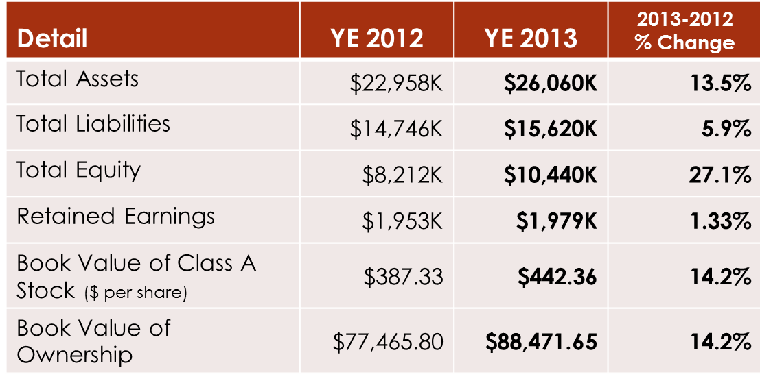
How do the proposed RBC and CUSO rules affect how we celebrate success?
The potential negative impact of the RBC proposal is that it will materially change how CUSOs build and retain capital
If CUSOs are deemed a material risk to credit union agendas, every CUSO will need new targets and tactics for inspiring CU investment and sources of cash for CUSOs in the future
Announcing a debenture payoff program beginning in July 2014
Not a departure from our current tactic, simply an event to set a precedent

Slide 20
Year-end 2013 Dividend Payments These numbers can flex, and I predict they will again in the future
Detail | YE 2012 | YE 2013 | 2013-2012 % Change | 2012-2011 % Change | 2011-2010 % Change
Patronage Dividend ($) | 700,000 | 800,000 | 14.3% | 0.0% | 0.0%
Bonus Patronage ($) | 1,000,000 | 550,000 | - 45.0% | 42.9% | 40.0%
Ownership Dividend Rate | 4.45% | 4.0% | - 10.1% | 1.1% | 1.1%
Ownership Dividend ($) | 364,333 | 406,404 | 11.5% | 33.0% | 31.3%
Book Value of Class A Stock ($ per share) | 387.33 | 442.36 | 14.2% | 20.0% | 17.1%
Price to Purchase CUSO Ownership | 150,000 | 180,000 | 20.0% | 20.0% | 20.0%
At yesterday’s Board meeting, I reported 2014 Net Earnings (as of 5/2014), after an adjustment for an $800 Patronage Dividend and taxes, of $886K
(Projected to be $1.283M by 9/30/14)

Slide 21
Net Income & Patronage Dividends What do shareholders get, and what are we putting away for our future?
$2,780M
$800K
$???
What do we think this curve will look like over the next decade as we adjust our models to the economic opportunities of credit unions?
*Before Consolidation

Slide 22
2013 Return on Investment
2013 Gross Income Submitted by Owners to CU*Answers $ 16,539,398 (Excludes all vendor pass-throughs)
2013 Patronage Dividends Paid $ 1,350,000
2013 Class A Stock Dividends Paid 406,404 (4.0%)
2013 Interest Paid Credit Unions on Loans 360,949 (~5.1%)
Total Revenue Returned to Credit Unions $ 2,117,353
Return Per Total Dollars Received: $0.1280
$2,117,353 ÷ $16,539,398 (excludes vendor pass-throughs) = 12.80% return per CU*A $ received

Slide 23
Understanding this formula is important to how we set the boundaries for our future
2011 Return Per Total Dollars Received: $0.1530
$2,109,553 ÷ $13,791,870 (excludes vendor pass-throughs) = 15.29% return per CU*A $ received
2012 Return Per Total Dollars Received: $0.1623
$2,449,307 ÷ $15,094,488 (excludes vendor pass-throughs) = 16.23% return per CU*A $ received
2013 Return Per Total Dollars Received: $0.1280
$2,117,353 ÷ $16,539,398 (excludes vendor pass-throughs) = 12.80% return per CU*A $ received
The combination of how much you own, how much you lend, and how much you do is the balance that the NCUA seems determined to control
Do you have your own perspective?

Slide 24
Thinking About 2014 Year-End cuasterisk.com network revenue numbers continue to impress
CU*Answers direct revenues continue to evolve
Projected for 2014: $41.27M
CU*Answers’ influence continues to grow through partnering with other networks and investing in new initiatives
eDOC projected for 2014: $3.95M
CU*NW projected for 2014: $3.02M
Xtend projected for 2014: $2.59M
CU*S projected for 2014: $2.26M
BuffaloPacific projected for 2014: $1.80M
Site-4 projected for 2014: $452K
ChatterYak projected for 2014: $234K
CPS projected for 2014: $78K
Grand Total: $47.8 million
Visit www.cuasterisk.com to keep up with network partners, products and services

Slide 25
Investing in a Community and Building a Network
1.28% ownership stake
48%
ownership stake
0% ownership stake
5.3% ownership stake
15% ownership stake
20% ownership stake
12.5% ownership stake
1.18% ownership stake

Slide 26
Projecting Shareholder Value Depending on when you bought in, your perspective is different
Ownership price 1991: $59.31, 2000: $176, 2005: $460, 2010: $495, 2014: $995
Does this success warrant a higher reserve against your capital? When does success make you more at risk?
*Restated 9/30/08

Slide 27
The importance of our per-share price Balancing today’s payback against the value of your equity
The delta is set by your Board, and is part of our capital plan
We project that as of September 30, 2014, 61% of owners will be in the black
*Restated 9/30/08

Slide 28
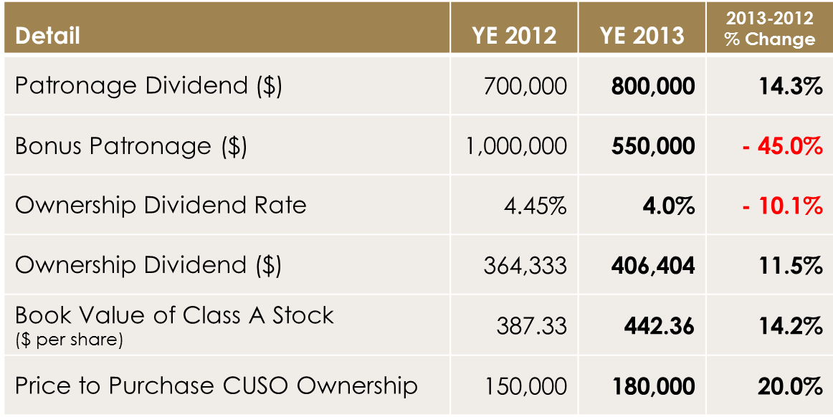
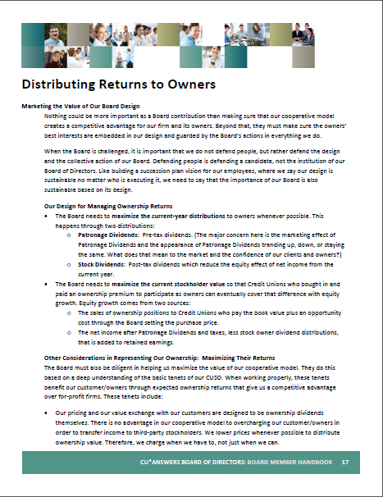
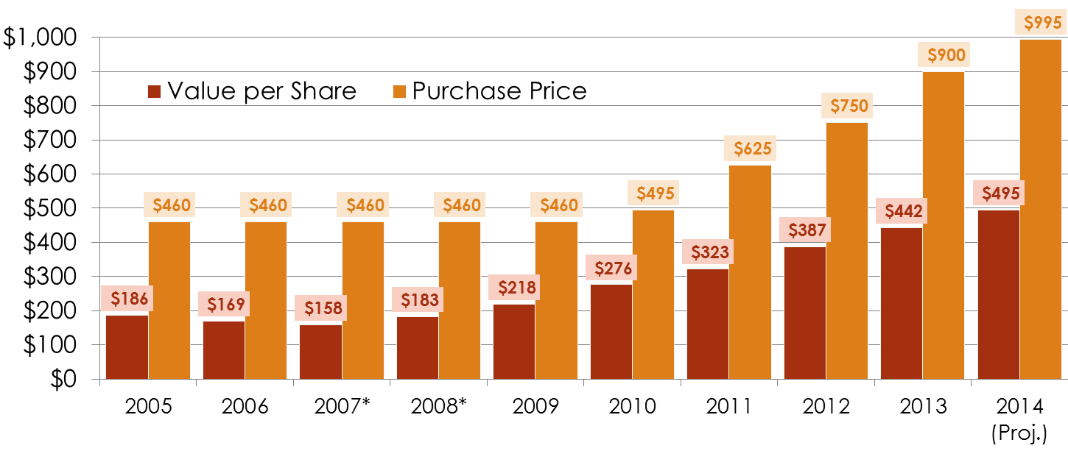
Balancing the perspective of a growing company
There may come a day when the NCUA will test your understanding of these models
They need to see your grasp to see the value

Slide 29
Working with a community of financial planners: Our goal, Your future
How did we do in 2013?
Looking for cycles or trends in this year’s numbers that hint at the future
Seeing the effects of a large investment in our future (FEP)
What is a good year, a great year, and what would be just too much?
How will credit unions make money in the next decade?
Do you agree with Randy’s predictions from today’s presentation?
How will we judge when we’ve passed the tipping point into a new future?
How will we adjust our financial models to a new future?
Do you think a vendor can be successful based on Randy’s goals?
What would you recommend to me in crafting a CUSO financial engine?

Slide 30
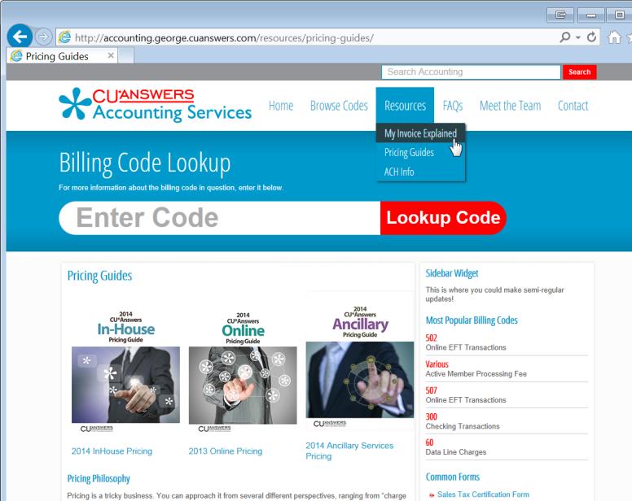
Can we predict the future of how CUs will make money?
Randy predicted that CUs will need to
Reject the concept that everything is for defense and saving member relationships
Refine how they invest for competitive advantage, and make it real
Ensure every program has some revenue contribution
Aggressively invest in or buy opportunity, and blatantly call it out as a talent
2014 was the first year for a network CFO Roundtable...we need to build a community of designers focused on the financial engines for CUs so that we can match the ability to pay with the strategies to do

Slide 31
Working with a community of financial planners: Our goal, Your future
How did we do in 2013?
Looking for cycles or trends in this year’s numbers that hint at the future
Seeing the effects of a large investment in our future (FEP)
What is a good year, a great year, and what would be just too much?
How will credit unions make money in the next decade?
Do you agree with Randy’s predictions from today’s presentation?
How will we judge when we’ve passed the tipping point into a new future?
How will we adjust our financial models to a new future?
Do you think a vendor can be successful based on Randy’s goals?
What would you recommend to me in crafting a CUSO financial engine?

Slide 32
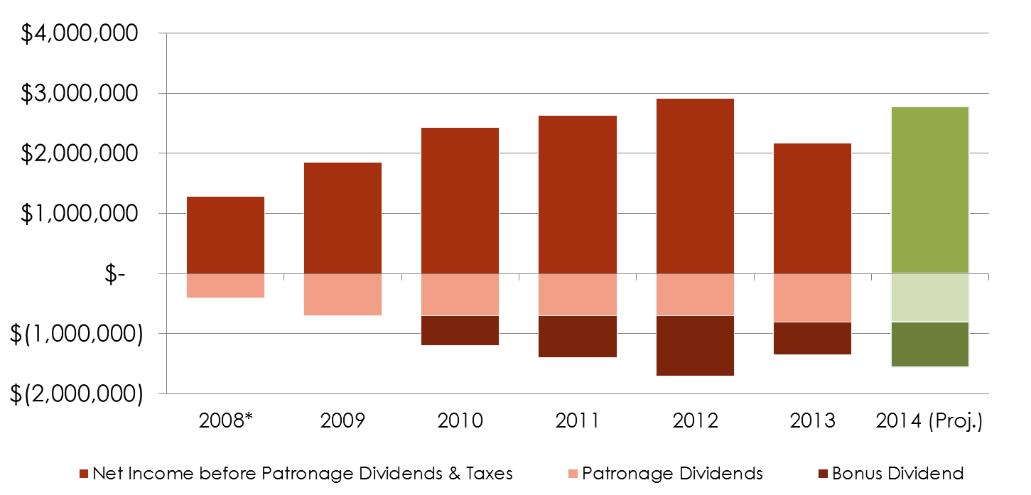
Can we predict the future of how we will make money?
Randy predicted vendors will need to
Redefine who takes the risk in making offers to credit union members
Create concrete returns, or don’t charge
Earn when the credit union earns
Fee for execution, not legacy investment
Pay credit unions to reach consumers, and share the harvested results
Specialize in models for cooperative designs, and match the expense to the credit union’s opportunities
The power of ownership is the right to set expected returns
We need the help of customer-owners to build a model where we use that power to fund the agenda of every network participant

Slide 33
Strategic Priority #1: Reaching for More Opportunity
Strategic Priority #2: Reaching for More Opportunity
Strategic Priority #3: Reaching for More Opportunity
CEO Report

Slide 34
How in the heck am I going to afford to jump into this tank?

Slide 35
It can seem like everything is a priority It gets really fuzzy between defense and offense
For all of us, the path forward can seem overwhelming, with the diversity of topics, the pressures for our attention, and the constant need to spend the same dollar over and over
It can be tough to tell the difference between what others think you should do, what they all want to do, and what they really will do
Knowing your culture and sensing how to commit your organization – based on what people will do – is the only hope a leader has of putting the pieces together in the right order
In this next decade, we need to continue to refine a system that filters out the noise and hones in on what members will do, what leaders will drive to the end

Slide 36
Commitment to a priority can seem like stubbornness Empathy, while socially valuable, will not save you here
The balance between what we will all do, versus what we are all interested in, can challenge a collaborative’s sense of cohesiveness
Will we ever see things the same way?
As we think about how best to leverage $200 million of cash flow in the next 5 years, we have an opportunity to transform, not simply to survive
To do that, we must capitalize on opportunities that we will harvest, as priority #1...and minimize our investments in tangents that capture our fancy, but not our commitment
The challenge is how we collectively agree on the difference
You are not customers of the future, you are the owners that need to come together and declare a future

Slide 37
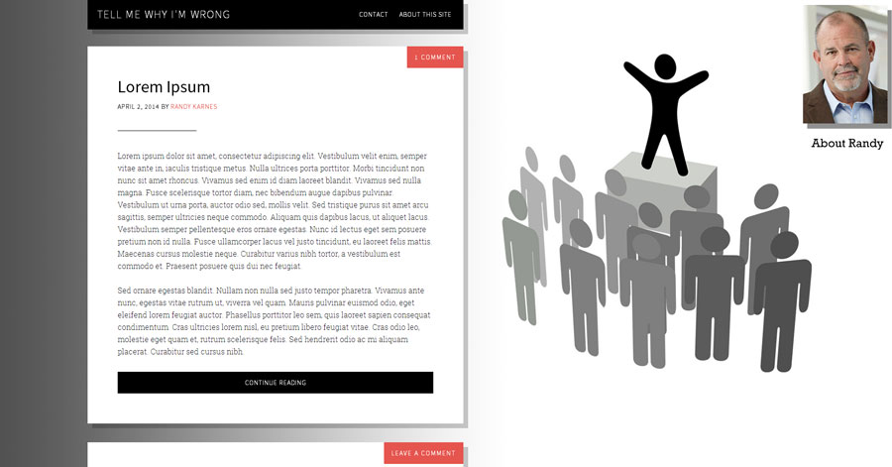
Building an engine for selecting what to do Our ultimate challenge for the next decade
z
x
http://tellmewhyimwrong.com/
Pushing things past the tipping point – without making civil people uncomfortable

Slide 38
Strategic Priority #1: Reaching for More Opportunity
How do you reach for more opportunity?
You increase your conversations with the marketplace
You find people with the challenges that will yield the greatest opportunity once the answers are found
You focus on offense to generate an opportunity to afford the investment in defense
You leverage connections (relationships, proximity, the moment) to find one more thing to do with a customer where the connection is the advantage, not what you do
You have the self-confidence to learn something new, to reach for more capacity, to assume that you can reset the game to your advantage

Slide 39
Reaching for More Opportunity The next decade: Finding opportunities to put ourselves to work
How will we reach for more opportunity?
We’ll continue to expand the tactics and toolkits we have to talk to credit union stakeholders (professionals, volunteers, members, vendors, regulators) – we’ll find opportunities to put ourselves to work
We’ll leverage CU*BASE and our copyrights in marketplaces that will challenge us for new solutions and generate the revenue to find them – we’ll find opportunities to put ourselves to work
We’ll expand our business development and round out our solutions to be as focused on the health of our clients as we are on the tasks that challenge our clients – we’ll find opportunities to put ourselves to work

Slide 40
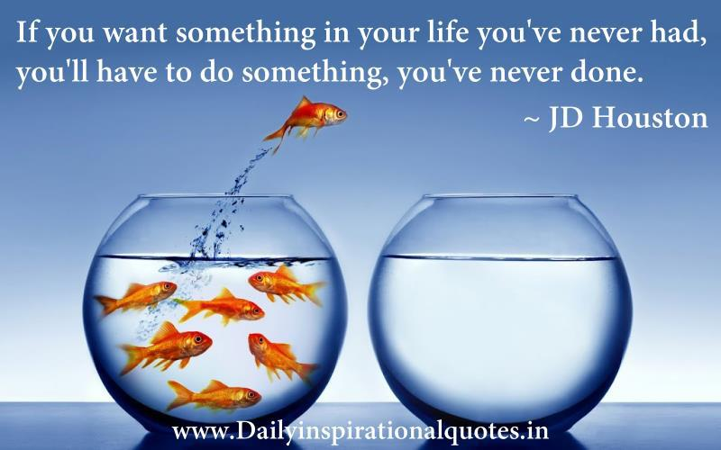
Reaching for More Opportunity The next decade: Finding opportunities to put ourselves to work
How will we reach for more opportunity?
We’ll redesign the assets that allow us to connect with our members’ world and the Internet economy. We’ll capitalize on connections and inventory every opportunity where the connection is the ultimate competitive difference – we’ll find opportunities to put ourselves to work
We’ll do everything we can to instill confidence in our network that we can learn, that we can do more. We will refuse to be mystified by challenges we just don’t understand yet – we’ll find opportunities to put ourselves to work

Slide 41
The advantage of a cooperative The drivers for reaching for opportunity
How did our founding pioneers create our current opportunity?
They found people where the solution was based on working together
They found people where their challenges were important enough to build a company and do it themselves
They prioritized the mutual needs (went on offense) without allowing the fear of what they couldn’t do to dissuade them (being on the defensive)
They knew if they created a community and bonded closely with it, that would be the advantage that would sustain them
They did something they’d never done before, in order to get something they didn’t have
These are the core traditions we need to hold on to, and make them work for this economy in the next decade

Slide 42
We are the builders of this cooperative business
We are the people who design the engines that identify opportunity – with the intent to harvest that opportunity for our customer-owners
Can we prioritize opportunity? Can we transform our designs to fit, so we can continue to succeed in the next decade?
Thanks for the day

Slide 43
Back to the party!

