Slide 1
Welcome!

Slide 2

Why this theme for 2011?
My credit union provides hope for my community
My credit union provides my career
My credit union provides my living
My credit union gives me a financial edge

Slide 3
What is a Community?
Who should we be talking about?
Our Communities
Our Localities
  Where you live
Our Members
  Yours and mine
Our Professionals
  Employees of CUs, regulators, trade associations, CUSOs, consultants, vendors
Our Network
  Our infrastructure, the technology that links us all and creates a communication highway
Our Volunteers
  Yours and mine
Your community is not just where you live...Your community is who you hang out with, who you work with, who you plan with...
Why would a community trust that your intentions are in their best interest?

Slide 4
Our Mission
What we want for and from our communities
We want to talk to communities
We want to influence communities
We want to interject value into communities
We want a reputation of being community-minded
We want a resume of good works towards our communities
We want to be valued community professionals
We want to be known as people with a spirit of volunteerism towards our communities
We want to earn from our communities
We want to know, learn with, and grow with our communities
We dream for our communities, and we execute those dreams
for community success
We want our communities to trust that our organizations are built to respect their needs

Slide 5
From the desk of Randy Karnes...
If we care about communities, what’s the best way to make sure they can trust that we’re built to respect their needs?
I believe that the Cooperative Business Design is the best choice for a business person who wants to be in harmony with the community they serve
  It intuitively fits with the Internet craze that first builds a community, aggregating participants, and then realizes the economic opportunity
You do have a choice: you can be organized as a traditional for-profit business, or you can choose to be a Cooperative
  What does a Cooperative guarantee that other designs don’t? A win-win for the consumer and the organization – it’s baked into our structure and our governance
Today I hope to combine a little food for the soul with a whole lot of things we can do for our communities

Slide 6



A Nation of Communities
A Network of Opportunity
# of CUs by State
189 CU*BASE Credit Unions
in 24 States
12
1
81
1
9
20
1
1
7
3
6
6
13
2
1
2
1
☺
1
5
2
2
7
1
1
3
156
20
Includes all clients that will be converted by the end of the 2011 business year (Sept 30)
13

Slide 7

A Nation of Communities
New Partners, New Leaders, New Opportunities
New CU*Answers Clients Since Last Time:
Florida
Florida Customs FCU
Tampa, FL
Illinois
NorthStar CU
Warrenville, IL
Oak Trust CU
Naperville, IL
Indiana
NorthPark Community CU
Indianapolis, IN
Public Service CU
Fort Wayne, IN
Iowa
Advantage CU
Newton, IA
Michigan
Chippewa Eagle FCU
Mount Pleasant, MI
Access First FCU
Mattawan, MI
Ohio
Cincinnati Interagency FCU
Cincinnati, OH
Riverview CU
Belpre, OH (converts 10/1/11)
New York
Lower East Side People’s FCU
New York, NY
Neighborhood Trust FCU
New York, NY
West Virginia
WV United FCU
Charleston, WV
Wisconsin
Horizon CU
Racine, WI
Best Advantage CU
Brillion, WI
Park City CU
Merrill, WI
Includes all CU*Answers clients that will be converted by the end of the 2011 business year (Sept 30)

Slide 8
Agenda
Think Community
Cooperative Business Design
1-2-3
Automating Your Participation in Key Communities
  The Internet Community
  Other Networked Communities
  Your Business Communities
  The CU*BASE Community
  Building a Healthy $$ Community
Big Concepts and Big Projects
  Lender*VP Top 10
  Aggregating Your Membership Relationships Inside CU*BASE
  Favorite New Tools Update
Wrapping Up the Day

Slide 9


Communities are Designed
And fostered by those with passion for collective value
Last year I challenged the group by asking
Are you an Artist?
Our day was spent looking for the inspiration and the passion embodied by the word “artistry”
Today, and throughout the rest of 2011-2012, we are going to focus at the core of our design:
Building
Communities as
a Cooperative
(creatively painting by the numbers)

Slide 10
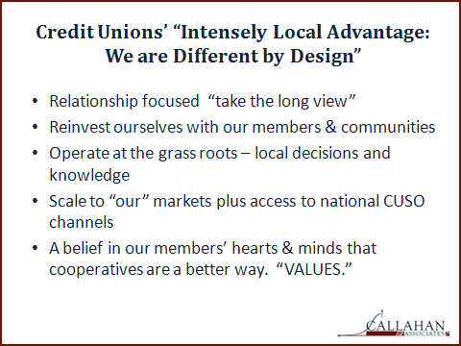
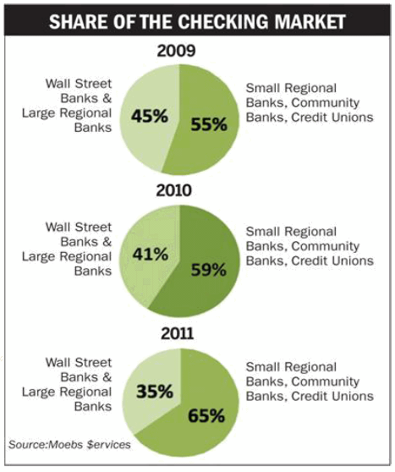
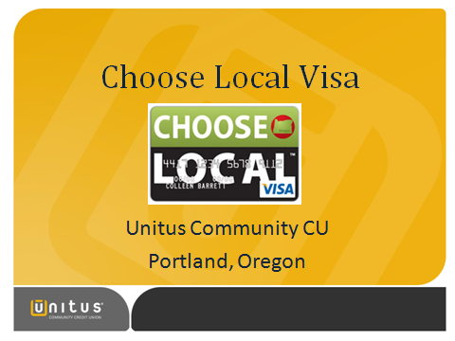
Local is In
Where communities are at their most intense
Beyond marketing, people are starting to build on the sense that we have to do it at home first to turn things around

Slide 11
Building Communities as a Cooperative
Inspiring Painters to Paint
I’m not talking about being cooperative
I’m talking about being a cooperative
There’s a difference between cooperation and the cooperative business design
  One is about getting along
  The other is about maximizing a business design to get ahead
There’s a difference between the social and the specifics of an economic license or charter that defines a business
  One is about being socially acceptable
  The other is about a business design to gain competitive advantage for your membership
We will investigate the difference between the credit union elevator speech and the cooperative elevator speech
Are there any hints to light a fire?

Slide 12
How passionate are you about the cooperative design?
Many of us run businesses that have been around for 25, 30, 40+ years
  The decision to organize our firms as cooperatives was several leadership generations ago
The day-to-day mission in running our businesses seems to drown out these ideals, and during interactions with our consumers never seems like a good time to bring them up
  It’s not uncommon for organizations to have a been-there, done-that attitude... “today’s consumers just don’t care”
But today we’re not talking about consumers – I’m talking to you as stakeholders challenged to design a business and constantly ignite the enthusiasm needed to propel your business into the future
You may have to say it differently, but the ideals that create the foundation for cooperative business designs are eerily close to the ideals that drive the Internet world

Slide 13
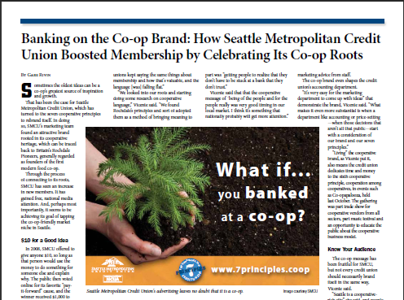
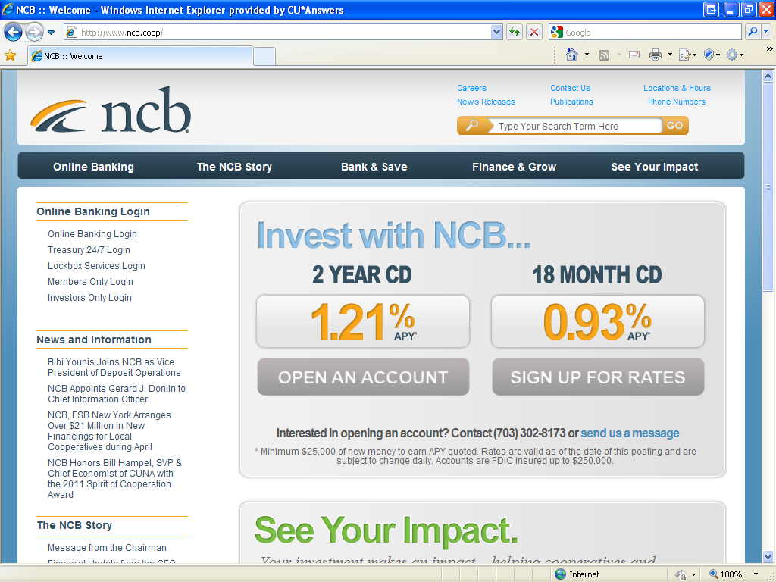
How passionate are you about the cooperative design?

Slide 14
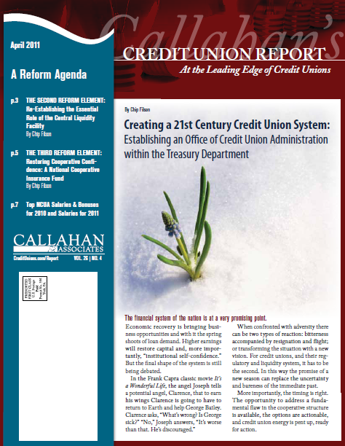

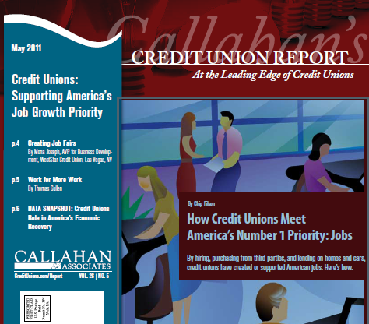
How passionate are you about the cooperative design?

Slide 15
How can we ignite this passion?
Step 1: Reconnect with the ideals of being a cooperative
  What is a cooperative? What are the guiding principles and business structure?
Step 2: Reaffirm our commitment to the fact that we are cooperatives, and that we need to think beyond what we do as cooperatives, to how cooperatives act no matter what they do
  We’re more than just a bank alternative; we execute with the cooperative economic model (just as CU*Answers does in differentiating itself)
Step 3: Work with each other to be the very best organizations we can be, driven by our commitment to these principles and our faith in the fact that this economic design will yield success
Are you interested in the task of igniting the passion of your stakeholders and peers for the potential of what your cooperative can deliver? Of what our industry might deliver?

Slide 16
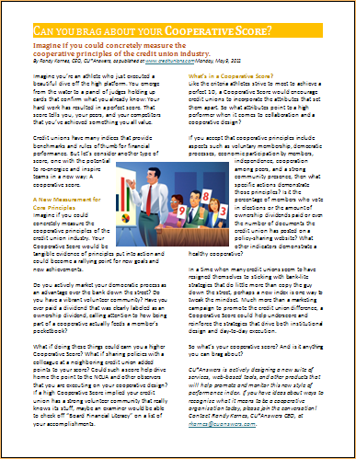

Step 1: Cooperative Business Design 101
What does it mean to be a cooperative?
Do you still sell it?
“...a cooperative is a business organization owned and operated by a group of individuals for their mutual benefit”
Do you still celebrate it?
“The common thread is... based on democracy”
“...the organization exists to produce goods and services for its members, by its members, and...all share the benefits”
Can you still guarantee it?

Slide 17
Step 1: Cooperative Business Design 101
What are the guiding principles of a cooperative?
Rochdale Principles of Cooperation
Voluntary and Open Membership
Democratic Member Control
Member Economic Participation
Autonomy and Independence
Education, Training, and Information
Cooperation Among Cooperatives
Concern for Community
How would you grade your execution?
A CUSO concern is that as we build businesses together, either peer to peer or with CUSO charters, we forget to bake these ideals into the design

Slide 18
Step 1: Cooperative Business Design 101
What is the business structure of a cooperative?
While the principles are universal, the legalities of incorporation vary greatly...research your opportunities
  Are you due for an upgrade?
By prioritizing and accentuating the principles differently, you can set your cooperative apart
  How do you prioritize these principles? What might you
  change to get your message across in a new way?
In building new businesses together, we need to remember that hybrid cooperatives are becoming more popular
  Consider how Xtend allows for credit unions who don’t use CU*BASE to become owners and participate

Slide 19

Step 1: Cooperative Business Design 101
Analyze Your Message (a quick exercise)
When your organization talks to the marketplace, to volunteers, to employees, and to all of your communities, what message about your cooperative do you lead with?
Rank these 1 through 7 (1 being first):
Voluntary and Open Membership
Democratic Member Control
Member Economic Participation
Autonomy and Independence
Education, Training, and Information
Cooperation Among Cooperatives
Concern for Community
Are your priorities the result of time? Happenstance? Habit?
Is your message based on the saying, “life happens,” or are you accentuating the power of these ideas?

Slide 20
Step 1: Cooperative Business Design 101
Cooperative business according to the SBA
Are more or fewer people voting today?
“...Members, regardless of the amount of their investment, have equal voting power to control the direction of the cooperative.”
“The management of the cooperative is carried out by a board of directors, elected by the members.”
The SBA needs some board member training

Slide 21
Step 1: Cooperative Business Design 101
Who consistently scores high in the cooperative business arena?
The people at cooperationworks.coop forgot about credit unions!
Agriculture
Child Care and Preschool
Consumer Retail
Energy
Conservation and Forestry
Health Care
Housing
Worker-Owned Business
Have we forgotten about our cooperative roots?
Can you identify why so many people thought a cooperative design would fit their particular circumstance, and provide a great way to be in business?

Slide 22
Step 2: If you were starting over today, would you choose to be a cooperative?
As a business person with options, can you see the value in a cooperative design that would set you apart? Can you reaffirm your commitment to being a cooperative?
How do you think you could accentuate the value of being a cooperative in your business today?
What would you change about the average credit union message so that your community would see your choice to be a cooperative as the right choice for their future?
How can we maximize our business potential if we’ve lost the passion for our very design?
Not the design to simply be better than the banks, but the design to maximize the opportunity of cooperative thinking

Slide 23
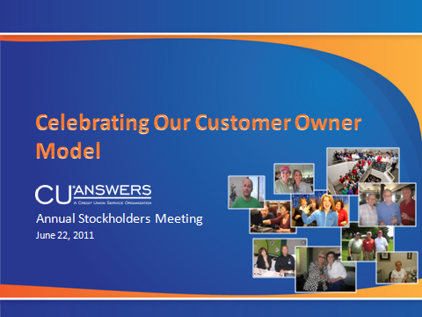
Tonight’s Annual Stockholders Meeting
Celebrating Our Customer Owner Model
How can we maximize our business potential if we’ve lost the passion for our very design?
Not the design to simply be a better technology vendor, but the design to maximize the opportunity of cooperative thinking
At tonight’s stockholders meeting I’ll relate how our organization being a cooperative leads to a competitive advantage for their investment and support
Cooperatives working with cooperatives: We have 11 new owners since we last met, our biggest gain since 1999-2000...
cooperative-designed business is a growing niche

Slide 24
Step 3: Working Together
Highlighting a network of highly functioning cooperatives
What do we know about each other, and about how we act independently and as a group, that could prove our point that cooperatives are the best model for our communities?
  As a network, we do pretty well working together, and over the last few years we’ve all been on the fast track to do even more
  Technology and our mutual interests create an interesting opportunity for us to interact...but does the rest of the market get it?
I think if we step up our efforts to highlight our intentions around our cooperative designs, we can make working together a competitive advantage – and what many see as old will be new again
The CEO Strategies event in November has become an ongoing business development think tank
As CEOs, in 2011 and 2012 we will focus on
showing how cooperative business designs maximize the return in a networked world

Slide 25
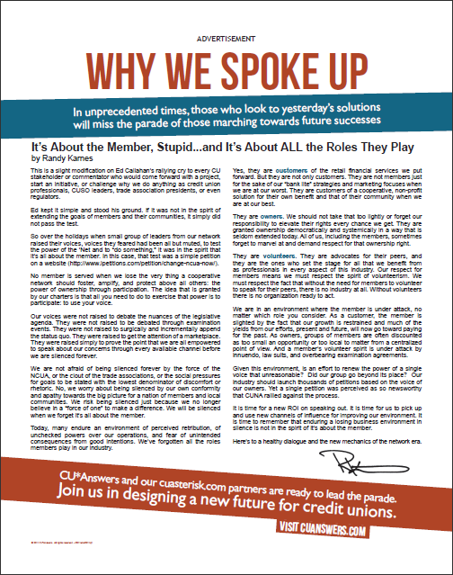
The Past Year Put into Perspective
Timing is everything, and boy, is it time
I don’t ever remember a year where I felt so compelled to
speak out about the owners of our cooperatives
In a perfect storm, the economy, the overreaction of regulators, and the finger pointing all came together to shake the core stakeholders of our industry, to the point where some wonder if it’s even worth it anymore
Economics will not wipe our credit unions...an aging population will not spell our doom...the turbulent changes of the Internet will not leave our industry in the dust...even a regulator ultimately cannot end our efforts
The only thing that might do us in is when volunteers won’t volunteer, when professionals don’t want the career anymore, and when we simply no longer have the heart to persevere
The only way to carry the torch into the future is never to lose the passion for how unique our opportunity is, and how vested we are in every consumer that will get out of bed tomorrow and face the day

Slide 26
The Past Year Put into Perspective
It’s still all about the member, and how we express our faith in them
Members are customers
  When we are at our best, members choose a Cooperative for their own benefit and for that of their community at large
Members are owners
  We should marvel at and demand respect for that ownership
  right
Members are volunteers
  We must respect that without the need for members to
  volunteer to speak for their peers, there is no industry at all
I know you’ve heard this before, I know you’ve tried to stress this before, but you don’t get a pass, now or in the future
We must find a new energy around the concepts of being cooperatives that ignites a renewed passion, one leader at a time

Slide 27


It’s still all about the member, and how we express our faith in them
# of Mbrs by State
OH
IL
WI
IN
SD
NY
WA
MA
MI
OR
CT
CA
TX
CU*BASE Credit Unions: 189
Total Members: 1,452,800
UT
ME
FL
AL
DC
IA
MS
CO
Includes all cuasterisk.com network partners, all clients that will be converted by the end of the 2011 business year (Sept 30)

Slide 28
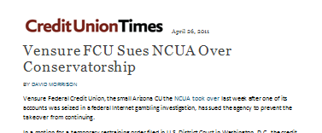
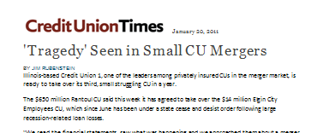
My Favorite Cooperative Principle:
Autonomy and Independence
In a world that believes so strongly in scale, to the point where it pushes for consolidation, the cooperative principle of autonomy and
independence aligns perfectly with the networked world and how people will interact and aggregate opportunity in the future
Challenge #1:
  How do we crack the code on working together and aggregating communities, without consolidating what makes each of our communities unique?
Challenge #2:
  How do we show a new generation of business people and consumers that the model to gaining the benefits of scale is already here?
Maybe we need some healthy evangelism to reignite everyone’s passion for our business design...
one person, one cooperative, one community at a time

Slide 29
My Favorite Cooperative Principle:
Autonomy and Independence
When you can’t find a gigantic win to prove your point, work hard every day on
having a million little wins to do it for you
How can nearly 200 small cooperatives, through their day-to-day work,
highlight enough cooperative wins
to prove our point?
In a world that believes so strongly in scale, to the point where it pushes for consolidation, the cooperative principle of autonomy and
independence aligns perfectly with the networked world and how people will interact and aggregate opportunity in the future
Challenge #1:
  How do we crack the code on working together and aggregating communities, without consolidating what makes each of our communities unique?
Challenge #2:
  How do we show a new generation of business people and consumers that the model to gaining the benefits of scale is already here?
Maybe we need some healthy evangelism to reignite everyone’s passion for our business design...
one person, one cooperative, one community at a time

Slide 30

Step 3: Introducing SCORE
Highlighting a network of highly functioning cooperatives
We are setting a new goal for every credit union and CUSO that is designed as a cooperative: Raise Your Cooperative Score
  A Cooperative Score can be
    Tangible evidence of principles put into action
    A rallying point for new goals and new achievements
CU*Answers will work with our CUs to develop measurements or tracking mechanisms to confirm a credit union’s cooperative health
  Marketing your democratic process and measuring your members’ response
  Paying an ownership dividend, clearly labeled as such
  Interacting with other cooperatives
  Measuring the vitality of your volunteer community
  What else?

Slide 31
Step 3: Introducing SCORE
Highlighting a network of highly functioning cooperatives
You can get started today developing your own cooperative score, and there are many ideas in our Cooperative Score outline
Here are some out-of-the-gate offerings we’re working on now:
  CU*Answers new Cooperative Rewards program
  Board Election Services
  Promoting Volunteerism
  ExamShare
  PolicySwap
  Board Financial Literacy
  Software, software, software – development focused on highlighting the spirit of a cooperative
(Remember, it’s not just how you see yourself as a cooperative, but how you work with other cooperatives such as CU*Answers)

Slide 32

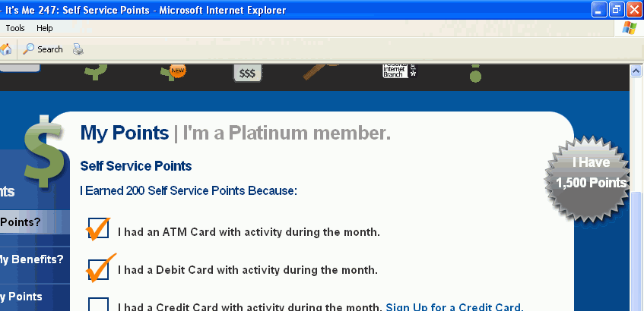
New Cooperative Rewards Program:
Can a $100,000 budget change your behavior?
How do you reward cooperatives for participating with other cooperatives? Pay ‘em
To raise the level of participation in our network, we’re going to steal an idea from you
In January 2012, CU*Answers will roll out its first Cooperative Rewards program that will allow your credit union to earn points that can be used for a direct discount on your CU*Answers invoice
Throughout the rest of the day, we’ll talk about different ways you can participate, and from your response, we’ll start working on the details of the program
How many Points for this?
Details will roll out at the
2011 CEO Roundtable (Nov. 9, 2011)

Slide 33

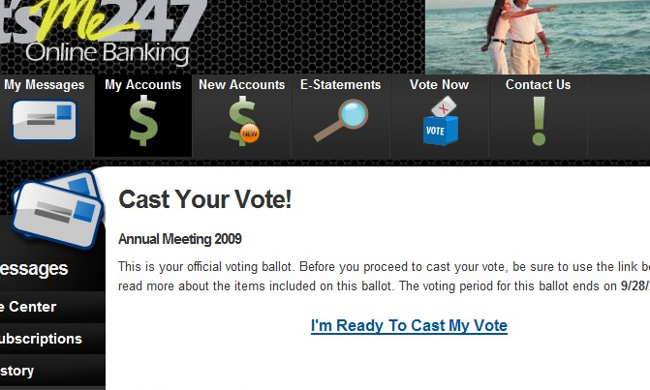
Board Election Services
Do your voter turnout trends point to a strength?
Voter Turnout
If a democratic process is the one of the things that sets you apart, then why are we reluctant to boast about our election processes, voter turnout, and the response of our empowered members?
What if every credit union had to prove that 25%+ of their membership was active in the leadership of their credit union?
We have to turn to the ‘Net
  For convenience
  To be able to afford the voter turnout we should demand
  To generate some buzz for our ownership community
  To add some drama and timeliness to being a member
  To create some in-your-face differences between you and other organizations

Slide 34

Board Election Services
Do your voter turnout trends point to a strength?
Voter Turnout
Our Board Election Management services include:
  Detailed analysis of bylaws, setup of election schedule
  Experienced advice on setting up an election policy that will survive legal challenge, to help fill in the gaps not covered by the bylaws
  Advice on bylaw amendments, if necessary, to ensure a smooth election process
  Setup of election paperwork, including marketing materials, notices, and ballots
  Setup of election kiosks for election voting right in the branch office
  Tabulation of electronic and paper balloting
  Certified and auditable results
We helped one CU hit 31.75% voter participation, with 42% of votes submitted electronically...can we pump up the turnout at your next election?
How many Points for this?

Slide 35

Promoting Volunteerism
We want you to talk to communities of volunteers
This video introduces the concept of SCORE and has a special focus on one of our passions: enhancing the respect for credit union volunteers
  Make Board members feel good about their work
  Inspire people inclined to volunteer their time to consider a credit union
  Promotes the cooperative nature of a credit union
We hope you will take the second half of this video, tag it as your own, and promote it through your video channels...and
into your members’ hearts
Introducing SCORE
and
“My Credit Union is My Community”
How many Points for this?

Slide 36
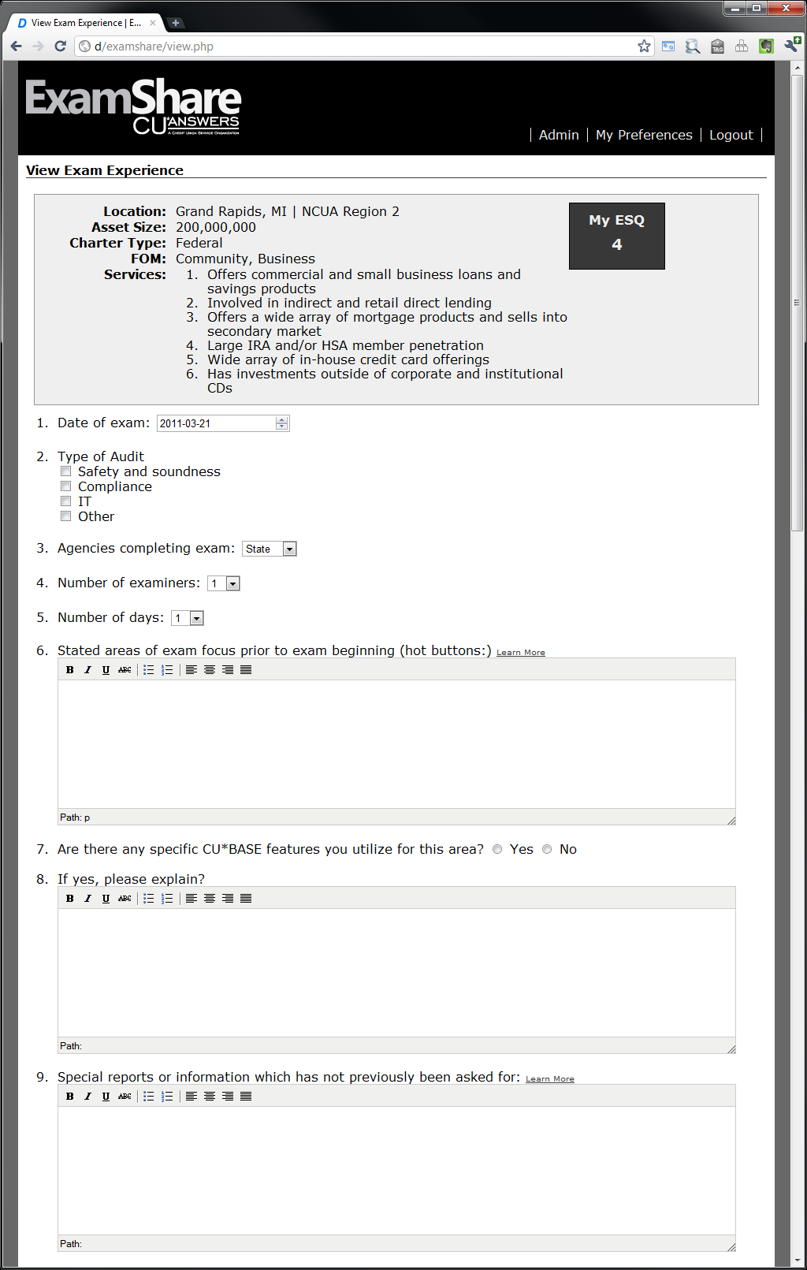
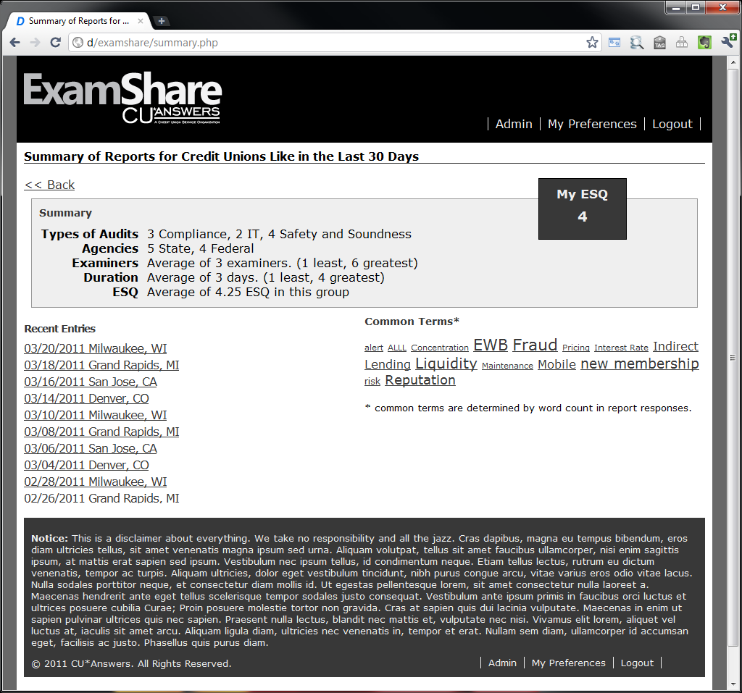
ExamShare
Learn From A Peer
Great idea from the CEO Roundtable as a business we should start – will you participate?
Share your own exam experience
Review another CU’s exam experience
Launching January 2012; details at CEO Strategies in November

Slide 37
ExamShare
Learn From A Peer
Not designed to post your gripes, but to post some insights and advice to others preparing for their next exam
  Designed to trend exams for the next ten years
  Designed to share what worked and what didn’t
  Designed to share exam protocols and other rules of engagement
  Designed to point out challenges and opportunities in this area, and potentially to launch new businesses
There are many urban legends about what you can and cannot say – we need to create a new playing field
How many Points for this?

Slide 38
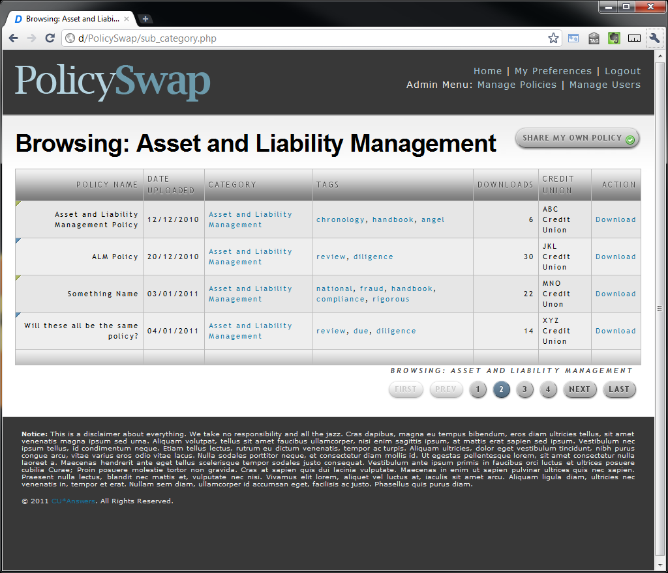
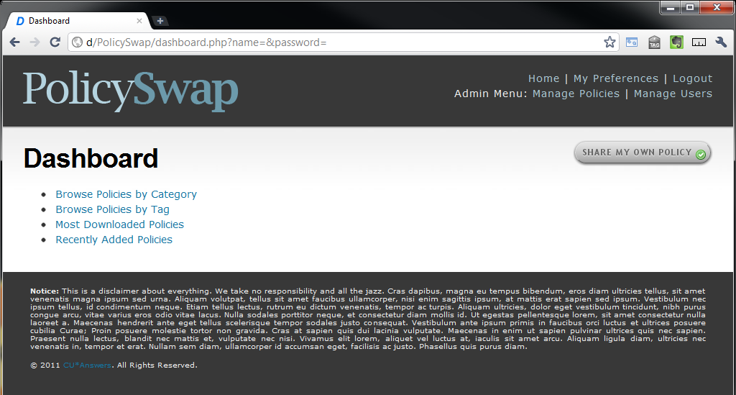
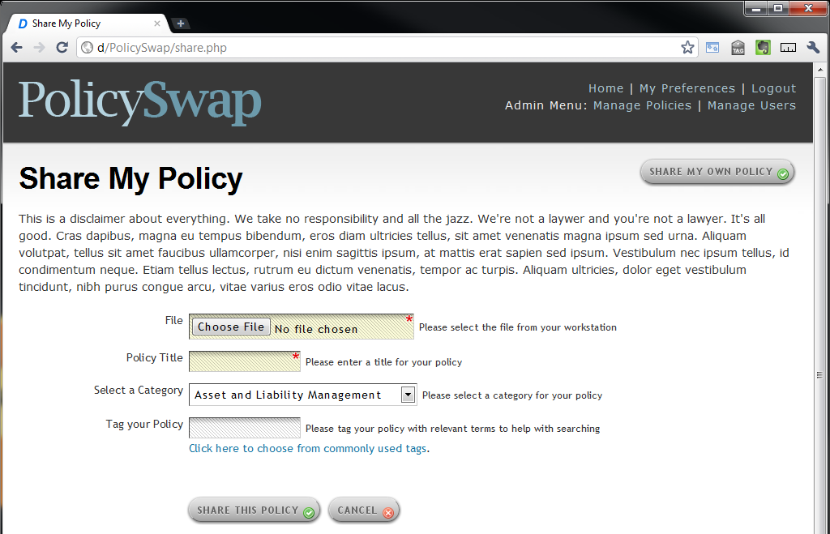
PolicySwap
Learn From A Peer
Review policies from your peers
Share your policies
Launching January 2012; details at CEO Strategies in November

Slide 39
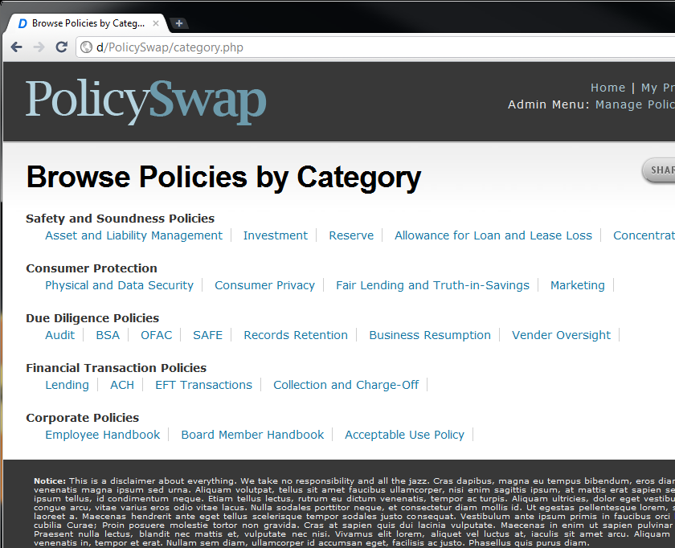
PolicySwap
Learn From A Peer
How will PolicySwap be different from all the other policy sharing sites on the web?
  We’ll use your expertise to rank and critique a policy to see whether it’s reasonable, easy to read, easy to comprehend, easy to sell to volunteers, easy to comply with
  Comprehensive audit plan based on the NCUA spreadsheet
  Integrated with ExamShare for everything you need in a single site: policy, exam advice, and exam prep materials that reference CU*BASE
  ...and potentially we’ll even pay you for posting
How many Points for this?

Slide 40
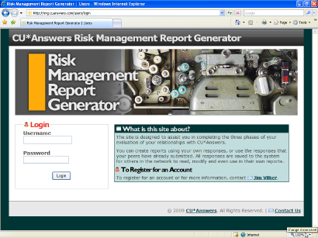
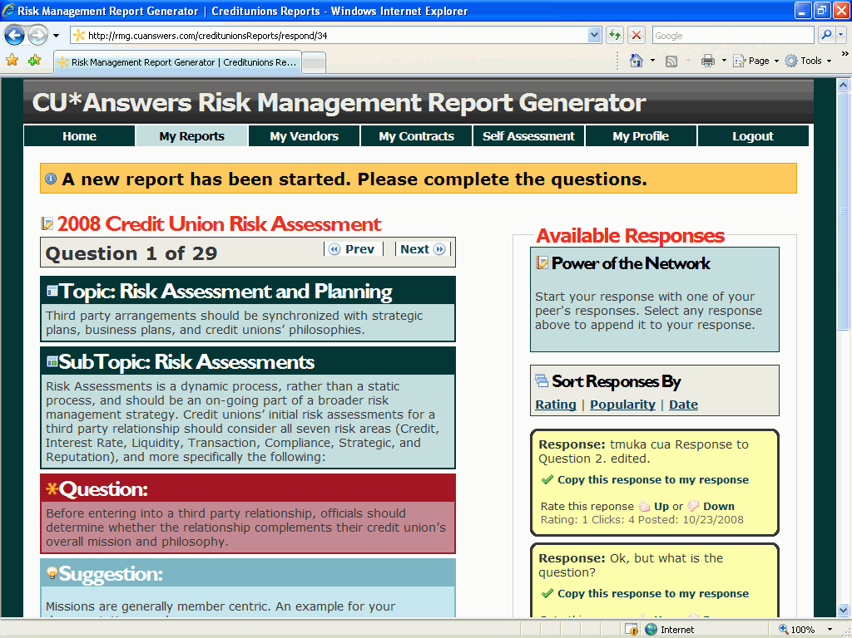
A Collective Site That’s Been a Real Success
Risk Management Report Generator
Risk Management Report Generator
  305 reports created since launch
  87 reports created so far in 2011
Risk Management Matrix
  Launched February 9, 2011
  Provides quantitative risk analysis for due diligence on new opportunities
  33 matrices created by 55 users since launch
http://rmrg.cuanswers.com/
How many Points for this?
If your response is anything like the RMRG site, we expect ExamShare and PolicySwap will be a great success

Slide 41

A Continued Focus on Board Interactions
To revitalize the role of volunteers in our boardrooms, we must take up the challenge of creatively improving board process, board meetings, and the emotional return board members get for serving
Whether it’s due to ingrained traditions or urban legends about what you “must” do, many CUs boardrooms have just become too mundane for the average consumer to endure
Throw in a little regulator pressure and some economic challenges, and even the most devoted volunteer might say, “maybe I should donate my time to the local community hospital instead”
How can we challenge the status quo?

Slide 42
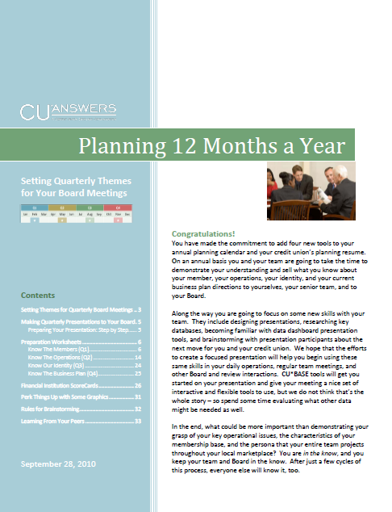
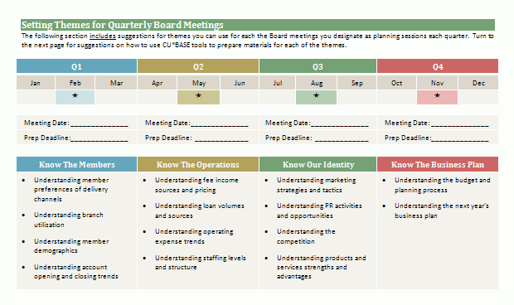
A Continued Focus on Board Interactions
Two years ago we started merging the ideas of what data and software could tell a leadership team, and how it could be presented in a boardroom
Last year we published “Planning 12 Months a Year” to encourage CUs to think about changing their monthly board interactions
In 2012, I will visiting as many CU board meetings as will have me, searching for the best and brightest ideas about how to keep a board engaged

Slide 43
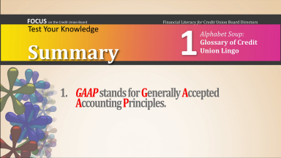
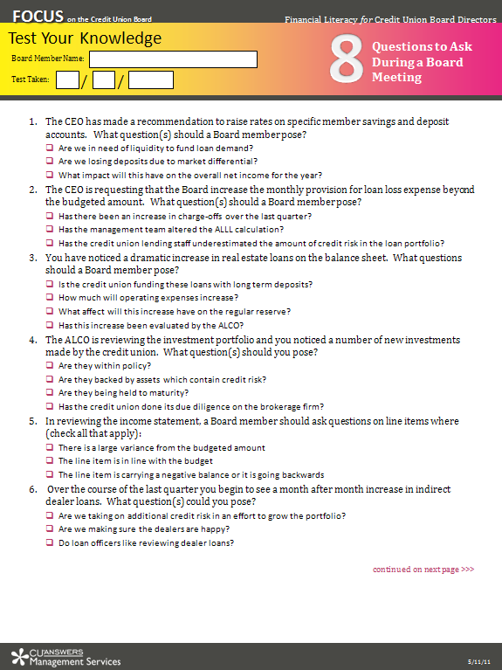
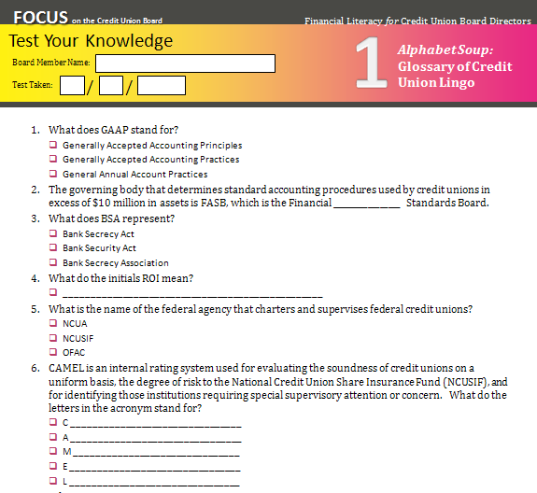
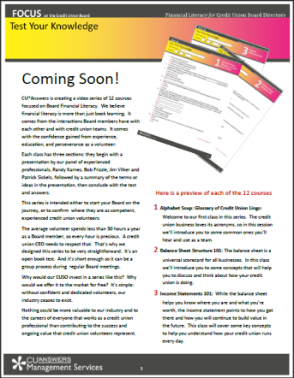
A Continued Focus on Board Interactions
Board Financial Literacy
This year the NCUA added a little urgency to board interactions and board member quality by declaring the need to certify all board members as “financially literate”
That’s a cooperative task...this is not about the confidence of only one credit union; it’s about the confidence of an industry, and a cornerstone based on our respect for volunteers
Our first pass at tackling this will be released to all of our clients, and to the industry at large, by
October 1, 2011
How many Points for this?

Slide 44






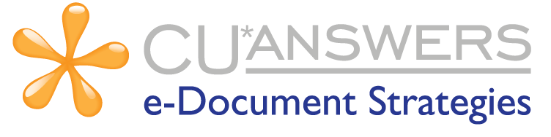



Cooperatives Working With Cooperatives
Are you working with these teams?

Slide 45
Cooperatives Working With Cooperatives
Are you working with these teams?
Generating the next set of project managers
for the next big thing
Reward Checking, Round Up, Bump CDs
OBC 2: online marketing meets online banking
ACH Repost, 5300, 90-day delq. adjustment
Teller Receipts, loan forms, driver’s licenses, Check 21, remote e-signatures
Top 10 Loan Projects, Concentration Risk, Credit Score Trending
Privacy Controls, Web Chat, Trackers
BSA, Risk Analysis, Reg. E, MFOEL, OFAC
When challenged about our diverse brands and multiple priorities, I remind everyone that it’s still about software, and it’s still about solutions

Slide 46
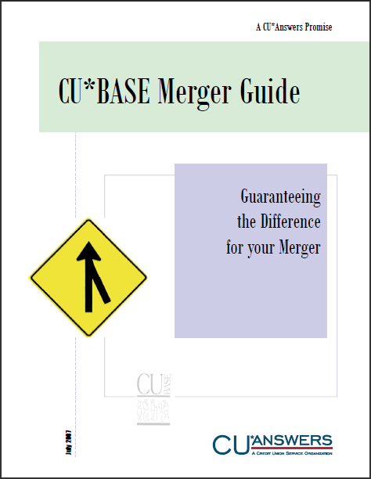
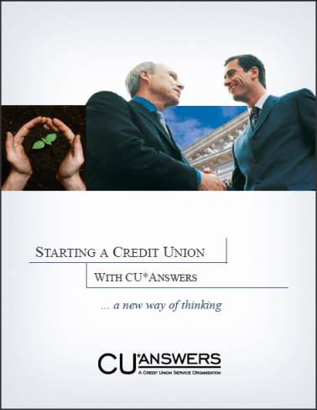
Cooperatives Working With Cooperatives
Gaining an Edge in Bidding on New Communities
Have you ever bid with the NCUA or your state regulator on a merger opportunity? Did you wish you had an edge or an outright advantage?
You do...but are you aggressive enough to grab it?
  Do you know about CU*Answers merger support programs, and financial advantages you have in bidding for these projects?
  (someone missed out on $250K in 2010)
  Do you know about the CU*Answers scholarship program that allow you to be the white knight in your community?
  (we have 4 sponsors today; why not you tomorrow?)
  Do you know about CU*Answers de novo support programs that allow you to be the fostering community volunteer?
We are looking for the entrepreneurs in the room who want to work with a network willing to invest in a big way in their next collaboration

Slide 47

Congratulations to these Scholarship Winners!
Spirit of CU*Answers Scholarship Program
CU Name | Neighborhood Trust CU | Lower East Side Peoples FCU | Community Driven CU | Birmingham-Bloomfield CU
City State | New York, NY | New York NY | Ypsilanti, MI | Birmingham, MI
# of Members | 3,335 | 5,777 | 10,200 | 5,872
Conversion Date | 5-1-2011 | 5-14-2011 | 4-1-2012 | 6-1-2012
Sponsor | Consumers FCU | Consumers FCU | AAACU | Chiropractic FCU
Who do you know that might someday be a key partner and opportunity for you, but needs a fresh chance right now?

Slide 48
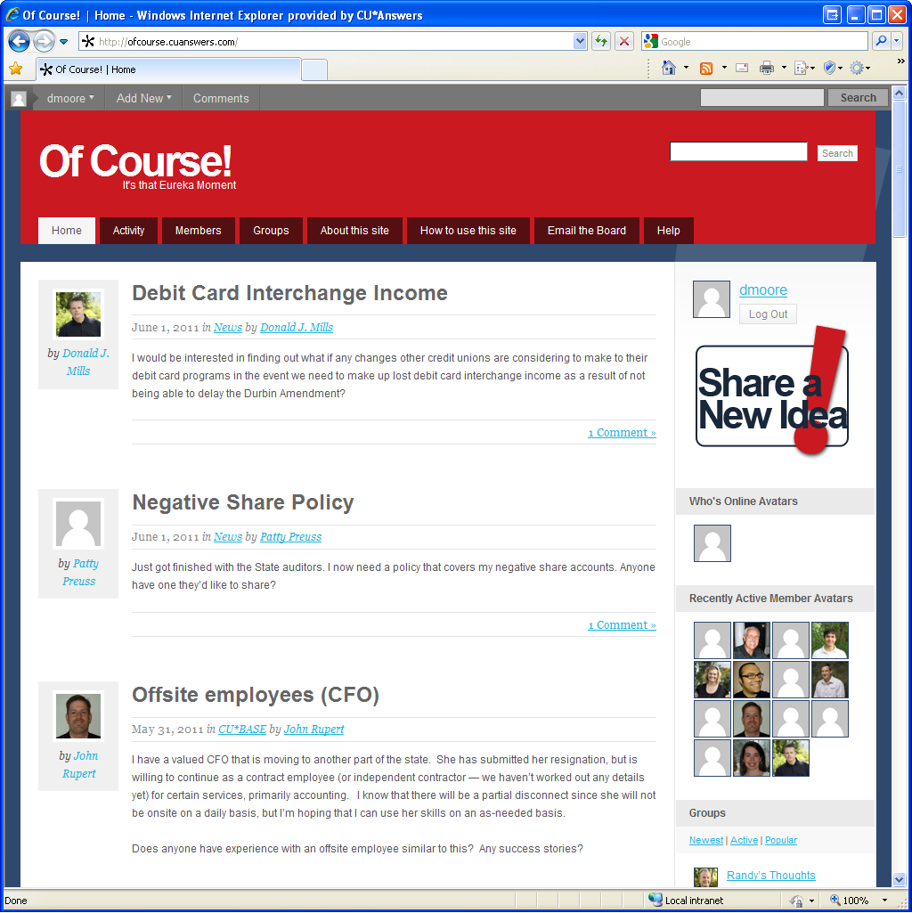
Cooperatives Working with Cooperatives ofcourse.cuanswers.com
Over the years we have launched a half dozen interactive sites for credit union professionals to use
Of Course! seems to be catching on and we hope you are bookmarking it as one of your favorite share-with-peers sites
And soon you’ll be able to earn when you sign on
http://ofcourse.cuanswers.com
How many Points for this?

Slide 49
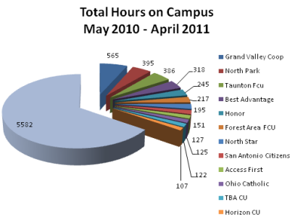
Cooperatives Working with Cooperatives
Education
Online University
Opportunities for your team in 2011:
Classroom training
  35 days
  125 classes offered
Web conferences
  300 events offered
Regional events
  5 events
  10 days
  25 classes offered
12 CUs logged more than 100 hours each, and 4 CUs logged over 300 hours on our online campus!
Our spending for education approaches a quarter of a million dollars for 2012...what is your budget?

Slide 50
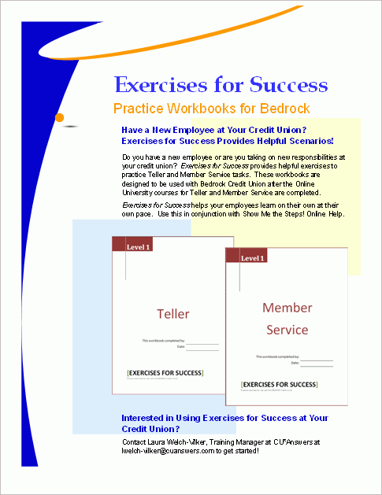
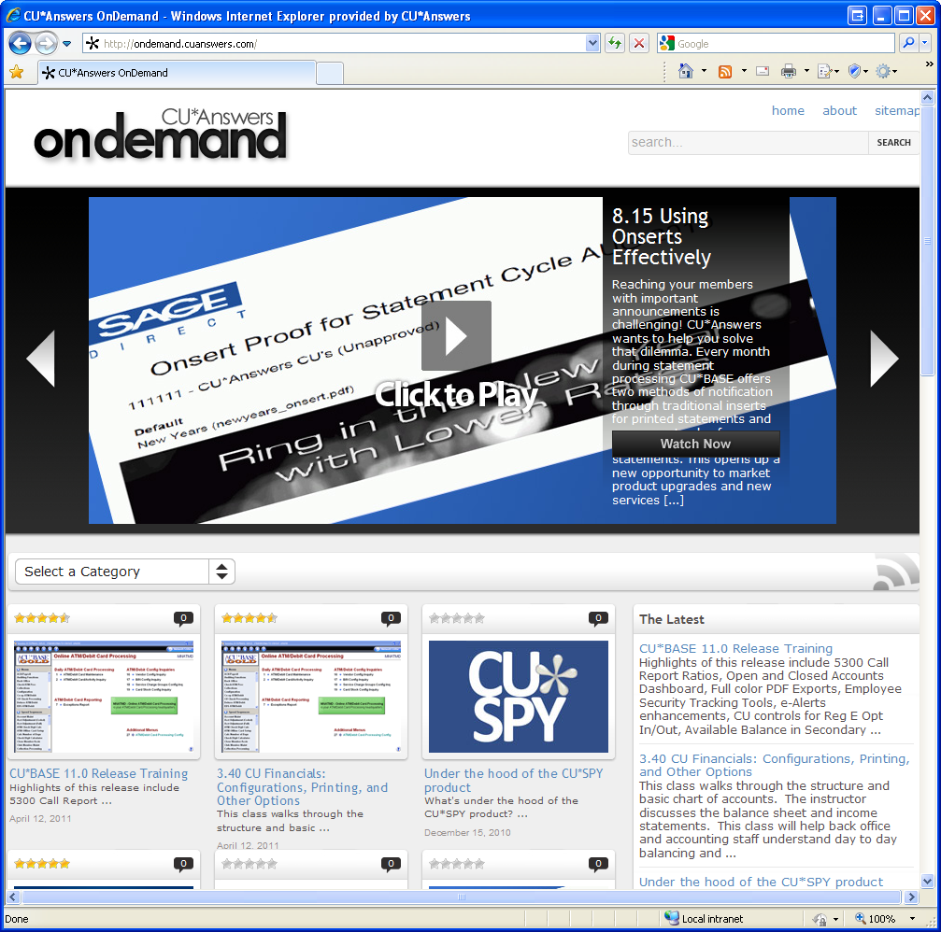
Cooperatives Working with Cooperatives
Education
How many Points for this?
http://ondemand.cuanswers.com
Something new...ask Laura about this tool for your new employees!
“You have archived webinars?” Yes we do, at ondemand.cuanswers.com

Slide 51
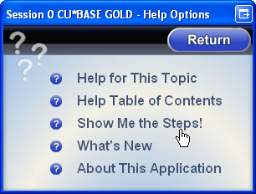
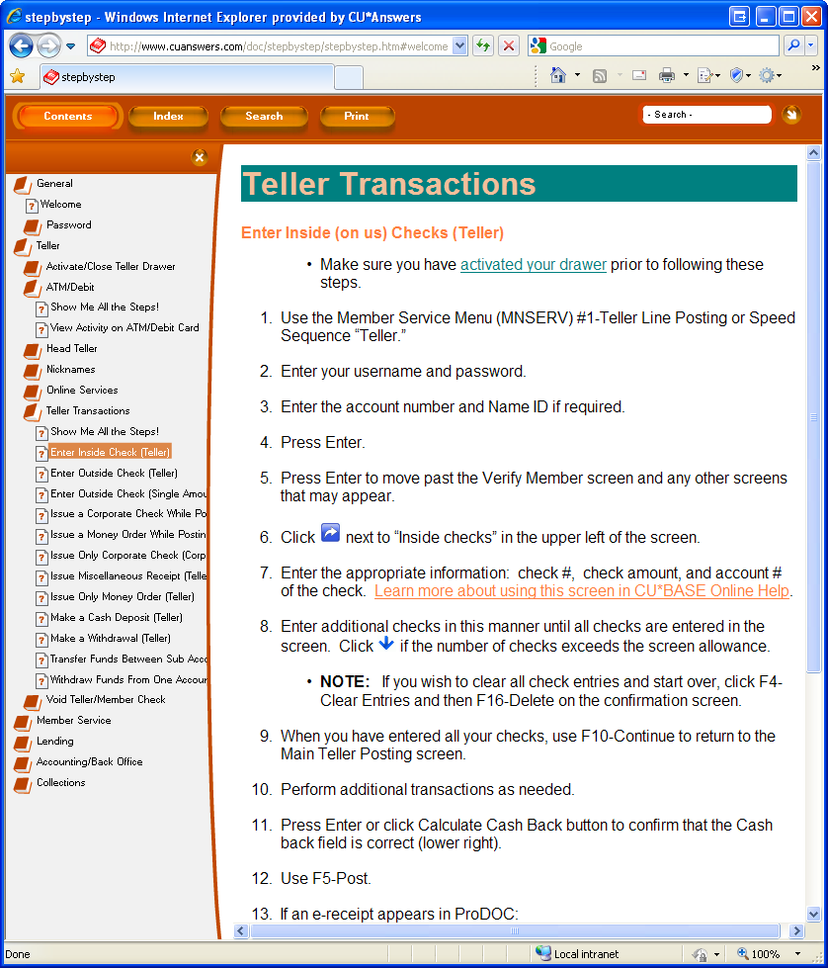
Cooperatives Working with Cooperatives
Show Me The Steps (SMTS) Help
Continuing to expand the breadth of depth of our help and online self-learning tools
  Launched October 2010 (10.3 release) with 25 topics
  Today there are 145 topics under 6 categories (General, Teller, Member Service, Lending, Accounting/Back Office, Collections)
  Truly a team effort (Writing Team, CSRs, Collections, Lender*VP, Education, Xtend, CU*South...)
2011 Service Award Winner

Slide 52
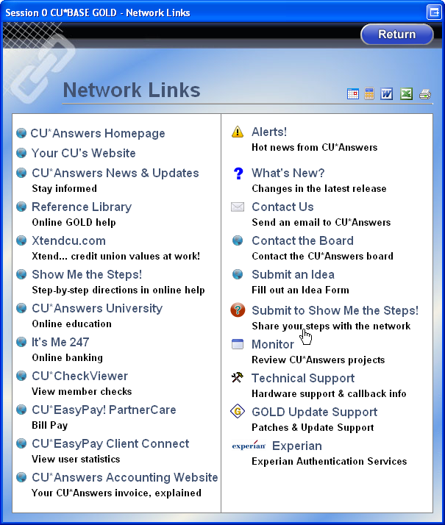
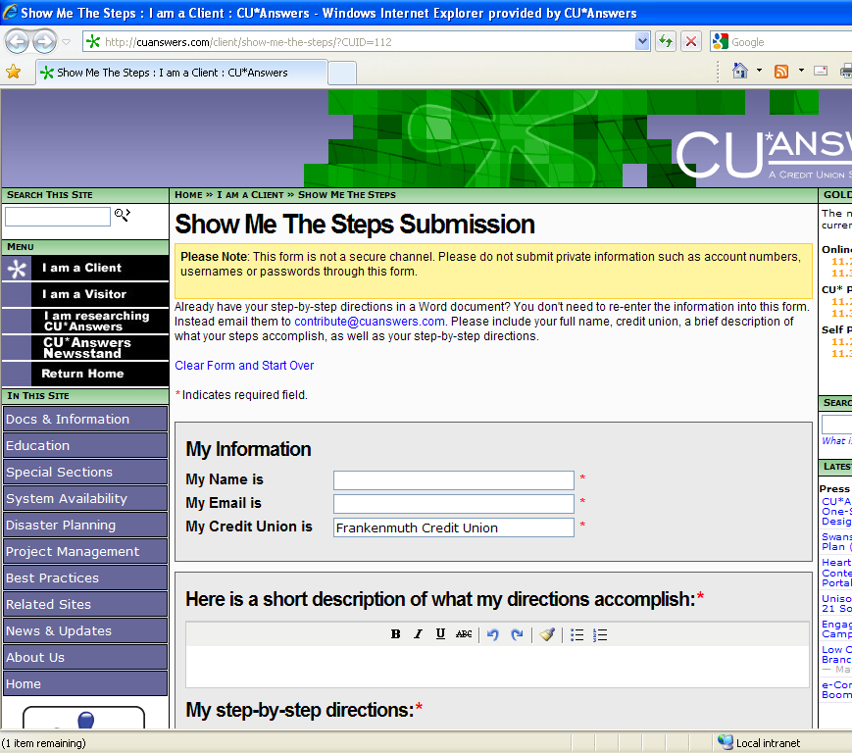
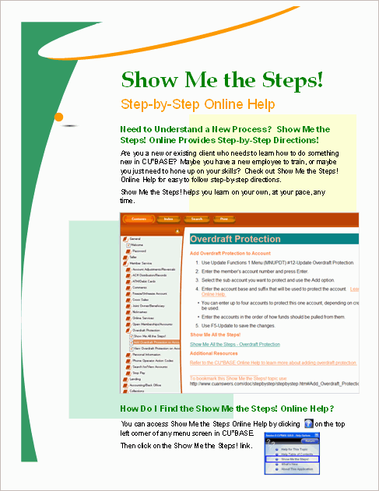
Cooperatives Working with Cooperatives
Show Me The Steps (SMTS) Help
Win $$ for submitting your own step-by-step topics for this tool
  Top submission: $250 gift card
  Most submissions per CU: Pizza lunch for your entire staff
How many Points for this?

Slide 53
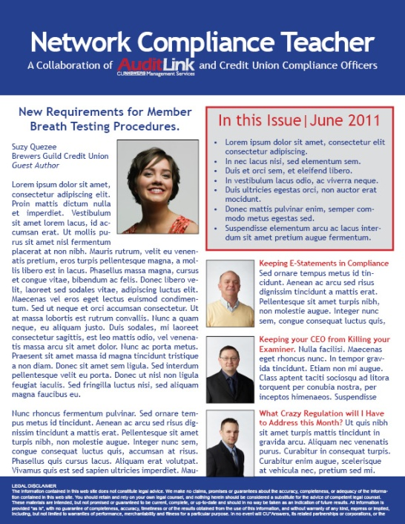
Cooperatives Working with Cooperatives
NCT (Network Compliance Teacher)
Coming soon!
Bi-monthly newsletter written by and for credit union internal compliance teams
  What are you training your credit union employees on related to compliance this month or this quarter?
Submit an article and have it selected for the NCT, and you’ll receive $200
Audit Link will publish the NCT and distribute to everyone in the Audit Link focus group so everyone can learn at your elbow about a timely topic
Our goals is to raise the compliance chatter
in our network by 10x – not the noise,
but the real deal: we gotta focus on this...
How many Points for this?
Build a network of authors, and tap into the spirit of Wikipedia for our own network compliance thinking

Slide 54
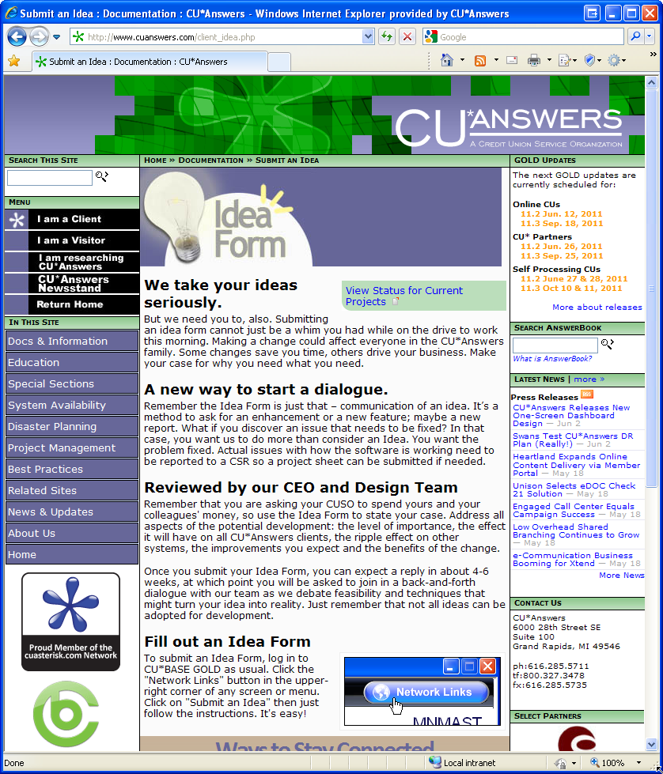
Cooperatives Working with Cooperatives
Idea Forms
For 2010, the Idea Form site was viewed 812 times, with visitors spending an average of 6:33 minutes
Last year we started introduced a new technique for sending ideas directly to a subject-matter expert
  CEO
  Lending & Collections
  Auditing & Compliance
  Online Banking
  General Development
How many Points for this?

Slide 55
Cooperatives Working with Cooperatives
Idea Forms
This is, and will continue
to be, a developer’s blog
Ideas meet teams, teams debate, push it around, disagree, and from that we hope an idea moves a project forward
It’s not a request for a simple “I want it,” it’s a request for “here’s how it could work.”
For 2010, the Idea Form site was viewed 812 times, with visitors spending an average of 6:33 minutes
Last year we started introduced a new technique for sending ideas directly to a subject-matter expert
  CEO
  Lending & Collections
  Auditing & Compliance
  Online Banking
  General Development
How many Points for this?

Slide 56
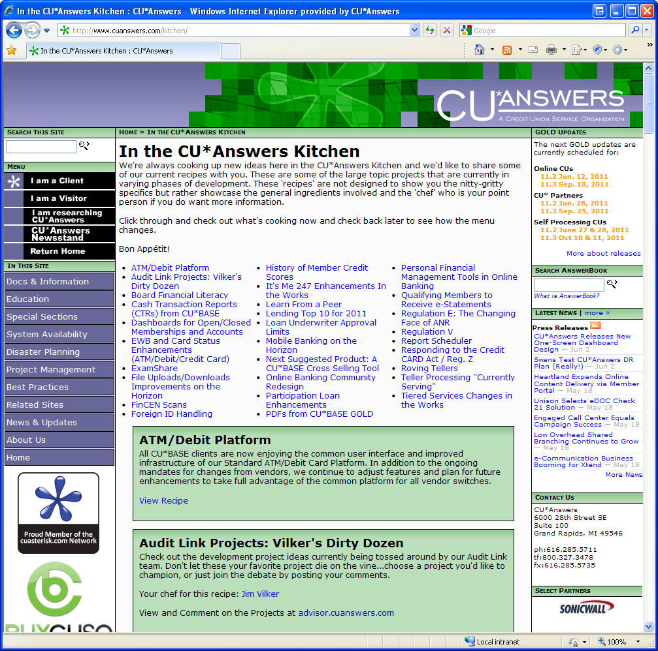
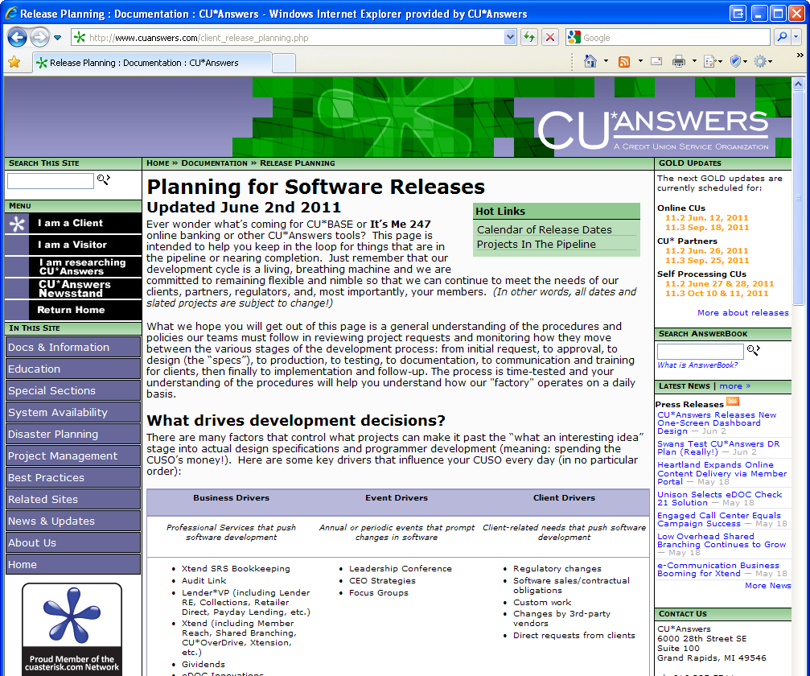
Cooperatives Working with Cooperatives
Staying in the Loop
http://www.cuanswers.com/kitchen/
Last year the Kitchen was the 4th most-visited page on our website
Our working release schedule is updated every Wednesday
http://www.cuanswers.com/client_release_planning.php
How many Points for this?
This might be tricky – any ideas?

Slide 57
Cooperatives Working with Cooperatives
Staying in the Loop
There’s a new skill evolving in consumers and business people today: managing to ask the world “what’s up?”
  People carve out the time and have organized what communities they’re catching up with – sometimes they’ve even automated it with RSS feeds and the like
How is your business doing in tackling this new skill? Here are some things we push into our communities on a regular basis:
  The Education Report (bi-monthly)
  Did You Know? newsletter (monthly)
  CEO Tickler (bi-monthly)
  Remember This? email (monthly)
  AnswerBook reminder (monthly)
  Miscellaneous monthly task reminders from client services (statement insert, EOM checklist)
Being in the loop can make the difference between being in the right spot at the right time or not
Think Groupon... you can miss a deal at your favorite retailer in seconds unless you’re in the loop

Slide 58
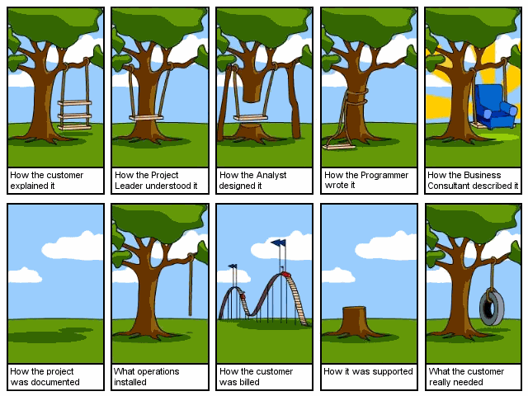
Step 3: Highlighting a network of highly functioning cooperatives
Software, software, software
It takes a vested community to make this work, and if you don’t hear me say thanks for everything you do to make this works, then hear me now

Slide 59

Speaking of a vested community...
For a cooperative to stand out in the marketplace, it takes leaders
For a network of cooperatives to stand out in the marketplace, it takes leaders who can cooperate with others and pull things together
It is in that spirit that every year we honor one of our network’s leaders with the Robert H. Mackay award
And the winner is...

Slide 60
Automating Your Participation in Key Communities
Together we prioritize and search for communities we have to hook into...
If you had to give me your top 10, what would you say?

Slide 61
What are we doing on the Internet?
Your online member community is growing in importance every day...
If not in the number of members, certainly in the top-of-mind marketing of your competitors

Slide 62

The World is Crazy About Mobile
SMS will be a star, and Firethorn bit the dust
Our biggest problem when we lost Firethorn was how we were going to get text banking
We went back to the drawing board, decided to do our own text banking and partner directly with mBlox, with no Mobile App vendor in the middle
We will be announcing a signup for beta participants in July, and are confident about a full release by the end of the year
Pricing
  You will be charged 3.25 cents for text messages, and there are two types:
    1-way messages (marketing, text e-Alerts)
    2-way text messages (answering interactive member requests)
  You will be able to set up fee programs where you can charge members on a tiered basis according to volume of text messages
Look for an invitation soon to a webinar: “Understanding your SMS text program through It’s Me 247”

Slide 63
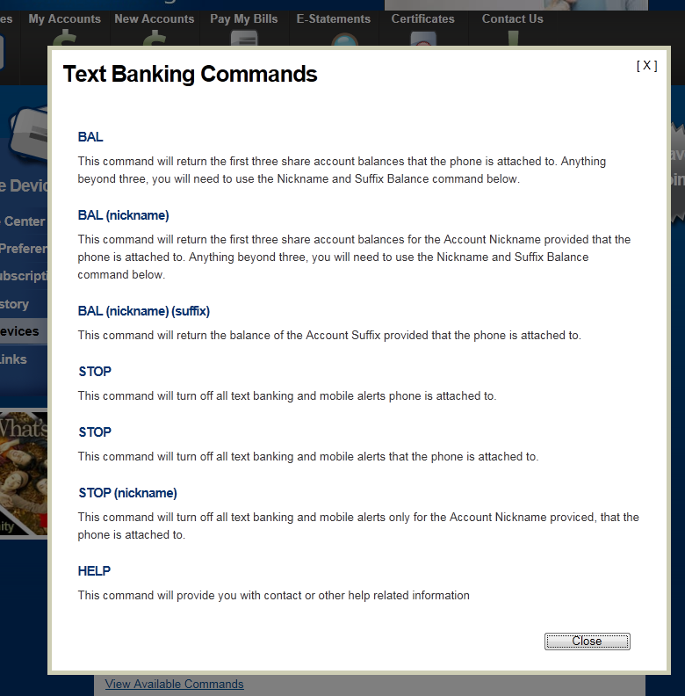
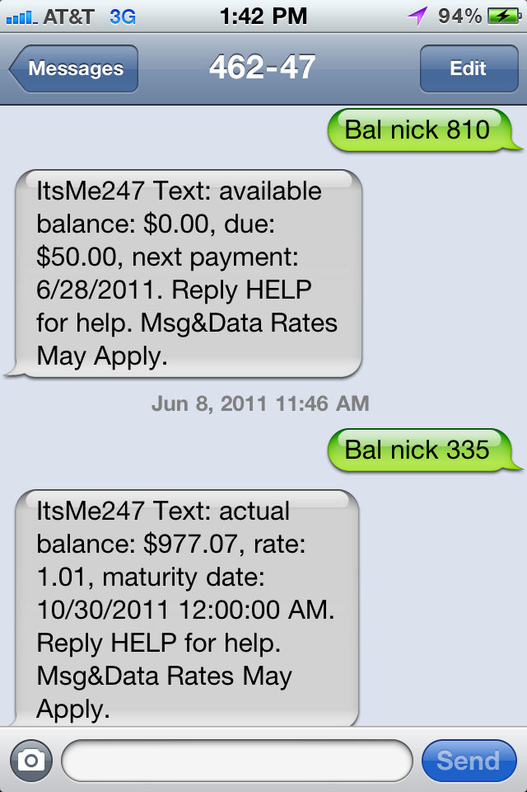
The World is Crazy About Mobile
SMS will be a star, and Firethorn bit the dust

Slide 64
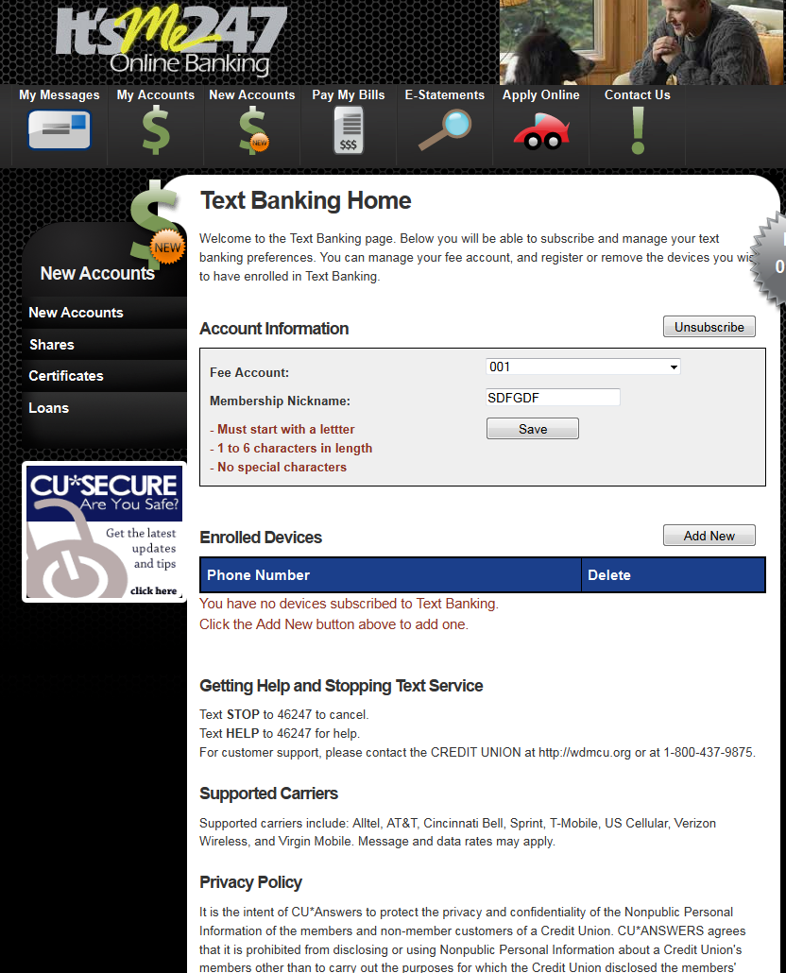
The World is Crazy About Mobile
SMS will be a star, and Firethorn bit the dust
All carriers have now been certified:
  Alltel
  AT&T
  Cincinnati Bell
  Nextel
  Sprint
  TMobile
  USCellular
  Verizon Wireless
mBlox offers connections to more than 60 carriers in North America alone

Slide 65
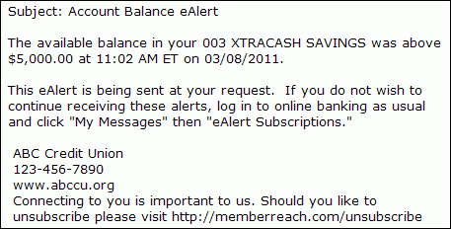
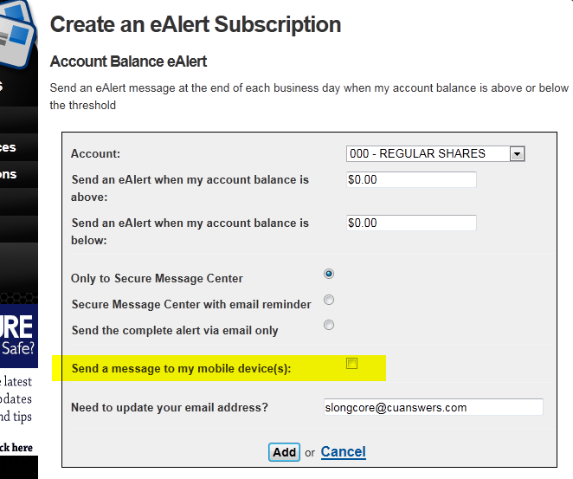
Remember this? e-Alerts Enhancements in the 11.0 Release
Near real-time e-Alerts
  e-Alerts notify members within 30 minutes of changes to their accounts
  Balance tolerance e-alerts now based on member’s available balance
  Members can select to receive
  complete alerts - directly to their
  email
This was all to get ready for text alerts, which will be based on the same engine, but the messaging will be shorter and more “text-y”
Matt and Jody have one more trick to make this even faster; we’ll be looking at how many of you roll this out in 2012 before making that investment

Slide 66

Firethorn Bites the Dust
The Future of Mobile Apps
There is a lot of noise now about what we are going to do to replace the Mobile App project with Firethorn
What I’m not clear about is whether people are talking about another mobile banking app or a mobile phone app to sell on app stores
  What are you thinking?
What if we could create an app for app stores that made it easier for your members to click on their phone and find themselves in It’s Me 247 Mobile Web?

Slide 67


The Future of Mobile Apps
There are new solutions being invented every day
Yesterday’s thinking was that
CU*Answers would make 6-digit
investments, you would pay large
installation fees and be charged
a lot for every member
How can we design a system where mobile apps will not bankrupt us all?

Slide 68



Drilling Down on Mobile Headlines
Near-Field Communication Payments the Latest Technology for CUs to Watch
“Just as credit unions are trying to get up to speed on mobile banking and smartphone apps comes news that the industry may change again, this time to “wave and pay” technology, essentially turning your smartphone into a payment device.
Last week, Google announced it has begun testing of its Google Wallet system in select markets on the West and East coasts. Initially, the system will only work on Sprint’s...”

Slide 69
Are you thinking interactive ACH?
A2A: I think I feel a dashboard coming on
How the world is using ACH might be the greatest clue you have about the future of payment system innovation
Are you in the game? Have you really studied interactive A2A?

Slide 70


Remember this?
Online banking stats today, mobile web coming soon
MNMGMT #10 ARU/Online Banking Summary Stats”
In the 10.3 release last fall, we introduced a new dashboard
Coming soon on this dashboard...mobile web activity stats
  In the meantime, you can monitor mobile web activity yourself by adding a selection parameter to the existing Online Banking Stats canned Query (MNQURY #17)
Check out our News page to review the instructions you received via email on May 18

Slide 71
The Next Generation of Bill Pay
Today, CU*Answers uses an SSO connection with Fiserv (formerly CheckFree) and iPay to create a partnership between online banking and bill pay services
We are working with these vendors as well as a new entry to the bill pay marketplace on a new vision for how we hope to delivery bill pay in the future
We cannot do this alone – if we are to be successful in developing a cost-effective and aggressive solution, you will have to be ready to move and convert your bill pay accounts
  What would motivate you? Better pricing? More features? A seamless experience for the member? A different vision for the future (a la carte purchasing)?
In the next 90 days I need to hear from your team about what you think are the most important bill pay concepts going forward
Where do you want to be 3 years from now?

Slide 72






The Next Generation of Bill Pay
A More Seamless Experience for the Member
Messages
Widgets
Single-sign on to bill pay features presented via iPay or Fiserv tools

Slide 73

The Next Generation of Bill Pay
A More Seamless Experience for the Member
Member Reach and batch email messages
Messages
Quick Pay
Style sheets more consistent with the
It’s Me 247
look and feel
Widgets
Person-to-Person Payment
Single-sign on to bill pay features presented via iPay or Fiserv tools

Slide 74
Concepts for our Bill Pay Future
A more seamless experience for the member
  Create an It’s Me 247 online banking look and feel for the bill pay style sheets
  Bill pay messages presented by It’s Me 247 before the member clicks on the bill pay icon (SSO launch)
  Person-to-person payment widgets embedded in It’s Me 247 that process person-to-person payment transactions – potentially available for both bill pay and non-bill pay subscribers
  A Quick Pay widget embedded in It’s Me 247 to accelerate payments
  A special module: Bill Pay for Businesses (iPay only so far)
Connect It’s Me 247 Mobile Web to iPay and/or Fiserv by end of year
Contracts with our bill pay partners are up in the next 18 months...this is a network effort, so listen for more information and be ready to give your input

Slide 75
Concepts for our Bill Pay Future
What if it was EasyPay powered by us? Have you thought about what it would mean if we offered a CUSO solution as a third choice?
Could we agree to group buy if it meant guaranteeing a new partner $1 million up front?
A more seamless experience for the member
  Create an It’s Me 247 online banking look and feel for the bill pay style sheets
  Bill pay messages presented by It’s Me 247 before the member clicks on the bill pay icon (SSO launch)
  Person-to-person payment widgets embedded in It’s Me 247 that process person-to-person payment transactions – potentially available for both bill pay and non-bill pay subscribers
  A Quick Pay widget embedded in It’s Me 247 to accelerate payments
  A special module: Bill Pay for Businesses (iPay only so far)
Connect It’s Me 247 Mobile Web to iPay and/or Fiserv by end of year
Contracts with our bill pay partners are up in the next 18 months...this is a network effort, so listen for more information and be ready to give your input

Slide 76




OBC Next Generation
Get ready for many, many more evolutions
OBC saw 2.9 million visitors in just the first month
We continue to enhance and add new features that coordinate the dance between your Internet persona and your most active Internet members

Slide 77


OBC Next Generation
Get ready for many, many more evolutions
This is no longer a one-size-fits-all feature
You can coordinate and configure the value of your OBC and make a difference for your Internet members

Slide 78

OBC Next Generation
Coming soon...
Manage your custom OBC stories
Opt in to the stores you like best from our library of standard marketing and security messages
Watch for more news this fall...
Who is your OBC coordinator? Who is managing your portion of 3 million visits a month?

Slide 79





It’s Me 247 Marketing and Sales With a Click
Smart Messages
Randomly displayed, but with the individual member in mind
Activate as many or as few as you wish (ten promos, each with two different designs)
Show all or manually manage to coordinate with other campaigns
Offers with a right-now
navigation click
  Clicks are designed to highlight what a member can do in It’s Me 247
Not annoying pop-ups; these are well-placed marketing offers that do not alienate the online banker who has something to do
Have you already seen a navigation click on an
e-Notice? We’re hearing good things

Slide 80












It’s Me 247 Marketing and Sales With a Click
Smart Messages
Month after month, It’s Me 247 becomes more involved with more of your traditional departments
In this case, your sales team needs to get involved

Slide 81





Web Chat
It’s Me 247 partnering with your response teams
In 2012, will you combine It’s Me 247 and Xtend operators as part of responding to your members’ immediate questions?
What if we could hook up your operators?

Slide 82

Speaking of Xtend and the call center...
69 credit unions took us up on our free offer of 500 outbound calls (?!?)
33 projects completed year-to-date with 36 to go before year-end
Credit unions chose between 10 different campaigns for their free calls
  Where Members Borrow (14% lead rate)
  Member Appreciation (12% lead rate)
  Contest (19% lead rate)
Xtension has had a great year – when will the evidence change your mind about using outbound and third-party call center services?
  Averaging over 4,000 member contacts per month
  30% success rate reaching members in person, 15% of those became leads for credit union follow up
69 is a big improvement from 17...
so let’s try it one more time
Xtend will be reaching out to you and asking what program you want to use for your free calls in 2012

Slide 83



See/Jump/Transfer Update
First of three aggregation projects for our network
From last year...
The next generation of Transfer Control (to start, members must contact an MSR to set up this relationship list)
You control which options are available
PIB will still allow Transfer control, but See and Jump will be coming in phase 2 (PIB revamp)
We’re still not clear on how many of you will turn this on and how aggressive you’ll be in letting members manage it

Slide 84

See/Jump/Transfer Update
What might Bill Johnson see as My Other Accounts?
Just missed 11.3...but coming soon!
View the accounts and/or jump to that account via SSO connection (no login required!)
“Other” accounts will be grouped on a new page
May be your kids, your brother, or just some guy who lets you see his account...but it’s his choice
Of course, aggregating a person’s membership relationships in
It’s Me 247 means we have work to do in CU*BASE, too (more on that later)

Slide 85


MoneyDesktop
Second of three aggregation projects for our network
Project Champions:
Frankenmuth CU &
Heartland CU (Springfield)
In this case, credit unions are choosing an Online Financial Management (OFM) tool that includes the ability to aggregate across financial institutions, as well as other features
  Check out the Kitchen for our current project vision
A half dozen of our largest credit unions have already agreed to be betas; they’ll be live by year-end
Are you interested in an OFM for your membership?

Slide 86
Freemiums
Putting the horse back in the barn
Freemium is a business model that works by offering a basic product or service free of charge (such as software, web services or other) while charging a premium for advanced features, functionality, or related products and services
From Wikipedia:
Across the board, everything members do with credit unions has become simply MORE...what used to be simple is now more complex with variety and options for every member
Unfortunately, our pricing models, and what we think we have to give away, have not kept up with our joy in making everything a premium service
If you think online banking, there are a half dozen strategies where you may someday need a direct revenue model
In your 2012 business plan, I hope you will introduce your Board members to the Freemium idea and how it could change something as basic as statements

Slide 87



Freemiums In Action in 2012
Zeroing Out Your Statement Expense
Still pushing for the 11.3 release

Slide 88
It’s Me 247 Communicating More than Dollars and Cents
Expanding the Use of $0 Memo Transactions
Currently, $0 memo transactions produced by CU*BASE for the following types of transactions, in cases where there isn’t a regular member transaction to tell the member what happened or what they did:
  A2A deposits
  Effective dating opening memberships
  Stop pay orders
  (can also be created manually by CU employees via Account Comments)
Coming soon
  OTB payments via Teller Misc. Receipts (more on that in a moment)
Still under consideration
  Check cashing transactions
  ATM inquiries
  What else??
Like CUFMNT, this stuff
can get out of hand
Do we really want to record every piece of history and put it into
online banking, statements, etc.?
Or is it valuable to see who
cashed checks this month?

Slide 89

It’s Me 247 Communicating More than Dollars and Cents
The Available Balance Challenge Continues
From the 11.0 release
This is what the member sees now in e-Statements and It’s Me 247, and what your employee sees in CU*BASE

Slide 90

It’s Me 247 Communicating More than Dollars and Cents
The Available Balance Challenge Continues
From the 11.0 release
But what if the resulting balance wasn’t a negative number?

Slide 91
It’s Me 247 Communicating More than Dollars and Cents
The Available Balance Challenge Continues
If you could approve debit card transactions based on an ANR limit, but then when the transaction comes in, use the current balance instead of the available balance to decide whether or not to charge an ANR fee, would you?

Slide 92
It’s Me 247 Communicating More than Dollars and Cents
The Available Balance Challenge Continues
Are you still seeing market pressure to limit the number of Courtesy Pay fees in a day?
Should we tackle this early in 2012?
If you could approve debit card transactions based on an ANR limit, but then when the transaction comes in, use the current balance instead of the available balance to decide whether or not to charge an ANR fee, would you?

Slide 93




One Size Fits All
The Biggest Myth Around It’s Me 247
Personalization is baked into It’s Me 247, from credit union-configurable options to member personal preferences
But people still think it needs more
  “I want it to look my way, and you won’t do it”
We would love to sit down with a champion for this project
  Your budget for an original skin with some leeway in navigational styles should start at about $35,000 and it would increase your monthly e-commerce fee to $3,500
If it looked just like your website with the same navigation theme, would that be enough to spur you to be an expert in driving what the member can do with online banking?

Slide 94



Before you design your own...
What We’re Thinking About for 2012
Ideas for new navigation techniques for It’s Me 247
In the next few months, we need some examples of navigation templates from your favorite websites

Slide 95
Reaching Out for Opportunity Through Other Networked Communities
What important communities might you tap into for more opportunity?
Are these communities ready for an automated hookup?

Slide 96
How often do you think about where you need to “hook it up” next?
(and I’m not talking like a U.S. congressman)
When do you need CU*BASE to interact with another software product for opportunity?
  How about having the network reach out for loan applications?
  How about having the network reach out to an alternative servicing community?
  How about having the network reach out to work with a Corporate or the Fed?
  How about having the network reach out and take a deposit from a member?
  How about reaching out to another credit union to participate in opportunity?
  How about having the network reach out and...?
Together, we need the market to understand how focused we all are, including CU*Answers, on communicating with every community we can possibly find that will add
value to our participants
Maybe not for free, but more often than not,
CU*Answers will invest

Slide 97



Introducing Lender*Hub
A 2012 initiative to tap into loan volume
Approaching 9 connections for loan opportunity, including
MicroLender pay day lending
  4 being added this year alone: Meridian Link completed in 2011,
  RouteOne goes live end of August, LSI slated for later this fall, and TCI being quoted as we speak
  Did you know your loan department could team with so many automated sources of loan apps? Hire a partner, join a new community in 2012
Lender*Hub in a Month:
$22.7 million
in potential loans
$5 million
in finance charges
1,650
applications

Slide 98


Introducing Lender*Hub
A 2012 initiative to tap into loan volume
To date, CU*Answers generally talks about only two copyrights: CU*BASE and It’s Me 247
Lender*Hub is now a large enough body of work for us to think about this middleware as the third major copyright in our suite
Dedicated resources will now be focused on expanding these capabilities on a daily basis, and redundancy for these critical contact points is the next big system to be added to our DR/BR plans since It’s Me 247
When applications aren’t just walking into your lobby, you have capacity...is that capacity investigating where applications might be available?

Slide 99

Introducing Lender*Hub
A 2012 initiative to tap into loan volume
The point of Lender*Hub is that it is a middleware to push the application into the CU*BASE loan queue and underwriting toolkit
Be careful...this is not about replicating loan origination systems – this is about buying opportunity and automating the flow into an aggregated toolkit for servicing, reporting, data mining, and the big picture

Slide 100

Special Note from Lender*VP Development Teams
Helping You Take the Lead on Adding New Communities

Slide 101
It’s Me 247 and CU*BASE GOLD
Connecting to the World
GOLD SSO connections:
  Statements
  Receipts
  ID Verification
  ProDOC
  Check Ordering
Other links from CU*BASE GOLD:

Slide 102



Passing Data Between CU*BASE and the World
File Downloads (CU*BASE to your PC)
Coming in 11.3!
1
Taking the geeky out of using your data with other systems and vendors
2
3

Slide 103


Passing Data Between CU*BASE and the World
File Uploads (your PC to CU*BASE)
Coming in 11.3!
1
Sets the stage for some new “Upload Your Work” tools coming in 2012 (have you tried Direct/Mail Post imports yet?)
2
3

Slide 104

It’s Me 247 and CU*BASE GOLD
Connecting to the World
SSOs:
  2 – Bill Pay
  3 – eDOC/Statement/Portal
Secure Communication APIs:
  20 – Check Image
  1 – A2A Middleware
  1 – SMS Middleware
  1 – iPay enrollment middleware
  1 – cuchecks.itsme247.com API to CUA IP platform
Other internal APIs:
  1 – Satellite rate boards
  1 – Satellite credit union info feed for OBC
Internal SSOs:
  1 – to Online Loan App
  1 – to Mobile Web (on Try Mobile page)
In the pipeline:
Secure Communication API:
  2 – Mobile Web Bill Pay
  1 – OFM (Money Desktop)
In the future:
  1 – Mobile App API
If you are doing things manually and you haven’t wondered if there was already a connection, do your work...call us
This area is expanding rapidly

Slide 105

OTB Accounts & Online Banking
Connecting CU*BASE and It’s Me 247 to the World
Coming in 11.3!
Project Champion:
Fox
Communities CU
Optional display of OTB account data to members in online banking
This is another form of account aggregation, but this time we’re aggregating your member relationships across multiple servicing platforms

Slide 106


OTB Accounts & Online Banking
Connecting CU*BASE and It’s Me 247 to the World
As of date shows the last time you received an upload with status details from your vendor
Next up: “Jump to my account” feature with SSO connectivity
Pay Now button jumps to the Transfer Wizard

Slide 107

OTB Accounts & Online Banking
Connecting CU*BASE and It’s Me 247 to the World
Members can transfer funds to their OTB account via the Transfer Wizard

Slide 108

OTB Accounts & CU*BASE
Connecting CU*BASE and It’s Me 247 to the World
Payments directly to OTB accounts via a Teller or Phone Misc. Receipts
After choosing a special M/R posting code, system prompts employee to choose the specific OTB account for the transfer

Slide 109

OTB Accounts & CU*BASE
Connecting CU*BASE and It’s Me 247 to the World
A $0 memo transaction is recorded on the base share account , advising that the member paid another account servicing vendor
If you don’t know about OTB, you need to learn
If you currently are using OTB, these new features should pump a little life into your program

Slide 110


Packaging Loans for Sale
Buying and brokering opportunities to each other
Project Champion:
Progressive CU
17 ways to combine loan portfolio parameters in a way to find the perfect block of loans for your partner...a precursor to concentration risk selections

Slide 111

Packaging Loans for Sale
Buying and brokering opportunities to each other
Project Champion:
Progressive CU
Do you have a profile of some loans you’d like to buy? Do you have some loans you’d like to sell?
There is opportunity everywhere in our network if we simply get busy and talk to each other, and now the software makes it easier than ever

Slide 112
Connecting With Your Business Communities
Everyone asks what we have, but few are saying “I’m aggressively wanting to roll something out by xx/xx/xx”
Here are some things we plan to do in 2012

Slide 113
Connecting with Business Communities
When do pieces and parts equal a major focus?
Can CU*Answers and your credit union declare a plan for business members? Can we show a body of work that says this is a focus of our organizations?
  What do we have to change to say this is one of our network’s specialties?
Here are some stakes we wish to put in the ground in 2012
  Launch a credit union focus group/think tank for serving businesses
  Develop a certification process to allow a credit union to be designated as Business-certified (Business-ready? Business-friendly?)
  Launch and complete three marketed business solutions as part of the program
CU*BASE has always had the building blocks for servicing businesses, as long as you could put them in the right configuration
In 2012 we want tailored packages and the recognition from the marketplace that we have business solutions

Slide 114

Project #1: Business Servicing Fee Packages
Replacing Marketing Clubs as the Business Aggregator
Configure Business Servicing Packages
(“Low Volume Checking,” “High Volume Checking with Cash Management Services,” “Small Employers,” “Big Employers,” as many as you want)
Link sub-accounts to the package
Package multiple fees and process monthly with unique offsets
  Can post two separate transactions (total fees debit and offsetting credit) or post a single net transaction
  Can include fees for deposited items, checks cleared, ACH incoming credits, and ACH incoming debits...sets the foundation for innovation
  Includes ability to add special fees manually, one CU at a time...blend direct charges with automated calculations
Analysis inquiry – take the guesswork out of fees for your business members
  3 months of posted fee data available online
How can we take old-school banking ideas and show businesses how a Cooperative might play the game?

Slide 115


Project #2: Multiple Logons for It’s Me 247
Tailored authority for teams to use online banking
Our current vision:
Up to 6 logons IDs per membership, each with its own password and security questions
Control access by ID
  Who can post transfers?
  Who can see which sub-accounts?
  Who can do maintenance-type functions?
  Who can jump via SSO links?
  (bill pay, etc.)
CEO
CFO
This will take an active and interested
set of CUs to work through what is
enough but not too much
Security and your examiner’s perspective will be an important part of how we build this
Hope to be in beta this time next year

Slide 116



Project #3: eDOC Mobility
Remote Capture of Deposits
We need the network to go active and start developing working foundations for the evolution of remote activities with members
  Building an active set of users of Remote Check 21 solutions
    Merchant Deposit Capture
    Member Deposit Capture – via PC and phone
  Working with eDOC Innovations and their new e-Sign initiative
Remember these?
Is this a matter of wine before its time? What do we have left to do so you will launch these important member services?

Slide 117


Project #3: eDOC Mobility
Remote Capture of Signatures and Managing Packages of Forms
I know this is on your radar, and I believe you will need this capability in the future...start working with eDOC today

Slide 118
Continuing to Learn in the CU*BASE Community
With over 1.4 million members, 189 credit unions, and 3,000+ CU professionals, we still have a lot to share
Will you use the speed of a click?

Slide 119






A New Programming Team
Analytics at a click: a dedicated effort
What started with the Know Your... (Member, Operations, Identity) dashboard projects has now grown to a full-time team driving a new kind of answer into CU*BASE
This team is directly linked to credit union CEOs through the CEO Strategies focus group, but their work is raising the standards inside CU*BASE

Slide 120


Learn from a Peer
Another focus for the Analytics team
Existing tools
  Tiered Service Peer Analysis
  Cashed Check Fee Config
Coming in 11.3
  Deposit Item Fee Config
  Printed Check Fee Config
  Money Order Fee Config
  Phone Transfer Fee Config
  Self-Service Fee Config
  Online Bill Payment Fee
  Config
  Starter Check Fee Config
In 2012 cuasterisk.com will focus on partner-to-partner exchange

Slide 121




New/Closed Membership Dashboard
One of our recent favorites from the team
Watch for the companion New/Closed Accounts Dashboard coming later this year
pdf
Want to improve your Board literacy and grasp? Start with presentation

Slide 122

Analytics Ready for Publishing
Show it on a screen, email it, impress everyone
For the next few years we will focus on building a system with the lowest cost of converting data into knowledge that leads to action
Gathering Data (reduce $ cost)
Analyzing Data (increase time)
Acting on Data (multiply the events)
For the small cost of some software for a PC and some color print capabilities, you can change the way people see your grasp of the situation

Slide 123

Concentration Risk
Understanding the components of your loan portfolio
What’s next for the Analytics team?
Project Champion:
Progressive CU
It’s a simple formula: select loans or borrowers from your portfolio and then have the system draw a picture of your risk, one member, or one loan segment, at a time
Our first Concentration Risk tool looks at members and the risk they represent when they have very large balances or a lot of loan relationships
Our full portfolio concentration risk tool will be previewed at this year’s CEO Strategies conference, and released early in 2012

Slide 124

Concentration Risk
Understanding the components of your loan portfolio
Project Champion:
Progressive CU
26 different facts and totals about your borrower in a single click (along with some pretty graphs)

Slide 125

Learn From A Peer
Consumers do it, why shouldn’t we?
http://www.nerdwallet.com/credit-union/
There are dozens of sites on the web that help consumers understand how products are being designed, priced, and sold
They can see a complete marketplace with a single click - why can’t we see ours? And if we could, would we look at it? Would we think it through? And would we help each other put our best forward
David Damstra wants to know why we are not feeding all of your great rates to this site (or others)

Slide 126


Savings Rate Services
Learn From A Peer teaming with Xtend for a new product
Coming soon
CU*BASE creates the benchmark, Xtend helps deliver the local community competitive perspective

Slide 127

Savings Rate Services
Learn From A Peer teaming with Xtend for a new product
Coming soon
Starting with CDs, then savings and loan rates are next
This is Learn From A Peer at the highest level – what products have we
designed in our network? How are they priced? What might we be thinking about in the future as individuals but viewed as a collective?
At the 2011 CEO Strategies event in November we will talk about what it means to us all to see these numbers with a single click

Slide 128
Building a Healthy $$ Community
We all need to think about whether the businesses in our community are healthy, and what we could do to increase our GCUP economic indicator
Gross Credit Union Product

Slide 129

Christmas in June: $466K/year
Do smaller CU*Answers invoices lead to healthy communities?
I believe so, and based on some recent Senate action, I imagine you do too... so let’s get to it
Announcing a 10% price decrease for online ATM/Debit transactions, effective October 1, 2011
  CUs with online credit cards: $0.0563 per transaction
  CUs without online credit cards: $0.0608 per transaction
  Caps on EFT processing remain the same
  Total savings for all CUs: ~$341,000 in the 2012 business year
Announcing... COLA increase for 2012 will be cut by 50%
  Total savings for all CUs: ~$107,000 next year and every year after that
Announcing...eliminating minimum for check transaction fees
  Totals savings for all CUs: ~$18,000 annually
Disruptive pricing must be a significant goal, but the biggest goal needs to be expanding opportunity and creating the highest possible GCUP for everyone

Slide 130

Who doesn’t love a sale?
Add any service on this list that you don’t currently use, and we’ll waive the ongoing service fees for 2 years
2012 could be a lean year, and at the same time, demand that you innovate for new opportunity
If you’ve been waiting for some reason, maybe FREE will get you up and moving

Slide 131
Innovation or Filling a Hole?
How will CU*BASE service income programs change in 2012?
For years, we have taught how to configure service income programs in CU*BASE...the software is rich in the ability to mix and match service income concepts for new ways to earn revenue
For last year’s CEO School, we did a research project to document custom fees we had written over the years for CUs – fees that CU*BASE standard programs could not handle
  For the balance of this year, we are researching all of the standard fee programs you have set up using CU*BASE tools (Minimum Balance, Account, and Transaction Service Charges) for a complete inventory of fee program ideas throughout the network
  Next, we will begin writing some enhancements to our standard programs to include the best and brightest ideas from the custom programs
If the point is to generate service revenue, don’t fall in love with the specifics and pay for a wrinkle, when 90% of the automation is free!
Get creative, know your configurations

Slide 132




Building a Healthy $$ Community
One of my favorite GCUP initiatives...
Network redundancies can cause collaborating businesses to fail at a win-win propositions, by creating an environment of “it’s us or you”
The best chance for our network not to fall into this trap is peer-to-peer businesses and shared resources, instead of overlapping ones
This initiative has two payoffs to CU*Answers:
  Use a collective to design businesses, document them, and create development think tanks
  To put credit union resources to work and focus on generating direct credit union income from making everyone important to the economic activity inside our network

Slide 133

Building a Healthy $$ Community
Working Example: NMS
Neighborhood Mortgage Solutions is a peer start-up that sets the bar for what can be done
Started in November 2008, here’s a look at NMS today:
  30 member credit unions in 7 states, owned by 3 CUs, 12 employees
  The network generated 2,916 loans totaling $310 million
  Income on selling loans to FNMA has generated $3.8 million in revenue
  7 delinquent loans, 0 buybacks from FNMA
NMS
represents bright entrepreneurs riding a shared distribution network...what might you do in this community?

Slide 134


Building a Healthy $$ Community
Working Example: Mi-CPR
What if your community could make a very special
workforce visible to everyone that needed a new HR design?
What if you took what we’ve learned from shared branching and members and applied it to a network of employees and credit union leaders?
  Do you need temporary coverage? Are you overstaffed today just because of emergencies? Do you wish you could share training?
  Do you wish you could match your capabilities with other people’s challenges, and vice versa?
“Start a Business” templates and the experience of CU*Answers and Xtend in building processes to share employees might be the catalyst you need to going into business

Slide 135



Building a Healthy $$ Community
Working Example: Social Media Consulting
Chatter Yak
Many of us think we know what this is, have teams honing their own skills, and are sure it’s something we should be paying attention to
Now it’s time for a network to tackle this

Slide 136
The 2011 “Spirit of CU*Answers” Award
This new award lets us recognize a client for excellence:
  The CU that best exemplifies our Leadership Conference theme for the year, or
  A CU with an especially strong and vital volunteer program, or
  A CU that demonstrates the principle of being “all about the member,” or
  A CU with an innovative example of collaboration and cooperation (the highest Collaborative Score), or
  A CU that has started a business in the network, or
  A CU that shows strong execution and performance, especially in the face of adversity or despite overcoming a significant challenge, or
  A newly-converted CU that really hit the ground running with adoption of CU*BASE tools (or an existing CU that has really plunged into the tools in a new way), or
  A CU that started a new initiative that really demonstrates the credit union spirit, or that moves the industry in a positive direction, or that is inspirational to other CUs in some way
And the winner is...

Slide 137
Big Concepts and Big Projects
Whether by discipline or department or new concept, some projects grow into a portfolio of projects around a good idea

Slide 138
Lender*VP Top 10
The first CMS initiative and the most advanced...when was the last time you took a hard look at Lender*VP?
Designed with building tools in mind, but its purpose is to put our network in the loan business

Slide 139

Lender*VP Top 10
Development Priorities for 2011
Have you been tracking these and adding your comments?
Visit the Kitchen to stay in the loop
http://www.cuanswers.com/kitchen
Let’s get a progress report on just a few of these...

Slide 140



A new vision for how credit report data interacts with applications and CU*BASE
Project 1
View trade line detail directly from the credit report while working an app

Slide 141


A new vision for how credit report data interacts with applications and CU*BASE
Project 1
More comprehensive analysis of key credit report indicators
Search for a trade line in the detailed report
Plus about eight other projects related to storing and accessing credit report data

Slide 142

Slicing and Dicing Your Loan Portfolio
Improvements to the Loan Queue
Projects 3 & 4
Maximum flexibility for selecting which apps to work

Slide 143

Slicing and Dicing Your Loan Portfolio
Organizing loans by Business Unit
Projects 3 & 4
Configure Business Units to group your loan categories

Slide 144



Slicing and Dicing Your Loan Portfolio
Changing the way you use some of your favorite loan reports
Project 3
When we expanded the database and put in new selection criteria, it causes a wave throughout the rest of the software, leading us to improve things you’ve counted on for a long time
Where we could only handle things one category at a time, we now have a new level of flexibility
Has your team revisited these reports, or are they still working Queries and other workarounds when they could simply press a key and get what they want?

Slide 145

Skip-a-Pay Tools for Consumer Loans
Project 9
This new tool will include five major elements:
Schedule skip-pay programs (timing, eligible products)
Member opt in via CU*BASE and It’s Me 247
Evaluate loans for eligibility (loan status, credit score, membership designation, etc.)
Data on loan and history of member-elected skip pays (# of skips per year and per life of loan)
Collect income (fee and/or interest due) and advance the dates (next due date, maturity date, review date)
Skip-Pay options

Slide 146
Lender*VP Top 10...you didn’t think we meant only 10 projects, did you?
No good deed goes unpunished...as we change the infrastructure for the Top 10 projects, it is taking us in many directions
Here are some other projects also underway or on the drawing board:
  Managing credit score histories (coming, with an It’s Me 247 sparkle)
  Loan officer approval limits (11.3 release)
  Collateral enhancements, including automated repricing tools
  Participation Loan rewrite (11.3 release)
  Automating the income adjustment for 90-day delinquency (11.0 release)
  Mortgage Payoff Prep tool (10.3 release)
  360 mortgage rules for ACH (11.0 release...oops)
  Modified APR for balloon loans (11.1 release)
  Plus about 10 projects related to credit report data
Geoff Johnson wants me to remind everyone that the Allied and SWBC CPI Insurance Premiums posting project will be released by end this calendar year

Slide 147

Making Collateral Data More than Just a Memo
Project Champion:
Progressive CU
What do you do if the collateral tied to a loan is subject to periodic revaluation?
We used to have some CUs that used the Stock collateral type tied to LOC limits, but recently examiners are talking more about what collateral is worth and how that changes over time
This is our first project that sets the foundation for automating periodic collateral analysis and re-pricing
  Reluctantly thinking about mortgages and what you might be forced into in the future

Slide 148


It Looks a Lot Like Re-pricing Investments
Today it’s Medallions, what will it be tomorrow?
For progressive; no shots available yet

Slide 149


Credit Score History
Credit score trending will lead to new opportunities
It started with the MFOEL requirements, but what else might you do as far as marketing, servicing, and defending your portfolio with this data?

Slide 150


Credit Score History
Credit score trending will lead to new opportunities
Credit score history direct from CU*BASE
Potential SSO service if you wish
Combine this option with MFOEL pressures, and pulling credit scores on everyone every six months seems very cost-effective

Slide 151
Aggregating Your Member Relationships Inside CU*BASE
Today’s online consumer has taught us that they expect your staff to have the same power as they do on the ‘Net: One click, see everything about me
Continuing to move away from doing things one membership at a time

Slide 152
Improving Global Search
See, move, and serve from a single picture
Coming in 2012
Global Search now:
Account # | Type | Rel Code | Member Name |  |  | SSN/TIN | Primary Name
557651 | 000 | MI | JONES | JOHN | B | *****6283
557785 | 000 | JI | JONES | JOHN | B | *****6283 | COMPUTEC, INC.
557785 | 001 | JI | JONES | JOHN | B | *****6283 | COMPUTEC, INC.
557785 | 011 | JI | JONES | JOHN | B | *****6283 | COMPUTEC, INC.
557876 | 000 | JI | JONES | JOHN | B | *****6283 | JONES
558970 | 000 | JI | JONES | JOHN | B | *****6283 | JONES
557876 | 786 | CB | JONES | JOHN | B | *****6283 | JONES
557876 | 772 | CB | JONES | JOHN | B | *****6283 | JONES
557876 |  | TB | JONES | JOHN | B | *****6283 | JONES
With this other account...
Which is owned by...
This person...
Has this relationship...
New and improved:
Name | SSN/TIN | Relationship | Account # | Type | Primary Name
JONES, JOHN B | *****6283 | Member (Individual) | 557651 | 000
JONES, JOHN B | *****6283 | Joint (Individual) | 557785 | 000 | COMPUTEC, INC.
JONES, JOHN B | *****6283 | Joint (Individual) |  | 001 | COMPUTEC, INC.
JONES, JOHN B | *****6283 | Joint (Individual) |  | 011 | COMPUTEC, INC.
JONES, JOHN B | *****6283 | Joint (Individual) | 557876 | 000 | JONES, MARY L
JONES, JOHN B | *****6283 | Co-borrower |  | 772 | JONES, MARY L
JONES, JOHN B | *****6283 | Co-borrower |  | 786 | JONES, MARY L
JONES, JOHN B | *****6283 | IRA Beneficiary (Trad.) |  | IRA | JONES, MARY L
JONES, JOHN B | *****6283 | Joint (Individual) | 558970 | 000 | JONES, TIMOTHY R

Slide 153



See My Other Accounts
Third of three aggregation projects for our network
Coming in 2012
My Other Accounts
Account 1075
Name JOHN Q MEMBER
Jump to this membership

Slide 154

Teller “Currently Serving”
A member is a member is a member
Coming in 2012
At the core of our design, we have always kept the separated the primary member’s status from secondary owners
Members don’t – they don’t care if they are a joint owner or the primary member... they’re a member and
they want to be treated that way, no matter what membership or sub-account they are working with
  “Give me the same deal...call me by name...move easily from my membership to my wife’s...see me as an important person at the point of service”
This project will yield ownership automation, aggregate views, BSA across all owners, and a new slant on everybody in a credit union’s community
Bonus benefit: Streamlining the “Photo ID on file” feature

Slide 155

Teller “Currently Serving”
A member is a member is a member
Coming in 2012
New feature
Work with primary member now
OR Serve another owner
New Global Search
Open your drawer and go to work, in one option

Slide 156

Teller “Currently Serving”
A member is a member is a member
Coming in 2012
ID verification for the owner you are serving now
The rest of the window is still about the membership account you are accessing

Slide 157

Teller “Currently Serving”
A member is a member is a member
Coming in 2012
Owner you are serving
Data is masked on accounts not owned by this person, and withdrawals are blocked

Slide 158

Outstanding Loan Recap
Aggregated analysis at a click
Coming in 2012
Project Champion:
Progressive CU
Also on the drawing board for the Analytics Team in 2012 is an Outstanding Savings recap

Slide 159
Favorite New Tools Update
Past and Present

Slide 160

Favorite New Tools Update
Past and Present
http://www.cuanswers.com/client_release_summaries.php
Since last June, we have pushed six releases: 10.2, 10.3, 10.4, 10.6, 11.0 and 11.2
And over 40 pages just introducing the software you now have in your toolbox
How does an individual balance their own priorities against an army of individuals building a comprehensive solution?
Understanding the
squeaky wheel
principle (some
call it escalation)

Slide 161


Top 3 Favorites Released in the Past Year
#1: Automating Effective Date Processes
10.1 Release (last June)
Effective dating for opening memberships and accounts
10.3 Release (October)
Effective dating for transfers and account adjustments
“Unlock
the Date”
Project Champion:
Heartland CU/Springfield
Have you upgraded your exception handling, or are you still limited to a few in-the-know people, slowing your member response?

Slide 162

Top 3 Favorites Released in the Past Year
#2: Reg. E Opt In via It’s Me 247
Project Champion:
Member Reach
10.2 Release (last July)
Have you changed your organization’s mindset
about reaching out to members?
Contacting members with the confidence that they have the control to take themselves off your contact list

Slide 163


Top 3 Favorites Released in the Past Year
#3: 5300 Call Report Ratios
Project Champion:
Xtend SRS Bookkeeping
11.0 Release (April/May)
The first project to leverage our
5300 automation tool
Ratio trending at the click of a button,
presented for your team to
brainstorm around

Slide 164


Favorites Released in the Past Year
Honorable Mentions
It’s Me 247 Security Enhancements (10.3 release)
  The more members want to do online, the better you have to be at marketing and defending how the channel is secure
Debit Card Round Up (10.3 release)
  A nationally-marketed consumer product that everything thinks is great...and it’s free! Have you kicked off your program yet?
Certificate Maturity Management
in It’s Me 247 (10.3 release)
ACH Repost (10.3 release)
Teller Deposit Calculator (11.0 release)
There’s bound to be something on the Release Summaries page that’s just what you need for your 2012 business plan

Slide 165


Top 3 Coming Next Year (that we haven’t already mentioned)
#1: Next Suggested Product
Coming soon!
Project Champion:
Park City CU
Or you provide the picture
You enter the words...
Expanding the power of the Cross Sales Task List
Choosing the community to receive your message, and putting it at the point of sale

Slide 166


Top 3 Coming Next Year (that we haven’t already mentioned)
#2: Menu Search
Coming in 11.3!
Now you can search for “Collateral” and also find Misc. Loan Maintenance!
Project Champion:
The Writing Team

Slide 167


Top 3 Coming Next Year (that we haven’t already mentioned)
#3: Roving Tellers
Coming in 2012
Eliminating the need for “floating” teller drawers
  Single Teller Employee ID will be able to work from multiple branch vaults in the same day
  CU can choose authorized branches, and only one drawer can be open at a time
Project Champion:
Every Head Teller I Ever Met
Check out the Kitchen to preview our vision for this project

Slide 168
Favorites Coming Next Year (that we haven’t already mentioned)
Honorable Mentions
Printing CTRs...finally! (targeted for 11.3 release)
  More than just printing a form, we will be retaining CTR data as a companion to your BSA database, and will include tools for keeping an audit trail
Foreign ID Handling (coming in 2012)
  ID Type codes to allow for multiple records with the same 9-digit SSN; eliminating the need for “imitation” SSNs
Report Scheduler (coming in 2012)
  Another gem from the CEO Strategies focus group
EWB Enhancements (coming in 2012)
  Get ready for a big project announcement from our EFT team
Enhanced limit checking for debit card activity (coming in 2012)
As always, watch the Kitchen and your email for updates on these and many more projects in the pipeline

Slide 169
Wrapping Up the Day

Slide 170
Have you forgotten who’s watching?
Your next set of volunteers, the next new member, your whole community
It’s a cynical world, and when no one can see the reason for your passion, you might have lost the ability to continue with that passion
  We have a business design that provides a competitive advantage...improve your elevator speech; move from bank “lite” to cooperative power
  We are driven by principles that the networked world accepts without even talking about them...marry yourself to these ideals and start piling up small wins
  Our communities are searching for a new norm in the chaos of change all around us...remind them that our history provides a template for that norm;
  be the local solution
The inspiration that comes from passion is not about what you do, but why you do it...renew your passion in 2012 and your stakeholders will follow

Slide 171








What else is in your packet?

Slide 172

Pass It On...
As always, all materials related to this week’s events will be posted on our website
http://www.cuanswers.com/lc2011

Slide 173


Tonight
For our owners:
We’ll see you downtown at the B.O.B. for the Stockholders Meeting (cocktails start at 5:00)
Hop on I-96 W and follow the directions on your map to the B.O.B. in downtown Grand Rapids
Park across the street at the ramp - there’s no parking next to the building!!

Slide 174

A big thank you my backstage community...

Slide 175

Celebrating a Career
Great companies are based on a great body of work
Great bodies of work are based on dozens and sometimes hundreds contributing individuals
The body of work that Jim Conroy leaves behind for his peers is one to admired

Slide 176
And thank you for coming!

