Slide 1





Welcome!
June
2010
wed
23
leadership
conference

Slide 2


Slide 3
Agenda
This Morning
This Afternoon
The Spirit of an Artist
Since we last met...
  2009-2010: A Year Dominated
  by a Regulator’s Agenda
  A Network Feeling Some
  Release Fatigue
  Some of My Favorites Since
  Last June
Increasing Our Investment in Network Execution
Summarizing the Morning
Your CU is Everywhere
‘Til we meet again...
  Looking Forward to the 2011 Development Agenda
The Power of the Network
  Working Hard to Include Everyone in the Vision
Report on CU*Answers Management Services
Wrapping Up the Day

Slide 4
Celebrating Our Artistry
artistry [är'tĭ-strē] n
a superior skill that you can learn by study and practice and observation

Slide 5
The Spirit of an Artist
It has been an interesting year, for our country as well as for the credit union industry
We all seem to agree about the downside, the crises, the negative economic impact of the last year...what we can’t seem to agree about is the recovery
There are two very different points of view
“The economy and the CU system are showing signs of recovery, and the future is bright.”
“All the signals are still there for another bad year, and a double scoop of bad times. We should all be worried.”
What we need most from credit union leadership is action that is based on the spirit of an artist

Slide 6
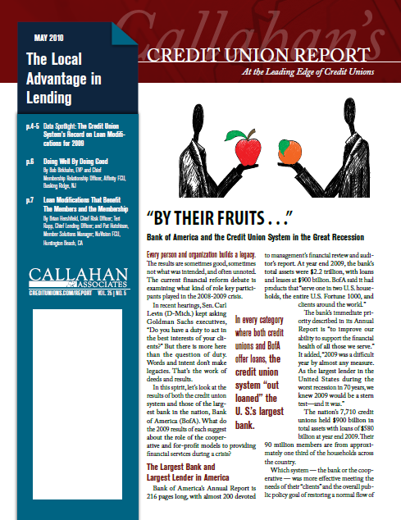
Chip Filson: A Champion of the Brighter Side
Callahan Presenting Credit Union Report to White House
4/2/2010
By Claude R. Marx, Credit Union Times
In an effort to raise the visibility of credit unions’ accomplishments in serving their members in particular and the economy in general, the consulting company Callahan & Associates plans to give a report on the industry’s performance to the Obama administration.
The report will include state-by-state and consolidated financial information on industry performance in 2009. The firm is seeking the signatures of credit union leaders to include on the letter accompanying the report.
“Credit unions continued to lend throughout the financial crisis. With all the negative news about the financial industry, we believe it’s time Washington learns about credit unions’ excellent–incredible really–results,” said Callahan President/CEO Chip Filson.

Slide 7
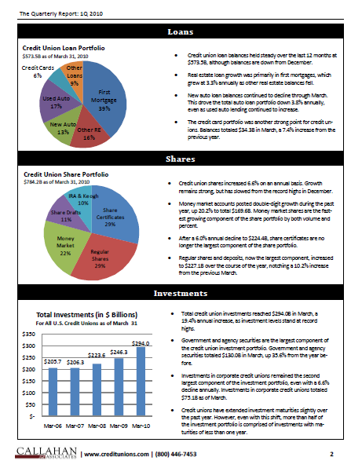
Industry Highlights
Recent Good News
As of the end of March:
Assets increase 4.7% over the last twelve months to $909.8B
Credit unions began the year strong, originating $51.8B in loans during the first quarter of 2010
Credit unions are selling more than half of their total first mortgage originations to the secondary market. Total secondary market sales in the first quarter were $7.9B
Share balances increased 6.6% over the last 12 months
Total membership rose 1.0% to 91.5M as increased
awareness of the credit union industry brings in new
members
The net worth to assets ratio stands at 9.9% as of
March
Source: Callahan 1Q 2010 TrendWatch
www.creditunions.com

Slide 8
1st Qtr Economic Trends
Recent Good News
The Federal Funds Target Rate has remained at the historic low range between 0‐25 basis points since December 2008
Existing home sales increased 14.9% from totals reported in March 2009
  A large contributor to this growth was the success of the First Time Home Buyer Credit
Auto sales are back on the rise, up 15.5% through the first 3 months of 2010
Outstanding consumer credit increased by 40 basis points in March, the first increase since 2008
  This increase was driven by the 4.0% growth in non‐revolving credit
The personal savings rate has declined to a preliminary 3.4% in March, down from 3.7% in the previous year
Source: Callahan 1Q 2010 TrendWatch
www.creditunions.com

Slide 9
Some not-so-good news...
From the Credit Union Industry
Members United MCS Now 97% Impaired
5/18/2010
Credit Union Times The $9.5 billion Members United Corporate Federal Credit Union released its April 2010 and year-end 2009 audit today, reporting additional OTTIs that will impair member capital shares by 97%.
December 2009 OTTIs numbered $116.9 million, and Members United recorded an additional $21.1 million OTTI in April, resulting in a retained deficit of $130 million. The Warrenton, Ill.-based corporate will eliminate the deficit using capital effective May 28, including some $11 million worth of MCS on-notice for withdrawal.
Losses Surge at NCUSIF
Credit Union Journal Daily Briefing | Thursday, May 20, 2010
ALEXANDRIA, Va. — NCUA had more bad news for credit unions this morning, announcing it has added eight more credit unions to its troubled list and set aside an additional $170 million to cover losses at natural person credit unions.
The additional reserves cut the reserve ratio for the National CU Share Insurance Fund and, with two other negative indicators, point to a higher premium assessment later this year, agency officials said during the NCUA Board's monthly meeting. The other negative indicators are significantly lower interest earnings on the NCUSIF's $9.4 billion in Treasury securities and high share growth of 11% for the first quarter of the year, which would cause to greater dilution of reserves later in the year.
NCUA Extends Emergency Forbearance for Corporates
Credit Union Journal Daily Briefing | Thursday, April 29, 2010
ALEXANDRIA, Va. — The NCUA Board voted this morning to extend an emergency order essentially allowing corporate credit unions to ignore the agency's minimum capital standards until the end of 2011.
The order will allow corporates to operate at the capital ratios they had at November 2008, before the failure of U.S. Central FCU wiped out as much as half of all corporate capital, putting all but three of the nation's 28 corporates in violation of regulatory capital minimums.
The media constantly gives us signals to worry about

Slide 10
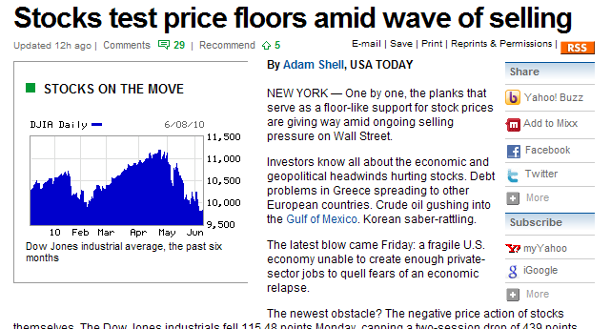
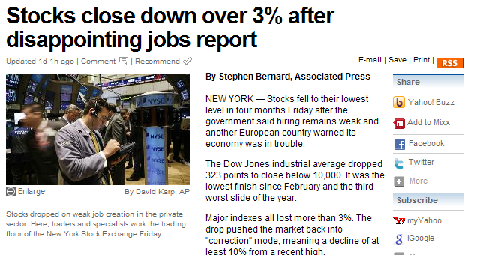
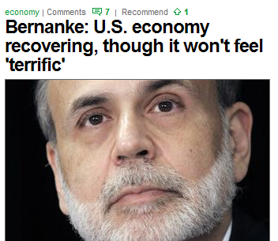
Some not-so-good news...
From the Economy
With the general consensus that we will have to pay our way out of this mess, no matter how good you are doing, you’re concerned about the pending bill

Slide 11
The Spirit of an Artist
So many concepts come to mind when you consider the question: “Are you an artist when it comes to your career? Your leadership? And how you craft solutions for your members?
“Artists to my mind are the real architects of change, and not the political legislators who implement change after the fact.”
William S. Burroughs (American poet, novelist & essayist)
Throughout the day, I hope we can challenge ourselves to declare everyone in this room an artist, and to search for the artistry in all we plan to do

Slide 12
What do you think of when you think of the word “artist?”
passion
perseverance
enthusiasm
practice
edgy
creativity
labor of love
knowing your tools
being observant
skill
zeal
patience

Slide 13

Speaking of Artistry...
Like a true artist is never content to stop at his last work of art, we thought it was time to develop a fresh new self-service video for play in credit union lobbies
  Replacing the “stickman” (introduced in 2006)
Introducing the credit union babies
and our new self-service short...
(we’ll start with a little “edgy” already this morning)
Self-Service Short
(2006-2010)
2010 Self-Service Short

Slide 14
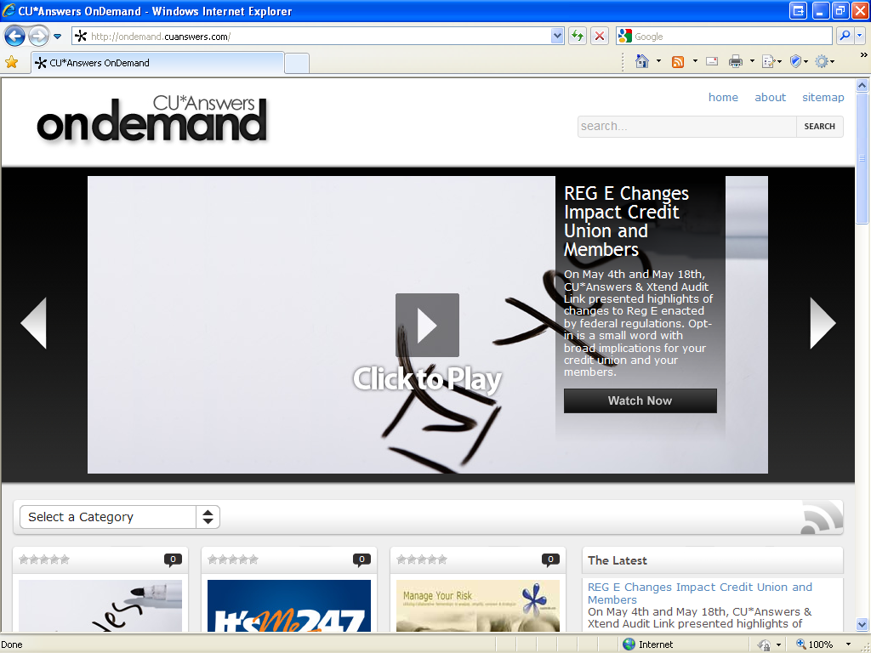
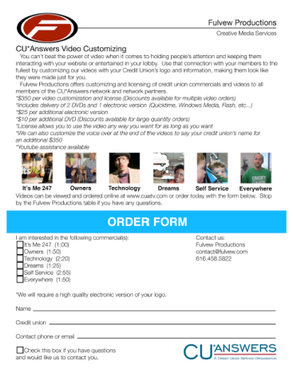
Another Example of Artistry
The OnDemand site has rapidly evolved to become one of our most artistic examples of
creativity and network outreach
http://ondemand.cuanswers.com

Slide 15
2009-2010: A Year Dominated by a Regulator’s Agenda
We’re not done yet, but there is light
at the end of the tunnel
And we did all have plans BEFORE these regulator deadlines came up...

Slide 16
Artistry in Compliance Design
While it has been a strange year, we’ve seen this cycle many times over our careers
  Responding to TIS, Reg. CC, Y2K...any rule of the day
We need to remember to take an artist’s approach to designing our response to compliance...as a network, as software developers, and as credit union operators
It all comes down to your perspective
  Follow the rule at all costs, with the most narrow interpretation of the risk-to-reward ratio
  Compliance with an inside-out (employee convenience) or outside-in (member convenience) design
  Making a dollar in spite of the rule – designing a winning formula for your ultimate goal: a profitable businesses
artistry [är'tĭ-strē] n a superior skill that you can learn by study and practice and observation

Slide 17

The Never-Ending Cycle
Everybody knows that regulations take forever to get through a market
  First there’s the rule,
  Then a great debate about how the rule will be applied,
  Then a long period of speculation on the design of tools to make
  compliance easy,
  Then software development projects begin, get released, and get re-released,
  Then through experience, everyone starts to modify their positions at every level (remember the hot “flood or not flood” debate
  over next payment dates?)
What do we know for sure? Everything we are doing with regulation design in 2010 will have a ripple effect into 2011 and 2012, and we’ll evolve the tools based on the market’s response
The Kitchen (www.cuanswers.com/kitchen) has a wealth of historical data about this process, so let’s look at some recent recipes...

Slide 18
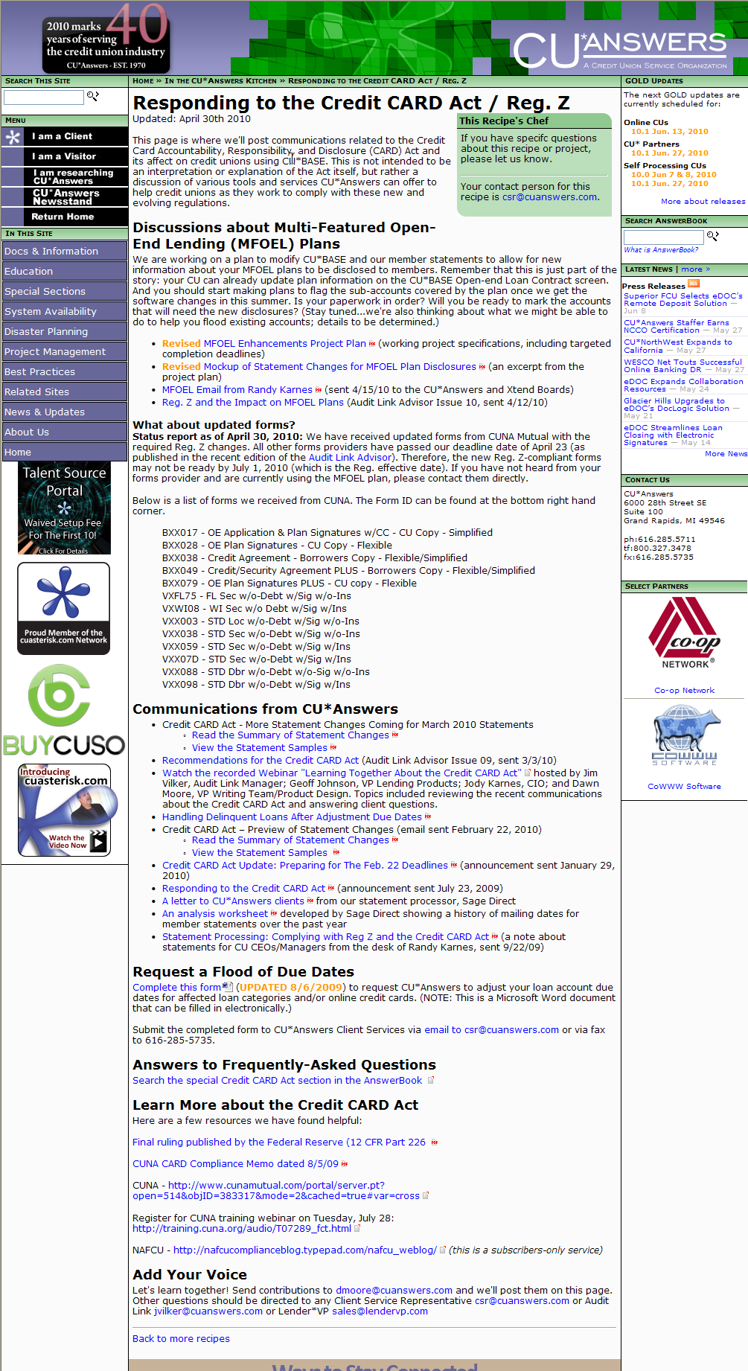
Recipes in the Kitchen
#1
Responding to the Credit CARD Act / Reg. Z
Kitchen page currently contains 24 links to information related to this regulation and our network response (last update posted April 30)
Two rounds of significant statement changes, 13 forms reprogrammed in record time
Next up: MFOEL plan updates (10.2 release in July)
A ripple in 2011: Improving management of credit card fee disclosures
Who did this affect?
  70+ CUs with CU*BASE online credit card programs
  65+ CUs with MFOEL plans

Slide 19
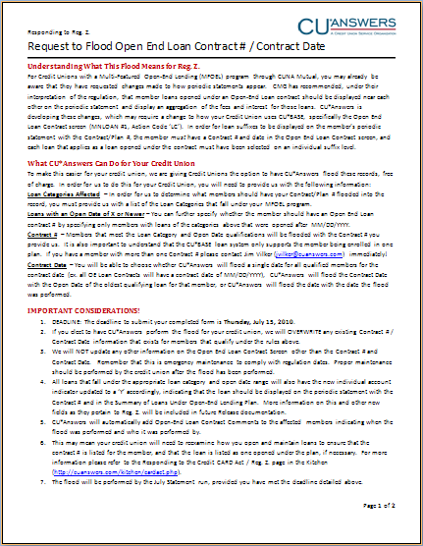
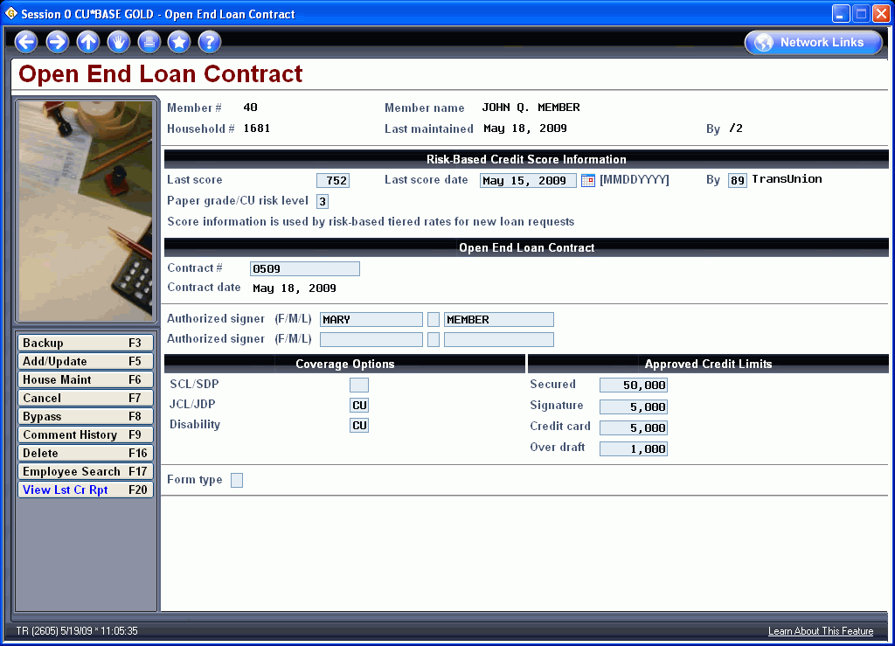
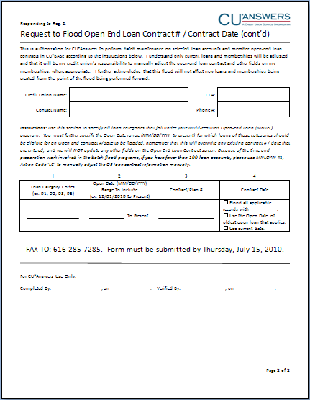
Reg. Z and MFOEL Plans
Part of the 10.2 release (July 18 for online, July 26 everyone else)
A new command key on the Open-End Loan Contract screen will allow you to flag which loans are part of that MFOEL contract
If you haven’t been using CU*BASE to log contract #s thus far, start gathering your contract paperwork now!

Slide 20
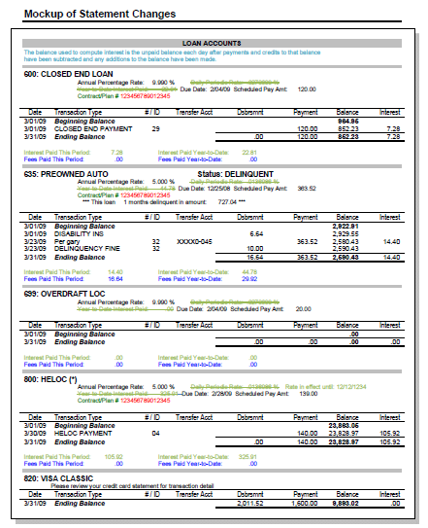
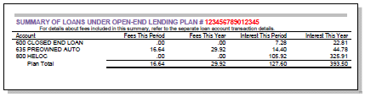
Reg. Z and
MFOEL Plans
Statements can then summarize all flagged loans by contract #, including a breakdown of period and YTD fees
  Contact a CSR to activate this statement print option!
To flood or not to flood...
  Regulatory compliance starts with a spirit to comply, then taking the experience of trying to comply, we all develop the precision in complying
  Move quickly to the spirit

Slide 21
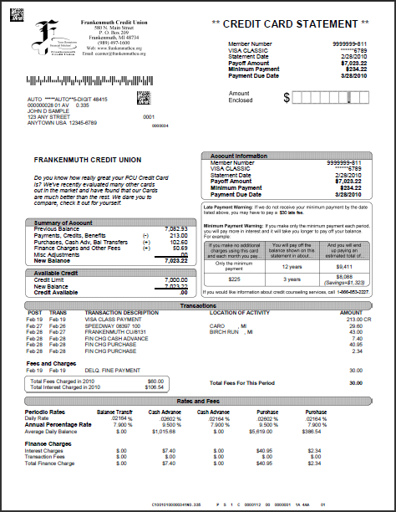
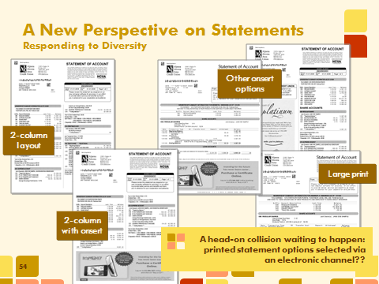
The Year of Statement Changes
It’s been quite a year for changes to account and credit card statements, as you’ll see throughout this presentation
It’s even slowed down progress on some of our goals for statements from last year
  Remember member-selected statement print styles?

Slide 22
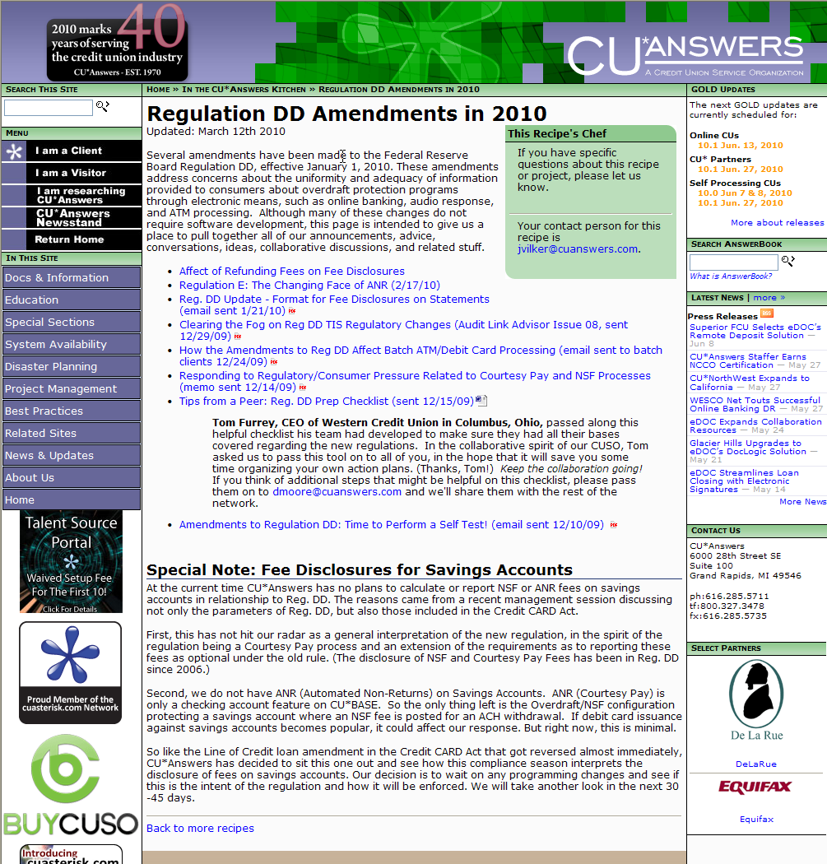
Recipes in the Kitchen
#2
Reg. DD Amendments in 2010
Kitchen page currently contains 8 links to information related to this regulation and our network response (last update posted March 12)
The great debate – does this apply to savings accounts too?
Next up: NSF/ANR Fee Summary on statements for savings accounts (10.1 release in June)
The challenge for 2011: Automating fee reversals and reconciling the multiple views of NSF/ANR analysis (period- and year-to-date)
Who did this affect?
  Everyone that has any kind of NSF or non-return fee
  This was the last shoe to drop related to your options (remember, you could have been doing this for years already if you marketed Courtesy Pay)

Slide 23
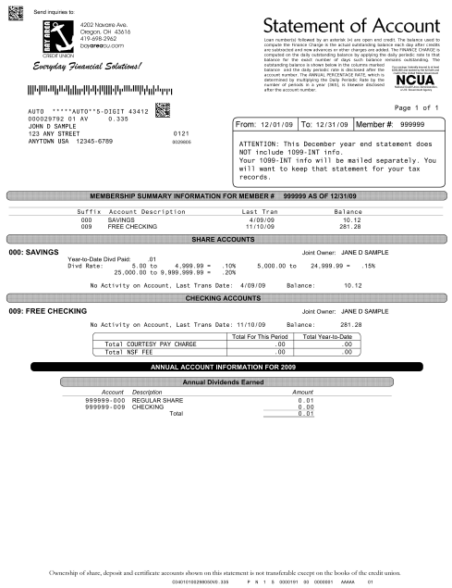
Reg. DD Fee Disclosures
(and the now-infamous gridlines)
We added the disclosures back in 2006, and the gridlines went in with January 2010 statements (flat file only)
In 10.1 we added the option to disclose these same fees for your savings accounts
We believe Reg. DD will kick off a whole new series of development projects in 2011 as members start to ask questions about this disclosure, and employees start realizing that reversing a fee has a year-long affect on the numbers

Slide 24
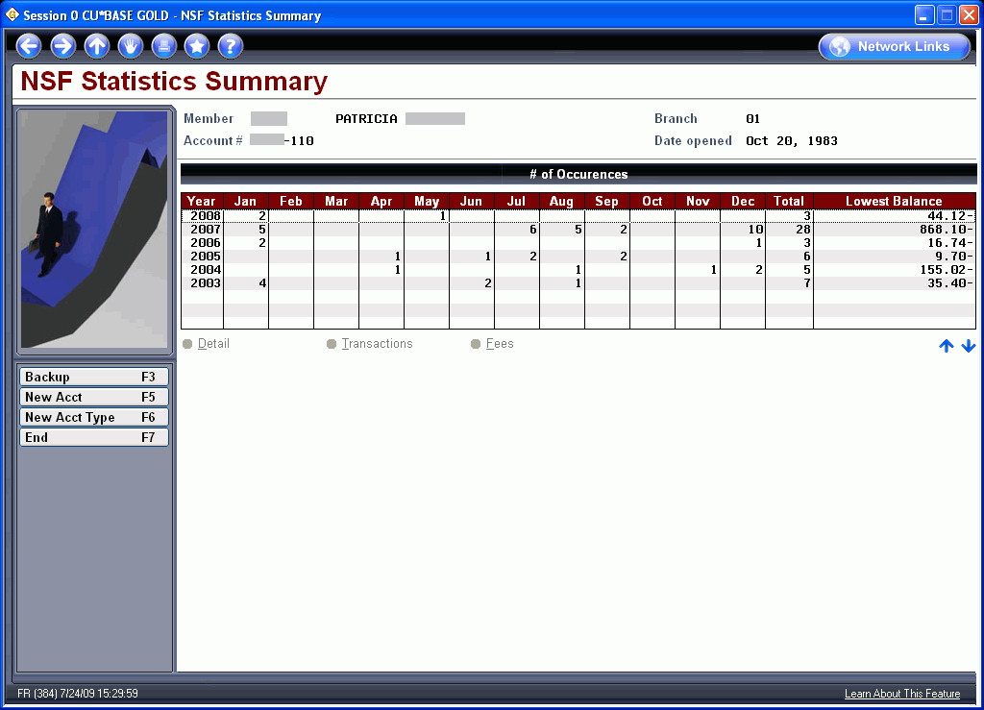
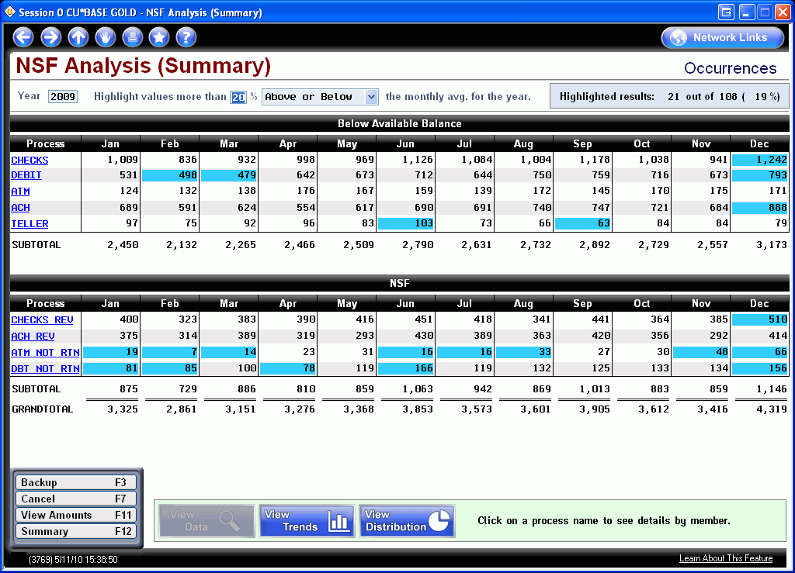
Reg. DD (with a hint of Reg. E)
Account Inquiry > F13-NSF
A little history...for years we’ve had an NSF inquiry at the individual member level
This year we added a new NSF analysis aggregated for the entire membership
MNMGMT #26 NSF Statistics Dashboard
Randy’s compliance disclaimer: Move quickly to the spirit: Regulatory compliance starts with a spirit to comply, then taking the experience of trying to comply, we all develop the precision in complying

Slide 25
Reg. DD (with a hint of Reg. E)
Until now this data has been trend data, with two different goals:
  Understanding occurrences (events, not items)
  Understanding fees charged
They were never designed to correlate to each other, although it could be interpreted that way
  Check comes in NSF (no fee posted, but occurrence counter updated)
  Next morning, user re-posts that same item against an early morning deposit
  Non-return fee is charged (fee amount updated) and occurrence counter updated once more
    → For this member: 2 occurrences, 1 fee amount
  2011 software development quandary: how to create a menu option that automates the reversal of a fee and also updates the NSF/ANR fee disclosure database
All of this is screaming for smarter and more automated Account Adjustments (I wonder what will be announced after lunch?)

Slide 26
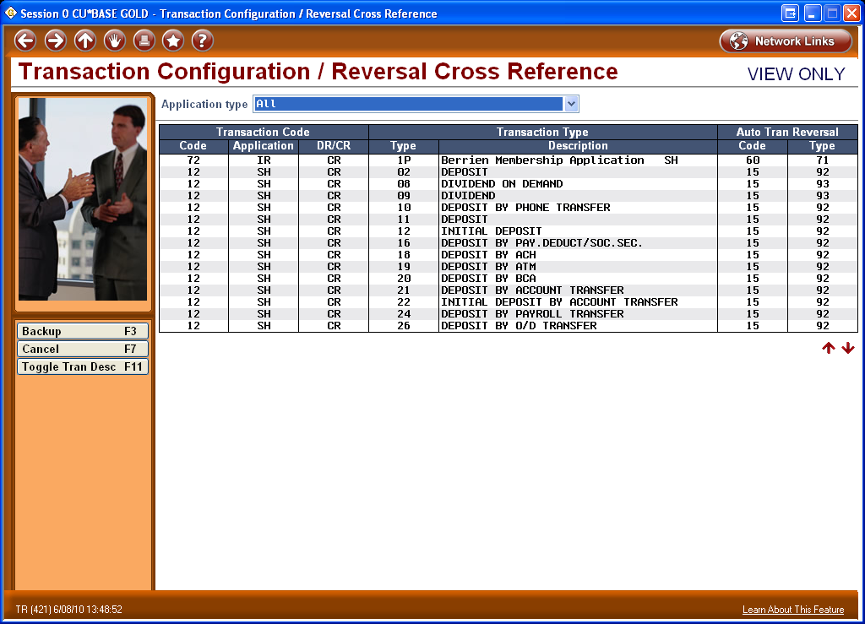
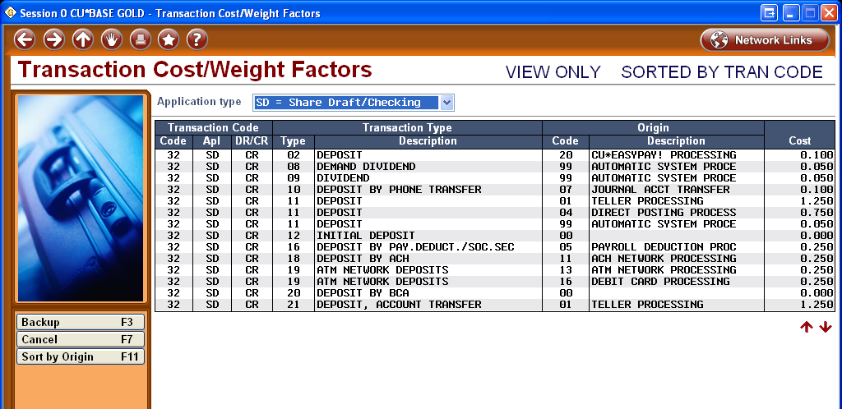
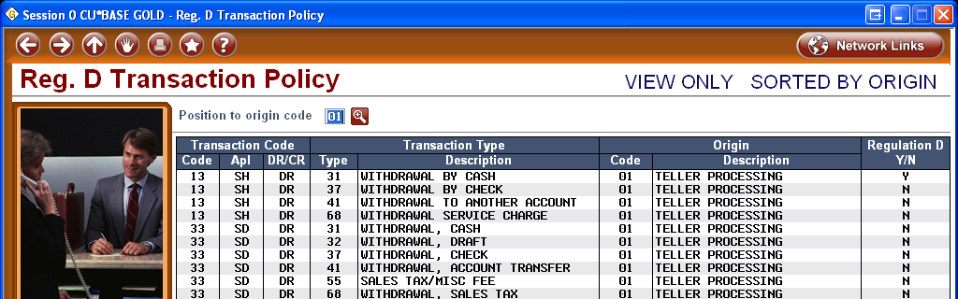
The Importance of Transaction Data
Nothing has emphasized the need for improving the clarity about transaction origins, types, and codes in our database than the changes related to fee disclosures (Reg. DD and Credit CARD Act/Reg. Z)
We use this data everywhere, from Know Your Member analysis tools, to Reg. D, to understanding transaction costs, to configuring how to reverse a transaction
In 2011 we will need to upgrade how everybody views, uses, and maintains this data

Slide 27
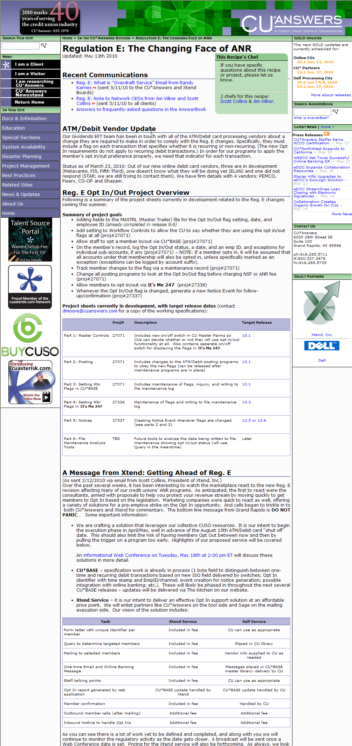
Recipes in the Kitchen
#3
Regulation E: The Changing Face of ANR
Kitchen page currently contains 8 links, tables of projects and target release dates, ATM/Debit vendor updates, and even a new service from Xtend related to this regulation and our network response (last update posted May 13)
6 project sheets that will span several releases
A plan to flood/un-flood your member data, based on the 45-day window in the reg (July 1 – Aug 15)
Next up: Member opt in/out in It’s Me 247 (10.3 or possibly 10.4 release)
Who did this affect?
  Everyone that offers an ATM or Debit card (even if you do NOT have an ANR program!)
Randy’s compliance disclaimer: Move quickly to the spirit: Regulatory compliance starts with a spirit to comply, then taking the experience of trying to comply, we all develop the precision in complying

Slide 28
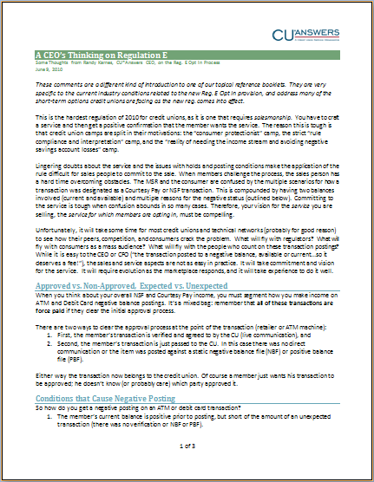
Reg. E Requires a Lot of Artistry
What’s different about Reg. E in your credit union’s operation?
  ATM/debit card NSF posting fees were thrown under the bus: unlike checks and ACH, all ATM/debit postings are force-posted
  All overdraft services programs are not created equal
    Checks and ACH were left alone
    ATM and debit card overdraft services are unique
  All debit card transactions are not the same
    One-time vs. recurring (not all vendors can even tell us the
    difference yet)
    Approved transactions vs. non-approved transactions
  Hold processes are not cut and dried
    Matched transactions vs. unmatched transactions
    Balancing the risk of expiring holds
  All negative balances are not created equal
    Approved negative balance postings (Courtesy Pay) vs. non-approved (member opted out, or transactions beyond the negative balance limit)

Slide 29
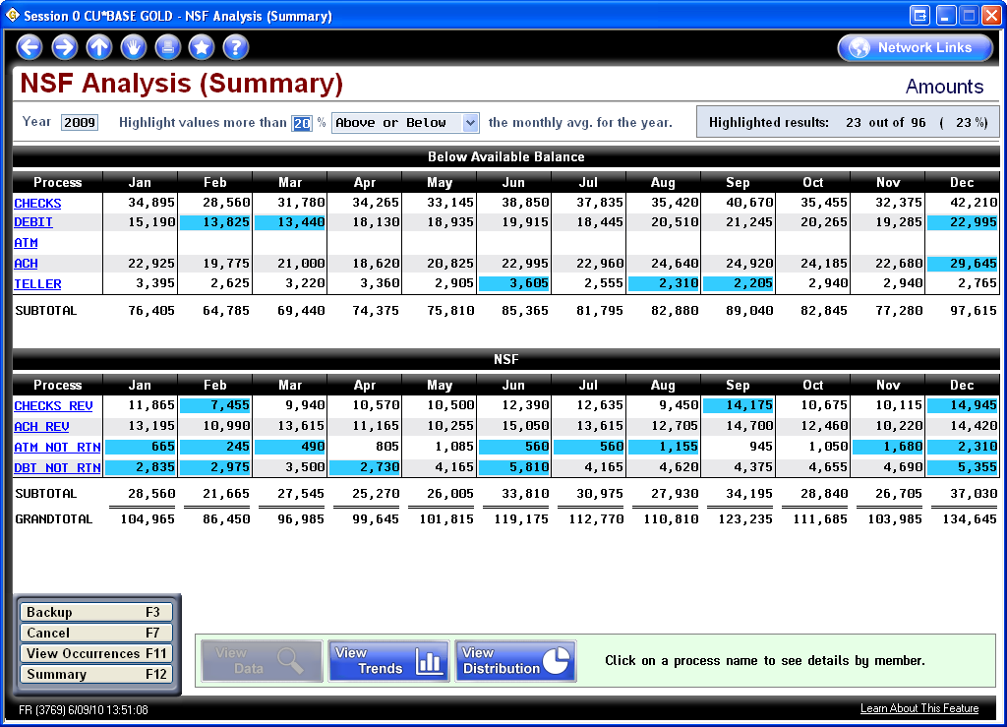
Reg. E Requires a Lot of Artistry
Understanding Your Volumes and What’s at Stake
MNMGMT #26 NSF Statistics Dashboard

Slide 30
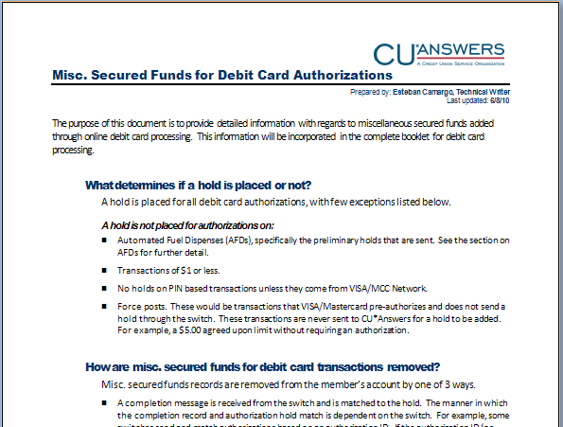
Reg. E Requires a Lot of Artistry
Increased Sensitivity to Hold Management
For a long time, members have struggled with “why did I get a fee when I never went negative?”
This pressure on credit unions to define hold processing has everyone looking for more information and definition
  What determines if a hold is placed or not?
  How are misc. secured funds for debit card transactions removed?
  How do Automated Fuel Dispenses (AFDs) work?
  How are transactions posted in CU*BASE when there is a matching record?
  Rules and exceptions by switch

Slide 31
Reg. E Requires a Lot of Artistry
The biggest wrinkle in Reg. E is that you now have to legitimize the member’s desire to actually use the service...you have to SELL it
Therefore, you have to design a program worth taking, and
sell the service to the member as a member advantage
There are multiple perspectives
  “No one would opt in to pay a fee when they could avoid
  negative balance fees by simply saying no”
  “Everyone is going to want to opt in to this service; it’s a no brainer, it saves members money and embarrassment to avoid transactions being turned down or services being suspended.”
  “Only time will tell. Members who are used to these fees and doing business this way will come back to the service if we sell it openly and candidly.”
Your perspective on how to sell this is important to
how you configure the software in future releases

Slide 32
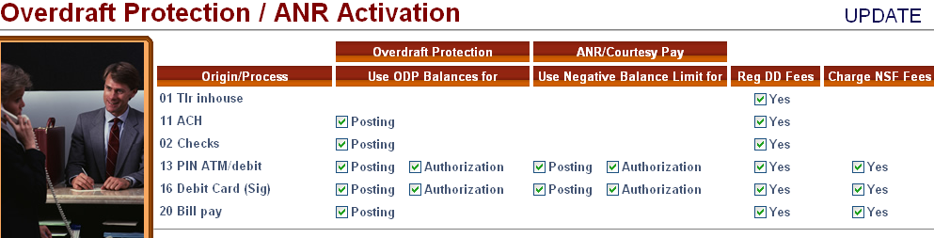
Reg. E Requires a Lot of Artistry
How do you interpret this statement?
When you set up your ANR/Courtesy Pay settings for ATM and debit card processing, you’re telling CU*BASE to communicate in a very distinct way to your ATM and debit card networks
“Member wants the CU to authorize and pay overdrafts on ATM and everyday debit card transactions”
MNCNFA #9 NSF/OD Transfer Configuration
Remember this is online only (PBFs are custom!)
Have you done the scenario planning with your staff to empower them to sell your program’s unique advantage and exactly how it will work?

Slide 33
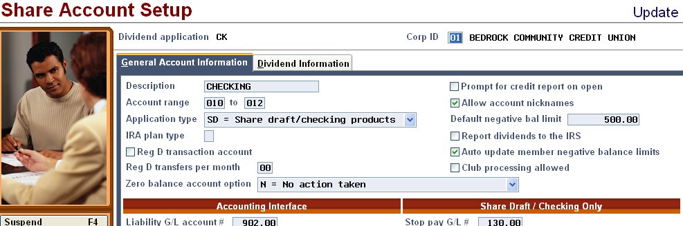
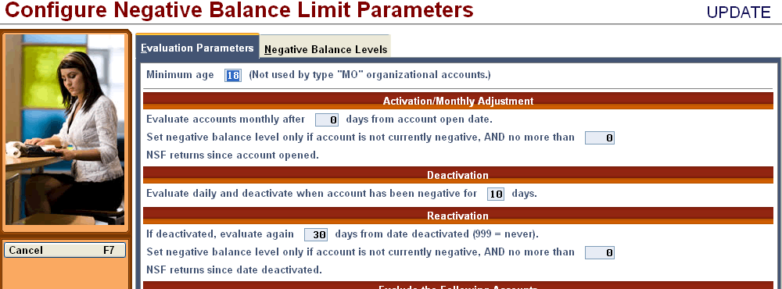
Reg. E Requires a Lot of Artistry
Consider the day-to-day automation of negative balance postings:
  The member has opted in to your overdraft services for ATM/Debit card transactions – the computer still has some decisions to make about when to assign a limit, when to suspend the service, and when to reactivate the service
  What does it mean to a member when they’ve opted in, but you have suspended their ANR service? Can you charge them your NSF fee? Can someone opt in without ever getting a negative balance limit?
  And remember that
  your ANR program
  doesn’t stop at ATM
  and debit card
  transactions!

Slide 34
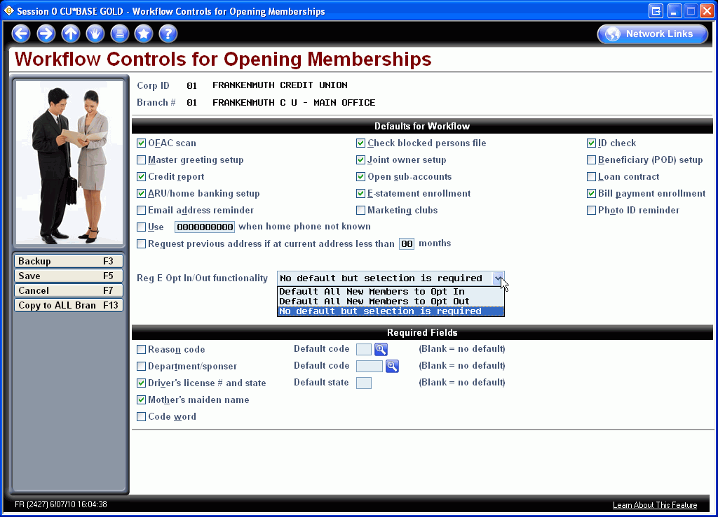
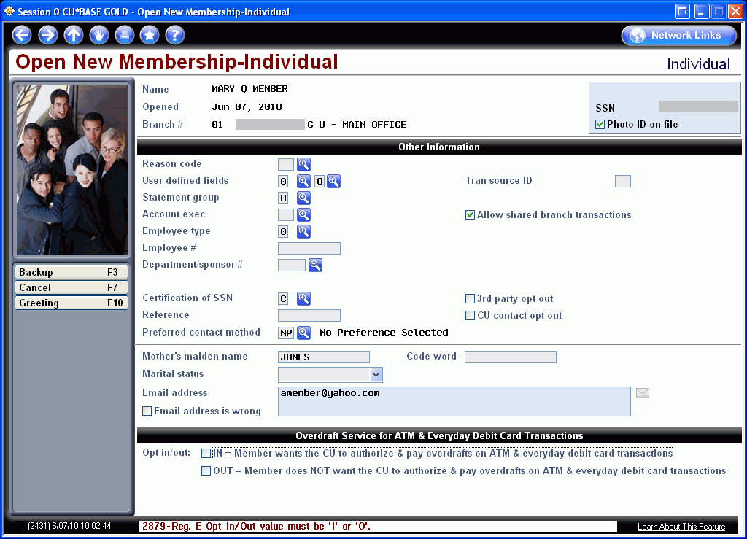
Your Opportunities to Sell
Selling the member when opening their membership (starting July 1)
How will you sell new members on opting in?
For new members, will force a decision, but when updating an existing member (maybe for another reason), will not

Slide 35
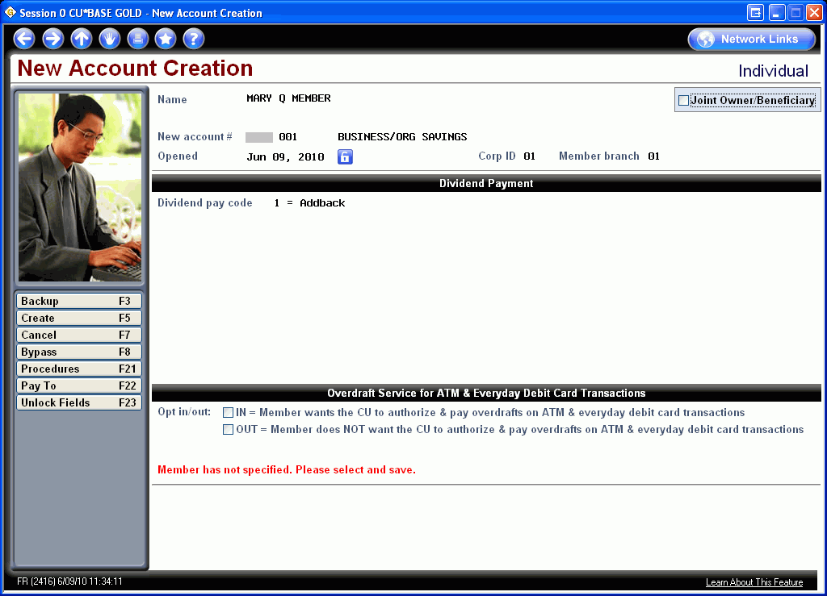
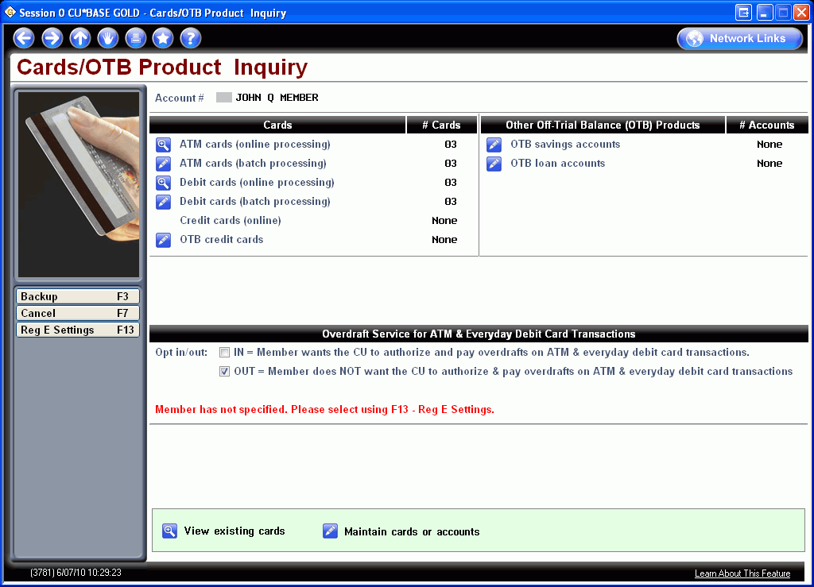
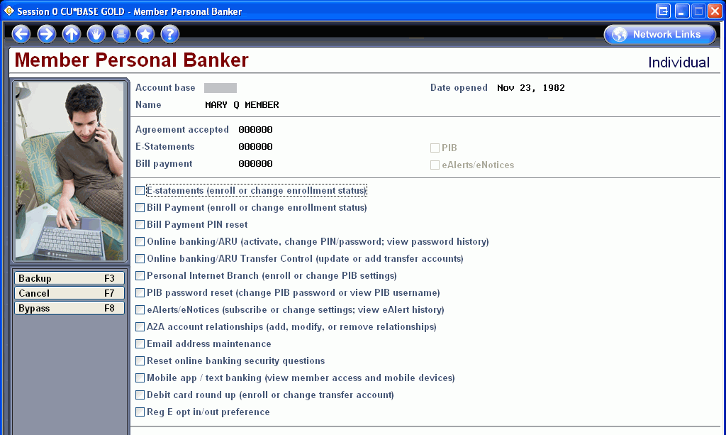
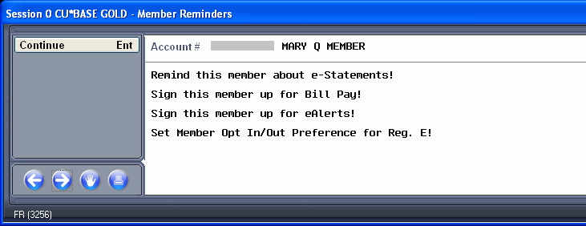
Your Opportunities to Sell
Selling existing members from now on (starts now, required as of August 15)
(The jury’s still out on this “what’s in your wallet” screen...and we’re listening!)

Slide 36
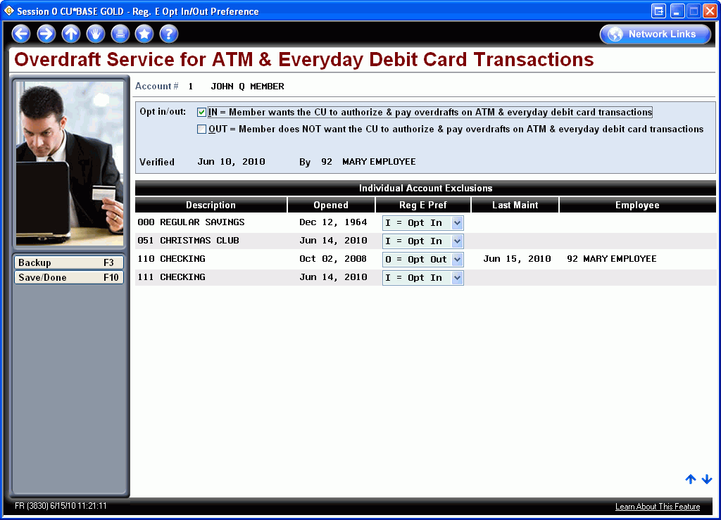
Another Wrinkle
The regulation confuses the idea of the member opting in for an ATM or debit card service, versus the member opting in at the individual account level
  Why would someone opt in or out on a Christmas Club account?
One thing to remember: when you have the member in front of you, you sell them, even before they get their first piece of plastic
You want them to default to taking your service

Slide 37
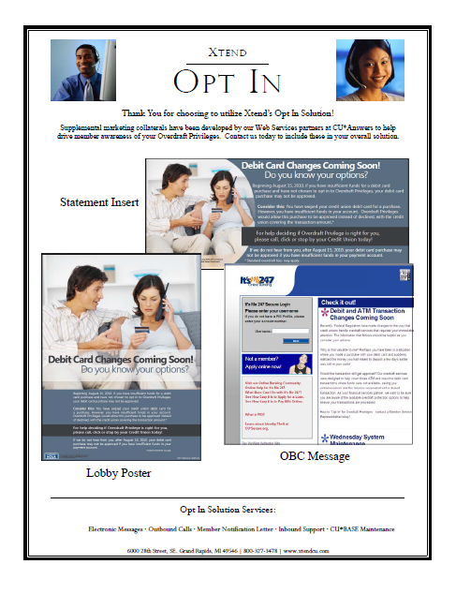
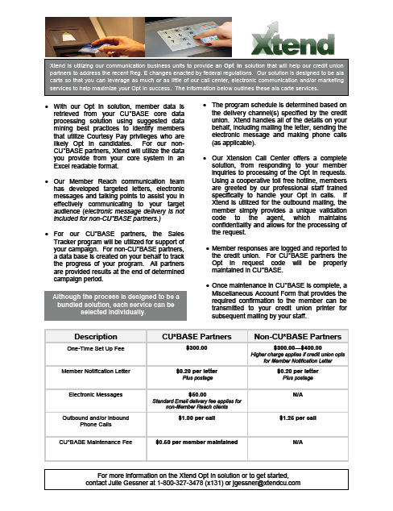
Network Tools to Help You Sell
38 CUs using Xtend in some capacity for Reg. E, including 2 non-CU*BASE
Another two dozen are corresponding with Client Services to data-mine CU*BASE for targeted response
Over 125,000 mail pieces being sent from Sage…
most will be hitting the mail during Leadership Conference week
More than two dozen credit unions are using the Xtension Call Center as part of their Opt In execution strategy

Slide 38
Reg. E Increases Need for More Information at the Point of Posting
In 2011, CU*Answers plans to add more information to the transaction record related to what the available balance was that caused the NSF/ANR to be posted in the first place
This will enable us to add a new secondary transaction description to NSF and ANR fee transactions, to explain the available balance that resulted in the fee
Tran Amount | Resulting Balance | Transaction Description | Current Secondary Description | Suggested NEW Secondary Description
20.00 | 12.66 | CHECK 00508300210
30.07 | 17.41- | DBT/WDR | MARTHAS VINEYARD GRAND RAPIDS MI
20.00 | 37.41- | COURTESY PAY FEE | MARTHAS VINEYARD GRAND RAPIDS MI | AVAIL BALANCE WAS $12.66 BEFORE DBT/WDR TRANS
3.74 | 41.15- | DBT/WDR | MEIJER GARDEN CAFE NE GRAND RAPIDS MI
20.00 | 61.15- | COURTESY PAY FEE | MEIJER GARDEN CAFE NE GRAND RAPIDS MI | AVAIL BALANCE WAS -$37.41 BEFORE DBT/WDR TRANS
11.46 | 72.61- | DBT/WDR | MEIJER INC
20.00 | 92.61- | COURTESY PAY FEE | MEIJER INC | AVAIL BALANCE WAS -$61.15 BEFORE DBT/WDR TRANS

Slide 39
CU*BASE Using the Opt In / Out Flags
CU*BASE will now have to interpret how to authorize member transactions at the member level, not just the credit union level
  If the member has a negative balance limit, and the credit union has activated that balance for use in authorizations, now the system has to see whether the member has opted in or out to determine the amount that can be approved
  Remember, just because the member opted out for ATM/Debit, we cannot touch the negative balance limit that is still being used for ACH and checks
CU*BASE will now have to interpret how to post fees at the member level
  If the member has a negative balance limit, and the credit union has activated that balance for use in posting, now the system has to see whether the member has opted in or out to determine whether to charge the fee
    Remember, these items can’t be returned (like checks or ACH can)
  Opt out: no NSF or ANR fee will be charged in the first round
  Opt in: both NSF and ANR fees are in play
These changes are scheduled for the 10.2 release (July 18 or 26)...just under the wire

Slide 40
All Members are Not Created Equal
Members who opened their memberships prior to July 1, 2010
  A decision must be made on how to sell the member on opting in now (even though the posting programs won’t be ready until later in July)
  We will opt them in on July 1 (except if you manually set their flag prior to then) and opt them out on August 15 (unless you’ve set their flag)
  But until July 18 (or 26), we will post fees same as now
Members who open their memberships between July 1 and August 15
  These members must make a decision when they open their account (you can set a default according to your Workflow Control configuration)
  You’ll need to monitor any members who: open an account, opt out, get a piece of plastic, and overdraw their new account prior to when the posting programs are in (you may have to manually refund these fees/update counters)
Members who open their memberships after August 15
  These members must make a decision (default per your Workflow Controls) and the new posting rules will immediately be in play

Slide 41
All Members are Not Created Equal
This was a no-win situation:
Manually track new members who opt out and reverse fees for 45 days
vs.
lose income on all existing members who opted out early, prior to August 15.
Some people wanted fee programs to start working July 1; some wish they wouldn’t start working until August 15. What was the Fed thinking?
Members who opened their memberships prior to July 1, 2010
  A decision must be made on how to sell the member on opting in now (even though the posting programs won’t be ready until later in July)
  We will opt them in on July 1 (except if you manually set their flag prior to then) and opt them out on August 15 (unless you’ve set their flag)
  But until July 18 (or 26), we will post fees same as now
Members who open their memberships between July 1 and August 15
  These members must make a decision when they open their account (you can set a default according to your Workflow Control configuration)
  You’ll need to monitor any members who: open an account, opt out, get a piece of plastic, and overdraw their new account prior to when the posting programs are in (you may have to manually refund these fees/update counters)
Members who open their memberships after August 15
  These members must make a decision (default per your Workflow Controls) and the new posting rules will immediately be in play

Slide 42
Reg. E Still to Come
Projects for Reg. E range from “already released” to “still on the drawing board”
Project | Release Target
New configuration, Opt In/Out flags, and maintenance features | 10.1 release (already in for online, June 28 for everyone else)
Changes to all ATM/Debit posting programs | 10.2 release (July 18 or 26)
**ONLY supported under the new Standard ATM/Debit platform**
Member setting their own Opt In/Out flag in It’s Me 247 online banking | Target: 10.3 or 10.4 release
Notices for when members Opt In | Target: 10.5 or 10.6 release
File maintenance analysis tools | Target: To be determined

Slide 43

Responding to the Ripple Effect
As these regulations become mature, it will become clearer to everyone how to make compliance more convenient for the credit union employee, the member, and the credit union’s income statement
We all just need the time and experience with the reg. to prioritize the changes
One thing that has been clear this year, is that all of this activity has everyone focused on compliance and regulations at every level
  Nothing has slowed down when it comes to the latest and greatest improvement to OFAC, BSA, Reg. D, etc.
  The industry, like the nation, is in a regulatory mode
Randy’s compliance disclaimer: Move quickly to the spirit: Regulatory compliance starts with a spirit to comply, then taking the experience of trying to comply, we all develop the precision in complying
Of course this is nothing new...let’s take a look at a few more compliance-related projects we’ve have been dealing with or will deal with in 2011

Slide 44
Reg. D Monitoring
Recently added the automated counter/warning message for Phone Op transfers
Ideas Forms and comments about Reg. D
  When you talk about Reg. D, the elephant in the room is whether or not the system should deny members access to their money
    Should a teller have to say, “No, you can’t do this!”?
    Should online banking say, “Transaction not allowed, call your credit union!”?
  In almost every case, when someone is in support of this idea, they are thinking about the convenience of the CU employee and the regulator, not the member
  In an age where we make the member’s money so readily available to them, and self-service is seen as the glistening promise to reduce costs, how can we continue to think telling members “you can’t have your money” is a good idea?

Slide 45

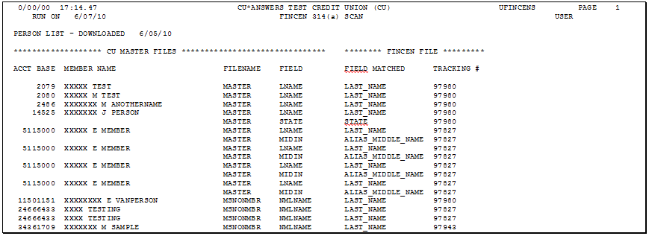
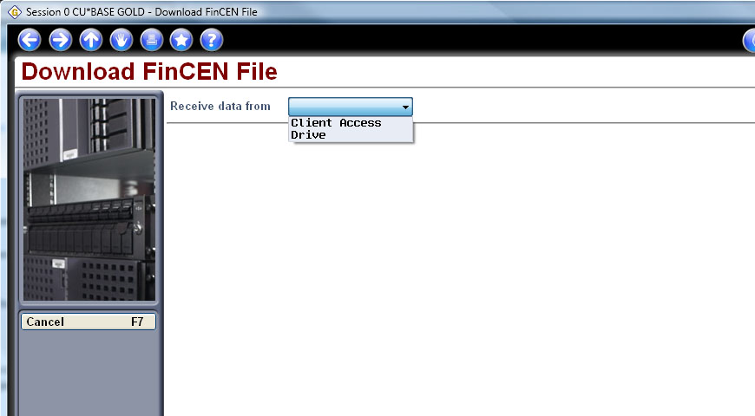
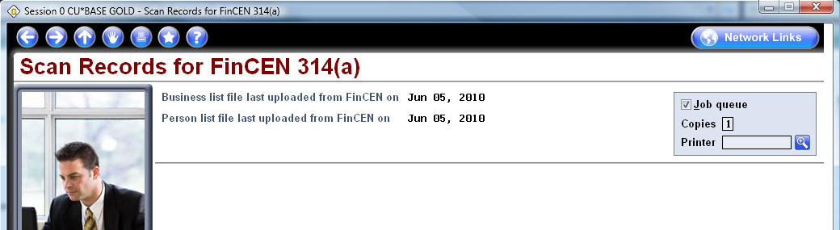
FinCEN Verification Tools
Coming
soon!
FinCEN will only share this list with financial institutions, so unlike OFAC, the onus is on you to:
  Upload the file
  Run a new CU*BASE report against that file
Will be released by the end of this year (10.4 or 10.5)

Slide 46
OFAC Fever
OFAC scanning enhancements we’ve made since last year:
  OFAC scans on international ACH transactions
  Improvements to the batch scan reports for more hits (...you asked for it!)
  Standalone, on-demand scan for vendors, incoming wires...or anyone you want to run against the OFAC list!
Coming soon...
  Automated scan for corporate checks/money orders (Target: 10.3 release)
  New maintenance log for OFAC scans performed on names other than members, which are stored in Audit Trackers (Target: 10.3 release)
  New configuration file for country names, to be used in both interactive and batch scans (Target: 10.3 release)
When will it end? Without a doubt, OFAC “scope creep” has been around for a couple of years now – are we running out of things to compare to OFAC? When does a business (yours) have to say, “enough!”
Are CU compliance professionals creating a career out of OFAC and BSA?

Slide 47
A Network Feeling Some
Release Fatigue
Assimilating and managing the pace of change is different from year to year, but the tools and the skills remain the same
“Slow down! (except for the stuff I want)”

Slide 48
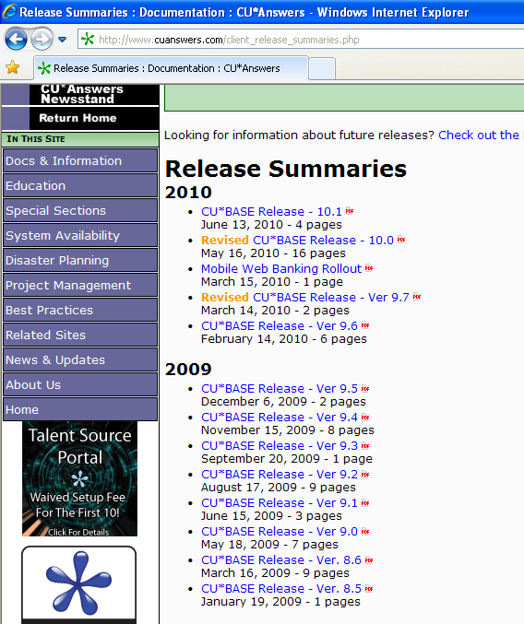
A Network Feeling Some
Release Fatigue
A year dominated by a regulator’s agenda has yielded a release agenda that is not typical
Since we last met, we’ve seen 8 pretty significant releases
Remember that the effect of regulatory changes has been added to the dam being opened after the release of NGS in November 2008
We have no choice but to respond to the market, to the times, and to the business plans of our clients
http://www.cuanswers.com/client_release_summaries.php

Slide 49
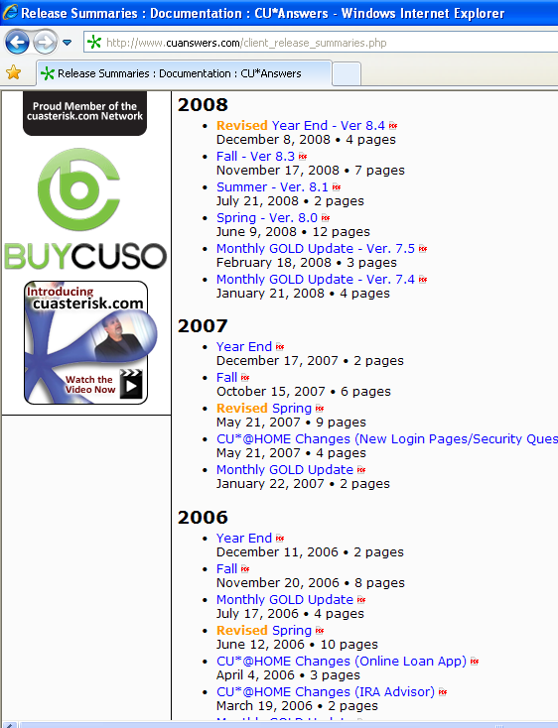
Assimilating Change
In 2011 we hope to return to a release schedule that is closer to the pace of years past
  Major release in spring and fall
  Minor release year-end
  Minor GOLD updates as needed
One fly in the ointment is the pace of change for online banking and mobile banking in the future
  These will occasionally cause special releases to be intermixed with our normal annual calendar
http://www.cuanswers.com/client_release_summaries.php

Slide 50
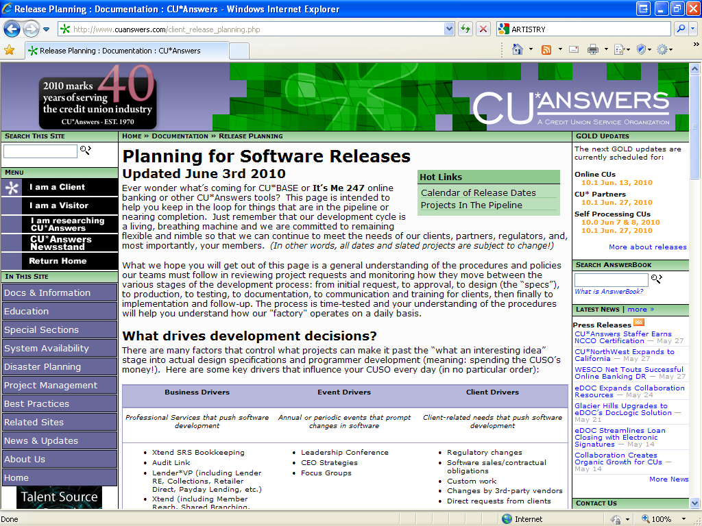
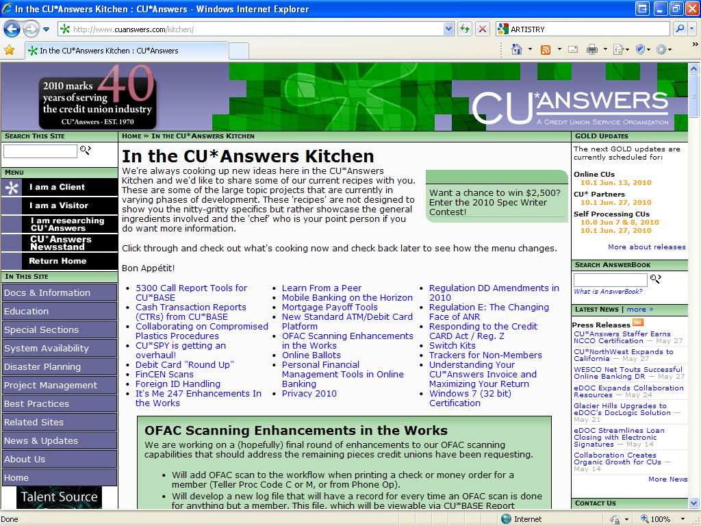
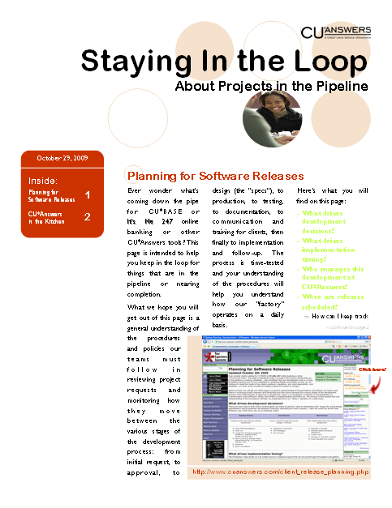
Helping You Deal with the Pace of Change
http://www.cuanswers.com/client_release_planning.php
http://www.cuanswers.com/kitchen/
In the past, it’s been a nice option to stay in the loop... But in a year like this where the pace is so fast, it’s almost mandatory if you are going to keep your sanity

Slide 51
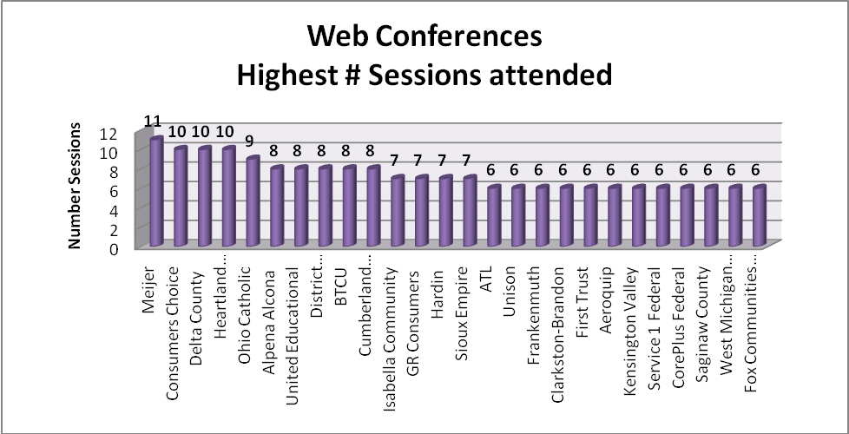

Helping You Deal with the Pace of Change
Education since last year...
541 web conference sessions (up 24%)
275 days of conversion training/support
In the 2010 Catalog...
60 days of training
50+ scheduled web conferences
80+ classroom
sessions
Of the 125 participating CUs, 26 of them attended more than 6 web conferences in the past year.
Laura’s education stats here
Visit Laura or Jane at their vendor booth today and ask how they can help you develop your own internal training plan like our EPP

Slide 52
Continued Investment in Written Communications
We’re proud of our culture of writing and communication – and we put our money where our mouth is by staffing a department that devotes itself to putting out the content
  Documentation – online help for all software tools, booklets, online training, user guides, training guides
  Communications – alerts, announcements, web page content
  Development – project requirements and product design specifications
  Marketing – content for brochures, flyers, invitations, presentations
  Department Playbooks – expanding our digital intelligence beyond software tools: promoting collaboration and shared work with templates on how to start a business
NEW!
Digital business intelligence is the currency of client service today, and the Web is the channel that is quickly surpassing the telephone in everyone’s mind
When we say written, we don’t always mean a piece of paper; we mean experience the communication of an idea through every possible channel

Slide 53
Some of My Favorites
Since Last June

Slide 54
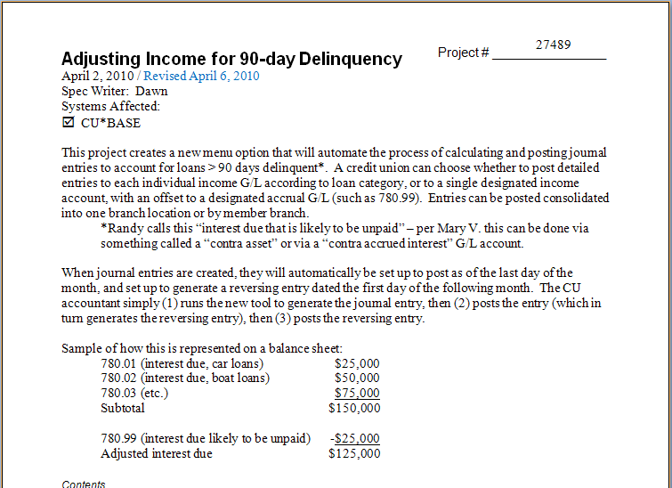
An Artist’s Editorial
Drivers Behind the Urgency to Improve
How do you accelerate innovation?
Unfortunately, the old saying, “necessity is the mother of invention” is pretty accurate
  It’s nice to think about where you would like things to be, but it’s a lot more effective to say “this is what I need and I need it NOW”
  You can’t just want innovation, you have to need it
  This is one of the primary drivers of SRS and the Xtend proof of concept
Today, we use another driver: constantly envisioning an organization that manages 50 credit unions at one time
  What processes do you complete today that need 50x more speed, a better design, and an adjusted sense of what the work is?

Slide 55
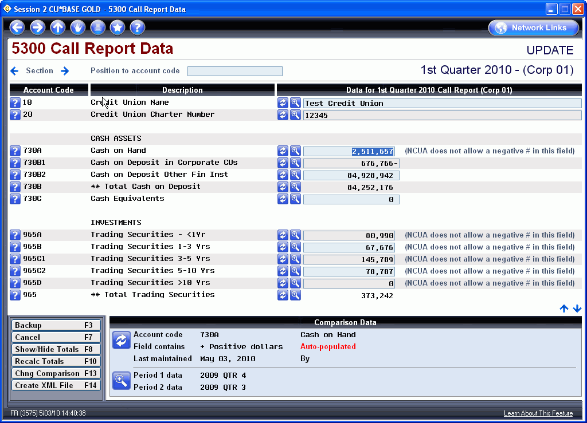
My Favorites From This Past Year
5300 Project Update
95 CUs have keyed at least one Call Report into the CU*BASE tool
  We have 11 auto-pop routines to help gather the data direct from your CU*BASE G/L and member files
  Last quarter we saw 25
  online CUs upload their
  call report from
  CU*BASE to the NCUA
  website

Slide 56
My Favorites From This Past Year
5300 Project Update
On the drawing board now:
5300 Key Ratios
  A new dashboard showing your favorite ratios, calculated automatically using your 5300 Call Report data (even for the in-between months when you don’t file one!)
    Net Worth
    Delinquent Loans/Total Loans
    Return on Average Assets (ROA)
    Fee and Other Operating Income/
    Average Assets
    Net Income Margin
5300 Data Trending Dashboard
  Like Tiered Services, why shouldn’t that history that’s embedded in your 5300 database be at your fingertips?
    Operating Expense/Gross Income
    Net Operating Expense/Average Assets
    Loan to Assets
    Members to Full Time Employees
    Salary and Benefits per Employee
We’ll have prototypes of these ready for the November CEO Strategies event, with full release next spring

Slide 57
An Artist’s Editorial
Data for the Sake of Data is a Missed Opportunity
Dashboards get me going, because they create an opportunity to lower the cost of driving action into our business plans at the press of a button
  A screen refreshes, and by the time the data is apparent to the room, someone is saying, “we need to do something about that”
Gathering Data (reduce $ cost)
Analyzing Data (increase time)
Acting on Data (multiply the events)
Because of the nature of the beast, we gather data to comply, to imply, but very seldom to apply what we learned

Slide 58
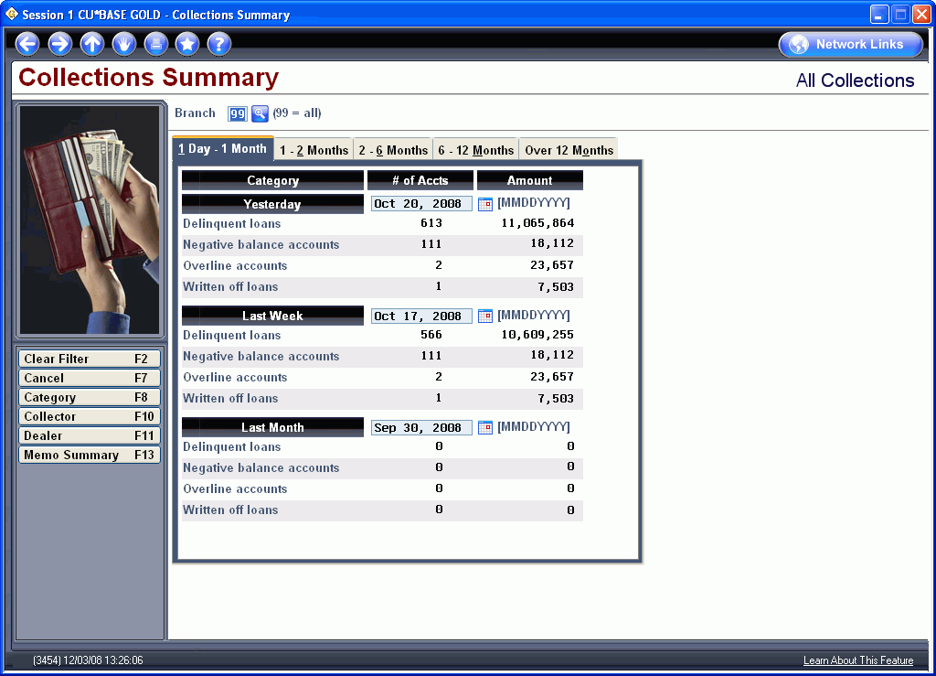



My Favorites From This Past Year
Dashboards
In 2011, CU*Answers will staff an Analytics Programming Team to intensify our focus on automated micro-awareness tools

Slide 59
An Artist’s Editorial
Micro-Awareness: A CEO Strategy
I’m concerned that so many institutions have vilified micromanagement that the resulting effect is that they have lost track of what I call
“micro-awareness”
Has your team truly mastered the art of using data and dashboards as part of the culture of your organization?
Can you agree on how a dashboard’s data should look at first glance?
  On the 15th of the month, how many loan apps should the loan team have processed?
Can you agree after perusing a few key department dashboards, that the credit union is about to have a good day?
  After a quick glance at a dashboard screen, does the accounting team have a
  green light that everyone’s in balance?
Micro-awareness is contagious, but it is based on layers of team members pulling in the same direction, searching for the right answers, and agreeing on what to do next
Micro-awareness will be a major focus of this year’s CEO Strategies week...hope to see your leadership there

Slide 60




My Favorites From This Past Year
Mobile Web Banking
Although the stats are changing almost too fast to count, as of last week, 97 CUs network-wide have activated
It’s Me 247 Mobile Web
  Over half of all online clients are already live!
I will talk about this in more detail after lunch, but it’s one of my favorites this year based on the way it was rolled out, the speed of assimilation, and the spirit of the CUs who pushed it to their members

Slide 61


My Favorites From This Past Year
Learn From a Peer
MNMGMB #17 Tiered Svc Peer Analysis
MNMGMB #18 Cashed Check Fee Configurations
It’s tough to be open, not only for the
person who is putting themselves out there, but also for the people who should use the insight, but who feel a little strange about looking over a peer’s shoulder
Learn From a Peer might not be intuitive for everyone , but it is picking up steam

Slide 62







My Favorites From This Past Year
Honorable Mentions
Gender Identification and Gender Generator
Misc. Member Account Forms Enhancements
  More lines, more paragraphs, and more forms per product...control paragraph spacing and reorganize lines in a snap...choose font type (get those fee schedules lined up!)...edit before printing...it’s not word processing, but it’s as close as we’re ever going to get!
Password Strength Meter in online banking
.NET graphs
Almost made it to my Favorites list, but not quite enough PT Barnum for me...
Which means they’re probably
on your staff’s favorites list

Slide 63
Increasing Our Investment in Network Execution
Getting more from electronic documents  Harvesting new facilities  New and improved network disaster and business recovery planning

Slide 64



Getting More from Electronic Documents
Big changes coming for our e-document strategies:
The move to CU*Spy powered by eDOC for CU*BASE reports and statements
Big plans for e-Receipts, Photo IDs, and e-Loan forms
A new document type for the CU*Spy vault
Check 21 advances through CheckLogic

Slide 65




Where We Are Today
Vaults and Options
Remember that electronic document strategies are agnostic when it comes to which vendor the CU chooses to use
  Whether it be eDOC Innovations, CoWWW, or MVI, we are building capabilities through expanding our integrations
  Obviously, we are vested in eDOC operations, and they are the proving ground for future expanded capabilities
Have you met John Beauchamp? Do you know he is our Electronic Document Strategies Manager and leads a team on these initiatives?

Slide 66

Where We Are Today
CUs and e-Document Solutions
116 CUs utilizing CU*Spy (powered by CoWWW) for CU*BASE-generated data (reports/statements)
47 CUs generating image data to CU*Spy powered by eDOC
  e-Receipts: 45
  Photo IDs: 42
  e-Loans: 5 (plus 4 more on their way!)
23 CUs using an in-house eDOC system
4 CUs using a 3rd party vendor (MVI)
2 CUs using an Online eDOC solution
116 CUs will be moving to CU*Spy powered by eDOC by year-end

Slide 67

Where We Are Today
CUs Participating in a Shared Solution
In our CU*SPY Vault:
Document Type | Currently in the Vault | % of All CUs
e-Receipts | 19,703,279 | 31.07%
Photo IDs | 176,042 | 29.0%
e-Loan Forms | 4,948 | 3.4%
These tactics are not about doing it for the sake of doing it, they are about what fits the credit union
This should be an evolution springing from the credit union’s business plan, not a keep-up-with-the-joneses, one-size-fits-all response

Slide 68

Where We Are Today
CUs Participating in a Shared Solution
Differentiating a shared solution from an in-house investment
  It’s all about the credit union’s strategy and ability to assimilate the project
    A shared solution is crafted by the vault architect (CU*Answers), and the pace of change is set by the architect and the participating CUs
    An in-house solution is crafted by the vault architect (the CU), and the pace of change is set by the CU staff and their project management
  Therefore, the ROI is based on what you use and when
CU*Answers, as the CU*Spy vault architect, continues to modify our ASP offering every year
  Remember that there is an honor system involved in the ASP model, and CU*Answers expects your team will only store documents
  in the vault that are covered by the warranty
It’s really simple: the shared community agrees to a set of documents and the retention timeframe

Slide 69

Plans for e-Receipts
Today, CUs benefit from multiple forms of receipt
storage and presentation as part of CU*BASE
  Rolling 90-day database of teller receipt information that can be retrieved from account history
  Automated integration to electronic receipt images, including signatures, that can be retrieved from account history
  A unique Teller Receipt Analysis as part of e-Statements
What’s next?
  In 2010, CU*Archives and CU*Spy will partner to produce e-Receipts archives on CD-ROM (this will finalize the vision for retrieval vs. archival)
  This will allow the CU to have their own archived data to ensure long-term retention compliance versus the ASP warranted retention period
  This will allow eDOC in-house users to have an inexpensive backup to their online servers

Slide 70




Plans for e-Photo IDs
In the 10.0 release we introduced the new
“Photo ID on file” indicator in CU*BASE to let
you log which members have a photo ID stored in the vault
This gives CUs an inventory of who has been scanned and who has not
The bigger picture: lays the foundation for CU*BASE to use this information in new ways
  In 2011, we will begin work on automating the connection between the eDOC ID scan/save process and updating this new flag in CU*BASE
  Will also work on automatically initiating the ID display
  when an account is accessed
    Meeting of the minds: Do we launch the member and you
    have to go searching for the joint owner, or do we pause to
    let you choose who you want to see first?

Slide 71

Plans for e-Loan Forms
The biggest plan of all for 2011 is getting more CUs
participating in e-Loan forms!
  We want to encourage CUs who have enjoyed success with e-Receipts,
  e-Photo IDs, e-Statements, and e-Reports, to go to the next level with their loan department
  While everyone talks about “the paperless loan department,” e-signatures, and electronic closings, far too many CUs are not laying the foundation by changing the culture of their loan departments to anticipate even more from e-Loan form capabilities in the future
It all starts with selling the team on the vision and the need for small steps starting today
  It appears that in-house CUs get started faster because they are vested in a big up-front expense...what a shame, when ASP clients have the ability to add loan forms and start this learning with no monthly investment
We continue to work on the pitch and the collateral materials that will resonate with your team

Slide 72


Your “Paper” Process Today

Slide 73

The CU*Spy e-Loan File

Slide 74

What’s new?
Without fail, a credit union considering its options
between a shared vault and purchasing their own,
will lead to this question: “How do I know you won’t eventually add everything I want to the shared solution, and I will have bought my own for naught?”
My response is, “you don’t!” It’s very likely we will add more documents, year, after year
So...this year we’re adding the Signature Card/Membership Agreement as our first warranted custom share form type
  Indexed by Account number, FName, LName, SSN,
  Form name, Date
  Retained indefinitely, but not less than 36 months
  (long-term archival will be a CD-ROM solution)

Slide 75



The Transition to
CU*Spy Powered by eDOC
The Goal
  Starting in 2009, we set out to replace our existing CU*Spy tools for statements and reports (powered by CoWWW) with the new
  CU*Spy powered by eDOC
Best laid plans...

Slide 76
The Transition to
CU*Spy Powered by eDOC
Best laid plans
  We worked very hard and believed we had a winner...then we went to beta and boy, did we learn a lot!
  While eDOC Innovations had great products for the individual CU, we quickly learned that we needed to step back and scale it up
Back to the drawing board
  We went back, made it industrial strength and built it stronger for the data center environment
  Separation of data
    We separated CU generated data (receipts, IDs and loan forms) from CU*BASE generated data (reports, statements, credit reports)
  Separation of environments
    We invested over $90,000 in new hardware to create separate hardware environments to shoulder the load

Slide 77


The Transition to
CU*Spy Powered by eDOC
Coming by year-end 2010...
  We anticipate being live in our new hardware environments with more robust software by fall and we anticipate being live by year end 2010
Project milestones:
Date | Action
June 1-18 | Install new hardware
July 5-19 | Install new code
July 20-August 16 | Load testing, verifications, QC testing
August-November | Beta testing (test clients already determined)
September-October | Documentation, announcements, sneak peeks
November 15-26 | Client training
December 6 | GO LIVE!

Slide 78
The Transition to
CU*Spy Powered by eDOC
Benefits of this project
  Leverages the network’s investment in eDOC Innovations
  Creates a template for best practices between eDOC in-house and CU*BASE, for statements and reports (Client Service support, documentation, etc.)
  Future investments in developing e-document capabilities will be based on the two teams closely coordinating as network partners
  CU*Spy and CU*Archives will merge and a new capability for eDOC CD-ROM archival management will emerge for both ASP and in-house clients
  CU*Answers will lengthen the months of retention for statements from 13 to 18 months with this change
  CU*Answers will review report retention timeframes and look to reduce the frequency of CD creation from CU*Archives, reducing costs for everyone
  What we learn from an insider’s viewpoint with eDOC, we will be able to extend to CU*BASE users who have chosen other third-party products

Slide 79
Check 21 at the Credit Union Level
Nothing legitimizes the use of an image in business strategy more than Check 21
  Today, an image is a negotiable item for moving money from a person to a financial institution, and from one FI to another
  Images are currency with Check 21
So where are we today? CU*Answers partners in two initiatives:
  Processing Alliance
    37 CUs (105 branches)
    Average 587,000 items/month
  eDOC CheckLogic
    27 CUs (58 branches)
    Processed 220K+ items last month (14% increase per month over the past three months)
    6 CUs (14 branches) scheduled to convert from PA to CheckLogic within the next 3-6 weeks

Slide 80


Check 21 Beyond the Branch
The interesting thing about Check 21 is the minute Check 21 came out as a replacement for Fed Deposit processing at the CU branch level, everybody got excited about all the other places this technology could be applied
Two of these continue to be on everyone’s minds, but not on everyone’s radar to go active – how about you?
  CheckLogic Lite is available today for Merchant Capture
    CU*Answers and eDOC use it for their own accounts,
    and we have 3 CUs that are ramping up their programs today
    Would you like to offer a Merchant Capture program?
    Contact our sales team
  CheckLogic Lite will be available for Member Capture later this year
Maybe this video will help with your vision of how CheckLogic Lite fits your 2011 business plan

Slide 81

Check 21 at the Front Counter
What’s on the drawing board for Check 21? Check 21 integration with CU*BASE Teller Processing
  We are in the very early design stages; a project planning kickoff session is planned for July
  Network champion:
  Fox Communities CU
And we’re getting smarter all the time...As part of a related project, we will soon start counting the checks entered on the Teller Outside Checks screen and, if you charge Deposit Item Fees, carry that count back to the teller screen automatically!
Coming
soon!

Slide 82
Harvesting New Facilities
Balancing the cost of multiple facilities against the value of redundancy, risk concentration, managing physical security, marketing your presence...

Slide 83


Data Center Update
Muskegon Goes Live
Remember this from last year...
2 sites in GR
1 site in Muskegon

Slide 84

Data Center Update
Muskegon Passes Its First Test
The Muskegon data center was part of the 2010 Disaster Recovery test at our IBM hot site in Chicago (May 18-20)
  These new capabilities challenge us to think differently about disaster recovery and business continuity
  The 2010 DR test included Chicago connected with It’s Me 247 online banking via the Muskegon center (CU*Answers closed
  test with staff accounts only)
    Muskegon online banking capabilities match full production capabilities in Grand Rapids
  2011 DR test will include credit unions and their members
2 sites in GR
2010 DR test was also our first test of ACH returns through FRB via a disaster site
1 site in Muskegon

Slide 85

Data Center Update
Muskegon 2011
This month we hope to sign the High Availability communications contracts to service the Muskegon data center
This will set the stage for our teams to move our HA server from the 28th St. location to Muskegon by the end of 2010
Nothing like a live event to bring home the importance of the CU*Answers High Availability market promise...
2 sites in GR
Remember May 28, 2010?
1 site in Muskegon

Slide 86

CU Board Alert!
The work completed by network participants should be viewed as your work
Make sure that you take key reports from the CU*Answers team directly to your Board meetings and make them part of your official records
We’ll also email an electronic version of these reports to you this later this week

Slide 87

Data Center Update
44th Street, Grand Rapids
The latter half of 2010 and all of 2011 will be an exciting time for our main Production data center
We will remodel the existing computer operations footprint (5,000 sq. ft.) to increase the potential for additional server and hardware capabilities
We will remodel the remaining 5,000 sq. ft. to create a new campus for housing Systems, Network, and Programming resources
We are intensifying our focus on 2nd shift credit union support
  New resources for overnight problem solving and systems innovation
  Additional team members for
  behind-the-scenes design work

Slide 88
Data Center Update
44th Street, Grand Rapids
Beginning with our 2011 fiscal year, we are planning to adjust our operational schedules to improve operations across the country with a split production cycle
  Zone 1: Eastern and Central time zones
  Zone 2: Mountain and Pacific time zones
When you consider the cuasterisk.com network, we have resources available to us across the country, with a sister data center in the Pacific, 2 data centers in the Eastern, and 1 in the Central time zone
It’s time for us to think about how partners across the country can change something right here at home
When your industry peers who are not part of the network think about CU*Answers, do they have this picture in their minds?
How can we change what
the CU industry thinks about CU*Answers?

Slide 89
Updating our Digital Intelligence
With all of the changes in our data center configurations, it’s time for a revamp of the way we think about using our DR plan and presenting it to the market
One of the ways we can think global and act local, is by making sure our DR plan outlines are online and can serve from remote locations, should they ever be needed
In 2011 our DR teams will complete a migration of our Disaster Recovery and Business Continuity plan database to a new web-based, hosted service
  Like an intranet that is separate from our system, so it remains globally available even in the event of a local disaster
Look for more throughout 2011 on how this new service can keep you informed about your CU*Answers DR/BC plan
Have you been thinking about a remote management system for your DR plan? In a disaster, how will your team members connect with your plan?

Slide 90
Updating our Digital Intelligence
A growing trend across the country for DR/BC plans is to include a crisis management notification system as one of the tools in your toolbox
  These packages use email, true SMS, and outbound voice systems to send notification to your staff and important stakeholders in the event of a disaster
  Some even record the response of your key team members and track their locations during a disaster – “who’s missing?” is an important bit of information when responding to a real disaster
In 2011 CU*Answers plans to implement and activate this type of system for our DR teams
  What about you? Is this a resource our network should build for its participants? Could our centers throughout the country easily cover each other and the credit unions from alternate time zones?
On May 28, we proved that once in a while, these investments are worth our trust
It’s time to consider what our national footprint could do for every network participant

Slide 91
Wrapping Up the Morning

Slide 92

Summarizing This Morning
I think we can all agree, it’s been a tough 12 months since last we met
  It takes a real artist to persevere and perform in an environment
  like we’re experiencing
I know everyone hopes the next 12 months are not dominated by responding to the regulator’s agenda more than our members’ agendas
  It takes a real artist’s creativity to adjust a business plan
  when the outside world is setting the agenda
While we are all happy about the network’s ability to respond, release after release, I’m sure we’d all like to return to a more normal pace in 2011
  It takes a real artist’s patience to keep moving forward

Slide 93

Summarizing This Morning
How about one more award before lunch?
Our network comprises many things, from the infrastructure and facilities we talked about this morning, to the tools and ideas that forge our capabilities, to the people who vest their dreams through their participation
The key ingredient in a network’s execution is leadership, but unlike the leadership that is exhibited inside a firm, in a network your leadership must win through alliances, cooperation, and vision to be bigger than you are when you stand alone
Based on that, this year’s Robert H. Mackay Award goes to...

Slide 94
Let’s eat!

Slide 96
Your Credit Union is Everywhere
Does your strategy reflect the goal of having your member think of you first in every financial transaction, at every stop along their busy day?

Slide 97



Your Credit Union is Everywhere
Everyone knows it: the success of credit unions today is being top-of-mind with the member as they go about their daily lives
We wish to participate in every possible activity and transaction that a member experiences, whether it be in our lobby, at a retailer, on an ATM, through their phone, or on the ‘Net
We need to be everywhere
To be everywhere, we must have our own realignment as to what is top of mind: no longer is what happens in our lobby the number one stimulus to our next activity
This morning we went through debit card and ATM concepts based on a regulator’s agenda...what agenda do we have for our “everywhere” products in 2011?

Slide 98




Your Credit Union is Everywhere
These tools help with your micro-awareness of where your members act with you, outside of your offices
Do you use these tools proactively and as a result of your top-of-mind awareness that your members carry you with them everywhere
they go?
Dashboards are not for the isolated “I need to know” person – they are for a team, and they are for action
Have you activated your dashboard culture?

Slide 99







Video is worth a million words...
This year’s video theme: Your Credit Union is Everywhere
We took this “everywhere” idea as the catalyst for our 2010 video contest
We wanted to combine the need to tell members that your credit union is everywhere, with the reminder that you must constantly be aware of this fact in planning for your 2011 activities
How will you use our network to touch more members outside of your organization and your direct employees in 2011, beyond anything you might have done in the past?
2008 Contest Winner:
“The Owners are Here”
2009 Contest Winner:
“Realizing Dreams”
2010 Contest Winner:
“Your CU is Everywhere”

Slide 100
2011 Video Contest
Adding a new wrinkle to this contest next year: We will still have the $1,500 prize for the best video idea (watch your email around Feb. 1)
  $1,500 “Screenplay Idea” prize
Next time we are going to allow you to submit your own finished videos to win a prize as well
  $1,500 “Director” prize
  1-5 minute video
And for the musical artist in the room: Announcing our first-ever jingle contest
  $1,500 “Recording Artist” prize
  1-5 minute audio recording
For years, businesses have been calling to the
‘net for solutions – from companies who post bounties for solving ideas, to companies who openly let software developers see their code
A network is a source of creativity and solutions...we need to tap that in more ways than ever in 2011

Slide 101

Your Credit Union is Everywhere

Slide 102



The year began with a little regulator twist...
Last fall we saw a shift in the way examiners saw our software and its ability to be configured by our users
  They wanted to audit, through CU*Answers, which credit unions where choosing the “right” options
We were pretty sour on this idea, and pushed back pretty hard
But in the end, we now see this was a chance to turn lemons into lemonade

Slide 103


Responding to Auditor Concerns in 2010
Security enhancements recently made:
(9.6 release, February 2010)
  Security questions required at login
  Sunset of the 4-digit PIN
  Masking account #s on e-Notices
  Password strength meter

Slide 104
Responding to Auditor Concerns in 2010
Still coming later this year (all targeted for the 10.3 release)
    Password resets done by CU employee will expire within 24 hours unless member sets a new password
    New members must log in within 5 days or online banking will be deactivated/expired and member must contact CU
    Redesign the open enrollment process to be less problematic for new conversions and annual open enrollment promotions
    Configurable option for initial password
      Choose from any combination of two letters of last name, full birth year, and last four or first four digits of SSN
    Allow for login user IDs (instead of acct #) to be set independent of PIB
    Stronger controls for multiple login attempts and other behind-the-scene enhancements
Moving forward on an overhaul of the PIB wizard to make it easier to extend even more layered security controls to your members

Slide 105




Mobile Banking Update
Mobile Web Banking – we talked about this this morning, and it’s doing very well
  In 2011 we will work hard on our cooperative marketing materials and bring bill pay forward into this new channel
Mobile App Banking – augmenting your browser phone strategy with a tactic for members who still carry the “other” type of phone
  Ready for alpha August 1, and multiple betas by Sept. 1*
Mobile Text Banking – for the text-crazy member who wants to text a computer system directly
  Ready for alpha Sept. 1, and multiple betas by Oct. 1*
*remember those best laid plans...

Slide 106

Mobile Strategy
Do you have a vision for how your mobile strategy will evolve over the next 24-36 months?
  You jumped on Mobile Web – do you need Mobile App?
  You think you need Mobile Text – have you figured out a pricing strategy where you’ll make money?
  You know that Text and App require CU*Answers to use a third-party partner – how long do you think that partner will be in play?
What will you say about your evolving strategy?
Learn more in the kitchen http://www.cuanswers.com/kitchen/mobile.php

Slide 107


Configuring Service Charges for Mobile App and Text

Slide 108



But we did a lot more than mobile...
New features added during the past year:
Pending ACH transactions
Enter secondary transaction descriptions when transferring $$
New renewal options for certificate products offered online
View dividend details for closed accounts (tax prep time)
Principal and interest breakdown on loan payments
Display of zero-dollar
memo transactions
in It’s Me 247
And don’t forget about Online Ballots!

Slide 109



Coming Soon
Coming
soon!
In QC and getting ready for this fall:
A new way to add joint owners when opening new accounts
A new feature for certificates only: adding beneficiary names!
Hover help will explain the member’s choices

Slide 110


Coming Soon
Coming
soon!
In QC and getting ready for this fall:
Certificate maturity management
  Configurable options for new accounts, and to let your members respond online to renewal notices they receive
A precursor to “Smart Notices” – notices with clicks for action
Then Member Reach will
follow up Smart Notices with “Smart Promos” – online advertisements with clicks for immediate action

Slide 111

Coming Soon
Coming
soon!
In QC and getting ready for this fall:
New flow for the Transfer Wizard
  Now we will ask for accounts before the amount, so it can only present the right questions (this was a nice byproduct of the AFT enhancements project)
  New AFT balance sweep option and member-friendly language for all AFTs (you’ll hear more about that later)
Also in development: Printing loan coupons from online banking!

Slide 112
Multiple Membership Management
When it comes to managing a single member’s money across multiple accounts, whether as an individual or a family, it’s time to make the system more convenient
“Let me see all my accounts, no matter where they are at the credit union”
“Let me move more easily to my other memberships”
“Let me move money from my membership to others”
SEE
JUMP
TRANSFER

Slide 113



Multiple Membership Management
SEE
New feature for CU*BASE and It’s Me 247: The ability to be in one membership and see basic details about all of your accounts that might be part of other memberships
Stay where you are, but see accounts where you are attached to other memberships
  The “SEE” list - a new kind of automated authority list, pulling in all accounts where you are listed as a joint owner or co-borrower

Slide 114



Multiple Membership Management
JUMP
New feature for It’s Me 247 that will allow the member to jump quickly to a list of other memberships
CU can define the authentication:
  Force credentials – Member chooses an account from their “jump” list and then enters that account’s password and security questions
  SSO (single signon) – Member creates an access list of “who can jump to my account” without any additional authentication
    Managed much like the current Transfer Control list, this list will speed members from one membership to the next, without
    re-authentication
A new kind of automation for total access to your It’s Me 247 accounts

Slide 115

Multiple Membership Management
TRANSFER
Today we have two kinds of transfer features: Wide open (member
enters an acct # manually) and Transfer Control (member gives you an account list)
We’re planning to add a third kind and
let your CU choose which method(s)
you want to allow
  Transfer Control list (like now)
  “SEE” list (auto-approved list for all joint/co-borrower relationships)
  Wide open (enter the account # manually) but with new controls
    If Transfer Control is off, would require the member to enter both the account # and the first 3 letters of the other member’s last name as a verification, similar to Name ID in the teller line
Remember that this will control only the transfer TO authority – you will only be able to transfer from the accounts to which you have FULL access authority

Slide 116


OBC Refresh (2.OBC)

Slide 117

OBC Refresh (2.OBC)

Slide 118

OBC Refresh (2.OBC)
New look, with available custom-color background to match your website
Login to It’s Me 247 right from OBC
Banner ads managed by ad management application
  If you sign up for a CU*Drive campaign (including CU*Drive+ and all of CU*Overdrive), and we manage your website, the same campaign will appear on your website, on the OBC, and in e-Info!
  Looking to expand touch points next year
A “New User” section with quick tips on how to use Online Banking
New pages that support every CU*Drive campaign (including CU*Drive+ and all of CU*Overdrive)
  Each campaign will have a webpage – no more linking to PDFs!
A similar treatment is also coming for PIB, along with a tighter integration into It’s Me 247 (no separate user ID!) and easier authentication management for the member

Slide 119
A glass half empty or half full?
We are extremely proud of the network and how far we have come when it comes to online services, and we have big plans and goals for the future
Do any of these stats surprise you?
Online Banking Service or Feature | % of online CUs using this service or feature
Transfer Control for inter-member transfers | 86.7%
Check Requests | 64.4%
Stop Pays | 54.1%
Online Membership Application | 48.9%
ACH Maintenance | 44.4%
AFT Maintenance | 25.9%
CU Tiered Services marketing messages | 25.9%
CFT Maintenance | 21.5%

Slide 120
and Your 2011 Business Plan
Some goals for your 2011 activities, out of these changes:
  Push your members never to use their account number on the Web – it will soon be easier than ever to set up your user name right in It’s Me 247
  Plan to have an online banking enrollment promotion every year using the new tools
  Revamp your new membership procedures and get people online faster
  Start using web page sales services inside of It’s Me 247 – raise your members’ expectations for purchasing and starting things through online banking (Mobile Web will be next)
  Refresh your security education materials and push another round of online security best practices at your members
  Plan to use OBC and become an online banking publisher
  Use SEE / JUMP / TRANSER concepts to create a portfolio management persona for your online banking channel – start with your internal accounts and expand it through A2A for all of your members’ FI relationships

Slide 121
Something to Think About
From videos, to all of the content in the OBC, to collateral marketing materials, to online help, to the collective vision...we believe having a collaborative brand is the best way to manage the investment in these channels
But not everyone agrees with us, and there is still an audience (and at least a marketing department hunger) for private branding of online and mobile banking products
In 2011, CU*Answers will announce a proof-of-concept project with 1-3 credit unions on designing our first privately-branded online banking site
  It won’t be as expensive as you think – today we project a $5,000 setup fee and a $3,500/month e-commerce fee
  Are you one of the teams that wants in on this project?
Before you go running around the office doing back flips and cheering for this new revolutionary new online banking site, let’s negotiate what “private label” means

Slide 122
Looking Forward to the 2011 Development Agenda
Some of our favorite projects in the works, on the drawing board, or prioritized as “get started soon”
It was hard to boil down the list to my Top 7!

Slide 123
“Unlock the Date”
Never Say Never...
#1
Some people call it “back-dating,” some people call it “effective dating” –we are going to give it a new name and apply it to a lot more than just account adjustments
Introducing “Unlock the date”
  This means to take a standard CU*BASE option for processing member requests, then allow the user to “unlock” and enter a prior date, and automate any necessary adjustments
    Dividend or interest adjustments, dates on printed forms, etc.
The idea is to mainstream the tough calculations related to posting transactions that should have been posted in the past
  Network champion:
  Heartland CU (Springfield, IL)
This is not just one feature: it’s a new standard
for how we look at all features
Where can we turn processes that require several steps today, into a simple one-step process?

Slide 124
“Unlock the Date”
We’re Going All Out
Effective date for opening shares and loans
(part of the 10.1 release, so people are still working their way through it)
Effective dated account adjustments for average daily and simple daily savings and 365-day loans (in beta over the summer, releasing this fall)
  New screen handling to walk the user through the adjustment process, pre-filling the adjustment and dividend/interest calculators automatically
Effective-dated transfers will be part of the normal member transfer feature, posting a single transfer with multiple adjustments for effective-dated dividends and interest (in beta over the summer, releasing this fall)
Effective-dated teller posting – a new Proc Code that will automate multiple adjustments for effective-dated dividends and interest (on the drawing board for next spring)
Effective-dated transaction reversals – to include multiple automated adjustments for effective-dated dividends and interest (on the drawing board for next year)

Slide 125


Effective-Dated Transfers
Unlock the date

Slide 126

Effective-Dated Transfers
A quick recap of recent transactions for both accounts

Slide 127

Effective-Dated Transfers
Secondary trans description to explain the effective date
Automatic dividend adjustments
Automatic dividend adjustments

Slide 128
Custom Posting at the User Level
Importing Files & Posting Transactions to Member Accts
#2
Network champion:
Every creative CU out there who can dream up a reason to give or take money away from members
Every year, some creative CU team says, “We can identify the members, we know the formula to figure the debit or credit amount, and we understand why this would be a great option...if only we could post it!”
We are developing a new tool that will mark a turning point in how CU*BASE allows credit union teams to get creative with debiting and crediting batches of members
  Give a rebate to all members who use their debit card (% of transactions per month)
  Post a special reward for Platinum members
  Fee members a special assessment from a Query formula
  Post a new third-party fee for a new service, from an external source

Slide 129



Custom Posting at the User Level
Importing Files & Posting Transactions to Member Accts
This will be in beta this summer...look for a full release by year-end

Slide 130
Custom Posting at the User Level
Importing Files & Posting Transactions to Member Accts
During 2011 we’ll add additional formats beyond ACH and Flat:
  User-defined fixed length
  Comma-delimited
  XML
We believe that when this is completed, CU*BASE will be much more attractive to creative marketing and IT teams who are used to direct input without the need for a standard program or custom project

Slide 131
Two Slick Ideas for Certificates
#3
Amortized Certificates
  Disburses both interest and principal as a cash-flow type investment
  For the member who wants to earn dividends and have a budgeted principal disbursement back to themselves over the term of the certificate
  Network champion:
  Superior Choice CU (WI)
“Bump Your Rate” Certificates
  CUs will be able to configure certificates that let members bump to a higher rate a specified number of times during the term
  Member can bump to the then-current rate via a self service option in It’s Me 247 or via an employee in CU*BASE
  Network champion:
  Services Center FCU (SD)
In 2011, CU*Answers has several projects slated to better understand how member savings and member investment products could be enhanced
Do you have any ideas you would like Gividends to drive for your savings offerings?

Slide 132
AFT Enhancements
#4
Full Balance Sweeps – an AFT without a specified transfer amount
  For years, members have been able to regularly sweep money from their accounts to the credit union for things like credit card payments, third-party mortgage payments, or even third-party investment transfers
  This new project allows members to use a similar feature as part of their personal money management, account to account
    Using a special savings account to accumulate funds for a mortgage payment – helping members with weekly or sporadic mortgage payment budgeting
    A new way for members to automate transfers to higher-earning accounts (e.g., “transfer everything over $2,500 from my checking account to my money market account every week”)
  We will eventually use this foundation to help businesses with cash management
Network champion:
Heartland CU (Madison, WI)

Slide 133



AFT Enhancements
Walking Members Through Their Transfer Options
The way people use online banking is starting to change how we think about walking employees through CU*BASE options as well...

Slide 134

AFT Enhancements
Walking Staff Through Member Transfer Options
A similar step-by-step logic will also work great in making AFT setup more intuitive for employees
The screens are always smart enough to show only the decisions the user needs to make
After you choose the FROM and TO accounts, we can ask the right question to choose a transfer type . . .

Slide 135

AFT Enhancements
Walking Staff Through Member Transfer Options
A similar step-by-step logic will also work great in making AFT setup more intuitive for employees
The screens are always smart enough to show only the decisions the user needs to make
. . . and then subsequent screens can ask only for the details you really need for that AFT

Slide 136

AFT Enhancements
Walking Staff Through Member Transfer Options
A similar step-by-step logic will also work great in making AFT setup more intuitive for employees
The screens are always smart enough to show only the decisions the user needs to make
Simplifying the controls, and asking the question only when setting up an AFT loan payment

Slide 137

Dashboard for Your
New & Closed Memberships/Accounts
#5

Slide 138
New & Closed Memberships/Accounts Dashboard
Goals for the Project
An on-the-fly analysis and report system for new and closed memberships and their accounts
  Choose a “from” and “to” timeframe
  A palette presentation to process new and closed relationships, from a welcome basket to verifying an MSR checklist for when a member leaves
  Demographic breakdown for gender, employee, branch, and ZIP code
  A.S.A.P. tools for Member Connect strategies
  Summary analysis consistent with the Activity Analysis feature in the Loan Application queue
More than a set of dashboards, these analysis tools will come with a built-in report package as part of our new CU*BASE PDF project
Network champion:
CEO Strategies event focus groups

Slide 139


Privacy 2010 2011 2020!
Redesigning Member Authentication
#6
Parts 1-3 already in
  New configurable Privacy Controls; sanitize teller/phone/inquiry screens; expand security audit files to include Shared Branch activity
  These parts laid the foundation for segmenting “trusted individuals” both inside and outside of our CU staff, for working with members
Part 4 coming soon (Target: 10.3 release)
  This part automates the compliance and consistency of authentication, with new controls and the ability to audit trusted individual performance
    Code word pop-up
    Out-of-wallet questions
Network champion:
Xtension Call Center
Another tool in the Xtension toolkit to assure your team that your policies and the member’s desires are being respected by a third-party call center

Slide 140



GOLD Team Leads the Way
#7
In 2011, we plan to use the power of PDF to change the way many people think about computer reports and forms
Three projects are slated for the development season:
  Analysis packages directly from CU*BASE dashboards – CU*BASE GOLD PDFs
  Improved graphical printing from CU*BASE reports – iSeries PDFs
  PDF forms for members from online banking – It’s Me 247 PDFs
Not only does this produce a slick, high-quality output that looks like a finished product right off the printer, the ability for members to open and save even without printing makes it an easy way to communicate with members via the web
  Look for more during 2011
  Network champions:
  Community CU (WI), Sioux Empire FCU (SD),
  and Alpena Alcona Area CU (MI)

Slide 141
An Artist’s Editorial
What past generations might have dismissed as frivolous attempts at cheap entertainment and salesmanship, the current generation simply accepts as “the way things are done”
Today, presentation is the competitive differentiator
  Video is a way to teach
  Color is a way to make things more intuitive and speed up comprehension
  Symbols are multi-lingual
  Good design just makes it more fun for everyone, from the developer to the end-user
  ...and yes, it sells – but unless we sell, there’s no chance for it to evolve
“In the eye of the beholder” is a phrase we all attribute to compromising the critique of an artist’s work
Sometimes it takes the spirit of an artist to consume as well as create – we’re a cooperative of consumers and creators, exchanging our hopes and dreams, one project at a time

Slide 142


Speaking of network champions...
I am constantly amazed by the spirit of those who are so willing to contribute great ideas to our network
A new flow for Idea Forms, coming in October!
Sometimes I laugh, sometimes I cry, sometimes I swear...
...but Ideas Forms are one way
I reconnect with the reason
we write software:
the CU employee

Slide 143
Listening to Network Champions
Ideas and Projects
In the period June 1, 2009 through June 1, 2010, the team reviewed 2,105 project sheets (86% approval rate)
Of projects that were completed during the year:
  1,588 were completed with changes
  124 were duplicates of projects already in process
  49 were education issues
  524 will closed with no action taken
  27 requests were cancelled by clients
Breakdown of project types:

Slide 144

Speaking of network champions...
At tonight’s Stockholders Meeting, the Chair of the Board will talk about how the concept of Idea Forms might be used for Building a Business, from an
owner’s point
of view

Slide 145

Speaking of network champions...
We hope that all of our owners are planning to attend tonight’s birthday celebration for one of the country’s oldest CUSOs!
At tonight’s Stockholders Meeting, the Chair of the Board will talk about how the concept of Idea Forms might be used for Building a Business, from an
owner’s point
of view

Slide 146



Moving Beyond Ideas
Last year we announced our first-ever Spec Writer Contest
This is for the Idea Form enthusiast who has no problem with the 50-word quota
This contest was in the spirit of “we’re on your team” and there are talented individuals in the network that could be on our team
It takes the idea of being a champion up several notches to being a designer, an architect of a blueprint
And the winner is...
Michelle Broderick from Cumberland County FCU!

Slide 147

A Year Later
Lender*VP  Gividends  Audit Link  cuasterisk.com

Slide 148
Playing Up
A lot has happened since I saw you last June related to CU*Answers Management Services and the role they play in our network
Geoff Johnson was promoted to Executive Vice President of Client Interactions, and the CMS team was officially aligned with the overall Client Service response teams here at CU*Answers
  The design ensures that CU*Answers project management can now be coordinated from the conceptual, to the development, to the execution
  The products placed in our clients’ hands come from the shared perspective of a management team ready to go to work with you
For our network to be successful in the future for all of its participants, we must work from the perspective of a credit union operator, with the talents related to being an artistic operator
  Not only for software, but for the day-to-day activities of a credit union
CMS gives us the vision and the hope to work in the spirit of an artist

Slide 149



Favorites from the CMS Team
I’ve shown you some of my favorite new products and features that we’ve completed, plus my top 7 for what is on the development schedule
So I asked the Lender*VP, Gividends, and Audit Link teams to tell me some of their favorite accomplishments from the past year, and to give us all a project or two they are looking forward to for 2011

Slide 150



2009-2010 Favorites
Mortgage Projects
It was a great year for everything “mortgage” in the CU*Answers network
Lender*VP has been a driving force and is very proud of these changes
  Bringing smart mortgage payments to the online channel
  Smart mortgage messaging at the teller line and in transfers
  New handling for delinquency fines
  365 escrows
  Mortgage balance sweeps
  (Randy already picked that for his favorite)
  Escrow statement enhancements

Slide 151

2009-2010 Favorites
Mortgage Payoff
This work is nearly done, so it qualifies for the 2009-2010 favorites list, but with all the reg changes, it had to take a back seat and won’t be out until the fall (Target: 10.3 release)
Nothing is more frustrating than all the little steps in preparing a mortgage for final payoff at the teller line
  Adjust interest due
  Pay delinquency fines
  Handle escrow funds
  Pay miscellaneous fees
This new tool automates these four big areas and sets the foundation for a back-office-to-front-office expertise transfer

Slide 152
Can’t Wait to See in 2011
Participation Loan Upgrade
Mortgage account servicing continues to be an area where LenderRE and credit unions want to see more process automation, control, and intuitive design
We’ve already put a lot of work in the can, and here are some of the features you’ll see this fall:
  All monthly tasks will be organized, step by step, on a new CU*BASE menu
  Specific logic for unique servicing and settlement requirements of FNMA, FHMC, FHLB, NMS
  On-screen tips for processing with the government investors (Freddie, Fannie, FHLB), and comprehensive new documentation for each with specific step-by-step instructions
  Help for 360 loans: Separate option to accrue 360 interest, new edits to ensure that monthly steps are done in the proper order
  New reports to help with the settlement process
  ...and more!

Slide 153



Can’t Wait to See in 2011
A Fresh Look at Credit Reports
A project that is about to hit the drawing board is a complete review of how credit reports interact with applications, and a “what if?” review of how we handle credit reports today in comparison to new programming standards here at CU*Answers
  Link to a trade line from a debt on the loan application
  New trade line display controls
  Quick links from Profile to special trade line conditions (e.g., public records, etc.)
  Special project to reconsider smart analysis of trade lines
The new Lender*VP section for Idea Forms will be the collection point for your comments about this project later this fall

Slide 154




2009-2010 Favorites
Instant Issue
Service 1 CU (5th/3rd) – launched as our first beta on May 27
Services Center (FIS) – launch date June 22 (yesterday!)
Frankenmuth (COOP) – card issue launch date July 13
(Instant Activation launches in August per COOP’s certification)
Others in process: Fox Communities and Sioux Empire,
with over 40 other clients
starting the learning process with our
Gividends team and DCS
What starts out as a cool thing to do when a new member wants a card, becomes a necessity when a national database is compromised

Slide 155
2009-2010 Favorites
Standard ATM/Debit Card Platform
ISO 8583 Conversion of ATM/Debit Card Processing Platform
  This is the now-infamous PFC (Pause For a Cause)
All day long we have been talking about issues related to ATM and debit card changes
  The industry already had enough goals for this technology; the industry was already dealing with the constant consolidation and logo changes at the switch level, then along come all the regulations as well
  Thank heavens we started this project a couple of years ago – there is no way we would have been able to handle the changes and the future need for even more changes if we were running multiple platforms per switch
This is just the beginning...
  We’re reworking your reconciliation process, we are recertifying your network for Reg. E, and we are beginning to envision what it will take to have an ATM/Debit card platform that is smart enough to harvest service income in the future
Something we’re especially proud of came out in the 10.0 release...

Slide 156


2009-2010 Favorites
Standard ATM/Debit Card Platform
Mark this release as a change in how things get done

Slide 157
A Shift From the Back
Office to the Front
Questions your front-line staff can now answer right from CU*BASE:
Response code/description received from the switch
Local date and time (at the point of the member’s transaction)
Settlement date (when the trans actually posted to the mbr’s acct)
Indicators showing whether ODP/ANR amounts were used in the approval
Original amount and the final transaction amount including ATM surcharges
Available balance
ISO fees, surcharges and activity fees
Posted status (stand-in vs. active)
etc., etc...
Bottom line...you have a member on the phone who just got turned down at Walmart, and you’re wondering how your switch is communicating with CU*BASE – go directly from the member’s account and work the problem with the member on the phone, in the front office
What Gividends can’t wait to see in 2011? High utilization rate for Instant Issue, and everyone getting more out of the new ATM/Debit platform

Slide 158





2009-2010 Favorites
Red Flag (and the Advisor)
Visit http://advisor.cuanswers.com and search for “Red Flag”

Slide 159


2009-2010 Favorites
RMG (Part A and Part B)
It all started with the vendor risk assessment requirements thrown on credit unions last year
  As part of the first version of this new web tool, 96 active users have completed 182 risk assessment reports online
We look forward to 2011 as this project evolves into a full-out risk management site with the following new features
  Risk Management Matrix – quantitative risk analysis for due diligence on new opportunities
  Risk Concentration Analyzer – review where your greatest areas of risk lie
  Compliance Audit Template – understand how to fulfill your NCUA mandates
http://rmrg.cuanswers.com/

Slide 160

Can’t Wait to See in 2011
The SARs “Dirty Dozen”
One of the areas that seems to be heating up for credit union compliance purchases is automated monitoring systems that scour what sometimes appears to be random data and kicks out hints about activities that might be normal, irregular, or risky
In many cases, these systems will require downloads from CU*BASE to third-party software, which can be expensive
The data is there, why not use it?
  Excessive abnormal activity
  Identity theft
  Check kiting
  OFAC scans
  Debit/credit card fraud
  ...oh, you can read for yourself

Slide 161
15 Minutes in the Sun
It’s been said that every person has his 15 minutes of fame
I think you will agree with me that initiatives like CMS Audit Link and
SRS Audit Link are destined to be stars for a long time
If you didn’t have a chance to really interact with these two teams in 2010, I’d make it a priority to get to know them in 2011
Audit Link is going to be a strong player in the CU*Answers network for a long time to come
LEGAL DISCLAIMER The information contained in this web site does not constitute legal advice. We make no claims, promises or guarantees about the accuracy, completeness, or adequacy of the information contained in this web site. You should retain and rely on your own legal counsel, and nothing herein should be considered a substitute for the advice of competent legal counsel. These materials are intended, but not promised or guaranteed to be current, complete, or up-to-date and should in no way be taken as an indication of future results. All information is provided "as is", with no guarantee of completeness, accuracy, timeliness or of the results obtained from the use of this information, and without warranty of any kind, express or implied, including, but not limited to warranties of performance, merchantability and fitness for a particular purpose. In no event will CU*Answers, its related partnerships or corporations, or the partners, agents or employees thereof be liable to you or anyone else for any decision made or action taken in reliance on the information provided or for any consequential, special or similar damages, even if advised of the possibility of such damages.

Slide 162

The CMS MVP
This year’s winner of the CMS “Most Valuable Partner” award goes to...the Xtend team!
Picking up the tools and doing the work at 100x

Slide 163

This Year’s MVP
The Xtend initiative is one of the most important contributors to the whole idea of our network’s execution
It is a key plank in CU*Answers Management Services
  Participation in design
  New business offerings
  High-throughput laboratory for CU*BASE tools (bookkeeping, mortgage servicing, internal auditing, call center, etc.)
It also provides the drive for new ideas and vision for doing things faster, more often, and in a new way for network efficiencies
  From this morning: You can’t just want innovation, you have to need it

Slide 164

Xtend as a Product
Designer and Catalyst
Member Reach, Xtension, and the Collections team continue to be huge supporters and drivers of the CU*BASE Trackers system
In 2010, the Tracker system saw some impressive growth in both utilization and capabilities (44 project sheets completed since last June!)
  From Cross Sales, to the automation of Audit events, to the improvements in the workflow and functionality, the Xtend teams are a major reason why our customer information database is tops in the market today

Slide 165
One of My Favorite
Network Initiatives
Call centers are one of the most oft-cited
initiatives for CUSO innovation
Everyone agrees with the concept of a shared call center, but not everyone seems to be as ready to jump in with a tactical plan to use one
The results are impressive, but a bit anemic from where I sit
For the first 4 months of 2010:
  Xtension serviced 21,694 members with inbound operators
  Xtension made 13,514 outbound calls to members
  Xtension helped 16,662 members with its Conversion Call Center service
  Xtension made 7,597 FREE outbound calls (out of a potential 67,500+) in the last year
Only 17 credit unions out of 135+ participated in the
FREE OUTBOUND CALL proof of concept
Saved CU*Answers a boatload of money...but what does it say about credit union commitment to reach out to members?

Slide 166
Compare Xtension to
Member Reach
For the first 4 months of 2010:
  Weekly/monthly scheduled emails sent: 876,398
  Weekly/monthly scheduled online banking messages delivered: 689,686
  Custom emails: 59,963
  Custom online banking messages: 32,855
  e-Info promotional messages presented: 91
  OBC custom articles published: 87
Credit unions have truly embraced the automation of matching CU*BASE leads with electronic communication techniques
Can this kind of enthusiasm translate
to call center initiatives, or is the phone just passé?
(Hope 2-way text is a good bridge)

Slide 167

The Power of the Network
The Power of Ownership is to create The Place To Be and show the world the Power of the Network
The power for you to succeed

Slide 168

The Power of the Network
An Ongoing Debate...or Debate Over?
If you are still wondering why to use the networked world, you’re behind the curve
Using the network does not mean you don’t still act in your own best interest – you’re independent; you are yourself in a crowd that helps you get things done
Everyone around you is learning to expect a network solution – CU*Answers isn’t teaching this to them; they’re learning it as part of their daily lives
Therefore, act with your stakeholders, and take advantage of the network

Slide 169
The Power of the Network
An Ongoing Debate...or Debate Over?
What started as an idea about how to do things yesterday, has turned into a template for doing things tomorrow
CU*Answers was in the right place at the right time, and that means we can get started NOW on what others are just starting to think about
CU*Answers is The Place To Be – the proof of concept for network ideas

Slide 170

Using the Power of the Network
Tapping Into Collective Knowledge
Recently a Board Chair from one of our network credit unions reached out to all of us to help his Board gain some insight on how to go about securing a new CEO for their credit union
More importantly, he wanted some feedback from experienced leaders as to what they as candidates would expect from the process, or what they would recommend to a CU Board of Directors about how to interact with potential candidates
  The Chair wanted candid answers direct from credit union leaders, not a consultant’s theory wrapped around a package to buy
  He was asking what did the network know, and how could it help with his challenge
I think the answers might surprise you, and the quality of the exercise is something we should repeat over and over for other challenges

Slide 171


From holysh_t.com to http://ofcourse.cuanswers.com
From special projects like the CEO Succession Plan brainstorming to everyday work...a new interactive community
The marketplace is not going to let us drop the idea of shared community sites – it’s part of the culture of our society today
We need to keep doing this until we get it right

Slide 172



Using the Power of the Network
To Earn and Employ More People
Once a hub becomes an open network, the aggregated participants create a potential economy for exchange and for serving each other
Every participant can be both supplier and consumer of the resources within a network...we’ve been talking about this for years, and the first player to take advantage of it was Xtend
This fall we want to talk about you and your team taking advantage of this same idea: Start a business within the CU*Answers network
Mark your calendars for
Wednesday, September 22, 2010

Slide 173
Goals for September 22
  Encourage a CU to start a business to compete with a CUSO business
Encourage a CU to start a business within the network that
is not currently offered by the CUSO
Encourage a CU to start a business to outsource resources and
capabilities to another business within the CUSO network
Encourage a CU employee to start a business to sell their
services to another business within the CUSO network
Consider this an innovation event, a job fair, or an intellectual exercise...I just hope to see you there and get your point of view

Slide 174

The Power to Innovate
Enlisting 150+ Accounting Teams to Design...
Networks create systems for innovation – how about one for innovating our pricing models into the future?
In 2011, I believe we will start a journey with our network participants that will revolutionize the way people think about building financial models in a cooperative environment
We’ve published two pricing studies covering the past 10 years, and through our focus groups, we have created the transparency into our financial dealings that our participants demand
This new website takes that to a whole new level

Slide 175


The Power of the Network
The Ability to Have Christmas in June
What better tradition could a network have than an expectation of increasing its value and lowering its costs every year?
In the most recent published quarterly Financial Performance report, here were my top 5 for investments we could make with our 2010 returns:
  Regulatory changes without fees
  DR/BC for online banking and web services without fees
  Announce more fee reductions (e.g., ATM/debit/credit)
  Continued COLA relief (2 years in a row)
  Match or exceed our 2009 Patronage Dividend of $700K
If you don’t get this newsletter, owner or not, contact us to be added to our distribution list, or check them out at http://www.cuanswers.com/client_financials.php

Slide 176
Christmas in June!
Savings for Your 2011 Business Plan
Goal | Christmas in June
Regulatory changes for free | You’ve heard all day that we are on track and I don’t see that changing – this is a major investment by the CUSO
DR/BC for the web | You saw in the Gap Analysis that It’s Me 247 is now part of our redundant services; Web Services is next in 2011
More fee reductions | Here’s how far we can go today (Reg. E has even us a bit spooked): Reducing ATM/Debit card fees by 3%, starting with July 1 activity (for online switches) 2011 Special: Waiving fee for converting from batch ATM/debit to an existing online switch Eliminating the per transaction fee for CUSC shared branching Eliminating the setup fee on Spanish CU*Talk
Continued COLA relief | We will waive the COLA increase for 2011 (2nd year in a row) – but don’t count on this in 2012
Match 2009 Patronage Dividend | I won’t steal the Board of Directors’ thunder here, but boy does it look good!
It’s been a tough year for credit unions, and looks like a rocky future until we get through special assessments
CU*Answers is vested in your future and will do all we can

Slide 177

The Power of the Network
Driving Growth
New CU*Answers Clients Since Last Time:
Michigan
Credit Union Plus
Bay City, MI
Grand Valley Co-op CU
Grand Rapids, MI
Amalgamated CU
Saginaw, MI
Utah
Horizon Utah FCU
Farmington, UT
(self processor)
Missouri
Table Rock FCU
Shell Knob, MO
South Dakota
Rapid City Telco FCU
Rapid City, SD
Iowa
EdCo Community CU
Des Moines, IA
Des Moines Police Officers’ CU
Des Moines, IA
Illinois
Heartland CU
Springfield, IL
Ohio
Vacationland FCU
Sandusky, OH
CommStar CU
Elyria, OH
New York
East River Development Alliance FCU
Long Island City, NY
Includes all clients that will be converted by the end of the 2010 business year (Sept 30)

Slide 178



The Power of the Network
CU*BASE As the Common Factor
# of CUs by State
178 CU*BASE Credit Unions
in 26 States
11
1
83
1
9
19
1
1
5
2
4
4
11
1
1
1
1
☺
1
1
1
1
1
6
1
1
1
3
148
19
11
Includes all clients that will be converted by the end of the 2010 business year (Sept 30)

Slide 179
The Power of the Network
CU*BASE As the Common Factor
# of Mbrs by State
OH
WI
SD
IN
IL
WA
MI
NY
OR
CT
CT
FL
TX
CU*BASE Credit Unions: 178
Total Members: 1,333,800
UT
MA
ME
AL
DC
KY
MS
CO
148
19
11
Includes all clients that will be converted by the end of the 2010 business year (Sept 30)

Slide 180
The Power of the Network
A Network of Owners
98 Credit Union Owners
in 13 States
11
58
1
1
2
10
3
1
3
4
1
Percent of Total CUs: 55%
1
2
86
12
0

Slide 181
Wrapping Up the Day

Slide 182




What else is in your packet?

Slide 183

Pass It On...
Same as before, all materials related to this week’s events will be posted on our website
http://www.cuanswers.com/lc2010

Slide 184

Tonight
For our owners:
We’ll see you downtown at the B.O.B. for the Stockholders Meeting (cocktails start at 5:00)
Hop on I-96 W and follow the directions on your map to the B.O.B. in downtown Grand Rapids
Construction alert!! Get a new map with alternate directions before you leave!

Slide 185

Thank you to our artists...
It takes a troop of artists to pull off a conference like this...and every year I forget to thank someone

Slide 186

Thanks to a network
of artists...
Here’s an illustration of how big the talent pool is

