Slide 1


It’s a Birthday Party!
Annual Stockholders Meeting
June 23, 2010

Slide 2
Agenda
Call to Order
Chair of the Board: Year in Review
  Review 2009 Minutes
  Chairman’s Comments
Election of Board Members
CFO Report
  Review Financial Reports
CEO Report
  When Is “Let Them Eat Cake” a Positive...?
Board Election Results
Adjourn

Slide 3

The Power of the Network:
The Shareholder Opportunity
Chairman’s Comments

Slide 4
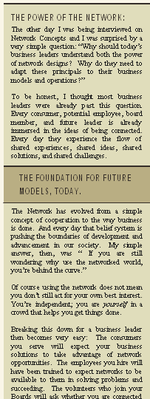
The Power of the Network
The Shareholder Opportunity
Earlier today Randy made several references to the power of the network and what it means in today’s marketplace
  He highlighted the promise that the power of the network holds for credit unions, their members, their employees, and business designers
What does this opportunity mean to us as shareholders?
  What does it mean beyond building a great business?
  How can we interact differently to leverage this for our personal stakeholders?
  How can we act locally while thinking globally?
The CU*Answers Board hopes to be at the center of shareholder network interactions

Slide 5
The Power of the Network
The Shareholder Opportunity
We all have the responsibility of being network architects, and designing activities and systems to harvest the power of our collaboration
  We no longer feel it is enough to tell you we are available, to let it be known you can call us at any time
  We want to get proactive and interact in a new way...do you?
We’re not talking about micromanagement of our CUSO team or simply responding to momentary grievances...we’re talking about micro-awareness of what opportunities we might all harvest together

Slide 6
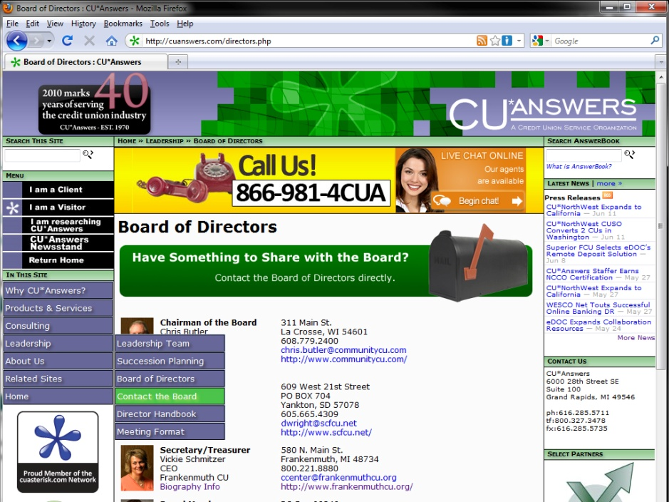
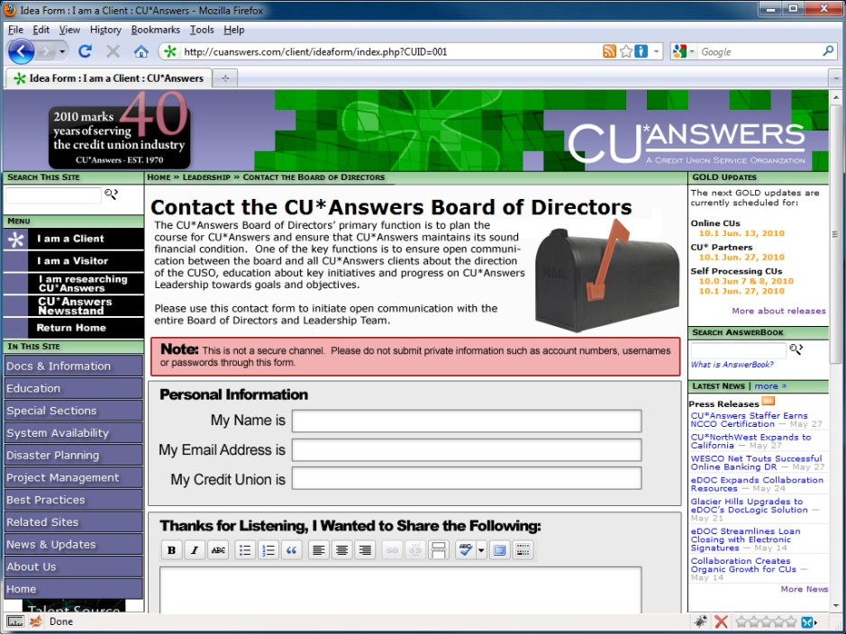
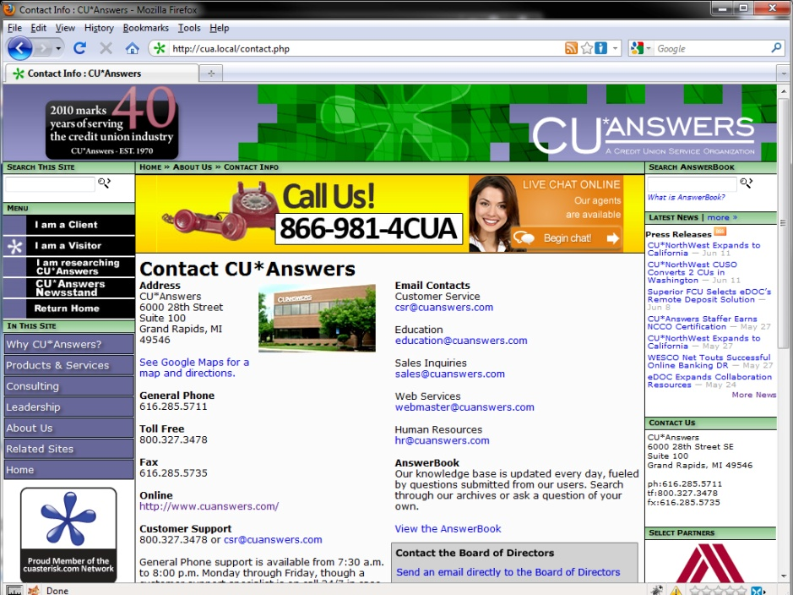
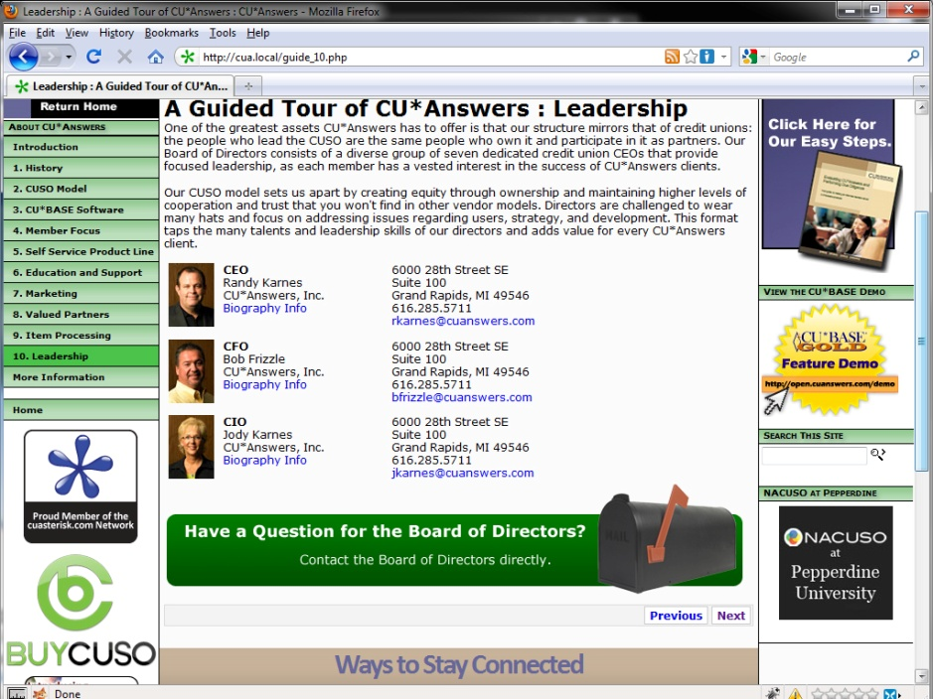
The Power of the Network
New Shareholder Tactics for 2011
Shareholder Idea Form
Advise the Board as an Industry Commentator
Find the Board as a Client
Find the Board During Due Diligence Research
Meet the Board as a Visitor

Slide 7
Our Responsibility to Harvest Potential
Whenever you celebrate history, it gets you wondering
about what they will say about you when your efforts
have been recorded in the history books
Consider this quote from Randy’s Power of the Network:
What will we do with this responsibility? What will they write about us at the 80th anniversary of our CUSO?
“And the cool thing about CU*Answers is, we have a short-term advantage from being in the right place at the right time. So we can get started NOW on what others are starting to think about. CU*Answers is a proof of concept for network ideas.”
The Board is committed to the vision of the shareholders and what they want our legacy to be

Slide 8
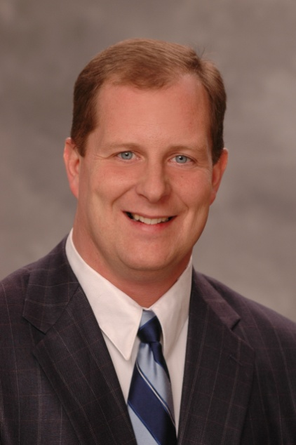
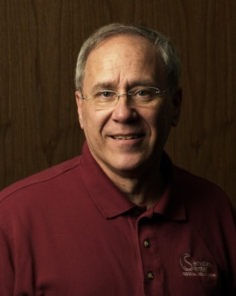
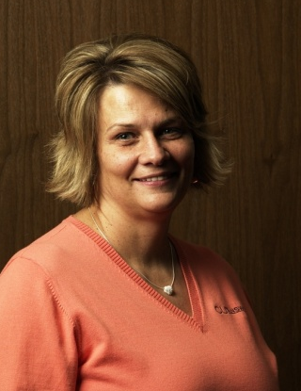
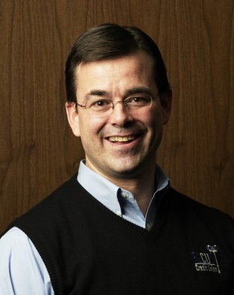
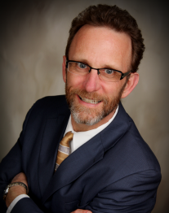
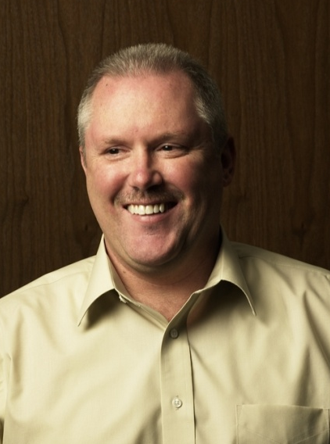
Another Great Year with a Great Team
Dave
Wright
Scott McFarland
Vickie Schmitzer
Dean
Wilson
Jeff
Jorgensen
Chris
Butler

Slide 9

2010 Board Elections
A New Wrinkle
A vote of unanimous consent
for two unopposed seats
A Special Election for a
vacated seat

Slide 10
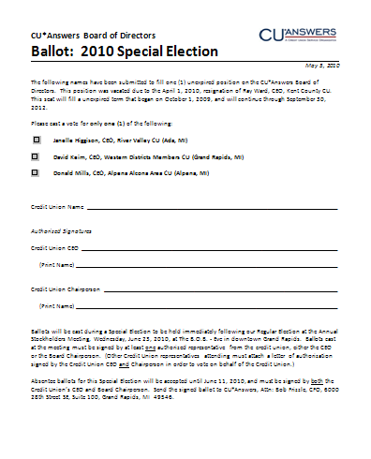
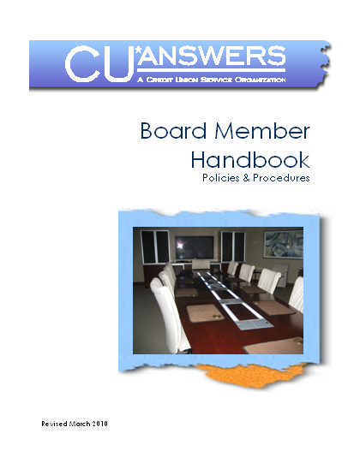
2010 Special Election
Let’s Hear from the Candidates
In alphabetical order...
Janelle Higgison, CEO
  River Valley CU (Ada, MI)
David Keim, CEO
  Western Districts Members CU
  (Grand Rapids, MI)
Donald Mills, CEO
  Alpena Alcona Area CU (Alpena, MI)
Special thanks to this year’s Board Member Handbook Committee for updating our election and appointment procedures

Slide 11
Tonight’s song and dance team will entertain you while we wait for the results...
The CFO Report
The CEO Report

Slide 12

A Look at The Numbers
CFO Report

Slide 13


This is the 2010 Annual Meeting, but...
Every year about this time, Randy sets the vision for next year (2011)
But remember that our annual Stockholder’s Meeting is about last year’s numbers (2009), and my comments tonight are about where I see us closing out the current year (2010)
It’s kind of a “who’s on first” scenario, and you have to pay attention

Slide 14
Inventorying our Assets
There are as many perspectives as there are observers...
The traditionalist perspective...
 | 2009 ($K) | 2008 ($K) | % Change
Cash | $ 5,204 | $ 3,739 | 39.2%
Accounts Receivable | 1,069 | 1,329 | -19.6%
Prepaid Expenses | 725 | 691 | 4.9%
Fixed Assets | 4,994 | 4,832 | 3.4%
Miscellaneous | 3,180 | 5,672 | -43.9%
 | $ 15,172 | $ 16,263 | -6.7%

Slide 15





Inventorying our Assets
There are as many perspectives as there are observers...
The cuasterisk network perspective...
2.1% ownership stake
48% ownership stake
50% ownership stake
7.7% ownership stake
50% ownership stake

Slide 16








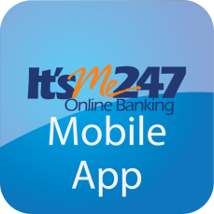

Inventorying our Assets
There are as many perspectives as there are observers...
The intellectual capital perspective...

Slide 17


Inventorying our Assets
There are as many perspectives as there are observers...
And let’s not forget the future value of contracts perspective
In the end, the most meaningful figures to your examiners and auditors continue to be purely financial
So let’s take a look at the big picture...

Slide 18
2009 Numbers Worth Celebrating
The big picture:
Detail | YE 2008 | YE 2009 | % Change
Total Assets | $16,262K | $15,172K* | -6.7%
Total Liabilities | $12,213K | $8,930K | -26.9%
Total Equity | $4,050K | $3,527K* | -12.9%
Retained Earnings | $4K | $716K | 17,800%
Book Value of Class A Stock ($ per share) | $183.03 | $217.69 | 18.9%
Book Value of Ownership | $36.606 | $43,537.85 | 18.9%
*Company redeemed Class B shares in 2009 for $1,194,264 (vs. $52,000 at time of purchase)

Slide 19
2009 Numbers Worth Celebrating
Year-end 2009 dividend payments:
Detail | YE 2008 | YE 2009 | % Change
Patronage Dividend ($) | $400,000 | $700,000 | 75.0%
Ownership Dividend Rate | 4.25% | 4.30% | 1.2%
Ownership Dividend ($) | $125,200 | $154,489 | 23.4%
Class B Payout Rate | 4.00% | n/a
Class B Payout Dividend ($) | $22,304 | n/a
Book Value of Class A Stock ($ per share) | $183.03 | $217.69 | 18.9%
Price to Purchase Ownership in CUSO in 2010 | $92,000 | $99,000 | 7.6%

Slide 20
2009 Return on Investment
2009 Gross Income Submitted by Owners to CU*Answers $ 11,345,813
(Excludes all vendor pass-throughs)
2009 Patronage Dividends Paid $ 700,000
2009 Class A Stock Dividends Paid 154,489 (4.30%)
2009 Class B Stock Dividends Paid 0 (retired in 2009)
2009 Interest Paid Credit Unions on Loans 543,371 (~8.00%)
Total Revenue Returned to Credit Unions $ 1,397,860
Return Per Total Dollars Received: $0.1232
$1,397,860 ÷ $11,345,813 (excludes vendor pass-throughs) = 12.32% return per CU*A $ received

Slide 21
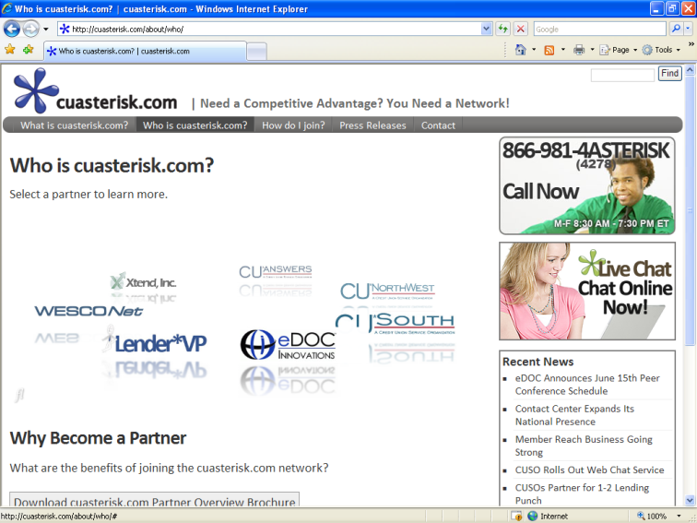
Thinking About 2010 Year-End
Network revenue numbers continue to impress
CU*Answers direct revenues continue to evolve with new processes, internal capabilities, and new offerings
  Projected for 2010: $30.944M
Just as important, CU*Answers’ influence through partnering with other CU*BASE networks and investing in new initiatives is starting to really add up
  Xtend projected for 2010: $1,167K
  eDOC projected for 2010: $3,552K
  CU*NW projected for 2010: $1,862K
  CU*S projected for 2010: $300K
  Processing Alliance proj. for 2010: $505K
  Grand total: $39 million
Keeping track of all of our network
partners, products, and services is a real challenge
Visit www.cuasterisk.com for a running total

Slide 22
Net Income & Patronage Dividends
What do shareholders get, and what are we putting away for our future?
$1.833M
$800K
*
*
*Before Consolidation

Slide 23
Projecting Shareholder Value
Depending on when you bought in, your perspective is different
Ownership price 1991: $59.31, 2000: $176, 2005: $460, 2009: $460 , 2010: $495
*
*
*Restated 9/30/08

Slide 24
Members Served
The Point of All of Our Efforts...
What some might consider to be Randy’s “sales jargon” is truly the driving force behind our financial model – we are built to facilitate credit union success

Slide 25
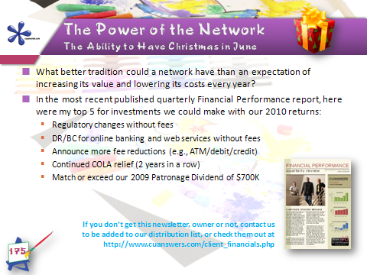
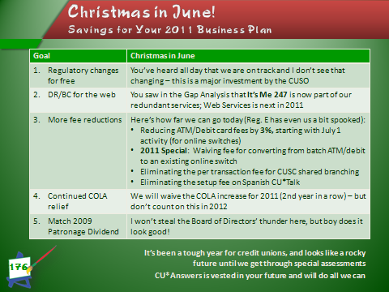
The CFO’s Perspective...
It’s a point of pride that our cooperative thinks about all network participants, not just shareholder return
But it’s also a great driver for growth when you drive more margin in the day-to-day for an entire network

Slide 26
When Is “Let Them Eat Cake” a Positive...?
CEO Report

Slide 27
...when a CEO knows to keep the comments short and get everybody to the party!
I have been humbled many times by all of the wonderful things accomplished by so many people involved in this network
Earlier today, we showed the “We Get It” model to the Leadership Conference audience – did you catch these numbers?
1 EMPLOYEE WORKING WITH 150 CU*ANSWERS EMPLOYEES SUPPORTING THEIR 390 FAMILY MEMBERS SERVING 216 CREDIT UNIONS WITH 3379 EMPLOYEES AND THEIR 8785 FAMILY MEMBERS IN 138 COMMUNITIES IN 22 STATES SERVING 1,000,000 MEMBERS 1 EMPLOYEE WORKING WITH 150 CU*ANSWERS EMPLOYEES SUPPORTING THEIR 390 FAMILY MEMBERS SERVING 216 CREDIT UNIONS WITH 3379 EMPLOYEES AND THEIR 8785 FAMILY MEMBERS IN 138 COMMUNITIES IN 22 STATES SERVING 1,000,000 MEMBERS 1 EMPLOYEE WORKING WITH 150 CU*ANSWERS EMPLOYEES SUPPORTING THEIR 390 FAMILY MEMBERS SERVING 216 CREDIT UNIONS WITH 3379 EMPLOYEES AND THEIR 8785 FAMILY MEMBERS
We could have continued with what a million citizens touched by CU*Answers means to the U.S.

Slide 28
Almost to the party...
When an anniversary like this comes around, I am
humbled by the fact that generations before me had the vision to get the whole thing started, that year after year they laid the foundation to bring us where we are today
Earlier tonight the Chairman challenged us to remember our responsibility to the people who worked together, giving us this opportunity to be in the right place at the right time
Our industry is being challenged like never before, and many think that we are precariously close to the end of what our industry has meant to so many...I do not agree
In the power of collaboration and the models presented in the networked world, I see all the inspiration I need to believe that our 80th anniversary is a solid bet
A legacy is not defined by what you did in your life, but by what you gave to the future...an opportunity

Slide 29
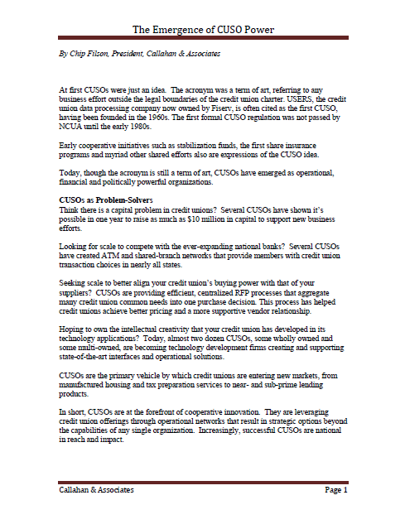
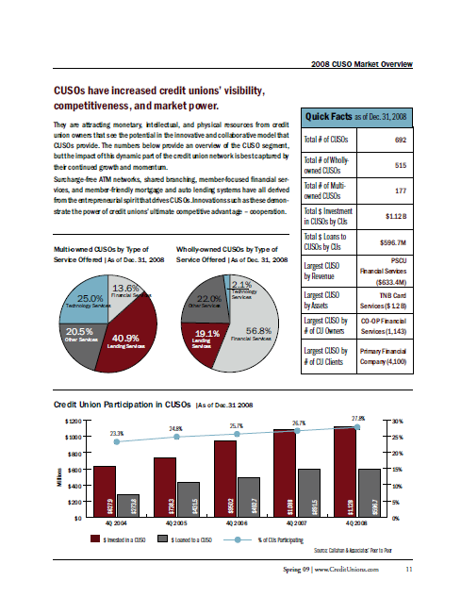
You’re at the door, get your drink order ready...
Your personal situation, or your credit union’s status, might have you doubting the potential of where we are today
You are challenged by your concern that the models we used in the past don’t seem to be what we can count on for the future...and you’re right
That reality is exactly why CU*Answers is in the right place at the right time
We need a new solution, we need a new model...and we are a new model
Consider Chip Filson’s article, “The Emergence of CUSO Power,” marry that to the power of the network, and you will conclude that there is an opportunity to be the new model for the future

Slide 30
Please join me upstairs for my last speaking assignment of the night...a toast to all of you!

