Slide 1

Understanding Your CU*Answers Invoice and Maximizing Your Return
Correlating CU*Answers Pricing and Monthly Invoices With The Way Your Credit Union Earns
Live Interactive Session: Tuesday, July 28, 2009
Web Conference Summary: Tuesday, August 4, 2009
Notes:
Putting your best foot forward (with auditors)

Slide 2
Introduction
As we interact today, we all have several hats to wear:
  As credit union buyers of CUSO services, you’re here to make sure you understand “the deal” and how that deal is evolving (due diligence)
  As credit union operators, you’re here to help us better match our services with your business plans and future directions (focus group)
  As CUSO stakeholders, you’re here to make sure that the CUSO is putting its best foot forward in designing products and services that are priced properly for credit union operations (due diligence)
  As CUSO stakeholders, you’re here working by proxy for all of the interested parties who are vested in the success of our network and the credit union industry (focus group)

Slide 3
How the CU*Answers Accounting Team Works for You
We’re more than just the people who send you your bill...

Slide 4
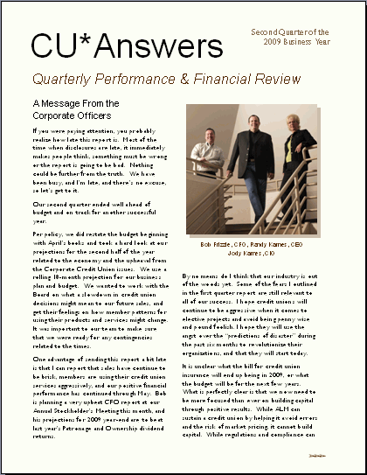
The CU*Answers Accounting Team
An Untapped Resource for Your Credit Union?
Every department at CU*Answers is a client service department...
Sometimes clients overlook how the CUSO’s accounting team can add to a credit union’s success
More than bookkeeping, the accounting team is a valuable resource for how to make a buck on some big investments

Slide 5







Of course we do send a lot of bills...
Average more than 670 invoices per month
Average more than 111 invoices per month
No recurring invoice responsibility
Average more than 70 invoices per month
Average more than 223 invoices per month

Slide 6
Invoice Activity: CU*Answers
Types of Invoices We Produce
Monthly Online Processing Invoices
Monthly Statement Processing Invoices
Monthly Self Processing Invoices
Monthly WESCONet Invoices
  Equipment
  Maintenance
  Web Hosting
Monthly Miscellaneous Invoices

Slide 7
Invoice Activity: CU*Answers
Interesting Statistics
  In May, we issued 412 total invoices for CU*Answers
In May, the total invoices exceeded $2,470,000
We currently maintain 1,887 inventory items on our accounting system
  All departments are responsible for billing to some extent

Slide 8
Invoice Activity: CU*Answers
How It’s Done
Great Plains Dynamics is the core accounting platform
  We use the iSeries to compile a great deal of information
  We then integrate the data from the iSeries into Great Plains
  Manual input for external (non-automated) items
Billing draft file is prepared and read by 2 staff members for validation and checks for accuracy
  Management review of billing file
  Invoices are prepared and a random 10 are pulled for further verification
Invoices are delivered to clients via email
Notes:
Coded line items aren’t very descriptive and it’s difficult to get the right answer about what they all mean – would be nice to set up a further description/help to explain what all of the line items mean
Also want a report to verify all of those item counts
CU*A does provide help with reconciling for new CUs back to their contract
We do publish the pricing guide which explains the concepts
Need a new website to translate all of the billing codes and also work on reports to verify all of the individual line items
Make sure it includes specific calculation routines as much as possible (i.e., run a Query of file xxx on date xxx with this criteria, etc…)
LGLACT for the end of the month – remember that we pull out members with written off loans
Doesn’t matter to us whether they are below par or not
Asked group to send us the codes that are most confusing and need to be documented
Remember that the reports on the system are designed to look at members in a different way depending on different perspectives – they won’t correlate and they aren’t supposed to and they never will
We think more about how we can align our bill with your profitability, but there are many different ways to look at members

Slide 9
Delivering Invoices via Email
What’s We’ve Done So Far
Implemented for the following companies
  CU*Answers - all
  Xtend - most
  eDOC - many
  CU Student Choice - all
Each client can have up to 5 email accounts on file
IMPORTANT REMINDERS:
  Please let us know about any changes to these email addresses!
  Remember that this list is separate from the list used for broadcast emails (from dmoore@cuanswers.com)

Slide 10
Delivering Invoices via Email
Important Reminders
We will call all clients when an email is returned as “Undeliverable” in an attempt to get a new valid address
The email invoices are a slightly different format and presentation from the printed versions
  We can re-email or reprint them for the next 7 years
Questions? Need a copy of an old invoice?
Contact Carlynn DeKraker (ext. 172 or email to cdekracker@cuanswers.com or) for help with research or if you need any old invoices recreated!

Slide 11
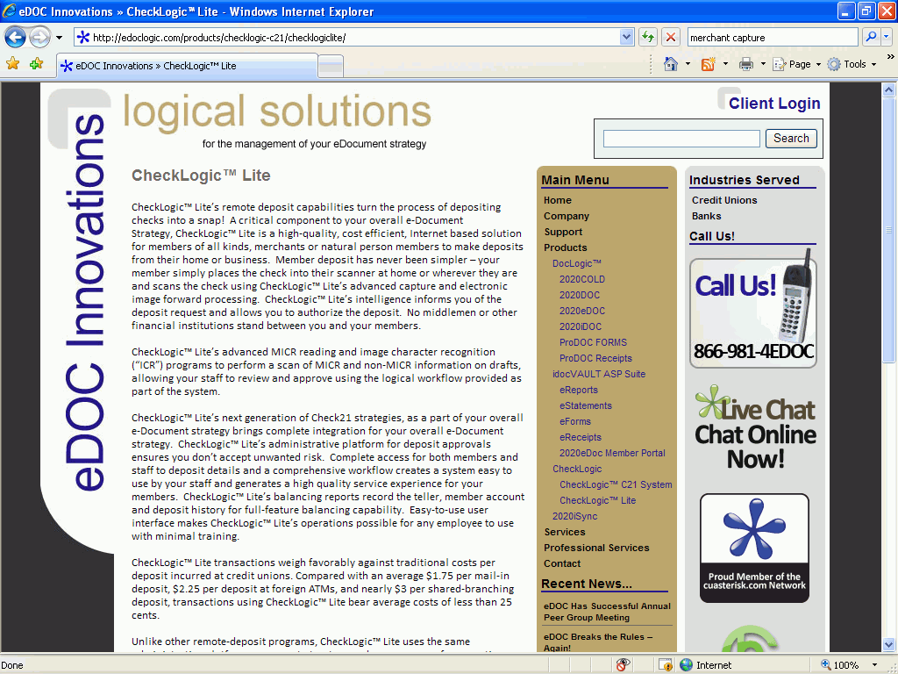
Implementation of CU Check 21 for Merchant Capture
What is it?
  Electronic deposit of our business checks
  eDOC Merchant capture technology to be used (Check Logic Lite)
All CU*Answers deposits (Xtend and eDOC also) will be scanned and deposited remotely to our accounts at Corporate One FCU
  We expect a late summer
  implementation

Slide 12
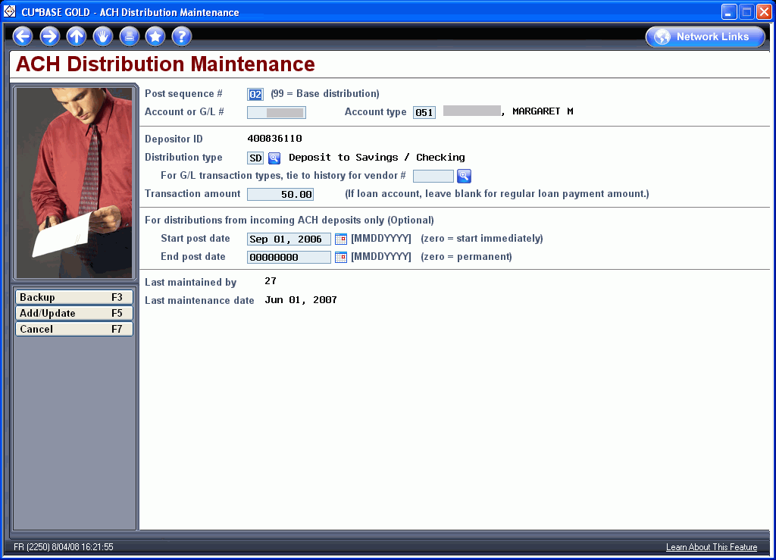
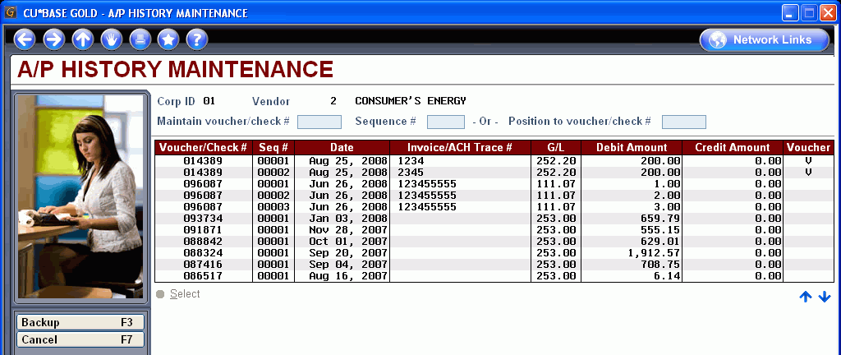
Paying Invoices via ACH
What We’ve Done So Far
Last summer (release 8.1) we added a feature to CU*BASE Accounts Payable that links incoming ACH debits to A/P Vendor history
  Like bill pay for
  credit unions!
Setting up an ACH distribution record
A/P vendor payment history

Slide 13
Paying Invoices via ACH
What We’ve Done So Far
Benefits
  No postage or paper expenses
  No chance of lost or stolen checks
  Creates a record in the A/P vendor file
How it works
  We will continue to email the invoice to you on or about the 12th of the month
  We will process an ACH Debit against the account you designate later in the month

Slide 14
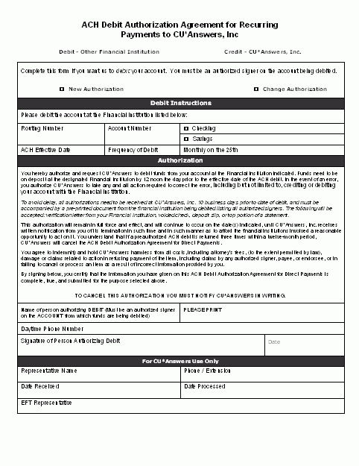
Pay Your Invoice via ACH
We tested this process with a client in July and all went well
All early movers will be implemented on 8/10/09
Sign up form available on our web site
Form available online at:
http://www.cuanswers.com/lc2k9/index.php

Slide 15
Reading That Monthly Invoice
Our Invoices and Your Chart of Accounts
Matching Invoices to Revenue

Slide 16
Our Invoices & Your Chart of Accounts
Why does it matter?
Every month your accounting team creates a history of your operational decisions, strategies, tactics, and outcomes
  This becomes part of your corporate record, and ultimately your 5300 profile for third parties
Ratios are important...but there sometimes end up as simply the result of day-to-day clerical tasks, rather than a well-thought-out, best-foot-forward plan
CU*Answers is trying to automate billing processes so that credit unions can streamline their tactics for reporting expenses and, ultimately, their operational success
  Improper recording could be detrimental to CU in the examination process
  Improper recording could be detrimental to our network’s reputation

Slide 17
Our Invoices & Your Chart of Accounts
Why does it matter?
More importantly, how do you match key expenses with tactics for earning on your investment?
  Isolate expense areas to get a picture of the potential need to focus strategies for payback
    If you don’t know bill pay costs you $12K a month, then how can you prioritize the need to get a positive return ($12K+)?
  In all the noise of running a credit union, it’s easy just to lump it all together and cover it as part of general accounting overhead
    CU*Answers has dozens of specific tactics for earning: automated service income programs, relationship fees, rate discounts, etc.
    These often go unused because there is no priority to match expenses to potential earning opportunities
Have you ever thought things were getting more expensive in general, only to find out that CU*Answers prices have declined or there was a new feature that could turn an expense into a net gain?

Slide 18
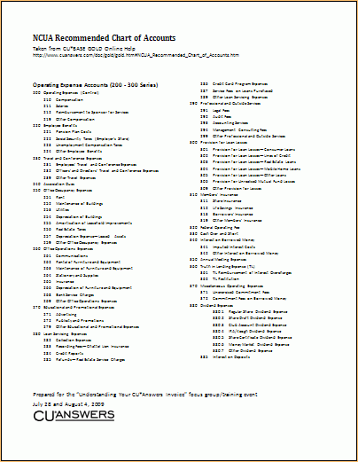
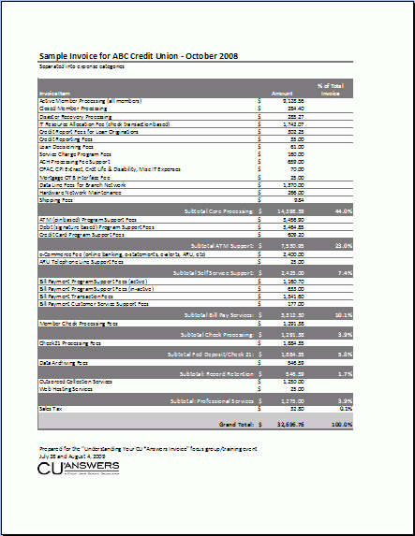
Our Invoices & Your Chart of Accounts
Why does it matter?
Notes:
(I did not understand all of the categories Bob mentioned when going through the sample, but I assume he can remember what he said and say it again)
Need to make sure to use this sample, not the one Becky handed out (hers still has the discount amount for Affinity)

Slide 19
Our Invoices & Your Chart of Accounts
What could we do differently tomorrow?
As we automate this function, how can we standardize invoices around the way credit unions see their expenses and their offsetting income opportunities?
Let’s get organized...
  Any ideas on how we might sort the invoice items?
  What categories of expenses should we highlight?
  What G/L summary or other suggestions could we give on the invoice?
  Should we have a consolidated invoice? More, separate invoices?
  Should we package more pricing instead of the a la carte breakdown?
Evolution will require input from you
Notes:
Need a better way to explain how to identify the WESCO Net items on the full CU*Answers bill (apparently there is a “W” but if you don’t happen to know that secret code, it would be confusing)

Slide 20
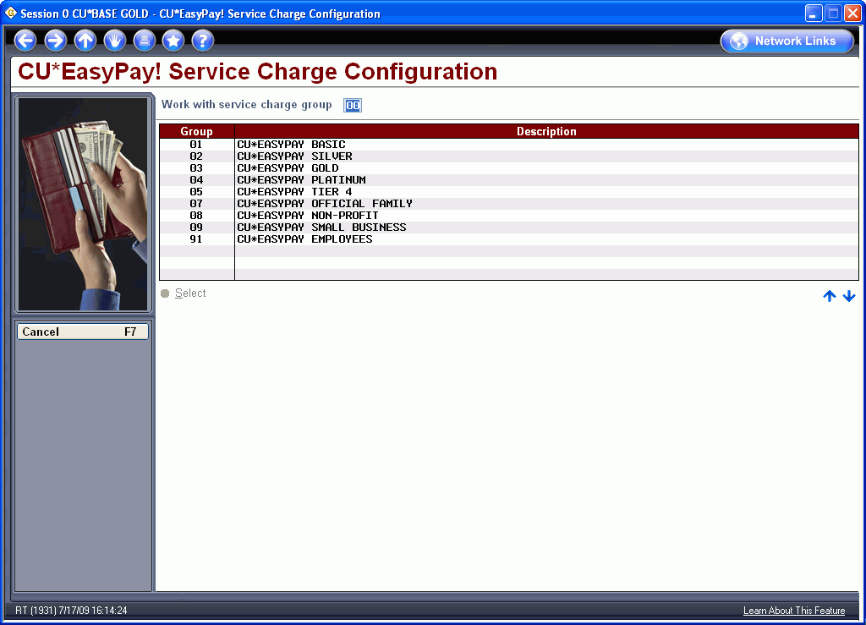
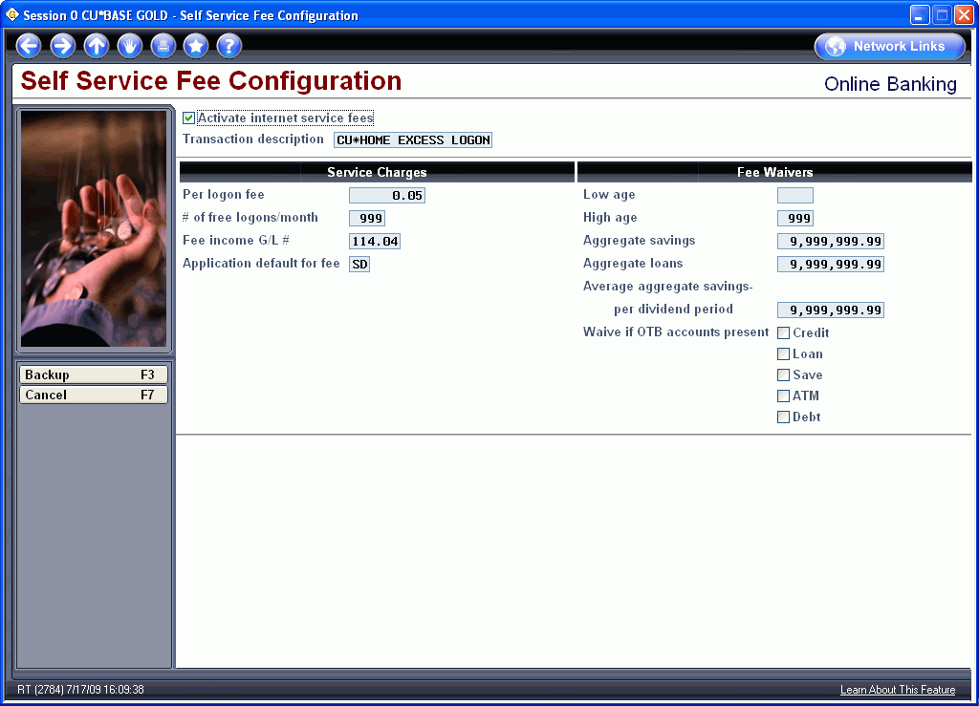
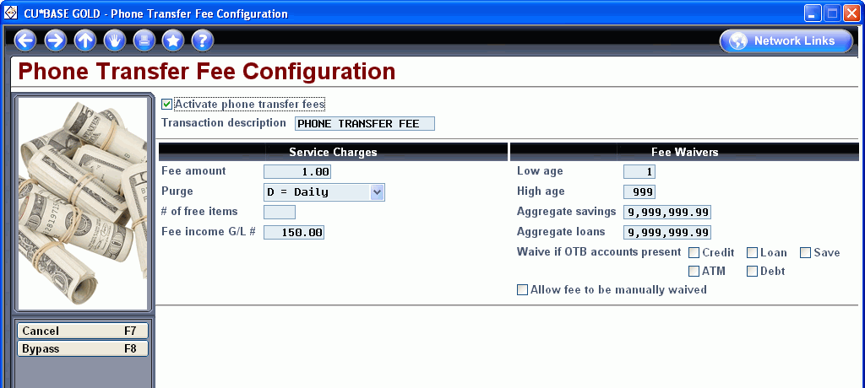
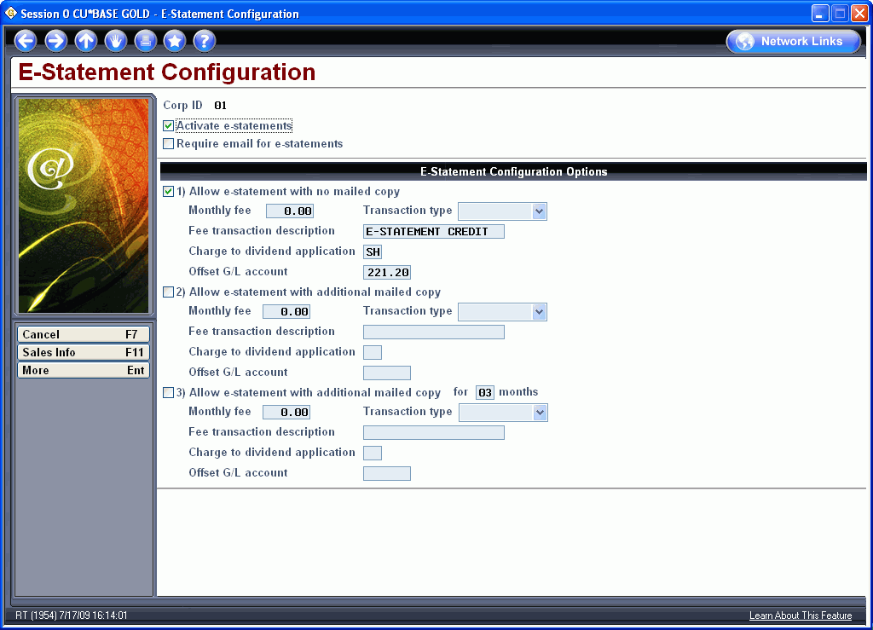
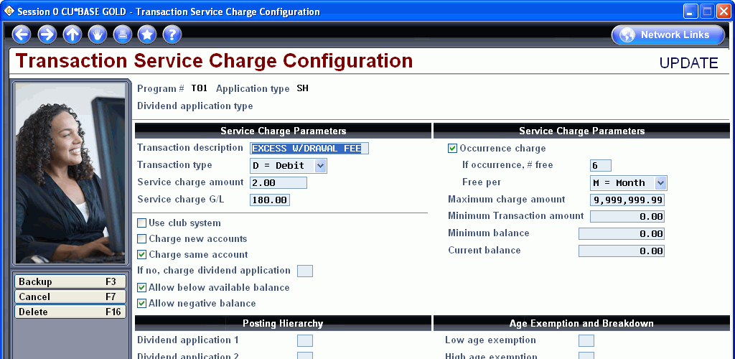
Matching Invoices to Revenue
Thinking About Your 2010 Business Plan
When your Board asks, “How are we going to get our money back?” and you can’t say, “Through member retention,” what are your favorite tactics for automating return on technical investments?
Notes:
Side-by-side comparison of expense to revenue options
This is my expense | Here are all of the ways I can get that $ back
General overhead on a mbr | Minimum relationship fees (Min Bal Svc Chrg*)
Selected service overhead | ???
(understand your package price, and understand the a la carte boundaries)
Market Incentive costs | ???
(what are you giving away for marketing reasons?)
*Configure a minimum balance service charge that takes into account all of the relationships the member has with you (i.e., aggregate balance waivers)

Slide 21
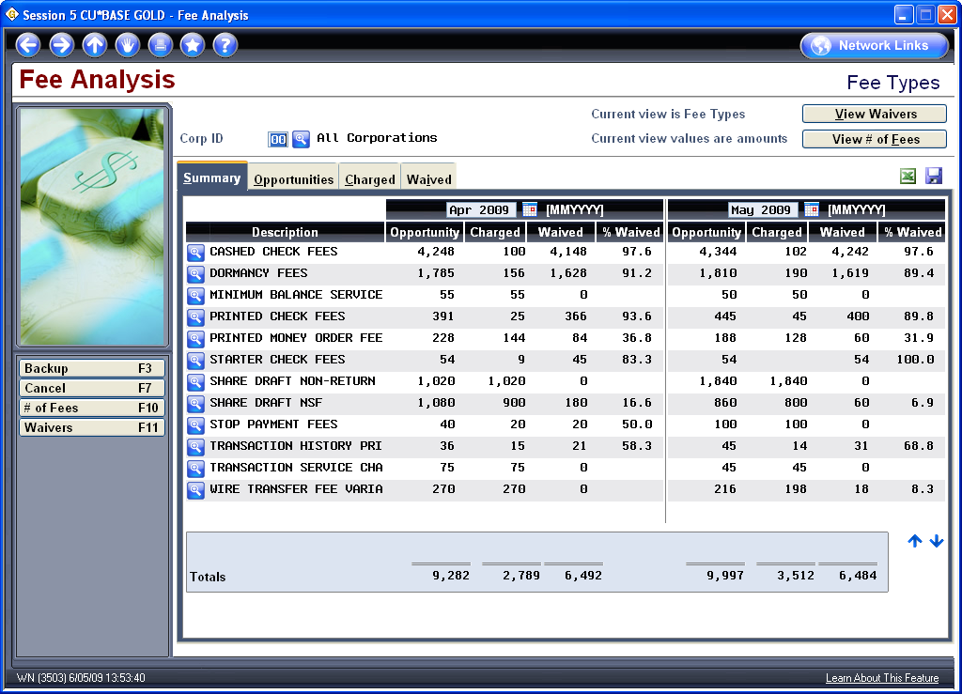
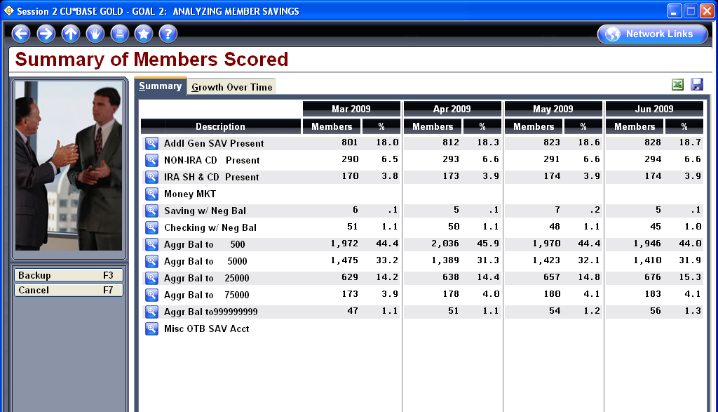
Matching Invoices to Revenue
Thinking About Your 2010 Business Plan
Fee waiver analysis
Can you write a tactic for earning on investment for every line in these dashboards?
Notes:
Should the fee analysis count even if the CU doesn’t configure the fee at all?
Verify if that is happening now or not – then make sure help is updated to explain that

Slide 22
Matching Invoices to Revenue
Thinking About Your 2010 Business Plan
Your mission, should you choose to accept it, is to send Randy a line item by line item expense-to-revenue tactic for your CU*Answers invoice.
Randy will highlight a report on this project at the 2009 CEO Strategies event.
Fee waiver analysis
Can you write a tactic for earning on investment for every line in these dashboards?
Notes:
Capital building/restoration
ALM doesn’t make money, but Pricing does
Contract marketing – If you do this, I’ll pay you
The best thing about my invoice is that CU*Answers has a strategy to get me a direct return on every expense on this invoice

Slide 23
Thinking About Pricing
What does history tell us? Can we continue the trends? What might be changing? Are we transparent enough? Do we stand out from the crowd?

Slide 24
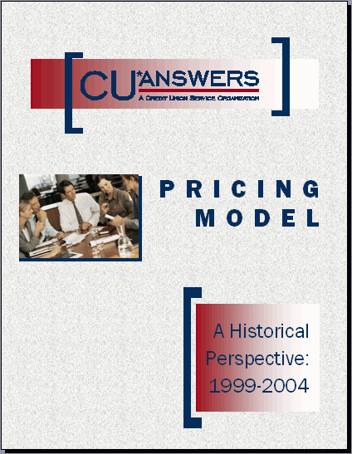
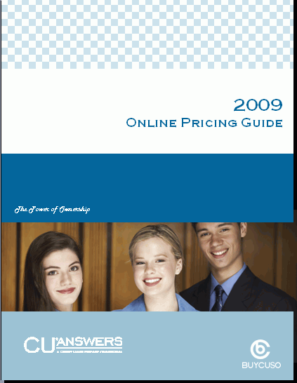

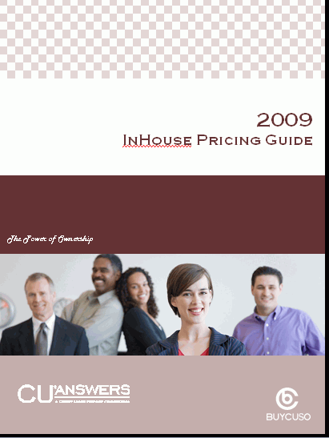
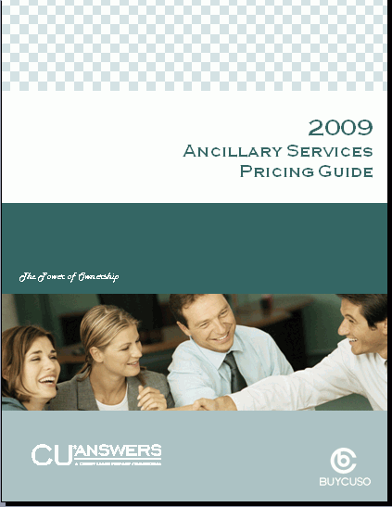
Communicating the Evolution of Our Pricing Model
A CUSO Directive
Working to earn your constant respect for our efforts, and making sure you understand “the deal”

Slide 25
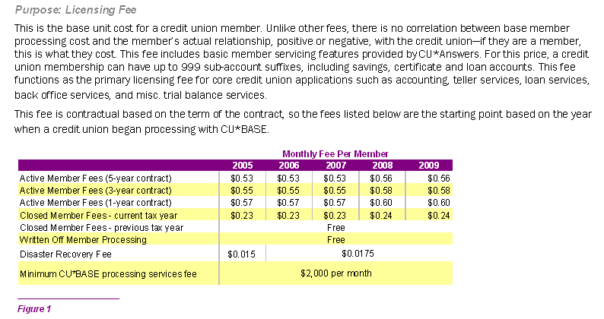
Base Member Processing
Selling to New Clients
Comparing your current deal to the off-the-rack rates of today
Notes:
D1 on your contract
Fees shown in the pricing guide/analysis – this shows the fees for “startups” (I don’t know what you meant by this)
A member that opens in January and closes a week later, you still pay $0.23 for the rest of the year (remember we have to create tax forms at the end of the year; we keep the data so you can look it up; blocked membership database, etc.)
We subtract your written-off members from the active member counts (if you have released the member from debt, then we call that “charge off” not written off, and the balance on a released member is $0 and is a closed account) but if you write-off a loan (doubtful loans) but are still trying to collect on the loan, then we remove those members from your active member count for billing
THIS IS NOT ACTUALLY VERY CLEAR FROM THIS CHART – IT SORT OF IMPLIES THAT THE PROCESSING (WHATEVER THAT IS) IS FREE, BUT IT DOESN’T REALLY STATE THAT THESE MEMBERS ARE SUBTRACTED FROM THE ACTIVE COUNTS
DR pricing is going up in 2010 (new Muskegon data center, redundancy for It’s Me 247, etc.)

Slide 26
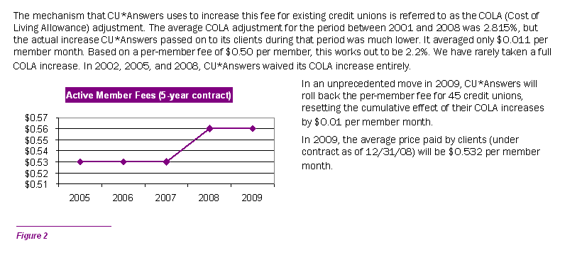

Base Member Processing
Understanding the Potential for Change During a Contract Term
Understanding the potential increases over the life of a contract...although contracts are often a worse-case scenario
Notes:
If you started with CU*Answers in 2003, based on your contract you should know how much you would be paying in 5 years based on COLA
But when we waive COLA fees, you still need to remember your original contract projections
We give you the deal every year; we don’t wait to the end of the contract and then see what kind of negotiator you are
COLA is ONLY on the base member fee
(COLA is why you don’t get release fees, for example)

Slide 27
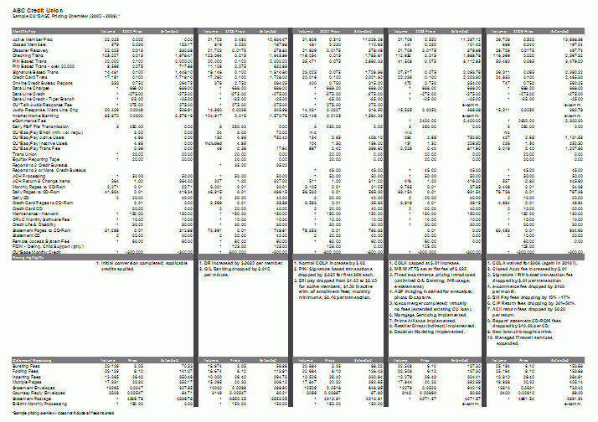
Base Member Processing
Understanding the Value You Receive Over a Contract Term
How do you get down to the nitty gritty in understanding the difference between a growing invoice and the price for services?
Do you understand the CU*Answers contract renewal philosophy?
Notes:
Contract philosophy
We could run things like the Fiservs of the world – let you go up and up and then plan to cut you a deal at contract renewal, or we can give you a deal every year, year after a year
Will automatically send this 3-6 months prior to contract renewal

Slide 28
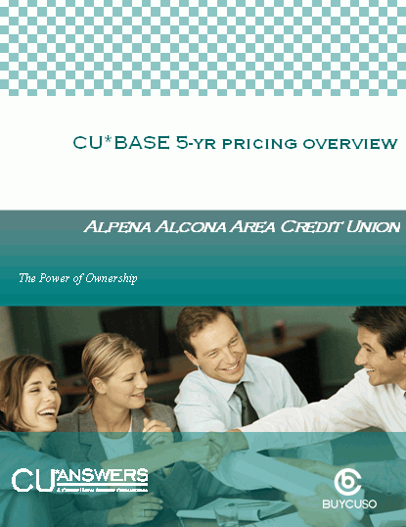
Base Member Processing
Understanding the Value You Receive Over a Contract Term
New Offering:
We’ll complete this 5-year analysis for your credit union at any point during your contract, for just $250
Contact Scott Page

Slide 29
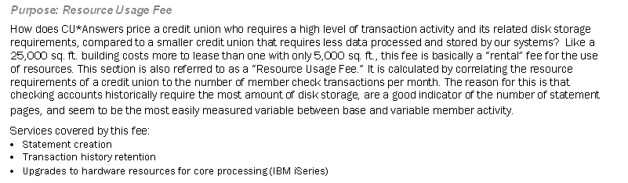
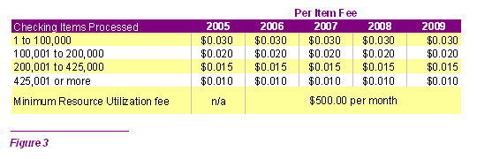
Platform Technology Updates/
Disk Retention/Statements
Let’s talk about where this is going
Notes:
Covering statement creation, hardware upgrades, disk space, etc.
What causes investments in hardware, etc.? In the old days, the best indicator was checking accounts/transactions. The more checks clear a member’s account each month, the higher these costs
But checks cleared is going way down; some months this fee doesn’t even cover our statement costs anymore
We do see a change coming in the tactic for this fee in 2010/2011 (maybe debit cards?) – but the big variable is statement costs (paper, processing, etc.) – maybe change from this to something more closely related to statements
(Talked about statement insert hold fees and how the ramifications of holding statements for inserts are costly, even more now with the Credit CARD Act requirements)

Slide 30
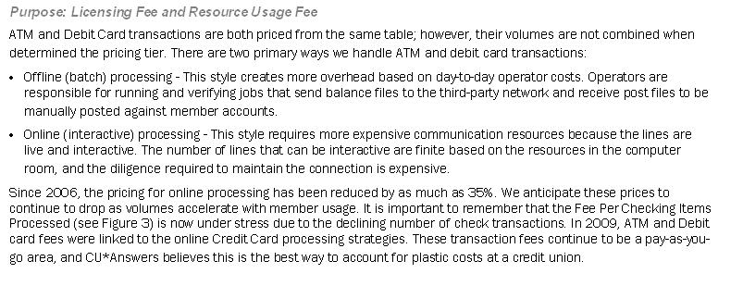
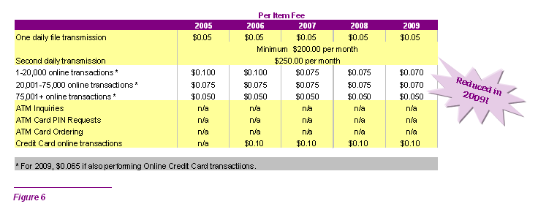
A New Era for EFT Services at CU*Answers
ATM and Debit Card Transactions
Notes:
New department
Down 30%-35% since 2005
Starting to put more emphasis on helping CUs understand what they get from their EFT vendors
Talked about the new standard ATM/Debit platform being rolled out for all CUs in 2009/2010
History of denial reasons from the switch, right in CU*BASE
Asking all accounting departments to send us their cost accounting studies on ATM/debit cards – at what level of activity do you make money? We would love to say CU*Answers only makes money on these transactions if the credit union makes money – but how can we know that? We would give incentives if we can figure out how
Rebate programs for debit cards? You can do rebates on transactions by amount if you want?
Bob had some idea he was excited about – something about tiered fees so you would charge for small transactions but only if they didn’t keep a balance or something??? Didn’t catch this
ODP on for approvals and posting, or just on the posting side – pros and cons
If you don’t included it in approvals, make sure you educate members that they need to do the transfer ahead of time so the transaction is authorized
Do an analysis of cost recovery on your plastics
We’d love for these fees to go down, but we have to keep on eye on statement pricing too
How do we tell members how much money we’ve saved them? Also on credit cards? New ideas for e-messages??

Slide 31
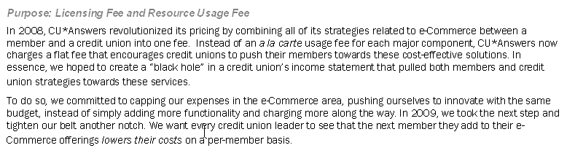
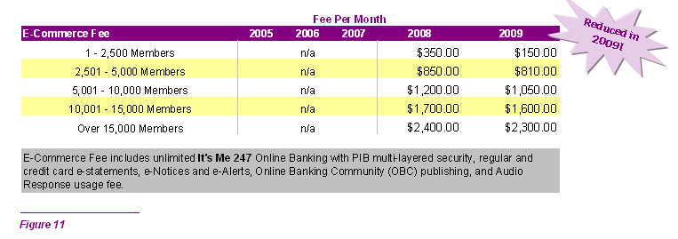
The e-Commerce Fee
Affording Tomorrow, Today
Notes:
(We will get closer to eliminating this fee for small credit unions)
We believe e-commerce concepts are ways to make smaller CUs more cost-effective

Slide 32
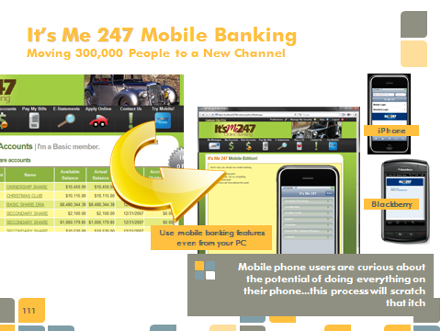
The e-Commerce Fee
Affording Tomorrow, Today
Notes:
Prices did go down even more in 2010: we didn’t announce a price decrease, but instead announced mobile phone banking at no cost to CUs
Both the simulator for the PC as well as the real thing for iPhone, Blackberry, etc.
This gives us a bridge marketing approach so evefry time a user comes to onoline banking
By June next year we will announce WAP-based marketing (wireless marketing built specially for certain types of phones) – will likely have an a la carte price because it is thru a third party (but you’ll also have the ability to sell it) – this is for members who don’t have a browser-capable phone like iPhone or Blackberry, but the member would need to pay for it
YOU NEED TO START WITH EXPLAINING MOBILE BANKING FOR THE IPHONE AND BLACKBERRY FIRST, THEN EXPLAIN THE BRIDGE MARKETING (FREE MARKETING TO YOUR ONLINE BANKING USERS)
All of the mobile bankers and EFT people are working on making the phone a payment device, and therefore getting debit/credit card interchange income via mobile phone usage (tap your phone on a device and it pays the merchant ?!)

Slide 33
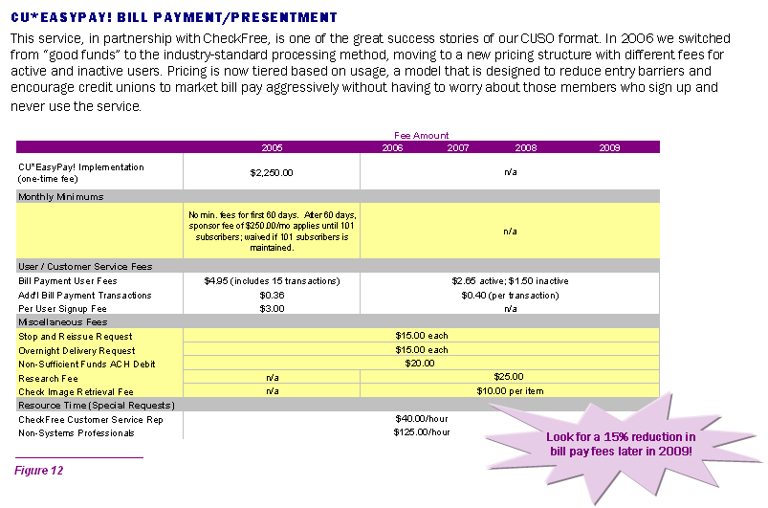
Evolving Concepts
Bill Pay
Notes:
Bill pay fees went down with last month’s invoice (June, sent in July??)
CU*Answers will be offering alternative bill pay partners, basic interfaces (not as tight as CU*EasyPay!)
So CUs coming in who already have a bill pay relationship don’t have to move their members to CheckFree
The more vendors we have, the less aggregate buying power we have, but it probably won’t be a big impact for a while

Slide 34
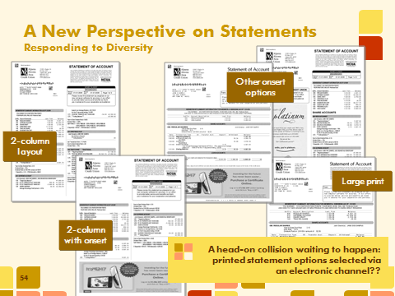
Evolving Concepts
Statements
Notes:
Tell the Board, “By 2012 we will be charging for printed statements.” – put a stake in the ground
In online banking, the member would be able to go into online banking, they could choose a paper statement and agree to a fee online
why not let the member decide what they want as long as they are willing to pay for it?
“We are planning to eliminate first class postage by 2012”

Slide 35
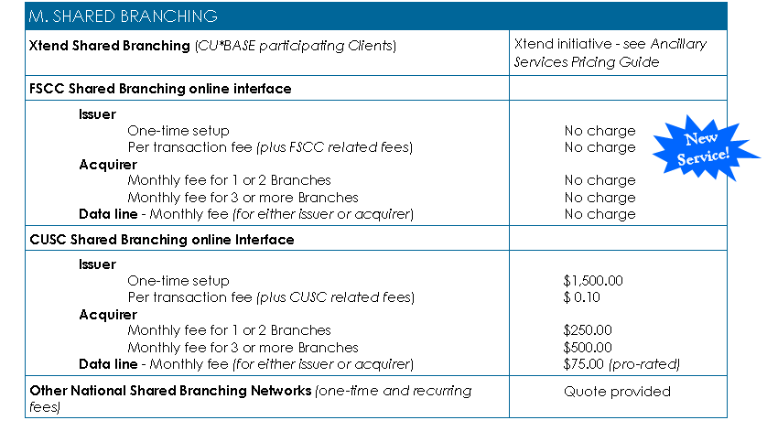
Evolving Concepts
Shared Branching
Notes:
The big evolution was adding FSCC at no charge
CUSC – we charge that because CUSC will not allow Xtend CUs and CUSC credit unions to live together – if they change their political position, we’ll waive these fees!
Also added BSA monitoring for shared branch activity
You pay for shared branching for 3 reasons: your branching strategy (we need a branch in this area); because you can (if you have a budget for charitable donations to CUs; where tactical reasons don’t exist); take one for the gipper (??)
Demographic software that gives the CU better analysis of members within a 5-mile radius of a particular potential shared branch location

Slide 36
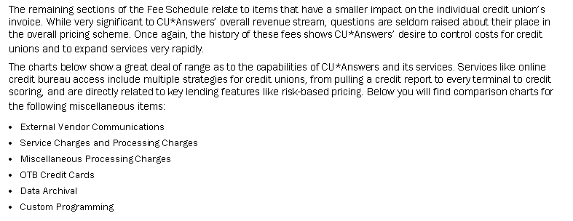
Other Miscellaneous Fees

Slide 37

Best Guesstimates for the Future
Notes:
Don’t see major changes in 2010; major changes in 2011 are less than 50% chance
Soft conversion year for 2010 compared to recent years, but still strong compared to several years ago

Slide 38
Thanks for the day!

