Slide 1
2010 CEO Roundtable
November 10, 2010
at the Frederik Meijer Gardens & Sculpture Park
Welcome!

Slide 2
Today’s Agenda
Morning (10:00-12:30)
Afternoon (1:15-3:45)
10:00 Introduction
Architects of Crowds (Randy Karnes)
A Message from the Chairman (Chris Butler)
Report to Owners Video
11:00 Topic 1 Group Interaction
15 minutes “meet the group” and assign a presenter
30 minutes group discussion
5 minutes for each group to report to the entire room
1:15 Topic 2 Group Interaction
30 minutes group discussion
5 minutes for each group to report to the entire room
2:35 Break
2:45 Wrap-Up

Slide 3
Architects of Crowds
When thinking about what it means to lead and build a company, an exercise I have personally found helpful, and healthy for CEOs in general, has been to try to see my role from different perspectives, to assume other personas
It’s easy to see yourself through your job description and your industry’s terminology, in a limiting way
But try thinking of yourself as a general running the army...
or a politician getting reelected...
or an evangelist fostering a belief system
Translate their vocabulary and tactics into your role as a CEO, and see a different twist on your problems

Slide 4
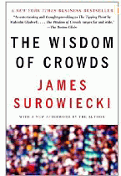
Architects of Crowds
Our 2011 Business Plan has the theme of “Still The Place To Be”
In choosing that theme last year I thought about what it means to craft an environment as the place to be
What is a place to be if it’s not enjoyed by a crowd? Respected by the crowd, and valued by the crowd for what they plan to harvest from their participation
That got me thinking about architecting a place to be, and what kind of crowd we would want to show up
That led me to some interesting ideas about networks, the Internet, today’s plugged-in consumer, and a whole lot of other CEOs (you) trying to build their own crowds and places to be

Slide 5
Architects of Crowds Accepting the Mantle of Leadership
ar·chi·tect [ahr-ki-tekt] noun
The deviser, maker, or creator of anything: the architects of the Constitution of the United States.
How differently you see your role when you move from managing the existing creation of past leaders, to one where you know you have to create it
We have to build businesses, not just run them
Have we just accepted the crowd we inherited?
Or are we totally engaged in redesigning that crowd with a vision of sustainability and moving our capabilities to the future?
Think about this room: are we the crowd we hope to be? Do you find yourself in crowds that you are proud of and confident about their future successes?

Slide 6
Architect of Crowds The Foundation for Bigger Things
crowd [kroud] noun
any group or set of persons with something in common: The restaurant attracts a theater crowd.
audience; attendance: Opening night drew a good crowd.
the common people; the masses
Sociology . a gathering of people responding to common stimuli and engaged in any of various forms of collective behavior.
As an architect of a crowd, what kind of crowd are you trying to build?
Whether a set of peers, an employee team, a Board of Directors, or even your membership, have you identified the qualities the crowd will need to create a fertile environment for success?
Is the crowd wise? Can you draw from the crowd the ideas, the hopes, and the collective vision for your own success?

Slide 7
Types of Crowd Wisdom Are there advantages in being able to watch the crowd?
Cognition
The crowd naturally knows the lay of the land and can make judgments faster and more reliably than a committee of experts
With Learn From A Peer product development, can we improve the speed at which we interpret the crowd here at CU*Answers?
Coordination
The crowd tends to follow the path of least resistance and their movements signal a natural path to follow
As we write more analysis software to watch your members move, does it make sense to watch all memberships within the network move?
Cooperation
People naturally form their own networks of trust without anyone directing them or enforcing their compliance
The value of CU*Answers: a network where individuals thrive
Cited from The Wisdom of Crowds by James Surowiecki as reported on Wikipedia

Slide 8
Are all crowds wise?
The architect hopes so, and shoots for that
According to Surowiecki, these key criteria separate wise crowds from irrational ones (like mobs or crazed investors in a housing bubble):
Criteria | Description
Diversity of opinion | Each person should have private information even if it’s just an eccentric interpretation of the known facts.
Independence | People’s opinions aren’t determined by the opinions of those around them.
Decentralization | People are able to specialize and draw on local knowledge.
Aggregation | Some mechanism exists for turning private judgments into a collective decision.
Here’s where the architect has to go against some natural urges in building a business: you have to trust and build these concepts into your crowd

Slide 9
The Place To Be
For the rest of the day, we are going to talk as architects who have accepted the responsibility of building an environment that can attract the right crowd for our success, collectively and independently
We’re going to think about the strategies and tactics that can emerge from the crowd in this room as signals for future directions
Are we a wise crowd?
Throughout the day I hope you will evaluate our crowd and think about ways to bring the wisdom forward for everyone
Guard the elements of a wise crowd: diversity of opinion, independence, decentralization, and aggregation
I hope we can build a place where respect for these elements is apparent to the next person who joins the group
When we reference this crowd and encourage others to join, they should trust we’re not asking for conformity – we want people who are different enough to add to the value

Slide 10
Rev Up the Crowd...
...and Create a Buzz

Slide 11
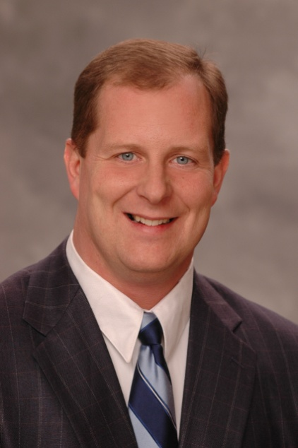
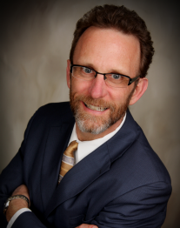
Speaking of a crowd, let’s hear from one of our key architects...
Our Board Chairman, Chris Butler
Scott McFarland
Chris Butler
Don Mills
Dean Wilson
Jeff Jorgensen
Vickie Schmitzer
Dave Wright

Slide 12
2010: A Milestone for This Crowd
Declared 2010 Patronage Dividends:
$ 700,000 Standard Patronage Dividend
$ 500,000 Bonus Patronage Dividend
$1,200,000
A Bonus Patronage Dividend is unprecedented here at CU*Answers, but warranted this year as all credit union industry participants need to dig deep and participate in our economic recovery (nice birthday present, huh?)
Projected Stock Dividend: 4.35%
Projected Increase in Stock Equity: 27%
Projected Stock Price: $125,000 per owner share
These are all projections and should be finalized by December based on our CPA’s work...then look for a check!

Slide 13
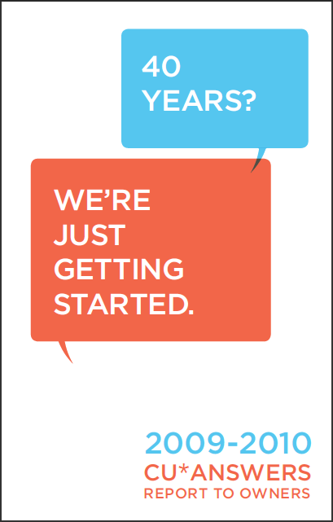
If the 2010 CEO Roundtable was a video shoot, what might you say about how we are all walking the talk together?
Let’s start with the Board of Directors...

Slide 14
But enough about the crowd that is CU*Answers...
For what we need to accomplish, it’s not enough to talk about our crowd in a way that pushes CU*Answers to the forefront
We need to talk about what this crowd is accomplishing for an industry, and how we benefit from being part of the crowd to succeed as individuals
It’s the same for our members: we hope they will reference our credit union; that they will see that when they come together, they do so to succeed for their own personal situation
We are a crowd where the individual’s hopes are never lost
We are The Place To Be: we are credit unions

Slide 15
Your Assignment, Mr. Phelps...
Topic 1 Theme (a.m.)
Leveraging This Crowd for Personal Advantage
Topic 2 Theme (p.m.)
Headaches & Aspirin
There is a freedom in being faceless in a crowd that is moving in the right direction
But for that momentum to continue you sometimes have the responsibility of being the individual with a plan
Are we confident in our direction and loaded with leaders to keep us on track?
The classic presentation needed to move venture capitalists from skeptics to supporters of a business idea is to convince them that you have the medicine for the crowd’s most common headache
Are we ready to invest in the ventures identified by this crowd?

Slide 16
Topic 1 Theme (a.m.) Leveraging This Crowd for Personal Advantage
Group | Topic
1 & 6 | Discuss how this crowd could design a system to communicate examination experiences. How could you better prepare and use crowd data at your next examination? (For example, a survey completed and shared with everyone in this room within 2 days of the exam.)
2 & 7 | List 7-10 answers you wish you could gather from this crowd for your next Board meeting, business plan, or staff pep rally. How could we turn crowd surveys into a business advantage?
3 & 8 | Contrast building a crowd with a CUSO at the center versus building a crowd with a credit union at the center. How could we translate each model for the benefit of CUSO CEOs and credit union CEOs?
4 & 9 | Think about the crowds that you coordinate in managing your credit union (volunteers, staff, members, customers, your community). List 1-2 things this CUSO could do to help with each crowd.
5 & 10 | For a few minutes, let’s break the 10th commandment and look around our crowd and covet the resources, the opportunities, the assets, the members, and the communities of those around us. List the top 3 things that you would recommend we aggregate and use as a crowd.

Slide 17
Lunch
Let’s eat!

Slide 18
Topic 2 Theme (p.m.) Headaches & Aspirin
Group | Topic
1 & 6 | Personnel: List 3-5 of your worst HR headaches. See if you can match one potential cure for each one.
2 & 7 | Volunteers: List 3-5 of your worst Board headaches. See if you can match one potential cure for each one.
3 & 8 | Regulators: List 3-5 of your worst Auditing and Compliance headaches. See if you can match one potential cure for each one.
4 & 9 | Operations: List 3-5 of your worst Operational headaches. See if you can match one potential cure for each one.
5 & 10 | Capital and Growth: List 3-5 of your worst capital and growth headaches. See if you can match one potential cure for each one.
If your presentations yield 25 ideas for all of us to consider as seeds for new businesses, our CUSO will have a very good year in 2011 and 2012

Slide 19
Wrapping Up the Day

Slide 20
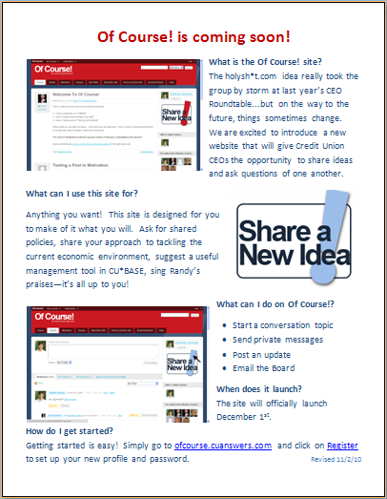
Of Course! There needs to be an automated voice for our crowd
Launching officially on December 1
Requires registration to get your user ID and password (see the flyer)
This new site certainly allows you to read and be faceless and enjoy the freedom of a group going in the right direction...
...but without participating leaders, that direction will not be positive for very long
Coming December 1, 2010: www.ofcourse.cuanswers.com

Slide 21
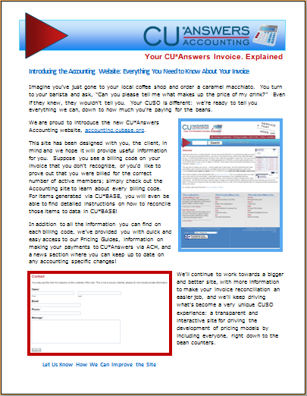
Participation Changes Everything Watching the Crowd Respond to Pricing
Introducing the Accounting Website: accounting.cubase.org
One of the most unique experiences I believe available to any crowd of CUSO participants: a transparent and interactive site for driving the development of pricing models by including everyone, right down to the bean counters

Slide 22
Thanks for the week!
We started our 2012 planning with our August Board Planning Session
This week is the first event in that planning cycle: one of my favorite weeks of the year
Thanks for participating!

