Slide 1
The Next Face of the CU*BASE “View of the Member”
A sneak preview of ideas we are working on to prepare the CU*BASE Phone Op, Inquiry, Teller, & Transfer (PITT) screens for the future
Prepared November 3, 2009
For the 2009 CEO Strategies Event

Slide 2
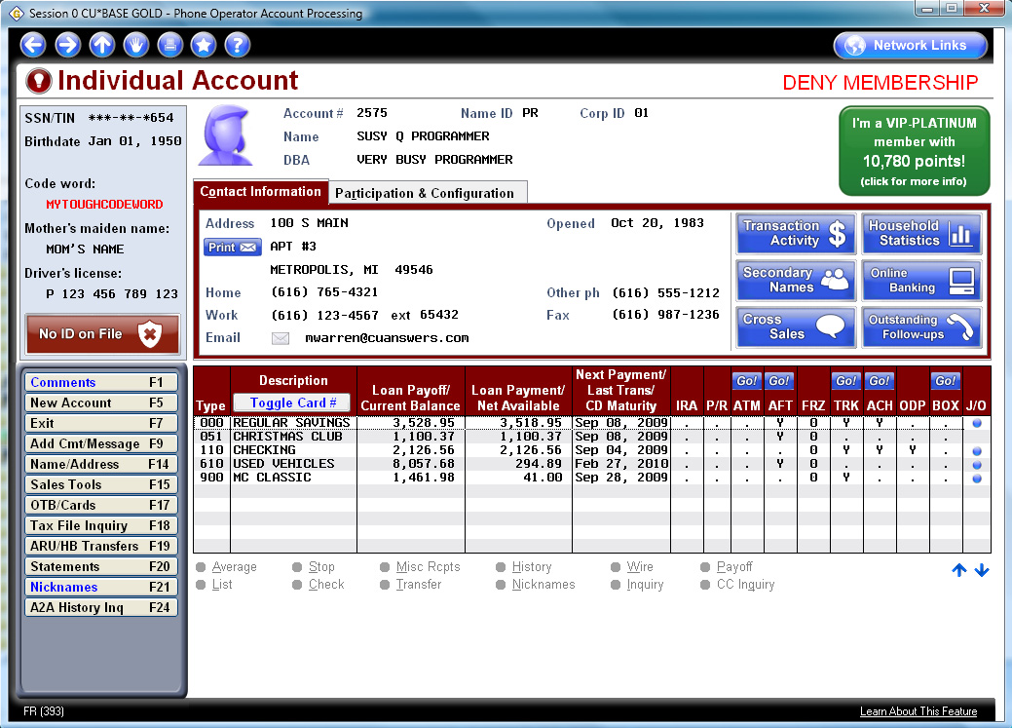
Graphics indicate male or female (or “unknown” or organization)
New emphasis on Tiered Service points and rewards
This will tie to a new “Photo ID On File” flag you will be able to update after you scan an ID into your electronic vault
Space for Next Suggested Product prompts

Slide 3
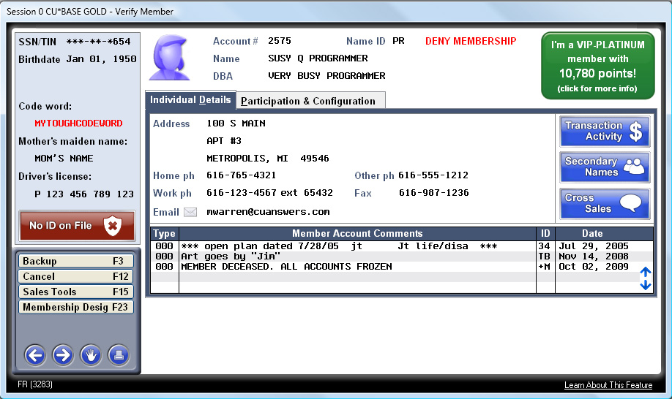
Same idea for the Teller and Transfer “Verify Member” pop-up window

Slide 4
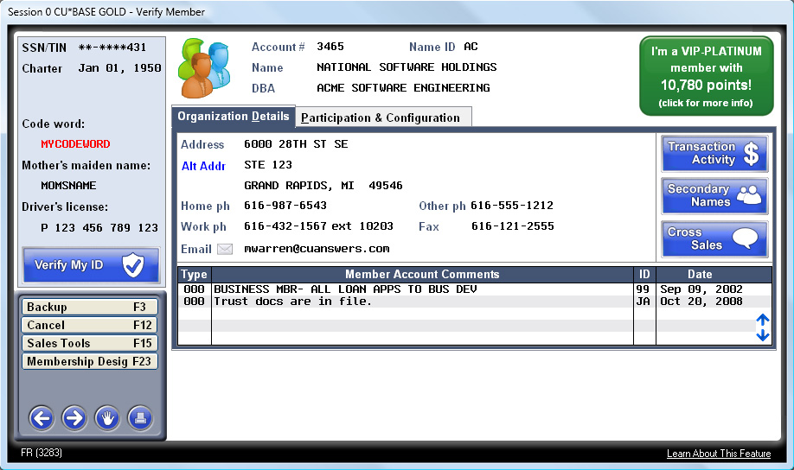
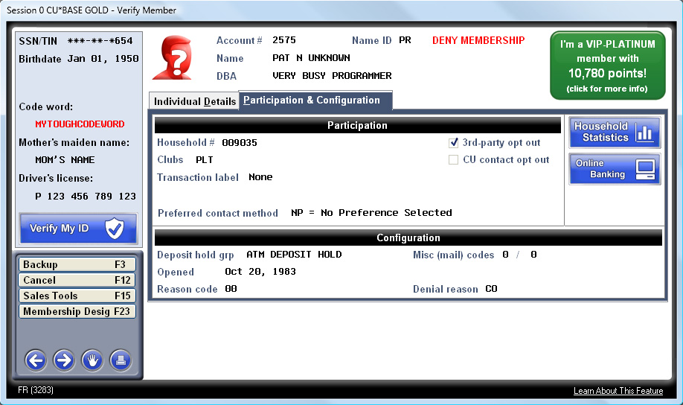
An organization
Gender unknown
(time to update your database!)

Slide 5
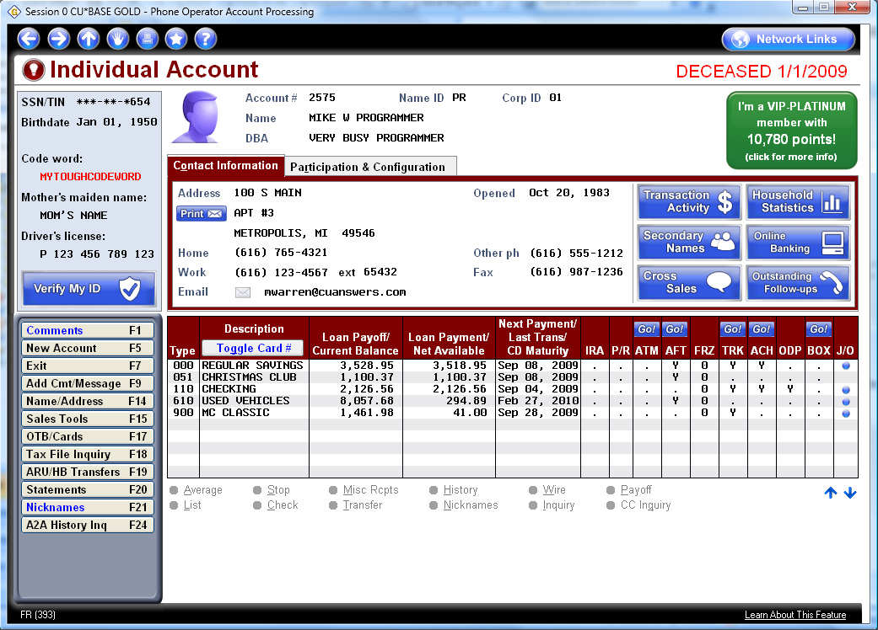
Quick access to the drill-down inquiry tool (room for more command keys!)
Notice the button changes so you know whether to scan an ID, or just check one
New host layout gives us room for 3 more accounts!

