Slide 1
Welcome to the September Tricks of the Trade
webinar!

Slide 2
What is Tricks of the Trade?
From brochures to booklets,
From charts to checklists,
From flyers to forms,
There is a lot of documentation on our website about CU*BASE and the programs and features it offers. That’s why each month, we send you a Tricks of the Trade email and hold this companion webinar, to highlight
key documents that will make your job easier!

Slide 3
What is Tricks of the Trade?

Slide 4
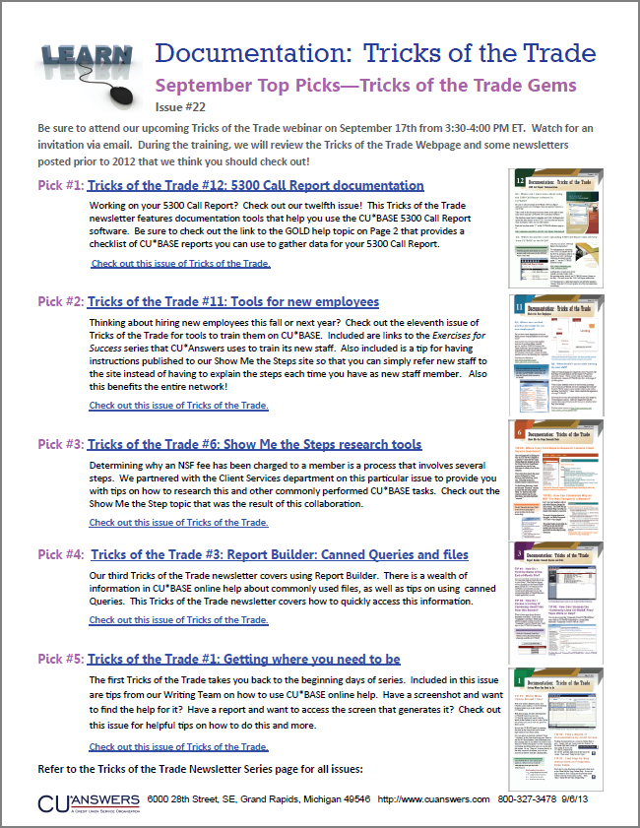
What is Tricks of the Trade?

Slide 5
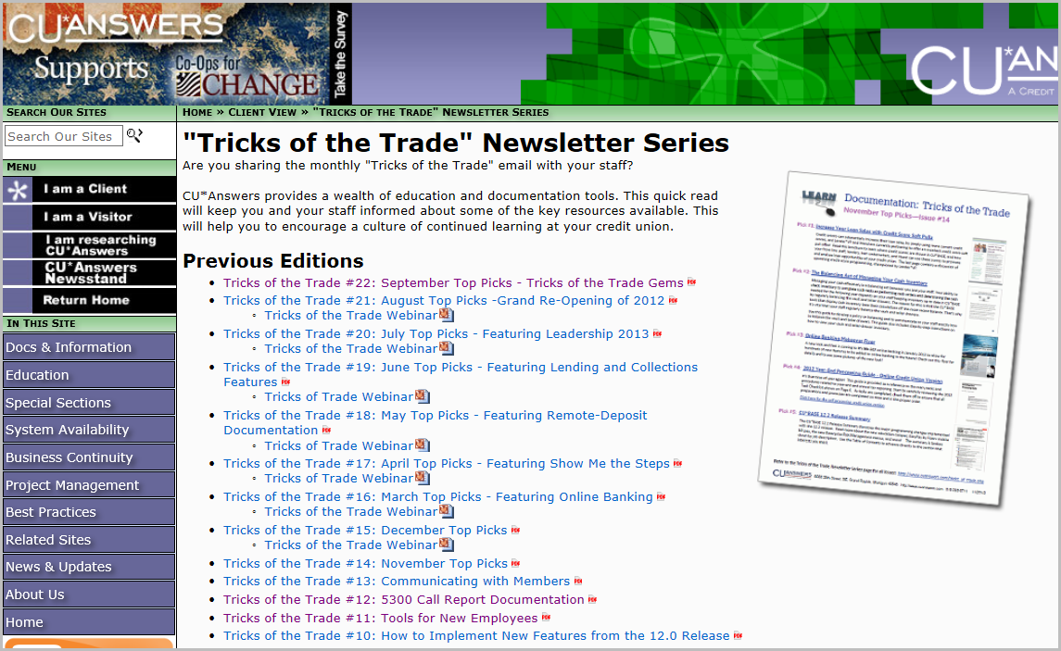
What is Tricks of the Trade?
Check out all our Tricks of the Trade webinar presentations and newsletters: http://cuanswers.com/tricks_of_trade.php

Slide 6
Focus of This Month’s Webinar: Gems of Tricks of the Trade
Today we’ll be looking back through previous issues of Tricks of the Trade to find some gems you do not want to miss!

Slide 7
Ice Breaker
Insert an arrow next to your favorite fall time activity.
Raking leaves
Going for walks
Picking apples
Carving pumpkins
Eating apple pie
Color tour

Slide 8
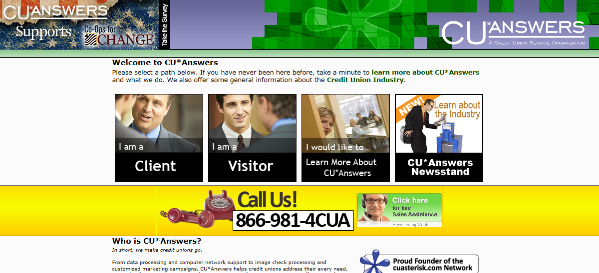
Gems of Tricks of the Trade
Please follow along in this webinar while I show you how to find this brochure.

Slide 9
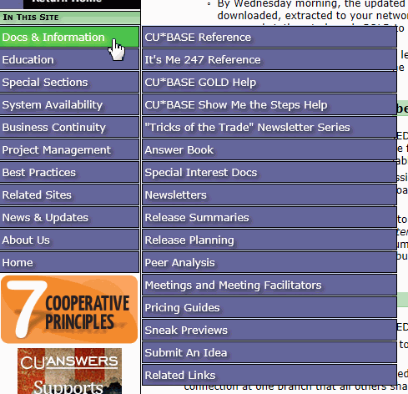
Gems of Tricks of the Trade

Slide 10
Gems of Tricks of the Trade

Slide 11
Fun Fact
Gems of Tricks of the Trade
How many the Tricks of the Trade webinars have there been? (This does not count today’s webinar.)
Insert an arrow in the box with the correct answer.
6
3
7

Slide 12
Fun Fact Answer
Gems of Tricks of the Trade
7
Source: The Tricks of the Trade page:
http://www.cuanswers.com/tricks_of_trade.php

Slide 13
Fun Fact Prize
Gems of Tricks of the Trade
Great job!
You’ve won ride in a hot air balloon!

Slide 14
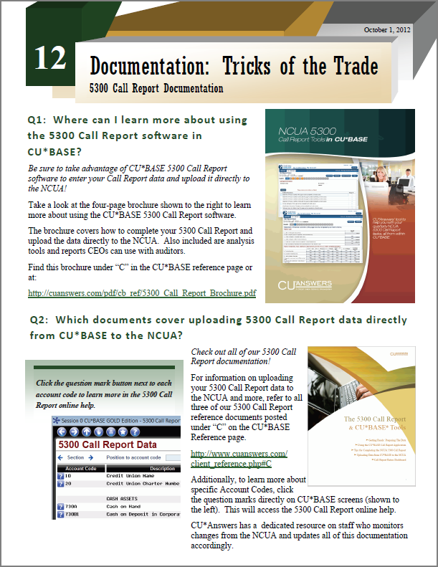
Tricks of the Trade #12 5300 Call Report Documentation

Slide 15
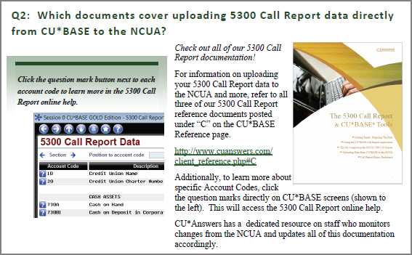
Tricks of the Trade #12 5300 Call Report Documentation

Slide 16
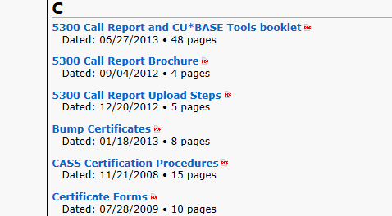
Tricks of the Trade #12 5300 Call Report Documentation
http://www.cuanswers.com/client_reference.php#C

Slide 17
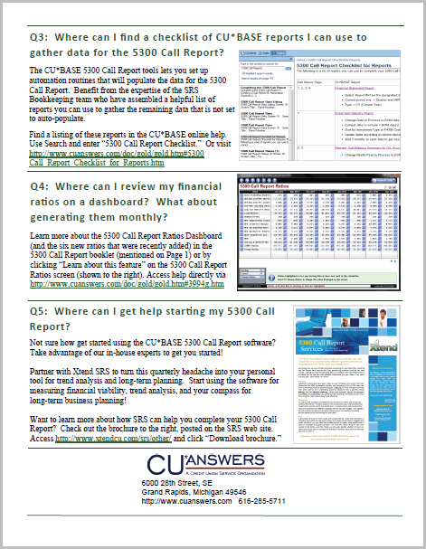
Tricks of the Trade #12 5300 Call Report Documentation

Slide 18
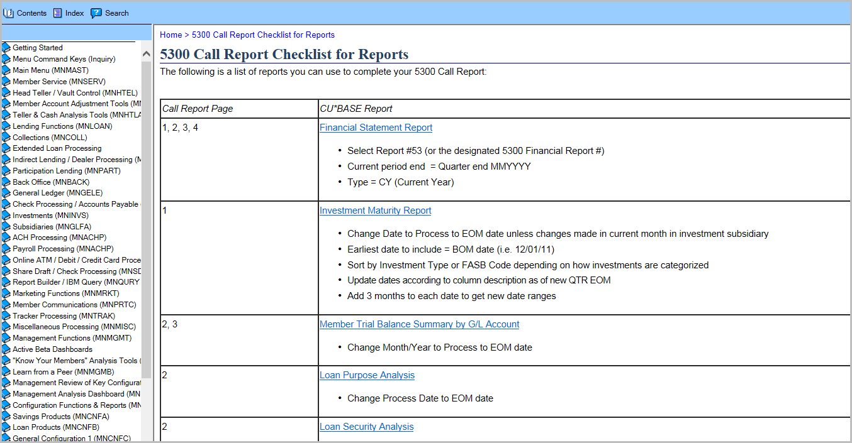
Tricks of the Trade #12 5300 Call Report Documentation

Slide 19
Pop Quiz
Tricks of the Trade
Under what letter is the 5300 Call Report documentation listed on the Reference Page?
Insert an arrow in the bubble with the right answer.
C
Both A and B.
A
Under “F” for “5300”
B
Under “C” for “Call Report”

Slide 20
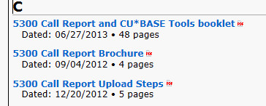
Pop Quiz Answer
Tricks of the Trade #12 5300 Call Report Documentation
Answer B
Under “C” for “Call Report”.

Slide 21
Pop Quiz Prize
Tricks of the Trade #12 5300 Call Report Documentation
Bravo! You’ve won a cinnamon bun, hot out of the oven!

Slide 22
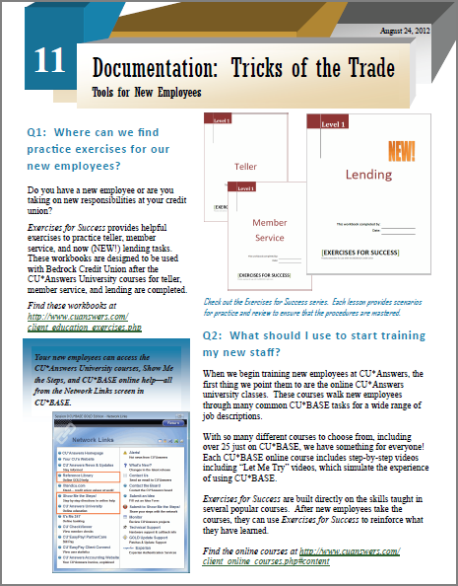
Tricks of the Trade #11 Tools for New Employees

Slide 23
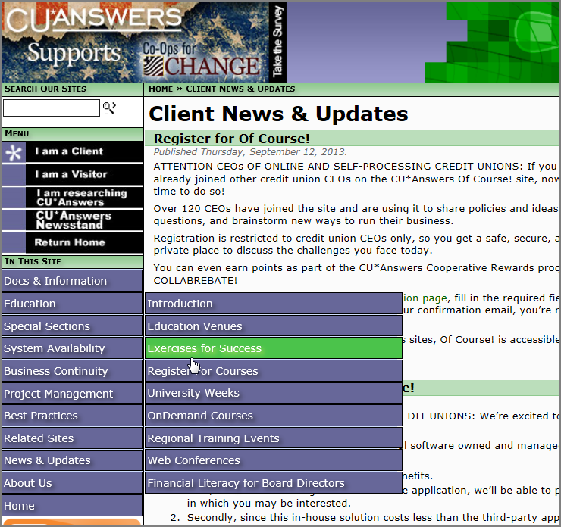
Tricks of the Trade #11 Tools for New Employees

Slide 24
Tricks of the Trade #11 Tools for New Employees

Slide 25
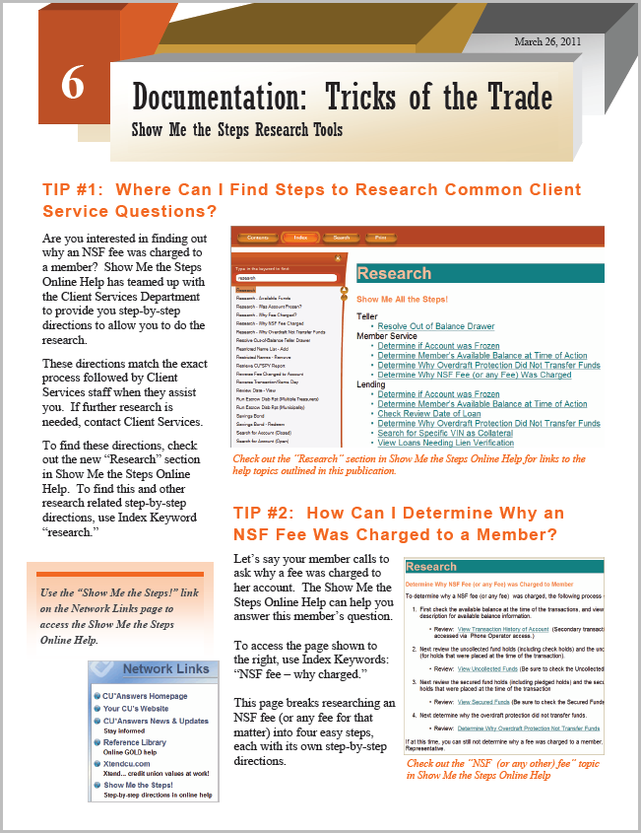
Tricks of the Trade – Show Me the Steps Research Tools

Slide 26
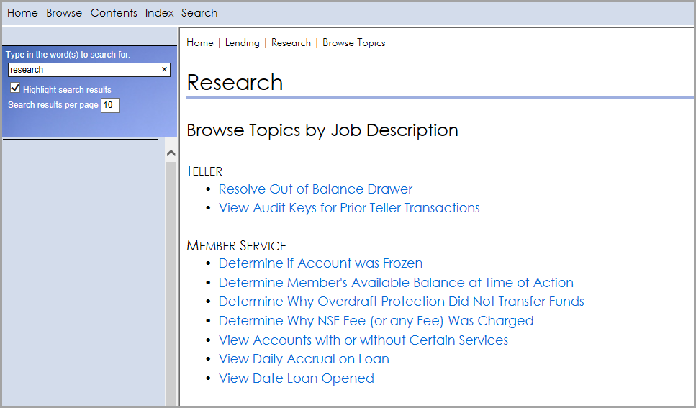
Tricks of the Trade – Show Me the Steps Research Tools

Slide 27
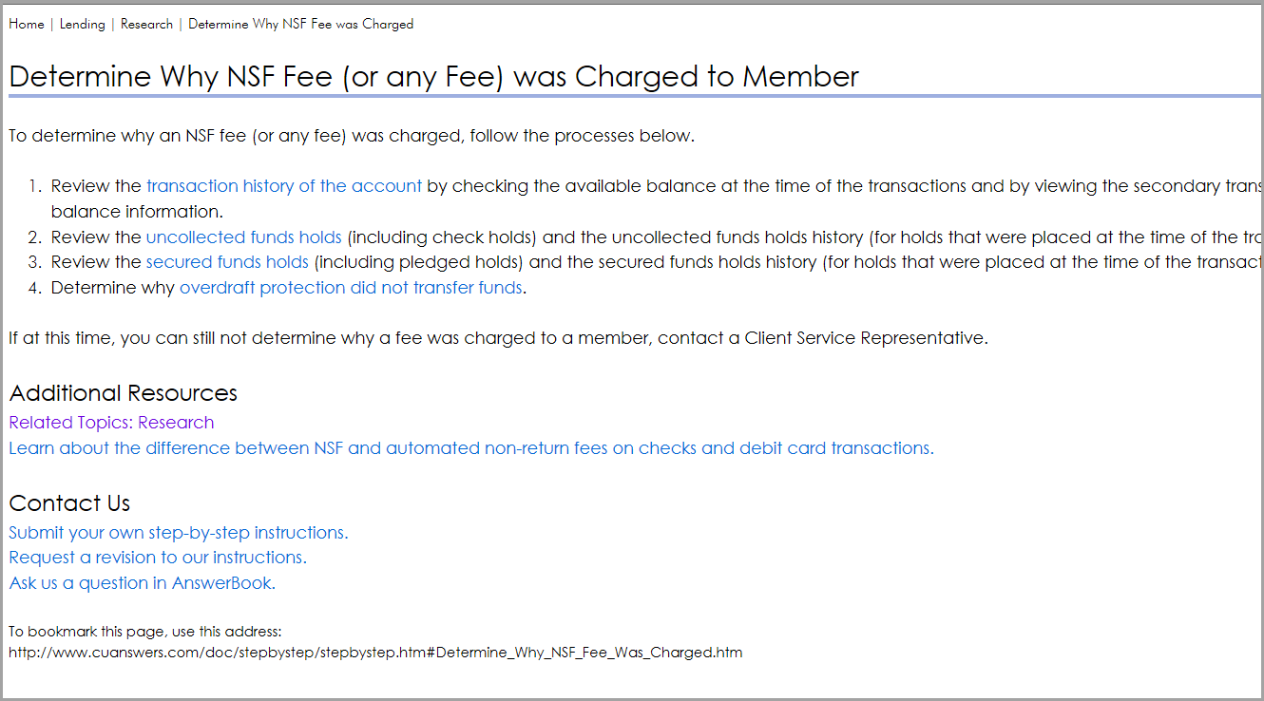
Tricks of the Trade – Show Me the Steps Research Tools

Slide 28
Pop Quiz
Gems of Tricks of the Trade
What workbook series can be used to train new employees?
Insert an arrow in the square with the right answer.
Exercises for Success
New Employee Trainer

Slide 29
Pop Quiz Answer
Gems of Tricks of the Trade
Exercises for Success

Slide 30
Pop Quiz Prize
Gems of Tricks of the Trade
Excellent! You’ve some funky name tags

Slide 31
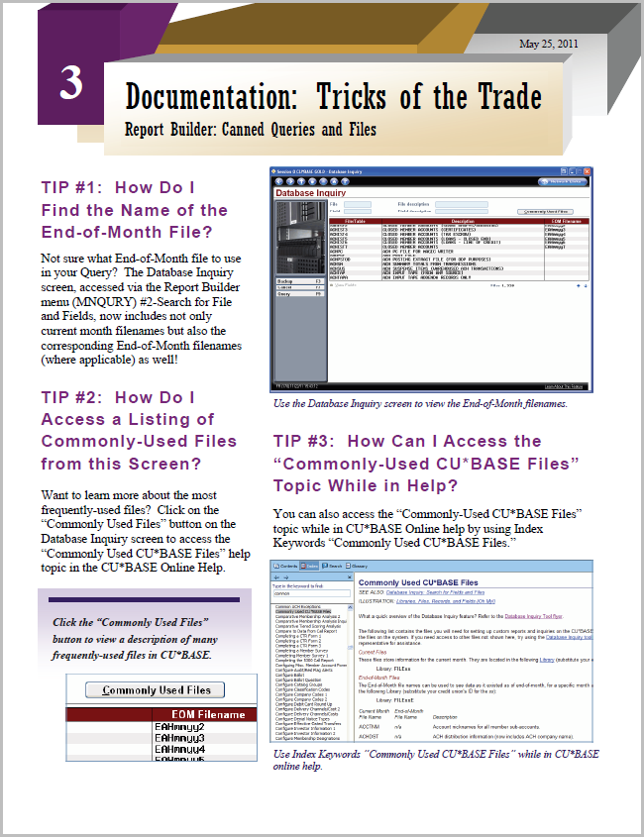
Tricks of the Trade #3 – Report Builder: Canned Queries and Files

Slide 32
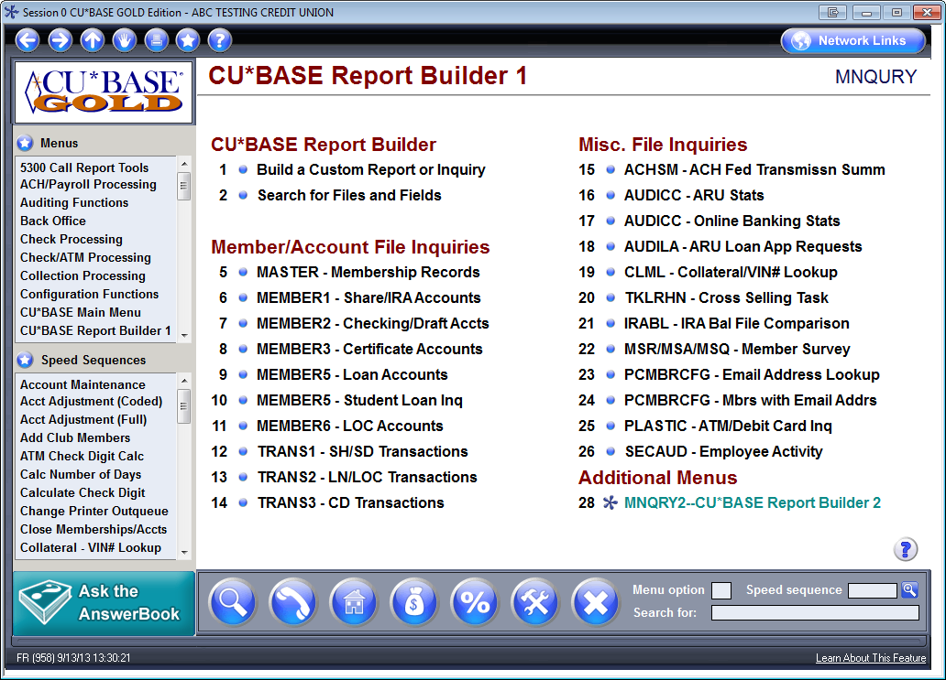
Tricks of the Trade #3 – Report Builder: Canned Queries and Files

Slide 33
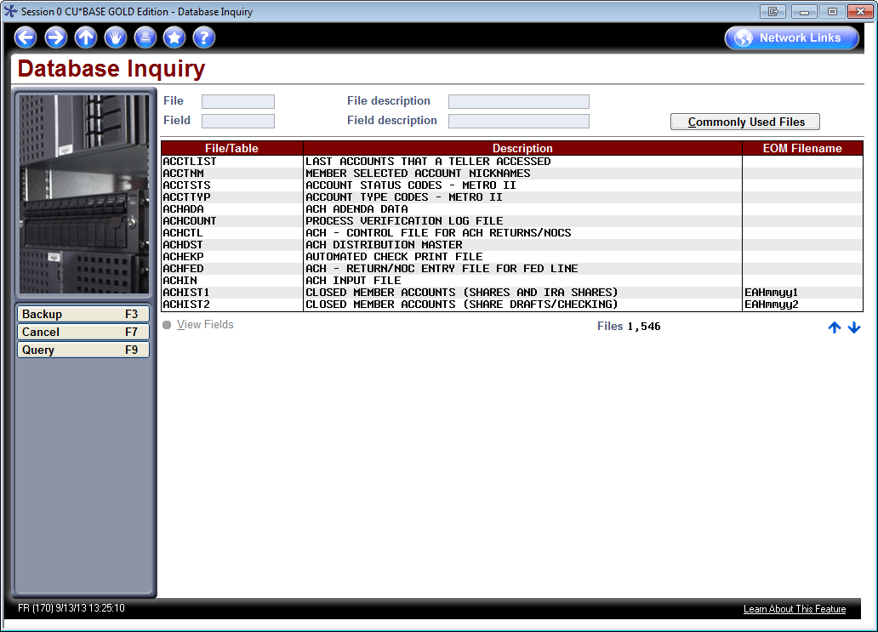
Tricks of the Trade #3 – Report Builder: Canned Queries and Files

Slide 34
Tricks of the Trade #3 – Report Builder: Canned Queries and Files

Slide 35
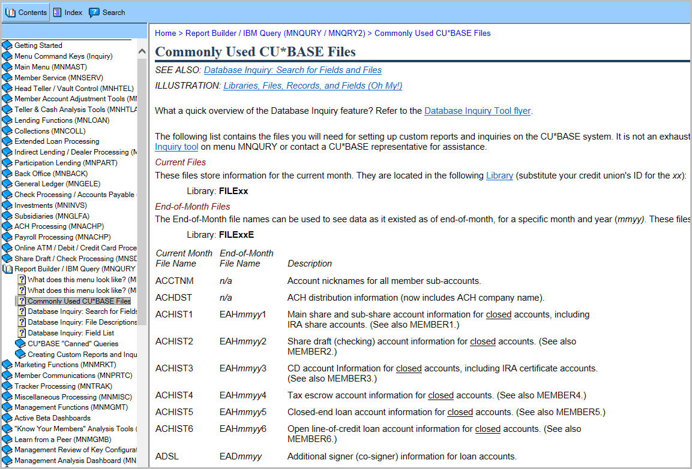
Tricks of the Trade #3 – Report Builder: Canned Queries and Files

Slide 36
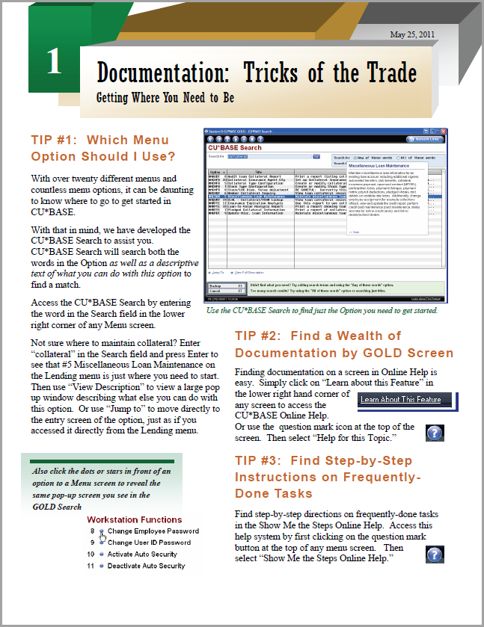
Tricks of the Trade #1 Getting where you need to be

Slide 37
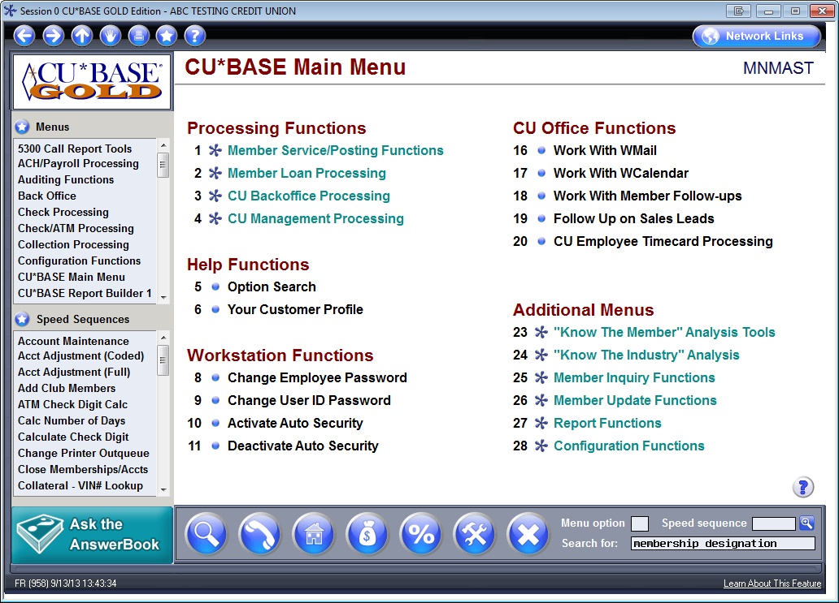
Tricks of the Trade #1 Getting where you need to be

Slide 38
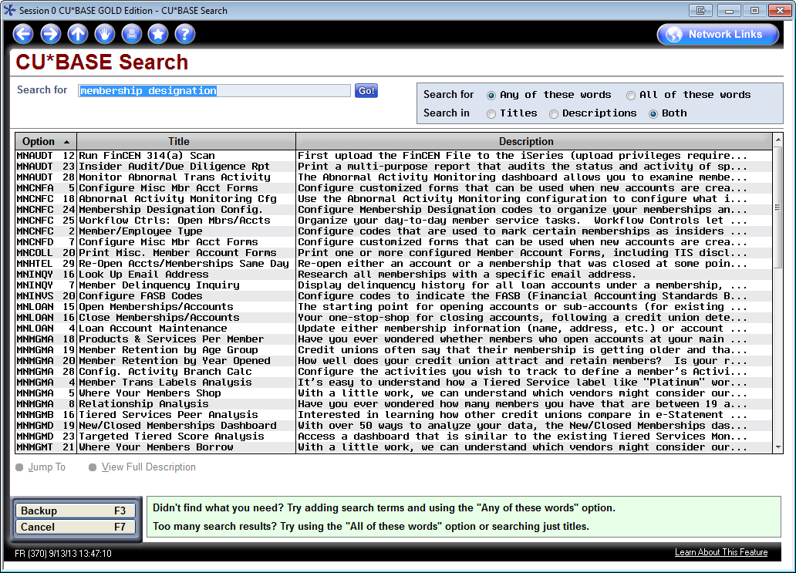
Tricks of the Trade #1 Getting where you need to be

Slide 39
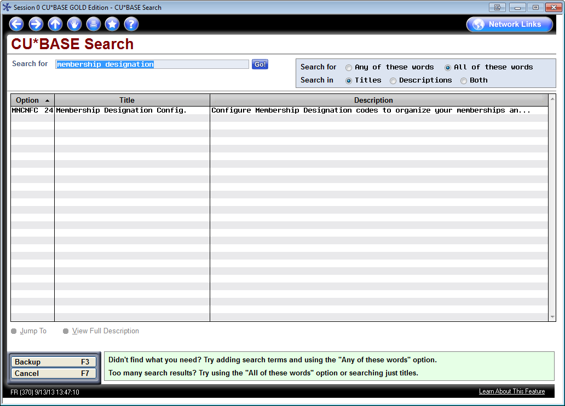
Tricks of the Trade #1 Getting where you need to be

Slide 40
Tricks of the Trade #1 Getting where you need to be

Slide 41
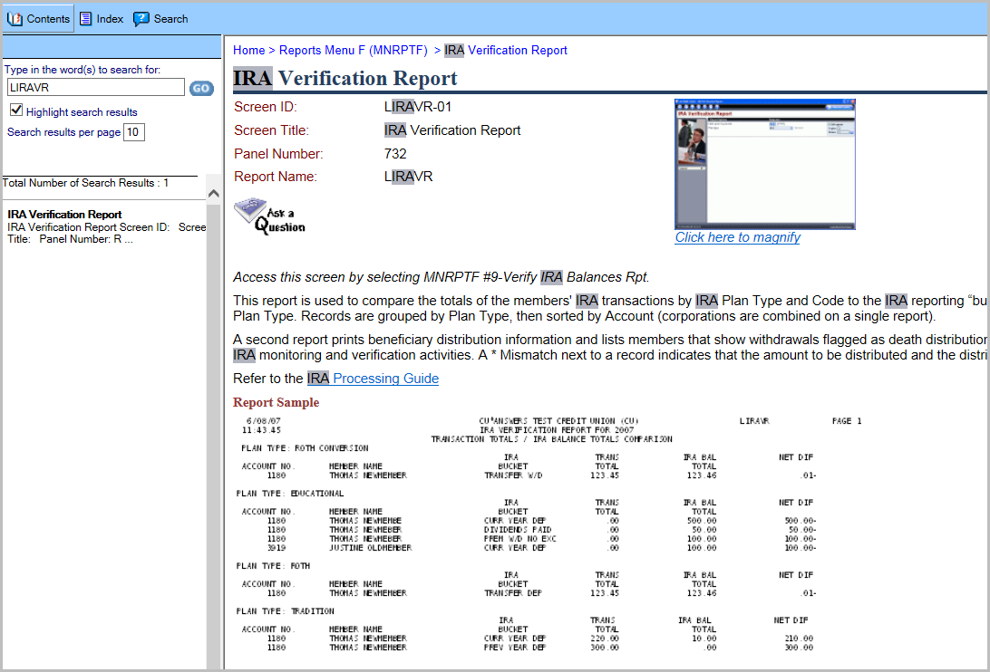
Tricks of the Trade #1 Getting where you need to be

Slide 42
Takeaways
Webinar Wrap-Up
On the whiteboard:
Write down your most valuable takeaway from today’s webinar.

Slide 43
Thank you for attending the September Tricks of the Trade webinar!
For questions regarding today’s topics. Please refer to the documentation referenced in today’s webinar:
Tricks of the Trade #22 - Gems of Tricks of the Trade
Tricks of the Trade #12 – 5300 Call Report documentation
Tricks of the Trade #11 – Tools for new employees
Tricks of the Trade #6 – Show Me the Steps research tools
Tricks of the Trade #3 – Report Builder: Canned Queries and files
Tricks of the Trade #1 – Getting where you need to be
See you at next month’s Tricks of the Trade webinar!

