Slide 1
Welcome to the March Tricks of the Trade
webinar!

Slide 2
What is Tricks of the Trade?
From brochures to booklets,
From charts to checklists,
From flyers to forms,
There is a lot of documentation on our website about CU*BASE and the programs and features it offers. That’s why each month, we send you a Tricks of the Trade email and hold this companion webinar, to highlight
key documents that will make your job easier!

Slide 3
March Tricks of the Trade

Slide 4
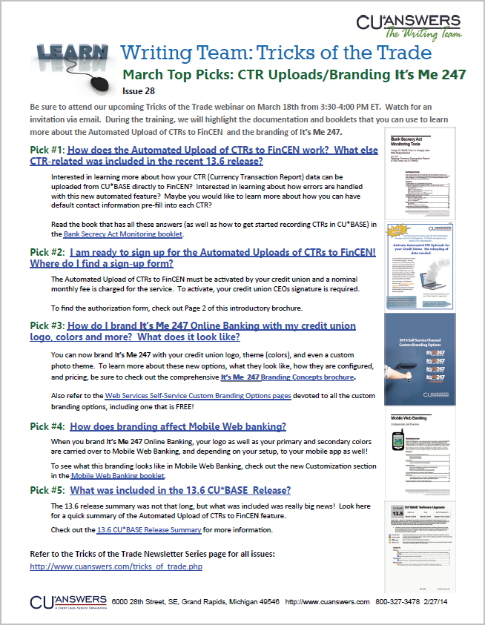
March Tricks of the Trade

Slide 5
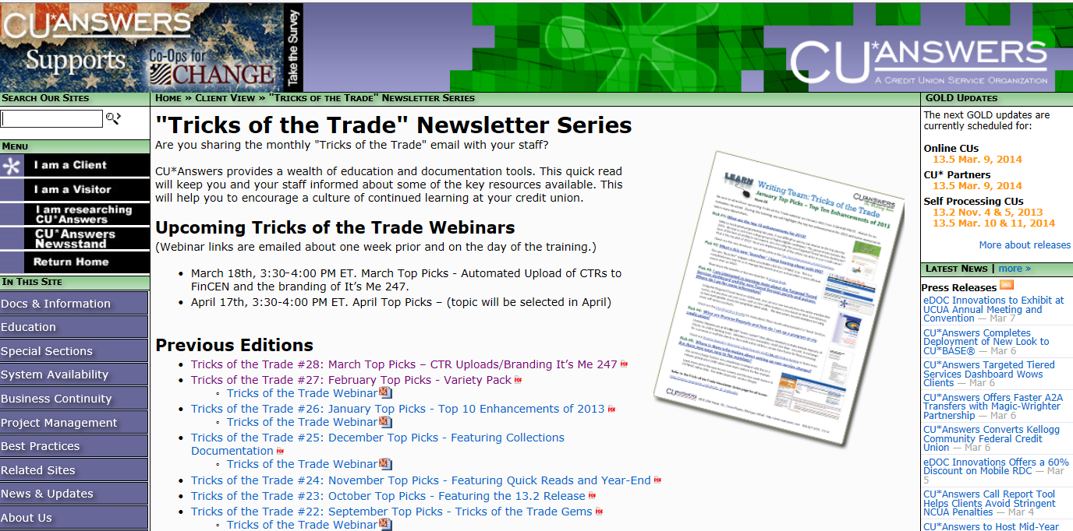
What is Tricks of the Trade?
Check out all our Tricks of the Trade webinar presentations and newsletters: http://cuanswers.com/tricks_of_trade.php

Slide 6
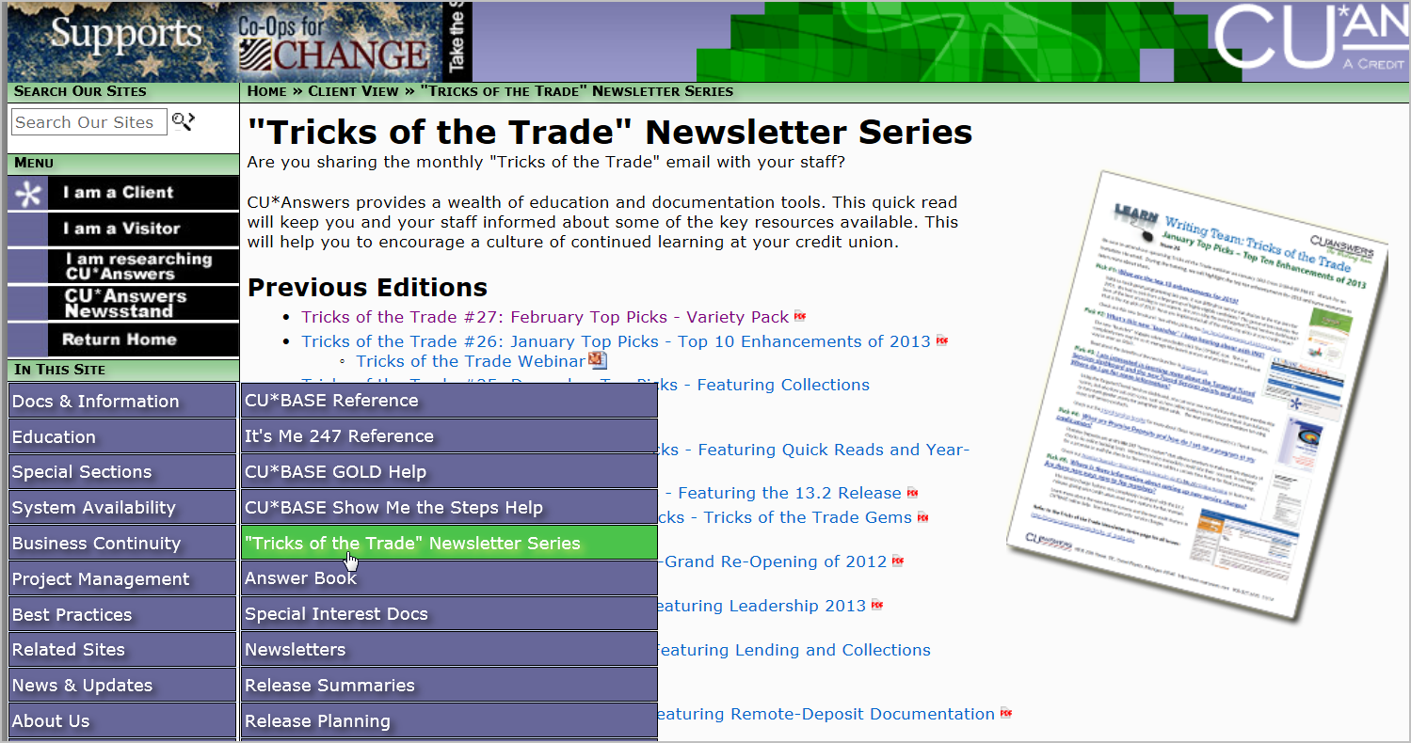
March Tricks of the Trade

Slide 7
Ice Breaker
Insert an arrow next to your favorite lion or lamb.
Roaring Lion
Little lamb
Blue lion
Thinks she’s a lion
Big-eyed lamb
Fuzzy lamb

Slide 8
Fun Fact
March Fun Fact
How many workstations now have ING GOLD on them?
Insert an arrow in the box with the correct answer.
Just over 2,000
About 3,000
Just under 5,000

Slide 9
Fun Fact Answer
March Fun Fact
Just under 5,000 workstations
Source: ING Tracking documentation

Slide 10
Fun Fact Prize
March Fun Fact
Great job!
Little Lamb says you are #1!

Slide 11
Focus of This Month’s Webinar: CTR Uploads to FinCEN and Custom Branding
Today we’ll review a variety of documentation resources.

Slide 12
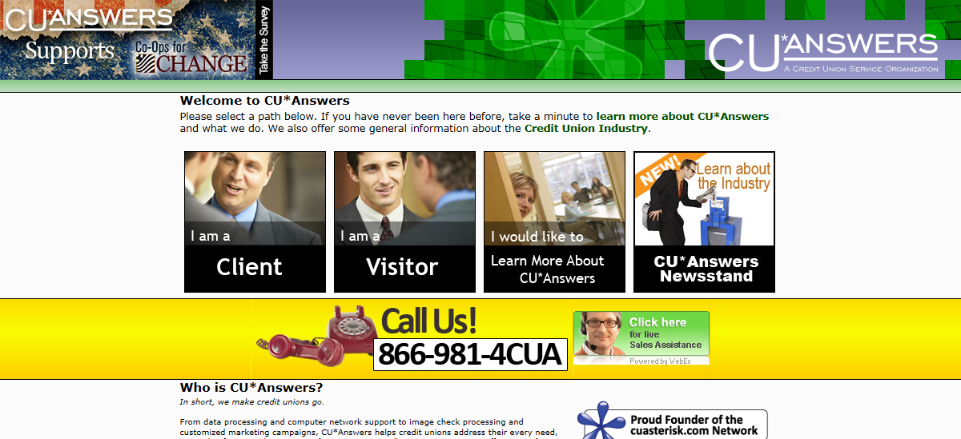
How to get to the Reference Page
Please follow along in this webinar while I show you how to find this booklet.

Slide 13
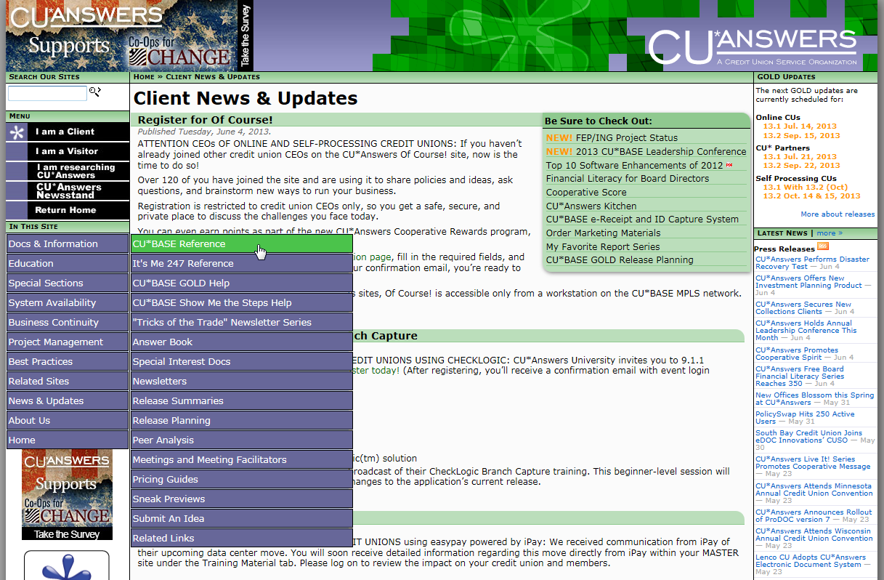
How to get to the Reference Page

Slide 14
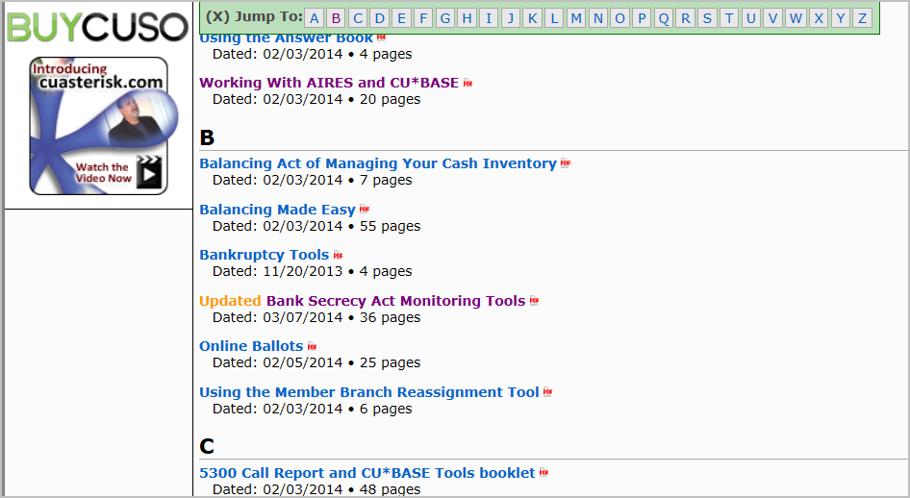
Bank Secrecy Act Monitoring booklet

Slide 15
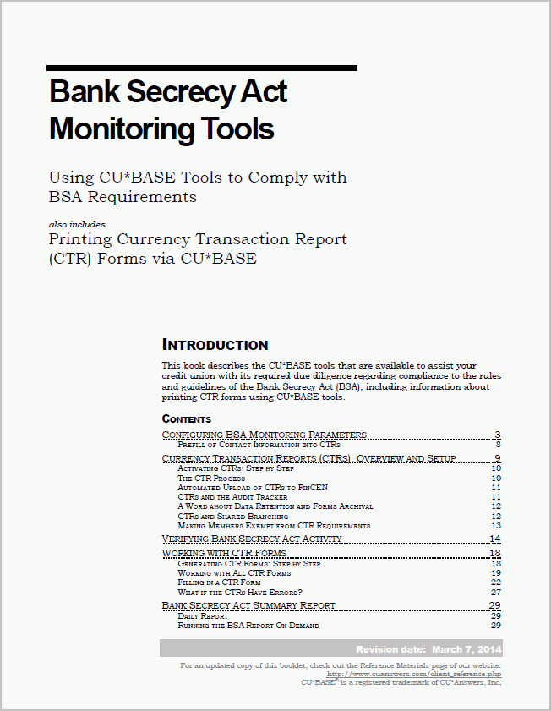
Bank Secrecy Act Monitoring booklet

Slide 16
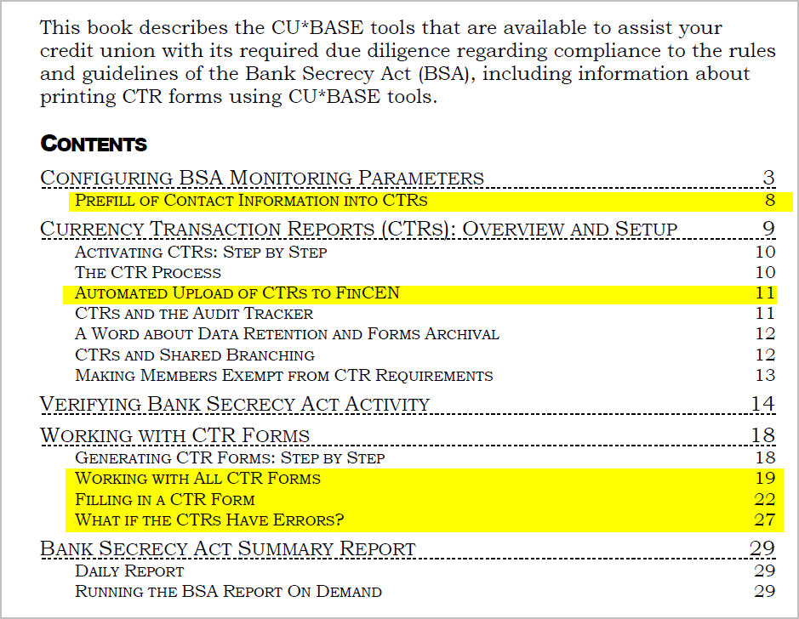
Bank Secrecy Act Monitoring booklet

Slide 17
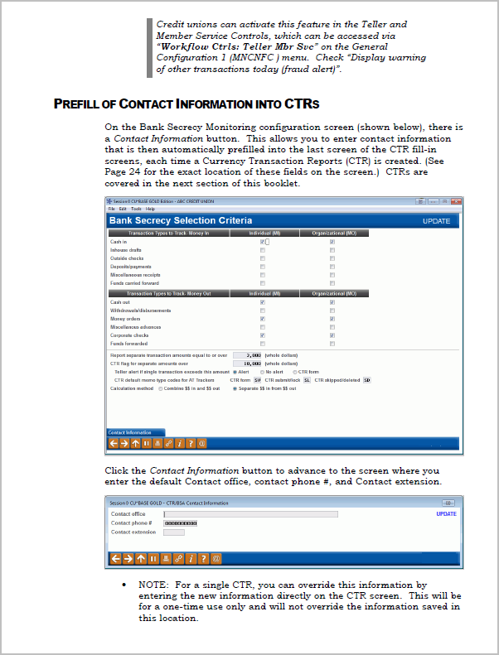
Bank Secrecy Act Monitoring booklet

Slide 18
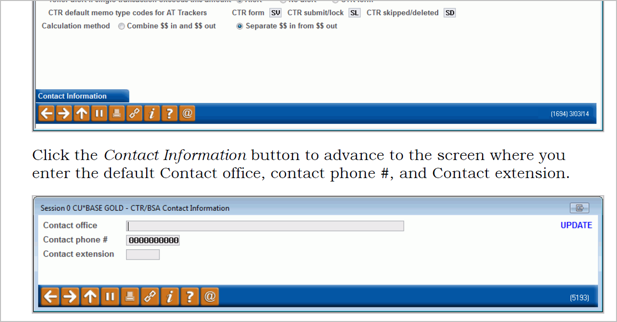
Bank Secrecy Act Monitoring booklet

Slide 19
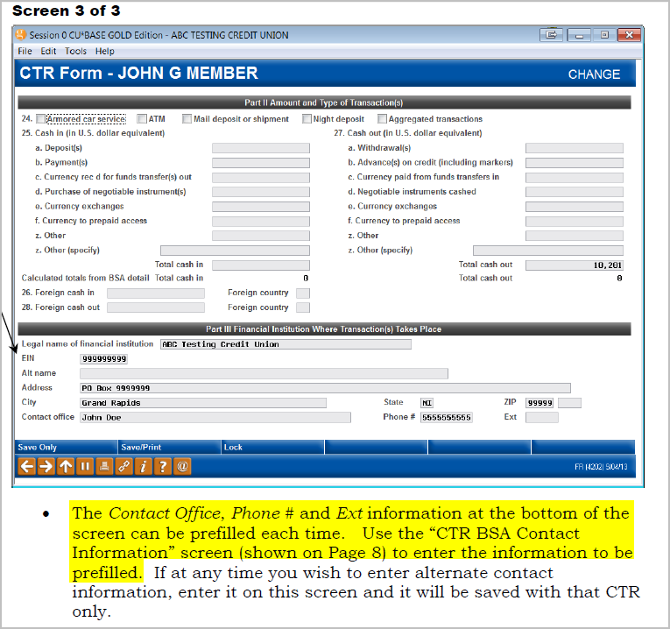
Bank Secrecy Act Monitoring booklet

Slide 20
Bank Secrecy Act Monitoring booklet

Slide 21
Bank Secrecy Act Monitoring booklet

Slide 22
Pop Quiz
Bank Secrecy Act Monitoring booklet
Where do you configure the contact information to be prefilled into the last CTR screen?
Insert an arrow in the bubble with the right answer.
C
Last CTR fill-in screen, then Contact Information (F22)
A
Bank Secrecy Configuration, then Contact Information (F22)
B
Bank Secrecy Verify Member screen, then then Contact Information (F22)

Slide 23
Pop Quiz Answer
Bank Secrecy Act Monitoring booklet
Answer A
The contact information is entered on the screen you access from the Bank Secrecy Configuration, then Contact Information (F22).

Slide 24
Pop Quiz Prize
Bank Secrecy Act Monitoring booklet
Bravo! You’ve won a trip anywhere you want to go!

Slide 25
Bank Secrecy Act Monitoring booklet

Slide 26
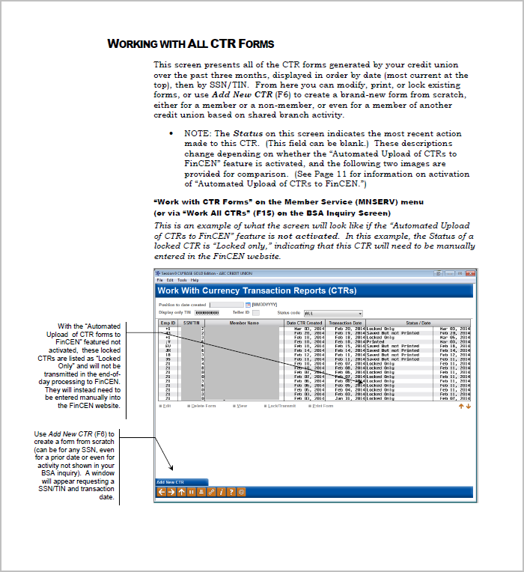
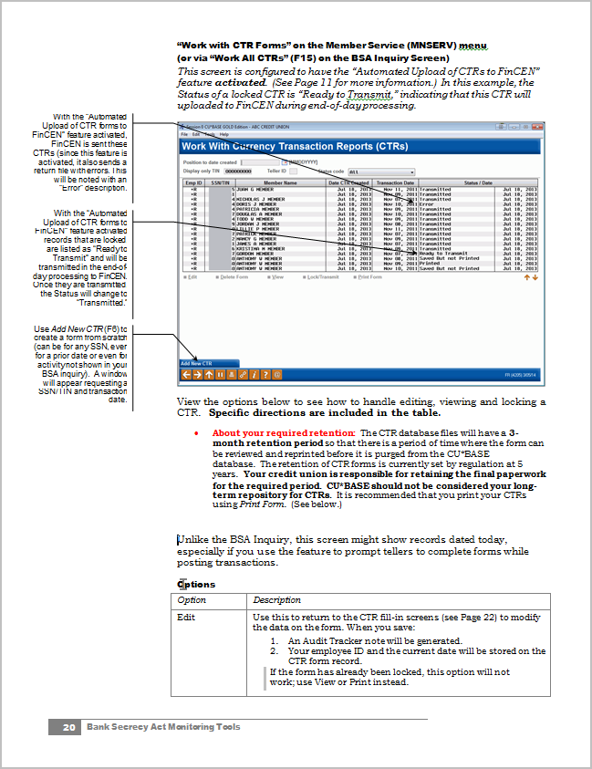
Bank Secrecy Act Monitoring booklet

Slide 27
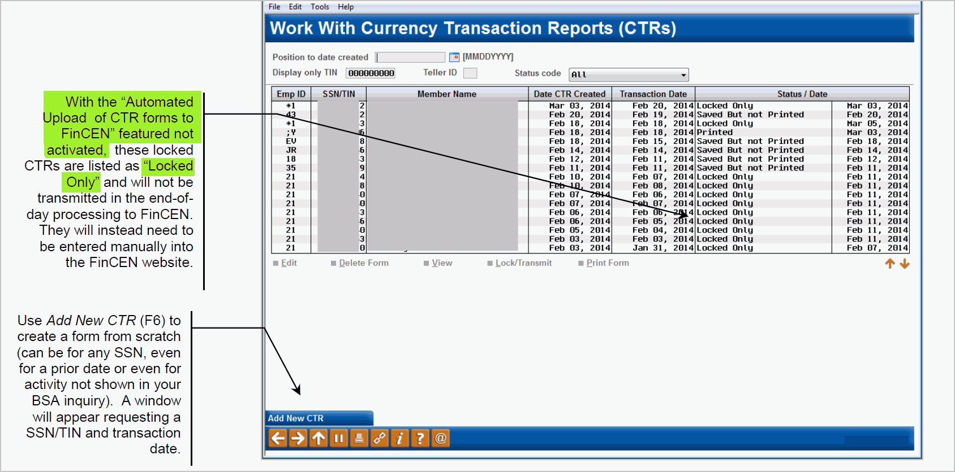
Bank Secrecy Act Monitoring booklet

Slide 28
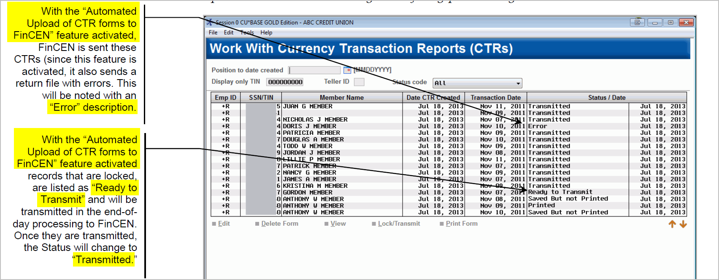
Bank Secrecy Act Monitoring booklet

Slide 29
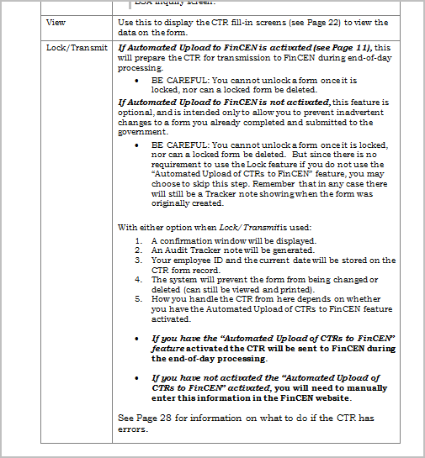
Bank Secrecy Act Monitoring booklet

Slide 30
Bank Secrecy Act Monitoring booklet

Slide 31
Bank Secrecy Act Monitoring booklet

Slide 32
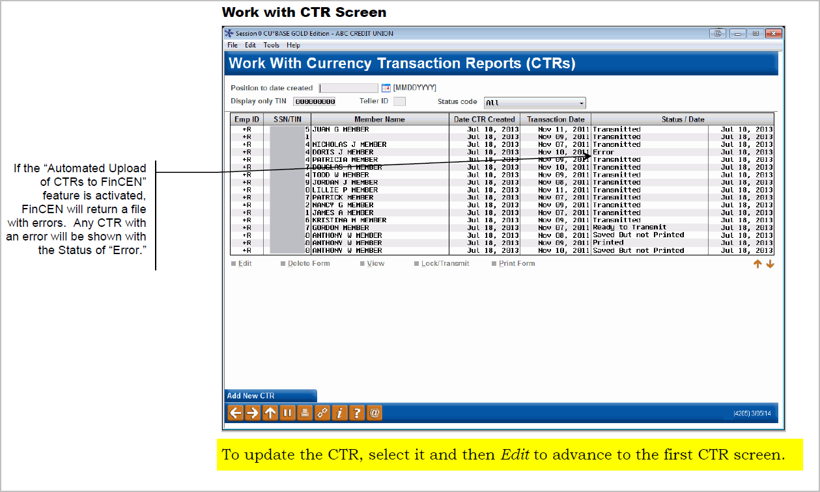
Bank Secrecy Act Monitoring booklet

Slide 33
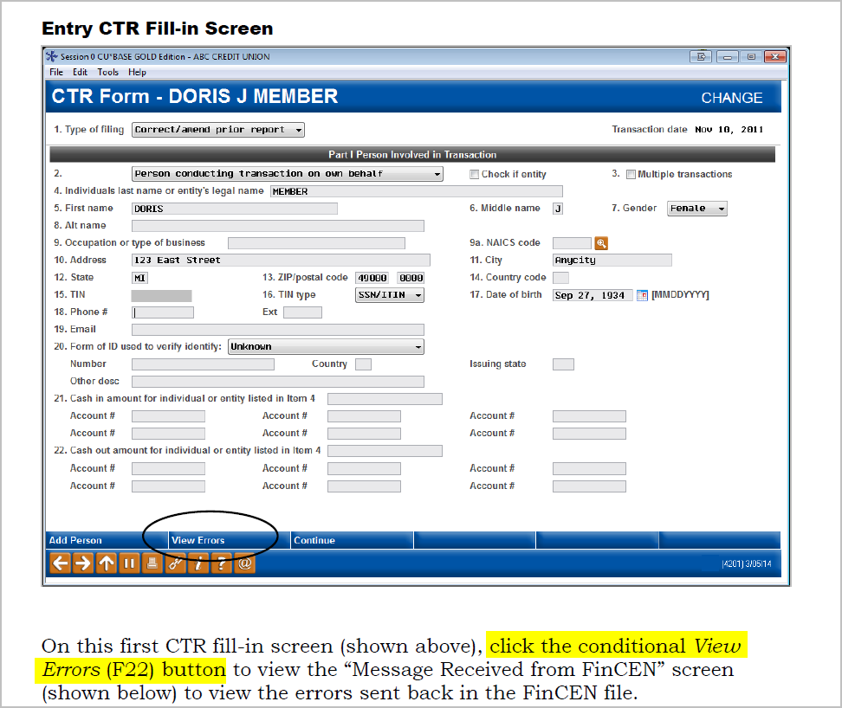
Bank Secrecy Act Monitoring booklet

Slide 34
Bank Secrecy Act Monitoring booklet

Slide 35
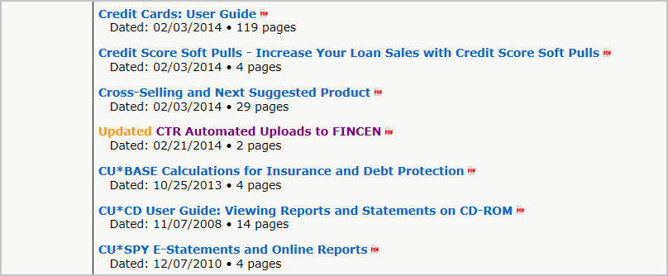
CTR Upload to FinCEN brochure

Slide 36
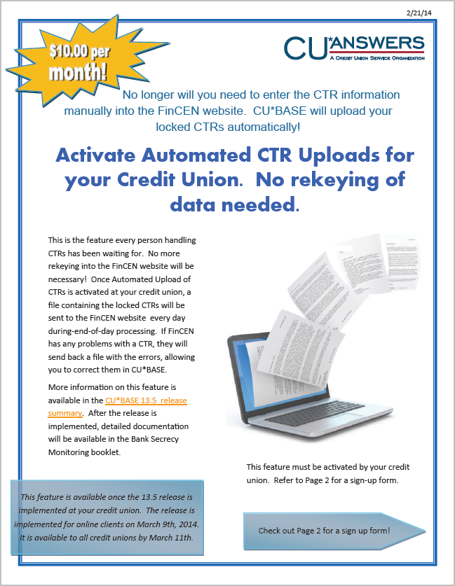
CTR Upload to FinCEN brochure

Slide 37
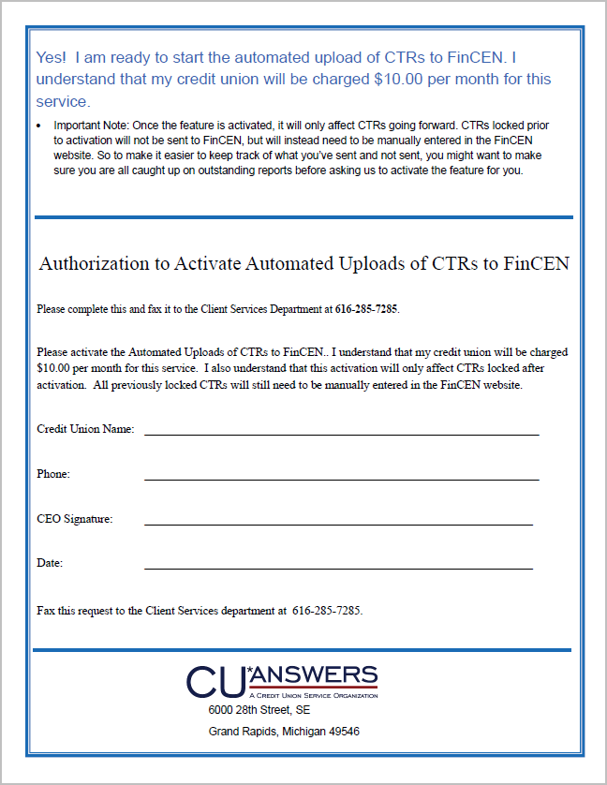
CTR Upload to FinCEN brochure

Slide 38
Pop Quiz
March Top Picks
Where can you find the authorization form to activate the “Automated Uploads of CTRs to FinCEN” feature?
Insert an arrow in the square with the right answer.
Under “C” on the Reference Page
The link in the Bank Secrecy Monitoring booklet
Both locations will get you to the form

Slide 39
Pop Quiz Answer
March Top Picks
C
Both
You can find a link to the authorization form (Look on Page 2 of the brochure) on the CU*BASE Reference Page and also in the Bank Secrecy Monitoring booklet

Slide 40
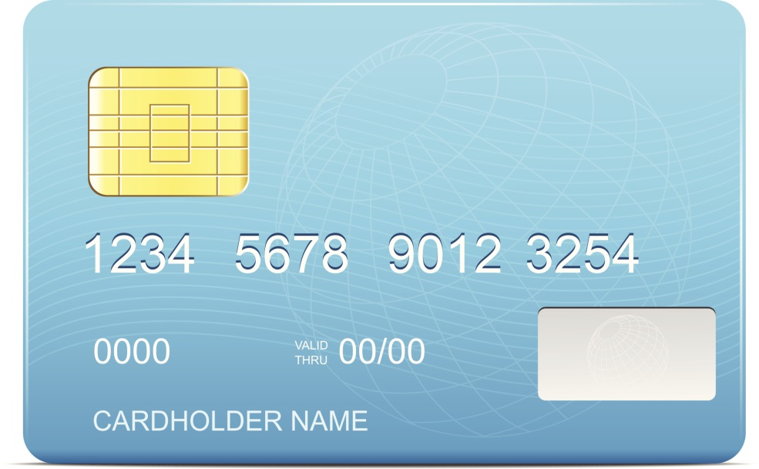
Pop Quiz Prize
March Top Picks
Excellent! You’ve a charge card with money for your trip!

Slide 41
Self Service Channel Branding

Slide 42
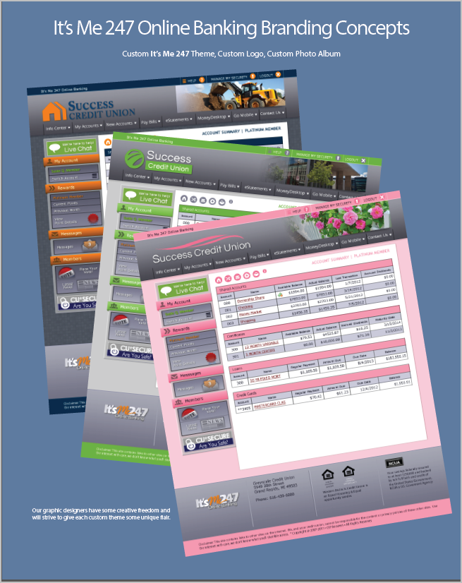
Self Service Channel Branding

Slide 43
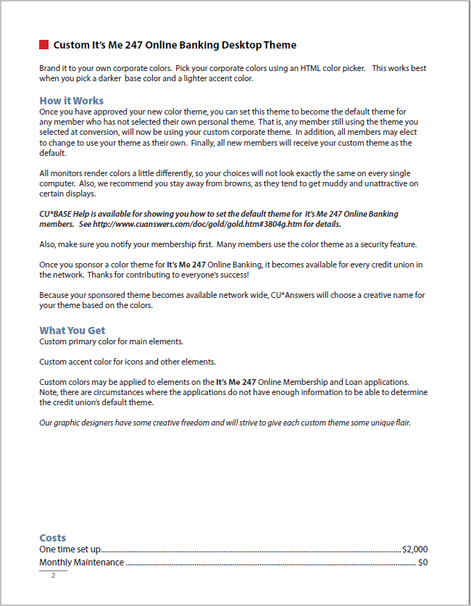
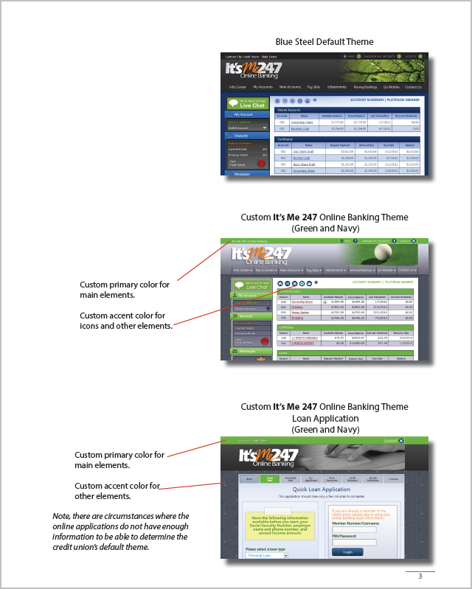
Self Service Channel Branding

Slide 44
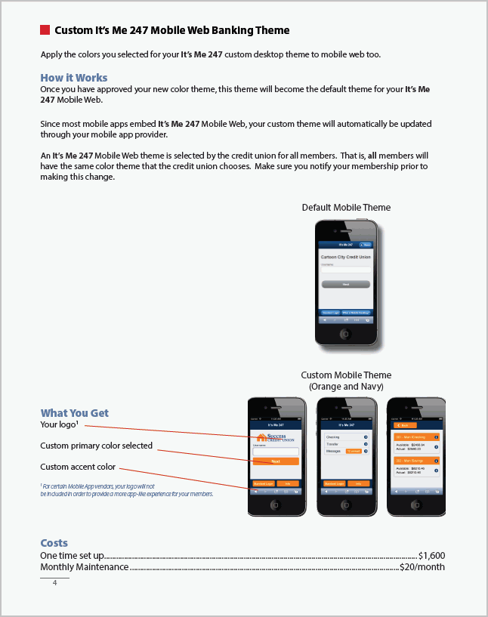
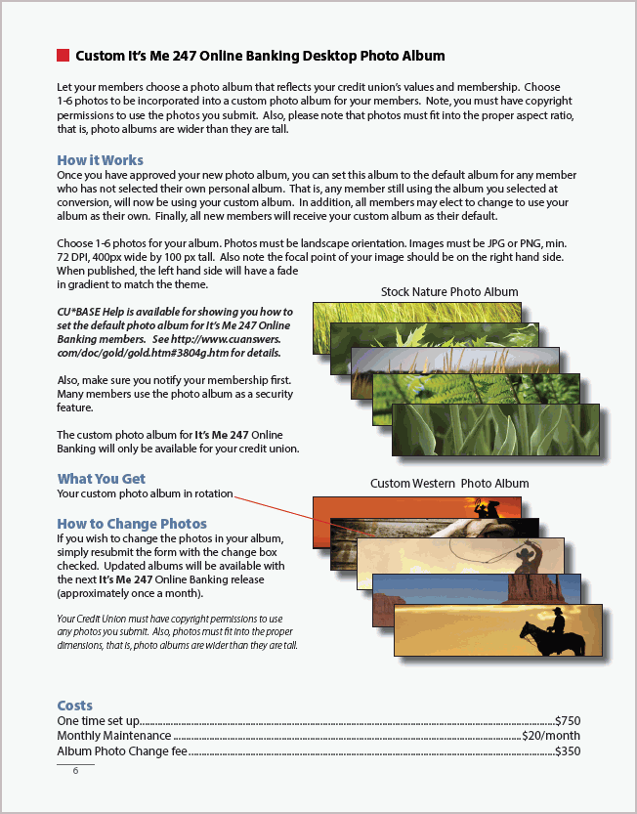
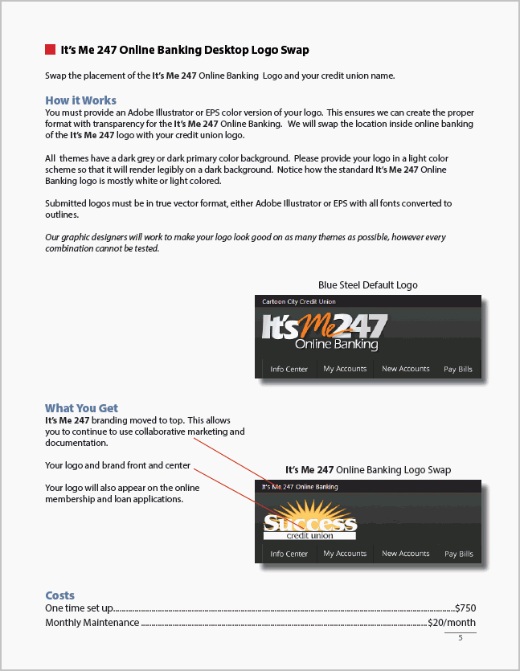
Self Service Channel Branding

Slide 45
Self Service Channel Branding

Slide 46
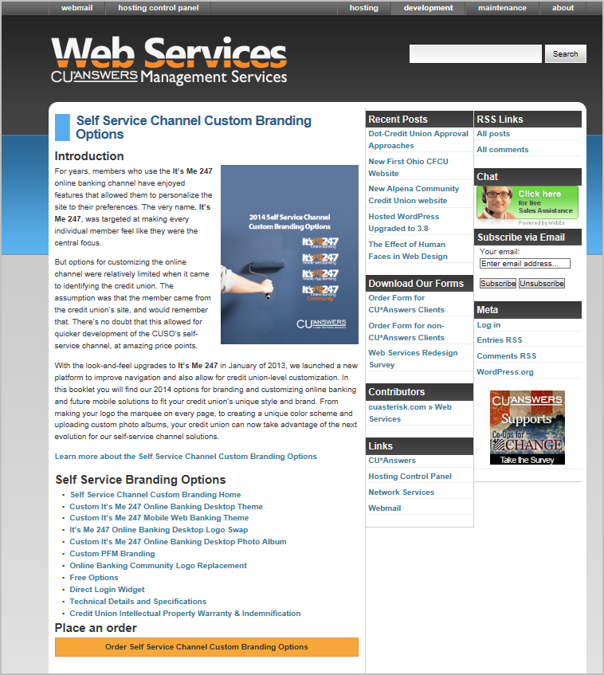
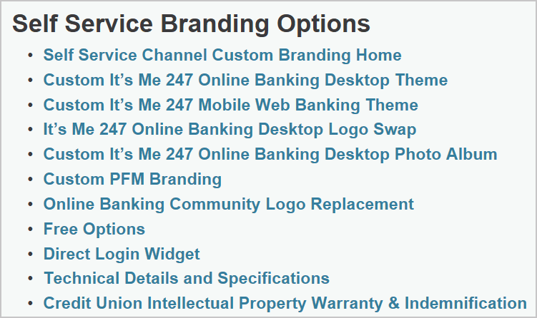
Self Service Channel Branding

Slide 47
Takeaways
Webinar Wrap-Up
On the whiteboard:
Write down your most valuable takeaway from today’s webinar.

Slide 48
Thank you for attending the March Tricks of the Trade webinar!
For questions regarding today’s topics. Please refer to the documentation referenced in today’s webinar:
http://cuanswers.com/pdf/cb_ref/Documentation_Tricks_of_the_Trade28.pdf
http://www.cuanswers.com/pdf/cb_ref/BankSecrecyMonitoring.pdf
]http://www.cuanswers.com/pdf/cb_ref/ctr_automated_upload.pdf
http://ws.cuanswers.com/wp-content/uploads/self-service-branding-options1.pdf
http://ws.cuanswers.com/development/self-service-branding/
See you at next month’s Tricks of the Trade webinar!

