Slide 1
Welcome to the June Tricks of the Trade
webinar!

Slide 2
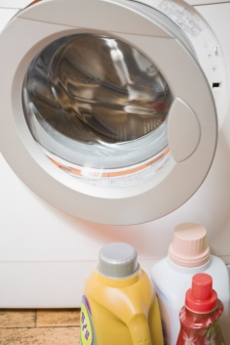
Ice Breaker
Insert an arrow next to your 4th of July plans.
Doing housework
Catching some Z’s
Working at home
Gardening
Going to the beach
Going on a trip

Slide 3
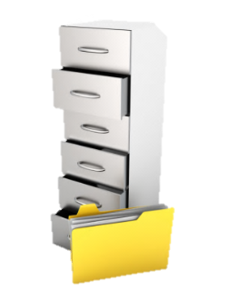
What is Tricks of the Trade?
From brochures to booklets,
From charts to checklists,
From flyers to forms,
There is a lot of documentation on our website about CU*BASE and the programs and features it offers. That’s why each month, we send you a Tricks of the Trade email and hold this companion webinar, to highlight
key documents that will make your job easier!

Slide 4
What is Tricks of the Trade?

Slide 5
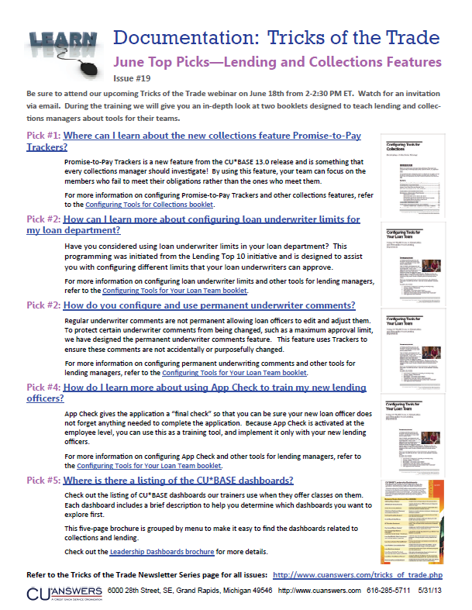
What is Tricks of the Trade?

Slide 6
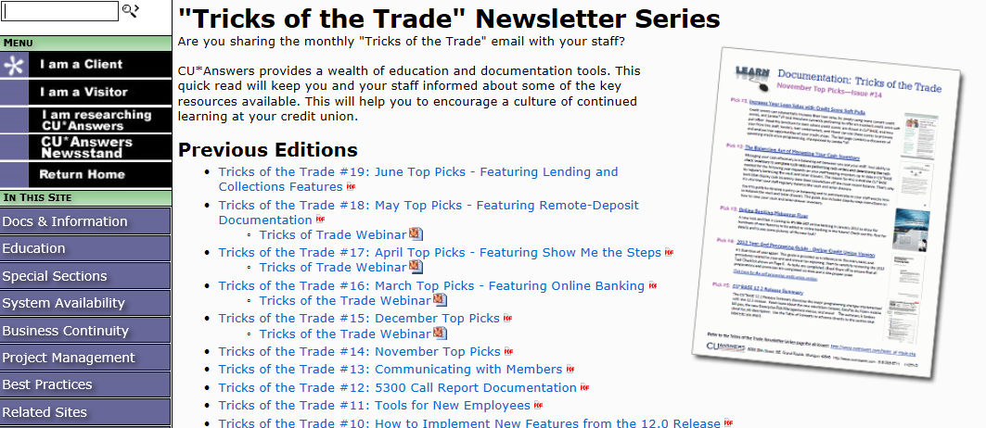
What is Tricks of the Trade?
Check out all our Tricks of the Trade webinar presentations and newsletters: http://cuanswers.com/tricks_of_trade.php

Slide 7
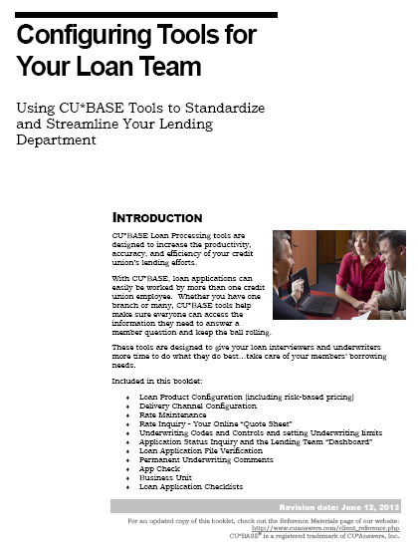
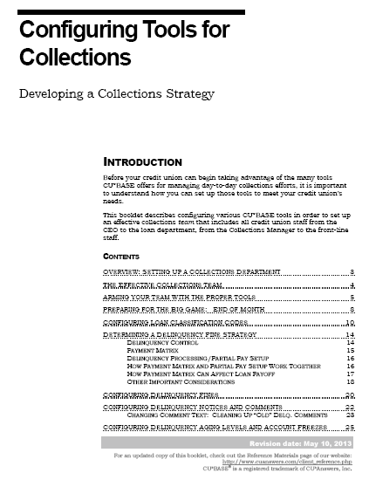
Focus of This Month’s Webinar: Collections and Lending Tools
Today we’ll show you some neat lending and collections tools discussed in the following booklets:
Configuring Tools for Collections
Configuring Tools for Your Loan Team

Slide 8
Configuring Tools for Collections Booklet

Slide 9
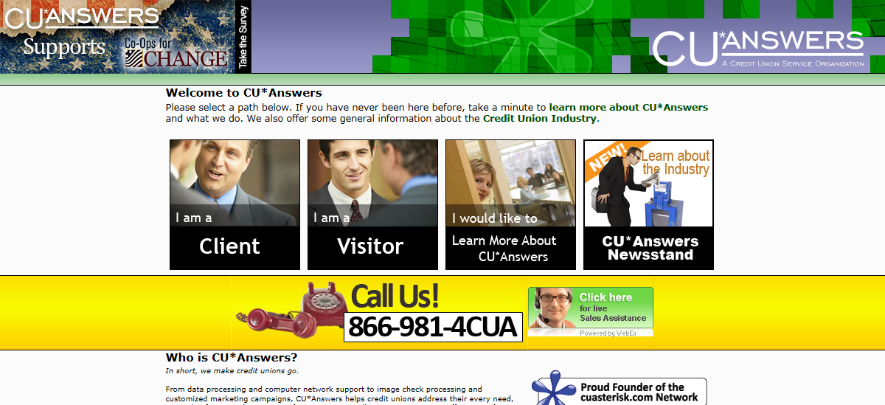
Configuring Tools for Collections Booklet
Please follow along in this webinar while I show you how to find this booklet.

Slide 10
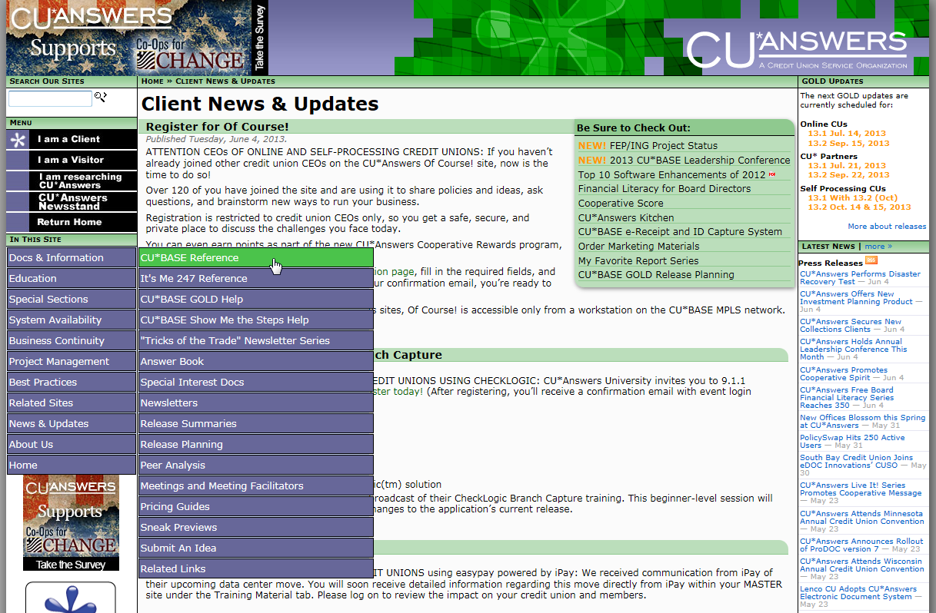
Configuring Tools for Collections Booklet

Slide 11
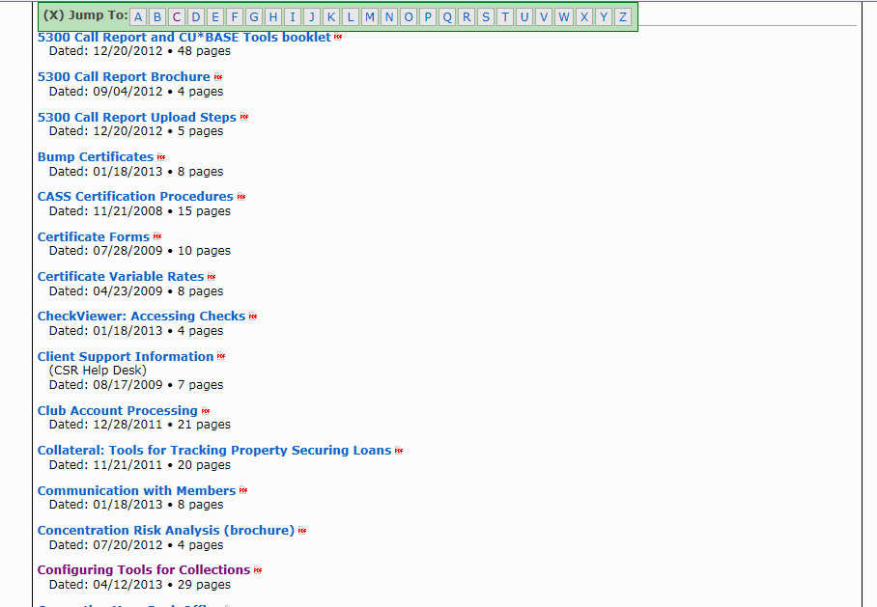
Configuring Tools for Collections Booklet

Slide 12
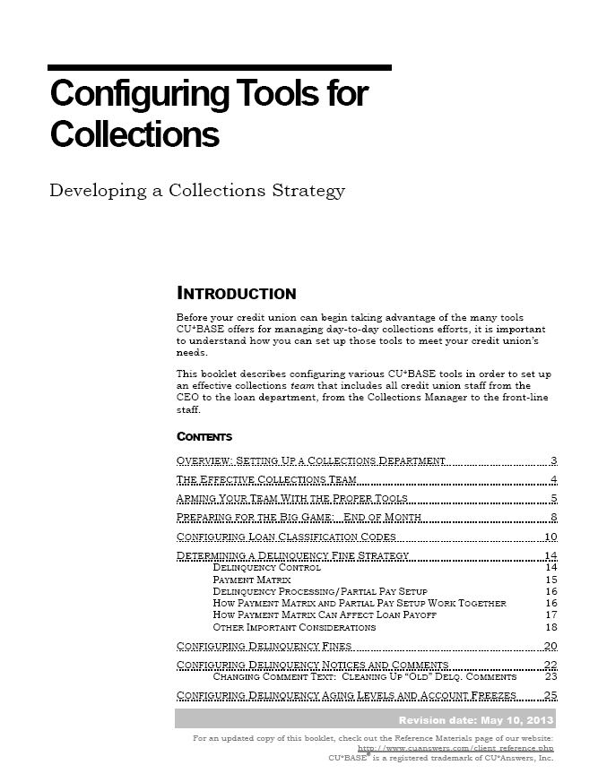
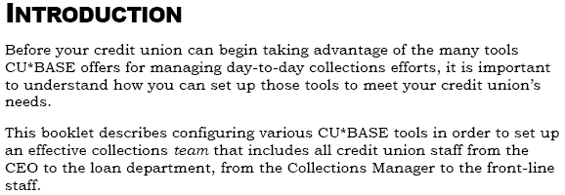
Configuring Tools for Collections Booklet

Slide 13
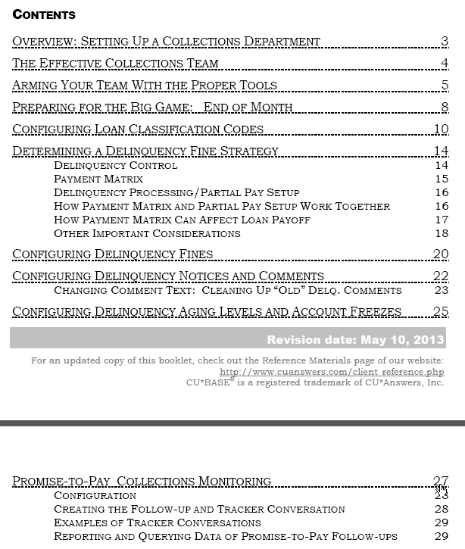
Configuring Tools for Collections Booklet

Slide 14
Fun Fact
Configuring Tools for Collections Booklet
How much money does the collection industry save the average American household per year?
Insert an arrow in the box with the correct answer.
$0
$354
$1,289

Slide 15
Fun Fact Answer
Configuring Tools for Collections Booklet
$354
(source: http://www.acainternational.org/files.aspx?p=/images/13005/j-creditindustryfacts.pdf)
“An independent study by PricewaterhouseCoopers found the collection industry saves the average American household $354 a year. This represents money consumers would have spent if businesses raised their prices to cover losses to bad debt instead of recovering the revenue through a collection agency.”

Slide 16
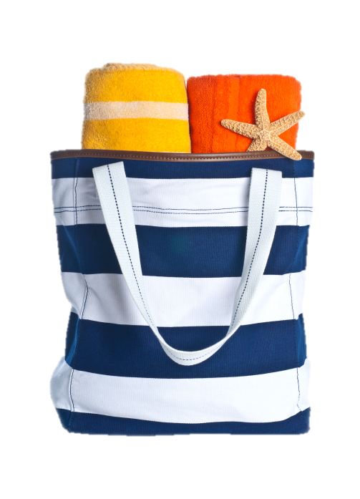
Fun Fact Prize
Configuring Tools for Collections Booklet
Great job!
You’ve won a set of beach towels!

Slide 17
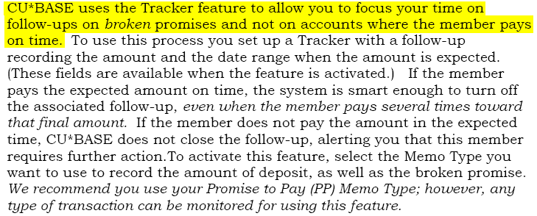
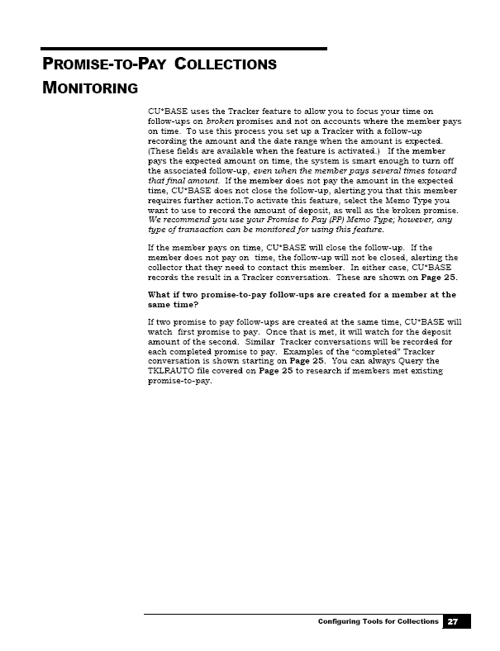
Configuring Tools for Collections Booklet

Slide 18
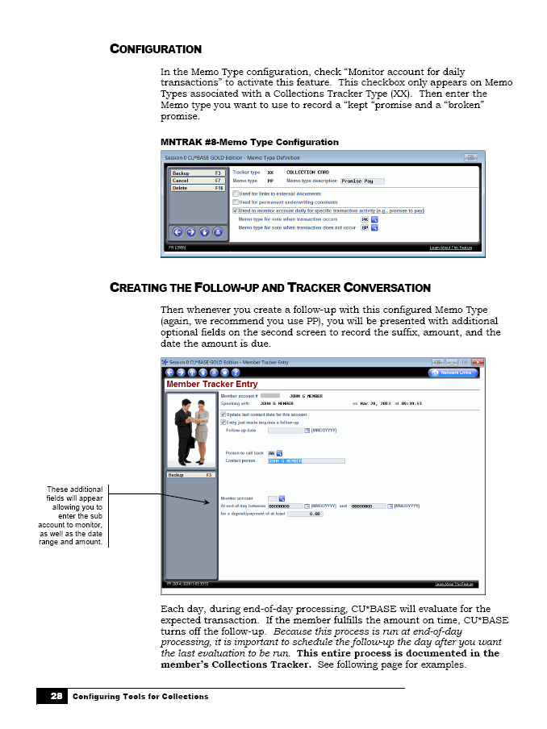
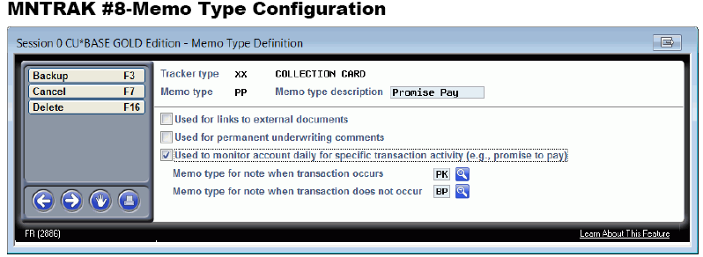
Configuring Tools for Collections Booklet

Slide 19
Configuring Tools for Collections Booklet

Slide 20
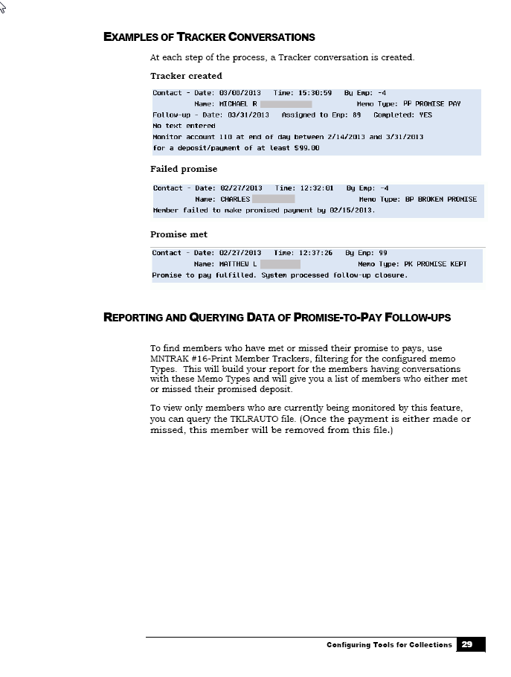
Configuring Tools for Collections Booklet

Slide 21
Pop Quiz
Configuring Tools for Collections Booklet
How will you know that the member hasn’t made a payment?
Insert an arrow in the bubble with the right answer.
C
Both A and B.
A
It will be evident in the member’s Collections Tracker.
B
The follow-up will remain open.

Slide 22
Pop Quiz Answer
Configuring Tools for Collections Booklet
C
It will be evident in the member’s Collections Tracker and the follow-up will remain open.

Slide 23
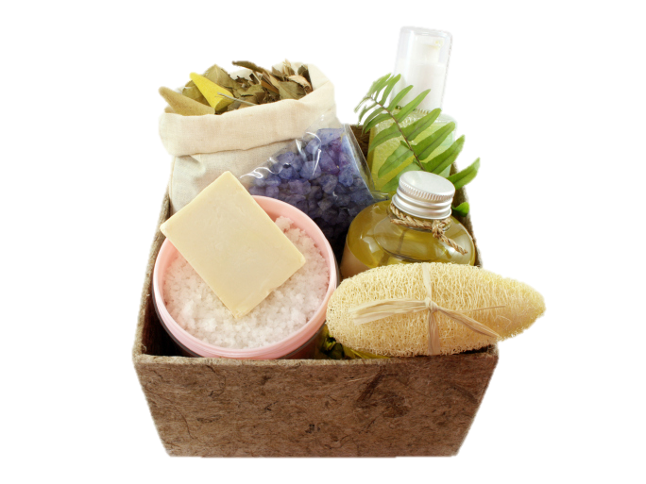
Pop Quiz Prize
Configuring Tools for Collections Booklet
Bravo! You’ve won a home spa set!

Slide 24
Configuring Tools for Your Loan Team Booklet

Slide 25
Configuring Tools for Your Loan Team Booklet
Which feature are you most interested in learning more about?
Insert an arrow on one of the sticky notes.
App Check
Permanent Underwriting Comments
Underwriting Approval Limits

Slide 26
Configuring Tools for Your Loan Team Booklet
Please follow along in this webinar while I show you how to find this booklet.

Slide 27
Configuring Tools for Your Loan Team Booklet

Slide 28
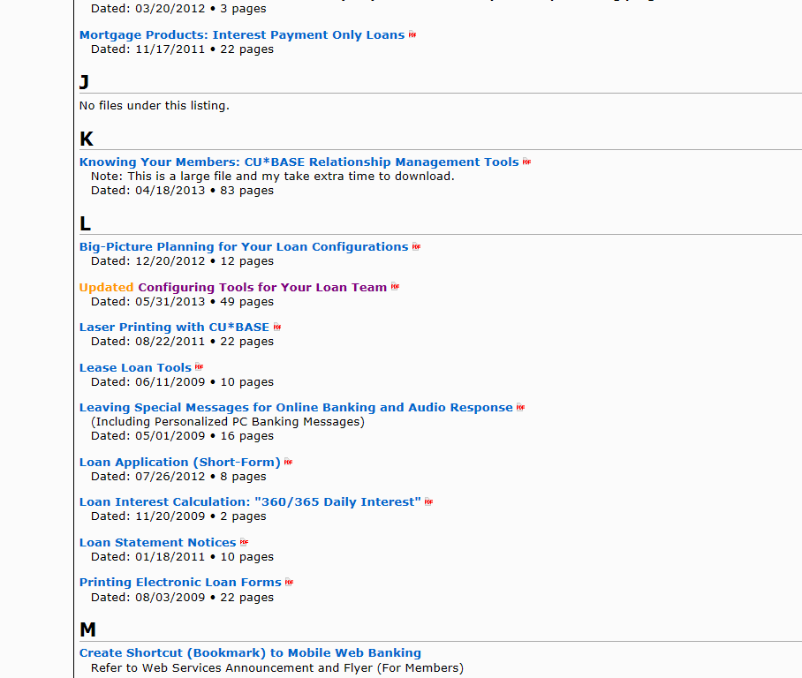
Configuring Tools for Your Loan Team Booklet

Slide 29
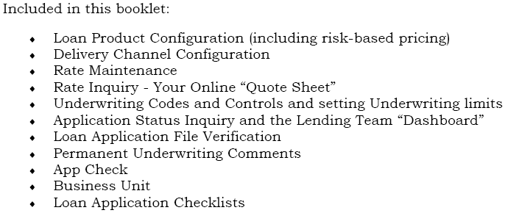
Configuring Tools for Your Loan Team Booklet

Slide 30
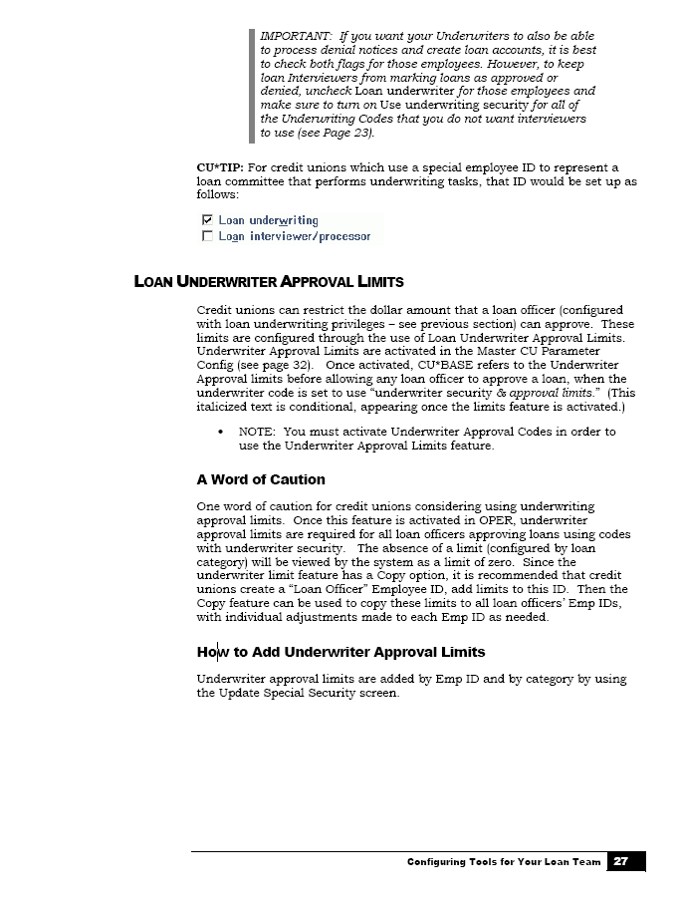
Configuring Tools for Your Loan Team Booklet

Slide 31
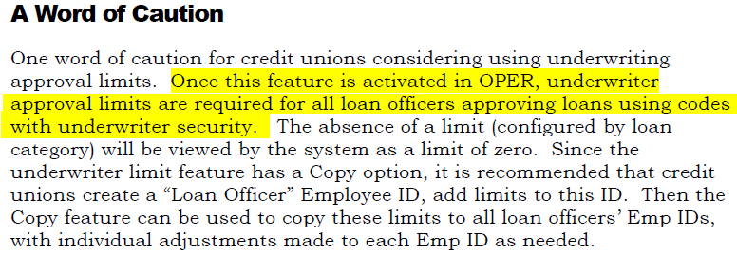
Configuring Tools for Your Loan Team Booklet

Slide 32
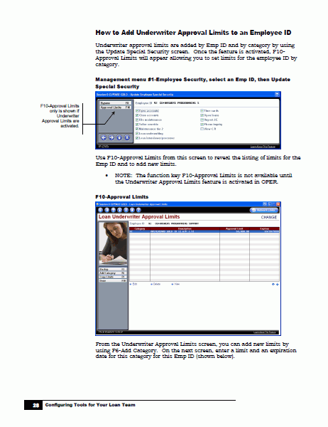
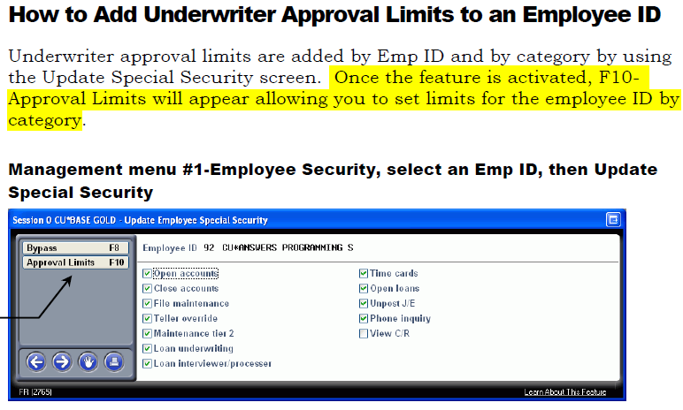
Configuring Tools for Your Loan Team Booklet

Slide 33
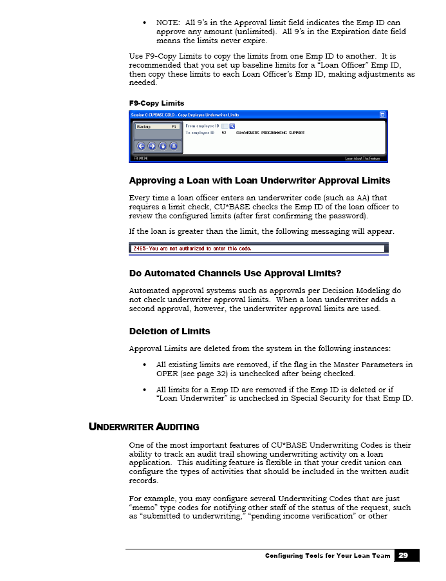
Configuring Tools for Your Loan Team Booklet

Slide 34
Pop Quiz
Configuring Tools for Your Loan Team Booklet
Are underwriter approval limits added for each employee separately or for all staff at the credit union?
Insert an arrow in the square with the right answer.
For each employee separately
For all staff at the credit union

Slide 35
Pop Quiz Answer
Configuring Tools for Your Loan Team Booklet
For each employee separately

Slide 36
Pop Quiz Prize
Configuring Tools for Your Loan Team Booklet
Excellent! You’ve won a box of Belgian chocolates!

Slide 37
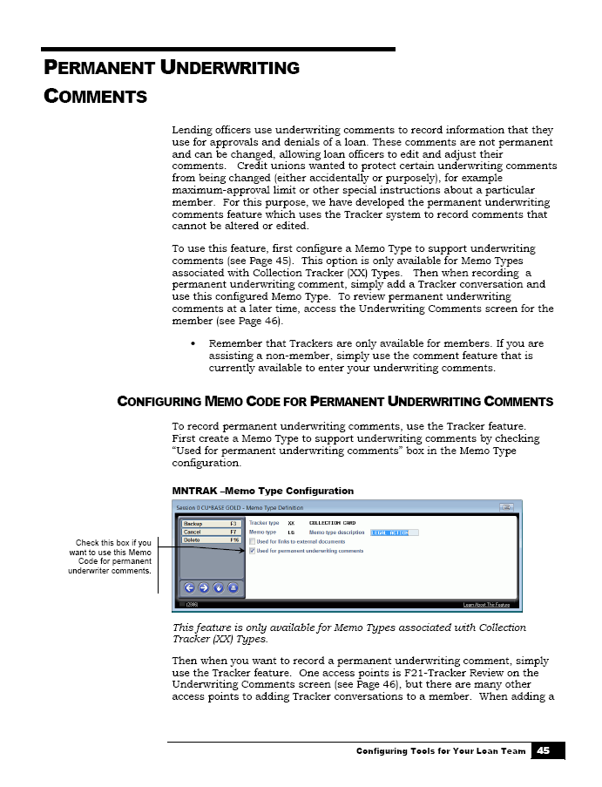
Configuring Tools for Your Loan Team Booklet

Slide 38
Configuring Tools for Your Loan Team Booklet

Slide 39
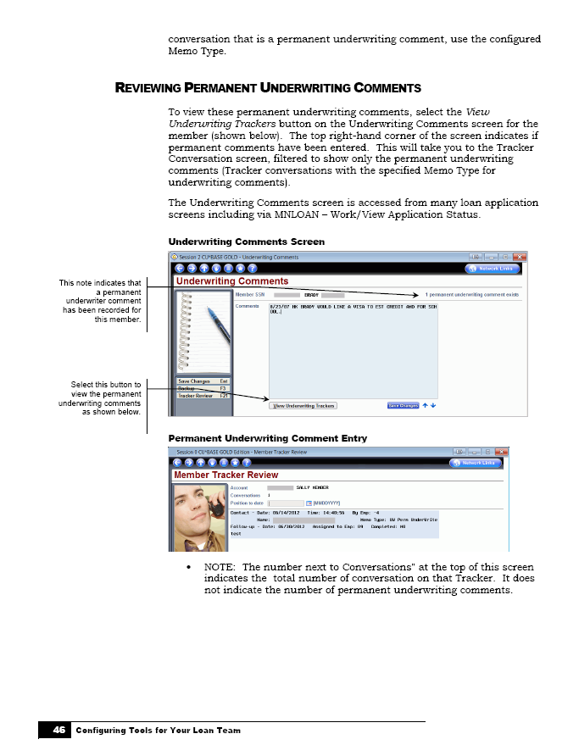
Configuring Tools for Your Loan Team Booklet

Slide 40
We want your input!
Configuring Tools for Your Loan Team Booklet
Do you think it would be a good idea to have permanent underwriting comments that cannot be changed or deleted?
Insert an arrow on or beside one of the rings.
Yes
Not sure
No

Slide 41
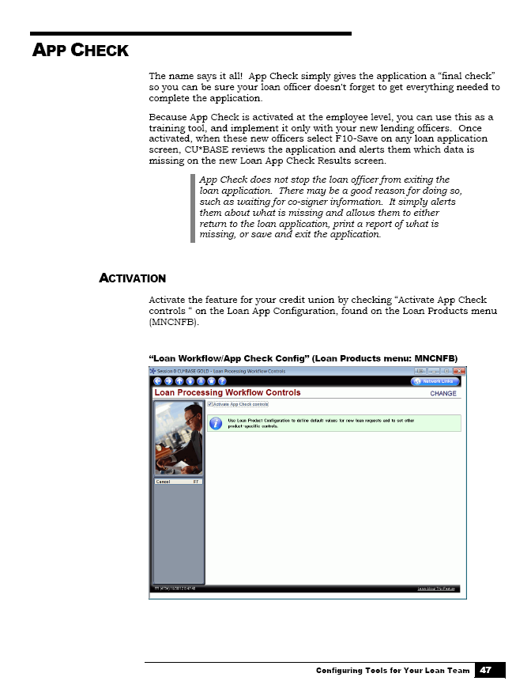
Configuring Tools for Your Loan Team Booklet

Slide 42
Configuring Tools for Your Loan Team Booklet

Slide 43
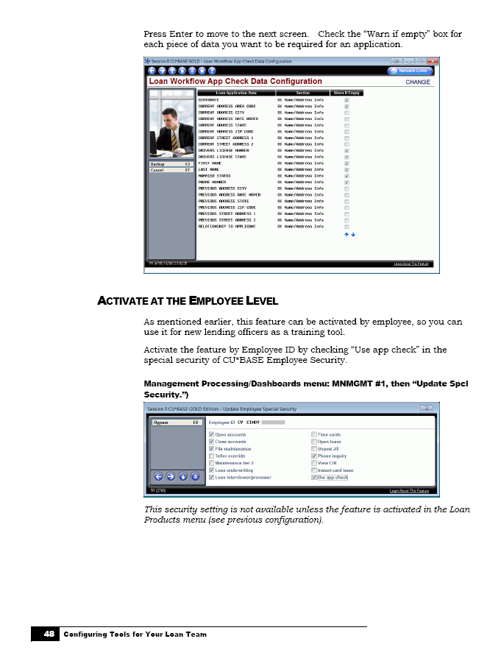
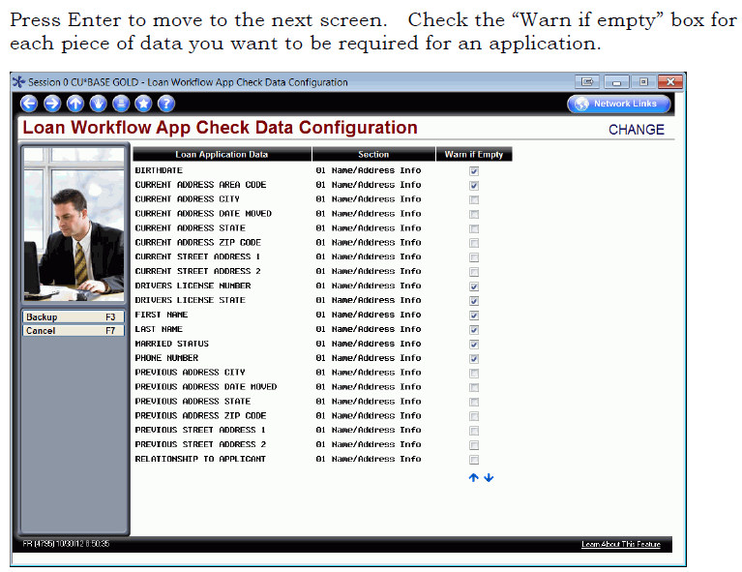
Configuring Tools for Your Loan Team Booklet

Slide 44
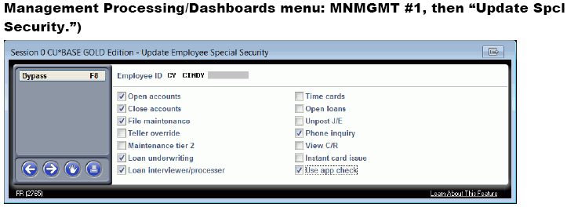
Configuring Tools for Your Loan Team Booklet

Slide 45
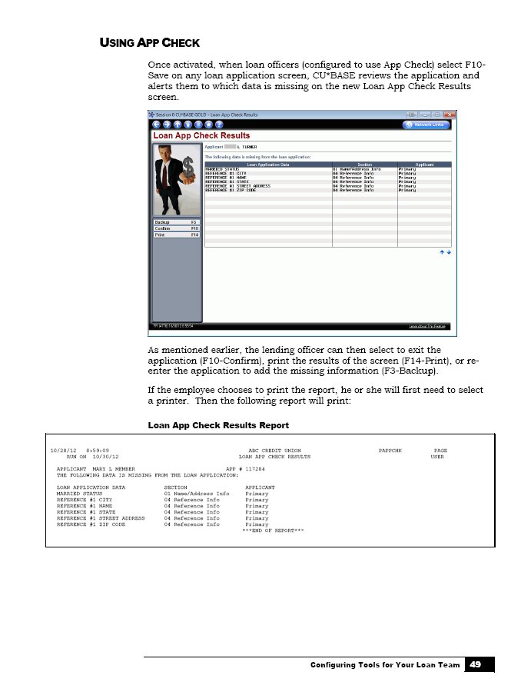
Configuring Tools for Your Loan Team Booklet

Slide 46
Takeaways
Webinar Wrap-Up
On the whiteboard:
Write down your most valuable takeaway from today’s webinar.

Slide 47
Thank you for attending the June Tricks of the Trade webinar!
For questions regarding today’s topics. Please refer to the documentation referenced in today’s webinar:
Configuring Tools for Collections booklet: http://www.cuanswers.com/pdf/cb_ref/C-Collections_Tools.pdf
Configuring Tools for Your Loan Team booklet: http://www.cuanswers.com/pdf/cb_ref/LoanTeamTools.pdf
See you at next month’s Tricks of the Trade webinar!

