Slide 1
Welcome to the February Tricks of the Trade
webinar!

Slide 2
What is Tricks of the Trade?
From brochures to booklets,
From charts to checklists,
From flyers to forms,
There is a lot of documentation on our website about CU*BASE and the programs and features it offers. That’s why each month, we send you a Tricks of the Trade email and hold this companion webinar, to highlight
key documents that will make your job easier!

Slide 3
What is Tricks of the Trade?

Slide 4
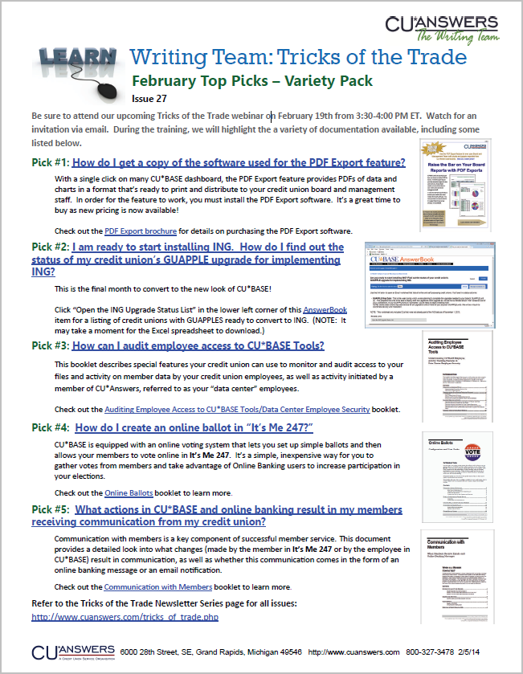
What is Tricks of the Trade?

Slide 5
What is Tricks of the Trade?

Slide 6
What is Tricks of the Trade?

Slide 7
What is Tricks of the Trade?

Slide 8
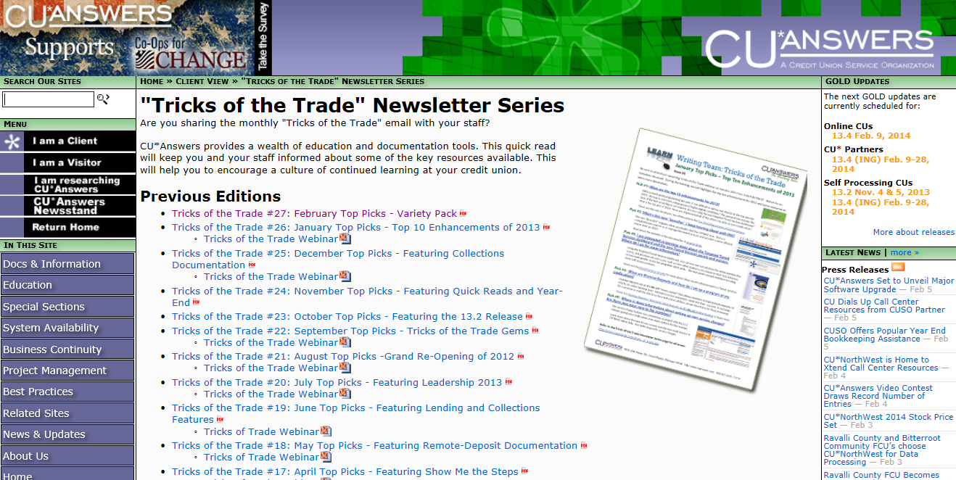
What is Tricks of the Trade?
Check out all our Tricks of the Trade webinar presentations and newsletters: http://cuanswers.com/tricks_of_trade.php

Slide 9
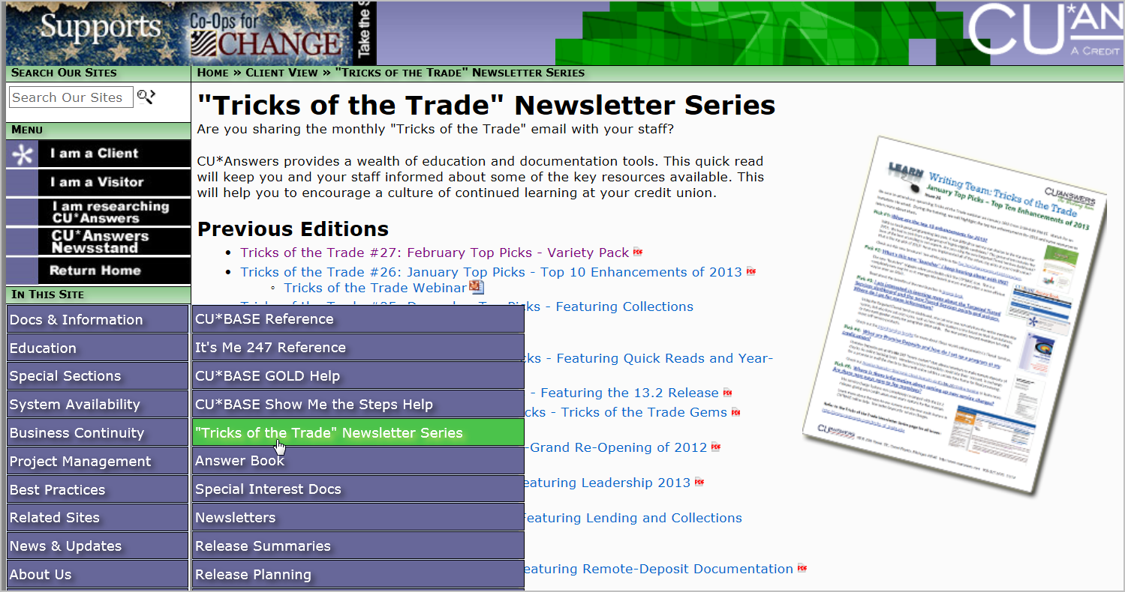
What is Tricks of the Trade?

Slide 10
Ice Breaker
Insert an arrow next to your favorite picture.
Calendar
Red Velvet Cake
Crazy Heart
Many hearts
Chocolate Heart
One Heart

Slide 11
Fun Fact
Featuring February’s Top Picks
How many boxes of chocolate are sold on Valentine’s Day?
Insert an arrow in the box with the correct answer.
38 million pounds
48 million pounds
58 million
pounds

Slide 12
Fun Fact Answer
Featuring February’s Top Picks
48 million pounds
Source: Google
https://www.google.com/#q=how+much+chocolate+is+sold+for+valentine's+day

Slide 13
Fun Fact Prize
Featuring February’s Top Picks
Great job!
Yum! Here’s some more!

Slide 14
Focus of This Month’s Webinar: February Picks – Variety Pack
Today we’ll review a variety of documentation resources.

Slide 15
PDF Export Brochure

Slide 16
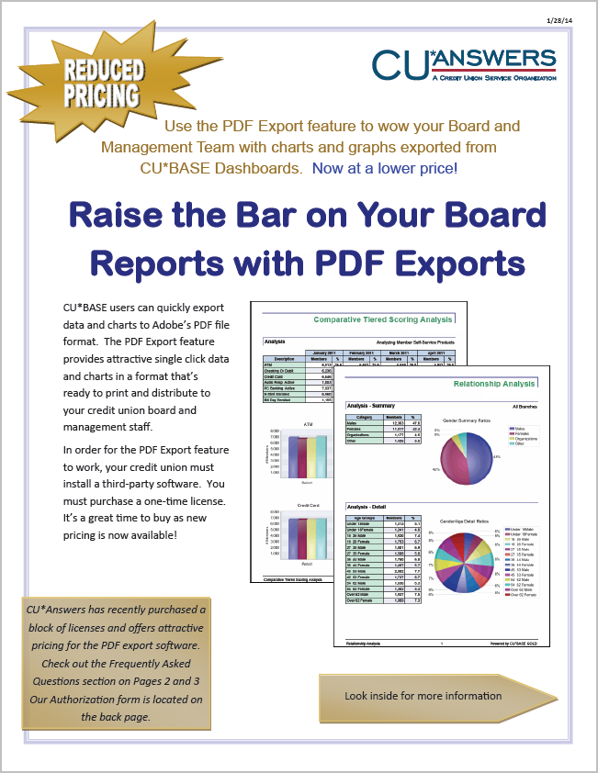
PDF Export Brochure

Slide 17
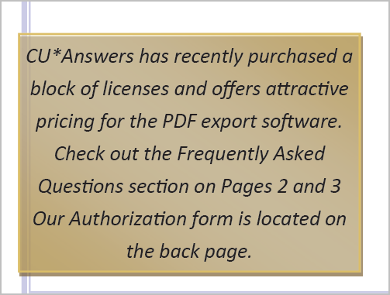
PDF Export Brochure

Slide 18
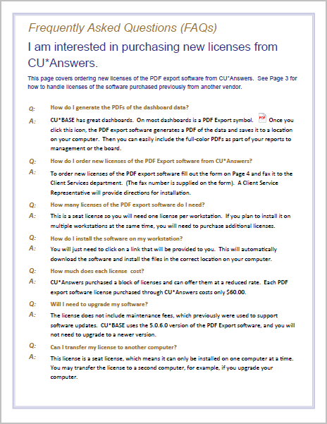
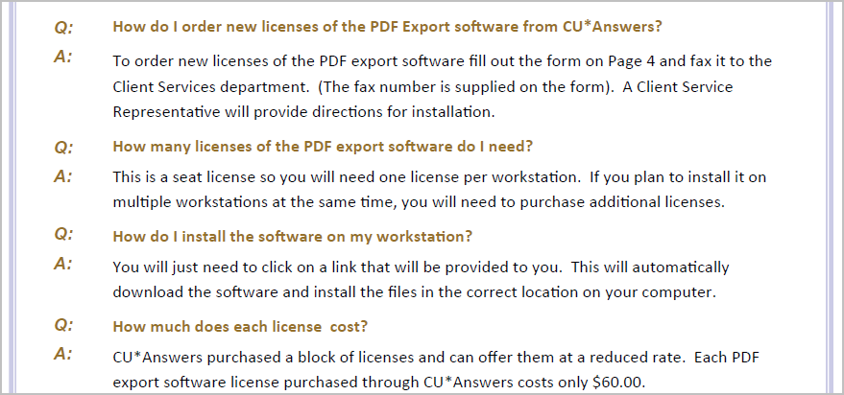
PDF Export Brochure

Slide 19
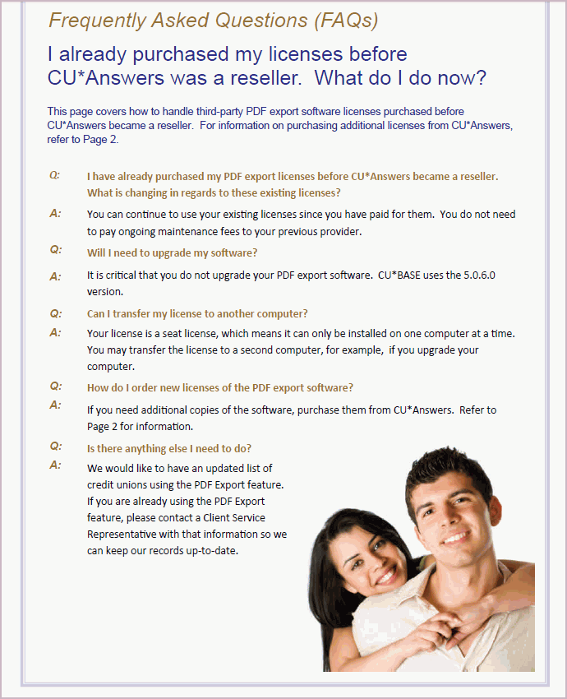
PDF Export Brochure

Slide 20
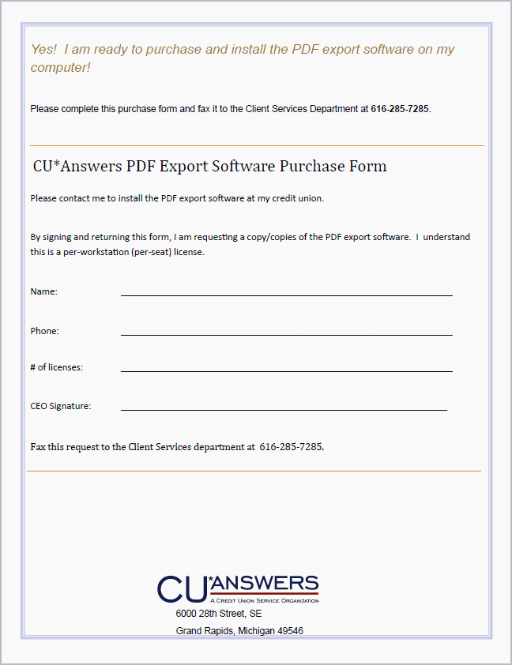
PDF Export Brochure

Slide 21
PDF Export Brochure

Slide 22
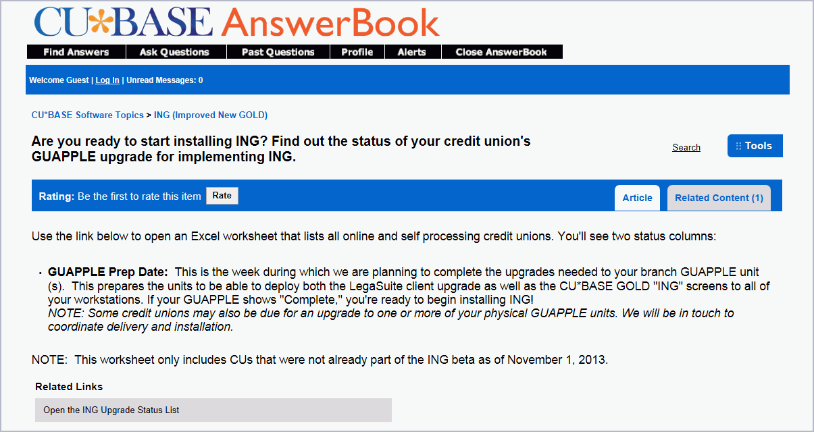
PDF Export Brochure

Slide 23
Auditing Employee Access

Slide 24
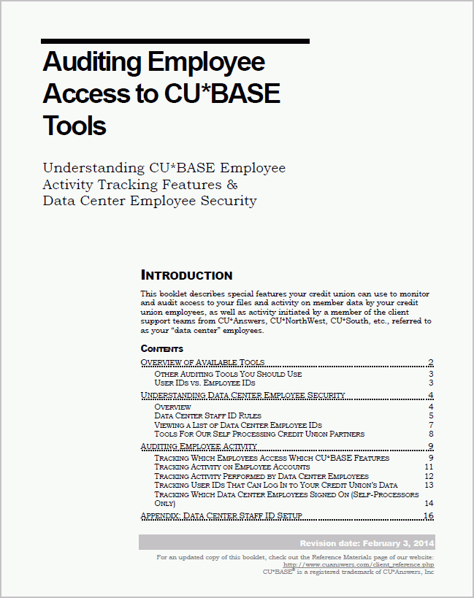
Auditing Employee Access

Slide 25
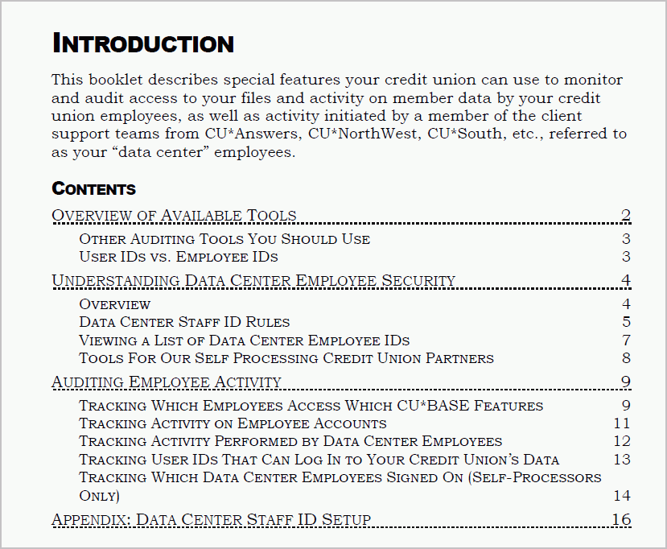
Auditing Employee Access

Slide 26
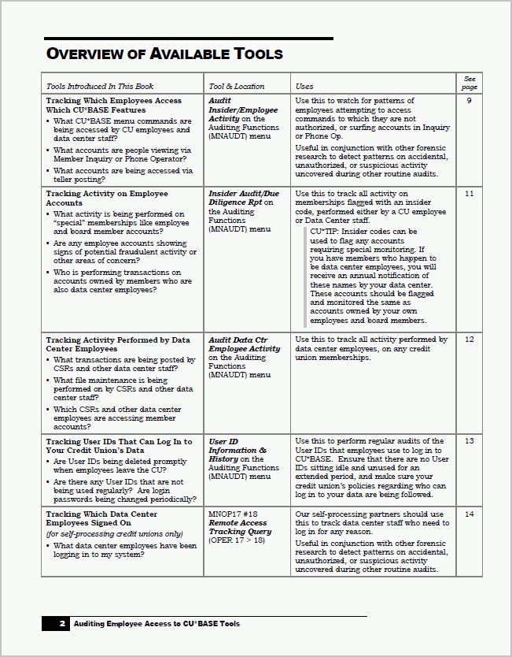
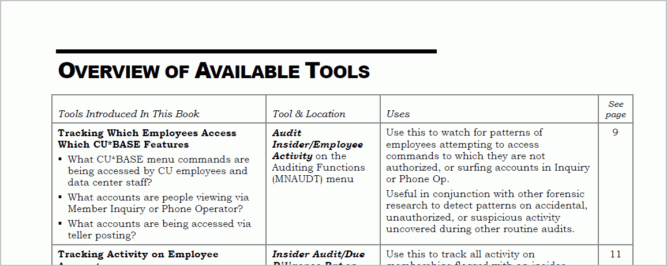
Auditing Employee Access

Slide 27
Pop Quiz
February Top Picks
Which answer is not correct?
Insert an arrow in the bubble with the right answer.
C
Fax the form to the number provided on the form.
A
The form to purchase the software is on the last page of the brochure.
B
CU*Answers pricing is more expensive.

Slide 28
Pop Quiz Answer
February Top Picks
Answer C
CU*Answers has purchased a block of licenses and are selling them at a reduced rate.

Slide 29
Pop Quiz Prize
February Top Picks
Bravo! You’ve won a hot cinnamon bun.

Slide 30
Online Ballots

Slide 31
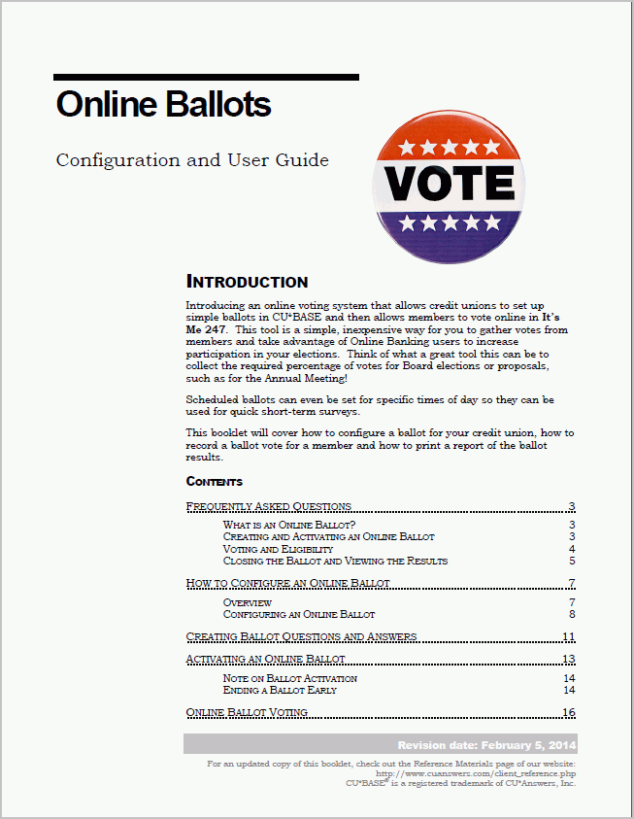
Online Ballot

Slide 32
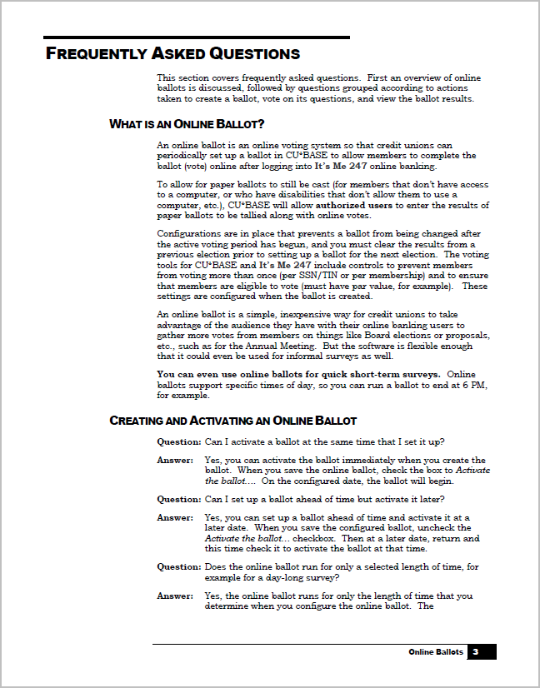
Online Ballot

Slide 33
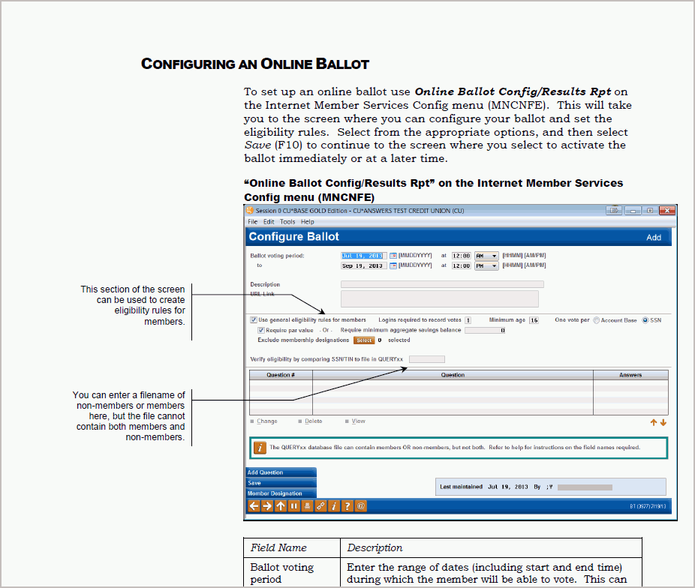
Online Ballot

Slide 34
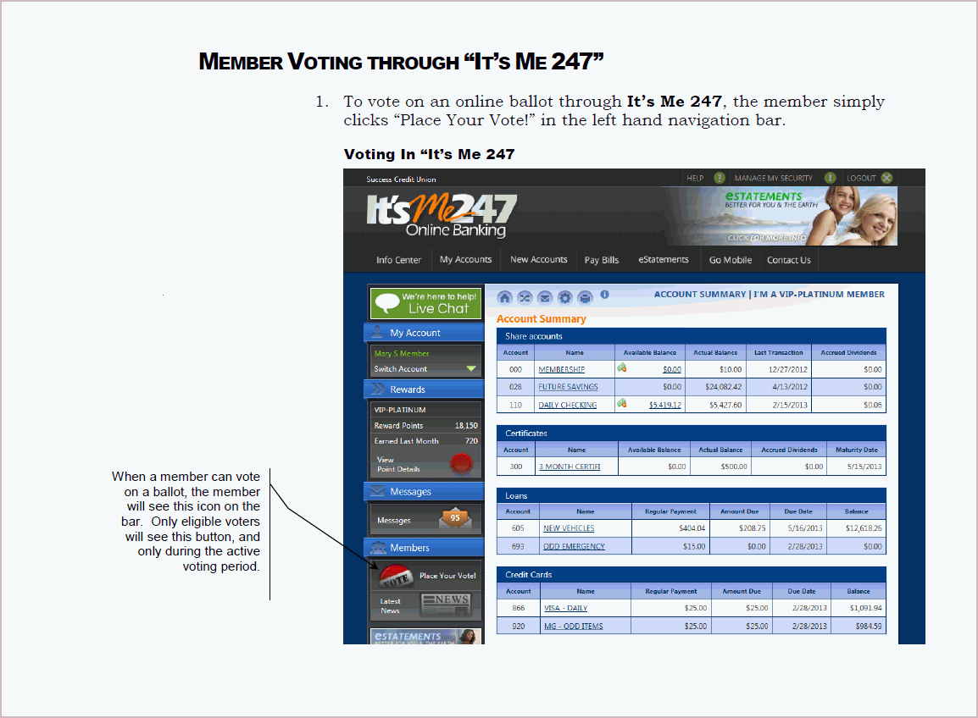
Online Ballot

Slide 35
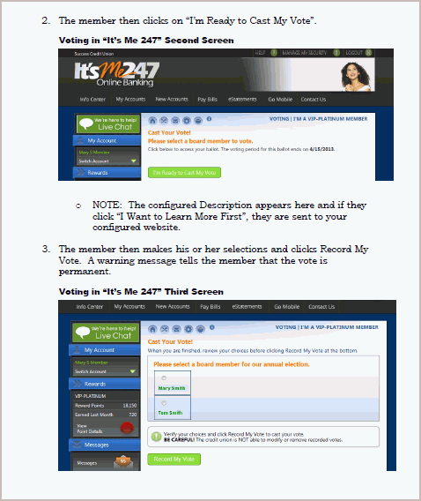
Online Ballot

Slide 36
Online Ballot

Slide 37
Pop Quiz
February Top Picks
Can a member cast their vote both online and in a branch?
Insert an arrow in the square with the right answer.
Yes
No

Slide 38
Pop Quiz Answer
February Top Picks
Yes, a member can cast a vote online and an employee can assist a member with voting in CU*BASE.

Slide 39
Pop Quiz Prize
February Top Picks
Excellent! You’ve won a juicy hamburger!

Slide 40
Communication with Members

Slide 41
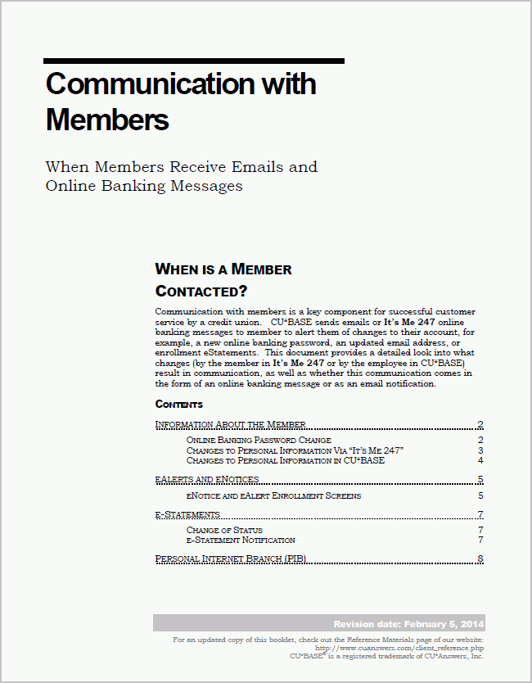
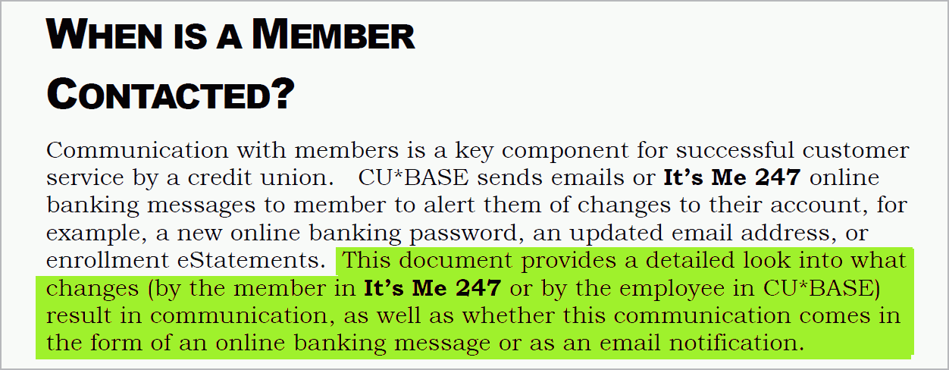
Communication with Members

Slide 42
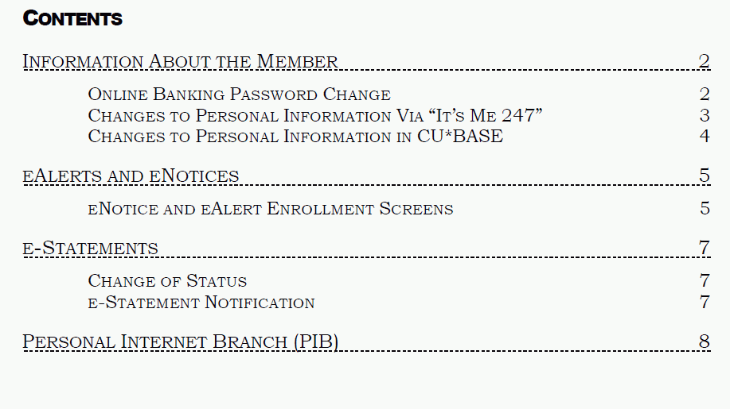
Communication with Members

Slide 43
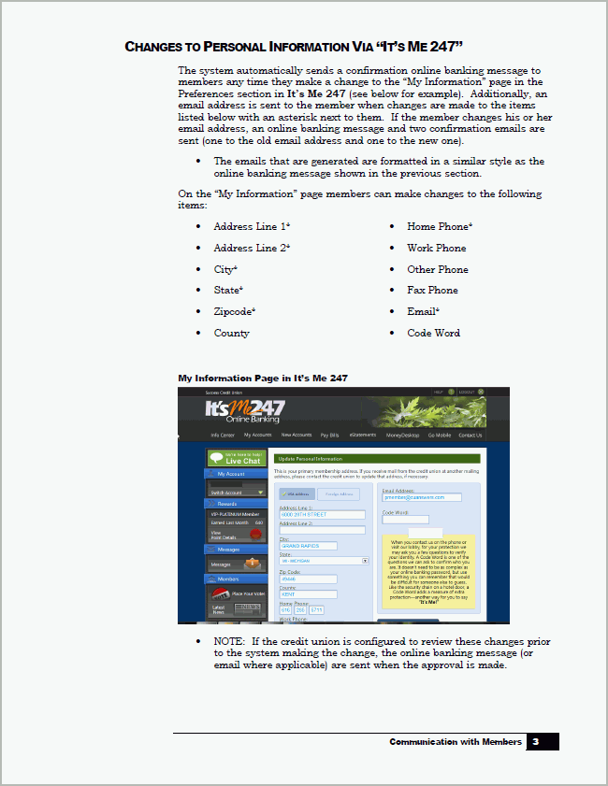
Communication with Members

Slide 44
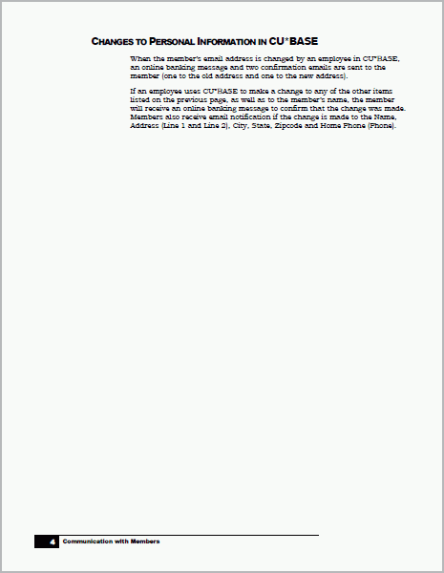
Communication with Members

Slide 45
Takeaways
Webinar Wrap-Up
On the whiteboard:
Write down your most valuable takeaway from today’s webinar.

Slide 46
Thank you for attending the February Tricks of the Trade webinar!
For questions regarding today’s topics. Please refer to the documentation referenced in today’s webinar:
http://cuanswers.com/pdf/cb_ref/Documentation_Tricks_of_the_Trade27.pdf
http://www.cuanswers.com/pdf/cb_ref/pdf_export.pdf
https://kb.cuanswers.com/cuanswers/ext/kbdetail.aspx?kbid=3924
http://www.cuanswers.com/pdf/cb_ref/DCEmpSecurity.pdf
http://www.cuanswers.com/pdf/cb_ref/onlineballot.pdf
http://www.cuanswers.com/pdf/cb_ref/communication_with_members.pdf
See you at next month’s Tricks of the Trade webinar!

