Slide 1


CEO School
Responding to the challenges of big data
Welcome!
November 5 & 7, 2013

Slide 2
What is CEO School?
We Are All Cooperative Business Designers
Why has CEO School become a tradition at CU*Answers?
With the expansion of our network, we have more talented CEOs than ever, and the value put on collaborative efforts is at an all time high
CEOs need to develop networks where they can coach and mentor each other from the unique position of being a CEO
More than ever, today’s CEO is expected to be engaged with technology and the concepts of data mining, opportunity demographics, and being plugged in
CEOs wear more than one hat, and CEO School is a safe training environment

Slide 3
CEO School speaks to the essence of why credit unions own CU*Answers: so that their voice is heard, their ideas are worked on, and their priorities are considered as part of everything this CUSO tries to accomplish

Slide 4
Confirming Grasp in a Challenging World
Are you ready to compete in a self-service database world?
As CEOs, we know that the requirements of our job and the expectations of the teams and our employers are changing dramatically with each new gadget that comes onto the market
  It’s a database world, it’s a search engine world, it is the day of the presentation, live and in color
  No longer can we rely on others to give us information, press the buttons for us, or type up black-and-white Word documents to carry our message
Understanding where and how to look for current information is trumping experience – in today’s world, you need both
Can your stakeholders testify to your grasp of today’s credit union database and what it means to success?
CEOs cannot afford to assume that past talents will ensure their future careers

Slide 5

Today’s Agenda
Actionable Analytical Approach 2.0
Are you ready to extend data and your insight to the customer-owner?
Patronage Databases
The cornerstone of cooperative business financial engines – what’s the key to the CU’s success, member money or member activity?
Big projects where CEOs need to lead the way
Do we know the difference between our day-to-day jobs and the ones we should do to change the next decade?

Slide 6
Actionable Analytical Approach 2.0
Are you ready to extend data and your insight to the customer-owner?

Slide 7
A.A.A. 1.0: A Rating for CU Management
A quick refresher
Actionable
Analysis with an expected outcome: I will act
  Before you ask for data, before you read a report, before you hear a proposal for action, you already anticipate doing something
  Data is not just noise to you
Analytical
The ability to analyze: A budgeted commitment
  You’ve prioritized analysis, put some of your best thinkers on the project, budgeted time and cash to the project, and you’re determined to get an ROI on the data work you do
Approach
A manner in which a problem is solved: A plan
  You’ve made a commitment to yourself and your Board that this is a management priority and approach
  You’ve sold it as one of your talents

Slide 8
A.A.A. 1.0: A Rating for CU Management
A quick refresher
You’re here to commit to action by knowing what is possible
Actionable
Analysis with an expected outcome: I will act
  Before you ask for data, before you read a report, before you hear a proposal for action, you already anticipate doing something
  Data is not just noise to you
Analytical
The ability to analyze: A budgeted commitment
  You’ve prioritized analysis, put some of your best thinkers on the project, budgeted time and cash to the project, and you’re determined to get an ROI on the data work you do
Approach
A manner in which a problem is solved: A plan
  You’ve made a commitment to yourself and your Board that this is a management priority and approach
  You’ve sold it as one of your talents
How could CU*Answers build a collaborative investment for analysis?
Why we’re all here: to share and exchange plans in the hope that a group of thinkers is better than one

Slide 9
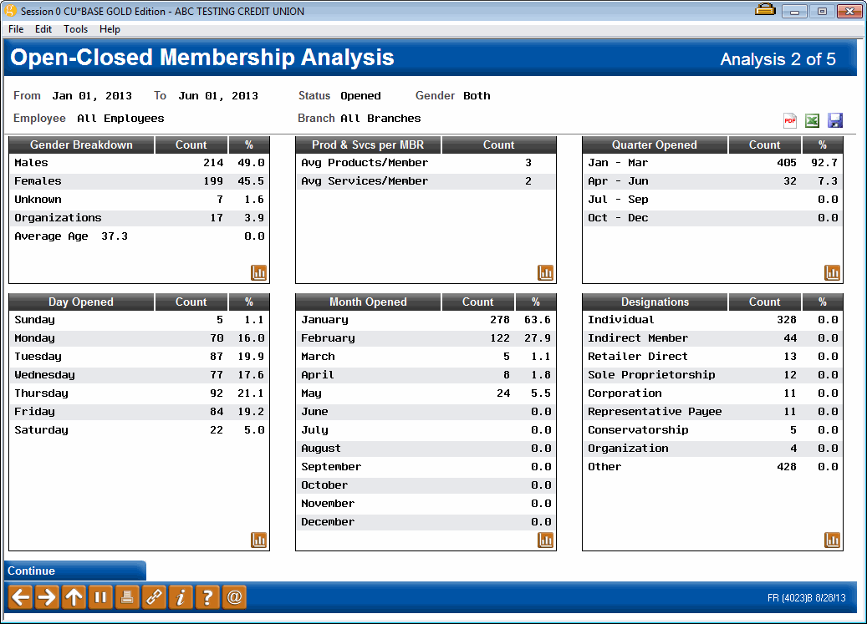
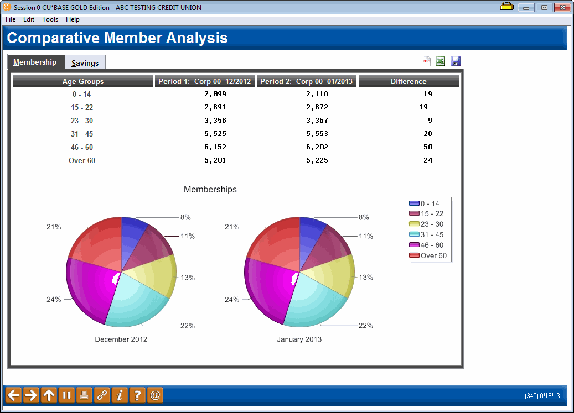
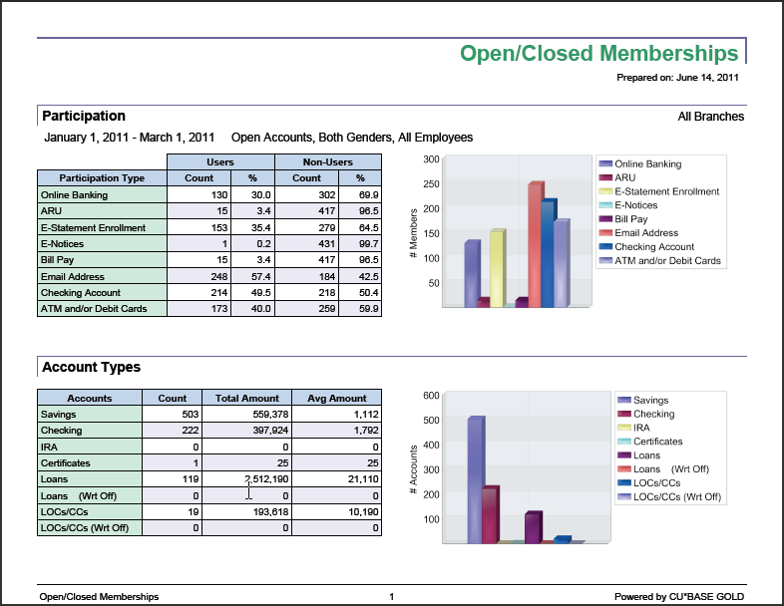


A.A.A. 1.0: A Rating for CU Management
Continuing to develop presentation skills
Where are you on the evolution of data presentation in your operation?
  We’ve gone from print, to on-screen presentation, to delivering PDFs...and today we’re discussing web presentations
  Are you maximizing all of your options? With your staff? With your senior team?
  Can you move data directly to your board
  and the everyday customer-owner?
Who at your credit union has a graphical eye that could add to the development effort focused on presenting data to win?

Slide 10
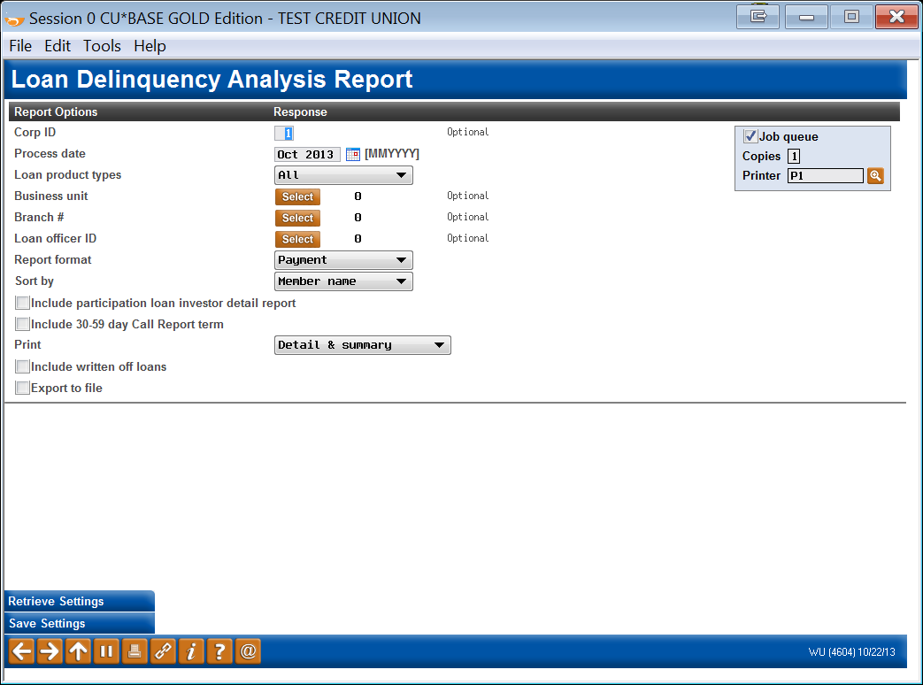
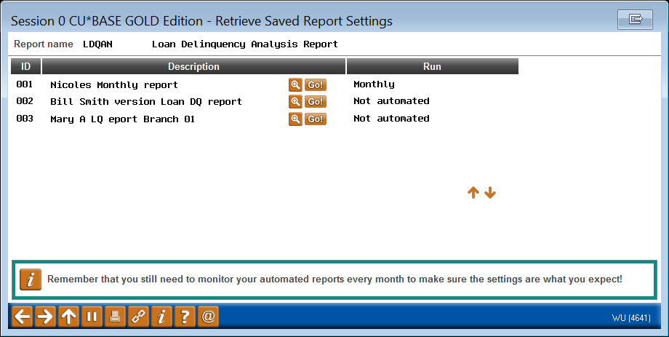

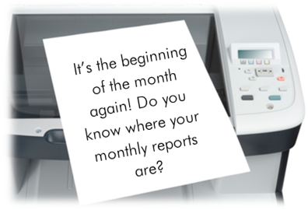
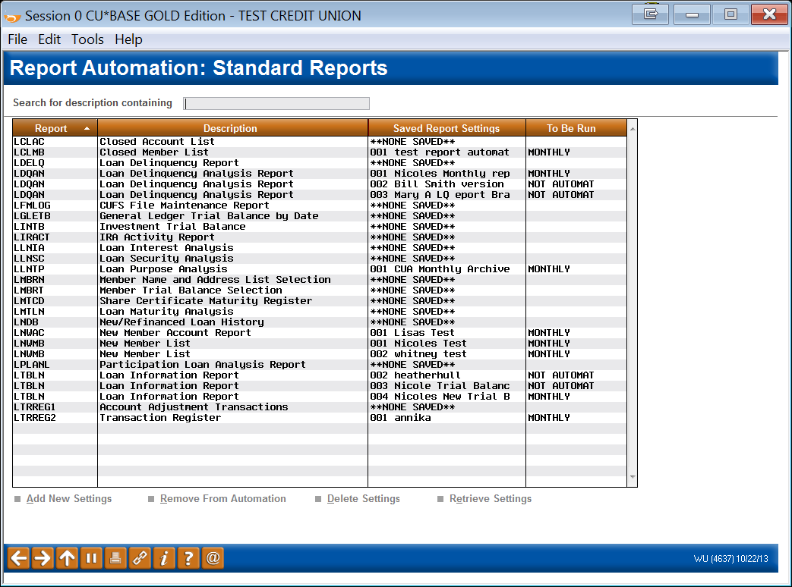
Another tool to get a better return on gathering data
Report/Query Scheduler
Can you verify that you have upped your game in the last 12 months?
We’re working on even more options here...is your team part of this effort for efficiency?
Notes:
If he asks how many reports have been automated, go to MNCNFX #24 Standard Reports and look at the list there (22 of them)
more are coming in future release (Proj# 31833) - primarily Participation Loan reports for NMS

Slide 11
Why We Gather Data
Is it by plan, or just the result of your team’s daily activities?
To comply with archival regulations and best practices
To validate and affirm the results of our efforts
  To present to examiners and Board members and create a corporate record
  To present to management and use in performance analysis (staff)
  To comply with third-party obligations such as the 5300
To analyze and calculate adjustments to our plans and futures
  Know our member and make adjustments to keep their attention
  Know our operations and make adjustments to build an effective factory
  Know our identity and validate the response to who you think you are
  Know our plan through verifying the hypothesis and the hopeful outcome
Gathering Data (reduce $ cost)
Analyzing Data (increase time)
Acting on Data (multiply the events)
When was the last time you really challenged your ROI on these activities and your effectiveness around crafting designs and planning data-related tactics?

Slide 12
Why We Gather Data
Is it by plan, or just the result of your team’s daily activities?
As the CEO of CU*Answers and the Chairman of eDOC Innovations, I’ve never had a CU ask me how to gather less data
Most of you can’t wait to gather more, store more, and move ahead at a faster pace for everything – including spending more money
Is that our plan, or just the fallout of our daily activities?
To comply with archival regulations and best practices
To validate and affirm the results of our efforts
  To present to examiners and Board members and create a corporate record
  To present to management and use in performance analysis (staff)
  To comply with third-party obligations such as the 5300
To analyze and calculate adjustments to our plans and futures
  Know our member and make adjustments to keep their attention
  Know our operations and make adjustments to build an effective factory
  Know our identity and validate the response to who you think you are
  Know our plan through verifying the hypothesis and the hopeful outcome
Gathering Data (reduce $ cost)
Analyzing Data (increase time)
Acting on Data (multiply the events)
When was the last time you really challenged your ROI on these activities and your effectiveness around crafting designs and planning data-related tactics?

Slide 13
A.A.A. 2.0: Thinking Bigger
Putting insiders and outsiders on equal footing
Do the math:
A cooperative with 5,000 participants
5,000
One formula to consider when looking at how to design a cooperative:
You (the designer) want as many participants in your cooperative (customers) as possible
Of those unlimited customers, you work to make at least 60% of them identify themselves as owners
Of those people who call themselves owners, you work even harder to make a third of them active, to yield a 20% active owner base among all participants
All participants
3,000
Owner-aware participants
Active owners
1,000
Whatever formula you use, you need one
It sets targets, helps you prioritize
the plans, and balances your investment:
Get a plan and make sure everyone knows it

Slide 14
Putting insiders and outsiders on equal footing
Boundary for private member data
Boundary for board-restricted data
CU Users
Logged in to CU*BASE
CU Executives
Not logged in to CU*BASE
Members
Volunteers,
Customer-Owners
Heavily controlled for security
and member privacy
A mobile, fluid, and changing space that needs data automation
Easier to reach than ever before;
a place to change the perception
of CUs
Movement of credit union data
How can we leverage our investment in the processes that generate data (CU*BASE and It’s Me 247) into spaces for new opportunity and service?

Slide 15

Putting insiders and outsiders on equal footing
Boundary for private member data
Boundary for board-restricted data
CU Users
Logged in to CU*BASE
CU Executives
Not logged in to CU*BASE
Members
Volunteers,
Customer-Owners
Heavily controlled for security
and member privacy
A mobile, fluid, and changing space that needs data automation
Easier to reach than ever before;
a place to change the perception
of CUs
Can we build a new software product to
reach every stakeholder in a credit union cooperative?
Can we set ourselves apart with the model no one else has tried yet?

Slide 16




“It’s My Data 247”
What this brand might mean to you
Take this literally:
“This is MY DATA, as the CEO of the credit union. I write business plans that coordinate the sharing of this data with my staff, with my executive team, with credit union volunteers, and even my everyday members.”
Continued development of CU*BASE and self-service products for members
Introducing new products such as the Board website and “It’s My Data 247” for the mobile world
Introducing new products such as the Board website and “It’s My Data 247” for the mobile world
Leveraging “It’s My Data 247” through It’s Me 247 for the owner’s perspective in every member
Once we can move data to every corner of the credit union and every stakeholder, we’ll have a highway to expand on for years, whether it be inside the walls of the CU or traveling with the mobile audience

Slide 17
“It’s My Data 247”
What this brand might mean to you
For more information about
“It’s My Data 247” and the vision for progress in 2014, see the CEO Collaboration Workshop materials from Monday/Friday and connect the dots for yourself
Take this literally:
“This is MY DATA, as the CEO of the credit union. I write business plans that coordinate the sharing of this data with my staff, with my executive team, with credit union volunteers, and even my everyday members.”
Continued development of CU*BASE and self-service products for members
Introducing new products such as the Board website and “It’s My Data 247” for the mobile world
Introducing new products such as the Board website and “It’s My Data 247” for the mobile world
Leveraging “It’s My Data 247” through It’s Me 247 for the owner’s perspective in every member
Once we can move data to every corner of the credit union and every stakeholder, we’ll have a highway to expand on for years, whether it be inside the walls of the CU or traveling with the mobile audience

Slide 18
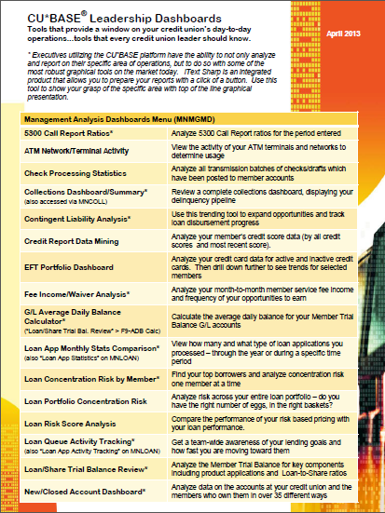
CEO Dashboards
Understanding the Potential of our Data and our Opportunities to make Data a Special Focus in our Business Plans
Notes:
This section is where he’ll spend the bulk of the time, looking at actual dashboards on PROD – he usually jumps around between CUs, based on who’s in the room
He said he might stop on each menu and ask for suggestions from the crowd first, then poke around for interesting tools to show
The trick in this section is to help him not to hurry too much

Slide 19


Signals to stop and think
Wanna keep me out of your pockets?
Build a system with us that won’t make your invoice(s) go up!
Data helps you put together the puzzle of how to succeed as a business...more importantly, how to succeed with your members
What we do together natively is the key to lower expenses and higher returns

Slide 20
CEO Dashboards
A Novelty That Has Become an Expectation
Our standard for CU*BASE dashboards:
  Select a group of records with something in common to analyze (loan apps processed between Oct 1 & 31, members who joined the CU last year, checking accounts opened last month, etc.)
  The user is presented with a series of options to work with each of these records, one at a time (approve the app, send TIS disclosures, order a debit card, etc.)
  The user is presented with a set of analyses that take the selected records and show as many pertinent facts as possible about that batch (# of apps pending, # of members who joined by age or gender, checking accounts opened by a specific employee, etc.)
Step 1 is like a report, Step 3 is like the totals or summary section on a report, but Step 2 creates a unique palette of opportunity to work and analyze at the same time
Is this gaining traction in your shop?

Slide 21
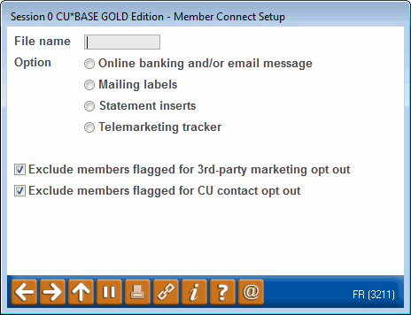
CEO Dashboards
A Novelty That Has Become an Expectation
A.A.A. Moment
Embedded in these dashboards
is the ability to go active, right now, every time...and all you have to do is plan to do so
Have you created a communication manager and assigned them regular dashboard activities to ensure a low-cost reach-out to your members?
Our standard for CU*BASE dashboards:
  Select a group of records with something in common to analyze (loan apps processed between Oct 1 & 31, members who joined the CU last year, checking accounts opened last month, etc.)
  The user is presented with a series of options to work with each of these records, one at a time (approve the app, send TIS disclosures, order a debit card, etc.)
  The user is presented with a set of analyses that take the selected records and show as many pertinent facts as possible about that batch (# of apps pending, # of members who joined by age or gender, checking accounts opened by a specific employee, etc.)
Step 1 is like a report, Step 3 is like the totals or summary section on a report, but Step 2 creates a unique palette of opportunity to work and analyze at the same time
Is this gaining traction in your shop?

Slide 22

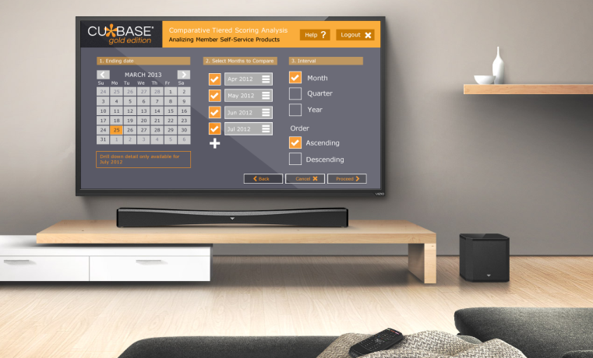
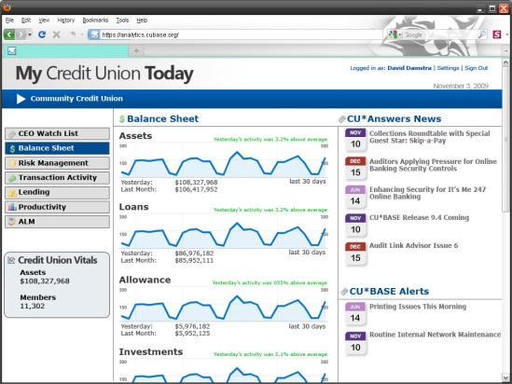
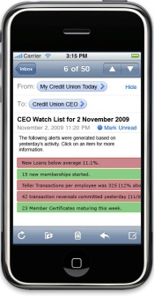
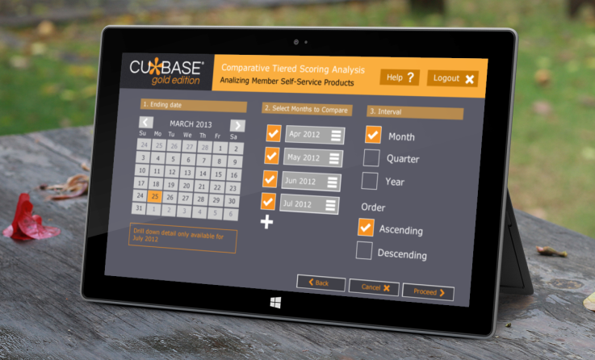
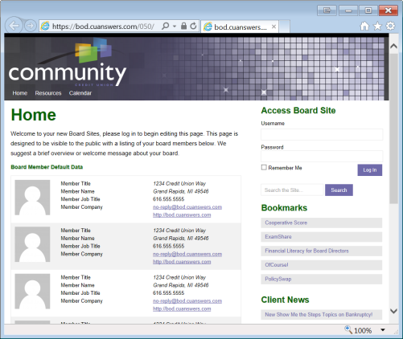
Your dual assignment for today
Focus on the data and how you could use it RIGHT NOW – know the tools
Start prioritizing data tools for
Remember, just looking at stuff won’t change anything
You need to connect ideas to action...and that’s what we are going to talk about, all day

Slide 23
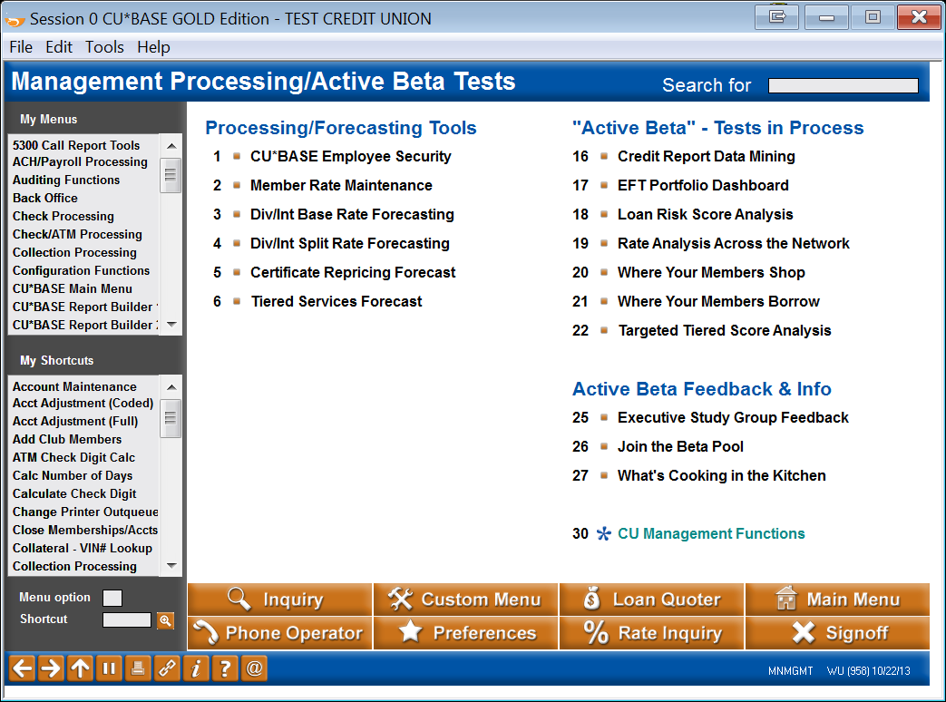
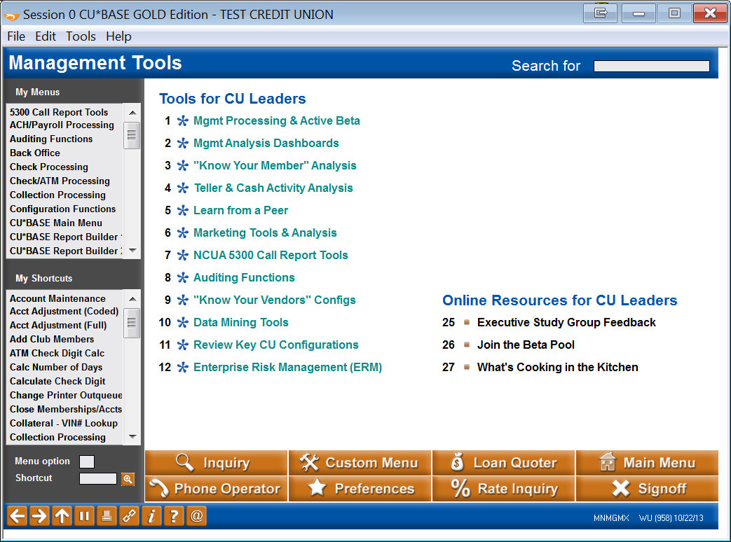

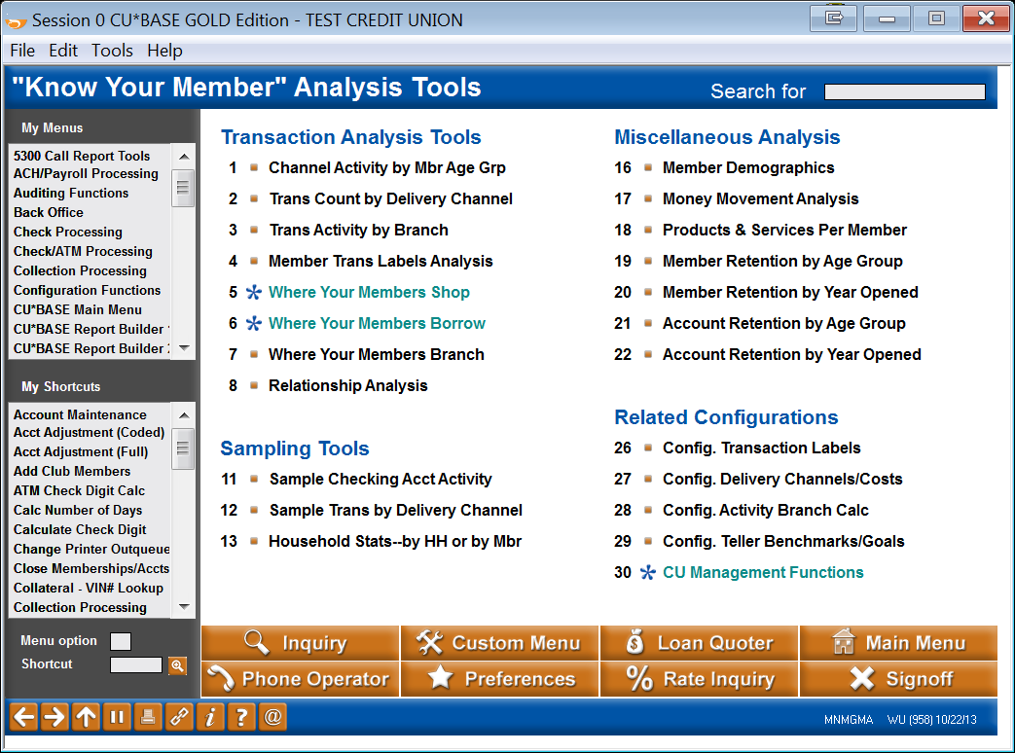
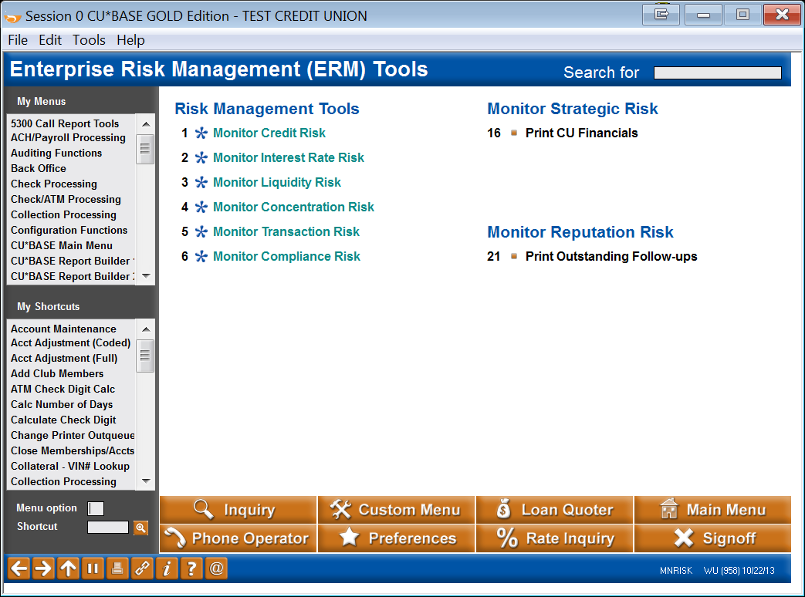
One Stop Shopping for Management Tools
Login > #4 CU Management Processing
(By the way, notice how ING emphasizes the menu name, not the MNXXXX shortcut?)
Notes:
Suggest showing the login > #4 process, then when you are navigating to these menus, as much as possible use “back” to go to MNMGMX and choose the menu name from there (rather than using the MNXXXX shortcut)

Slide 24

Management Processing/Active Beta Tests Menu
Anything here for
New!
New!
New!
New!
Enhanced!
Enhanced!
New!

Slide 25
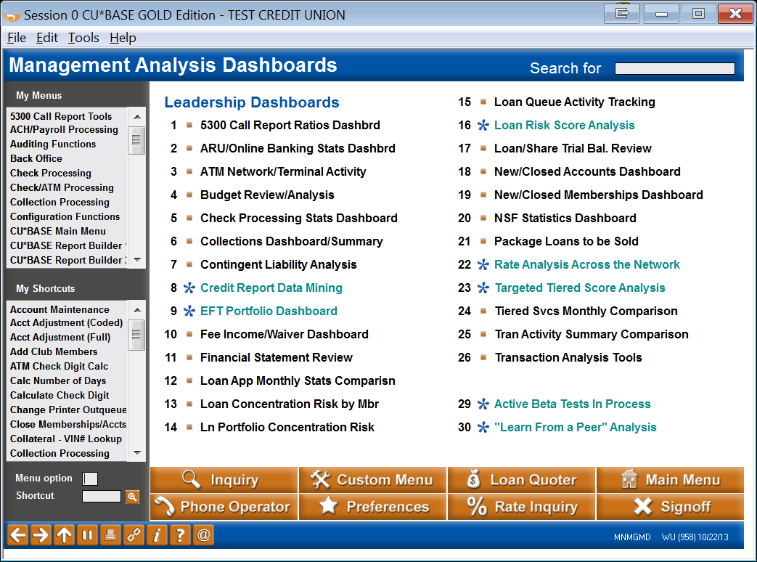

Management Analysis Dashboards Menu
Anything here for
Enhanced!
Enhanced!
Enhanced!
New!
Enhanced!

Slide 26
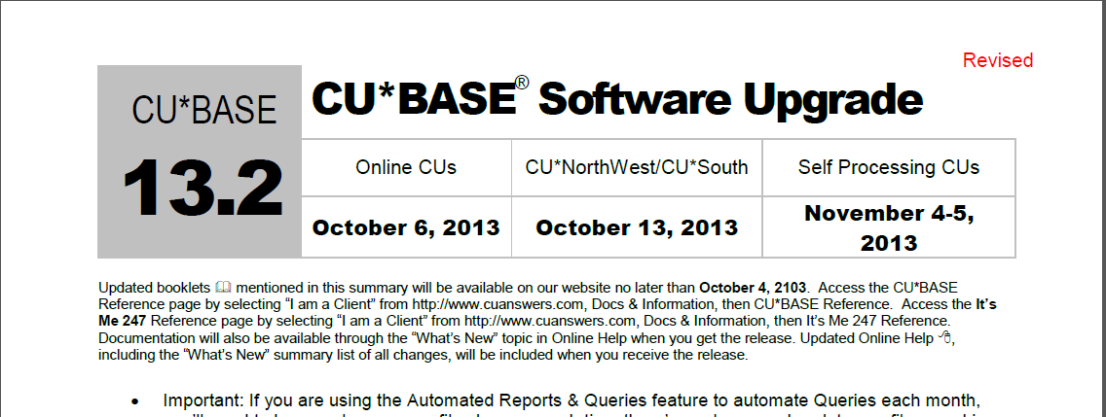
Quick sidebar...Service Charge Rewrite
Set up service charges on loan accounts
Configure annual service charges
Optional notices for fees assessed
Allow partial fees to be posted
More exemptions
  Online credit card
  Membership Designation
  Consistent relationship and aggregate balance exemptions for all service charge types
More flexible settings for choosing which accounts to fee
  Wrong address fee
Complete revamped configuration flow, much easier to configure and revise settings
Easy audit runs to see your income potential and fine-tune your settings before activating
Avoid the investment (and reinvestment) in custom programming by creatively configuring fees where you earn more

Slide 27
“Knowing Your Member” Analysis Tools Menu
Anything here for
Enhanced!
Enhanced!

Slide 28
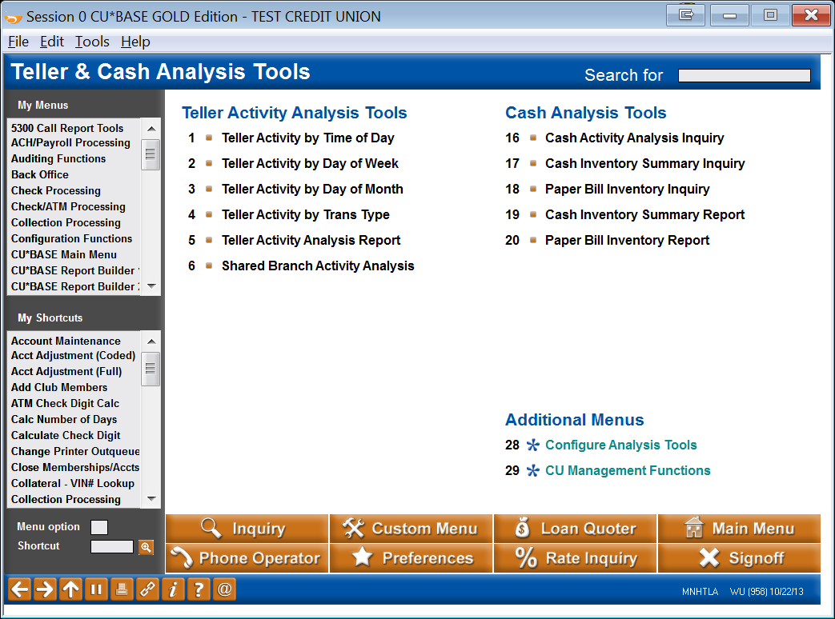
Teller & Cash Analysis Tools Menu
Anything here for
Enhanced!

Slide 29
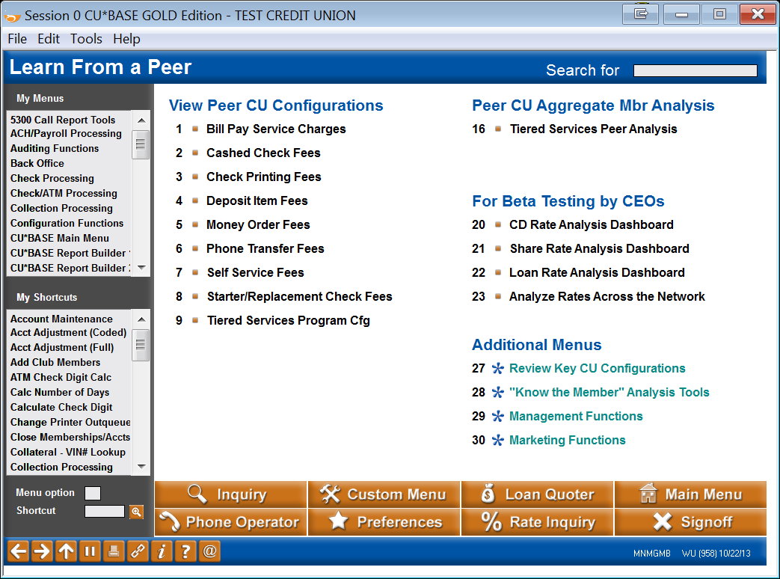
Learn From a Peer Menu
Anything here for

Slide 30
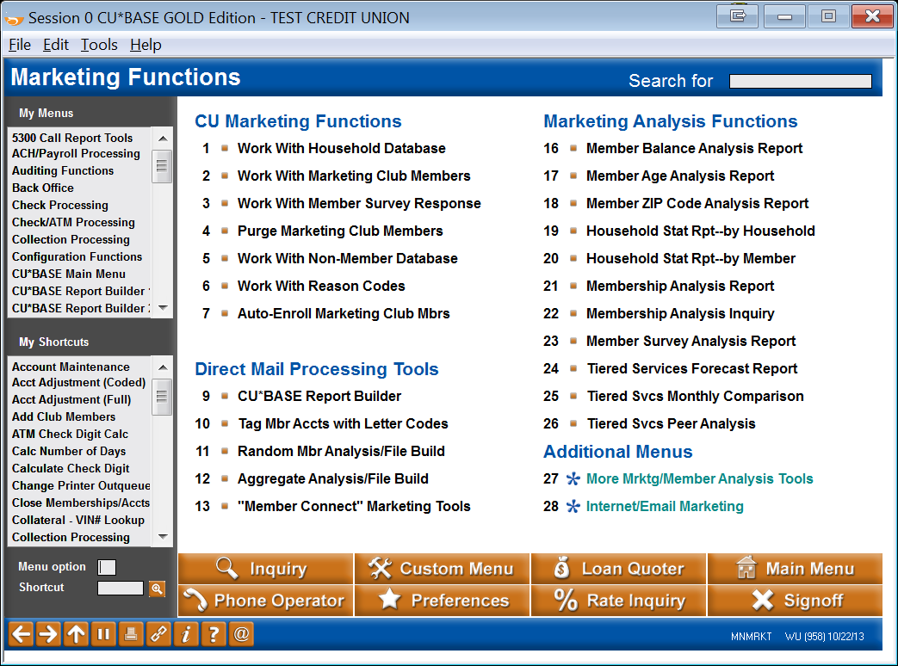
Marketing Functions Menu
Anything here for

Slide 31
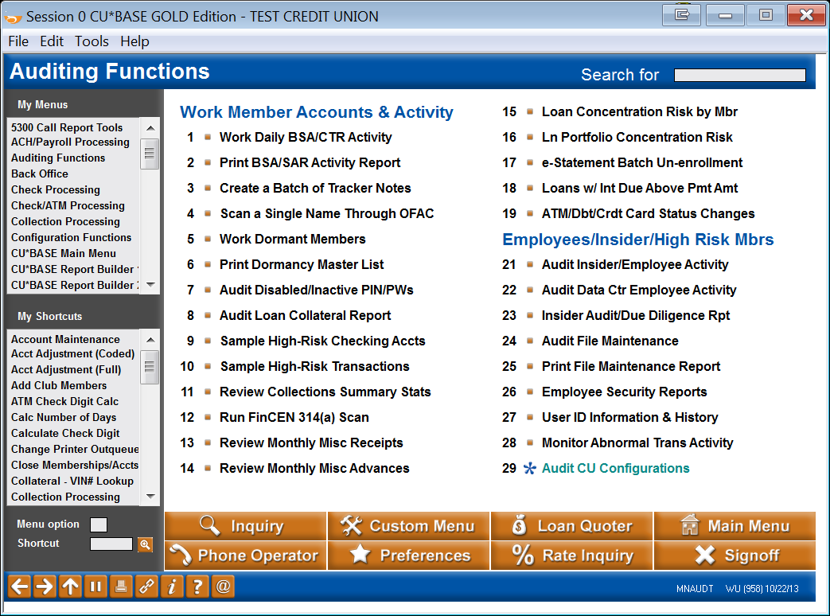
Auditing Functions and ERM Menus
There will likely be an explosion
of data analysis around automating auditing concepts
From employees to members,
you will want CU*BASE and
It’s Me 247 to interactively analyze what’s going on ... and for the first time ever, potentially even block activity from ever occurring
Wanna keep me out of your pockets?
Build a system with us that won’t make your invoice(s) go up!

Slide 32
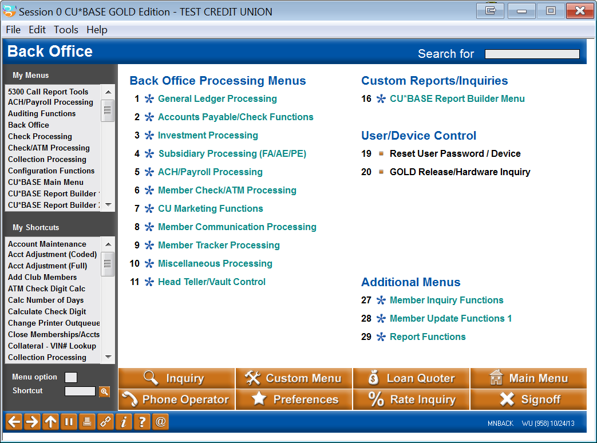
BONUS: Back Office Menu
Don’t forget this one – where else can you get this level of detail about your workstations?

Slide 33
Patronage Databases
The cornerstone of cooperative business financial engines
What’s the key to the credit union’s success, member money or member activity?

Slide 34
What are the key databases we need to focus on as business designers?
Most of the databases in CU core processing systems are related to transaction processing
  The transaction of getting or losing a member
  The transactions to service member accounts
  The transactions to process third-party activity with member accounts
  The transactions of running a business (general ledger, accounts payable, etc.)
These transactions yielded lots of information, some of which we even discarded, since we were paying attention only to the data that made us efficient in processing the transaction (let’s talk about statements)
Big Data says there is a story around every transaction – there are hints, connect-the-dot moments that allow you to create new opportunities and be in the right place at the right time
We have cool databases already; do we talk about them as databases to be mined, or do we just think of them as interesting data that’s a byproduct of doing transactions?

Slide 35
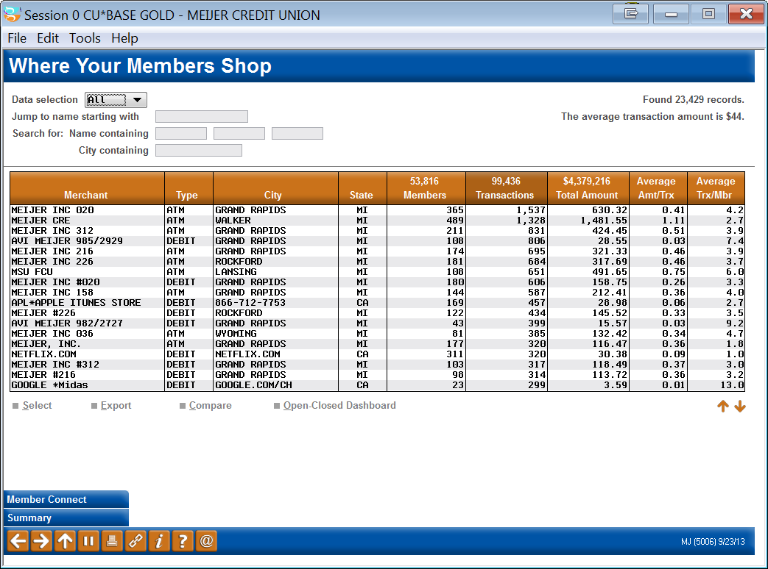
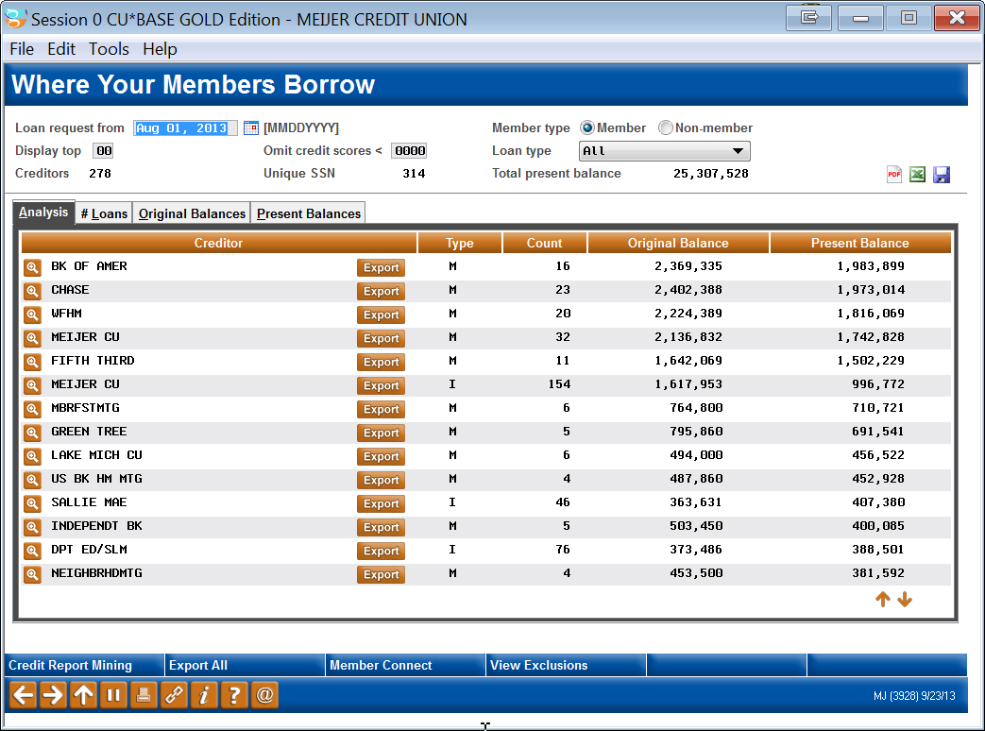
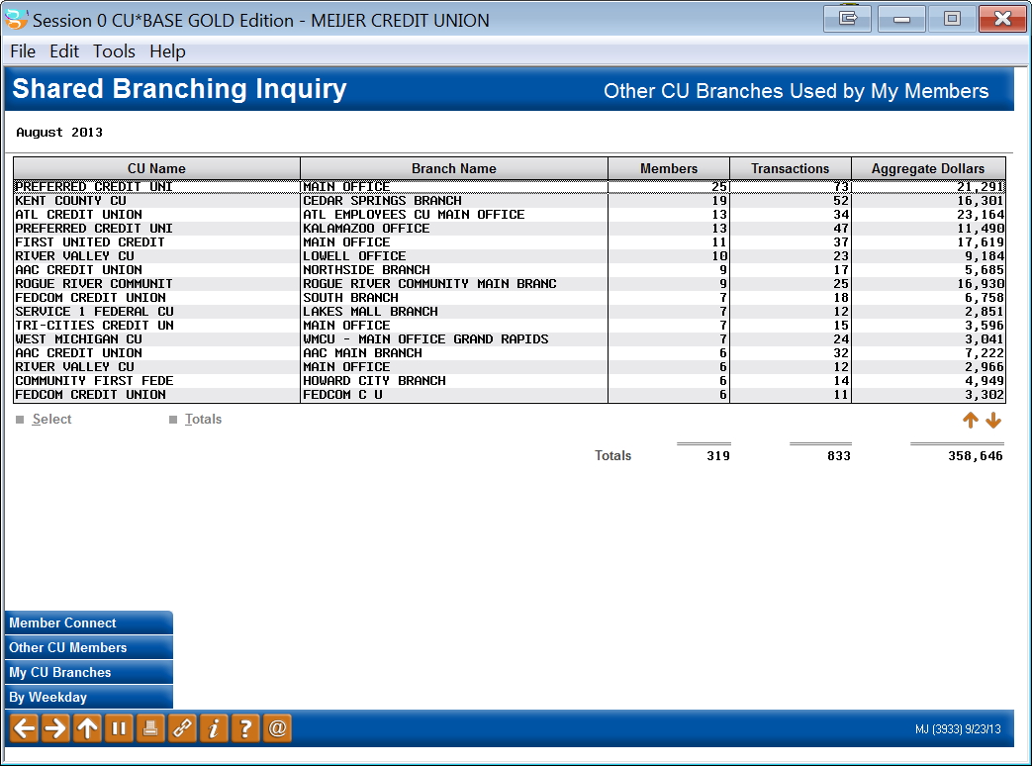
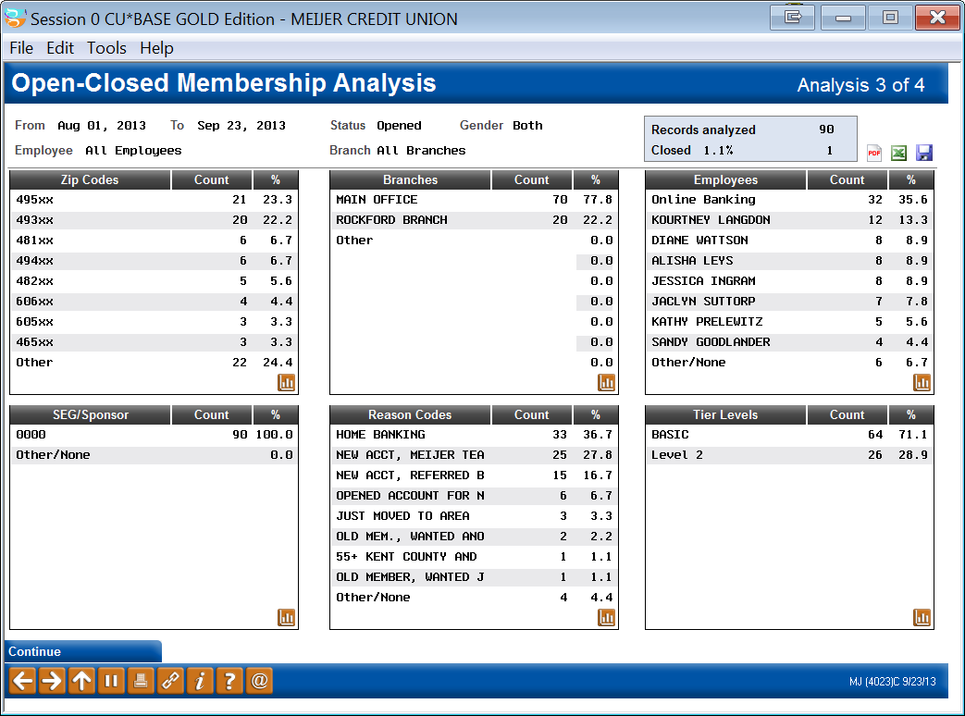
Big Data: The data around a transaction
Transaction

Slide 36
Maximizing our “native” opportunity
The whole point of our CUSO
As a collective, why would we buy external data before we take the time to identify what we do well with the data we already own at almost zero cost to our organizations?
Wanna keep me out of your pockets?
Build a system with us that won’t make your invoice(s) go up!
  When we are ready, what should our first three projects be around external data? (we have a non-member database, should we write an upload to it?)
What projects should we take on in the future to bring important databases into our native space?
  Where can we create a competitive advantage for ourselves by lowering the cost of external databases that will be a requirement for CUs in the future?
Let’s discuss a few:
  The possibilities in redefining patronage databases and their importance to our cooperatives
  The need for activity databases that can interactively reduce risk and highlight out-of-the-norm activity – for opportunity as well defense

Slide 37
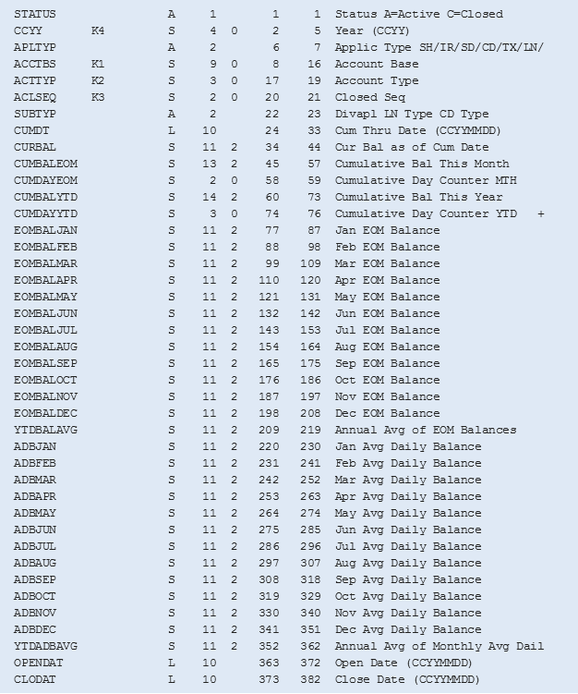
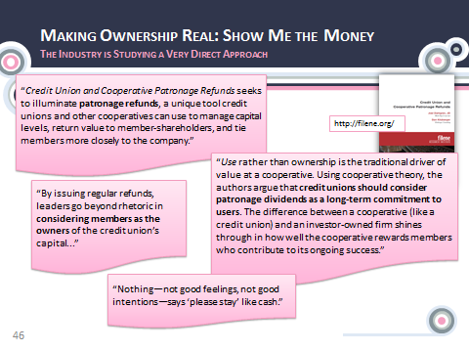
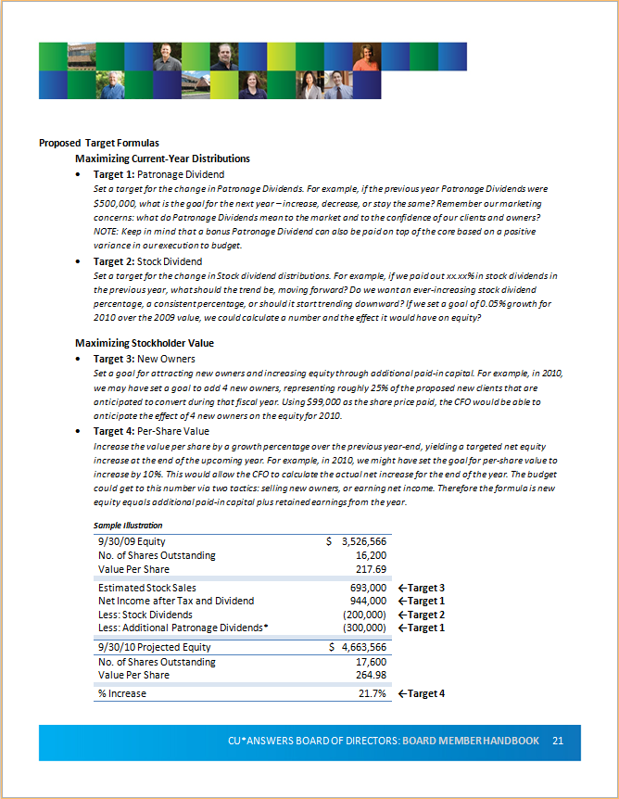
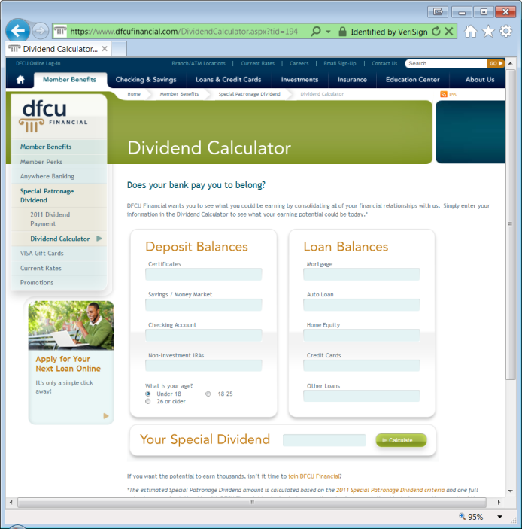
Patronage Databases
How did we get where we are today?
If you think this is a new idea, you haven’t been paying attention...check out Leadership Conference and past CEO School materials

Slide 38
Year 2 of the Member Average Balances Summary File
Everything you want to know about member owner balances
On 12/31/2013 we will have completed a full year cycle on collecting this data – you can Query it today (filename: MBRBAL) to learn:
What’s the average daily balance for loans that were just paid off?
What’s the monthly average balance of members who are enrolled in eStatements?
How does the monthly average balance compare between males and females? Organizations? Other member types?
What branch has members with the highest monthly average balance in loan dollars?
How many members had increased their average daily balance in savings dollars between January 2013 and June 2013? (Could an investment opportunity be offered to them?)
What is the monthly average balance of members who applied for a loan during the last month?
How does the monthly average balance compare between tier levels?
What is the monthly average balance for members who performed more than 30 debit card transactions? How does this correlate to members who do not have a debit card?
I told you about this file last year and you knew it was available on 1/1/2013 – did you plan to Query anything? What will you Query in 2014?

Slide 39
Year 2 of the Member Average Balances Summary File
Everything you want to know about member owner balances
On 1/1/2014 we’ll start collecting 2014 balance information
  I look forward to developing some comparison data and analysis (although it’s not clear yet how we’ll do it or to what end...)
This is some easy, clean data for
and the mobile space
Let’s look at some projects the Analytics team has been working on that do not require Query...

Slide 40
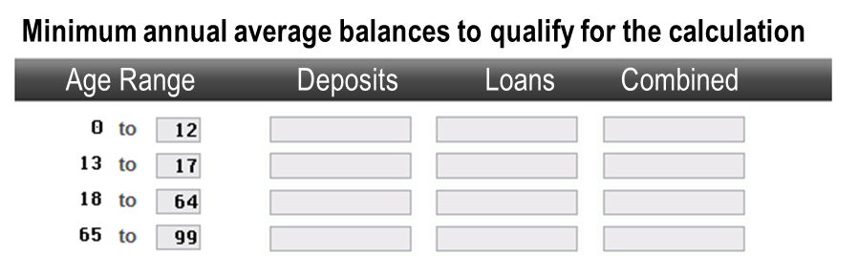
Year 2 of the Member Average Balances Summary File
Enhancements for paying an Ownership Dividend
Patronage/Ownership Dividend Enhancements (MNMISC #27 Patronage Dividend Configuration)
Adding options to take advantage of the new Member Average Balances Database (MBRBAL), populated for all CUs since January 2013
  Calculate patronage dividend based on: dividends/interest paid (like now)
  OR average member balances (using new database)
  Calc 3 different rates in one pass (x% on savings/checking, y% on loans, z% on LOCs)
  Exclusions (delinquency, dormancy, etc.) can be based on a previous EOM snapshot – such as December 31 if posting mid-January
  Can choose to pay only if member earns a certain minimum PD
  Can choose to pay a minimum dividend (or even a fixed amount)
  Age range and aggregate balance exclusions:
Delta County CU will be champion for this in January
(kind of an alpha-active-beta)

Slide 41
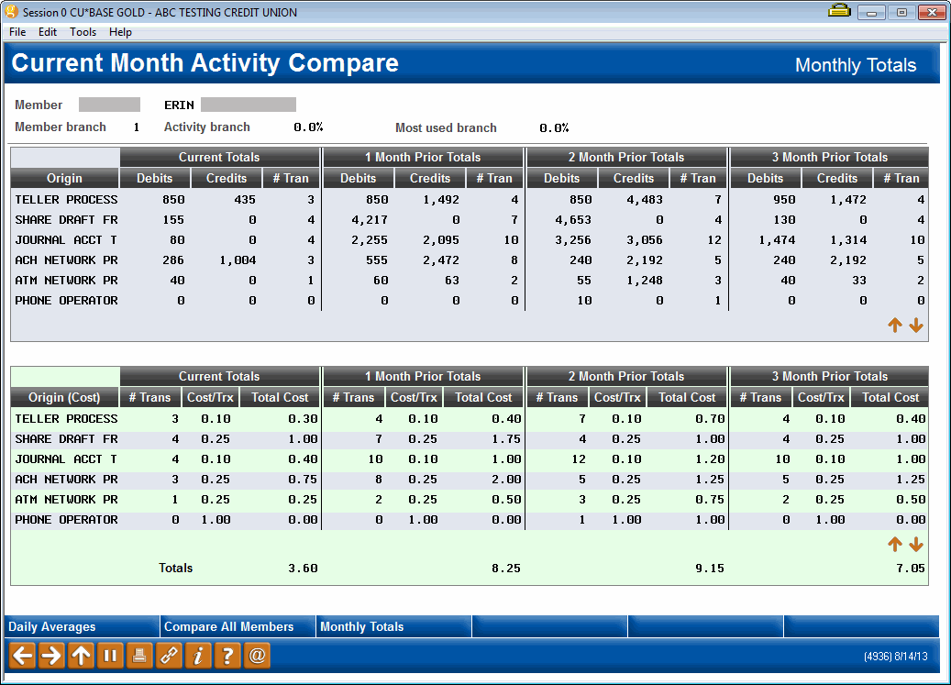

Transaction activity databases
What do they say about patronage?
It all started with the idea, “How can I know how much John Q. Member does with my credit union?”
So we built a database and
displayed it in Inquiry and Phone
...great for when you’re talking to John, but not so great if you want some trending across all members
Inquiry/Phone > Transaction Activity

Slide 42
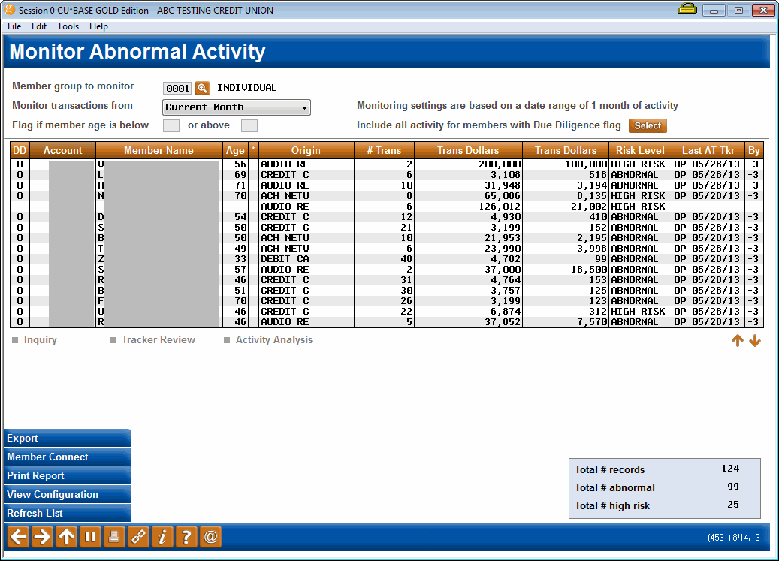
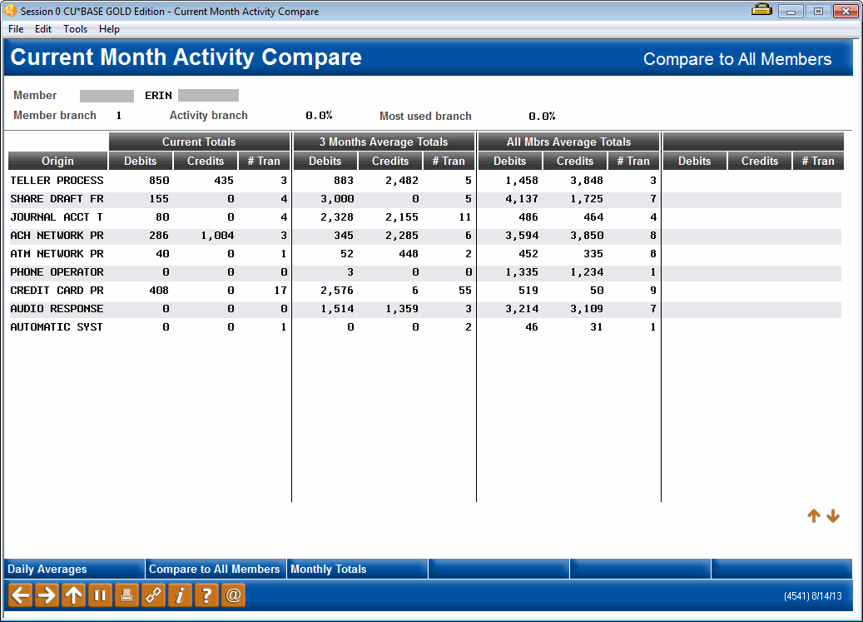
Transaction activity databases
What do they say about patronage?
Then we started thinking about how we could use this data about all members to mitigate risk and identify situations that need more research?
Auditing Functions menu >
#28 Monitor Abnormal Trans Activity

Slide 43
The future for monitoring abnormal member activity
Today, Abnormal Activity Monitoring is a solution for log-management
  After the fact, review what happened and look for anomalies, research why people are on the list and decide what action is needed
Tomorrow, we’ll use this database at the point of the transaction to potentially change the outcome of a member request
  If our software does not believe it is John Q. Member, based on the activity patterns, we might deny the transaction
  We believe examiners and risk management officers will push CUs to use this kind of trending database in many areas – online and mobile banking, across the counter, wire processing, etc.
  Yesterday, it was your employee who had a gut feeling about a transaction that seemed “off,” tomorrow the computer will sound the alarm and maybe act on your behalf
Talk about a place to save money for CUs: this has to be native in our future, and at $0 cost to our CUs and their tactics

Slide 44
The future for monitoring abnormal member activity
The world will make you
spend your money on this
That means we should invest the CUSO’s money so that you have an advantage where everyone else sees an expense
Today, Abnormal Activity Monitoring is a solution for log-management
  After the fact, review what happened and look for anomalies, research why people are on the list and decide what action is needed
Tomorrow, we’ll use this database at the point of the transaction to potentially change the outcome of a member request
  If our software does not believe it is John Q. Member, based on the activity patterns, we might deny the transaction
  We believe examiners and risk management officers will push CUs to use this kind of trending database in many areas – online and mobile banking, across the counter, wire processing, etc.
  Yesterday, it was your employee who had a gut feeling about a transaction that seemed “off,” tomorrow the computer will sound the alarm and maybe act on your behalf
Talk about a place to save money for CUs: this has to be native in our future, and at $0 cost to our CUs and their tactics

Slide 45
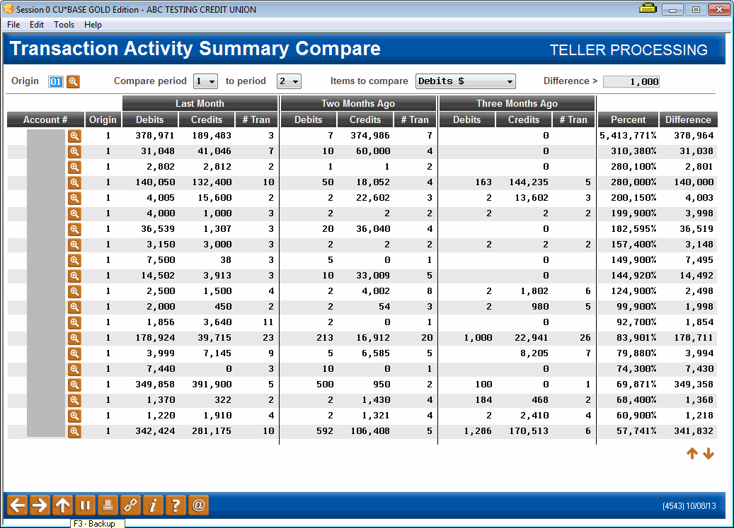
Transaction activity databases
What do they say about patronage?
The next thing we did was create a simple dashboard that allowed you to sample members quickly to see high volumes of activity and behavior differences from month to month
MNMGMD #25 Tran Activity Summary Comparison
Watch for summary totals coming in 2014!

Slide 46
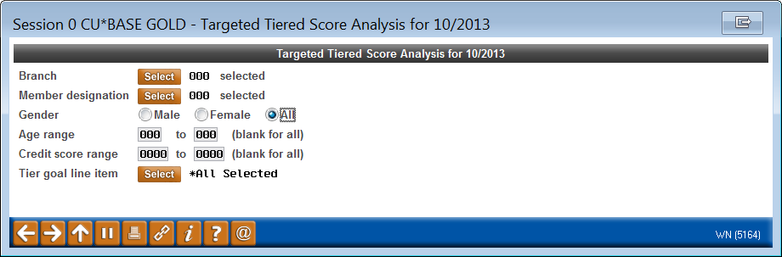
Transaction activity databases
What do they say about patronage?
Like this...
And now for the next big thing... summarizing and comparing
transaction activity based on demographic group and other commonalities
This will allow us to align a demographic group’s use of the credit union with their balances in the credit union: PATRONAGE
Will this lead to credit union leaders rethinking the way they design their products and financial engines?
  Can you say “Qualified Dividends” and BancVue?
Let’s take a look at what the Analytics team is working on for 2014...

Slide 47

Balances alone do not define patronage
What other data can we build patronage financial models around?
You inherited a way to make money (the spread model) – what are you thinking about for the future?
  Today – Spread model
  Tomorrow – Can we count on the spread model? How should we adapt it? Should we abandon it? Or are we simply heading to the service and lending model?
How do you relate patronage analysis for different CU business models?
  The traditional model – organic member relationships
  The indirect model – servicing accounts for profit
  The service and lending model – forget spread, we sell stuff
  The business service model – the CU for the business member
  The network model – a co-op of CUs under a single corporate management
When you need more than one model to serve diversity...

Slide 48
A fork in the road that leads nowhere
If you want a different future, you must have the integrity to say “THIS IS DIFFERENT!”
  Differentiate the path to the future in a significant way
What we did yesterday will often try to pull us back, one feature at a time
  “Why can’t It’s Me 247 members jump to It’s My Biz 247?”
  “Why can’t It’s My Biz 247 members use personal bill pay?”
  “Why can’t the features be exactly the same in both?”
  “Why can’t everything be exactly the same? It hurts to learn a new game!”
What can we learn about indirect models from trying to build two different online banking models?
If you want different outcomes and opportunities, have the courage to build different models

Slide 49
Looking for financial engines that will drive your success
Look high and low, and under every rock
  Consider everything as an asset with the potential to yield new returns
You are the vault keepers of what many people see as the
most important commodity in the world today: personal data
  Is it yours to use?
  What is happening all around us related to selling what we know
  about people with whom we do business? Can you trade on that?
  Is there a way to earn by saying you never will?
  Is there a way to inspire your member-customers to want to be member-owners of a personal data warehouse cooperative?
  When the world changes, will you already have discussed why?
More and more credit unions are wanting to pay for hints (triggers) about what their members might be doing...how long before someone wants to pay you for hints about what their customers are doing?

Slide 50
Big projects where CEOs need to lead the way
Do we know the difference between our day-to-day jobs and the ones we should do to change the next decade?

Slide 51
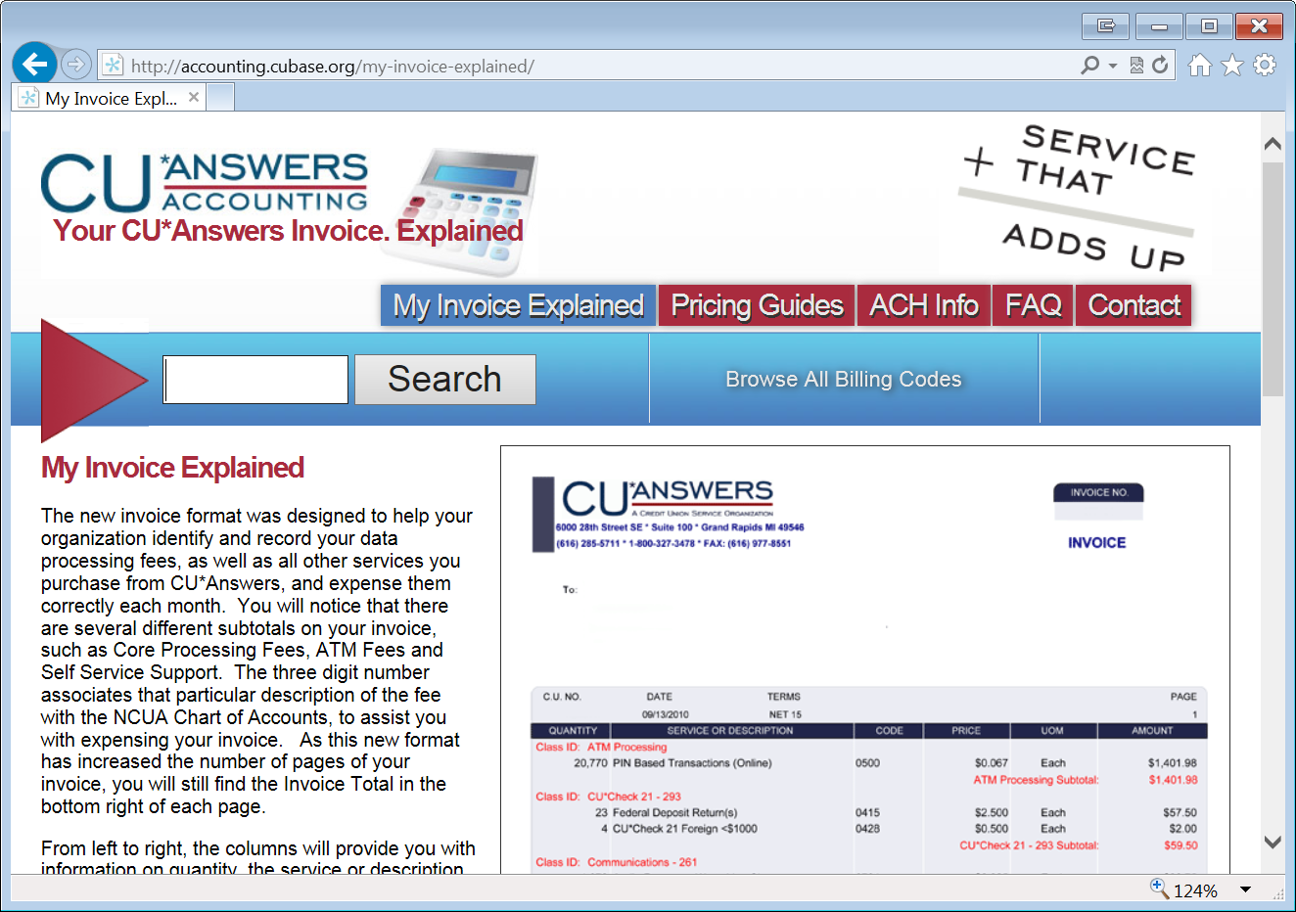
Does our network model align with your financial engines?
http://accounting.cubase.org/
On March 26, 2014, we have a unique opportunity to talk together about how our CUSO pricing engines for the future can continue to align with how credit unions are thinking about their future
Do you use the tools you have today? Do you need to do some research before March 26th?
No tool represents our commitment to being a cooperative,
to the power of ownership, more than this website
What is a nuance to some is a critical stake in the ground to CU*Answers...do you know why?

Slide 52
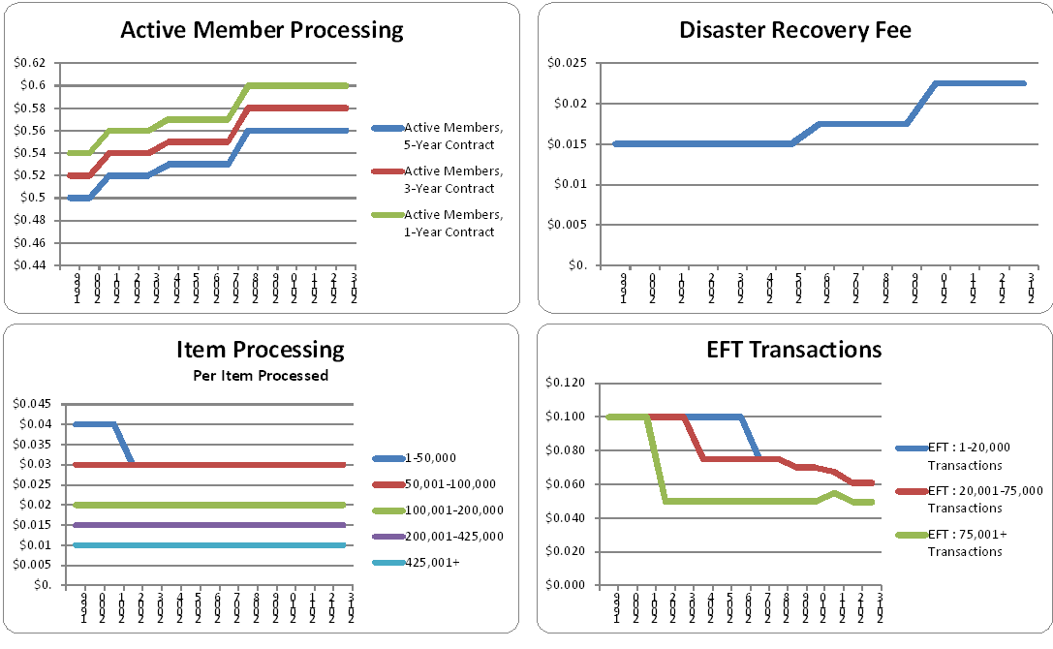
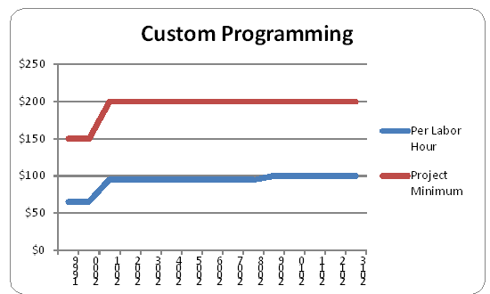
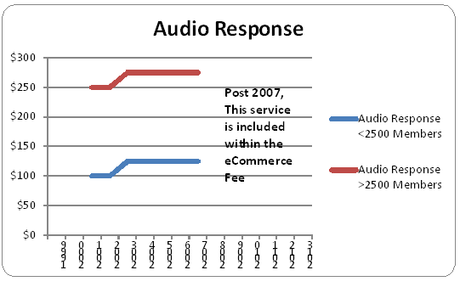
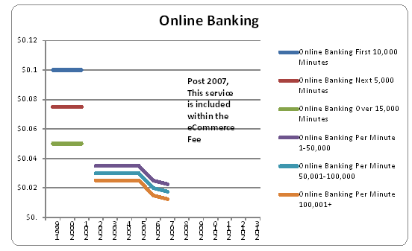
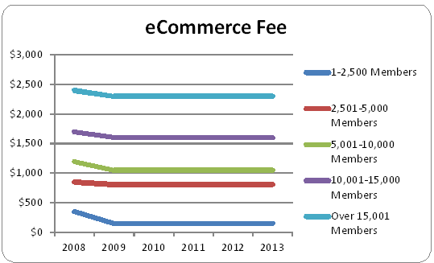
Pricing Focus Group: Sneak Peek
Some stats we’re working on for the 2010-2014 perspective
Pricing trends from
1999 to 2013

Slide 53
Pricing Focus Group: Sneak Peek
Some stats we’re working on for the 2010-2014 perspective
I constantly boast that no credit union with CU*Answers today is being charged what their contract allows us to charge them
We beat every pro forma projection that credit union leaders built into their analysis to join our network, way back when
We lower prices, not around our contract, but around what our CUSO thinks is right for the day – and hopefully right for the future
Do you know how this works? Do you understand how to have a voice in this? Do you think change is needed?
If so, then you’ll mark March 26th on your calendar and make sure your ideas are heard

Slide 54
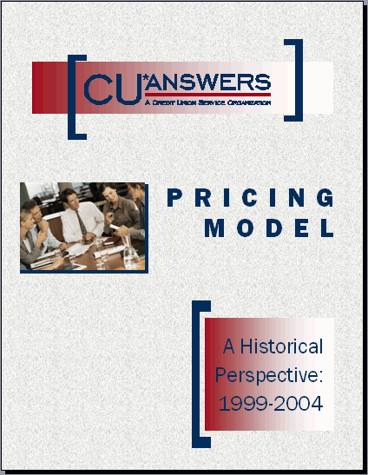
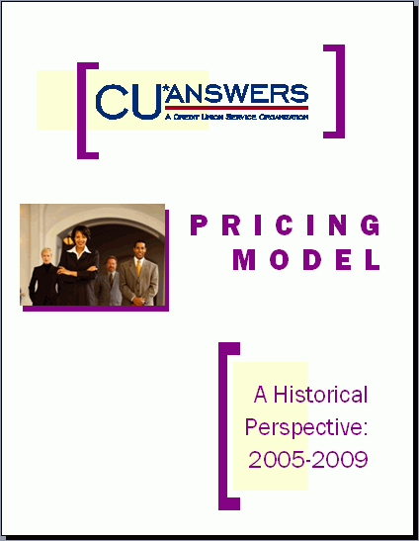
Mark your calendar now!
March 25-26, 2014
2014 Special Event
Tuesday, March 25
Accounting Top 10 Focus Group (meeting #3)
  Working with CU*Answers developers to prioritize, envision, and deliver new CU*BASE accounting tools
CFO Strategies Roundtable (inaugural meeting)
  A networking session for CFOs and accounting leaders, to discuss financial issues related to credit unions and the solutions within our network
Wednesday, March 26
2014 CUSO Pricing Focus Group (meeting #3)
  Discussion with CEO Randy Karnes on CU*Answers’ pricing trends, challenges, and potential future solutions
  Interact with CU*Answers Board and senior leadership on how CUSO pricing designs affect CU budgets and operations
  Learn what potential changes your CU might consider for business plans for 2015 and beyond

Slide 55
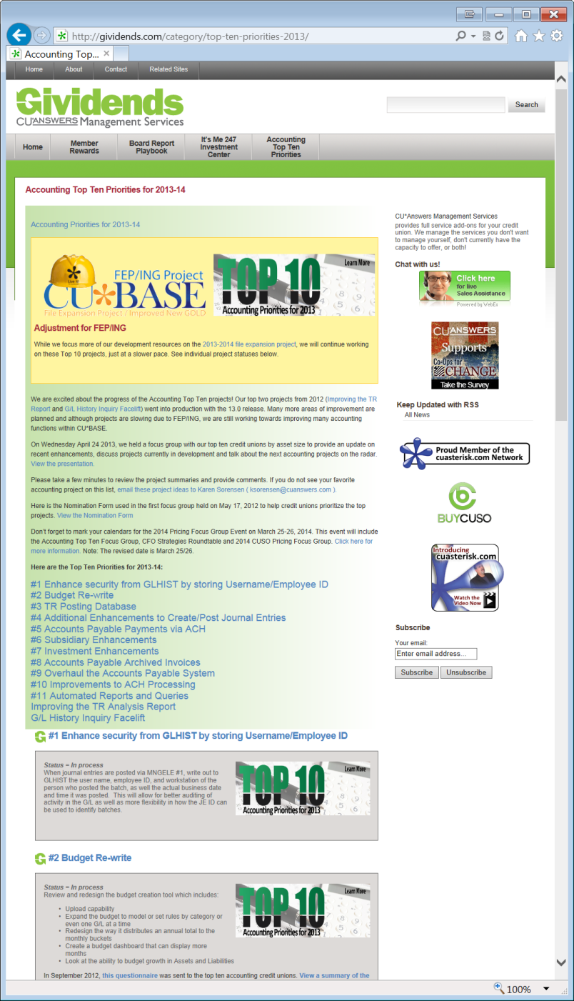
Are you tracking the Accounting Top 10?
http://gividends.com/category/top-ten-priorities-2013/
True to my heart as an ex-CFO, this focus group really has me going
These projects are changing the foundation of what we understand about accounting and how it interacts with every other part of CU*BASE
There are some quick-hit tools in here, but more importantly, there are ideas that will launch new businesses and secure business intelligence that has yet to be documented

Slide 56
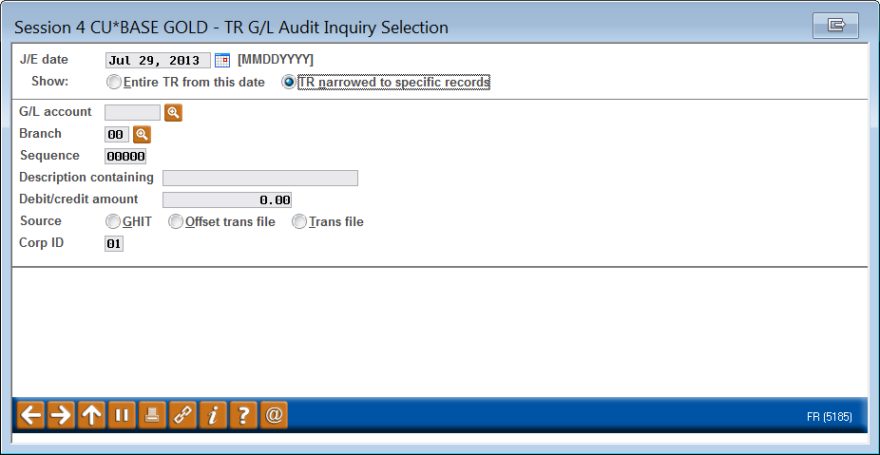
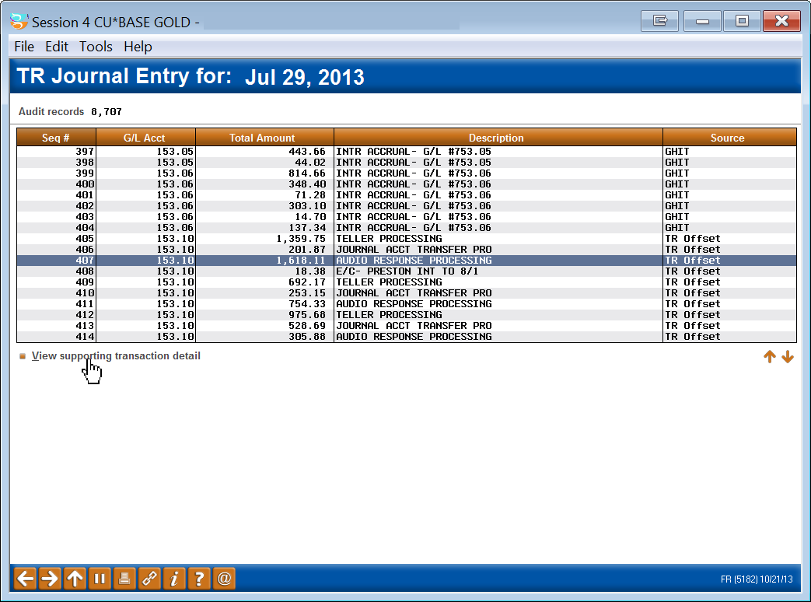


A dashboard to understand CU*BASE accounting concepts in a new way
Features in development, to be released as soon as FEP allows
TR Journal Entry “Breadcrumbs”
Let’s take a look...

Slide 57





Building a Budget Business as we build a solution for the Accounting Top 10
Features in development, to be released as soon as FEP allows
Let’s take a look...

Slide 58
Building a Budget Business as we build a solution for the Accounting Top 10
What it will be in 2014
What it will become as we work together
A tool that budgets every G/L for every branch based on your actual execution or previous budget plans
A simple calculation of net change per G/L
  Different formulas for different segments of your income statement
A tool that allows for interactive variance reporting, with dashboard-type tools to do it on the fly
A tool that lets you group G/Ls the same as the sub-totals on your income statement and see them online
A tool that will not only project your asset/liability growth, but also the resulting balance, month by month
Using the projected balance and estimated rates, calculate offsetting income and expense from assets liabilities
Eventually, create simultaneous budgets for both your balance sheet and income statement around member accounts
New tools to analyze past execution and calculate past yields

Slide 59
Building a Budget Business as we build a solution for the Accounting Top 10
There are two kinds of people in this world: people who want to watch as things evolve, and people who say, “call me when it’s done.”
This budget tool needs people to push it along, stage by stage ... I hope you’ll join us on March 25 at the Accounting Top 10 focus group meeting
What it will be in 2014
What it will become as we work together
A tool that budgets every G/L for every branch based on your actual execution or previous budget plans
A simple calculation of net change per G/L
  Different formulas for different segments of your income statement
A tool that allows for interactive variance reporting, with dashboard-type tools to do it on the fly
A tool that lets you group G/Ls the same as the sub-totals on your income statement and see them online
A tool that will not only project your asset/liability growth, but also the resulting balance, month by month
Using the projected balance and estimated rates, calculate offsetting income and expense from assets liabilities
Eventually, create simultaneous budgets for both your balance sheet and income statement around member accounts
New tools to analyze past execution and calculate past yields

Slide 60
A new strategy group
Led by our CFO, Bob Frizzle
On March 25, 2014, Bob Frizzle will lead a new CFO Strategies focus group to discuss how network CFOs and accounting leaders could work together, much like CEOs are working together this week
I would like to see this become an annual event, but we need to understand if your CU’s leaders have the energy for yet another annual meeting
  What time of year? How often?
  How does it align with CEO Strategies? Should it?
  Should CEO Strategies become “CU Officer Strategies” and we adapt our current format to a broader group?
  What will CFOs talk about that is bigger than our tools, that can change our network and how we all perform?
Bob Frizzle is a valuable architect of what our CUSO has become...I hope you’ll encourage your leaders to work more closely with Bob in the future

Slide 61




Mortgage Statements
When statements become bills
Might mortgage statements launch us towards statement cycles in the future, when bills need to go out more than once a month?
Special thanks to Alpena Alcona Area CU for some insightful analysis
Check out the Kitchen for the latest news!

Slide 62

When bills change everything about eStatements
In 2014, we’ll start projects to allow all credit unions (CU*Spy and in-house vaults) to offer new things in their “images portal”
  Regular statements
  Credit card statements
  Mortgage statements
  Teller receipt analysis
  Receipt images
  Loan documents
  ...a “Virtual StrongBox”
Images Portal
New!
We’re moving from the idea of eStatements to the idea of “images in the cloud” . . . the private cloud your member enjoys with your credit union

Slide 63

When a single product signals that you are your own private “cloud”
CU*Answers and eDOC are partnering to bring the cloud concept into credit union business plans and tactics
  It’s a new business model, one you should be tracking for 2014
What it changes for us as CEOs is how we will move members to the idea of “image portals” or “cloud storage” as part of their credit union
This is a good problem, but a marketing problem every CEO should understand

Slide 64
Two big projects picking up some steam
Find a way to get in the loop
Online Account Opening Systems
RDC: Should the CUSO invest?
Network CU groups are organizing to discuss their requirements for new investments around online account opening
  Can they agree on what they might buy from one of today’s market vendors?
  Can they agree on what they might ask CU*Answers to build, and guarantee they would use it?
Get in the loop: let people know if this is an area where you would like to add your voice
Should CU*Answers transfer its budget for free Xtension outbound calls to supporting credit unions learning about remote deposit capture?
  Should we buy 30K-40K check deposits for members?
  What conditions might we set?
  What advantages would we get from such an investment?
Is it worth it to jumpstart a network into new businesses that everyone thinks are important to their future?

Slide 65




What is “telepresence?”
...and who came up with the name Buffalo-Pacific?
Check out our first cut videos in our first floor Telepresence Conference Room

Slide 66
Wrap-up

Slide 67












Also in your packet...

Slide 68
Thanks for the day!

