Slide 1



CEO Collaboration Workshop
Building solutions with the spirit of collaborative venture capitalists
November 5 & 9, 2012

Slide 2
Today’s Agenda
Executive Study Groups
What can we do to inspire executive learning, sharing, and execution on the way to innovative new successes?
Building a Network of Business Developers
Do we study opportunity? Do we have the template to build the capabilities we need?
Securing Investment Grants
Understanding the current Investment Grant Program and its future evolution

Slide 3
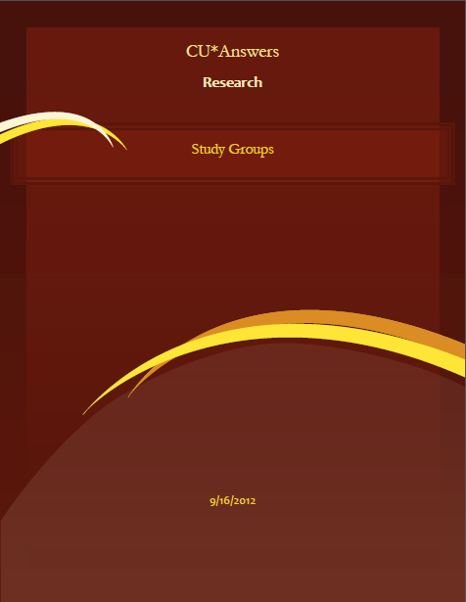
Executive Study Groups
What can we do to inspire executive learning, sharing, and execution
on the way to innovative new successes?

Slide 4

Executive Study Groups
Over the years I have referenced executive coaches and mentors as important aspects of my career development
I am frequently challenged to help CEOs find and develop their own mentoring resources...it’s time to start tackling this project
How can we create a program where CEOs believe their resume is improving because of their participation in our “NEED A BRAND” group?

Slide 5
Executive Study Groups
Every year at CEO School we talk about how CEOs need to be part of our design team
So most of the time when we interact, we do so with a focus on improvements, getting over hurdles so people will use it, and squeezing out the “focus group” value of CEOs as consumers
CEOs as
Solution Designers
CEOs as Developers
CEOs Inspiring Your Teams
to be Developers
CEOs Creating an
Innovator’s Culture
What goals might we have for a different kind of interaction for all of us as a network of CEOs?
  Identifying our personal best practices
  Identifying our favorite processes around our commonalities
  Sharing our competitive advantages
  Targeting areas for leadership improvement
  Learning to barter opportunity
  Increasing our ability to get to market
  Extending our competitive horizons
What should executives work on when they work together as executives? It’s okay to get personal when you’re with peers – what do you hope for from peer interaction?

Slide 6
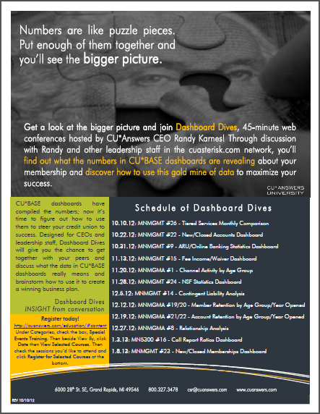
Practice Makes Perfect
12 weeks to develop an executive study approach
How can tools inspire change in the mindset of executives?
How do you make an “in the weeds” requirement to learn a tool inspire a big-picture strategy?
You engage executives so that they coach each other on the big picture, while they are learning in the weeds
Can we inspire CEOs to master new tools for their resumé?

Slide 7
Practice Makes Perfect
Round 2: Move the executive study goal to the front, and the weeds to the back
Can we take these proof-of concept-exchanges and learn a new way to bring interactive coaching among executives to the foreground?
From there, can we have a series of exchanges that take what have in common in the weeds and multiply everyone’s opportunity, by correlating it to new and innovative big pictures?
What might it mean for CU*Answers to have drop-by web study sessions?

Slide 8
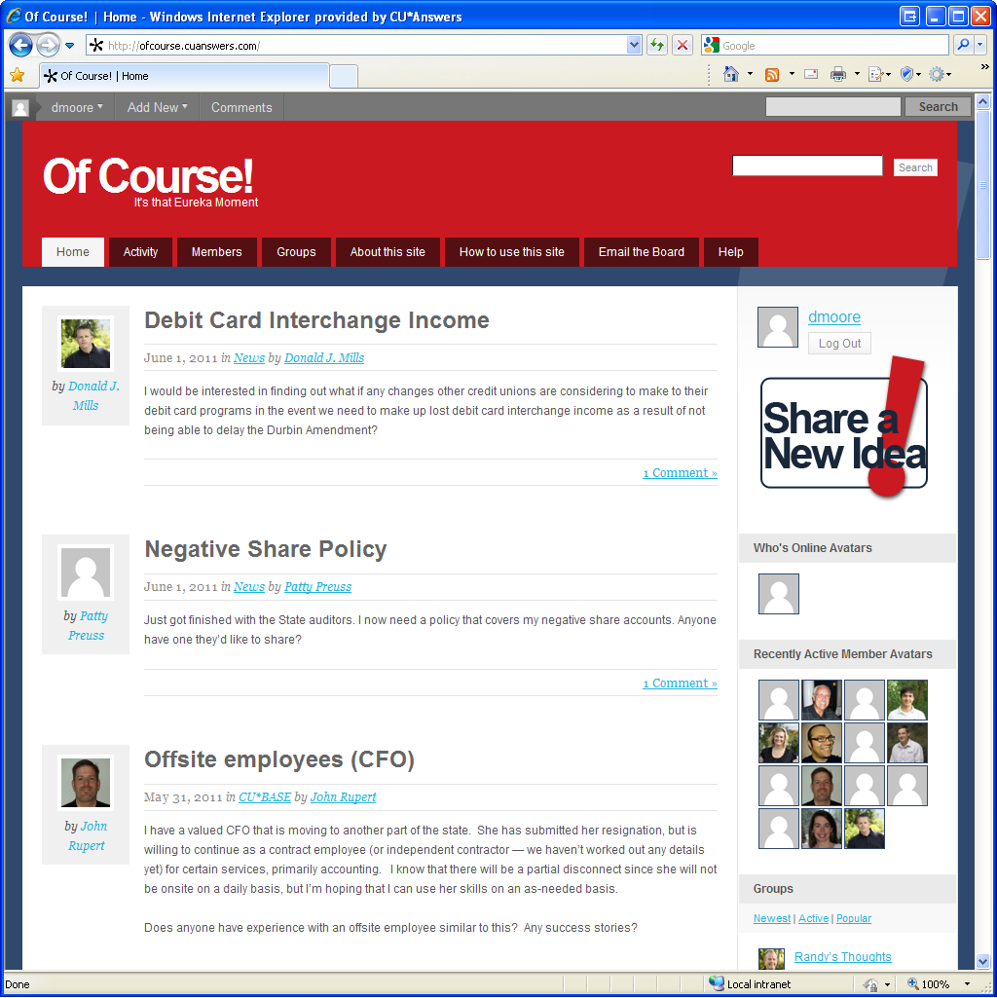

Practice Makes Perfect
Round 2: Move the executive study goal to the front, and the weeds to the back
Mockup only
Webinars can be problematic – we need more to leave a lasting record and an ongoing conversation to get the maximum from our interactions
http://ofcourse.cuanswers.com

Slide 9
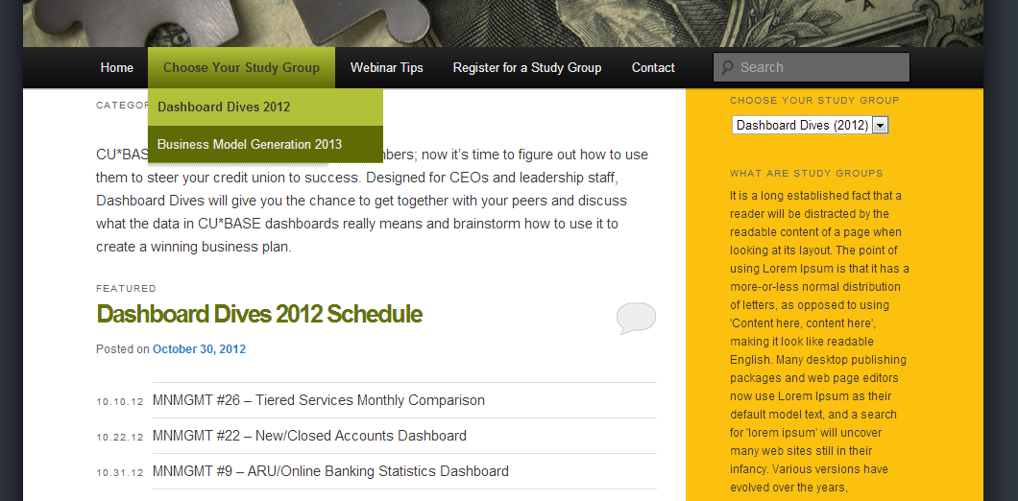
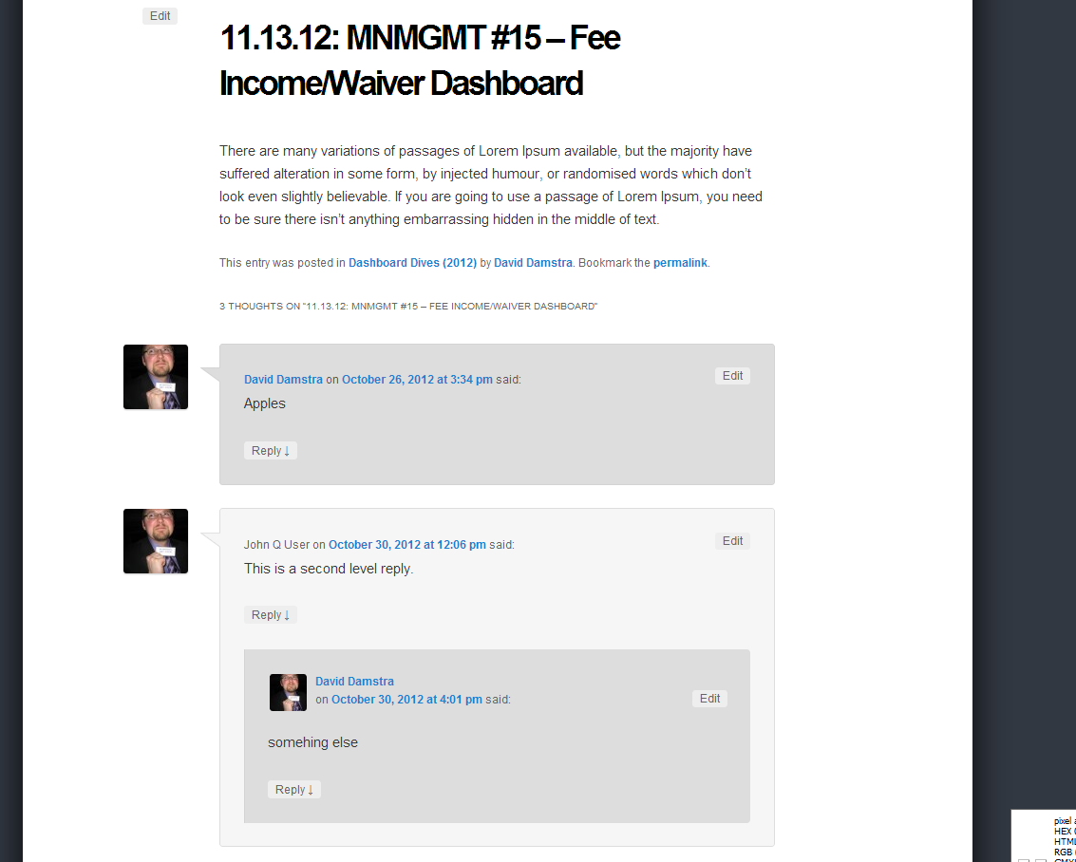
Practice Makes Perfect
Round 2: Move the executive study goal to the front, and the weeds to the back

Slide 10
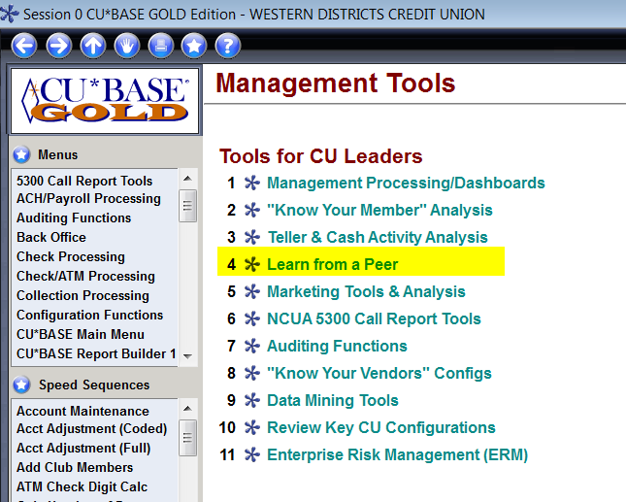

Studying a Network
Automating Executive Research and Learning
This is your peer group when it comes to tool sets and the opportunity to execute

Slide 11
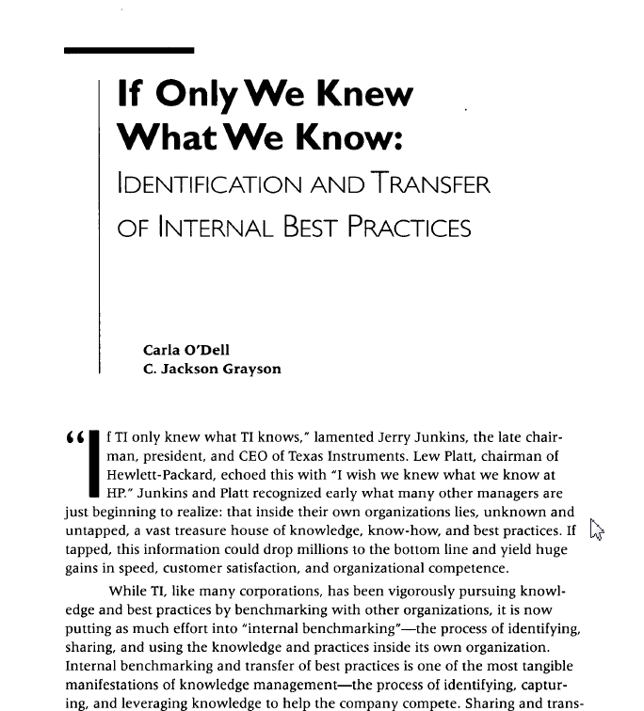
How can our network have a competitive advantage through the transfer of best practices?
When I hunt for a competitive advantage that would put all of us far ahead as leaders, I always come back to the idea that together, we must one day harness the insight of our network
With lightning speed, we need to act on what is already known, to replicate what already works, and to spread success to every corner of our network
Look for a session in 2013:
“Learning From A Peer”
California Management Review
Vol. 40 No. 3, Spring 1998

Slide 12
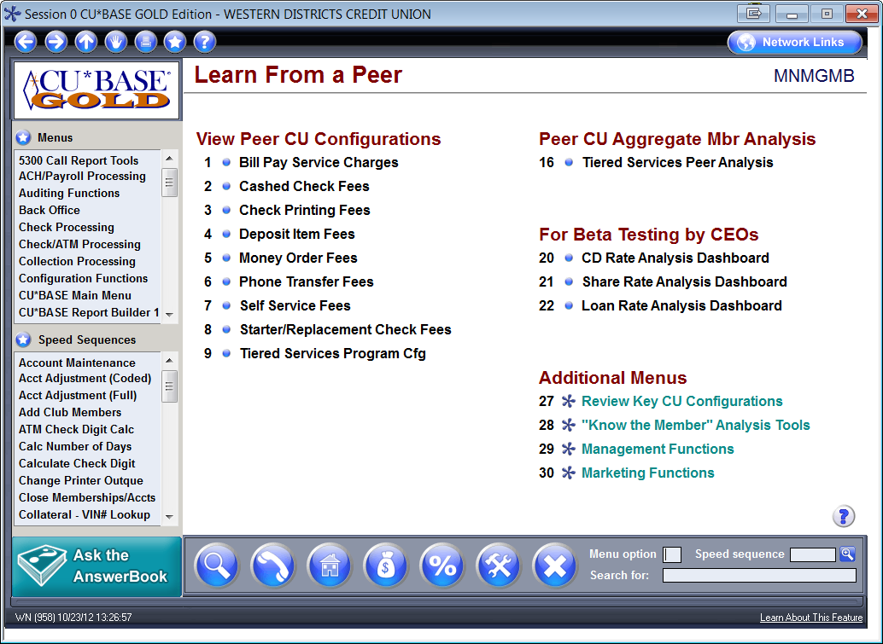
How to Network with a Click
Learning From Peers From Your Desktop
New!
New!
Do you have access to all of these commands?

Slide 13
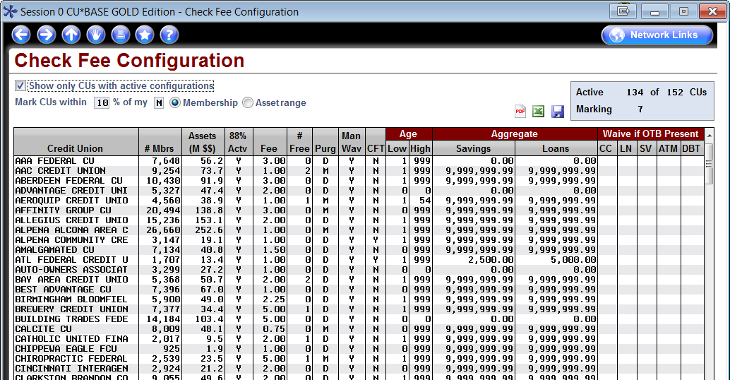
How to Network with a Click
Learning From Peers From Your Desktop
Side-by-side comparisons, one peer at a time, will still be useful on occasion for complex configurations, but most new LFP tools use an aggregate format listing all your peers
Mark peers similar in size to your CU
At-a-glance view of peer configurations

Slide 14
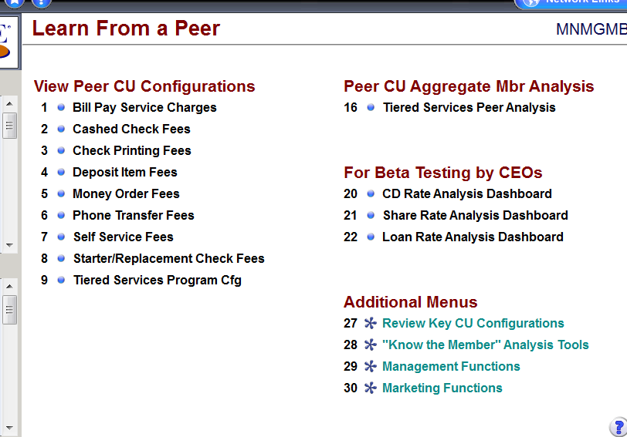
How can we make “coming soon” be even sooner?
CEOs as QC Testers?
Trying a new style of beta-testing
  We do a minimal amount of basic testing (screen functionality, data integrity, program errors, etc.)
  Then we place the command on a special area of the Learn from a Peer menu MNMGMB
  CEOs will have a period of time to test the tool and report problems or suggestions to our QC team
  We need you to dig into the data and verify a concept in the real world
Will you participate?

Slide 15
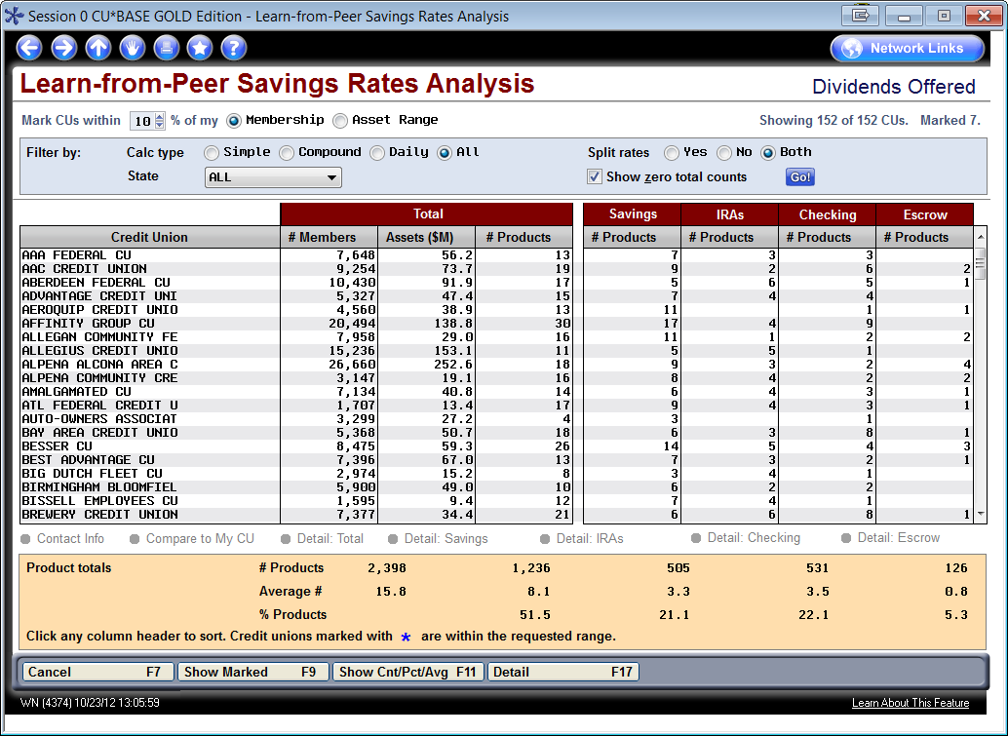
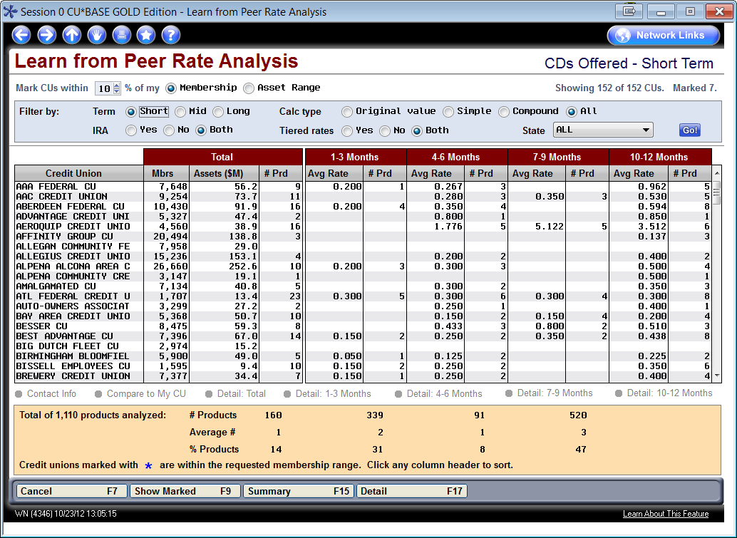
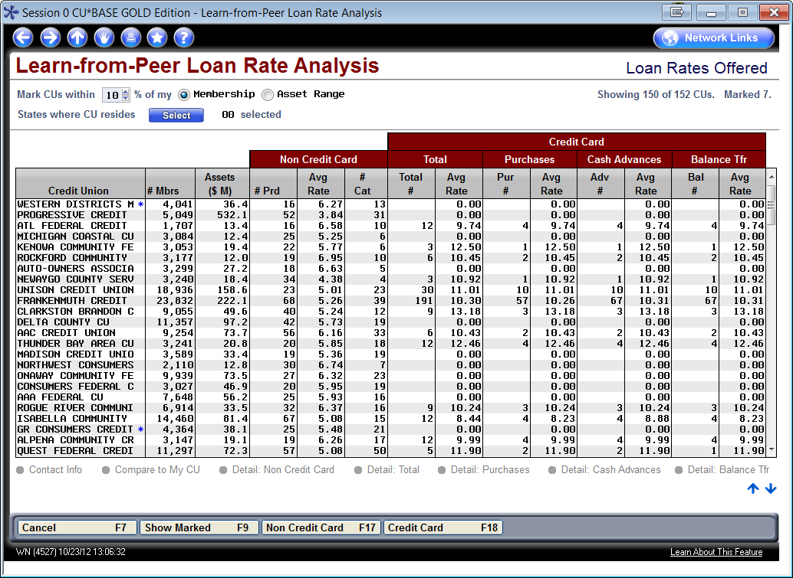
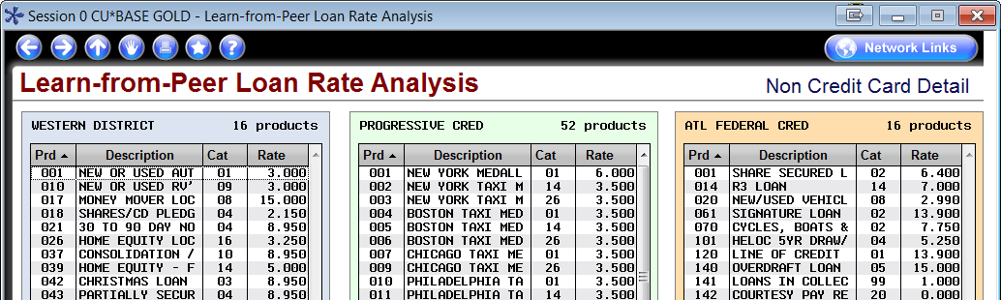
LFP Rate Analysis
Gividends and Lender*VP see these tools as an opportunity to consult on member product offerings, and how to use the power of CU*BASE

Slide 16
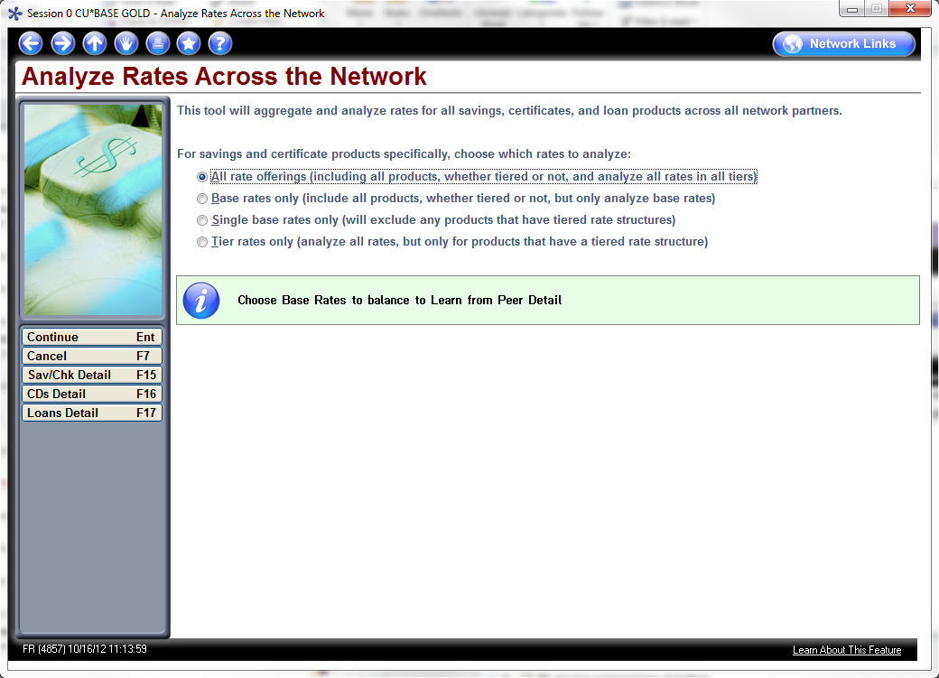
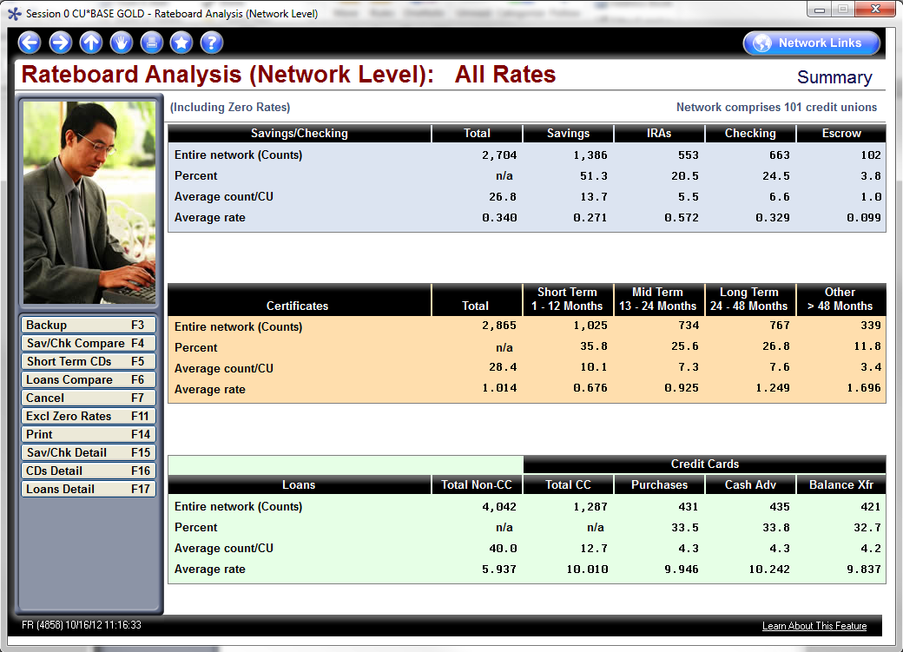
Coming Soon: LFP Rate Analysis at the Network Level
One level up from the weeds
Let’s take a test drive with the Analytics team...

Slide 17
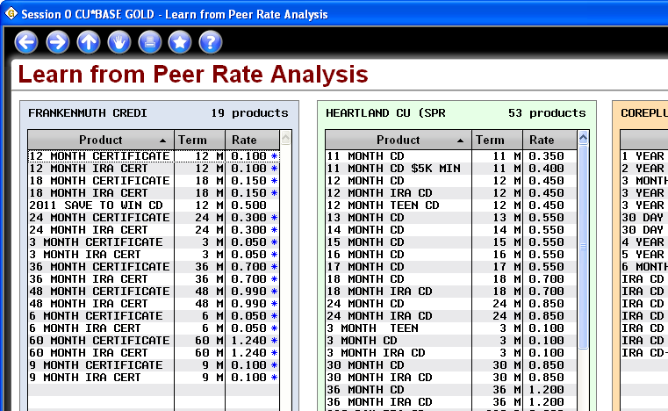
Building a Network Business
With a Free Baseline Tool
Many CUs in our network buy competitive rate analysis services from third parties
Xtend and CU*Answers have been tinkering with this for 18 months now
I’ve been dragging my feet on a major offering, wanting to build a foundation service where everyone could start thinking about rate analysis as native to CU*BASE
Still on the drawing board
Xtend is dying to make this a specialty business as well

Slide 18
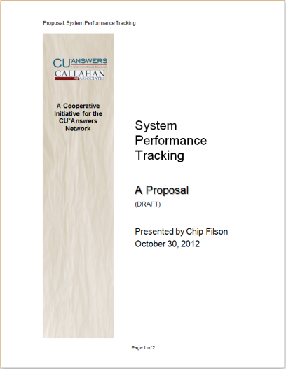
Even further out of the weeds...
A Project with Industry Implications
Chip Filson has made a career out of looking at our industry and thinking about how to learn from a network, through peer analysis
In his new role as Chairman of the Board for Callahan & Assoc., he has carved out some time to work with CU*Answers on a network project that could change our network and how we work together
  Could we create a network self-audit that cross references what we know about our operations with the macro-data we hear from the 5300 call reports?
  Can we be the fastest network in the industry to report and react to performance?
  Can we be proactive in changing the examination experience and reach for a better ROI from our interactions with examiners?
Is this a project worthy of our CEO peer group (credit union CEOs and CUSO CEOs)?

Slide 19
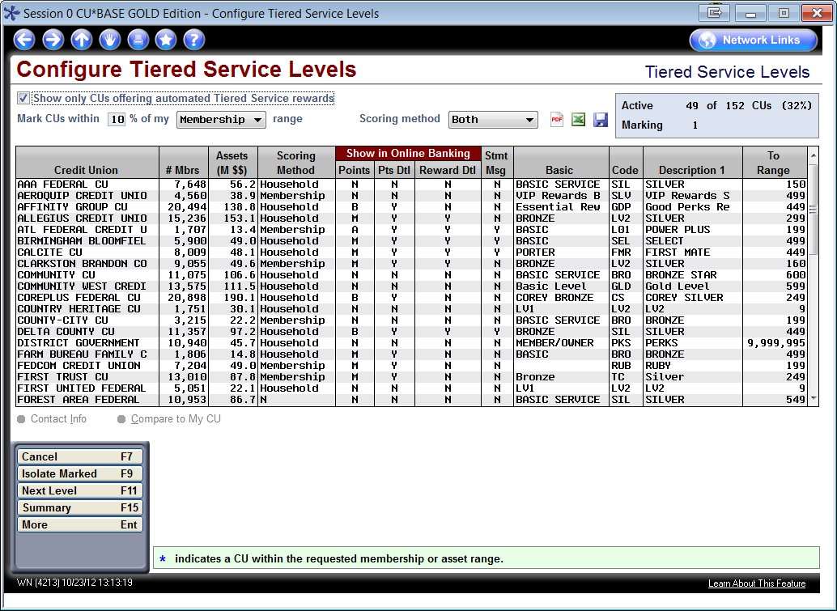
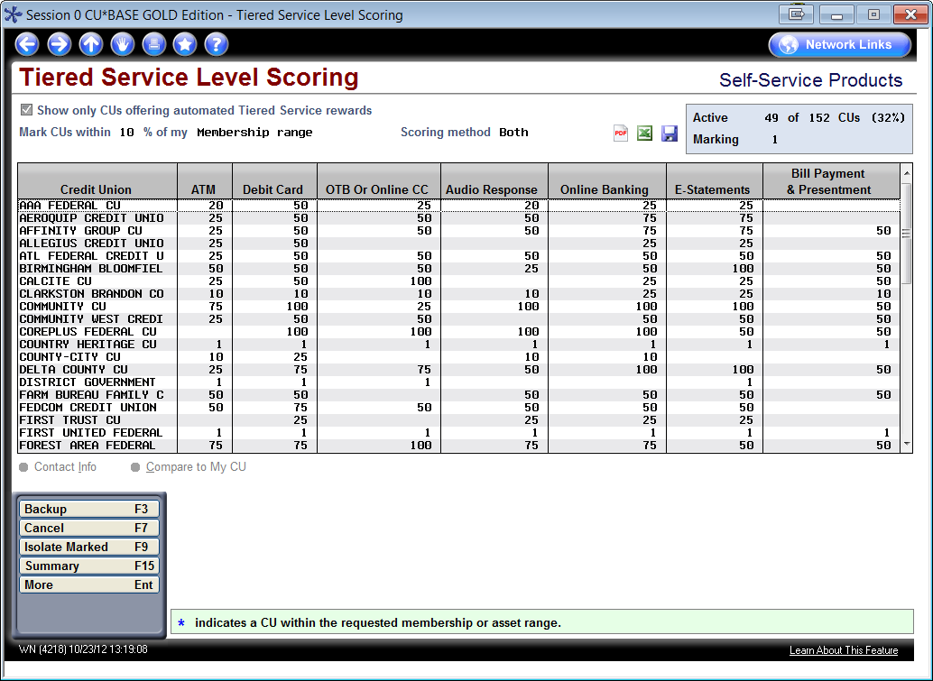
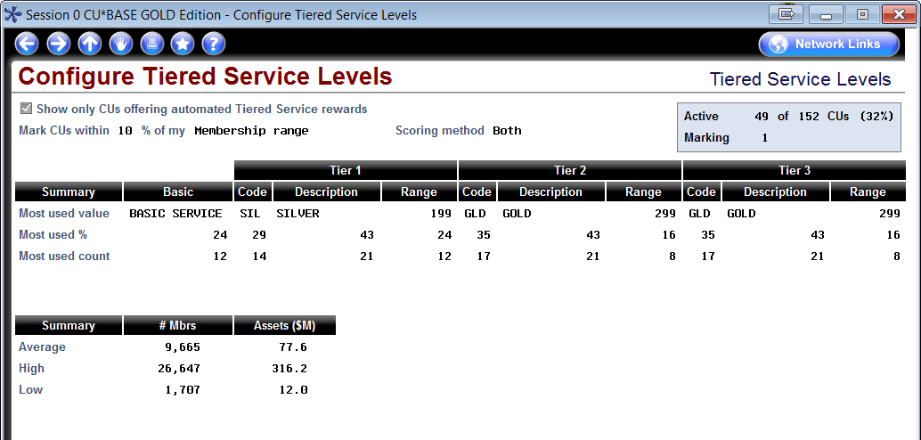
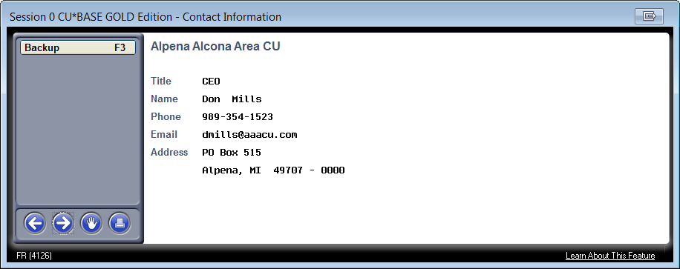
LFP: How does your Tiered Services program rate?
Is it time to change your strategy for awarding points?
(You might even find a study partner!)

Slide 20
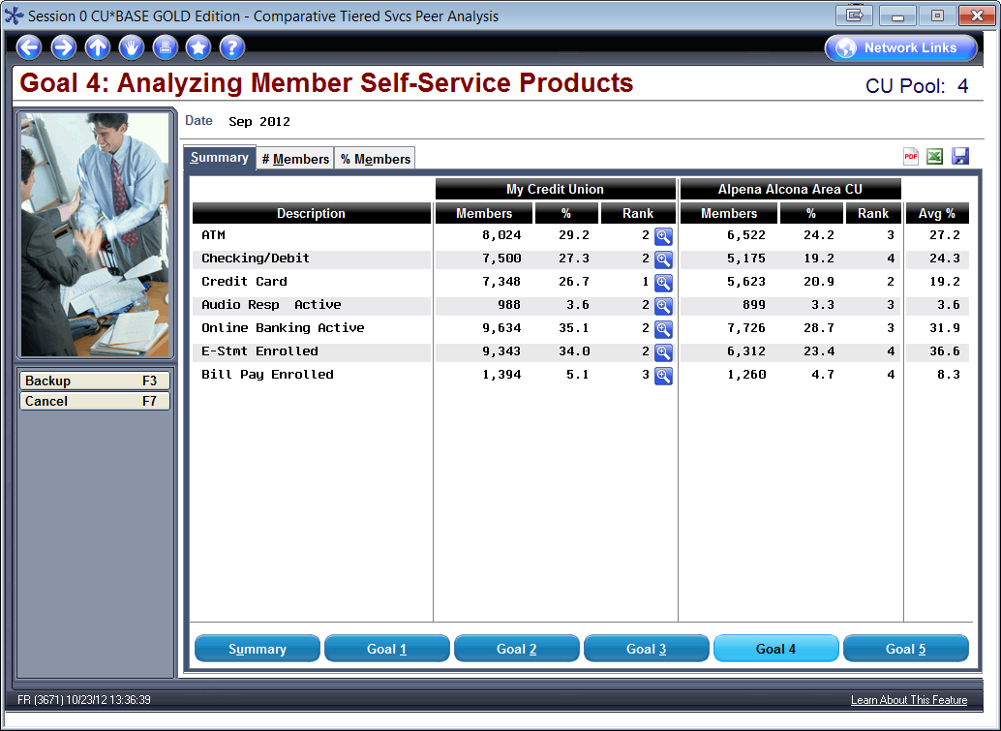
LFP: How is your Tiered Services program working?
Did you know it was this easy to get side-by-side product penetration stats?

Slide 21

Practice Makes Perfect
What would an executive study series look like on LFP?
How do we take this body of work and embed it in the periodic activities of a credit union, so that “learning from peers” represents a new talent for that organization and for the CEO?
Can “knowing what we know” faster than others become a competitive advantage for a CEO’s resumé?
What executive study groups might you suggest for 2013?

Slide 22
Building a Network of Business Developers
Do we study opportunity?
Do we have the template to build the capabilities we need?

Slide 23
Building a Network of Business Developers
As CEOs, you and I have the same challenge: how to create better business development resources and approaches based on our cooperative designs
It would be a shame if we each tried to overcome this challenge independently
  It would be a mistake if CU*Answers assumed the role of vendor and only worried about its own business development skills and what it could sell to you – we need a network of business developers as allies
  It would an equal mistake for a credit union to assume they could maximize their opportunity by doing it alone – credit unions need a network’s opportunity to maximize the return on their skills
So how can we get started on the project of building business development skill sets across 200 organizations, and succeed with
2 million customer-owners?
Do you know the difference between running a great business and building the next great business?

Slide 24
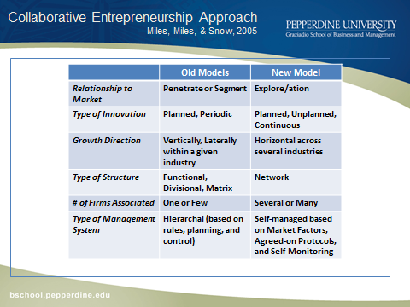
Sharing Some of CU*Answers’ Prior Work on Business Development Concepts
For two years CU*Answers worked with NACUSO on the idea of building network business designers
It resulted in an executive education series prototype that was conducted at the Graziadio School of Business and Management at Pepperdine University
In 2013, CU*Answers plans to use this work as one of the foundations for building business development resources and skills in the cuasterisk.com network
My favorite idea from this work: “Businesses become what they study, and they need to focus on opportunities, not problems“
(Dr. Gary Mangiofico, Graziadio School of Business & Management, Pepperdine University

Slide 25
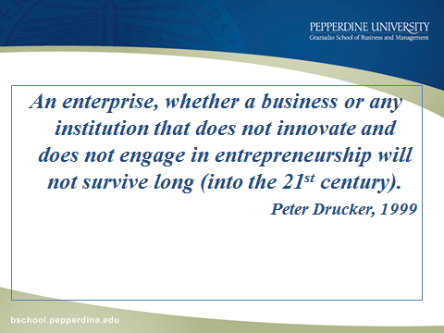
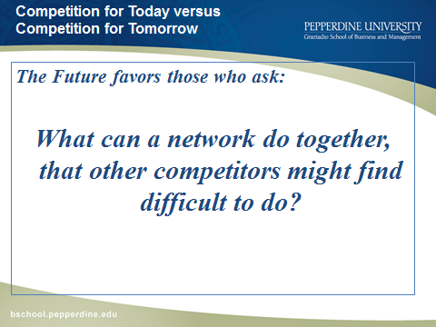
Sharing Some of CU*Answers’ Prior Work on Business Development Concepts
What does it mean to be a cooperative entrepreneur?
In 2012, credit unions were reawakening to the fact that they are cooperatives
But they have known for a long time that they have to increase the level of their entrepreneurship
Add to that the value of us working as a network, and we have an opportunity to be the premier cooperative and network entrepreneurs in our industry

Slide 26
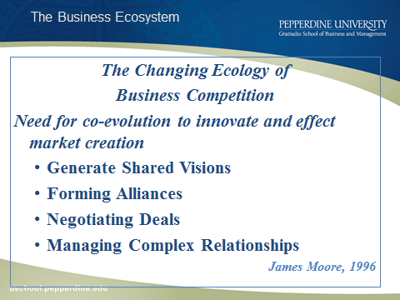
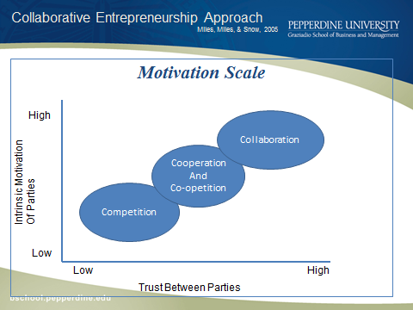
Sharing Some of CU*Answers’ Prior Work on Business Development Concepts
Competition today is based on clearly understanding the hats you are wearing and when
  I am not advocating that you never compete with each other, but you should know when and how to do it so it doesn’t ruin bigger opportunities
In the networked world, businesses understand that consumers are aware of us all, and have access to almost everyone
It’s how you work with everyone that differentiates your competitive advantage...avoid treating members like mushrooms

Slide 27
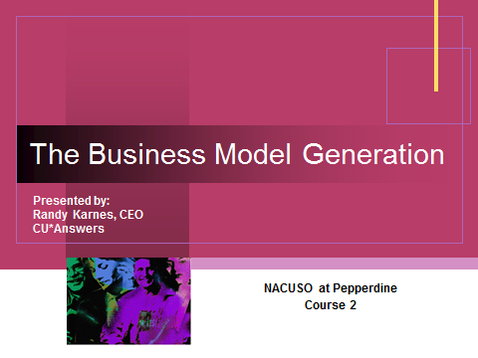

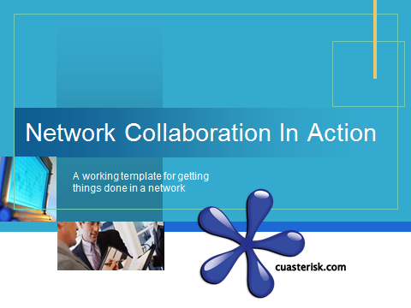
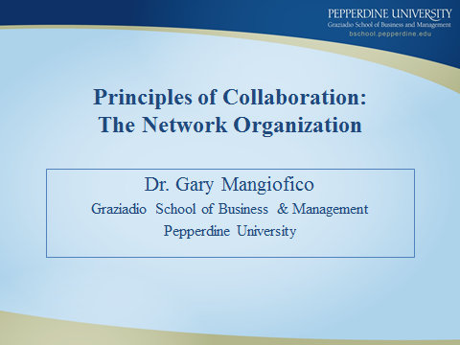
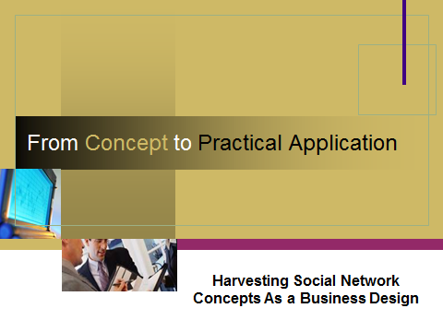
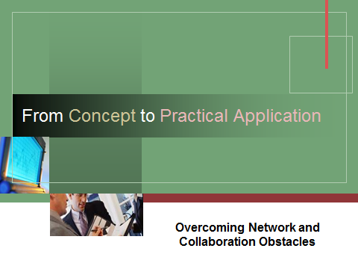
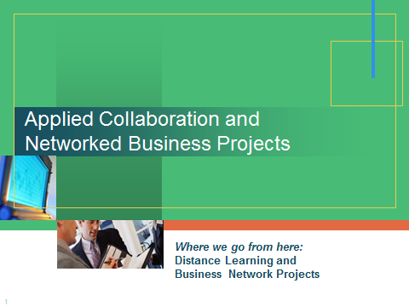
Bringing the NACUSO Pepperdine Executive Program to the CU*Answers Network

Slide 28
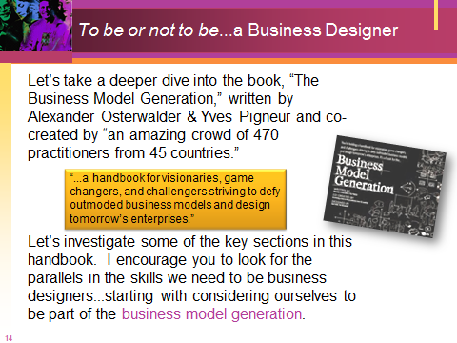
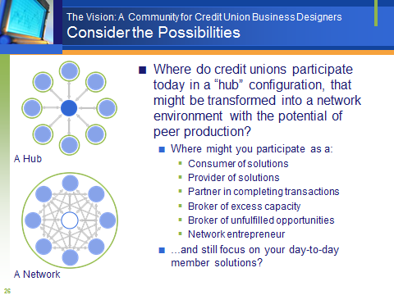
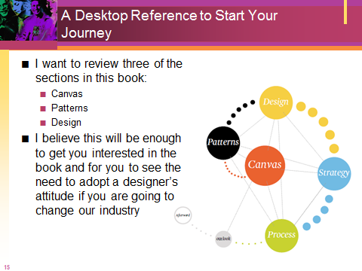
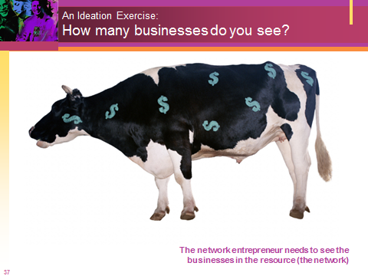
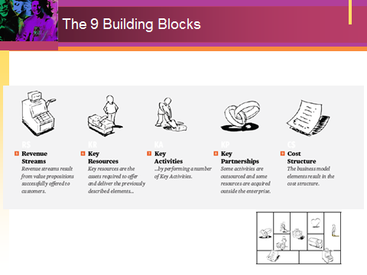
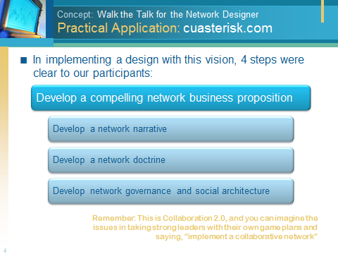
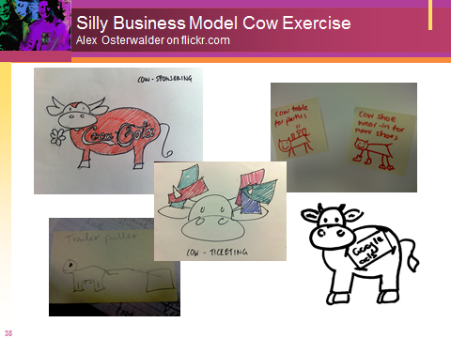
Bringing the NACUSO Pepperdine Executive Program to the CU*Answers Network

Slide 29

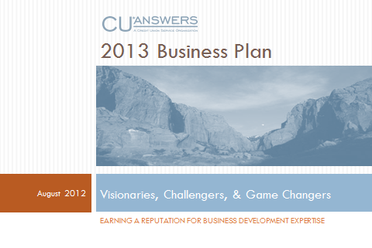
Our Project Here at CU*Answers in 2013
We’ll start a tactical approach to earning the reputation for business development expertise
This is about our future, not affirming our business development to date; this is about businesses yet to be built, opportunities yet to be conquered
It’s about inspiring not only our staff to improve their skills, but also a network
It’ll all start with the Board and a new agenda item each meeting
One of my favorite desktop references for explaining how to think about business development...soon to be on the desk of every CU*Answers business development leader
Would you like to participate?

Slide 30
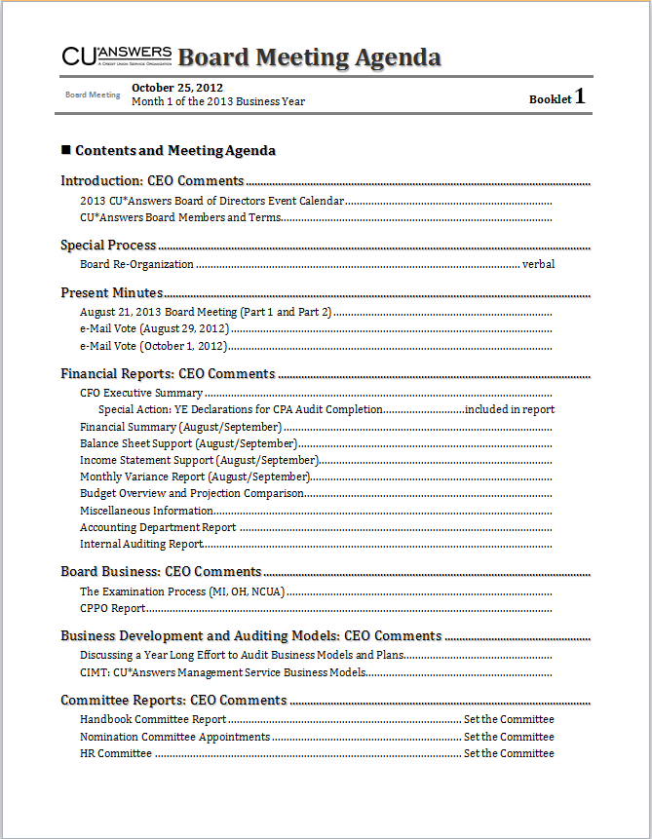

Our Project Here at CU*Answers in 2013
How do you work with your Board on understanding your business model, identifying your business developers, and explaining the approach for new business development in your cooperative?
January Board Meeting | Production Center Business Model (the emerging CU*BASE Operator Edition) CUSO Business Services Model (the emerging CU*BASE SE Edition catalyst)
March Board Meeting | cuasterisk.com Business Model (what drives our wholesale opportunities) CU*Answers Network Services (how infrastructure design and over sight work)
June Board Meeting | CIMT: Core Business Models (can we evolve Level One units for new revenues?) New Models for 2014 (DR/BR, Examination, and Risk Services need to launch)

Slide 31
Our Project Here at CU*Answers in 2013
Building consensus between our business developers and our Board – as both customers with a focus-group perspective and owners with the ultimate investor perspective – is key
  These audits are designed to prepare developer and owner to be ready to give the elevator speech about where our organizations are going
A Board/business developer must be solid on these elements:
  Know the Client/Member/Customer-Owner
  (you pick the label)
  Know the Operation
  (Here I focus on the model, design, and engines that propel)
  Know the Organization’s Identity
  (Do we agree that the external perspective equates to our internal hopes for who we are?)
  Know the Plan
  (Working to have the confidence in leadership’s understanding of, commitment to, and input into the plans of the firm.)

Slide 32
Our Project Here at CU*Answers in 2013
Developing a Template and Approach
Manufacturing Value
Can you bring a marketable value to the client, network, and environment? Remember, your customers own the place.
Packaging Value
How do we mold products and services from the value proposition?
Developing Customers
How do we create an audience, then develop customers from that audience to propel our business opportunities?
Pricing Value
Opportunities
Revenue Models
What are the steps in balancing cost and opportunity and pricing models for a cooperative business design and general marketplace acceptance?
How do you access opportunity, leverage it, and expand it? How do you match it with price, customer development, and investment to perform over the short and long term?
Can you maximize all of this to generate revenues and add to the bottom line?
Too many firms work from the bottom up...for a cooperative, we believe it starts at the top

Slide 33
Bringing the NACUSO Pepperdine Executive Program to Our Network
Proposed Schedule: Mark Your Calendars
Schedule for CU*Answers Executives
Schedule for Network CEO Sessions
Would you like to participate in our internal education sessions?
January 18 (9am-noon)
  Introducing “The Business Model Generation”
February 15 (9am-noon)
  Network Business Design: Introduction to Pepperdine Materials
March 15 (9am-noon)
  Customer Development: What Can We Learn from Steve Blank?
Would you like to participate with your peers only?
May 8-9, 2013 (times TBD)
  Introducing “The Business Model Generation”
  Network Business Design: Introduction to Pepperdine Materials
  Customer Development: What Can We Learn from Steve Blank?
Whether you participate with our team or your peers, we hope you’ll be part of our executive study program to develop network business developers in 2013

Slide 34
Giving Our Team Some Ideas to Think About
Did you do your assignment from this summer?

Slide 35

Securing Investment Grants
What does every business developer need? Money, to move an idea into the market and find success
Can we be a network with a venture capitalist inclination?

Slide 36

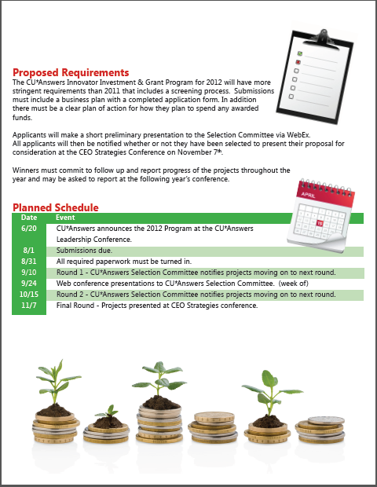

An Evolving Process with Big Goals
Can you make this program part of your long-term business development planning?
2011
2012
Whether you’re an award winner or an investor, this program might be one of your best sources for new ideas

Slide 37
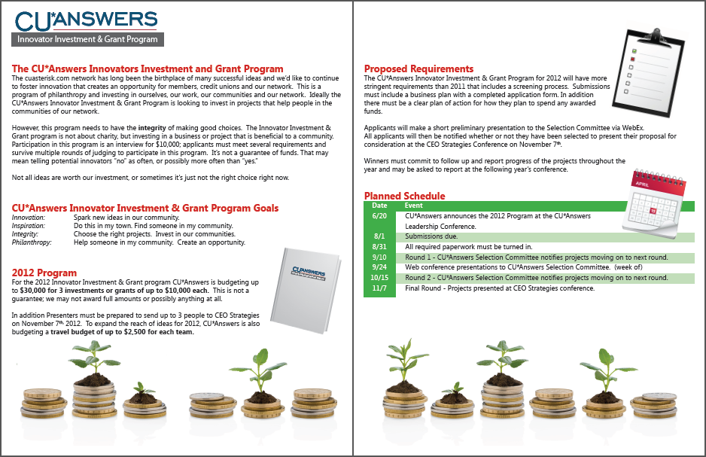


What should we announce at the 2013 Leadership Conference?
What worked in 2012? What didn’t work?

Slide 38
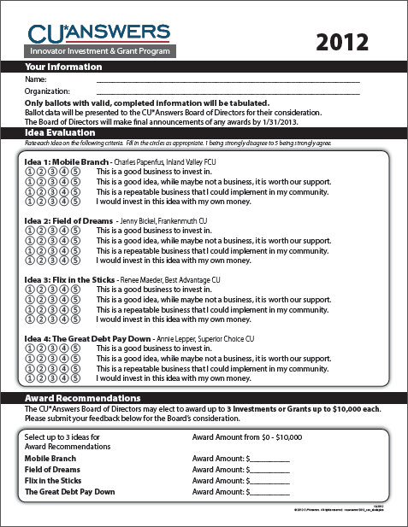
What to Plan For as an Applicant
...or even in the Board room as a business developer
1
Is this a good business for the network to invest its money?
2
If it’s not really a business per se, is it still a good idea? Something that is worthy of our financial support?
3
Is this a repeatable business that could potentially be implemented in your community, by other credit unions or network partners?
4
Thinking as a venture capitalist, would you invest your own money in this idea?
These are good tests, even when you are thinking about
getting a new business idea approved by your Board
How does your Board vote on business development?

Slide 39
Starting a Business in the CU*Answers Network
The goals haven’t changed
  Encourage a CU to start a business to
  compete with a CUSO business
Encourage a CU to start a business within the network
that is not currently offered by the CUSO
Encourage a CU to start a business to outsource resources and capabilities to another business within the CUSO network
Encourage a CU employee to start a business to sell their services to another business within the CUSO network

Slide 40
Conclusion
What should CEOs do when they get together?
Go to school on each other, and earn more
Increase their talent, and plan to build even more talent with their staff
Pool their money, pool their ideas, and inspire the best of the network to bring opportunities to us all
$200 million of cash flow will stream through our network in the next 5 years...are you part of the voice that will direct the returns?

Slide 41
Thanks for the day!

