Slide 1
11.6 Release Training
Published: March 9, 2012

Slide 2
Teller/Member Service
Roving tellers
Currently serving
Teller/Mbr Service workflow controls
Photo ID on file changes
Global Search update
Easy access to membership information
Access to teller drawer from teller
Enhancements to close process
Qualifile by ChexSystems

Slide 3
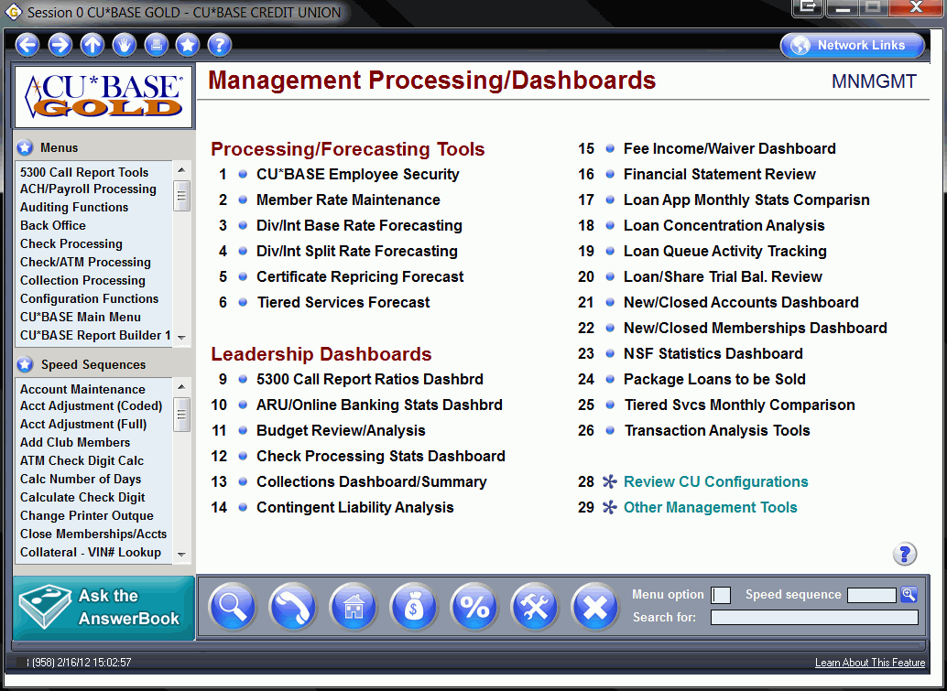

Slide 4
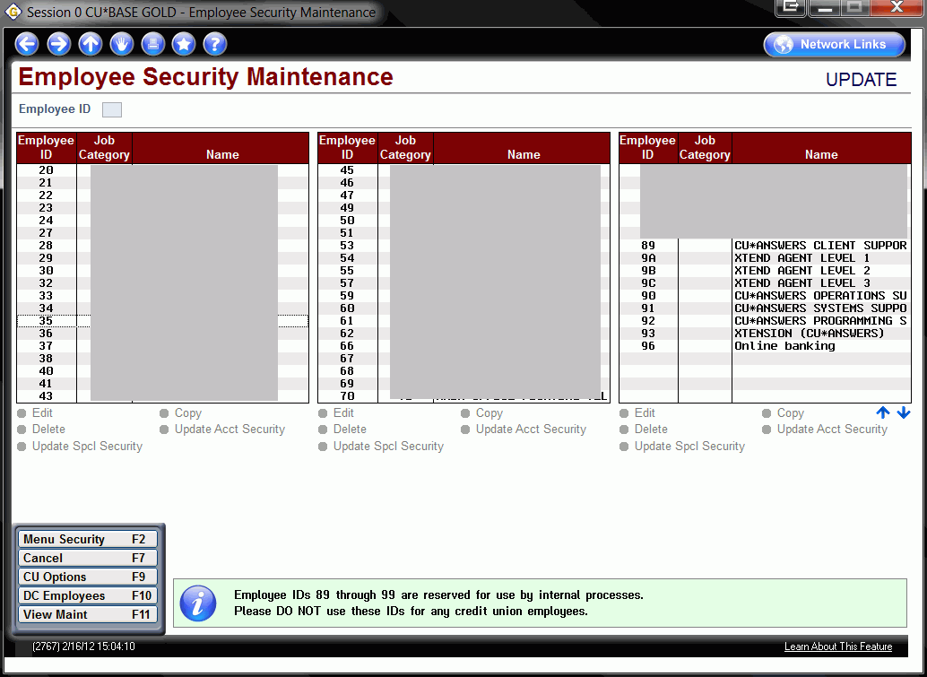

Slide 5
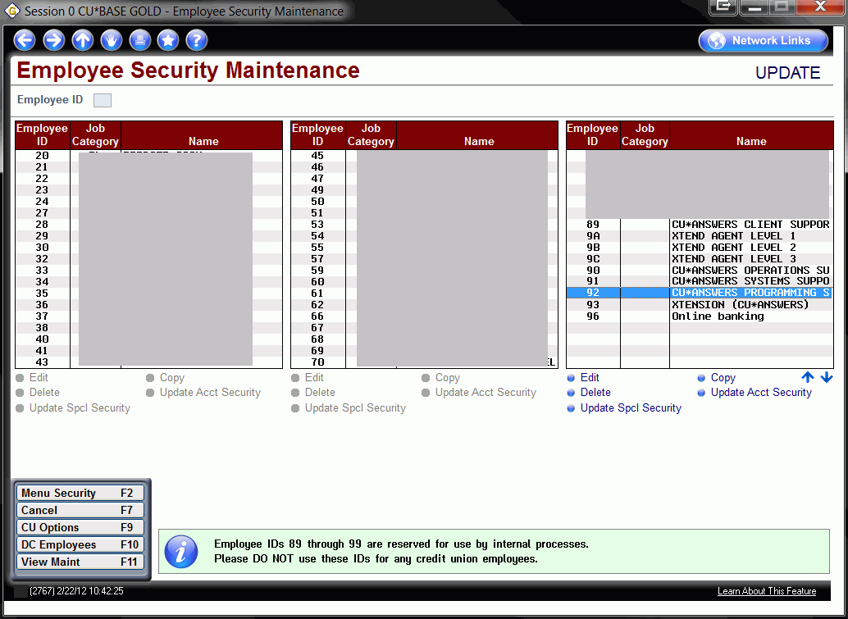

Slide 7
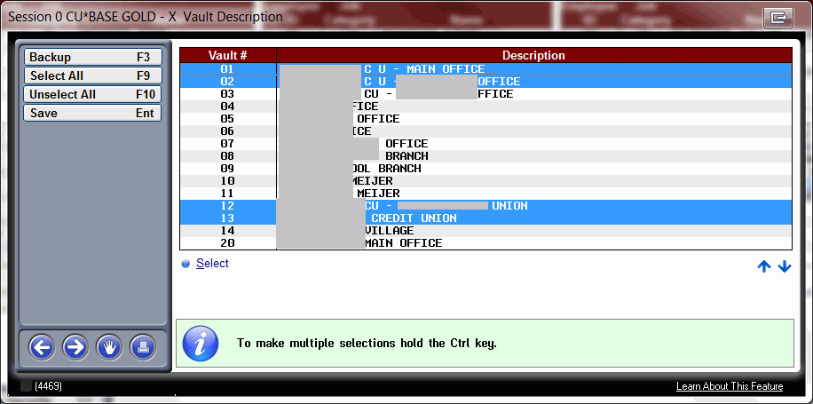

Slide 8
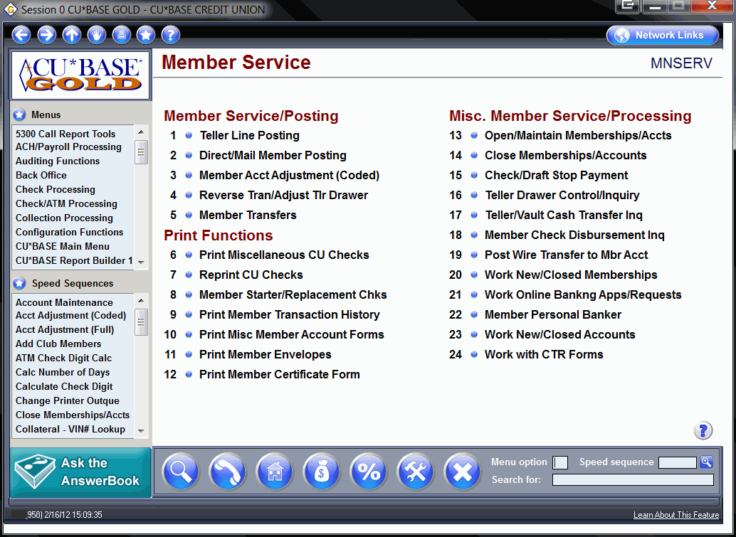

Slide 9
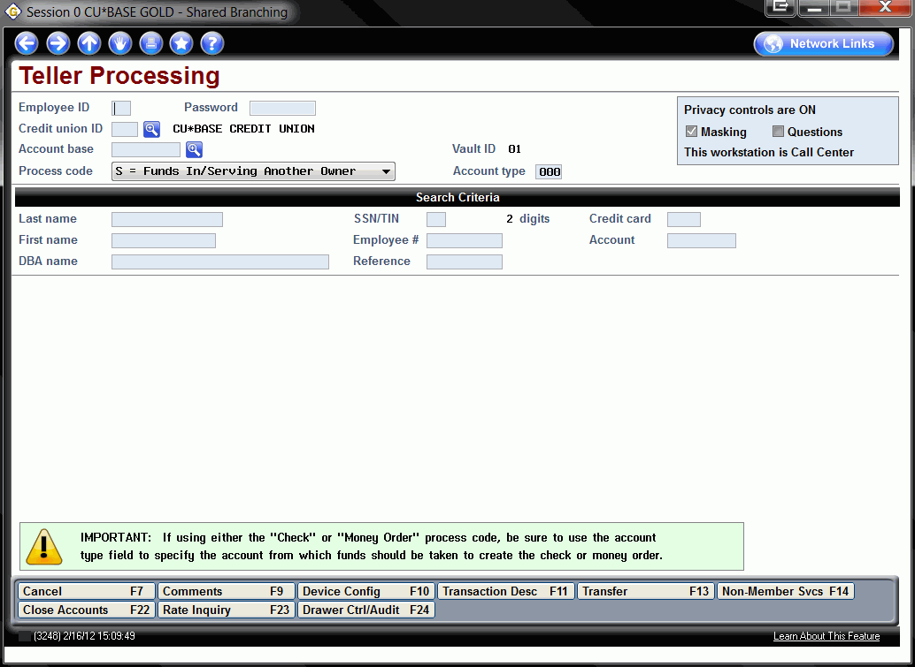

Slide 10
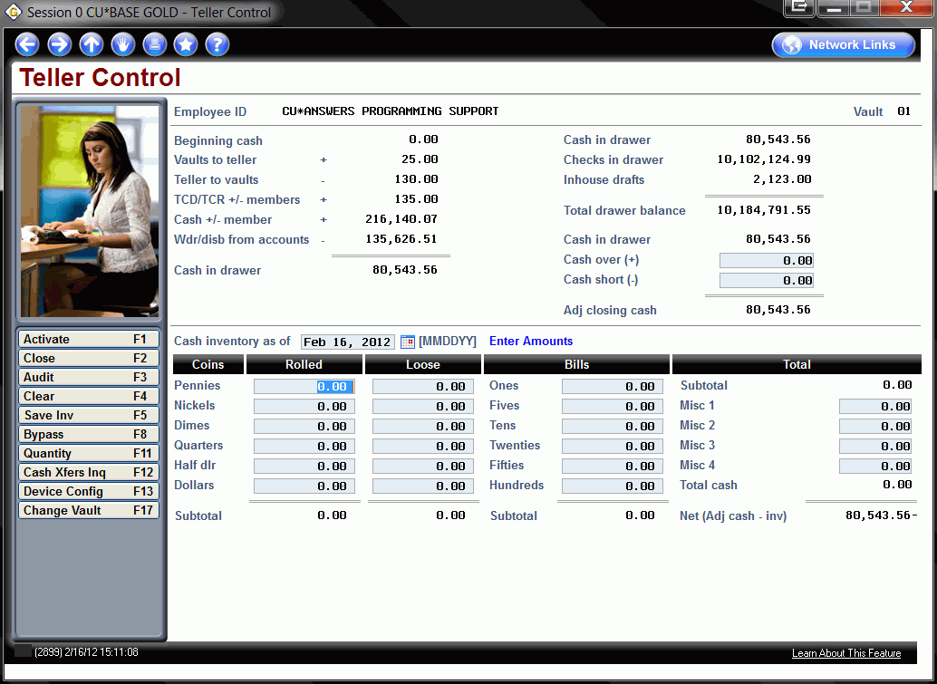

Slide 13
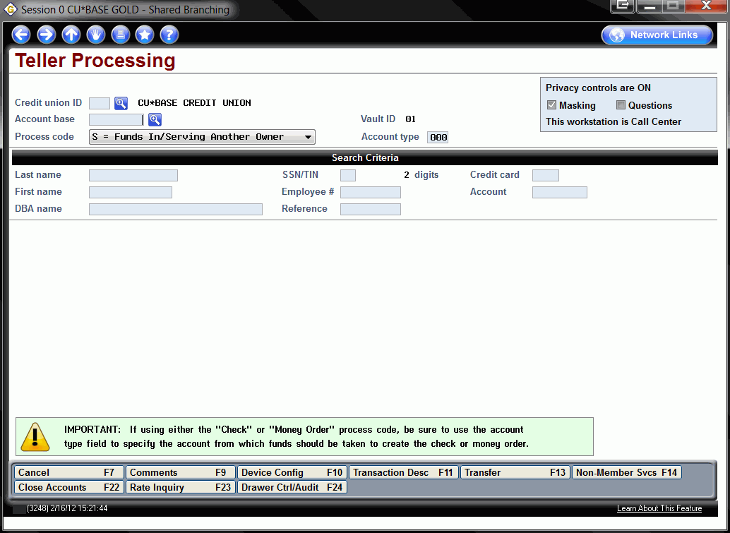

Slide 14
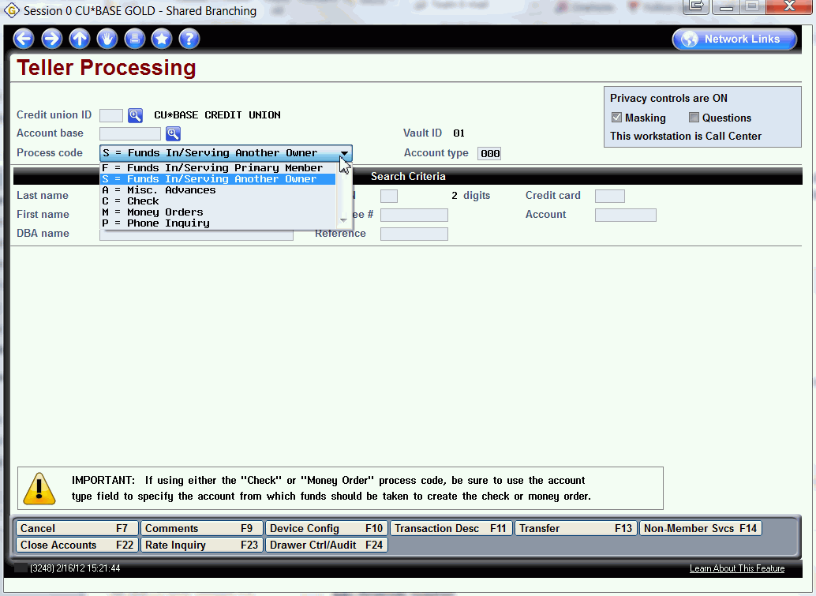

Slide 16
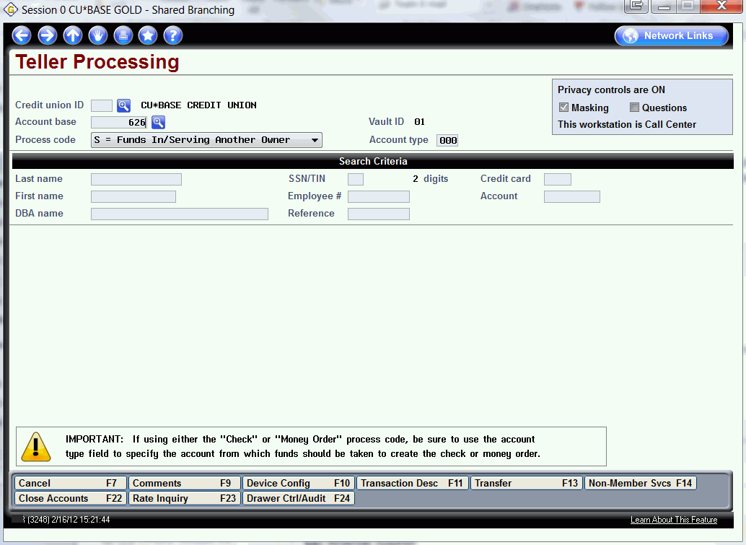

Slide 17
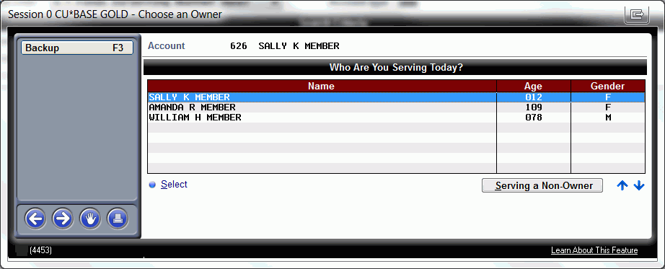

Slide 18
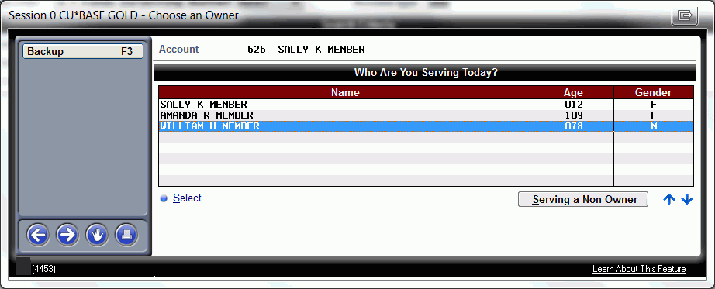

Slide 19
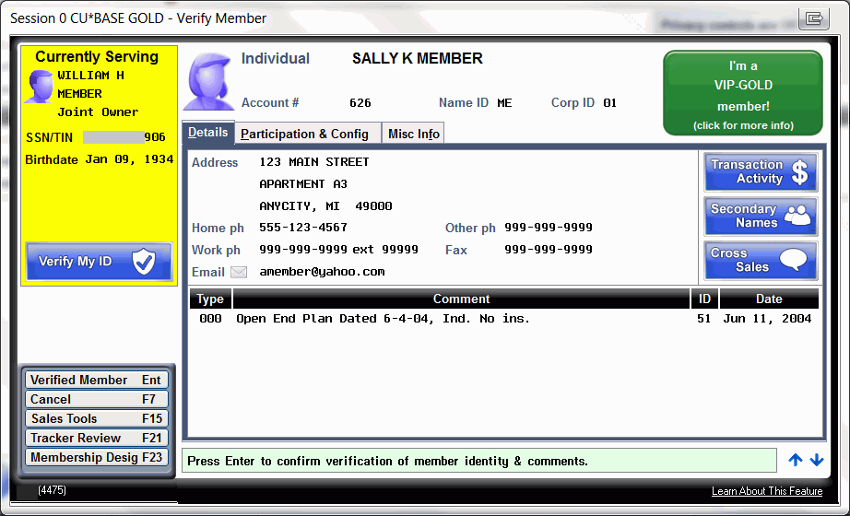

Slide 20
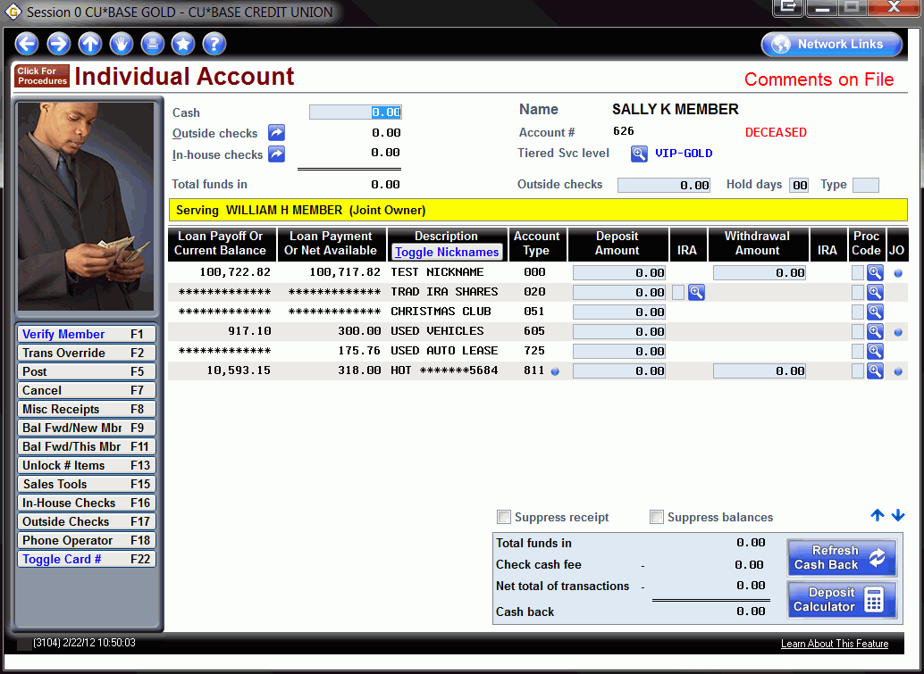

Slide 22
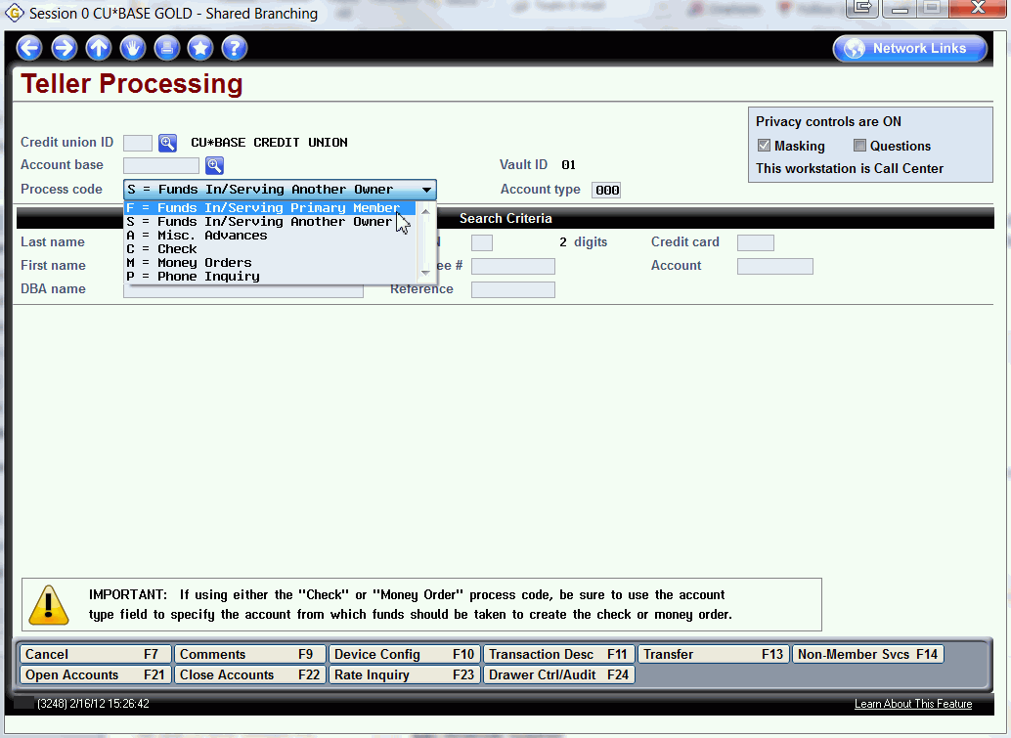

Slide 23
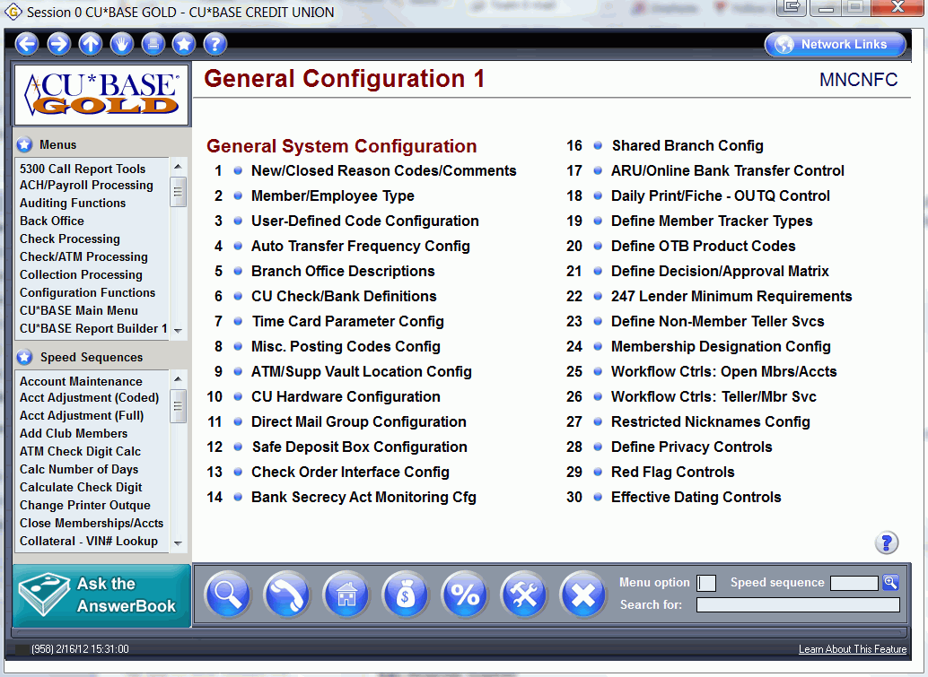

Slide 24
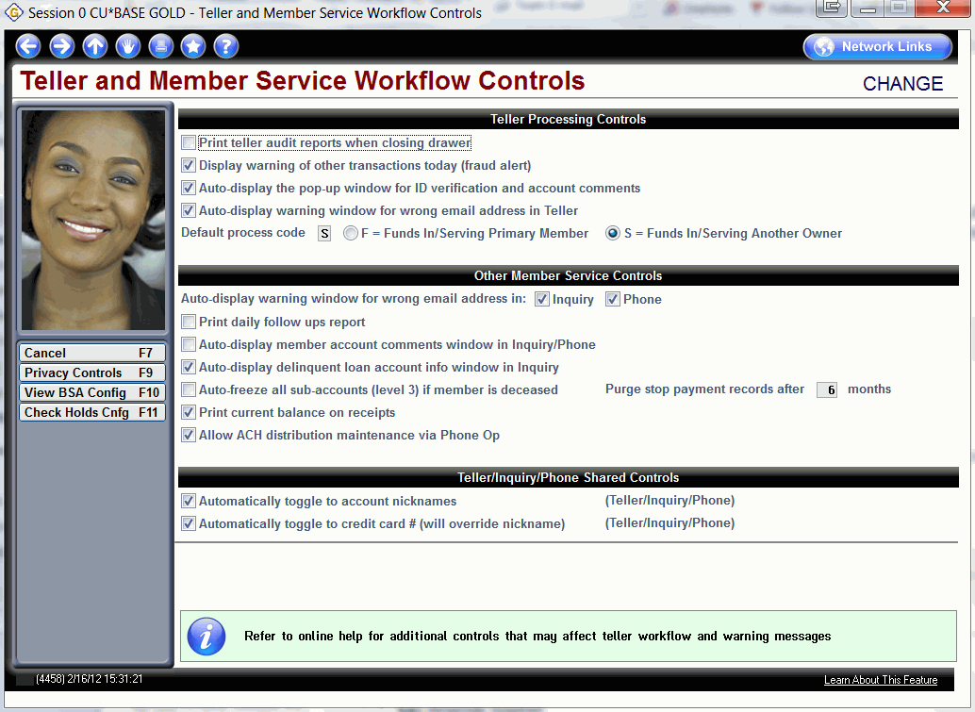

Slide 26
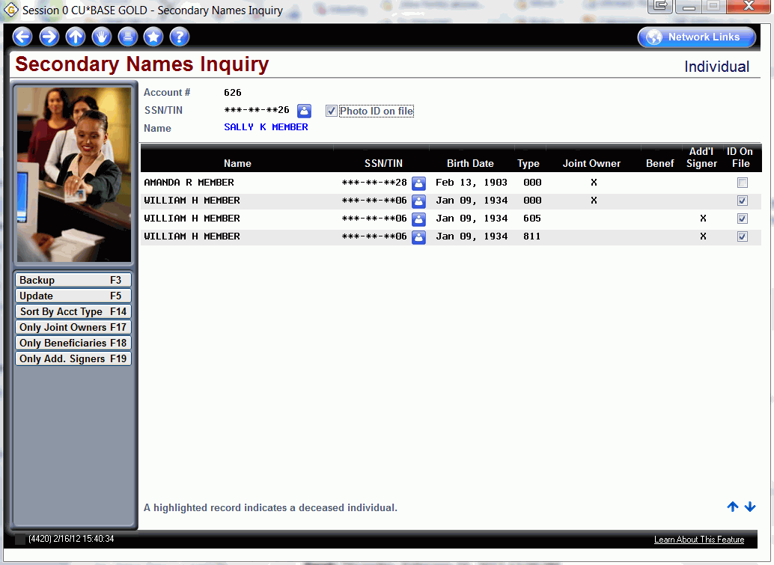

Slide 27
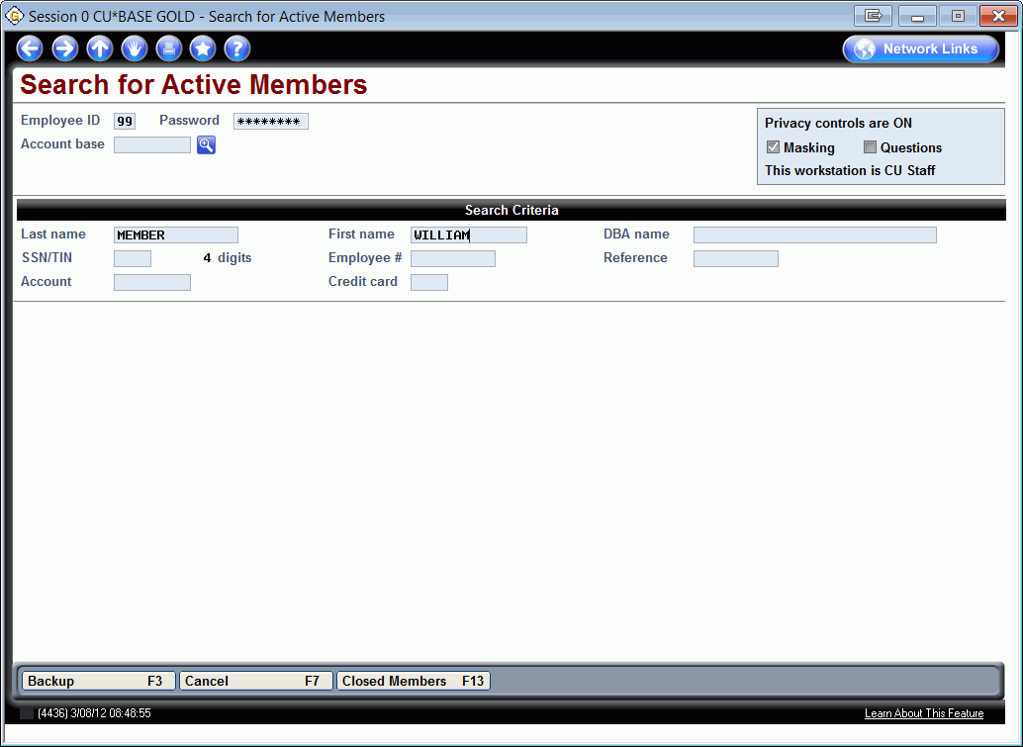

Slide 28
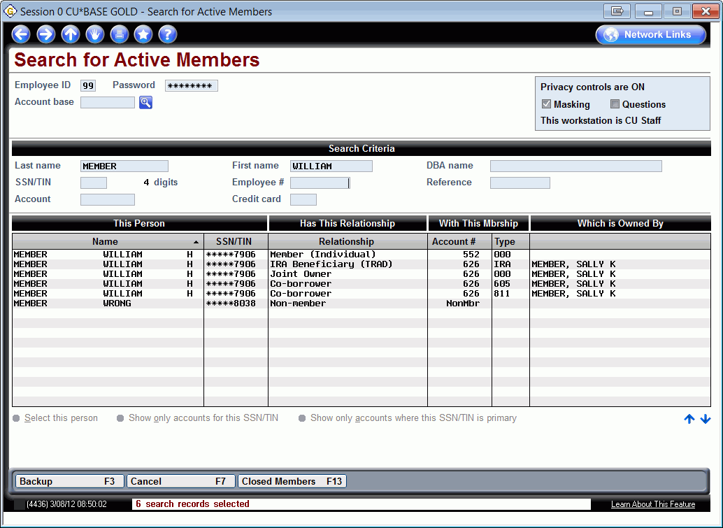

Slide 29
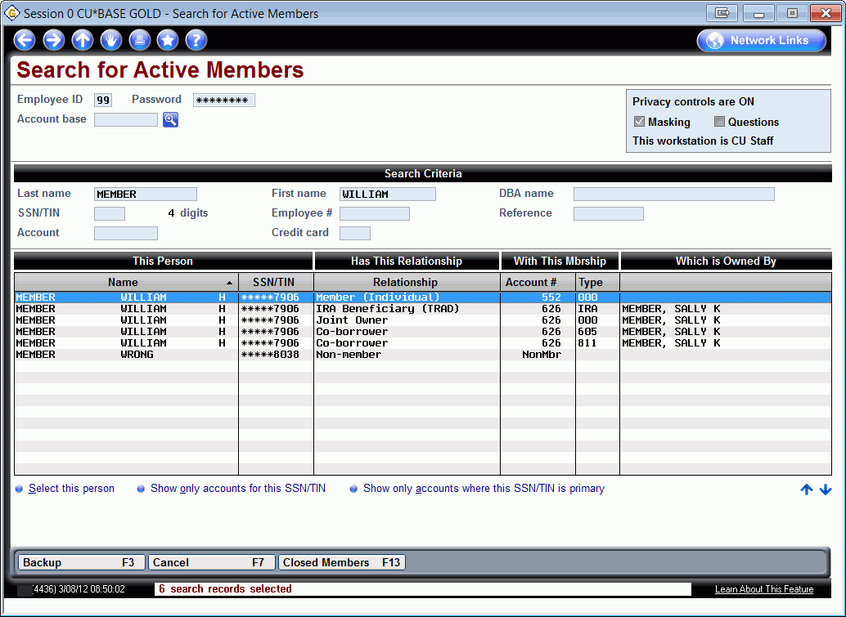

Slide 30
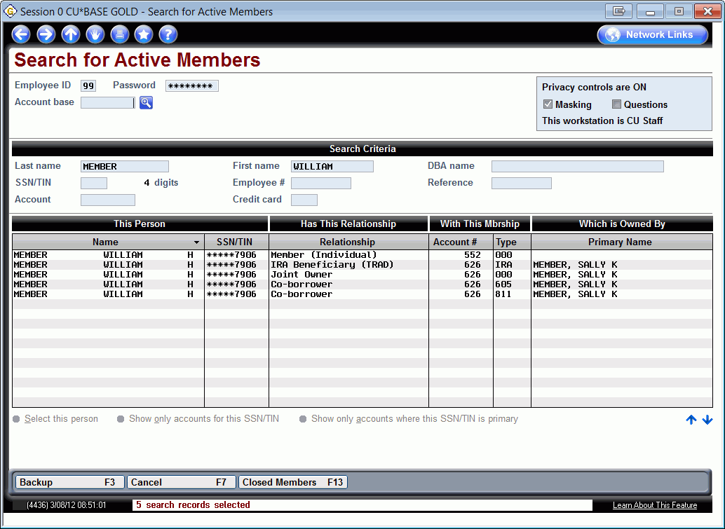

Slide 32
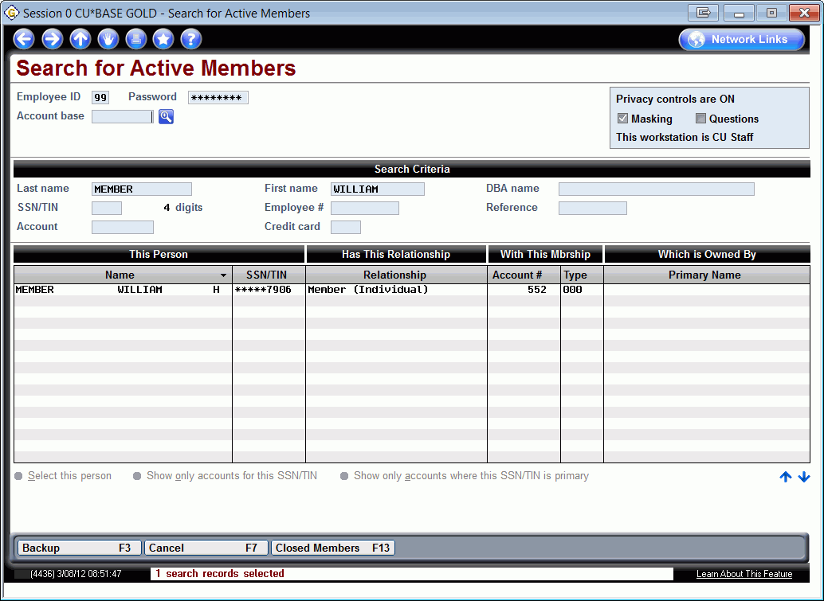

Slide 33
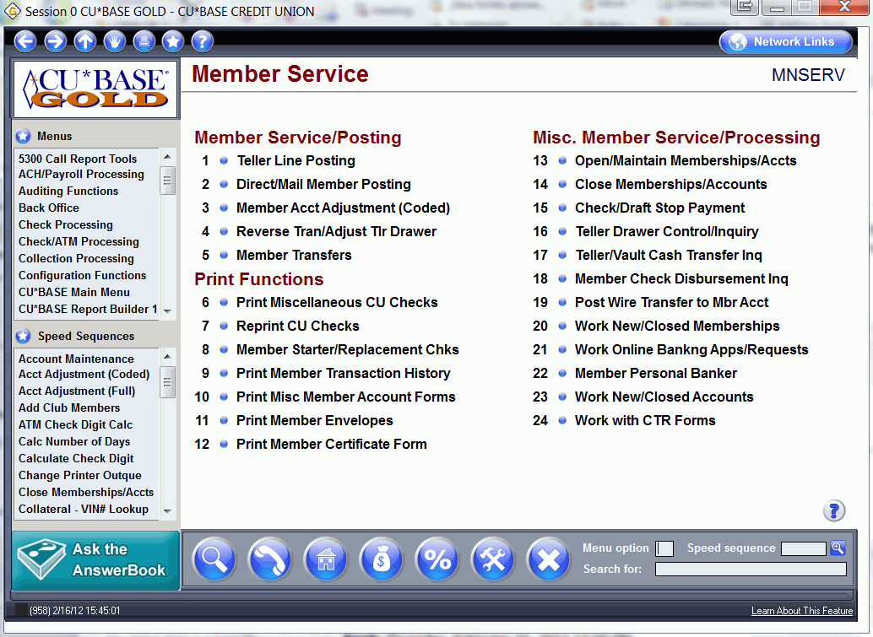

Slide 34
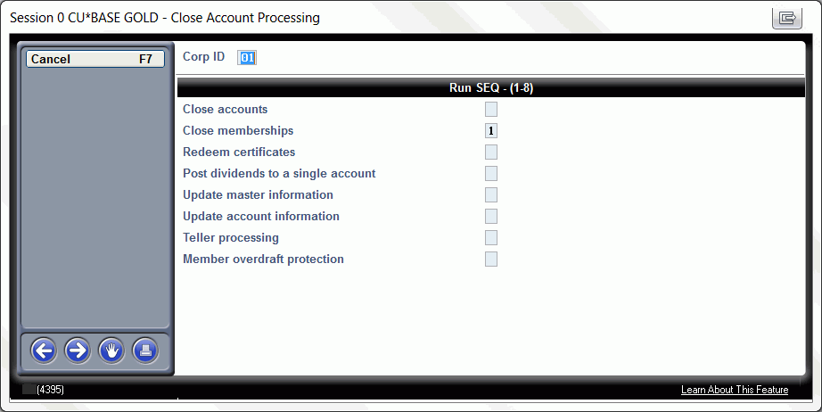

Slide 35
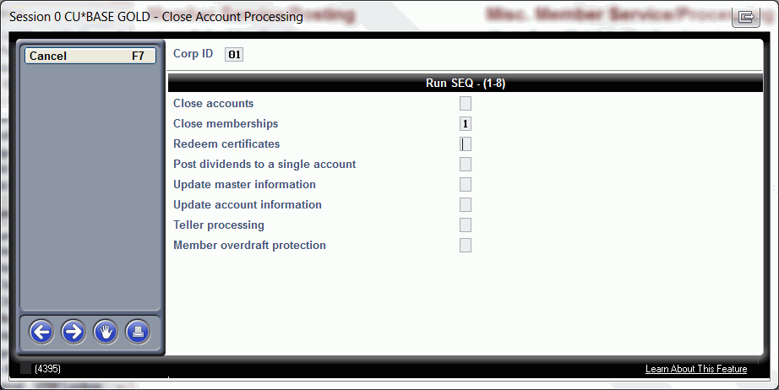

Slide 38
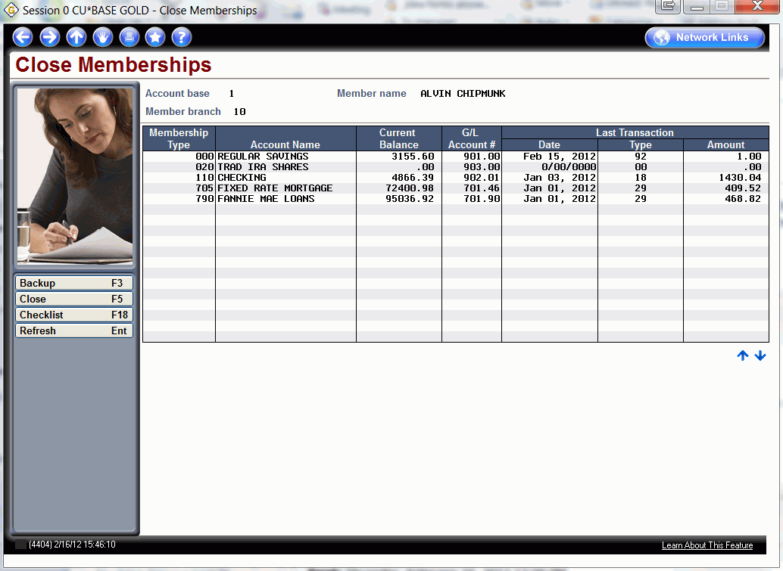

Slide 40
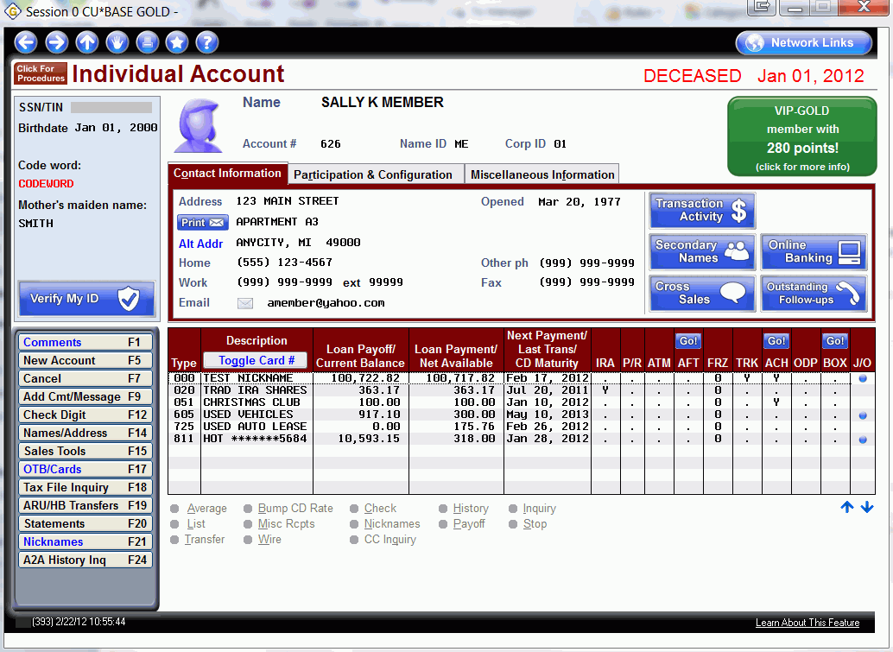

Slide 41
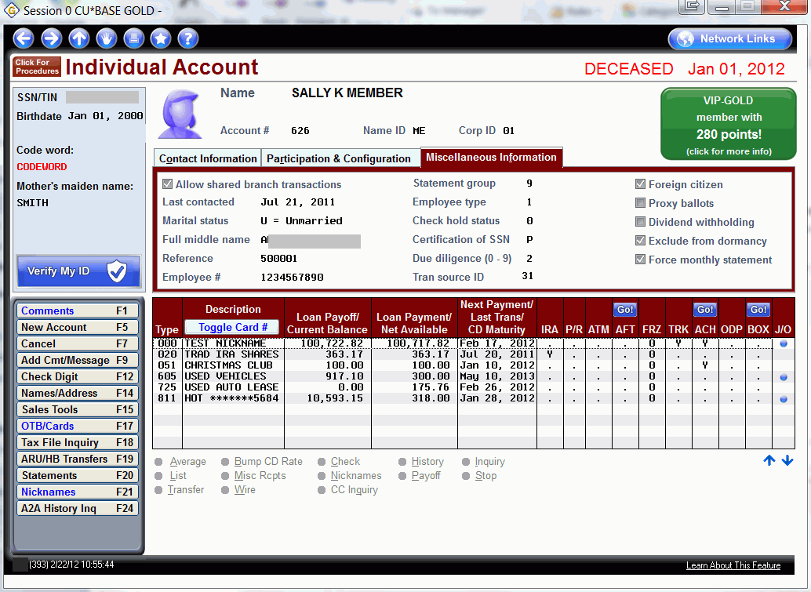

Slide 42
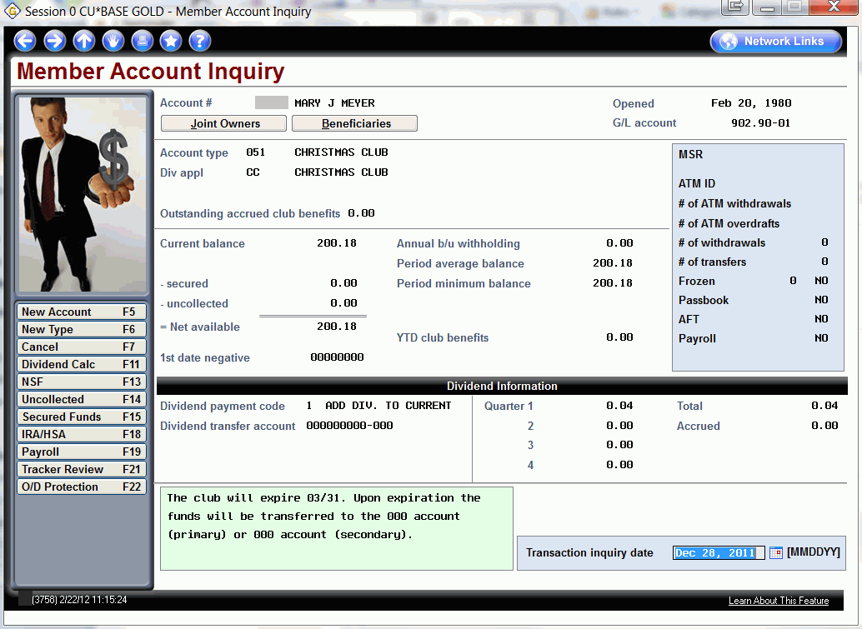

Slide 43
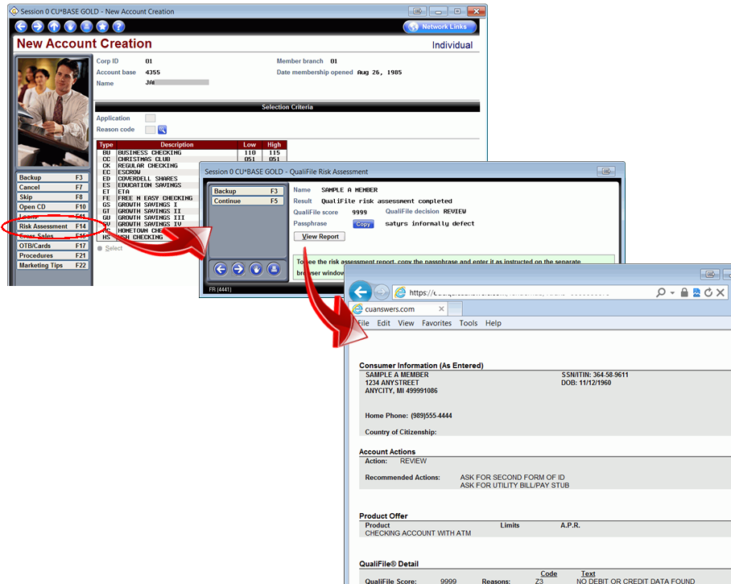

Slide 44
Member Facing
See/Jump controls
Members transfer with greater security
Direct pass through to PSCU (OTB Cards)
Members view IRA Plan Type

Slide 45
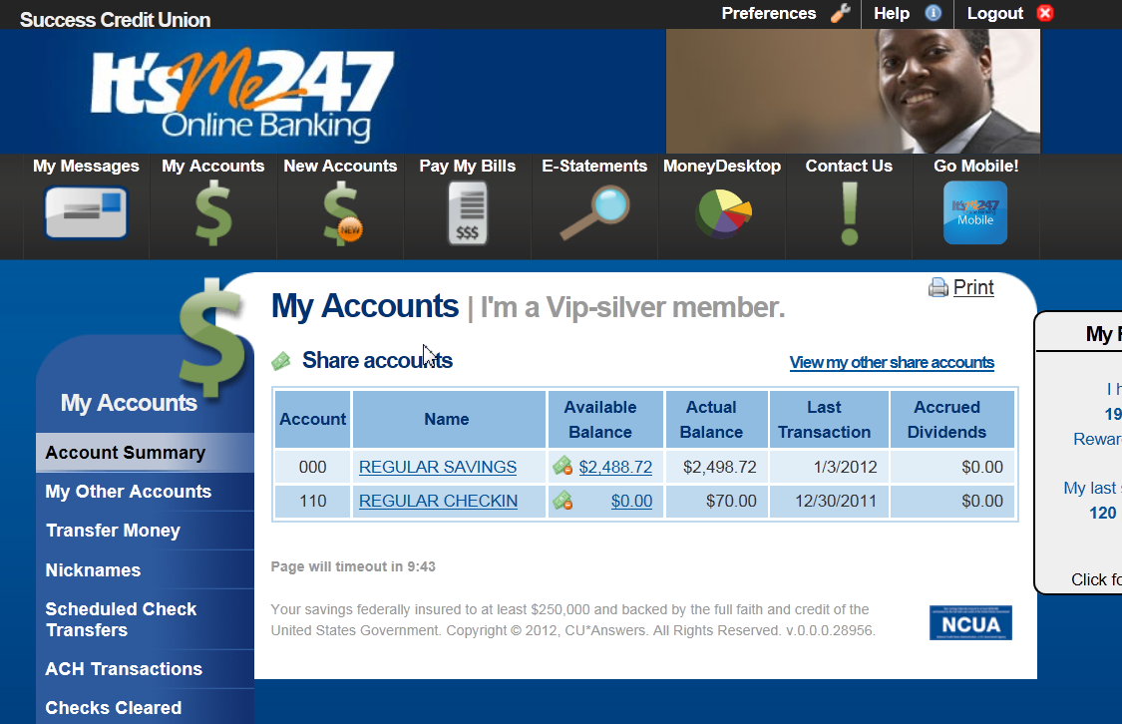

Slide 46
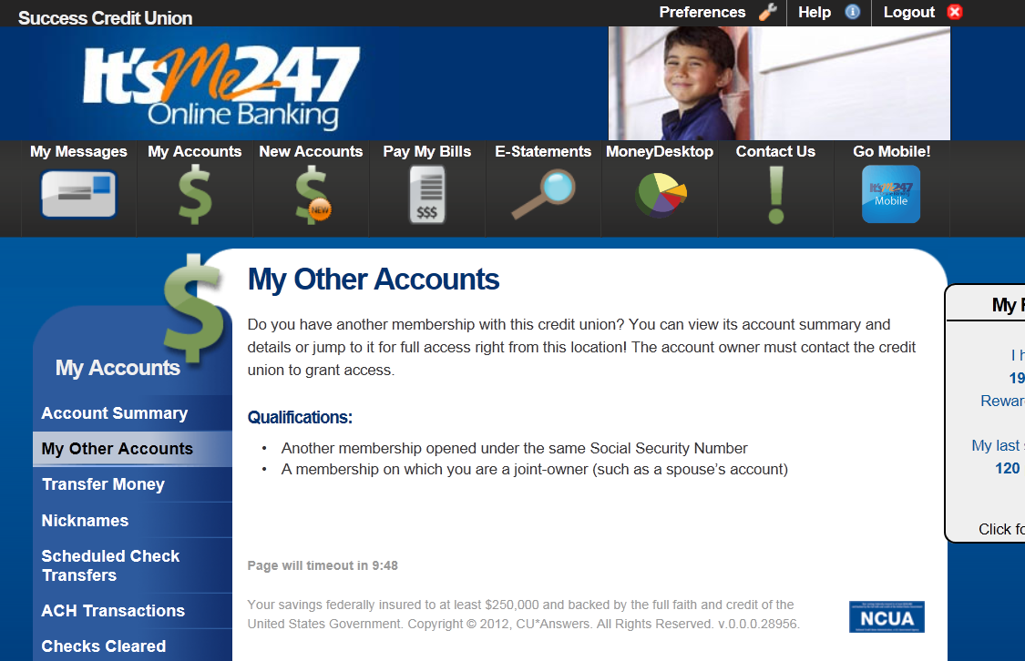

Slide 47
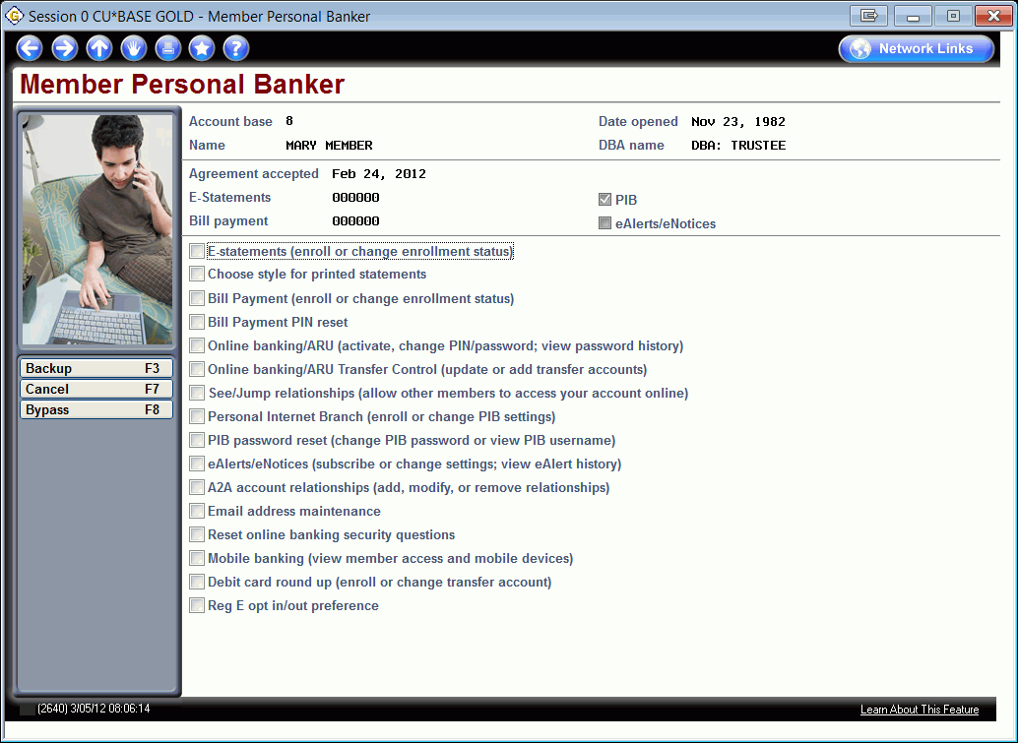

Slide 49
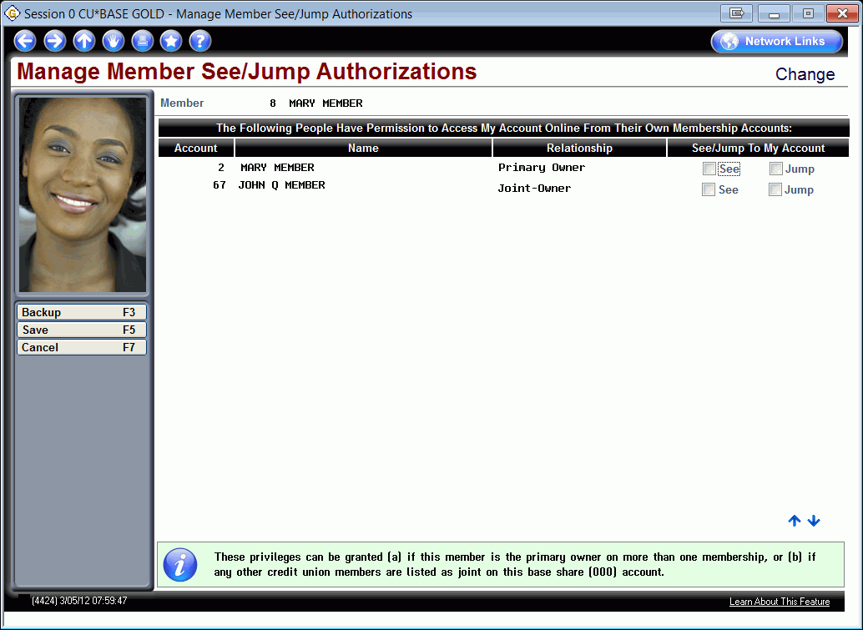

Slide 52
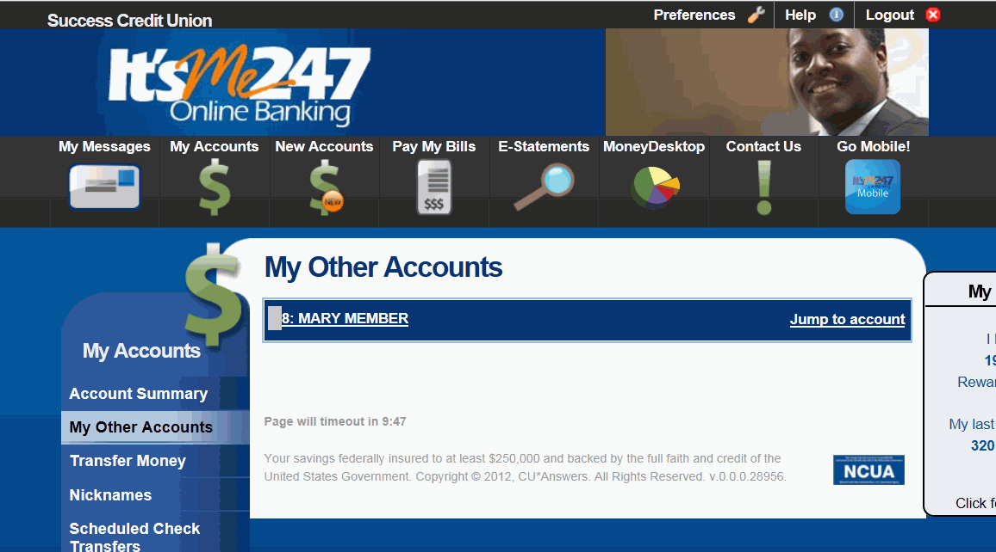

Slide 53
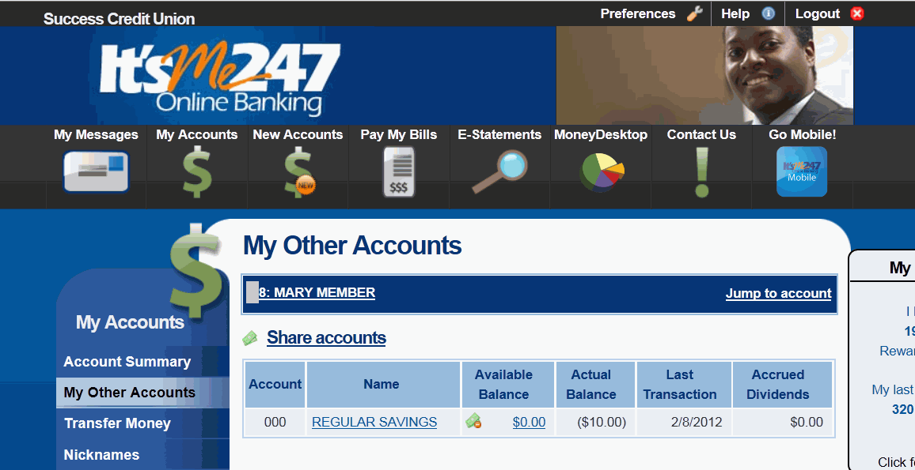

Slide 55
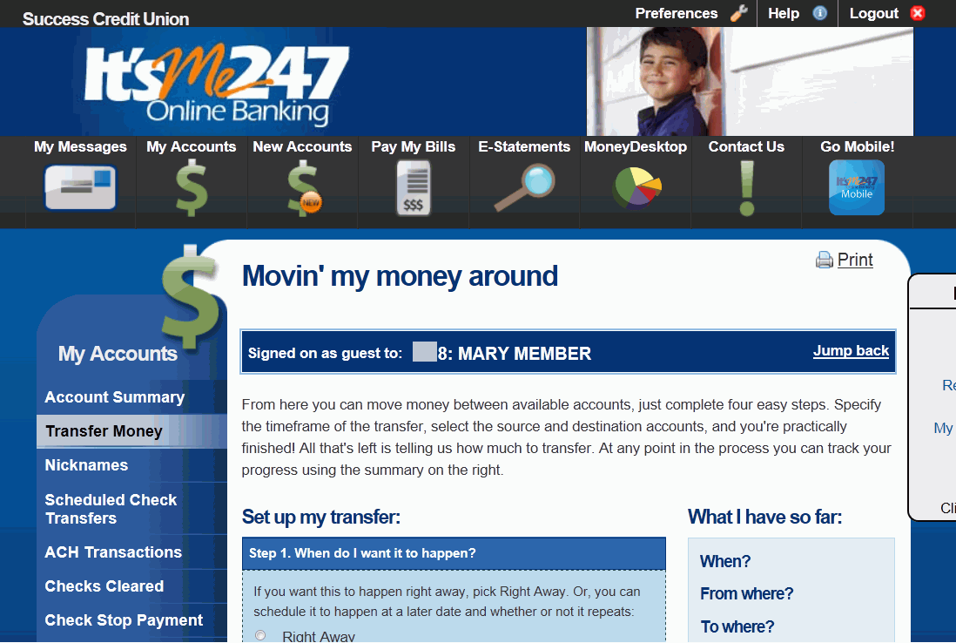

Slide 56
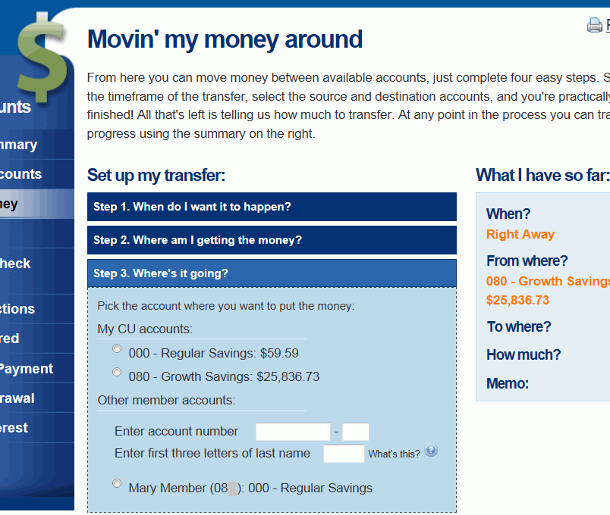

Slide 57
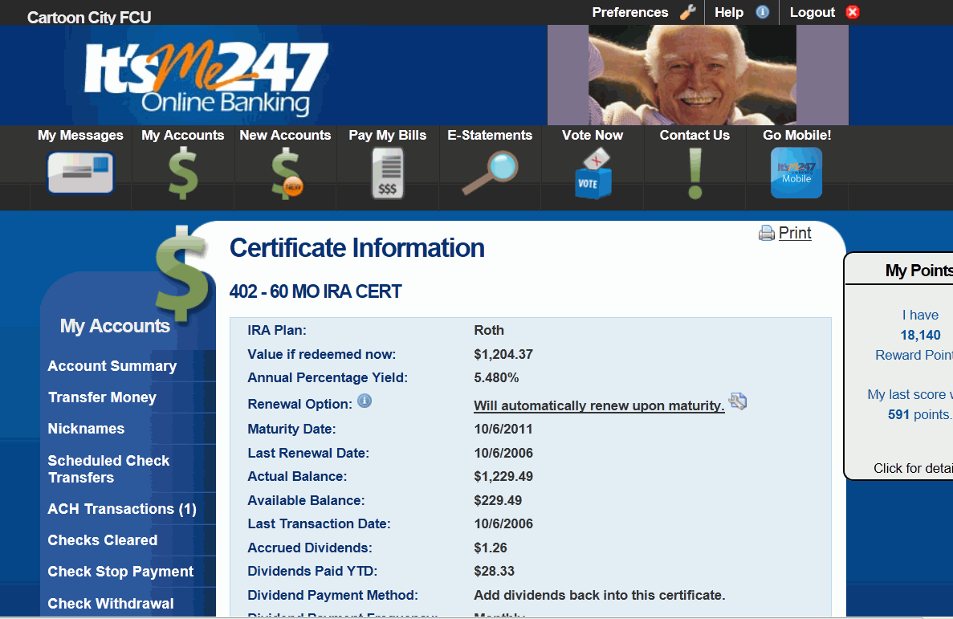

Slide 58
Lending
Credit report analytics
Redesigned loan application screens
Selective Loan Trial Balance enhancements
OTB maintenance changes
VIN lookup for closed collateral
Wait times now look at underwriter codes
Catch up calculator
Updated Participation Lending report
Delinquency fine calculation

Slide 59
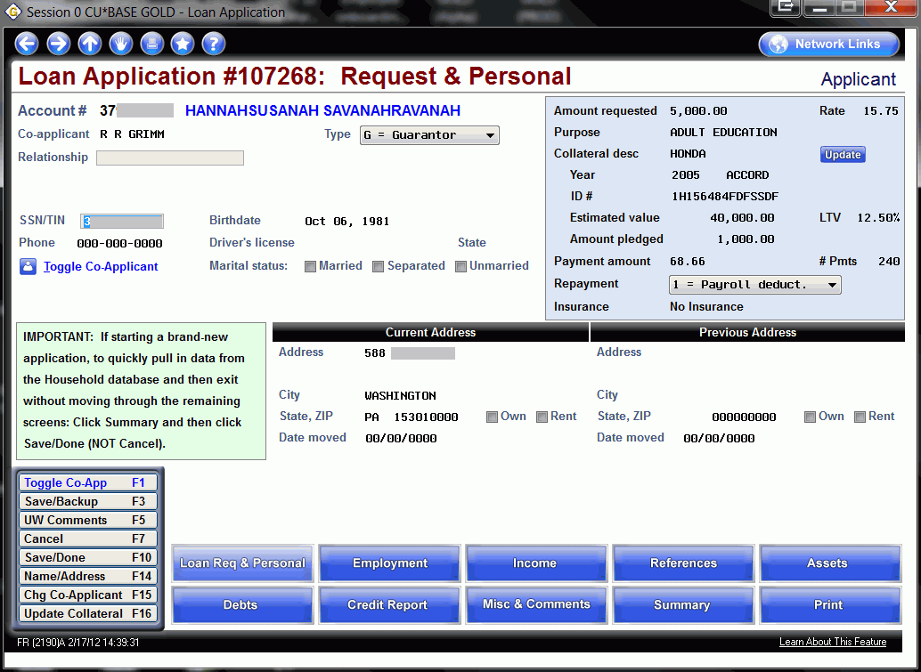
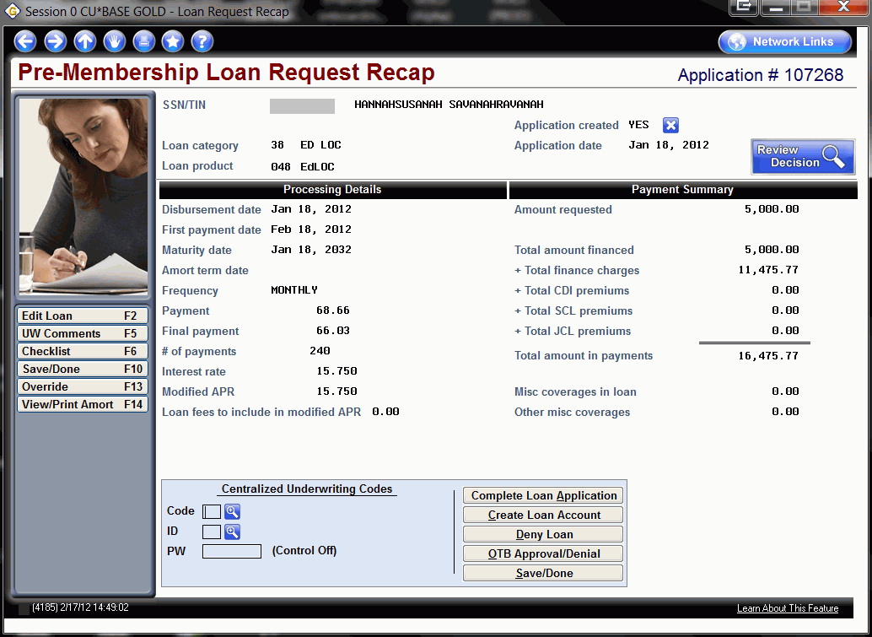

Slide 61
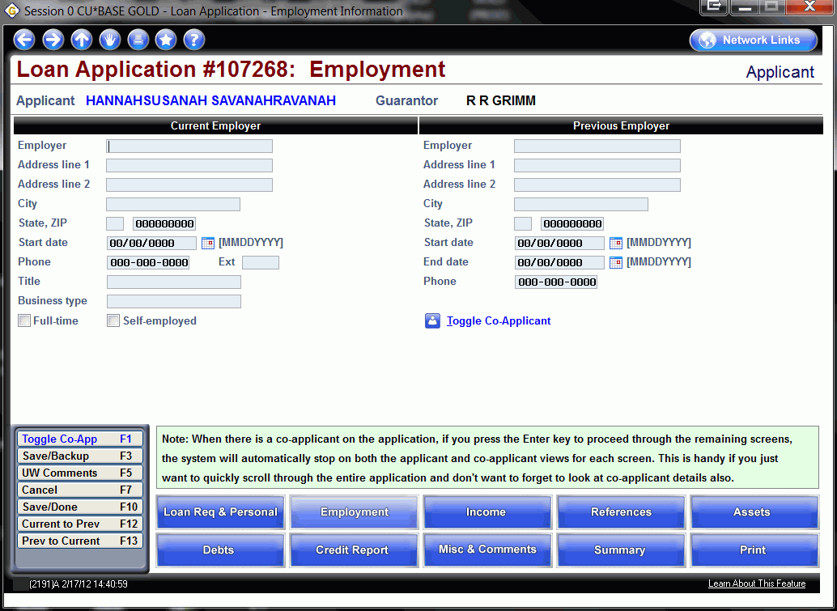

Slide 62
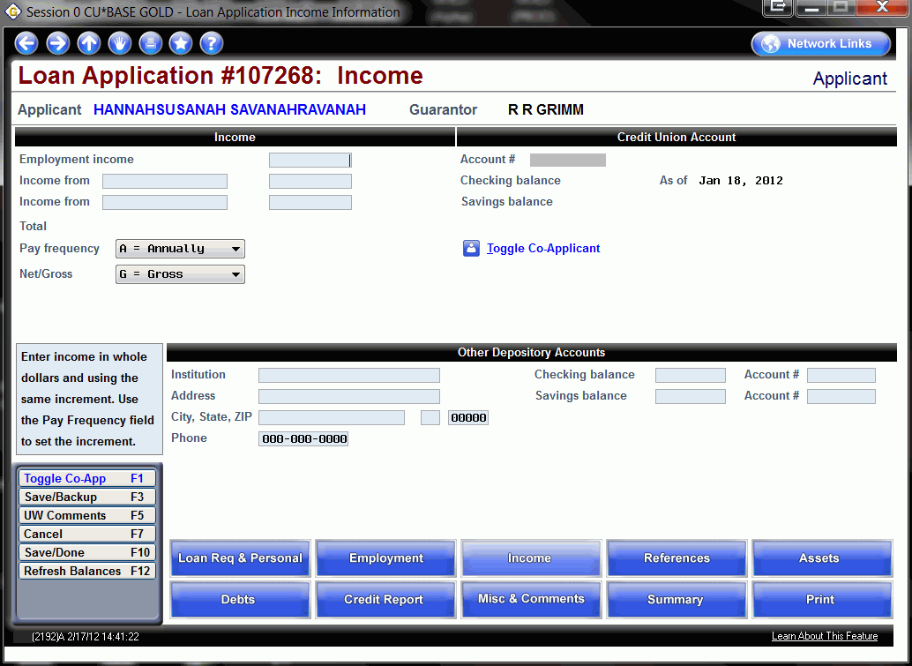

Slide 63
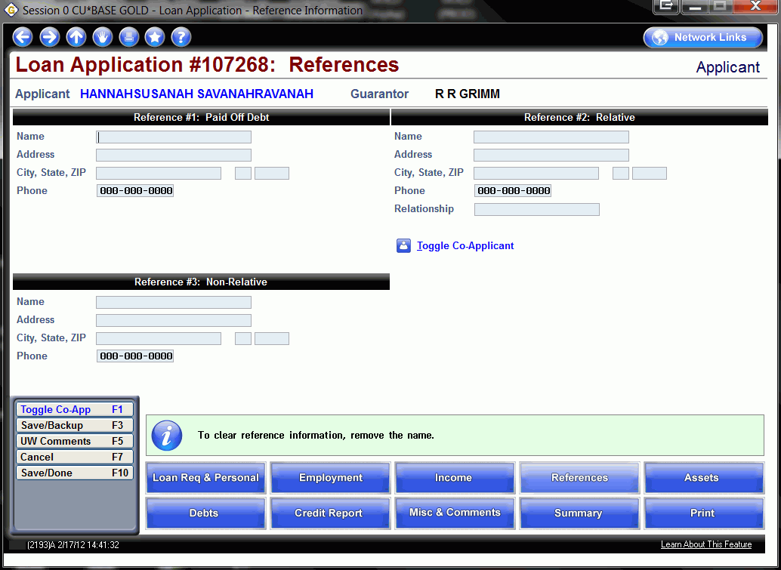

Slide 64
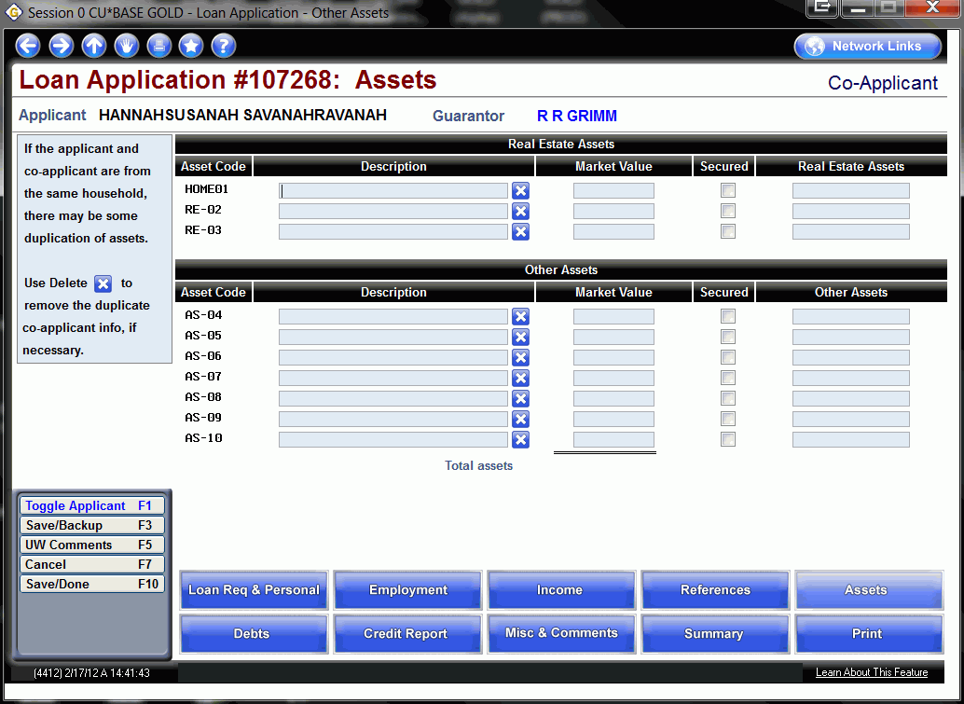

Slide 65
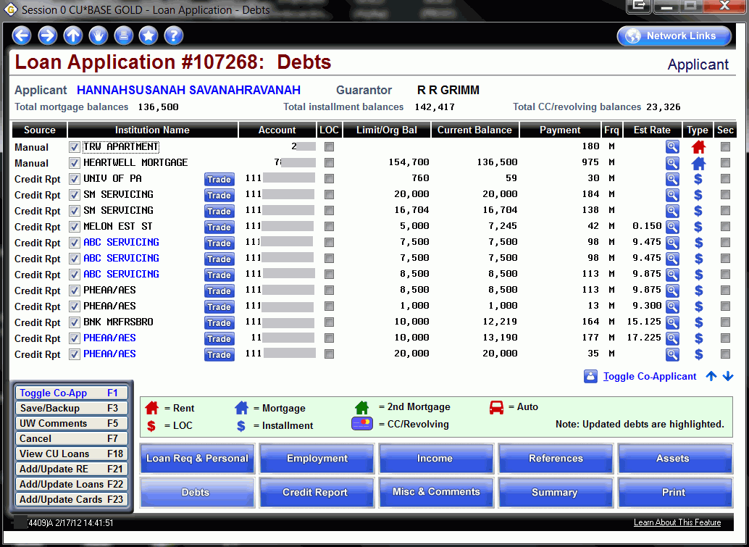

Slide 66
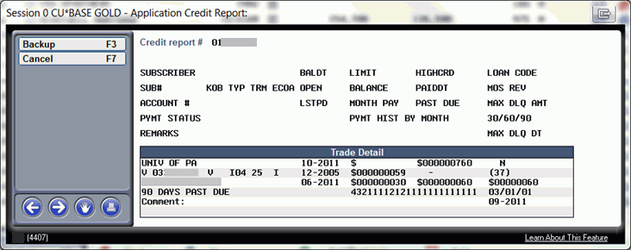

Slide 68
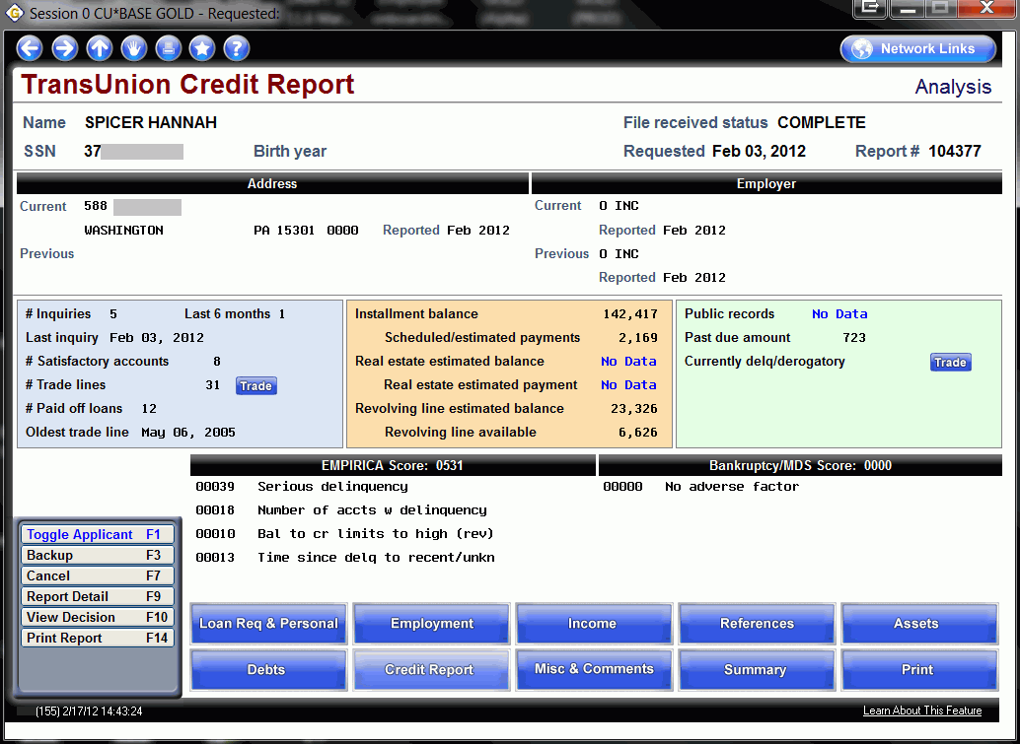

Slide 69
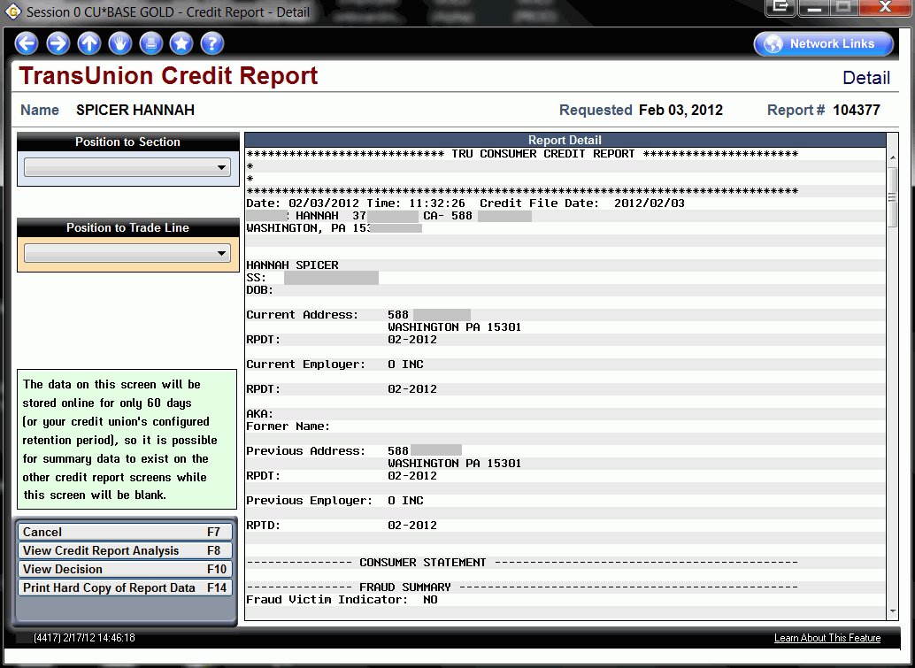

Slide 88
EFT
Credit CARD Act – Interest rate change management
Fee for batch card reissue and update
View credit card activity details
Last ten member account lookup for ATM/Debit and credit cards

Slide 100
Auditing
Interest due greater than scheduled amount report
Mandate of Employee ID for Inquiry
FinCEN Report Updates

Slide 103
Accounting/Back Office
Journal entry posting improvements
Upload your work…import data to post to the G/L
Customize your message on Annual Escrow Disclosure

Slide 111
Marketing
Multiple select to Cross Sales Analysis Report

Slide 113
Management
Learn from a Peer – Share Rate Analysis
View Teller/Mbr Service workflow controls
Any End-of-Month file for Raddon download

Slide 121
Shared Branching Enhancements
FSCC Shared Branch Enhancements
CUSC Shared Branch Enhancements

Slide 122
Introducing CU*BASE SE
Hide the 000 Membership Share Account

Slide 123
Questions?
How can I share this information at my credit union to further train staff?

Slide 124
Thank you for attending!

